Slide 1
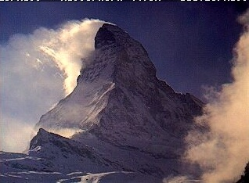
Orographic Banner Clouds
Björn Brötz,
Daniel Reinert,
Volkmar Wirth
Institute for Atmospheric Physics/
University of Mainz
2nd EULAG Workshop
14.10.2010

Slide 2
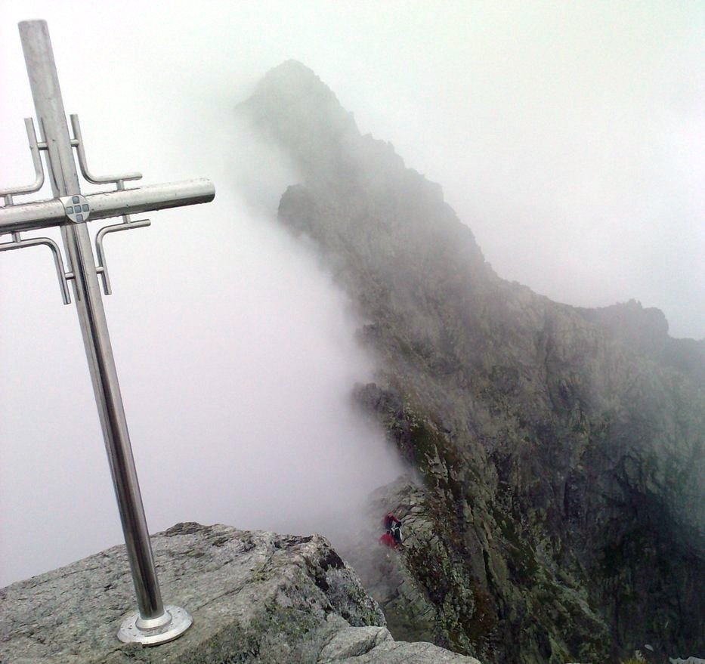
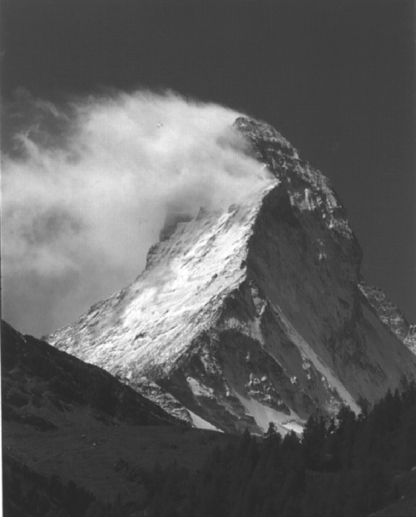
Occurrence:
Banner clouds are observed at steep
3D mountain summits or on
quasi 2D mountain ridges
Rysy, Poland
Characteristic property:
The cloud exists only in the leeward side
The windward side is cloud free
Matterhorn,
Switzerland

Slide 3
Outline
Definition of the banner cloud
Mechanism of formation
Previous work / Simulations with EULAG
Sensitivity on the thermodynamic conditions
Summary

Slide 4
Definition
Quasi stationary phenomenon
Lifetime up to several hours
Strong turbulence
Conic shape, strongest vertical extent close to the obstacle
Typical horizontal scale about 1 km
Frequent occurrence
(2-3 times per month at mount Zugspitze)
Matterhorn, Switzerland

Slide 5
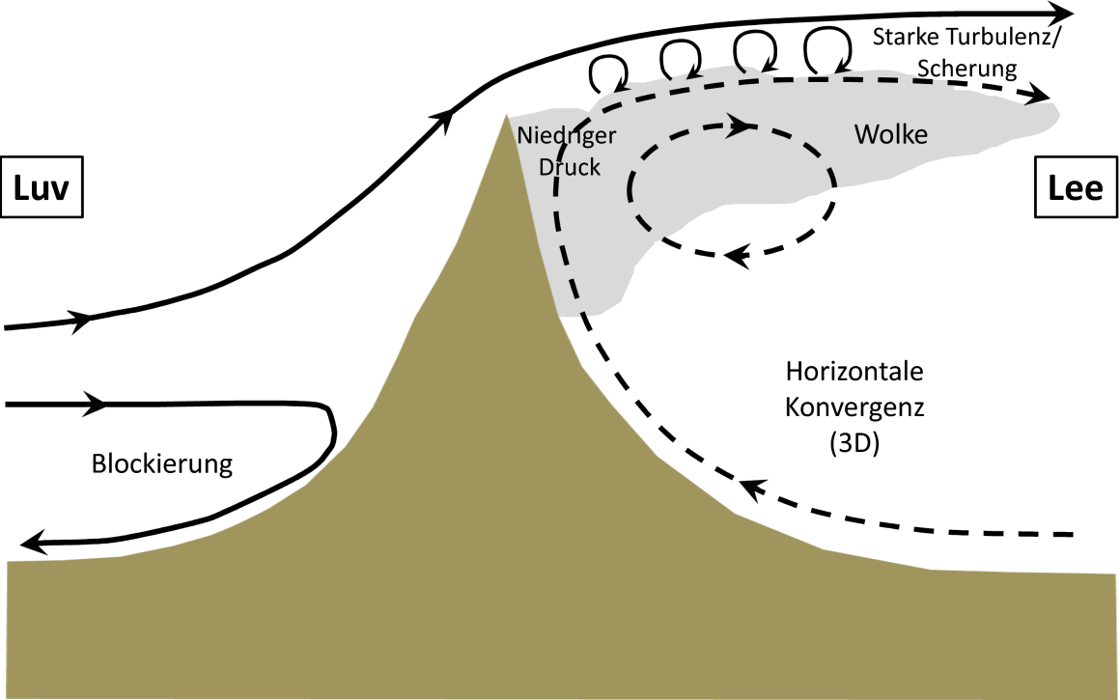
Mechanism behind
Bernoulli-Theory: Formation due to reduction of pressure (adiabatic expansion) in the area of strong acceleration close to the summit
(Beer, 1974)
Fog-mixing-Theory: The mixing of two differently saturated air masses with different temperatures and specific humidity (Humphreys, 1964)
Lee-rotor-Theory: The banner cloud is the visible result of forced ascent in the upwelling part of the lee rotor (Glickman, 2000)

Slide 6
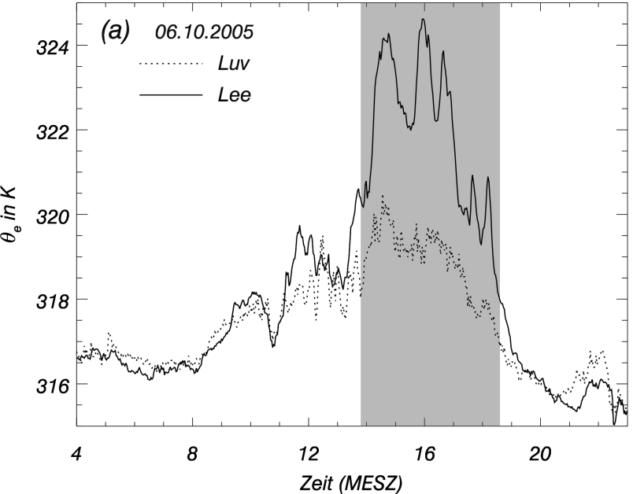


Meteorological conditions
  Leeward air is 3-4K warmer and 40-70% more humid then the cloud free air on the windward side.
  i.e. locally very strong instable stratification;
  even so the appearance of the cloud is stable and persistent
Bannercloud
Messungen am Zugspitzgrat (2005)

Slide 7
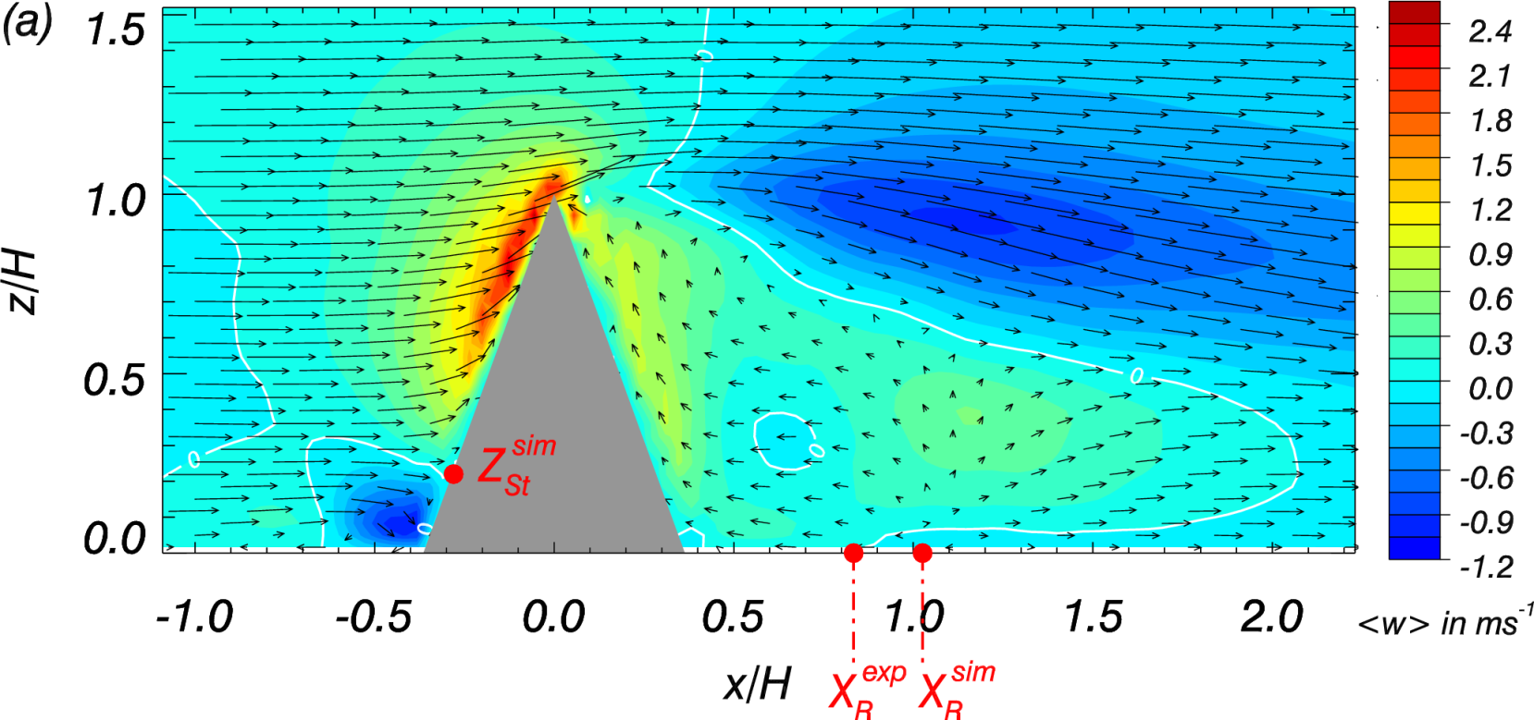
Previous work
Area of lifting
Staupunkt
Reinert, D., and V. Wirth, 2008

Slide 8
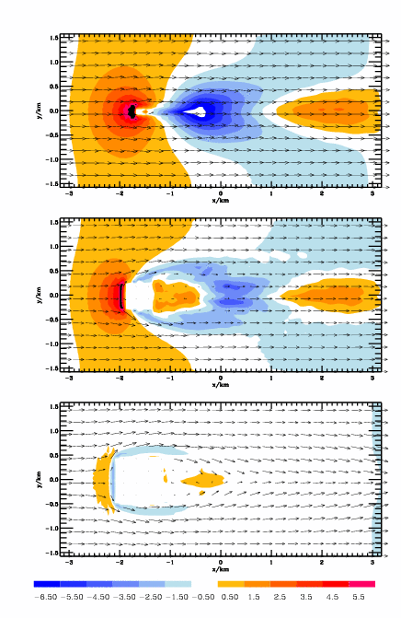
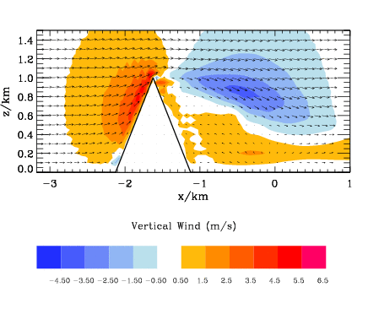
Simulations with EULAG
Significant ascent in the lee
Strong asymmetry between windward and leeward flow field
Larger vertical extent of ascending region in the lee ward side

Slide 9
That supports the lee rotor theory
In order to gain information about the needed thermodynamic profiles lagrangian information is important

Slide 10

Initializing of a passive tracer
z
Δz: mean vertical displacement
z_{s}
z_{s}
x
Advection of a passive tracer
Initialized by its altitude at t0

Slide 11
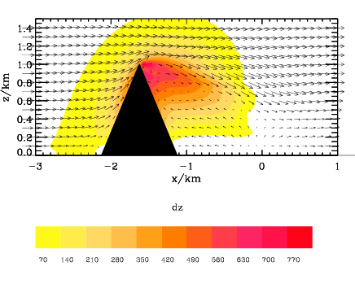
Mean vertical displacement, m
Strong windward leeward asymmetry
Strongest positive vertical displacement in in lee
Different air masses or additional sources of humidity are not necessary
Similarity of the tracer field to the banner cloud

Slide 12
Thermodynamic conditions
 | Thermodynamic Properties | Dynamic Properties
 | LCL(z_{s}) Vertical profile of the Lifting Condensation Level as a function of starting height z_{s}. | Vertical profile of the mean maximum height of air parcels in the very near of the leeward/windward side as a function of the starting height z_{s}.
 | 1 profile | 1 profile for the leeward and 1 profile for the windward side

Slide 13
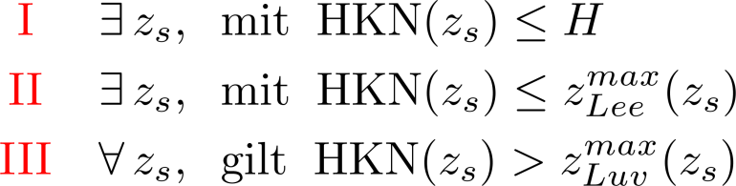
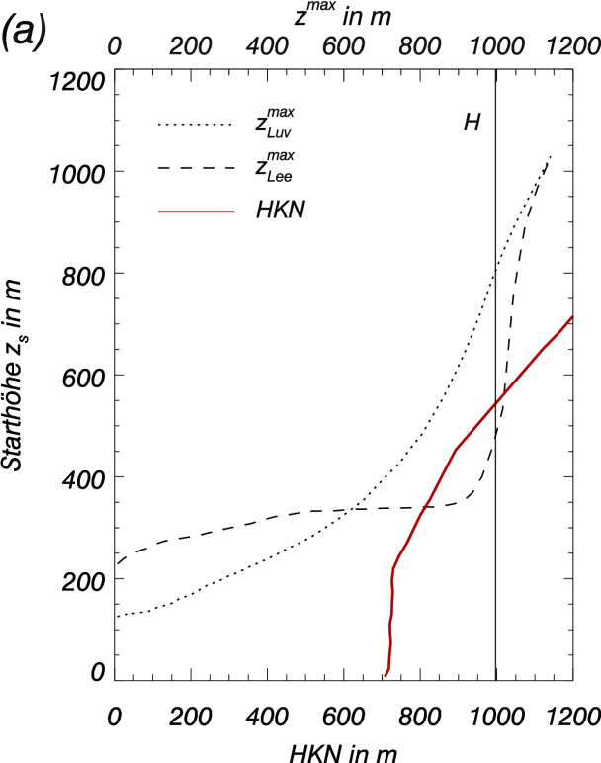
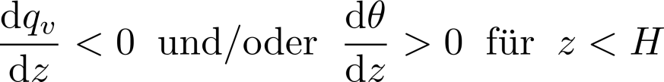
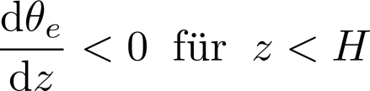
Conditions:
with LCL
with LCL
LCL
Diagram shows Situation that fulfills the conditions
Implications for the profiles of θ, q_{v}, θ_{e}
  LCL-Profile cannot be constant in height; needs to increase with height
  Very favorable are the situations with:
LCL
LCL

Slide 14
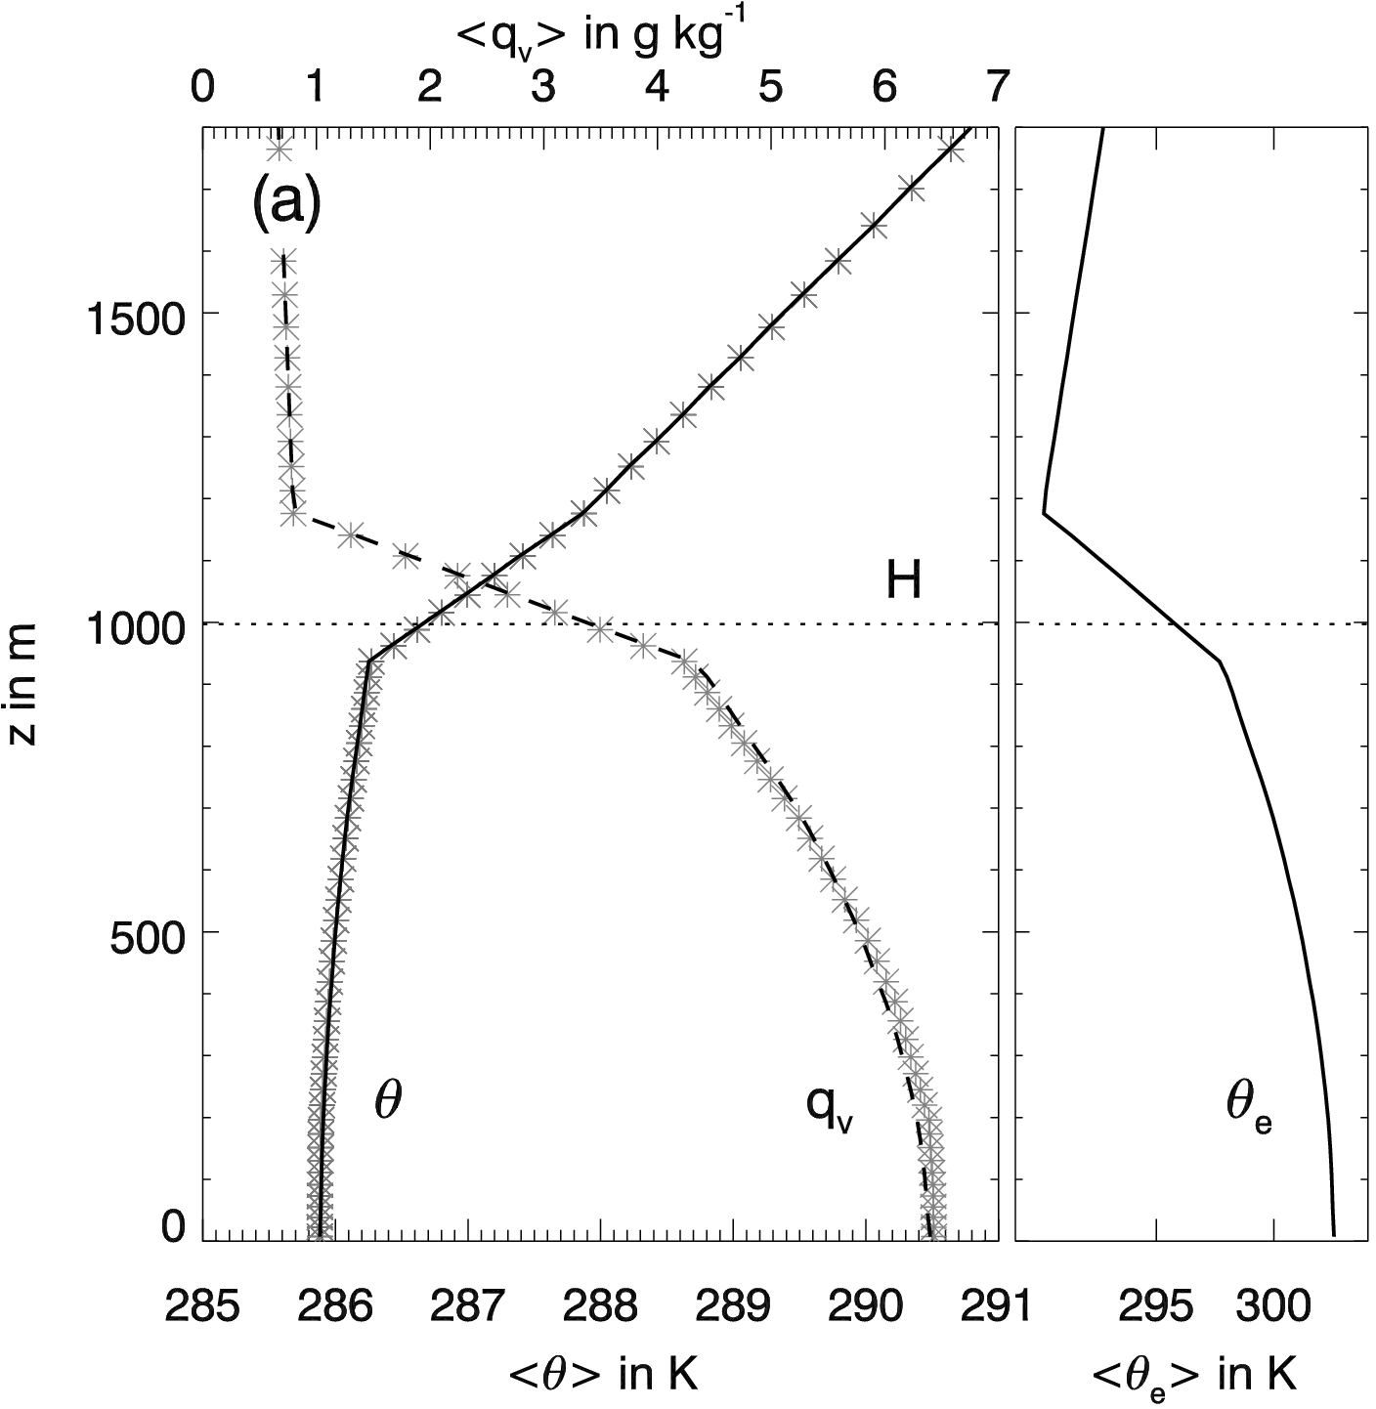
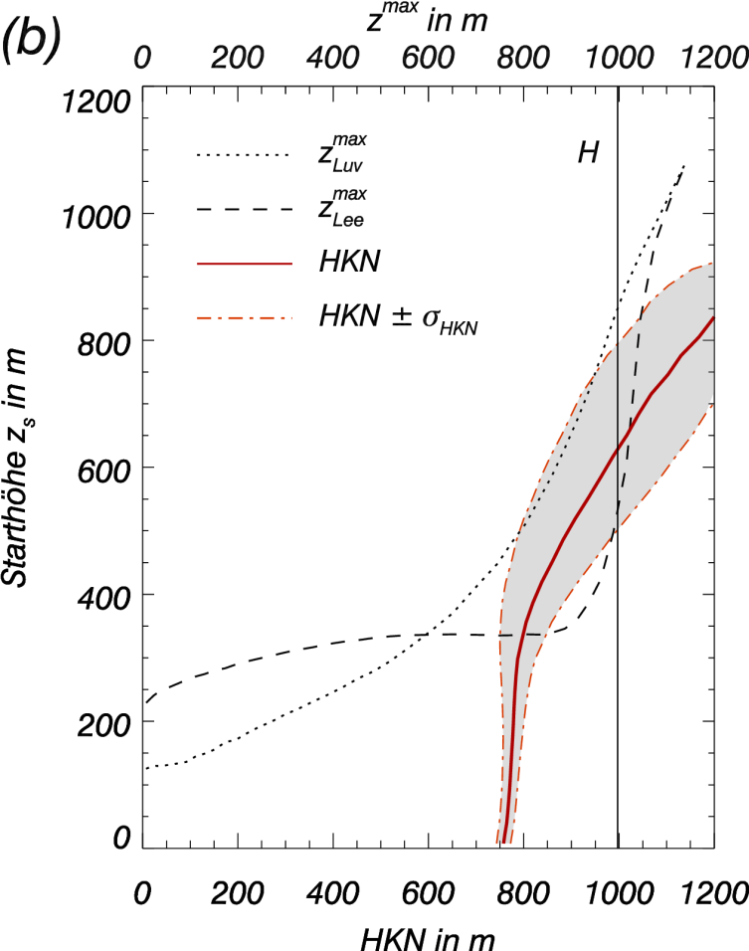
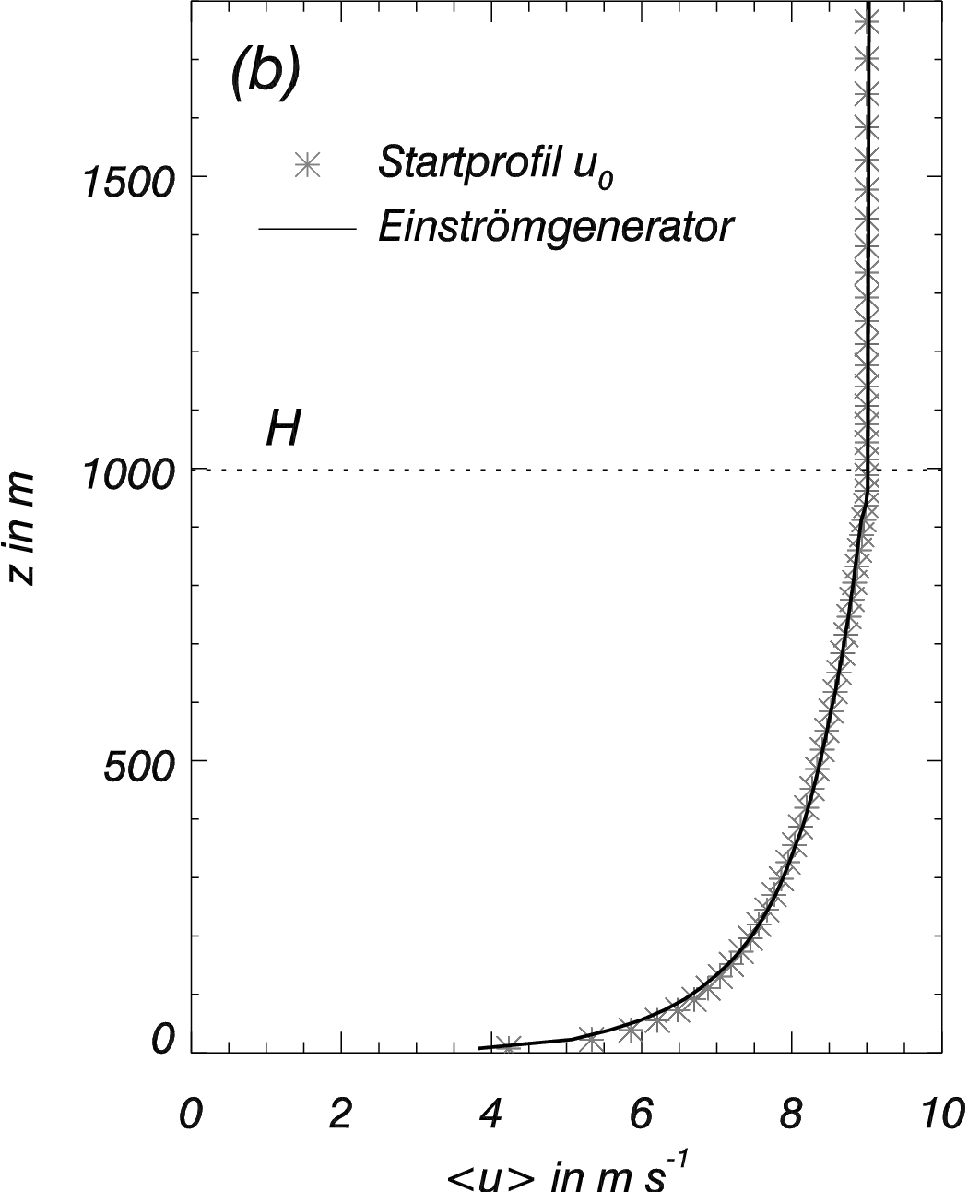

Initial conditions of the simulations
Structure of the profiles motivated by measurements at mount Zugspitze during a banner cloud event
Precise form was adapted to match the defined criterions
Mean environmental profiles for θ, q_{v}, θ_{e}
Satisfy the criterions
Mean environmental profile for u
moist stable
LCL
LCL
LCL

Slide 15
Simulated banner cloud
Unfortunately the banner cloud simulated by EULAG is still not available…
but coming soon

Slide 16
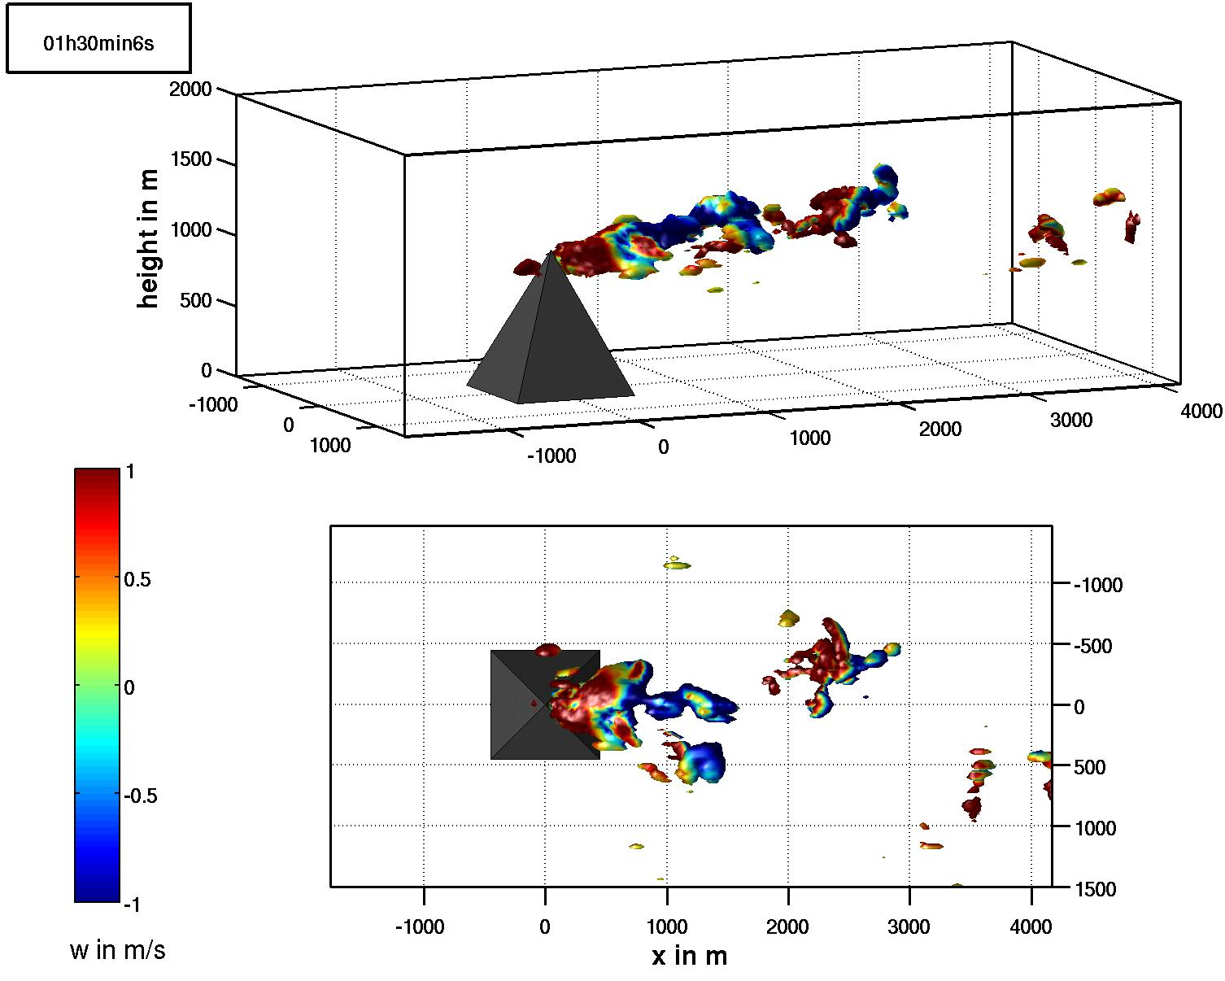
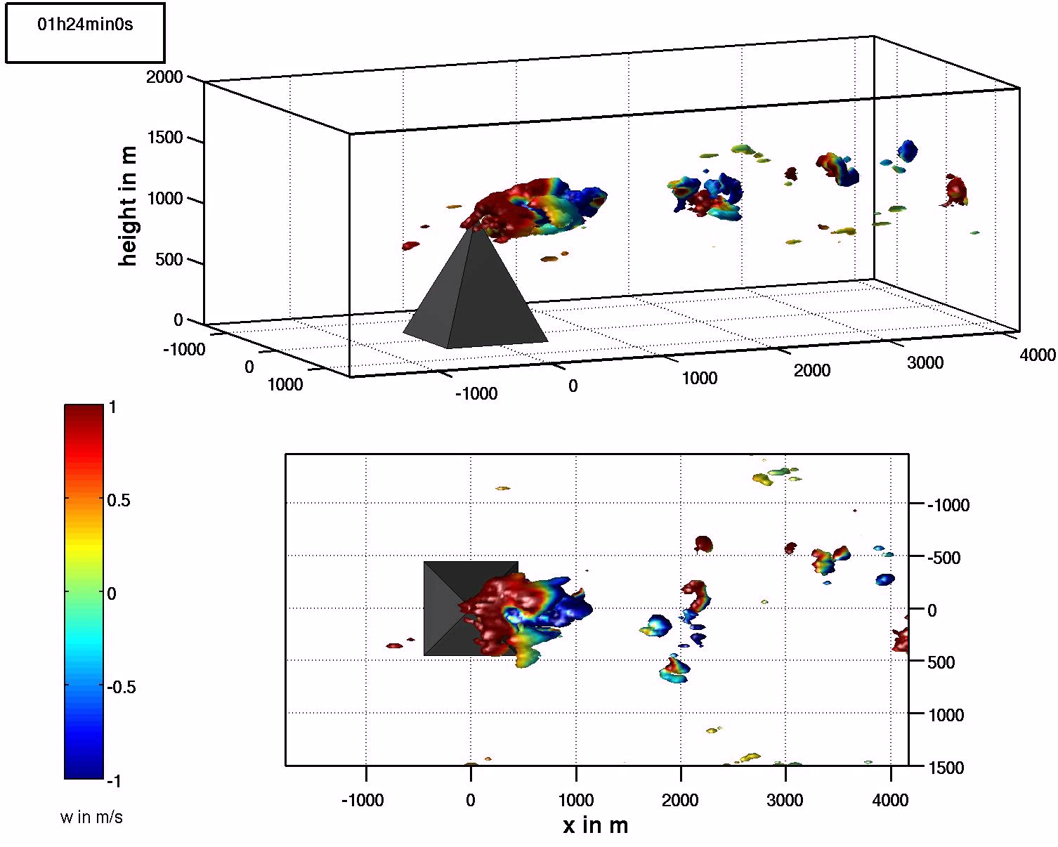
Simulated banner cloud of previous study
Iso-surface of the specific cloud water content q_{c}, colors show the instantaneous vertical velocities
Draufsicht

Slide 17
Sensitivity of the cloud on the LCL profile
Conditions:
with LCL
with LCL
LCL

Slide 18

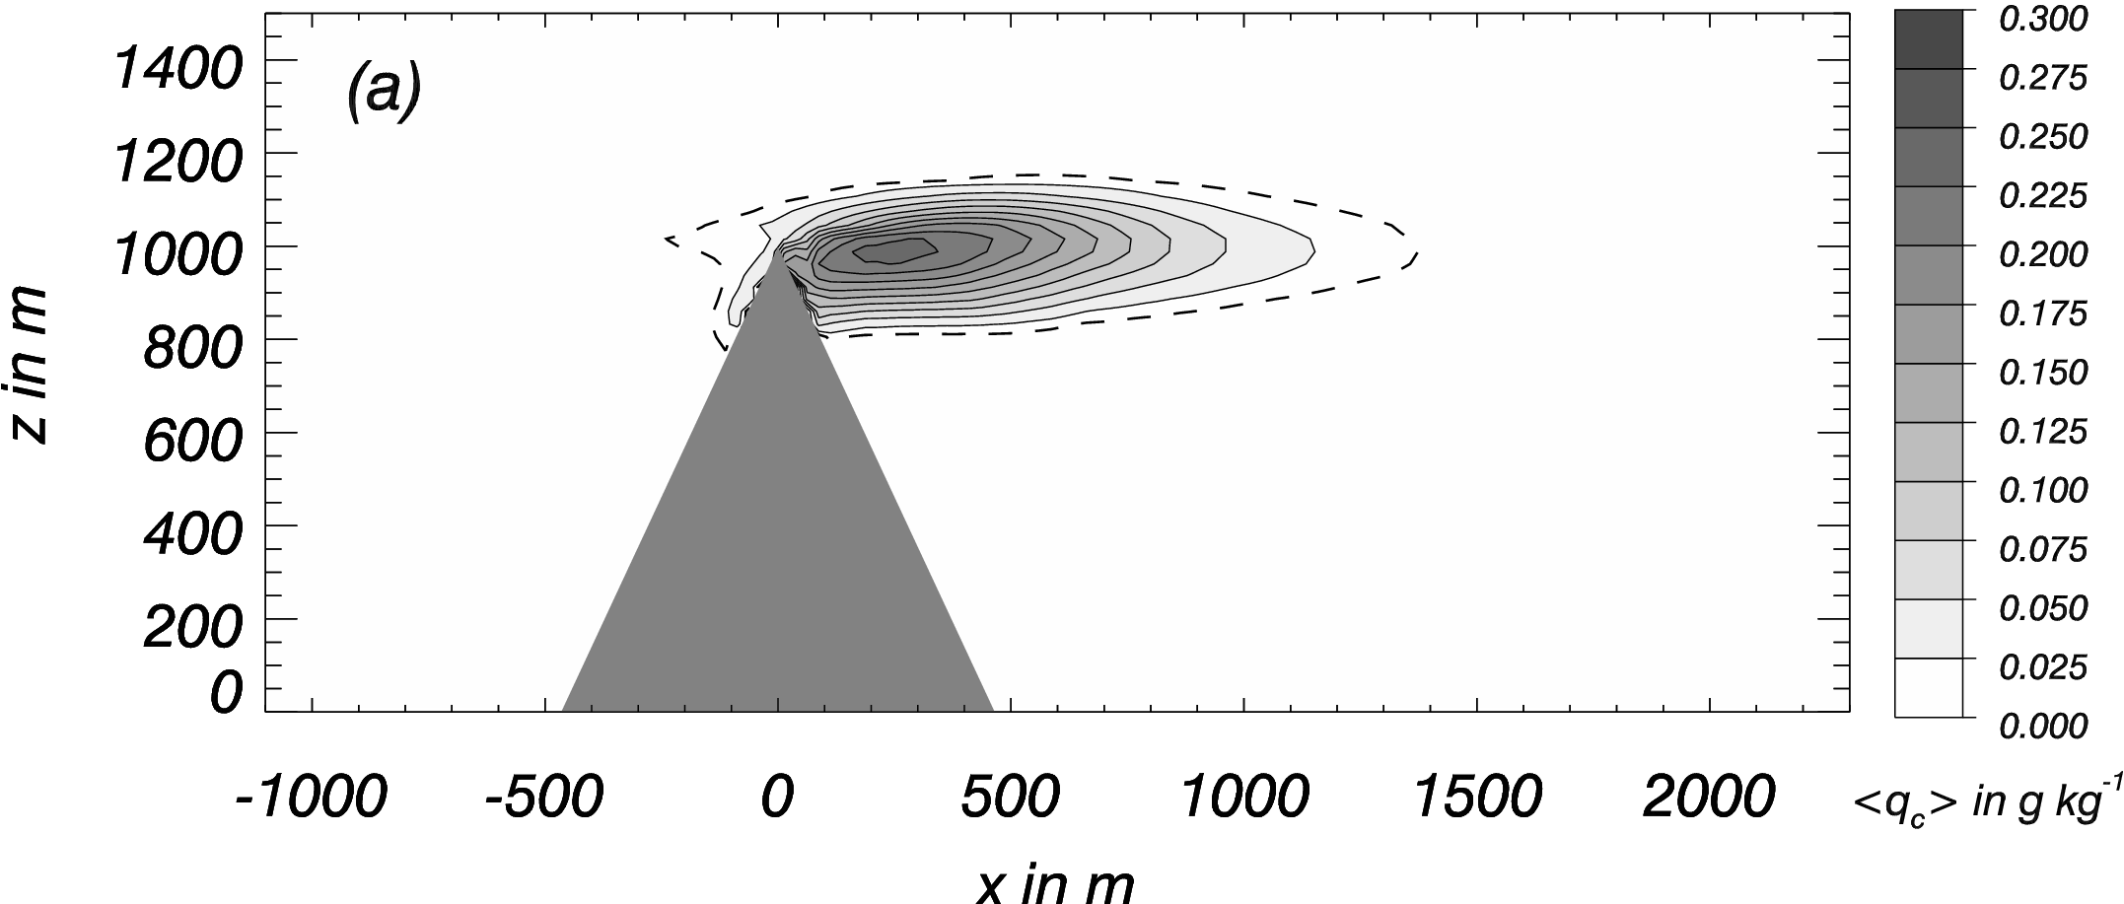
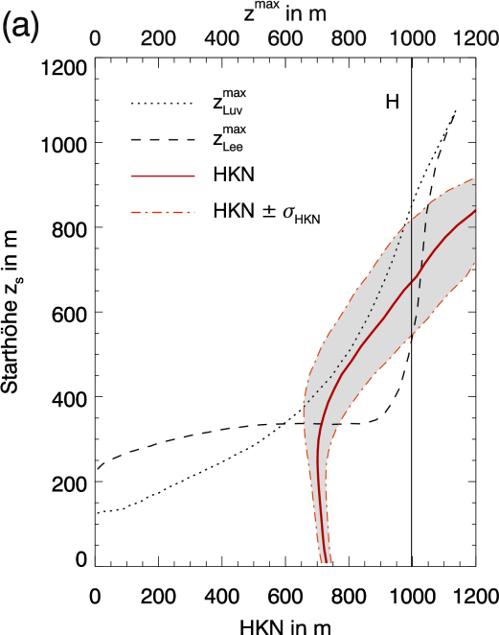
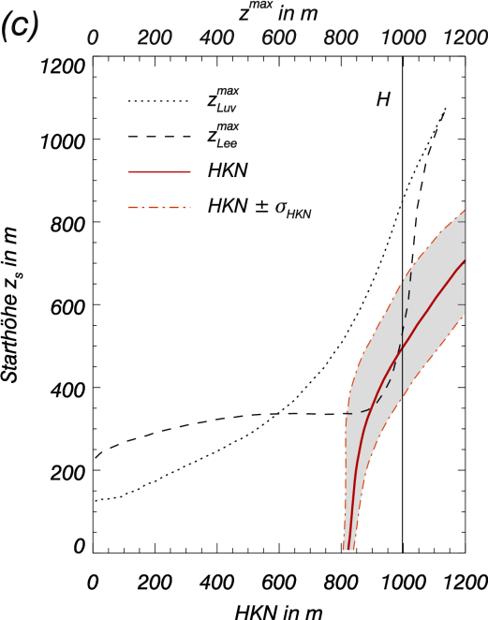
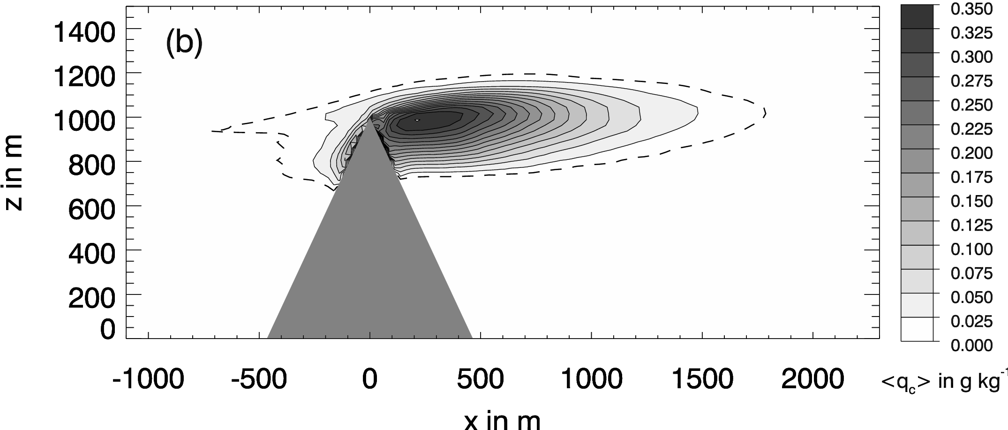
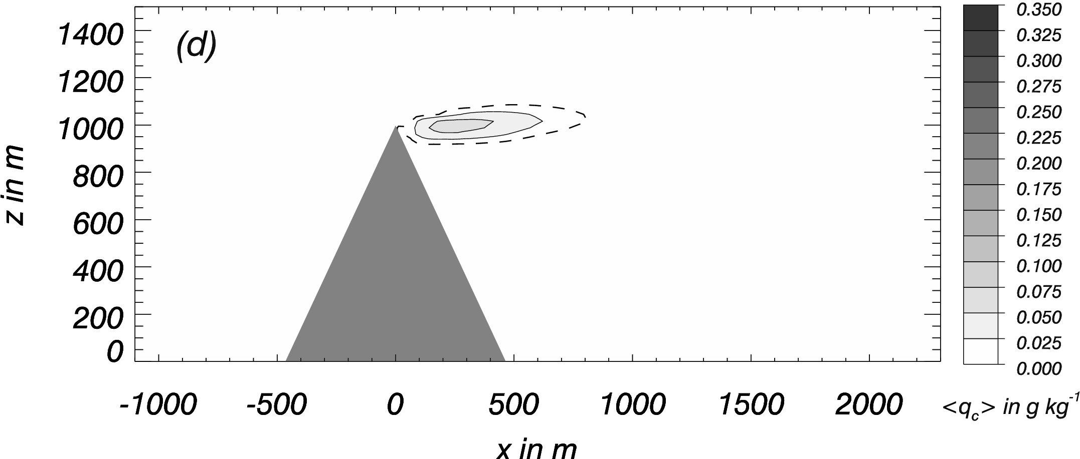
Sensitivity of the cloud on the LCL profile
Mittlerer Wolkenwassergehalt
Mittlerer Wolkenwassergehalt
Mittlerer Wolkenwassergehalt

Slide 19
Simulation compared to measurements
Typical observation for banner clouds:
higher values for T, q_{tot} (and so θ_{e}) in the lee
Bannercloud
Messungen am Zugspitzgrat (2005)

Slide 20
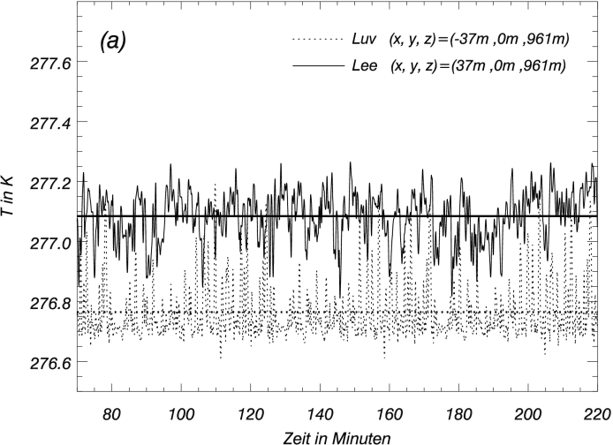

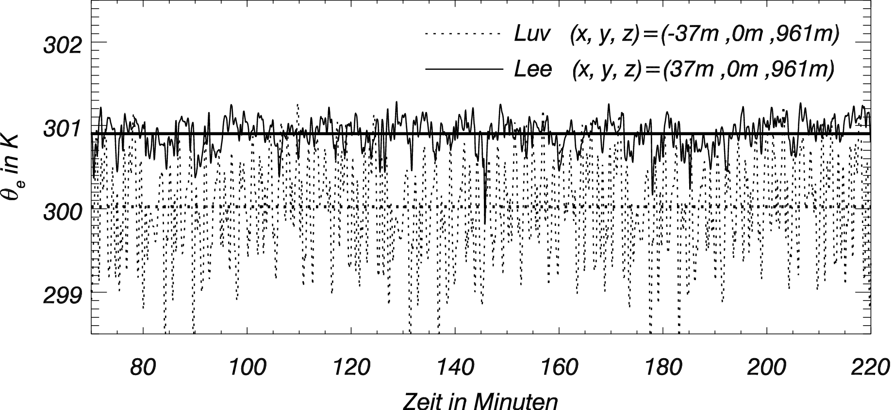

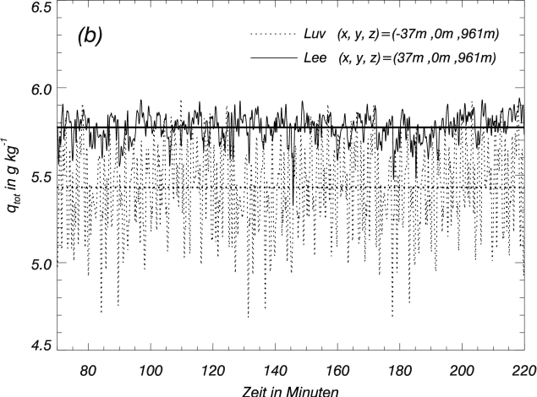

Simulation compared to measurements
Time series of θ_{e}, q_{tot}, T for simulated Banner cloud
Lee
Lee
Lee
Higher values of T, q_{tot} (θ_{e} ) in the leeward side in the simulation. This is the result of the differential lifting and the gradients in the imposed profiles of T and qtot

Slide 21
Summary
Recent research of our group strengthened the lee-rotor-theory as the mechanism behind the formation of the banner cloud.
(dynamic phenomenon)
The thermodynamic conditions had been identified for the case of a steep pyramidical shaped mountain
EULAG reproduced some of the results of previous simulations that give confidence if the previous results

Slide 22
Outlook
After the successful simulation of the banner cloud with EULAG the next steps will be
Investigation of the banner clouds on quasi 2D mountain ridges (like mount Zugspitze)
Use of real topography
Use of trajectories instead of the passive tracer
Investigations on the sensitivity of the static stability of the Flow. Is there a regime
a < Fr < b beyond the banner cloud cannot occur (e.g. due to the missing lee rotor)

Slide 23
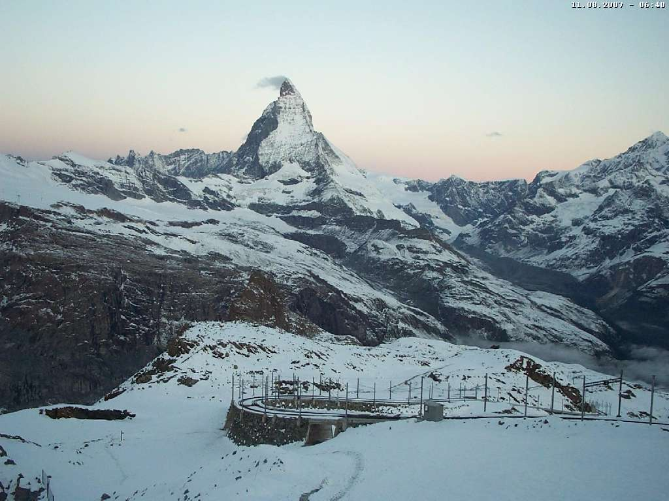
Thank you

