Slide 1
A Non-oscillatory Forward in Time Formulation for Incompressible Fluid Flows
Joanna Szmelter, Pradeep K Manickam

Slide 2

NFT Framework
For the generic equation
The NFT framework is written as
Explicit
Implicit
(non-symmetric Krylov subspace elliptic solver)
(P.K.Smolarkiewicz et.al., Monthly weather review,1993)

Slide 3
Governing Equations
Continuity equation
Momentum equation

Slide 4
Flow over a cylinder
Slip boundary
Outlet
Inlet
Slip boundary
No slip boundary

Slide 5

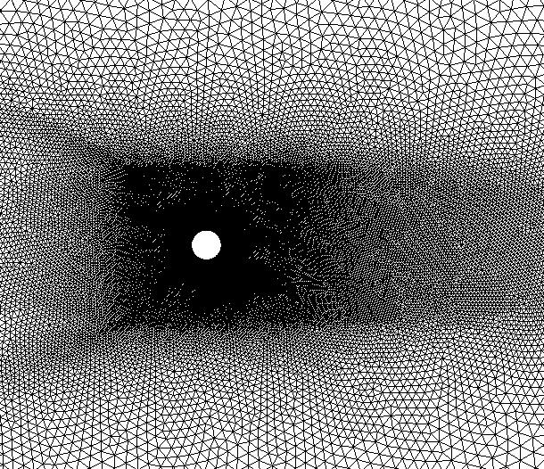

Computational mesh
Triangular
Hybrid

Slide 6
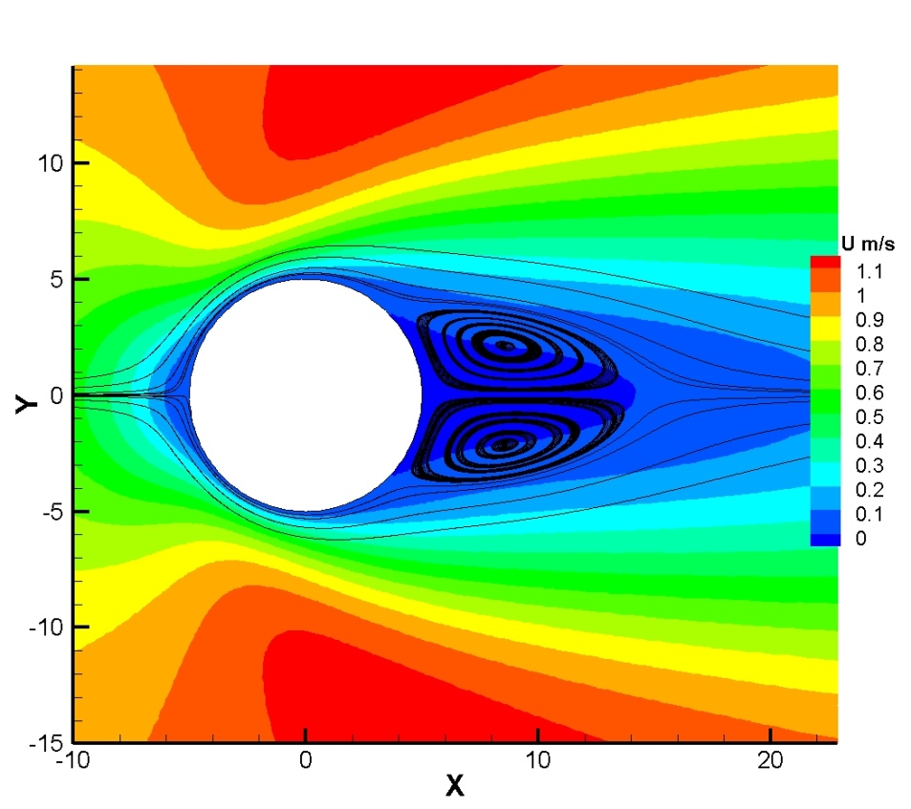
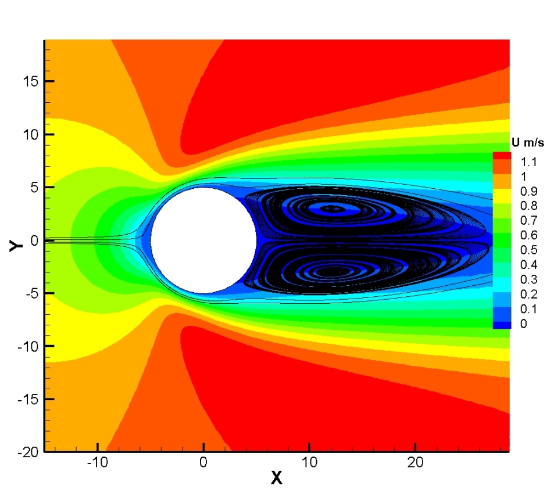
Velocity contours
Reynolds number 20
Reynolds number 40

Slide 7
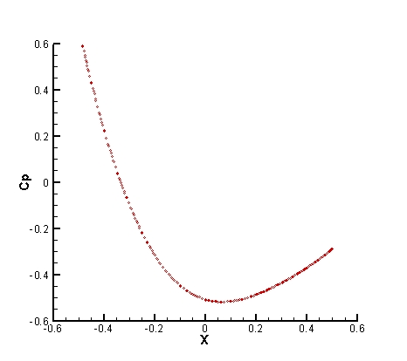
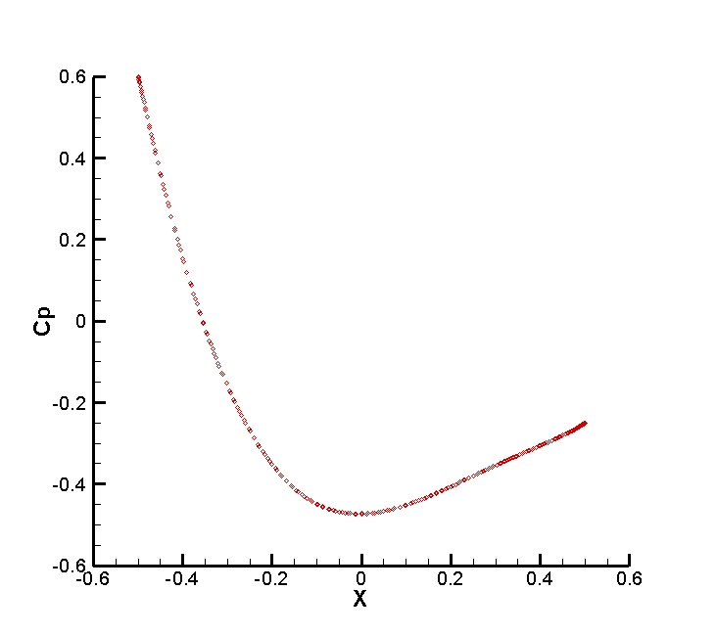
Pressure coefficient
Reynolds number 20
Reynolds number 40

Slide 8
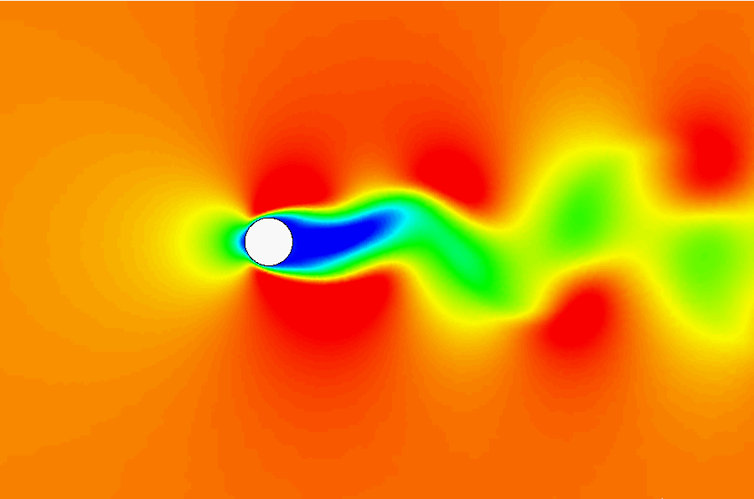
Periodic vortex shedding at Reynolds number 100

Slide 9
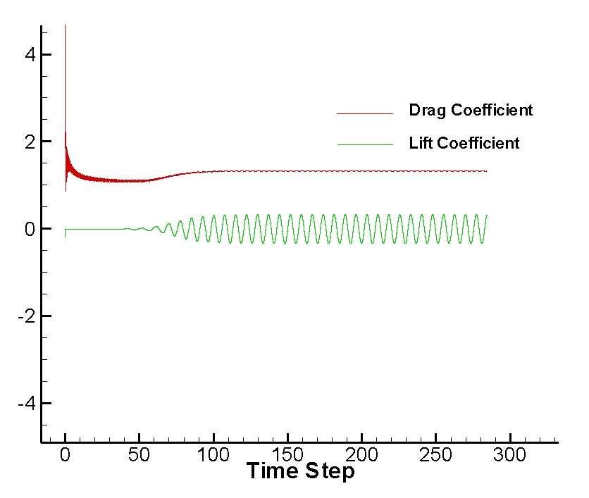
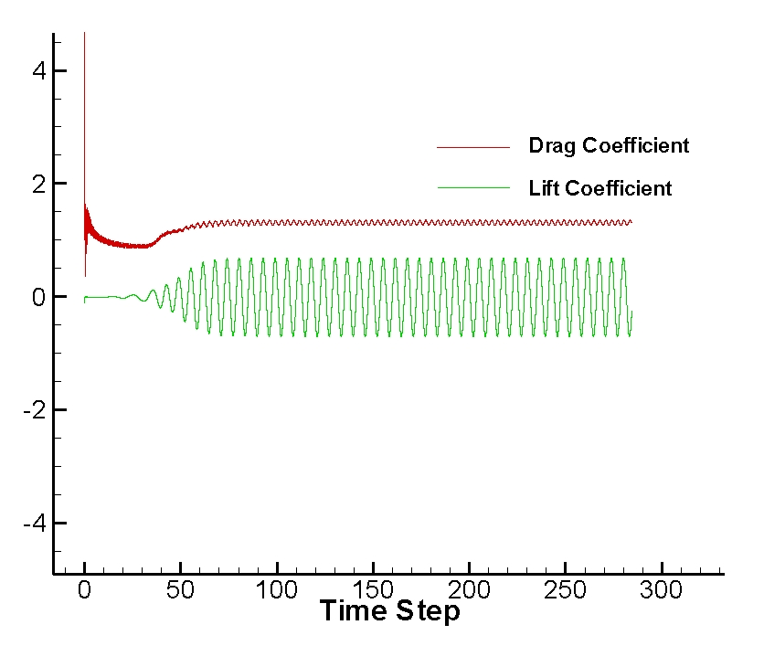
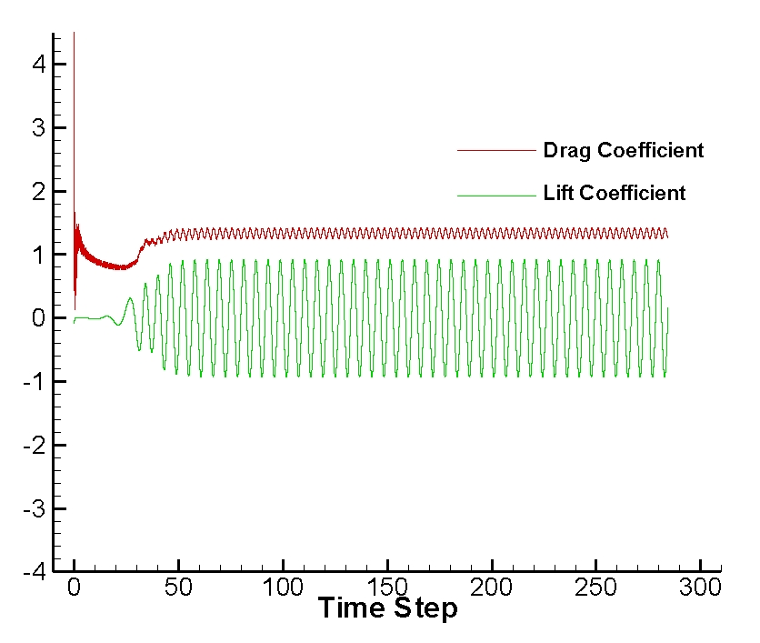
Drag and lift coefficients
Reynolds number 100
Reynolds number 200
Reynolds number 300

Slide 10
Drag Coefficient

Slide 11
Strouhal number

Slide 12
Summary
The NFT MPDATA edge based solver shows good agreement for the
initial computations. The next stage includes further validation for
turbulent flows.

