Slide 1
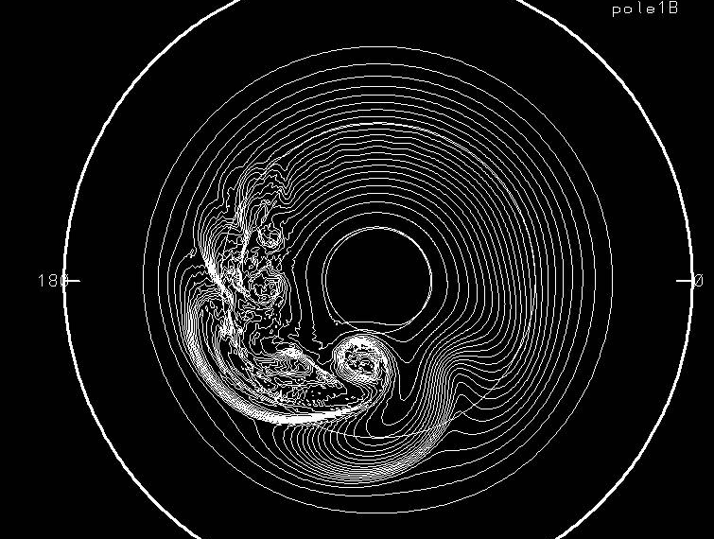
Multi-scale Waves in Sound-Proof Global Simulations with EULAG
3rd International EULAG Workshop, Loughborough, UK
J.M. Prusa¹ and W.J. Gutowski²
¹Teraflux Corporation, Boca Raton, FL; jprusa@bellsouth.net
²Iowa State University, Ames, IA; gutowski@iastate.edu

Slide 2
EULAG Computational Model (see Prusa, Smolarkiewicz, and Wyszogrodzki, J. Comp. Fluids 2008 for review)
NFT integration algorithm
• SL or fully conservative Eulerian advection
• Robust, preconditioned non-symmetric Krylov solver for pressure
• Implicit integration of θ perturbation
• Nonhydrostatic, deep moist anelastic equations
• Demonstrated scalability to thousands of PE’s
• GA via continuous remapping of coordinates
• Turbulence model options: DNS, LES, or ILES
Notes:
NFT works by maintaining “convexity” of flow; NOT flux limiting.
2. Pressure equation generated via exact projection of momentum equations onto continuity. Allows conservation to round off error.
3. Implicit theta integration increase accuracy of gravity waves. Generally, working with perturbation fields allows subtraction of known balances from equations and improves convergence/accuracy.
4. Default anelastic is lipps-hemler.

Slide 3
JW Baroclinic Instability Test (Jablonowski and Williamson, QJRMS 2006)
Idealized dry global baroclinic instability test
• Balanced initial state with prescribed environmental profiles
• Gaussian perturbation in zonal wind introduced to seed a perturbation to “grow” baroclinic instability
• Instability grows linearly for first 8 days. Characterized by (i) distinct waves, and (ii) amplitudes that grow exponentially in time
• Nonlinear interactions after 8 days and wave breaking after 10 days
Notes:
Baroclinic instabilities grow by converting PE associated with mean horizontal Grad(T) required for thermal wind balance (Holton, p 229) … into perturbation KE
Initially seeded disturbance is barotropic, 1 m/s at 40 deg. N and 40 deg. Long.

Slide 4
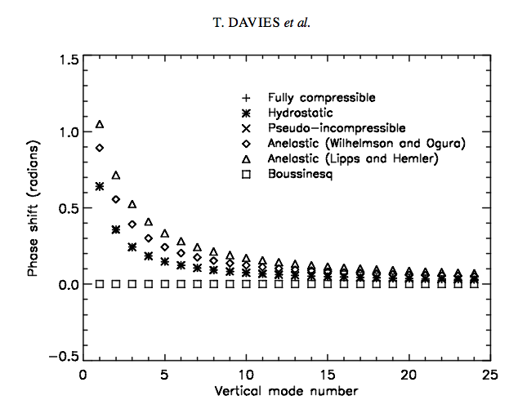
Linear Modal Analyses:
• Davies et al, QJRMS 2003 – 2D normal mode f-plane, isothermal analysis used to rigorously examine sound-
proof systems:
(i) “merit for small-scale motions
is well recognized”
(ii) Anelastic not good for amplitudes and height scales of external plane-tary modes, nor for finite amplitude
Lamb (acoustic) waves
(iii) Anelastic introduces phase error for deep wave modes
• Arakawa and Konor (MWR 2009) – analysis of Davies et al. extended to β-plane with similar conclusions.
Notes:
1. Bannon: piezotropic exponent (ie, rev. adiabatic expansion) for anelastic 1/(1-Gam*R/g) where Gam = lapse rate. For Gam = 10K/km, then exponent = 1.4 =cp/cv=gam, but for 7 and 0 K/km it is 1.25 and 1.
2.Bannon: anelastic system DOES have isentropic compressibility = rho^-1 x drho/dp (basic state variables). CANNOT rewrite in terms of sound speed… so use gam*R*T = g*H_rho instead.
3. Davies et al., FIGURE - compressible, hydrostatic, and psuedo incompressible all same; anelastic shows significant phase errors for deep waves; error independent of zonal wavelength.
4. NOT RECOMMENDED for NWP or climate simulation at ANY SCALES.

Slide 5
JW test 2
Balanced initialization for EULAG
is not given by JW initialization
–> A good match in linear regime will not occur unless the parameters controlling the waves for the balanced state match those of JW.
An elementary 2-layer, geostrophic model (Holton, 2004) – based upon the pioneering works of Charney (1947) and Eady (1949), demonstrates that linear wave properties are determined primar-ily by the mean wind <u_{e}> and thermal wind u_{T}
for representative values of static stability σ.
Notes:
Use JW temperature fields exactly as prescribed, although need to convert it into potential temperature and expressed in terms of physical altitude.
Invert geopotential to find pressure vs. altitude (done approximately).
However, zonal wind is determined from compatibility conditions (basically a thermal wind type equation) which require balance for anelastic equation set.
The “balanced” zonal wind is about 5% stronger than the JW specification.

Slide 6
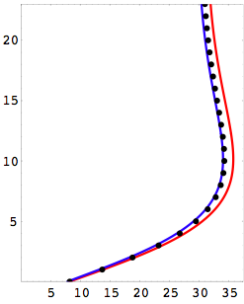
JW test 3
Balance, cont.
The thermal wind effect is secondary on phase speeds, but dominates disturbance growth rates.
, where
Env. zonal wind
JW
z (km)
balanced
balanced &
matched
If D < 0, then D^{1/2} = iζ and
τ = 1/(k ζ) is the growth rate
u_{e} (ms⁻¹)
Notes:
The balanced initialization for EULAG results in phase speeds about 5% too fast, using u00 = 35 m/s as per JW prescription. However, this balanced profile does not match the mean zonal wind of JW. When u00 is reduced 5%, then the mean wind for EULAG’s zonal wind profile matches that for JW and so do the resulting phase speeds!
Lambda(sigma) is wavenumber like term arising from environmental stability: lambda^2 = f0^2/(sigma * dp^2); and sigma = -RT_o / p_o dThe/dp
Estimated time scales for growth are ~ 2.0 days, vs 1.5 in EULAG results. Growth ~ - const * u_T and ~ sigma

Slide 7
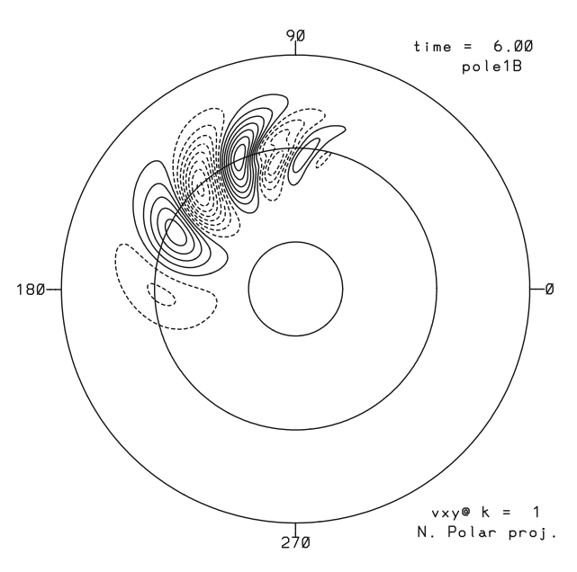
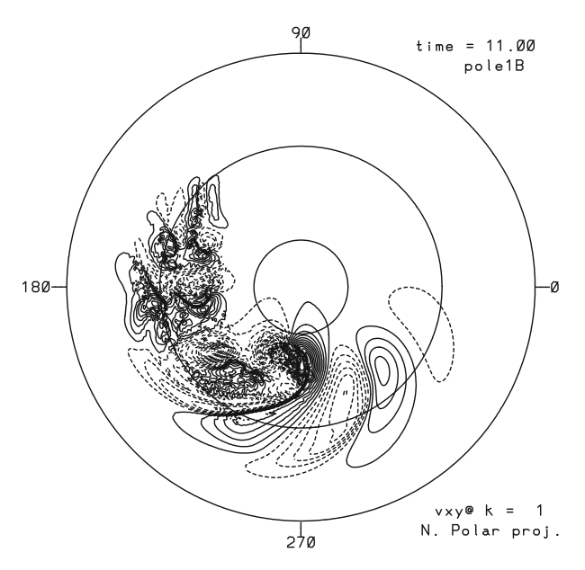
Baroclinic Instability Test: Linear and wave-breaking regimes (Jablonowski and Williamson, QJRMS 2006)
Meridional wind field (global 0.7º resolution)
(mx, mn, cnt)=(6, -6, 0.8) ms⁻¹
(mx, mn, cnt)=(40, -40, 3) ms⁻¹
Notes:
Latitude circles @ 15, 45, 75 degrees.
LEFT: linear baroclinic wave regime: highly regular well defined DISPERSIVE wave train. Wave speed is westward RELATIVE TO MEAN ZONAL WIND; with longer waves having faster relative westerly motion.
RIGHT: nonliinear breaking baroclinic wave regime: leading edge of wave packet still linear but packet core is undergoing breaking with generation of extreme gradients limited by numerical resolution followed by wake region of broken waves in trailing portion of wave packet.

Slide 8
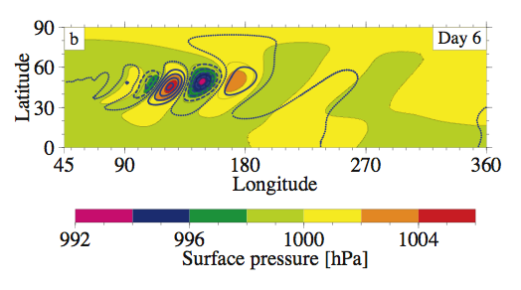
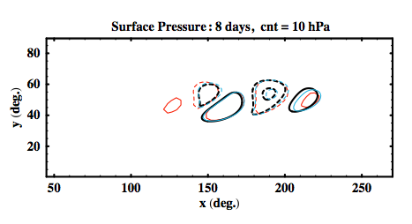
JW test 5
Surface Pressure Comparisons
BELOW:
resolution effects for EULAG simulations
Red - 2.8º resolution
Aqua - 1.4º
Dark Blue - 0.7º
ABOVE:
Color - JW results using CAM
FV dycore
Blue dots/dashes - EULAG
Δc_{x}/c_{x} ~ 0.3%
Notes:
UPPER RIGHT: FV dycore resolution is 0.5 x 0.625 degrees (colors). EULAG results at 1.4 x 1.4 degrees (BOLD blue solid & dashed contours). EULAG matches FV phase speed and amplitude in wave packet core. In particular the delta in wave speed is 0.1 m/s ~ 1%.
LOWER RIGHT: Effects of grid resolution on EULAG results show numerical dispersion effects are negligible in wave packet core.
Grid dependent resolution effects on dispersion do not fully account for differences between EULAG and JW at wave packet edges.

Slide 9
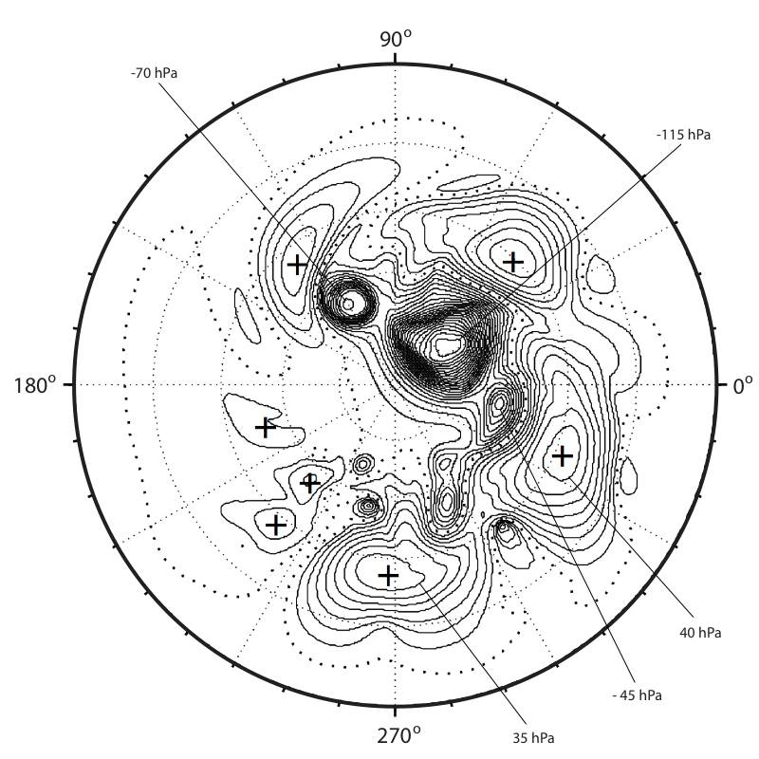
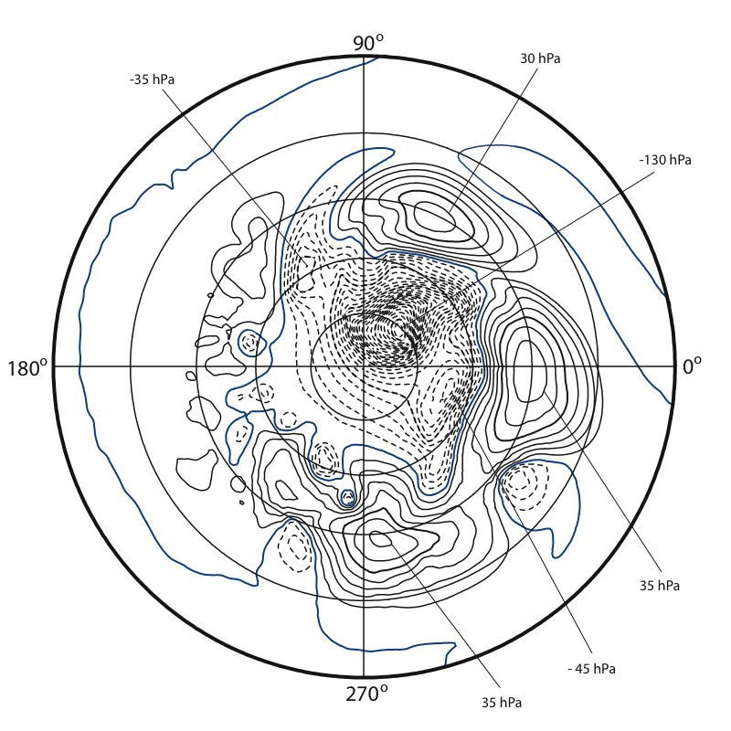
JW test 6
Surface Pressure:
High resolution grid: 16 days
JW results using CAM
Eulerian spectral dycore (T172)
EULAG results using
Eulerian advection (0.7º)
Notes:
DEEP WAVEBREAKING REGIME
1. LEFT: JW Eulerian spectral dycore resolution with T172 equivalent 0.7 x 0.7 degree resolution (NYQ = mode 256).
2. RIGHT: EULAG 0.7 x 07 degree resolution result.
GOOD AGREEMENT: Amplitude of major HI’s and LO’s as well as locations of major LO’s. Only location of one of major HI’s is a good match (near 270 deg. Long.).
LESS AGREEMENT: Other HI’s showing deltas upward of 20 deg. long. with EULAG more advanced. EULAG wake region more developed. Leading HI and LO in JW results near 120 deg. long. greatly attenuated in EULAG results. Note proximity to wake region.
SUMMARY: DIFFERENCES between EULAG and JW exist, but there is broad agreement in a number of major features and overall global structure of flow.

Slide 10
How consistent are these results with
compressible linear modal analyses?
Dispersion equation for 2D β-plane approximation, assuming static, isothermal environment (AK 2009):
ω = - βk /{k² ⁺ f_{o}² [ c_{s}⁻² + H M ² (κg)⁻¹]}
where ;
• Requisite parameters: (β, f_{o}, c_{s}, κ, H) <– environment
Anelastic model: c_{s} → ∞ and μ → 1 / 2H define phase error = 1-ω_{an} /ω_{com}
Notes:
Static stability is essentially ~ N²
Mu gives “correction” for density stratification.

Slide 11
What is appropriate vertical scale for baroclinic modes?
HS simulations
→ ~ 15 km
Notes:
The balanced initialization for EULAG results in phase speeds about 5% too fast, using u00 = 35 m/s as per JW prescription. However, this balanced profile does not match the mean zonal wind of JW. When u00 is reduced 5%, then the mean wind for EULAG’s zonal wind profile matches that for JW and so do the resulting phase speeds!

Slide 12
Consistency with compressible modes (AK2009)
BAROCLINIC: Shown: β-plane –
______________________________________
Red line λ = 3950 km
Notes:
One day period from 277.0 to 278.0 days.
Expanded time interval for packet evolution requires movement in longitude!
Delta(w) = 1 cm/s

Slide 13
HELD-SUAREZ FLOWS (Held and Suarez, BAMS 1994)
Idealized dry global climate simulation
• Prescribes Rayleigh damping of low level winds to approximate PBL
• Prescribes Newtonian relaxation of temperature to emulate radiative heat transfer
• Held-Suarez (HS) climate develops in an approximately stationary, quasi-geostrophic state that replicates essential climate features
Notes:
Replicates mean meridional circulation: including features such as equatorial easterlies, westerly mid-latitude jets, as well as surface fronts.
All figures from simulations with 1.4 deg. Horizontal resolution.

Slide 14
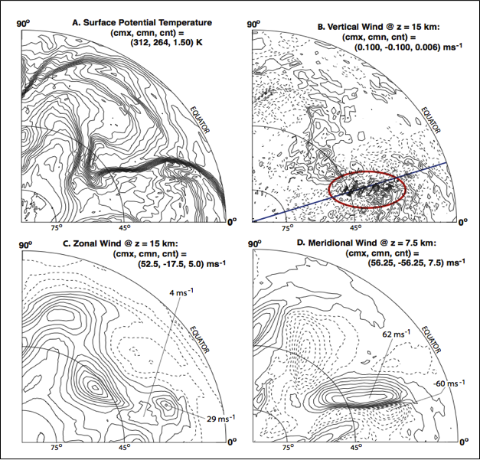
Event NW5 @ 277.50 days N. Polar proj.
NW5: yz slices
Notes:
Upper Left panel shows surface front moving east (counterclockwise rotation of front).
Upper Right panel shows internal gravity wave packet likely generated by (I) low level front, and/or (ii) resulting zonal jet oscillations. BLUE LINE: plane of yz slices in following animation and still frames.
Lower Left: zonal wind showing jet oscillations and pinched off core element to south
Lower Right: meridional wind showing extreme shear of 120 m/s over EW extent of wave packet.

Slide 15
Vertical Wind Field @ 15 km for 0.7º deg grid N. Polar proj.
cmx = 0.21
cmn = -0.21
cnt = 0.02
Notes:
Upper Left panel shows surface front moving east (counterclockwise rotation of front).
Upper Right panel shows internal gravity wave packet likely generated by (I) low level front, and/or (ii) resulting zonal jet oscillations. BLUE LINE: plane of yz slices in following animation and still frames.
Lower Left: zonal wind showing jet oscillations and pinched off core element to south
Lower Right: meridional wind showing extreme shear of 120 m/s over EW extent of wave packet.

Slide 16
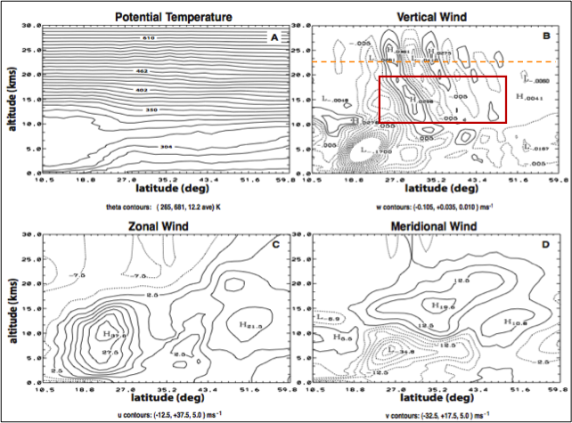
NW5 – Vertical x NS cross section meridional slice @ 18 deg. Long.
HS, cont.
Notes:
One day period from 277.0 to 278.0 days.
Expanded time interval for packet evolution requires movement in longitude!
Delta(w) = 1 cm/s

Slide 17
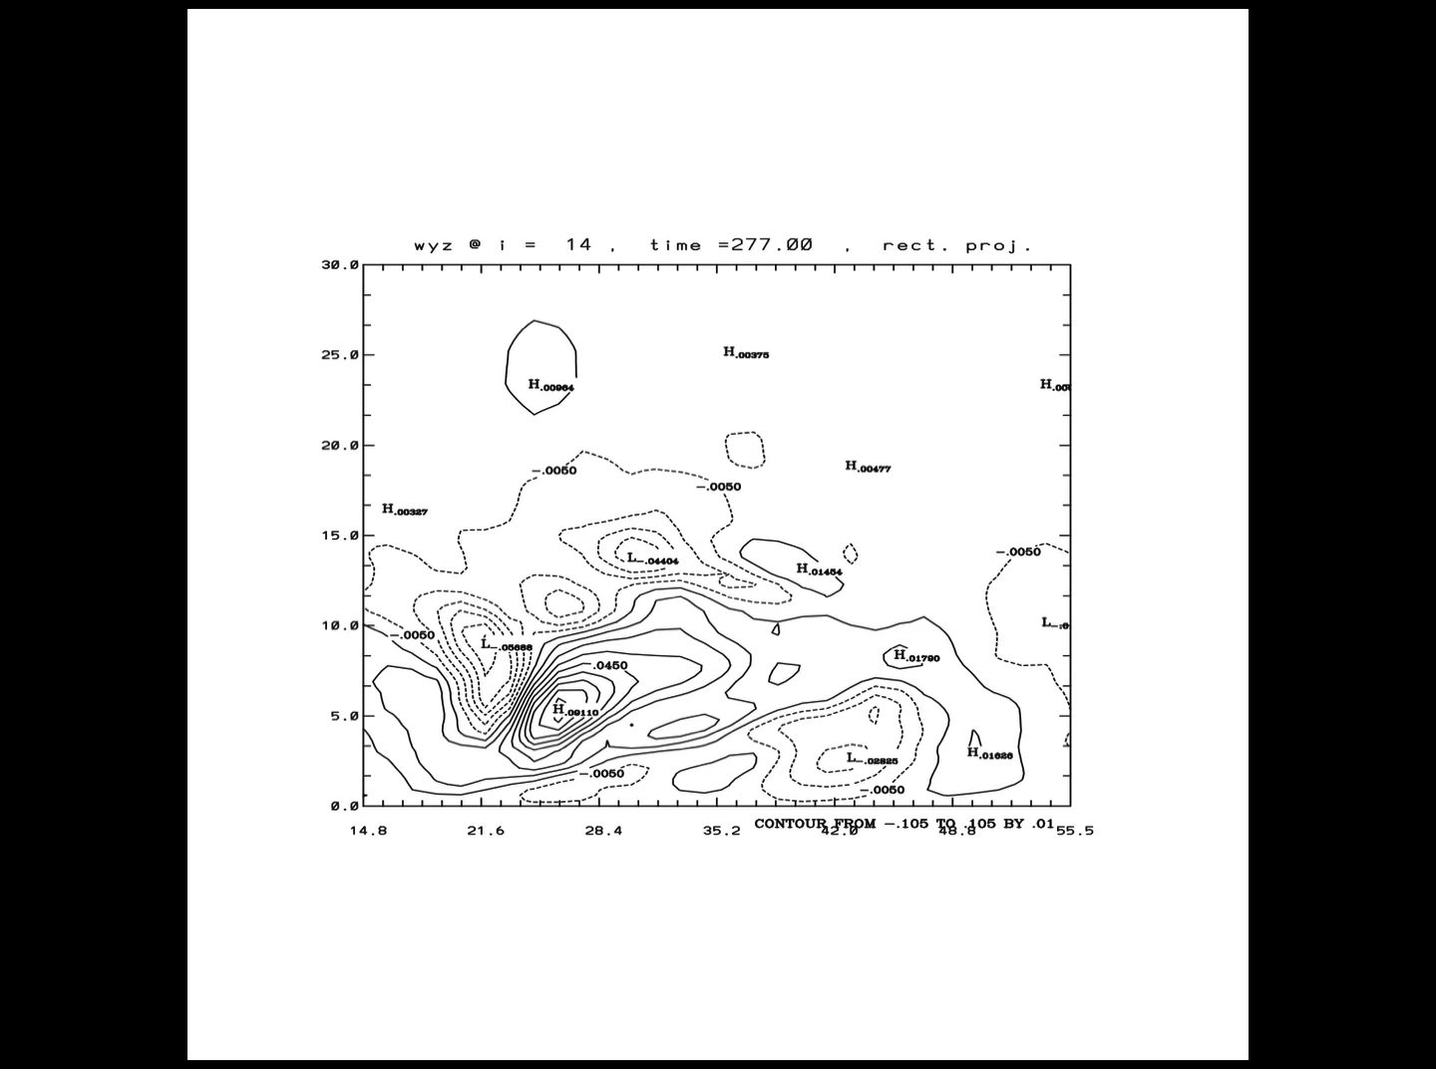
NW5 animation: meridional slice @ 18 deg. Long.
HS, cont. 6
Notes:
One day period from 277.0 to 278.0 days.
Expanded time interval for packet evolution requires movement in longitude!
Delta(w) = 1 cm/s

Slide 18
NW5 event: Analysis
HS, concluded
• Observed properties
• Deduced properties
(via dispersion eq. for IGW’s)
P_{i} = 5.3 hr
λ_{x} = 550 ± 60 km
λ_{y} = 620 ± 60 km
λ_{z} = 14.3 ± 1.1 km
K ²
Caveat: fields are not uniform in space or time
c_{x} = -31 ± 15 ms⁻¹
c_{y} = -32 ± 5 ms⁻¹
c_{gx} = 9. ± 1. ms⁻¹
c_{gy} = -2 ± 6 ms⁻¹
→ Choose negative root
.81
.33
c_{x} = -28.9 ms⁻¹ , c_{y} = -32.6 ms⁻¹
U_{e} = 12.6 ± 8 ms⁻¹
V_{e} = 14.9 ± 15 ms⁻¹
c_{gx} = -18.0 ms⁻¹ , c_{gy} = -12.3 ms⁻¹

Slide 19
WKB analysis: critical surface forms to the SW and blocks predicted wave propagation
Vertical structure equation indicates assumption of uniform wind may be serious error → nonlinear analysis required
WKB theory: handles effects of “weak” time and space gradients
Critical Surface defined by ω_{i} = 0 (Bretherton 1966, 1971)
Figure: ω_{i} along 215º ray into SW predicted by leading order WKB
Notes:
WKB – environmental and wave properties change slowly over a wavelength and period of waves.
Critical surface prevents vertical propagation of waves.

Slide 20
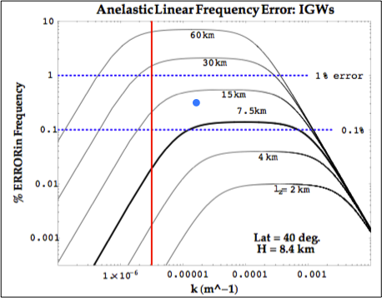
Consistency with compressible modes (AK2009)
BAROCLINIC: Shown: f-plane -
blue dot is NW5 → 0.3% phase error
______________________________________
β-plane – 0.1% phase error for λ~ 4000 km
BAROTROPIC: 0.3% phase err. for λ ~ 1500 km
Notes:
One day period from 277.0 to 278.0 days.
Expanded time interval for packet evolution requires movement in longitude!
Delta(w) = 1 cm/s

Slide 21
Remarks
• Baroclinic wave test results show excellent agreement with published results of JW (2006) in linear wave regime. REQUIRED: initialization balanced for EULAG; and
MATCHING of env. mean wind, thermal wind, and stability. In wavebreaking regime, differences arise in details.
Global HS simulations show (some) localized packets of internal gravity waves in lower stratosphere. Linear modal analysis predicts all properties of a representative wave packet except group velocity, which WKB analysis shows depends strongly upon wind gradients in local environment of waves. → Linear analyses do not give correct group velocities due to nonlinear synoptic scale wave interactions.
Notes:
environmental properties controlling baroclinic wave propagation are mean wind, thermal wind, and stability – determined via elementary 2-layer model (Holton 2004). All 3 environmental properties affect phase speed but mean wind is dominate factor.

Slide 22
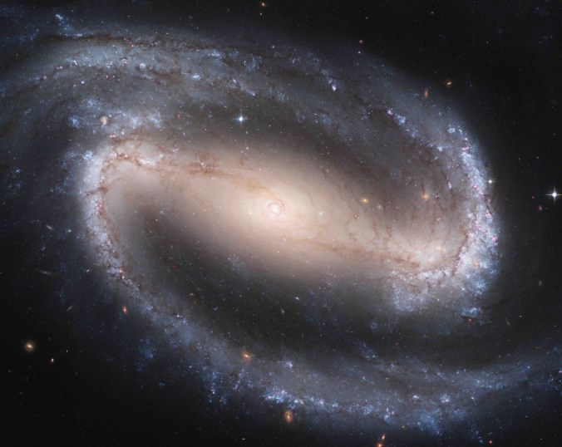

Slide 23
Why Baroclinic Motion?
“Baroclinic instability is the most important form of instability in the atmosphere, as it is responsible for mid-latitude cyclones” (Houghton, 1986)
• Baroclinic wave breaking radiates gravity waves, which act to restore geostrophic balance (Holton, 2004).
Notes:
QUITE SIMPLY …
2. OFFERS OPPORTUNITY FOR multi-wave scale interactions

Slide 24
Why Study Baroclinic Dynamics?
“Baroclinic instability is the most important form of instability in the atmosphere, as it is responsible for mid-latitude cyclones” (Houghton, 1986)
• Baroclinic wave breaking radiates gravity waves, which act to restore geostrophic balance (Holton, 2004) –> multi-scale physics
• J. Charney (J. Meteor 1947), E. Eady (Tellus 1949),
and J. Smagorinsky (MWR 1963)
• Good test case for multi-scale global atmospheric models
Notes:
QUITE SIMPLY …
2. OFFERS OPPORTUNITY FOR multi-wave scale interactions

Slide 25
Baroclinic Dynamics
• J. Charney (J. Meteor 1947), E. Eady (Tellus 1949),
and J. Smagorinsky (MWR 1963)
• Baroclinicity is due to a horizontal temperature gradient: is the baroclinicity vector, Ba
• Induced horizontal gradient in density creates yz circulation, in NH rising air moves N vs. sinking air moves S -> SLANTWISE CONVECTION
and are the resulting
geostrophically balanced, thermal winds.
Baroclinic instability grows planetary waves by convert-ing APE associated with the horizontal temperature gradients that are required for thermal wind balance (Holton, 2004)
Notes:
Charney: effect of zonal wind above 20 kms is of little consequence, and the effect of the zonal wind near 600 hPa is most significant to baroclinic waves. UNLIKE BAROTROPIC WAVES, all effects of baroclinic waves diminish to zero with height. DRY DYNAMICS OK only if w is small!
Baroclinic instabilities grow by converting APE associated with mean horizontal Grad(T) required for thermal wind balance (Holton, p 229) … into perturbation KE. Baroclinic waves convert available PE to perturbation KE (Holton, p. 251).
By contrast, BAROTROPIC wave instability takes energy out of KE of mean flow.

Slide 26
ANELASTIC elementary scale analysis– continuity (AK2009):
(i) Acoustic term:
reversible
gas dynamics
Notes:
NOTE 65 m/s (150 mph) -> M = 0.2 -> delta_theta = .02 (synoptic scale jet oscillations)

Slide 27
(ii) Thermobaric term:
Baroclinic dynamics
MOVING COLD FRONT
warm air
where
cool
air
~ 15K
Notes:
Baroclinic instabilities grow by converting PE associated with mean horizontal Grad(T) required for thermal wind balance (Holton, p 229) … into perturbation KE
Baroclinic density perturbation is similar in size to synoptic scale acoustic perturbations, to perhaps a few times larger.
For meso-scales, baroclinic density perturbation > acoustic perturbation

Slide 28
Baroclinic concerns…
• The anelastic system of equations are known to accurately represent “smaller scale” atmospheric gravity waves
But there are concerns about longer scale planetary waves, acoustic modes, and baroclinicity…
• Let , where is the anelastic basic state density. The basic state provides a hydrostatic reference that underlies the anelastic system.
0
0
• Then Ba ~
• Twisting/tilting of horizontal baroclinic vorticity will produce effects in the vertical
• (Bannon, JAS 1996a).
Notes:
0. Anelastic DOES capture much of vertical motion induced by Ba, which comes from horizontal components. Tilt/twist.
1. Baroclinic vorticity is grad(rho) X grad(p)/rho^2 and it’s sense is to create voriticity so as to reduce baroclinicity.
2. Bannon: piezotropic exponent (ie, rev. adiabatic expansion) for anelastic 1/(1-Gam*R/g) where Gam = lapse rate. For Gam = 10K/km, then exponent = 1.4 =cp/cv=gam, but for 7 and 0 K/km it is 1.25 and 1.
3. Bannon: anelastic system DOES have isentropic compressibility = rho^-1 x drho/dp (basic state variables). CANNOT rewrite in terms of sound speed… so use gam*R*T = g*H_rho instead.

Slide 29
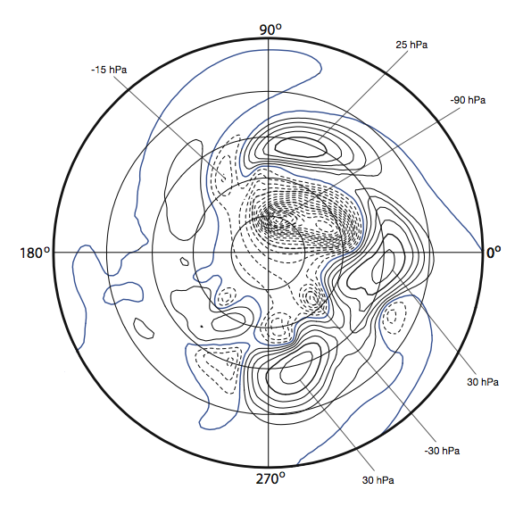
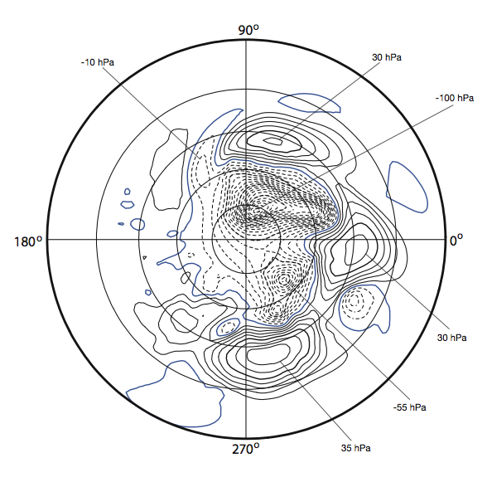
JW, concluded
Surface Pressure: 16 days
EULAG results (1.4º) using
Semi-Lagrangian advection
EULAG results (1.4º)
using Eulerian advection

Slide 30
How consistent are these results with
compressible linear modal analyses?
Dispersion equation for 2D f-plane approximation, assuming static, isothermal environment (AK 2009):
+ { N ² f ² + c_{s}² (N ² k² + f ² M ² ) } = 0
where ;
• Requisite parameters: (N, f, c_{s}, κ, H) <– environment
Anelastic model: c_{s} → ∞ and μ → 1 / 2H define phase error = 1-ω_{an} /ω_{com}
Notes:
Static stability is essentially ~ N²
Mu gives “correction” for density stratification.

Slide 31
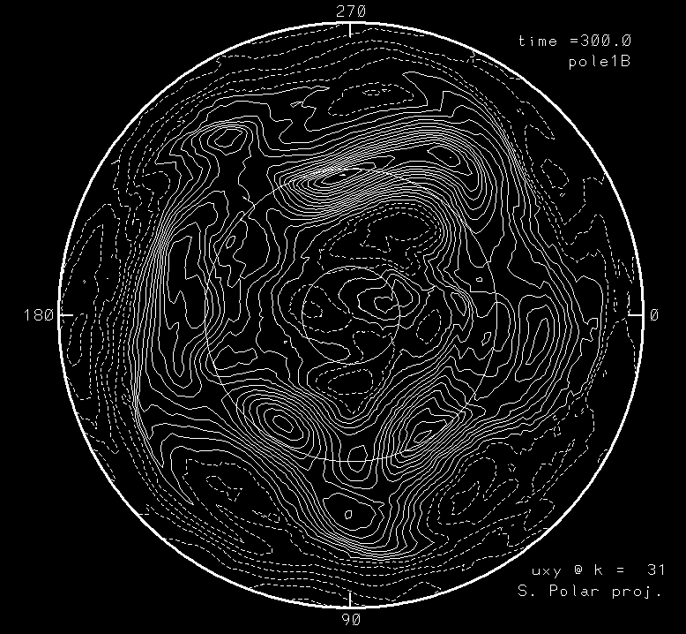
Held-Suarez flow
Isolines of
constant u
show
“westerly jets”
@ 15 km alt.
typical jet core
Δ u_{max} ~ 65 ms⁻¹ over synoptic scales
(mx, mn, cnt)=(48, -24, 4.2 ms⁻¹)
Notes:
Cnt = 4.2 m/s
Cmx = 48 m/s; cmn = -24 m/s

Slide 32
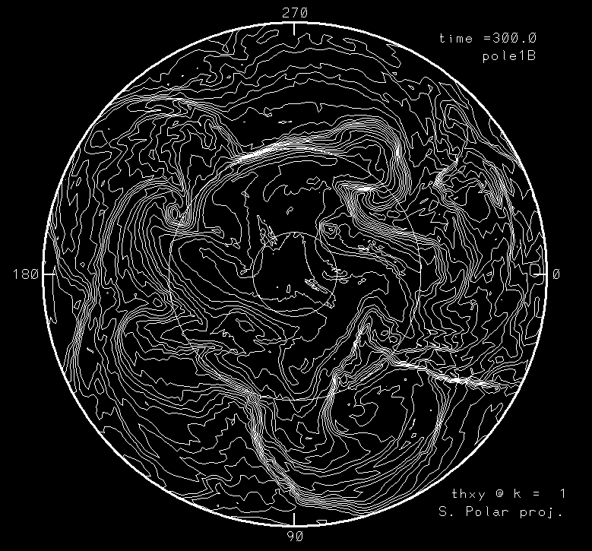
HS, cont. 1
Isolines of
constant θ
show “fronts” on surface
typical Δ T_{max} ~ 20K over mesoscales (surface fronts)
Notes:
Figures shows surface fronts, here rotatiing clockwise (S. pole).
Very sharp fronts with thicknesses of ~ dx are generated by NFT numerics --> effects of increasing resolution are dramatic.
Typical dt’s ~ 20K in ~ 200 kms with dx = 1.4 degrees (quite realistic),

Slide 33
Errors of anelastic arise in density (AK2009)
(i) Acoustic term:
NOTE: 65 ms⁻¹ → M = 0.2 → δ_{θ} = 0.02
(ii) Thermobaric term:
= - ρ₀ ΔT / T_{o} = - ρ₀ δ_{p}
NOTE: ΔT = 20 K → δ_{p} = 0.06
→ Compare with ω/N = 0.03 for synoptic waves
Notes:
Acoustic term approximation assumes revesible gas dynamics
NOTE 65 m/s (150 mph) -> M = 0.2 -> delta_theta = .02 (synoptic scale jet oscillations)
Thermobaric term approximation assumes ideal gas and defintion theta = T * (p_ref/p)^kappa
NOTE dt = 15 K across surface front

Slide 34
Event NW5 @ 277.50 days N. Polar proj.
NW5: yz slices


Notes:
Upper Left panel shows surface front moving east (counterclockwise rotation of front).
Upper Right panel shows internal gravity wave packet likely generated by (I) low level front, and/or (ii) resulting zonal jet oscillations. BLUE LINE: plane of yz slices in following animation and still frames.
Lower Left: zonal wind showing jet oscillations and pinched off core element to south
Lower Right: meridional wind showing extreme shear of 120 m/s over EW extent of wave packet.

Slide 35
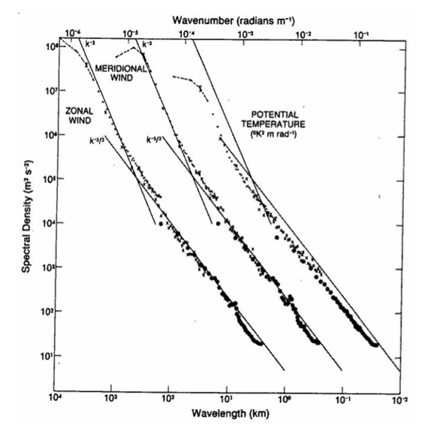
Universal Atmospheric Power Spectrum
(Gage and Nastrom JAS 1986)
-3 slope
-5/3 slope
700 km
Notes:
k^-3 from 3000 km down to 800 km
K^-5/3 from 600 km to << 1 km
~smooth transition at 700 km
Spectral obtained from GASP airplane data typically flying in upper troposphere.

Slide 36
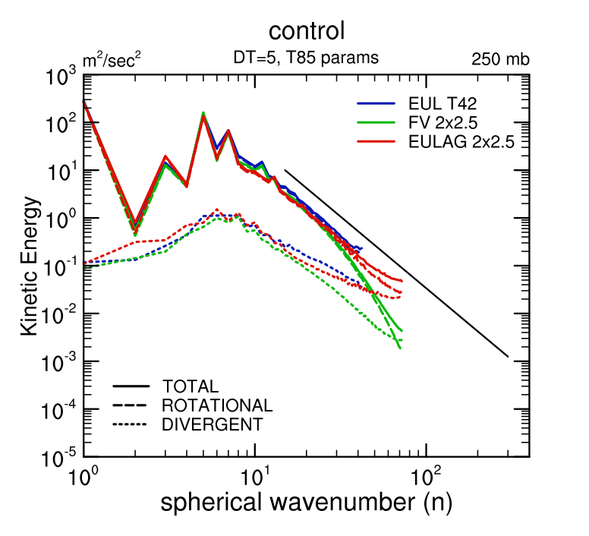
CAM Aqua-planet power spectra
(courtesy of Williamson NCAR, using results from Abiodun et el. Climate Dyn. 2008)
CAM-EULAG (CEU) result is in red. Cutoff n ~ 70 is Nyquist:
2πR_{o} / n_{nyq}
≈ 550 km
-3 slope
CAM-EUL and CEU match well to n ~ 40
N ≈ 50 → 800 km
CAM-FV match is to n ~ 25
Notes:
1. Note that CEU matches Eulerian spectral CAM (blue) very closely up to limiting resolution of Eulerian spectral model to wave number 42.
2. Finite volume CAM matches only up to n ~ 30, at which point spectral power is noticeably lower.
3 Recall Gage – Nastrom data indicating for n < 60, spectral power of atmosphere has -3 slope, gradually transitioning to -5/3 at higher wave numbers in range fof 800 to 600 kms. Only CEU shows some indication of this transition.

Slide 37
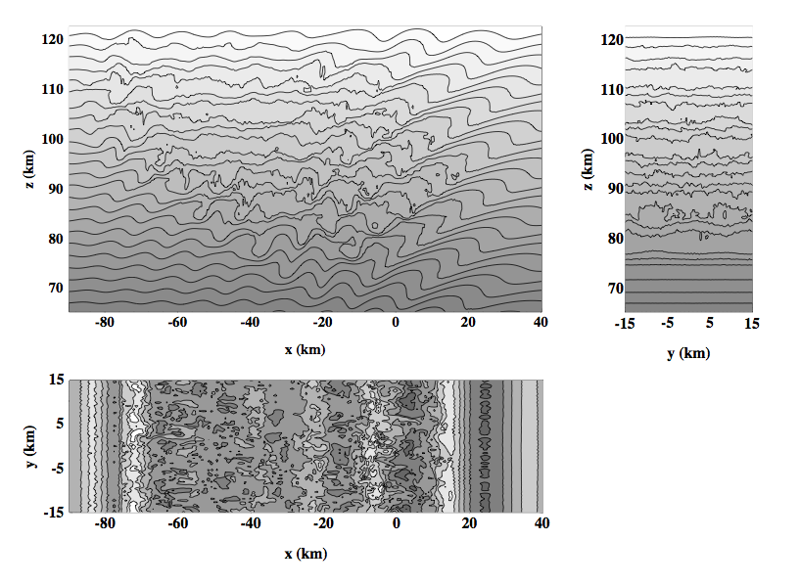
Examples
Homogeneity? Isotropy?
Breaking Gravity Waves @ 155 min depicted by potential temperature.
(Smolarkiewicz and Prusa, Chapter 8 Turbulent Flow Computation, Kluwer Academic Publishers, 2002)

Slide 38
Reverse cascade forcing of < u >
Initial domain averaged zonal wind is -25 ms⁻¹
Profiles shown every 5 min.
150 min
OBS: meridional flow near mesopause is opposite of what is expected from rad. cooling → requires forcing of 10-20 ms⁻¹/day
z km
125 min
Model results for EP flux divergence → ~ 2 cm s⁻² over 1 hr duration of maximum wavebreaking: APPEARS SUFFICIENT!
< u > ms⁻¹

Slide 39
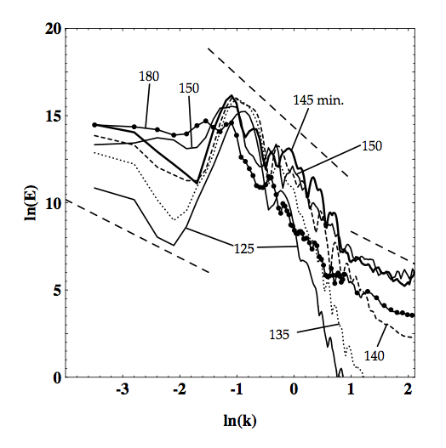
→ Multiple scale interaction can be upscale as well as downscale
Power Spectra of breaking gravity waves in upper atmosphere:
left side: ln(k) = -4 →
340 km (n ~ 115)
right side: ln(k) = 2.1 is Nyquist wavenumber
→ λ_{nyq} = 760 m
(Prusa et al. Int. J. Math. Comput. Sci. 2001)
→ downscale
-3
-5/3
-5/3
upscale ←
λ_{x} ~ 17 km
Notes:
Note transition in downscale energy transfer at ln(k) = +1 → k = 2.7 km^-1 → lx = 2.3 km = critical buoyancy wavenumber
Downscale of critical wavenumber the slope = -5/3 suggesting classical 3D inertial subrange (realistically speaking, ~ 2 km seems bit big?
Upscale of critical wavenumber the slope = -3 suggesting quasi-2D cascade (NOTE 2D simulations show ONLY – 3 slope downscale of energy injection point.
Downscale of energy injection point slope ~ -5/3 suggesting revered enstrophy cascade. Recall Gage & Nastron spectra show -3 in mesocale so this CANNOT be physical mechanism behind that.

Slide 40
less obvious, cont.
TURBULENCE CLOSURE:
• Large Eddy Simulation (LES): may be based upon 3D, isotropy, homogeneity, etc.,; and as a result may generate dissipation terms that are not consistent with turbulence.
hyperviscosity: may suppress intermittency (Novikov – conjecture, Proceedings Monte Verita, 1993), thus altering multiscale interactions; observed that resulting 2D cascades very sensitive to parameter settings (Gkioulekas & Tung J. Low Temp Phys 2006)
• high-resolution models have nonlinear leading order dissipation terms that are consistent with turbulent flow (Rider, IJNMF 2006)
→ offer effective resolutions of 3-5 Δx, vs. ~10 Δx commonly accepted criterion
Notes:
Note hyperviscoisy may have 2p or der Laplacian (ultraviolet dissipation) and -2m order inverse Laplacian (infrared dissipation); m,p integer

Slide 41
A Few Select Studies…
• Davies et al, QJRMS 2003 – 2D normal mode f-plane analysis used to rigorously examine sound-proof systems:
(i) Anelastic works well for all gravity wave frequencies
(ii) Anelastic not good for amplitudes and height scales of external planetary modes, nor for finite amplitude Lamb (acoustic) waves
(iii) Anelastic introduces phase error for deep wave modes
• Klein et al., JFM 2010 – multiple parameter, singular perturbation analysis that examines multiscale interaction between planetary and gravity wave modes:
(i) The anelastic sytem “gets it right”, with differences from elastic systems being asymptotically small, of order ~ O( M^{2/3} )
(ii) This translates into stratification increases of ~ 10% over a pressure scale height
Notes:
1. Bannon: piezotropic exponent (ie, rev. adiabatic expansion) for anelastic 1/(1-Gam*R/g) where Gam = lapse rate. For Gam = 10K/km, then exponent = 1.4 =cp/cv=gam, but for 7 and 0 K/km it is 1.25 and 1.
2.Bannon: anelastic system DOES have isentropic compressibility = rho^-1 x drho/dp (basic state variables). CANNOT rewrite in terms of sound speed… so use gam*R*T = g*H_rho instead.
3. M^2/3 ~ 0.1 --> M ~ 0.15 --> u ~ 45 m/s at 300K
4. Method of DISTINGUISHED LIMITS for Klein.

Slide 42
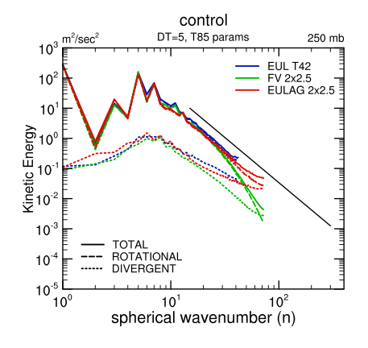
Numerical Results
from EULAG…
Select studies, concluded
• HS simulations (Smolarkiewicz et. al., JAS 2001):
zonally averaged fields compare well to those of Held and Suarez (1994)
• Aqua-planet simulations – EULAG is coupled to CAM physics (Abiodun et. al., Clim. Dyn. 2008a,b):
(i) Zonally averaged fields compare favorably to those in Neale and Hoskins (Atm. Sci. Lett. 2000a,b)
(ii) Good comparisons with standard CAM dycores in
baroclinic modes

