Slide 1

EULAG 2012
APPLICATION OF LES TECHNIQUE
FOR THE CALCULATION OF
INTERNAL COMBUSTION ENGINE FLOWS
Ranasinghe R.A.C.P.
Malalasekera W.
Clarke A.
Department of Mechanical and Manufacturing Engineering
Loughborugh University

Slide 2
LES FOR IC ENGINE SIMULATIONS
LES resolves all the turbulent spectrum larger than the grid scale ( filter scale) & only the sub grid scale motion (SGS) is to be modelled
SGS scales are isotropic and less sensitive to model parameters
Hence LES provides an accurate way to investigate unsteady effects associated with mixture formation, combustion & cyclic variations in IC engines
Present study aims to develop & validate an LES code for IC engine simulations
Department of Mechanical and Manufacturing Engineering
Loughborugh University

Slide 3




COMPUTATIONAL APPROACH
KIVA 4 RANS code was modified to incorporate LES capability
It uses an arbitrary Lagrangian Eularian approach to solve governing equations in unstructured hexahedron grids with moving boundaries
SGS viscosity was modelled using SGS kinetic energy
$$k_{sgs}− SGS kinetic energy$$
$μ_{sgs}=C_{ν}\overline{ρ}k_{sgs}^{1/2}\overline{∆}$
$$\overline{∆ } − filter width$$
$$ρ − density$$
Filter width is taken to be the cubic root of the computational cell volume
Department of Mechanical and Manufacturing Engineering
Loughborugh University

Slide 4

COMPUTATIONAL APPROACH
The following transport equation is solved for $k_{sgs}$
$$\frac{∂}{∂t}\left(\overline{ρ}k_{sgs}\right)+∇.\left(\overline{ρ}k_{sgs}\tilde{U}\right)=−\left(∇⊗\tilde{U}\right):{\overline{τ}}_{sgs}−C_{ε}\overline{ρ}{k_{sgs}^{3/2}}/{\overline{∆}}+∇.\left(\frac{μ_{sgs}}{{Sc}_{k}}∇k_{sgs}\right)+{\overline{\dot{W}}}^{spary}$$
No-slip boundary conditions were imposed on solid walls
Piston motion was modelled by removing and addition of cell layers to minimise the deformation of cells, so that the commutation error is minimum
$U−velocity vector$ ${\overline{τ}}_{sgs}−SGS stress tensor$
Department of Mechanical and Manufacturing Engineering
Loughborugh University

Slide 5
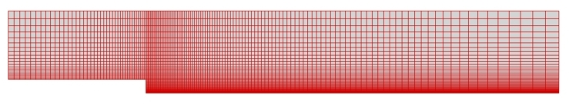



VALIDATION OF KIVA4:LES
FLOW OVER A BACKWARD FACING STEP
Computational mesh & instantaneous U velocity
contour snaps at three instances
ER =1.2, Re= 5100 & averaged over 5 flow through times
Symbols show measured values & lines show simulated results
Department of Mechanical and Manufacturing Engineering
Loughborugh University

Slide 6
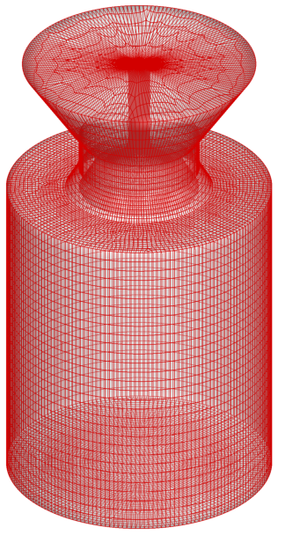
VALIDATION OF KIVA4:LES
FLOW IN AN AXISYMMETRIC ENGINE
RPM= 200 & averaged over 5 cycles
Crank position = 36 ATDC
Department of Mechanical and Manufacturing Engineering
Loughborugh University

Slide 7
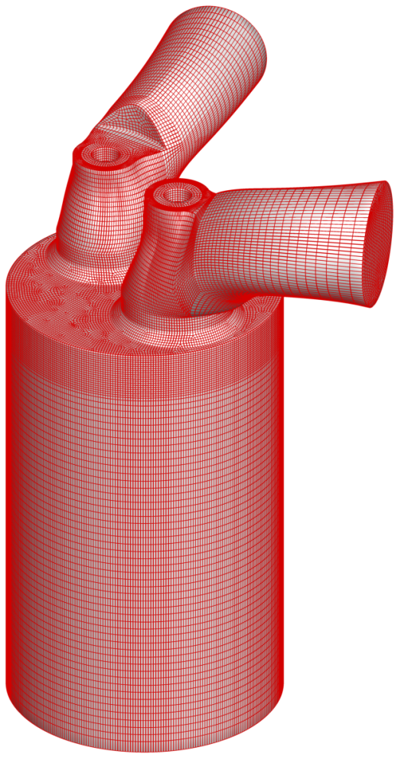
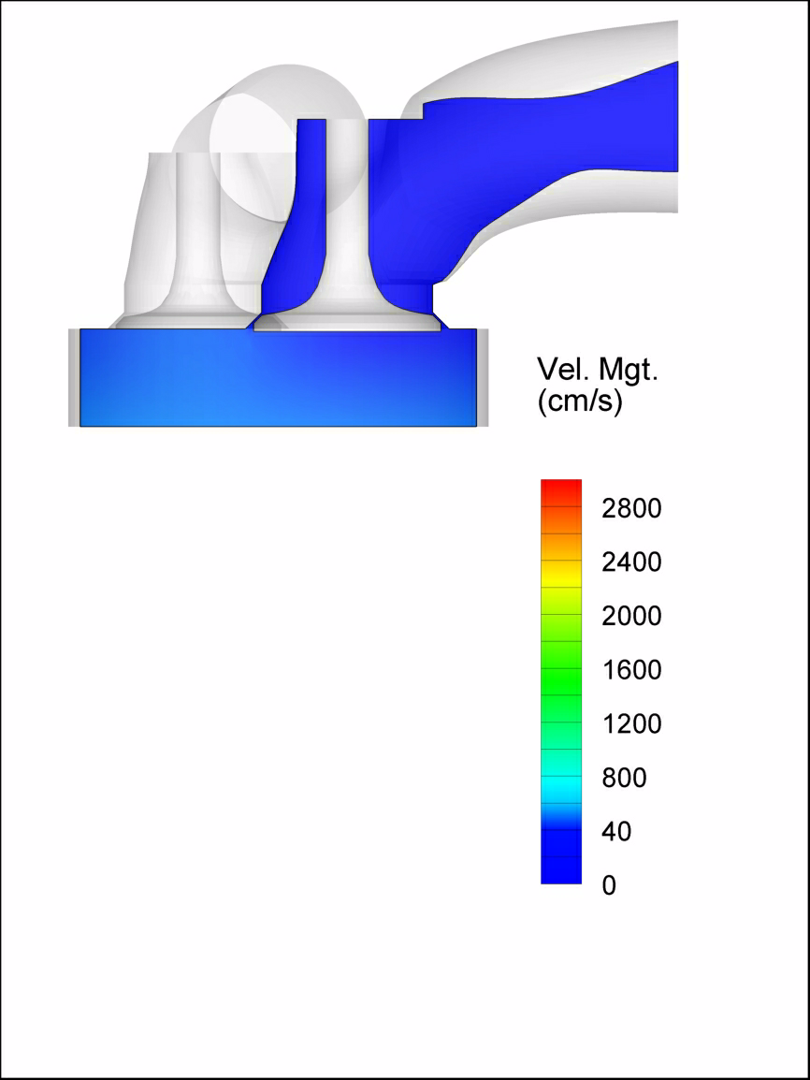
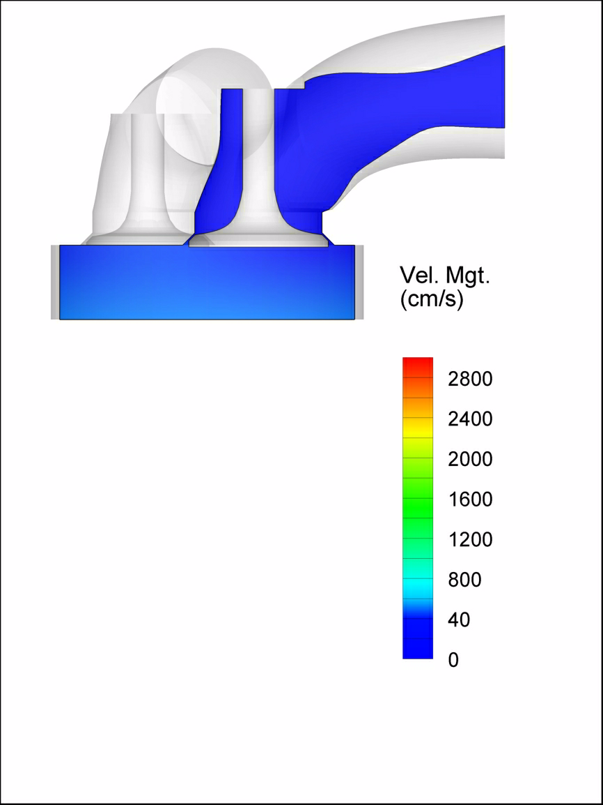
APPLICATION TO SI ENGINE FLOWS
RICARDO E6 ENGINE
BORE | 7.62 cm
STROKE | 11.11 cm
RPM | 1800
NO. OF CELLS | 0.8M
RANS RESULTS
LES PREDICTIONS
Department of Mechanical and Manufacturing Engineering
Loughborugh University

Slide 8
CONCLUDING REMARKS
KIVA4:LES is only 2nd order accurate but predictions are in good agreement with experimental measurements
Present LES formulation has been able to resolve most of the energy containing large scale motion
Accuracy of the predictions are quite satisfactory compared to the relative low mesh densities used
Thank you very much for your cooperation !
Department of Mechanical and Manufacturing Engineering
Loughborugh University

