Slide 1
The direct modeling of subgrid-scale stresses and its relevance for medium range weather prediction
Loughborough 2012
Nils Peter Wedi*
*European Centre for Medium-range Weather Forecasts, wedi@ecmwf.int

Slide 2
Outline
The spectral transform method: de-aliasing of spectral computations on the linear grid
The role of horizontal diffusion
Non-linear diffusion

Slide 3
Schematic description of the spectral transform method in the ECMWF IFS model
Grid-point space
-semi-Lagrangian advection
-physical parametrizations
-products of terms
FFT
Inverse FFT
No grid-staggering of
prognostic variables
Fourier space
Fourier space
LT
Inverse LT
Spectral space
-horizontal gradients
-semi-implicit calculations
-horizontal diffusion
FFT: Fast Fourier Transform, LT: Legendre Transform

Slide 4
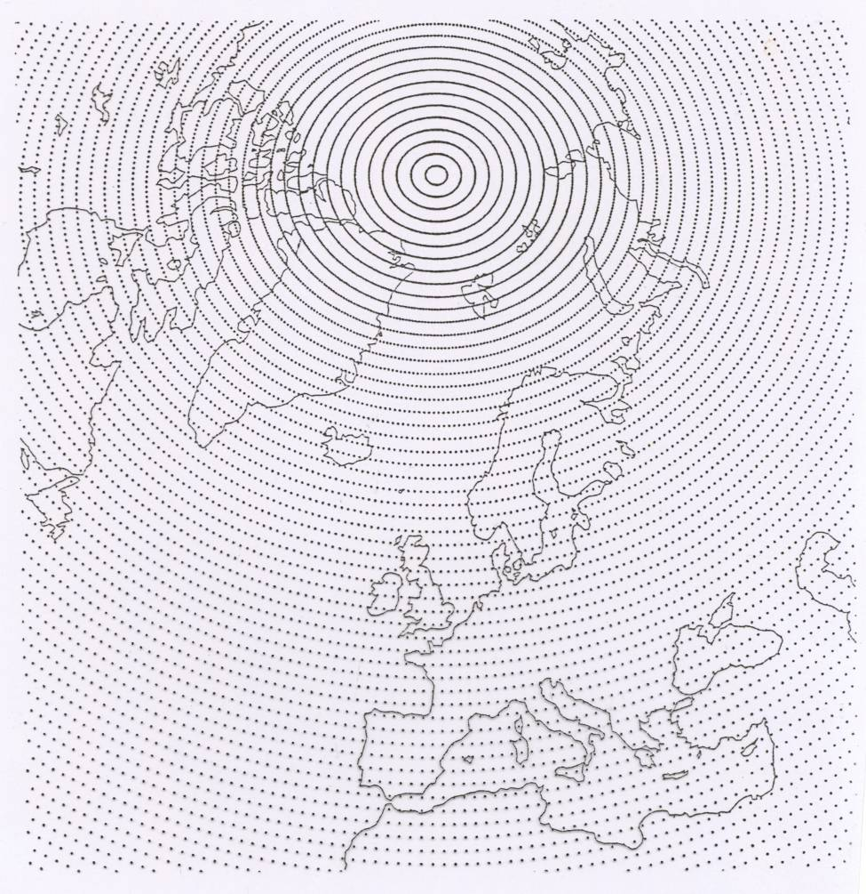
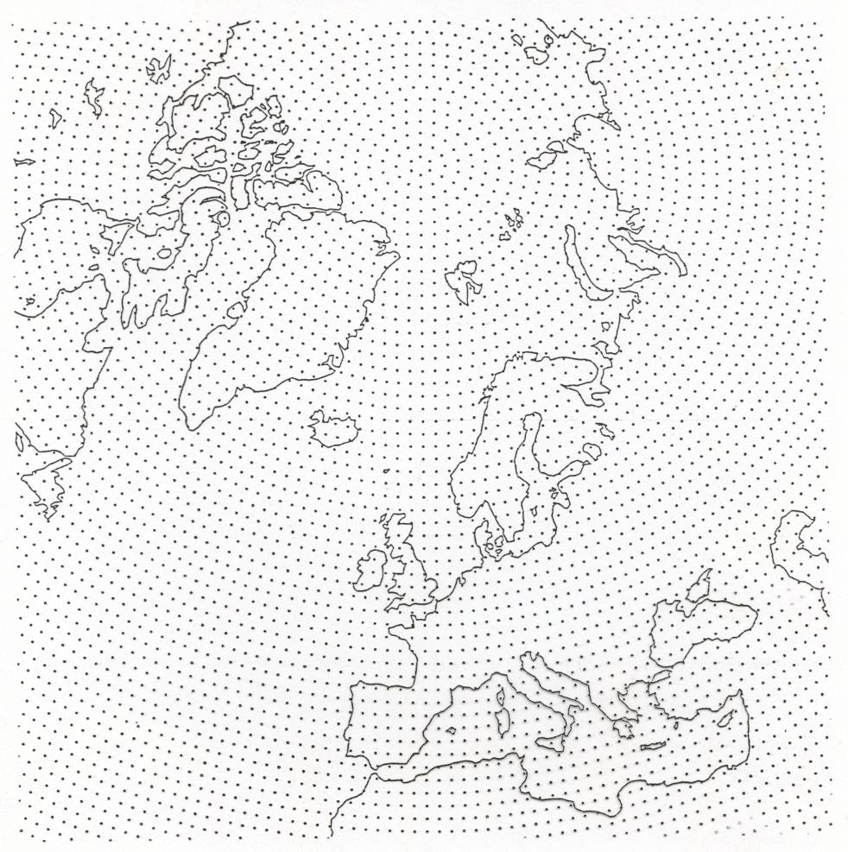
The Gaussian grid
About 30% reduction in number of points
Full grid
Reduced grid
Reduction in the number of Fourier points at high latitudes is possible because the
associated Legendre polynomials are very small near the poles for large m.

Slide 5
De-aliasing
Aliasing of quadratic terms on the linear grid (2N+1 gridpoints per N waves), where the product of two variables transformed to spectral space cannot be accurately represented with the available number of waves (as quadratic terms would need a 3N+1 ratio).
Absent outside the tropics in E-W direction due to the design of the reduced grid (obeying a 3N+1 ratio) but present throughout (and all resolutions) in N-S direction.
By subtracting the difference between a specially filtered and the unfiltered pressure gradient term at every time-step the stationary noise patterns can be removed at a cost of approx. 5% at T1279 (2 extra transforms).

Slide 6
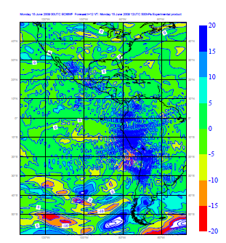
De-aliasing
E-W
500hPa adiabatic
zonal wind
tendencies (T159)

Slide 7
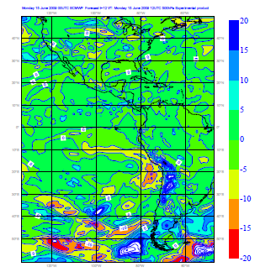
De-aliasing

Slide 8
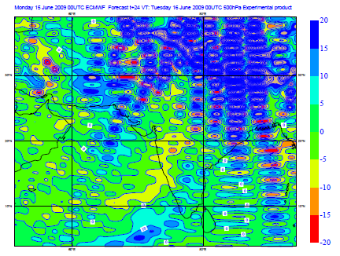
De-aliasing
N-S
500hPa adiabatic
meridional wind
tendencies (T159)

Slide 9
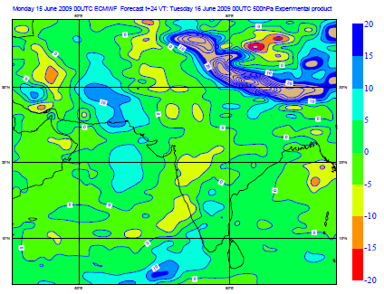
De-aliasing

Slide 10
de-aliasing: vorticity noise

Slide 11
De-aliasing: vorticity noise

Slide 12
Kinetic Energy Spectra – 100 hPa

Slide 13
Kinetic Energy Spectra – 100 hPa

Slide 14
Horizontal Diffusion
Four reasons for horizontal diffusion:
“Sponge” for vertically propagating gravity waves
Dampen the accumulation of KE and enstrophy at the smallest resolved scales
Represent unresolved subgrid-scale mixing
Make tangent-linear and non-linear evolution more similar (relevant for variational data-assimilation)
Given the removal of aliasing, horizontal diffusion can now be reduced or alternative schemes applied to represent unresolved subgrid-scale mixing
=> Non-linear horizontal diffusion

Slide 15
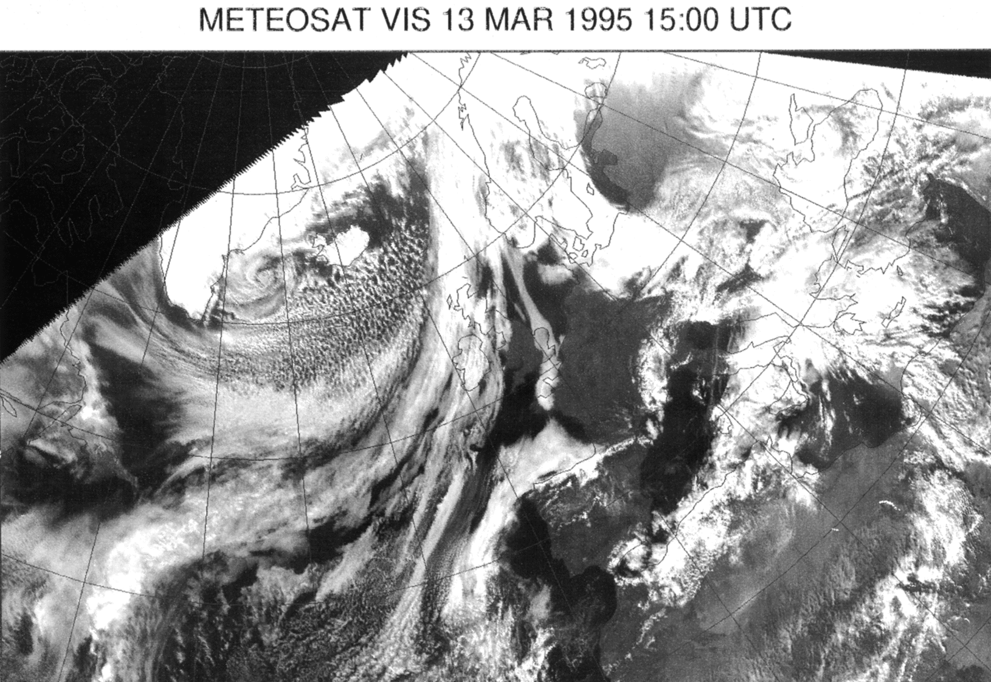
Satellite picture of N. Atlantic
Large-Scale:
Frontal systems on scale of N.Atlantic.
Cellular convection S. of Iceland.
2d vortex shedding S. of Greenland.

Slide 16
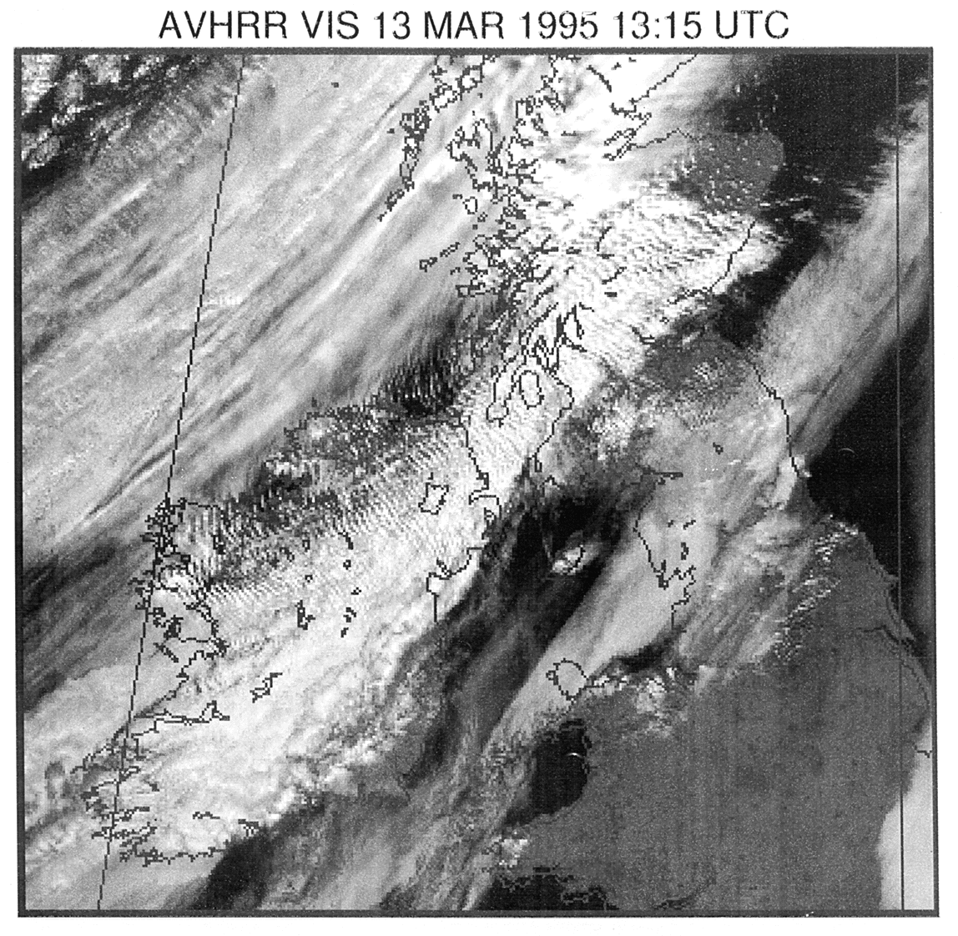
Enlarged picture over U.K.
More detail …
Gravity-wave train running SW-NE over UK.

Slide 17
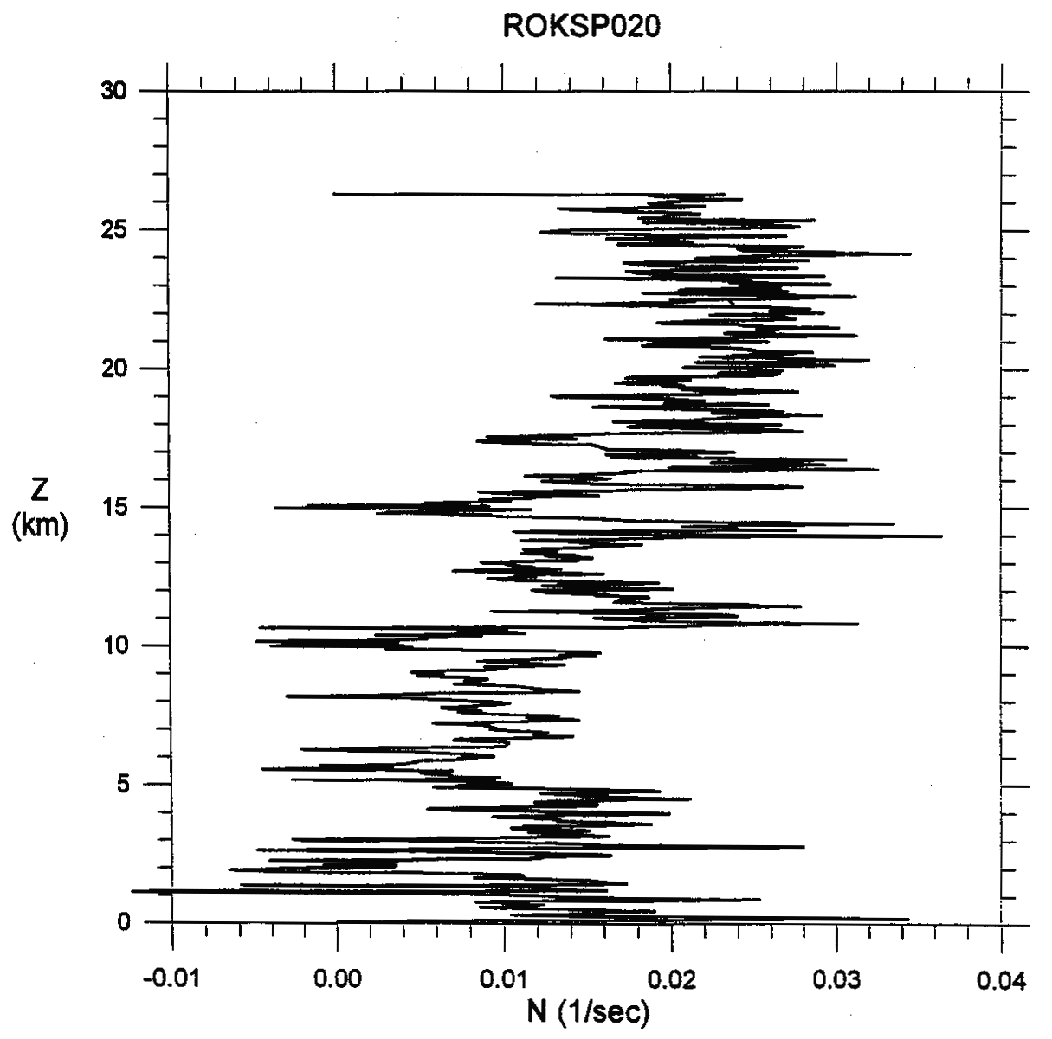
Balloon measurements of static stability
Static stability S
Brunt-Väisällä frequency N
Potential temperature θ
Idealized reference or
initial state often assumed
in idealized simulations
Notes:
And using an initial or reference state that is close to the truth may actually never provide the correct solution
Because it does not satisfy the equations since it is/contains already the nonlinear response of some forcing far
downstream

Slide 18
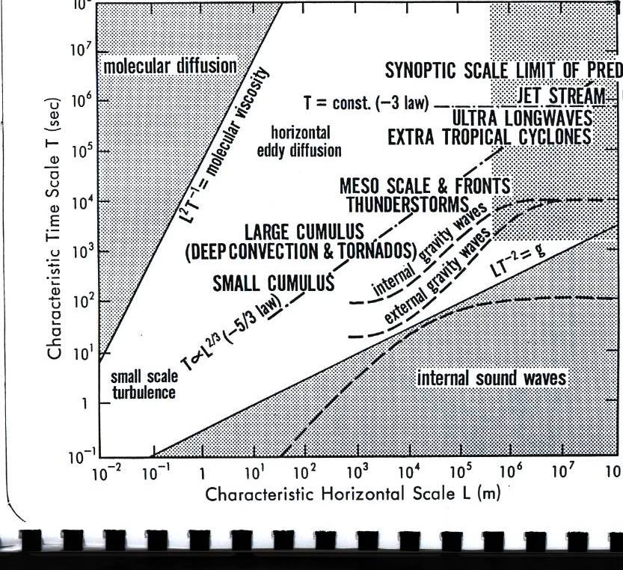
Scales of atmospheric phenomena
Practical averaging scales do not necessarily correspond to a physical scale separation.
If equations are averaged, there may be strong interactions between resolved and unresolved scales.

Slide 19
“Averaged” equations
The equations as used in an operational NWP model represent the evolution of a space-time average of the true solution.
The sub-grid model represents the effect of the unresolved scales on the averaged flow expressed in terms of the resolved flow variables which represent an averaged state.

Slide 20
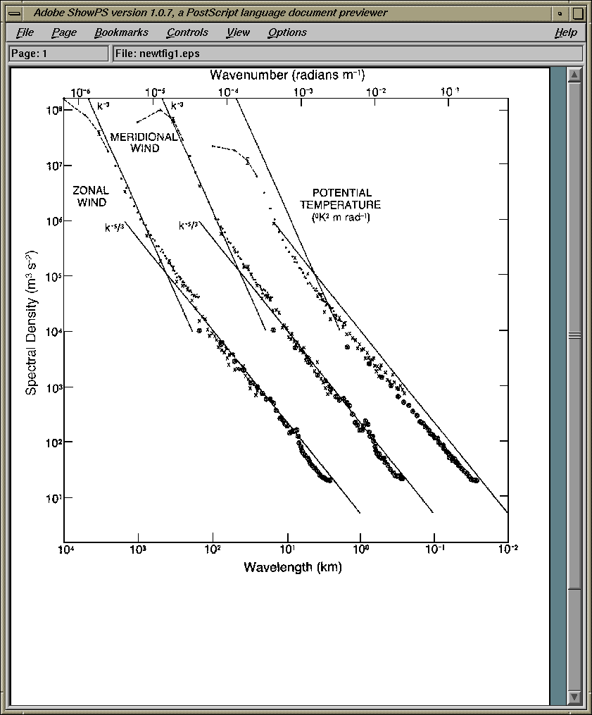
(Aircraft) observed spectra of motions in the upper troposphere
Spectral slope near k⁻³ for wavelengths >500km. Near k^{-5/3} for shorter wavelengths.
“It is remarkable that no scientific consensus yet ... whether the energy cascade through the mesoscale range is upscale or downscale. “
(Vallgren et al., 2012)
Notes:
Possibly investigate the Fourier representation of the heavy side function, example that single point can transfer
Energy to all scales

Slide 21
2D vs 3D turbulence
So far horizontal correlations are simply neglected and only the vertical correlations of subgrid-scale fluctuations are parameterized.
based on scale arguments accelerations of the larger scale flow caused by eddy motions …
… in 2D turbulence decrease as the scale of motion decreases (i.e. as the model resolution increases)
… in 3D turbulence increase as the scale of motion decreases (i.e. as the model resolution increases)
So as long as the resolved flow regime behaves like 2D turbulence the neglect of horizontal eddy fluxes in NWP is okay …
(Tennekes , 1978)

Slide 22
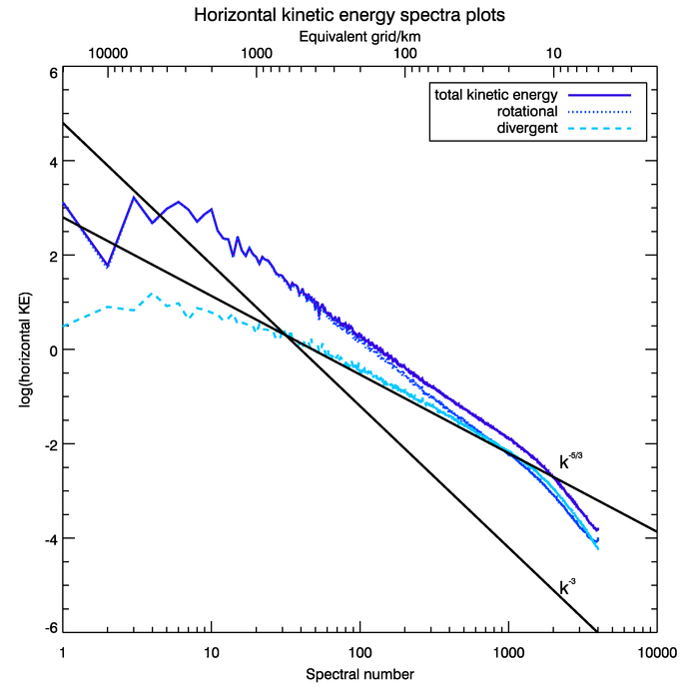
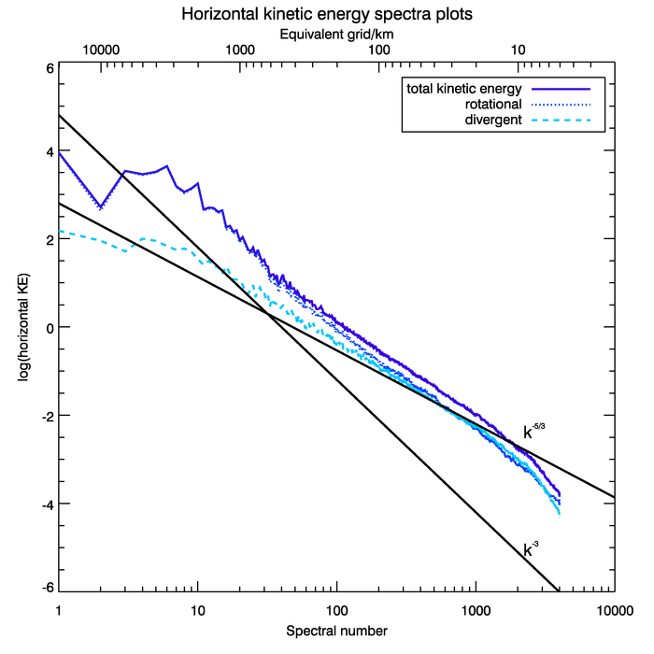
rotational/divergent energy of T3999 10 day fc
500hPa
200hPa

Slide 23
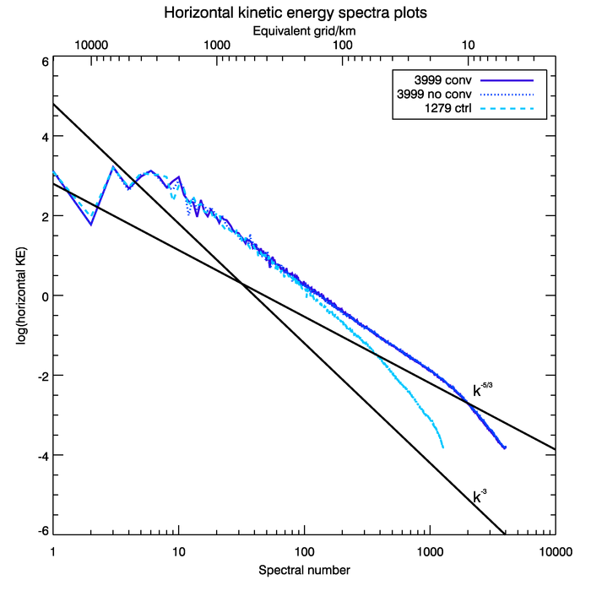
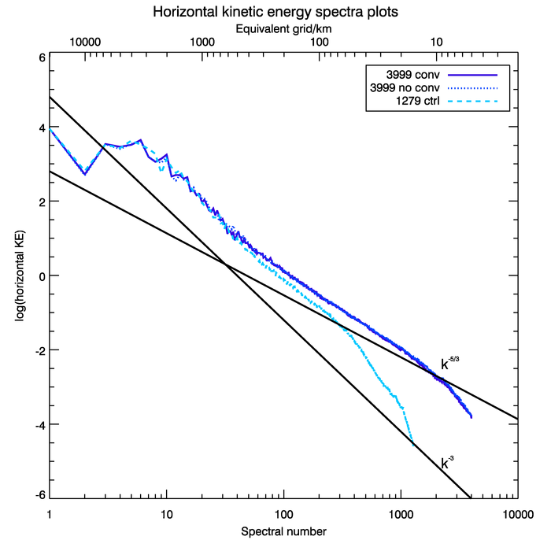
Kinetic Energy of T3999 10 day fc
T1279 10 day fc
500hPa
200hPa

Slide 24
Attempt to apply LES techniques to global NWP
Take into account horizontal and vertical non-linear interactions of scales that are still represented on the grid.
Utilize similarity of spectral slope over a wide range of wavenumbers while assuming self-similar behaviour of nonlinear interactions at the smallest resolved scales and at the largest unresolved (subgrid) scales.

Slide 25
Two parts to the SGS stress tensor
Domaradzki and Adams (2002)
The result of non-linear interactions of scales
actually represented on the numerical grid
truly subgrid-scale

Slide 26
Truly subgrid-scale
In EULAG ==
ILES of MPDATA ?
== Model with spectral viscosity in IFS
e.g. Gelb and Gleeson (2001)

Slide 27
SGS Stress tensor - similarity model
De-convolution operation to recover the “true” velocity

Slide 28
The Gaussian filter
e.g.
Has the same shape in physical and in wave space !

Slide 29
SGS Stress tensor - similarity model
Based on the idea of similar behaviour between the smallest (well) resolved scales and the actual subgrid scales
Secondary filter
Minimize error norm (Lilly 1991)
Notes:
Based on the idea that

Slide 30
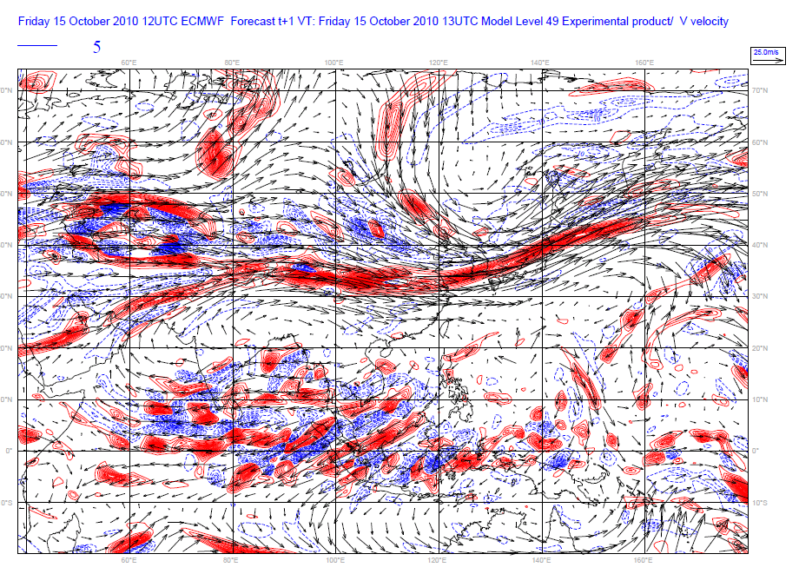
C_{L}
T511 simulation with 6,8 dx filters ~ 240km

Slide 31
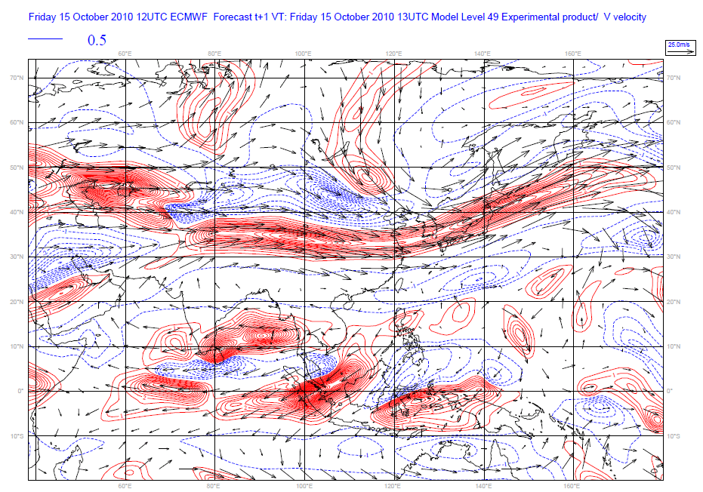
C_{L}
T159 simulation with 6,8 dx filters ~750km

Slide 32
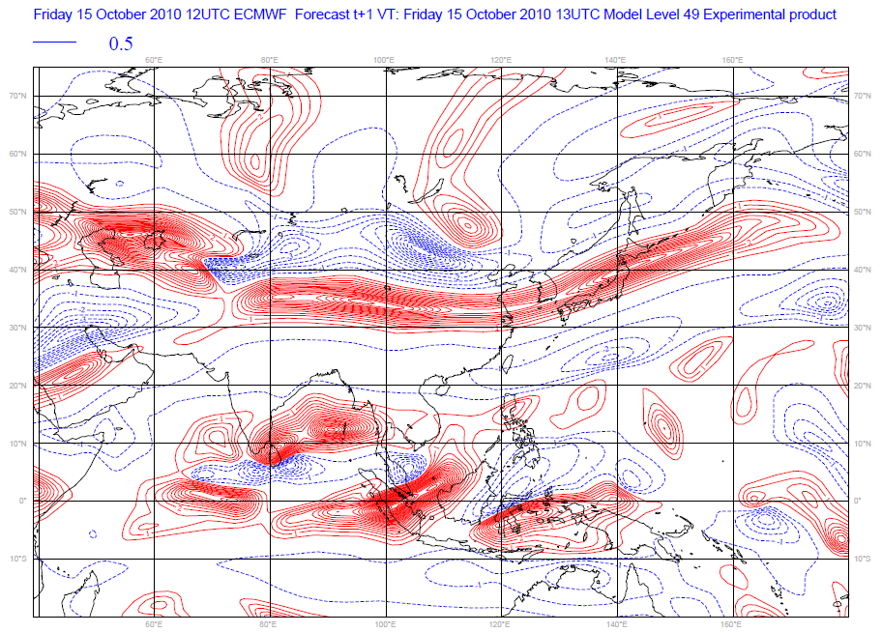
C_{L}
T511 simulation with 19,25 dx filters ~750km

Slide 33
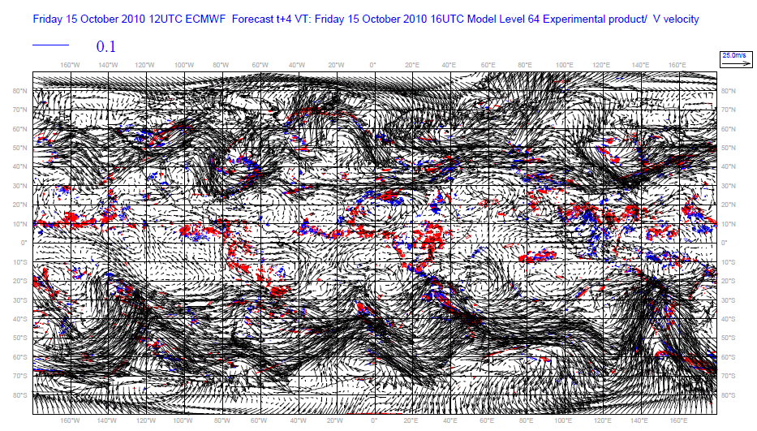
Total physics tendency ∆u
T511 simulation

Slide 34
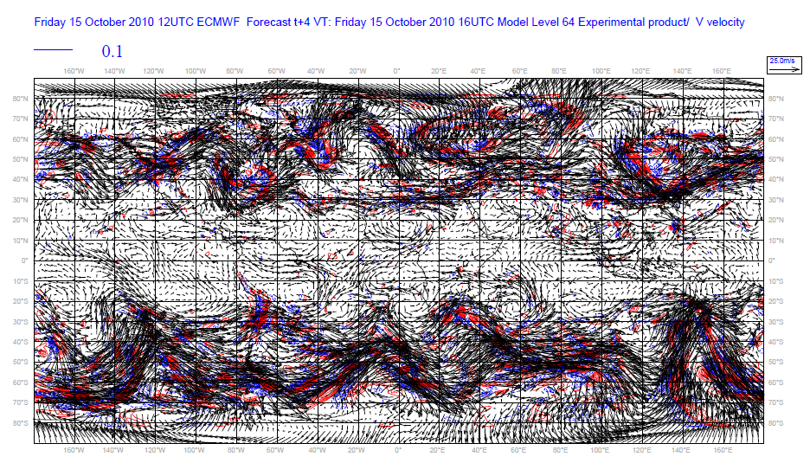
New stress ∆u
T511 simulation

Slide 35
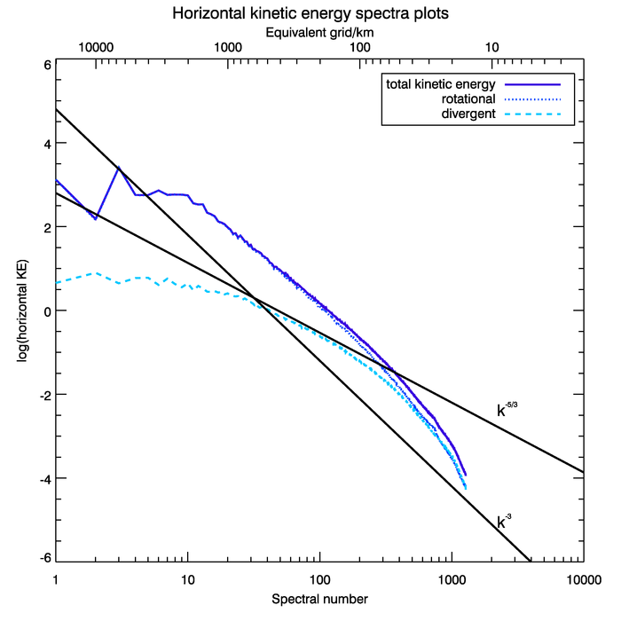
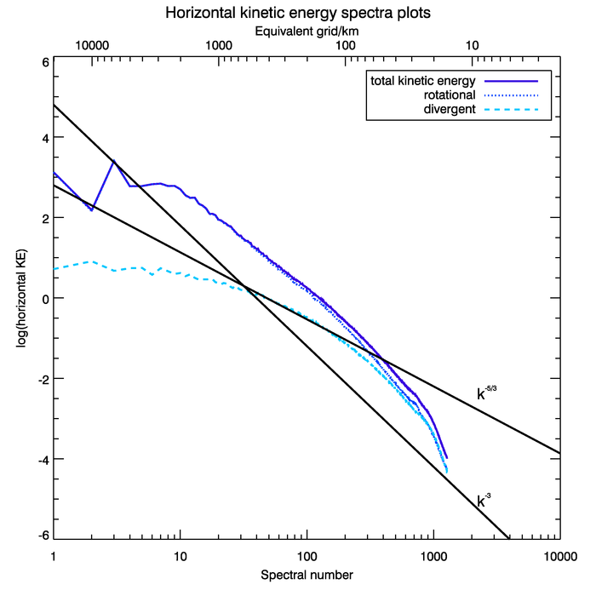
Spectra T1279
Hyper diffusion
Non-linear stress, 6,8 dx
But no change in the spectra ...

Slide 36
SGS Stress tensor – similarity model
The turbulent stress clearly not “random” and complimentary to physical parameterizations
Similarity constant appears to be a property of the flow, quite independent of the model resolution while it’s value is influenced by the chosen physical length-scale of the flow.
Similarity constant naturally defines (dynamically consistent) backscatter (positive and negative C_L) that may be used in generating EPS perturbations.

Slide 37
Summary
De-aliasing improved mass conservation by 50 %, improved energy spectra and removed unphysical noise “seen” (and compensated in part) by the physical parametrizations.
Potential for weaker and/or alternative schemes for horizontal (hyper-)diffusion
Potential for the use of a dynamic similarity model to compute non-linear velocity correlations, in particular in the context of ensemble prediction systems
More work required to assess the impact of different filter choices on the resulting kinetic energy spectra

Slide 38
Additional slides

Slide 39
The final additional contributions to the IFS equations

Slide 40
Direct spectral transform
Fourier transform:
FFT (fast Fourier transform)
using
N_{F} ≥ 2N+1
points (linear grid)
(3N+1 if quadratic grid)
Legendre transform:
Legendre transform
by Gaussian quadrature
using N_{L} ≥ (2N+1)/2
“Gaussian” latitudes (linear grid)
((3N+1)/2 if quadratic grid)

Slide 41
Inverse spectral transform
(normalized) associated Legendre polynomials
Triangular truncation
(isotropic)
Triangular truncation:
n
Spherical harmonics
N
m = -N
m = N
m

Slide 42
Heat

Slide 43
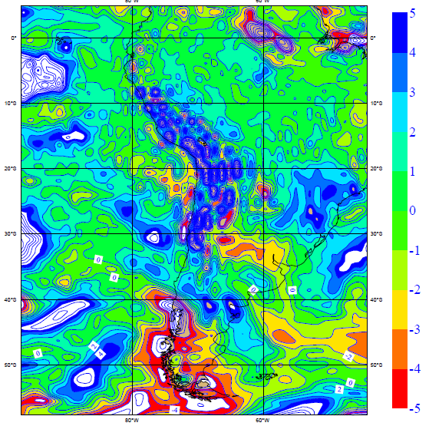
Temperature (Control)

Slide 44
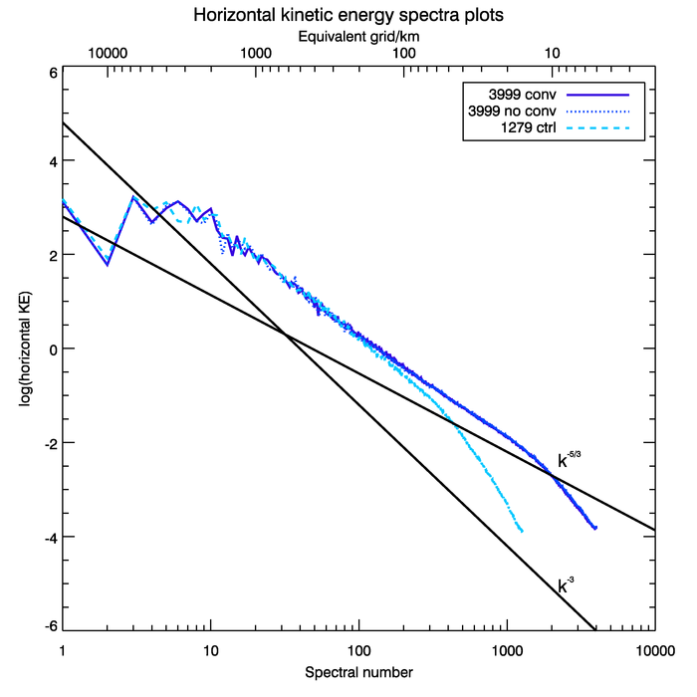
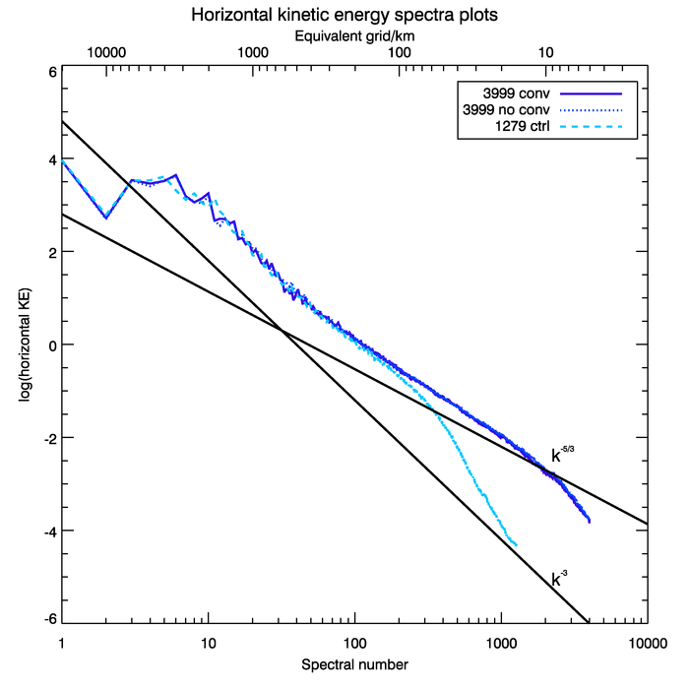
Kinetic Energy of T3999 10 day fc
T1279 analysis
500hPa
200hPa

Slide 45
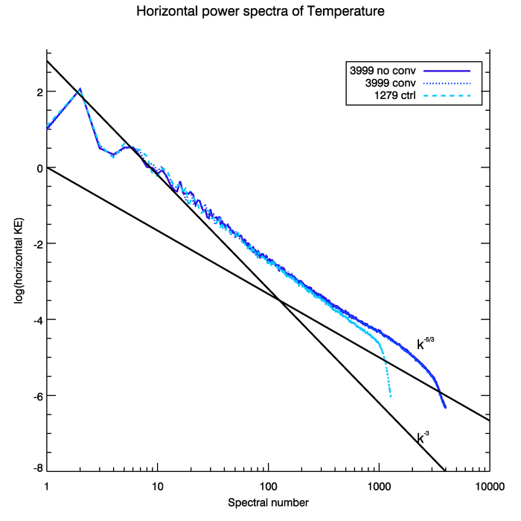
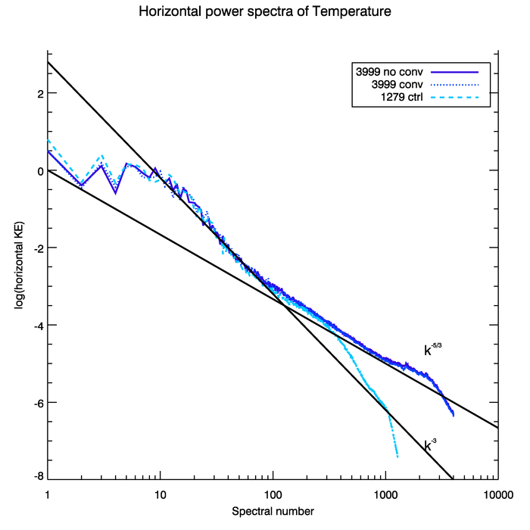
Temperature variance
500hPa
200hPa

