Slide 1
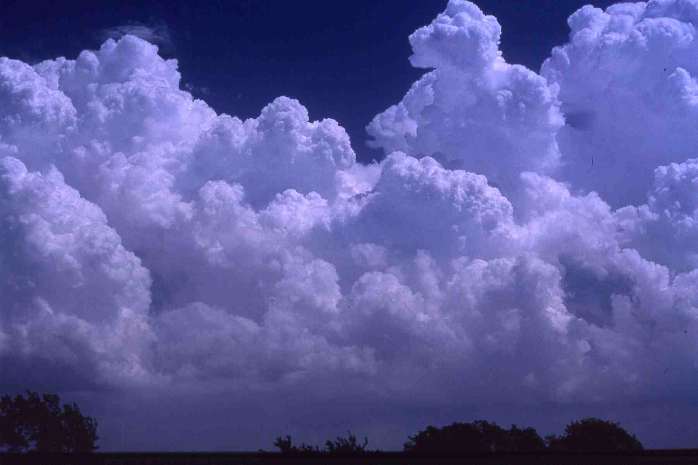
Mesoscale Convective Systems: Theory
Richard Rotunno
National Center for Atmospheric Research, USA
Photo © H. Bluestein

Slide 2
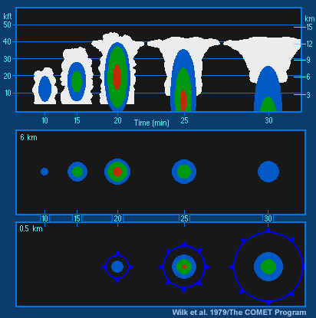
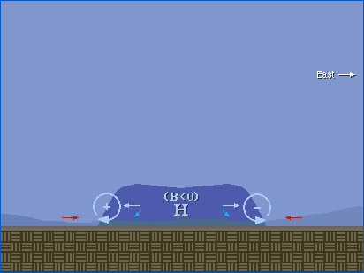
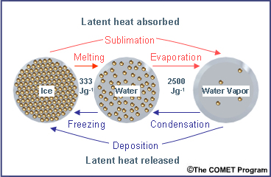
Ordinary Cell Review

Slide 3
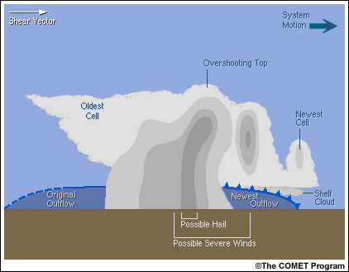
Lower Level Wind Shear: Multi-Cells
Wind Shear

Slide 4
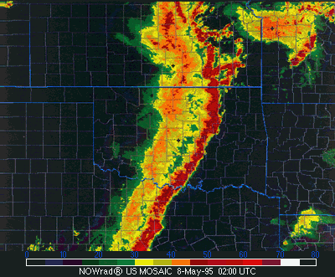
Squall Lines

Slide 5
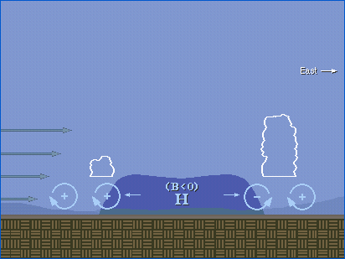

Slide 6
Rotunno, Klemp & Weisman (1988 J Atmos Sci)
“optimal” condition
environmental
“shear”
cold pool “strength”

Slide 7
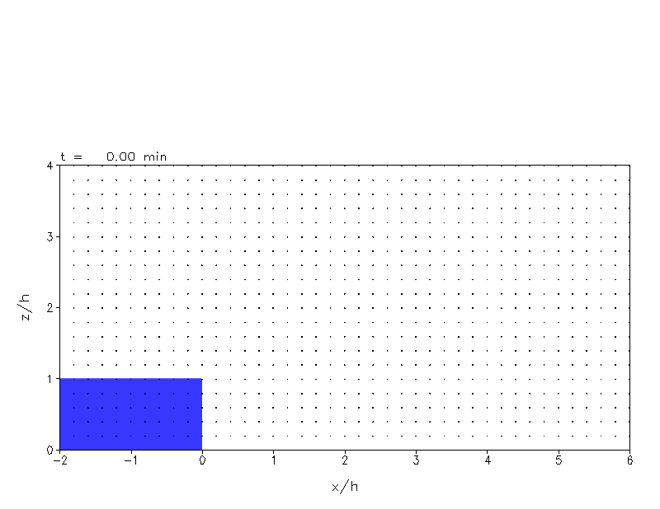
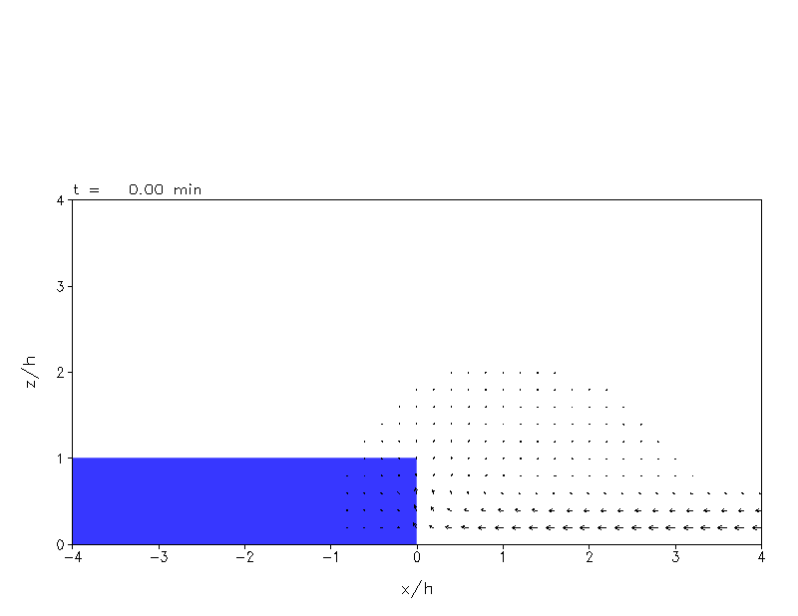
Cold Pool
/ No Shear
Cold Pool
/ Optimal Shear
Bryan and Rotunno (2014 J Atmos Sci)

Slide 8
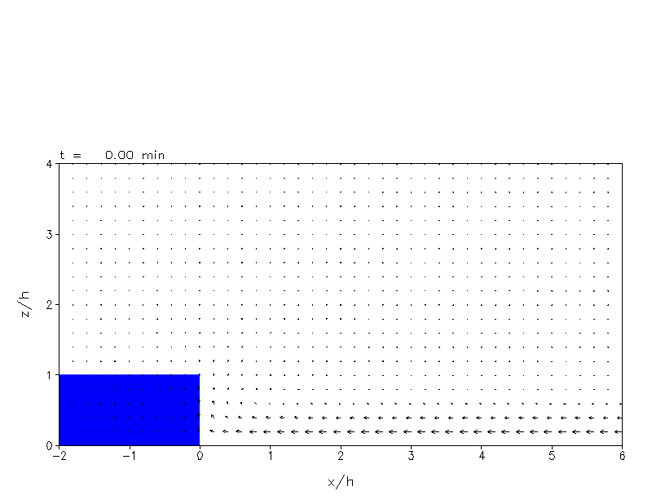
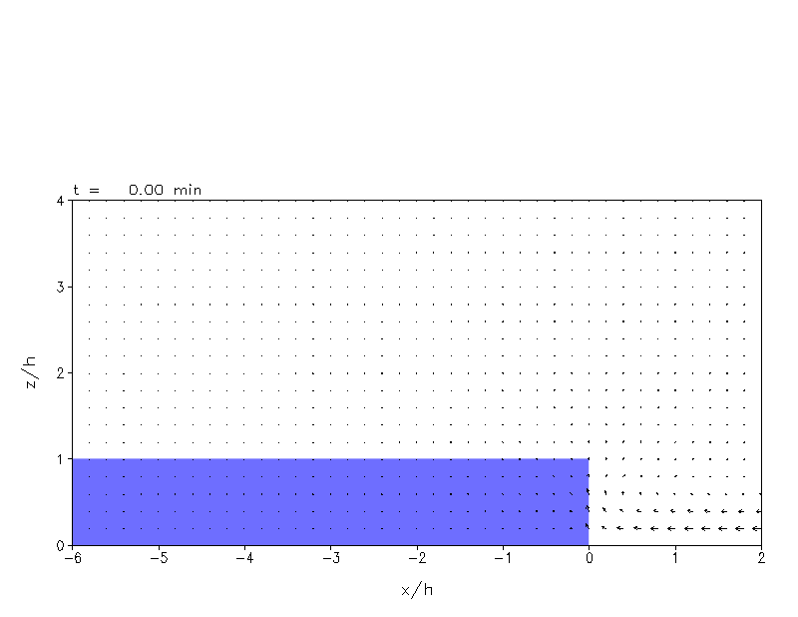
(Courtesy G. Bryan)

Slide 9
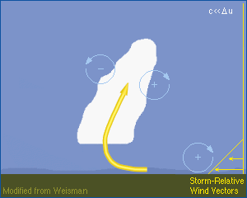
Early System Evolution

Slide 10
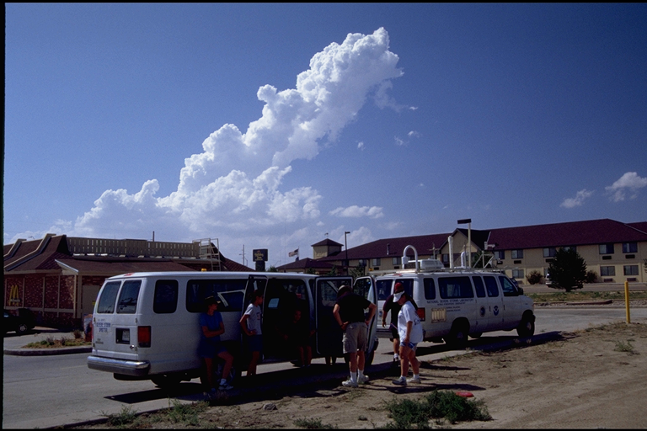

Slide 11
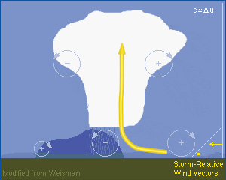
Early System Evolution

Slide 12
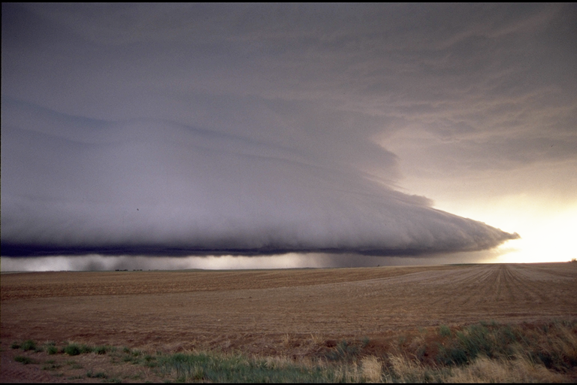

Slide 13
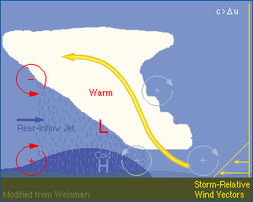
Mature System

Slide 14
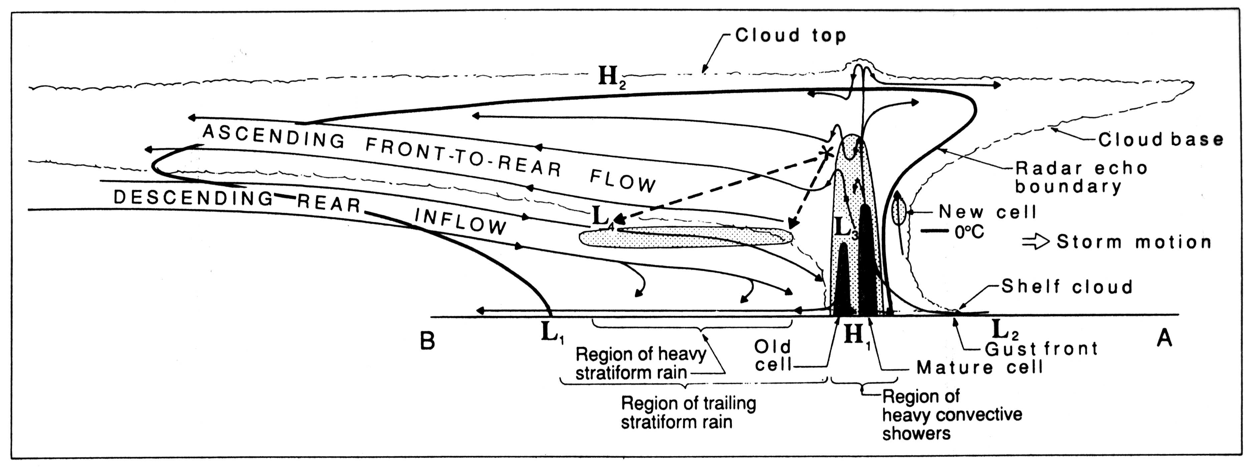
Houze et al. (1989 Bull Am Met Soc)

Slide 15
Mature System

Slide 16
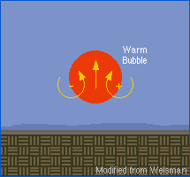
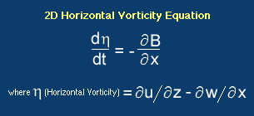
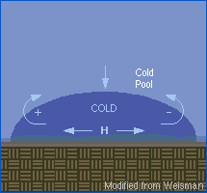
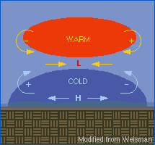

Slide 17
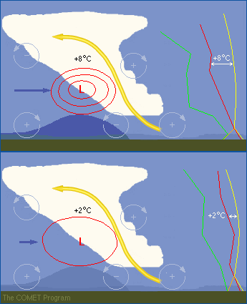
Strength of Rear-Inflow Jet ~ CAPE

Slide 18
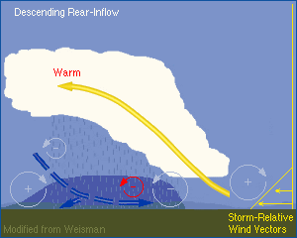
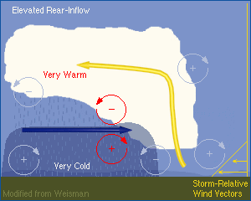

Slide 19
Radar Data from BAMEX
Davis et al (2004 Bull Am Met Soc)

Slide 20
Radar Data from BAMEX
Davis et al (2004 Bull Am Met Soc)

Slide 21
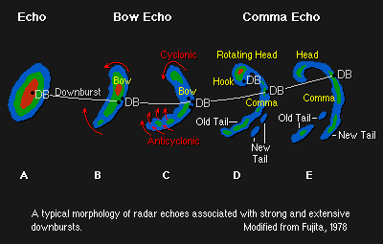

Slide 22
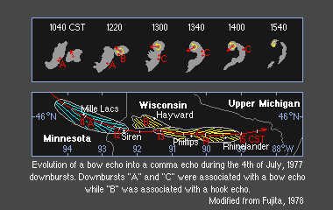

Slide 23
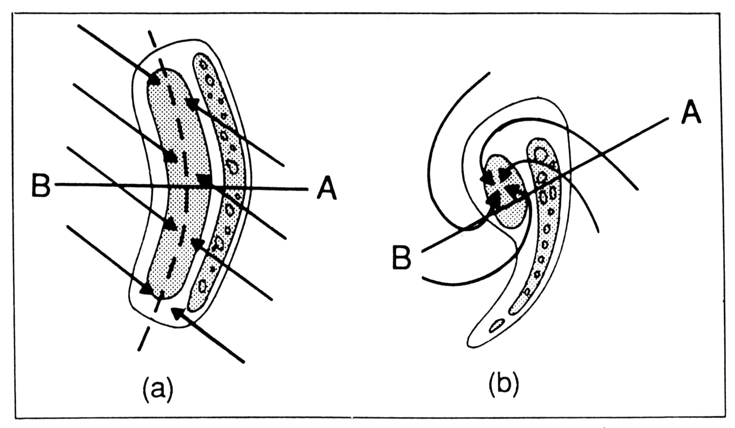
Squall Lines
Symmetric
Asymmetric
Houze et al. (1989 Bull Am Met Soc)

Slide 24
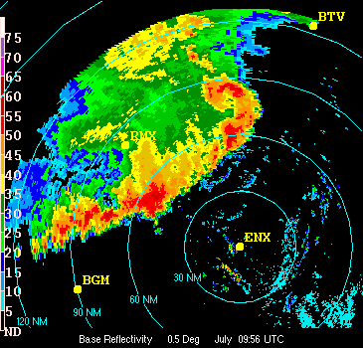
Squall Lines
Symmetric
Asymmetric

Slide 25
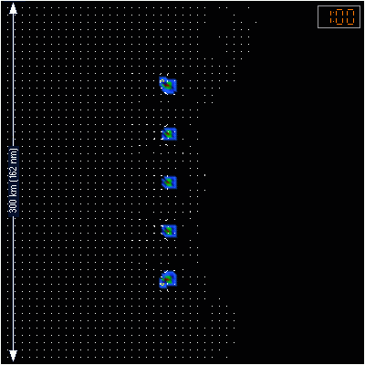
q_{r} (color)
w(contour)
@ _{z=2km}

Slide 26
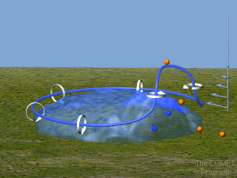
Line-End Vortex Mechanism
Mature Phase

Slide 27
Line-End Vortex Mechanism
Mature Phase
3D
2D

Slide 28
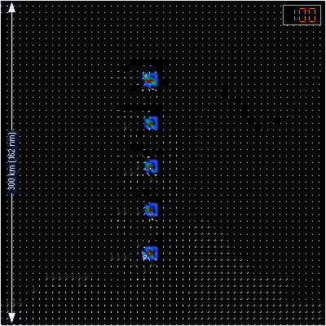
q_{r} (color)
w(contour)
@ _{z=2km}

Slide 29
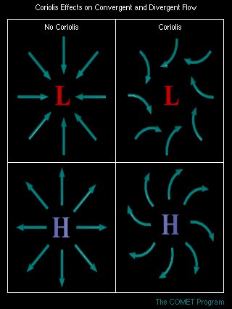
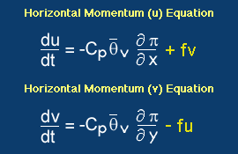
Coriolis Effect

Slide 30
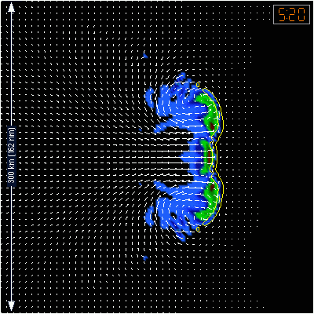
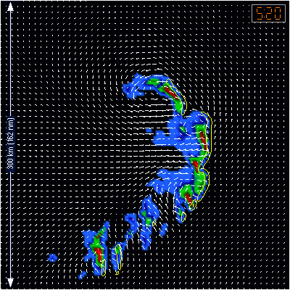
Squall Lines
Symmetric
Asymmetric

Slide 31
Summary Mesoscale Convective Systems
The wide spectrum of MCSs can largely be explained by just two environmental parameters:
Buoyancy and Vertical Wind Shear
Ordinary Cells → Occur in weak shear & have a 30-60 min life cycle.
Multicells (MCSs) → Long-lived group of ordinary cells organized by the vertical wind shear to produce mesoscale convective systems.
Tomorrow:
Supercells → quasi-steady, rotating, propagate to the right or left of the vertical wind shear vector

