Slide 1
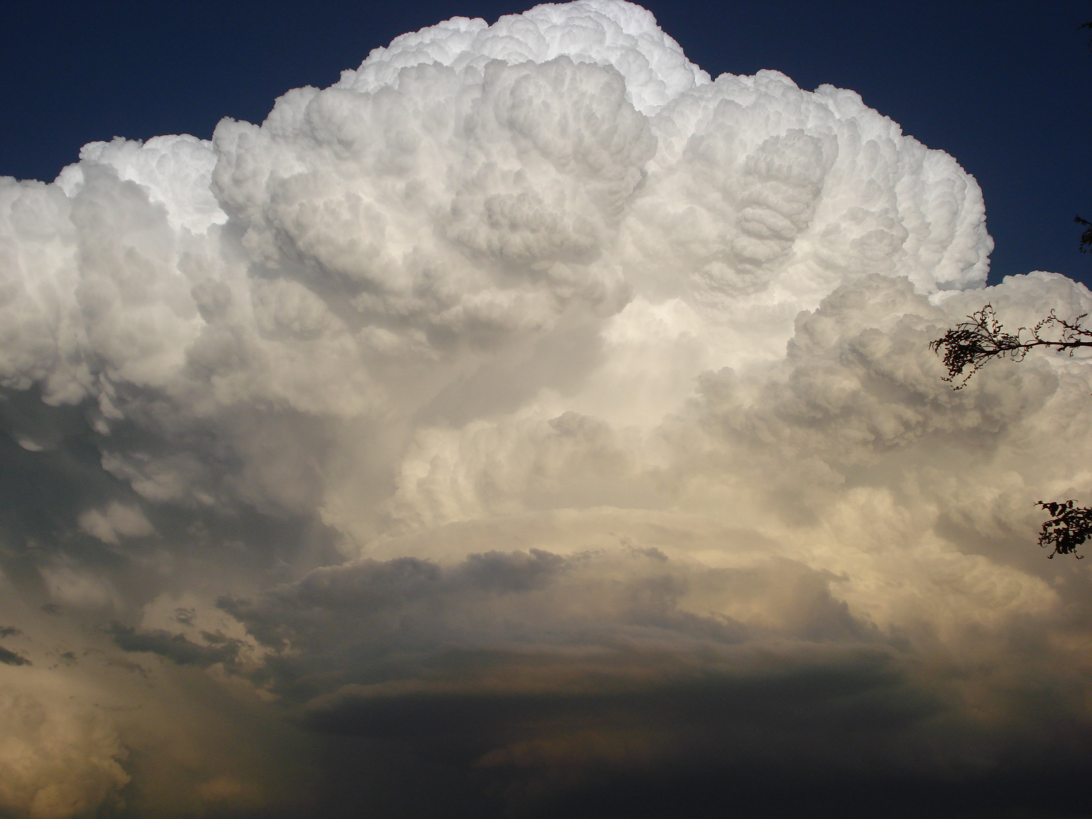
Ordinary Cells: Theory
Richard Rotunno
National Center for Atmospheric Research, USA
Photo by Alice Rotunno

Slide 2
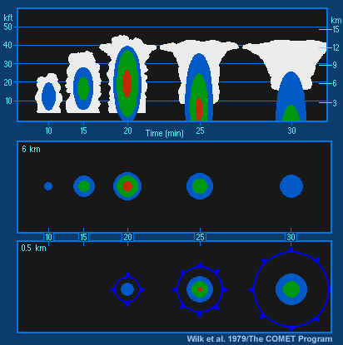
Ordinary Cell Evolution

Slide 3
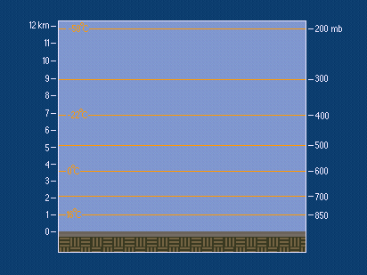
Ordinary Cell Evolution

Slide 4
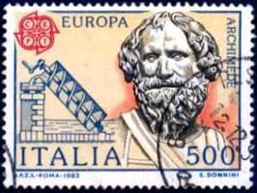
Basic Concept #1
Archimedes
Buoyancy
Displacement
= density
“env” = environment
“par” = parcel

Slide 5
Buoyancy in Terms of Temperature
Gas Law →
Displacement
T = temperature
p = pressure
R_{d} = dry air gas constant

Slide 6
Basic Concept #2
Stability

Slide 7
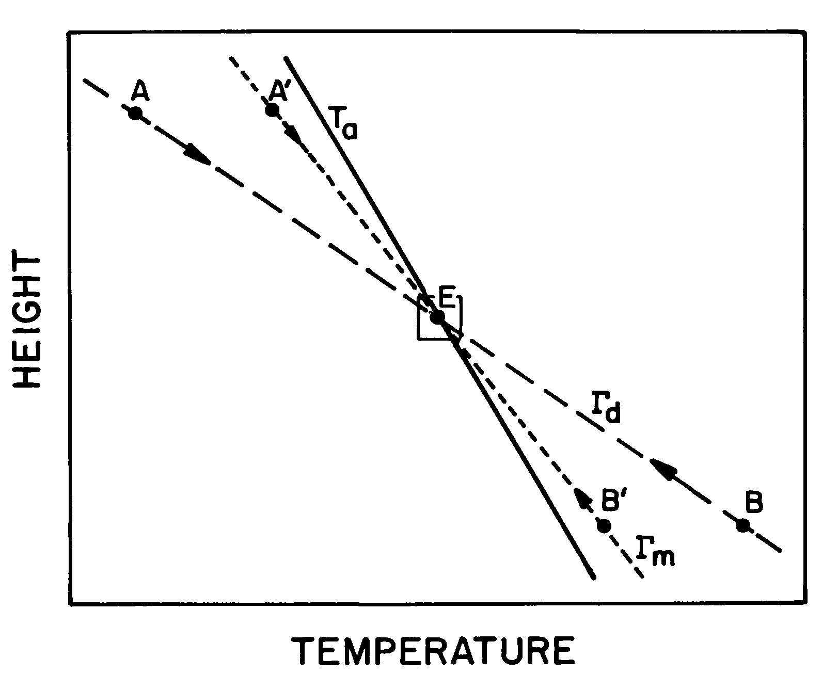
Air Parcel Behavior in a Stable Atmosphere
Temperature

Slide 8
Air Parcel Behavior in a Stable Atmosphere
Temperature

Slide 9
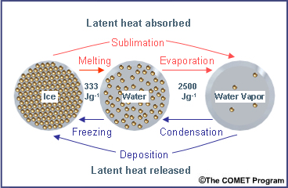
Basic Concept #3
Phase Change of H₂O → Latent Heating (Cooling)

Slide 10
Air Parcel Behavior in a Dry, Stable Atmosphere
Temperature

Slide 11
Air Parcel Behavior in an Moist, Unstable Atmosphere
Temperature

Slide 12
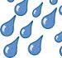
Air Parcel Behavior in an Moist, Unstable Atmosphere
Temperature

Slide 13
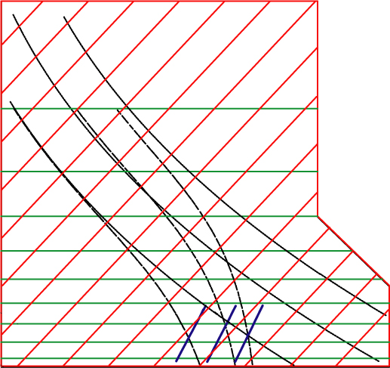
Skew T – Log P Diagram
Moist Adiabats
Dry Adiabats
Mixing
Ratio (g/kg)

Slide 14
Skew T – Log P Diagram
Dry Adiabats

Slide 15
Skew T – Log P Diagram
Moist Adiabats

Slide 16
Skew T – Log P Diagram
Convective Inhibition(CIN)

Slide 17
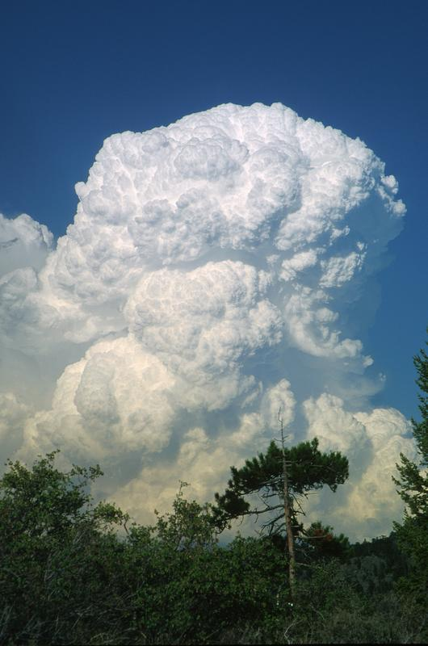
Buoyancy > 0
(Maximum updrafts: 60-80 m/s)

Slide 18
Skew T – Log P Diagram
Cold Outflow Produced thru Evaporation…
Evaporate Rain into Parcel at p=600mb
Descent along Moist Adiabat

Slide 19
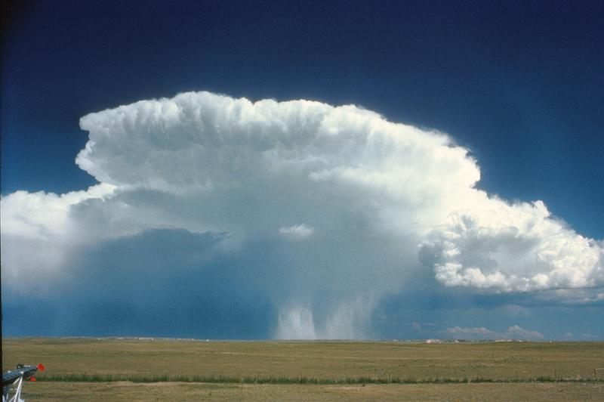
Buoyancy < 0
(Maximum downdrafts: 30-40 m/s)

Slide 20
Basic Concept #4
Buoyancy Produces
Vertical and Horizontal Motion

Slide 21
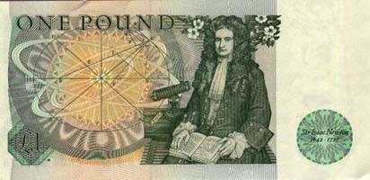
Newtons 2nd Law
pressure variable

Slide 22
Newtons 2nd Law
Vertical component

Slide 23
Newtons 2nd Law
Vertical component
High
Low
Large horizontal scale →
Hydrostatic Balance

Slide 24
Newtons 2nd Law
Vertical component
Small horizontal scale →
Parcel Limit

Slide 25
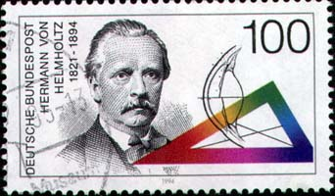
Vorticity Thinking

Slide 26
Vorticity Thinking
Restrict to two-dimensional motion

Slide 27
Vorticity Thinking
Vorticity Induces Velocity
continuity →

Slide 28
Vorticity Thinking
Buoyancy Produces Motion

Slide 29
Vorticity Thinking
Buoyancy Produces Motion

Slide 30
Vorticity Thinking
Effect of horizontal scale

Slide 31
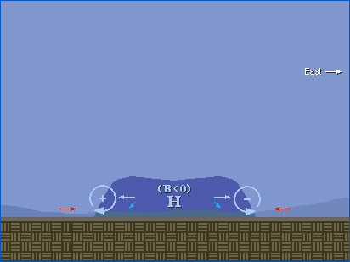
Density Currents

Slide 32
Vorticity Thinking
Density Currents
ground
Image Vorticity

Slide 33
Summary of Basic Concepts
1 Buoyancy
2 Stability
3 Latent Heating (Cooling)
4 Vorticity Thinking

