Slide 1
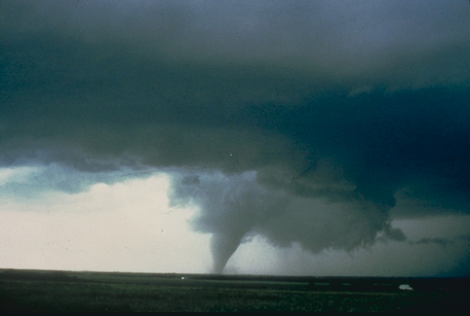
The Fluid Dynamics of Tornadoes
Richard Rotunno
National Center for Atmospheric Research, USA
Rotunno (2013 Ann Rev Fluid Mech)

Slide 2
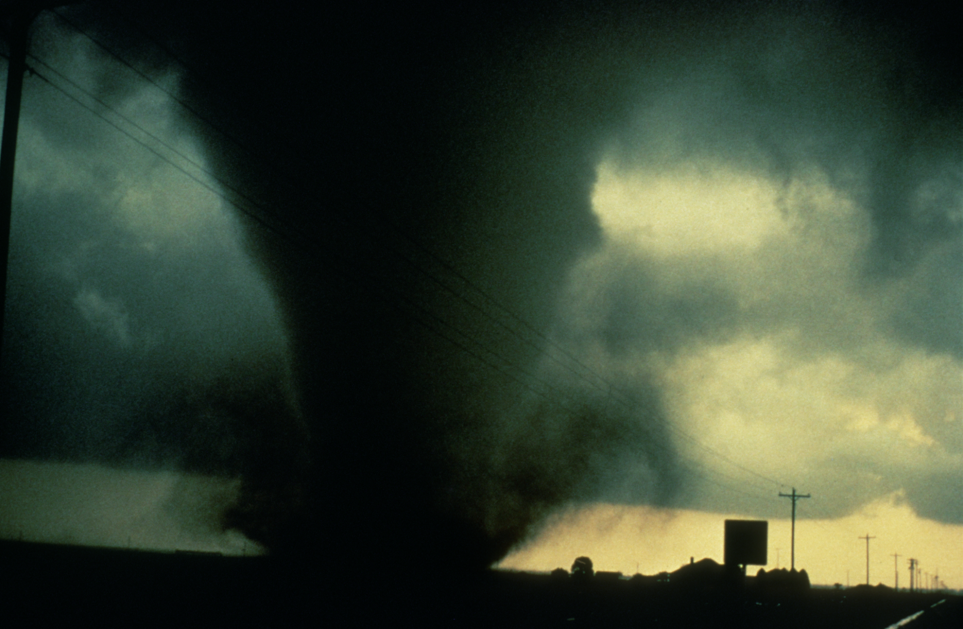
A tornado is a rapidly rotating column of air that occurs in association with a cumuliform cloud.

Slide 3
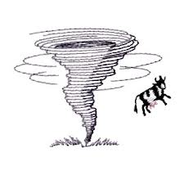
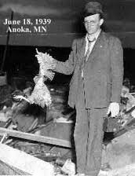
flying cow
chicken without feathers
Old methods for inferring tornado wind speeds

Slide 4
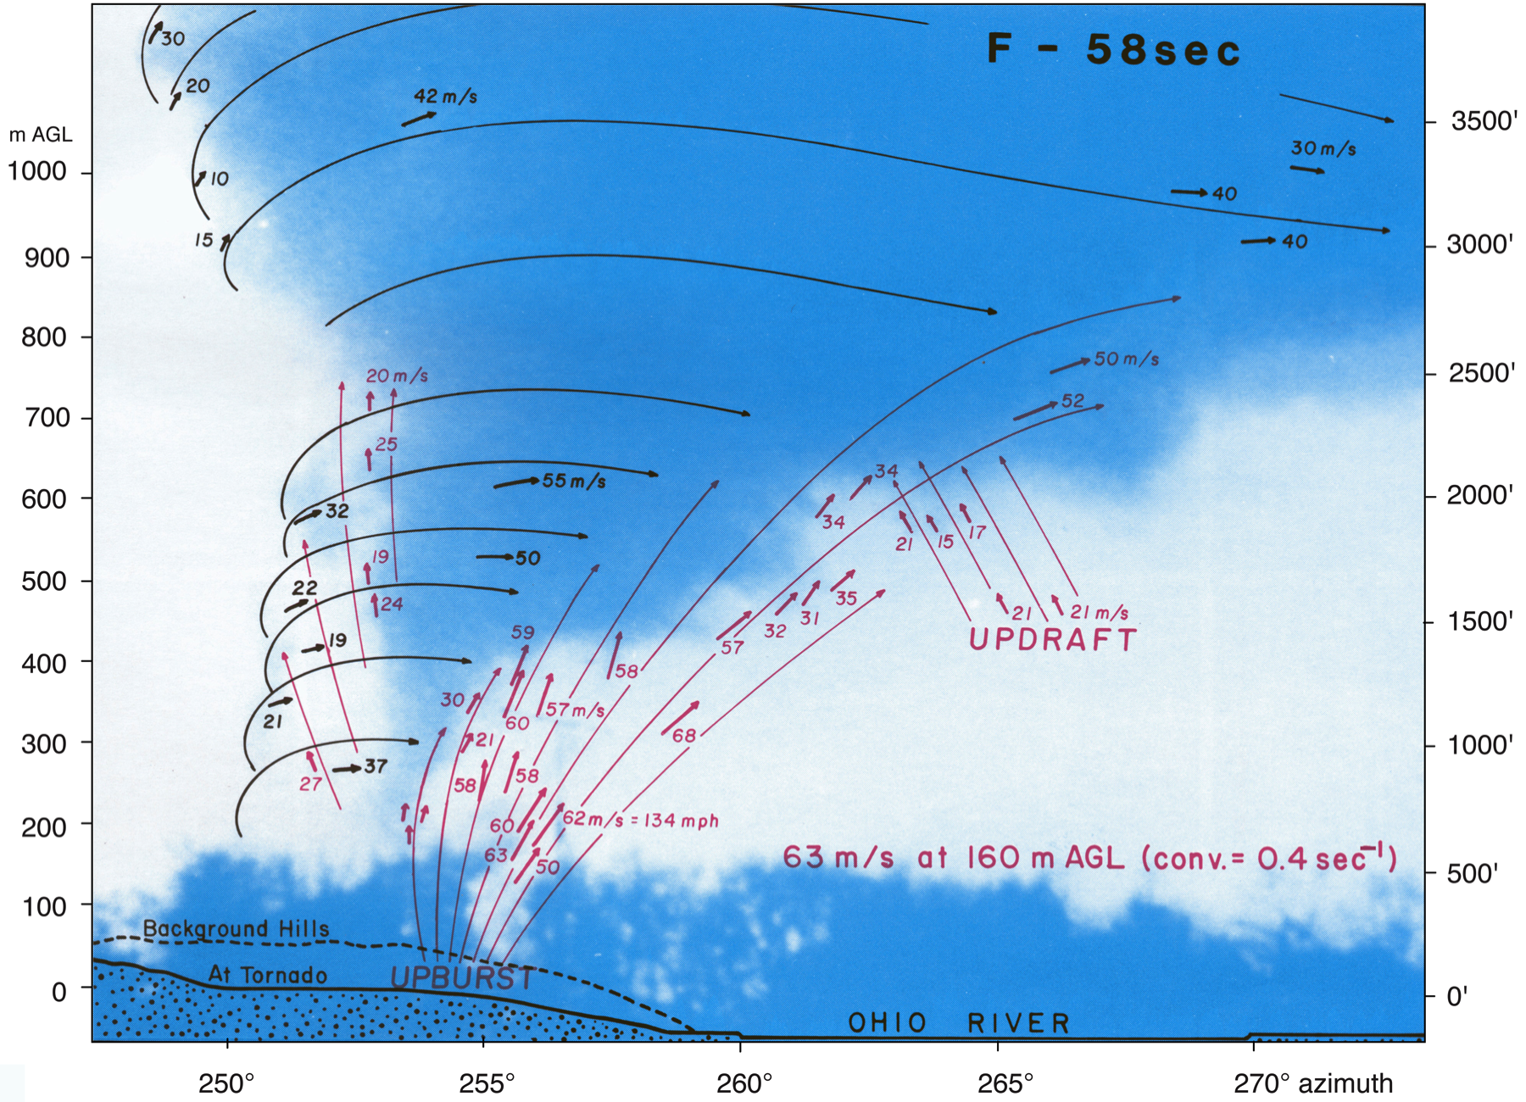
Photogrammetric Analysis of Tornado (Saylor Park, OH, 3 April 1974)
Fujita (1992, U Chicago Tech Report)

Slide 5
Supercell Thunderstorm with Tornado
Adapted from Klemp (1987, Ann. Rev. Fluid Mech.)

Slide 6
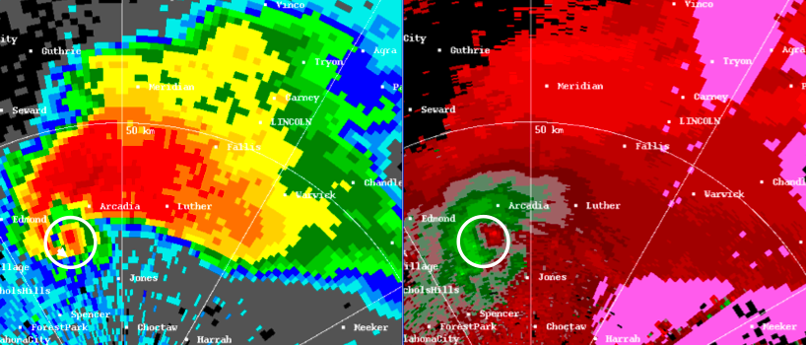
Supercell Surface Features
velocity couplet associated with mesocyclone
hook echo

Slide 7
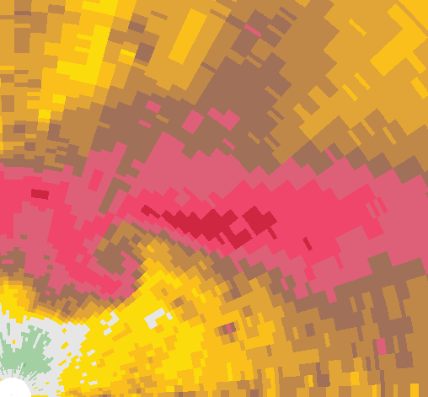
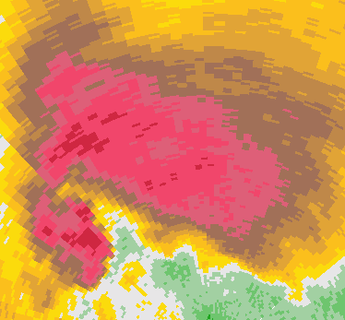
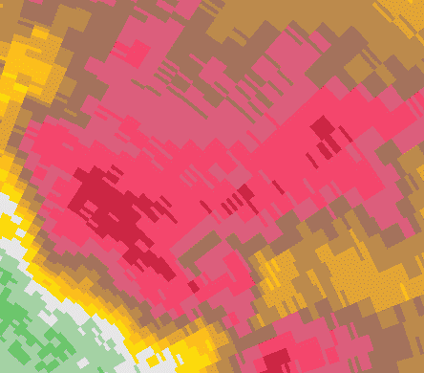
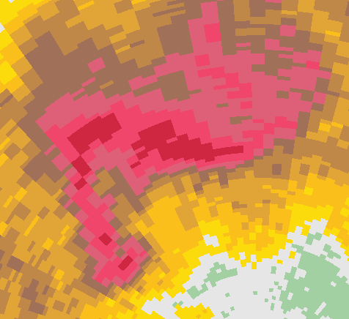
Outstanding Research/Operational Issue
Although most significant tornadoes are associated with
supercell thunderstorms, most supercells are not tornadic
Radar Reflectivity
nontornadic
nontornadic
tornadic
nontornadic

Slide 8
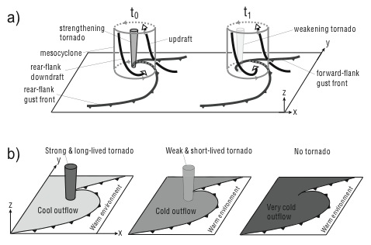
Tornadoes at the Cool-Air Boundary in a Supercell
Adapted from Marquis et al (2012, MWR)

Slide 9
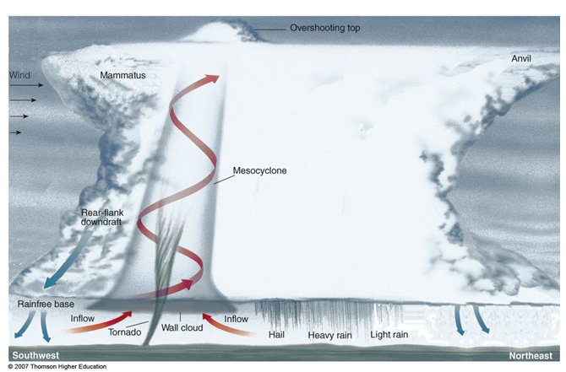
Tornado Vortex Laboratory Experiments

Slide 10
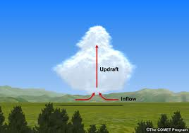
Idealization for Tornado Study
Adapted from Wakimoto et al (2011, MWR)

Slide 11
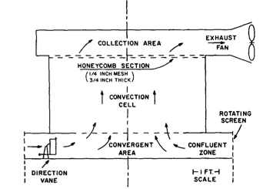
Ward Vortex Chamber
Ward (1972, JAS)

Slide 12
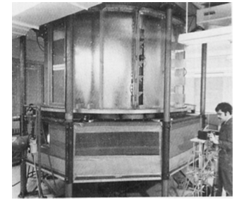
Purdue Vortex Chamber
Church et al. (1977, BAMS)

Slide 13
Ward Vortex Chamber
Swirl Ratio
Reynolds Number
Davies-Jones (1973, JAS)

Slide 14
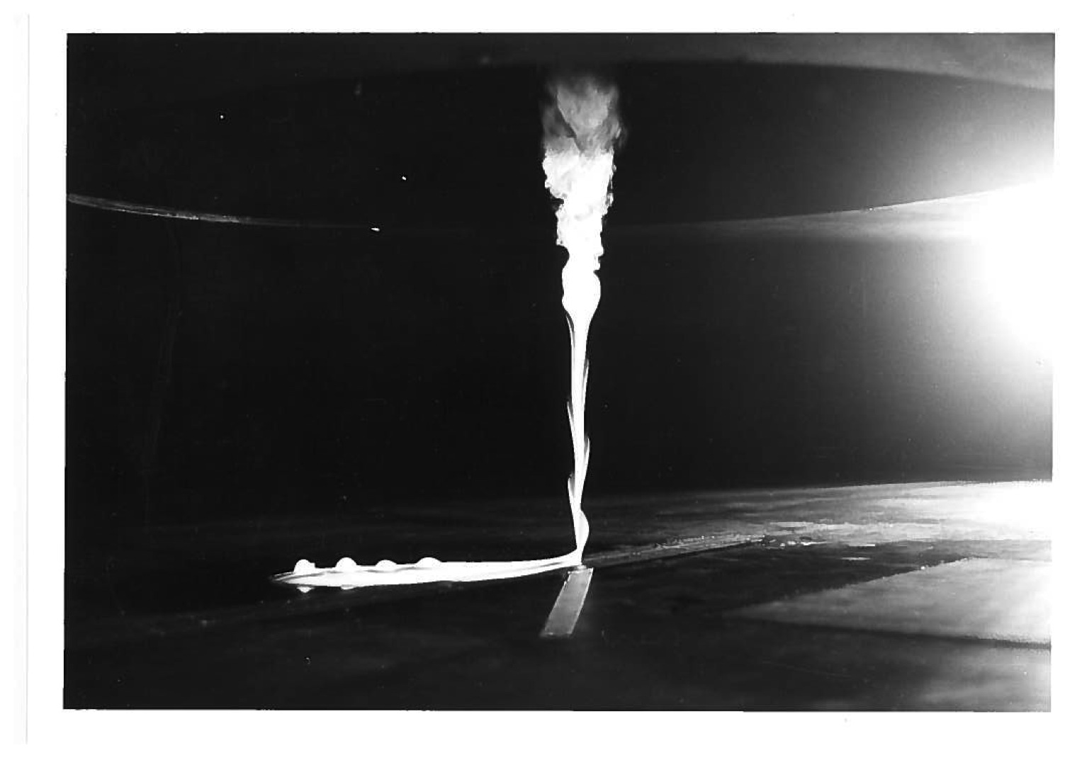
S = 0.1
Purdue Tornado Vortex Simulator
Church et al (1979, JAS)

Slide 15
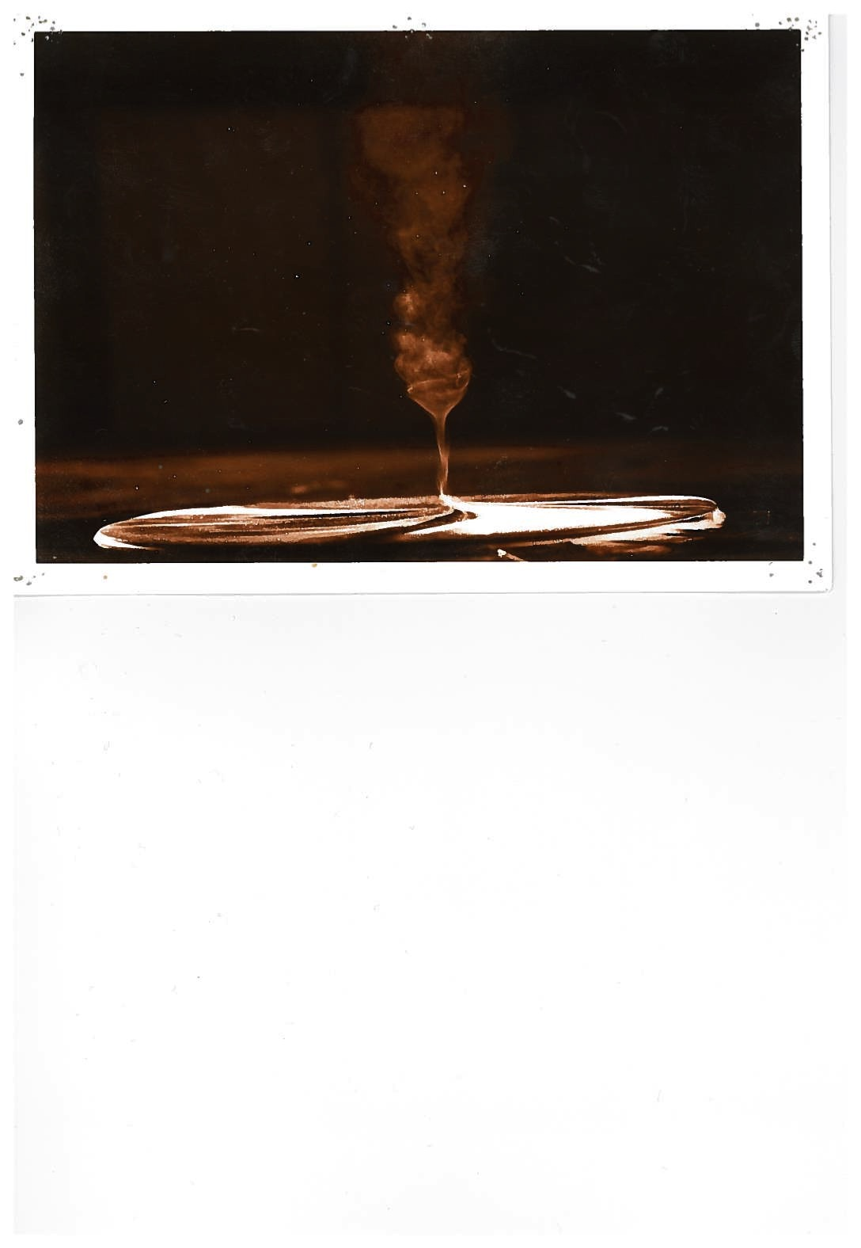
S = 0.4
Purdue Tornado Vortex Simulator
Church et al (1979, JAS)

Slide 16
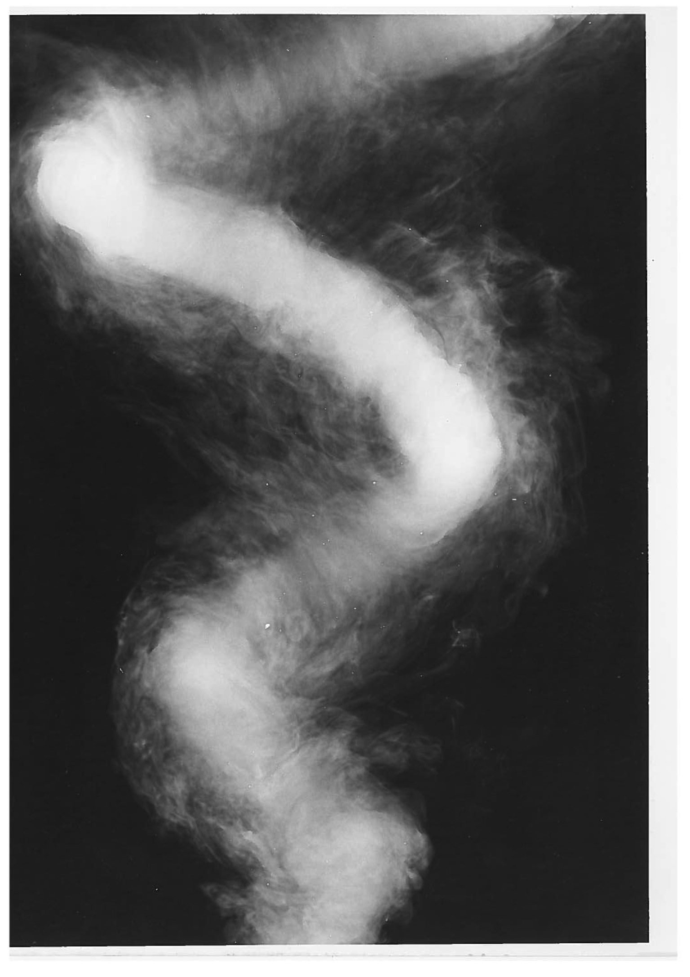
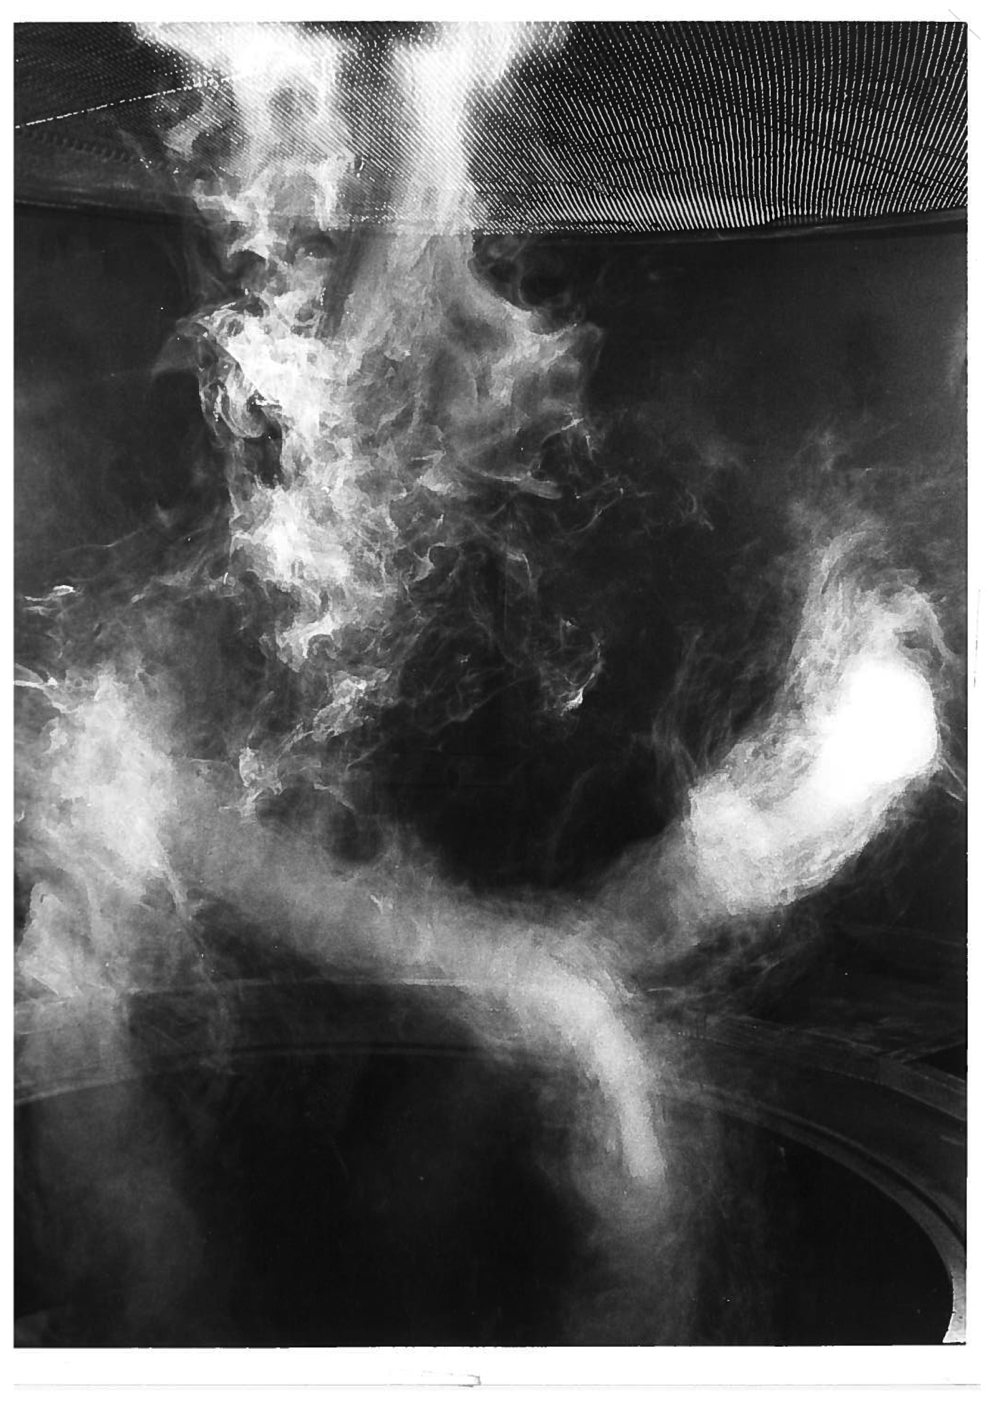
S = 0.5 S=1.0
Purdue Tornado Vortex Simulator
Church et al (1979, JAS)

Slide 17
Vortex Type v Swirl Ratio,
Small S
Medium S
Large S →
after Davies-Jones (1986)

Slide 18
Core Pressure Deficit vs S
S increasing
after Church & Snow (1985, JAS)

Slide 19
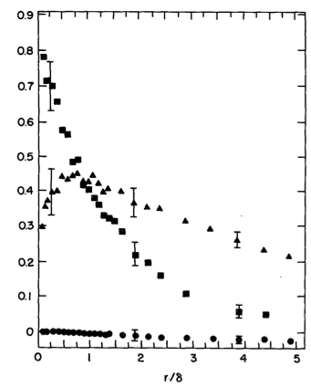
Laser-Doppler Velocimeter
Baker (1981, Ph. D. Thesis, Purdue)

Slide 20


Slide 21
Ward Vortex Chamber
Difficult to model top open boundary condition
Fiedler (1995, Atmos-Ocn)

Slide 22
Fiedler Chamber
Fiedler (1994, Atmos-Ocn)
Boundary condition
Swirl Ratio
Reynolds #

Slide 23
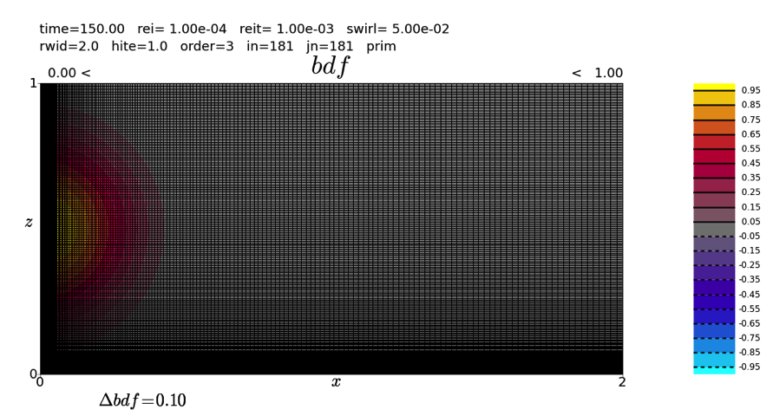
Imposed Buoyancy Force and Grid
New improved simulations based on Fiedler (1994, Atmos-Ocn), courtesy of B. Fielder

Slide 24
Imposed Buoyancy Force and Grid
New improved simulations based on Fiedler (1994, Atmos-Ocn), courtesy of B. Fielder

Slide 25
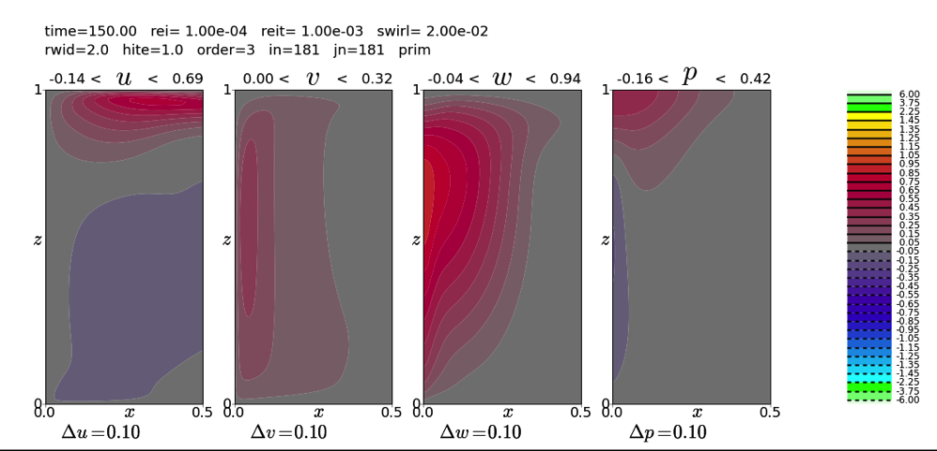
Steady Solution v. Swirl Ratio

Slide 26
Steady Solution v. Swirl Ratio

Slide 27
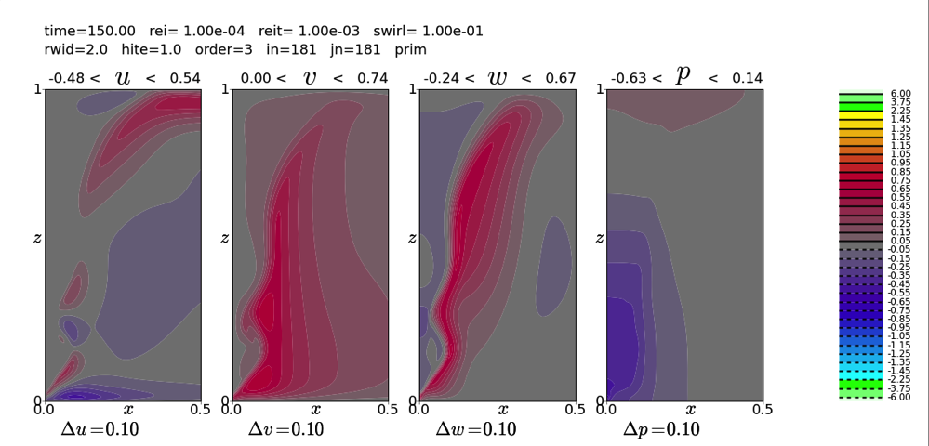
Steady Solution v. Swirl Ratio

Slide 28
Two-Celled Vortex
Outer Flow
End-Wall Vortex
End-Wall Boundary Layer
Corner Flow

Slide 29
Two-Celled Vortex
Outer Flow
End-Wall Vortex
Free-Slip @ z=0
End-Wall Boundary Layer
Corner Flow

Slide 30
No Slip @ z=0

Slide 31
Free Slip @ z=0

Slide 32
Two-Celled Vortex
Circulation Around the Domain
z
r
At steady state and applying boundary conditions →
Free-Slip @ z=0

Slide 33
Two-Celled Vortex:
Balance of Buoyancy and Centrifugal Tendencies
buoyancy
centrifugal
“Thermodynamic speed limit”

Slide 34
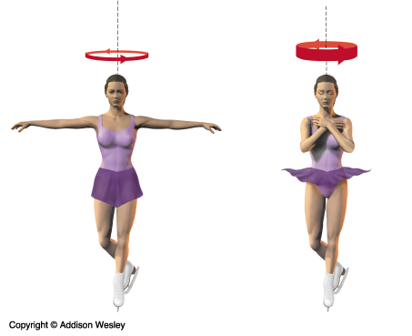
Two-Celled Vortex:
Balance of Buoyancy and Centrifugal Tendencies
“Thermodynamic speed limit”
Conservation of Angular Momentum
Core size increases with swirl ratio
Fiedler&Rotunno (1986, JAS)

Slide 35
Two-Celled Vortex
Core size increases with swirl ratio, Azimuthal velocity constant

Slide 36
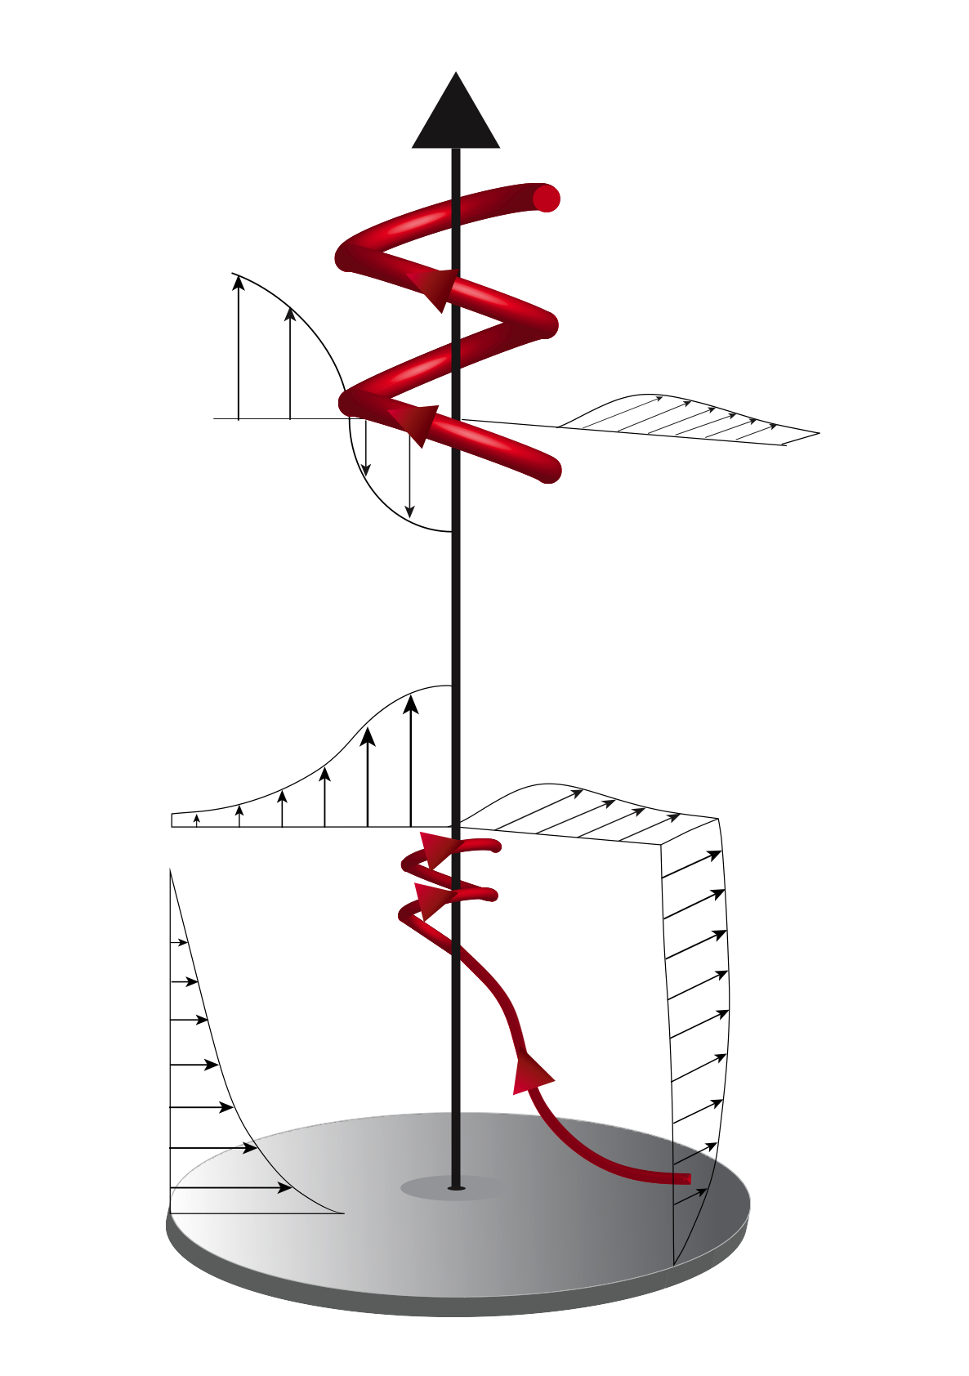
Vortex Lines and Flow Structure
Two-Celled Vortex

Slide 37
S = 0.5 S=1.0
Purdue Tornado Vortex Simulator
Church et al (1979, JAS)

Slide 38
Corner Flow, End-Wall Vortex and Boundary Layer
Two-Celled Vortex
Outer Flow
End-Wall Vortex
End-Wall Boundary Layer
Corner Flow

Slide 39
Corner Flow, End-Wall Vortex and Boundary Layer

Slide 40
Corner Flow, End-Wall Vortex and Boundary Layer
Simulations
End-Wall Vortex
Boundary Layer of a
Potential Vortex
Corner Flow
End-Wall Boundary Layer

Slide 41
Corner Flow, End-Wall Vortex and Boundary Layer
Theory
Fiedler&Rotunno (1986, JAS)
End-Wall Vortex
Corner Flow
End-Wall Boundary Layer of a
Potential Vortex
Rotunno (1980, JFM)
Wilson&Rotunno(1986, Phys. Fluids)
Batchelor (1967, Chap. 7.5), Yih (1965, Chap. 6.7)
Long(1953, J. Meteor.)
Burggraf et al (1971, Phys. Fluids)

Slide 42
Boundary Layer → Corner Flow → End-Wall Vortex
End-Wall Vortex
Corner Flow
End-Wall
Boundary Layer
vortex lines = streamlines
Burggraf et al. ’71
End-Wall Boundary Layer &,
consequently, also true for
Corner Flow & End-Wall Vortex

Slide 43
Reconciliation of Two-Celled Vortex with End-Wall Vortex ?
Two-Celled Vortex
Outer Flow
End-Wall Vortex
End-Wall Boundary Layer
Corner Flow
End-Wall Vortex is Supercritical

Slide 44
Vortex Breakdown
Pauley and Snow (1988, MWR)

Slide 45
Maxworthy (1972, Astro. Acta)

Slide 46
Condition for Vortex Breakdown to Remain Suspended
Fiedler (2009, Atmos. Sci. Lett.)

Slide 49
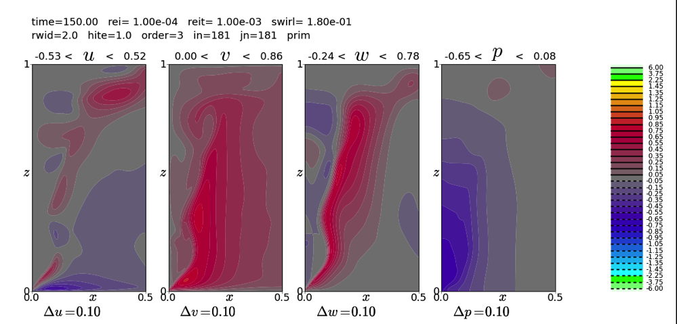

Slide 50
Maxworthy (1972, Astro. Acta)

Slide 51
Effects of Turbulence?

Slide 52
Large Eddy Simulation
Lewellen et al (2000, JAS)

Slide 53
Large Eddy Simulation
Each satellite
vortex has locally amplified velocity
in the boundary layer
Lewellen et al (2000, JAS)

Slide 54
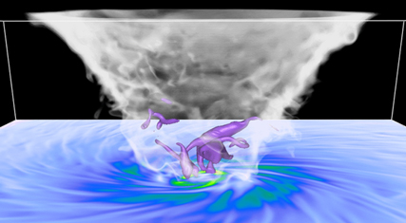
Large Eddy Simulation
500m
condensation
funnel
Shading:
near-surface
wind speed (m/s)
Bryan et al (2016, JAS)
Notes:
LES Hurricane
What: Large Eddy Simulation of the inner core of an idealized tropical cyclone (grid size dx=31m)
Why: Knowledge of the basic physics → better estimates of lateral and vertical diffusion → improved parameterizations -→ better predications of intensity and structure
How: NCAR CM1 model (G. Bryan)
Who: NCAR (MMML), Naval Research Lab, University of Colorado, NOAA / Hurricane Research Division
When: Ongoing
2) LES Tornado
What: Large Eddy Simulation of an idealized tornado (grid size=5m)
Why: Knowledge of the basic physics→ better predications of intensity and structure
How: NCAR CM1 model (G. Bryan)
Who: NCAR (MMML), U of Miami
When: Ongoing

Slide 55
Conclusions
Steady-State Theory of Axisymmetric Tornado-Like Vortices Well Developed and Tested in Laboratory and Numerical Models
3D and Turbulence Effects Less So…
Knowledge of Tornadogenesis Primitive
Intersection of Storm-Scale and Vortex-Scale Dynamics Next Frontier

Slide 56
End-Wall → Two-Celled Vortex
Two-Celled Vortex
Vortex Breakdown
End-Wall Vortex
End-Wall
Boundary Layer
Corner Flow
vortex lines = streamlines
Burggraf et al. ’71
End-Wall Boundary Layer &,
consequently, also true for
Corner Flow & End-Wall Vortex

