Slide 1
Fluid Dynamics for
Coastal Meteorology
Richard Rotunno
National Center for Atmospheric Research , USA

Slide 2
Coastal Meteorology
Length Scale ~ 1 – 1000 km
Time Scale ~ hours – days
Fluid Dynamics
Buoyancy
Earth’s Rotation

Slide 3
Topics
Lecture 1 : Concepts and Equations
Lecture 2: The Sea Breeze
Lecture 3: Coastally Trapped Disturbances

Slide 4
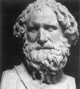
What do these phenomena have in common?
Buoyancy
Archimedes
Displacement
= density
“env” = environment
“par” = parcel

Slide 5
Buoyancy is Acceleration
To a good
approximation...
= pressure
= vertical coordinate

Slide 6
Buoyancy in Terms of Temperature
Gas Law →
1st Law of Thermo (adiabatic) & Hydrostatics→
= specific heat at constant pressure , R = gas constant for dry air

Slide 7
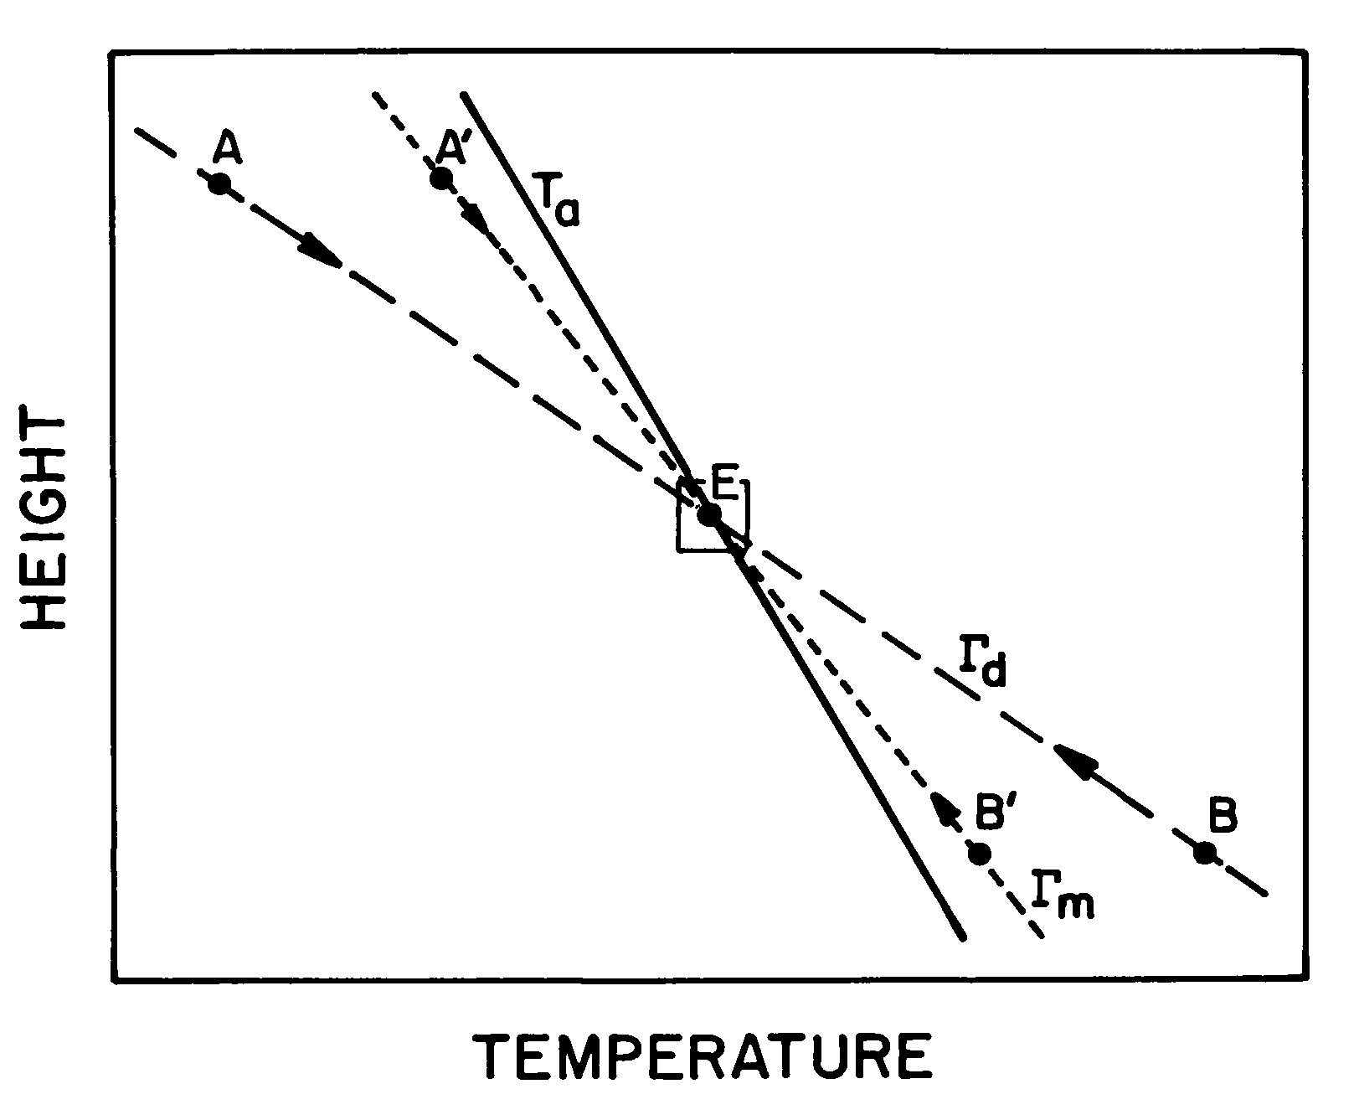
Air Parcel Behavior in a Stable Atmosphere
Air Parcel Behavior in a Stable Atmosphere
z
Temperature

Slide 8
Air Parcel Behavior in an Unstable Atmosphere
z
Temperature
Notes:
Klemp, 1992, Encyclopedia of Earth System Science, 3, 251-262, Academic Press

Slide 9
Buoyancy in Terms of Potential Temperature

Slide 10
Air Parcel Behavior in a Stable or Unstable Atmosphere
z
Potential Temperature

Slide 11
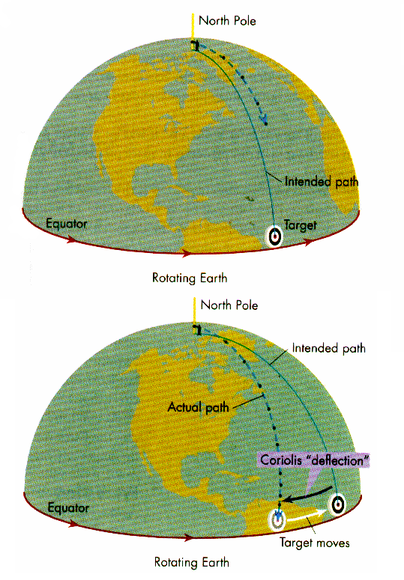
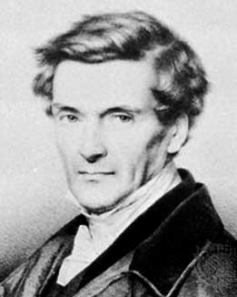
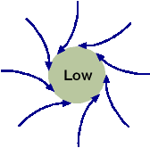
Coriolis Effect

Slide 12
Governing Equations

Slide 13

Newtons 2nd Law
With previous
definitions →
Coriolis parameter
= frictional force/unit mass

Slide 14

1st Law of Thermodynamics
Helmholtz
With previous definitions →
Common form…
In terms of
and …..

Slide 15
Mass Conservation
With previous definitions →

Slide 16
Summary of Governing Equations
Conservation of
momentum
energy
mass

Slide 17
Simplify Governing Equations I
Neglect molecular diffusion →
Conservation of
momentum
energy
mass

Slide 18
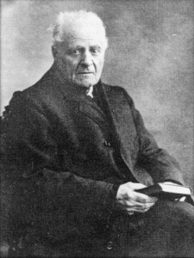
Simplify Governing Equations II
Conservation of momentum
Boussinesq Approximation

Slide 19
Simplify Governing Equations III
Conservation of energy
With

Slide 20
Simplify Governing Equations IV
Conservation of mass
By definition →
= speed of sound
3 conditions for effective
incompressibility
(Batchelor 1967 pp. 167-169)
= velocity, length, frequency scales

Slide 21
Summary of Simplified Governing Equations
Conservation of
momentum
energy
mass
Reynolds’ averaging -->
Turbulent Stress, Heat Flux
Still nonlinear (advection)

Slide 22
Summary
Buoyancy and Earth’s rotation are fundamental
Boussinesq approx. simplifies momentum equation
For most applications

Slide 23
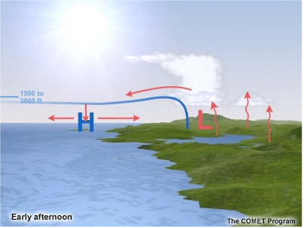
Lecture 2: The Sea Breeze
Richard Rotunno
National Center for Atmospheric Research , USA
Notes:
Sea breeze influence climate and of coastal regions and contribute to pollutant transport
Aggiungere figure e elenco problemi classici legati alle brezze nelle citta costiere (fumigation ritorno dell’ozono)
Data l’importanza della brezza questo lavoro vuole migliorare la nostra conoscenza della brezza tramite una simulazione 3d ad alta risoluzione.

Slide 24
Summary of Simplified Governing Equations
Conservation of
momentum
energy
mass

Slide 25
Vorticity
Batchelor (1967, Chapters 2 and 5)

Slide 26
Vorticity Induces Velocity
by definition
mass conservation
Example: Localized Vorticity in 2D

Slide 27
Baroclinicity Creates Vorticity

Slide 28
Differential Heating Creates Baroclinity
Heat Input
Sea
Land

Slide 29
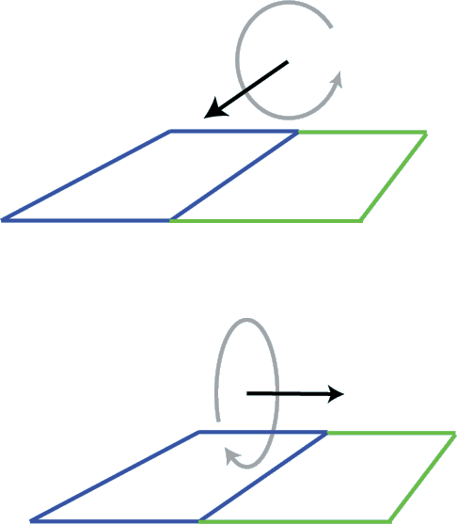
Coriolis Effect Turns Vorticity
Early
sea
land
Later
sea
land

Slide 30
Dependence of Circulation on External Conditions?
Vertical Scale? Horizontal Scale? Velocity Scale?
“Large Eddy Simulations of the Onset of the Sea Breeze”
M. Antonelli and R. Rotunno (2007, JAS, in press)

Slide 31
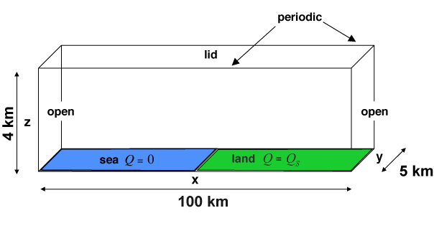
Rotating, uniformly stratified resting atmosphere, suddenly heated over the land part of the domain (no diurnal cycle, moisture, or large-scale flow).
Input Parameters:
Notes:
La figura e’ ritagliata da ppoint

Slide 32
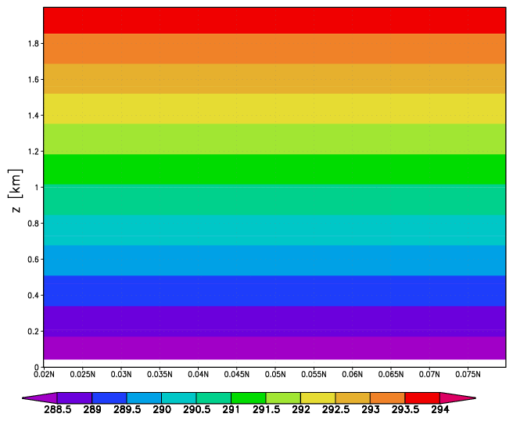

Slide 33
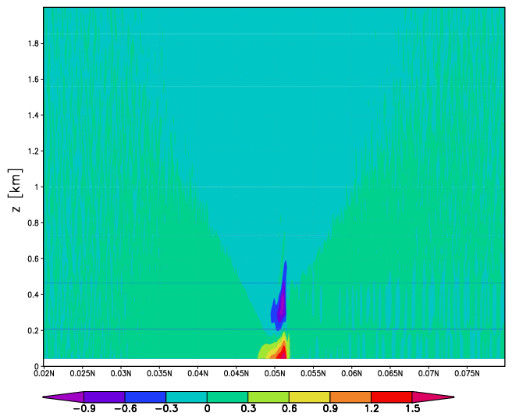

Slide 34
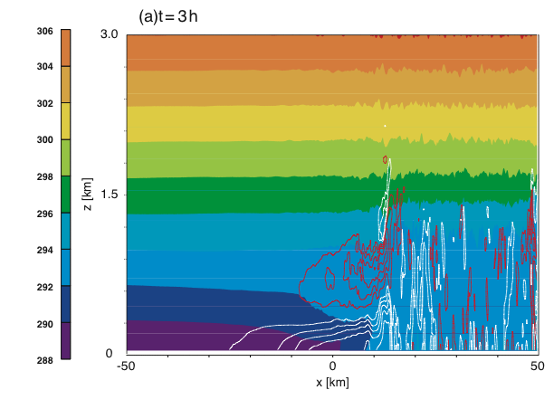
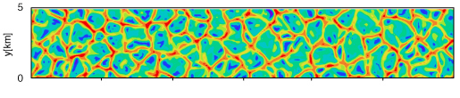
t=3h
10
x[km]
40
Notes:
A vertical section of potential temperature field (shaded) and longitudinal velocity field (c.I. 1m/s) ant t=3h and t=6h.
The coastline correspond to x=0.

Slide 35
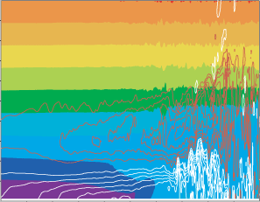

t=6h
10
x[km]
40
Notes:
A vertical section of potential temperature field (shaded) and longitudinal velocity field (c.I. 1m/s) ant t=3h and t=6h.
The coastline correspond to x=0.

Slide 36
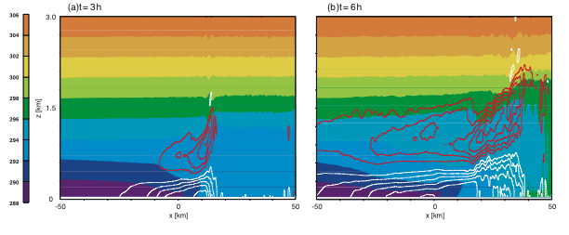

Slide 37
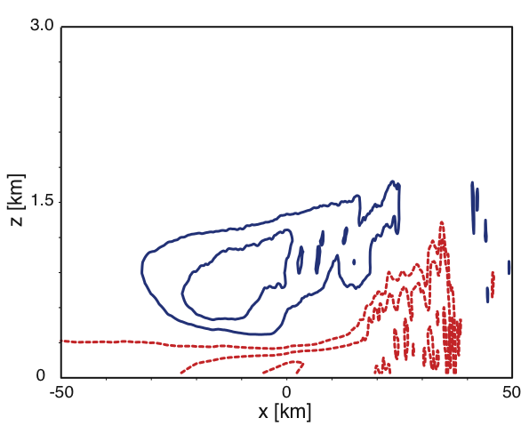
t=6h

Slide 38
Solution Dependence on External Parameters ?
case | a | b | c | d | e | f | a_f0
 | 0.06 | 0.12 | 0.06 | 0.12 | 0.24 | 0.24 | 0.06
Notes:
The assumption we made at this point is that the only relevant parameters are the surface heat flux, the parameter , the initial static stability parameter N, the Coriolis parameter f and the time t, implicitly assuming that, for instance, the scale of the transition between land and sea is not a crucial parameter. We refer to these as external parameters.

Slide 39
Vertical Length Scale
Velocity Scale
Horizontal Length Scale
Temperature Scale

Slide 40
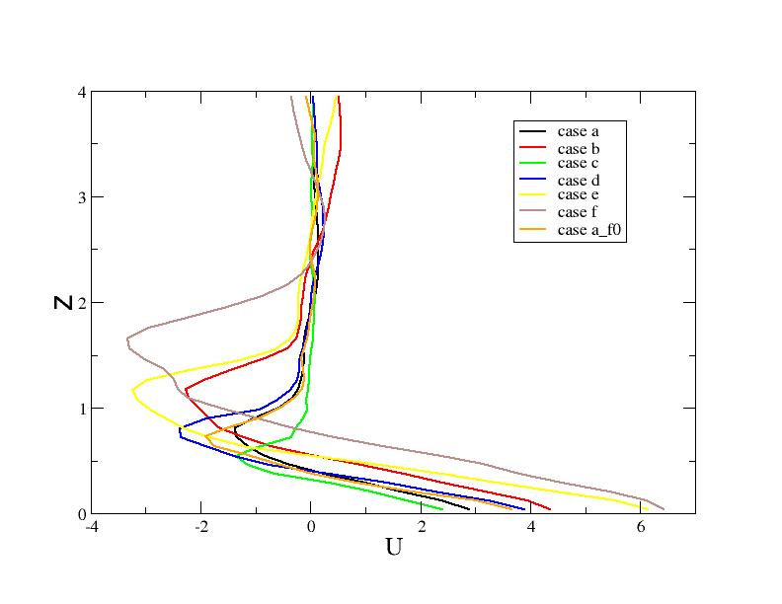
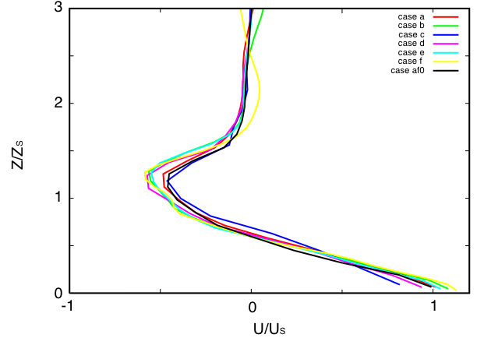
Across-Coast Velocity at x=0

Slide 41
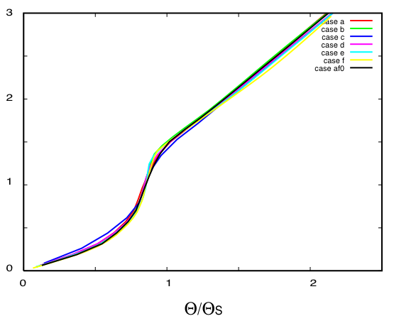
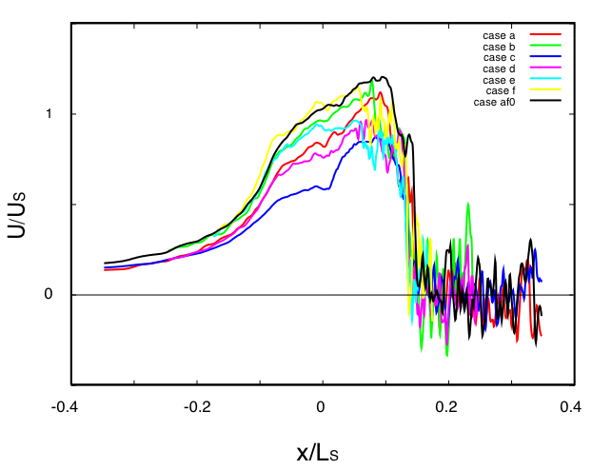
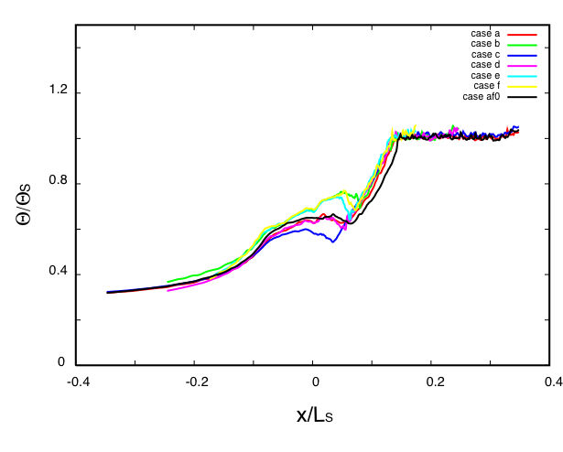
Nondimensional Profiles

Slide 42
Summary
Land-Sea Buoyancy Gradient Produces Sea Breeze
Coriolis Effect Turns Onshore Winds to Alongshore Direction
Height, Velocity Scale Follow Convective Boundary Layer

Slide 43
Lecture 3: Coastally Trapped Disturbances
Richard Rotunno
National Center for Atmospheric Research , USA

Slide 44
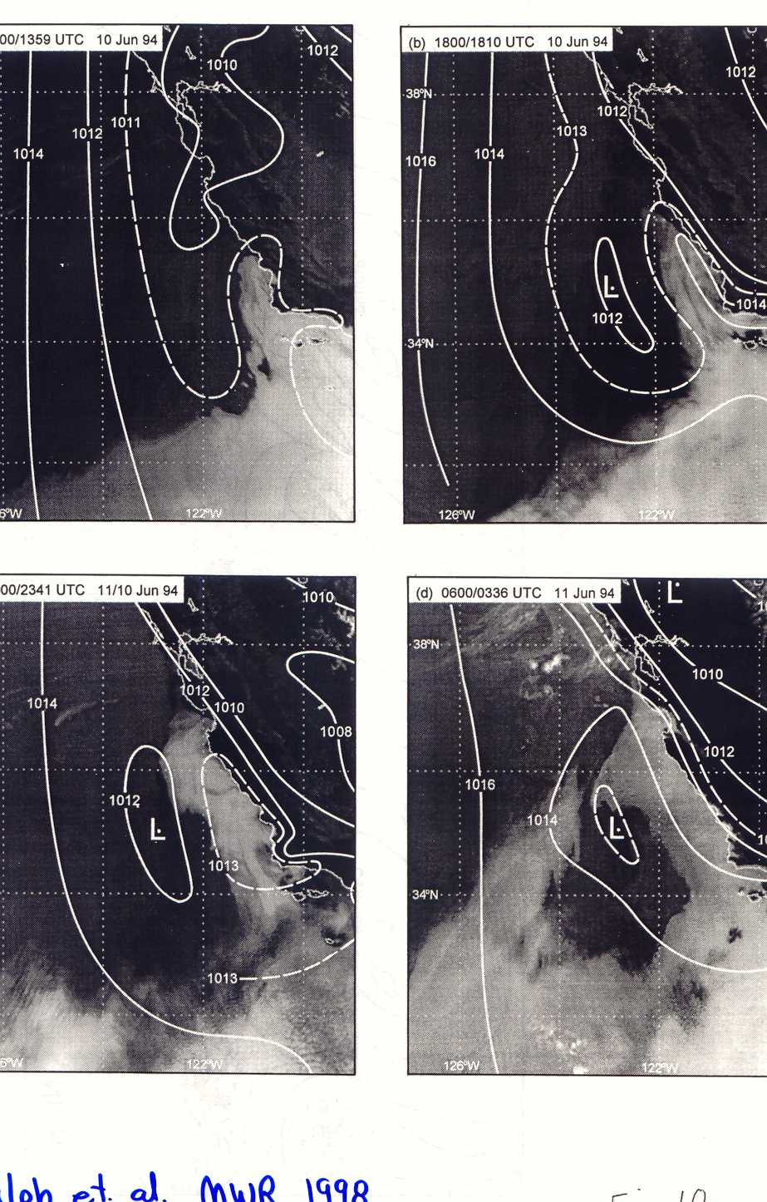
Climatological northerlies occasionally reverse, bringing cool cloudy marine layer air from the south.
This tongue of air along the coast is called a Coastally Trapped Disturbance (CTD).
Ralph et al. (1997, MWR)

Slide 45
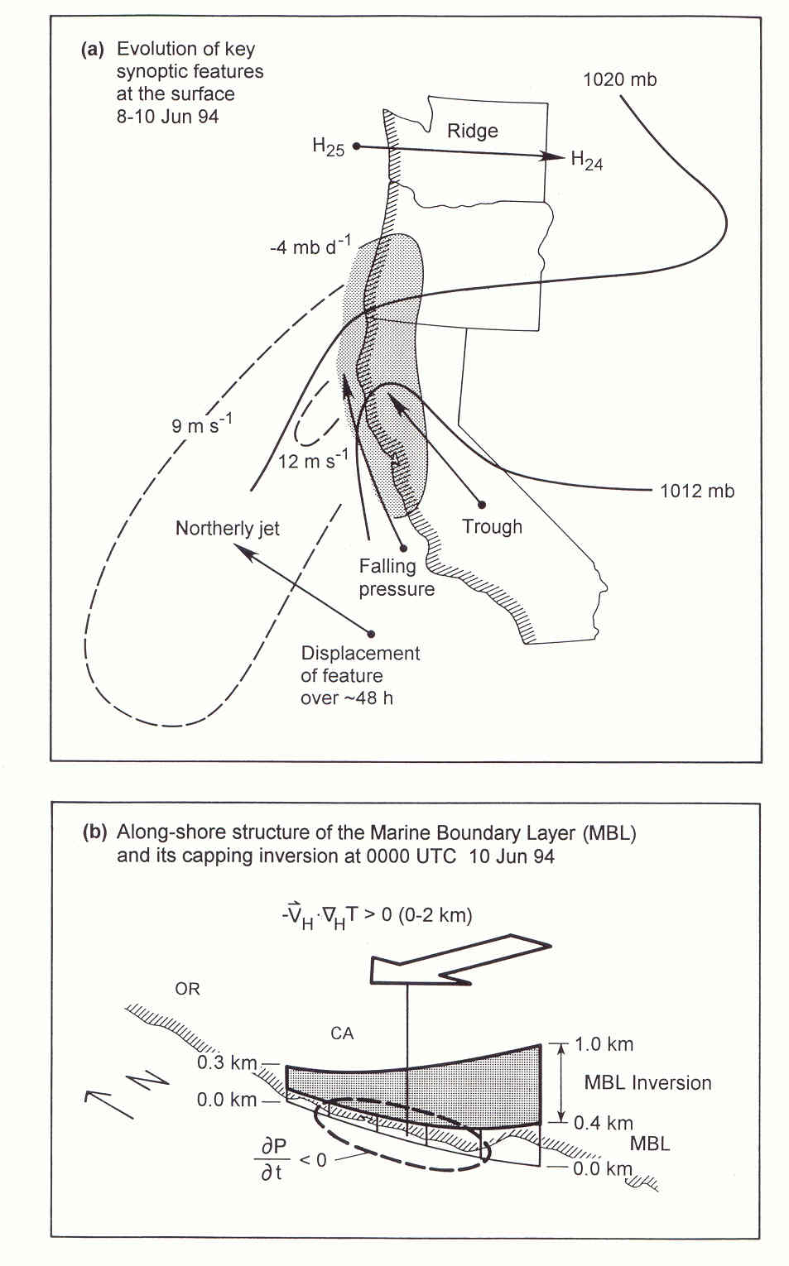
Observational Summary
Synoptic Scale:
High pressure builds in the North
Induces offshore winds
Mesoscale :
Low pressure form at the coast
Northerly jet moves offshore
CTD with southerly flow aloft
Propagating pressure signals inland
CTD:
Limited offshore extent
Transition to southerlies may be
abrupt or smooth
Wind shift with pressure rise,
with or without temperature fall

Slide 46
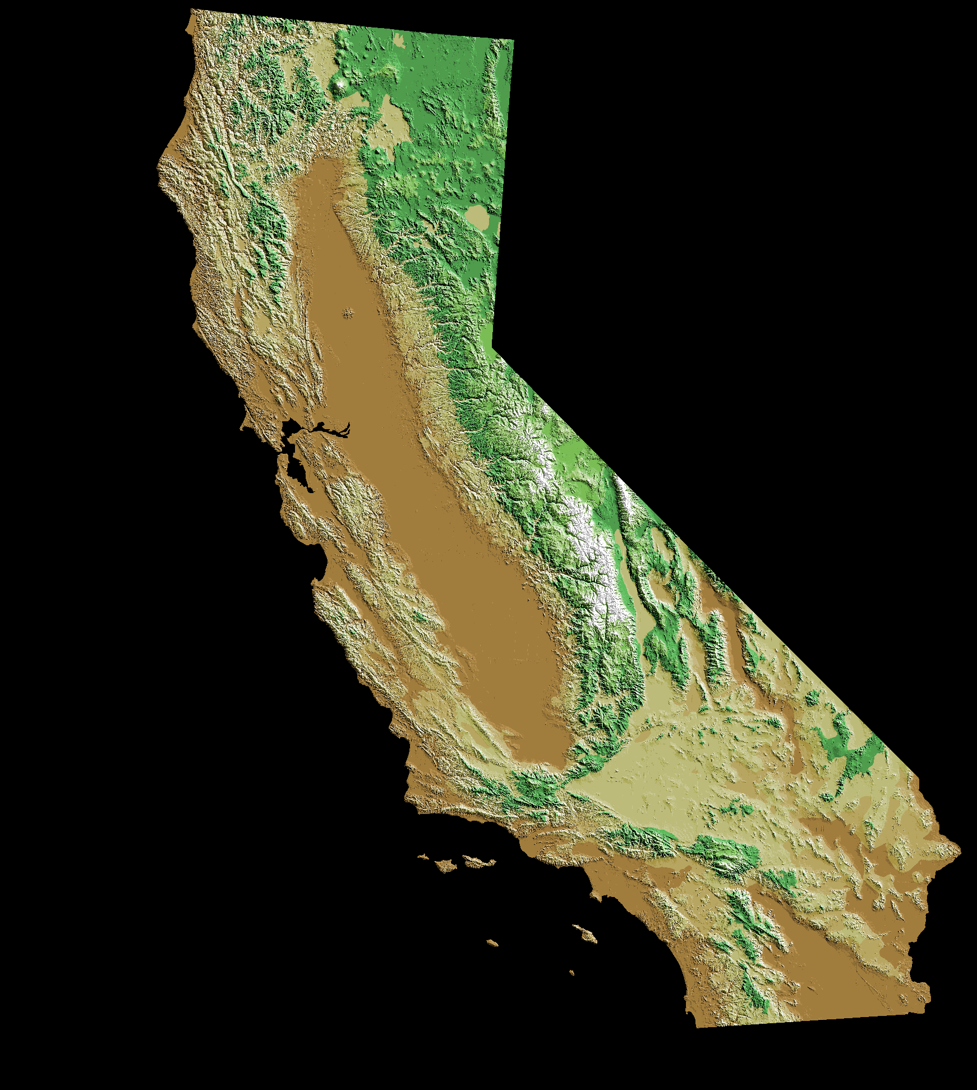
California
The marine inversion layer is almost always present here in Spring/Summer

Slide 47
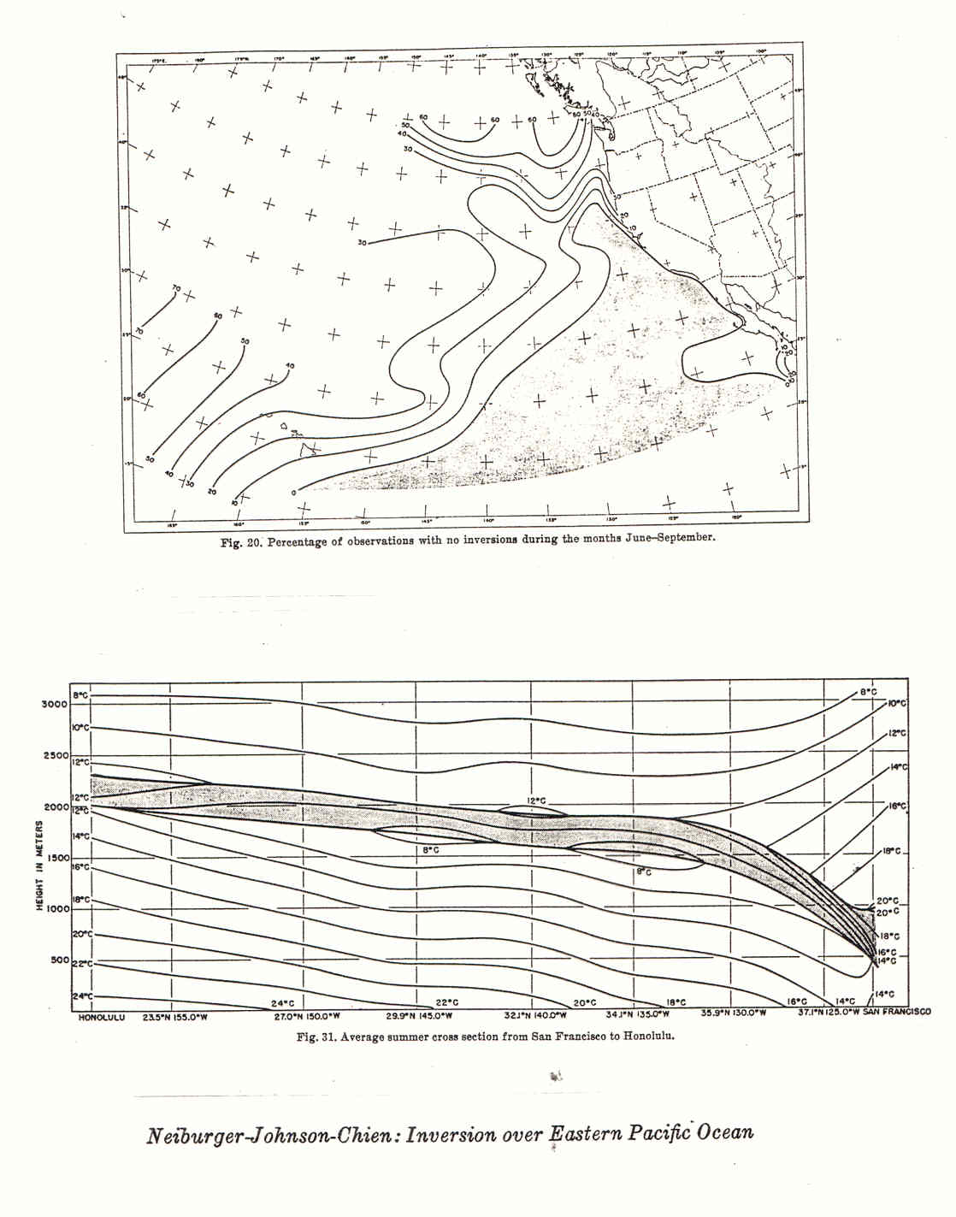
Vertical Section of Temperature
from Hawaii to San Francisco
weakly
stable
strongly stable
neutrally
stable

Slide 48
Recall 2D, Steady Vorticity Equation (Lecture 2)
or

Slide 49
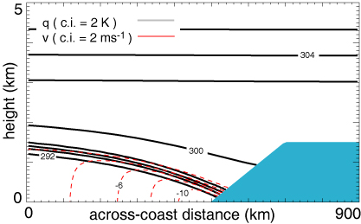
2D Basic State Represents Climatology
(Skamarock, Rotunno, and Klemp 1999 JAS)

Slide 50
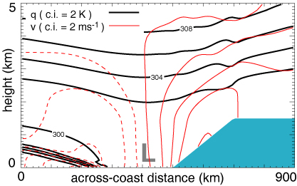
2D Response to Imposed Offshore Wind
new balance
SRK

Slide 51
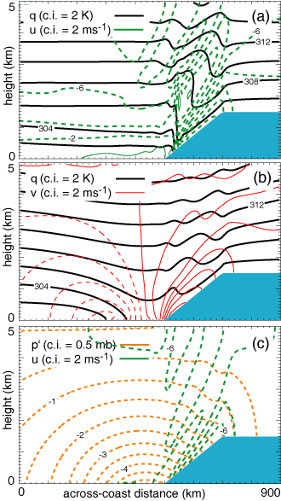
2D Response to
Imposed Offshore Wind
No Coriolis Effect,
No Lee-Side Pressure Fall
Coriolis Effect Important for
Lee-Side Pressure Fall
SRK

Slide 52
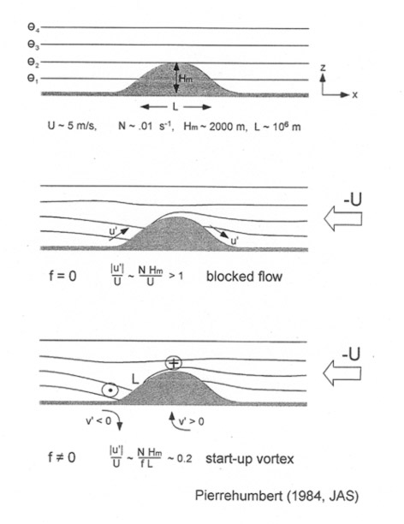

Slide 53
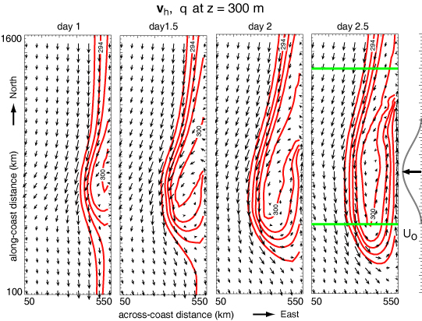
3D Response to Localized Offshore Wind
SRK

Slide 54
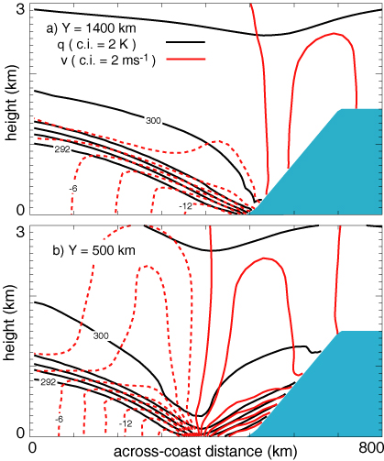
North
Day 2.5
Cross-sections
South
SRK

Slide 55
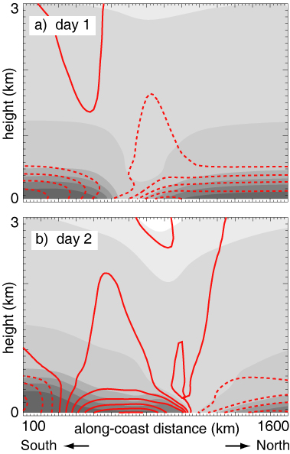
c.I.= 2m/s
Shading, 2K
SRK

Slide 57
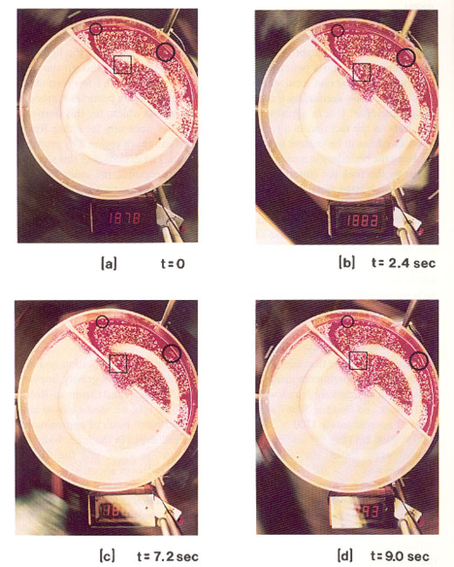
Nof (1995, J. Mar. Res.)

Slide 58
Idealization I : Shallow Water Equations (SWE)
(Ignore Upper-Layer Stratification)
Lecture 1
Assume hydrostatic and

Slide 59
Linearized SWE
Kelvin Waves
Combine (2),(3)
Solution
Gill (1982 Atmosphere-Ocean Dynamics)

Slide 60
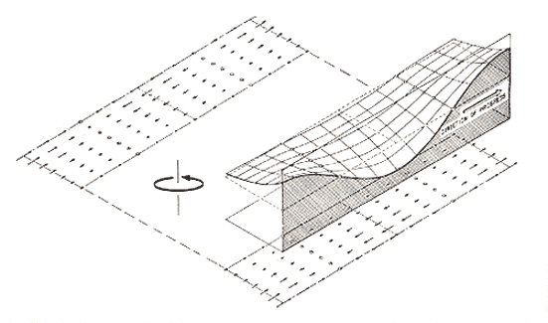
Condition (1) applied to (5),(6)
and
Gill ( 1982)

Slide 61
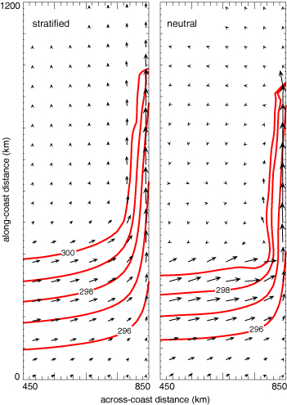
Effect of stratification above marine layer
SRK

Slide 62
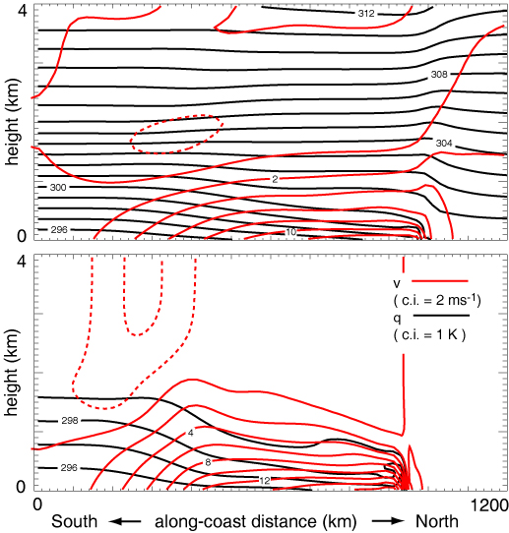
Stratified
Effect of stratification above marine layer
Neutral
SRK

Slide 63
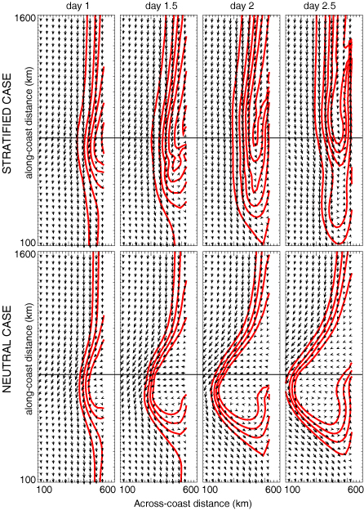
SRK

Slide 64
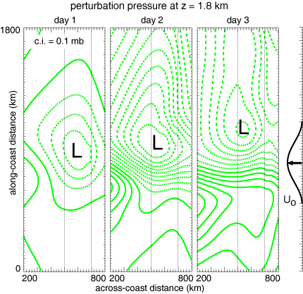
SRK

Slide 65
Idealization II : Surface Quasigeostrophic Approximation
(Ignore Lower-Layer Stratification)
Lecture 1
2D quasigeostrophic momentum equation
hydrostatic, geostrophic
combine

Slide 66
Topographically Trapped Rossby Waves
Elementary
Solution
Rhines (1970, Geophys. Fluid Dyn.)

Slide 67
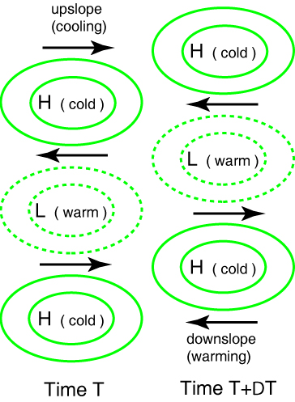
SRK

Slide 68
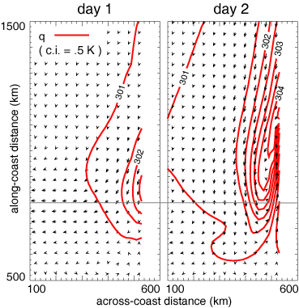
Stratified with No Marine Layer
SRK

Slide 69
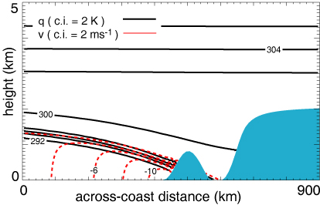
Simulations with More Realistic Topography
SRK

Slide 70
California

Slide 71
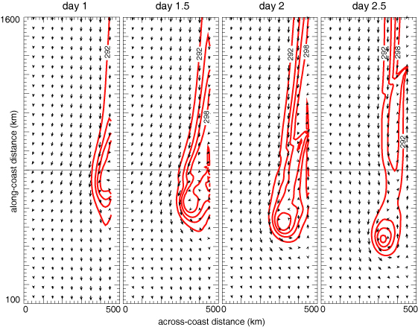
Simulations with More Realistic Topography
SRK

Slide 72
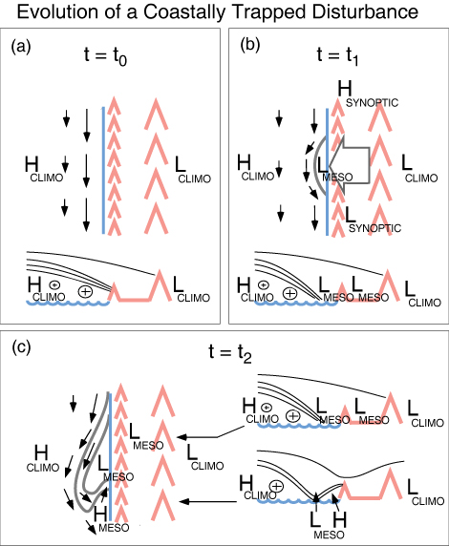
SRK

Slide 73
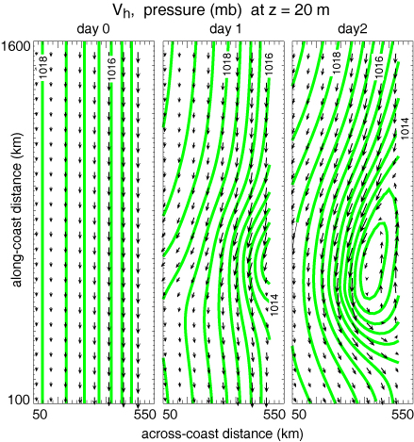
SRK

Slide 74
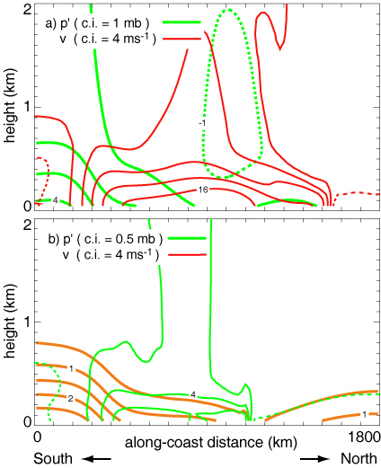
SRK

Slide 75
