Slide 1
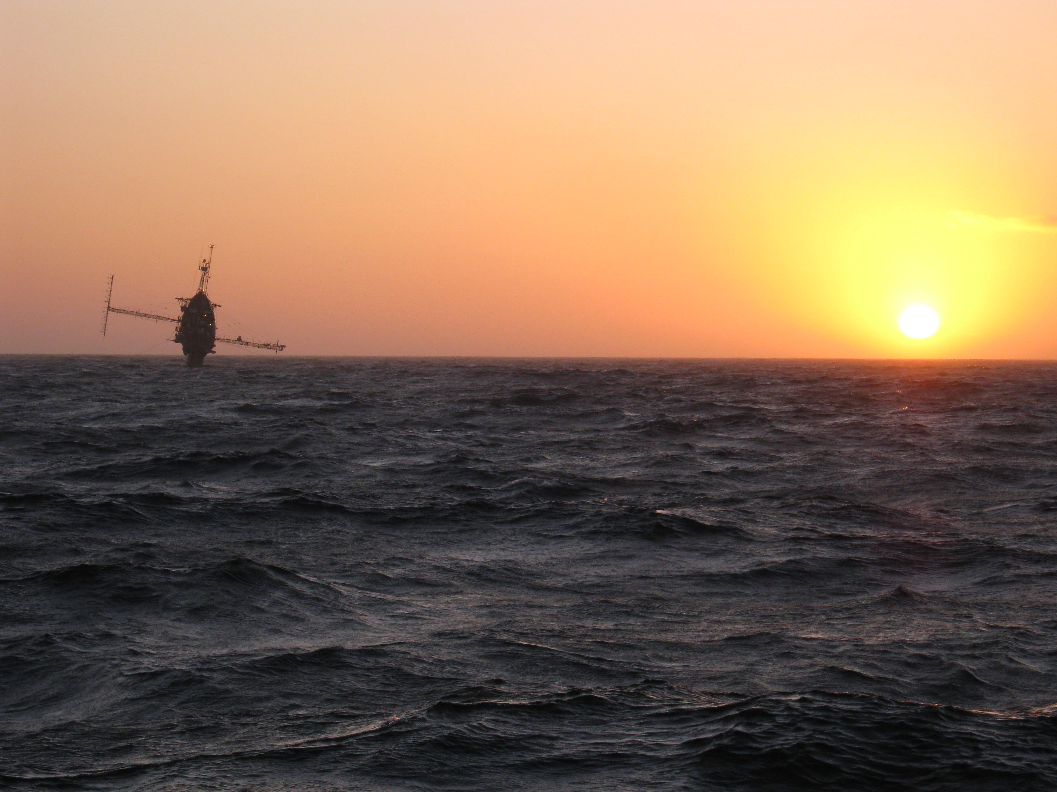
A LARGE EDDY SIMULATION PERSPECTIVE OF TERRA-INCOGNITA
Peter P. Sullivan
National Center for Atmospheric Research
NCAR is sponsored by the National Science Foundation

Slide 2
A LARGE EDDY SIMULATION PERSPECTIVE OF TERRA-INCOGNITA
WHERE IS MY JOURNEY TAKING YOU?
1. An introduction to Terra-Incognita
2. Rough wall SGS dynamics and Terra-Incognita
3. Large-eddy simulation (LES)
4. A potpourri of LES with complex boundaries

Slide 3
A LARGE EDDY SIMULATION PERSPECTIVE OF TERRA-INCOGNITA
1. An introduction to Terra-Incognita
2. Rough wall SGS dynamics and Terra-Incognita
3. Large-eddy simulation (LES)
4. A potpourri of LES with complex boundaries

Slide 4
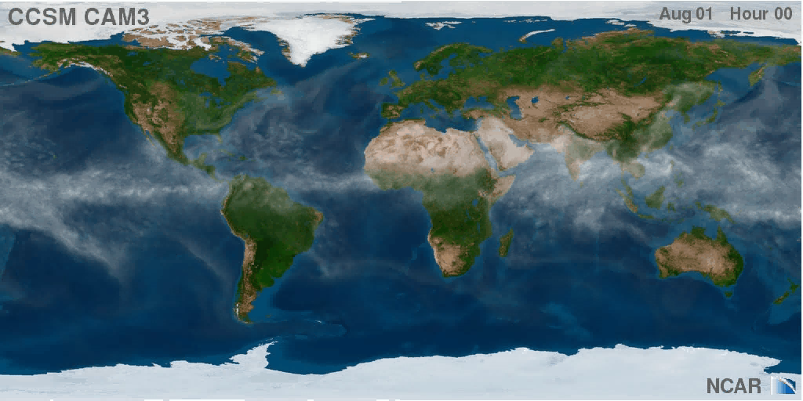
HIGH RESOLUTION GLOBAL SIMULATION Courtesy J. Hurrell and CGD/NCAR
MULTIPLE TIME AND SPACE SCALES ARE THE NORM

Slide 5
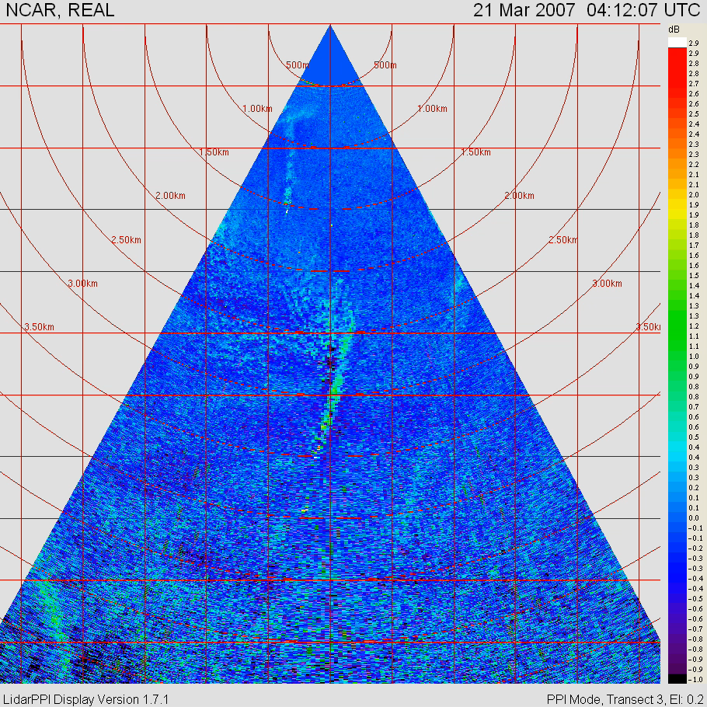
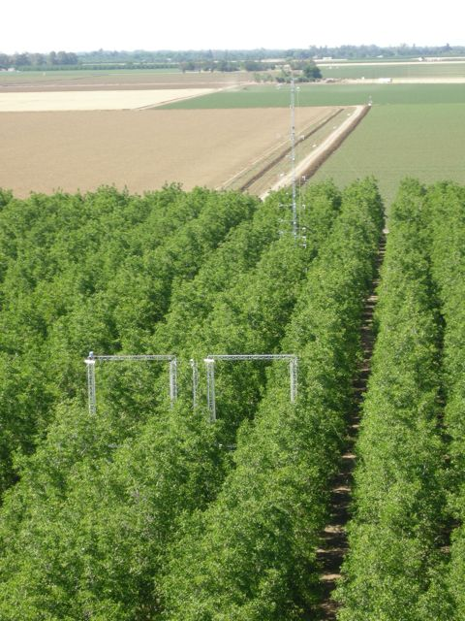
BOUNDARY-LAYER PROCESSES
Stably stratified turbulent flow just above a walnut orchard during the Canopy Horizontal Array Turbulence Study (CHATS)
REAL
3 km
4 km
Provided by Shane Mayor & Ned Patton

Slide 6
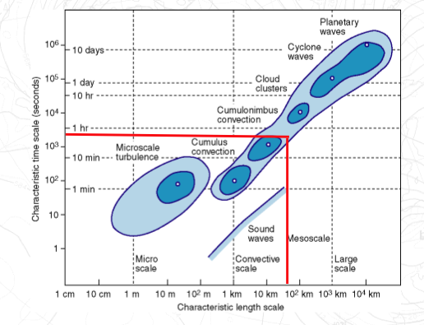

SCALES OF TURBULENCE RELATIVE TO NWP SCALES
Feedback small to large
Forcing large to small
?
Kolmogorov viscous dissipation scale
1mm
Courtesy Anton Beljaars (ECMWF)

Slide 7
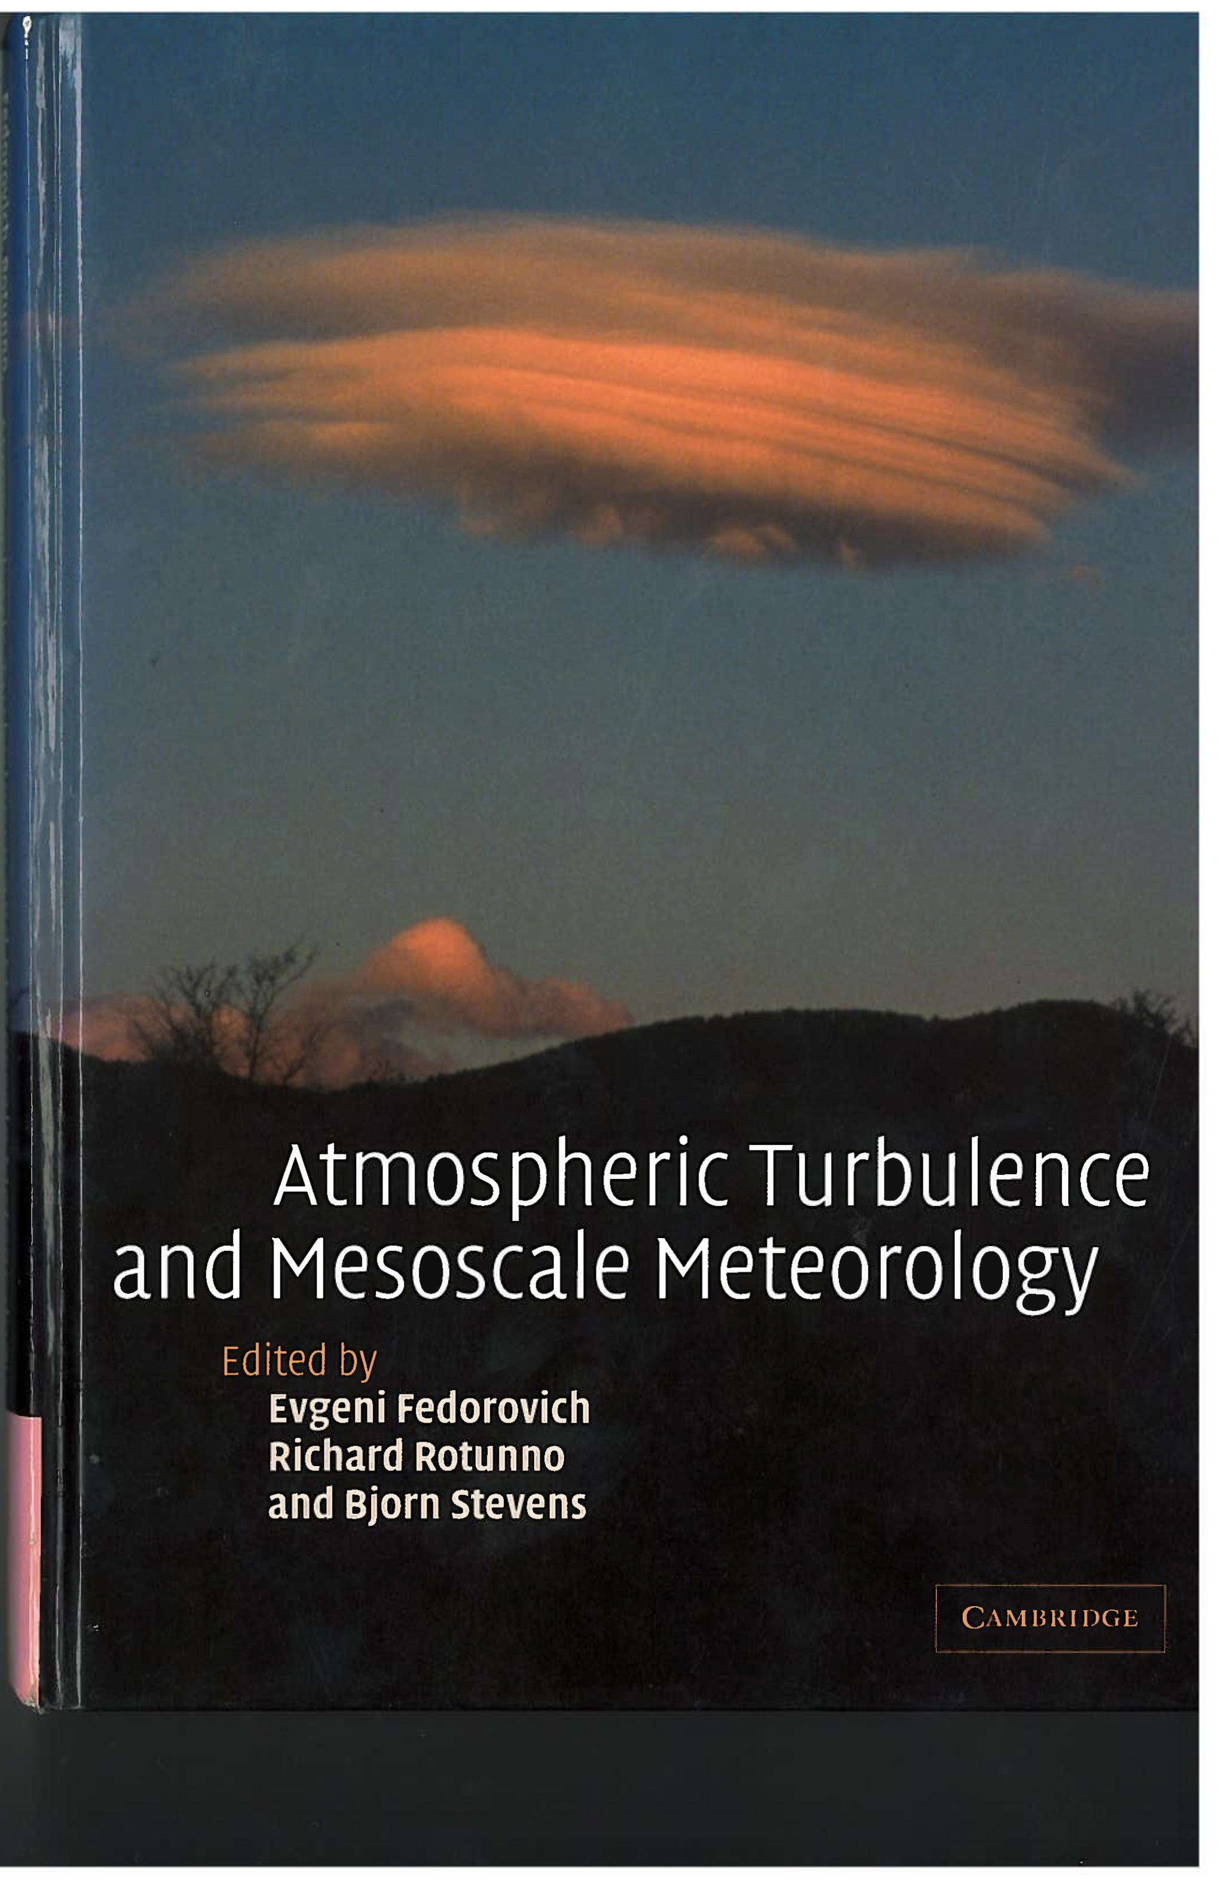
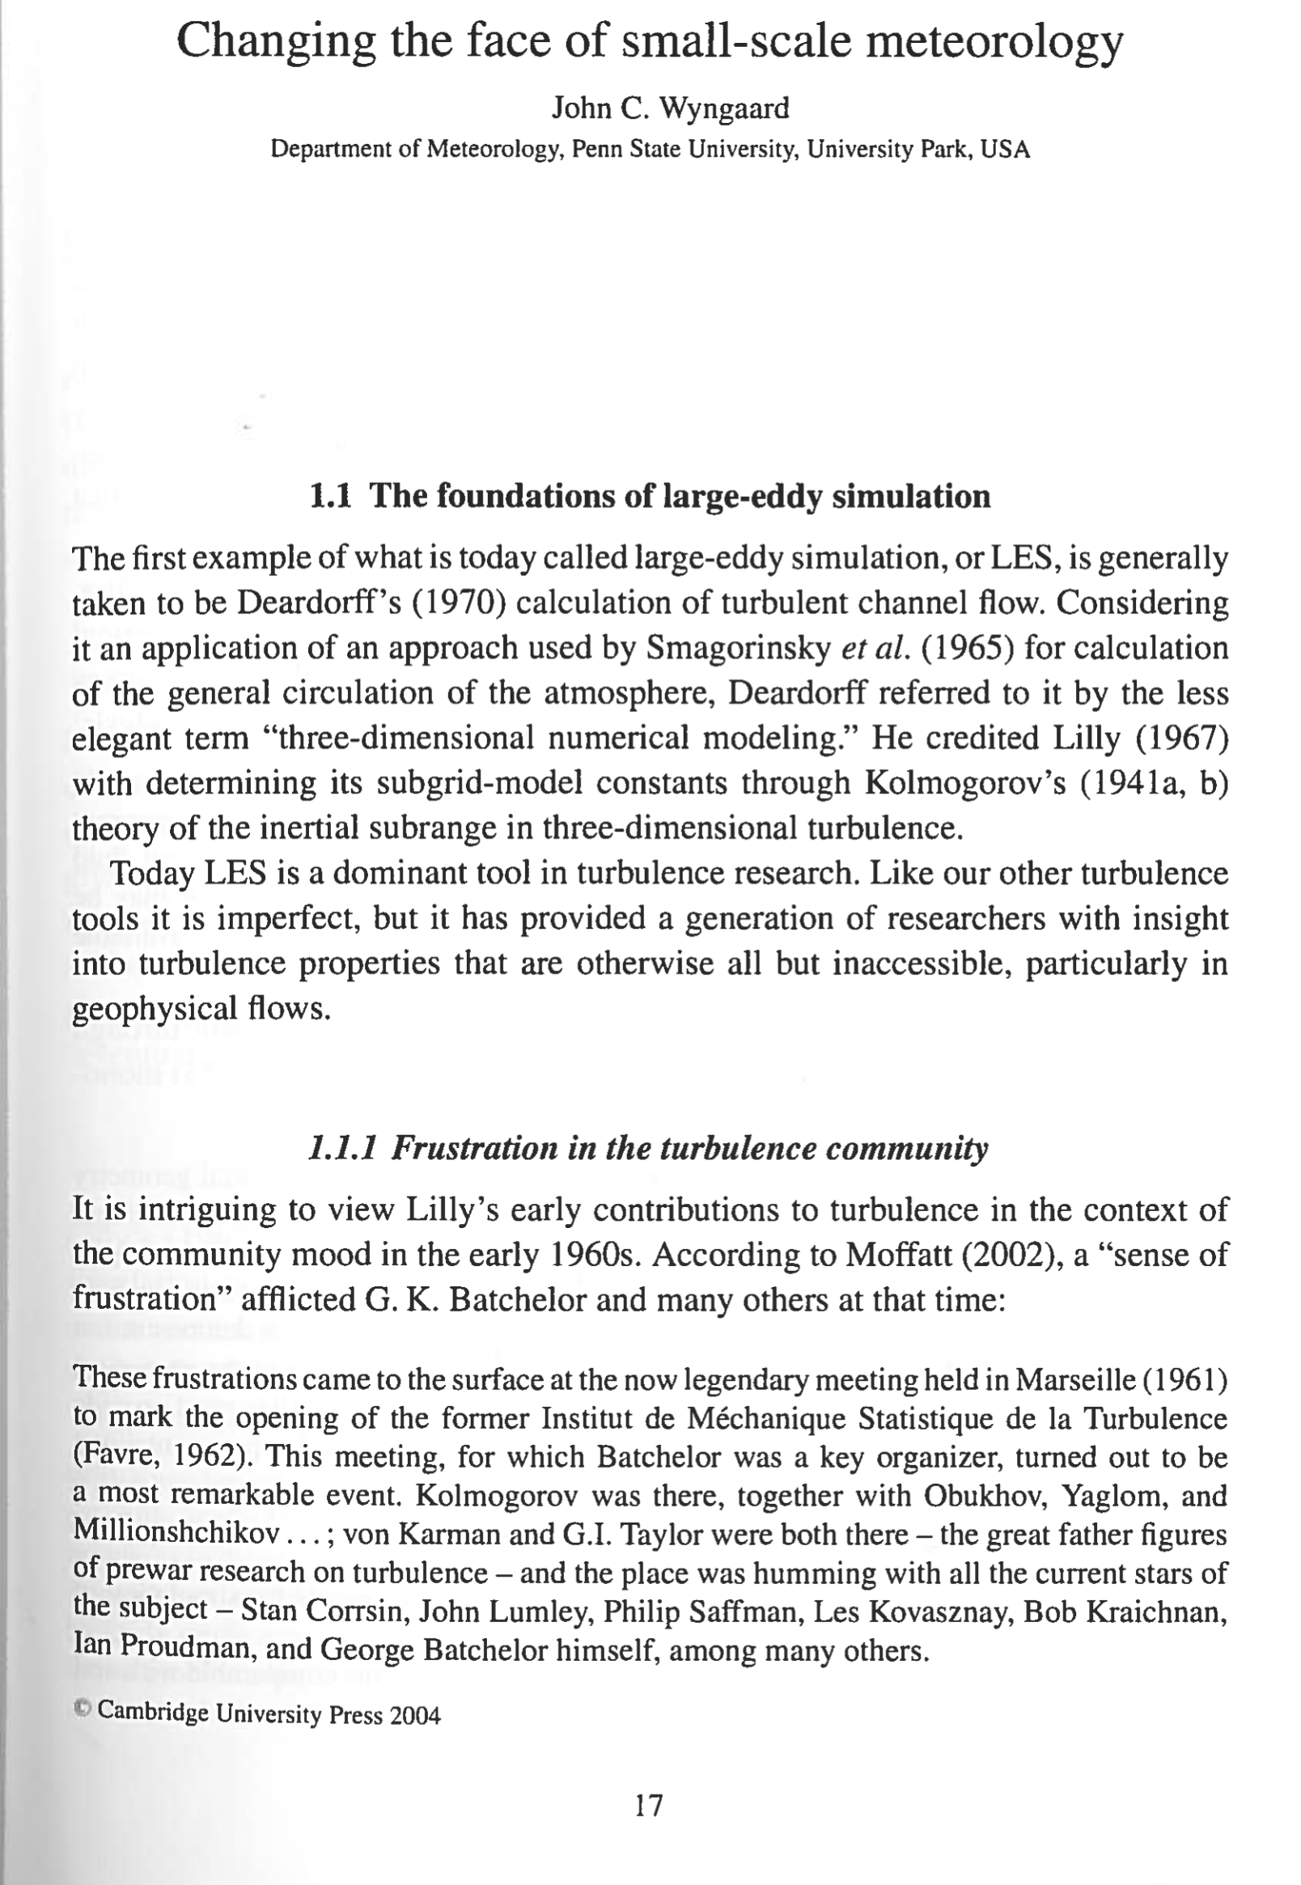
INTRODUCTION TO TERRA-INCOGNITA

Slide 8
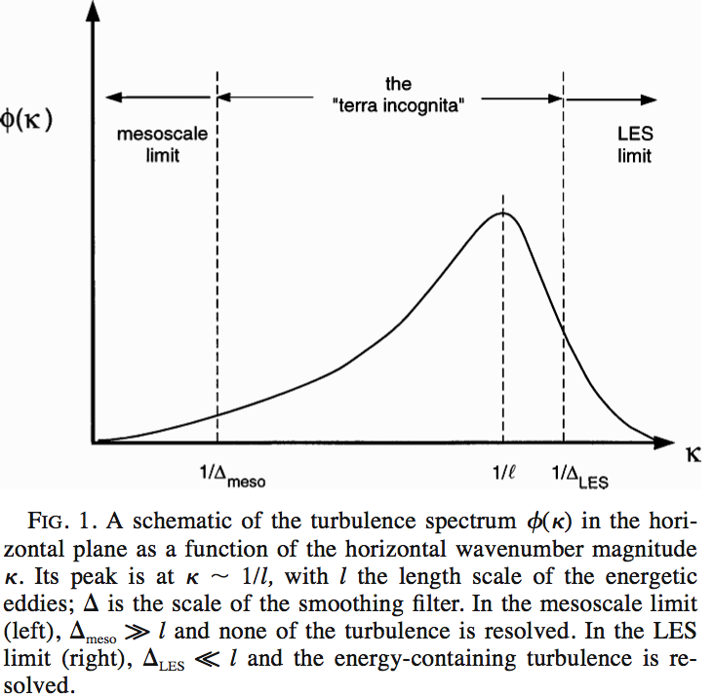
wavenumber

Slide 9


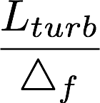




Slide 10
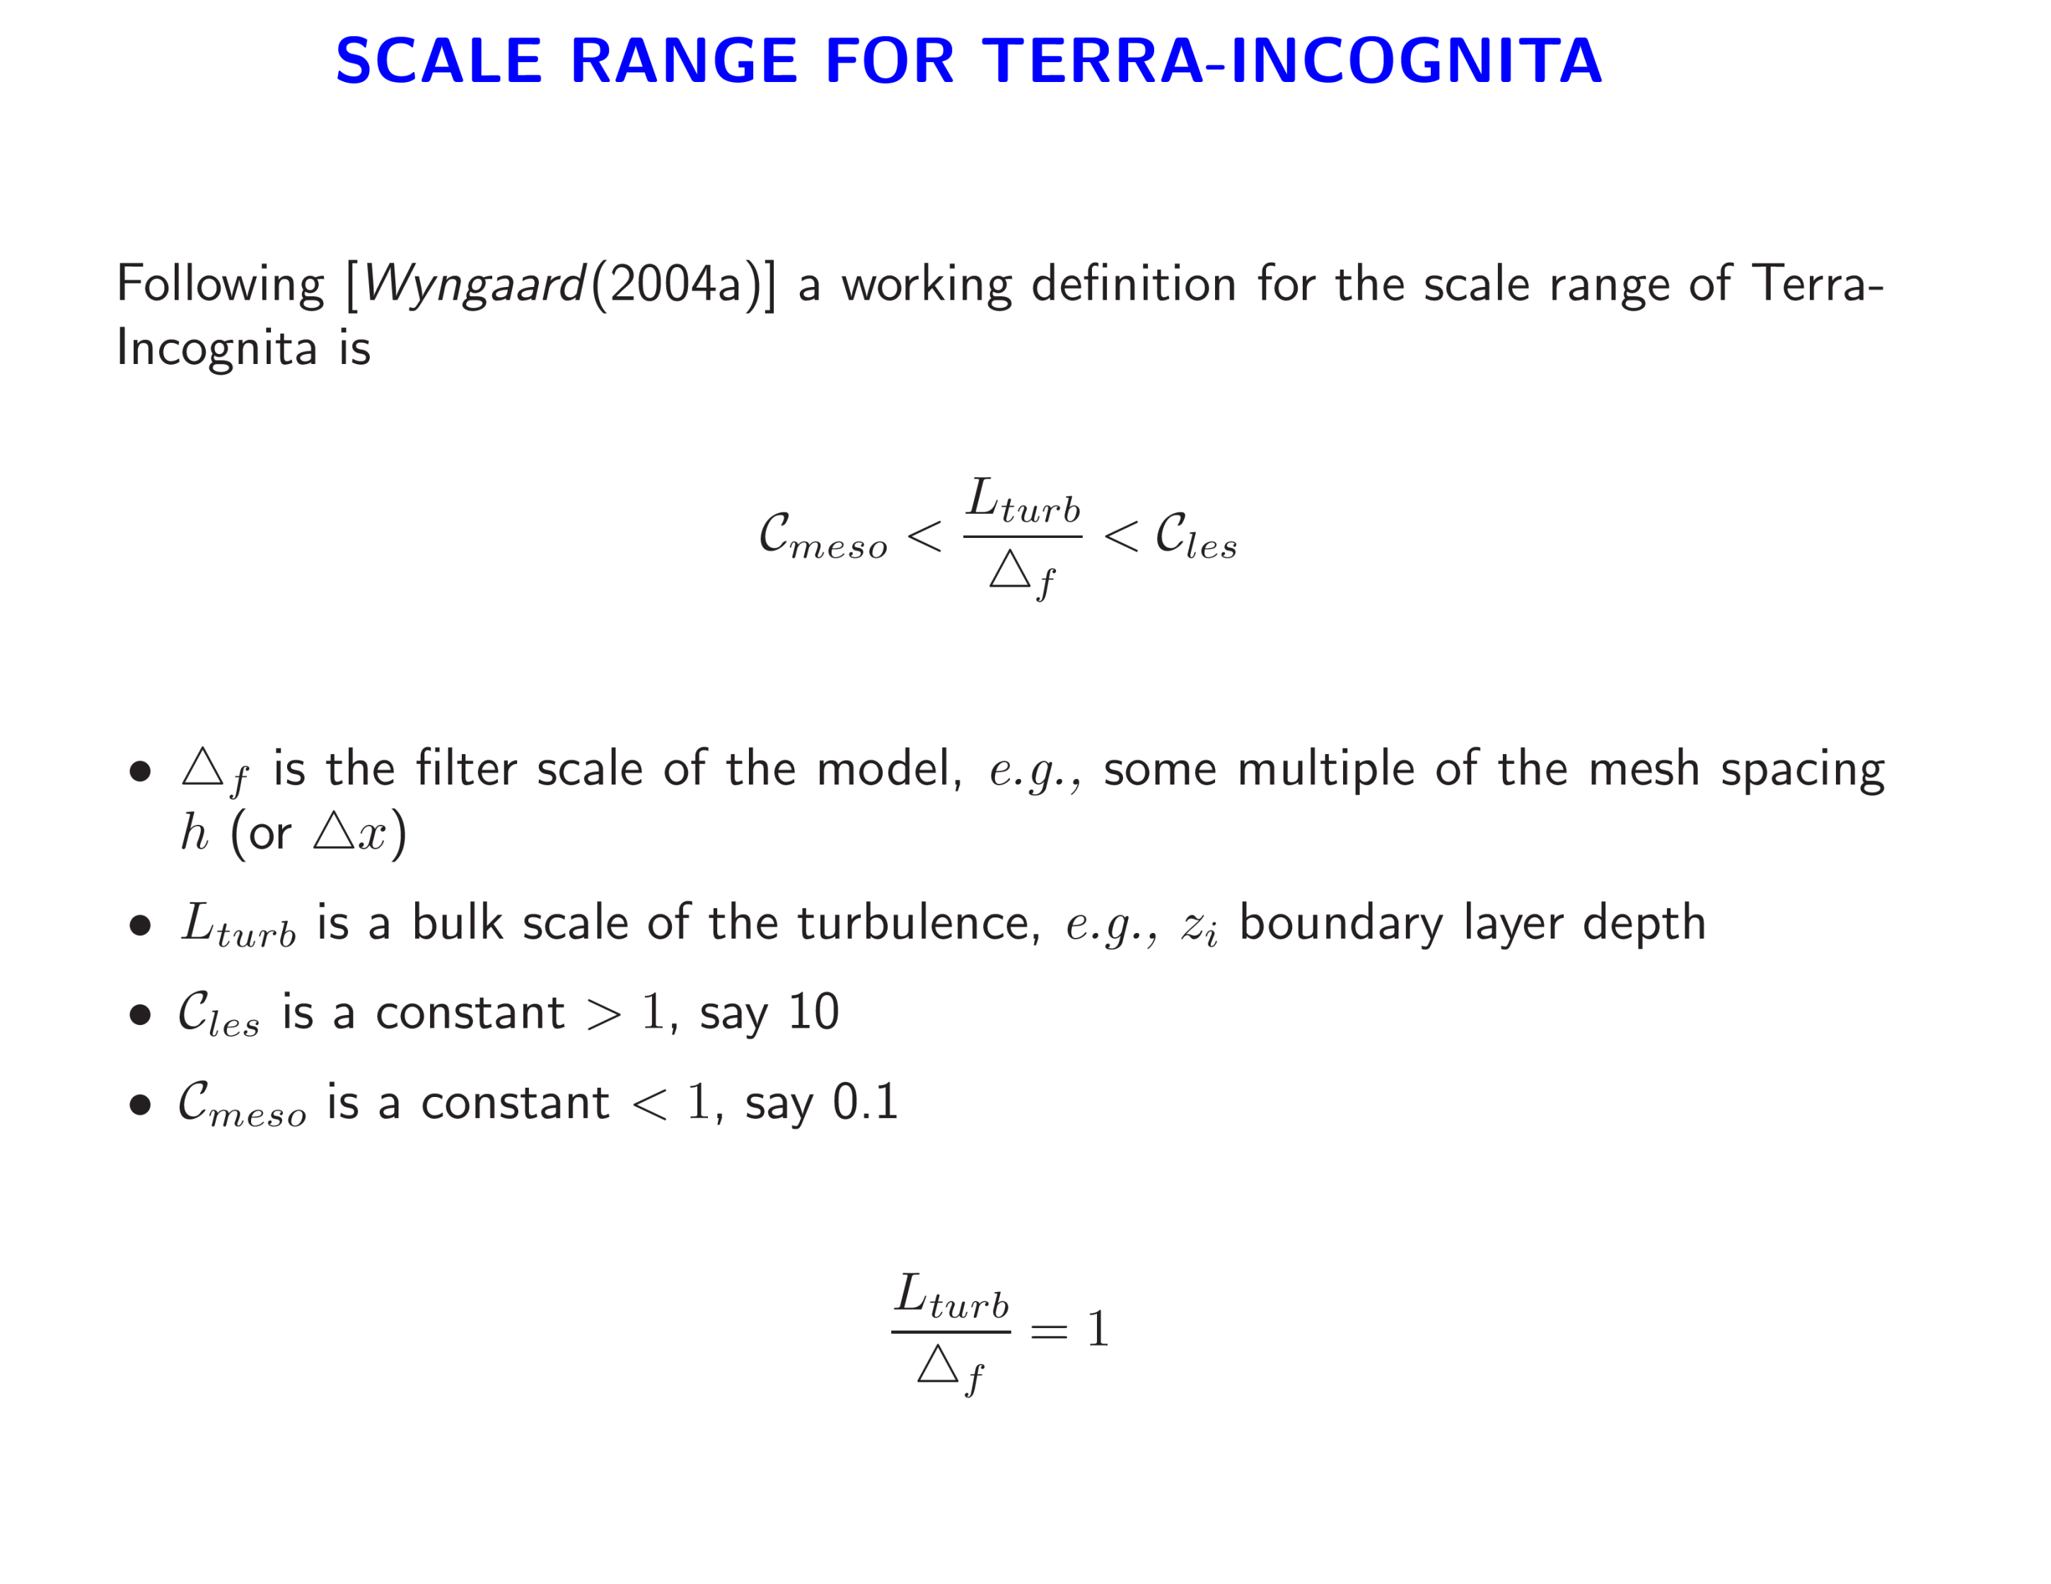
Particularly interesting?

Slide 11
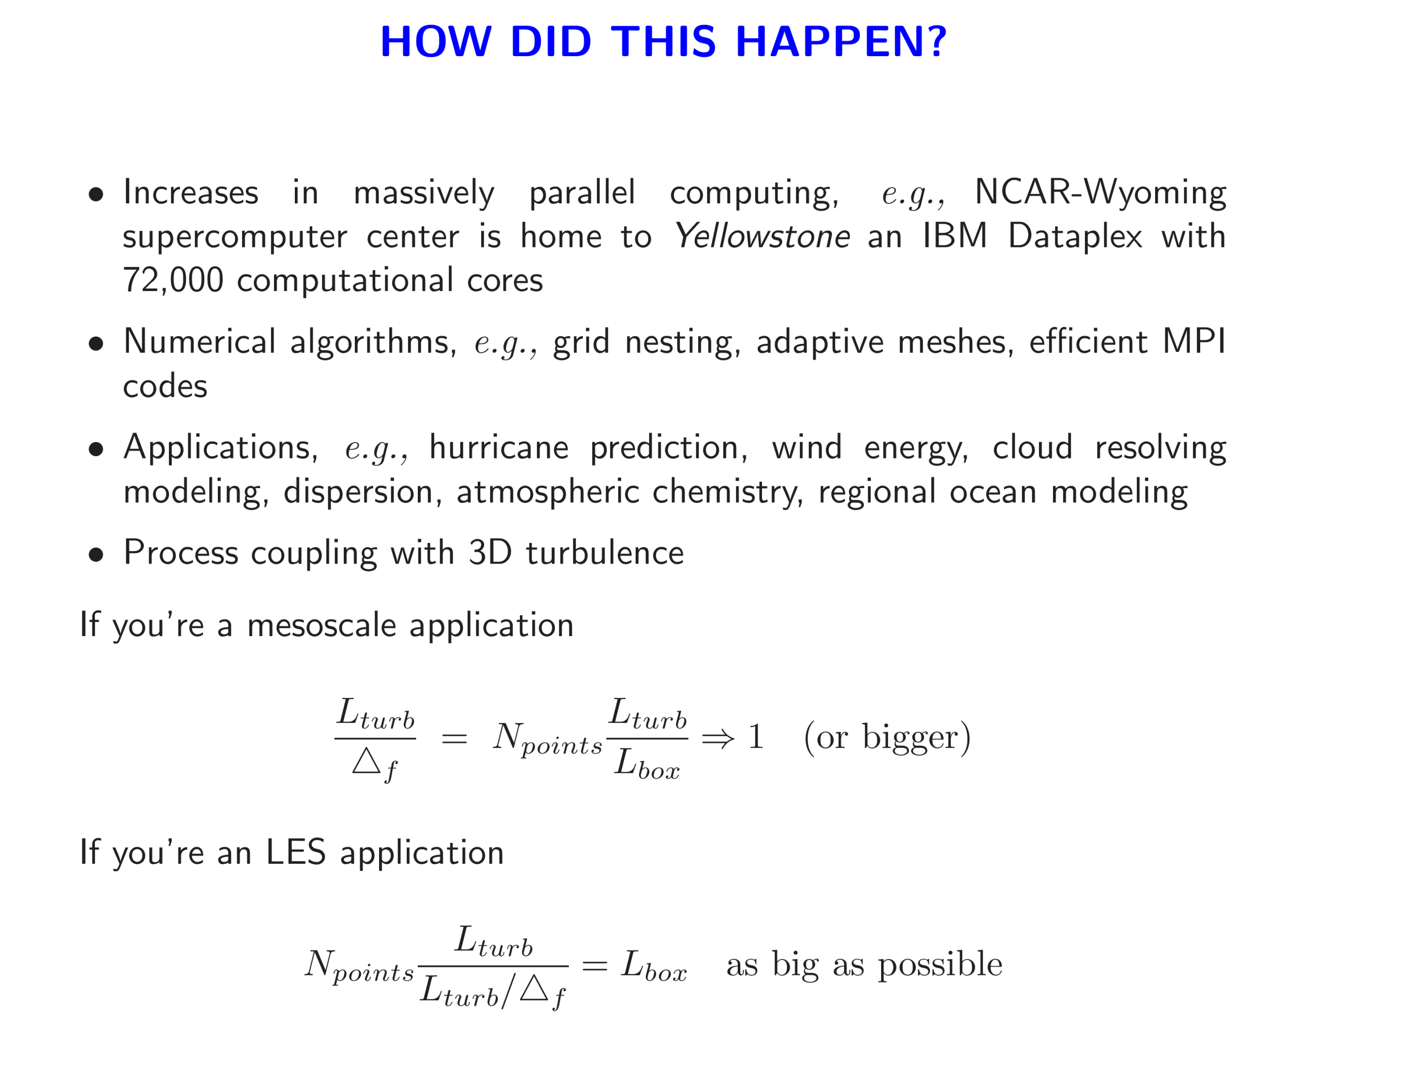

Slide 12
TERRA-INCOGNITA SIMULATIONS?

Slide 13
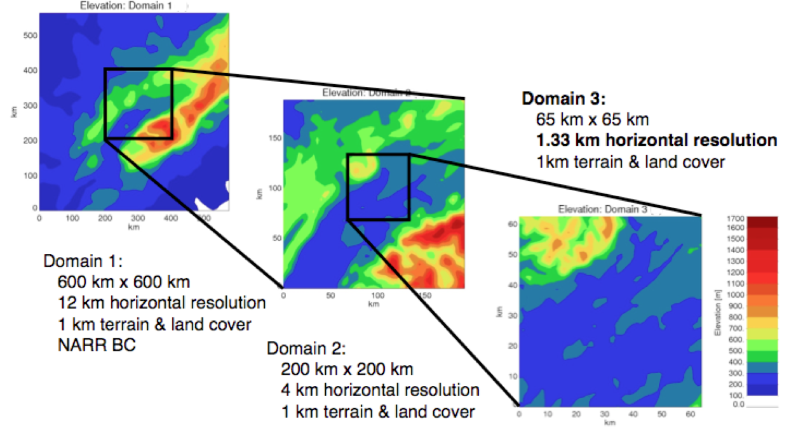
NESTING LARGE-EDDY SIMULATIONS WITHIN MESOSCALE SIMULATIONS IN WRF FOR WIND ENERGY APPLICATIONS LUNDQUIST ETAL (2010)

Slide 14
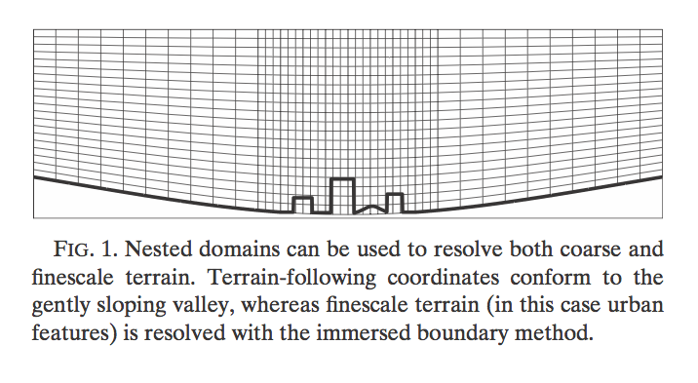
An Immersed Boundary Method for the Weather Research and Forecasting Model Lundquist etal MWR 2010

Slide 15
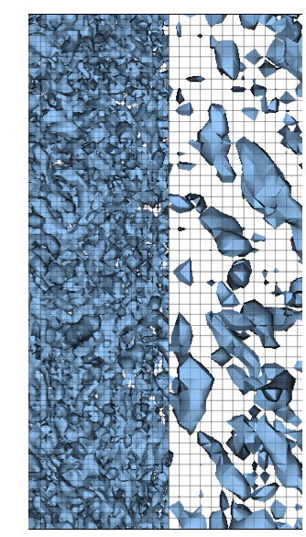
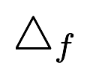
LARGE-EDDY SIMULATION ACROSS A GRID REFINEMENT INTERFACE USING EXPLICIT FILTERING AND RECONSTRUCTION
Goodfriend, etal, 20th BLT
Factor of 2 change in mesh resolution
Turbulent? Quasi-laminar?
Abrupt change in filter width at mesh boundary!
Notes:
Notice the flow isn’t smooth across the boundary
Non-conforming elements
Only a factor of 2 change
Looks more turbulent on one side of the boundary
How do you generate stochastic boundary conditions on the boundary of the inner mesh

Slide 16
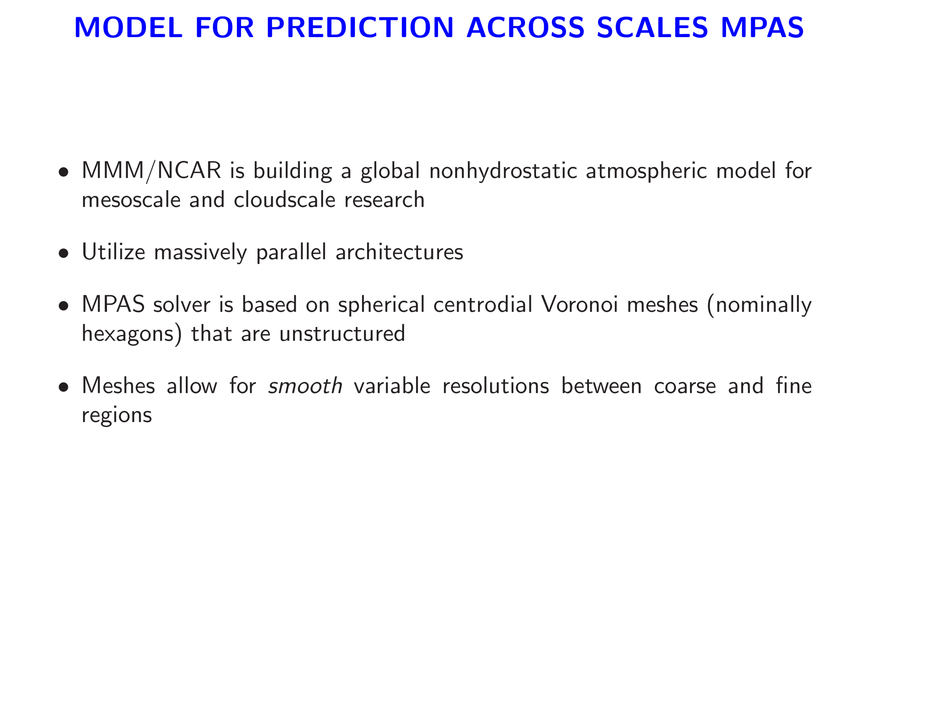

Slide 17
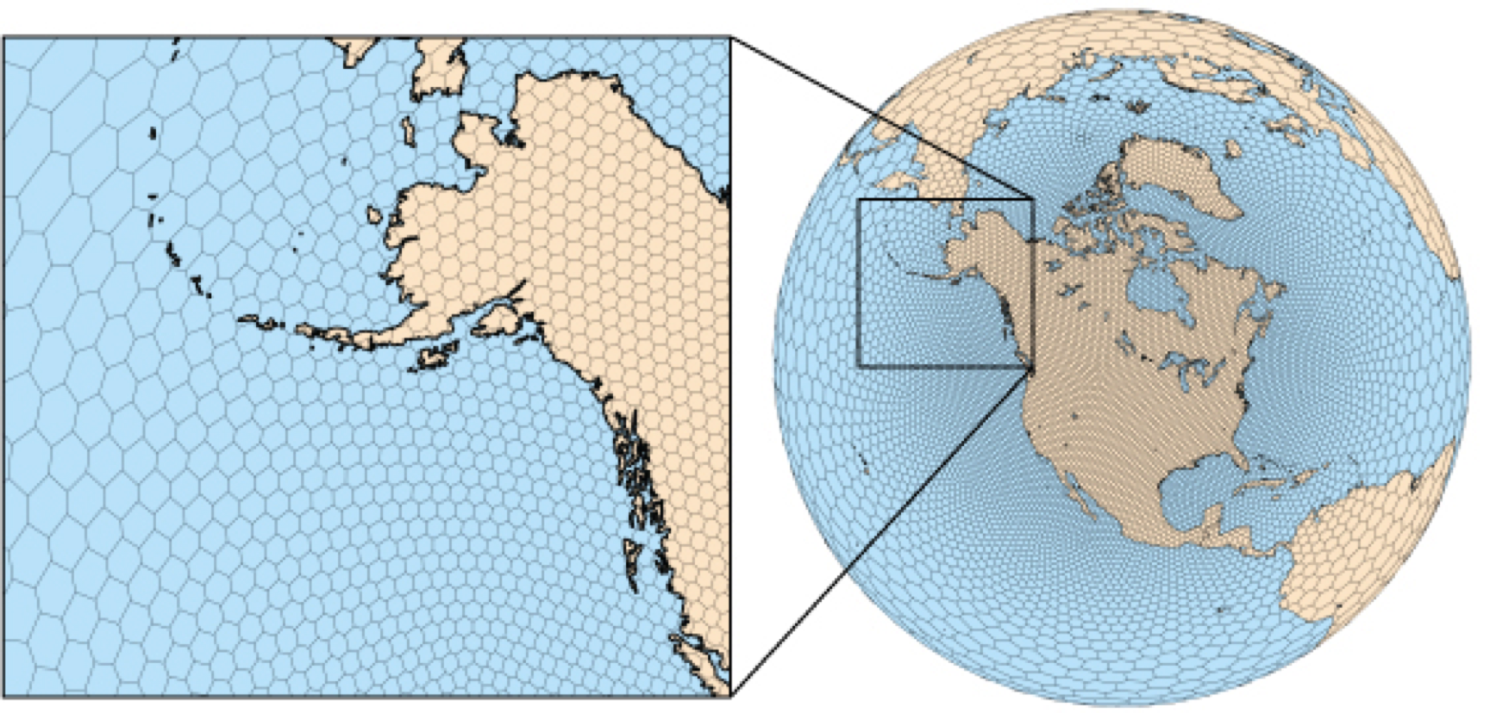
AN EXAMPLE OF AN MPAS MESH BASED ON SPHERICAL CENTROIDAL VORONOI TESSELLATIONS
http://public.lanl.gov/ringler/Voronoi.html
A need for scale aware parameterizations?

Slide 18
What are the appropriate equations for Terra-Incognita?

Slide 19
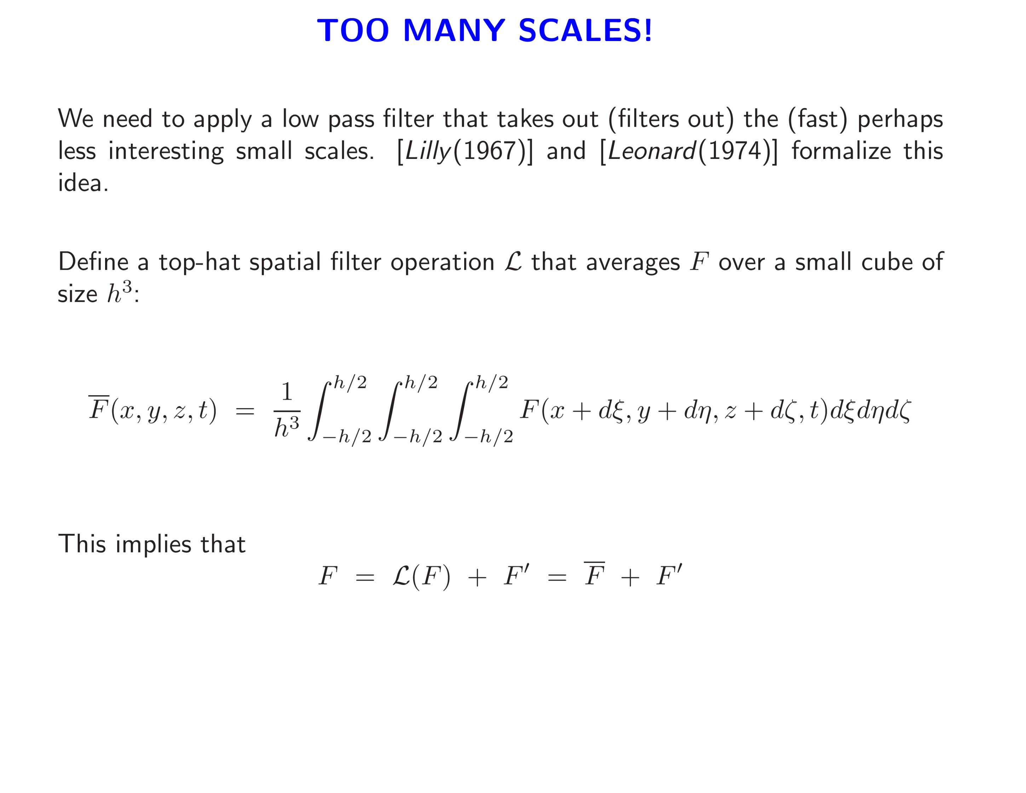
?
Resolved field
Subgrid (or subfilter) field

Slide 20
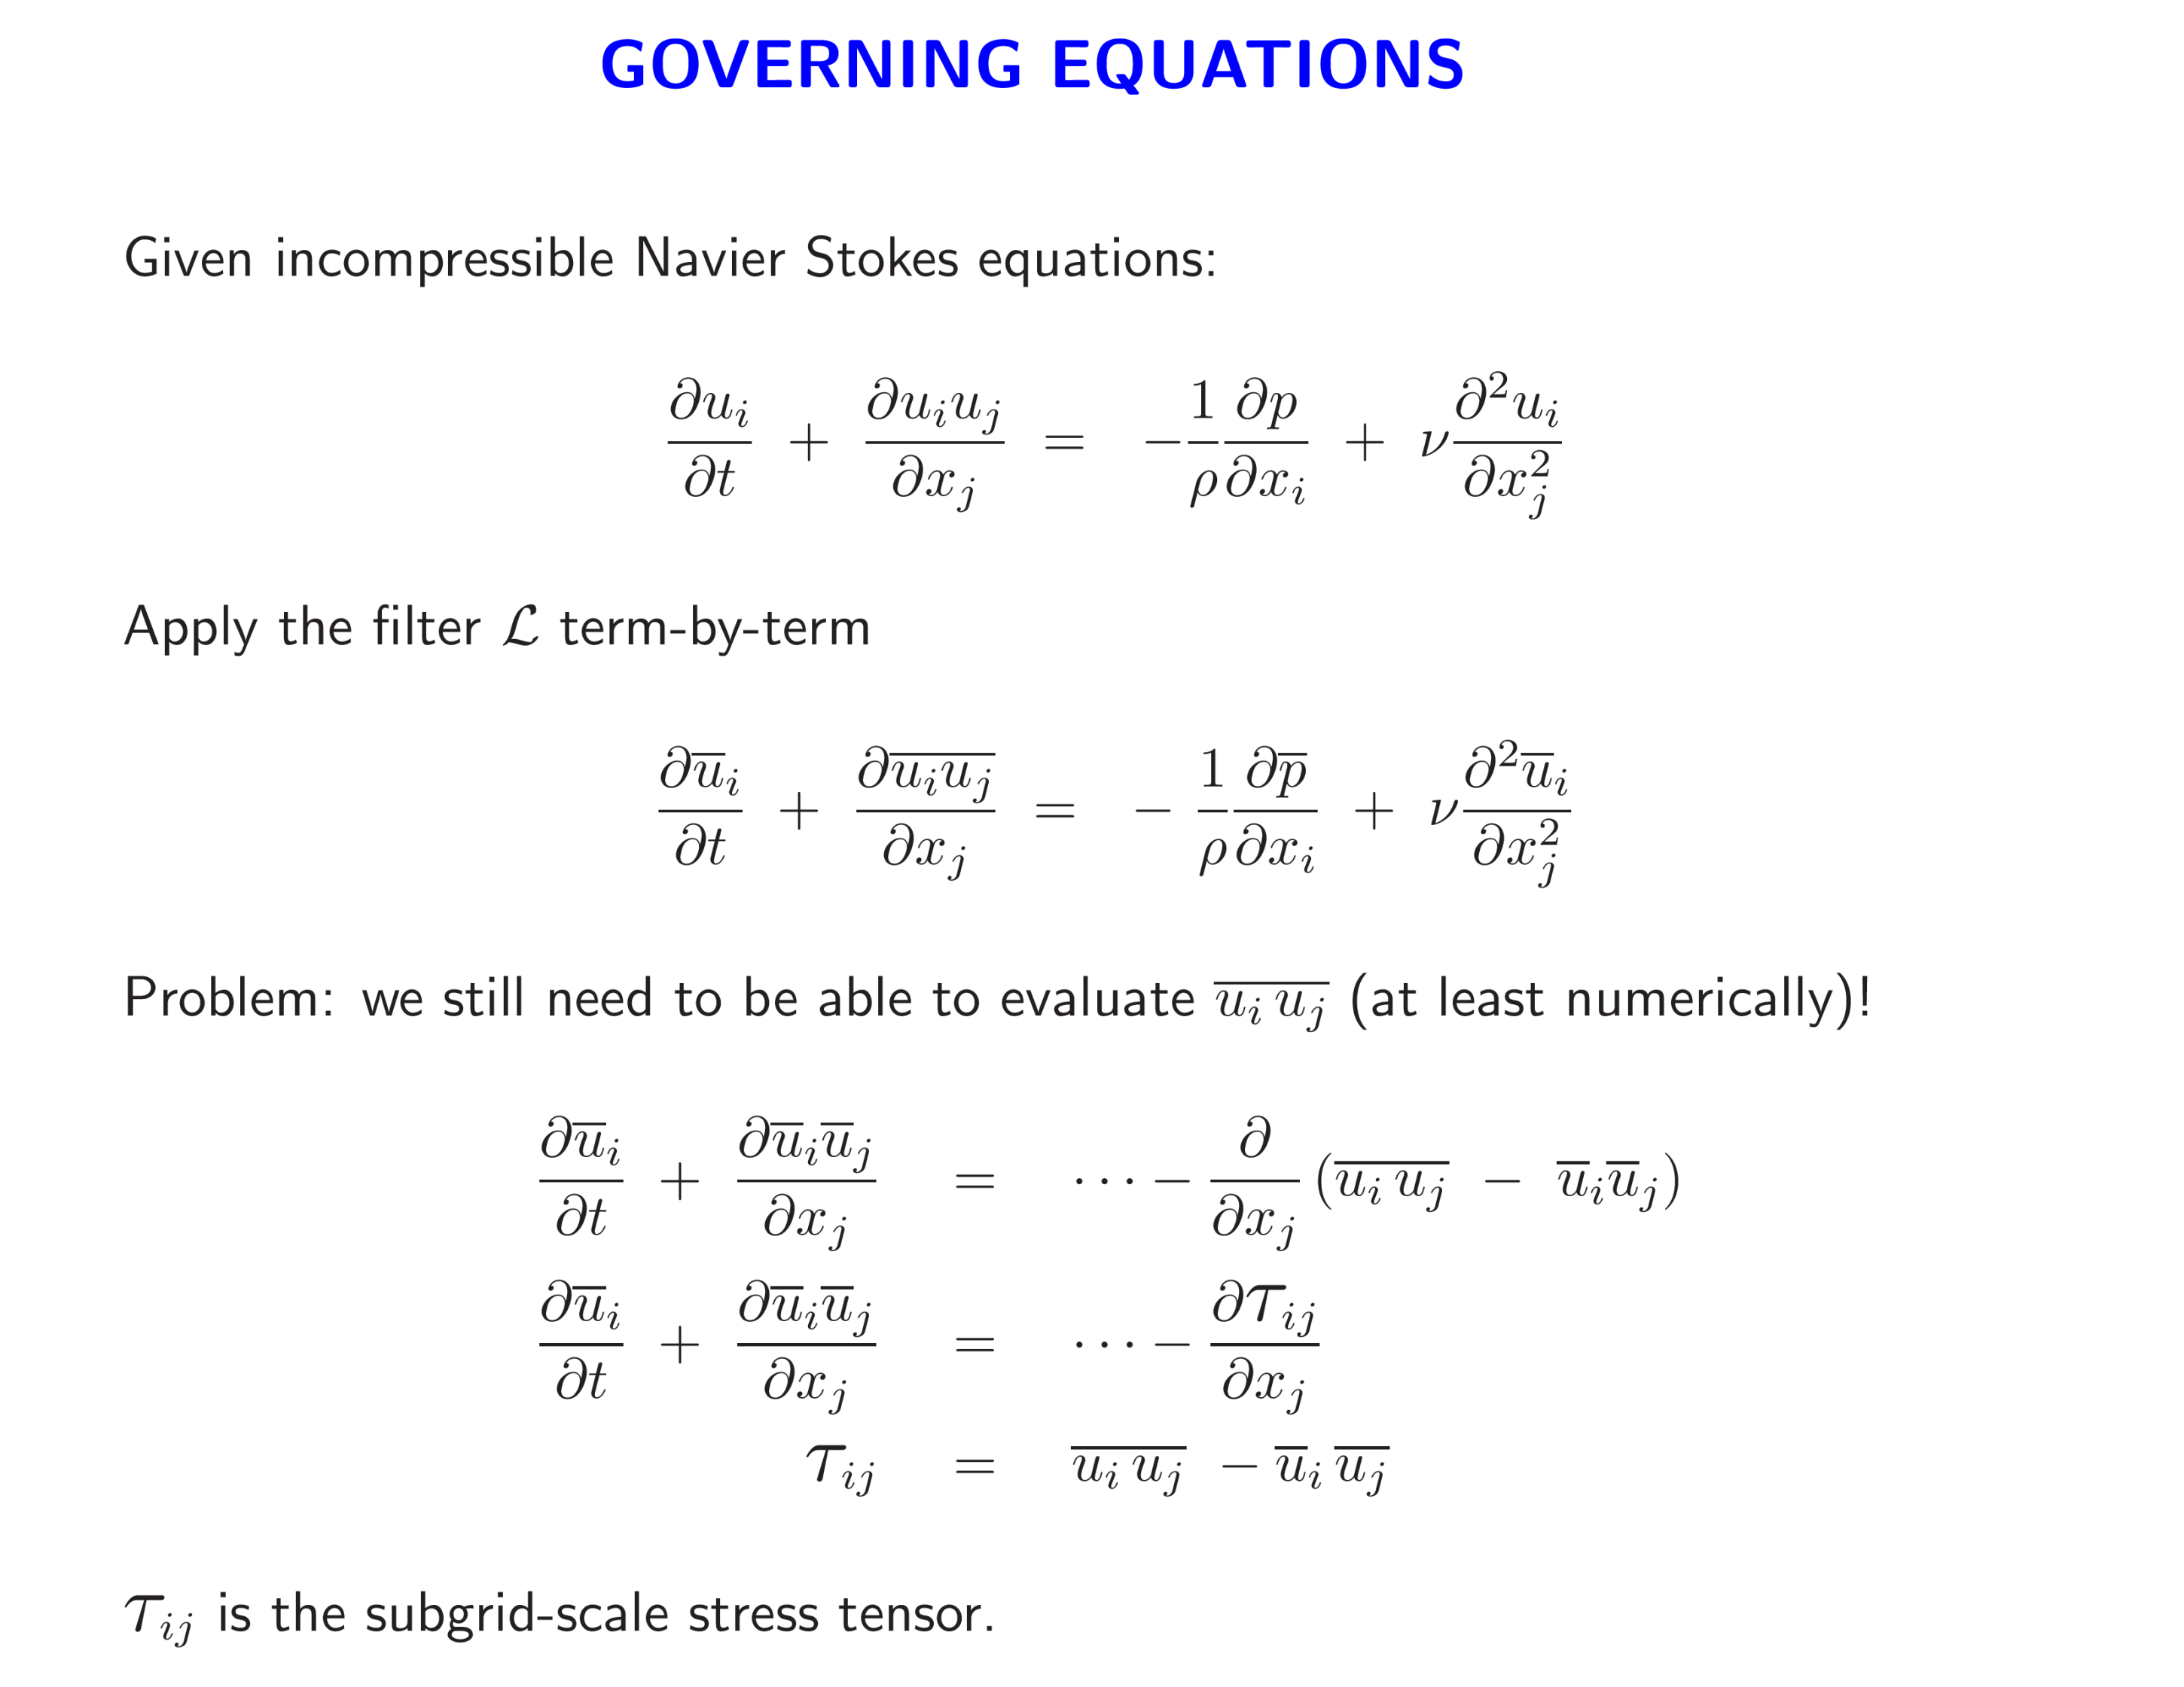

Slide 21
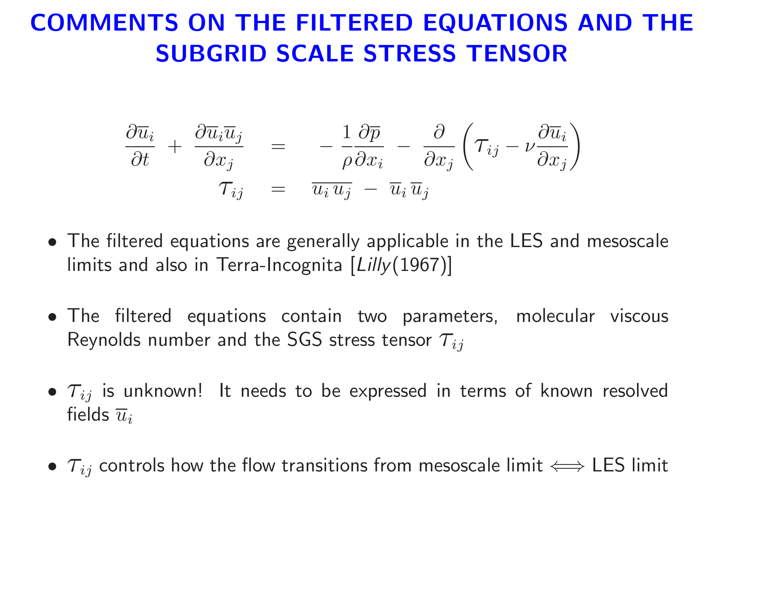
0

Slide 22
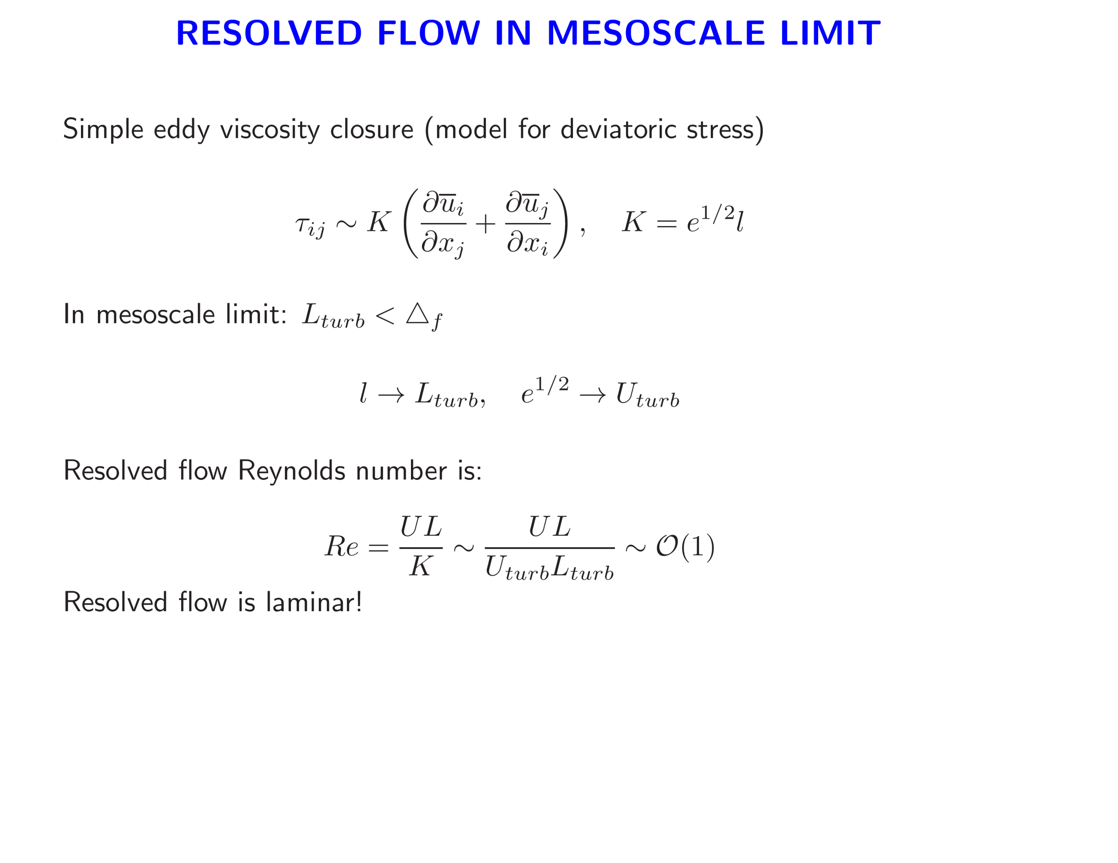

Slide 23
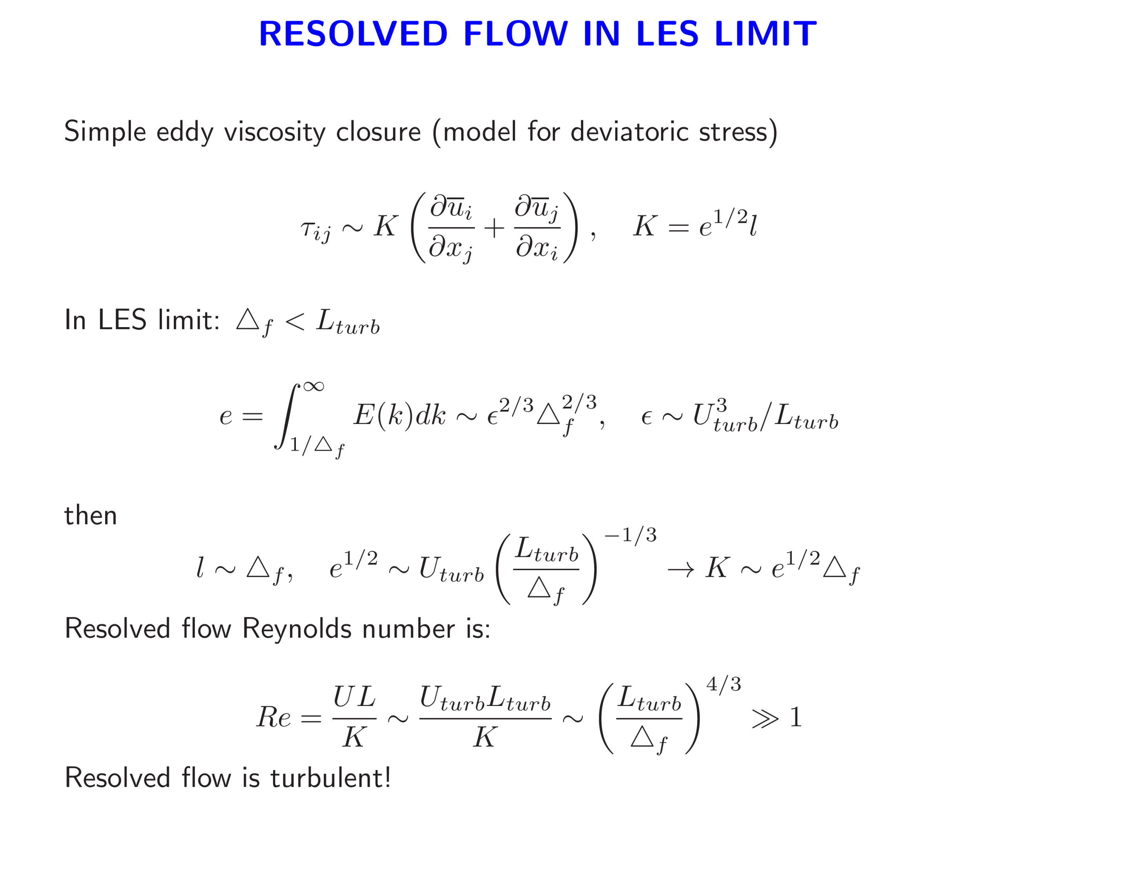
Classic LES
dissipation

Slide 24
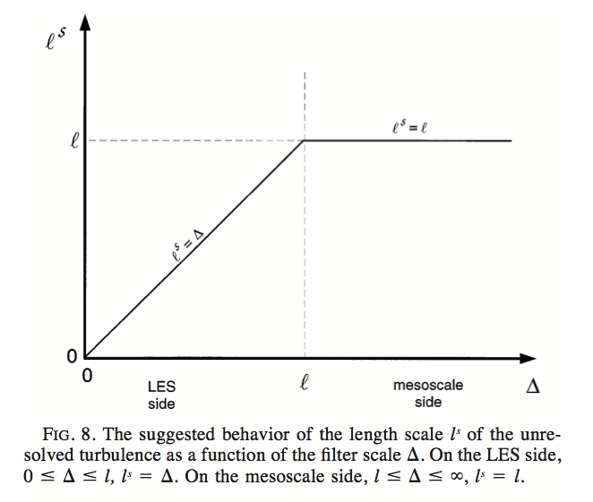


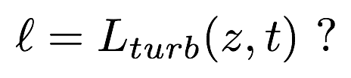
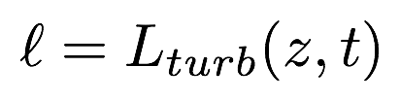




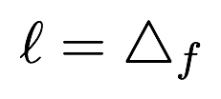
Wyngaard 2004
In PBL surface layer
Suggested behavior of the length scale of the unresolved turbulence as function of for a K-model

Slide 25
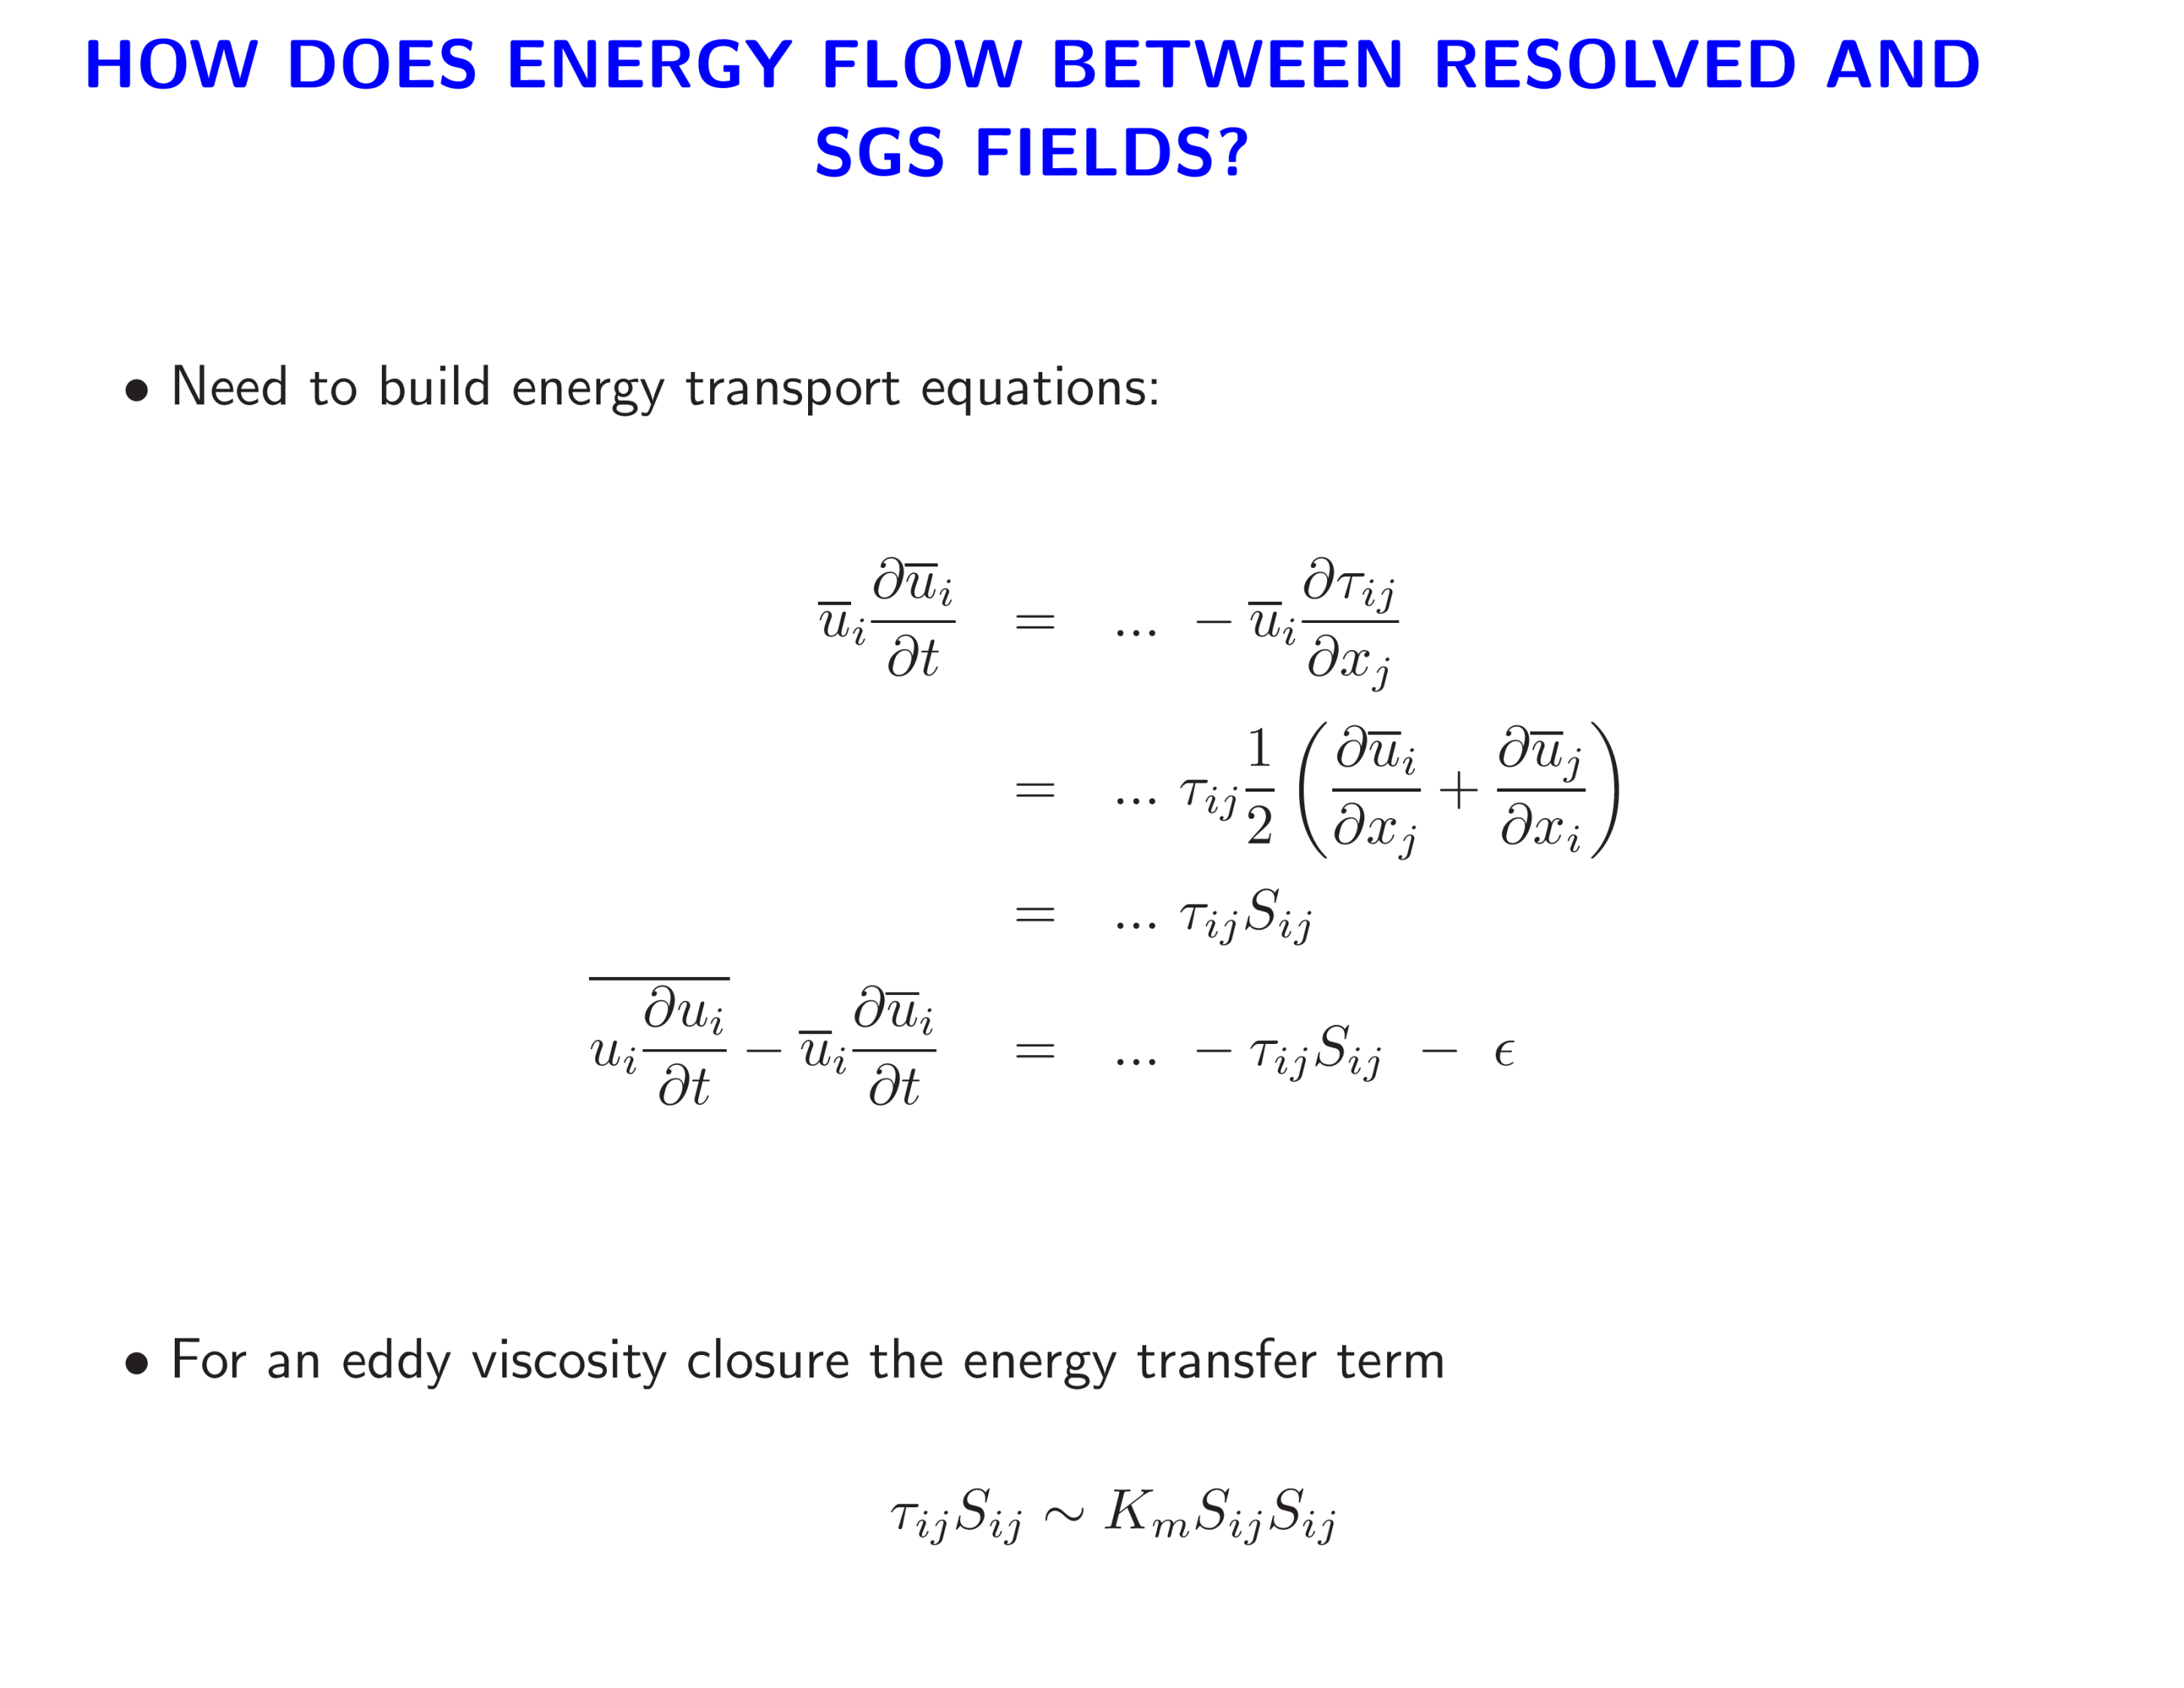


Filter scale
SGS energy
?
Resolved energy

Slide 26
Resolved energy
Energy transfer term
SGS energy
Molecular dissipation
> 0 !

Slide 27
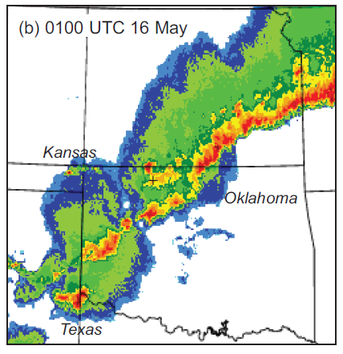
AN EXAMPLE WITH COMPLEX CLOUDS
Squall Line during VORTEX2

Slide 28
Sensitivity of a simulated squall line to horizontal resolution
Numerical Simulations
Numerical model: CM1 (compressible nonhydrostatic, similar numerics as WRF)
Horizontal grid spacing (Δx): 4 km, 1 km, or 0.25 km
100 vertical levels for all simulations (Δz varies from 100 m to 400 m)
Initialized using environmental sounding from 15 May 2009
No radiation or surface heat fluxes (to keep environment fixed)
Morrison et al (2009) microphysics
Fixed number concentration for cloud water (300 cm⁻³)
No explicit raindrop breakup parameterization (mean-mass raindrop diameter was limited)
Domain: 576 km x 144 km x 25 km
periodic
open
open
Initial
cold pool
periodic
Bryan & Morrison (2012) MWR

Slide 29
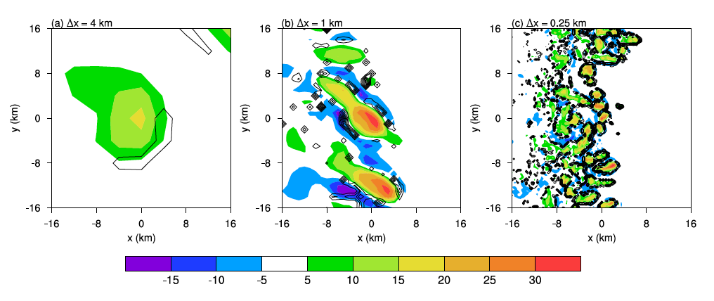
Sensitivity to Δx: vertical velocity (w, m s⁻¹) at 5 km AGL
Sensitivity of a simulated squall line to horizontal resolution
shading: w (m s⁻¹) at 5 km AGL contours: cloudwater evaporation rate
Bryan & Morrison (2012) MWR

Slide 30
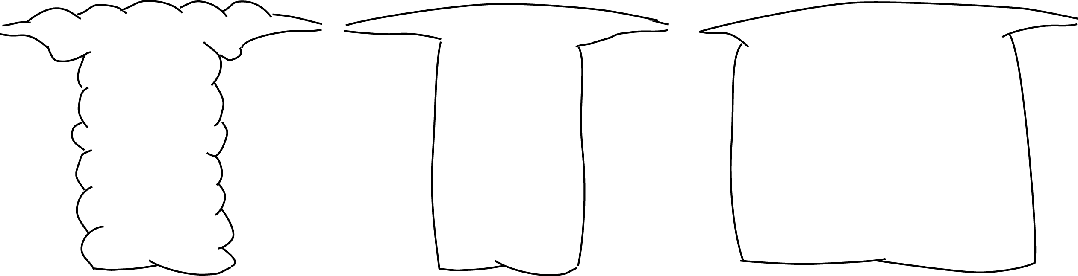
Conceptual Model of Resolution Dependence
Δ ≈ 4 km
(too wide, laminar)
Δ ≈ 1 km
(correct width, but laminar)
Δ ≈ 0.2 km
(turbulent)
Consequences:
too slow
Consequences:
too intense
over-stabilizes
Consequences:
very expensive
Bryan & Morrison (2012) MWR

Slide 31
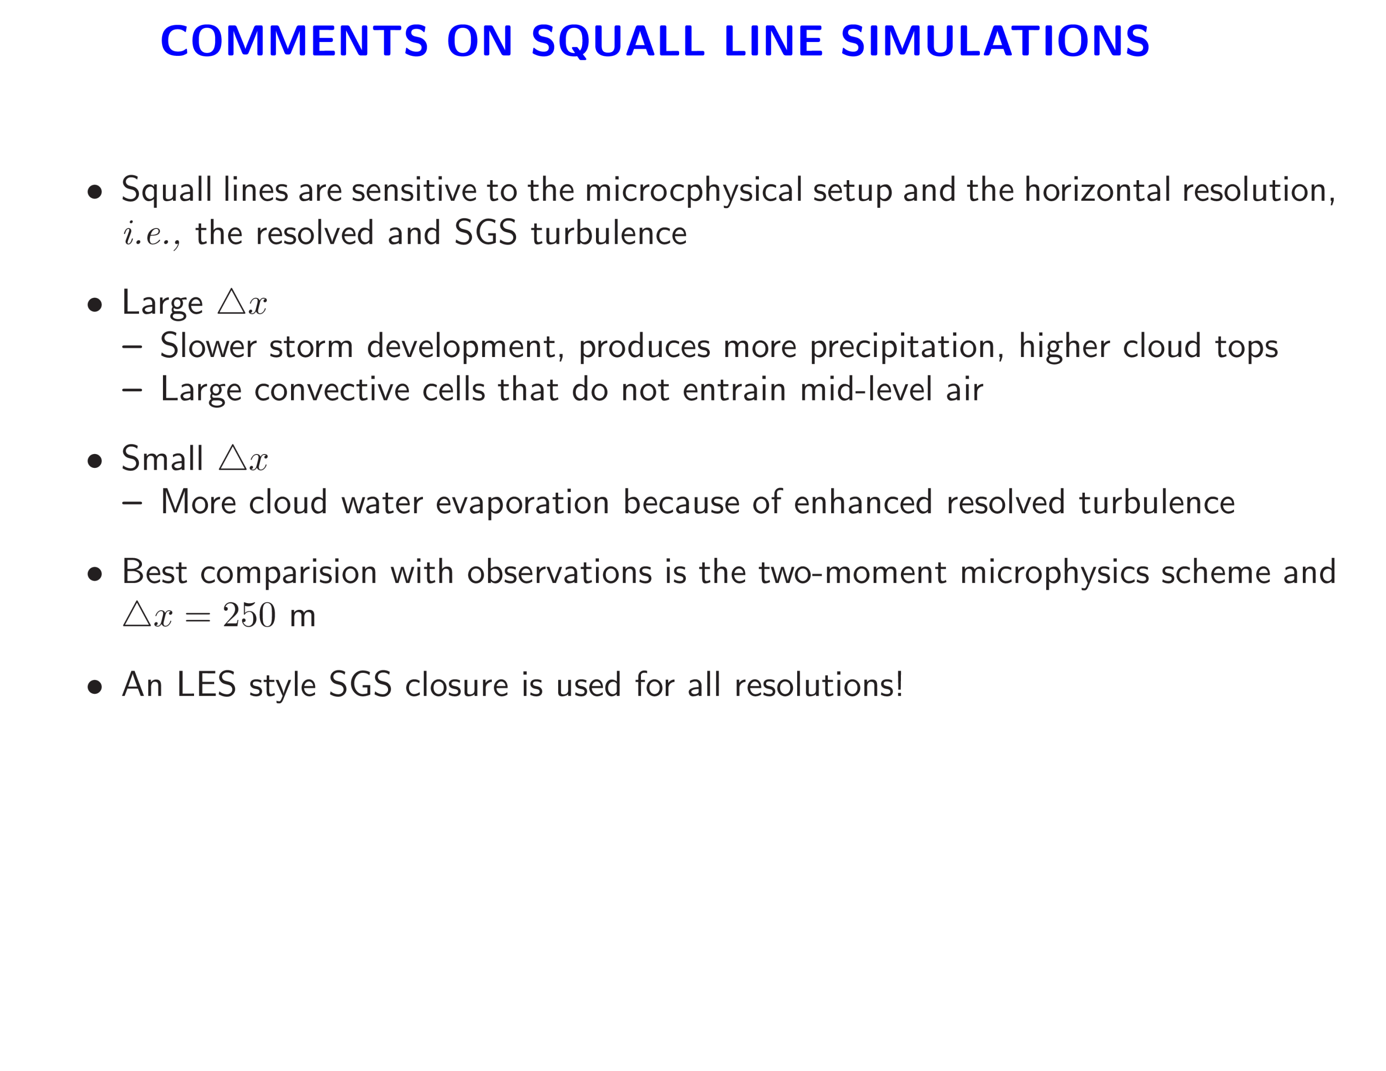

Slide 32
Engineering fluid mechanics is also aware of Terra-Incognita

Slide 33
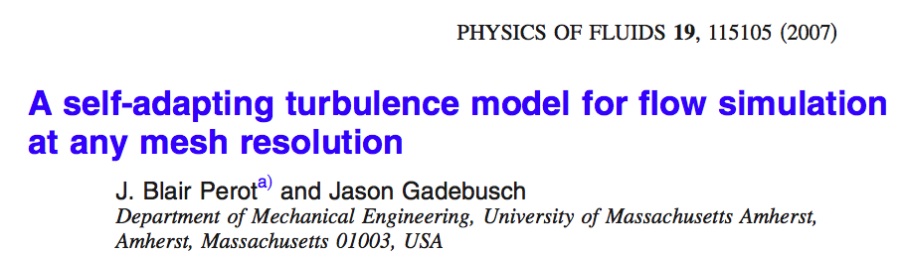
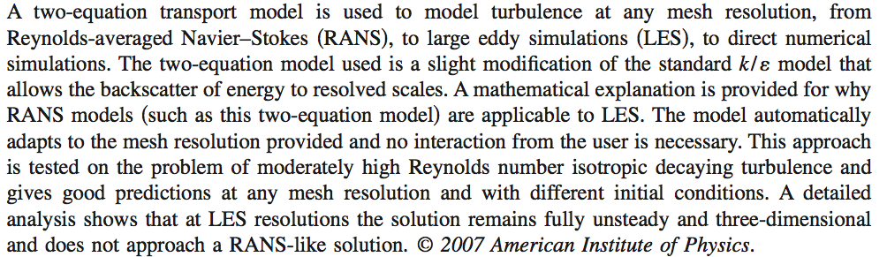

Slide 34
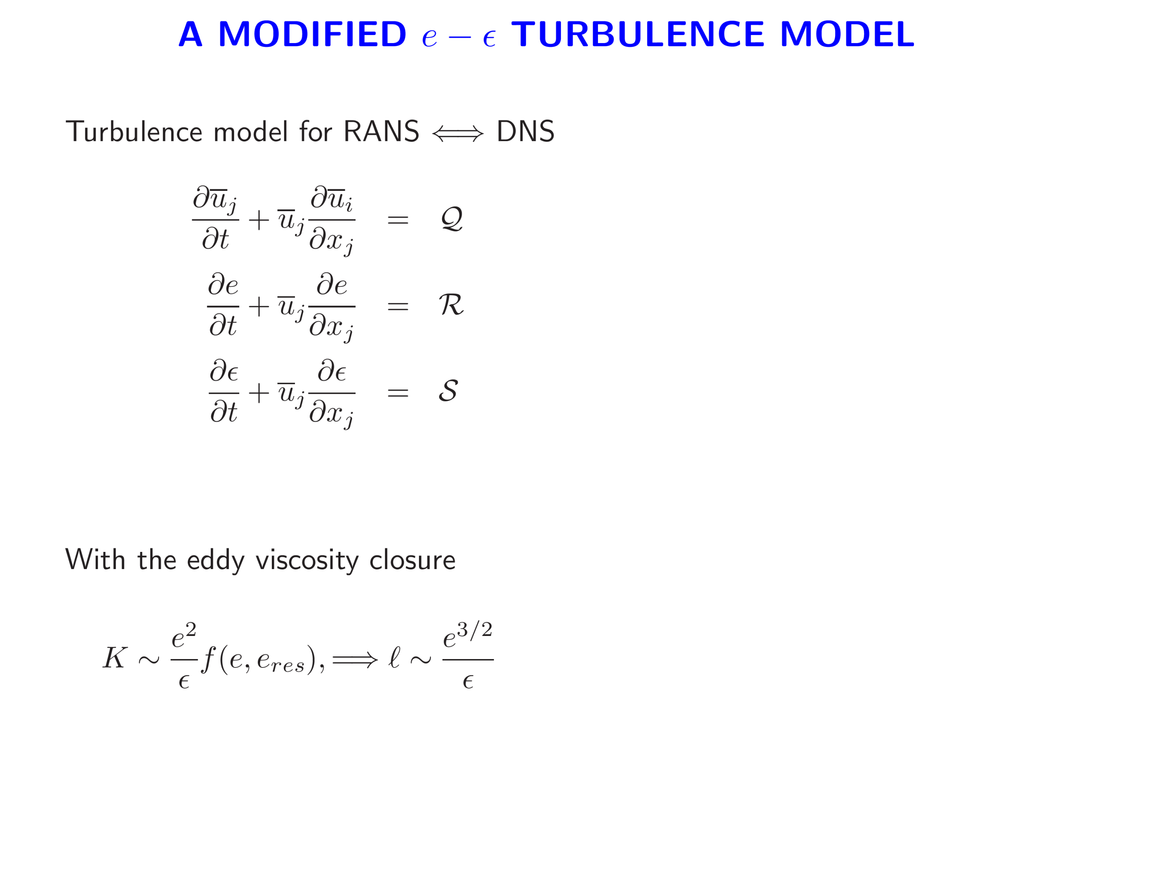
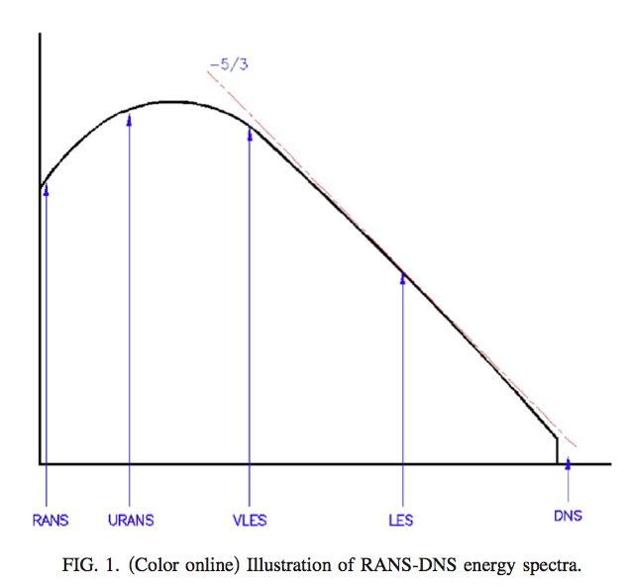
SGS energy
dissipation
Adaptive computation of

Slide 35
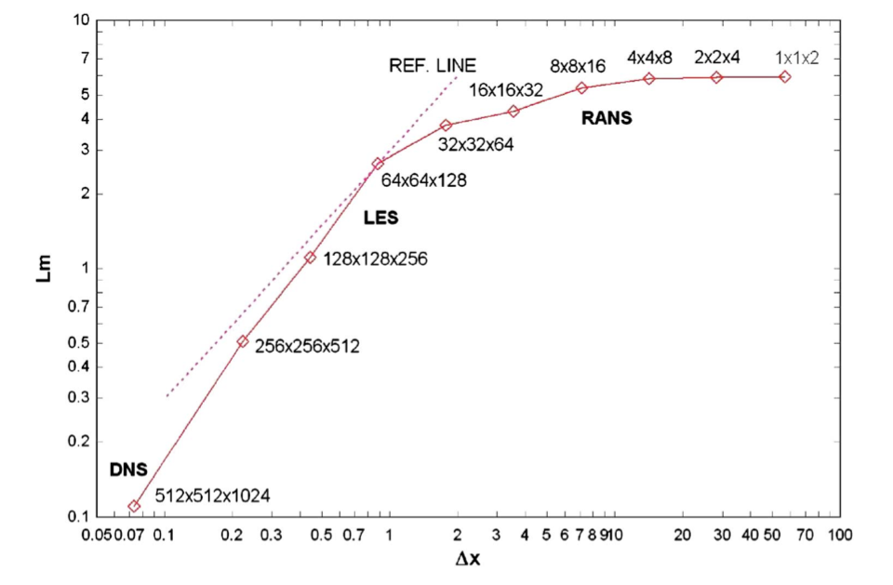
VARIATION OF LENGTH SCALE WITH MESH SPACING

Slide 36
Oceanographers are also coping with Terra-Incognita, they refer to it as submesoscale turbulence

Slide 37
SPECTRAL GAP BETWEEN MESOSCALE AND BOUNDARY LAYER SCALES?
Spectral gap?

Slide 38
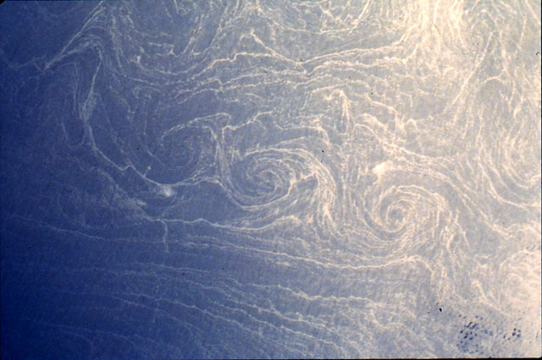
SPIRALS ON THE SEA
~ 10 km
Photograph of a cyclonic spiral-eddy street oﬀ the coast of the Egyptian/Libyan border. Eddy radii are ≈ 5 km, and scum convergence lines are ∼ 100s m wide. The street conﬁguration suggests a recent vortex roll-up from an unstable submesoscale front or wake. (Scully-Power, 1986), courtesy J. McWilliams.

Slide 39
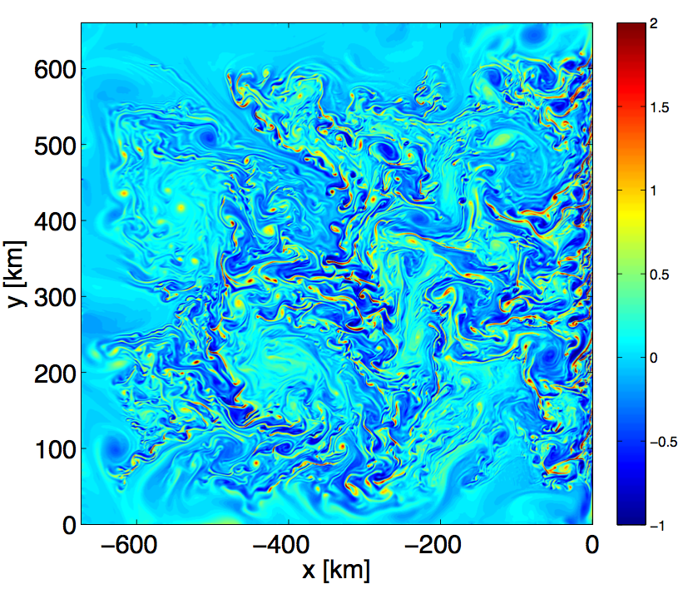
OCEAN WEATHER SYSTEMS
Simulated vertical vorticity normalized by f illustrating the interaction between fronts, instabilities and vortices in the ocean. Courtesy J. McWilliams (UCLA)

Slide 40
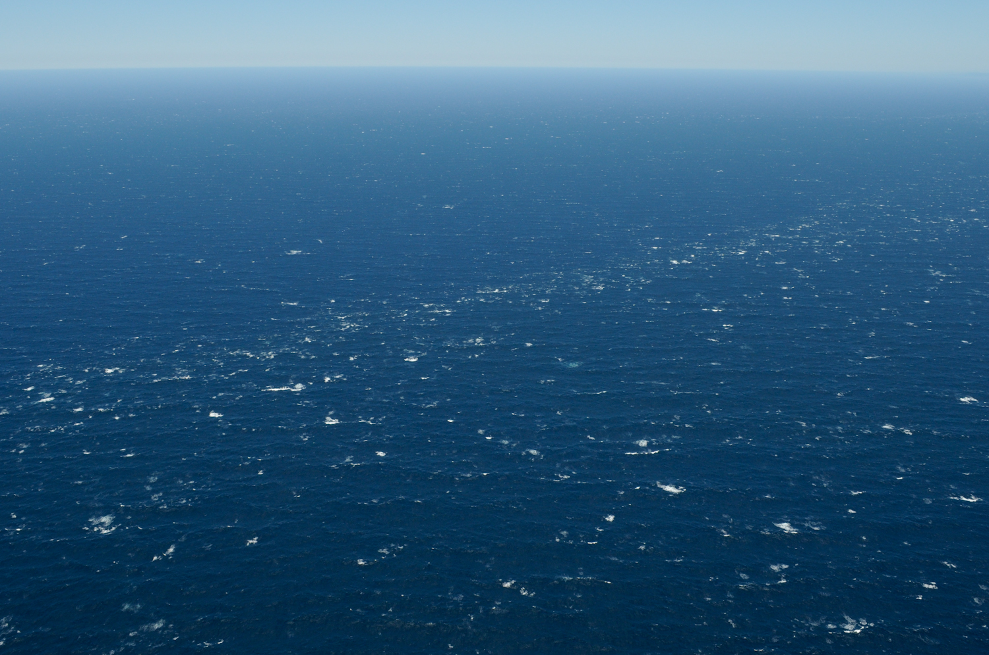
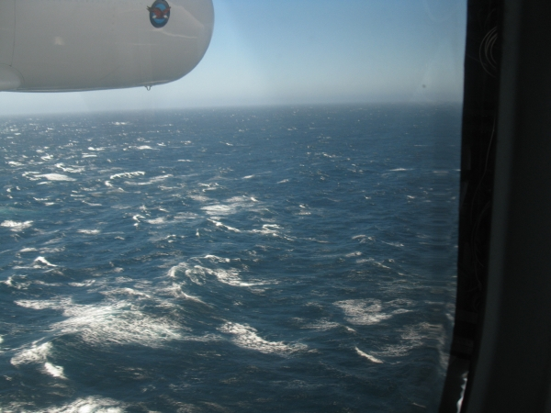
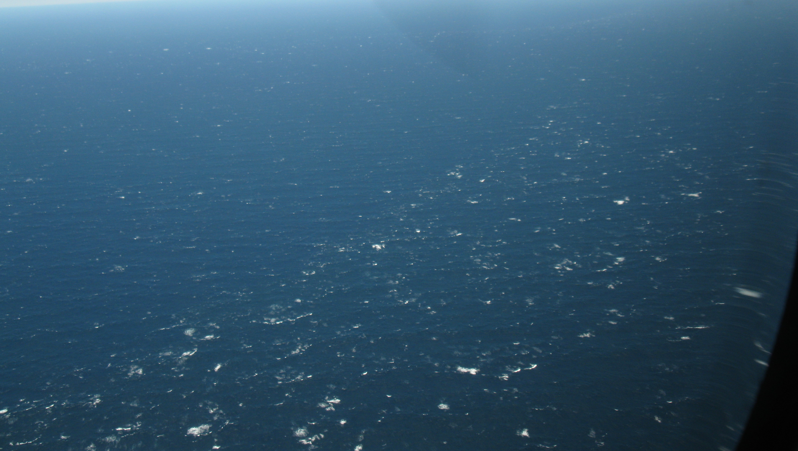
HI-RES Experiment June 2010, Courtesy Ken Melville, Scripps Institute of Oceanography
Wave-current interaction and ocean fronts
Notes:
Goal: Improve the quality of wave modeling in high winds, including the effects of currents.
Not just the spectrum but also the statistics.

Slide 41
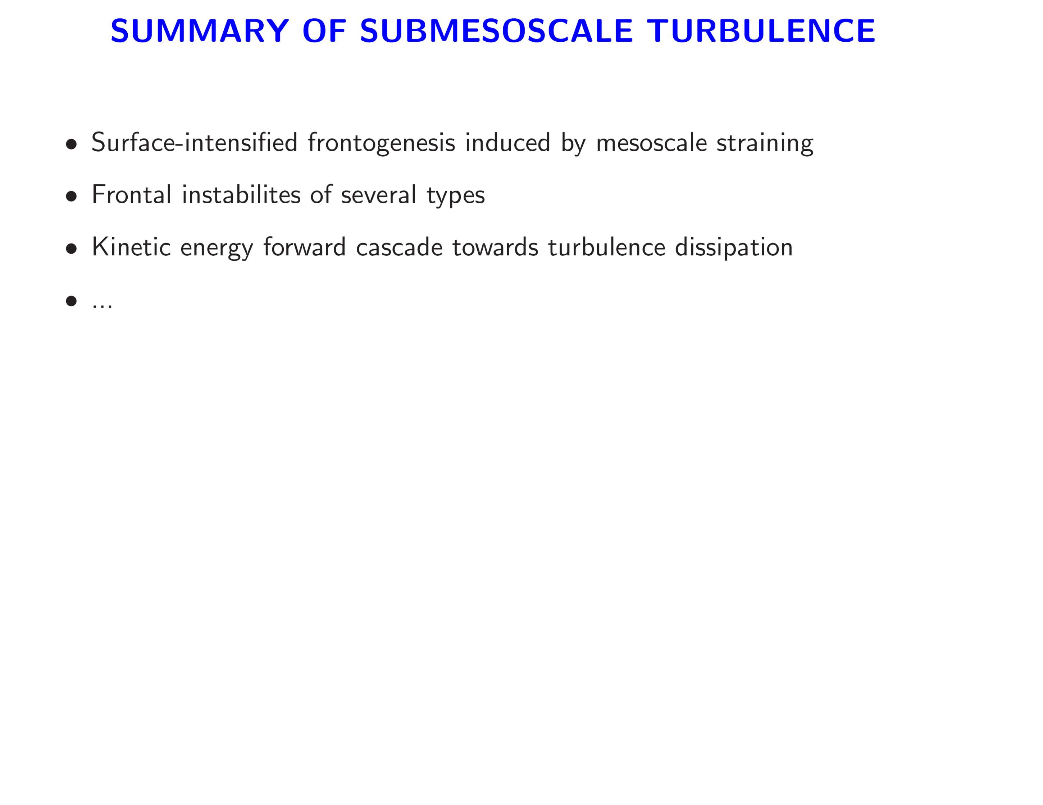
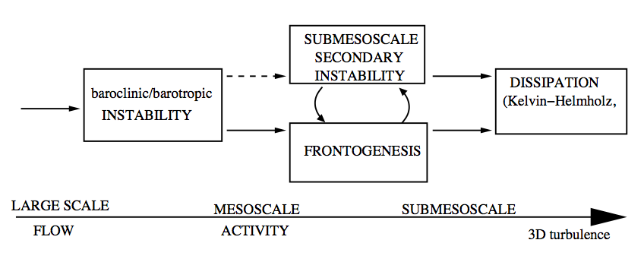
Courtesy Jim McWilliams (UCLA)
Resolved flow computations stop!

Slide 42
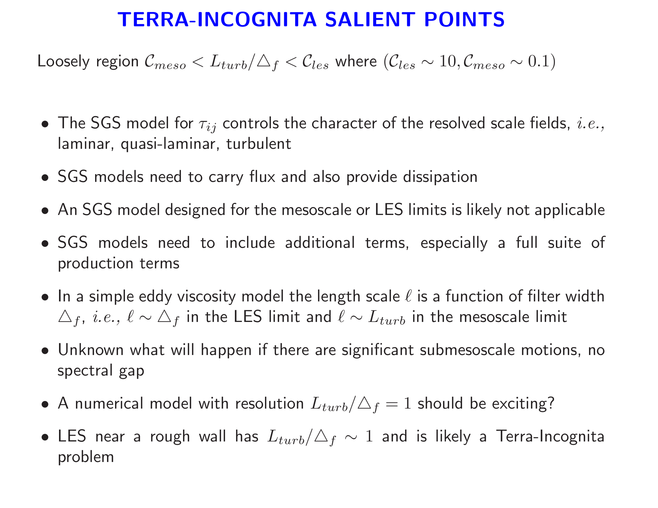

Slide 43
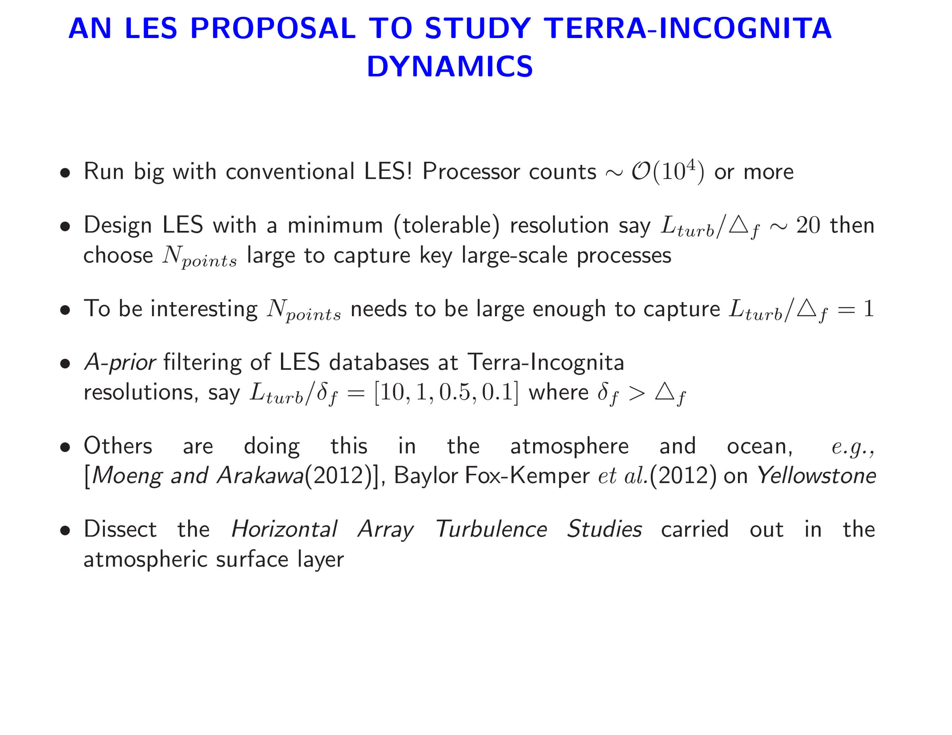

Slide 44
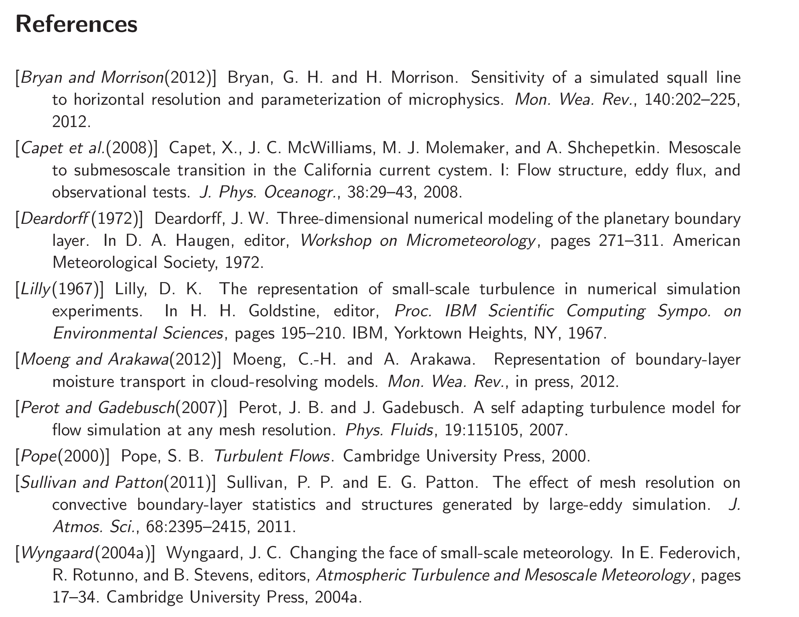

Slide 45
