Slide 1
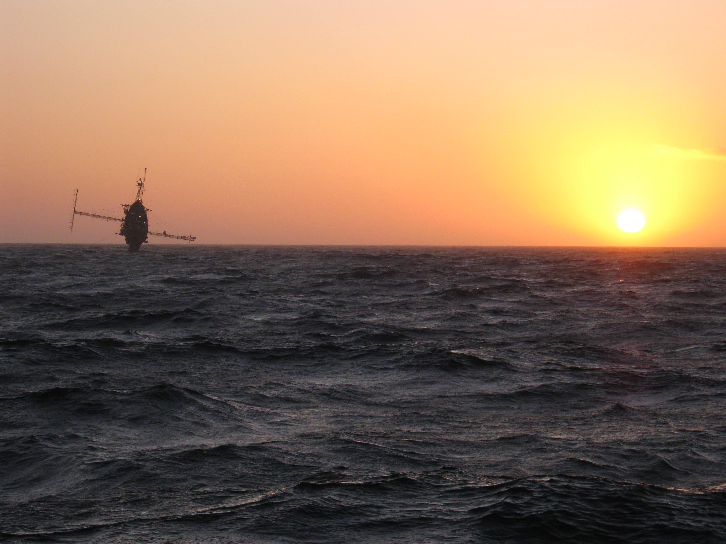
A LARGE EDDY SIMULATION PERSPECTIVE OF TERRA-INCOGNITA
1. An introduction to Terra-Incognita
2. Rough wall SGS dynamics and Terra-Incognita
3. Large-eddy simulation (LES)
4. A potpourri of LES with complex boundaries

Slide 2
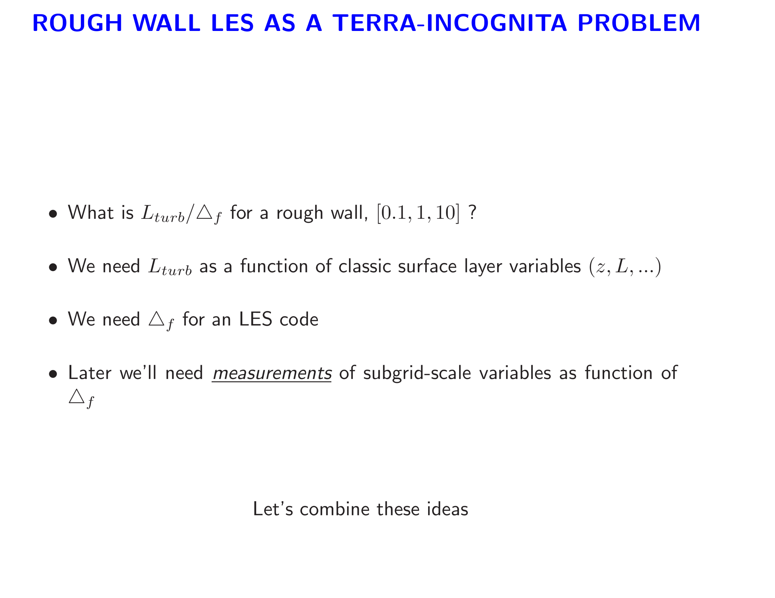

Slide 3
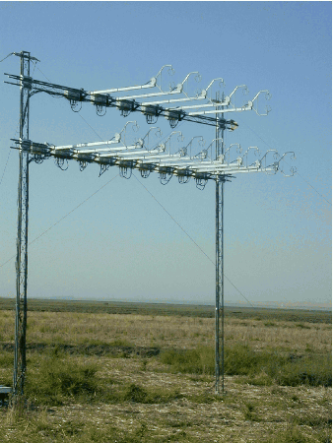

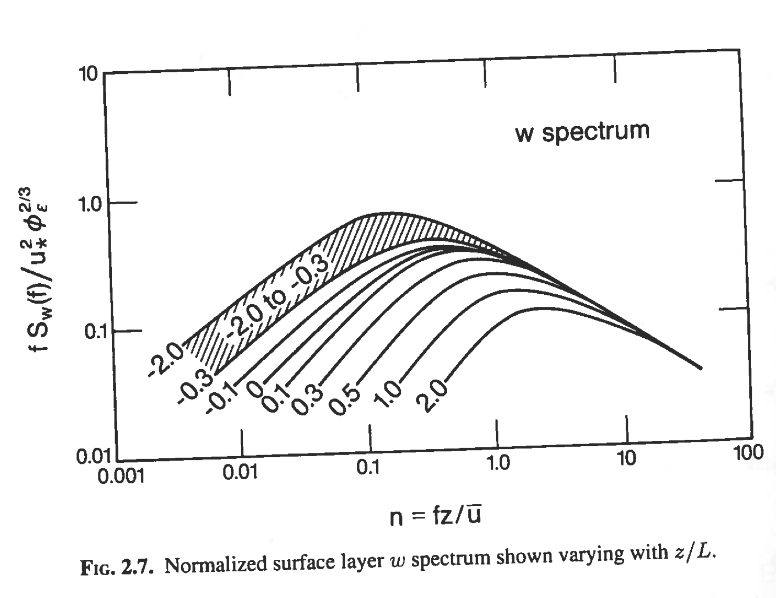
is the characteristic length scale of
the vertical velocity spectrum
Kaimal & Finnigan (1994)
Increasing stratification z/L

Slide 4
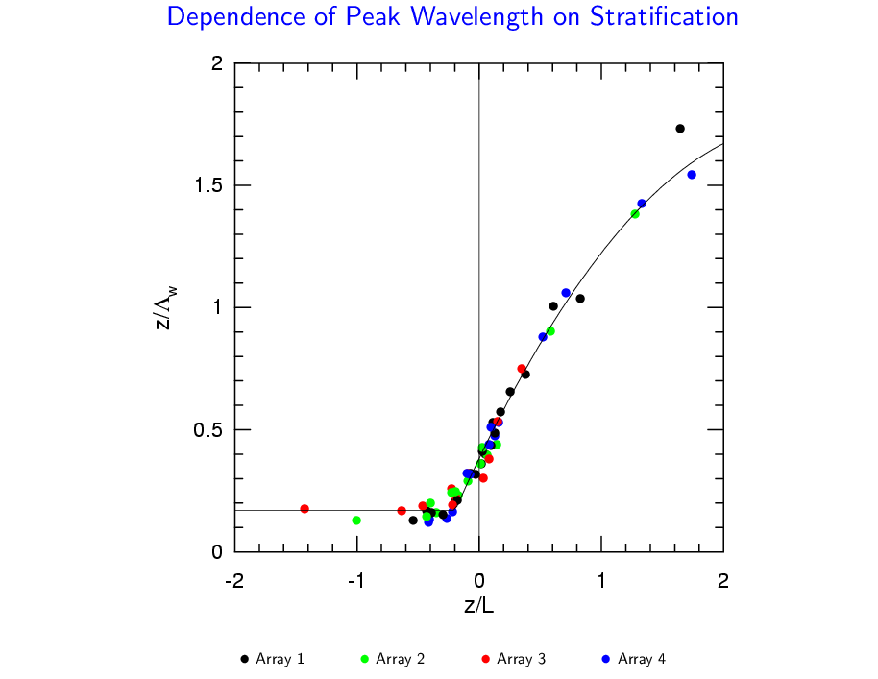
convective
stable

Slide 5
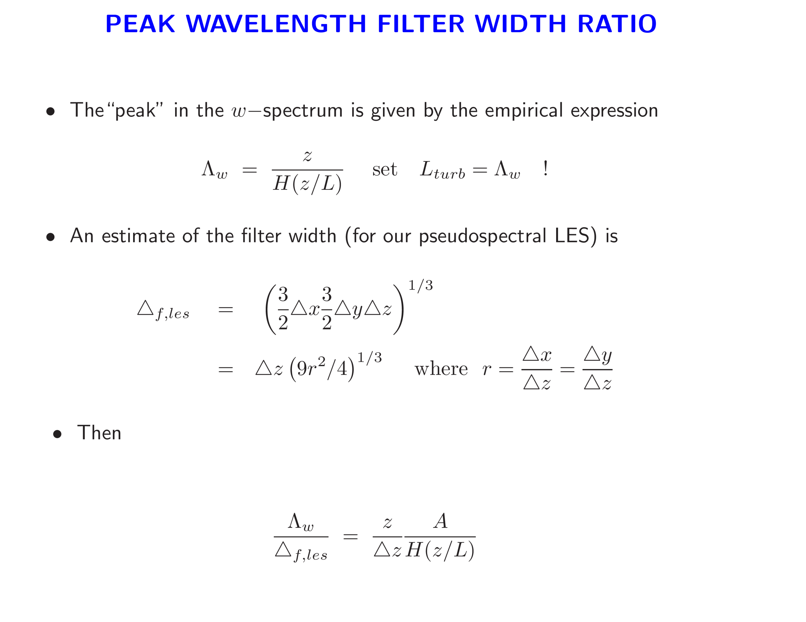

Slide 6
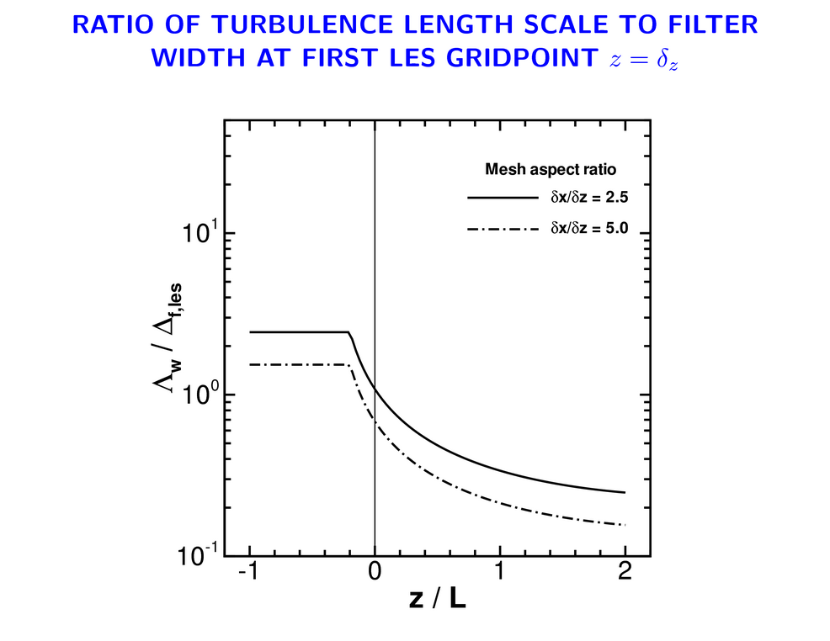
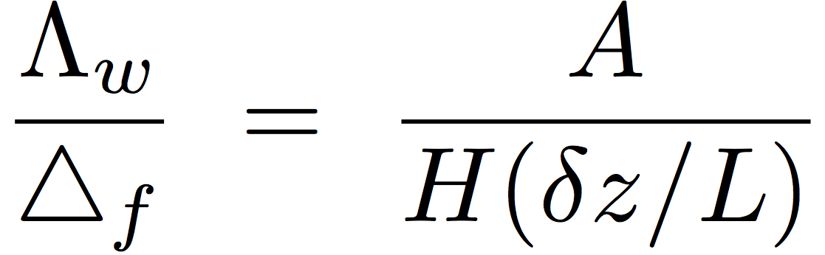
LES limit
Meso limit
convective
stable

Slide 7
A LOOK AT FILTERING

Slide 8
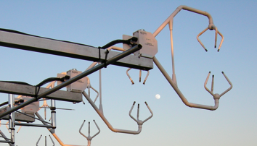
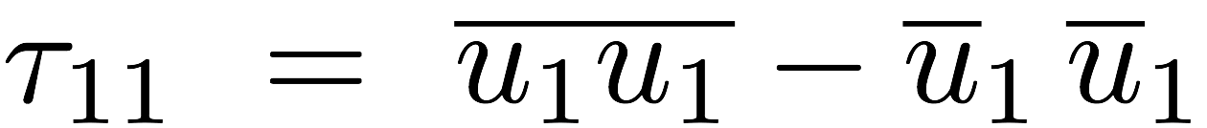
SIMPLE (CHEAP) FILTERING EXAMPLE …

Slide 9
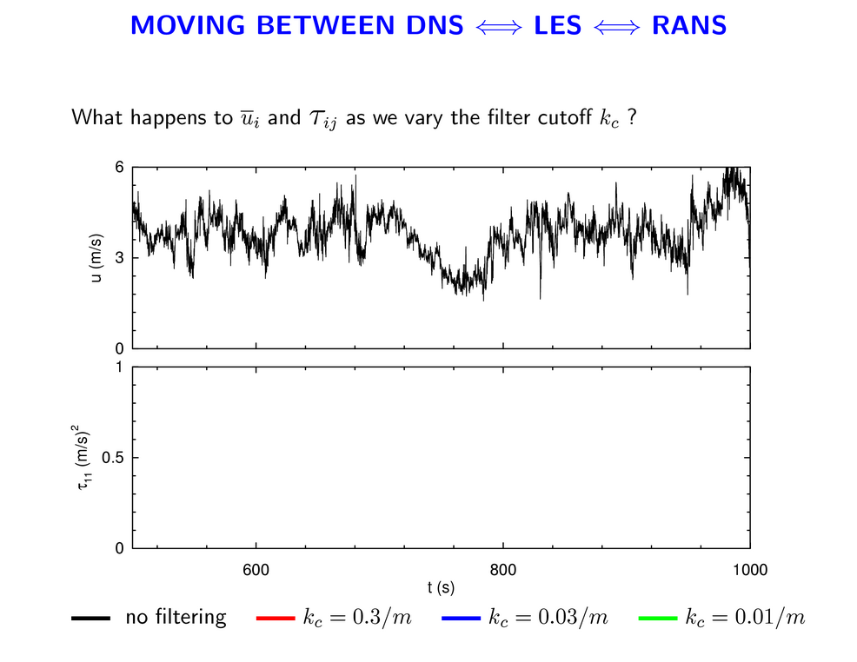
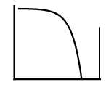
MOVING BETWEEN MESO LIMIT AND LES LIMIT
Data in the atmospheric surface layer

Slide 10
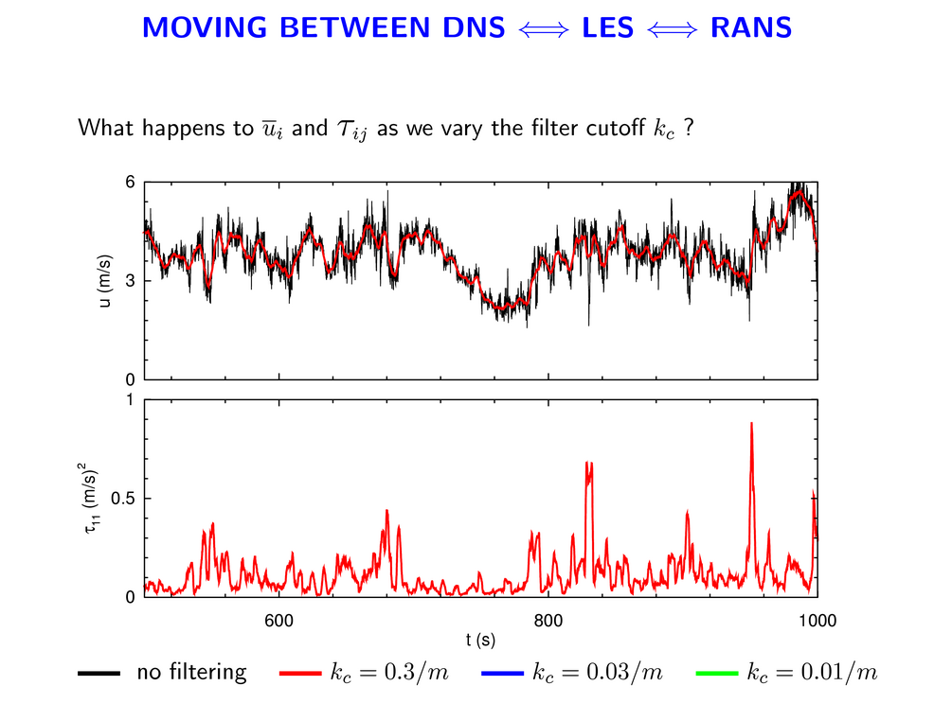
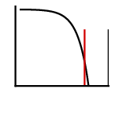
MOVING BETWEEN MESO LIMIT AND LES LIMIT

Slide 11
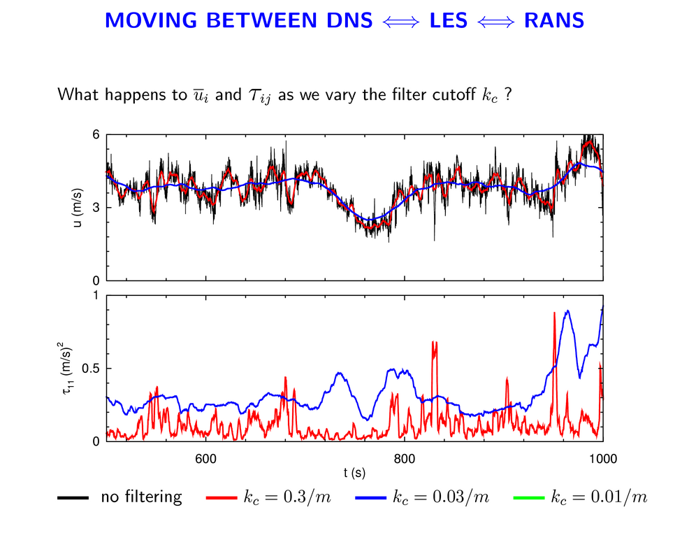
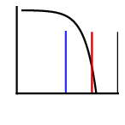
MOVING BETWEEN MESO LIMIT AND LES LIMIT

Slide 12
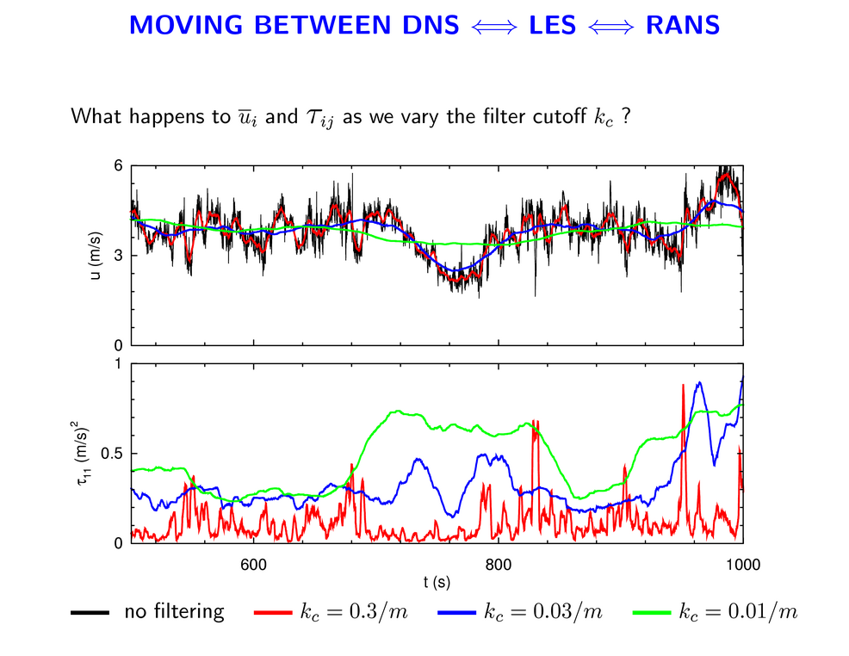
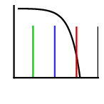
MOVING BETWEEN MESO LIMIT AND LES LIMIT

Slide 13

MOVING BETWEEN MESO LIMIT AND LES LIMIT
MESO limit

Slide 14
Can we use targeted observations to provide insight as to the nature of SGS motions in high Re PBLs, and the Terra-Incognita regime?

Slide 15
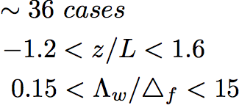
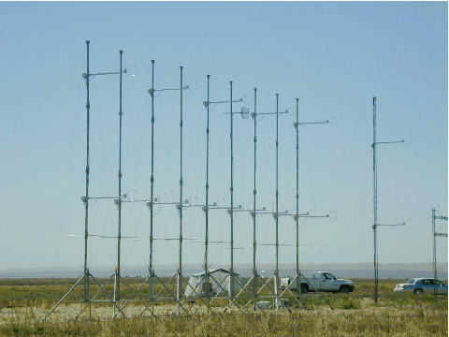
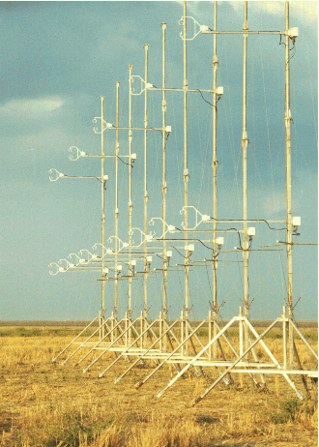
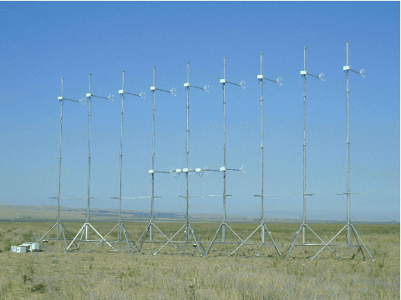
HATS CONFIGURATIONS
Wide
Narrow

Slide 16
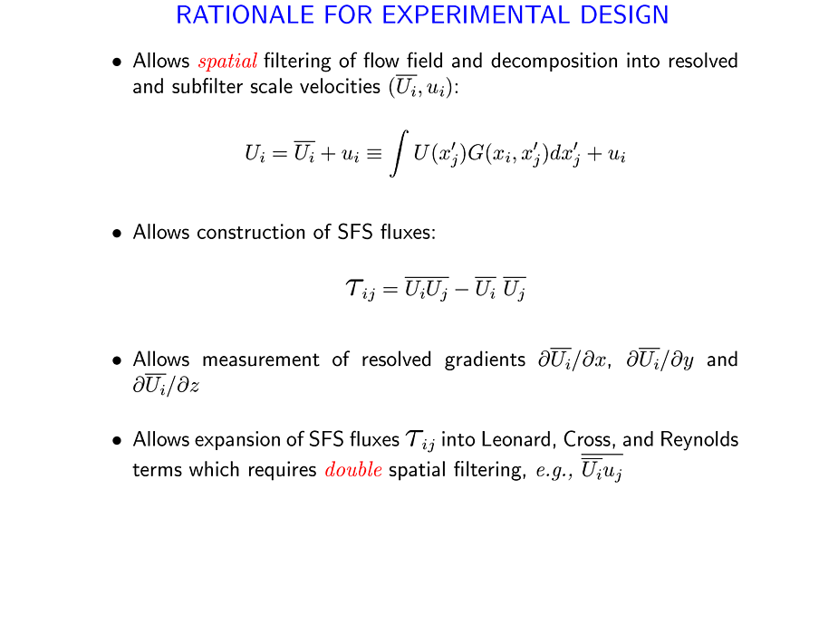

Slide 17
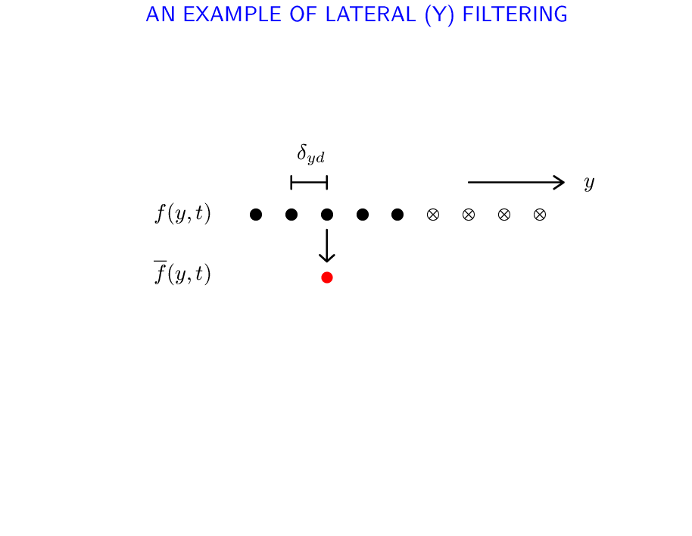
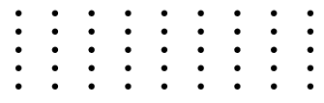


AN EXAMPLE OF LATERAL (Y) FILTERING
U
``2D plane of turbulence”

Slide 18
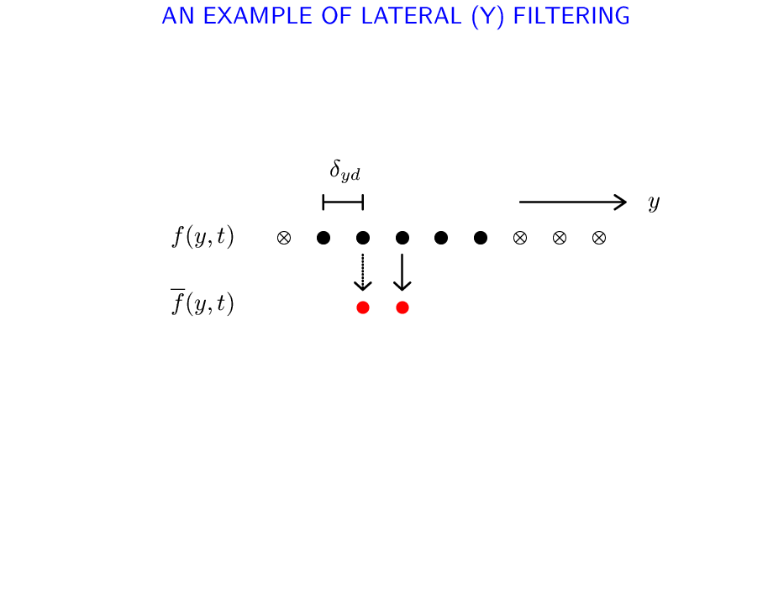
AN EXAMPLE OF LATERAL (Y) FILTERING
U

Slide 19
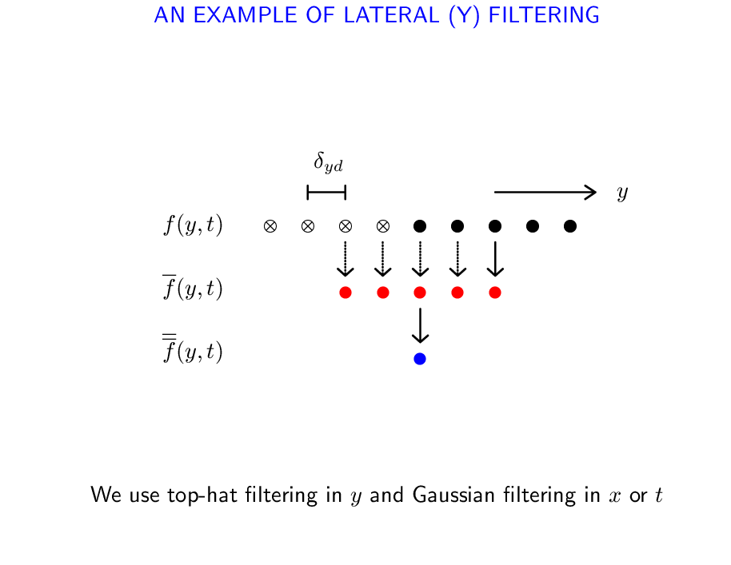
AN EXAMPLE OF LATERAL (Y) FILTERING
U

Slide 20
WHAT DO SGS STATISTICS FROM OBSERVATIONS LOOK LIKE?

Slide 21
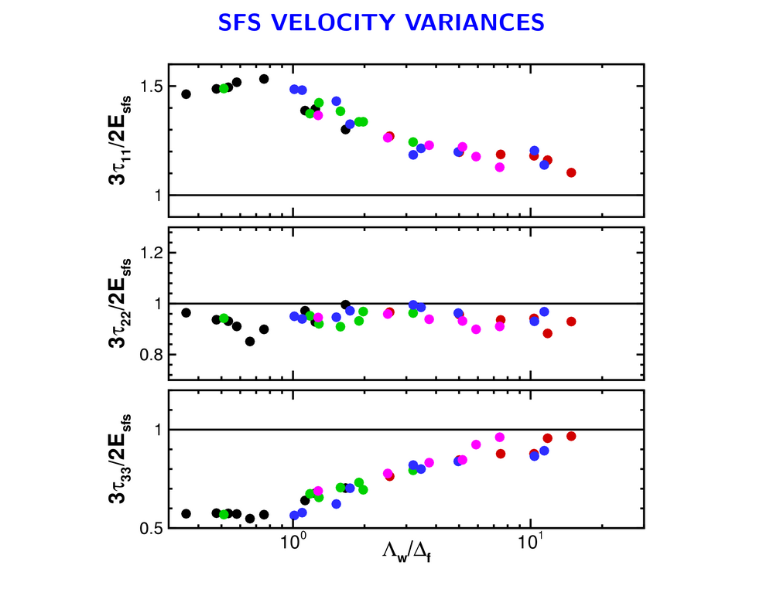

HATS ARRAYS
Isotropic

Slide 22
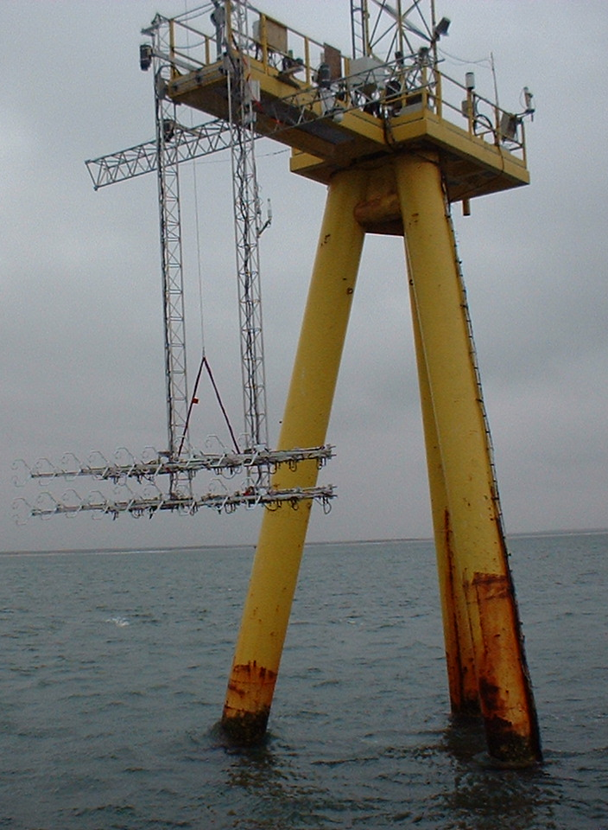
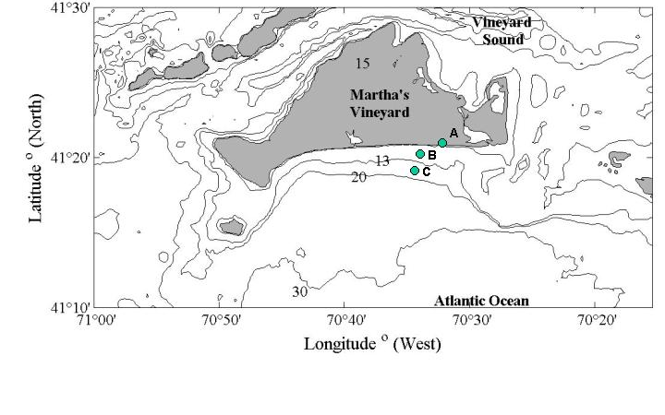
OHATS FIELD CAMPAIGN
ASIT
Laser altimeters
18 CSATS
275 hours ``12 days of data” analyzed

Slide 23
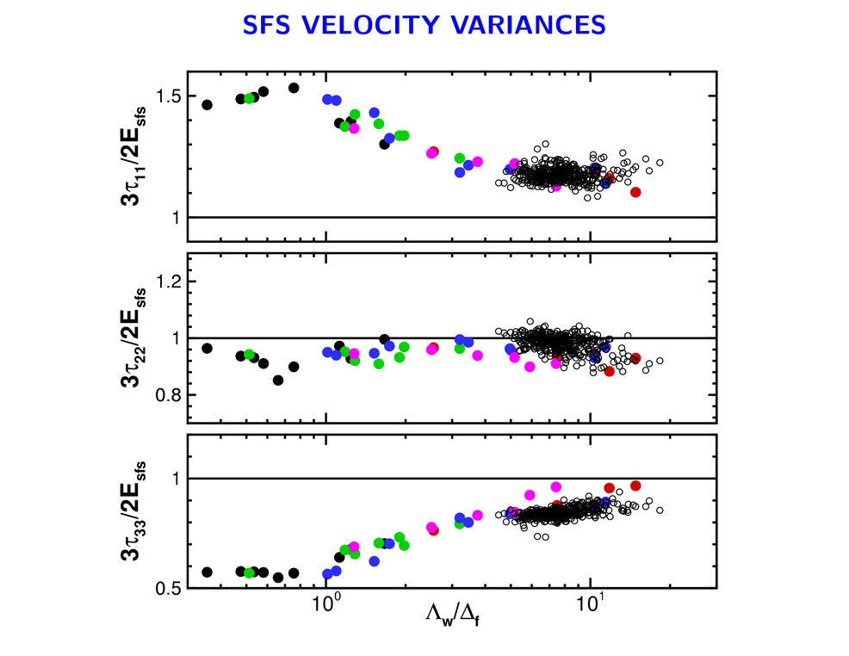
HATS
OHATS

Slide 24
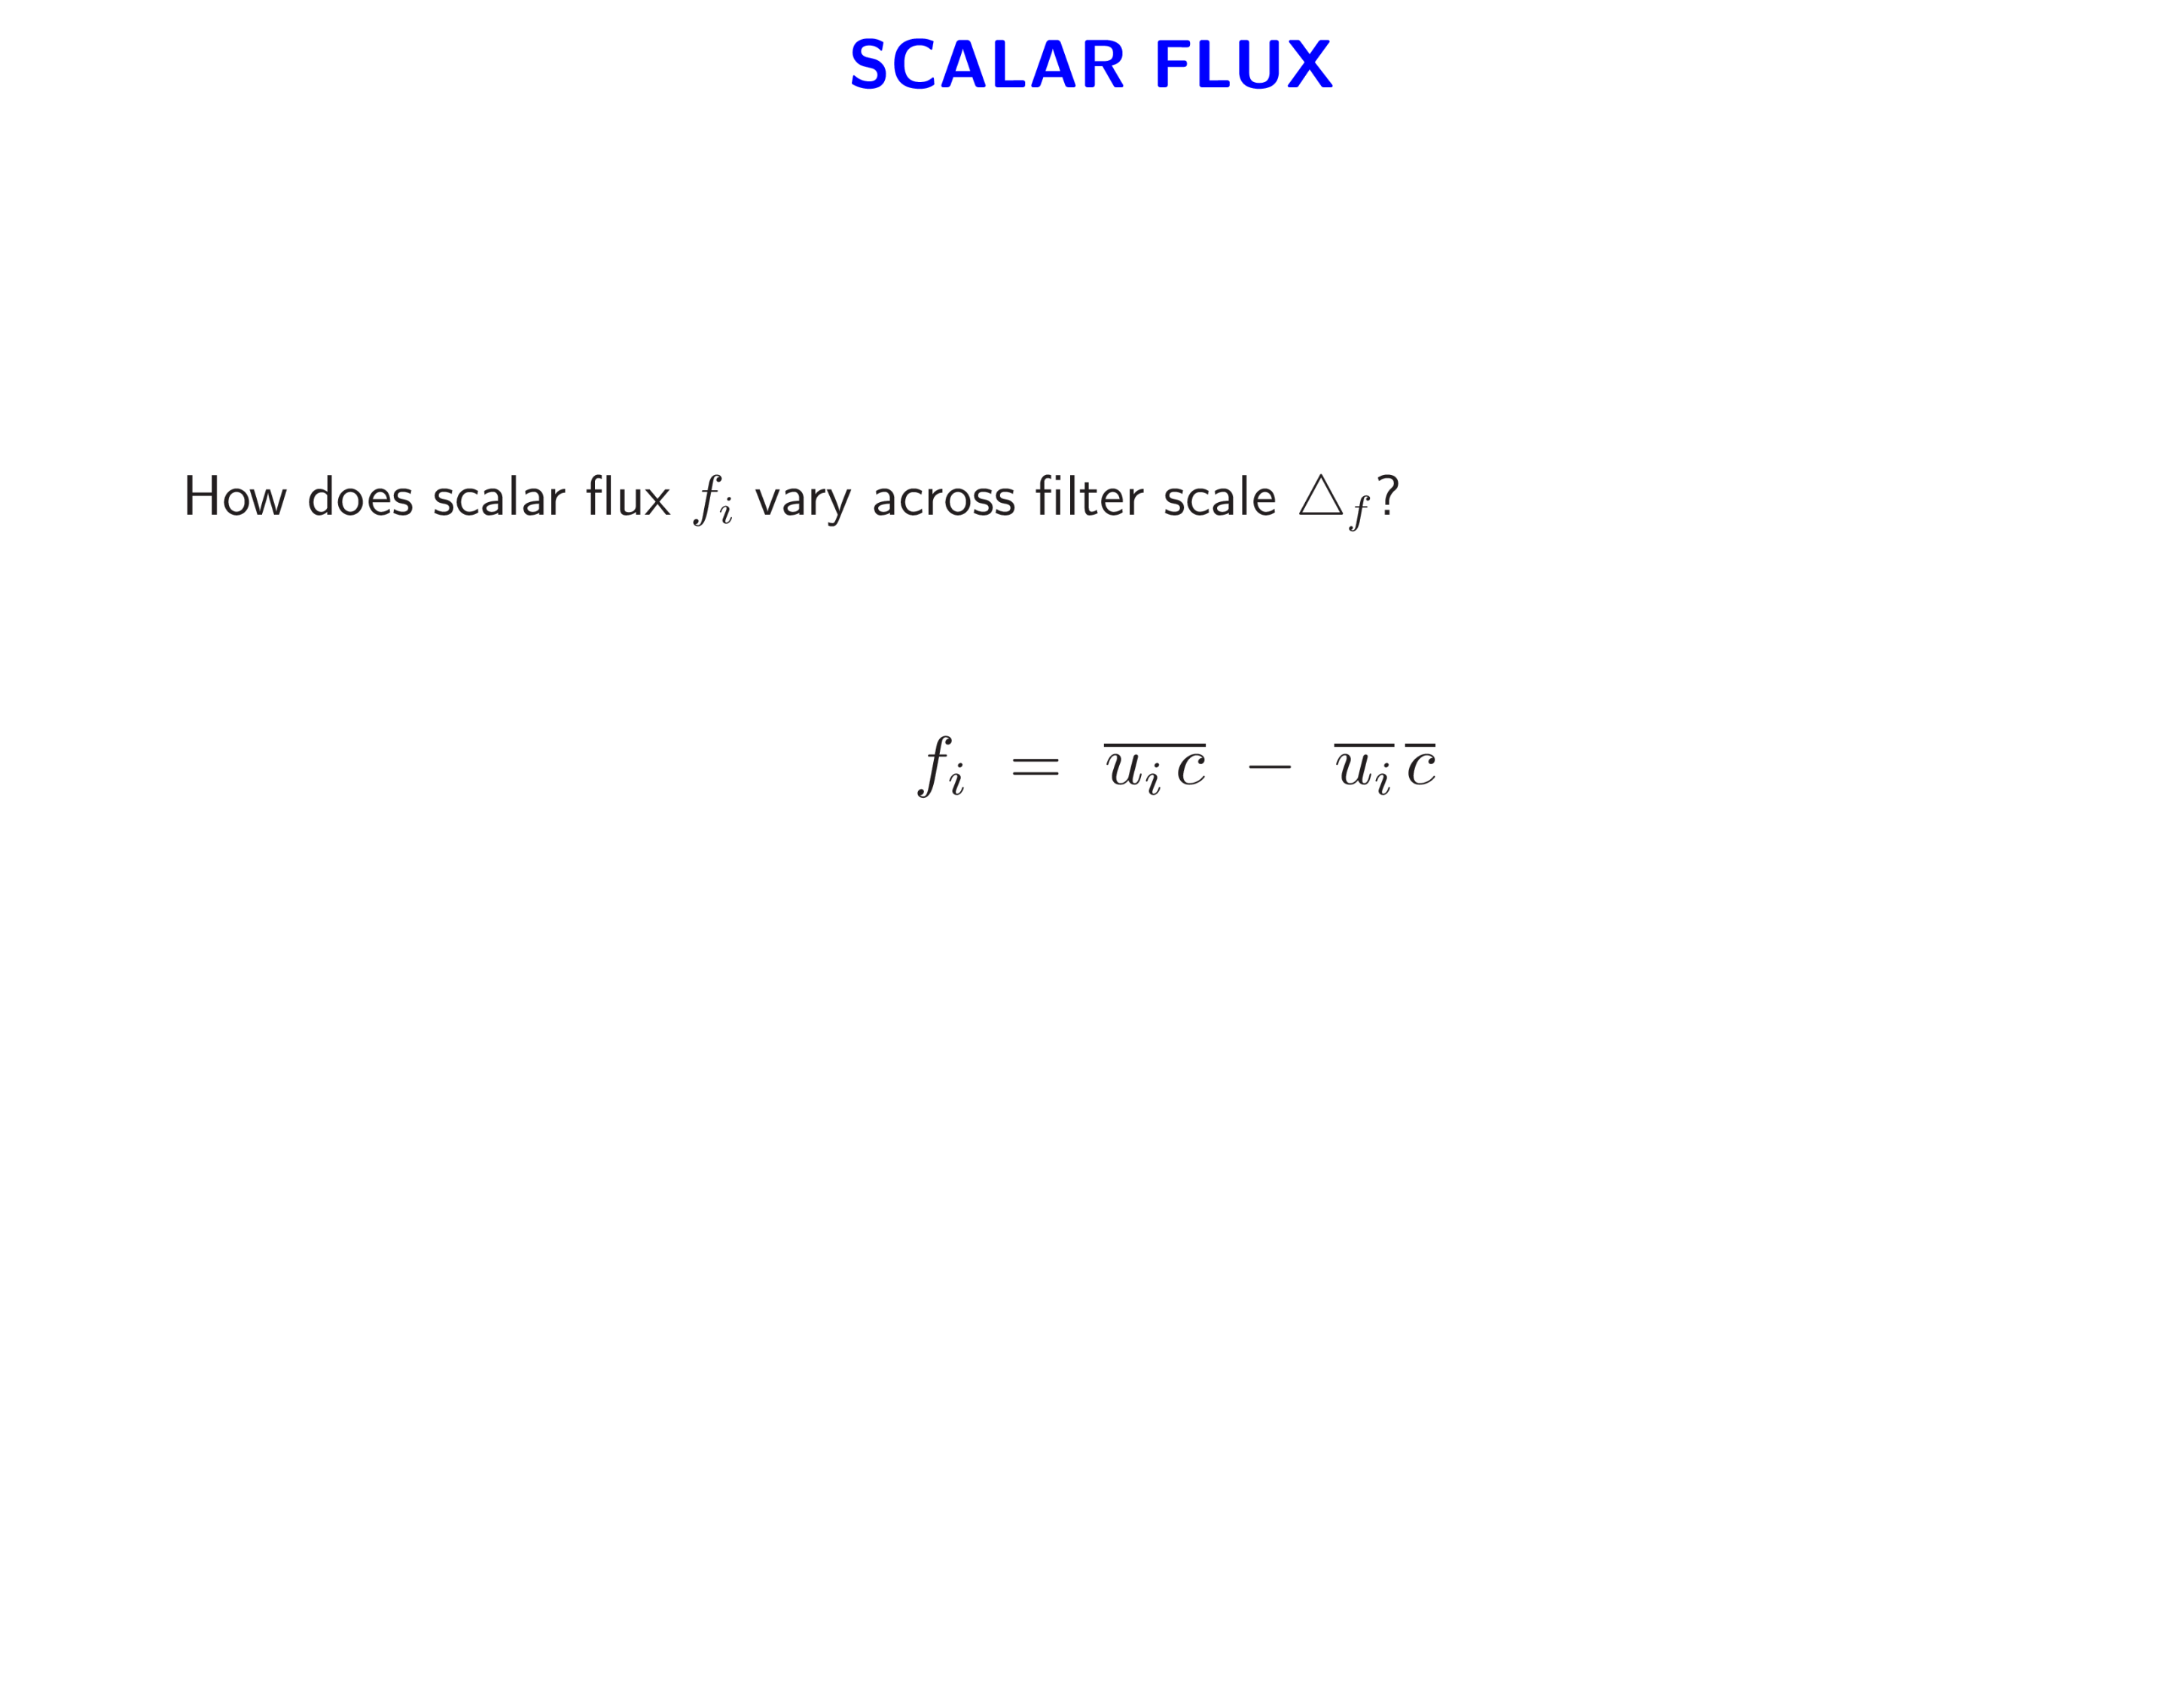

Slide 25

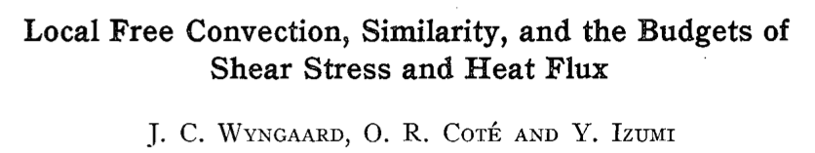
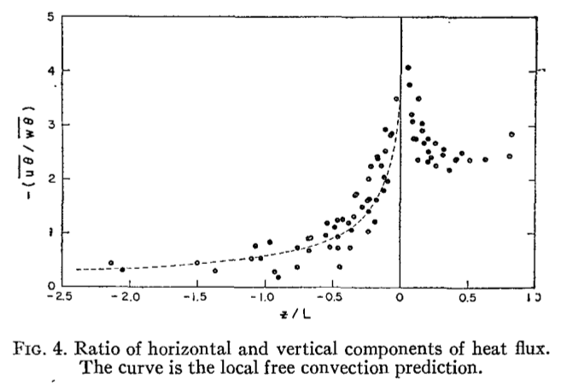
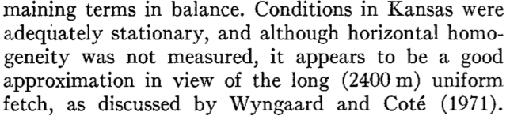


Meso Limit! What produces and ?

Slide 26
WHAT ARE THE FLUX EQUATIONS?

Slide 27
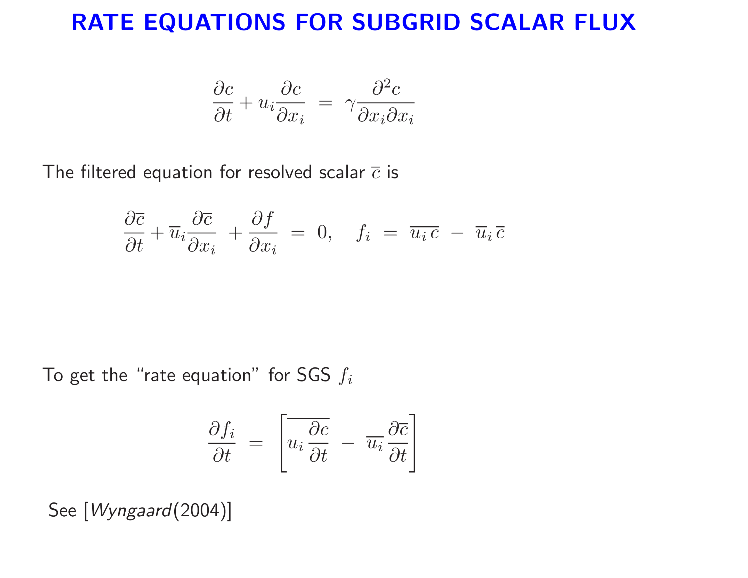
0
SGS scalar flux

Slide 28
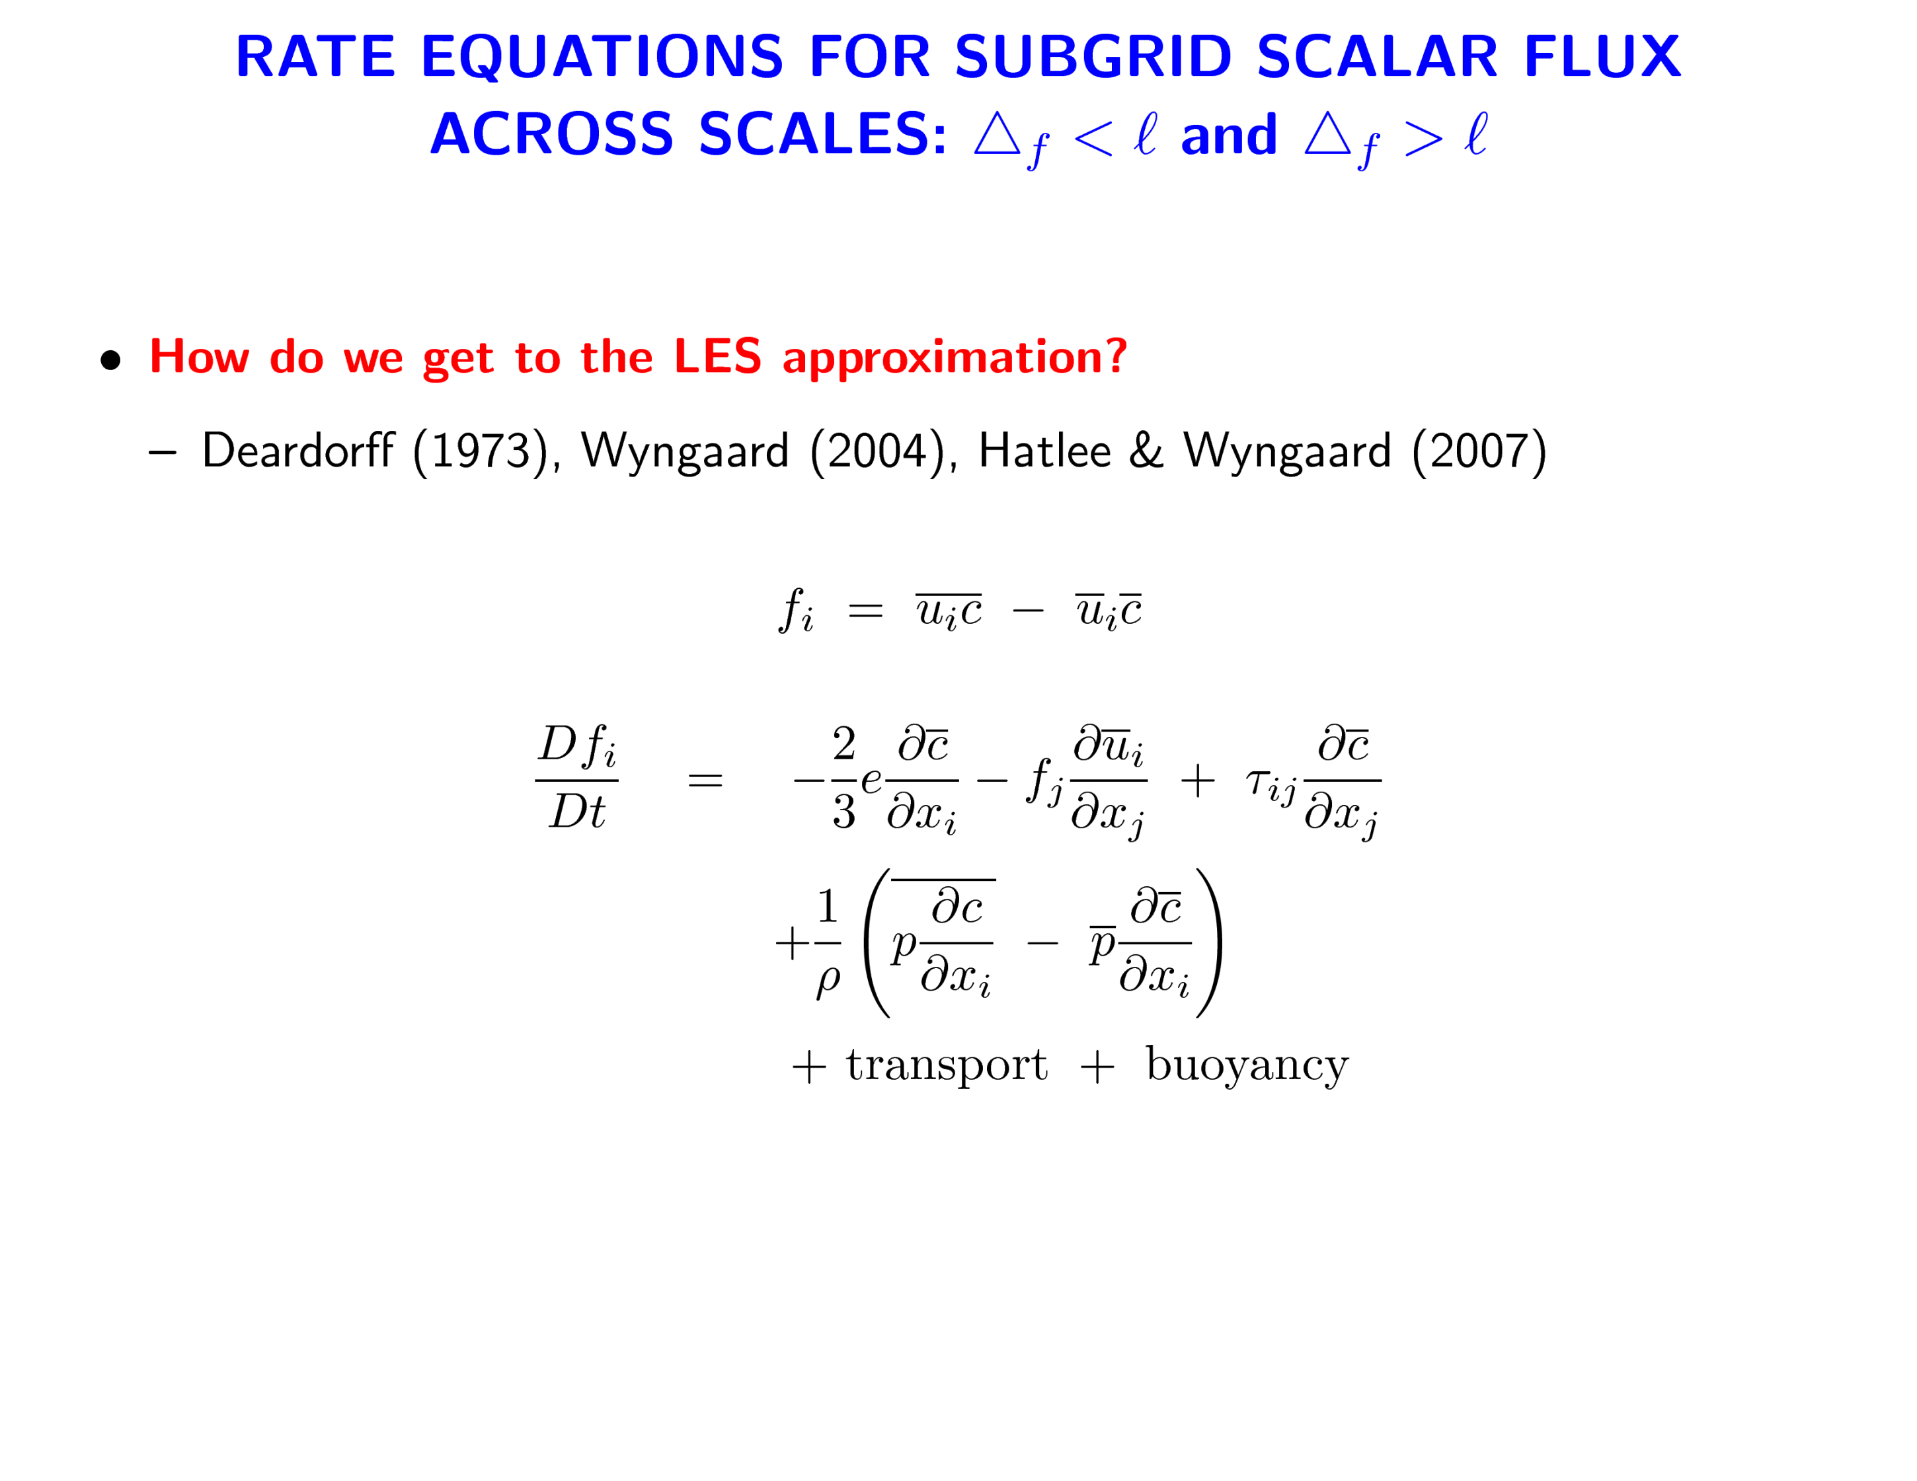
Isotropic production
Pressure destruction
Anisotropic production

Slide 29
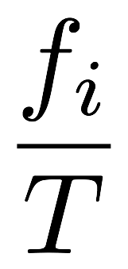



0
0
Rotta model
0
0
Eddy viscosity model
Time scale

Slide 30
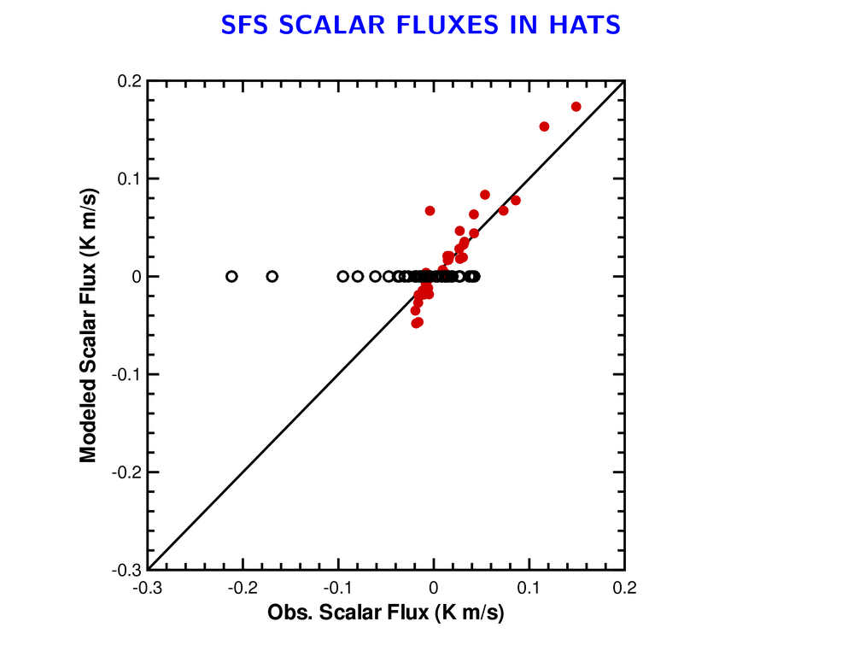
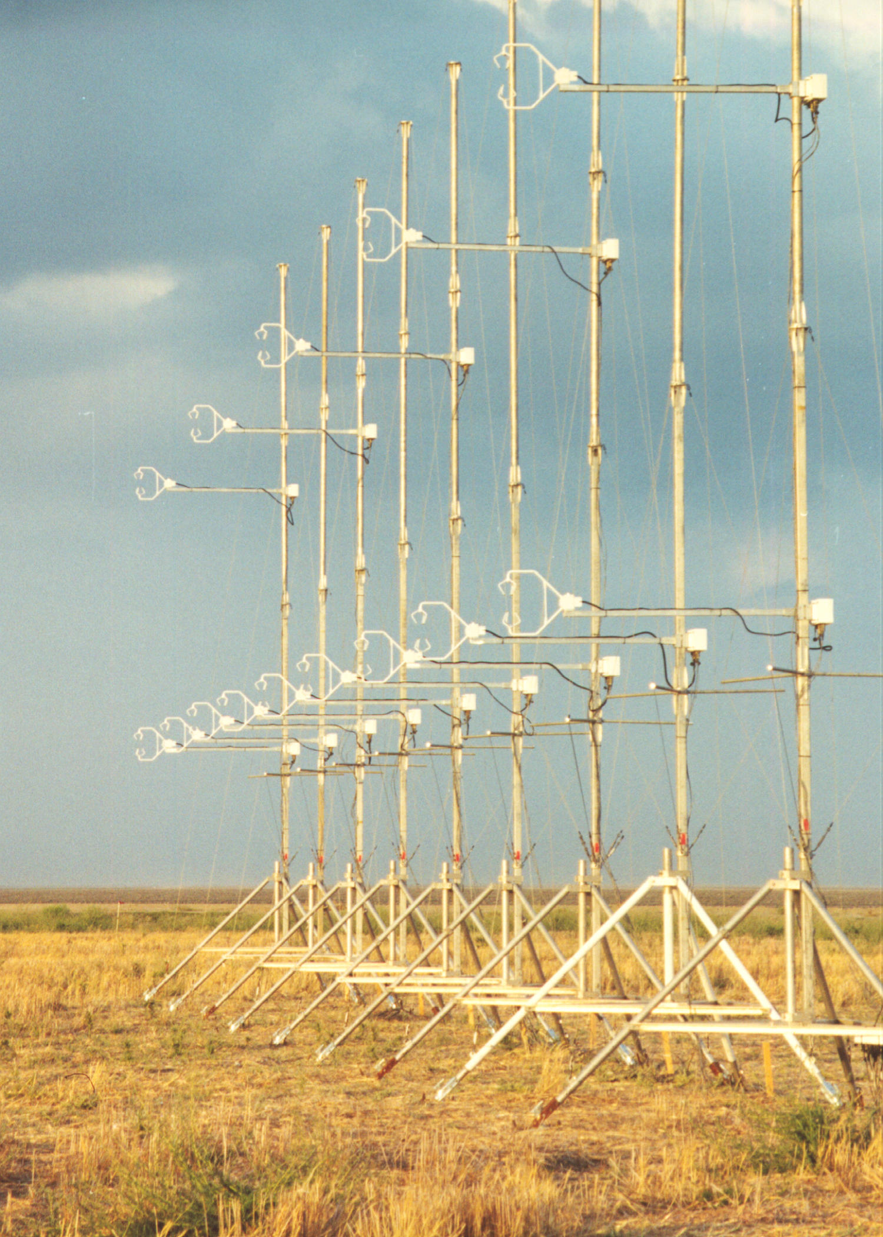
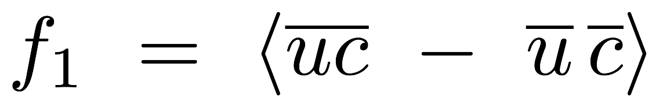
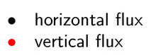
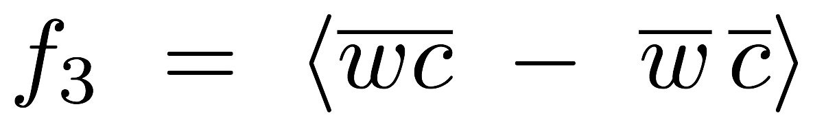
Eddy viscosity model

Slide 31
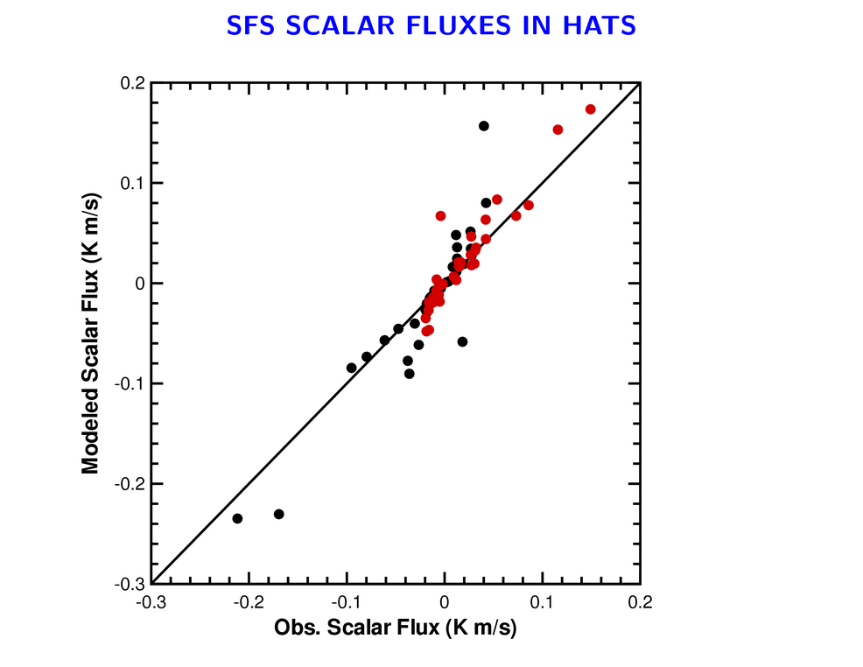
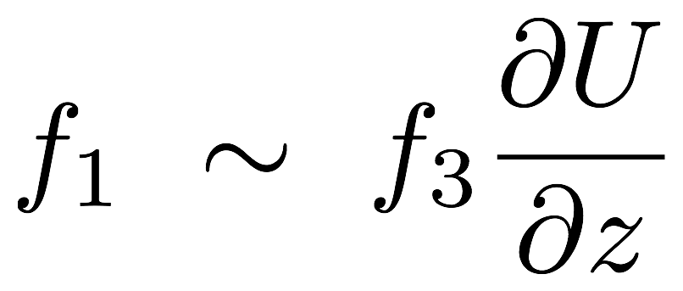
Anisotropic model
C=0.3 (Hatlee & Wyngaard, 2006)
Notes:
The anisotropic production term in the f_1 equation is a cousin to the stretching and tilting term in the vorticity transport equation. **** Can’t make horizontal flux with eddy viscosity **** even if
You make the coefficient dynamic !!!

Slide 32
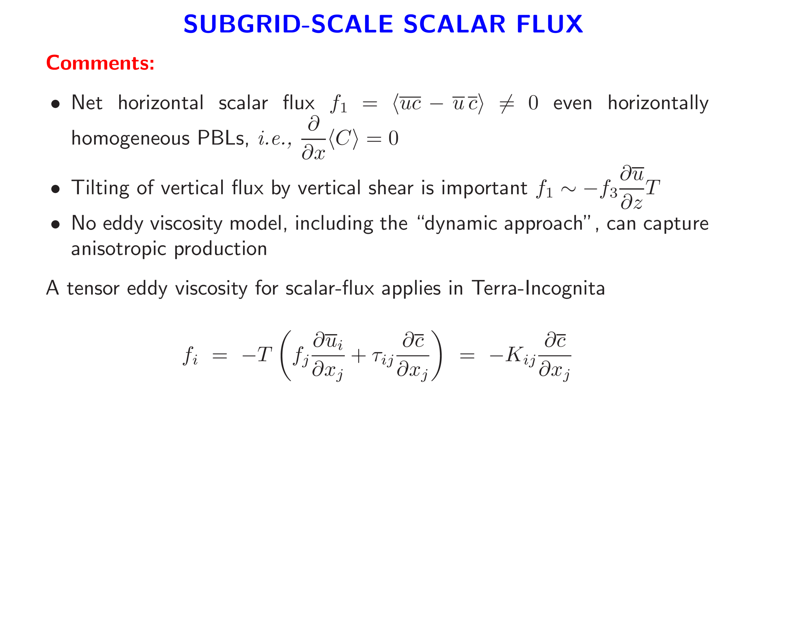

Slide 33
SGS MOMENTUM FLUXES

Slide 34
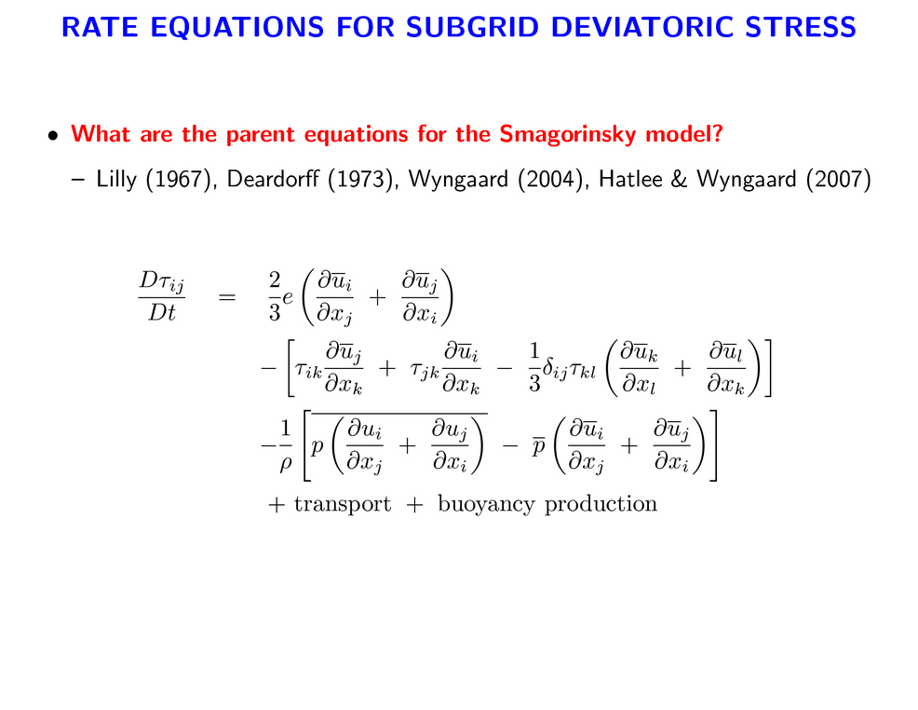

Slide 35
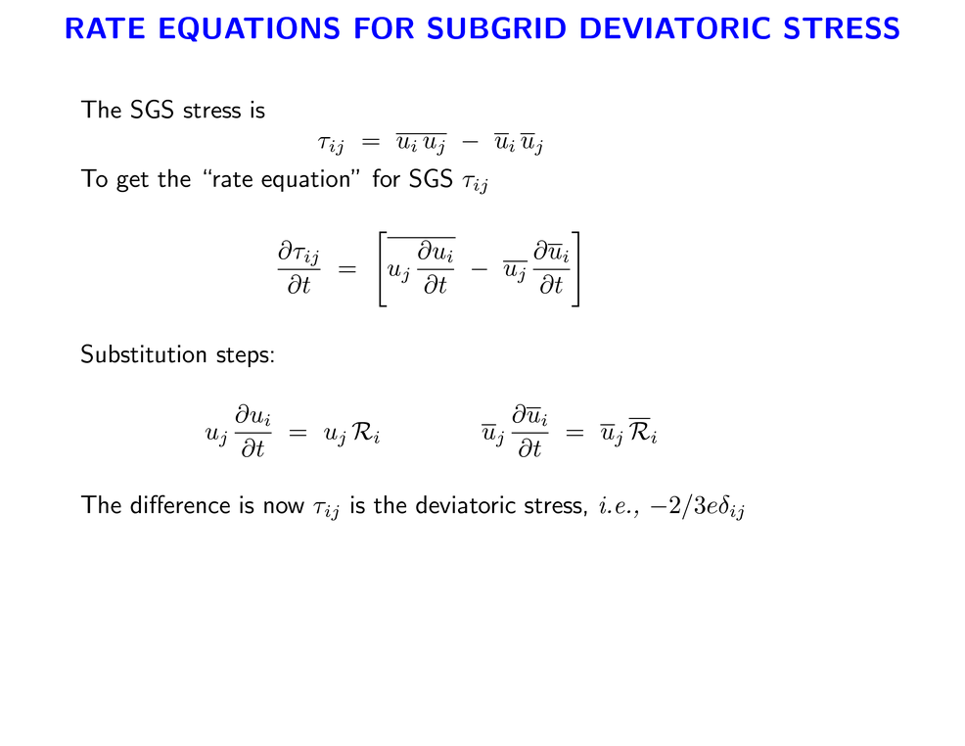
Considerable Algebra !

Slide 36
Isotropic production
Pressure destruction
Anisotropic deviatoric production

Slide 37
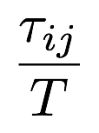

0
0
Rotta model
0
0
Time scale

Slide 38
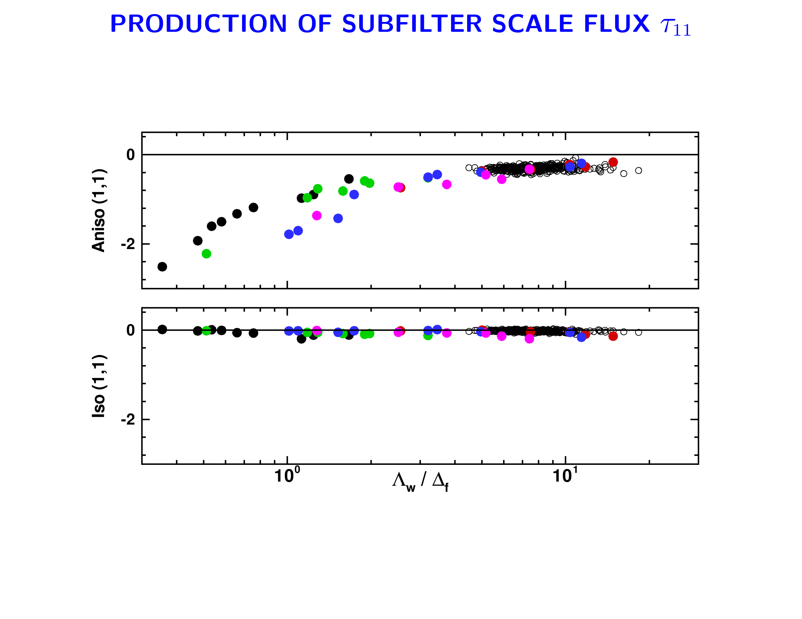



HATS
OHATS
MESO Limit
LES Limit
Measure of scale separation

Slide 39
HATS
OHATS
MESO Limit
LES Limit
Measure of scale separation

Slide 40

Notes:
Note opposite sign from tau_11

Slide 41


Slide 42


Slide 43


Slide 44


Slide 45


