Slide 1
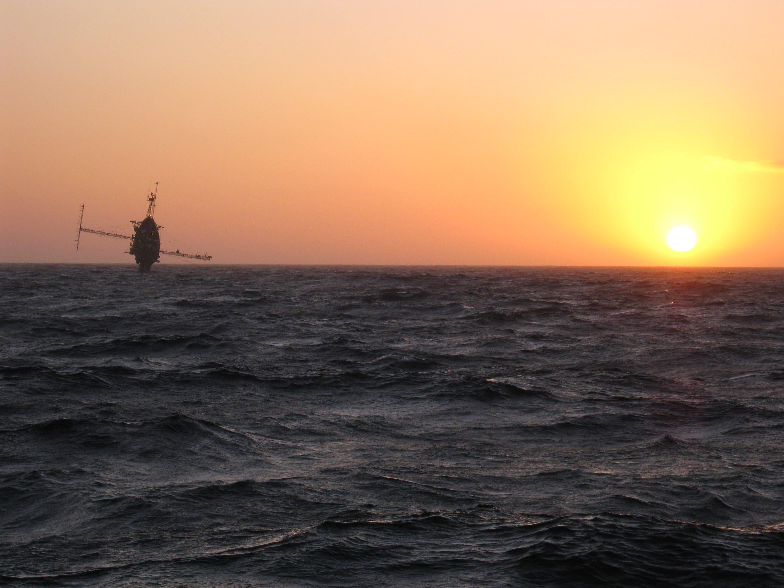
A LARGE EDDY SIMULATION PERSPECTIVE OF TERRA-INCOGNITA
1. An introduction to Terra-Incognita
2. Rough wall SGS dynamics and Terra-Incognita
3. Large-eddy simulation (LES)
4. A potpourri of LES with complex boundaries

Slide 2
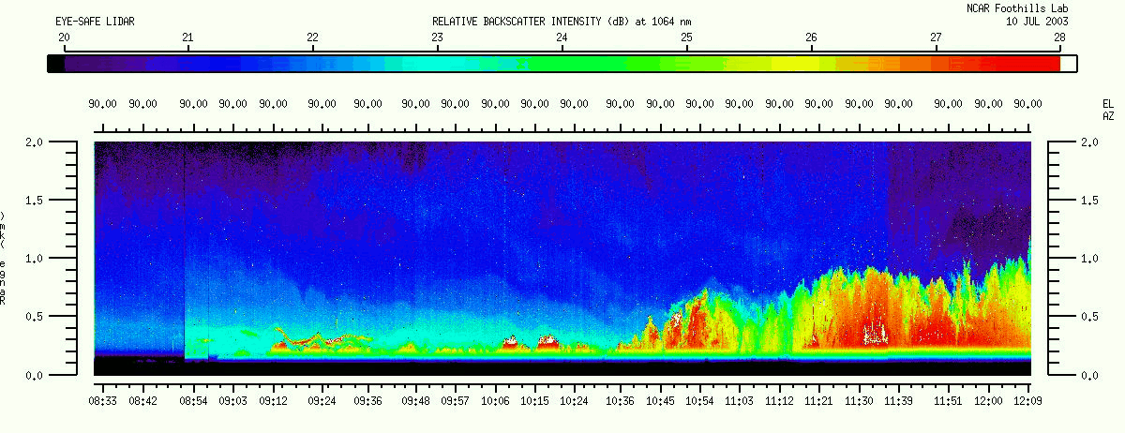
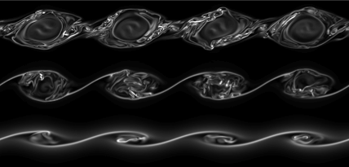
“ … We know what the PBL equations are …
let’s just use DNS?”
LIDAR OBSERVATIONS OF PBL DIURNAL EVOLUTION, COURTESY SHANE MAYOR
DNS 3000x1500x1500

Slide 3
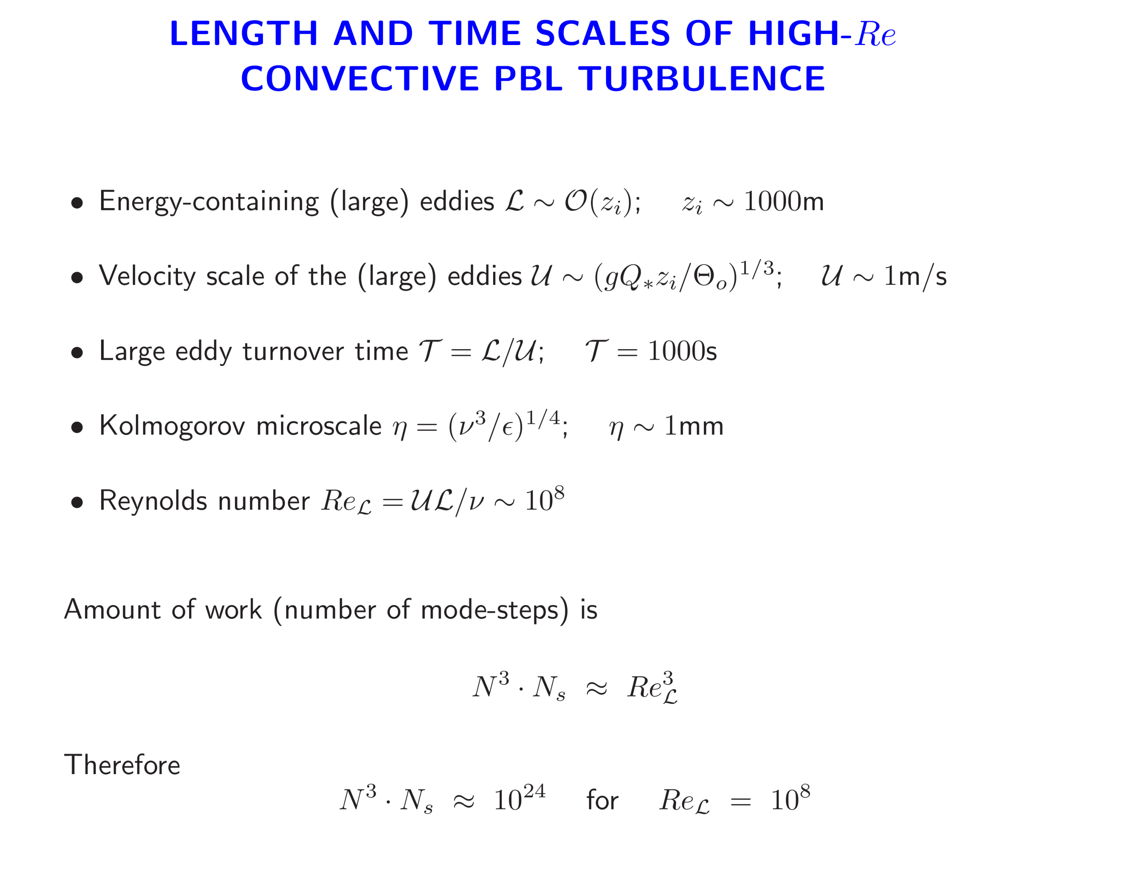


Slide 4
Pope (200), p. 348

Slide 5
“ … DNS is mighty useful, however we don’t have enough IBM SP’s to get to a PBL Reynolds number and resolve all scales of a rough wall … We need something else … LES?”

Slide 6
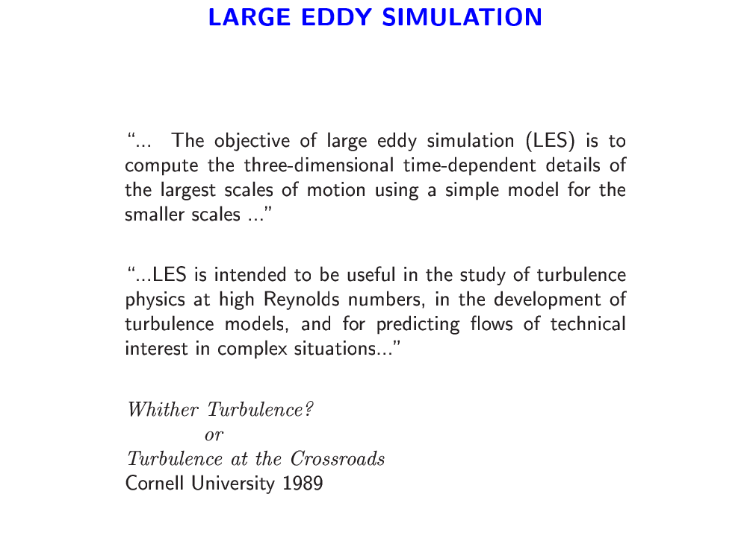

Slide 7
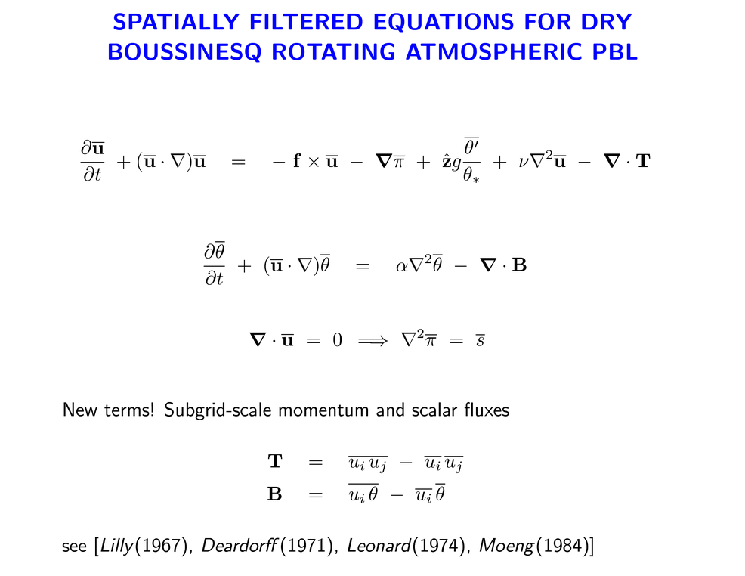


Slide 8
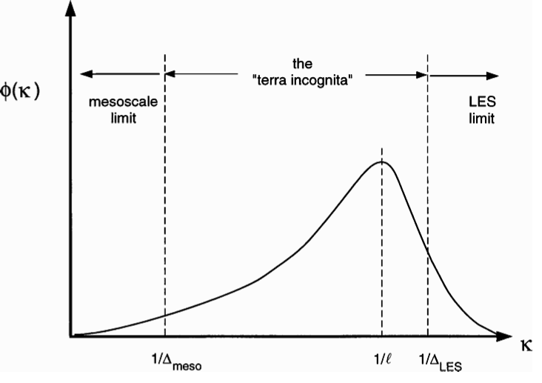
What’s the SGS model look like in the LES limit of Terra-Incognita?

Slide 9
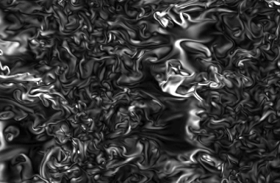
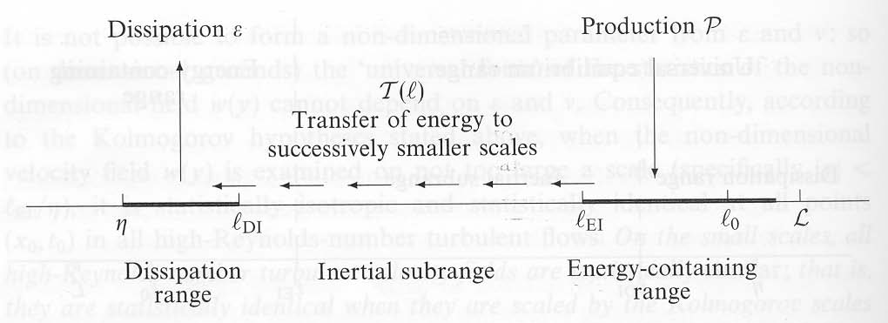
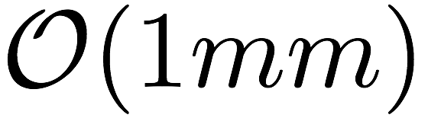
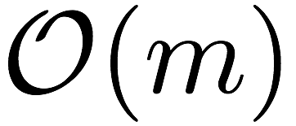

TURBULENCE ENERGY CASCADE CONCEPTS
SMALL
LARGE
Resolved scales

Slide 10
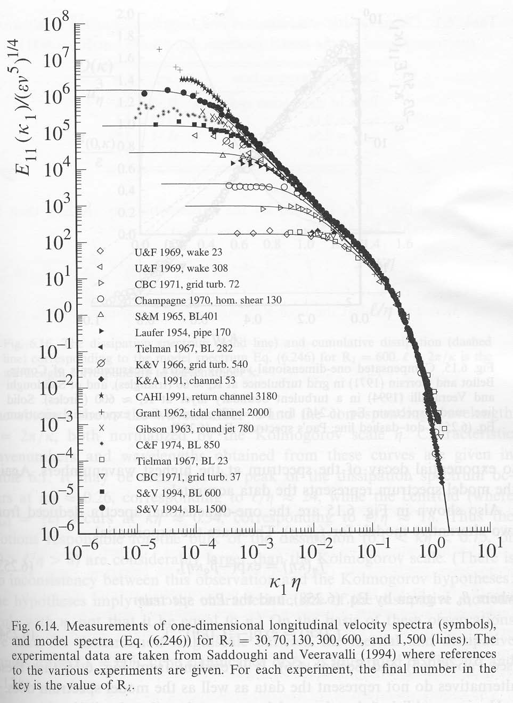
TURBULENCE ENERGY CASCADE CONCEPTS
Re
As Re increases the extent of the (universal) inertial subrange expands (Pope, 2000)

Slide 11

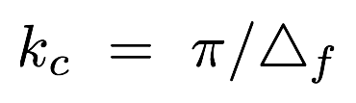

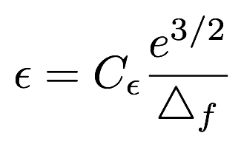
FILTERING IN THE INERTIAL RANGE
spectrum
sharp filter cutoff
subgrid-scale energy
resolved-scale energy

Slide 12
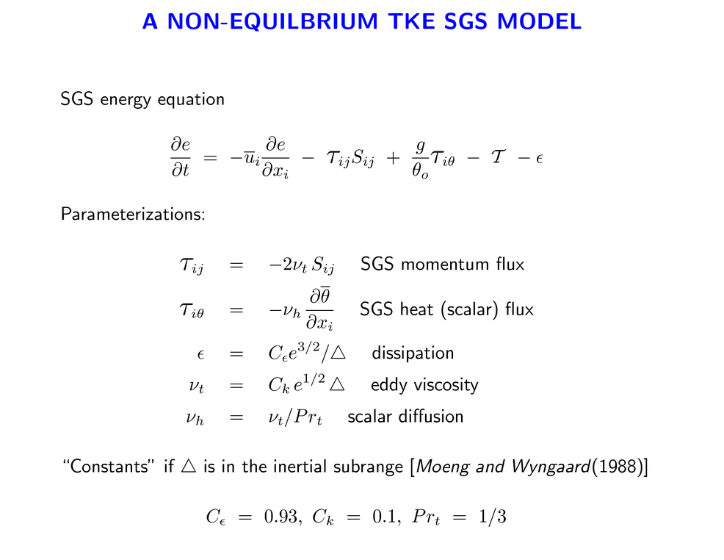
Production
Transport
Buoyancy
Model of viscous dissipation

Slide 13
“ … How do we make this all run on a modern machine?

Slide 14
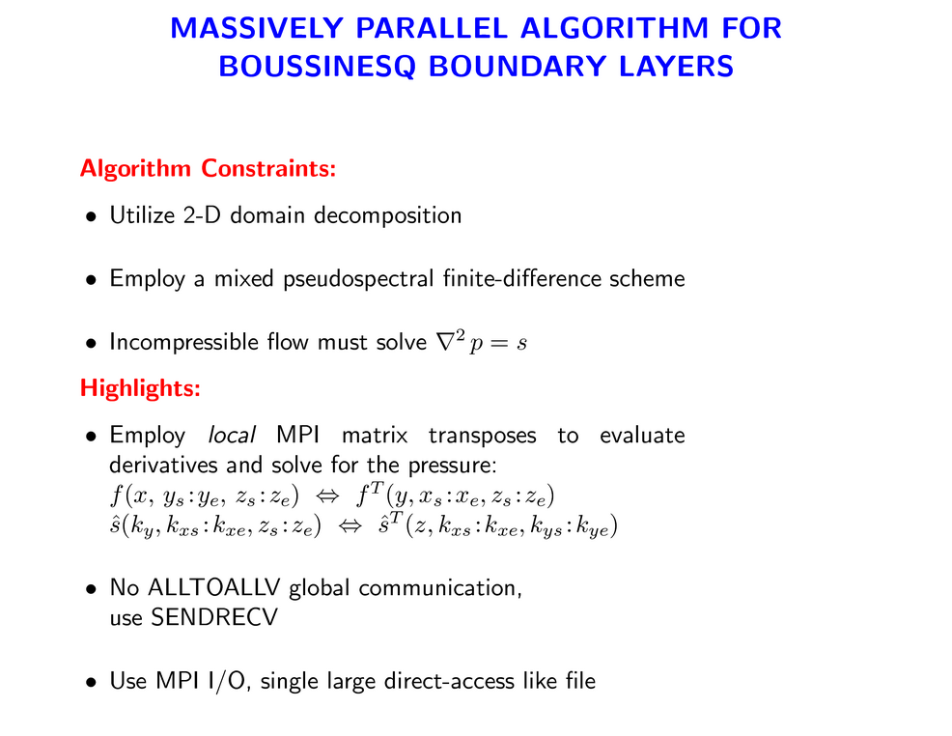
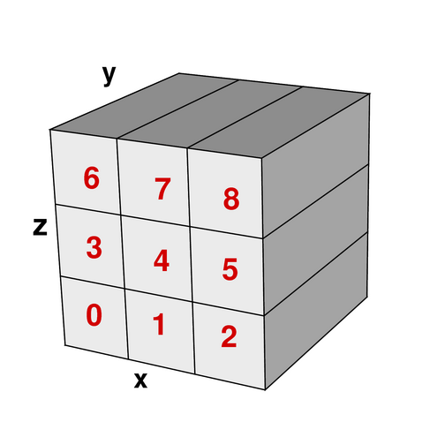
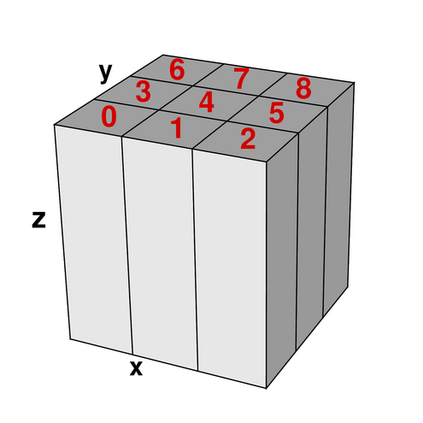
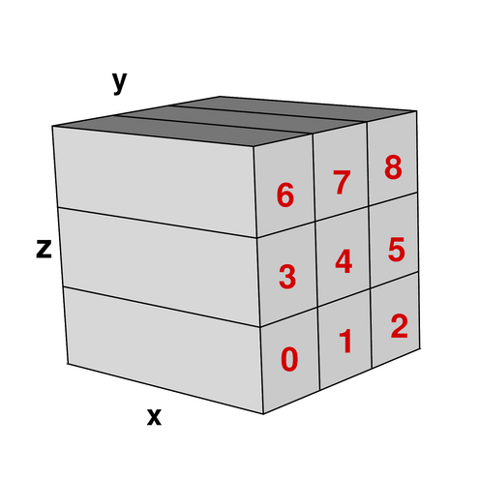

Slide 15




SCALING OF PARALLEL PSEUDOSPECTRAL ALGORITHM WITH 2D MPI DOMAIN DECOMPOSITION
Cray XT4, NERSC
XE6

Slide 16
“ … What kind of PBL problems can we do? …”

Slide 17
DO LES STATISTICS CONVERGE WITH
MESH REFINEMENT?
… OR …
HOW BIG DOES THE LARGE-EDDY REYNOLDS NUMBER NEED TO BE?

Slide 18
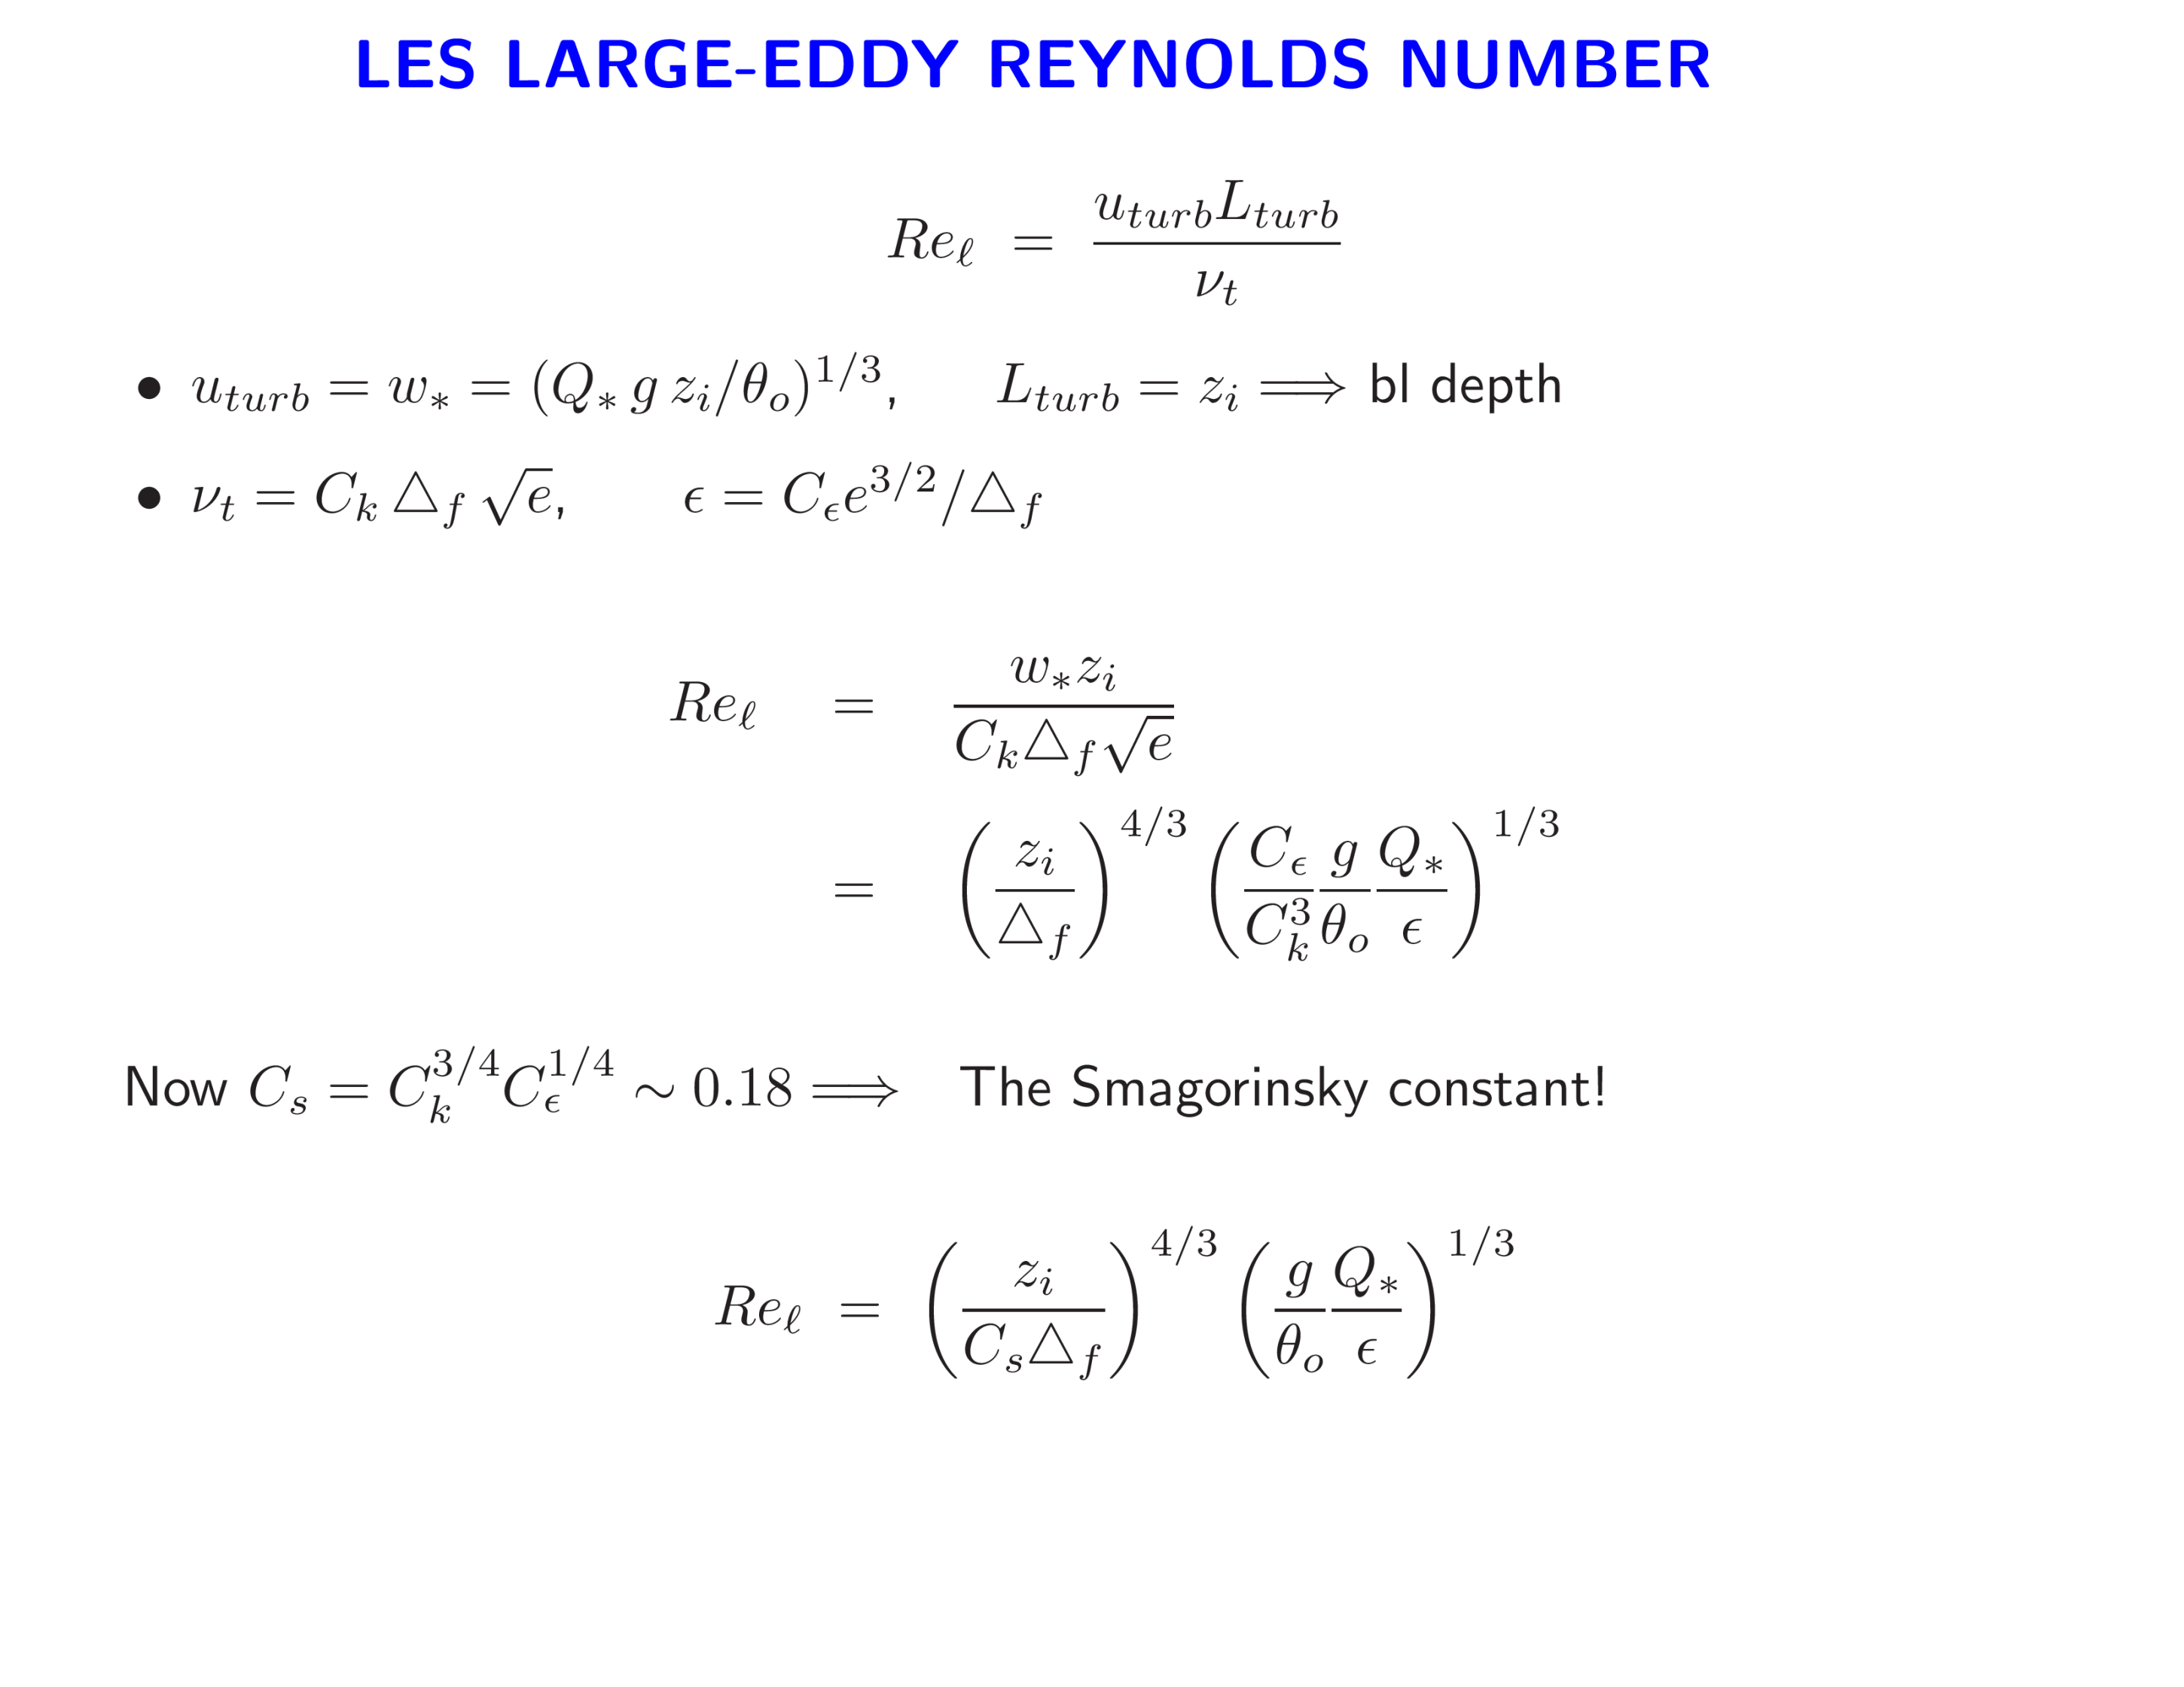

Slide 19
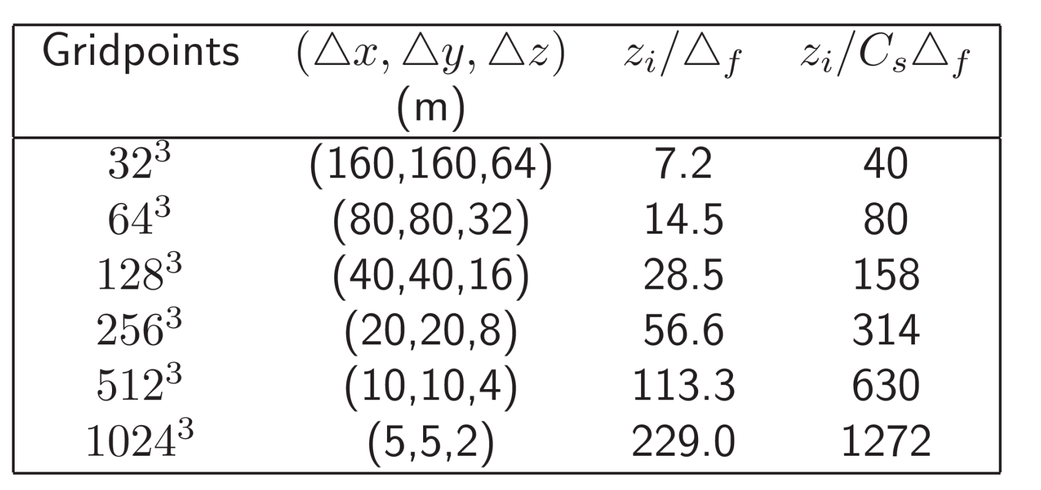
DO LES STATISTICS CONVERGE WITH MESH REFINEMENT?

Slide 20
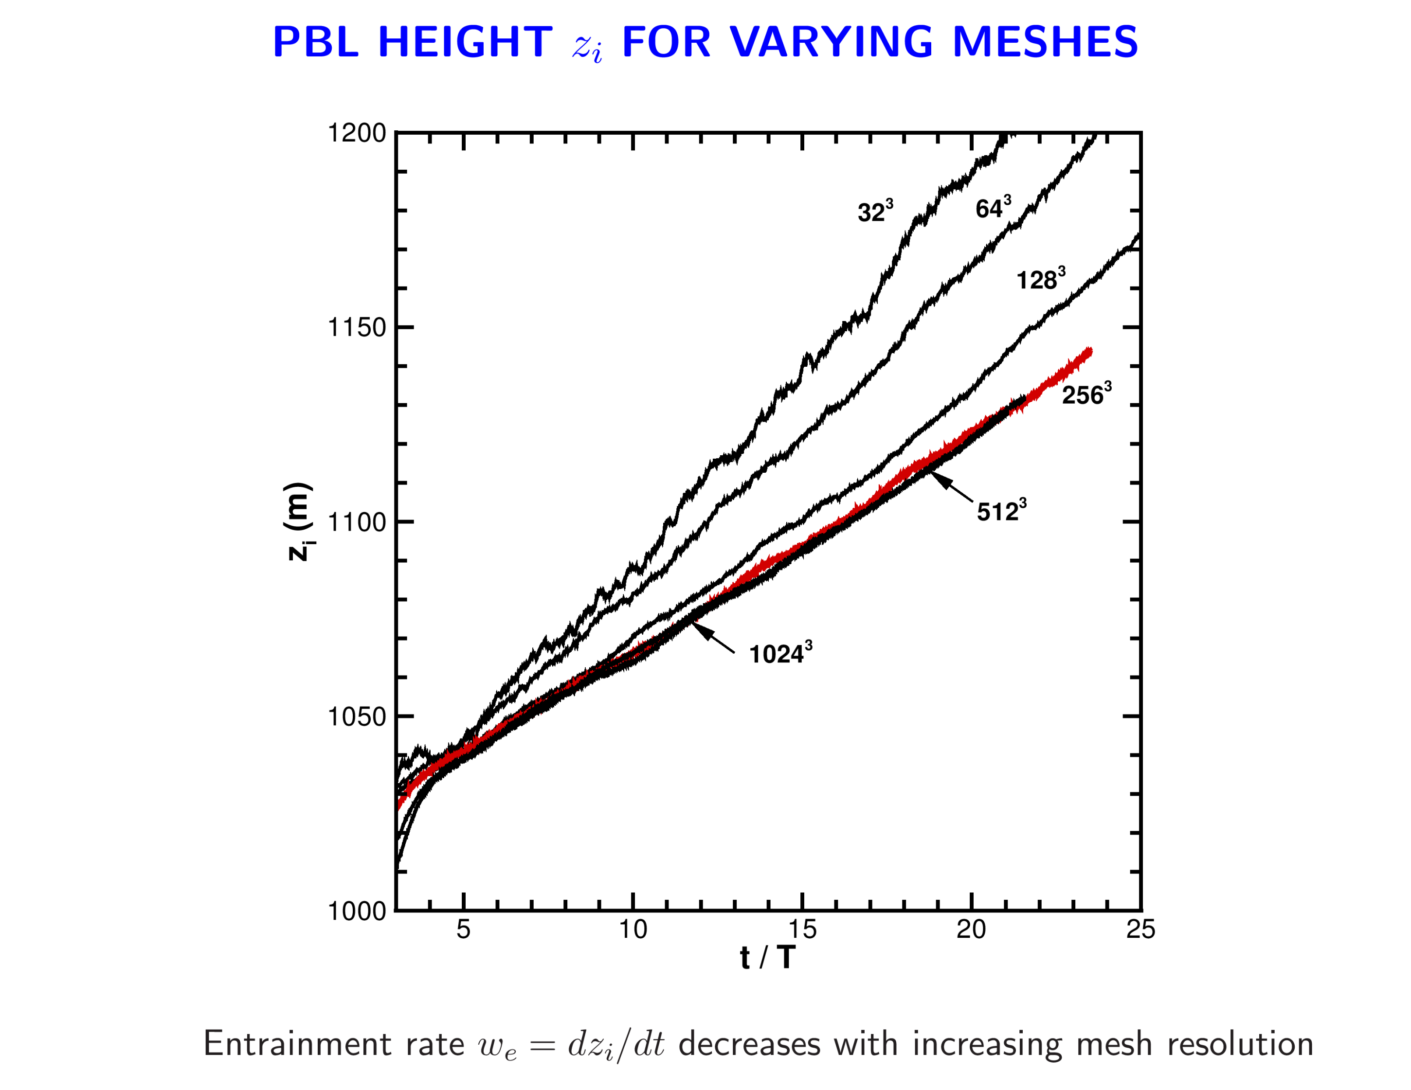


Slide 21
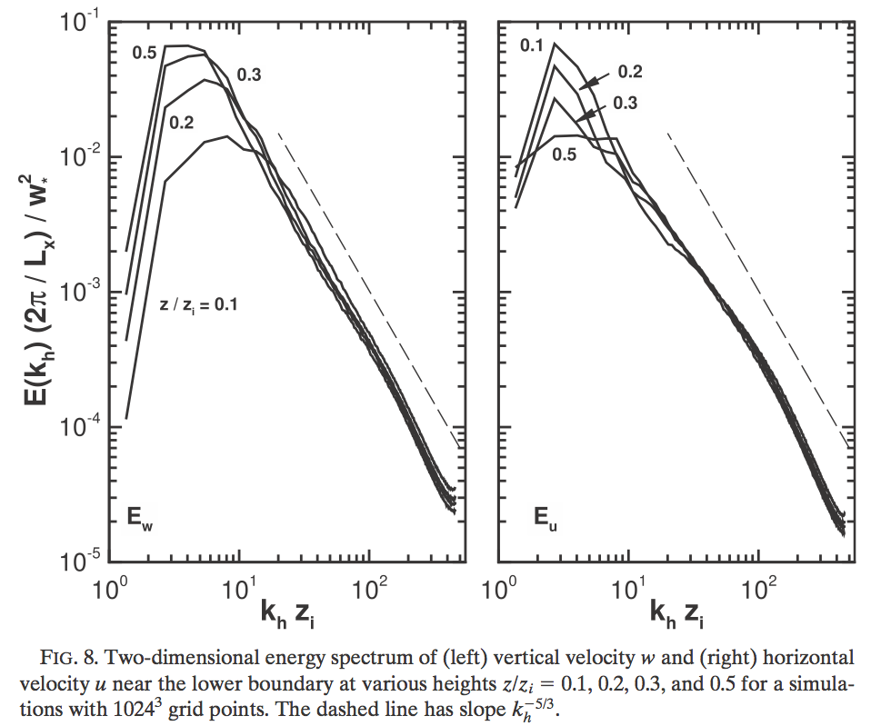
SPECTRA FROM 1024³ LES OF NEARLY FREE CONVECTIVE PBL
-5/3
-5/3

Slide 22
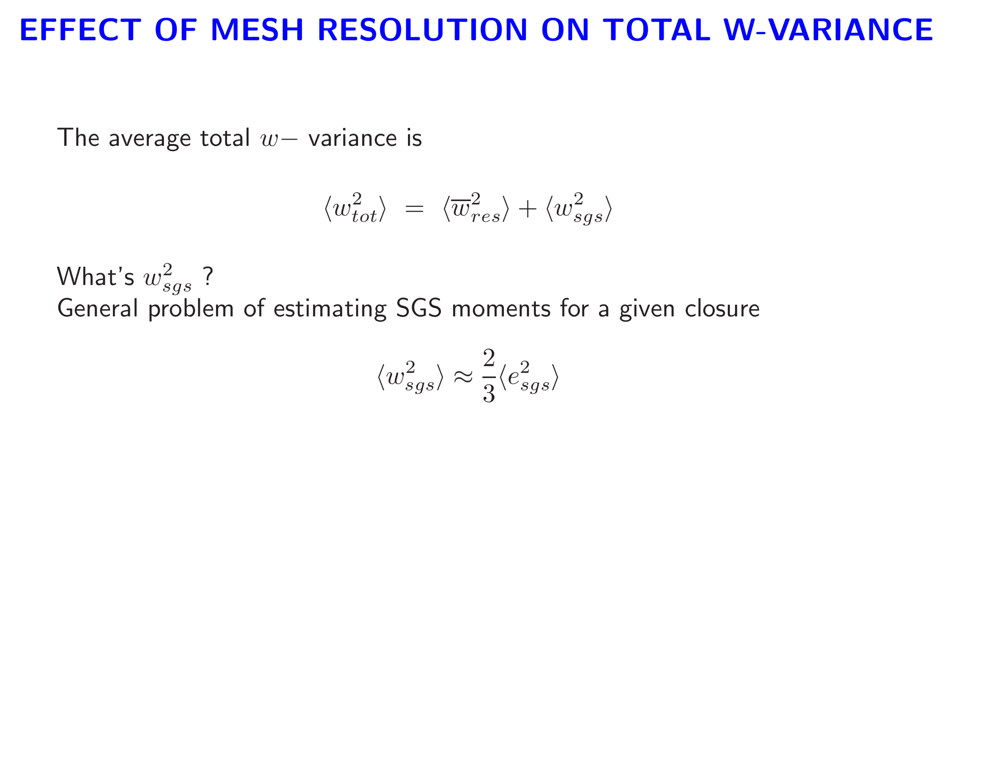

Slide 23
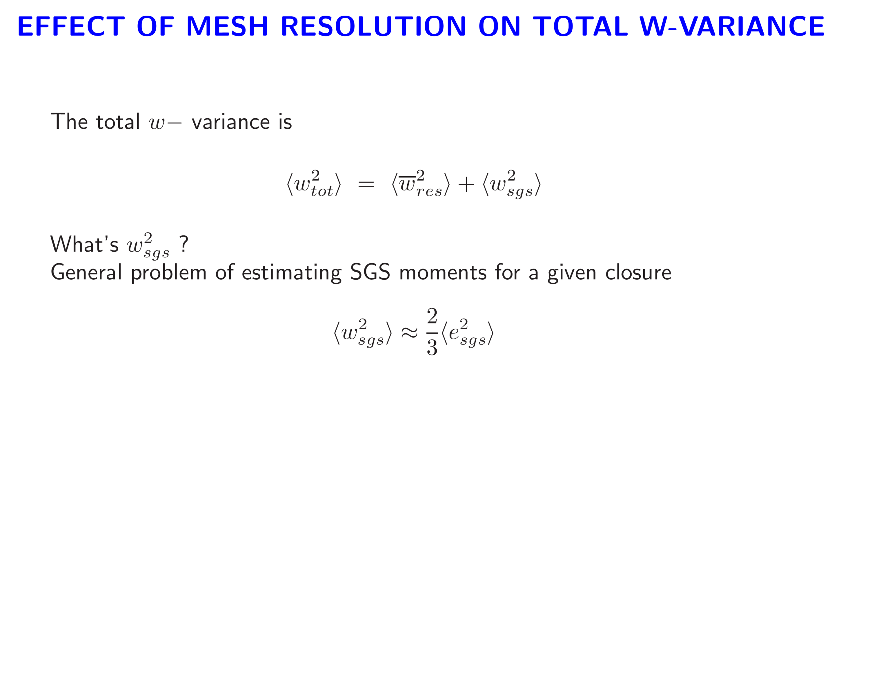
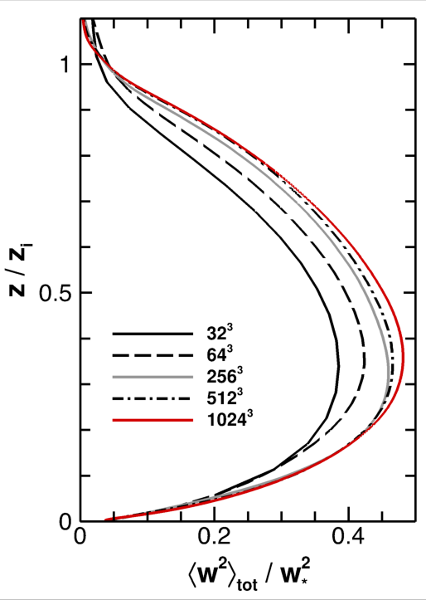
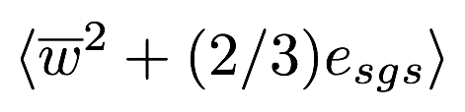

Slide 24
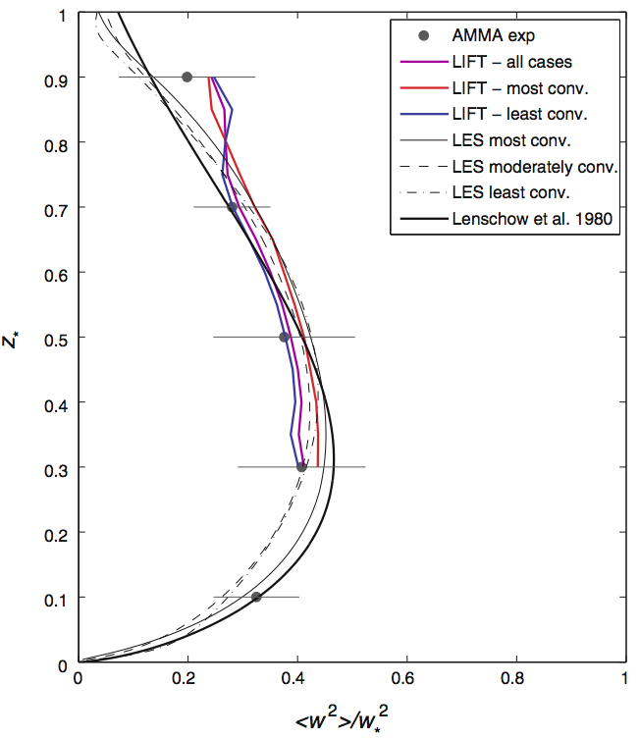
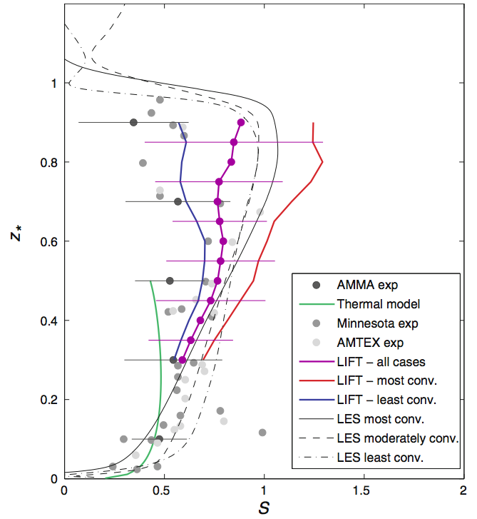
COMPARISON OF W MOMENTS FROM LES AND OBSERVATIONS Lenschow etal (2012)
512³ LES
W VARIANCE
W SKEWNESS

Slide 25
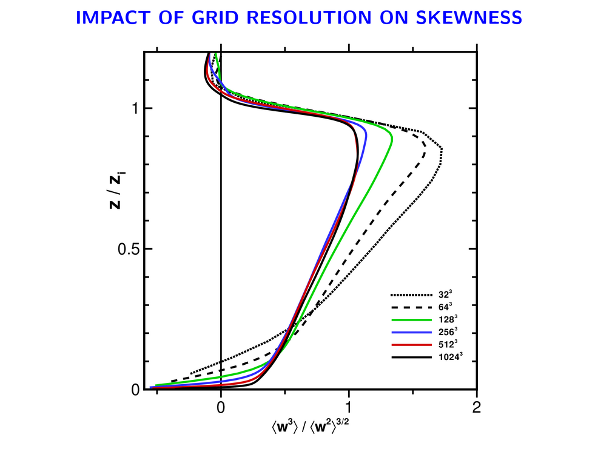
Small scales? Inversion strength? SGS model?
Notes:
25

Slide 26
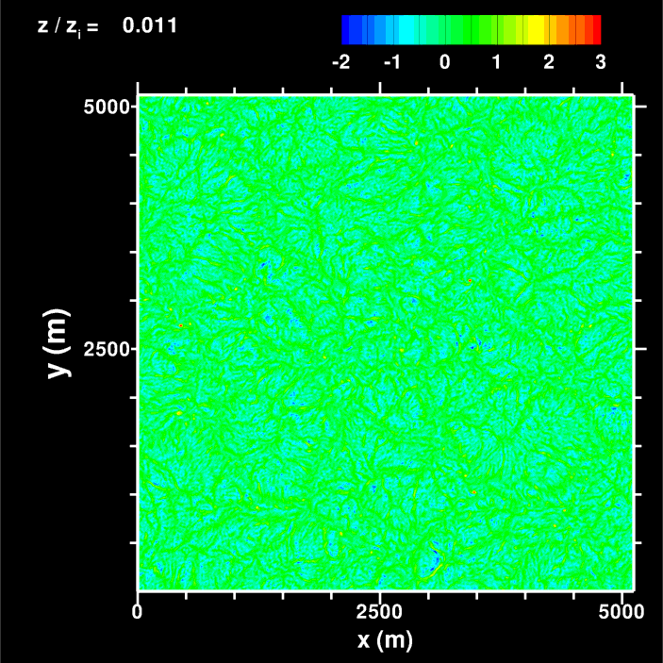


FREE CONVECTION 512³ W-FIELD

Slide 27
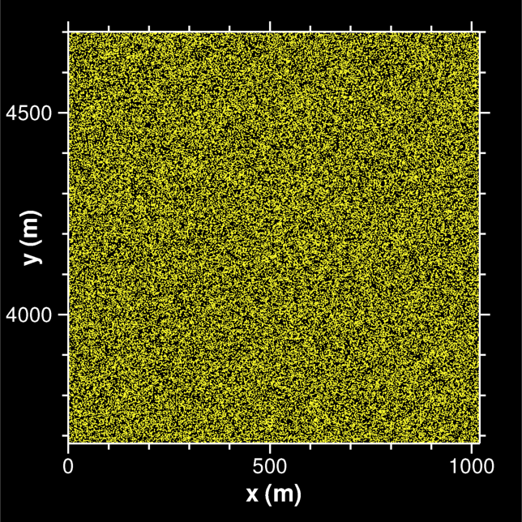
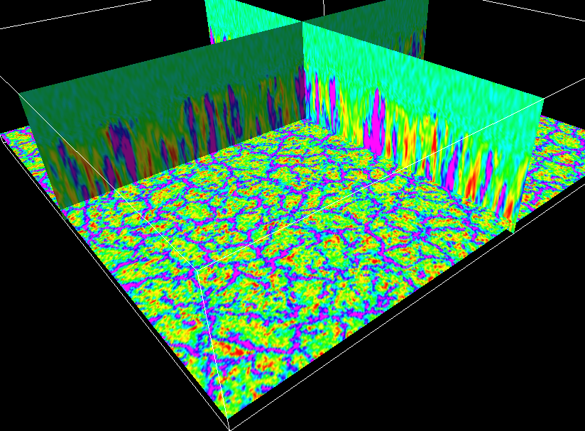
LES OF CONVECTIVE PBL, 4096 CPUS, 1024³ GRIDPOINTS

Slide 28
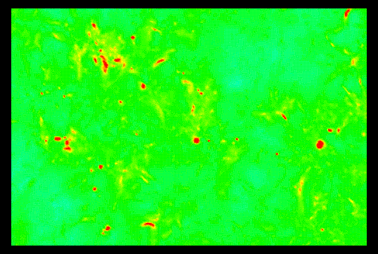
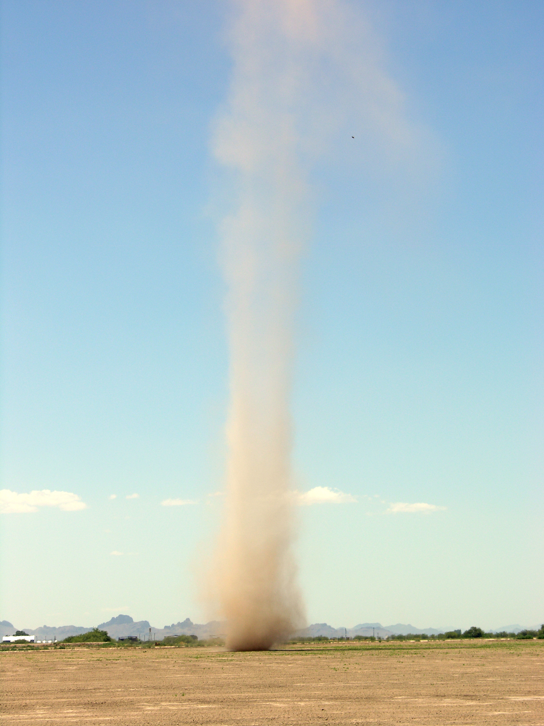


TEMPORAL EVOLUTION OF VORTICES IDENTIFIED BY LOW (NEGATIVE) PRESSURE
Dust devil image courtesy NASA

Slide 29
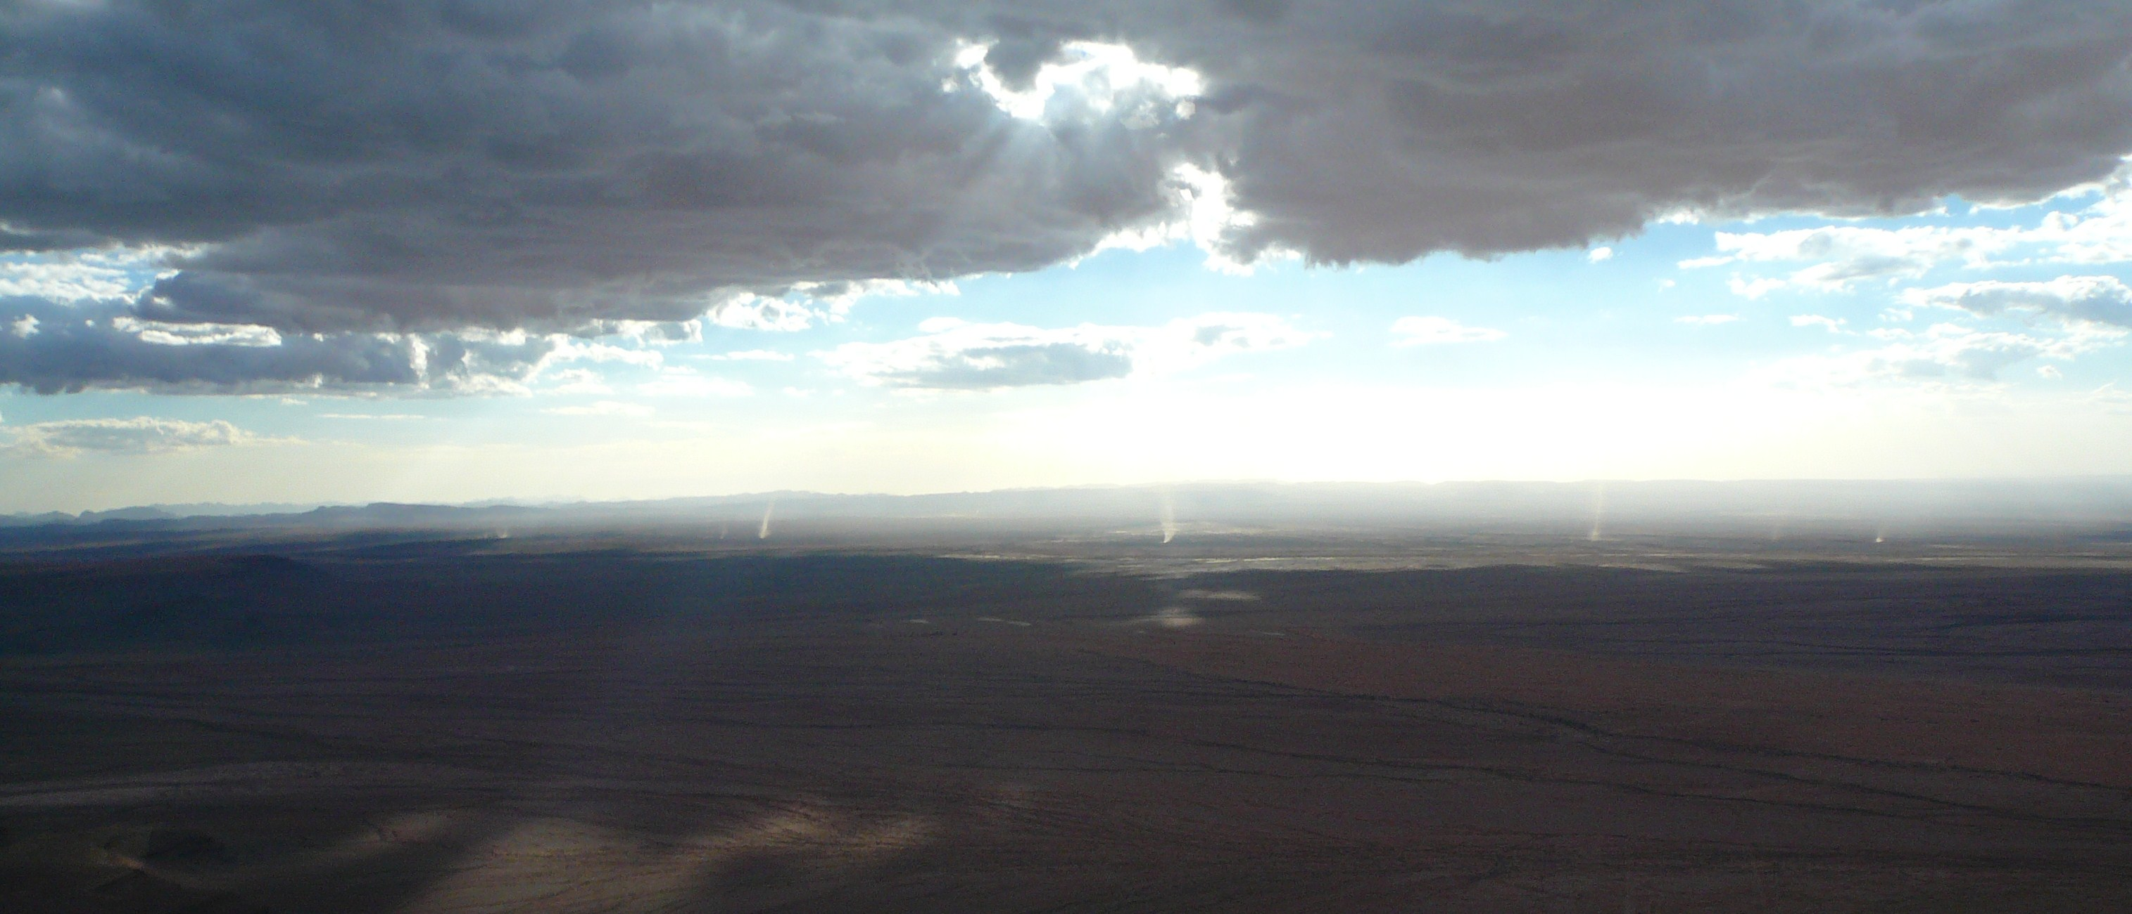
DUST DEVILS in TALAMAKAN DESERT OF CHINA Courtesy of Don Lenschow NCAR

Slide 30
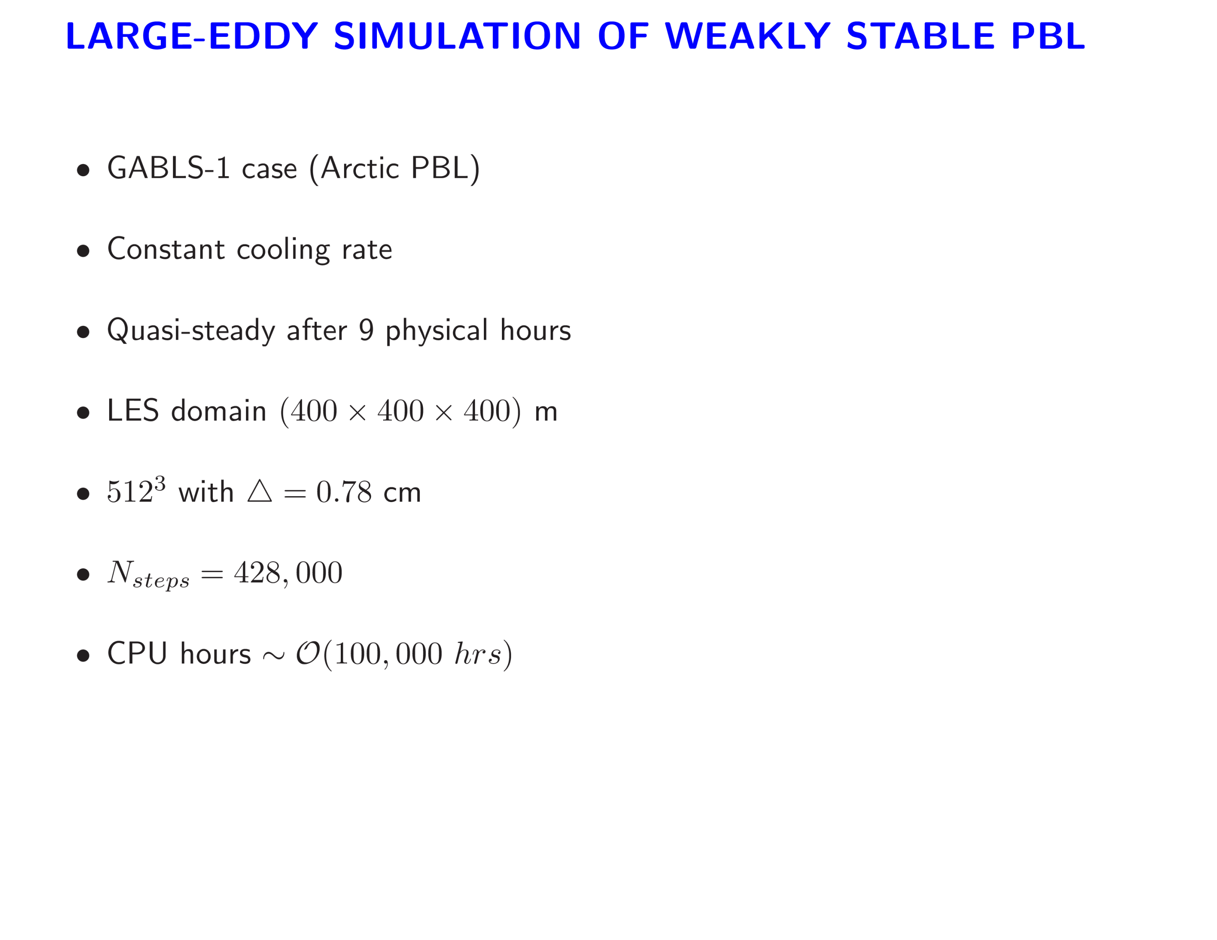

Slide 31
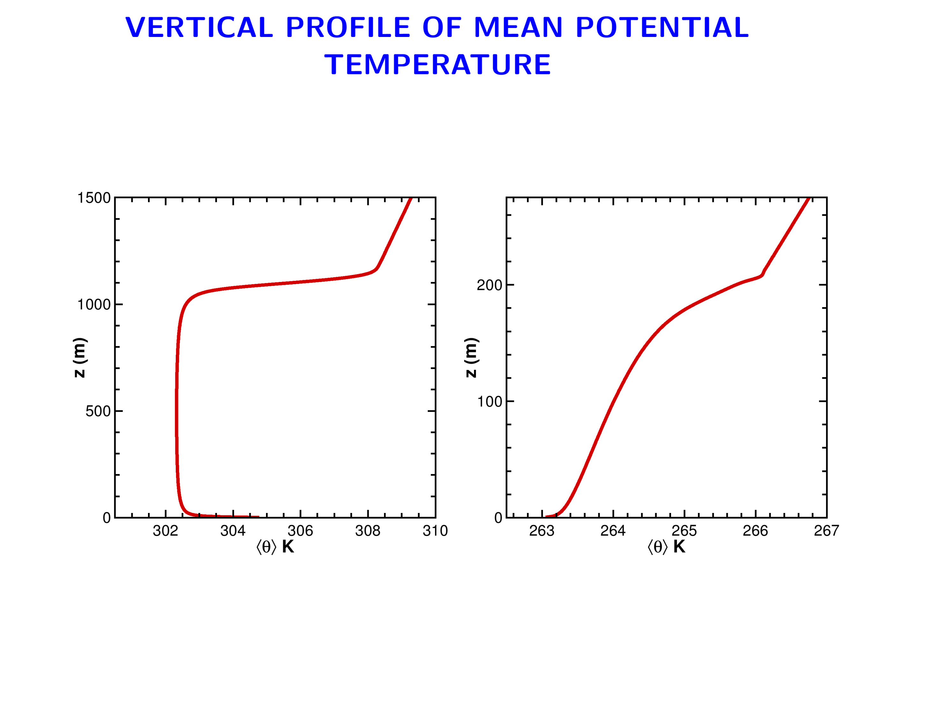
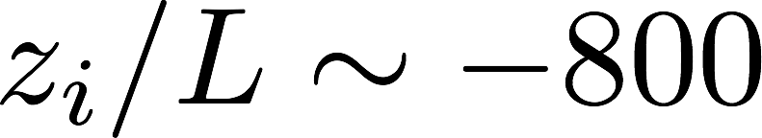
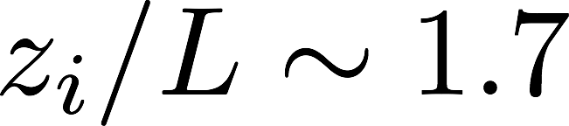
Convective
Stable

Slide 32
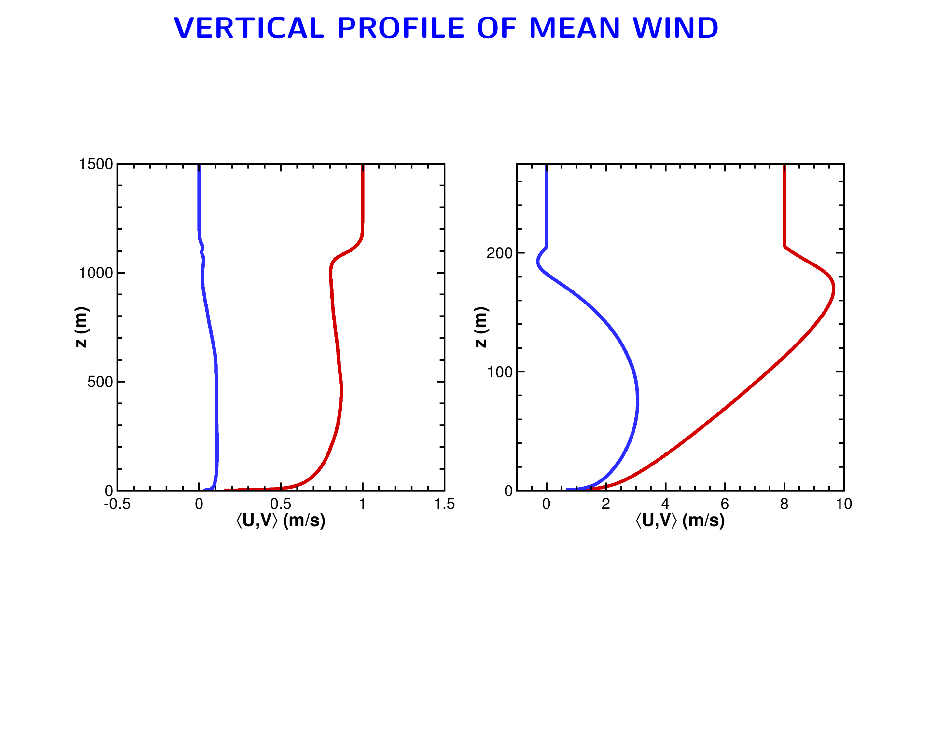
V
U
V
U
Convective
Stable

Slide 33
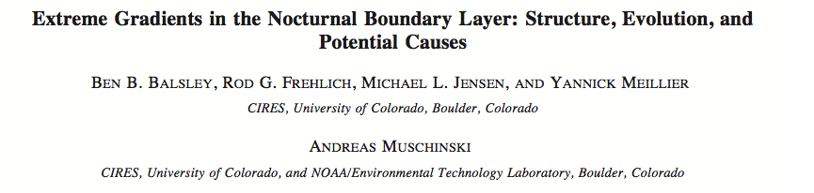
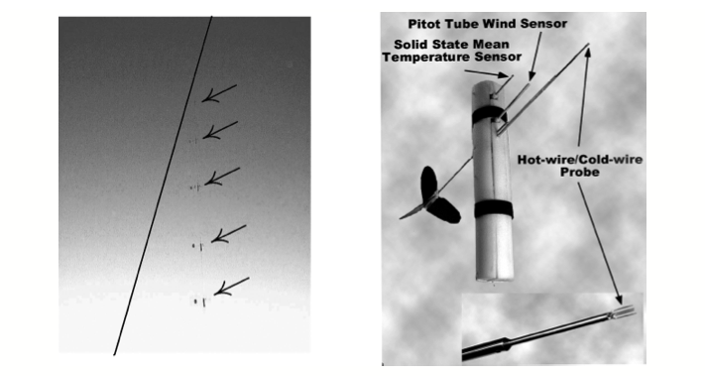

Slide 34
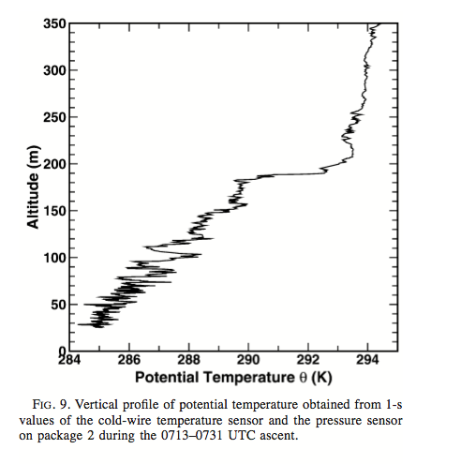

Slide 35
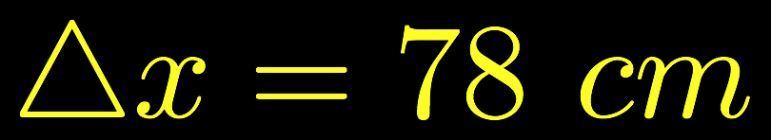
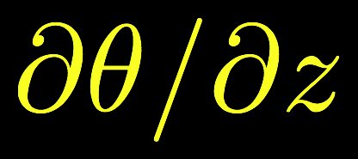
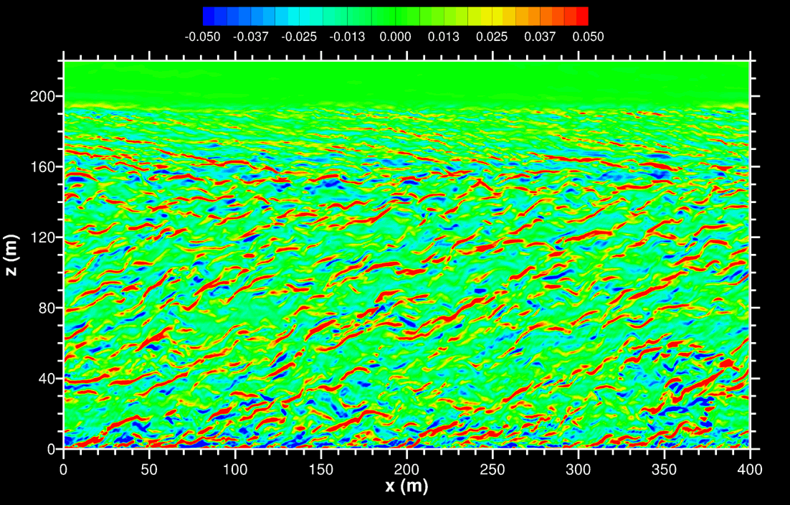
FLOW STRUCTURES IN STABLE PBL FROM 512³ LES
LLJ

Slide 36
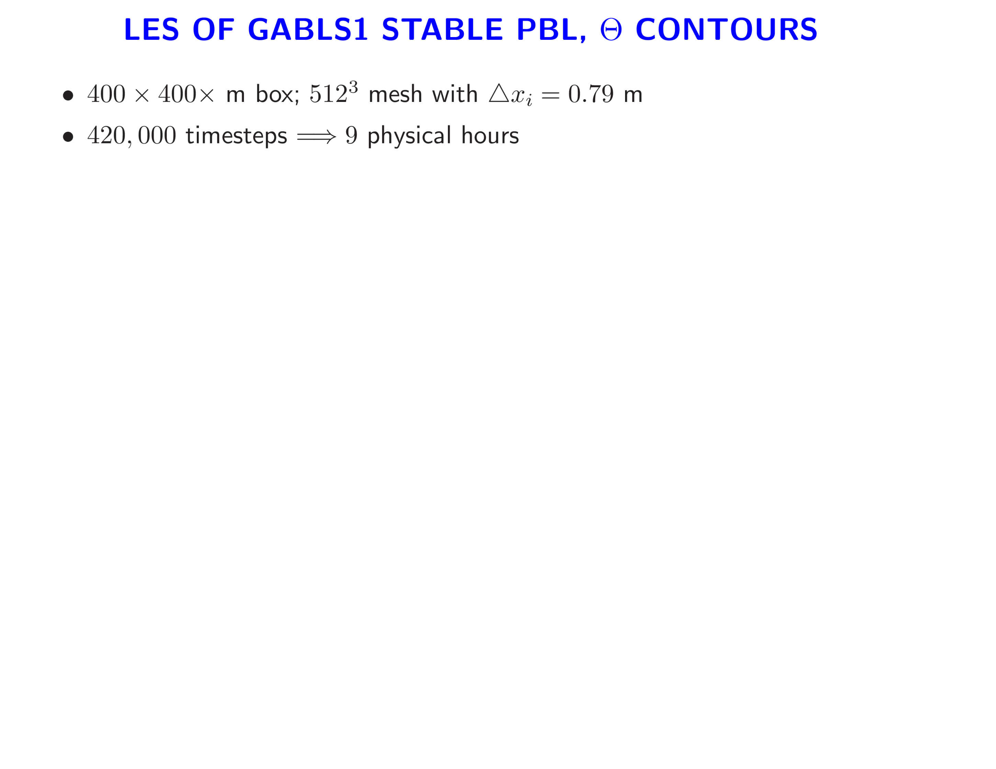
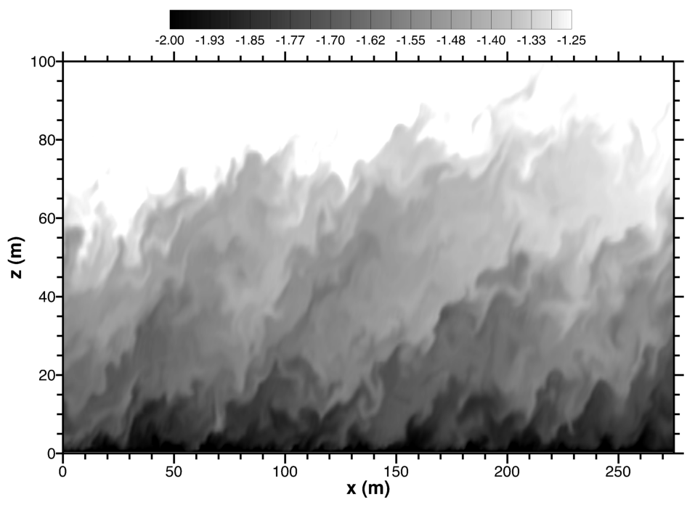

Slide 37
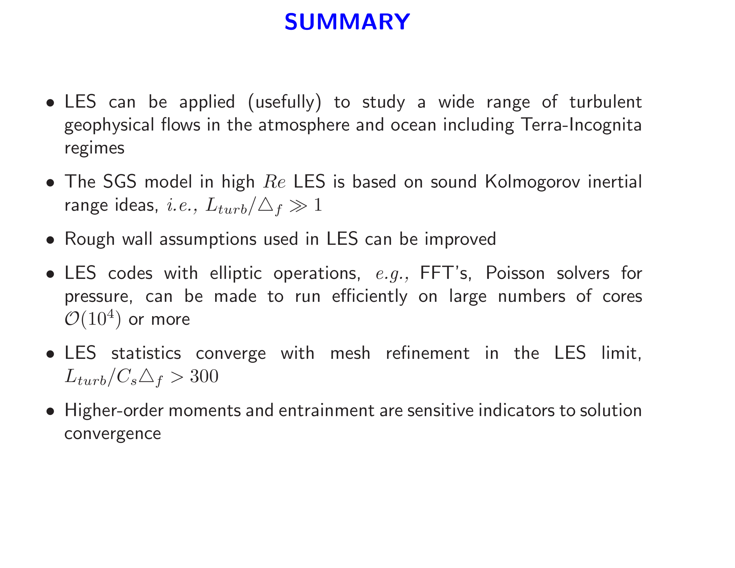

Slide 38

LOW LEVEL FLIGHT IN HURRICANE ISABEL

Slide 39

CBLAST HURRICANE FRANCES SST CHANGE “COLD WAKE”
Courtesy Eric D’Asaro (U. Wash.)

Slide 40


Hurricane Frances winds
LHS
X = -60km
RHS
X = 60km
LES domains

Slide 41

VERTICAL VELOCITY ON RHS
RIGHT
-2.5 m
-187
750 m
1024x1024x256, 70 hours

Slide 42

Non-resonant no waves
Non-resonant waves
Resonant no waves
Resonant with waves

Slide 44

360,000 core-hrs

Slide 45
Daytime Convective BL
DO LES STATISTICS CONVERGE WITH
MESH REFINEMENT?
… OR …
HOW BIG DOES THE LARGE-EDDY REYNOLDS NUMBER NEED TO BE?
8 am
Local time
Noon

Slide 46







DO LES STATISTICS CONVERGE WITH MESH REFINEMENT?
Large eddy Reynolds number
Dissipation
Notes:
46

Slide 47


Slide 48


