Slide 1
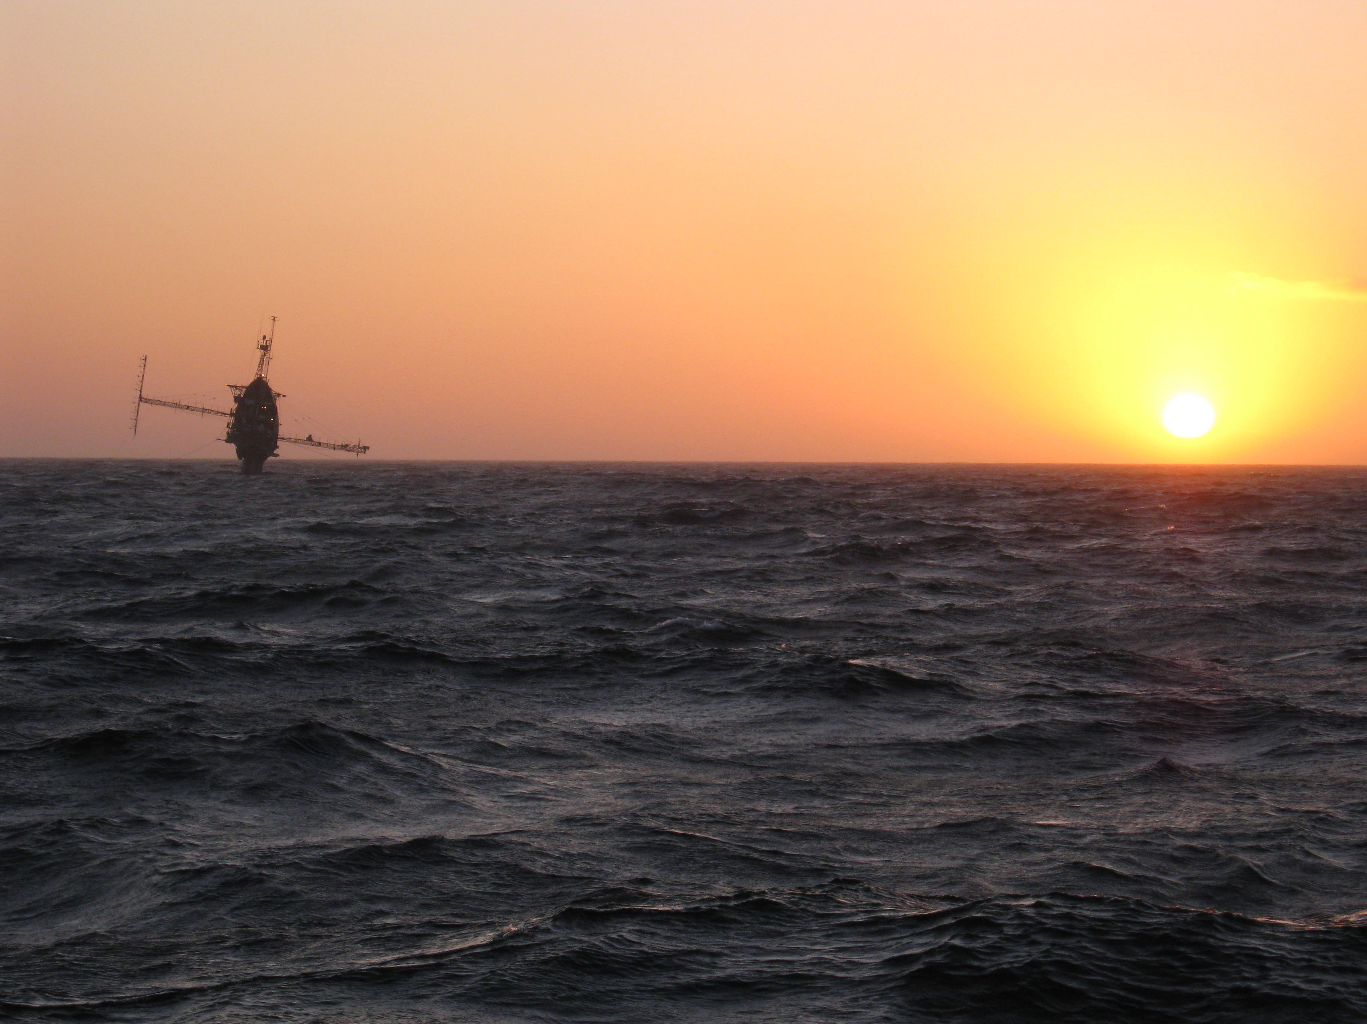
A LARGE EDDY SIMULATION PERSPECTIVE OF TERRA-INCOGNITA
1. An introduction to Terra-Incognita
2. Rough wall SGS dynamics and Terra-Incognita
3. Large-eddy simulation (LES)
4. A potpourri of LES with complex boundaries

Slide 2
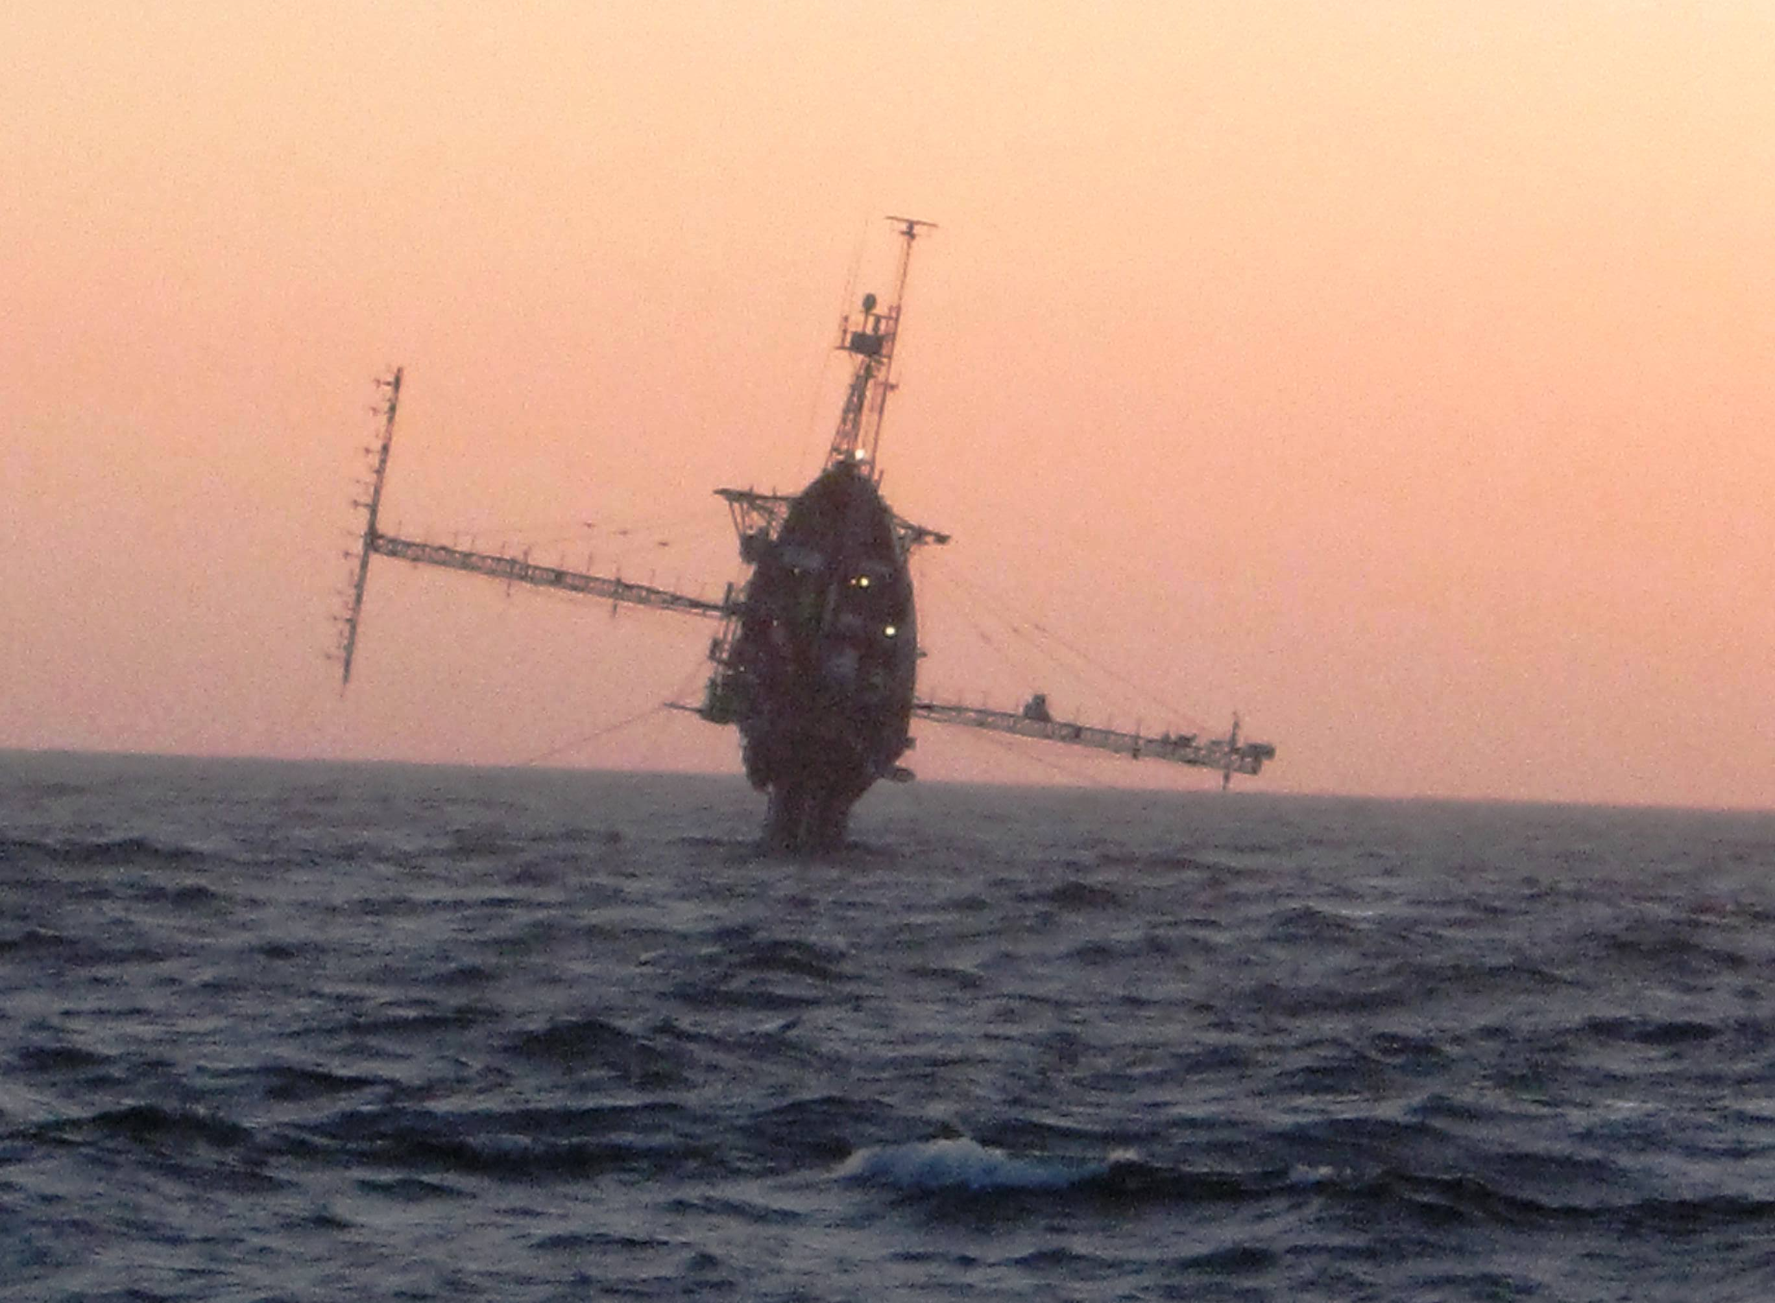
Eric Terrill, Scripps Institute of Oceanography

Slide 3
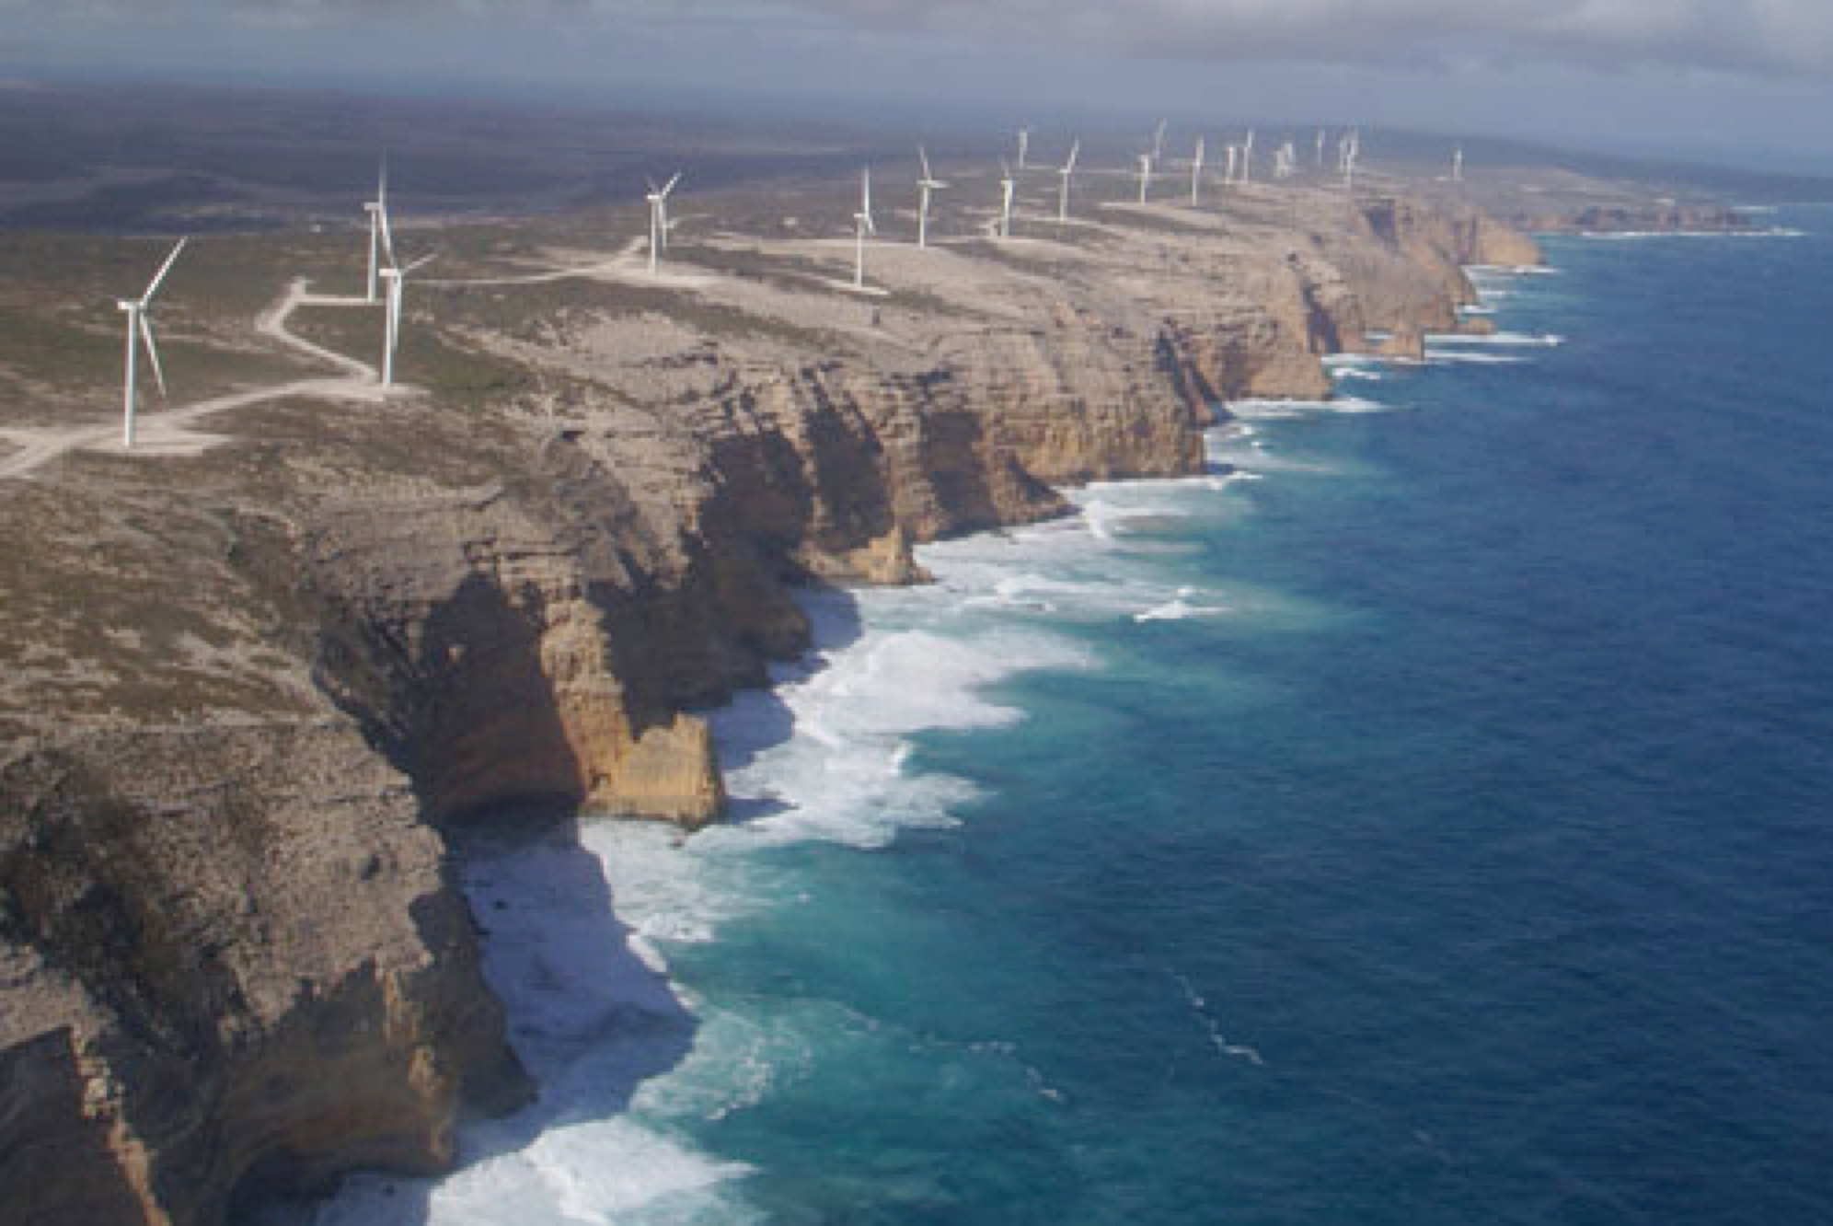
Cathedral Rocks, AU
Notes:
Start of the talk

Slide 4
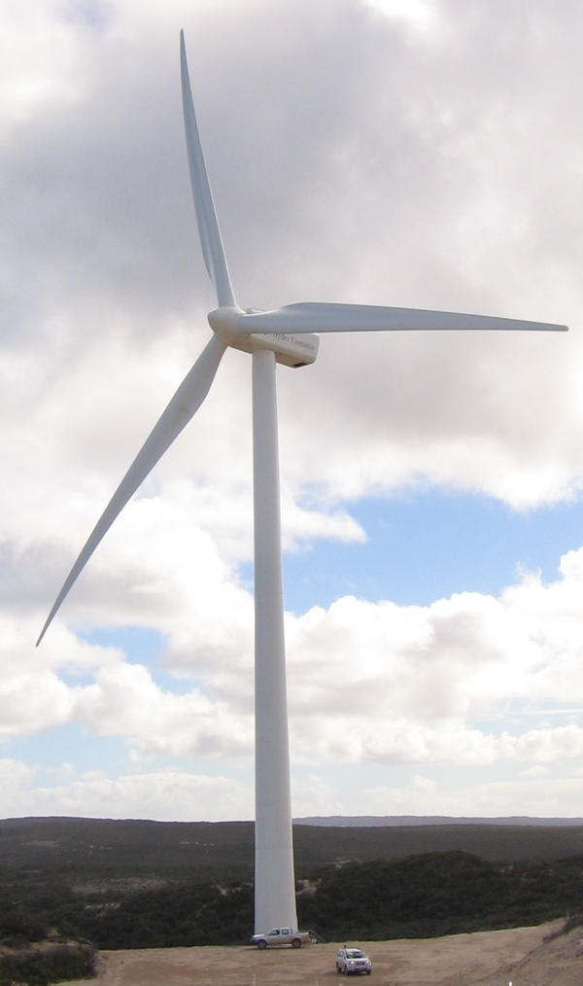
A MOTIVATION FOR OROGRAPHY AND TURBULENCE
40 m
~150 m
60 m
$100M wind park, 33 turbines
Extensive downtime due to wind gusts (turbulence)
Poor site
Notes:
Hub height 60m. Blade diameter 80m. Turbines are Vestas 2MW
Height of escarpment ~150m at the highest point.
33 turbines in farm

Slide 5
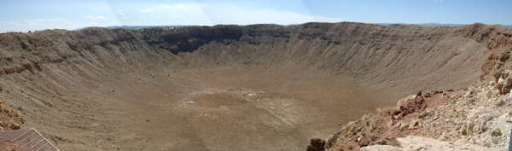
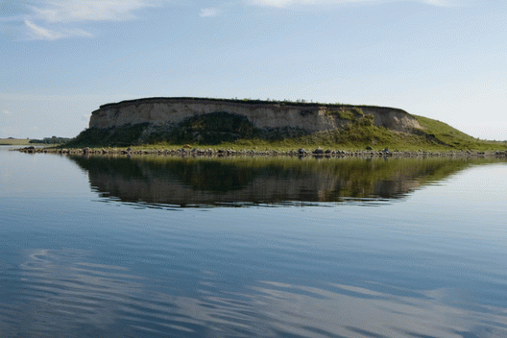
LES OF ABLs WITH COMPLEX TERRAIN AND STABLE STRATIFICATION
METCRAX is investigating the structure and evolution of cold-air pools and stable BLs that form in basins and valleys.
Bolund is a combined measurement and modeling project related to wind energy in complex terrain. An isolated steep hill, Bolund, at Roskilde Fjord will be equipped with nine measurement masts with conventional meteorological instruments and remote sensing Lidars at several positions for obtaining detailed information of mean wind, wind shear, turbulence intensities etc.

Slide 6
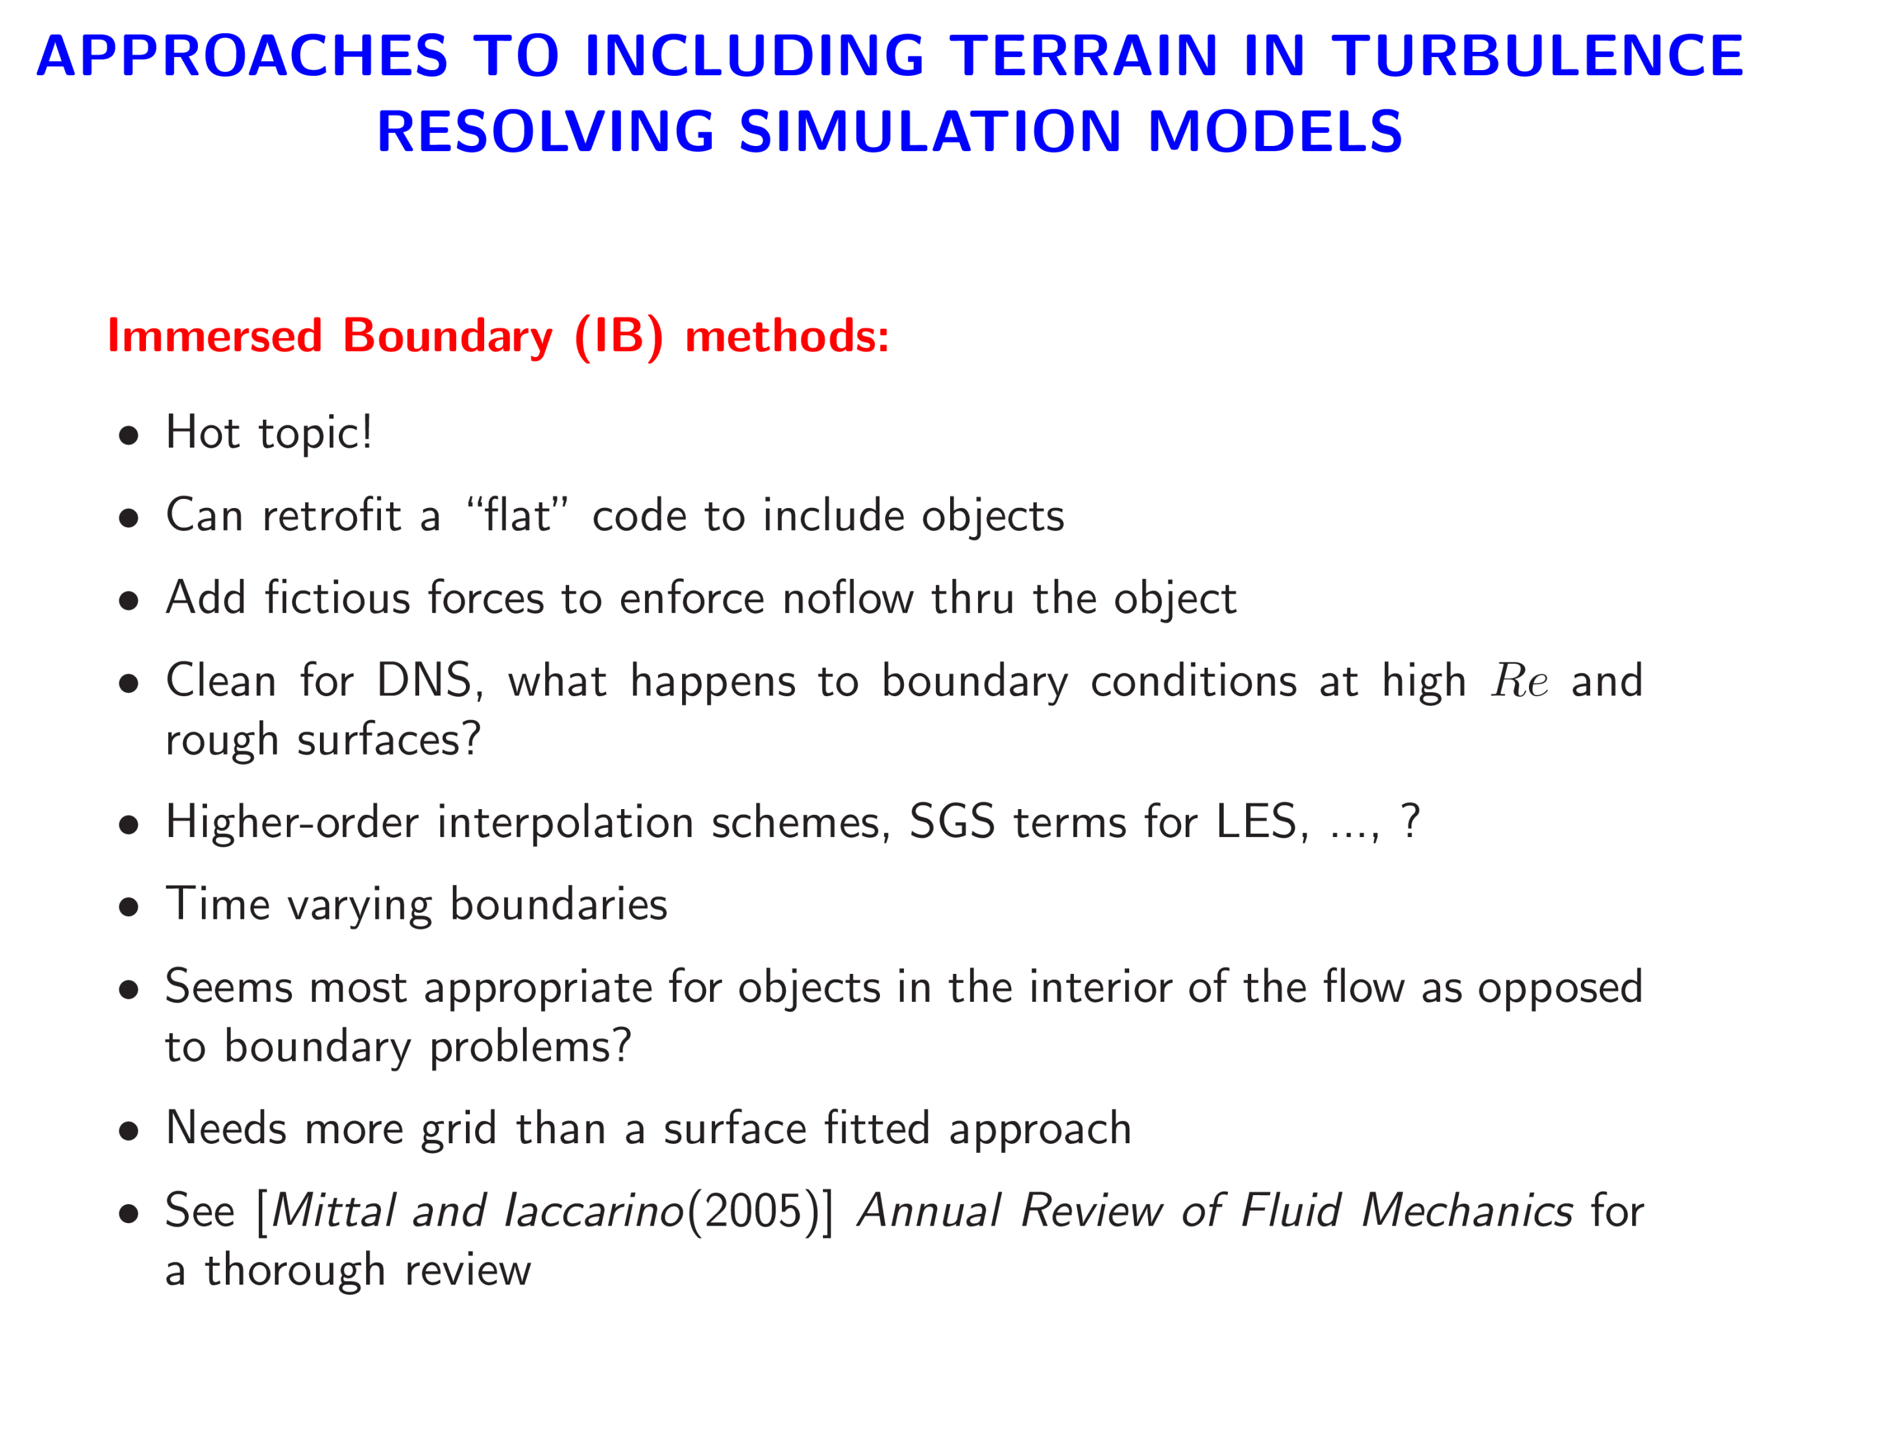

Slide 7
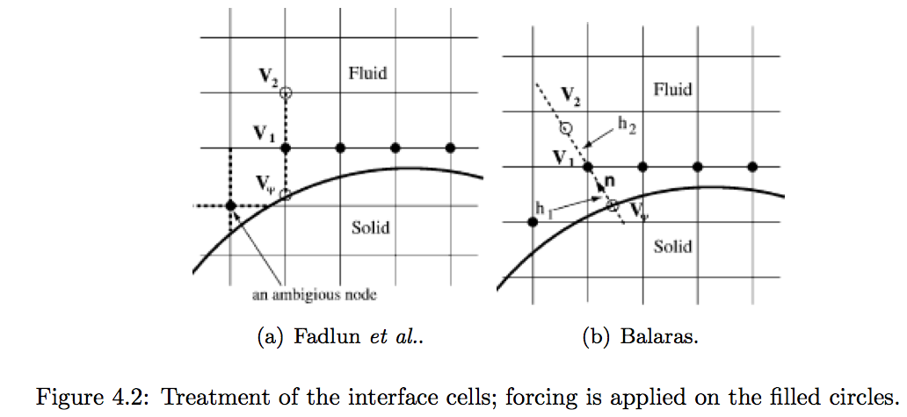

Slide 8
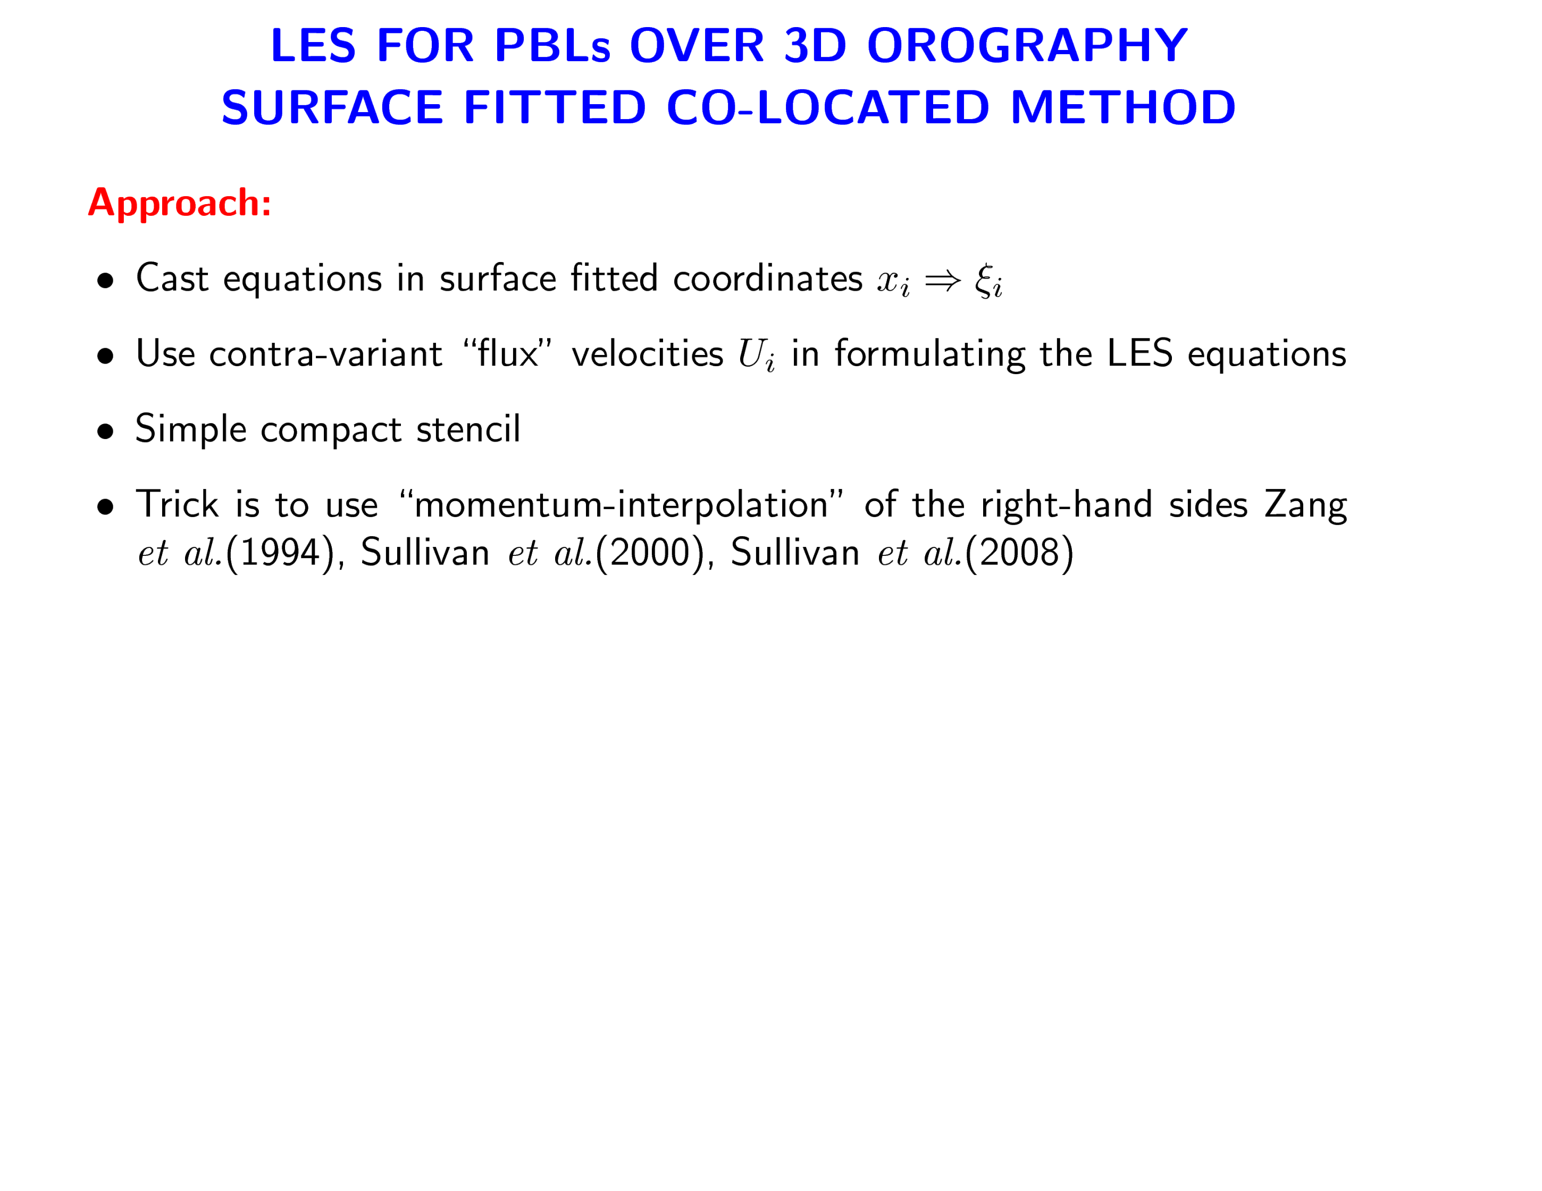
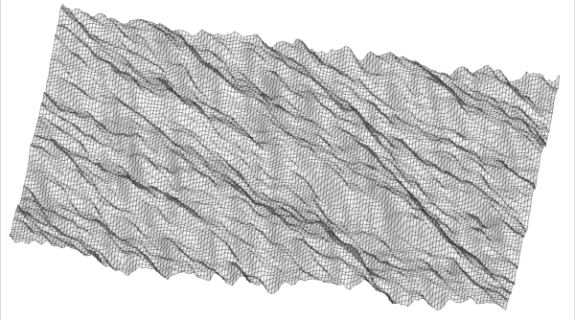

Slide 9






Computational space
Physical space
1-to-1 mapping
is the Jacobian of the transformation
Transform just the coordinates
Fundamental unknowns are Cartesian velocity components u_{i}

Slide 10
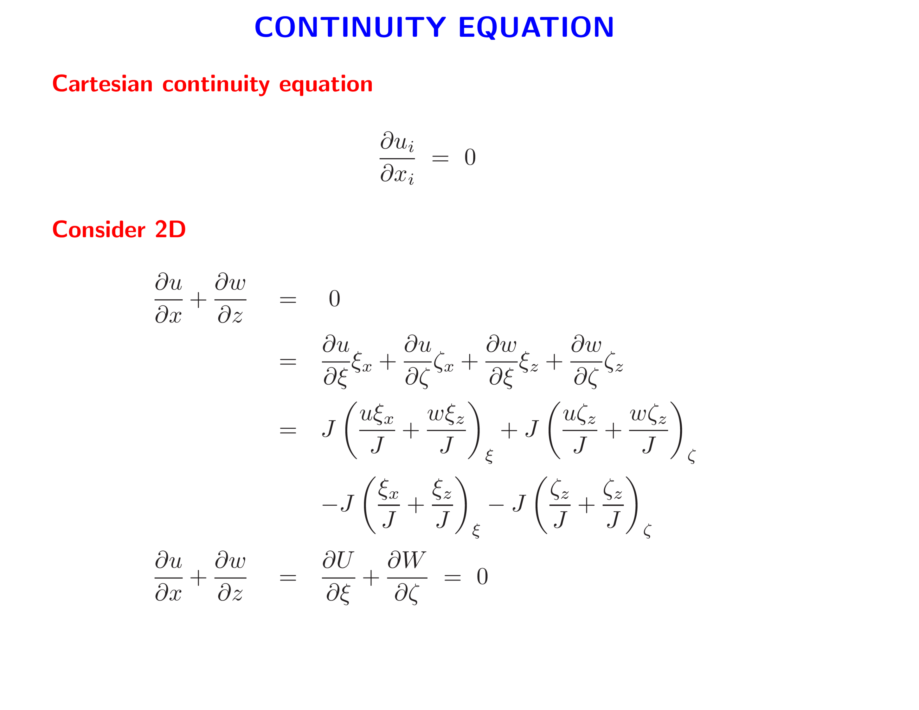

Slide 11
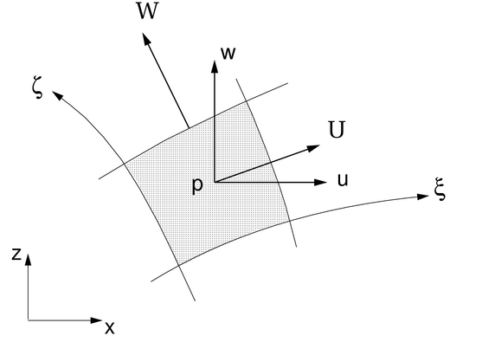

z
w
p
u
w
x
Vertically staggered scheme
Co-located scheme

Slide 12
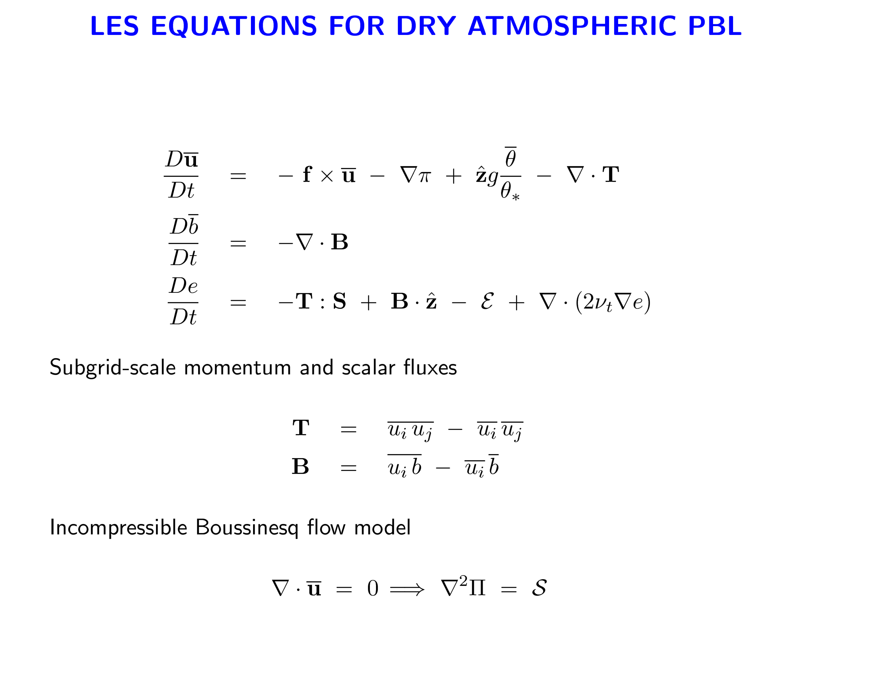
Momentum
Scalar
TKE

Slide 13
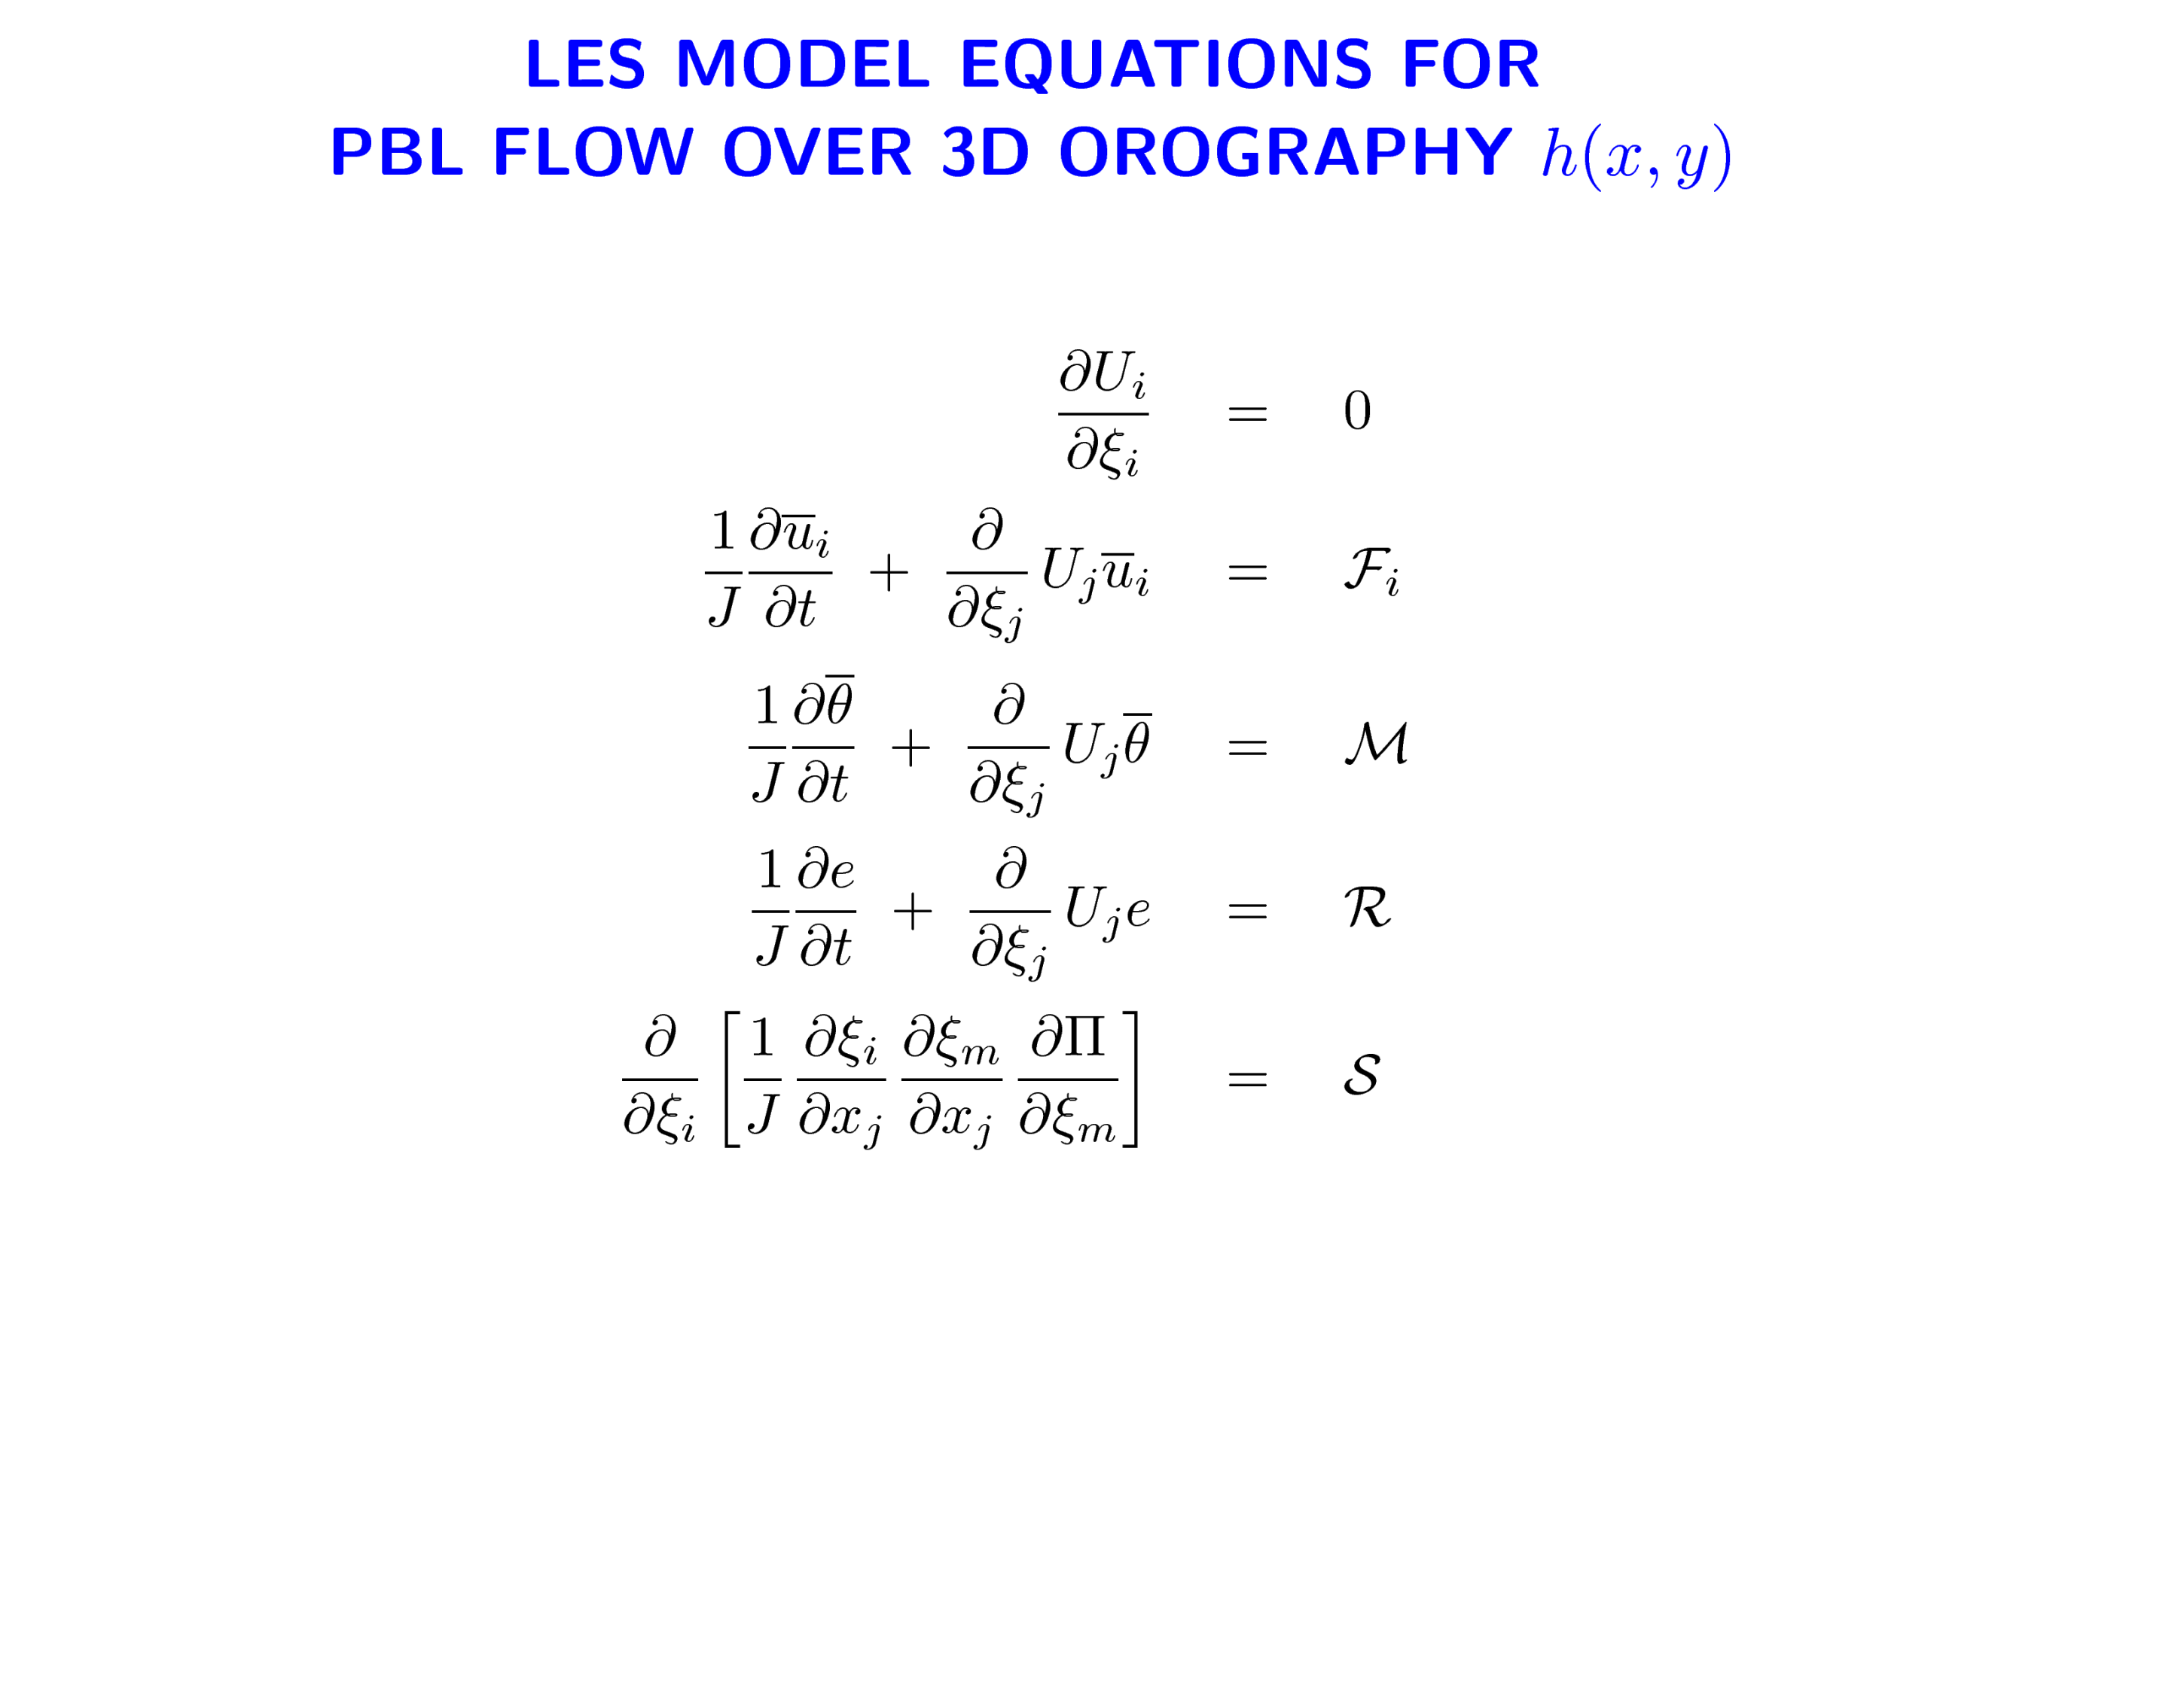
Continuity
Momentum
Scalar (temperature)
SGS energy
Pressure equation
Plus rough wall z_{o} boundary conditions

Slide 14
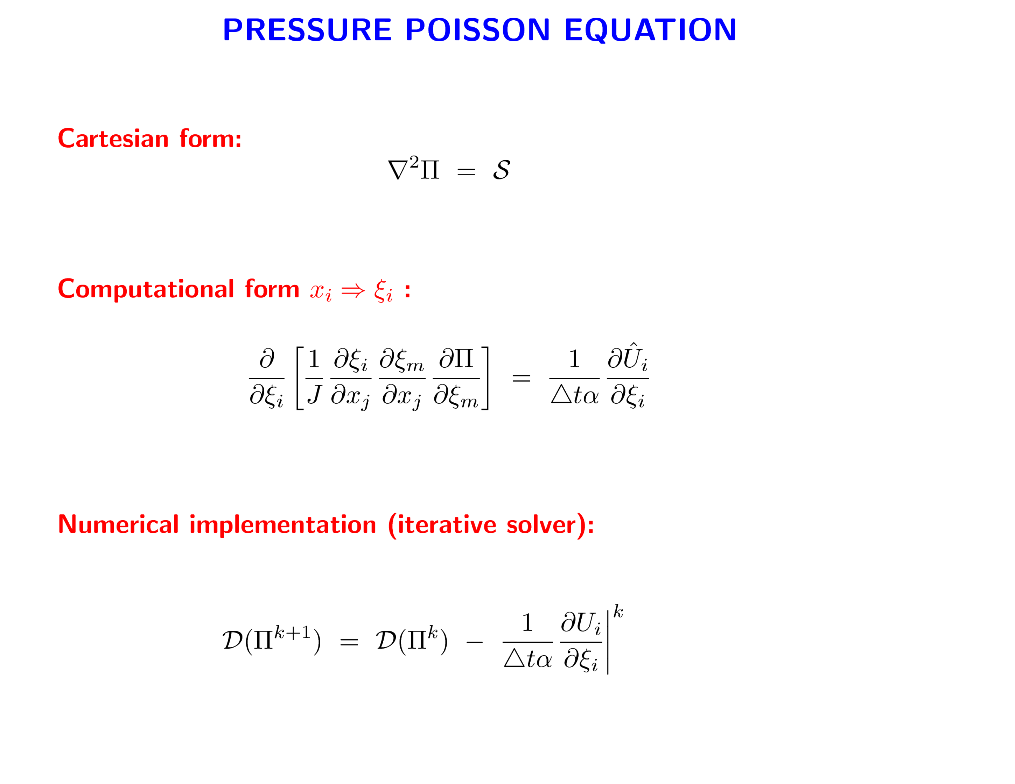
Continuity
Diagonal preconditioning matrix

Slide 15
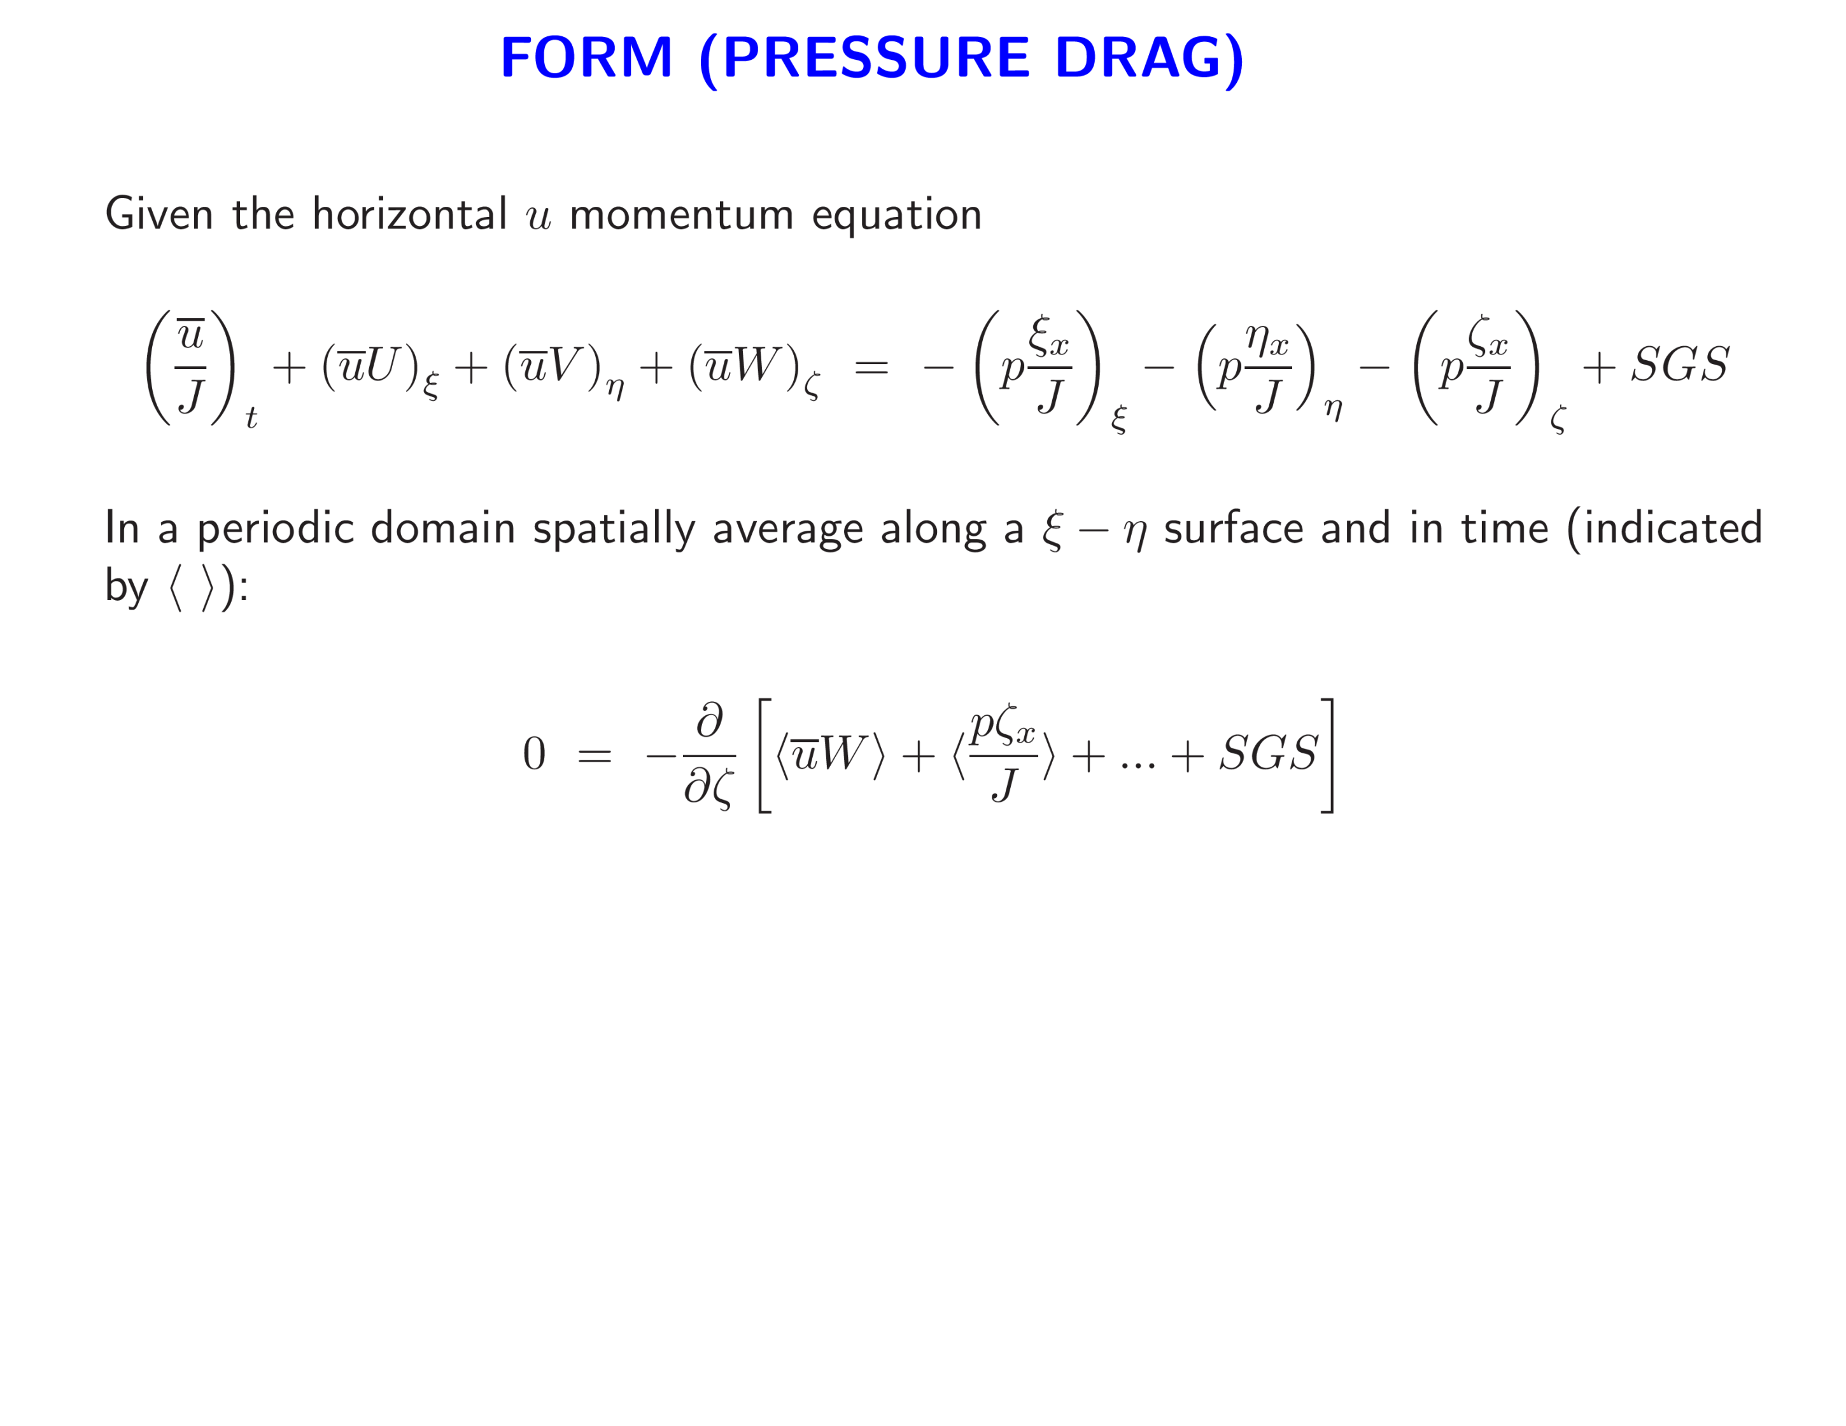
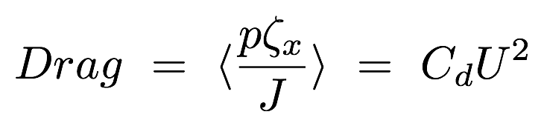
Resolved turbulent stress
Subgrid (viscous) stress
Form drag

Slide 16
EXAMPLES

Slide 17
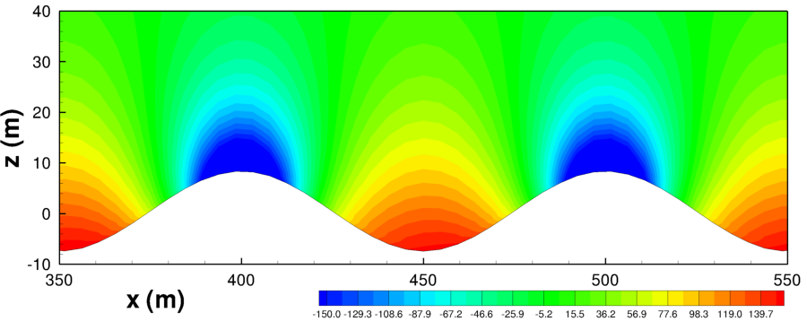
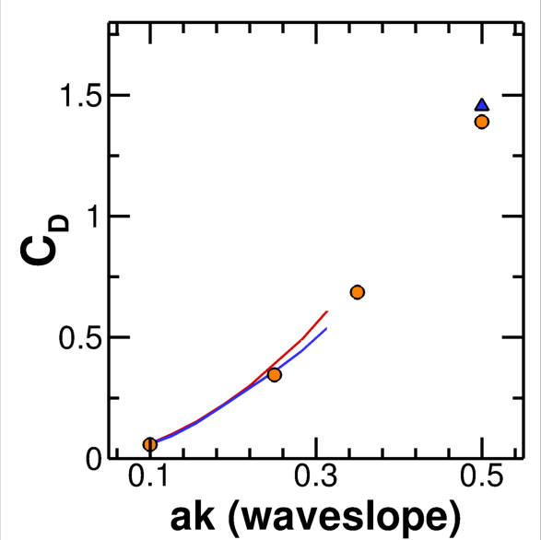
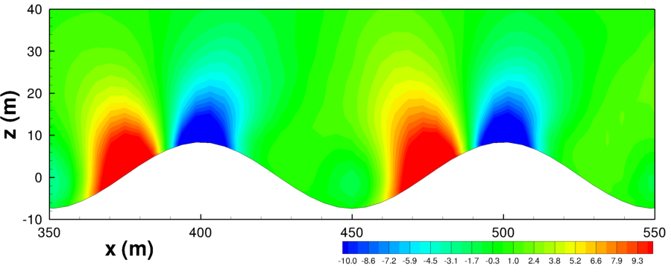
PRESSURE FIELD IN TURBULENT FLOW OVER 2D BUMPS
U
-
+
?
RANS MODEL (Taylor etal, 1998)
-
+
LES

Slide 18
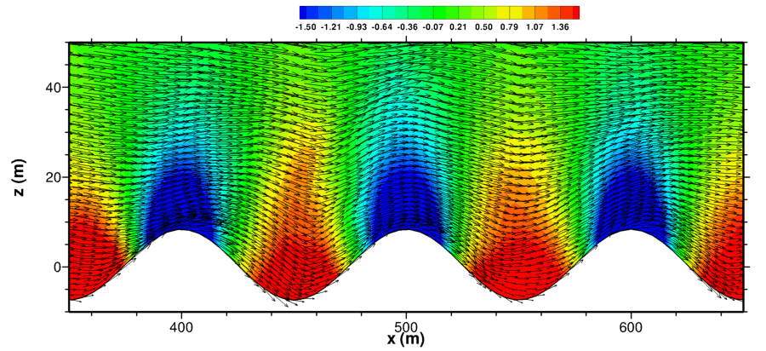
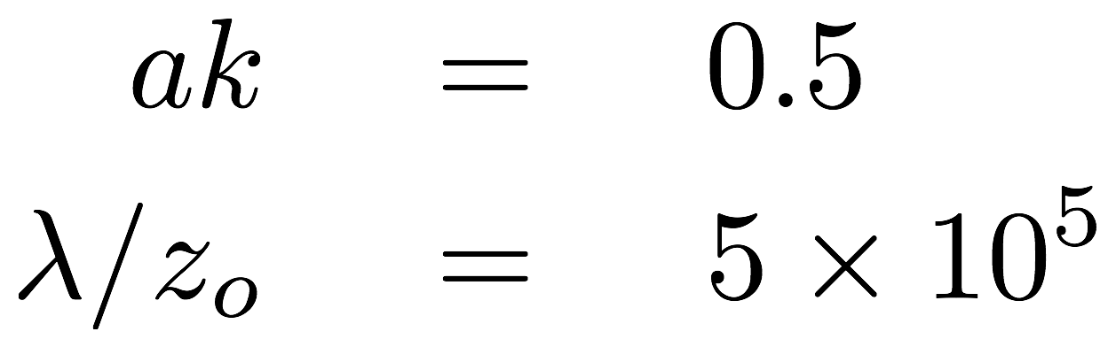
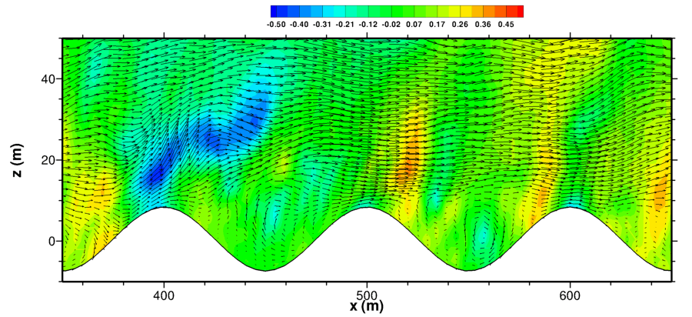
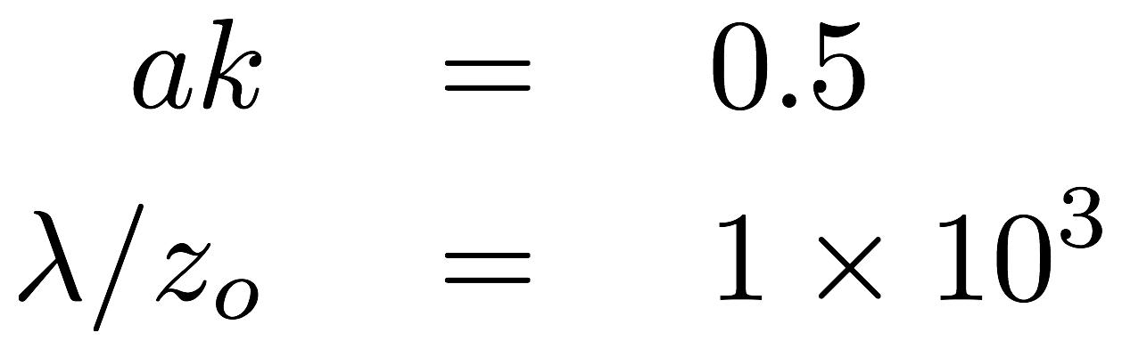
PRESSURE CONTOURS AND FLOW VECTORS
smooth
rough
Flow separation

Slide 19
TURBULENT FLOW OVER AND AROUND 3D OBSTACLES

Slide 20
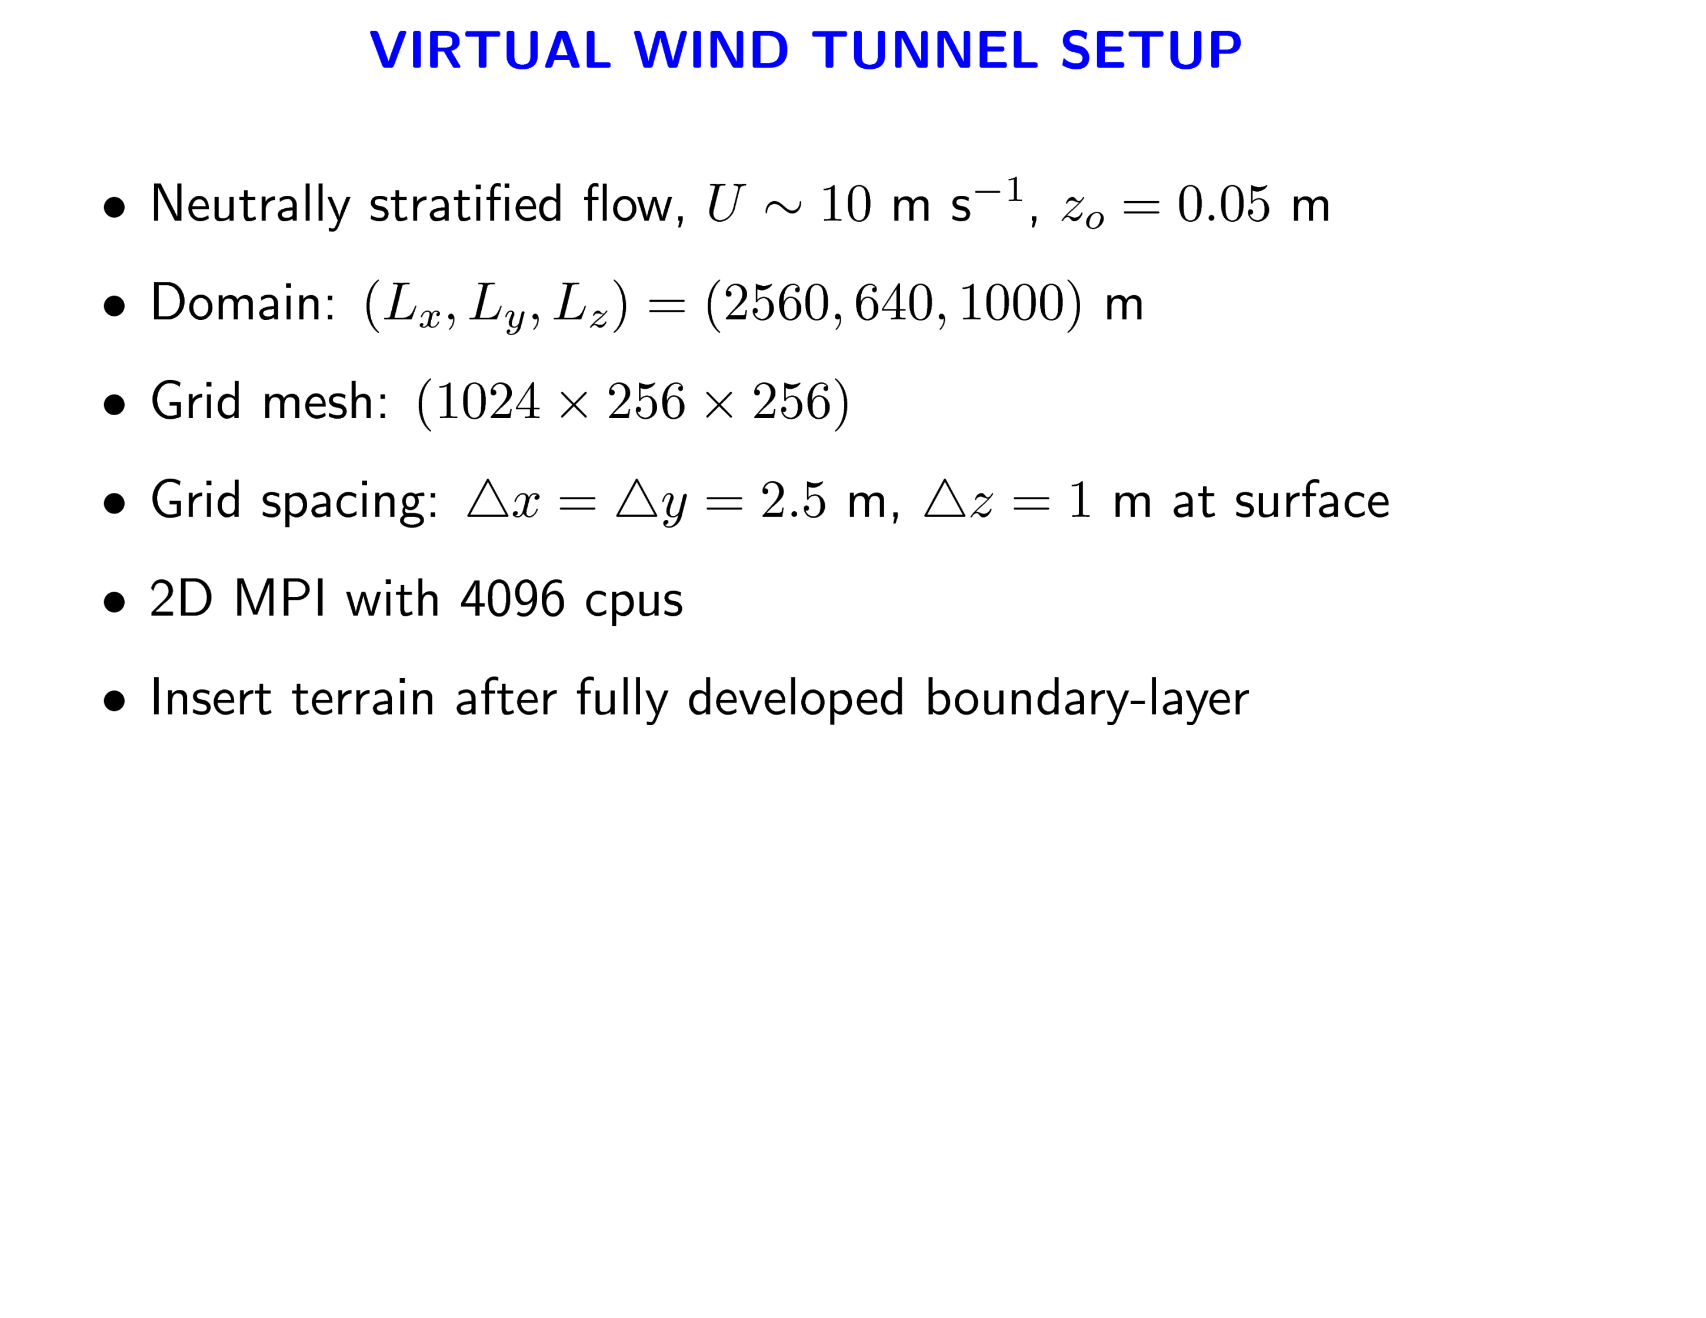
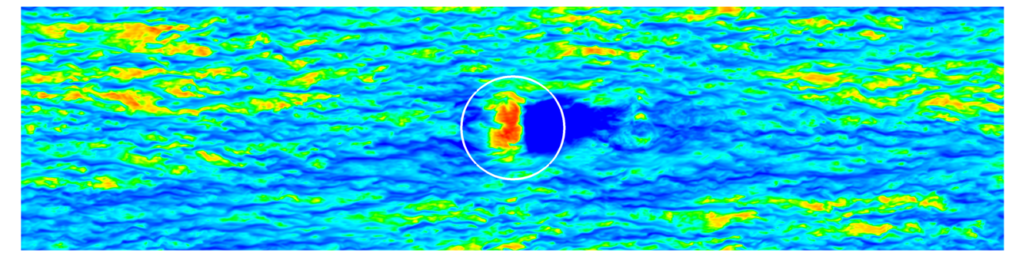
3D Hill

Slide 21
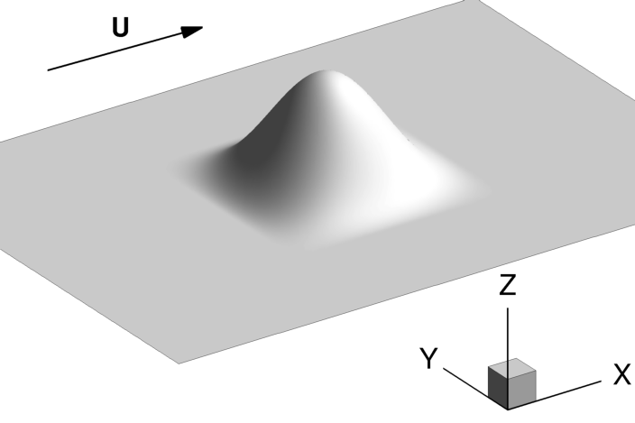
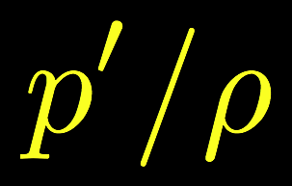
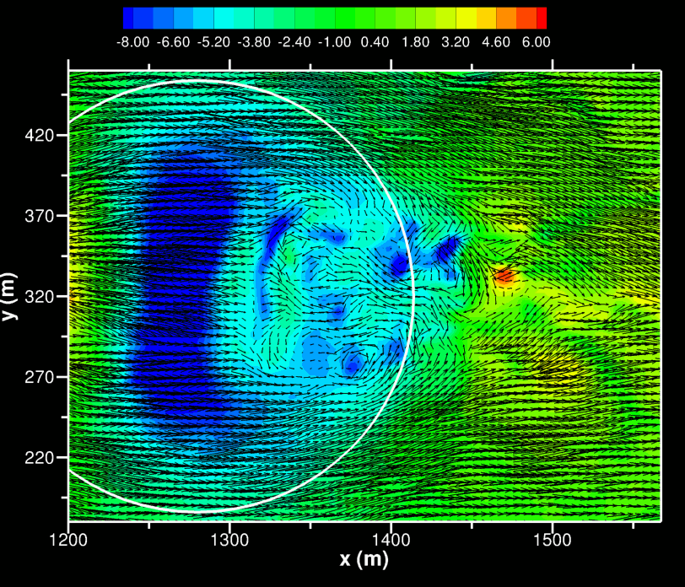
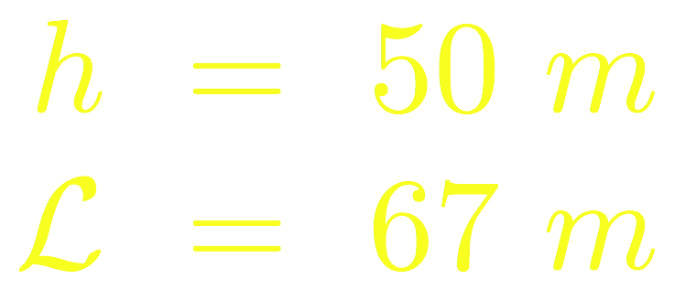
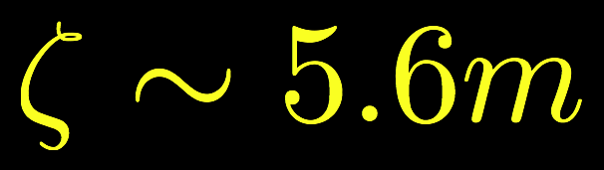

Slide 22
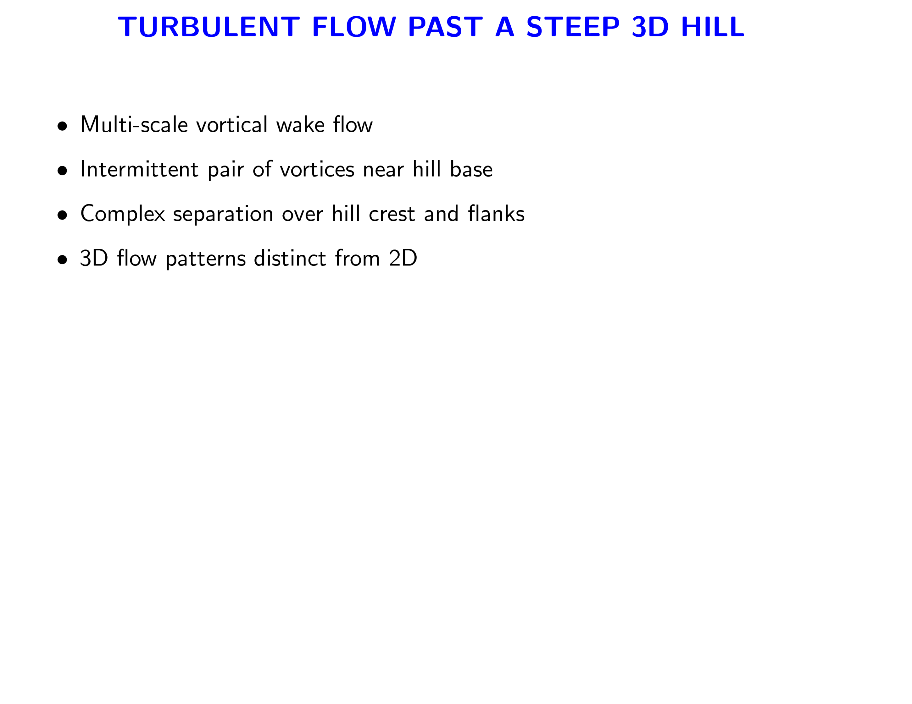
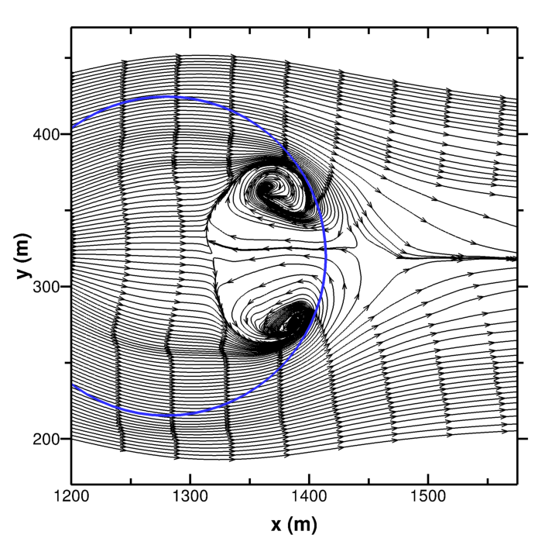
150 s time averaged streamlines

Slide 23
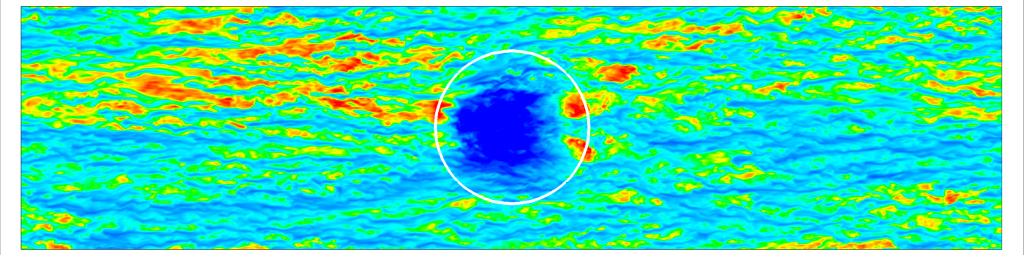
LES OF PBLs WITH COMPLEX TERRAIN AND STABLE STRATIFICATION
METCRAX is investigating the structure and evolution of cold-air pools and stable BLs that form in basins and valleys.
3D Crater

Slide 24
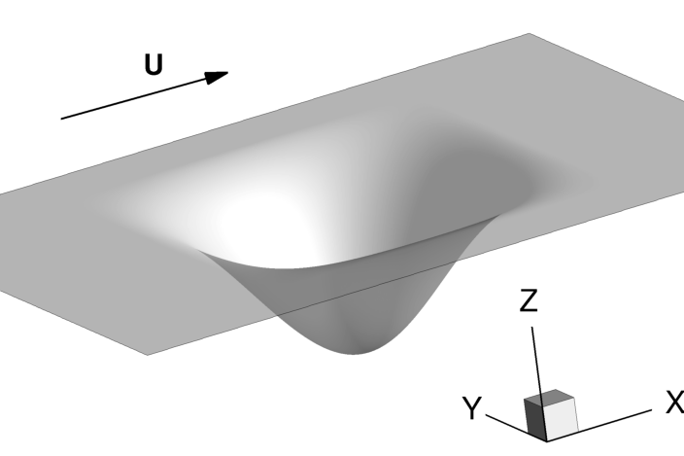
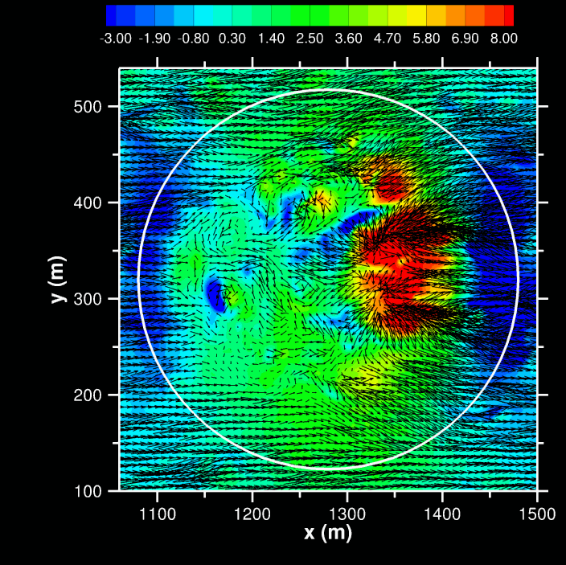
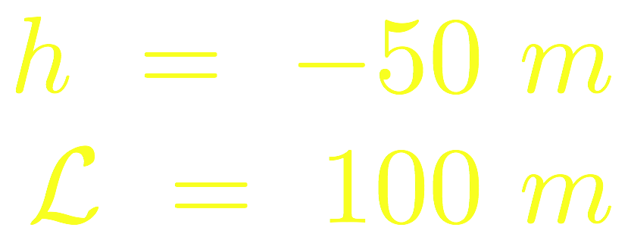
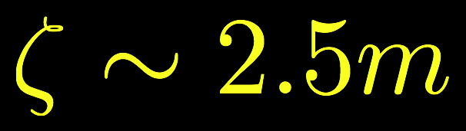

Slide 25
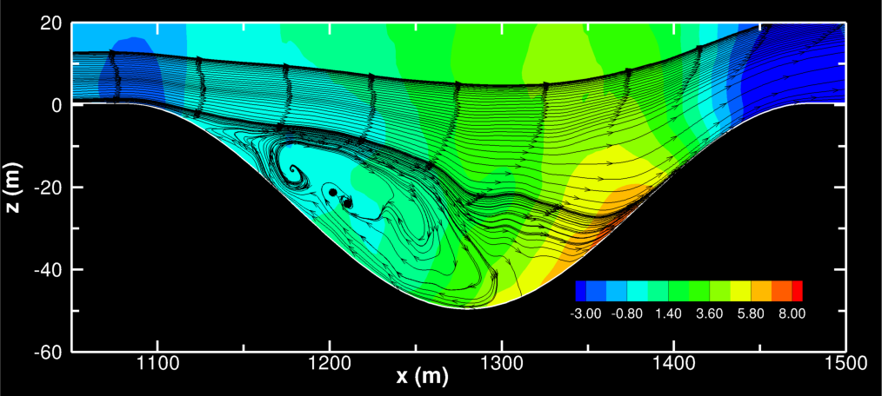
FLOWFIELDS ON CRATER CENTERLINE XZ PLANE
150 s Time Average P’, Streamlines

Slide 26
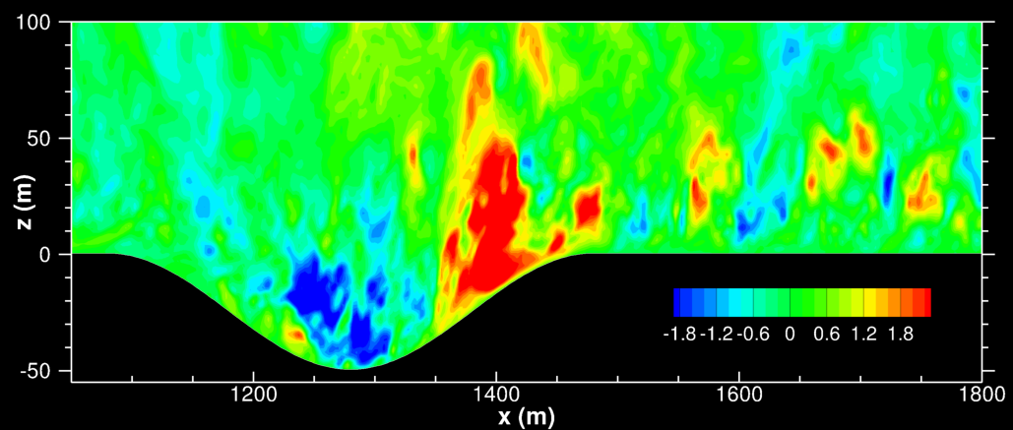
FLOWFIELDS ON CRATER CENTERLINE XZ PLANE
150 s Time Average P’, Streamlines
Snapshot of w

Slide 27
MOVING WAVES

Slide 28
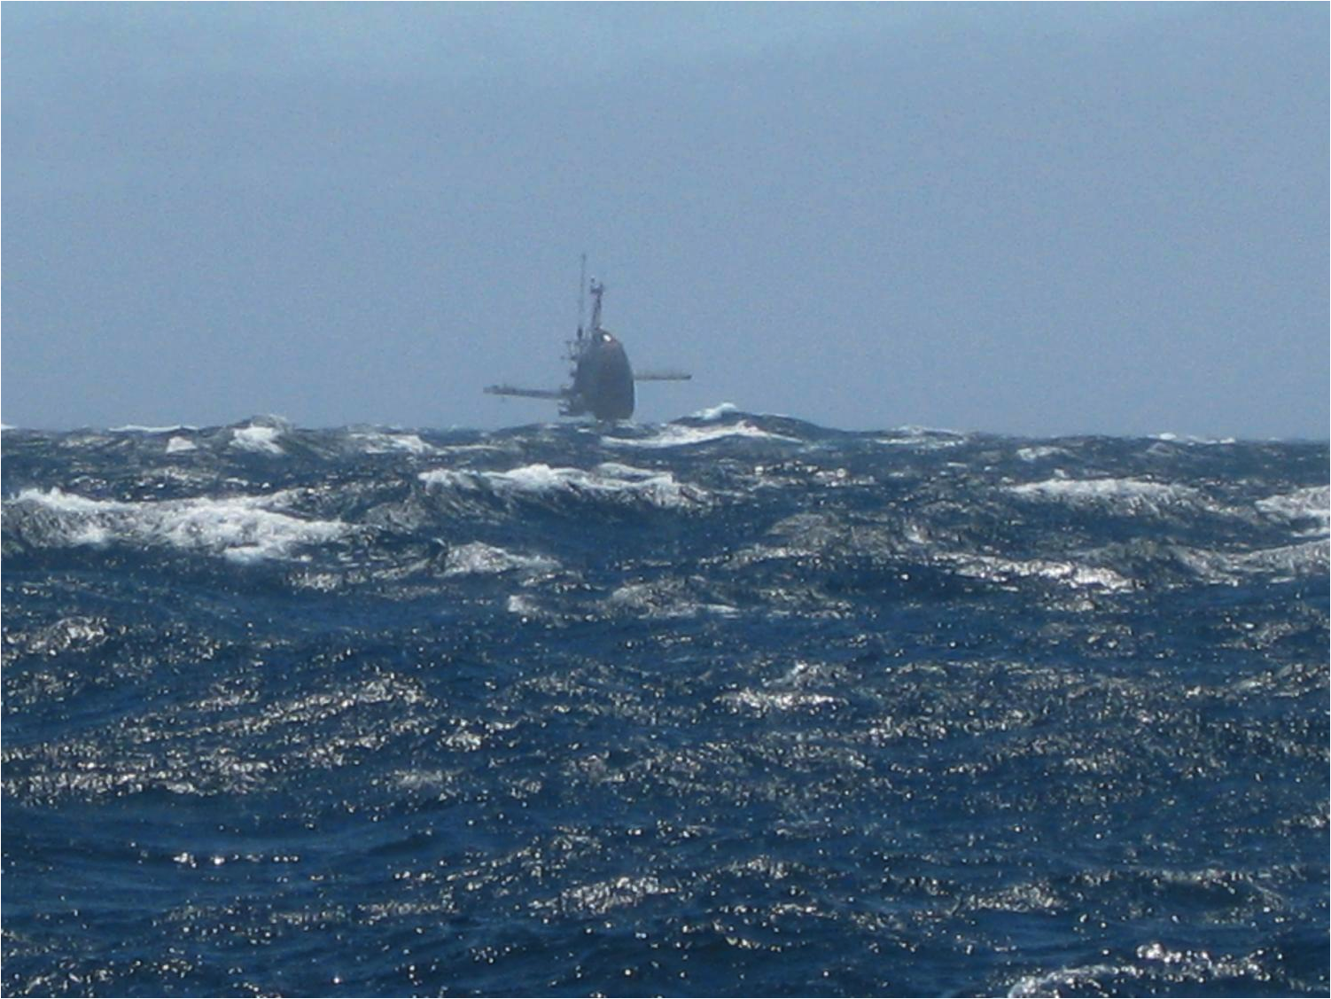
HIGH RESOLUTION AIR-SEA INTERACTION: U ~ 15 m/s courtesy Eric Terrill
Notes:
Start of the talk

Slide 29
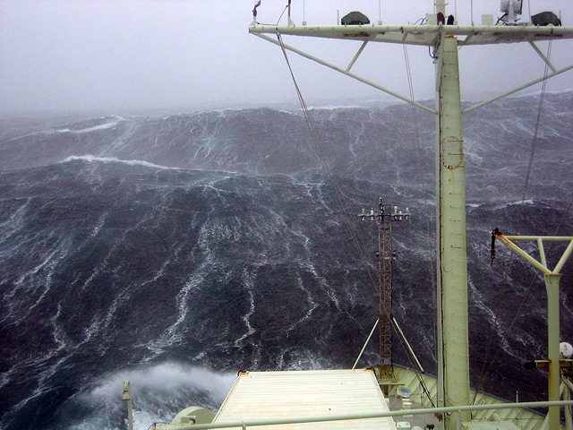
LANGMUIR CIRCULATIONS IN HIGH WINDS?
Photograph from the research vessel Knorr in winds ranging from 60 to 100 knots and 30-40 foot tall waves on an expedition to the Irminger Sea in October 2007. (Photo by Kjetil Vage, Woods Hole Oceanographic Institution)

Slide 30
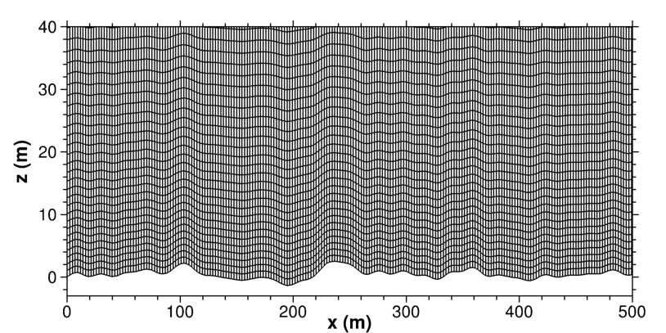
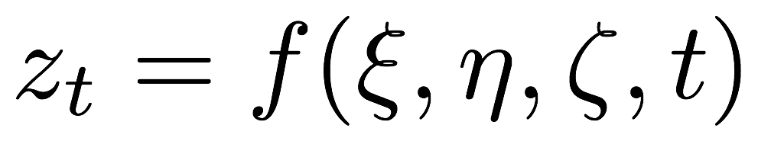
GRID MOVEMENT IN THE LOWER BOUNDARY LAYER
Grid speed

Slide 31
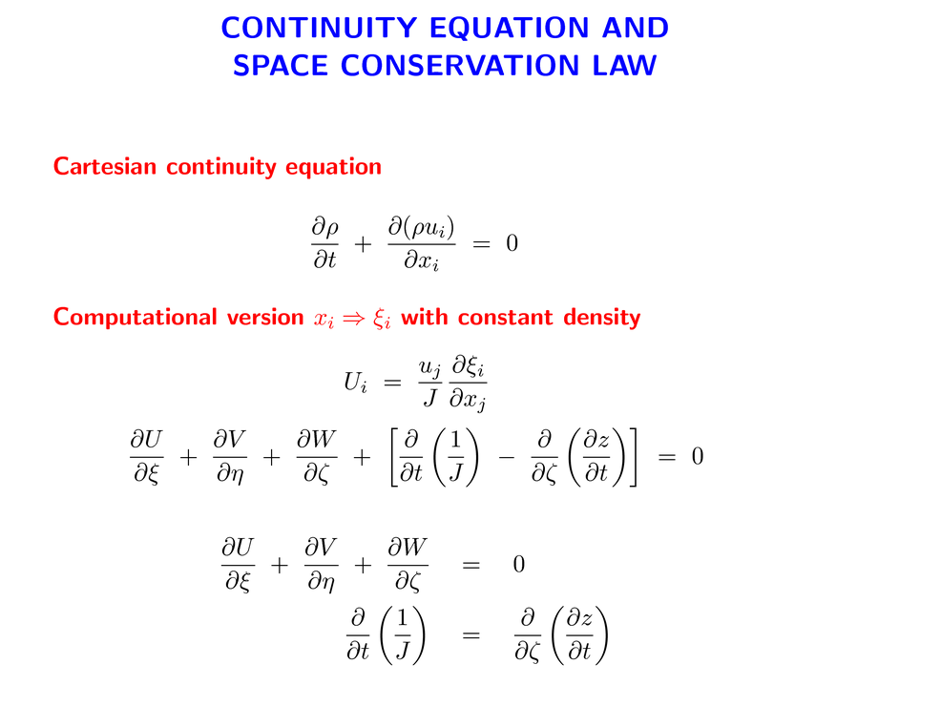
Continuity equation
Space conservation rule

Slide 32
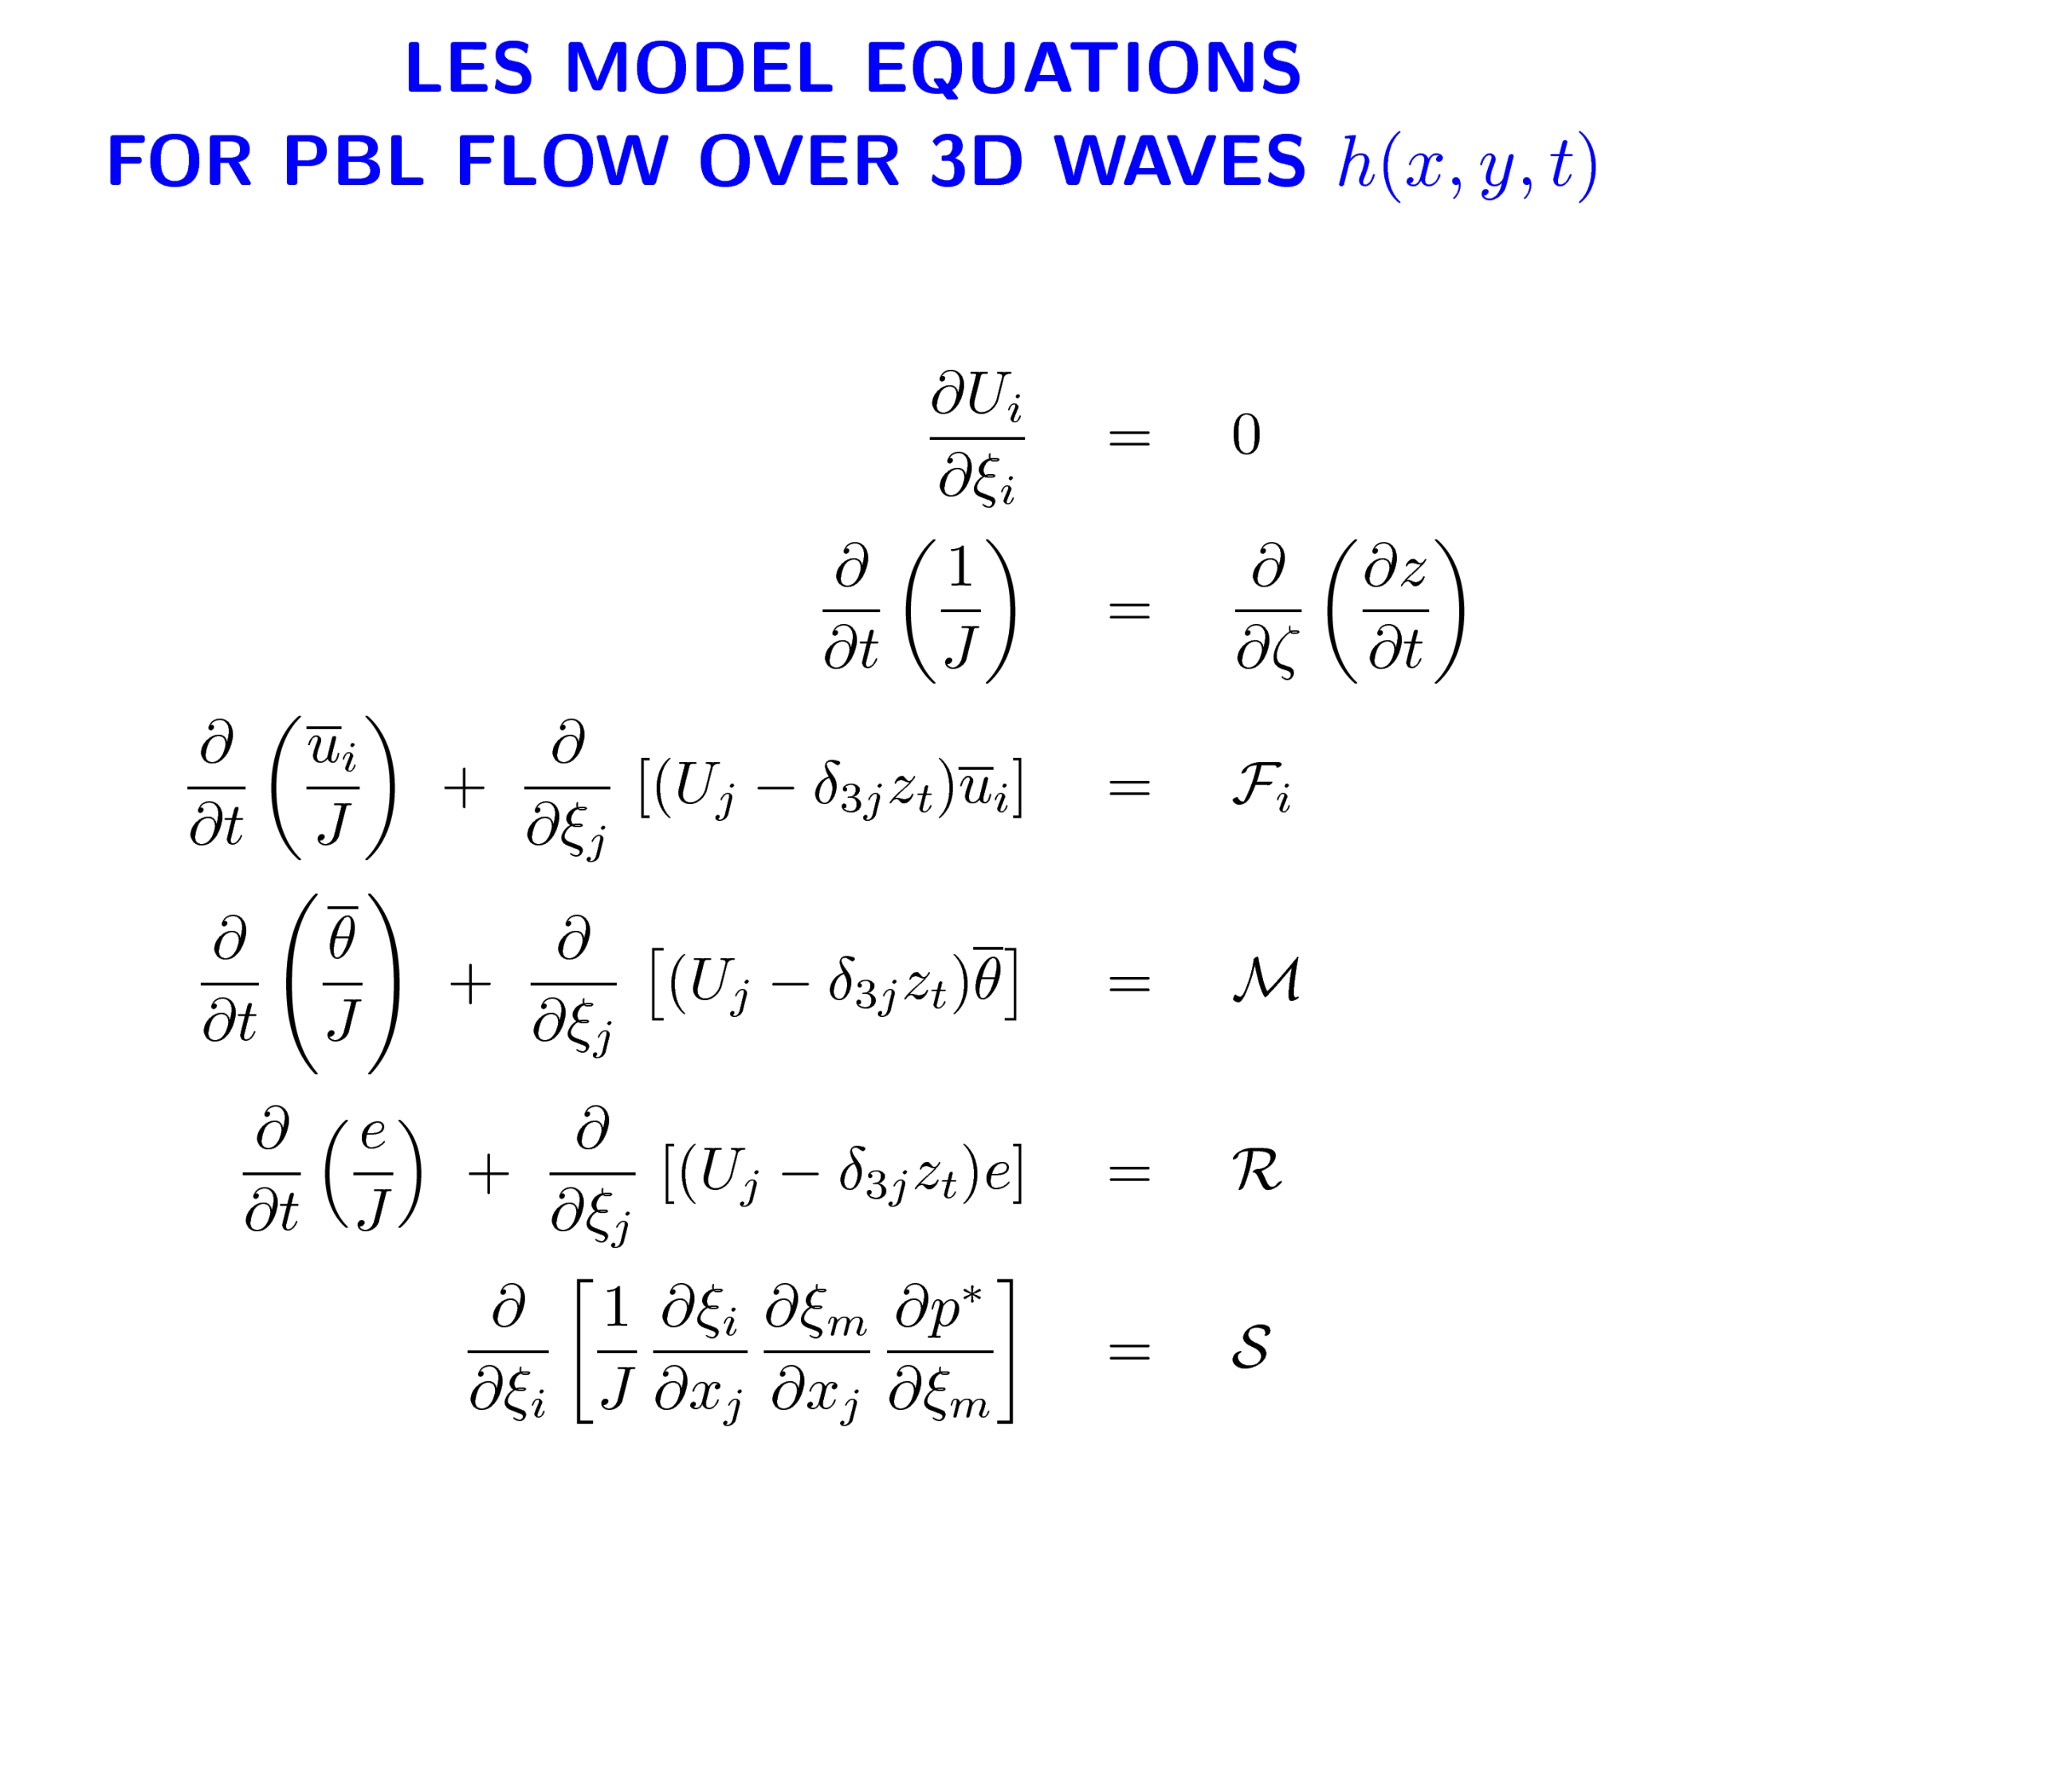
Continuity
Geometric conservation
Momentum
Scalar (temperature)
SGS energy
Pressure equation
Plus rough wall boundary conditions and matching to orbital velocity of wavefield

Slide 33
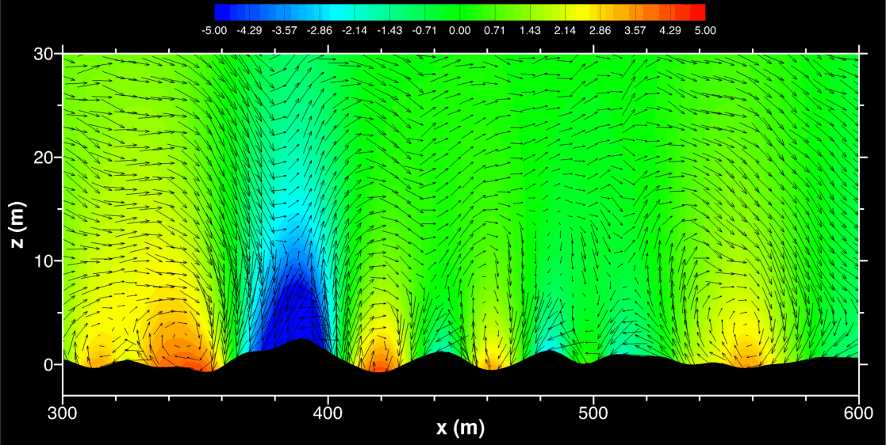
Ug = 5 m/s, WAVE AGE = 4.8, PRESSURE CONTOURS AND VECTORS
Moving swell

Slide 34
