Slide 1
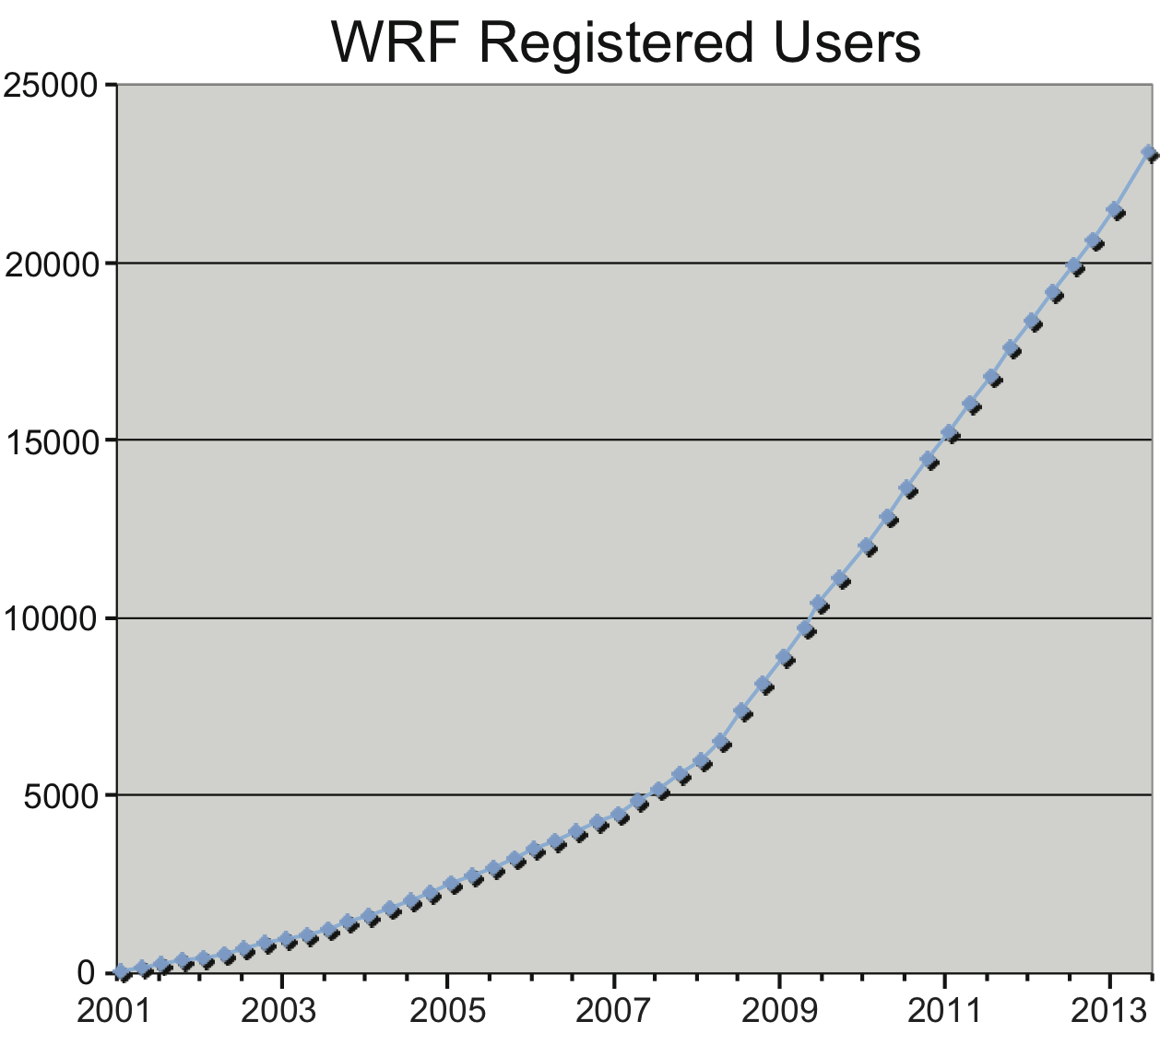
WRF User Participation
Registered Users
U.S. Universities, 7,490
Gov’t labs,
Private sector
Foreign users 16,777
--------
24,267
Countries represented: 153
>7,650 active subscribers to wrf-news@ucar.edu
Currently averaging 350 email inquiries per month to wrfhelp

Slide 2
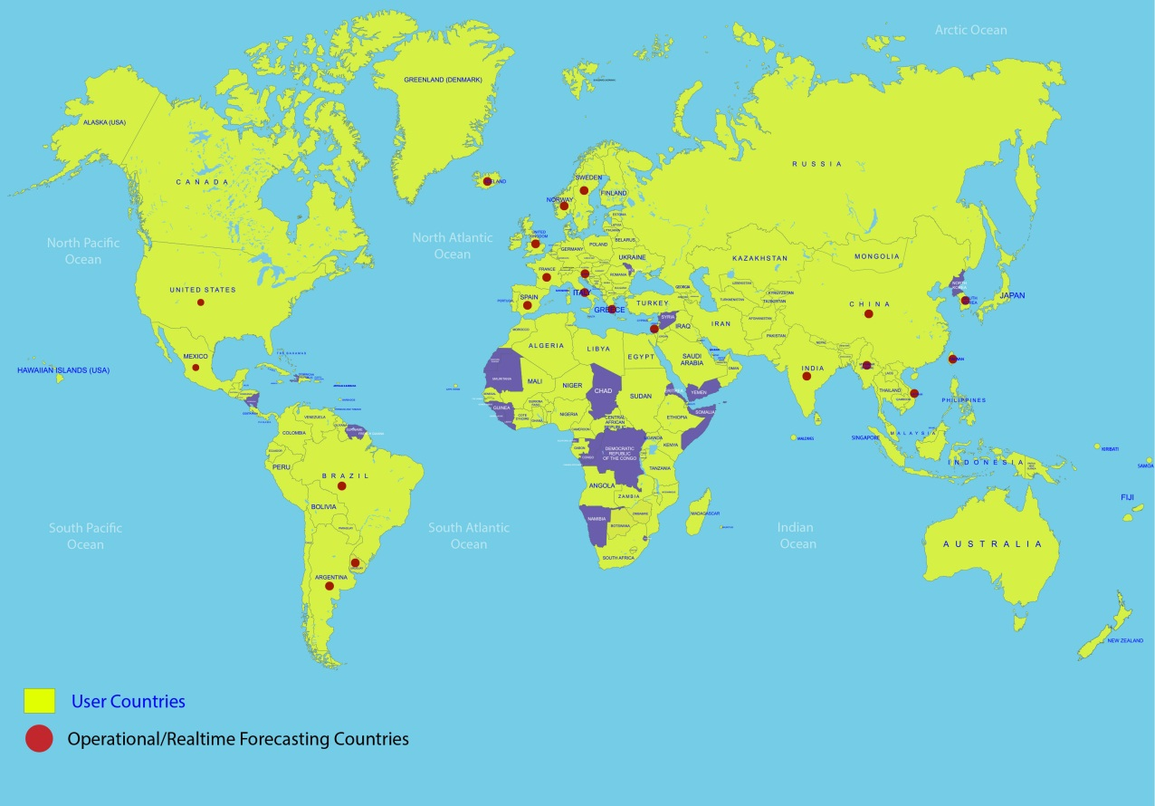
WRF User Participation
153 Countries

