Slide 1
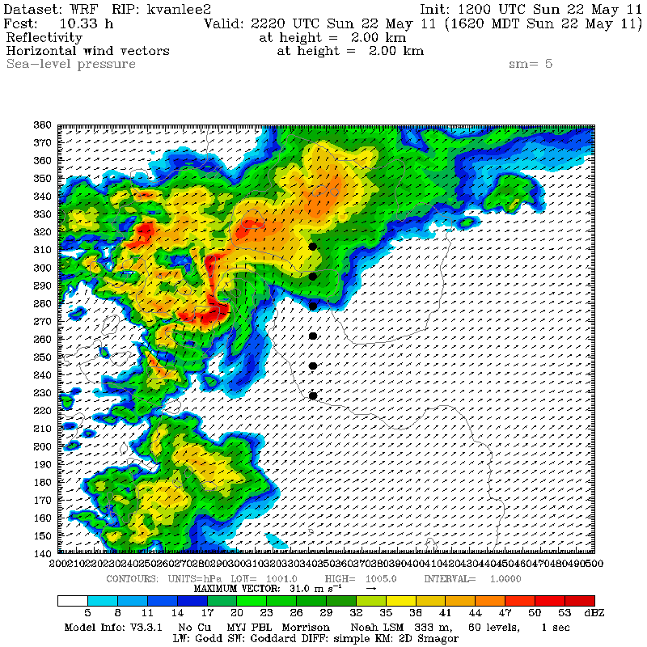
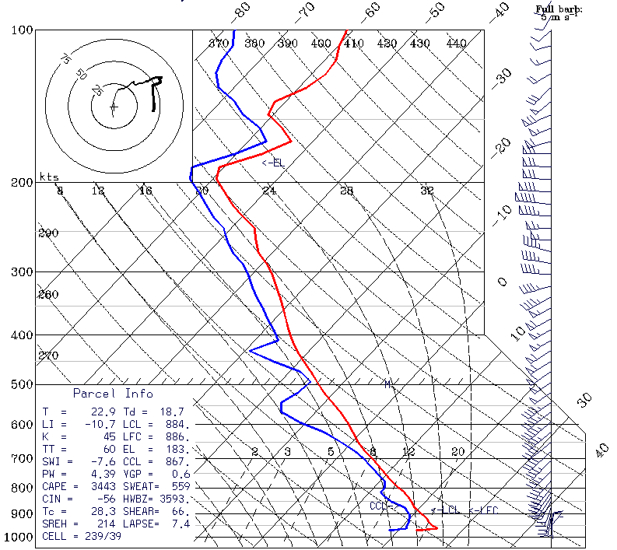
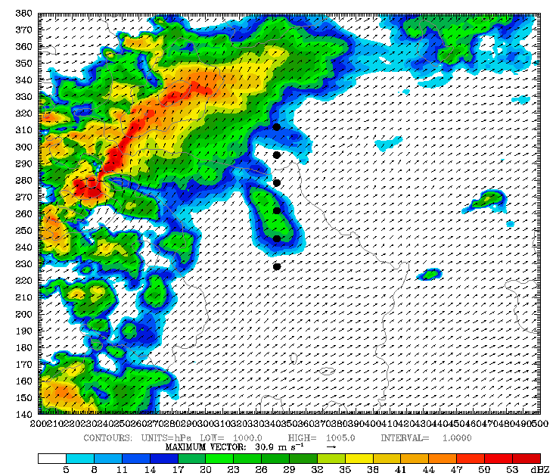
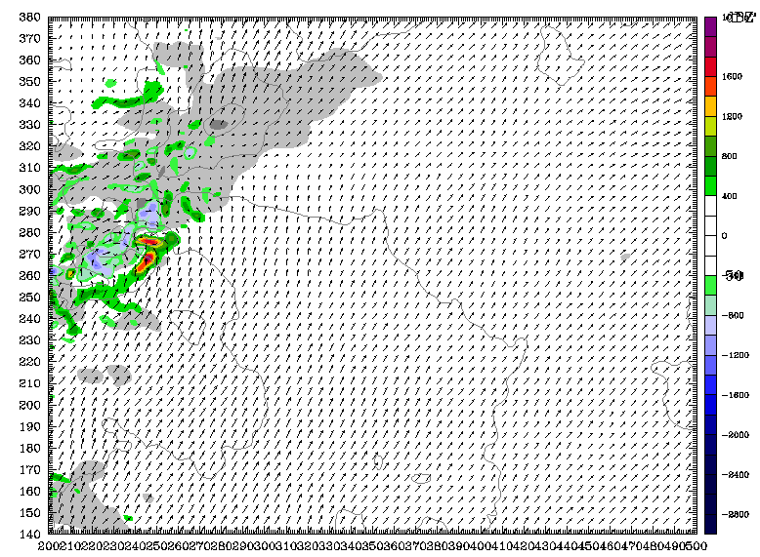
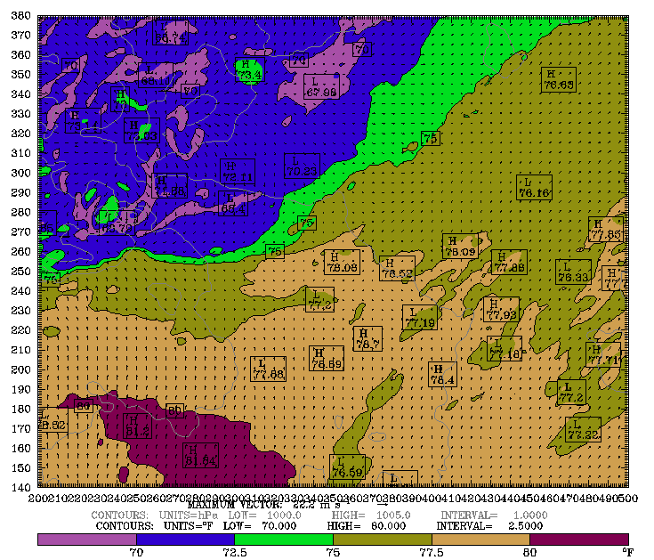
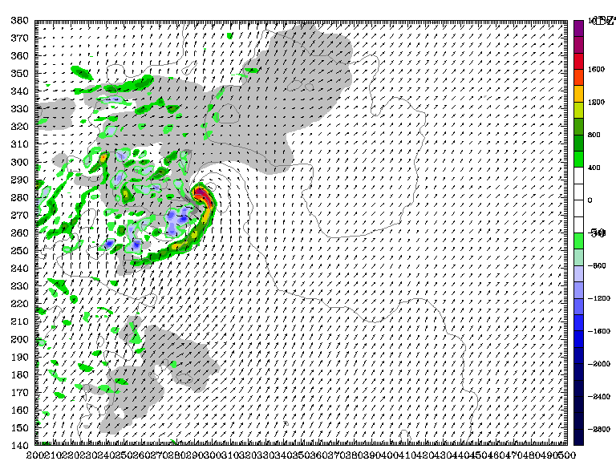
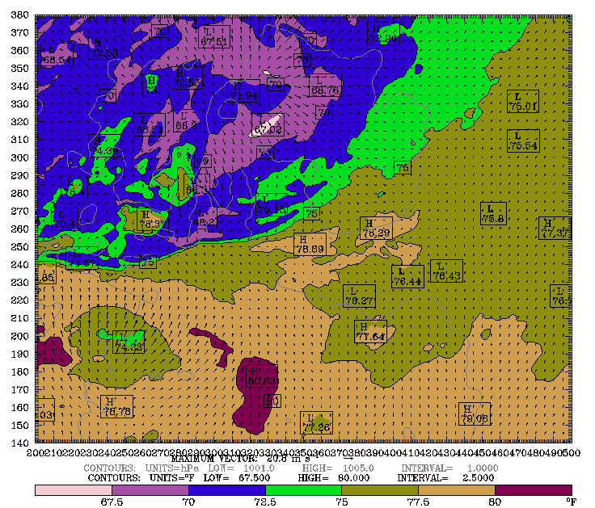
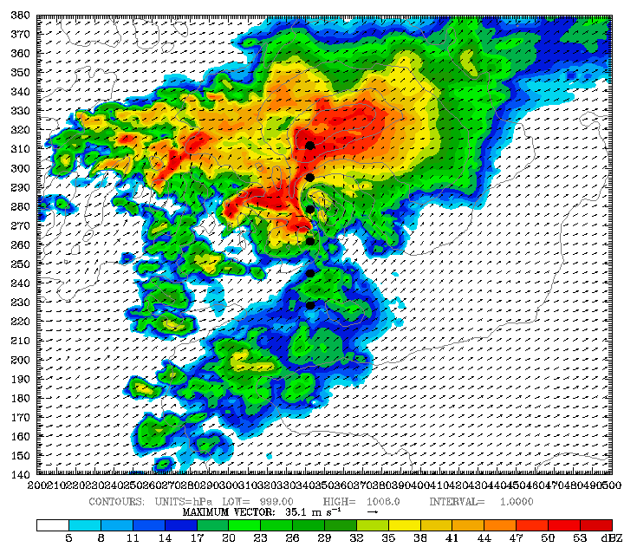
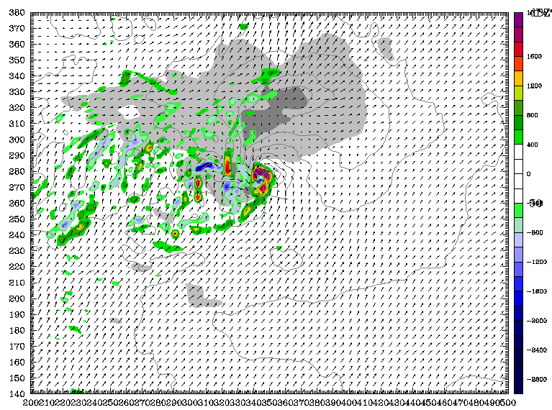
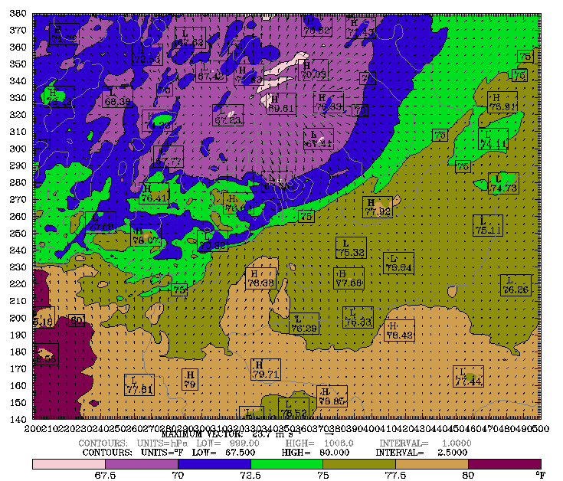
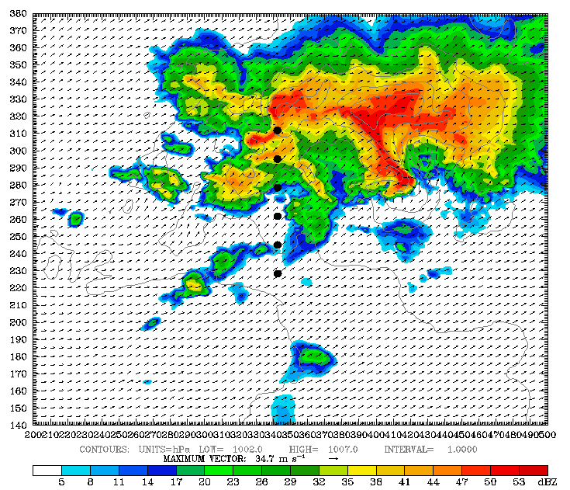
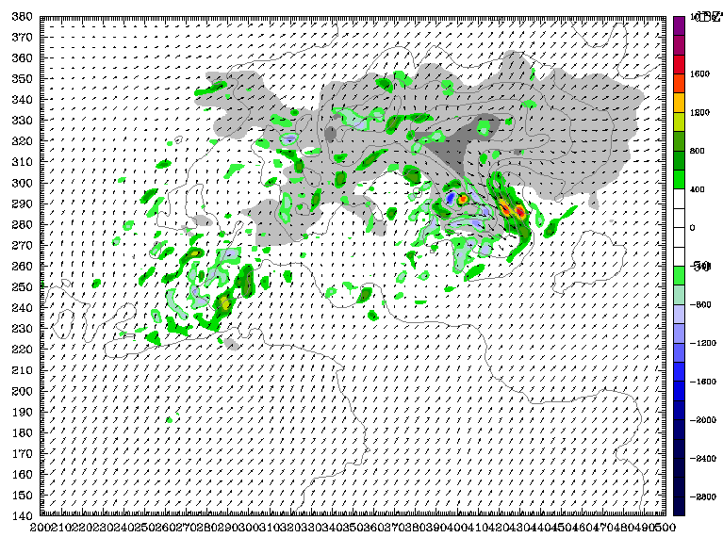
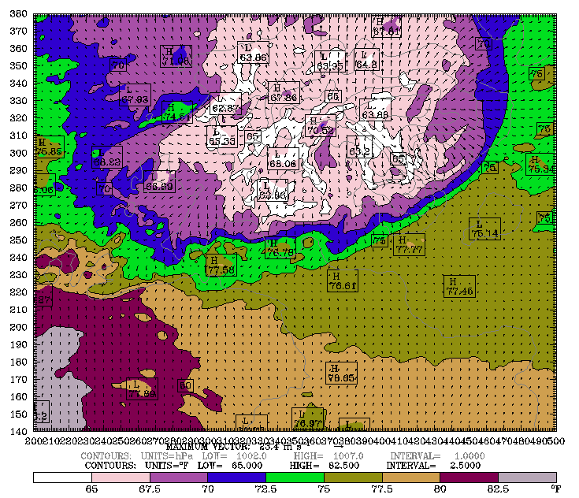
Investigating Rapid Storm Intensification Mechanisms Including the Role of Storm Mergers in the 22 May 2011 Joplin, MO Tornadic Storm
Kevin Van Leer*, Brian Jewett, Robert Wilhelmson
University of Illinois, Urbana-Champaign; National Center for Supercomputing Applications
MOTIVATION
MODEL CONFIGURATION
Near-Storm Environment Vertical Profiles
Model soundings are retrieved from the near-storm environment indicated by the picket-line of black dots. These soundings indicate the production of an excessively strong cold pool over a larger areal extent than the observed event. This cold pool may play a role in limiting the surface vertical vorticity peak intensity and duration in the real-data simulations. Significant cooling below 950mb and localized shear is present in the example inflow profile.
Rapid intensification of low-level vertical shear due to mechanisms such as storm mergers can result in local environments more favorable for tornadogenesis than the surroundings. Lemon 1976 and Lee et al 2006 noted the significance of cell mergers in the intensification of the mesocyclone. In the case of the Joplin tornado, the surroundings were a high CAPE, low shear environment, not favorable for the violent, EF-5 tornado which eventually occurred. This study utilizes high resolution WRF real-data simulations of the event to observe the storm mergers and subsequent intensification of the mesocyclone, as well as idealized runs using soundings from the model environment to test the effects from the resulting near-storm thermodynamic and shear profiles.
Weather Research and Forecasting (WRF) Model
ARW version 3.3.1
3 km outer grid
2 nests (1 km and 333 meter grid spacings)
Future nests will have < 100 meter grid spacing
10 second outer grid time step
61 vertical levels
North American Mesoscale (NAM) Initialization
Run from 12Z 22 May 2011 to 03Z 23 May 2011
Morrison 2-moment Microphysics
Mellor-Yamada-Janjic PBL
Unified Noah LSM
Goddard Longwave and Shortwave Radiation
936 km (3 km)
490 km (1 km)
300 km (0.333km)
792 km (3 km)
469 km (1 km)
300 km (0.333 km)
JOPLIN TORNADO
Domain for Real-Data WRF runs. Grid sizes with grid spacing in parentheses
Violent EF-5 tornado that struck Joplin, MO
22.1 mile path, up to 1 mile wide
38 minutes on the ground (2234-2312Z)
159 fatalities, 1000+ injured (Deadliest since 1947)
$2.8 billion in damage
3 cell mergers during evolution of tornado
First 2 rapidly intensified mesocyclone
Third resulted in weakening of the mesocyclone
Forecasters properly issued tornado warning due to presence of vorticity couplet and cell merger
Tornado occurred in a high CAPE, low shear environment
Information primarily from Joplin NWS Service Assessment
RESULTS
Storm Mergers and Vertical Vorticity in Real-Data Simulations
Rapid intensification of the mesocyclone from storm mergers has been reproduced in real-data simulations. Vertical vorticity throughout the column increases during instances of early storm mergers, until one occurs along the rear flank of the main storm. The peak of deep rotation occurs shortly after a merging event. Surface temperature is provided to display the cold pool and its rapid propagation out in front of the mesocyclone.
Simulated Reflectivity @ 2km AGL Vertical Vorticity @ 1km AGL Surface Temperature (°F)
333m WRF output Simulated Reflectivity @ 2km AGL and Sounding retrieved from noted location at 2220Z
DISCUSSION AND GOALS
Current Results
Successfully reproduced strong rotation and mesocyclone near time of observed tornado formation.
Simulated storm formation and decay closely mimics observed behavior, including storm mergers.
Problems currently being addressed
Highly sensitive to simulation approach (timing and placement of nests, microphysics, radiation scheme and call frequency).
Highly sensitive to environment (storm merger timing and location, synoptic front proximity).
Tests to improve results will include
Slight alterations of the microphysics scheme to reduce the strength and extent of excessively strong cold pool (i.e. changes in hail density or drop size distributions).
A decrease in grid spacing to sizes suggested by previous literature (i.e. < 100 meters).
Idealized simulations to isolate role of ambient shear and thermodynamic profiles
Investigation of storm morphology (e.g. duration of rapid rotation) without mesoscale boundaries or mergers.
Quantification of response to minor changes in shear and buoyancy.
Present goals
Numerical study aims to reproduce and understand the rapid intensification of the Joplin tornadic storm.
Identify and understand modifications in the near-storm environment that made an EF-5 tornado possible on this day.
Study results will aid in the forecasting of tornadic events in similar high CAPE, low shear environments.
2200Z
Early Stages
Isolated
Rotation
Forward Flank Downdraft (FFD)
Merging Cells
Merger #1
50 km
Vorticity Couplet
2219Z
2219Z
50 km
2220Z
Intensification
Hook Echo
Intensifying Rotation
FFD
Merging Cells
Merger #2
Intensified Couplet
2234Z
50 km
2234Z
50 km
2240Z
Peak Rotation
Rear Flank Merger
Hook Echo
Maximum Deep Rotation
Intensifying Cold Pool
FFD
Intensified Couplet
Merging Cells
2248Z
Merger #3
Merger #2
50 km
2248Z
50 km
ACKNOWLEDGEMENTS
2305Z
Decaying Stage
This work is funded by the NSF Grant AGS-0843566. All computational time resources are from Xsede Award TG-ATM050014N. Special thanks goes to the help desks at the Pittsburgh Supercomputing Center (PSC), National Institute of Computational Science (NICS), National Center for Supercomputing Applications, and WRF help. Also, to my advisor, Dr. Brian Jewett, and his extensive help with WRF and other computational problems.
Weakening Couplet
Merging Cells
Decaying Rotation
Strong Cold Pool
2258Z
Merger #3
50 km
2258Z
50 km
WSR-88D NEXRAD Radar Data retrieved from NCDC
333 meter output from Real-Data Simulations. Black dots indicate locations of vertical profiles. In vertical vorticity plots, light grey and dark grey represent 30 and 50 dBz respectively.
*Contact Information: kvanlee2@illinois.edu

