Slide 1
Recent Enhancements to THE MODEL EVALUATION TOOLS (MET)
Tressa L. Fowler
Barbara Brown, John Halley Gotway, Randy Bullock, Eric Gilleland, Tara Jensen, Nancy Rehak, Paula McCaslin, and Julie Prestopnik
June 2013

Slide 2
Thank You
Support for MET is provided by
the Developmental Testbed Center (DTC),
the Air Force Weather Agency (AFWA),
and
the Hurricane Forecast Improvement Project (HFIP).

Slide 3
What’s is it?
Free and supported model verification software.
Traditional statistics – continuous and categorical
Confidence intervals
Statistics for probability forecasts
Ensemble preprocessor and statistics
Cloud verification capability
Neighborhood methods
MODE object based verification
Wavelet decomposition

Slide 4
How do I get it?
Download from the web site.
Compile and run.
Read manual.
Attend Tutorial
Janurary 2014
Use met_help@ucar.edu

Slide 5
MET v4.1 – Released last month
MET – TC to support verification of tropical cyclone forecasts
Series analysis tool summarizes verification statistics in any series (e.g. time, height) at each grid point in domain.
MODIS data preprocessor.
Spread skill statistic in ensemble tool.
little_r and SURFRAD handled in preprocessing tools.
Notes:
SURFRAD data is a set of measures of solar irrandiance. Incorporation of this data type was completed under the LSM verification task as it is a commonly used data source in that arena. It also provides cloud verification capability at these sites and will assist the T&E of radiation schemes.
Little r data is the intermediate format for WRFDA, so now that data can be used in MET.

Slide 6
MET v4.0 – Released last year
GRIB2 support
Plotting tools for point and gridded data
Streamlined configuration files
Better unit testing
Bug fixes

Slide 7
MET-TC
Duplicates and extends NHC verification capability for A Decks and B Decks.
Track and Intensity Errors
Radius of Maximum winds by quadrant.
Basic rapid intensification evaluation.
Many R-scripts for plotting.
See poster by Kathryn Newman for details.

Slide 8
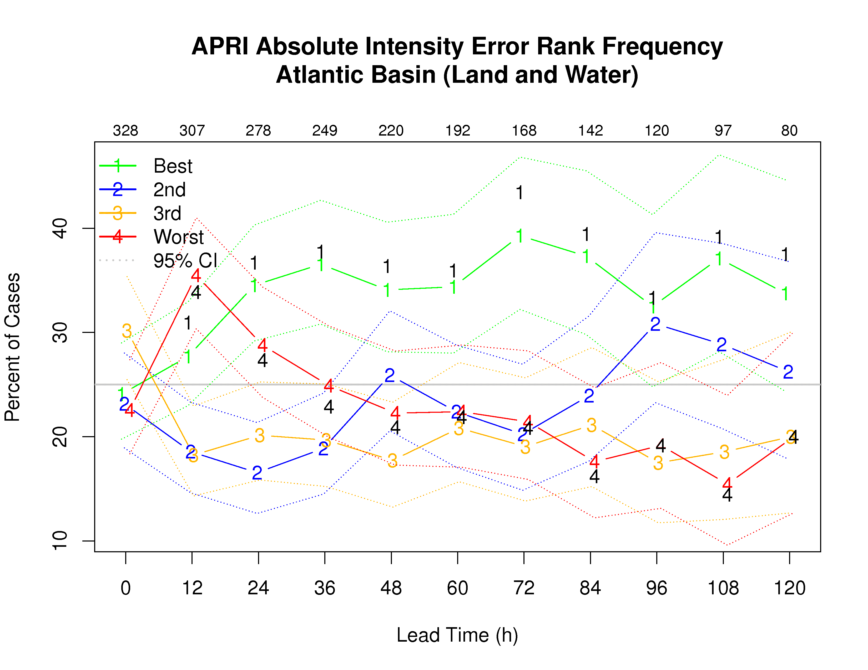
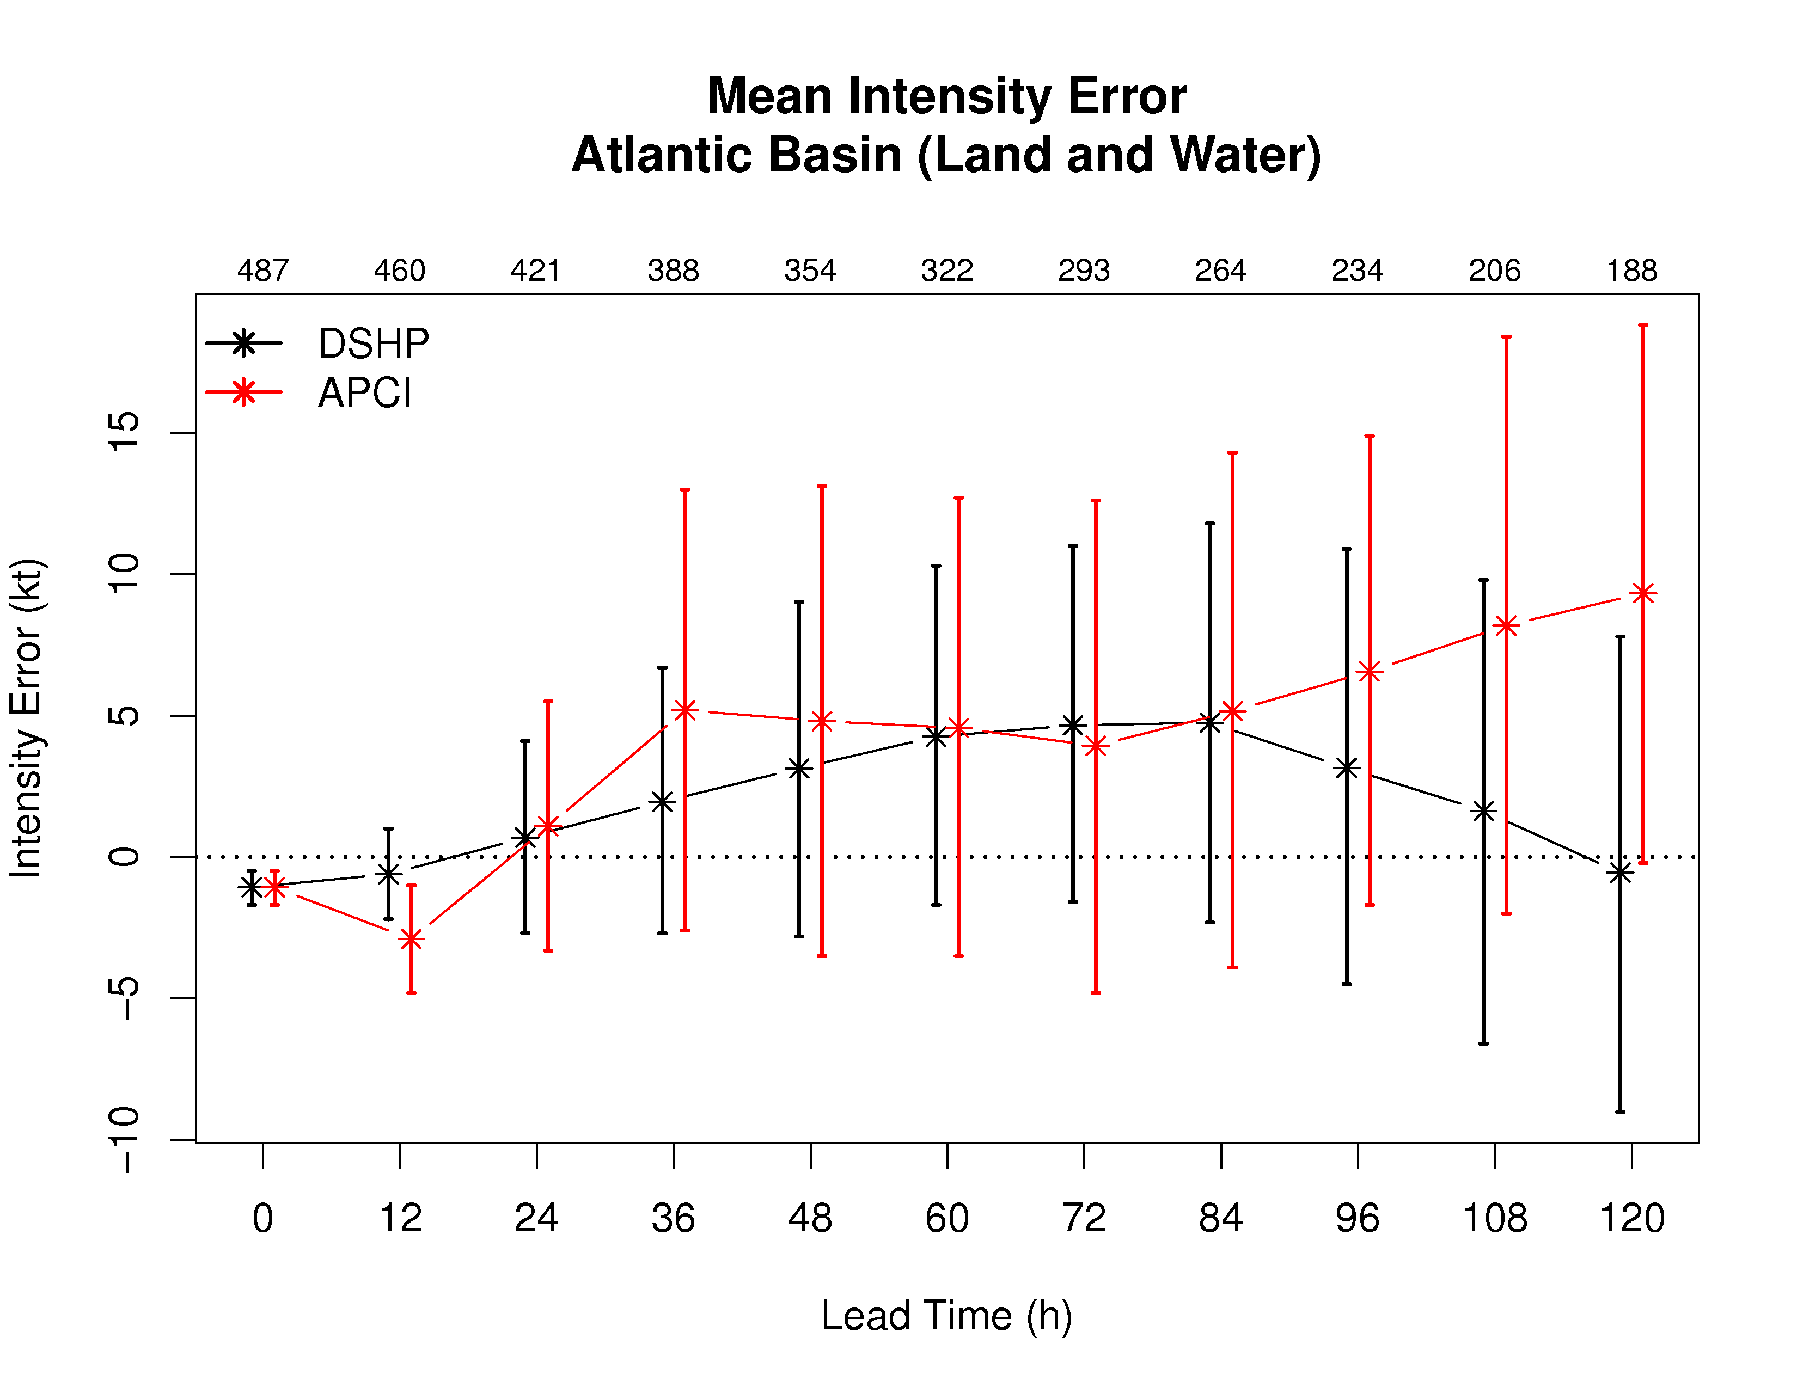
Example results from MET-TC.

Slide 9
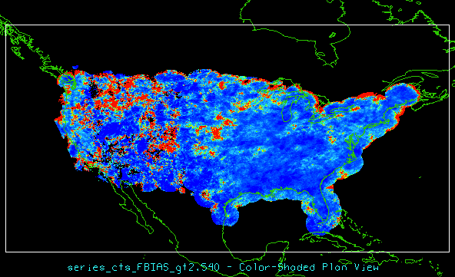
Ability to represent verification results spatially
Ability to accumulate statistics at each grid location over some series.
Time
Height
User-specified
Produces NetCDF file.
Notes:
This shows an example of the new capability to represent verification results spatially. These results are for example only since the tool has not undergone thorough testing yet, but red areas show areas of very high bias, most noticeable here in the mountainous areas and similar for the two models.
This task has been in our list for some time now, but code and library changes over in the last year facilitated development.

Slide 10
MODIS data preprocessor
HDF-EOS files converted into MET NetCDF.
Allows use of MODIS products as observations for verification.
Developed and tested on Level 2 cloud product.
http://ladsweb.nascom.nasa.gov/

Slide 11
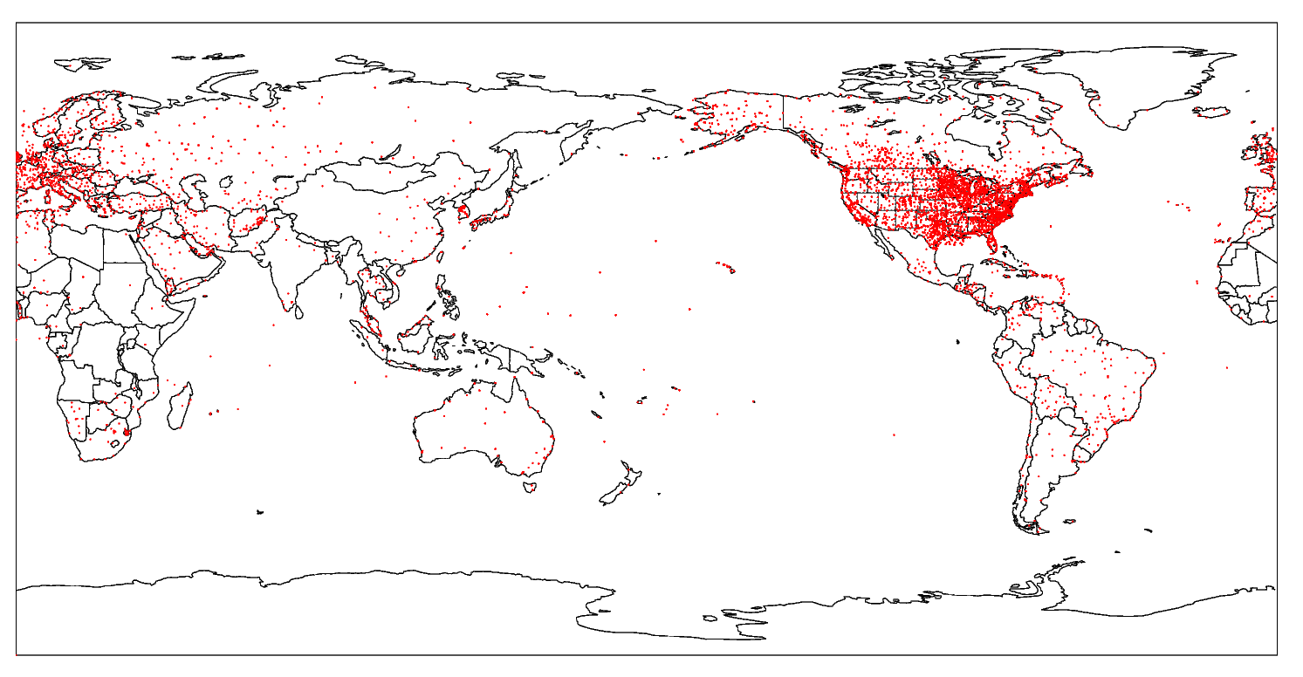
Example plots from plotting scripts
Notes:
Use this template for text bullets

Slide 12
Bug fixes
MODE areas
Previous versions overestimated areas somewhat
Larger objects less affected
Prepbufr virtual temperature coded as temperature.
Results may show false cold bias.
Other small bug fixes.

Slide 13
Summary
MET is a community tool for model forecast evaluation, which incorporates many of the latest methods
Modular architecture
Highly configurable
Extensive user support
New tropical cyclone verification
New spatial / series verification
Additional satellite observation preprocessor.
Little-r and SURFRAD observations preprocessed by existing tools.
More graphics support.
For more information:
http://www.dtcenter.org/met/users/

