Slide 1



The Weather Research and Forecasting Model: 2017 Annual Update
Jimy Dudhia
NCAR/MMM
Tests and Graphics: Ming Chen

Slide 2
WRF Community Model
Version 1.0 WRF was released December 2000
Version 2.0: May 2004
Version 3.0: April 2008 (add global ARW version)
… (major releases in April, minor releases in summer)
Version 3.8: April 2016
Version 3.8.1: August 2016
Version 3.9: April 2017

Slide 3
New in V3.8 (April 2016)
Kain-Fritsch cumulus potential scheme (KFCuP) – cu_physics=10 (Berg and Stull, 2005)
A new climatological aerosol option linked to Thompson microphysics – aer_opt=3
Flux-adjusting surface data assimilation system (FASDAS) – grid_sfdda = 2
New 30” global topography (GMTED) replaces GTOPO

Slide 4
Updates in V3.8.1 (August 2016)
Radiation
RRTMG redefine top to 0 hPa for LW diagnostics
Goddard improve shortwave clear-sky water vapor treatment
icloud=3 improved based on WRF-Solar testing
Microphysics
Thompson updates
HUJI Spectral Bin option fix error coupling to LSM
Minor changes to WSM, WDM and Morrison schemes

Slide 5
Updates in V3.8.1 (August 2016)
Cumulus
Zhang-McFarlane fix bug for cudt=0 case
Minor changes to new Tiedtke scheme
PBL
MYNN fixes and improvements including bug-fix for icloud_bl=1
LSM
NoahMP and RUC updates and improvements

Slide 6
Updates in V3.8.1 (August 2016)
Diffusion
Fix for diff_opt=2 vertical diffusion to allow conservation of scalars

Slide 7
New in V3.9 (April 2017)
Highlights
Introduction of physics suites
Hybrid vertical coordinate option
Predicted Particle Property (P3) microphysics
Stochastic physics options
NoahMP urban and crop capabilities
New 30” global soil dataset

Slide 8
Physics Suites
Suite is defined by microphysics, cumulus, radiation, land-surface, surface-layer and PBL schemes
Two initial suites available
CONUS (Thompson mp, Tiedtke cu , RRTMG, MYJ PBL and surface layer, Noah LSM)
Based on physics used in NCAR ensemble forecasts (talk 3.1)
Tropical (WSM6 mp, new Tiedtke cu, RRTMG, YSU PBL, MM5 surface layer, Noah LSM)
Based on physics used in MPAS for global TC forecasts (talk 9.4)

Slide 9
Physics Suites
Namelist selectable and modifiable
physics_suite = ‘tropical’
This replaces mp_physics, cu_physics, sf_sfclay_physics, sf_surface_physics, bl_pbl_physics, ra_lw_physics, ra_sw_physics
To change defaults can add line such as
cu_physics = -1, -1, 0
Keeps suite cu_physics in outer two domains, and turns it off in 3rd domain
Allows switching from suite option to another one
Why suites?
Need well-verified combinations to provide a common basis for
New users to start with
Community to evaluate, test and feed back improvements
Discussion topic 4:30 this afternoon

Slide 10
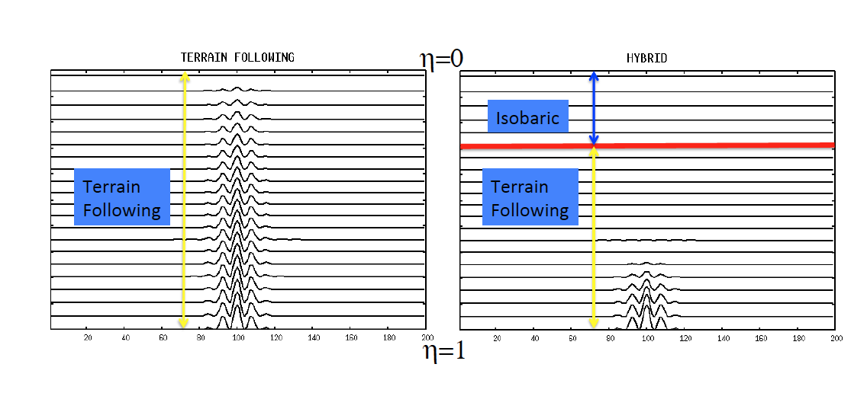
Hybrid Vertical Coordinate
New hybrid vertical coordinate option in V3.9
Isobaric at top means less noise in upper-air output over mountains
η_{c}

Slide 11
Hybrid Vertical Coordinate
Terrain Following
Hybrid Coordinate
Top
w
w
10 km
6 km
0
10
15
20
0
0.01
0.02
U (m/s)
N (s⁻¹)
In this 2d test, all the flow is above the terrain.
Terrain following coordinate shows response to coordinate in vertical motion (max < 1 m/s).
Hybrid coordinate correctly shows no significant response.
dx=1 km, dz=500 m
ht=2000 m, top= 20 km
η_{c}=0.3, 5 hrs

Slide 12
Hybrid Vertical Coordinate
V3.9 implementation
Compile-time choice to add hybrid option (./configure –hyb)
Uses C Pre-Processor (CPP) to mostly modify μ instances from 2d [μ(i,j)] to 3d [μ(i,j)C₁(k)+C₂(k)] form
Initial and boundary files from real.exe run with hybrid coordinate on (hybrid_opt=2)
Code compiled with hybrid option can also be run non-hybrid coordinate (hybrid_opt=0) – same results as original code
Only parameter to select is η_{c} level at which pure isobaric coordinate starts (etac=0.2 is default)
Below this level the coordinate is a weighted function of terrain-following and isobaric
See README.hybrid_vert_coord in WRFV3 directory
Works for real cases, hill2d_x and LES idealized cases only
Works for nesting, restarts, WRFDA, WRF-Chem
Works for WRF NCL, RIP, UPP

Slide 13
Predicted Particle Property Microphysics
Reference: Morrison and Milbrandt (2015, JAS)
New microphysics options
mp_physics=50 has single-moment cloud water fixed Nc
mp_physics=51 has double-moment cloud water with prognostic Nc to allow activation of given aerosols
Single ice category advected (qi) plus rimed ice mass, rimed ice volume and ice number concentration properties to predict density, fallspeed, etc.
Cloud and rain advected (qc and qr) with rain number concentration and (for option 51) cloud number concentration

Slide 14
Stochastic Physics Options
Stochastically perturbed physics tendencies (sppt=1)
Random pattern to perturb accumulated physics tendencies (radiation, cumulus, PBL) of potential temperature, wind and humidity (Berner et al., 2015 MWR)
Stochastic perturbed parameter scheme (spp=1)
Random pattern to perturb parameters in specific physics schemes, currently GF convection, MYNN PBL, and RUC LSM (Jankov et al. 2016 MWR)
Poster P11

Slide 15
Other New Features
Trajectory code has been updated by NCAR/ACOM to interpolate diagnostic quantities to trajectories
RASM (U Colorado) diagnostics for climate applications – includes diurnal and monthly averaging of surface and radiation budget terms
Physics tendencies (RTHRATEN, RQVCUTEN, etc.) are now output uncoupled to mu
HAILCAST diagnostic updated (hailcast_opt=1)

Slide 16
NoahMP Update
See talk 4.6 by Mike Barlage
NoahMP now has the urban options that were in Noah
Better capabilities with crops and groundwater
New option for hi-res global soil dataset for LSMs (default is not changed)
30” (~1 km) global
Old dataset only 30” US, effectively 5’ outside US

Slide 17
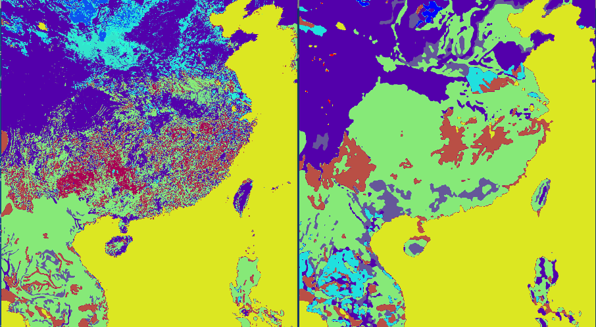
New Hi-Res Global Soil Data

Slide 18
Other Updates
topo_wind =1 has been modified to allow for the diurnal cycle variation of sub-grid effect, where in daytime the effect is reduced
Several important updates to RAP/HRRR physics (MYNN PBL, RUC LSM, GF cumulus)
icloud=3 has been improved slightly for surface solar flux
Noah LSM fix to allow very small fractions of snow cover to melt away faster

Slide 19
Bug Fixes
Bug since V3.7 tmn_update=1 regional climate option on restarts would lead to gradual cooling of deep soil layers – fixed in V3.9
Bug since V3.8: WSM3 and Kessler microphysics options would not provide cloud fractions to radiation – fixed in V3.9
Bug, combination of Hi-res Ferrier microphysics with CAM radiation misses ice/snow contribution – fixed in V3.9
Other bug-fixes were minor and listed on WRF V3.9 Updates page

Slide 20
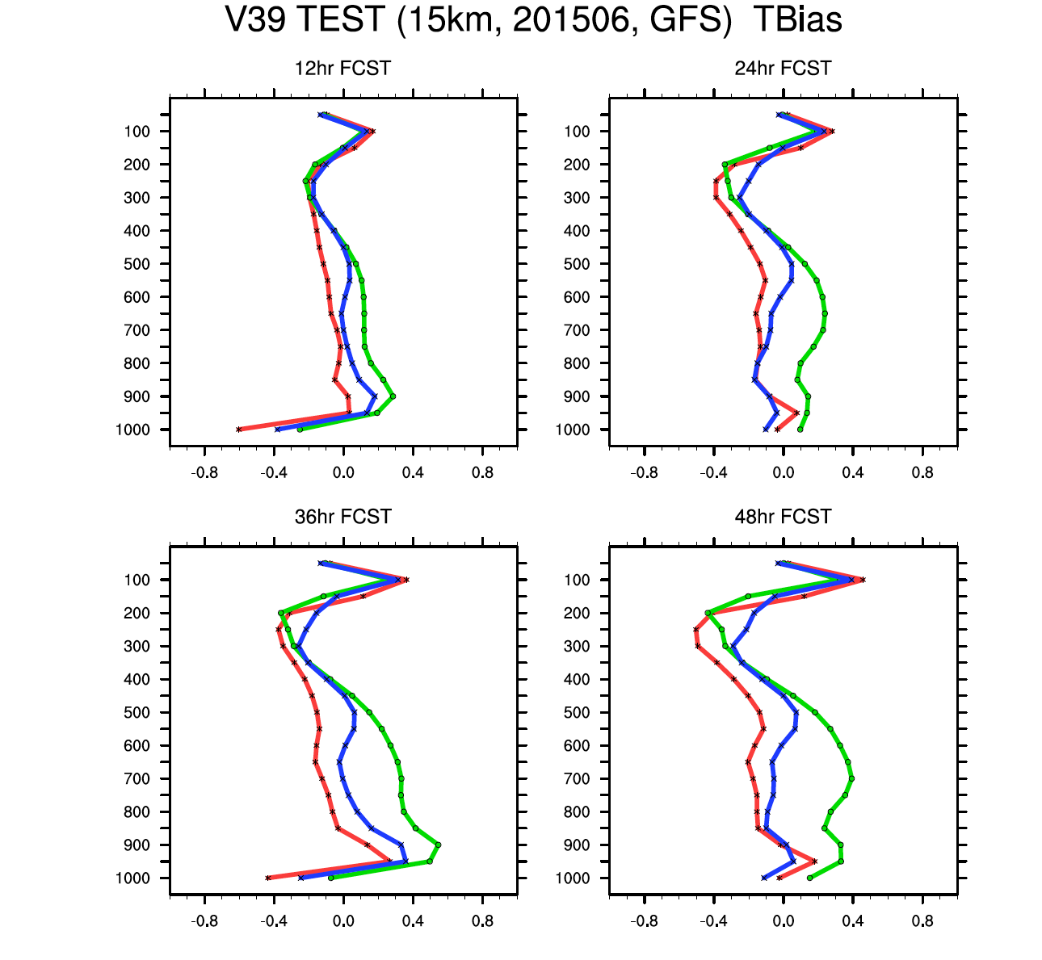
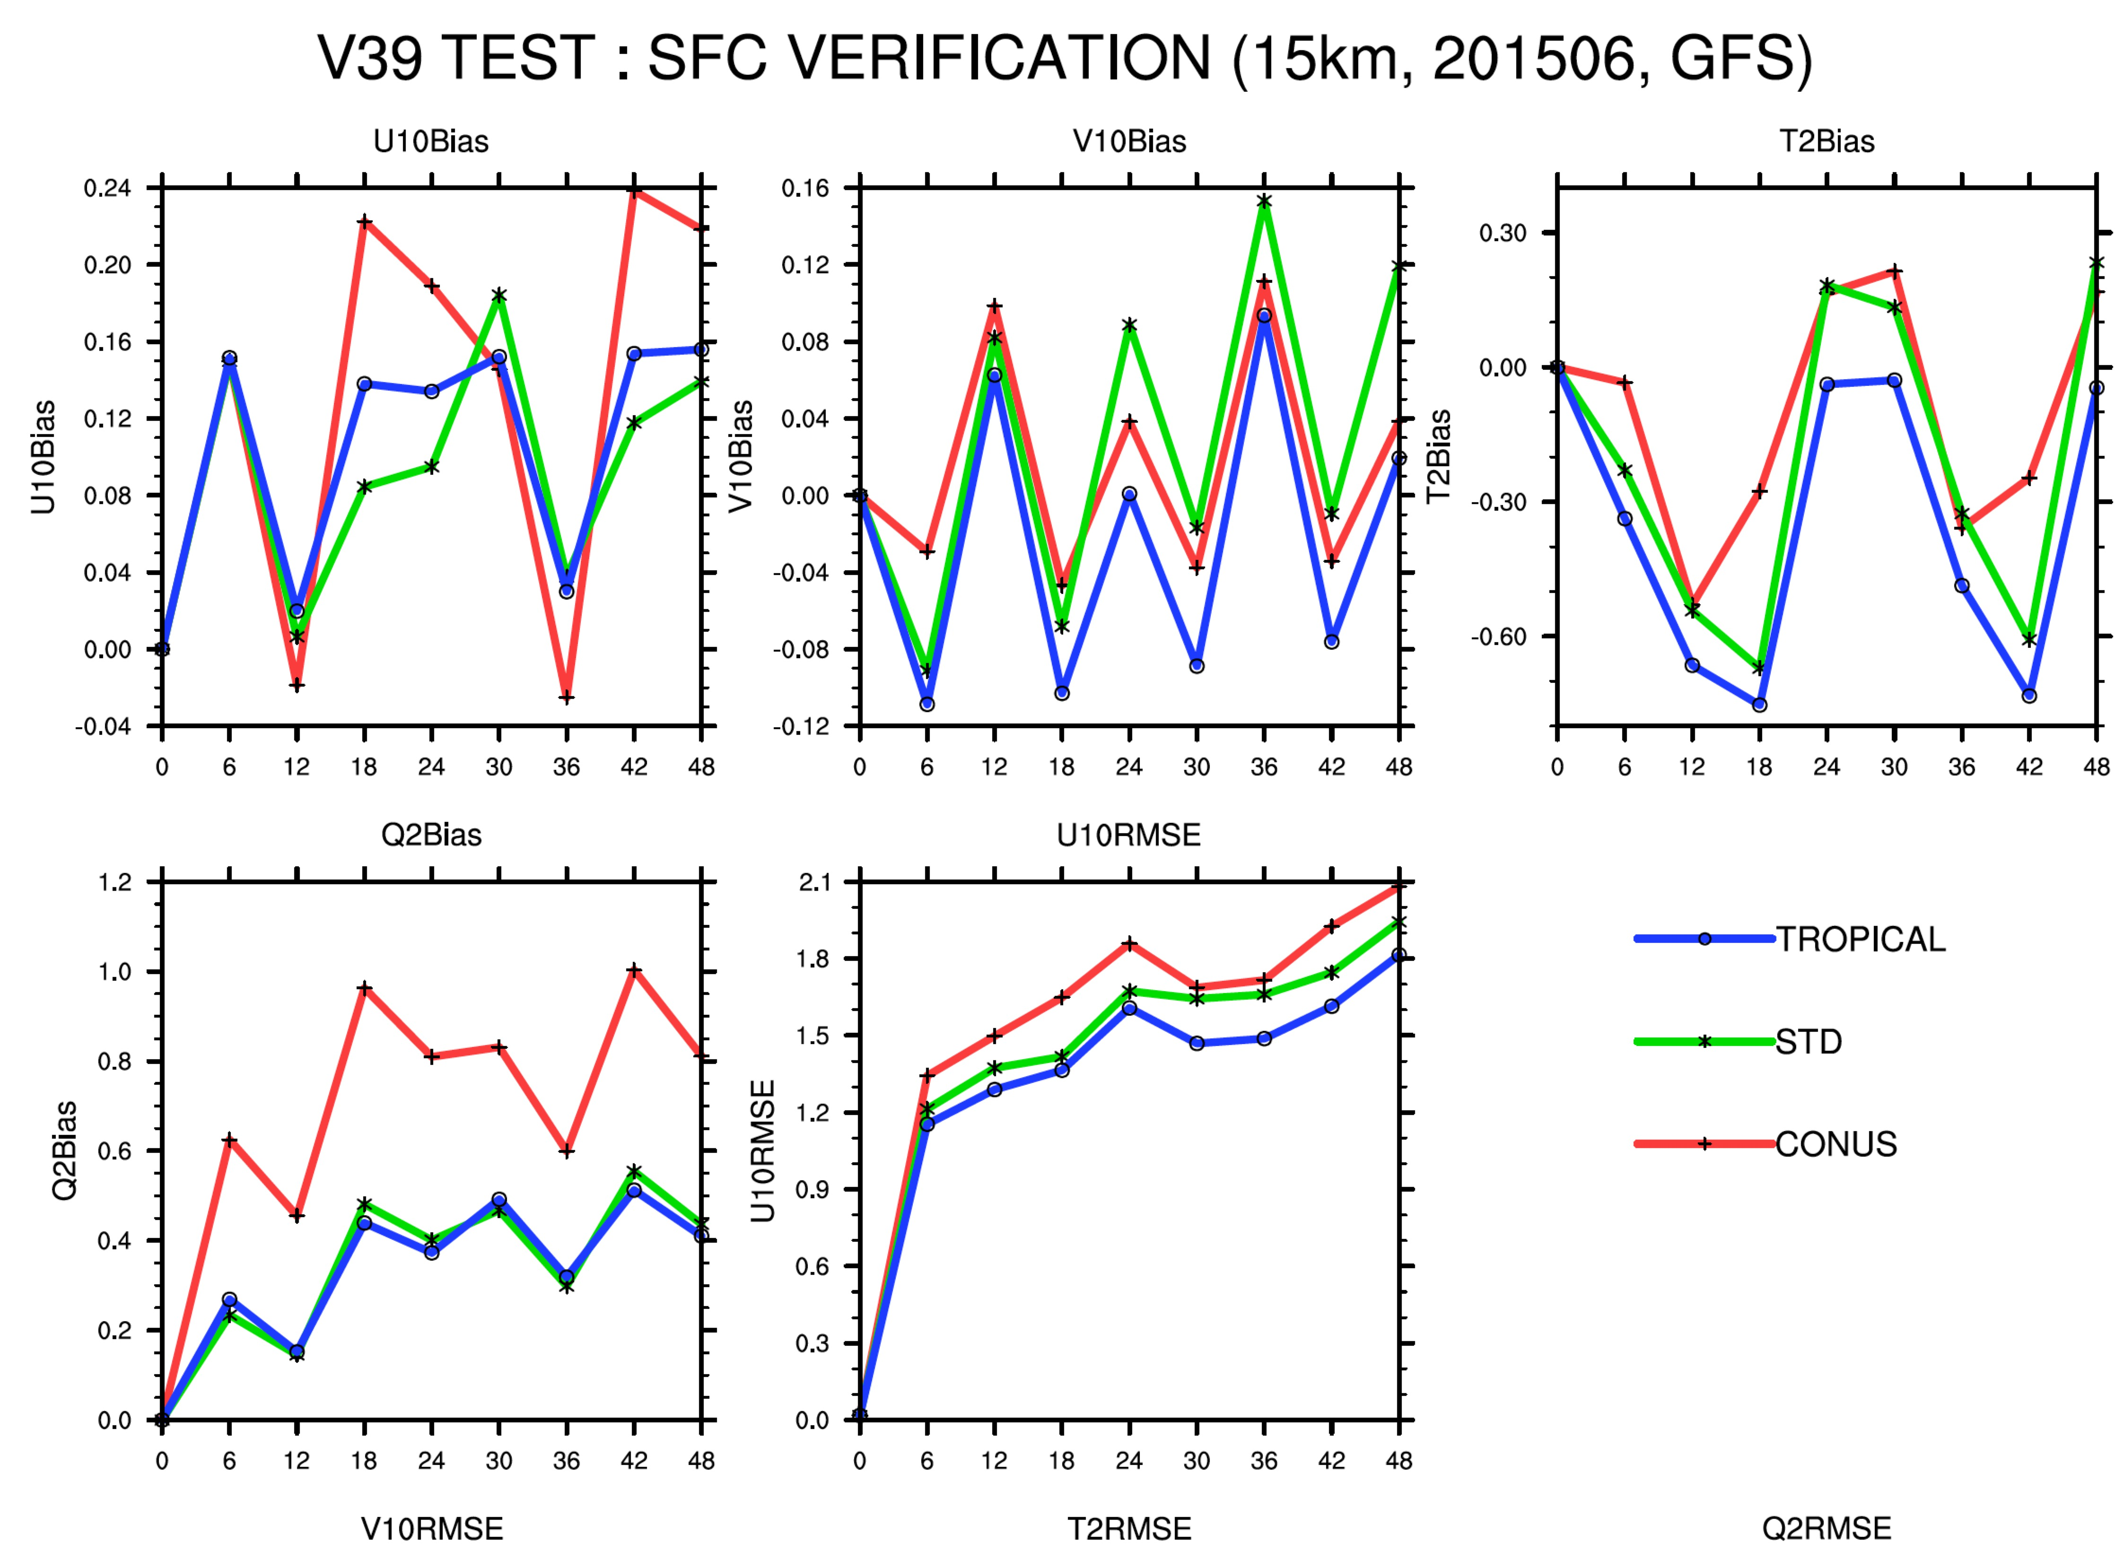
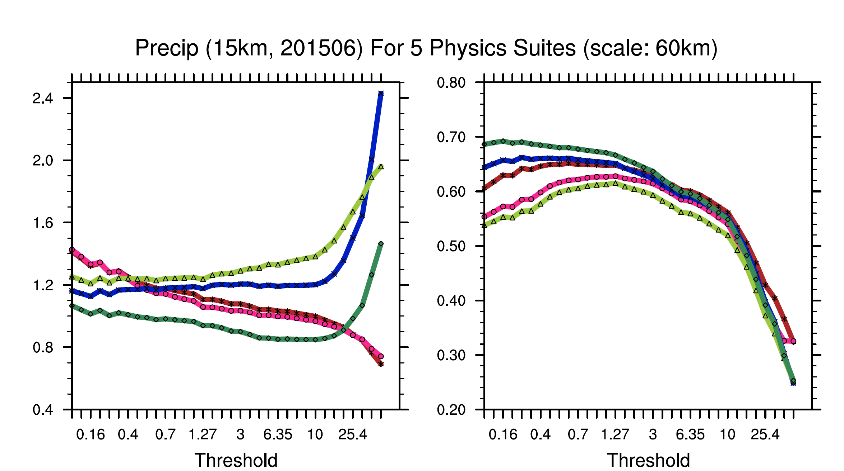
Release Testing
15 km – June 2015 and January 2016 – 28 cases each, test new suites, new and changed options and “standard configuration” new version against previous version (YSU, RRTMG, WSM5, Noah, KF)
3 km – May/June 2016 – 18 cases – CONUS suite

Slide 21
Test Suites
 | Microphysics | Cumulus | Radiation | PBL | LSM
STD | WSM5 | KF | RRTMG | YSU | Noah
Tropical | WSM6 | New TDK | RRTMG | YSU | Noah
CONUS | Thompson | TDK | RRTMG | MYJ | Noah
CU16 (CONUS) | Thompson | New TDK | RRTMG | MYJ | Noah
RAP2 (RAP/Noah) | Thompson-aero | GF | RRTMG | MYNN | Noah
RAP* | Thompson-aero | GF | RRTMG | MYNN | RUC
3 km (CONUS) | Thompson | none | RRTMG | MYJ | Noah
* We mostly show RAP2 because LSM initialization is with GFS soil

Slide 22
Surface Verification
Summer versus GFS analysis
CU16 and CONUS have higher 2m moisture bias (both MYJ suites) – also show in 2m T at 18Z
MYNN has low 2m Qv bias
For 2m T all other runs comparable including V3.8.1 versus V3.9 STD suite
Hybrid coordinate test also shows no difference from STD
MYJ
YSU
MYNN

Slide 23
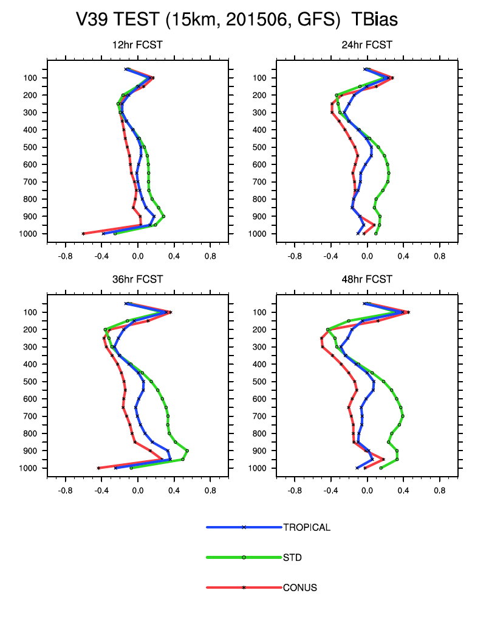
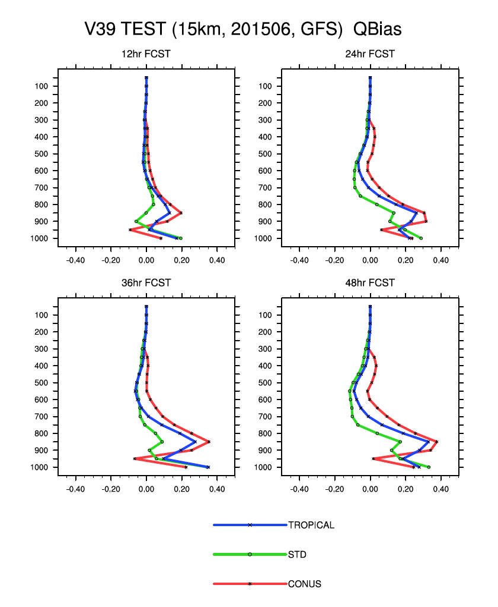
Profile Verification: Suites

Slide 24
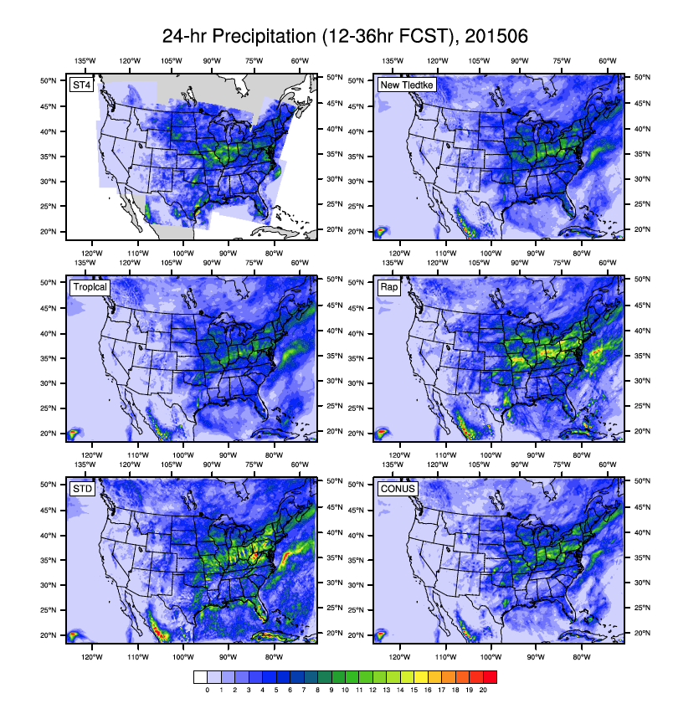
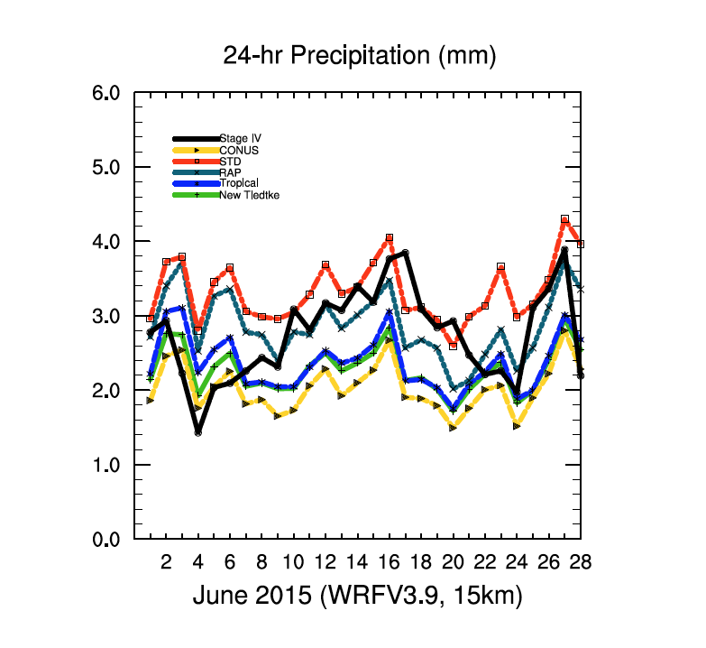
Precipitation Verification: 15 km Suites
June 2015 daily-averaged precipitation (observation is ST4): STD and RAP2 have higher peak values
Rap2

Slide 25
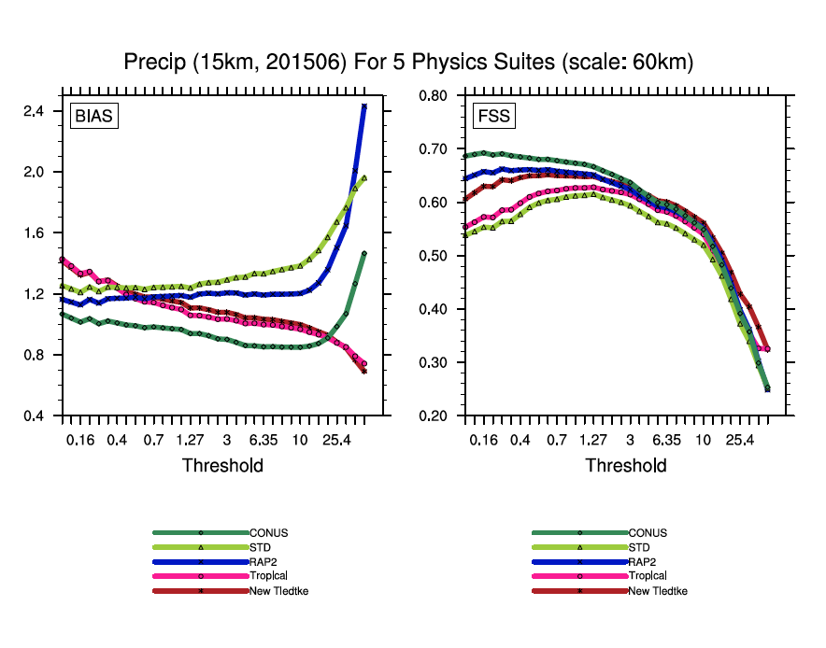
Precipitation Verification: 15 km Suites
FSS = fractional skill score – verifies probability within radius (accumulated monthly stats)
GF
KF
TDK
NTDK
Note: Biases same in Tropical and “New Tiedtke” which both contain same cumulus scheme but different other physics
Notes:
Need frequencies

Slide 26
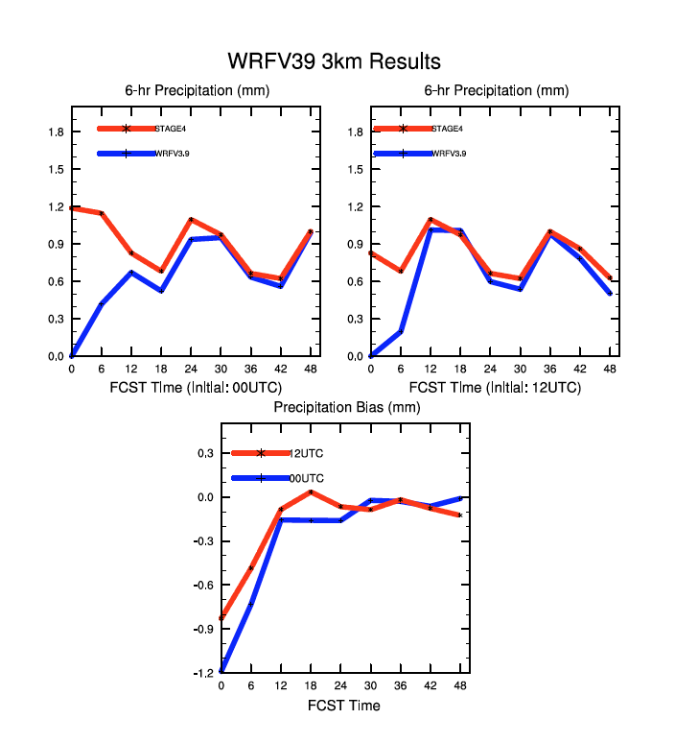
Precipitation Verification: 3 km CONUS
May/June 2016 average diurnal cycle of 6-hour precipitation (observation is STAGE4)
00Z init shows spin-up
Biases small after spin-up period of ~6 hrs

Slide 27
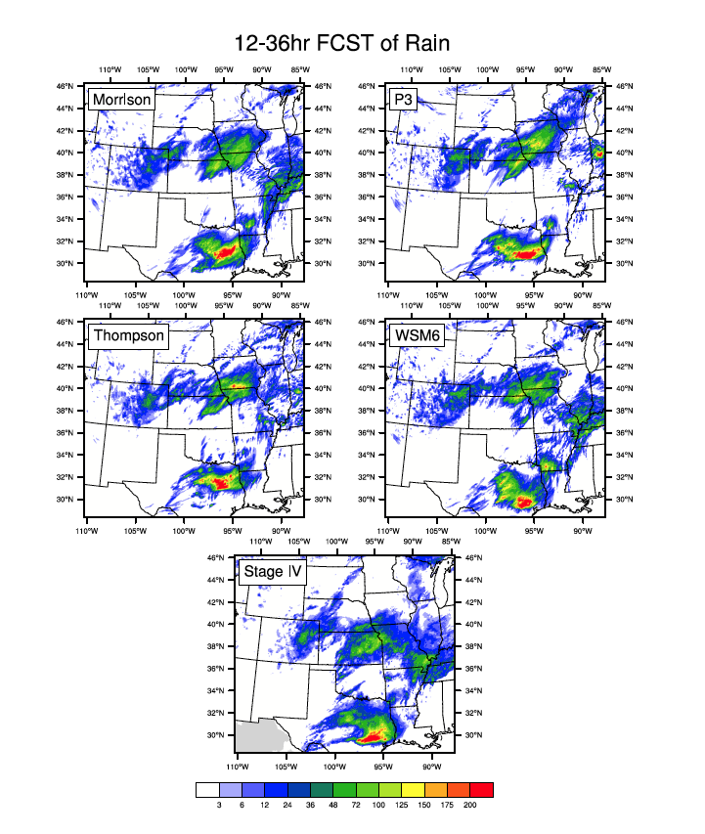
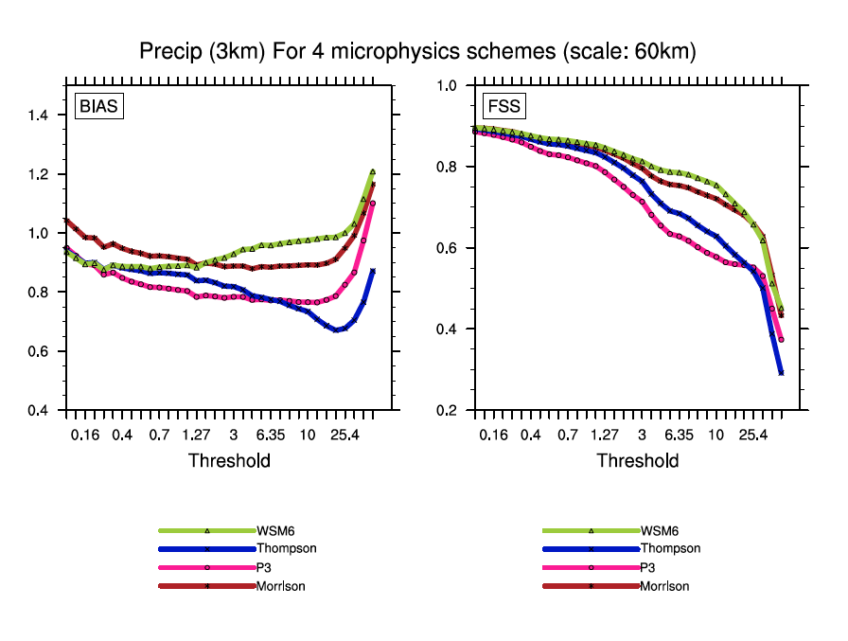
Microphysics Comparison: 3 km Case
Testing P3 against Morrison, Thompson and WSM6 in single case

Slide 28
Version 4.0
Planned for next major release in April 2018
Hybrid Coordinate built in (no special pre-processing of code)
Thermodynamic variable changes from θ to θ_{m}
θ_{m} = θ (1+(R_{v}/R_{d})*q_{v}) ≈ θ (1+1.61*q_{v})
Note difference from θ_{v} ≈ θ (1+0.61*q_{v})
θ_{m} is used in MPAS and was used in old height coordinate version of WRF (see Klemp et al., 2007, MWR)
This variable is more closely related to pressure in moist conditions which has subtle dynamical benefits
In V3.9 use_theta_m does this transformation
When built into code and boundary files, code is simplified
Lateral boundary file becomes uncoupled

Slide 29
WRF/MPAS User Support
Considering forum-based approach
Pros
User can search for previous answers to their questions
Answers can be seen by all and may be useful for general awareness of issues
Other users can answer questions in addition to official NCAR support that will be maintained
Forum can be organized by topics such as compiling, preprocessing, runtime problems, regional climate, etc.
Cons
Some problems require iterations of tests and data transfers so this seems to need an offline capability to be maintained
Not clear how to present resolution of these problems back to forum
Moderation needed as well as vetting answers

Slide 30

Thanks

