Slide 1


WRFDA 2017 Update
Jake Liu
Jamie Bresch, Michael Kavulich, Juanzhen Sun,
Junmei Ban, Ying Zhang
NCAR/MMM

Slide 2
Outline
New features in WRFDA V3.9
Ongoing R&D

Slide 3
New Features in V3.9
AMSR2 all-sky radiance DA
From beta release to official release, see Yang et al., 2016, Tellus.
Hybrid-4DEnVAR
4D extension of hybrid-3DEnVar (also known as hybrid-3DVAR)
No rain echo radar DA
Contributed by Prof. Ki-Hong Min of Kyungpook National University (kmin@knu.ac.kr)
3DVAR & hybrid-3D/4DEnVar work with new hybrid vertical coordinate WRF (not for 4DVAR yet)

Slide 4
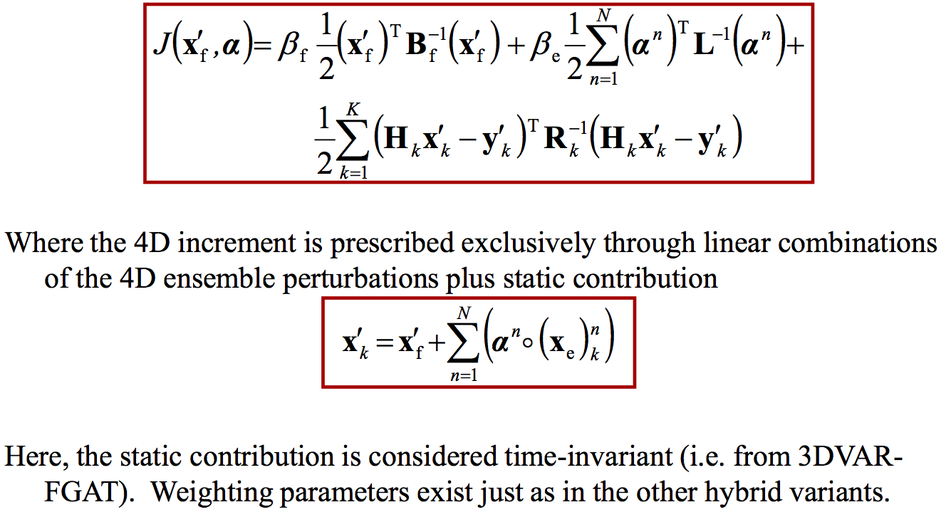
Cost function of Hybrid-4DEnVar
Time index k within DA time window
Ensemble perturbations
(4D at multiple times
within DA time window)
no TL/Adjoint of WRF needed

Slide 5
Namelist setting for hybrid-4DEnVar
&wrfvar3
num_fgat_time = 7,
&wrfvar16
use_4denvar = .true.,
ensdim_alpha = 50,
For this particular setting, will need 7 first guess files
to calculate OmB at 7 time slots within time window,
also need 50*7 ensemble files!

Slide 6
Other updates and fixes
Update CRTM from version 2.1.3 to 2.2.3
Fixed duplicate calls to adjoint and tangent linear models for 4DVAR with calculate_cg_cost_fn=true, unnecessarily doubling runtime.
Fixed discontinuities when using dual-resolution hybrid with 5:1 parent:nest ratio
See http://www2.mmm.ucar.edu/wrf/users/wrfda/updates-3.9.html
for a more complete list of fixes.

Slide 7
Ongoing R&D
Stage-IV rainfall 4DVAR DA at convective-scale
Multi-Resolution Incremental 4DVAR
Himawari-8 AHI clear-sky radiance DA
GOES-Imager radiance DA
WRFDA extension for chemistry DA

Slide 8
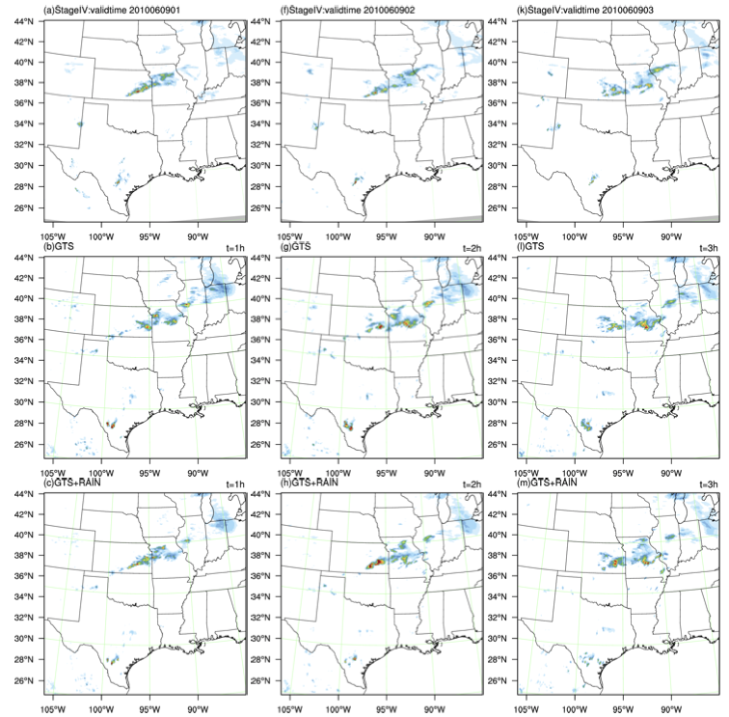
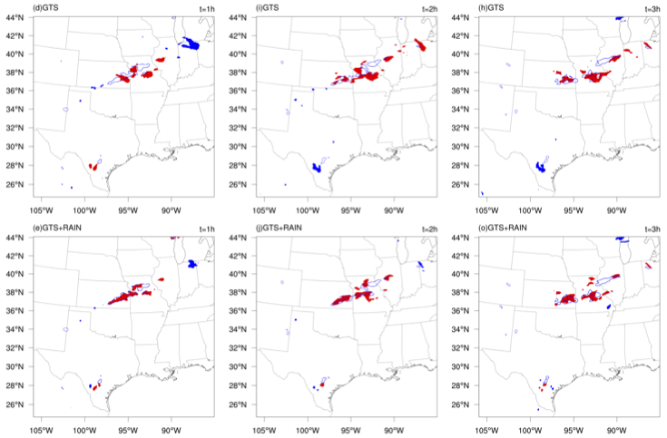

Stage-IV 4DVAR DA: 1h - 3h forecast
1-h 2-h 3-h 1-h 2-h 3-h
OBS
MET Object-based verification
GTS
GTS+Rain

Slide 9
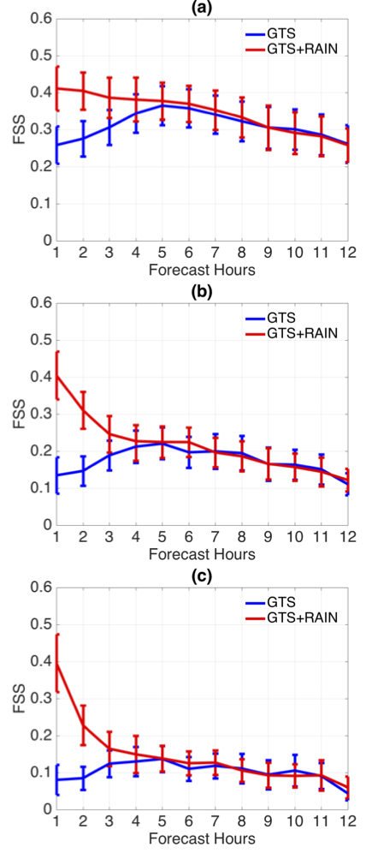
One week score (9-15 June, 2010)
1 mm
5 mm
10 mm
Statistics over 28 forecasts
Ban et al., 2017, Tellus, under review

Slide 10
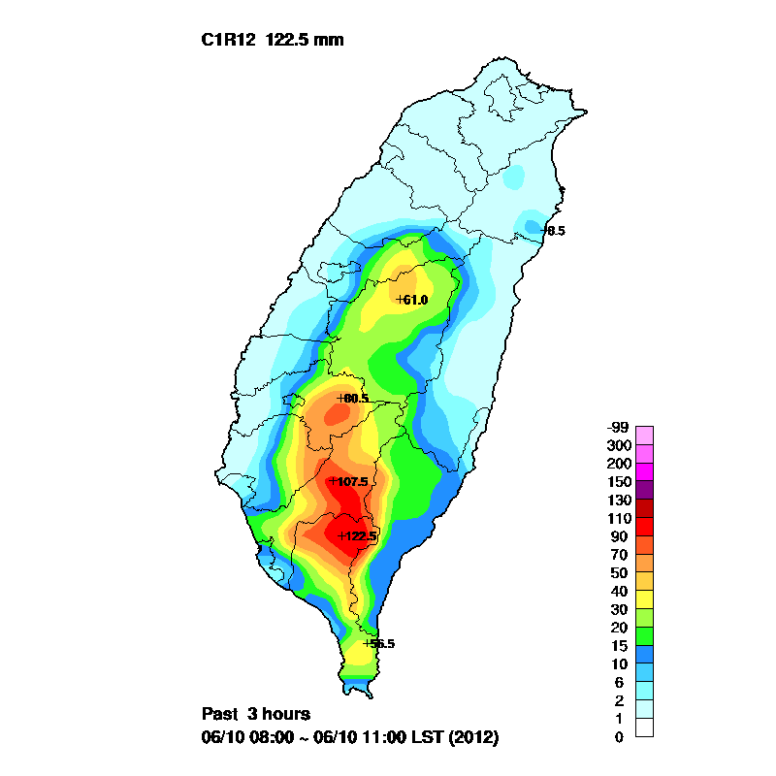
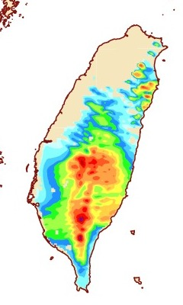
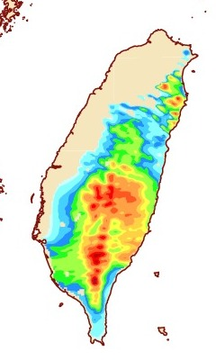
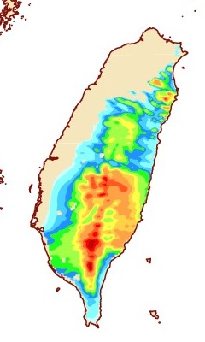
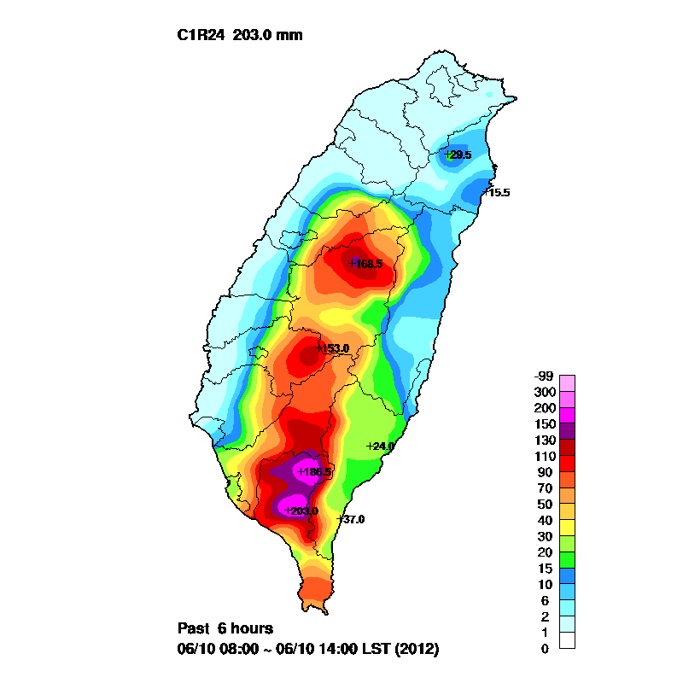
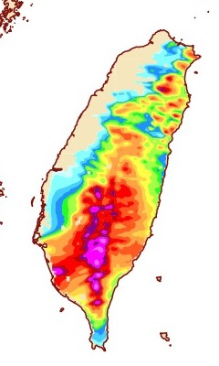
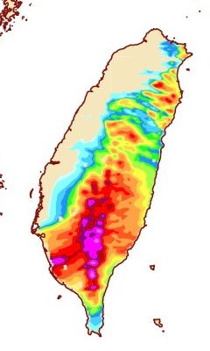
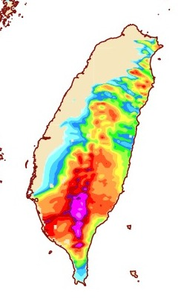
MRI-4DVAR: rainfall forecast over Taiwan
OBS 2km/2km 6km/6km 18km/6km
rainfall 4DVAR MRI-4DVAR MRI-4DVAR
3-hr acc.
Rainfall
6-hr acc.
rainfall

Slide 11
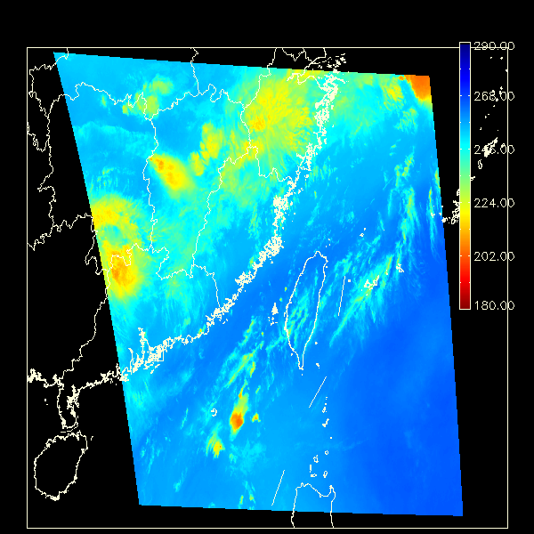
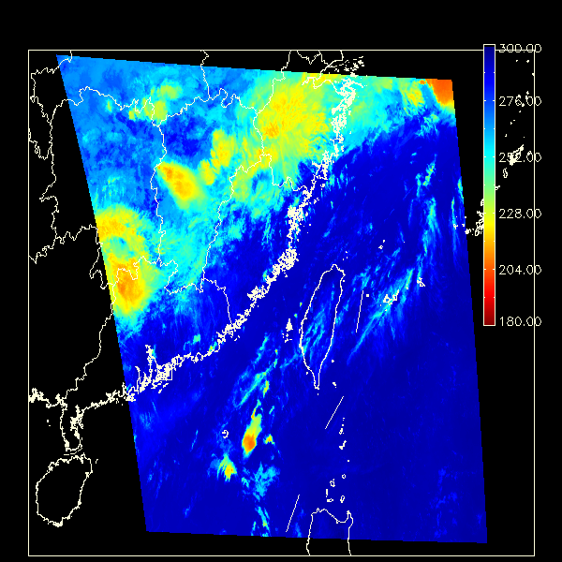
Himawari-8 AHI Imagery over Taiwan
7.3 um water vapor channel
8.6 um infrared channel
Every 10-min from 8am to 6:50pm local time, 2015-06-14

Slide 12
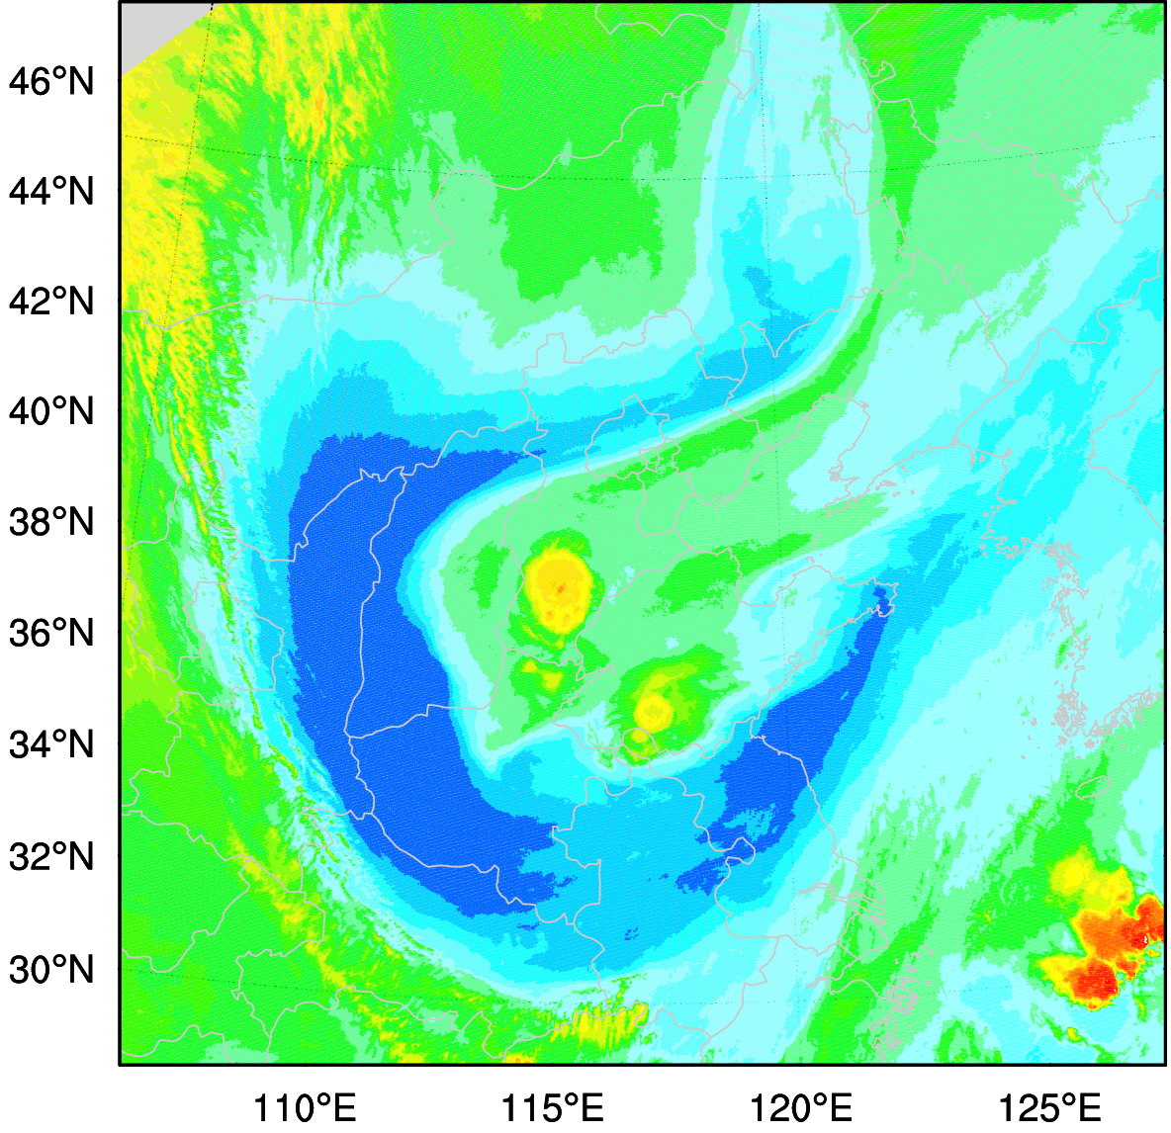
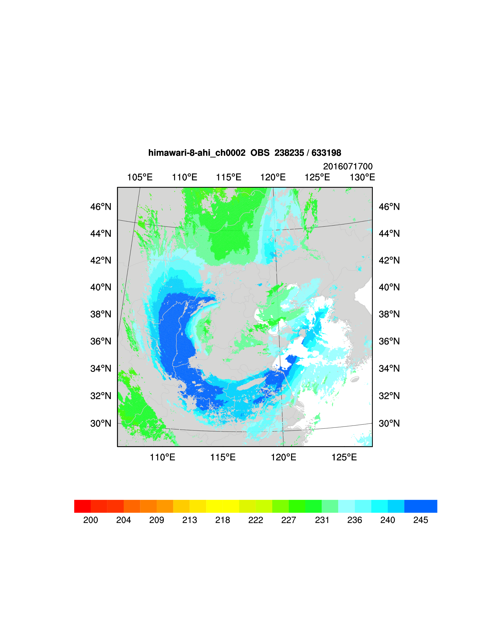
AHI 3 WV channels hourly clear-sky radiance DA
with WRFDA-3DVAR @3km
AHI Radiance water vapor channel
2016071800
Before QC
After QC

Slide 13
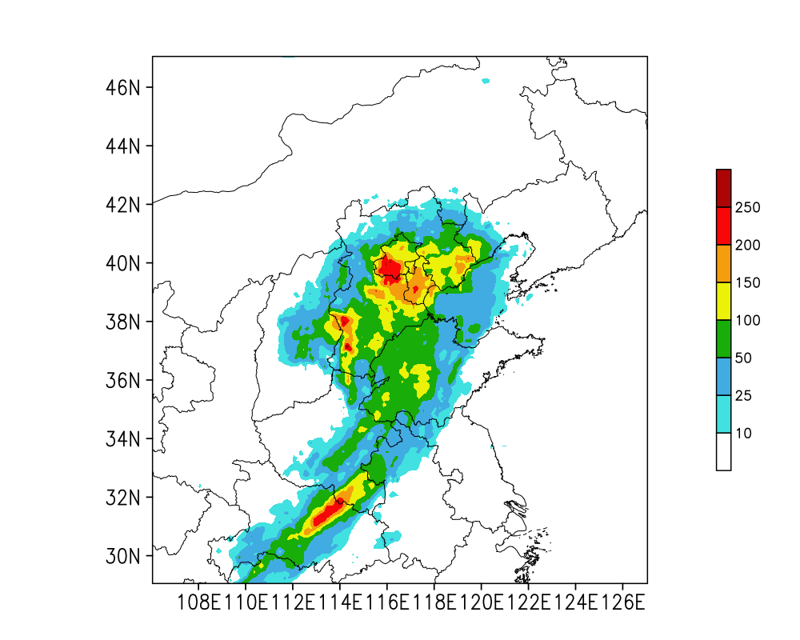
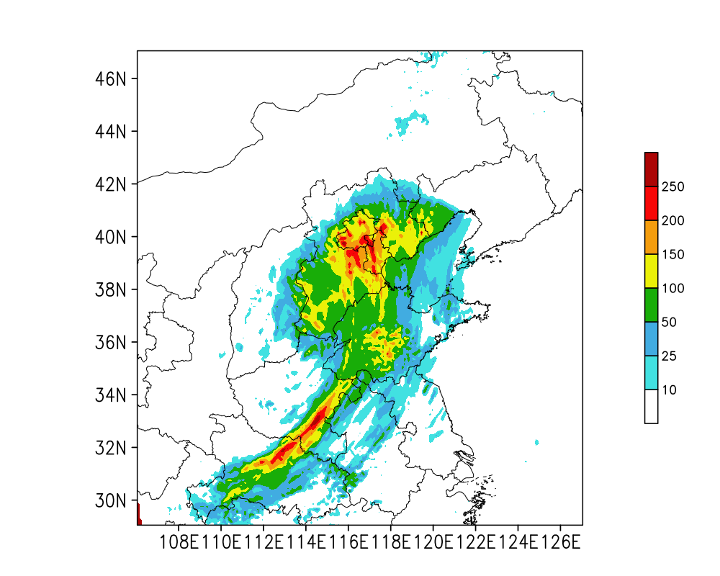
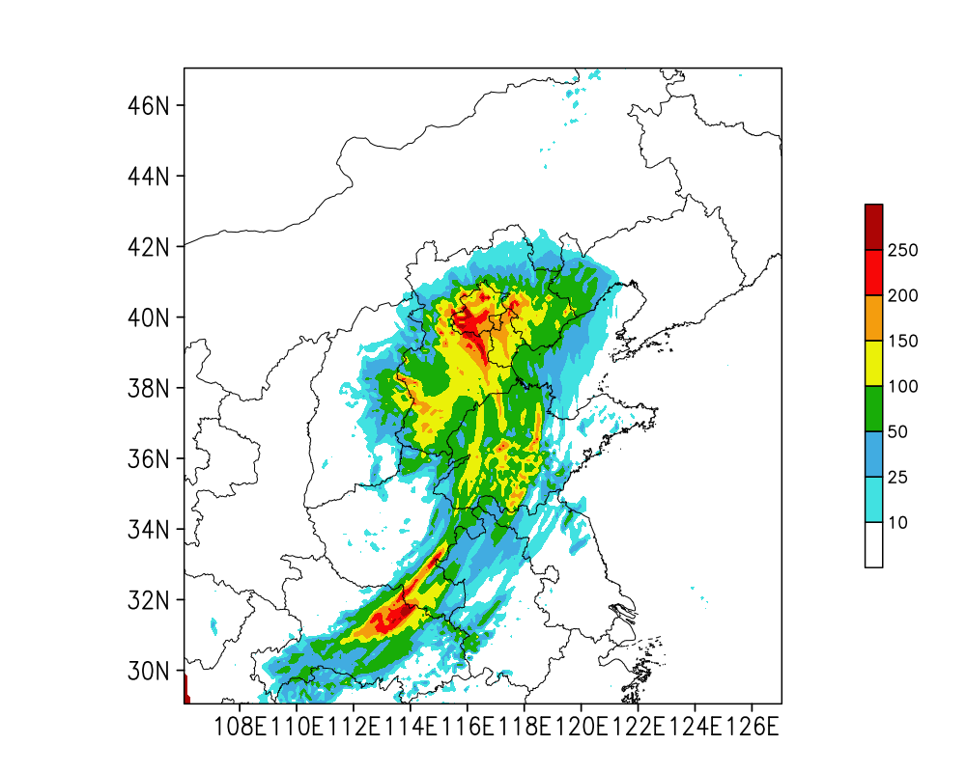

24h accumulated rainfall field initialized at 2016071912
OBS
CONV
AHI
Beijing Heavy rainfall

Slide 14
Thursday Morning DA Session
GOES-Imager radiance DA (2018 release)
WRFDA extension for WRF-Chem
We will further develop chemistry DA capability and target for public release in 2019

Slide 15
Began to design Next-Generation DA
New DA framework shall be generic, e.g., not tied to a specific model
However, MMM’s focus will be for MPAS convective-scale applications (both global and regional)
Key is to properly modeling forecast error covariances on unstructured mesh with local refinement
Partnership with other institutions having similar goal

