Slide 1

Software Updates and Plans
Dave Gill

Slide 2
OpenMP Parallelism is Pretty Good
January 2000 Benchmark
Radiation Day Radiation Night Not Radiation Timestep
Core Count | SM Efficiency | DM Efficiency
1 74x61 | 100 | 100
2 74x31 | 97 | 100
4 37x31 | 93 | 97
8 37x16 | 91 | 96
16 19x16 | 65 | 85
Core Count | SM Efficiency | DM Efficiency
1 74x61 | 100 | 100
2 74x31 | 97 | 100
4 37x31 | 93 | 95
8 37x16 | 88 | 92
16 19x16 | 59 | 83
Core Count | SM Efficiency | DM Efficiency
1 74x61 | 100 | 100
2 74x31 | 94 | 97
4 37x31 | 84 | 80
8 37x16 | 68 | 71
16 19x16 | 43 | 52
Avg 5.76 s Avg 2.16 s Avg 0.39 s
Std 0.019 s Std 0.005 s Std 0.012 s
n = 17 n = 24 n = 432

Slide 3
OpenMP Parallelism is Pretty Good
Mods to v3.9 fix “oops” in tile computations
On NCAR supercomputer cheyenne, use omplace to pin threads to the same core
Google “NCAR cheyenne OpenMP” for example batch scripts

Slide 4
MPAS -> WRF (v3.9 WPS)
Metgrid package directly ingests MPAS model output
No interim re-projection
&metgrid
constants_name = ‘mpas:120km.grid1.nc’
fg_name = ‘mpas.120km’

Slide 6
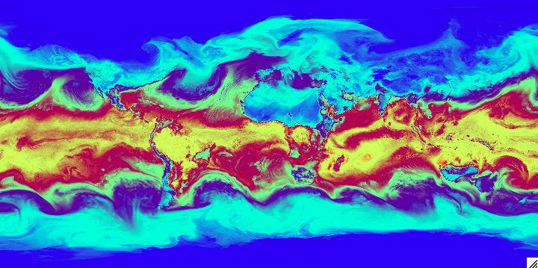

Slide 7
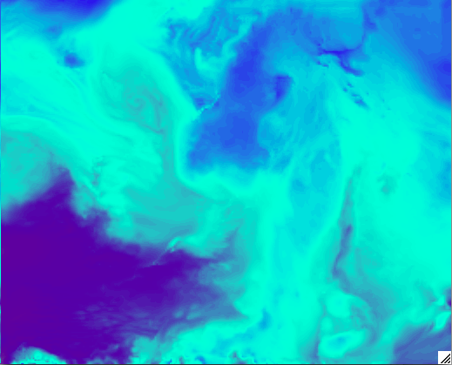

Slide 8
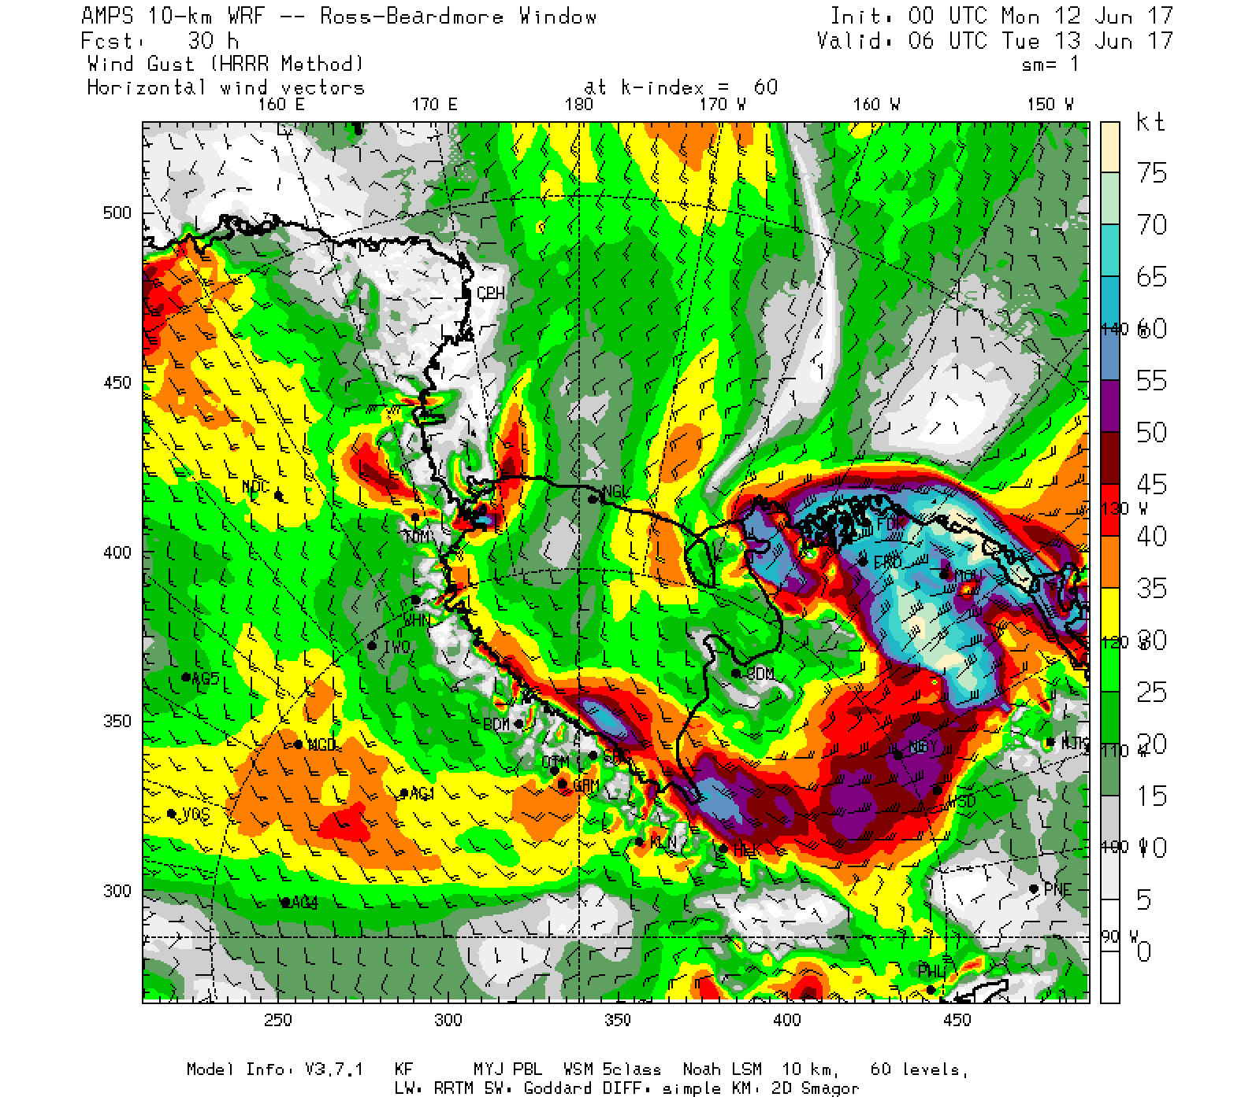
WRF&MPAS Share RIP!
WRF
Wind gust
South Pole

Slide 9
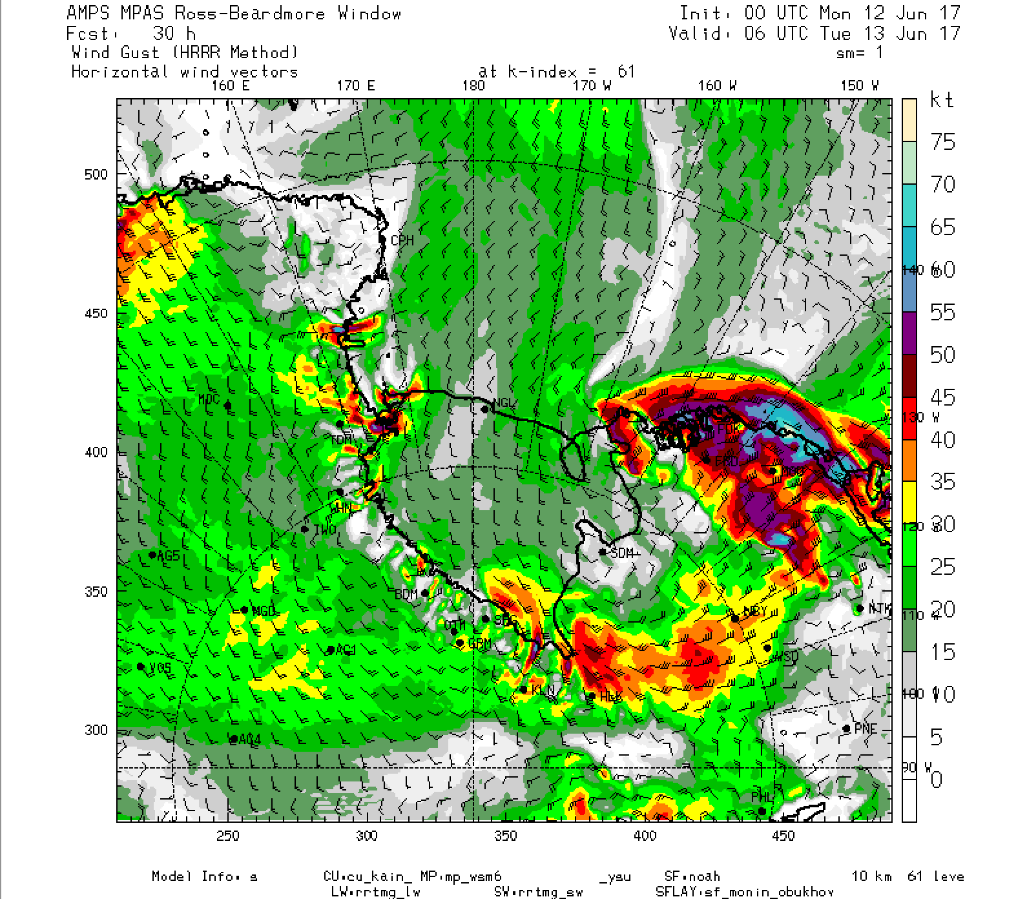
WRF&MPAS Share RIP!
MPAS
Wind gust
South Pole

Slide 10
WRF&MPAS Share RIP!
Priscilla Mooney and Kevin Manning
  Developers and image manufacturers
RIP
  Diagnostically rich
Currently:
  Intermediate lat-lon domain
  Direct mapping?? We’ll see
Available next major release

Slide 11
Shared Physics and Driver
Users
NCAR
Developers
NOAA
GFDL
Community
Supported
Repository
Oper
Univ

Slide 12
Shared Physics and Driver
Common Community Physics Packages (CCPPs)
Shared physical parameterization schemes
Ecosystem assumes git infrastructure
NCAR: CESM, MPAS, WRF participating
P1 The Common Community Physics Package, Bernardet, et al., DETAILS
Interoperable Physics Driver: Need a way to call these various physics packages

Slide 13
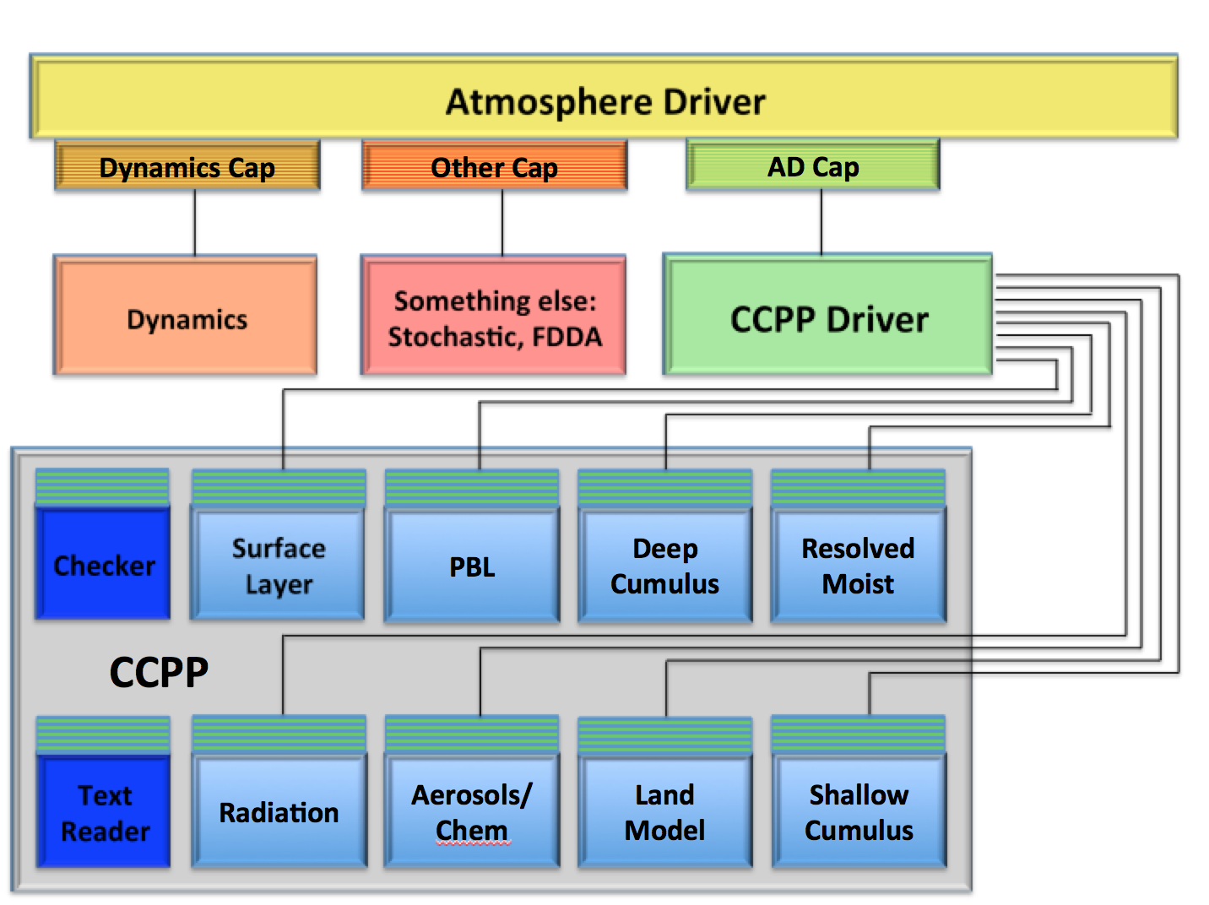
Shared Physics and Driver

Slide 14
Shared Physics and Driver
<?xml version="1.0" encoding="UTF-8"?>
<suite name="RAP">
<ipd part="1”> <subcycle loop="1">
<scheme>RRTMGLW</scheme>
<scheme>RRTMGSW</scheme>
<scheme>MYNNSFC</scheme>
<scheme>RUCLSM</scheme>
<scheme>MYNNPBL</scheme>
<scheme>GF</scheme>
</subcycle> </ipd>
<ipd part="2”> <subcycle loop="1">
<scheme>THOMPSONAERO</scheme>
</subcycle> </ipd>
</suite>
Suite Definition File: SDF
Text file of individual schemes which compose a “suite”

Slide 15
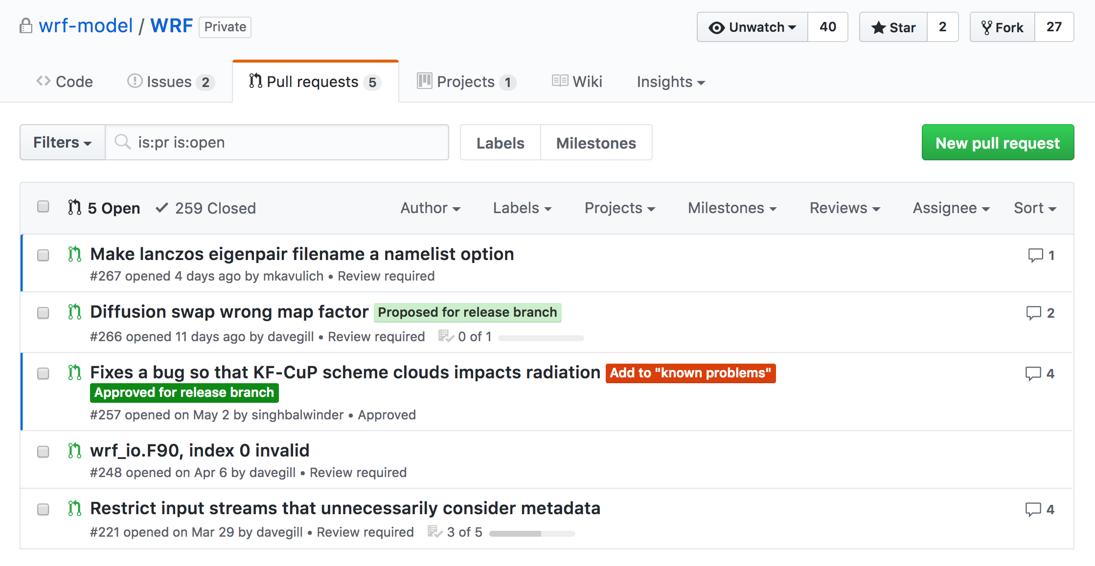
WRF+WPS on github
WRFv3.9 transitioned from NCAR based svn repository to git
Using github hosting services

Slide 16

WRF+WPS on github
Access is EASY: send your github User ID to Mike Kavulich kavulich@ucar.edu
ALL DEVELOPERS: contribute code via github pull requests

Slide 17
WRF Suites – Two So Far
IF ( model_config_rec % cu_physics(i) == -1 ) &
model_config_rec % cu_physics(i) = TIEDTKESCHEME
IF ( model_config_rec % mp_physics(i) == -1 ) &
model_config_rec % mp_physics(i) = THOMPSON
IF ( model_config_rec % ra_lw_physics(i) == -1 ) &
model_config_rec % ra_lw_physics(i) = RRTMG_LWSCHEME
IF ( model_config_rec % ra_sw_physics(i) == -1 ) &
model_config_rec % ra_sw_physics(i) = RRTMG_SWSCHEME
IF ( model_config_rec % bl_pbl_physics(i) == -1 ) &
model_config_rec % bl_pbl_physics(i) = MYJPBLSCHEME
IF ( model_config_rec % sf_sfclay_physics(i) == -1 ) &
model_config_rec % sf_sfclay_physics(i) = MYJSFCSCHEME
IF ( model_config_rec % sf_surface_physics(i) == -1 ) &
model_config_rec % sf_surface_physics(i) = LSMSCHEME
WRFV3/share/module_check_a_mundo.F

Slide 18

WRF Suites: Tropical
Implemented by Michael Duda
Currently inside check_a_mundo.F
Available: conus and tropical
Users can modify defaults
Info: WRFV3/test/em_real/examples.namelist

Slide 19
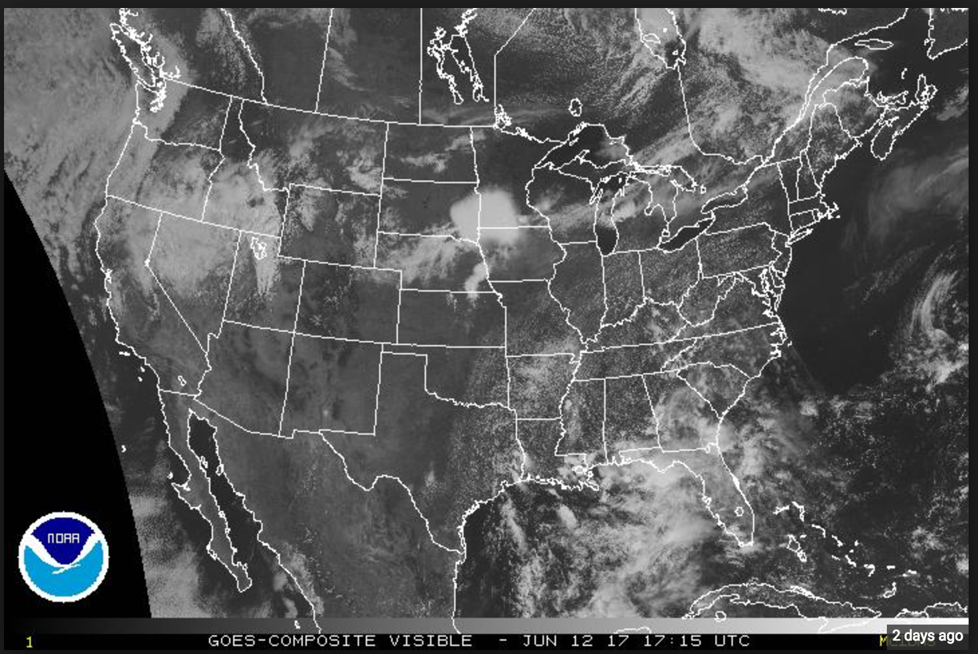
WRF Suites: Conus
&physics
physics_suite = 'tropical'
cu_physics = -1, -1, 0,
-1 = use what the physics_suite variable says

Slide 20
Plans
WRF v4.0 coming up in the Spring
  Not tied to backward compatibility
    LBC – maybe not coupled
    Moist theta default: changes to all of the ideals + real + DA + post-procs
  Shared physics
  Shared infrastructure for physics – maybe
  HVC:
    Un-cpp-ize
    All the ideals

Slide 21
Plans - Physics
Required of physics developers:
  Args commented:
    type, dim, in/out, char name, units
Physics Requirements (not exhaustive)
  Args simple Fortran types
  Routines: run, init, fini??, update??, restart??
  Nothing is “module USEd”, args or file input
  1d assumption
  Schemes do not call each other (or their subs)

