Slide 1
WRF, MPAS and Unified Modeling
Chris Davis
NCAR/MMM
Acknowledgements:
Joe Klemp, Bill Skamarock, Michael Duda, Dave Gill, Wei Wang, Jimy Dudhia, Chris Snyder, Dave Ahijevych, and Mariana Vertenstein

Slide 2
Purpose of this Talk
Define unified modeling
Describe the relationship of WRF and MPAS in a unified framework
Summarize ongoing work toward unification
Provide some thoughts on the future of WRF

Slide 3



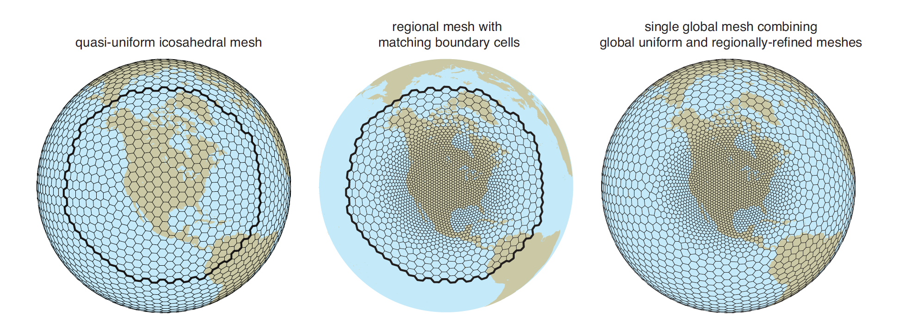
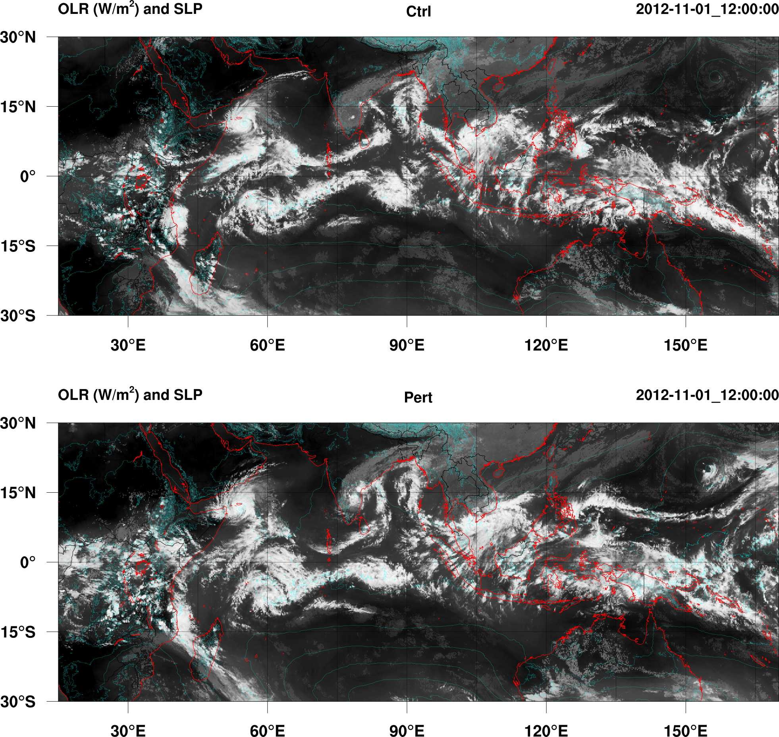
UNIFORM REGIONAL VARIABLE
See MPAS talks on Thursday

Slide 4
WRF
MPAS
Urban
meteorology
Regional NWP
Global NWP
Tropical cyclone/
hurricane prediction
LES modeling
Integrated global
/regional NWP
Convection permitting
hazardous weather forecasting
Nested regional
climate modeling
Regional atmospheric chemistry
research
Global atmospheric
chemistry research
Ensemble (EnKf), variational and Hybrid DA
Obs/grid nudging
applications
Global/regional
climate modeling
Idealized simulations
across scales
Fire model
coupling
Regional air-quality
forecasting
Seasonal
prediction
Notes:
Overlap between WRF and MPAS is large: argues for interoperability where possible

Slide 5
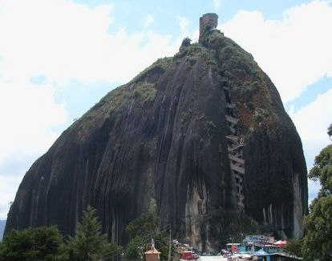
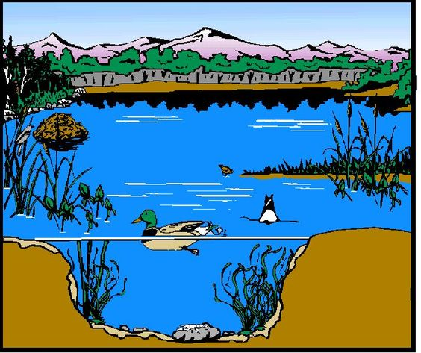
“Unified” Modeling
Monolith
Ecosystem
imgarcade.com
We are NOT building a monolithic unified system.
Unification will be realized through interoperability.
Notes:
represents not only WRF and MPAS, but broader effort at NCAR with CESM

Slide 6
Interoperability of WRF and MPAS
Common physics repository
Interoperable physics driver/interface
Common use of git for source code management
Development/support of a limited number of well tested physics suites
Coordination of user support
Use of MPAS to initialize and drive WRF
Common post-processing and graphics tools
git repositories
WRF code repository
common physics repository
MPAS code repository
WRF
MPAS
full model source code
checked out on file system

Slide 7
Common Physics Suites are Essential
More extensive testing possible
Reduced resources for support
Testing in MPAS can examine global suitability (benefits WRF)
Feasible for only a small number of suites
Better for migrating to future computing architectures
Intercomparison of results much easier
Recommendation to users is simplified
Emphasizes scale-insensitive physics

Slide 8
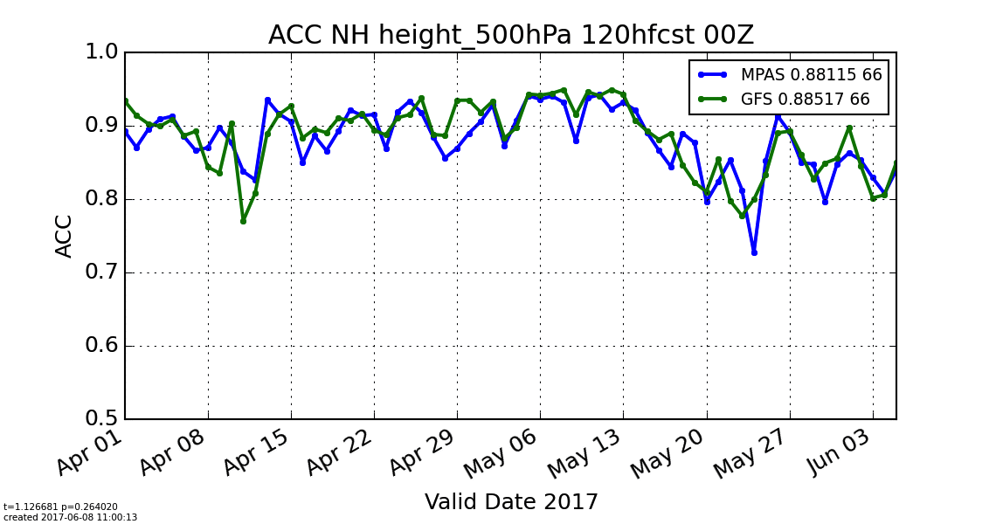
MPAS in Real-Time: Testing a Physics Suite
Mesoscale Reference Physics Suite
Northern Hemisphere Anomaly Correlation (20-80N)
60 km/15 km variable resolution
Notes:
In WRF, this is called “tropical” suite
No statistically meaningful difference between GFS and MPAS

Slide 9
Interoperable Physics
MPAS-A
Interoperable Physics Driver
WRF
Common Physics Repository
git repository
Physics Suites
MPAS Mesoscale Suite
NCAR Ensemble Suite
Notes:
So how does this physics testing with MPAS affect broader efforts? Through the CCPP
The CCPP Driver is what we have been calling the generalized IPD
A physics suite in the CCPP would also be used in porting an entire MPAS-based prediction system to a GPU architecture

Slide 10
Interoperable Physics
NEPTUNE
CAM-SE
FV3
MPAS-A
CCPP
Driver
WRF
EMC CCPP
NCAR Common Community Physics Package
(CCPPs)
Navy CCPP
What will (soon) be accessible through the NCAR CCPP?
HRRR/RAP physics from ESRL
WRF/MPAS suites from MMM
CAM6 physics from CGD
Atmospheric chemistry*
git repository(ies)
Notes:
So how does this physics testing with MPAS affect broader efforts? Through the CCPP
The CCPP Driver is what we have been calling the generalized IPD
A physics suite in the CCPP would also be used in porting an entire MPAS-based prediction system to a GPU architecture

Slide 11
Advantages of Interoperable Driver
Reduced effort to port physics to different dycores
Unambiguous single-source physics codes
Clean intercomparisons with different dycores and physics
More groups have a common ground on which to work together. R2O and O2R more likely.
Accessible innovation: sharing next-generation technology
Notes:
works for both the “weather” perspective, where “physics orbits around the dycore” or climate perspective where “dcores orbit around the physics”

Slide 12

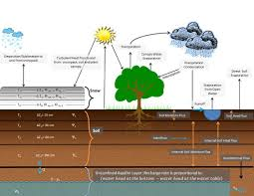
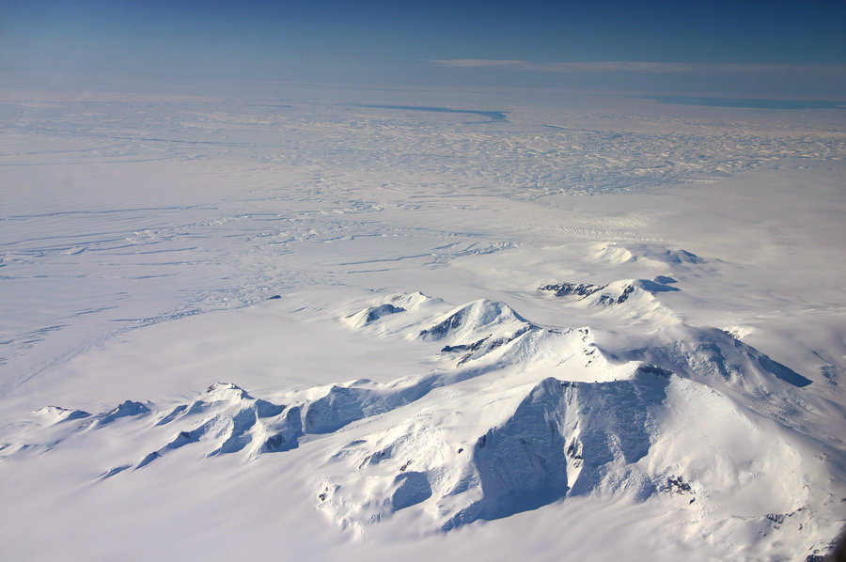
Earth-System Modeling: System of Ecosystems
Land
CLM (CGD)
CLM (CGD)
Ocean
CTSM
Noah-MP, WRF-Hydro (RAL)
NUOPC Mediator
(CIME)
Atmosphere
CTSM
Ice
NEPTUNE
CAM-SE
FV3
CAP
CAP
MPAS-A
CAP
CAP
CCPP
Driver
CAP
WRF
Common Community Physics Package
(CCPP)
Noah-MP, WRF-Hydro (RAL)
Notes:
The communication between ecosystems is “inter-component” coupling

Slide 13
Work in Progress
MMM
Common physics repository and testing (part of CCPP)
Regional MPAS: driving WRF and regional MPAS from global MPAS
Ensemble-variational DA for WRF and MPAS
Unified web-based community support for WRF and MPAS
NCAR-wide: Adapting CESM to support NWP as well as climate
NCAR/NOAA/NRL: Building and testing CCPP Driver with different physics and dycores
Notes:
unified support goals:
Tap the expansive knowledge of the community
Create searchable content
Focus effort on complex questions
Use same approach for WRF and MPAS
Migrate NCAR/MMM personnel to development and testing of interoperability of WRF and MPAS (and MPAS in CESM)

Slide 14
The Future of WRF and MPAS
WRF
Will remain as part of the NWP ecosystem
Will improve through development and testing of physics, chemistry and data assimilation
Will continue to address a range of applications and to capture sub-km scales.
MPAS
Will subsume a growing fraction of NWP science from WRF
Will move into seasonal prediction science using CESM components
Will be more easily adapted to future computing architectures
MPAS and WRF
Will share physics, pre-processing, post-processing, data assimilation and community support as part of an interoperable modeling ecosystem
Notes:
Further development of WRF, the dynamical core, will be small. Development will focus on MPAS, particularly using CESM components.
Will MPAS replace WRF? Possibly, eventually, but there is no time line for this. The priority is for shifting development from WRF to MPAS, making the models more unified so that improvements benefit both, and remaining flexible to take advantage of innovations. Interoperability reduces the need to make an irreversible decision now. External pressures, i.e. computing architectures, could emphasize MPAS over WRF in the next 5 years, but the computing landscape is highly uncertain. Coupled earth-system modeling will probably not be done with WRF.

Slide 15
Questions?

Slide 16
Extra Slides

Slide 17
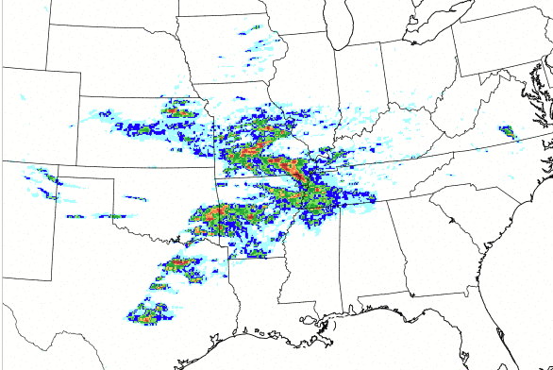
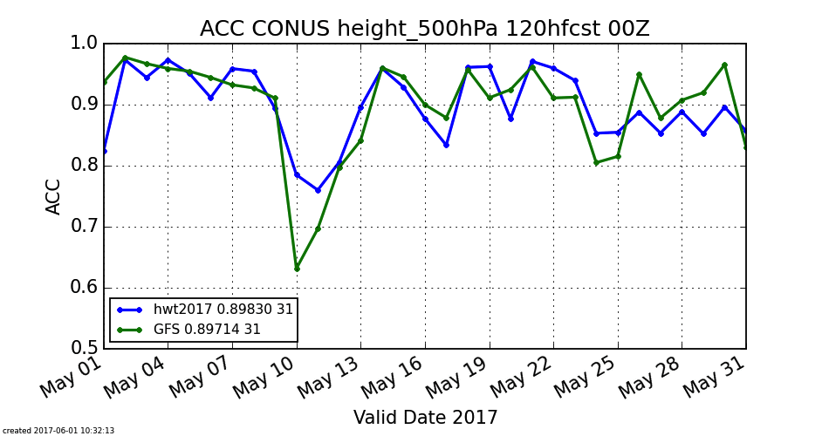
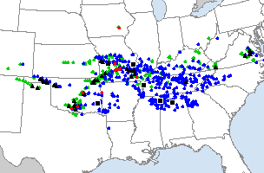
2017 HWT Forecasts
76-100 h forecast of 24-h maximum updraft helicity, initialized 00 UTC 24 May
SPC Storm Reports for May 27

Slide 18
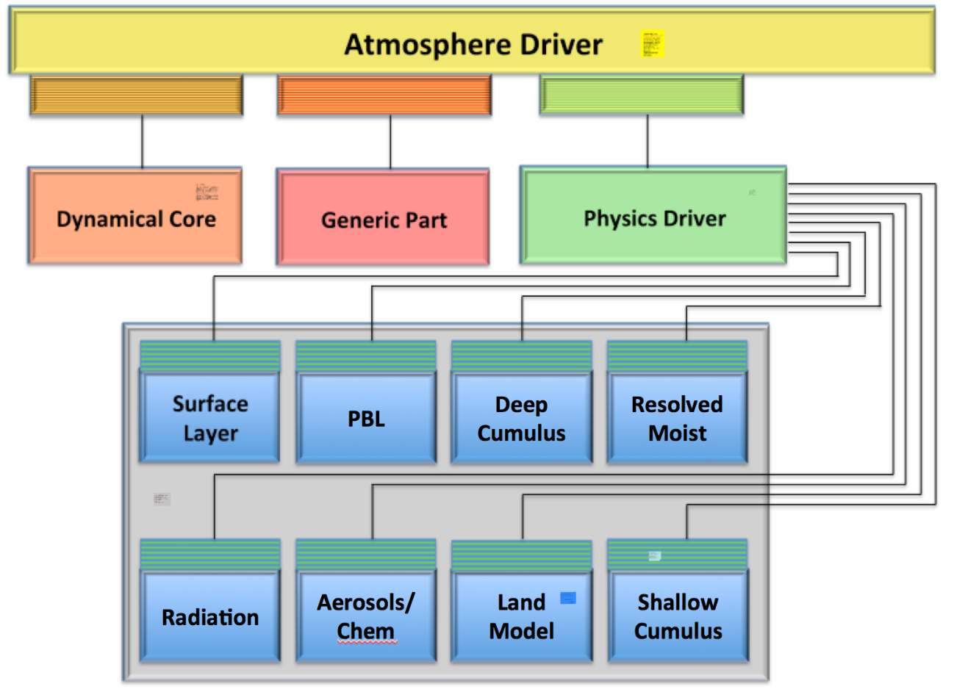
CCPP Driver
CAPS
CCPP
Courtesy of Dave Gill

