Slide 1
Providing Operational GSI and EnKF to the Research Community: 2017 Update
18th Annual WRF Users’ Workshop, 12 -16 June, 2017, Boulder, CO
Hui Shao^{1,2}, Ming Hu^{1,3,5}, Chunhua Zhou^{1,2},
Donald Stark^{1,2}, and Jeff Beck^{1,3,4}
¹ Developmental Testbed Center (DTC)
² National Center for Atmospheric Research (NCAR)/Research Applications Laboratory
³ National Oceanic and Atmospheric Administration (NOAA)/Earth System Research Laboratory
⁴ Cooperative Institute for Research in the Atmosphere (CIRA)
⁵ Cooperative Institute for Research in Environmental Sciences (CIRES)
Special acknowledgement to the National Centers for Environmental Prediction (NCEP) Environmental Modeling Center (EMC), and other code developers and collaborators
Sponsored by NOAA OAR and NCAR (supported by NSF)

Slide 2
Data Assimilation Software
Gridpoint Statistical Interpolation (GSI) analysis system:
Originally developed by NCEP/EMC
Community system since 2009
Active developers from various operational and research institutes and agencies
Centralized support through the Developmental Testbed Center (DTC)
Operational applications:
NCEP: Global Forecasting System (GFS), North American Mesoscale system (NAM), Hurricane WRF (HWRF), Real-Time Mesoscale Analysis (RTMA)
NOAA: Rapid Refresh (RAP), High-Resolution Rapid Refresh (HRRR)
NASA: Goddard Earth Observing System (GEOS)
Air Force: Mesoscale forecast analysis system
Ensemble Kalman Filter (EnKF) based analysis system:
Originally developed by NOAA/ESRL
Community system since 2015
Applications:
Operational as part of the GFS data assimilation (GDAS) system (GSI-EnKF hybrid)
Can be used for regional models and systems, e.g., HWRF, NAM, ARW

Slide 3
Supported DA Techniques
GSI:
2DVar
3DVar
3D (hybrid) EnVar
4D (hybrid) EnVar
EnKF: using GSI as the observation operators (assimilating same observation types as GSI)
Ensemble Square Root Filter (EnSRF)
Parallelization scheme based on NCAR Data Assimilation Research Testbed (DART) toolkit
Local Ensemble Transform Kalman Filter (LETKF)
EnVar : Variational (Var) DA using ensemble background covariances
Hybrid: Variational DA using a combination of climatological and ensemble covariances
- Nomenclature adopted from Lorenc (2013)

Slide 4
Code Management and Support
Code is managed by the Data Assimilation Review Committee, formed in 2010
Include major code development teams
Coordinate code development
Review code changes
All committee members are aware of latest code changes and responsible for their specific operational applications
The DTC provides centralized code support to the general research community
GSI/EnKF
Research community
Members since 2010
Member added in 2011
Members added in 2015
Member added in 2016

Slide 5
GSI v3.6/EnKF v1.2
July
August
September
2017
Full release scheduled for September 2017
Joint DTC-EMC-JCSDA GSI and EnKF summer tutorial, College Park, MD, 11-14 July, 2017
Beta release scheduled for early July 2017
Major changes:
Enhanced and updated capabilities
Code refactoring and optimization

Slide 6
Adding ARW Hybrid Vertical Coordinate Background to GSI
GSI is updated to run with ARW background using hybrid vertical coordinate
Resulting differences for analysis increments were found mostly at upper levels
T analysis increment at level 46
Terrain following
Hybrid coordinate
Hybrid
(Hu, GSD, GSI meeting, 2017)

Slide 7
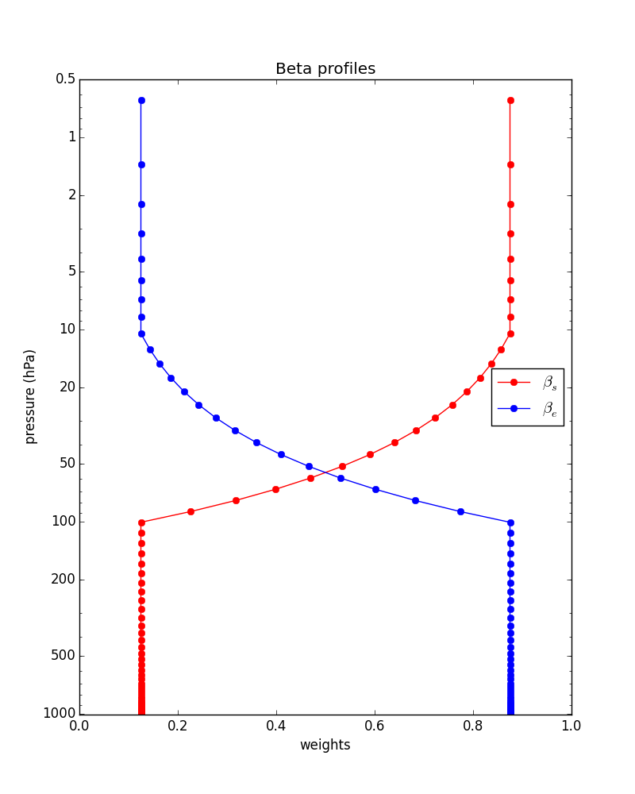
Update to Use of Hybrid Background Error Weighting Profiles in GSI
Static background error covariance
Incorporating ensemble background-error information through extended control variableα
β_{s} and β_{e} are weighting factors for static and ensemble background error contributions. In last GSI release,
β_{s} + β_{e} = 1
β_{s} and β_{e} were scalar constants
Currently, GSI loosens up β_{s} + β_{e} = 1 and uses vertical profiles of weighting functions
Use diagonal matrix of β_{s} and β_{e}
Fixed code bugs for implementation of diagonal matrices in GSI cost function preconditions
β_{s}
β_{e}
(Parrish, EMC, GSI meeting, 2016)

Slide 8
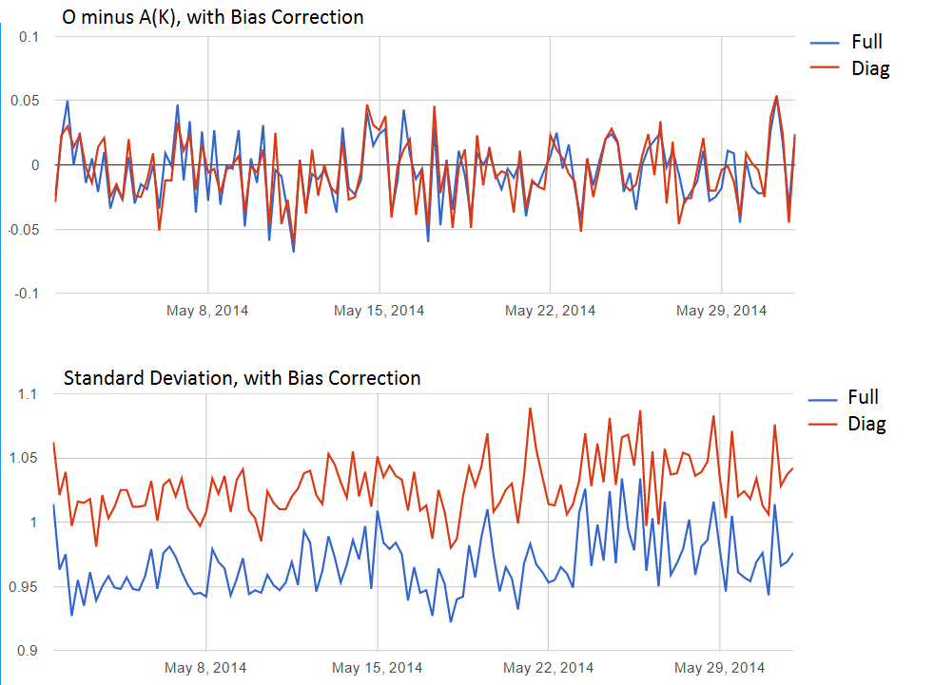
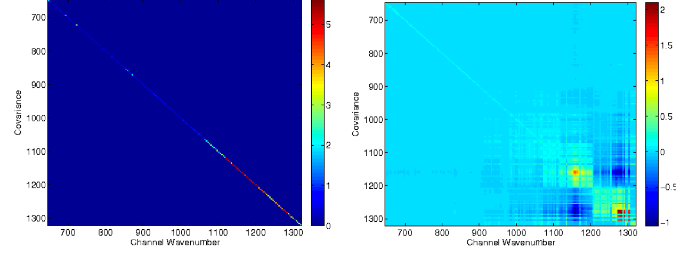
Correlated Radiance Observation Errors
For satellite observations, observation error covariance matrix (R), specified in the satinfo file, was originally a diagonal matrix => uncorrelated observation errors
GSI is now updated to use a full R as part of options
A utility cov_calc is added to util/Correlated_obs to compute a non-diagonal R and recondition
Observation-Analysis
Diagonal R
Full R
Bias
Full R
STD
Diagonal R
Bathmann, et al, EMC, GSI meeting, 2016

Slide 9
Application Specific Updates and Enhancements
Non-variational cloud analysis:
Added number concentration for cloud water, cloud ice and rain to match cloudy analysis with the Thompson Microphysical scheme
Visibility/fog observation namelist options for lowest two levels
Added capability to use NASA global LaRC cloud products
RTMA:
Variational QC algorithm using super-logistic distribution function.
Added cloud ceiling height and scalar wind as analysis variables
Other:
Now using full spectral resolution CrIS radiance observations
Using NCEP nemio interface
Unified RAP and NMM-B cloud analysis libraries
Near surface temperature (NST)
Utility updates
Bug fixes

Slide 10
Polymorphic Observations: from Procedural to Object-Oriented
Changes are related to steps for adding a new observation type
Bottom-up development through refactoring to improve overall modularity, extensibility and maintainability
Last release
Aggregate code segments
Layer code in an algorithm hierarchy
Provide generic interface
Reuse and extend generic code for adding new observations
New
(Guo and Todling, GMAO, GSI meeting, 2017)

Slide 11
Other Code Refactoring and Optimization Efforts
Generalized all radiance assimilation across different sensors/instruments for cloud and aerosol usages in GSI (Zhu, NCEP/EMC, GSI meeting, 2015)
Centralized cloud and aerosol usage information
Simplified code
Enhanced code flexibility to expand current capabilities to additional instruments
Removed the First-Order Time extrapolation to the Observation (FOTO) from GSI
Removed other unused modules/variables in GSI
Updated to netCDF v4.0 functionality

Slide 12
Toward Unified Operational and Research Build System
Unified build: Perl, shell, & cmake
User interface
configure
compile
Can be run from command line
Include both general platforms and NOAA-specific platforms
Support operational compilation flags
Include compilation of NCEP I/O library code
User support for both general usage and operational usage (NOAA)
May consider extension to other applications
Community release build: Perl, shell , & make
Two-step build with user-friendly interface
configure: WRF-like menu
compile
Created for general computer platforms
User support for general usage
Include compilation of NCEP I/O library code
EMC build: make
Command line
Tailored for NOAA computers
Operational compilation
Last release
New

Slide 13
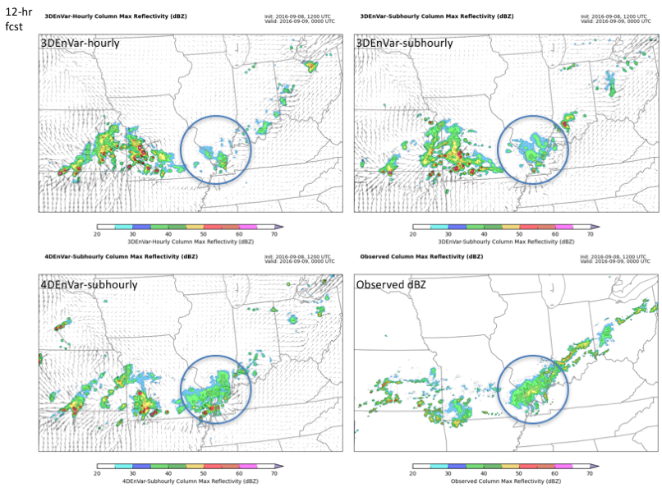
DTC Code Tests: Using 4D EnVar for Convective Weather Forecasts
Evaluate 4D EnVar hourly cycling for a convective scale case
7B.3: Zhou, Chunhua, et. al, Testing and evaluation of the hybrid 4D EnVar GSI for 3-km High-resolution regional applications
Evaluate 3D/4D EnVar for sub-hourly cycling
P12: Beck, Jeff, et. al, An evaluation of 3D- and 4D-EnVar sub-hourly data assimilation in the HRRR
3D hourly
3D 15mins
4D 15mins
Observation
Radar Reflectivity Comparison: 1200 UTC 8 September 2016

Slide 14
Call for Research Contributions
Repository
To apply for access, contact the helpdesk (gsi-help@ucar.edu)
Code transition support
DTC visitor program:
Proposals to work directly with the GSI system and/or the NOAA EnKF system are strongly encouraged.
Year-around applications
Apply via the DTC visitor program website: http://www.dtcenter.org/visitors/
DTC DA webpage:
GSI: http://www.dtcenter.org/com-GSI/users/
EnKF: http://www.dtcenter.org/EnKF/users/
(shared helpdesk and contact)

Slide 15
Future Plans
Joint DTC-EMC-JCSDA GSI and EnKF community tutorial:
11-14 July, 2017, College Park, MD
Annual code release for GSI v3.6, EnKF v1.2
by end of September 2017
The community code repository will be transitioned from svn to Git
Continue to perform code tests and evaluation
Coordinate with the Joint Effort for Data assimilation Integration (JEDI) led by JCSDA, in collaboration with major development teams
Encourage community contributions and collaborations

Slide 16
Observations Types (I)
Radiosondes
Pibal winds
Synthetic tropical cyclone winds
Conventional aircraft reports
ASDAR aircraft reports
MDCARS aircraft reports
Dropsondes
Surface land observations
Surface ship and buoy observation
Wind profilers: US, JMA
Tall tower winds
SSM/I wind speeds
MODIS IR and water vapor winds
GMS, JMA, METEOSAT, and GOES cloud drift IR and visible winds
GOES hourly IR and cloud top winds
QuikSCAT, ASCAT, and OSCAT wind speed and direction
ISS-RapidScat winds
GOES CAWV AMV
AVHRR winds
EUMETSAT and GOES water vapor cloud top winds
METAR cloud observations
SSM/I and TRMM TMI precipitation estimates
Doppler radial velocities
VAD (NEXRAD) winds
Radar Reflectivity Mosaic
Tail Doppler Radar (TDR) radial velocity and super-observation
Flight level and Stepped Frequency Microwave Radiometer (SFMR) High Density Observation (HDOB) from reconnaissance aircraft
GPS precipitable water estimates
GPS Radio occultation (RO) refractivity and bending angle profiles
Doppler wind Lidar data
SBUV ozone profiles, MLS (including NRT) ozone, and OMI total ozone
SST
Tropical cyclone VITAL (TCVital)
PM2.5, PM10
AOD: MODIS
Conventional
Radar
Satellite wind & retrievals
GPS
Others

Slide 17
Observations Types (II)
SBUV: n17, n18, n19
HIRS: metop-a, metop-b, n17, n19
GOES_IMG: g11, g12
AIRS:aqua
AMSU-A: metop-a, metop-b, n15, n18, n19, aqua
AMSU-B: metop-b, n17
MHS: metop-a, metop-b, n18, n19
SSMI: f14, f15
SSMIS: f16, f18, f19
AMSRE: aqua
SNDR: g11,g12, g13
IASI: metop-a, metop-b
GOME: metop-a, metop-b
OMI: aura
SEVIRI: m08, m09, m10
ATMS: Suomi NPP
CRIS: Suomi NPP
Satellite Radiance
GCOMW1 AMSR2
GPM GMI
Megha-Tropiques SAPHIR
Himawari AHI
Acronyms should be found from GSI and EnKF’s user’s guide

