Slide 1
A Unified Approach to Verification
Tara Jensen, Bonny Strong, John Halley Gotway, Ivanka Stajner, Glenn White, Fanglin Yang, Geoff Manikin, Barb Brown, Tressa Fowler and Randy Bullock
WRF Users’s Workshop – 12-16 June 2017

Slide 2
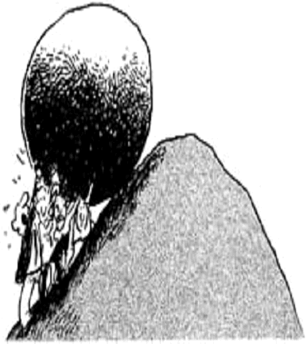
How this started
2015-2016 Recommendations to Unify:
UCAR Model Advisory Committee (UMAC) to NCEP
Next Generation Global Prediction System (NGGPS) Verification and Validation Team
2nd Convection Allowing Model (CAM) Ensemble Design Workshop
MET Released in 2007 - Now has 3300 registered users internationally – until recently low percentage at national centers/labs
EMC Vx, HIWPP Vx, MET and METViewer
Unification Let’s all work together to build a unified package
Notes:
There are multiple versions of verification at EMC along with other packages and the US community is now recommending to unify verification on the state of the science community software package called Model Evaluation Tools (MET)

Slide 3
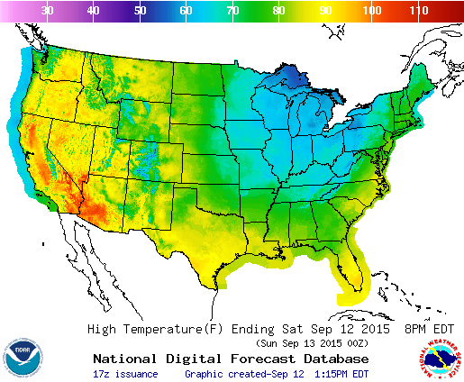
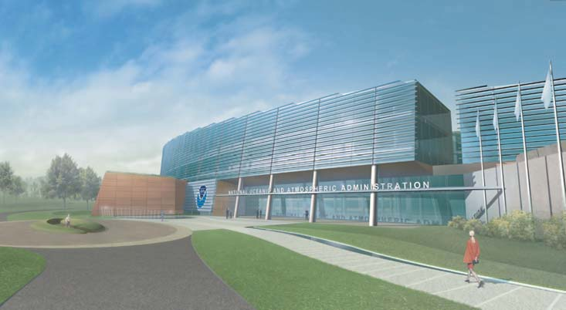
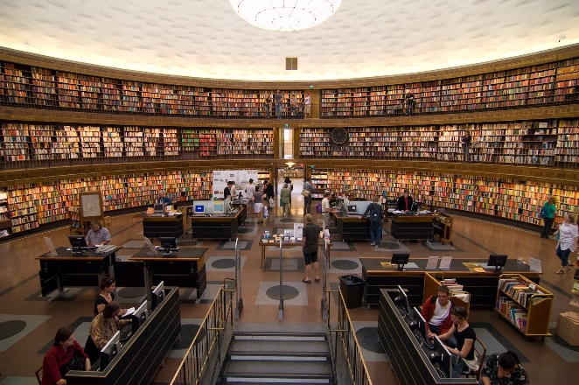
Why Unification
University and National Lab Researchers
Forecasters
Government Centers
Comprehensive and unified verification tool - Make R2O more efficient - Provide a consistent set of metrics
Allows Researchers and Operational Scientists to speak a “common verification” language
User Support of unified package provides greater opportunity to train all on verification best practices
Notes:
This slide pretty much speaks for itself. Unification will provide the community with a comprehensive and unified verification tool - Make R2O more efficient - Provide a consistent set of metrics

Slide 4
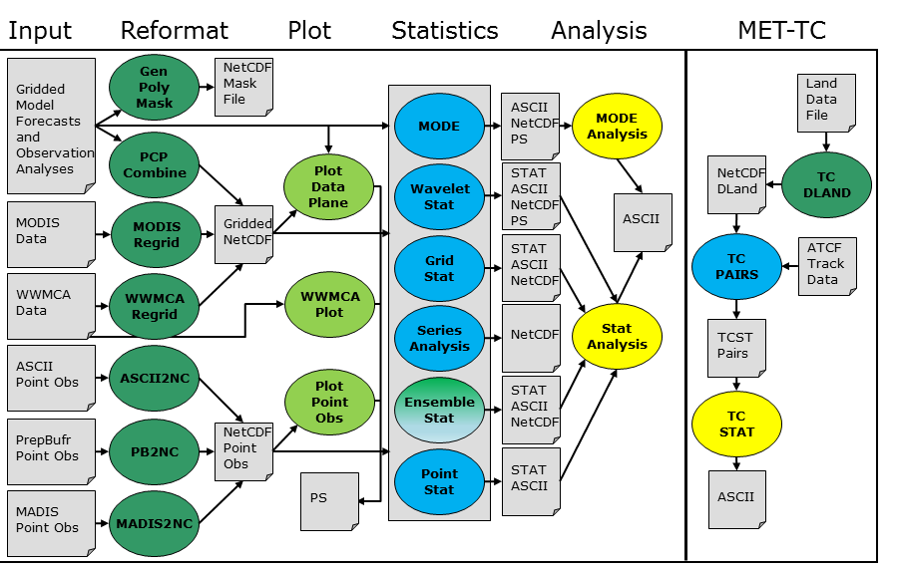
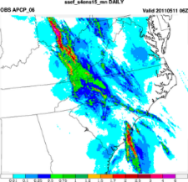
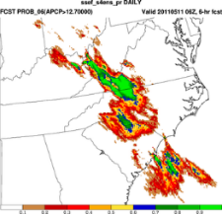
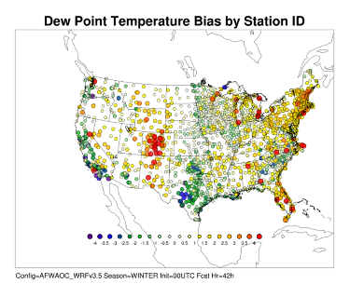
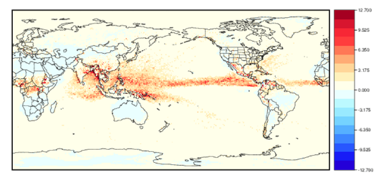
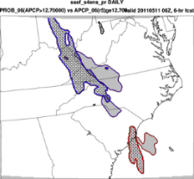
A verification toolkit designed for flexible yet systematic evaluation
(supported to the community via the DTC)
Over 70 traditional statistics using both point and gridded datasets
Multiple interpolation methods
Computation of confidence intervals
Able to read in GRIB1, GRIB2 and CF-compliant NetCDF
Applied to many spatial and temporal scales
3300+ users, both US (30%) and internationally (70%)
Object Based and Spatial Methods
Geographical Representation of Errors
90th Percentile of difference between two models
Bad forecast or
Good forecast with displacement error?
Notes:
Why was MET chosen? Because it’s a suite of tools designed to be flexible in it’s use and extensible (upper right). It has all of the capability listed in the bullets in the upper left, including evaluation of ensembles, probabilities and tropical cyclone track and intensity. It allows for less-traditional evaluation such as using object based and neighborhood methods and allows scores to be computed to provide geographic representation of errors.

Slide 5
METViewer components
Packages: Java, Apache/Tomcat, MySQL, R statistics
EMC Vx Output
Database and Display analysis tool
Notes:
A database and display system has also been developed and is used internally at DTC and EMC for aggregation and display of statistics. The output of MET is loaded into a MySQL database and then accessed via a GUI, for detailed interrogation of the data, or a batch engine for routinely producing thousands of plots (if you’d like). The aggregation and plotting relies heavily on R scripts, which are also made available via the GUI.

Slide 6
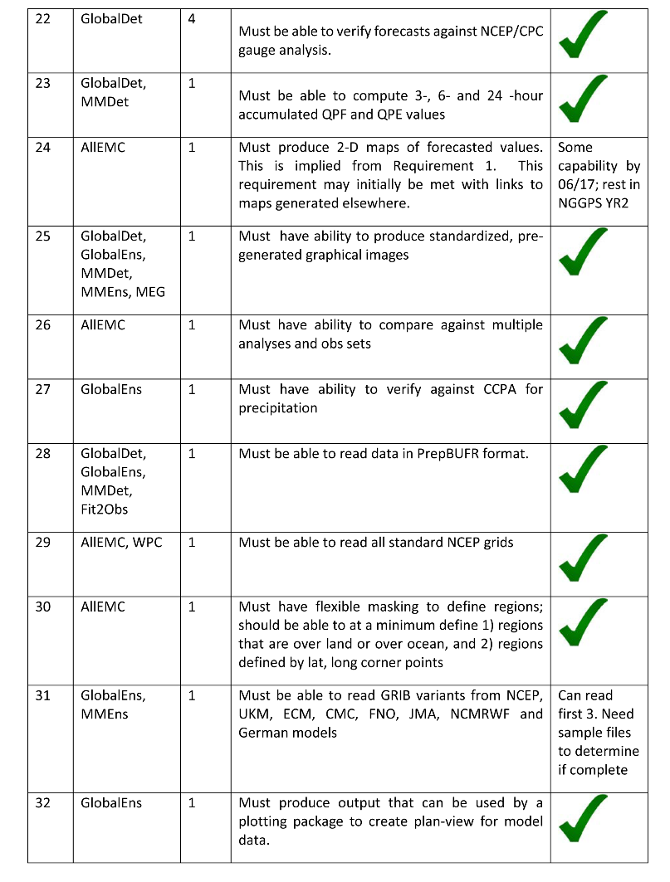
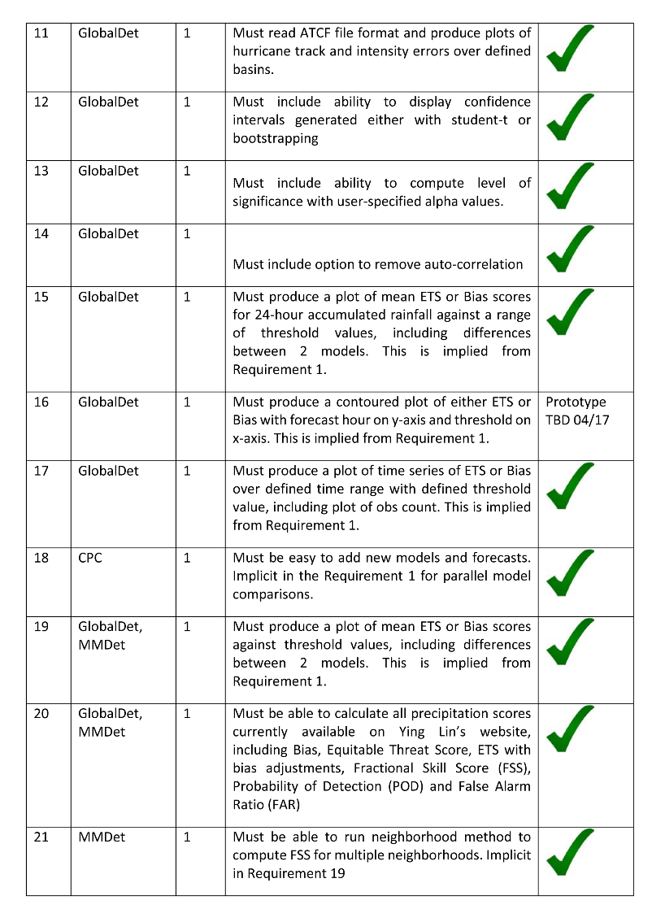
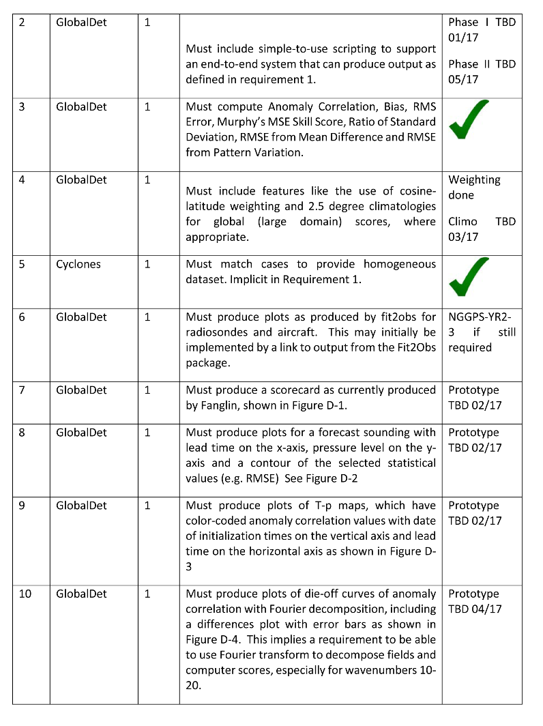
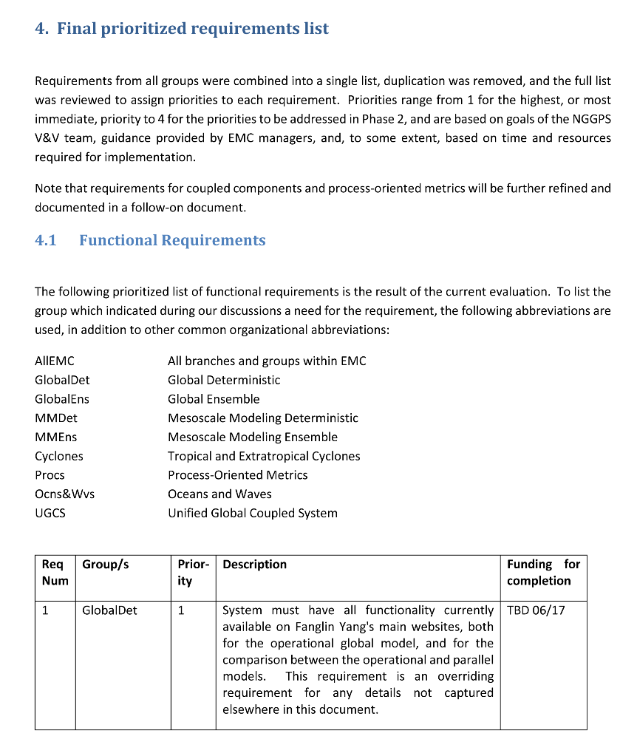
Unification Roadmap
Met with 50+ NCEP staff (EMC, WPC, CPC, NCO)
Included discussions with coupled system “components”
99 functional requirements and 19 non-functional broken down by priorities
Statistics
Plot types
Data types
Preprocessing
Database and display
Documentation and help desk
Notes:
In May last year, a three-person team went to EMC and help a week of meetings with over 50 staff. It included discussions with scientist specializing in: Global, Mesoscale, Ensembles, Marine, Aerosols, Climate, Synoptic, Land-Surface, Hydro, Tropical and Extra-tropical cyclones. The list of requirements was boiled down to 99 functional requirements (e.g. what the package needs to do) and 19 non-functional (e.g. helpdesk requirements and speed of processing). A team of scientist and developers at NCAR, NOAA/ESRL and EMC are now using this “roadmap” to move toward unification.

Slide 7
Areas of Focus
Treatment of uncertainty
Scorecard and weighted performance indices
Ensemble and probability verification metrics
Diagnostic tools (scales at which errors occur, energy spectra)
Physics-oriented metrics (radiation, fluxes, cloud verification)
Forecast consistency and extreme weather
Object-oriented metrics
Coupled model component performance
Validation – during development process
Notes:
Laundry list of priorities – note: it’s uncertain as to which uncertainty is embodied in the first bullet ;-)

Slide 8
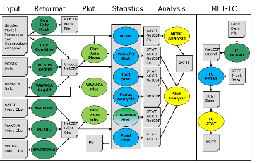
MET+ Unified Package
Python wrappers around MET and METViewer:
Simple to set-up and run
Automated plotting of 2D fields and statistics
Communication between MET & python algorithms (Cython)
Python wrappers
MET+
MET
ASCII
NetCDF
METViewer
Initial system - Global deterministic with plans to generalize across scales when possible to quickly spin-up Ensembles, High Resolution & Global Components
Spatial
Plots
Stats
Plots
GitHub Repository
Notes:
This is a high level schematic of what the unification looks like. Basically, it’s wrapping all the MET tools, METViewer and output with python wrappers and setting up a suite of high level configuration files to make it easier to run MET. Additionally, plotting of 2D fields will be added, which previously has been only available in a basic tool included in the MET suite.
The repository of python code has been established in GitHub to set us up for distributed development.
The initial focus is on setting up the system for our global deterministic partners but MET is flexible enough that is should be possible to generalized across scales.

Slide 9
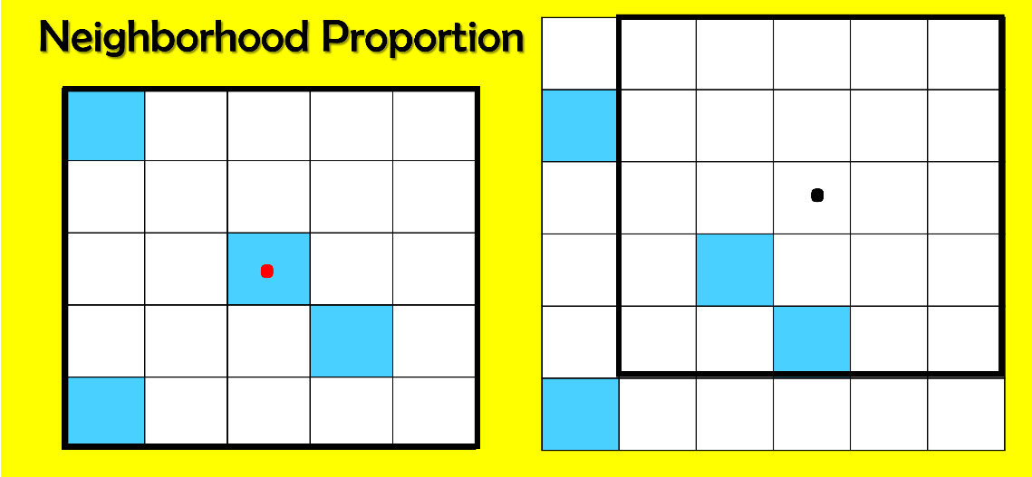
Recent Progress – MET Enhancements
Notable Enhancements
READ NETCDFv4
READ CALIPSO Layers and compute Cloud Base, Top
Addt’l Specialty Masking
Support for ATCF E-Decks (probability forecasts)
High Resolution Analysis Framework (HIRA)
Spatial/temporal uncertainty by giving credit for being ‘close’.
Comparison of deterministic and ensemble forecasts via the same set of probabilistic statistics (Mittermaier, 2014).
See Poster P39 Halley Gotway et. al, for more enhancements
Notes:
Uses neighborhood fraction of events
Point observation location defines neighborhood.
Allows for:
Spatial/temporal uncertainty by giving credit for being ‘close’.
Comparison of deterministic and ensemble forecasts via the same set of probabilistic statistics.
Comparison of models with different grid resolutions via adjustment of neighborhood size.

Slide 10
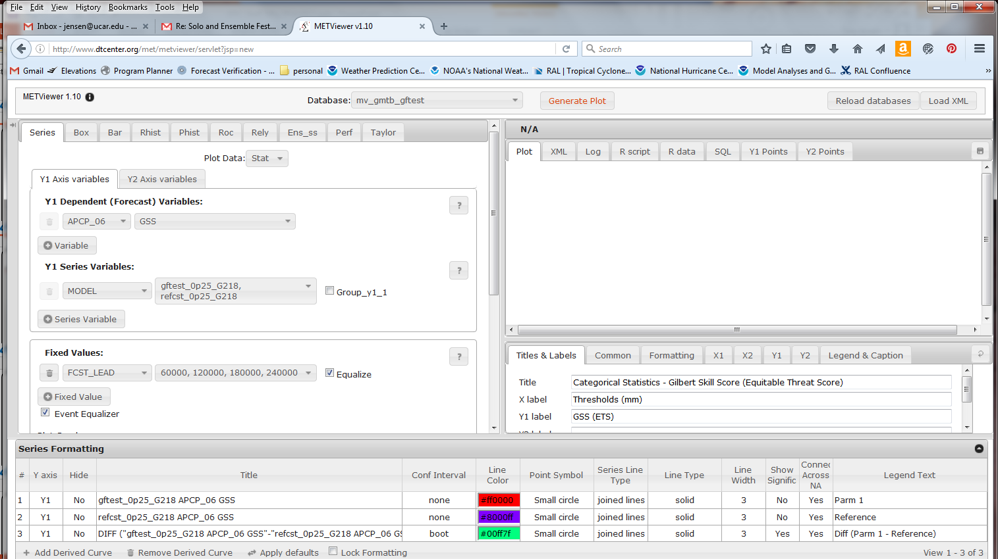
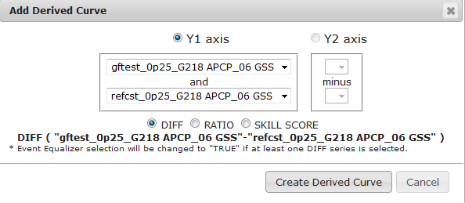
Recent Progress - METViewer
Performance and Taylor Diagram
Scripts to prune data
Speeded up boot-strapping
Updated event equalization
METViewer is our database and display system that uses MET output stored in MySQL
Notes:
We’ve added quite a few capabilities to MET as well as the ability to read in the EMC legacy statistics format for historical preservation. METViewer has templates to plot Series, Box and Whisker plot, Bar plots, Rank and PIT Histograms, ROC and Reliability Diagrams, a binned spread-skill. Performance and Taylor Diagrams were just added. Much work on the database, boot-strapped confidence intervals and event equalization have also been performed for METViewer.

Slide 11
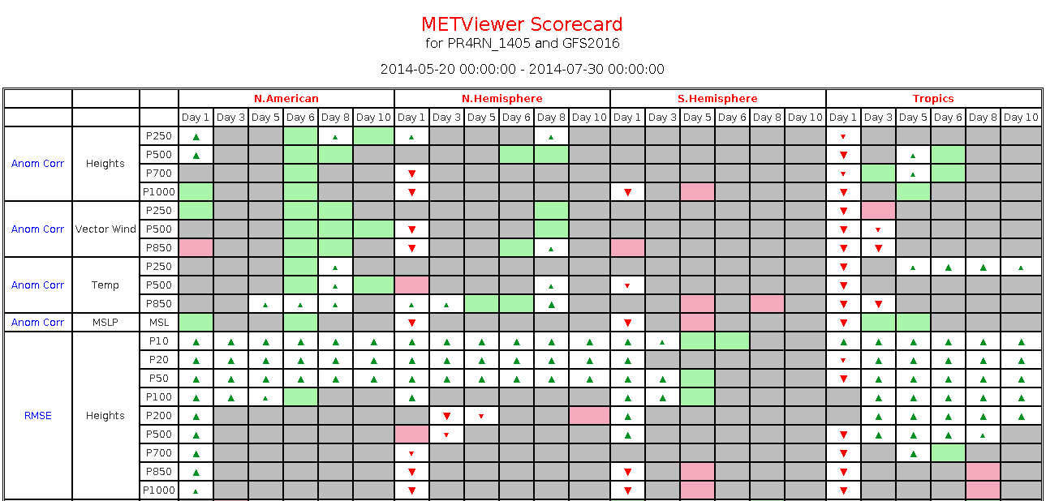
Recent Progress - METViewer Scorecard
Specify the Statistic
Specify the aggregations
Specify the regions
Specify the Field
Specify whether you have symbol, values or both
Submit to batch engine of METViewer
Notes:
The most recent addition to METViewer is the generation of a scorecard. As in all of MET/METViewer development, the goal is to be flexible and the scorecard is no different. While it’s only available for Continuous Statistics right now, we are expecting to expand this to other statistics types over the next year. It allows you to select all of the animated text here as well as the colors and the significance levels.

Slide 12
Recent Progress - What is already wrapped with Python?
Input
Reformat
Plot
Statistics
Analysis
MET-TC
Gridded
Forecast
Analysis
Obs
PCP
Combine
Gen
VxMask
MTD
ASCII
NetCDF
Land
Data
File
PNG
Regrid
Data
Plane
Shift
Data
Plane
NetCDF
Series
Analysis
NetCDF
DLand
TC
DLAND
MODIS
Data
MODIS
Regrid
Plot
Data
Plane
Plot
MODE
Field
MODE
ASCII
NetCDF
PS
Gridded
NetCDF
MODE
Analysis
WWMCA
Data
TC
PAIRS
ATCF
Track
Data
WWMCA
Regrid
STAT
ASCII
NetCDF
PS
WWMCA
Plot
Wavelet
Stat
ASCII
ASCII
Point
ASCII2NC
TCST
PS
Grid
Stat
STAT
ASCII
NetCDF
PrepBufr
Point
PB2NC
Stat
Analysis
NetCDF
Point
Obs
STAT
ASCII
NetCDF
MADIS
Point
MADIS2NC
Ensemble
Stat
TC
STAT
Plot
Point
Obs
STAT
ASCII
TCPlot -MPR.R
Lidar
HDF
LIDAR2NC
Point
Stat
STAT
ASCII
ASCII
ASCII
PNG
GSI
Diag
GSI
Tools
Copyright 2017, University Corporation for Atmospheric Research, all rights reserved
Copyright 2017, University Corporation for Atmospheric Research, all rights reserved

Slide 13
Recent Progress – Docker MET
Docker (Amazon Web Services):
Open-source technology to build and deploy applications inside software containers
Packages software containing: code, runtime, system tools, system libraries, etc
Enables you to quickly, reliably, and consistently deploy applications
MET compiled in a Docker Container
Set up to work with a suite of test-cases for NWP innovation testing (MMET/MERIT)
Bundled with MET online tutorial data
Docker MET should make it easier for scientists to test out MET’s capabilities
Will be attempting to put METViewer in a container this year
Contact met_help@ucar.edu for more info
See Poster P40 Harrold et. al, for more info on Containers
Notes:
NOTE: We will be placing METViewer in a container this year and testing it for public release.

Slide 14
Summary
Unification of verification capability has begun between NOAA EMC, DTC and partner organizations using MET+
Phase I to be completed by Summer 2017
Parallel MET+ system for global physics development at EMC and within the DTC Global Model Test Bed (GMTB)
Many enhancements to software and training material
Phase II to be completed by Summer 2018
MET+ available to community
MET+ examples for multi-scale evaluation (global to storm scale) available to NGGPS and research community on DTC website

Slide 15
Questions?
Contact: Tara Jensen – jensen@ucar.edu
MET Website: http://www.dtcenter.org/met/users/
MET Download: http://www.dtcenter.org/met/users/downloads/index.php
MET Helpdesk: met_help@ucar.edu
http://www.dtcenter.org/met/users/support/met_help.php
DTC Visitor Program: The DTC Visitor Program supports visitors to work with the DTC to test new forecasting and verification techniques, models and model components for numerical weather prediction (NWP). PI projects and Graduate Student Projects Available. Open Announcement of Opportunity can be found at:
http://www.dtcenter.org/visitors/opportunity/

