Slide 1
Hurricane WRF: 2017 Operational Implementation and Community Support
B. Liu, A. Mehra, Z. Zhang, K. Newman, S. Abarca, L. Bernardet, M. Biswas, L. Carson, J. Dong, J. Frimel, E. Grell, E. Kalina, H.-S. Kim, Q. Liu, T. Marchok, Z. Ma, J. Meixner, D. Sheinin, J. Sippel, B. Thomas, M. Tong, W. Wang, K. Wu, B. Zhang, L. Zhu, and V. Tallapragada
18th WRF Users Workshop, June 12-16, 2017

Slide 2
HWRF Overview
HWRF is the NCEP operational hurricane model providing model guidance to NHC/JTWC/ CPHC for tropical cyclones (TCs) in all global basins
HWRF is an air-sea coupled system specialized for hurricane forecasting
HWRF-POM(HYCOM)-WW3
Built within WRF infrastructure and based on WRF-NMM dynamic core
Rotated lat-lon projection
Arakawa E-grid
Hybrid sigma-pressure vertical coordinate
Triple nested vortex following domains
Triple nested (18-6-2km) vortex following domains

Slide 3
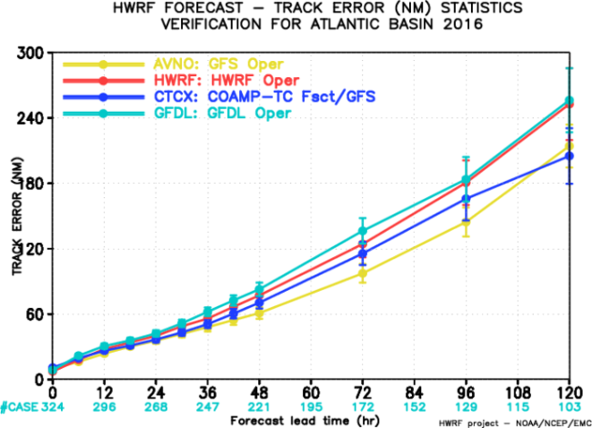
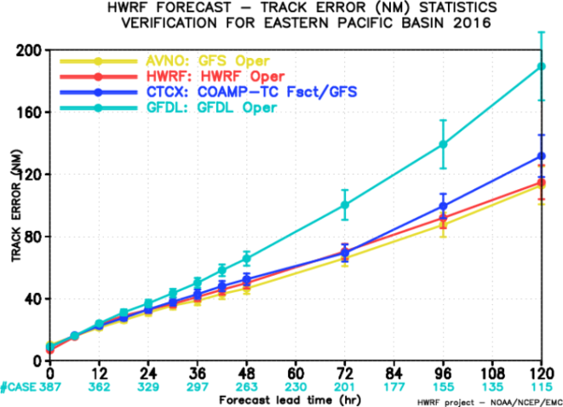
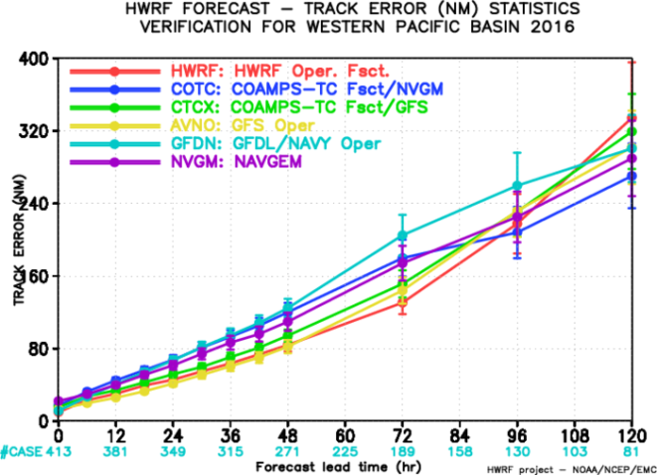
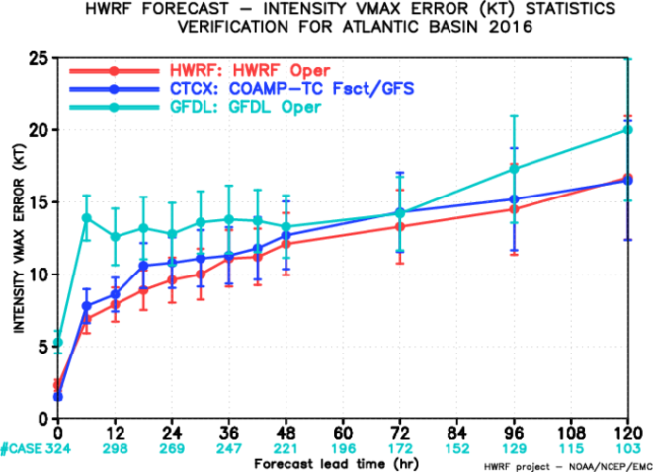
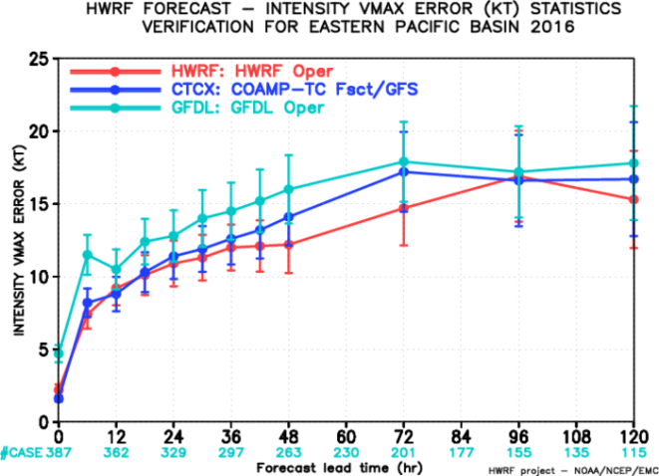
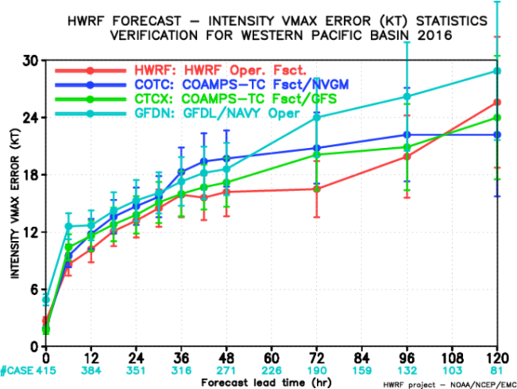
FY2016 HWRF Real-Time Forecast Performance
Track
NATL
EPAC
WPAC
Intensity
HWRF continues to be the best operational dynamic guidance model for hurricane intensity forecasting

Slide 4
Highlights of 2017 HWRF Upgrades
Infrastructure Enhancements
Upgrade dynamic core from WRF3.7.1a to WRF3.8.1 (with bug fixes)
T&E with new 2017 4D-Hybrid GDAS/GFS IC/BC
Consider storm’s meridional movement when determining parent domain center
Increase vertical levels to L75 with model top of 10hPa (H216: L61, 2hPa model top)
Reduce nested domain size: d02 (265x532), d03 (235 x 472) (H216: 288 x 576)
Updated GFDL vortex tracker
Vortex Initialization/Data Assimilation Improvements
Improve vortex initialization (new composite storm vortex)
GSI code upgrades together with new data sets for DA (hourly shortwave, clear air water vapor and visible AMV’s from GOES, HDOBS flight level data)
Fully self-cycled HWRF ensemble hybrid DA for TDR and priority storms
Increase the blending threshold of vortex initialization (VI) and GSI analysis (from 50 to 65 kt)
Physics Advancements
Updated scale-aware SAS scheme and Ferrier-Aligo microphysics scheme
Updated air-sea momentum and enthalpy exchange coefficients
Partial cloudiness modification for RRTMG
Air-Sea Interaction and Coupling
POM RTOFS initialization for CPAC, HYCOM ocean coupling for WPAC, NIO
Reduced coupling time step from 9 min to 6 min
Increased vertical level for POM from 24 to 41 levels
Hurricane sea surface wave forecasts for CPAC, in addition to NATL and EPAC
Sea surface wave boundary condition from global wave model

Slide 5
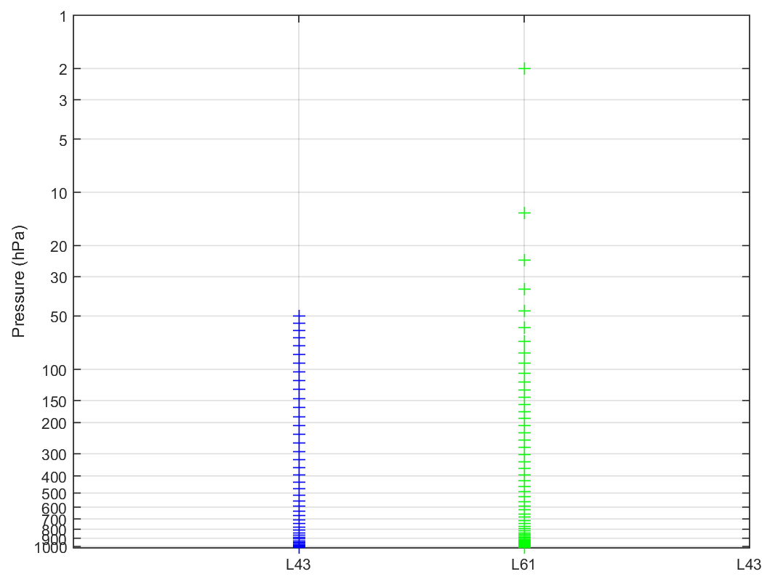
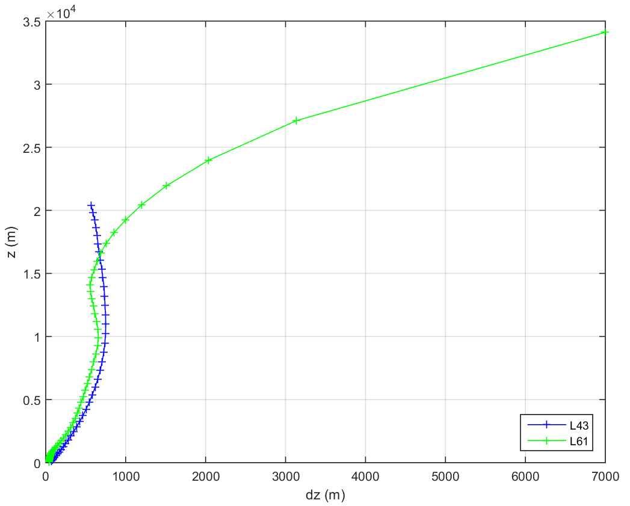
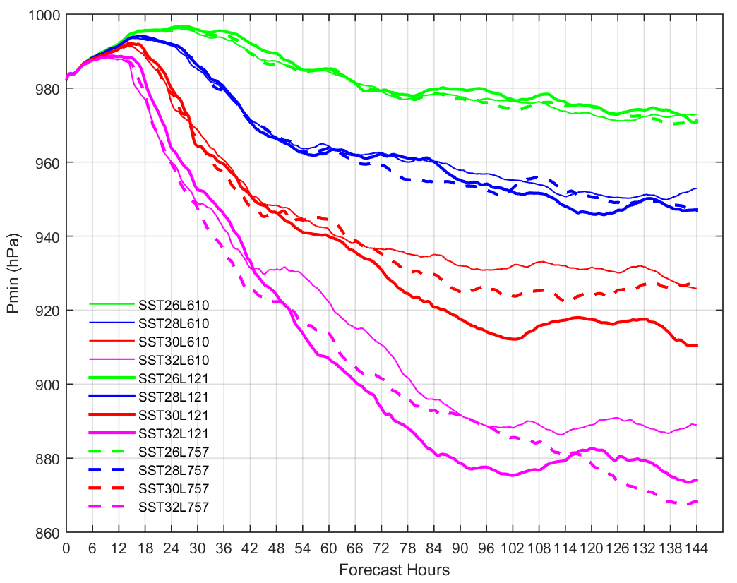
Hurricane Forecast and Model Vertical Resolution
Zhang et al. (2016) showed that the track forecasts of Hurricane Joaquin (2015) were greatly improved by using more vertical levels
L61 (2-hPa top): NATL, EPAC, CPAC
L43 (50-hPa top): other basins
Thin line:
L61
Thick line: L121
Dashed: L75
26 degC
28 degC
30 degC
32 degC
Idealized HWRF TC simulations with different vertical levels and different SSTs
Notes:
Sparse vertical levels near model top for L61
dz > dx
Lowest model level height
Lowest half sigma level height of ~20m (L61) and 34m (L43)
Relatively low vertical resolution in mid and upper troposphere

Slide 6
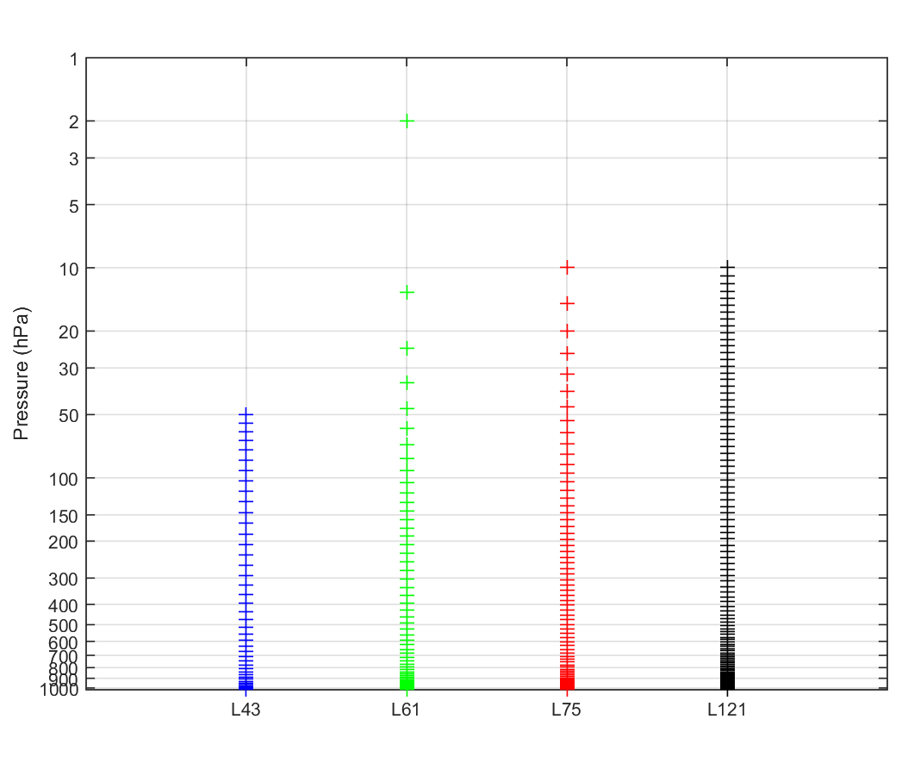
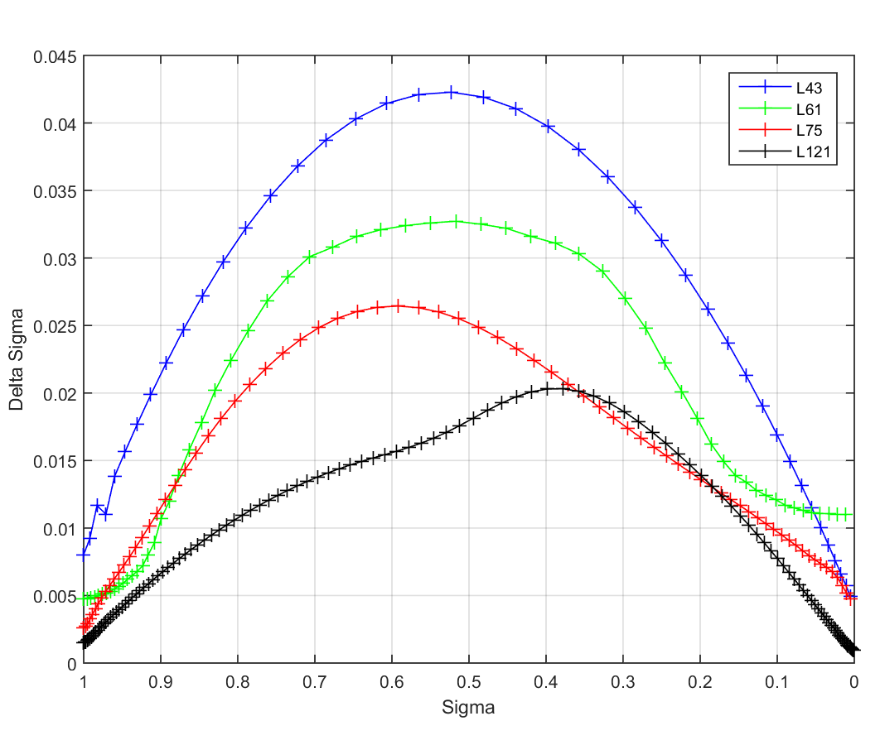
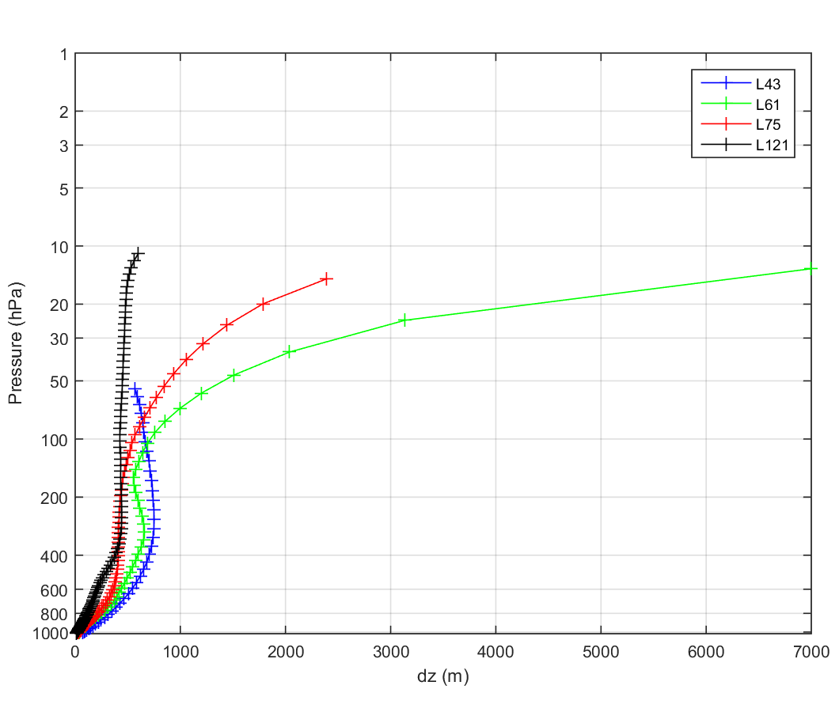
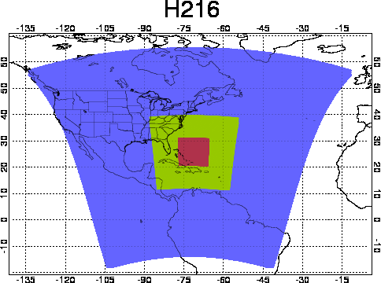
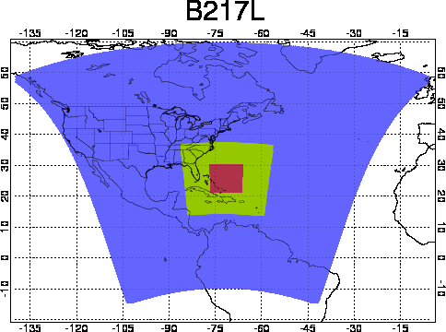
Increased Vertical Resolution and Adjusted Nested Domain Sizes
Model top=2mb
Model top=10mb
Increase from 61 to 75 vertical levels with model top changing from 2 hPa to 10 hPa and adjusted nested domain sizes
FY2016 HWRF
Levels: 61
Top: 2 hPa
D02: 288x576
D03: 288x576
FY2017 HWRF
Levels: 75
Top: 10 hPa
D02: 265 x 532
D03: 235 x 472
Consider storm’s meridional movement when choosing domain center

Slide 7
Updated Scale-aware SAS scheme
Updates of the scale awareness:
Cloud base mass flux reduction by clouds being advected before they complete their turnover time
For dx<8km, the cloud base mass flux is proportional to the mean updraft velocity and not by the Arakawa-Schubert quasi-equilibrium
Shallow convection cloud base mass flux is now a function of the cumulus updraft velocity averaged over the whole cloud depth
Reduced the decreasing rate of rain conversion rate with decreasing air temperature above the freezing level
Entrainment enhancement in dry environment
Precipitating shallow convection to reduce too many low clouds
Separation criteria between deep and shallow is changed to 200 hPa (previously 150 hPa) for cumulus depth
Update to the latest SAS scheme used in NCEP 2017 GFS

Slide 8
Update to the latest microphysics scheme used in the 2017 NCEP NAM model

Slide 9
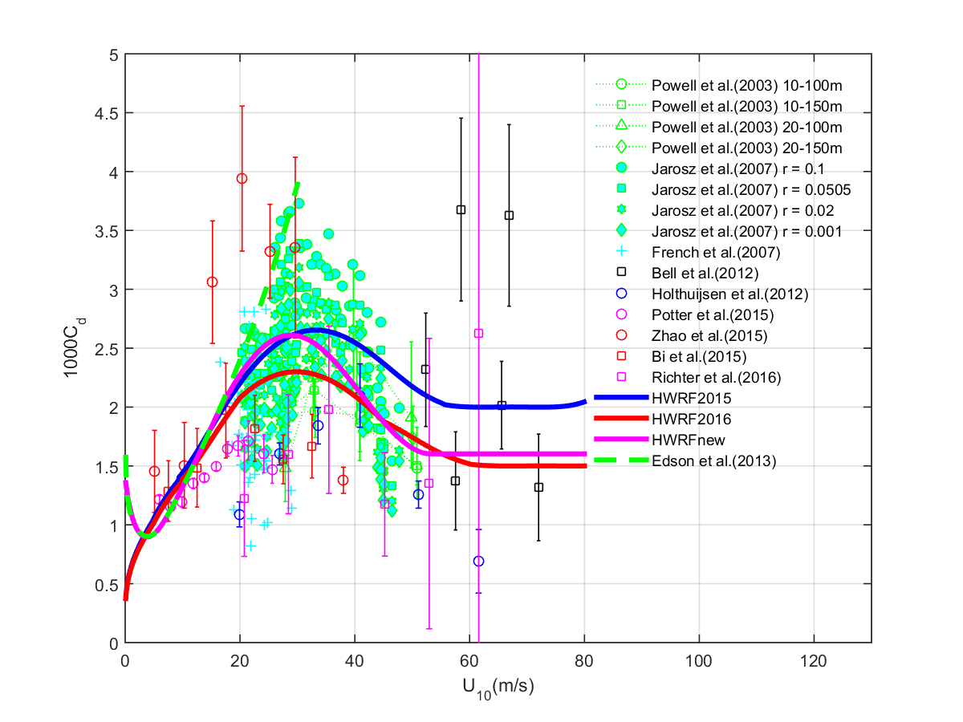
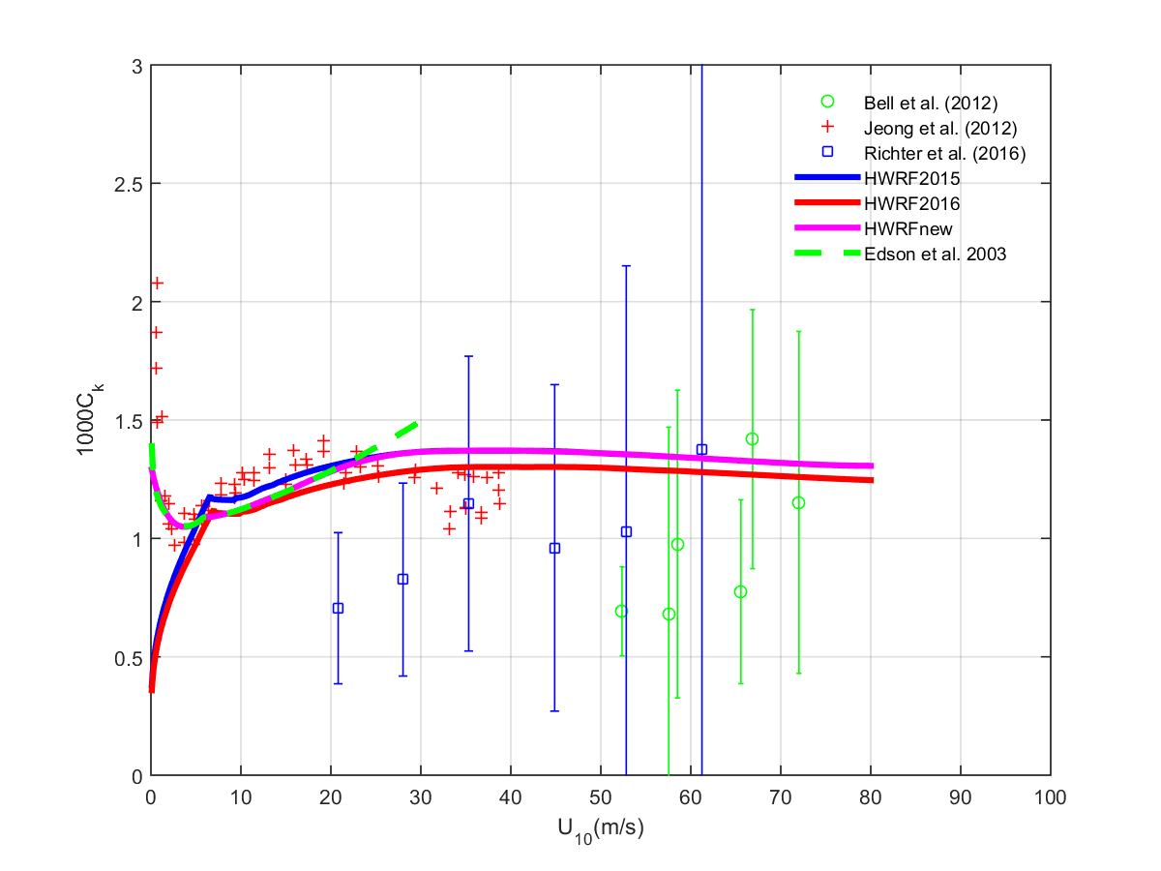
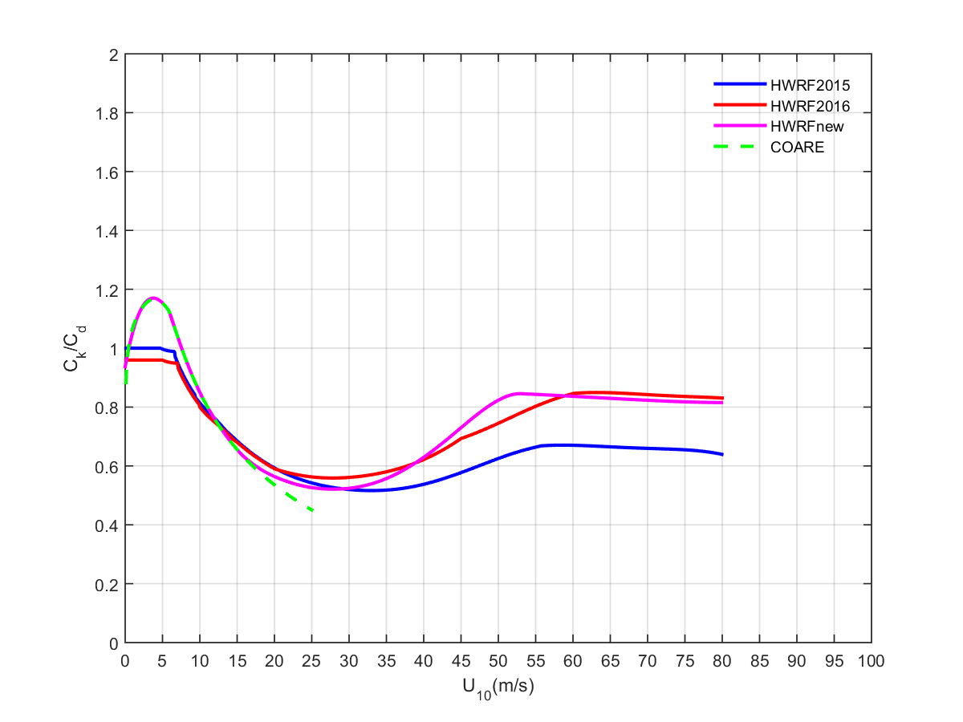
Adjustments of Air-Sea Exchange Coefficients
Cd
Ck
Ck/Cd
Magenta: FY2017 HWRF
Red: FY2016 HWRF
Blue: FY2015 HWRF
Emanuel’s MPI theory:
Low to moderate winds:
Using COARE algorithm
High winds:
Fitting to observed Cd
$$V_{max}^{2}∝\frac{Ck}{Cd}×\frac{Ts−To}{Ts}{×(k}_{0}^{∗}−k_{a})$$

Slide 10
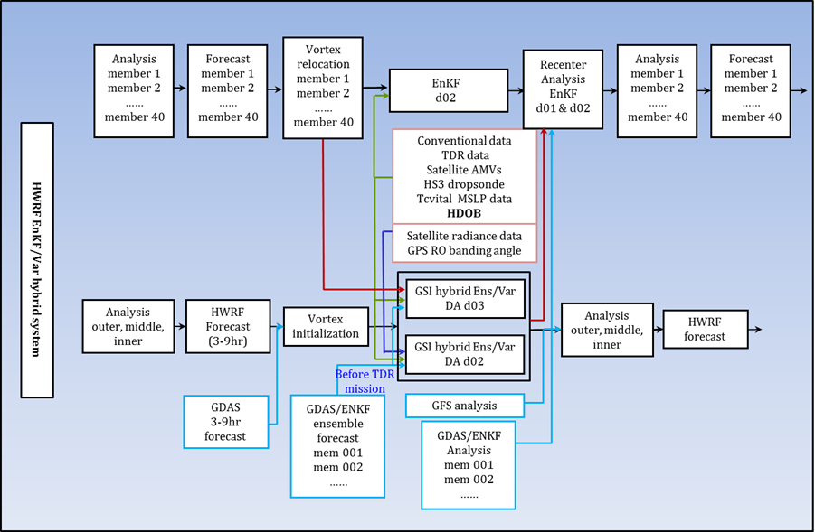
FY2017 HWRF DA Upgrades
GSI code upgrades (align with EMC GSI)
Increase the blending threshold of VI and GSI analysis (from 50 to 65 kt)
New data to be assimilated and other data usage changes
HDOB flight-level data
Hourly shortwave, clear air water vapor and visible AMVs from GOES
Flag Global Hawk dropsonde u/v observations in the inner-core area
Fully self-cycled EnKF ensemble hybrid DA system for TDR/priority storm

Slide 11
FY2017 HWRF Configurations for Different TC Basins
Basin | Ocean Cpling | Wave Cpling | Data Assimilation | Ensemble DA | Vertical | Top
NATL | POM GDEM/GFSSST | WW3 1-way | Always | TDR/priority storm | 75 level | 10 mb
EPAC | POM RTOFS | WW3 1-way | Always | TDR/priority storm | 75 level | 10 mb
CPAC | POM RTOFS | WW3 1-way | None | None | 75 level | 10 mb
WPAC | HYCOM | None | None | None | 61 level | 10 mb
NIO | HYCOM | None | None | None | 61 level | 10 mb
SIO | None | None | None | None | 43 level | 50 mb
SPAC | None | None | None | None | 43 level | 50 mb
EnKF self-cycled DA system for one TDR or priority storm
75 vertical levels with 10-hPa top for NATL/EPAC/CPAC
61 vertical levels with 10-hPa top for WPAC/NIO
Enable ocean coupling for all NH basins (POM for NATL, EPAC and CPAC, HYCOM for WPAC and NIO)
Utilize daily RTOFS (instead of GDEM climatology) data for POM initialization for CPAC basin
One-way coupling to wave model for NATL, EPAC, and CPAC to replace the NCEP standard-alone hurricane wave model (multi_2)

Slide 12
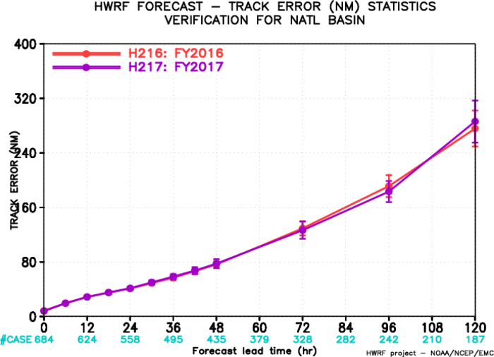
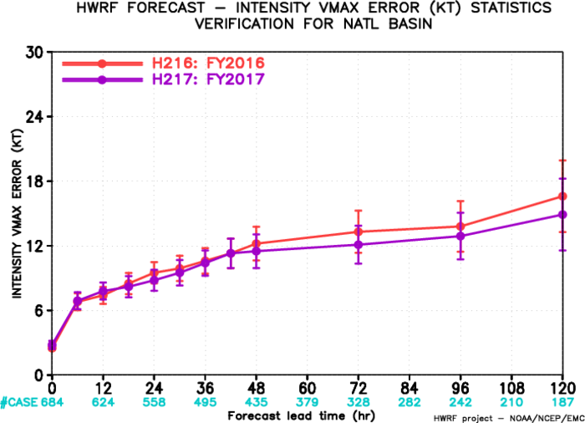
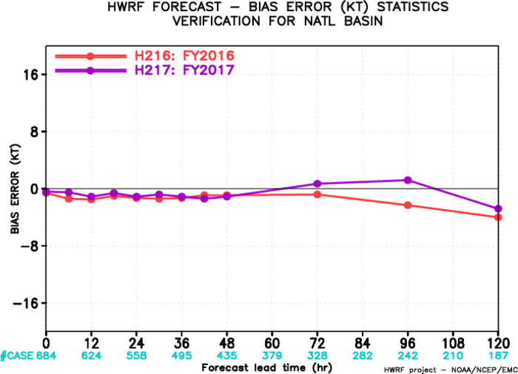
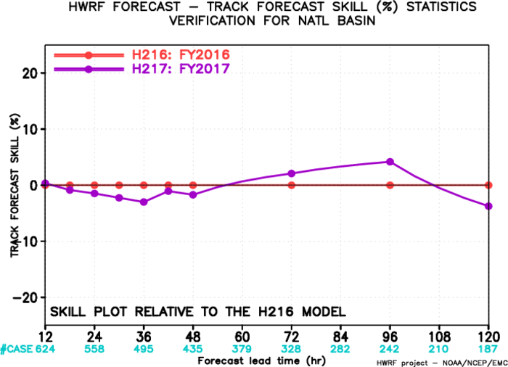
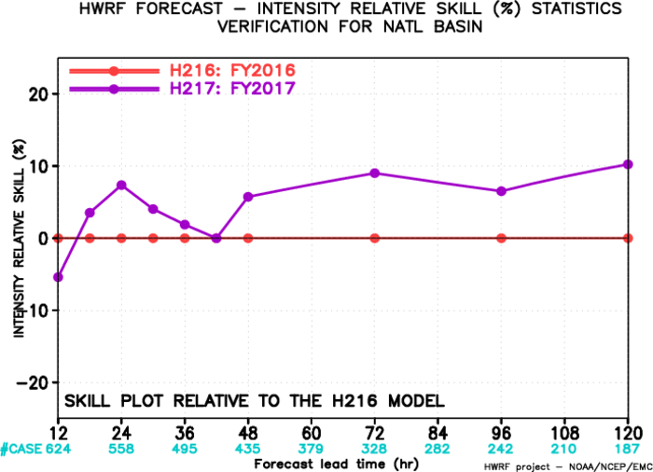
Evaluation of 2017 HWRF for NATL (2014-2016 storms)
Track
Intensity
Bias
Track
skill
Intensity skill
Track forecast: Mostly neutral with improvement for lead times from 60-108 hr
Intensity forecast: Improved at almost all lead times, around 10% at days 3-5
Intensity bias: Lower bias compared with H216

Slide 13
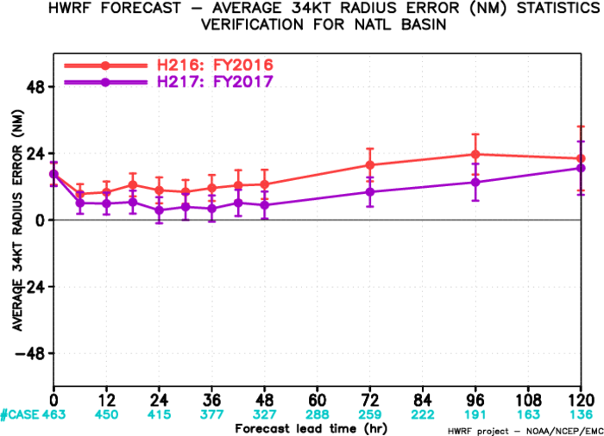
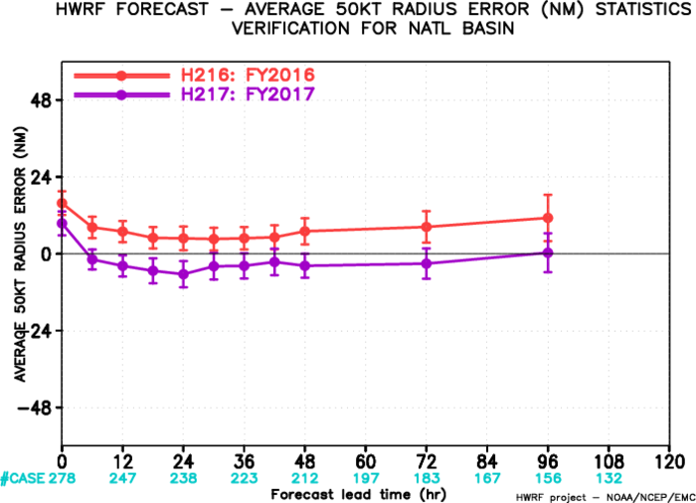
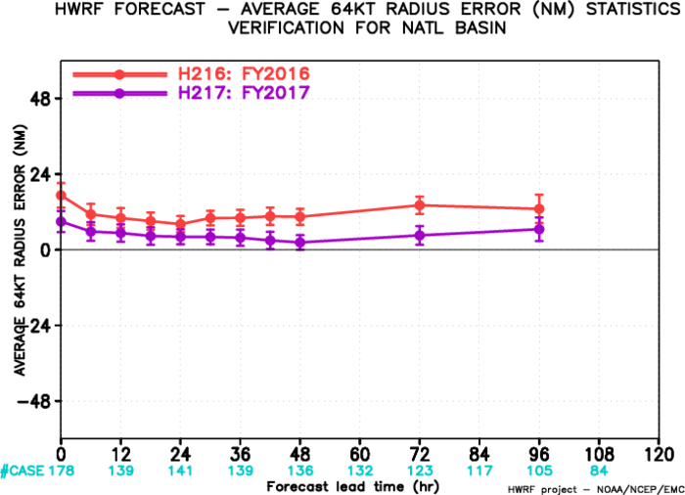
Evaluation of 2017 HWRF for NATL (Storm size errors)
R34
R50
R64
Storm size errors were significantly reduced in H217 for all lead times and for all radii (r34, 50 and 64 kts).

Slide 14
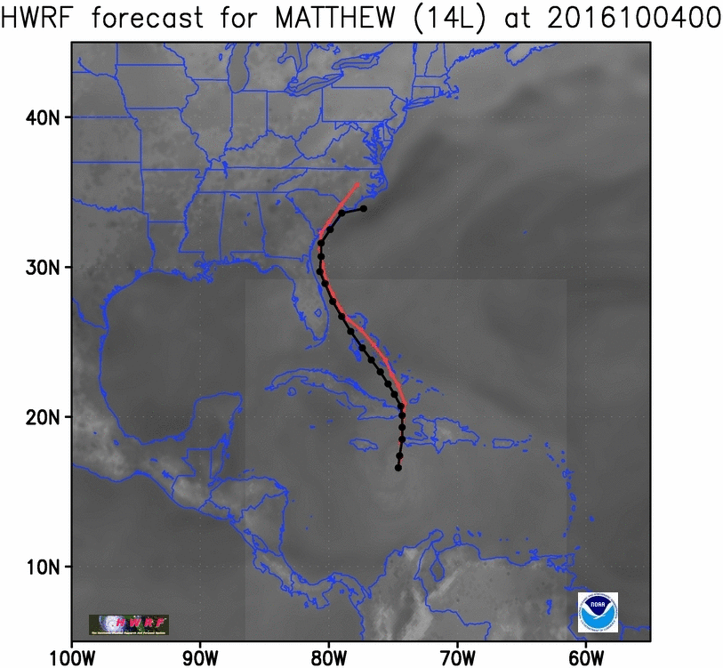
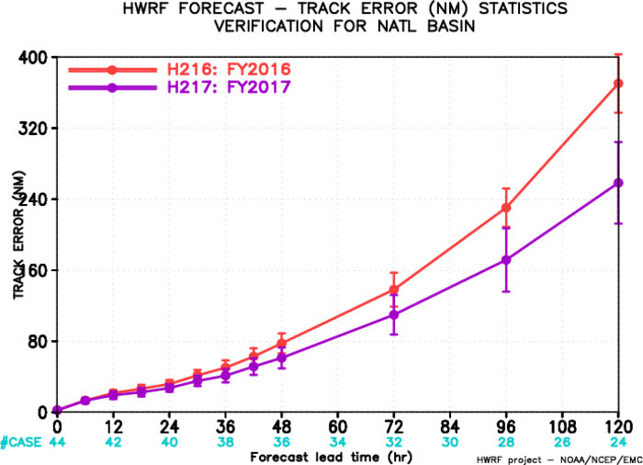
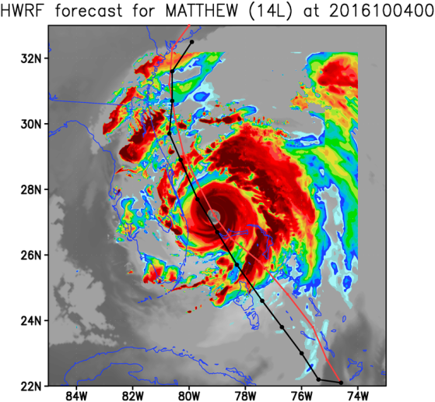
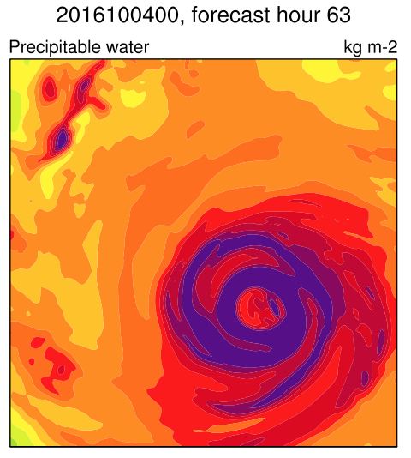
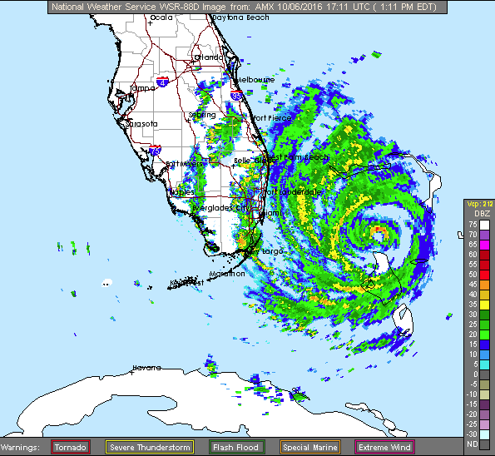
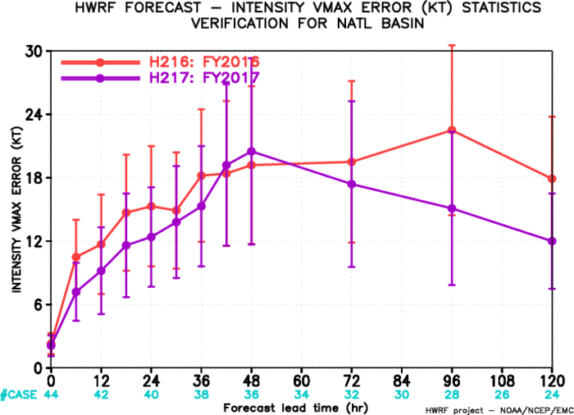
Evaluation of 2017 HWRF for NATL (Hurricane Matthew 14L2016)
Significantly improved track forecast
Track
Substantially reduced intensity errors except at day 2
Double eye wall structure
Intensity
PW[cm]

Slide 15
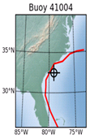
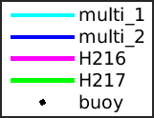
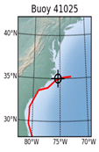
2017 HWRF WW3 Forecast (Hurricane Matthew 14L2016)
2016-10-04 00z
HS U10
2016-10-05 00z
HS U10
The NCEP hurricane wave model (multi_2) will be discontinued in NCEP operations with FY2017 HWRF upgrade

Slide 16
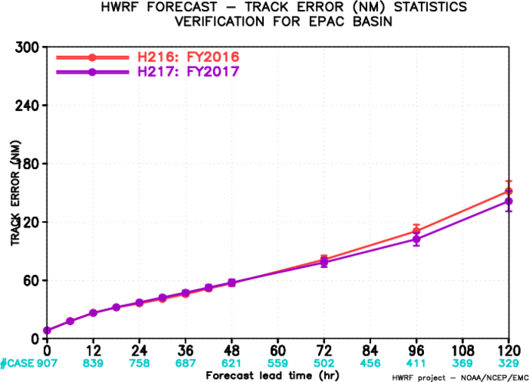
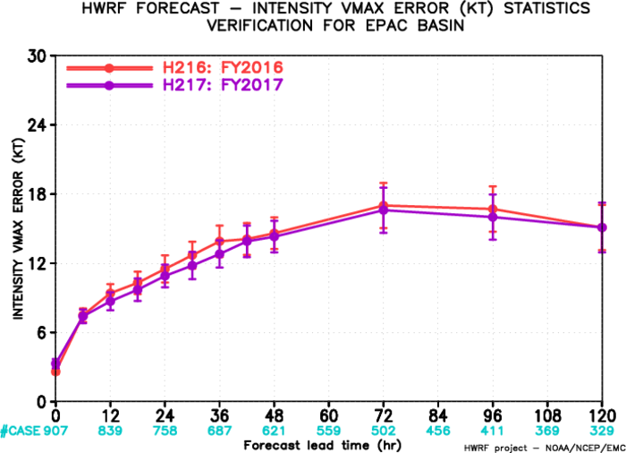
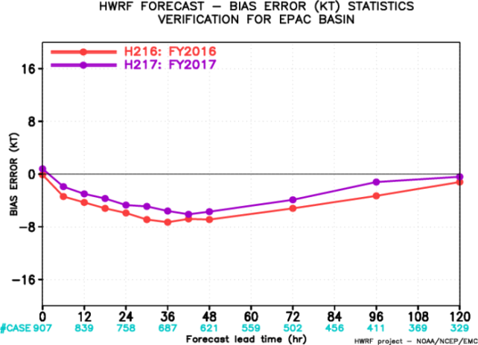
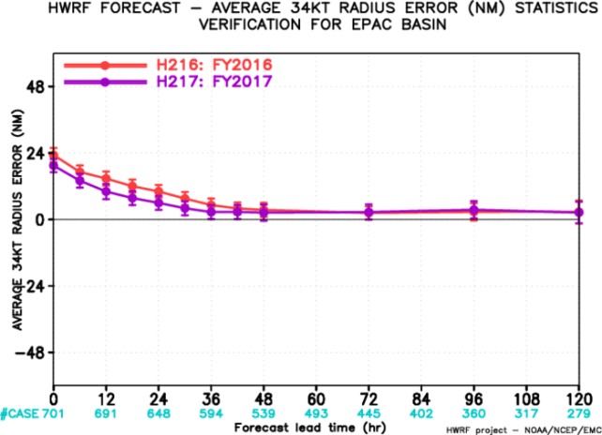
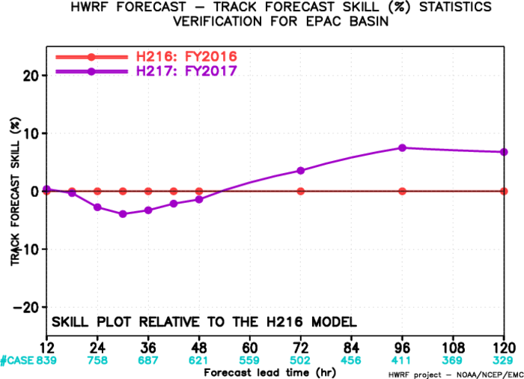
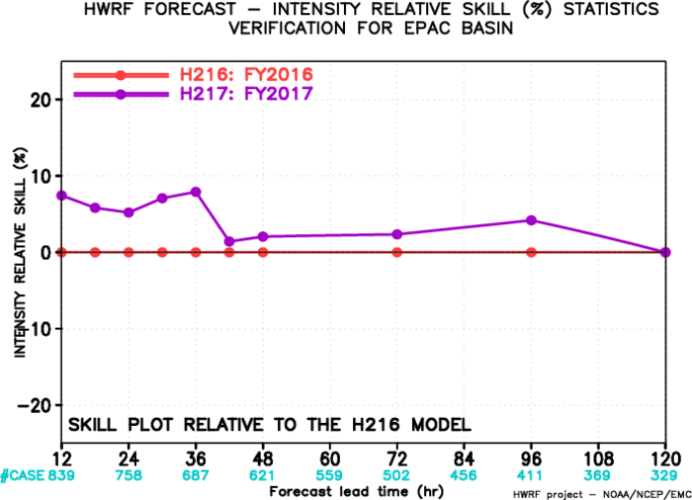
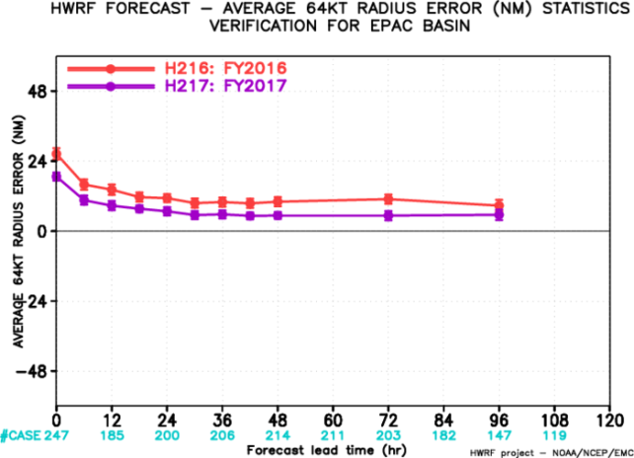
Evaluation of 2017 HWRF for EPAC (2014-2016 storms)
Track
Intensity
Bias
R34
Track
skill
Intensity skill
R64
Improved track for lead times after day 2
Improved intensity at almost all lead times
Smaller bias compared with H216
Better storm size forecast

Slide 17
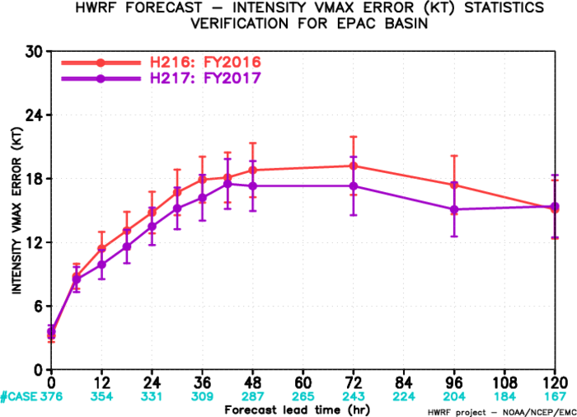
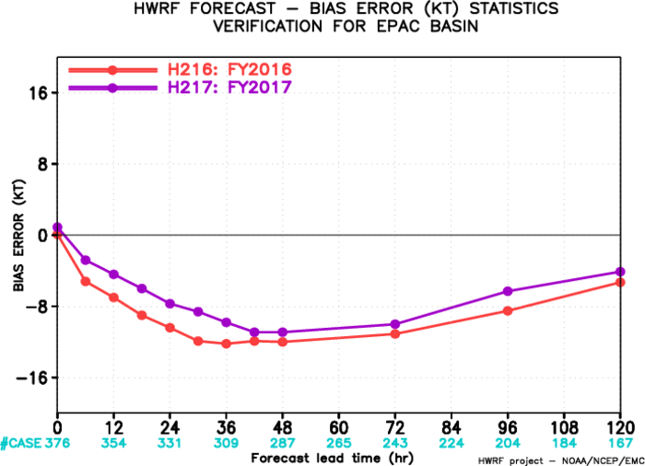
Evaluation of 2017 HWRF for EPAC (Rapid intensifying storms)
Track
Intensity
Bias
Track errors show improvement for at lead times of days 4 and 5
Intensity and bias errors show improvement at almost all lead times

Slide 18
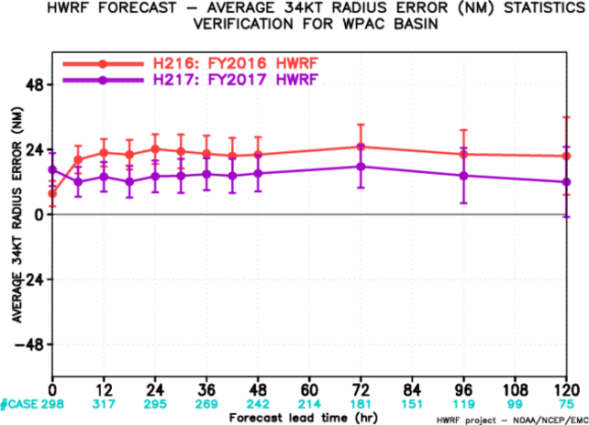
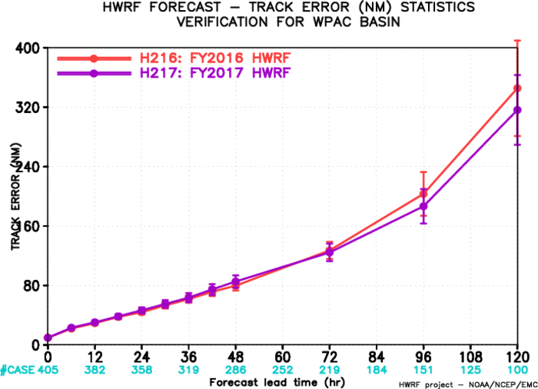
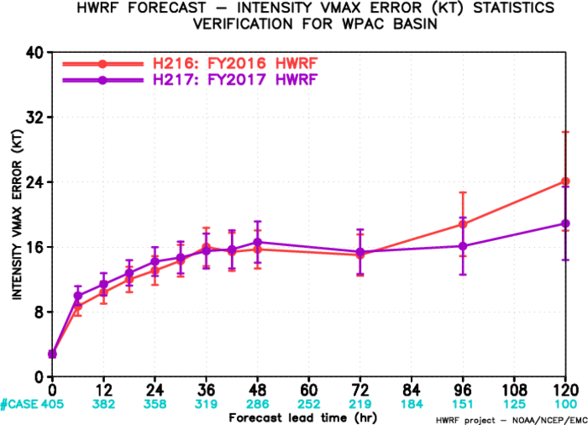
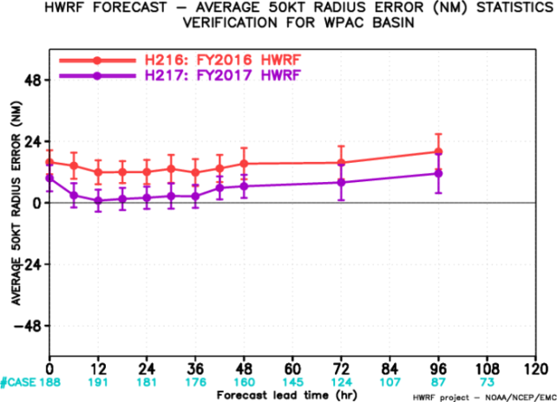
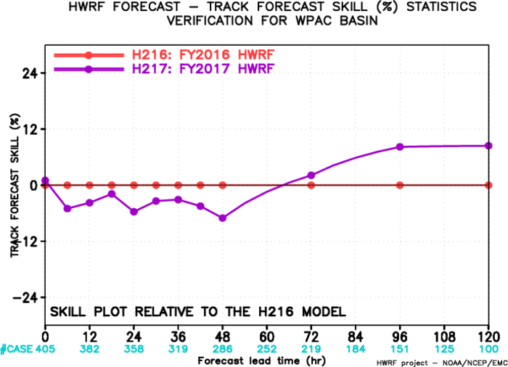
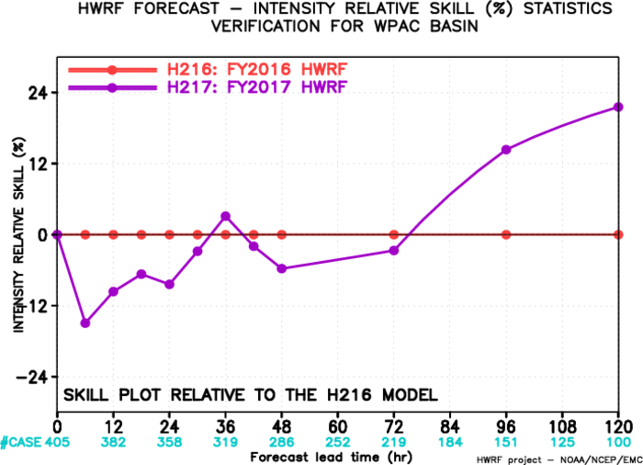
Evaluation of 2017 HWRF for WPAC (02-25W2016)
R34
Track
Intensity
R50
Track
skill
Intensity skill
R64
Improved track and intensity forecasts for longer lead times after day 3
Significantly improved storm size for all lead times

Slide 19
Successful R2O in 2017 HWRF Upgrades
EMC/NCEP: Model physics upgrades including scale-aware SAS scheme, Ferrier-Aligo microphysics scheme, adjustment of air-sea exchange coefficients; framework upgrades including vertical resolution change, etc. ; GSI upgrades; HYCOM ocean coupling; and pre-implementation T&E
DTC: Community support including code management; partial cloudiness modification of RRTMG scheme; and testing candidate physics schemes
HRD/AOML: Knowledge sharing for framework and physics upgrades; triggers for self-cycled EnKF DA for TDR/priority storms
FIU: Candidate PBL scheme modification
URI: RTOFS initialization for CPAC basin; increasing vertical levels for POM
OU: Self-cycled EnKF GSI upgrade
GFDL: Vortex tracker upgrade
NHC/CPHC/JTWC/NWS-PR: Diagnostics and evaluation of the HWRF pre-implementation tests and real-time guidance
This upgrade is a result of multi-agency R2O efforts

Slide 20
Developmental Testbed Center Support
www.dtcenter.org/HurrWRF/users
Yearly releases, code downloads, datasets, documentation, online tutorial, helpdesk
1300+ registered users
Stable, tested code
Benchmarks available
Support to HWRF developers in code management
Current release: HWRF v3.8a (2016 operational) November 2016
Next release: HWRF v3.9a (2017 operational) August/September 2017

Slide 21
HWRF community code
HWRF public release
End-to-end atmosphere-ocean coupled HWRF system corresponding to operational model of the year
Freely available and fully supported
Additional research capabilities
Idealized tropical cyclone
27/9/3 km domain configuration
Reduced d02/d03 grid sizes
Alternate physics schemes
Alternate configurations (i.e.: DA, ocean, input datasets)
HWRF developer support
DTC provides specialized support for HWRF developers using repository code
Streamlines transition of new developments to the HWRF model
DTC visitor program
The DTC is interested in engaging with the community about new developments that could be evaluated for HWRF
http://www.dtcenter.org/visitors/

Slide 22
Summary of FY2017 HWRF Upgrades
Highlights of FY2017 HWRF upgrades include:
Increased vertical levels to L75 with model top of 10hPa
Improved vortex initialization with new composite storm vortex
DA upgrades and fully self-cycled EnKF hybrid DA for TDR and priority storms
Physics advancements including updated Ferrier-Aligo microphysics and scale-aware SAS schemes, partial cloudiness modification for RRTMG, and updated air-sea momentum and enthalpy exchange coefficients
FY2017 HWRF retrospective implementation tests (total 684 verifiable cycles in NATL, 907 in EPAC, 405 in WPAC) demonstrated that (comparing to FY2016 HWRF):
Neutral to modest (< 5%) improvement for track forecast for NATL and EPAC
5-10% improvement for intensity forecast for NATL and EPAC
Substantial reduction in intensity errors and biases for storms undergoing RI
Significant improvements for storm size errors for both basins at all lead times
POM RTOFS initialization for CPAC and HYCOM ocean coupling for WPAC and NIO
One-way coupling to WW3 for NATL, EPAC and CPAC basins with wave BC from global wave model, to replace the phase-out NCEP multi_2 hurricane wave model

Slide 23
HMON: Hurricanes in a Multi-scale Ocean coupled Non-hydrostatic model
HMON is a new operational hurricane model at NCEP. It implements a long-term strategy at NCEP/EMC for multiple static and moving nests globally, and coupled to other (ocean, wave, sea ice, surge, inundation, etc.) models using NEMS infrastructure.
Advanced Hurricane Model using NMMB dynamic core which is currently being used in NCEP’s operational NAM and SREF systems
Shared infrastructure with unified model development in NEMS. A step closer towards NEMS/FV3 Unified Modeling System for hurricanes
Provides high-resolution intensity forecast guidance to NHC along with HWRF (replacing the legacy GFDL hurricane model)
Triple nested (18-6-2km) vortex following domains
Development supported by NGGPS, HFIP and HIWPP programs

Slide 24
Thank you!
Real-time NCEP operational model guidance for all global TCs
HWRF: http://www.emc.ncep.noaa.gov/HWRF
HMON: http://www.emc.ncep.noaa.gov/gc_wmb/vxt/HMON

Slide 25
FY2017 HWRF Performance for NATL (Early model guidance)
Comparing to FY2016 HWRF, tracks are overall neutral with improvements for lead times of 48-108 hrs, while intensity is improved at all lead times with 10% improvement at day 3
Meanwhile, still need to catch-up to official tracks, but are doing better for intensity after day 2

Slide 26
Evaluation of 2017 HWRF for NATL (Rapid intensifying storms)
For RI storms, the track, intensity and bias errors for H217 show improvement for all lead times

Slide 27
FY2017 HWRF Performance for EPAC (Early model guidance)
Comparing to FY2016 HWRF, track forecast is initially a little degraded but then show improvements after hr 60, and intensity skill is improved at all lead times with 8% improvement at hr 36
Still need to catch-up to official tracks and intensity for the first 3 days, but intensity is very close after day 3

