Slide 1
18th Annual WRF User's Workshop WRF-ARW Research to Operations Update: The Rapid-Refresh (RAP) version 4, High-Resolution Rapid Refresh (HRRR) version 3 and Convection-Allowing Ensemble Prediction
13 June 2017
Curtis Alexander, Steve Weygandt, Stan Benjamin, David Dowell, Ming Hu, Tanya Smirnova, Joseph Olson, Jaymes Kenyon, Georg Grell, Eric James, Haidao Lin, Terra Ladwig, John Brown, Trevor Alcott and Isidora Jankov
NOAA/ESRL/GLOBAL SYSTEMS DIVISION

Slide 2
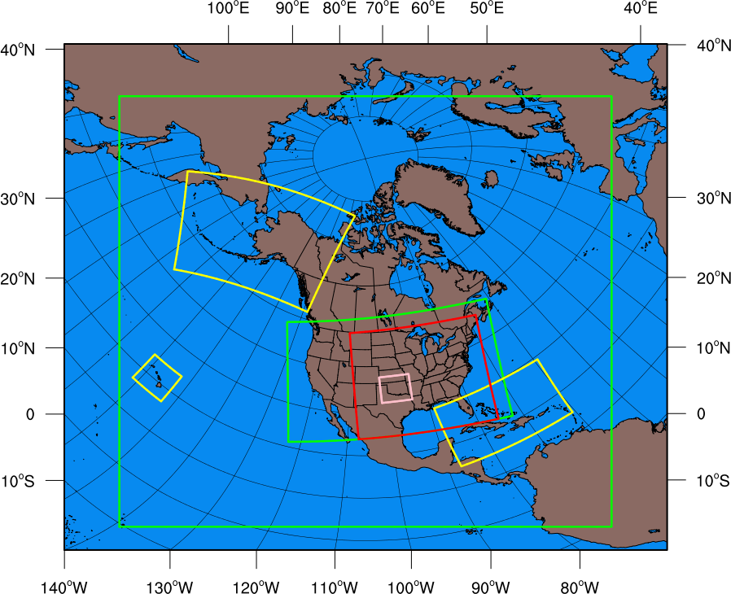
RAP/HRRR: Hourly-Updating Weather Forecast Suite
13-km Rapid Refresh (RAPv4) – to 39h (Feb 2018)
Initial & Lateral Boundary Conditions
3-km High-Resolution Rapid Refresh Alaska, Hawaii and Puerto Rico Testing (HRRR-AK, HRRR-HI, HRRR-PR) Experimental (ongoing)
3-km High-Resolution Rapid Refresh (HRRRv3) – to 36h (Feb 2018)
Initial & Lateral Boundary Conditions
3-km Storm-Scale Ensemble Analysis and Forecast (HRRRE) 55% CONUS HRRR Experimental (ongoing)
750-m HRRR nest Scale-ware Physics Testing (ongoing)
3-km High-Resolution Time Lagged Ensemble (HRRR-TLE)
3-km HRRR-Smoke (VIIRS fire data)
Overview

Slide 3
RAP/HRRR Implementation History
Operational Implementations
01 May 2012 RAPv1: Adoption of GSI, WRF-ARW and unified post Enabled use of community-developed software | 25 Feb 2014 RAPv2: Hybrid EnKF-3DVar data assimilation Significant improvement in upper-air forecasts
30 Sep 2014 HRRRv1: 3-km Radar DA in WRF-ARW Significant improvement in convective forecasts | 23 Aug 2016 RAPv3/HRRRv2: Aerosol Thompson MP, improvements to MYNN PBL, RUC LSM, RRTMG Rad, Grell-Freitas cumulus Significant improvement in surface forecasts
13 Feb 2018
RAPv4/HRRRv3: Hybrid Vertical Coordinate, Eddy Diffusivity Mass Flux PBL
Reduction in short-lead biases and improved mesoscale environment
Extended Forecast Lengths
RAP: 03z, 09z, 15z, 21z 21 hrs → 39 hrs
RAP: All other hourly cycles remain 21 hrs
HRRR: 00z, 06z, 12z, 18z 18 hrs → 36 hrs
HRRR: All other hourly cycles remain 18 hrs
OCONUS Domains
HRRR-Alaska:
Every 3 hrs to 18 hrs
Every 6 hrs to 36 hrs
HRRR-Hawaii: ??
RAP/HRRR Implementations

Slide 4
RAP/HRRR: Hourly-Updating Weather Forecast Suite
13-km Rapid Refresh (RAPv4) – to 39h (Feb 2018)
Initial & Lateral Boundary Conditions
3-km High-Resolution Rapid Refresh Alaska, Hawaii and Puerto Rico Testing (HRRR-AK, HRRR-HI, HRRR-PR) Experimental (ongoing)
3-km High-Resolution Rapid Refresh (HRRRv3) – to 36h (Feb 2018)
Initial & Lateral Boundary Conditions
3-km Storm-Scale Ensemble Analysis and Forecast (HRRRE) 55% CONUS HRRR Experimental (ongoing)
750-m HRRR nest Scale-ware Physics Testing (ongoing)
3-km High-Resolution Time Lagged Ensemble (HRRR-TLE)
3-km HRRR-Smoke (VIIRS fire data)
Overview

Slide 5
RAPv4/HRRRv3 Change Highlights
 | Model | Data Assimilation
RAPv4 (13 km) | WRF-ARW v3.8.1+ incl. physics changes Physics changes (12 changes): Thompson microphysics – improved upper-level clouds GF Convective update – more optimal precip bias MYNN PBL update – better sub-grid clouds, meso env LSM update – 15” MODIS data – better lower boundary Refined roughness lengths over various land use types Numerics changes (3 changes): Improved terrain (cell avg) – better winds /turbulence Hybrid vertical coordinate from NCAR – better meso env Full geometric diffusion – better winds/temp in terrain | Merge with GSI trunk – last updated in May 2017 New Observations for assimilation (4 changes): NCEP new VAD wind retrievals AMVs over land and TAMDAR Add IASI, CrIS, SEVIRI radiances Assimilation Methods (9 changes): Revised PBL pseudo-obs – reduce RH bias More ensemble weight in hybrid DA (0.85/0.15) METAR/GOES cloud consistent (<1200m AGL) Cloud building – smaller qc/qi – more retention Reduced latent heating – improved precip bias
HRRRv3 (3 km) | WRF-ARW v3.8.1+ incl. physics changes Physics changes (12 changes): Thompson microphysics – improved upper-level clouds MYNN PBL update – better sub-grid clouds, meso env LSM update – 15” MODIS data – better lower boundary Refined roughness lengths over various land use types Gravity wave drag (RAP and HRRR) – better winds Numerics changes (2 changes): Hybrid vertical coordinate from NCAR – better meso env Full geometric diffusion – better winds/temp in terrain | New Observations for assimilation (5 changes): NCEP new VAD wind retrievals AMVs over land and TAMDAR Radar radial velocity and lightning Assimilation Methods (9 changes): Revised PBL pseudo-obs – reduce RH bias More ensemble weight in hybrid DA (0.85/0.15) METAR and GOES cloud consistent (<1200 m AGL) Cloud building – smaller qc/qi – more retention
RAPv4/HRRRv3

Slide 6
RAPv4/HRRRv3 Summary of Changes
Operational
RAPv3/HRRRv2
Model | Run at: | Domain | Grid Points | Grid Spacing | Vertical Levels | Vertical Coordinate | Pressure Top | Boundary Conditions | Initialized
RAP | GSD, NCO | North America | 953 x 834 | 13 km | 50 | Sigma | 10 mb | GFS | Hourly (cycled)
HRRR | GSD, NCO | CONUS | 1799 x 1059 | 3 km | 50 | Sigma | 20 mb | RAP | Hourly (pre-forecast hour cycle)
Model | Version | Assimilation | Radar DA | Radiation LW/SW | Microphysics | Cumulus Param | PBL | LSM
RAP | WRF-ARW v3.6+ | GSI Hybrid Ensemble to 0.75 | 13-km DFI | RRTMG/ RRTMG | Thompson Aerosol v3.6 | GF + Shallow | MYNN v3.6 | RUC v3.6
HRRR | WRF-ARW v3.6+ | GSI Hybrid Ensemble to 0.75 | 3-km 15-min LH | RRTMG/ RRTMG | Thompson Aerosol v3.6 | None | MYNN v3.6 | RUC v3.6
Model | Horiz/Vert Advection | Scalar Advection | Upper-Level Damping | Diffusion Option | 6th Order Diffusion | SW Radiation Update | Land Use | MP Tend Limit | Time-Step
RAP | 5th/5th | Positive-Definite | w-Rayleigh 0.2 | Simple (1) | Yes 0.12 | 20 min | MODIS Seasonal | 0.01 K/s | 60 s
HRRR | 5th/5th | Positive-Definite | w-Rayleigh 0.2 | Simple (1) | Yes 0.25 | 15 min with SW-dt | MODIS Seasonal | 0.07 K/s | 20 s
RAPv3/HRRRv2

Slide 7
RAPv4/HRRRv3 Summary of Changes
Upcoming
RAPv4/HRRRv3
Model | Run at: | Domain | Grid Points | Grid Spacing | Vertical Levels | Vertical Coordinate | Pressure Top | Boundary Conditions | Initialized
RAP | GSD, NCO | North America | 953 x 834 | 13 km | 50 | Sigma-Isob Hybrid | 10 mb | GFS | Hourly (cycled)
HRRR | GSD, NCO | CONUS | 1799 x 1059 | 3 km | 50 | Sigma-Isob Hybrid | 20 mb | RAP | Hourly (pre-forecast hour cycle)
No Change in CONUS
Domains
Model | Version | Assimilation | Radar DA | Radiation LW/SW | Microphysics | Cumulus Param | PBL | LSM
RAP | WRF-ARW v3.8.1+ | GSI Hybrid Ensemble to 0.85 | 13-km DFI, ½ Strength | RRTMG/ RRTMG | Thompson Aerosol v3.8.1 | GF + Shallow | MYNN v3.8.1 | RUC v3.8.1
HRRR | WRF-ARW v3.8.1+ | GSI Hybrid Ensemble to 0.85 | 3-km 15-min LH | RRTMG/ RRTMG | Thompson Aerosol v3.8.1 | None | MYNN v3.8.1 | RUC v3.8.1
Newer Model Version
More Ensemble Weight
Advanced “Physics Suite”
Model | Horiz/Vert Advection | Scalar Advection | Upper-Level Damping | Diffusion Option | 6th Order Diffusion | SW Radiation Update | Land Use | MP Tend Limit | Time-Step
RAP | 5th/5th | Positive-Definite | w-Rayleigh 0.2 | Full (2) | Yes 0.12 | 20 min | MODIS Seasonal | 0.01 K/s | 60 s
HRRR | 5th/5th | Positive-Definite | w-Rayleigh 0.2 | Full (2) | Yes 0.25 | 15 min with SW-dt | MODIS Seasonal | 0.07 K/s | 20 s
Seasonal Vegetation
Fraction/Leaf Area Index
RAPv4/HRRRv3

Slide 8
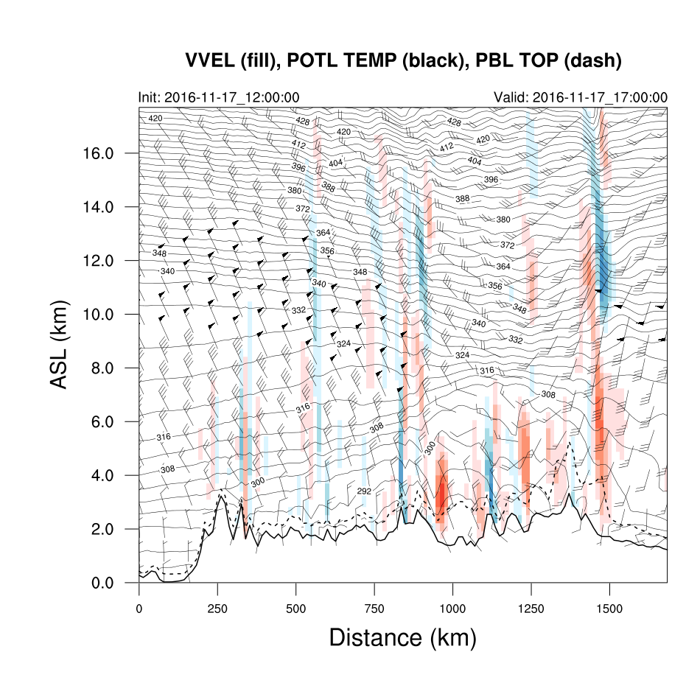
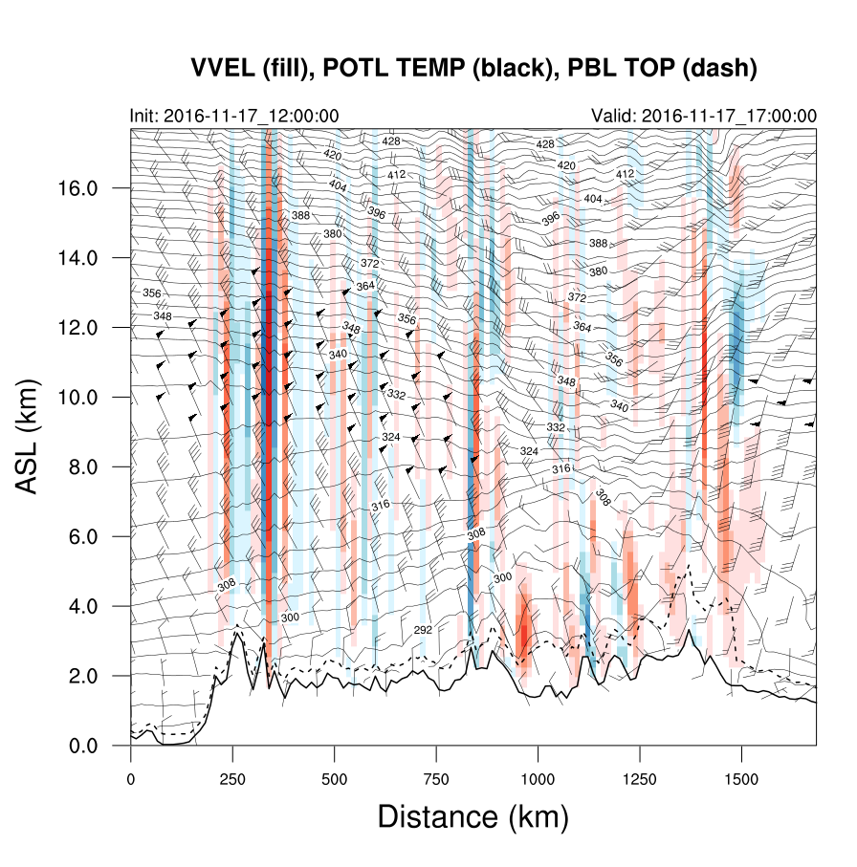
New RAP/HRRR Vertical Coordinate
Hybrid coordinate
Terrain-following coordinate
Less “Noise” in Hybrid
Hybrid Vertical Coordinate

Slide 9
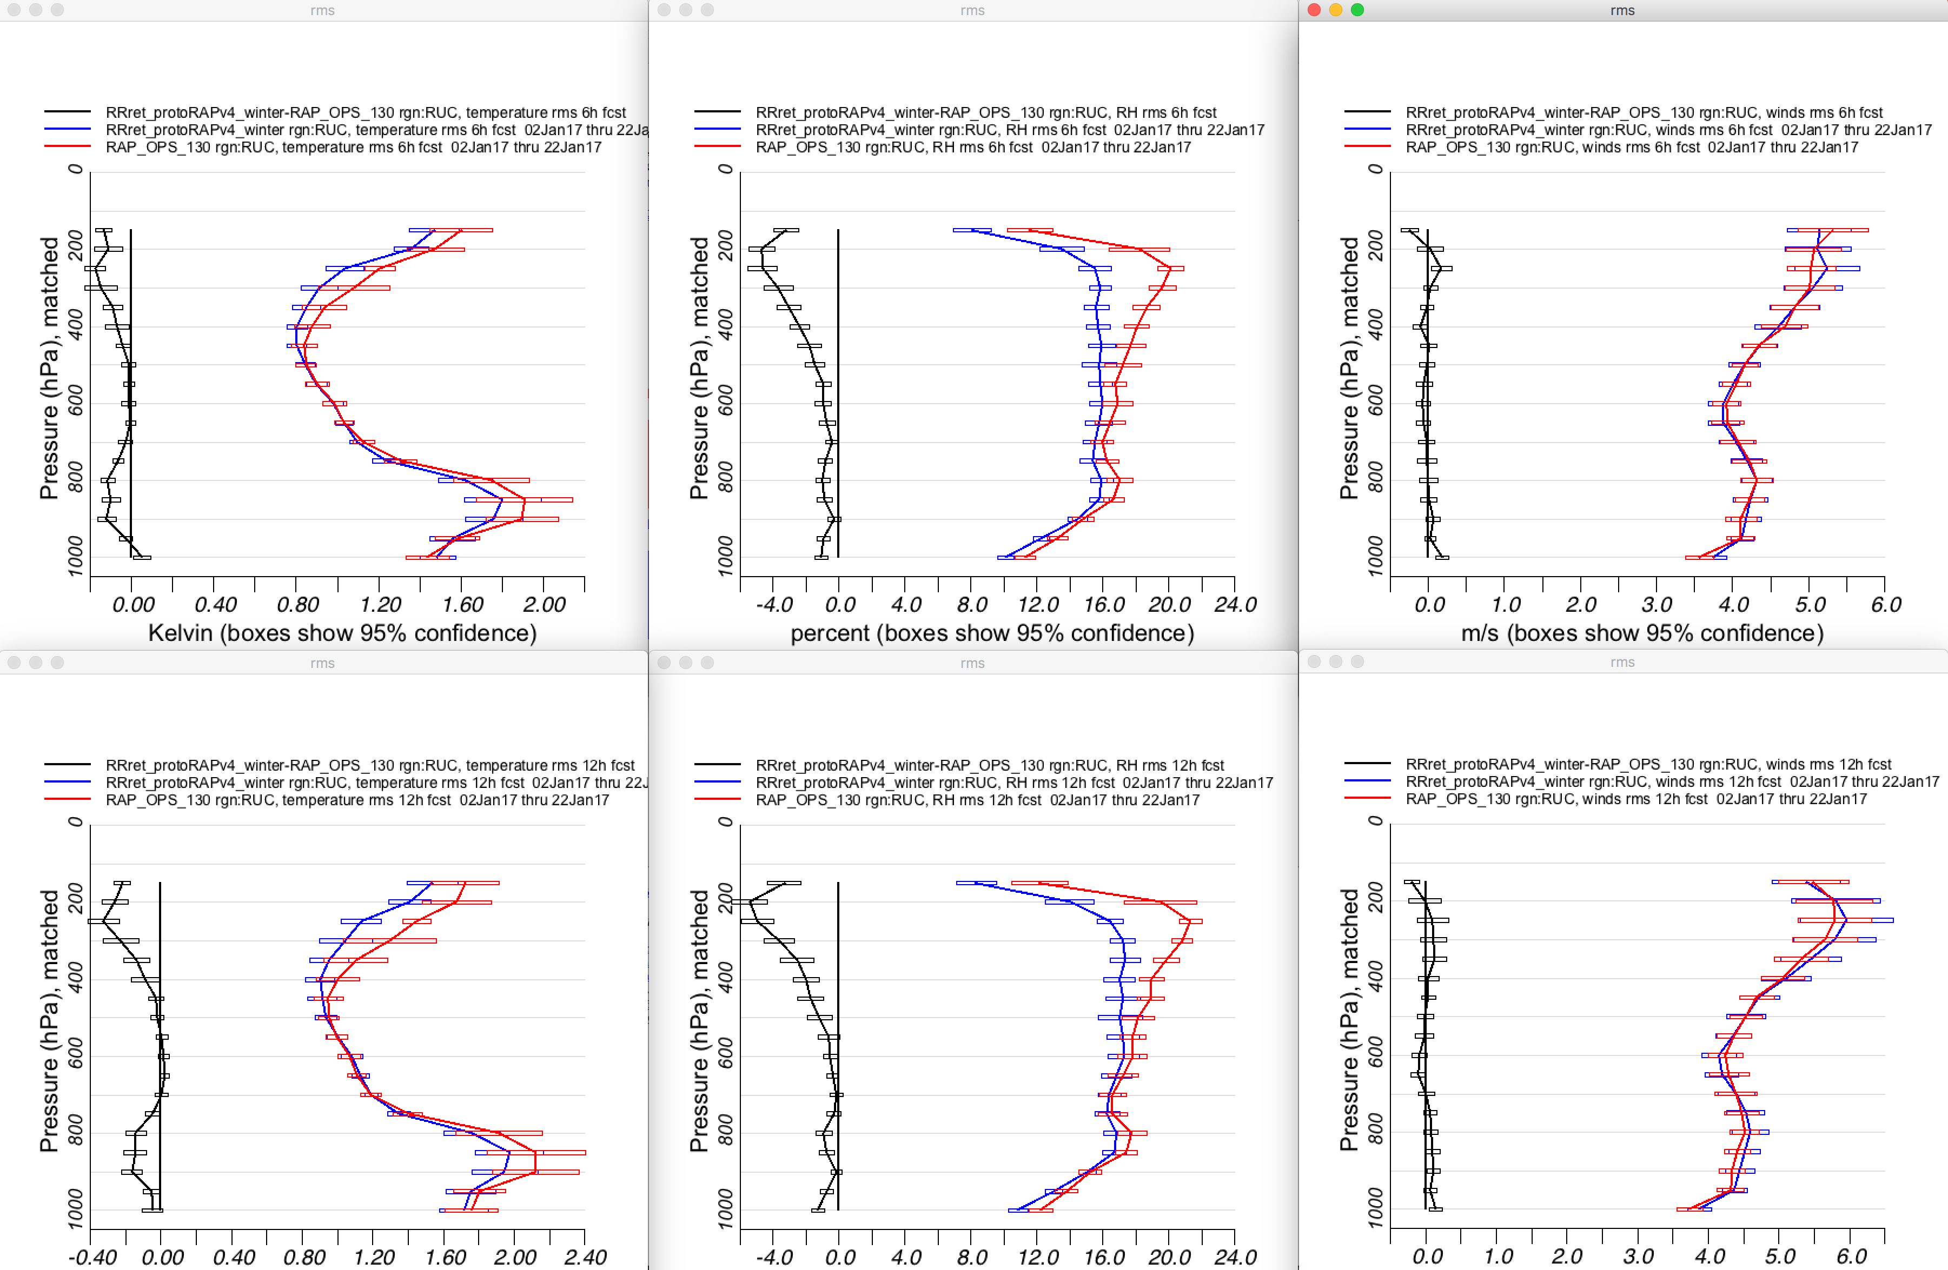
RAP RMSE Upper-Air Winter (Three Weeks Jan 2017)
RAPv4
RAPv3 (ops)
RAPv4-RAPv3
Temp
RH
Wind
6 hr
RAPv4
better
Full Tropospheric Improvements
12 hr
RAPv4
better
Upper-Air Verification

Slide 10
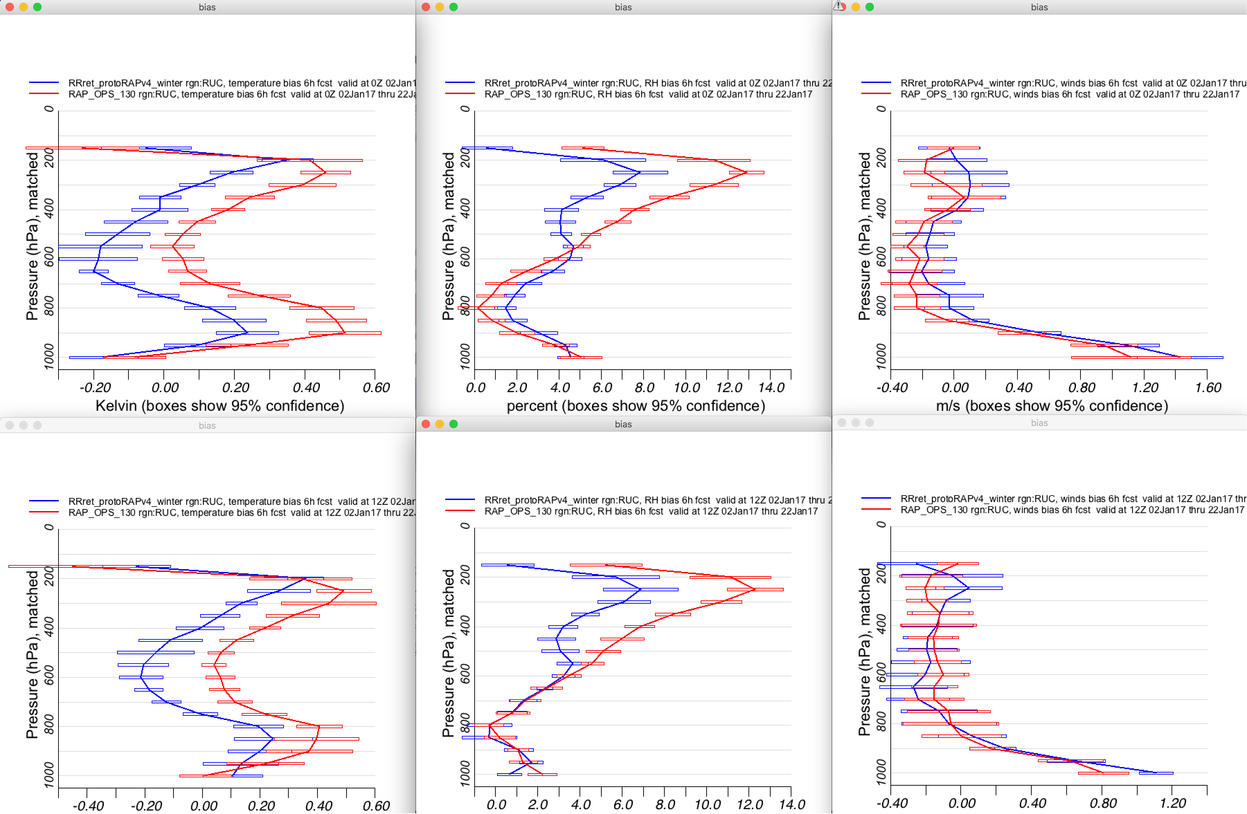
RAP BIAS Upper-Air Winter (Three Weeks Jan 2017)
RAPv4
RAPv3 (ops)
6 hr fcsts
Temp
RH
Wind
00 UTC
Reduced RH Bias Aloft
12 UTC
Upper-Air Verification

Slide 11
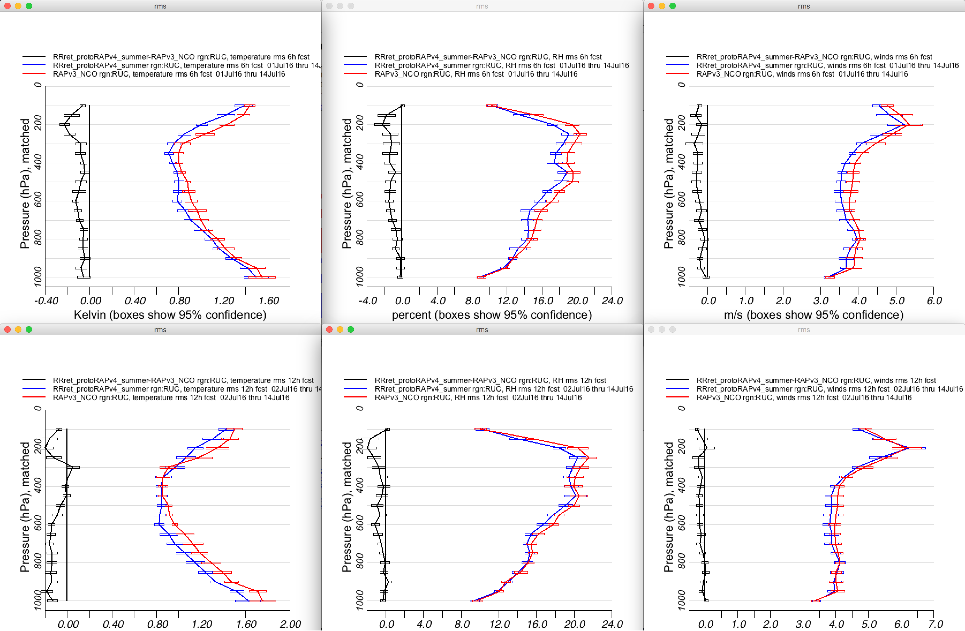
RAP RMSE Upper-Air Summer (Three Weeks Jul 2016)
RAPv4
RAPv3 (ops)
RAPv4-RAPv3
Temp
RH
Wind
6 hr
RAPv4
better
Full Tropospheric Improvements
12 hr
RAPv4
better
Upper-Air Verification

Slide 12
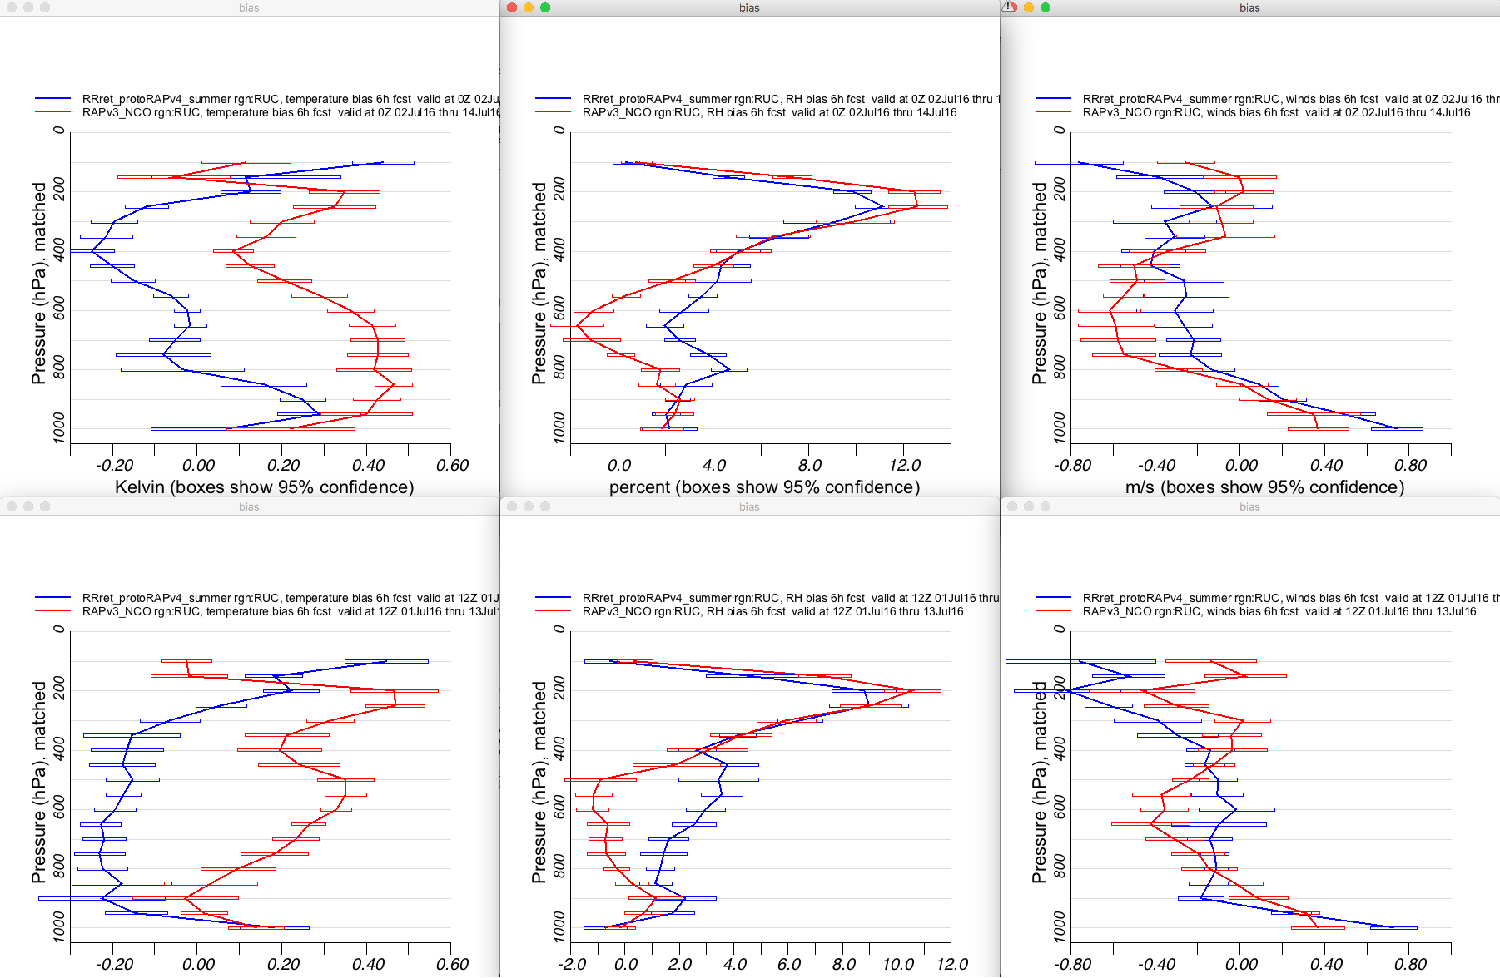
RAP BIAS Upper-Air Summer (Three Weeks Jul 2016)
RAPv4
RAPv3 (ops)
6 hr fcsts
Temp
RH
Wind
00 UTC
12 UTC
Upper-Air Verification

Slide 13
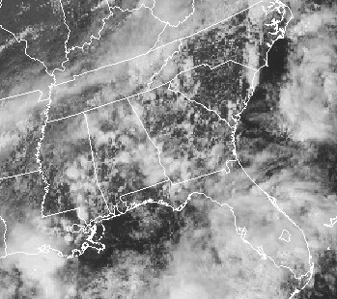
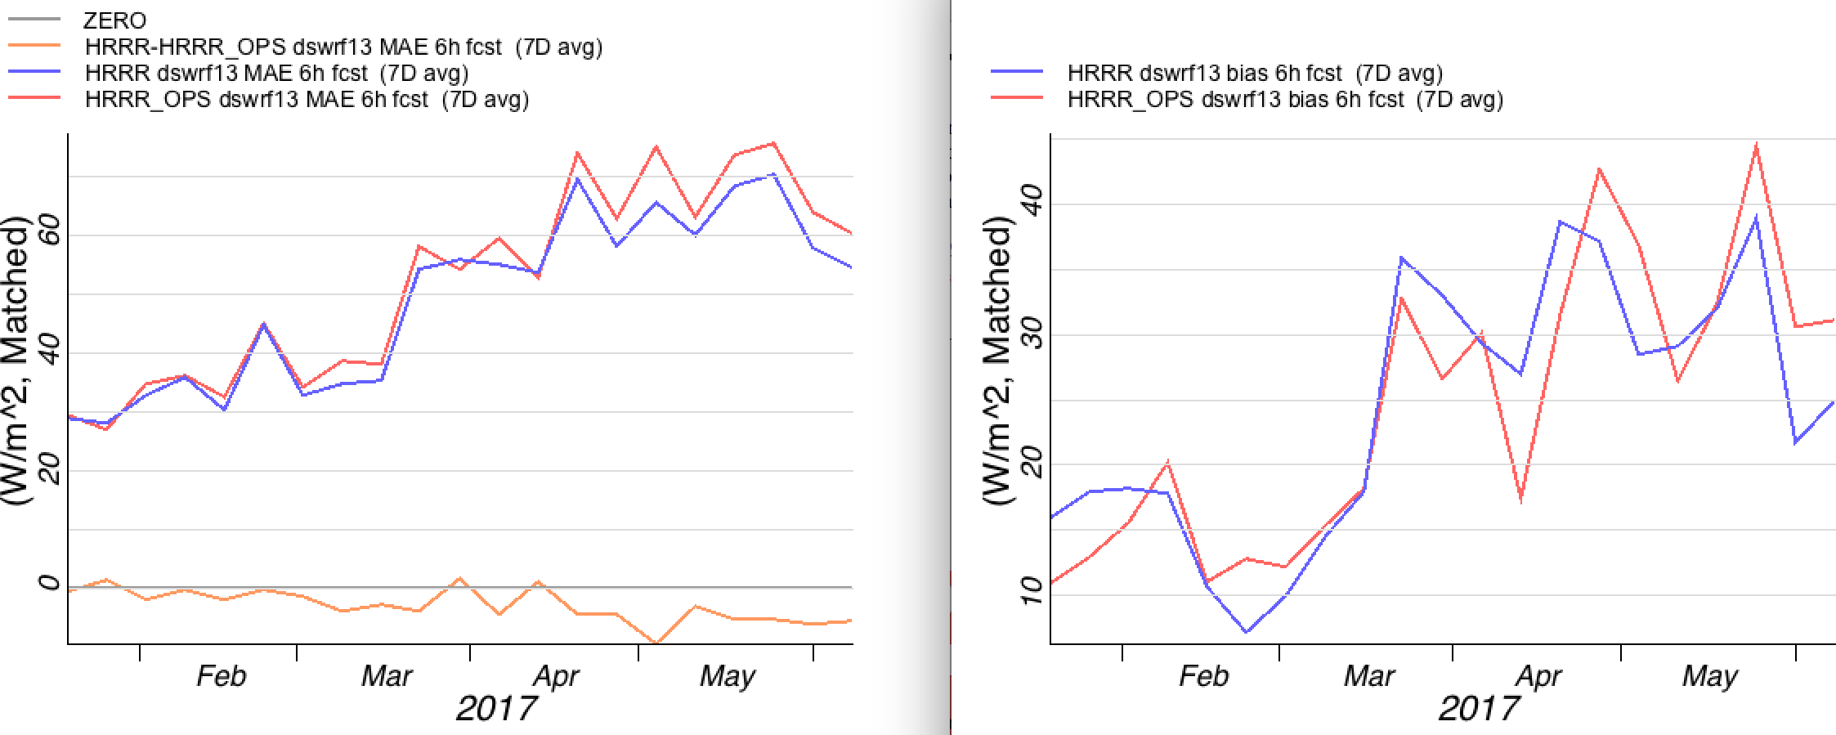
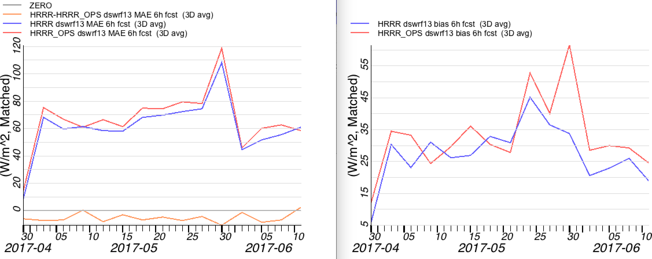
RAP/HRRR Improved Sub Grid Cloud Effects
SURFAD/ISIS DSWRF 6hr Fcst Verification
7D MAE
7D BIAS
Visible Satellite
HRRRv3
better
Experimental HRRRv3
3hr fcsts
Operational HRRRv2
3D MAE
3D BIAS
HRRRv3
better
More Shortwave
Attenuation
Improved Bias
Radiation Verification

Slide 14
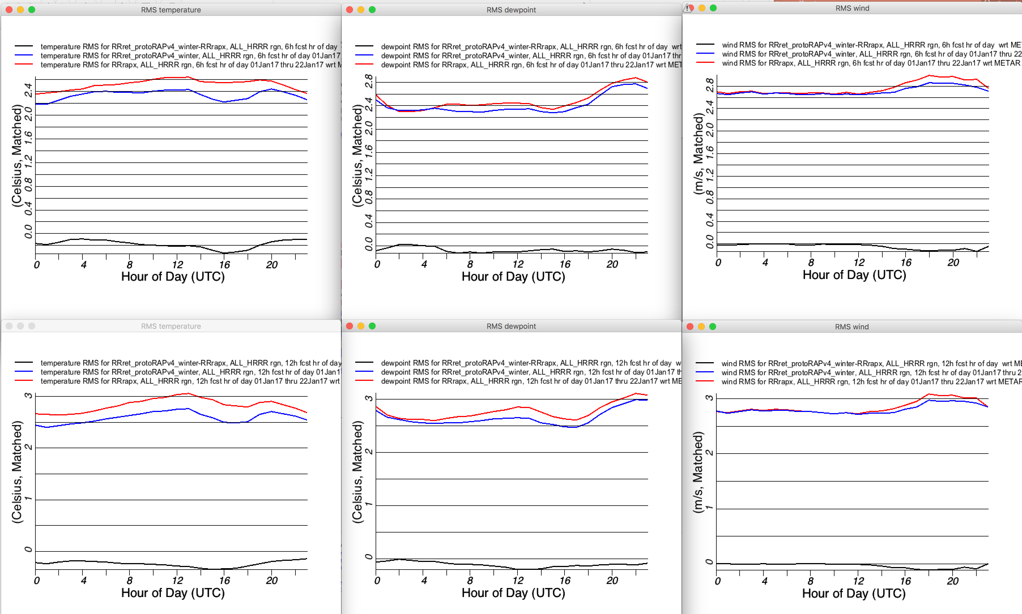
RAP RMSE Surface Winter (Three Weeks Jan 2017)
RAPv4
RAPv3 (ops)
RAPv4-RAPv3
2mT
2mT_{d}
10mWind
6 hr
Improved Diurnal T/T_{d}
RAPv4
better
12 hr
RAPv4
better
Surface Verification

Slide 15
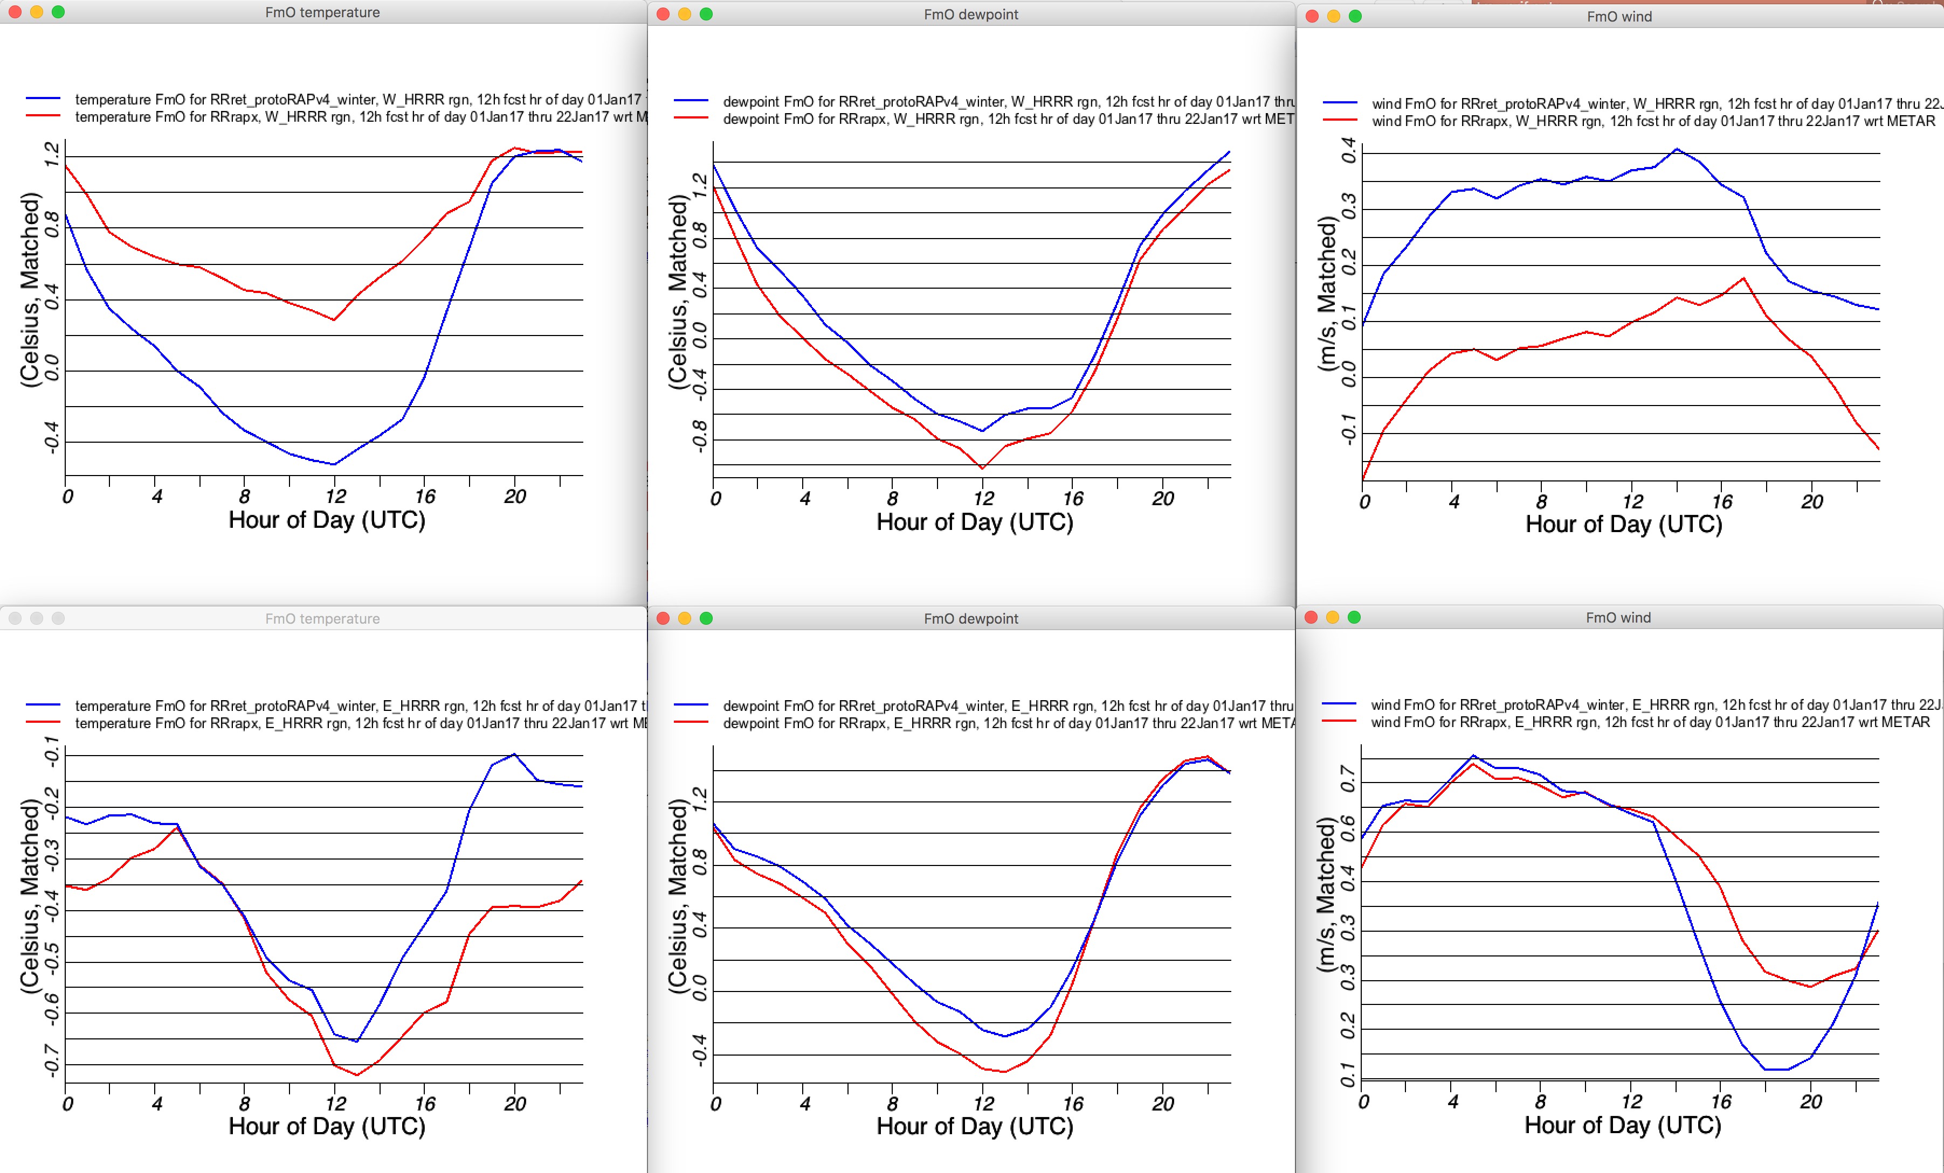
RAP BIAS Surface Winter (Three Weeks Jan 2017)
RAPv4
RAPv3 (ops)
12 hr fcsts
2mT
2mT_{d}
10mWind
West US
Optimal
Optimal
Optimal
Optimal
East US
Optimal
Optimal
Surface Verification

Slide 16
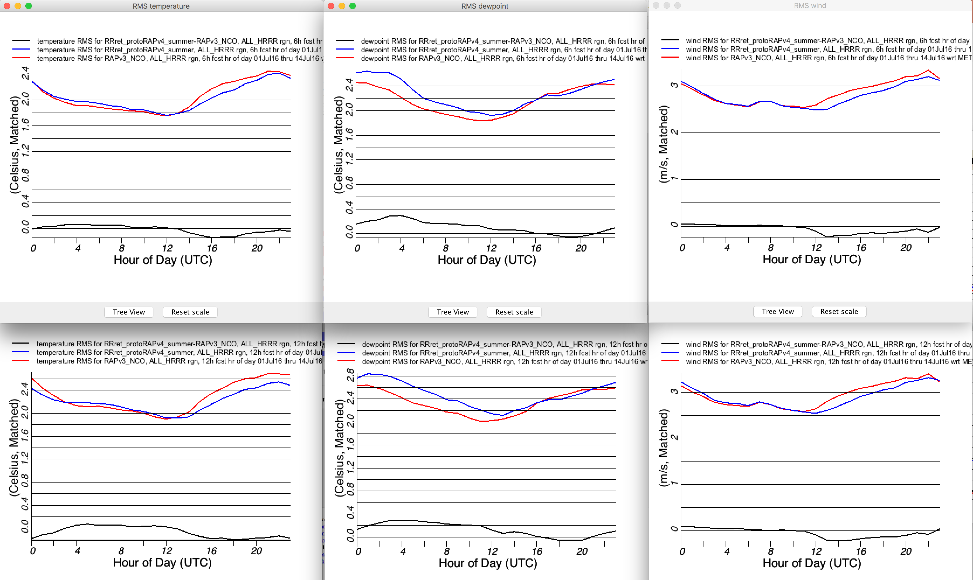
RAP RMSE Surface Summer (Three Weeks Jul 2016)
RAPv4
RAPv3 (ops)
RAPv4-RAPv3
2mT
2mT_{d}
10mWind
6 hr
Improved Daytime T/T_{d}/Wind
RAPv4
better
12 hr
RAPv4
better
Surface Verification

Slide 17
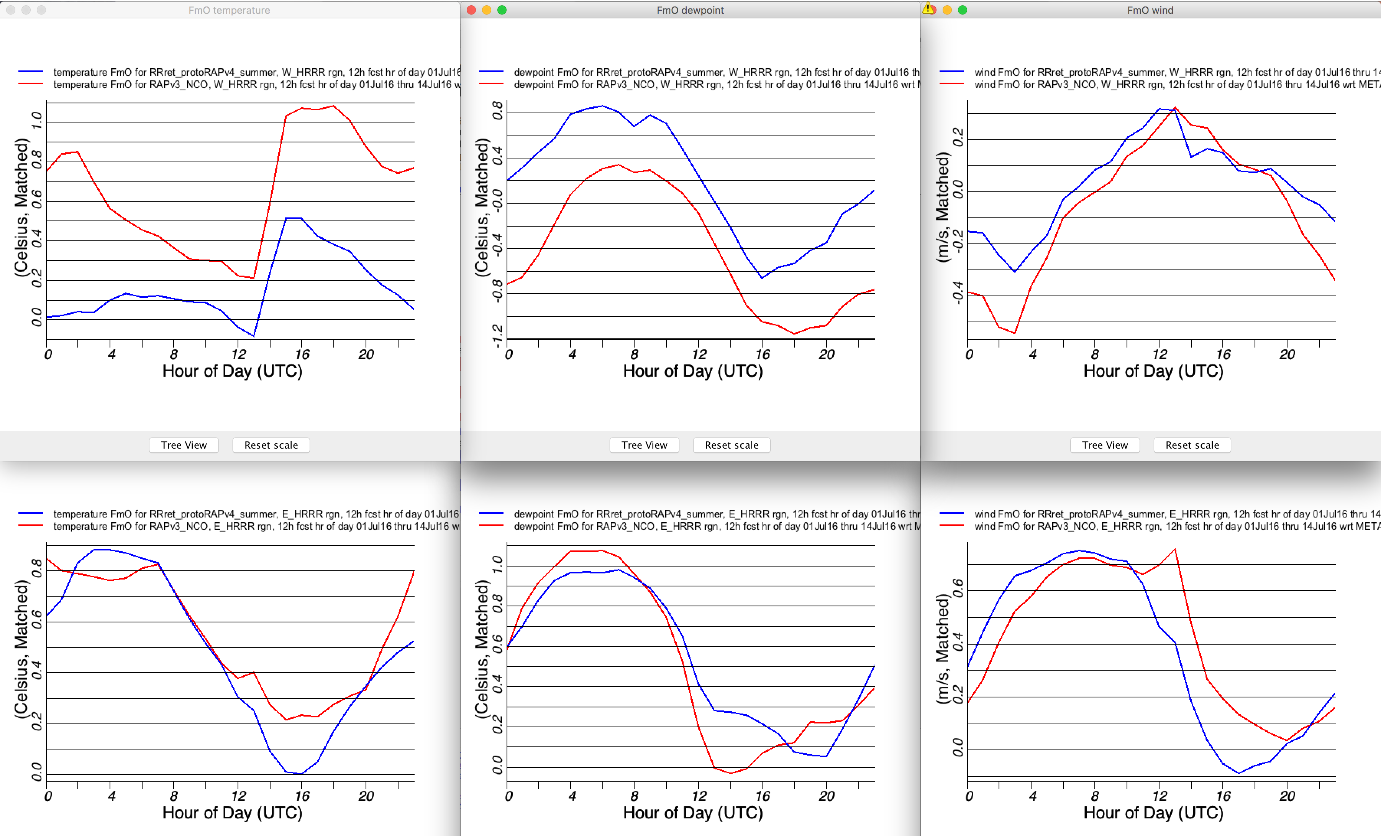
RAP BIAS Surface Summer (Three Weeks Jul 2016)
RAPv4
RAPv3 (ops)
12 hr fcsts
2mT
2mT_{d}
10mWind
Optimal
West US
Optimal
Optimal
East US
Optimal
Optimal
Optimal
Surface Verification

Slide 18
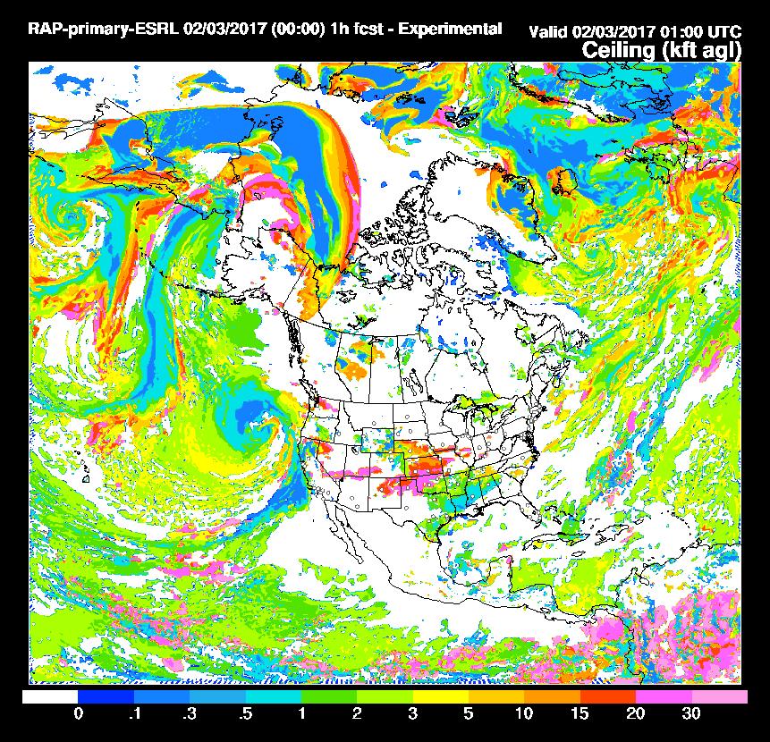
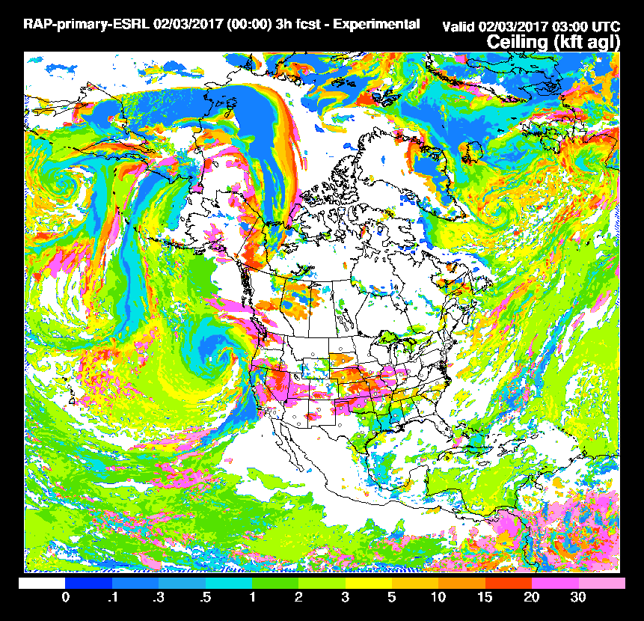
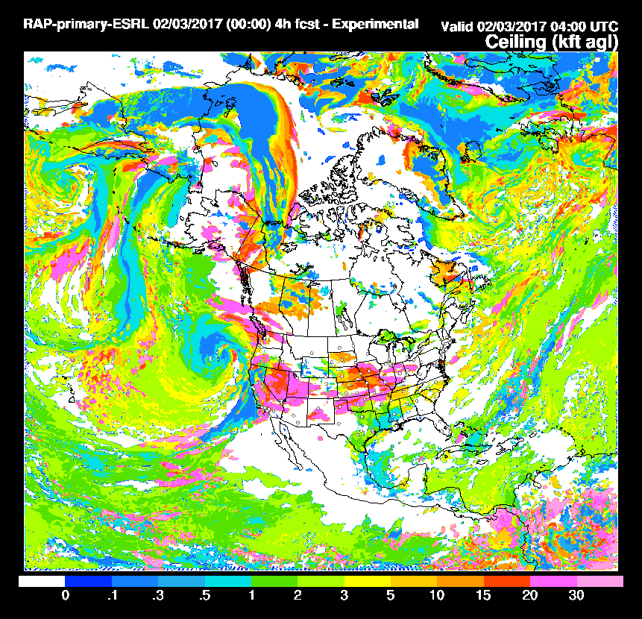
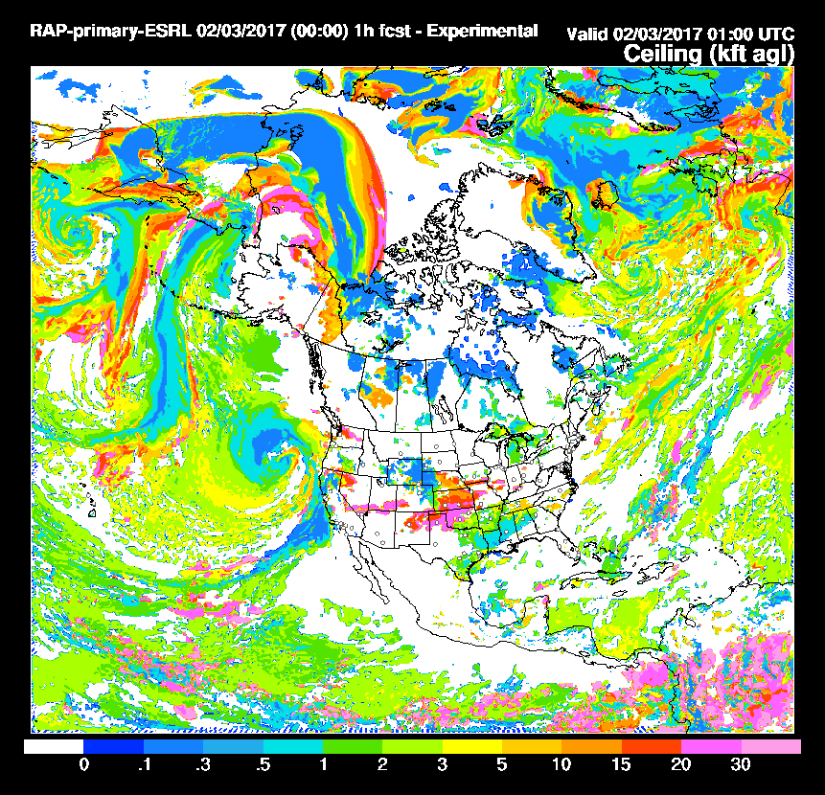
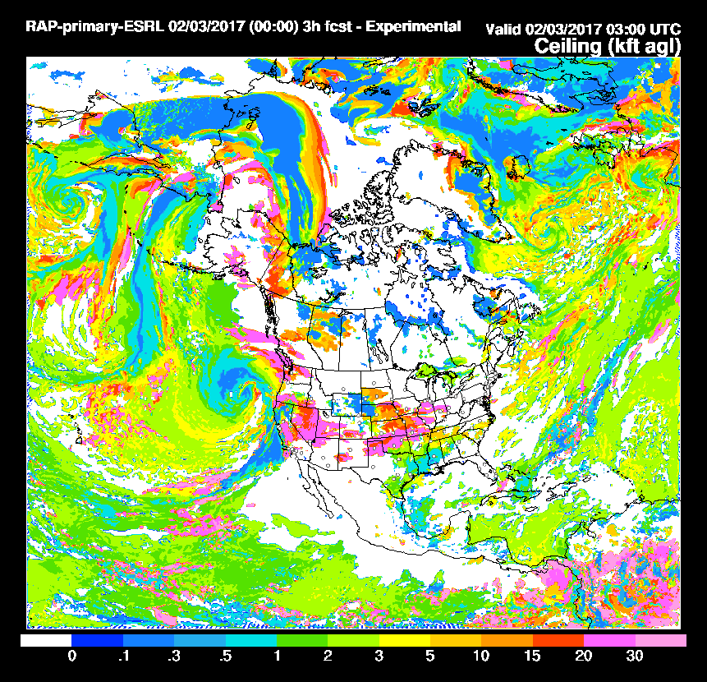
RAP/HRRR Cloud Building w/Smaller Size Distribution
1 hr
3 hr
4 hr
No
qnr/qni
specified
1 hr
3 hr
4 hr
qnr/qni
specified
at large
values
(small
sizes)
More
low clouds retained
Cloud Verification

Slide 19
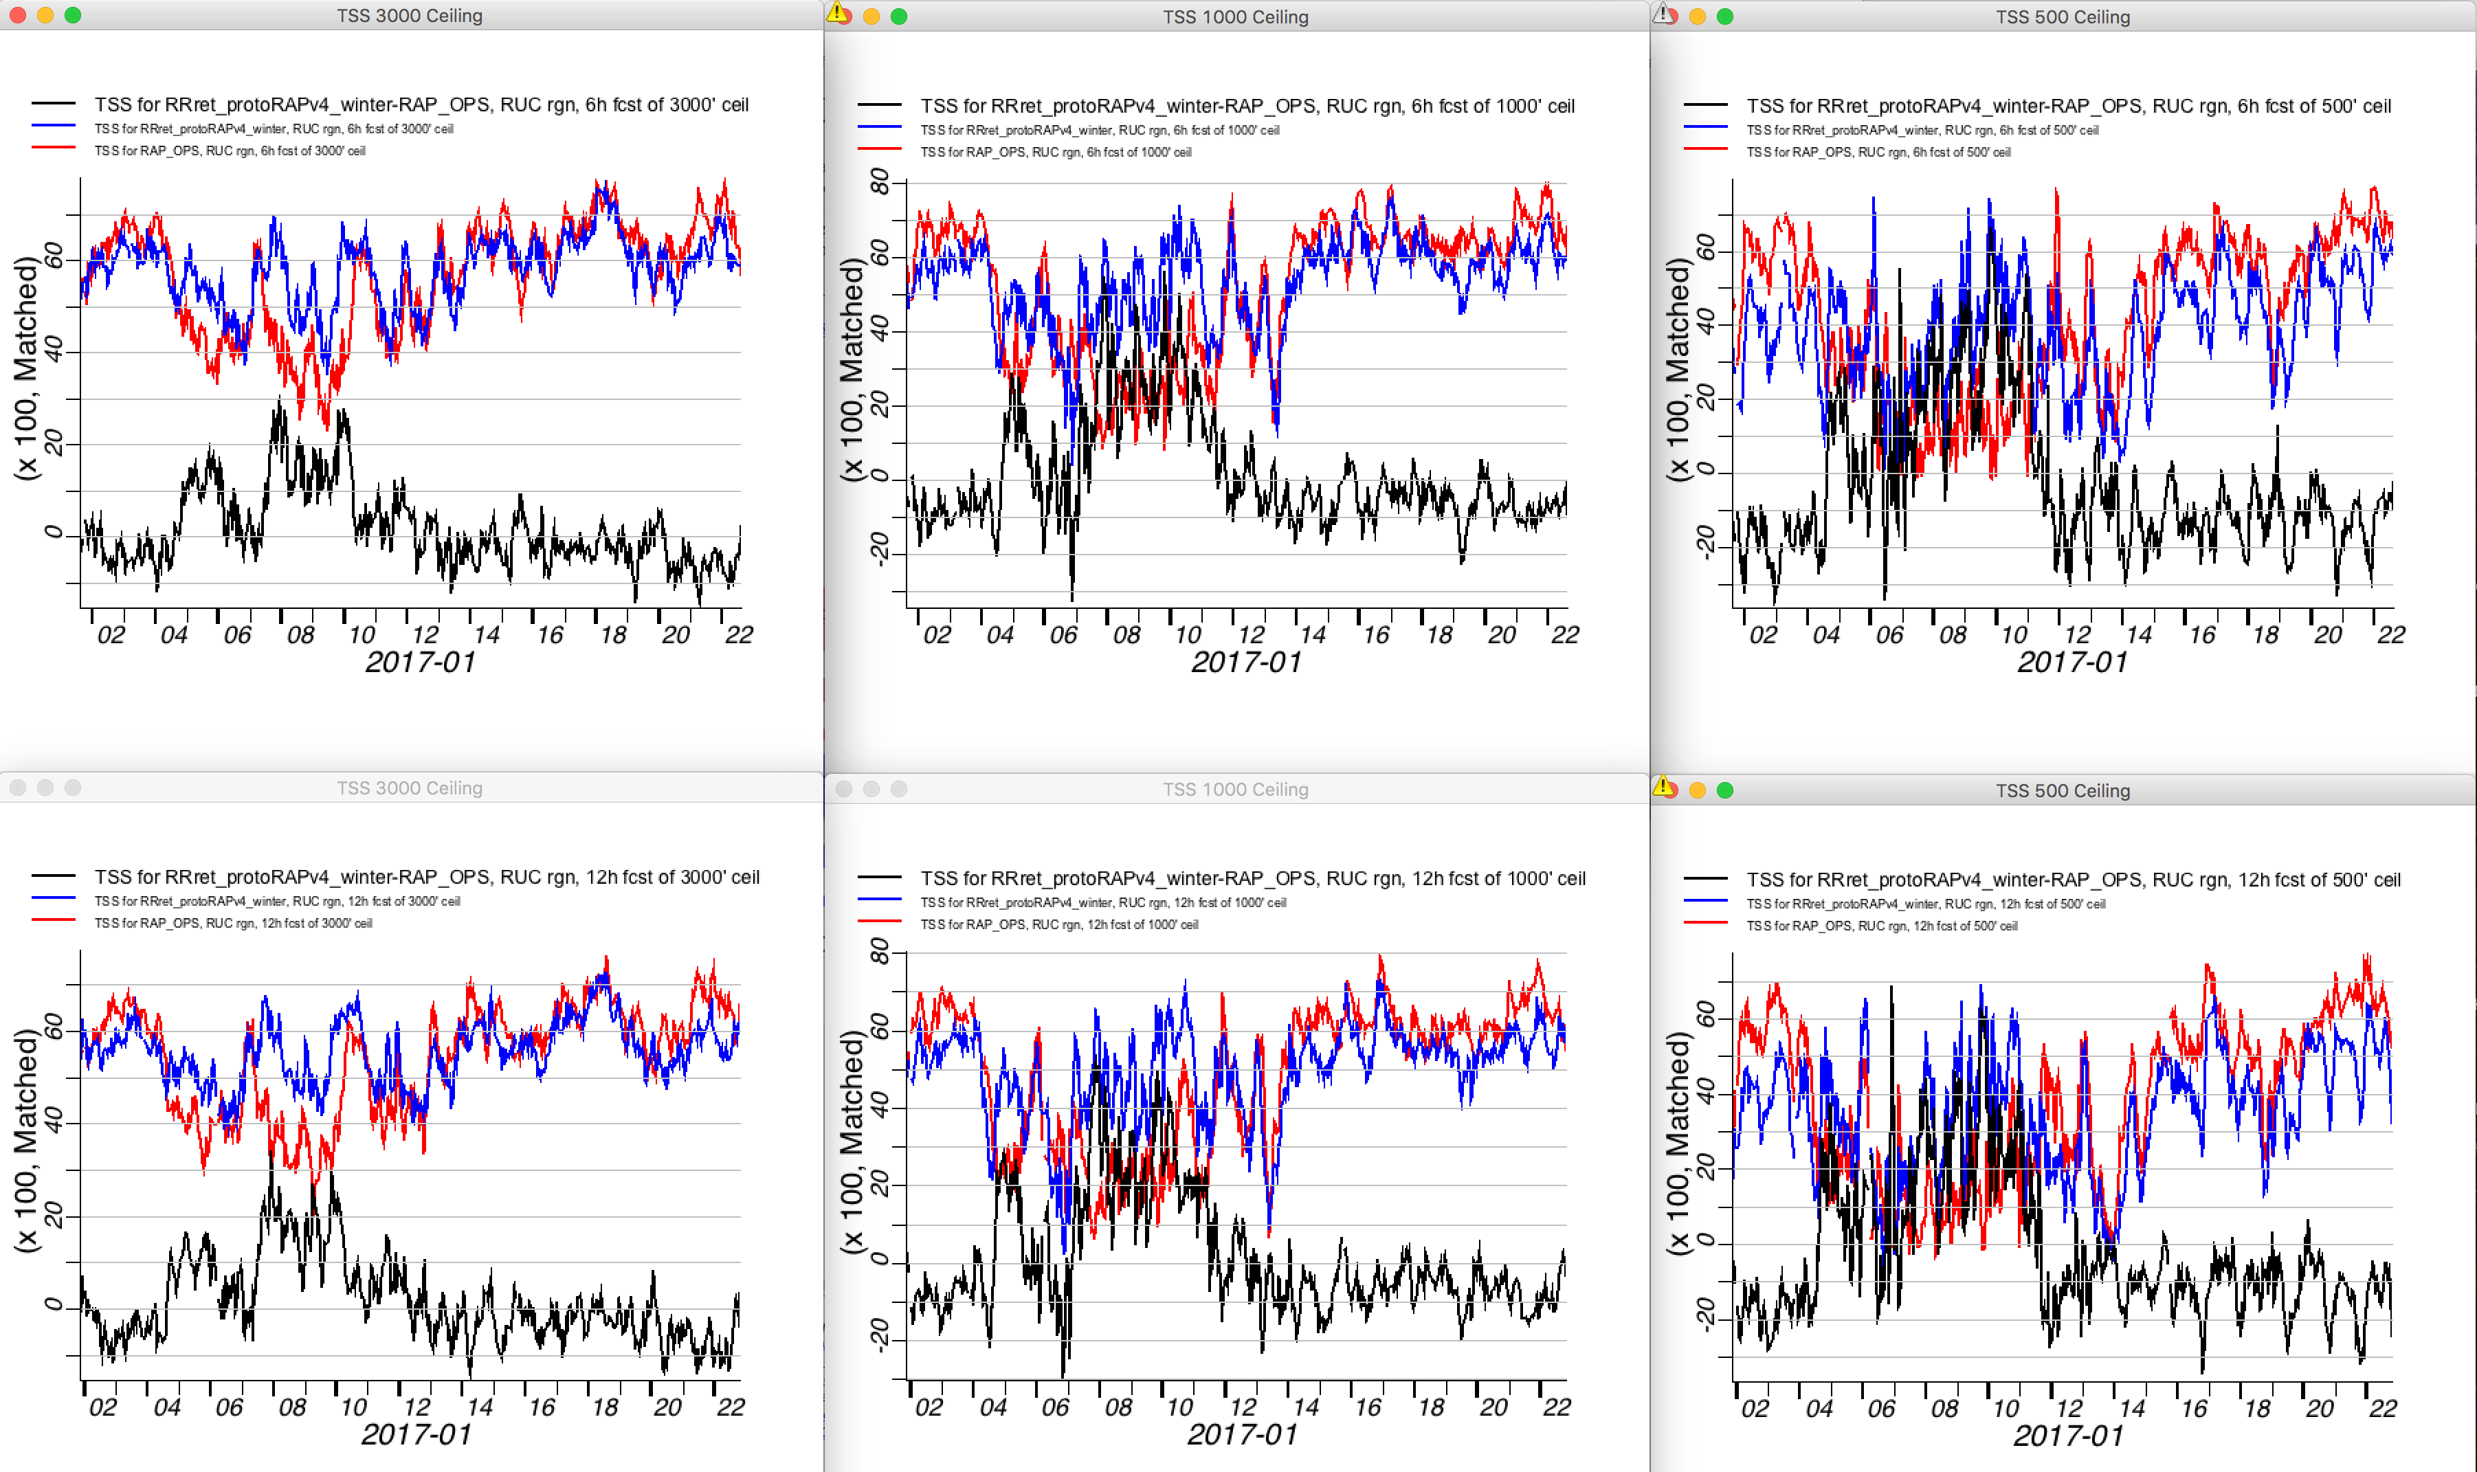
RAP TSS Ceiling Winter (Three Weeks Jan 2017)
RAPv4
RAPv3 (ops)
RAPv4-RAPv3
3000’
1000’
500’
6 hr
RAPv4
better
More Skill During Cold/Cloudy Outbreak
6-11 Jan
12 hr
RAPv4
better
Ceiling Verification

Slide 20
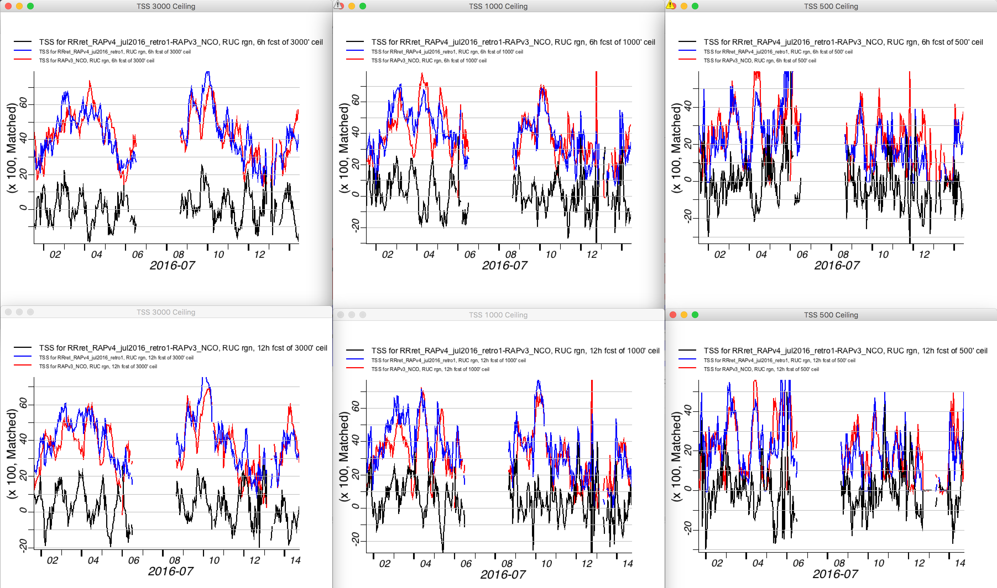
RAP TSS Ceiling Summer (Three Weeks Jul 2016)
RAPv4
RAPv3 (ops)
RAPv4-RAPv3
3000’
1000’
500’
6 hr
RAPv4
better
12 hr
RAPv4
better
Ceiling Verification

Slide 21
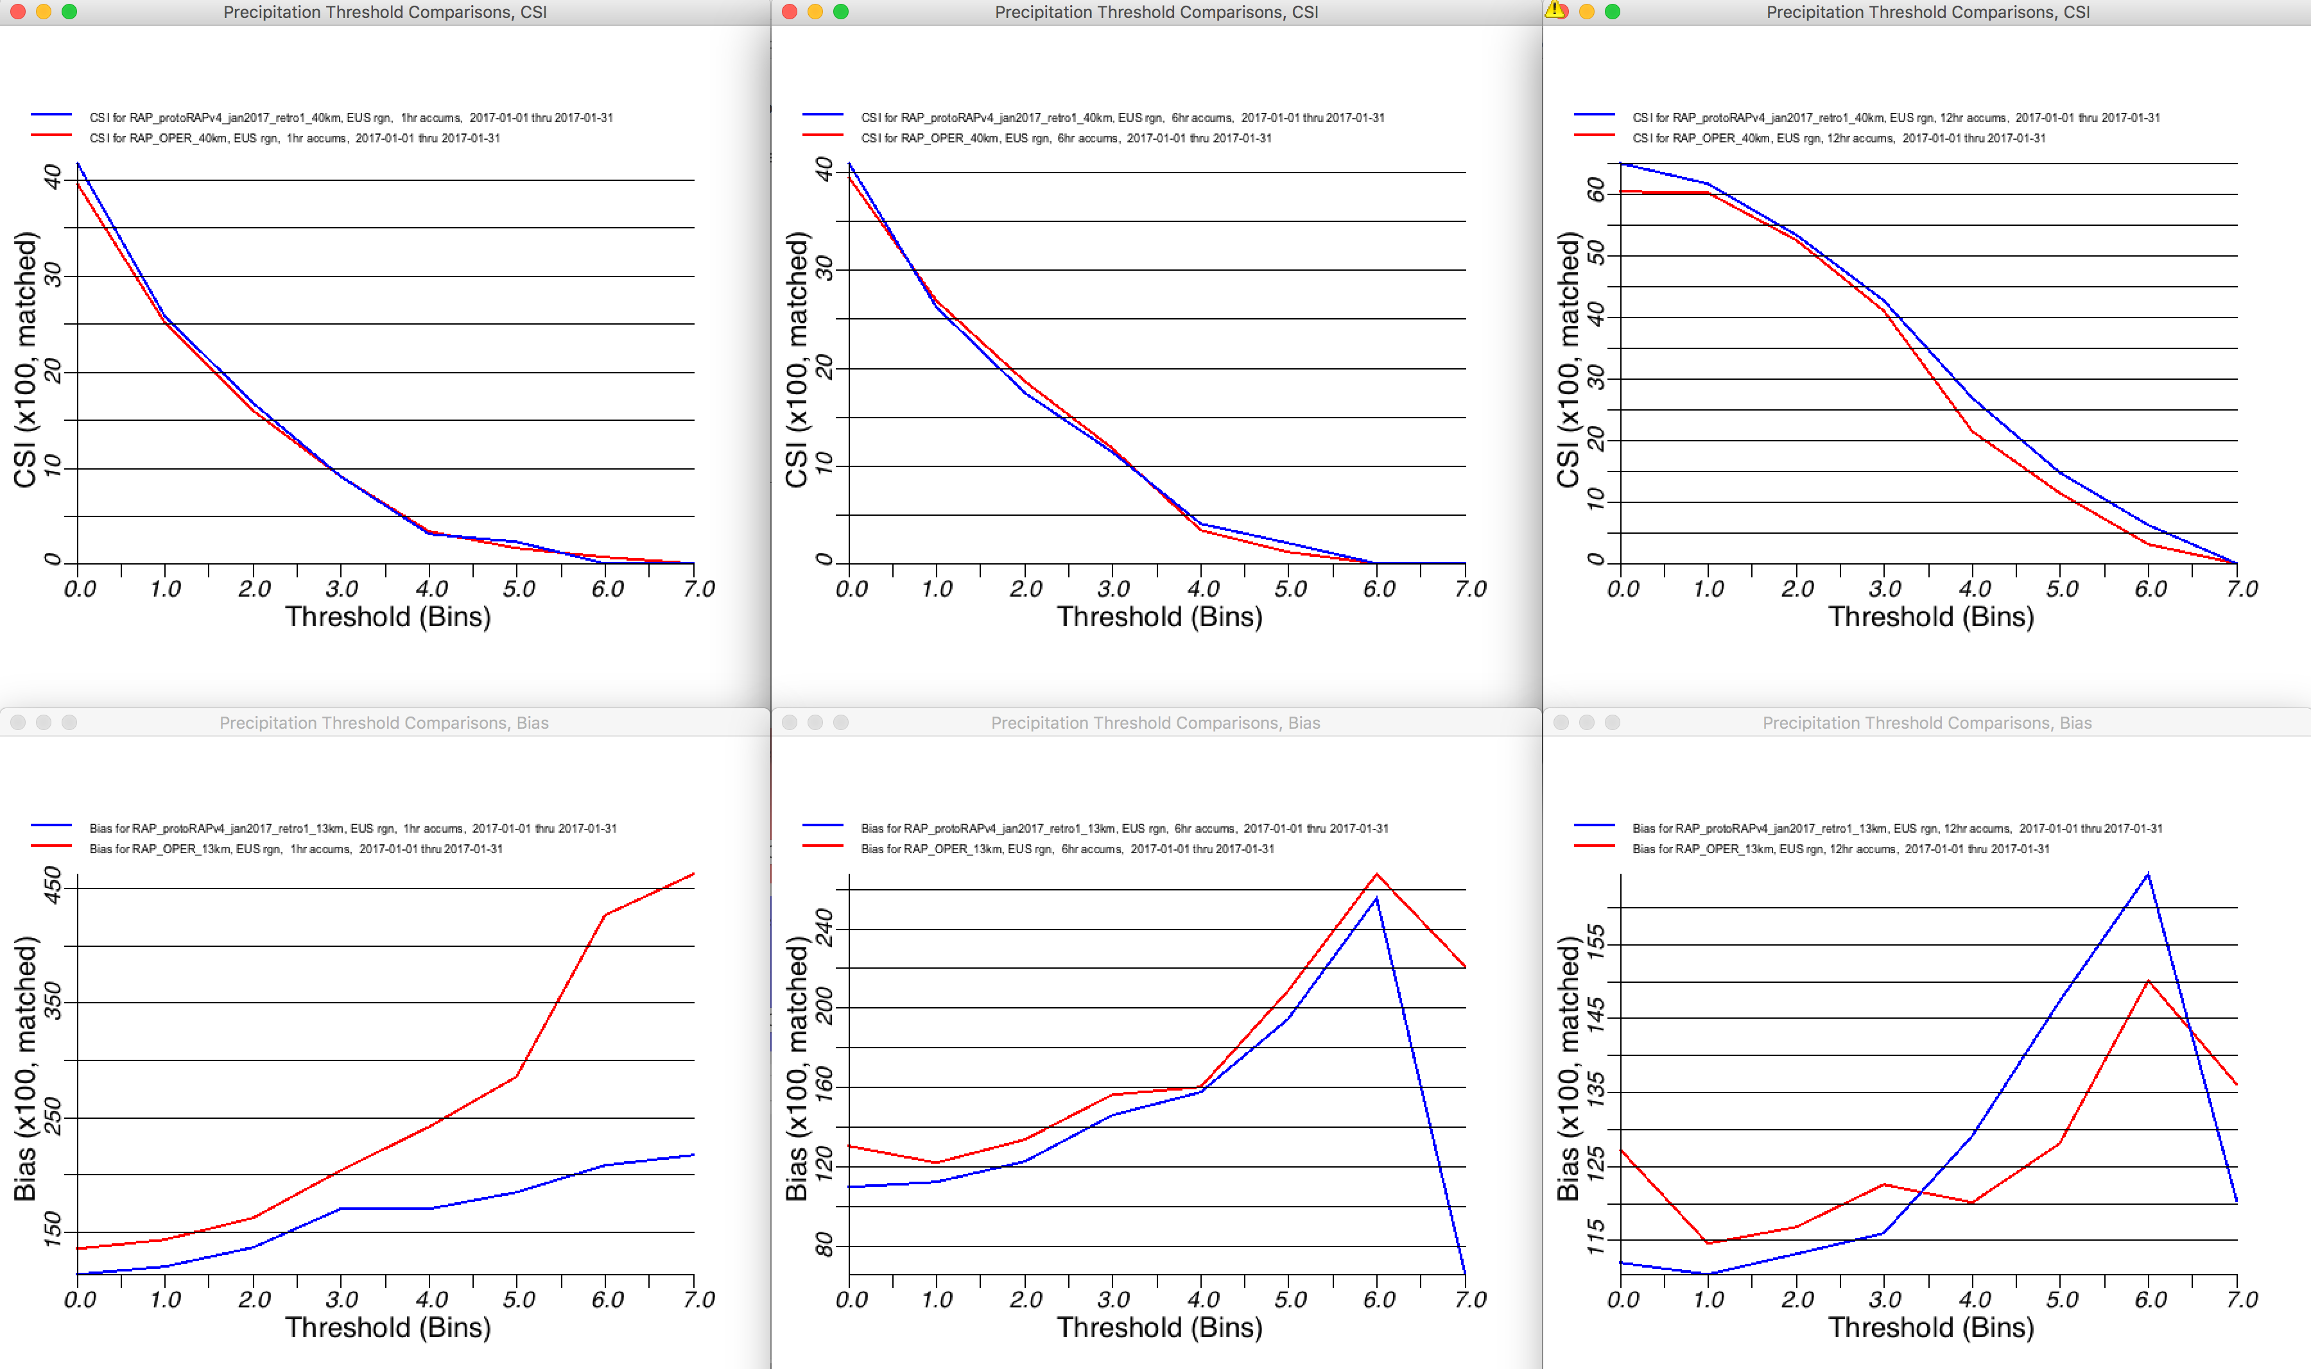
RAP CSI/BIAS Precipitation Winter (Three Weeks Jan 2017)
RAPv4
RAPv3 (ops)
1 hr
6 hr
12 hr
CSI
40 km
BIAS
13 km
More Optimal Bias
Optimal
Optimal
Optimal
Precip Verification

Slide 22
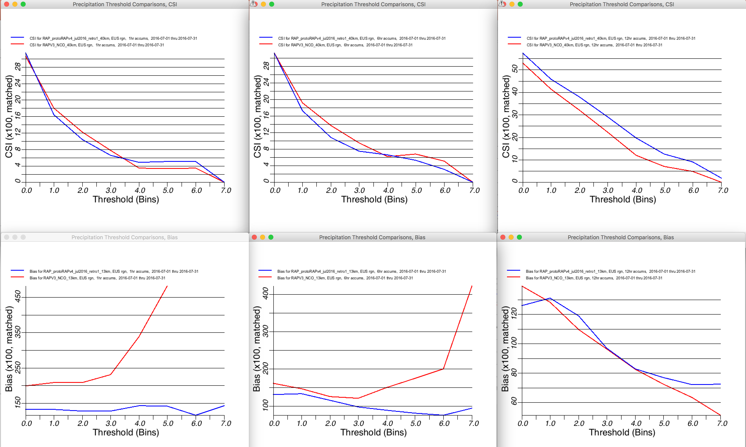
RAP CSI/BIAS Precipitation Summer (Three Weeks Jul 2016)
RAPv4
RAPv3 (ops)
1 hr
6 hr
12 hr
CSI
40 km
BIAS
13 km
Optimal
More Optimal Bias
Optimal
Optimal
Precip Verification

Slide 23
RAP/HRRR: Hourly-Updating Weather Forecast Suite
13-km Rapid Refresh (RAPv4) – to 39h (Feb 2018)
Initial & Lateral Boundary Conditions
3-km High-Resolution Rapid Refresh Alaska, Hawaii and Puerto Rico Testing (HRRR-AK, HRRR-HI, HRRR-PR) Experimental (ongoing)
3-km High-Resolution Rapid Refresh (HRRRv3) – to 36h (Feb 2018)
Initial & Lateral Boundary Conditions
3-km Storm-Scale Ensemble Analysis and Forecast (HRRRE) 55% CONUS HRRR Experimental (ongoing)
750-m HRRR nest Scale-ware Physics Testing (ongoing)
3-km High-Resolution Time Lagged Ensemble (HRRR-TLE)
3-km HRRR-Smoke (VIIRS fire data)
Overview

Slide 24
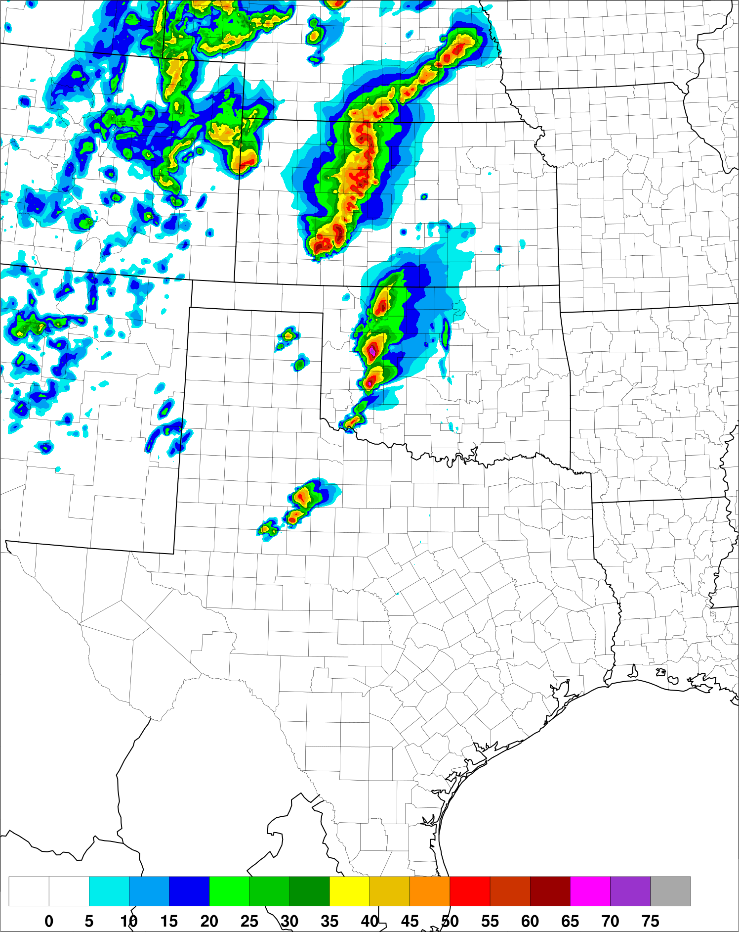
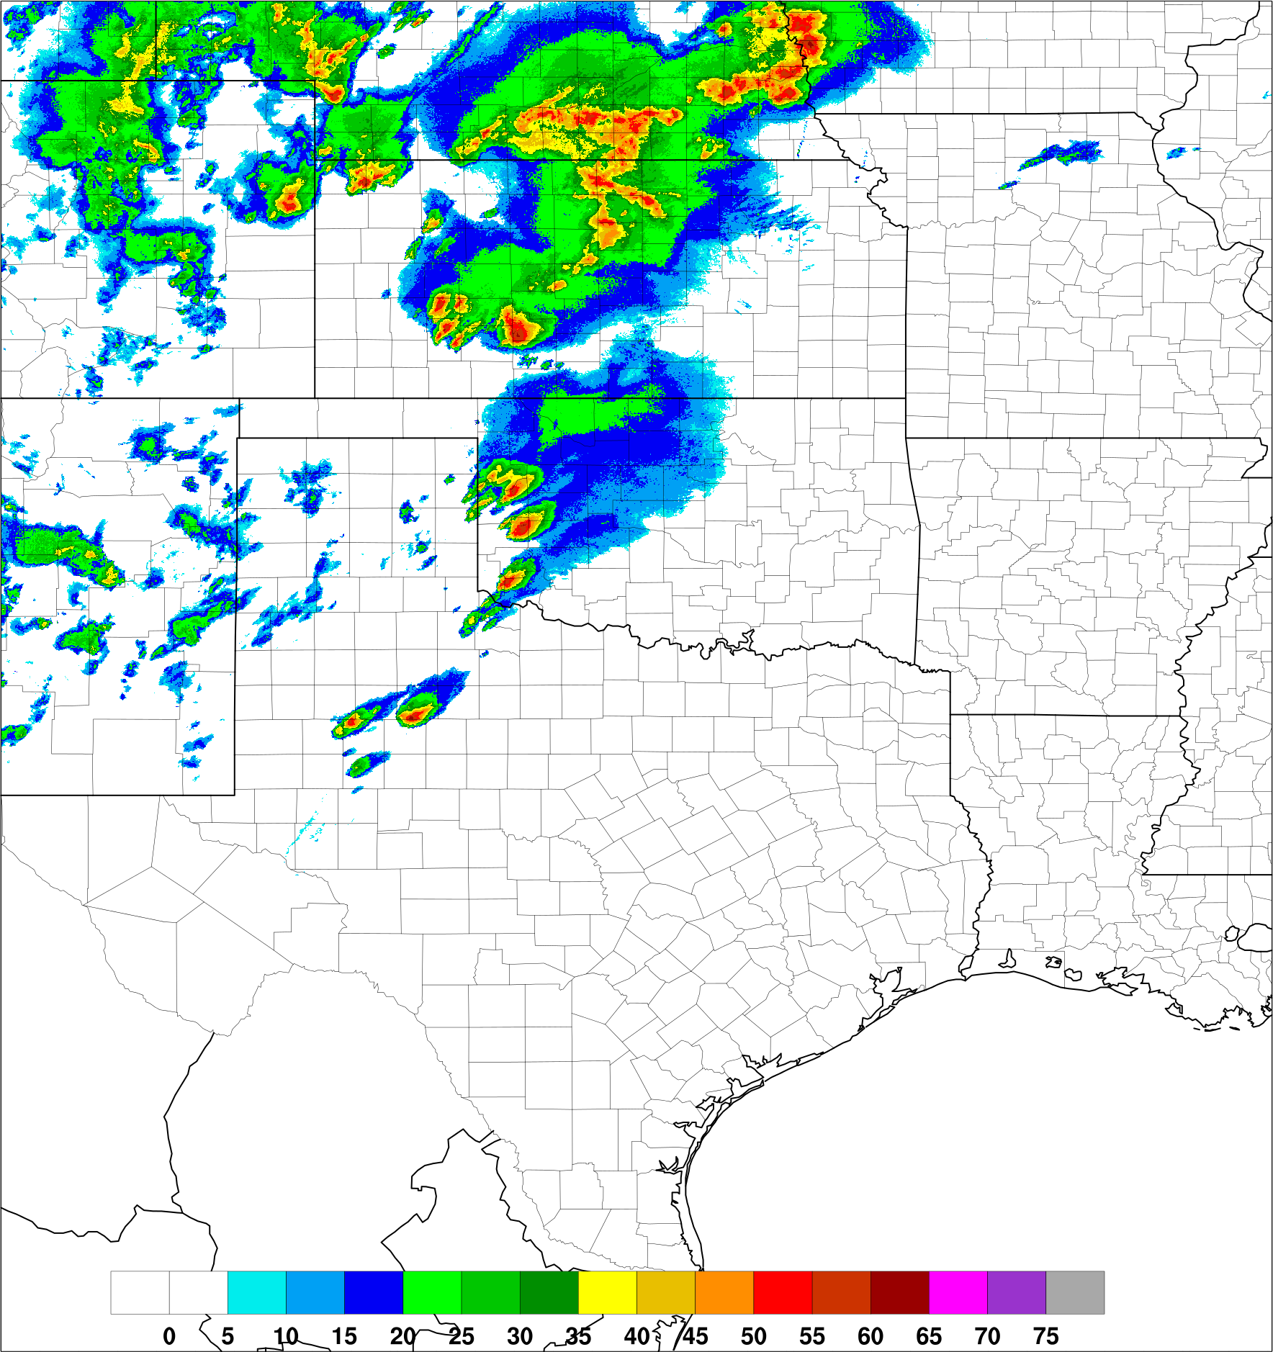
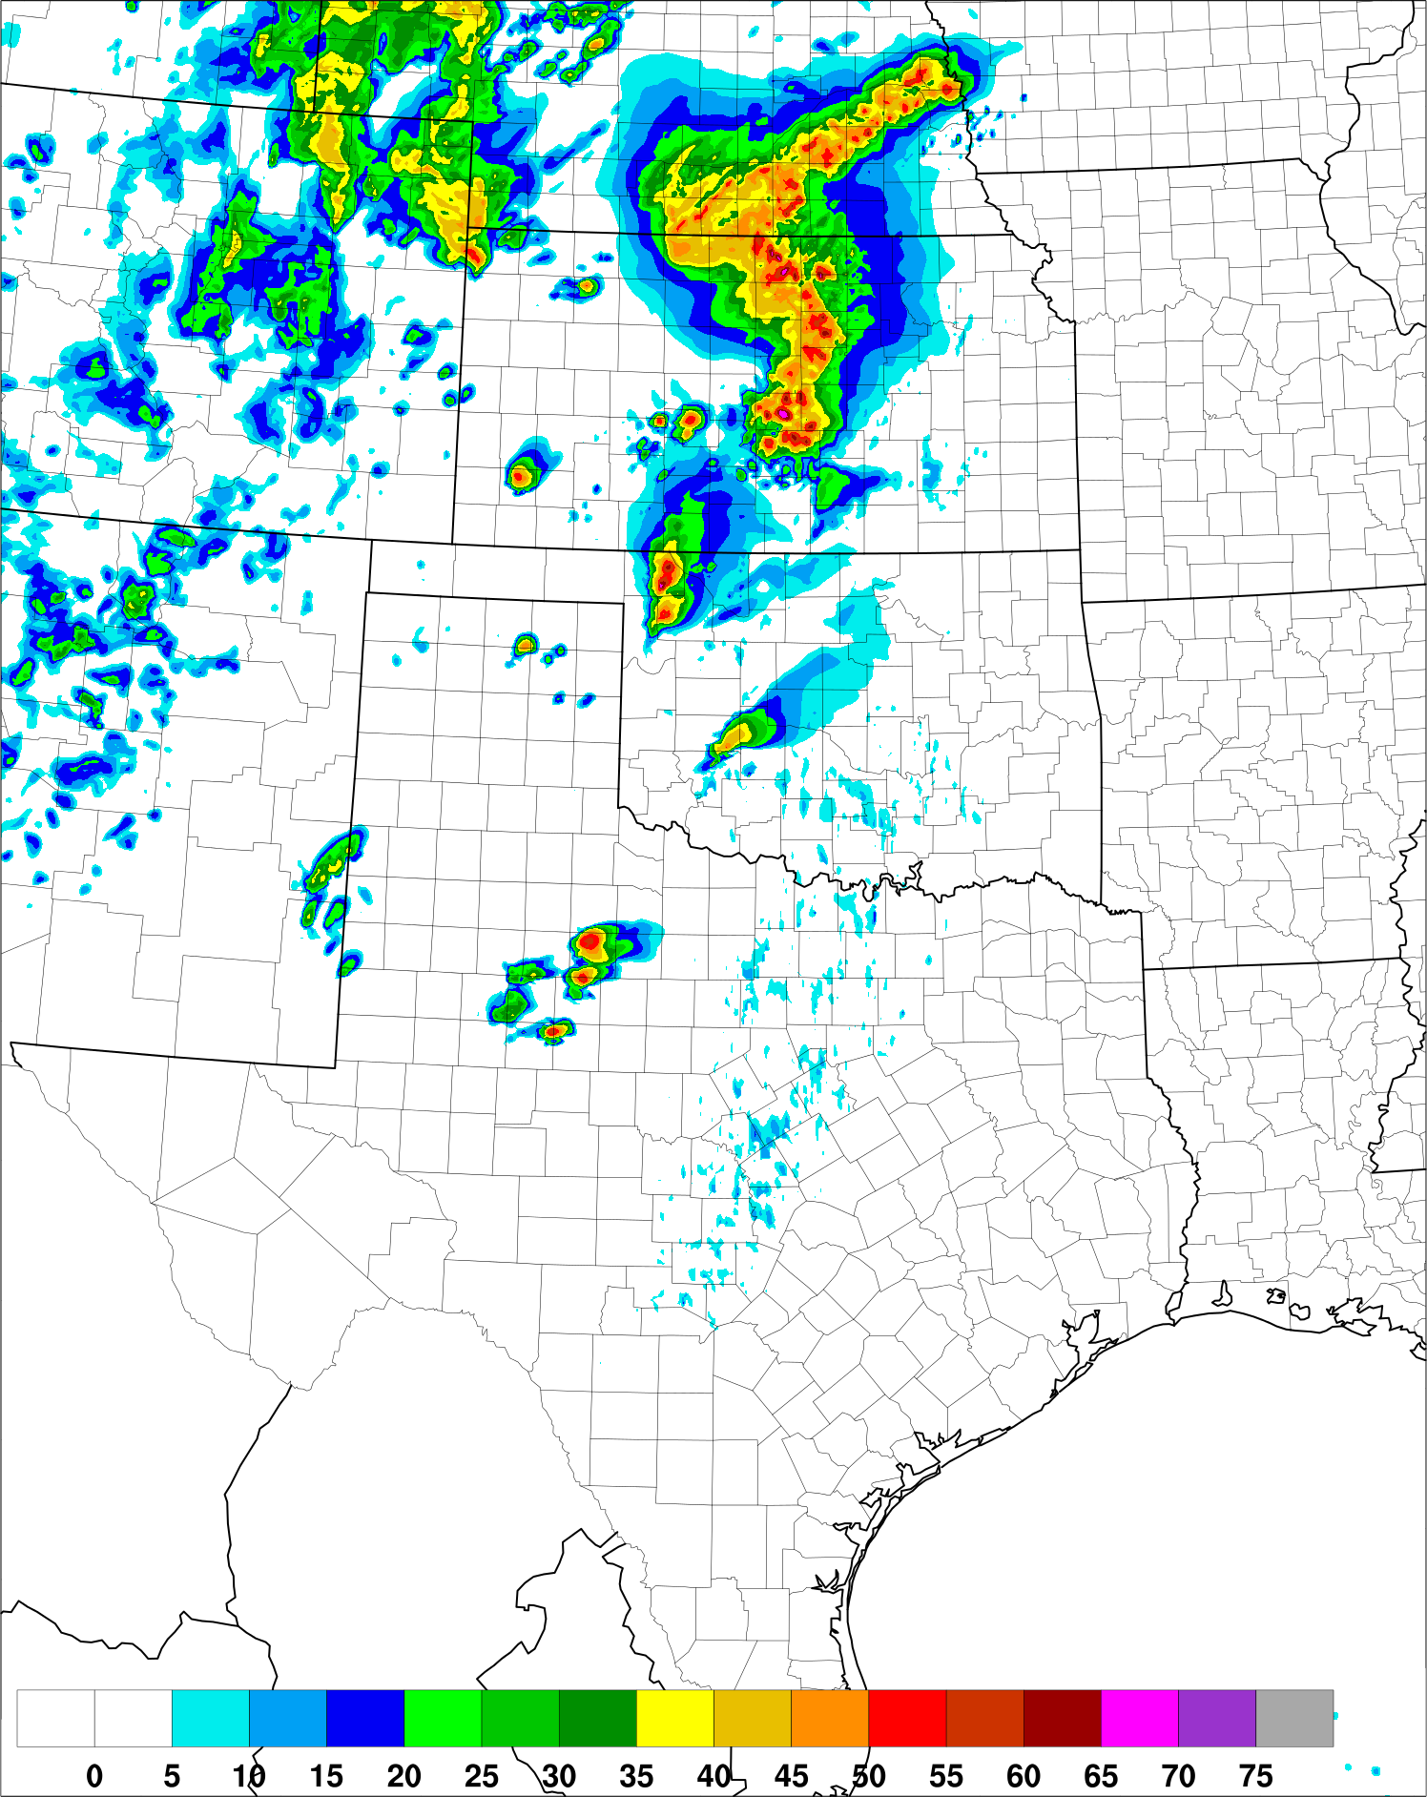
HRRR Improved Convective Forecasts
Experimental HRRRv3 13 hr fcst
Valid 00 UTC 17 May 2017
Composite Reflectivity Observations
00 UTC 17 May 2017
Operational HRRRv2 13 hr fcst
Valid 00 UTC 17 May 2017
More Accurate
Convection Along
Weakly-Forced Dryline
Reflectivity Verification

Slide 25
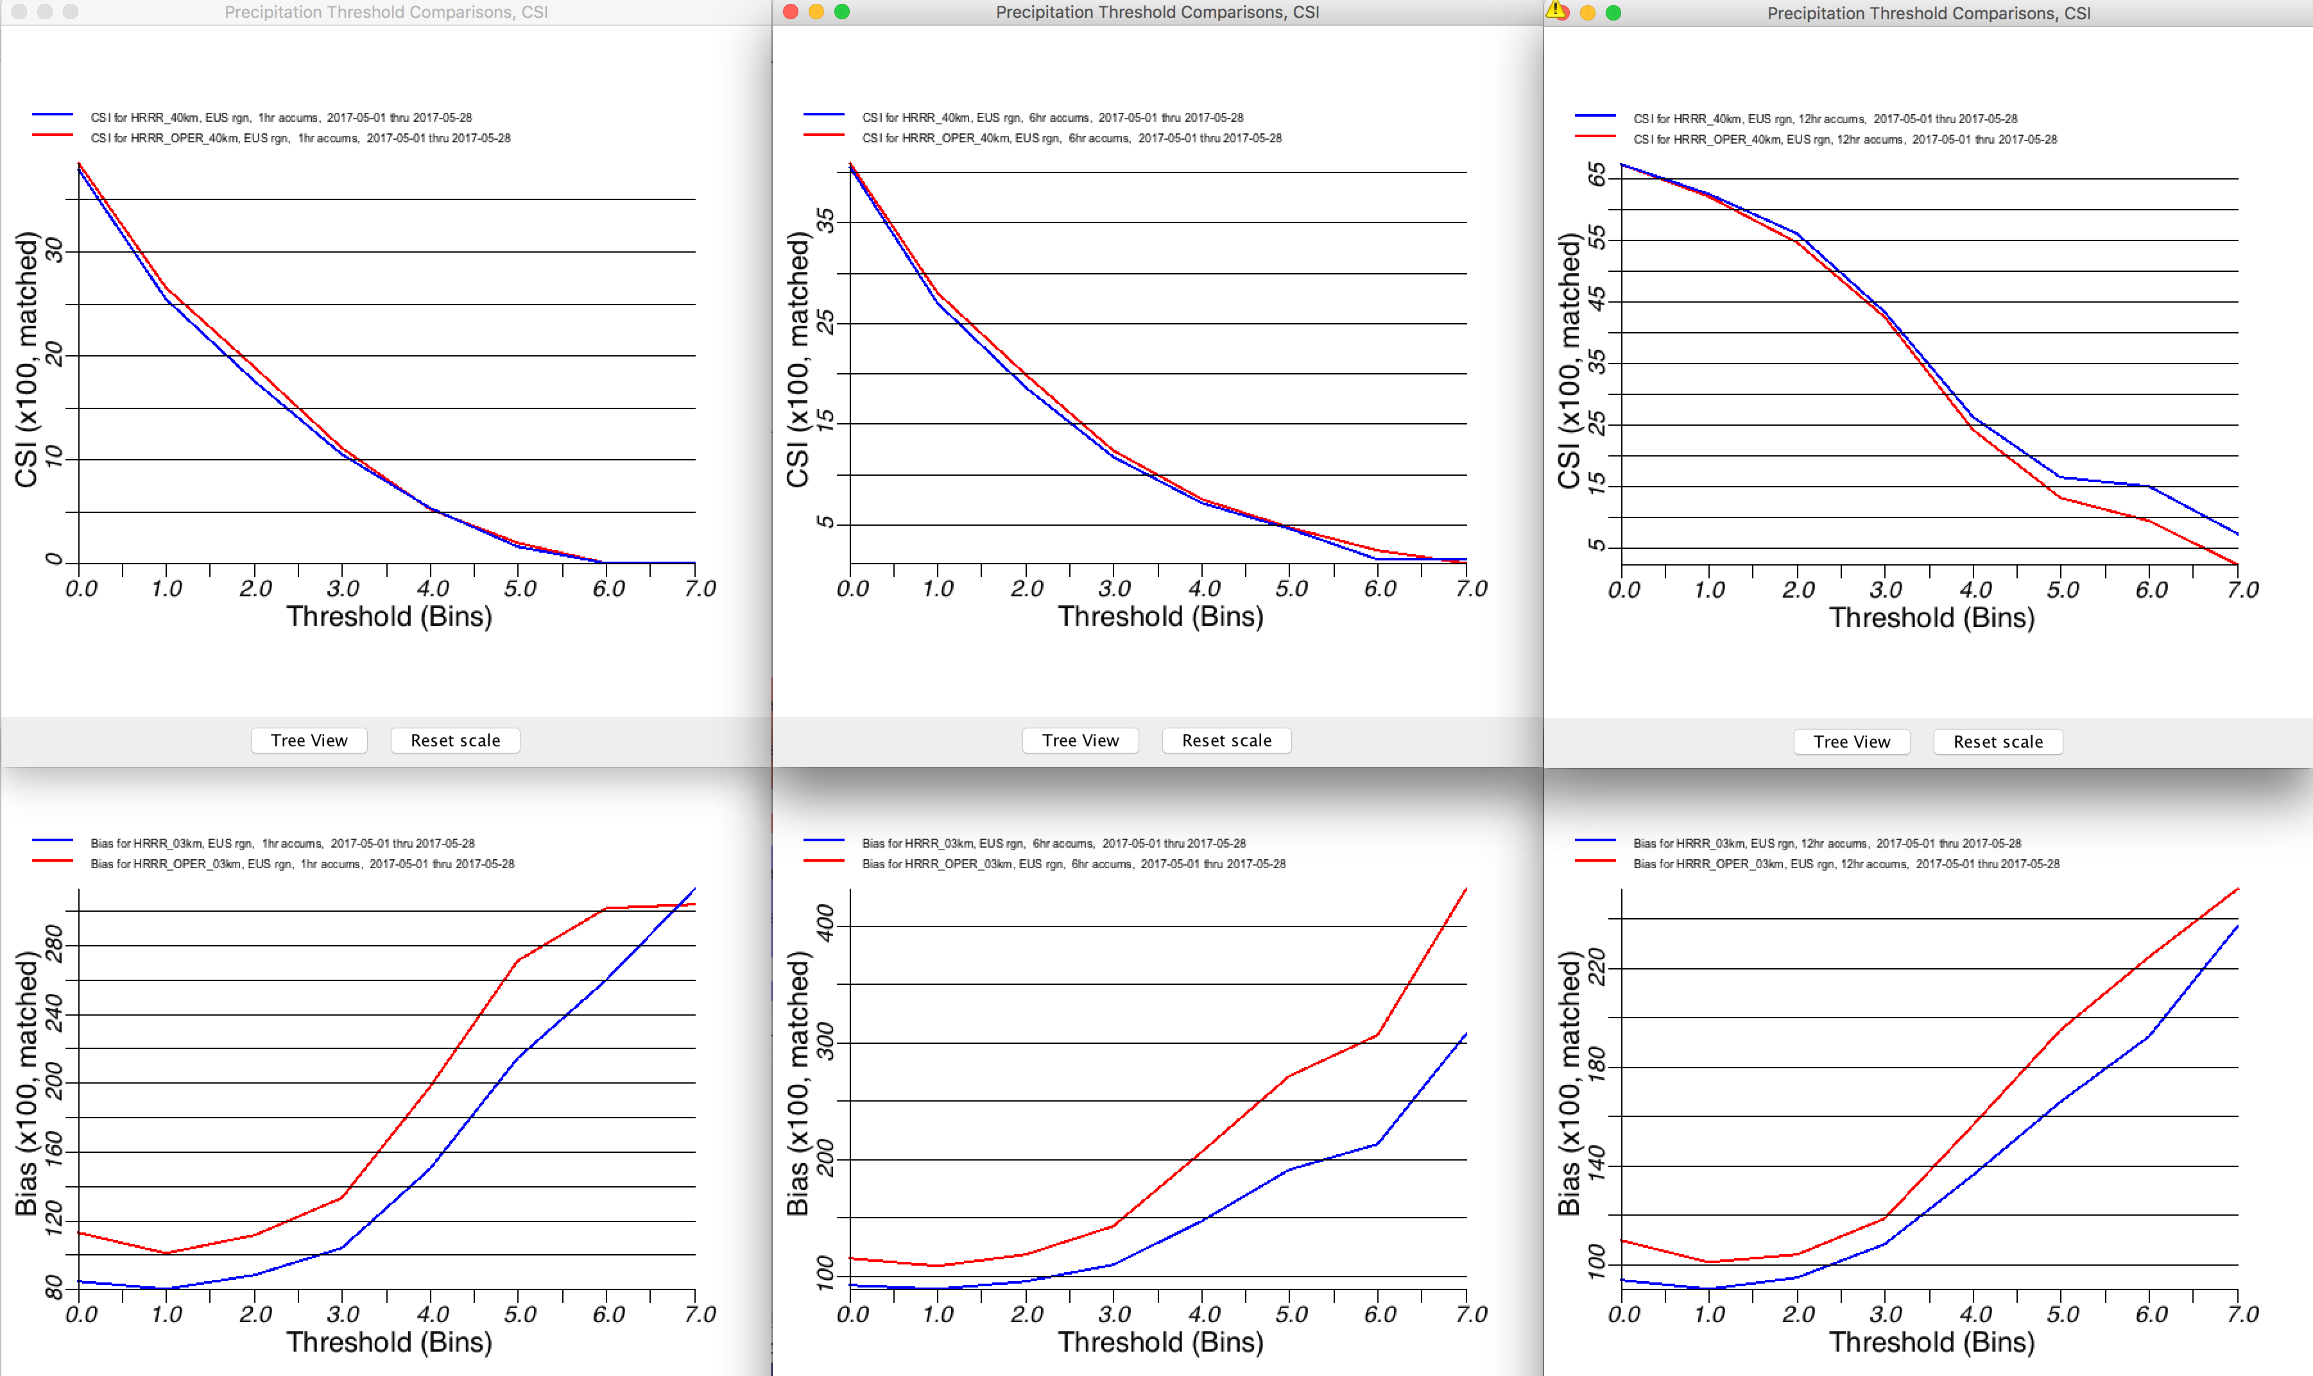
HRRR CSI/BIAS Precipitation Spring (Three Weeks May 2017)
HRRRv3
HRRRv2 (ops)
1 hr
6 hr
12 hr
CSI
40 km
BIAS
3 km
More Optimal Bias
Optimal
Optimal
Optimal
Precip Verification

Slide 26
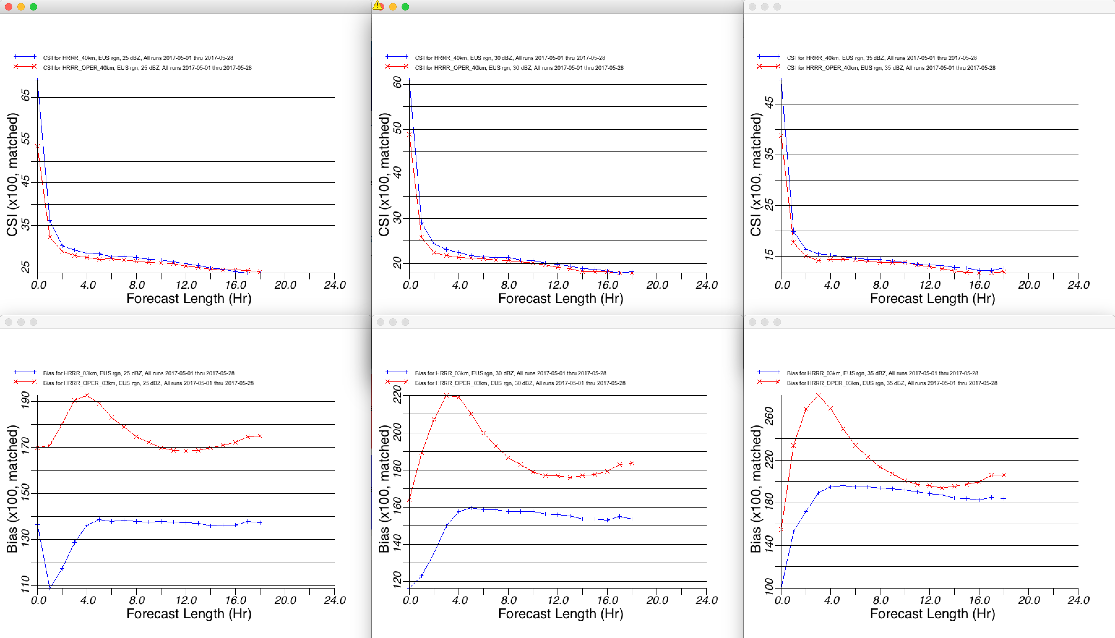
HRRR CSI/BIAS Reflectivity Spring (Three Weeks May 2017)
HRRRv3
HRRRv2 (ops)
25 dBZ
30 dBZ
35 dBZ
CSI
40 km
BIAS
3 km
More Optimal Bias
Optimal
Optimal
Optimal
Reflectivity Verification

Slide 27
RAP/HRRR: Hourly-Updating Weather Forecast Suite
13-km Rapid Refresh (RAPv4) – to 39h (Feb 2018)
Initial & Lateral Boundary Conditions
3-km High-Resolution Rapid Refresh Alaska, Hawaii and Puerto Rico Testing (HRRR-AK, HRRR-HI, HRRR-PR) Experimental (ongoing)
3-km High-Resolution Rapid Refresh (HRRRv3) – to 36h (Feb 2018)
Initial & Lateral Boundary Conditions
3-km Storm-Scale Ensemble Analysis and Forecast (HRRRE) 55% CONUS HRRR Experimental (ongoing)
750-m HRRR nest Scale-ware Physics Testing (ongoing)
3-km High-Resolution Time Lagged Ensemble (HRRR-TLE)
3-km HRRR-Smoke (VIIRS fire data)
Overview

Slide 28
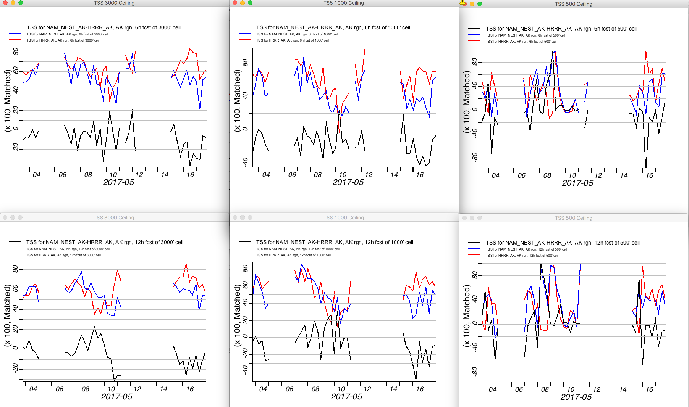
Ceiling (True Skill Score) HRRR-AK vs NAM-NEST-AK (two weeks)
NAM-AK
HRRR-AK
NAM-HRRR
3000’
1000’
500’ (rare)
6 hr
HRRR
better
12 hr
HRRR
better
HRRR-AK Ceiling

Slide 29
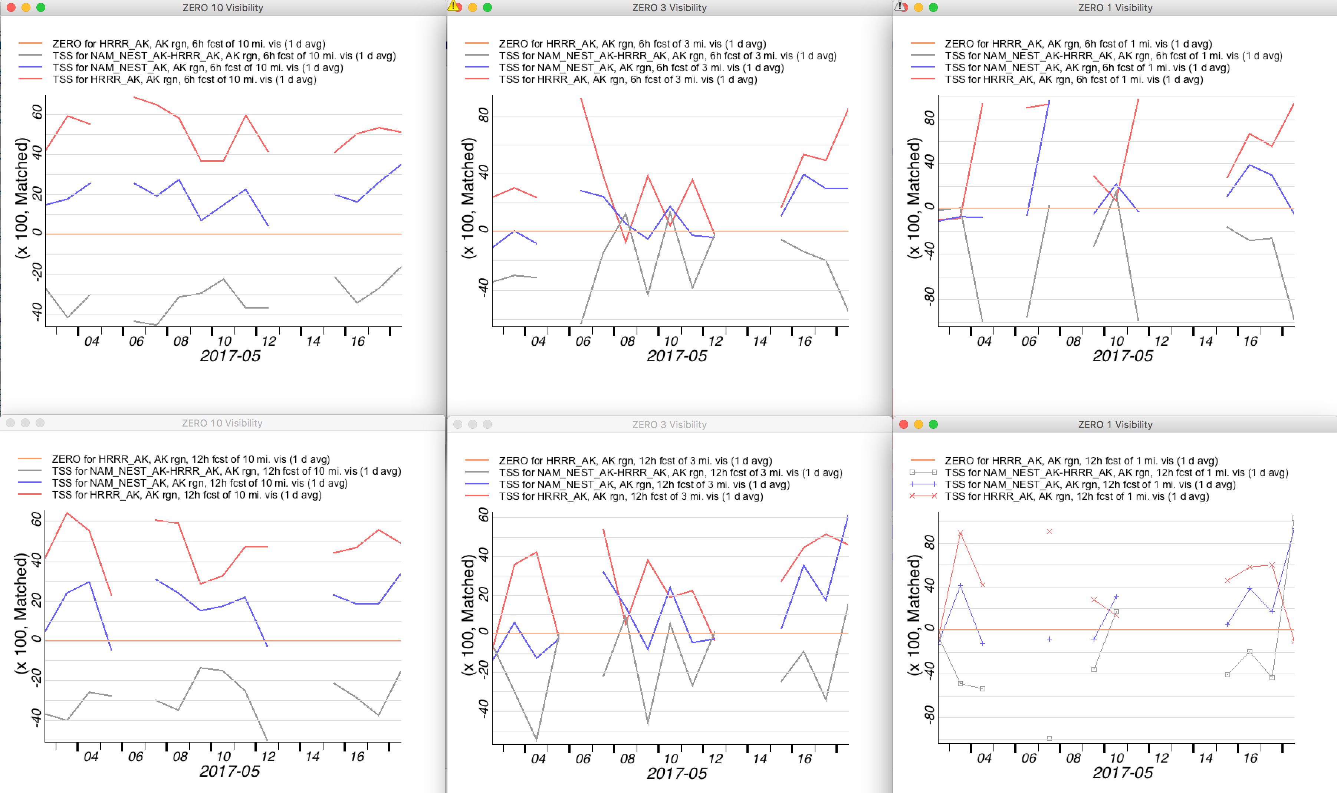
Visibility (True Skill Score) HRRR-AK vs NAM-NEST-AK (two weeks)
NAM-AK
HRRR-AK
NAM-HRRR
10 mi
3 mi
1 mi (rare)
6 hr
HRRR
better
12 hr
HRRR
better
HRRR-AK Visibility

Slide 30
RAP/HRRR: Hourly-Updating Weather Forecast Suite
13-km Rapid Refresh (RAPv4) – to 39h (Feb 2018)
Initial & Lateral Boundary Conditions
3-km High-Resolution Rapid Refresh Alaska, Hawaii and Puerto Rico Testing (HRRR-AK, HRRR-HI, HRRR-PR) Experimental (ongoing)
3-km High-Resolution Rapid Refresh (HRRRv3) – to 36h (Feb 2018)
Initial & Lateral Boundary Conditions
3-km Storm-Scale Ensemble Analysis and Forecast (HRRRE) 55% CONUS HRRR Experimental (ongoing)
750-m HRRR nest Scale-ware Physics Testing (ongoing)
3-km High-Resolution Time Lagged Ensemble (HRRR-TLE)
3-km HRRR-Smoke (VIIRS fire data)
Overview

Slide 31
HRRRE 2017 Design
DA
Ens
09z
10z
11z
12z
Radar Conv Obs
Radar Conv Obs
Radar Conv Obs
RAP Mean
36 GDAS Members
Ensemble
Kalman Filter
Ensemble
Kalman Filter
Ensemble
Kalman Filter
+
Sat/ Conv Obs
Sat/ Conv Obs
Sat/ Conv Obs
3-km interp
36 1-hr fcsts
36 1-hr fcsts
36 1-hr fcsts
GSI Soil Adj + Cloud Anal
GSI Soil Adj + Cloud Anal
GSI Soil Adj + Cloud Anal
36 HRRRE
members
36 HRRRE
Initial Conditions
36 HRRRE
Initial Conditions
36 HRRRE
Initial Conditions
HRRR
Soil Moisture Perts
Fcst
Ens
9 HRRRE
18-hr fcsts
Stochastic Parameter Perturbation (SPP) PBL - 00z Only
HRRRE Design

Slide 32
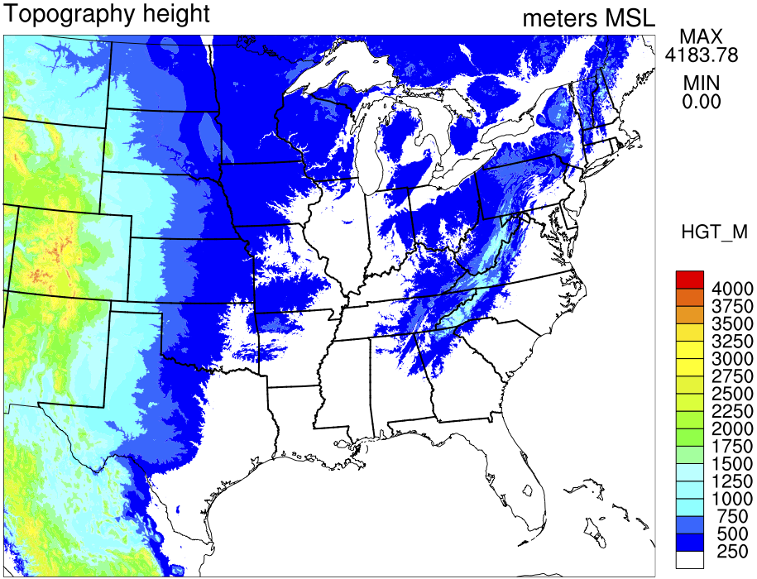
HRRRE 2017 (01 March – 30 June 2017)
55% CONUS HRRR
Real-Time Web Graphics
https://rapidrefresh.noaa.gov/hrrr/HRRRE
Single core (ARW)
Ensemble DA (DART and GSI-EnKF)
RAP mean + GDAS perturbations w/more inflation
Conventional observations
Radar reflectivity observations
Stochastic physics
Cloud analysis
Soil adjustments
HRRR-TLE post-processing
Assimilation Forecast
36 members 12z – Nine members to 18 hrs
1 hr cycling 15z – Nine members to 18 hrs
15 fcsts / day 18z – Nine members to 18 hrs Start 09z day one 21z – Nine members to 18 hrs
End 00z day two 00z – Nine members to 36 hrs
Proof-of-concept
Real-time demonstration
With NSSL Experimental
WoF System for ensembles
“NEWS-e”
HRRRE Design

Slide 33
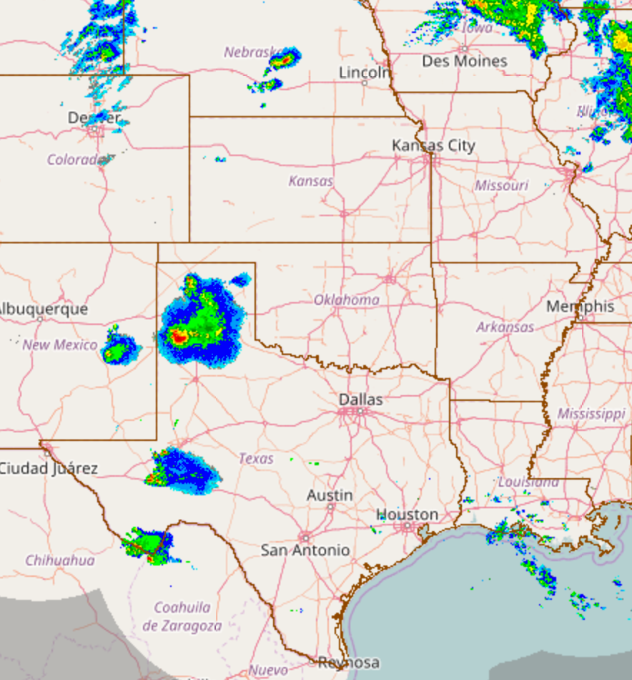
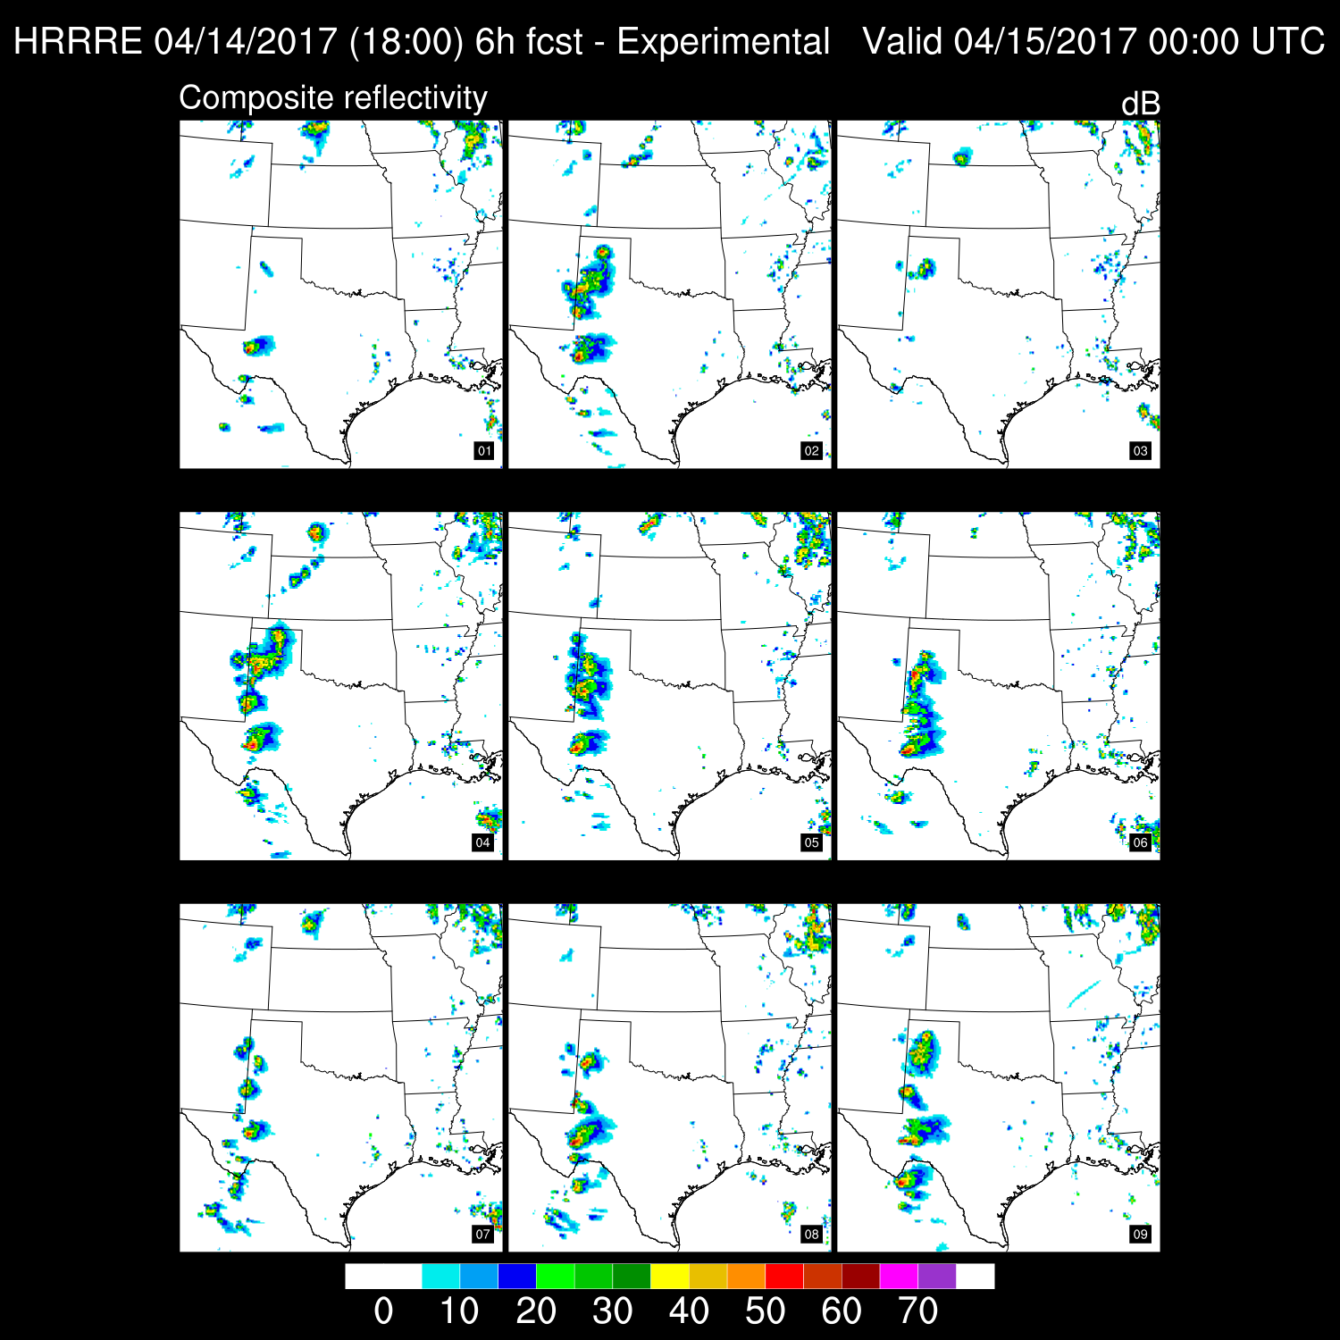
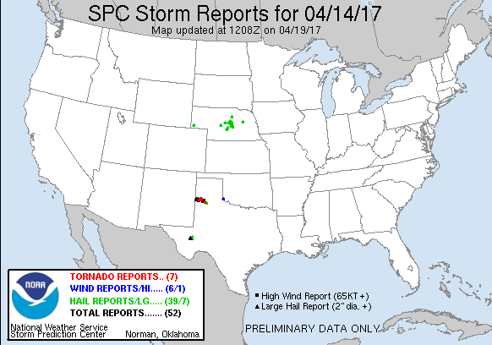
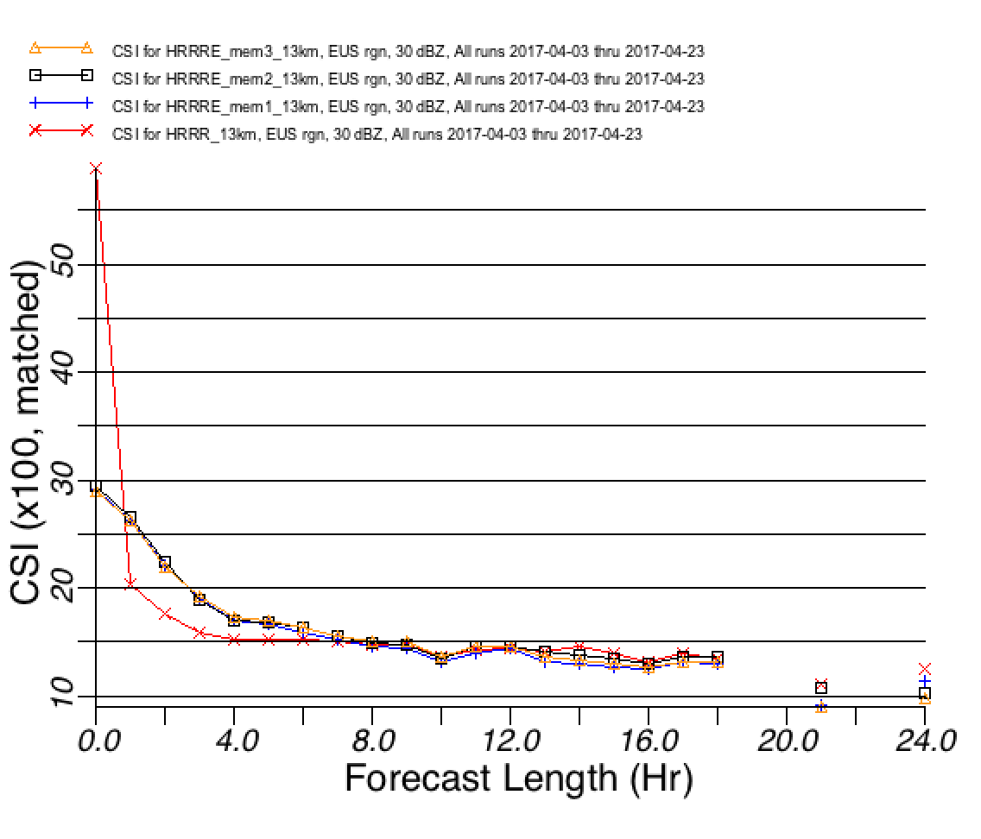
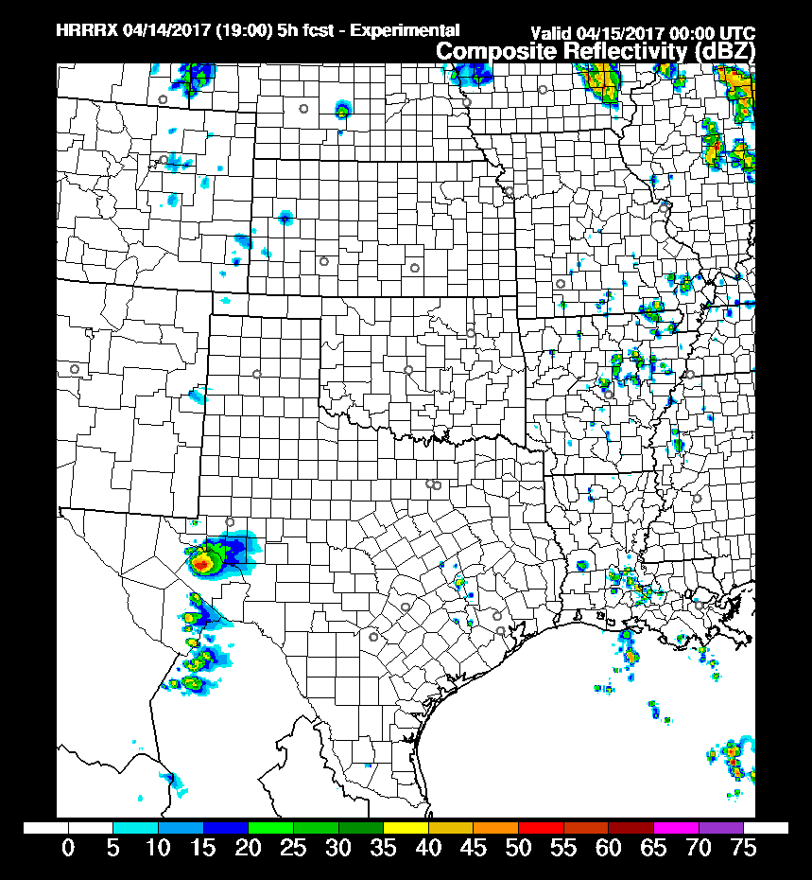
Ensemble Forecast Challenge: Spread vs Error
Isolated Supercell
00z 15 April 2017
More Accurate
Convection with CAM Ensemble DA
in 0-6 hrs
Deterministic
HRRR 6-hr
Forecast
HRRRE Case

Slide 34
RAP/HRRR: Hourly-Updating Weather Forecast Suite
13-km Rapid Refresh (RAPv4) – to 39h (Feb 2018)
Initial & Lateral Boundary Conditions
3-km High-Resolution Rapid Refresh Alaska, Hawaii and Puerto Rico Testing (HRRR-AK, HRRR-HI, HRRR-PR) Experimental (ongoing)
3-km High-Resolution Rapid Refresh (HRRRv3) – to 36h (Feb 2018)
Initial & Lateral Boundary Conditions
3-km Storm-Scale Ensemble Analysis and Forecast (HRRRE) 55% CONUS HRRR Experimental (ongoing)
750-m HRRR nest Scale-ware Physics Testing (ongoing)
3-km High-Resolution Time Lagged Ensemble (HRRR-TLE)
3-km HRRR-Smoke (VIIRS fire data)
Overview

Slide 35
RAP/HRRR ESRL/GSD Development Talks
6.1 Wed 10:30 Georg Grell New developments and applications using the scale and aerosol aware Grell-Freitas convection parameterization
P11 Wed 2-5 Isidora Jankov Stochastic Approaches Within a High Resolution Rapid Refresh Ensemble- Part I: Sensitivity Testing
P12 Wed 2-5 Jeff Beck An Evaluation of 3D- and 4D-EnVar Sub-Hourly Data
Assimilation in the HRRR
P34 Wed 2-5 Jaymes Kenyon The MYNN Turbulence Parameterization: Recent Development and Current Capabilities
8.1 Thu 10:30 Jeff Beck An evaluation of the new hybrid vertical coordinate in the RAP and HRRR
8.6 Thu 11:45 Joseph Olson Addressing systematic biases in RAP/HRRR physics for WFIP2
Talks

