Slide 1
RRTMG-P: An Updated and Standardized Radiative Transfer Package for Earth System Applications on High Performance Computing Systems
Robert Pincus
University of Colorado
Brian Eaton
NCAR/CGD
John Dennis, Youngsung Kim
NCAR/CISL
John Michalakes
(michalak@ucar.edu)
UCAR/CPAESS and NRL
18th WRF Users Workshop
13 June 2017
Notes:
Discuss the scalability issue for NWP going forward
Including what scalability means – what are we scaling to
Examples of work to improve scalability of NEPTUNE and MPAS
On latest generation Intel MIC processor, Knights’ Landing

Slide 2
RRTMGP Project
ONR/NOPP-funded: “RRTMGP: A High Performance Broadband Radiation Code for the Next Decade” *
Update science and software of AER’s widely used but 20-year old Rapid Radiative Transfer Model (background on next slide)
2013-2016, $625K between AER, U. Colorado, and NCAR
Continuing now under 2-year follow-up grant
Also some NASA support
Implementation in Community Atmosphere Model of CESM is nearing completion
Active interest: ICON (DWD), GFS (NCEP), NEPTUNE (NRL)
* Mlawer, Berthiaume, Pincus, Eaton, Liu, and Iacono https://www.earthsystemcog.org/projects/espc-aoli/2013_meeting
Notes:
NOPP: National Oceanographic Partnership Program
ESPC AOLI – Air-Ocean-Land-Ice Global Coupled Prediction

Slide 3
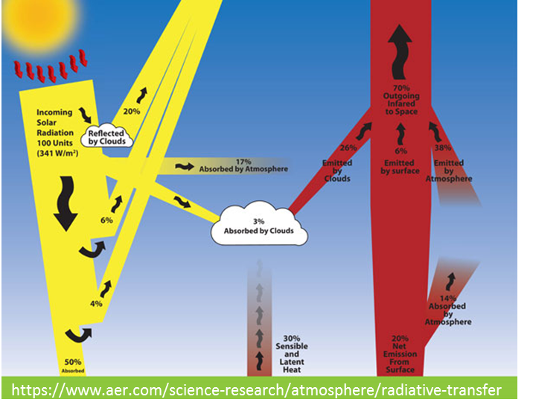
Background
RRTMGP* builds upon and updates science and software of the 20 year old Rapid Radiative Transfer Model (RRTMG)**
K-distribution treatment of absorption and emission by gases as a function of temperature, pressure, etc, coupled to two-stream methods for computing radiation transport
Expensive but highly efficient compared to the reference Line-by-Line RTM
RRTMG is widely adopted: NCEP, NASA, ECMWF, CESM, and WRF but each group has a different version of the software and these are diverging
Experimental versions of RRTMG ported/optimized for next-generation processors (MIC, GPU) ***
* Mlawer, Berthiaume, Pincus, Eaton, Liu, and Iacono https://www.earthsystemcog.org/projects/espc-aoli/2013_meeting
** Mlawer, Taubman, Brown, Iacono, and Clough. Journal of Geophysical Research: Atmospheres. vol. 102, no. D14, 1997.
*** Michalakes, , Iacono, Jessup. Parallel Processing Letters, 26 No. 4. World Scientific. Dec. 2016. http://dx.doi.org/10.1142/S0129626416500195
Notes:
Michalakes, J., M. Iacono, E. Jessup. Optimizing Weather Model Radiative Transfer Physics for Intel’s Many Integrated Core (MIC) Architecture. Parallel Processing Letters, 26 No. 4. World Scientific. Dec. 2016. 16 pp. http://dx.doi.org/10.1142/S0129626416500195

Slide 4
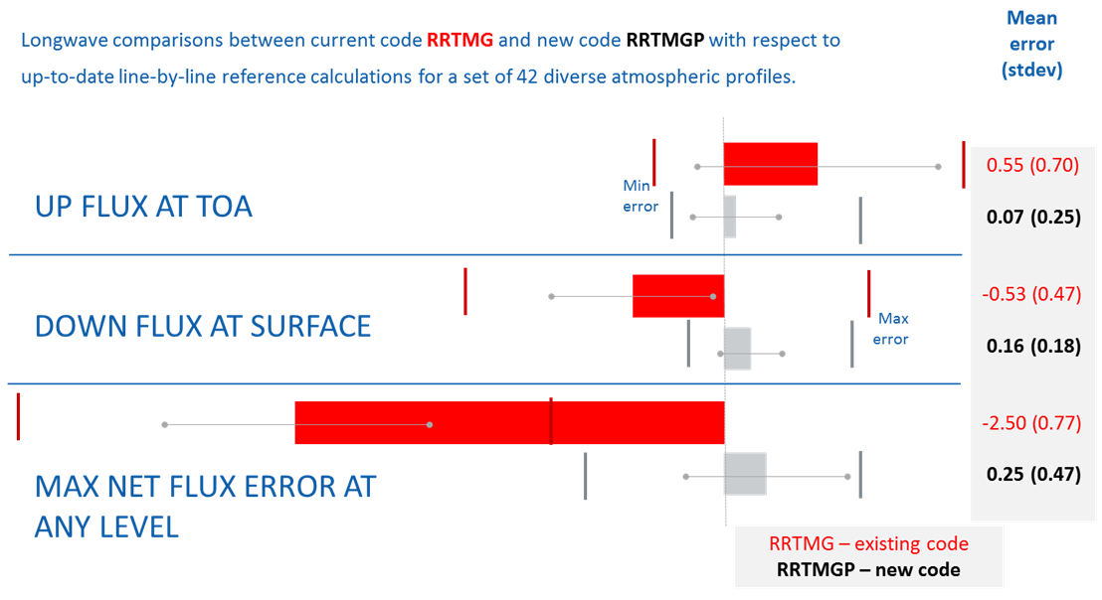
RRTMGP Science Improvements
RRTMGP is based on latest spectroscopic knowledge
Aer_v3.5 * based on HITRAN 2012 ** (vs. HITRAN 2002 for RRTMG)
Newly validated against Line-by-Line RTM
* AER Line Parameter Database: http://rtweb.aer.com/line_param_frame.html
** The HITRAN Database: https://www.cfa.harvard.edu/hitran/facts.html
Notes:
Compares the accuracy of RRTMG, in red, and a RRTMGP, in grey, against current reference (line-by-line models) across a range of 42 atmospheric profiles designed to explore model error with respect to various gases, temperatures, and so on (the GAR-rond atmospheres). The RRTMGP calculations use a prototype k-distribtion that’s still being tuned. For each model we show the mean error across the atmospheres as a bar, the standard deviation across atmosphere as whiskers, and the min and max across atmospheres as vertical lines. At every level TOA, surface, or the level of max error per column, errors are smaller for RRTMGP than for RRTMG. That’s partly because the prototype k-distribution has roughly twice as many spectral points, and partly because the current k-distribution is tuned to the reference calculation, while RRTGM is tuned to an older reference that ,for example, had less absorption of solar radiation by water vapor.
AER has its own linefile that is heavily based on HITRAN. So the most accurate statement about the spectroscopic basis for RRTMGP_LW is that it was built from the line parameter file aer_v3.5 and the MT_CKD_3.0 continuum. However, aer_v3.5 is (details on http://rtweb.aer.com/line_param_frame.html à What’s New) primarily based on HITRAN2012, with some exceptions for H2O in the far-IR and microwave and CO2 in one region in the near-IR.

Slide 5
RRTMGP Software Improvements
Seeks to balance efficiency and flexibility
Increased efficiency:
RRTMGP computational kernels structured to take advantage thread and fine-grain parallelism of new HPC architectures
Improve flexibility and modularity of the code:
Entirely new code using Fortran 2003 Objected Oriented features
Models specify clouds, aerosols, gas concentrations by calling “init” methods defined in RRTMGP classes
RRTMGP may be built and used as a library that need not be changed for different models and applications
Allows the currently numerous and divergent applications of the RRTMG to be updated to a single AER-supported community version RRTMGP software for HPC systems

Slide 6
RRTMGP Software Improvements
Flexibility: Object oriented brokering layer and interfaces written using Fortran 2003 classes to describe optical and physical properties of clouds, aerosols
RRTMGP provides classes for
Optical properties that can be used directly (RRTMG provides)
Abstract and example classes for aerosols, clouds, random numbers (Model developer provides)
Output classes that can be extended as needed
Computational kernels
Example ... (next slide)
Notes:
red layer sanitizes input to kernels – error checking (optical depth < 0).
don’t extrapolate k distribution with pressures or temps outside of range (relatively normal terrestrial)

Slide 7
RRTMGP Software Improvements
Example model code that uses RRTMGP classes to initialize and then call RRTMGP shortwave radiation
type(ty_gas_optics) :: kdist_sw
type(ty_gas_conc) :: gas_concs
type(ty_fluxes) :: fsw, fswc
type(ty_optical_props_cld) :: cloud_sw ! extended from RRTMGP class ty_optical_props
...
!< Set gas volume mixing ratios
error = gas_concs%set_vmr(‘h2o’, wv_vmr)
error = gas_concs%set_vmr(‘co2’, 400.*1.e-6)
! Cloud optical properties
!
error = cloud_sw%init(ncol, nlay, kdist_sw%get_ngpt())
call compute_cloud_optics(cloud_fraction, cloud_lwp, &
cloud_sw%tau, cloud_sw%ssa, cloud_sw%g, ... )
! Call the RRTMGP shortwave routine
errmsg = rrtmgp_sw( &
kdist_sw, gas_concs, pmid_rad, t_rad, pint_rad, &
... mu0, sfc_alb_dir, sfc_alb_dif, &
... cloud_sw, fsw, fswc, ... )
Blue: provided by or extended from RRTMGP
Notes:
fsw fswc fluxes short-wave clear sky
real, dimension(:,:,:), allocable :: tau ! optical depth real, dimension(:,:,:), allocable :: ssa ! single-scattering albedo
real, dimension(:,:,:), allocable :: g ! asymmetry parameter

Slide 8
RRTMGP Software Improvements
Example model code that uses RRTMGP classes to initialize and then call RRTMGP shortwave radiation
type, public :: ty_gas_optics
real, dimension(:,:,:), allocable :: tau ! optical depth
real, dimension(:,:,:), allocable :: ssa ! single-scattering albedo
real, dimension(:,:,:), allocable :: g ! asymmetry parameter
...
contains
procedure, public :: init
procedure, public :: get_ncol, get_nlay, get_ngpt
...
end type ty_gas_optics_specification
type(ty_gas_optics) :: kdist_sw
type(ty_gas_conc) :: gas_concs
type(ty_fluxes) :: fsw, fswc
type(ty_optical_props_cld) :: cloud_sw ! extended from RRTMGP class ty_optical_props
...
!< Set gas volume mixing ratios
error = gas_concs%set_vmr(‘h2o’, wv_vmr)
error = gas_concs%set_vmr(‘co2’, 400.*1.e-6)
! Cloud optical properties
!
error = cloud_sw%init(ncol, nlay, kdist_sw%get_ngpt())
call compute_cloud_optics(cloud_fraction, cloud_lwp, &
cloud_sw%tau, cloud_sw%ssa, cloud_sw%g, ... )
! Call the RRTMGP shortwave routine
errmsg = rrtmgp_sw( &
kdist_sw, gas_concs, pmid_rad, t_rad, pint_rad, &
... mu0, sfc_alb_dir, sfc_alb_dif, &
... cloud_sw, fsw, fswc, ... )
Blue: provided by or extended from RRTMGP
Notes:
fsw fswc fluxes short-wave clear sky
real, dimension(:,:,:), allocable :: tau ! optical depth real, dimension(:,:,:), allocable :: ssa ! single-scattering albedo
real, dimension(:,:,:), allocable :: g ! asymmetry parameter

Slide 9
RRTMGP Efficiency Improvements
Efficiency: redesigned computational kernels (solvers and other core routines) for efficiency on next generation architectures
Parallelism over adjacent columns as innermost dimension that allows efficient use of Intel’s AVX vector instructions and SIMT threads on NVIDIA’s GPGPU architecture
Thread safe software modules, can be called within threaded regions of host models
May involve trading off maximum performance for software flexibility, but goal is to at least match the performance of current RRTMG codes
Single source code designed for efficiency on multiple platforms

Slide 10
Computational Performance (Longwave)
Current kernel cost:
Baseline
RRTMG: 5.2 milliseconds
RRTMGP: 24.8 milliseconds (4.8x slower)
Observations
RRTMGP performs 4.4x more instructions
Two full executions, once for clearsky and once for cloudy (RRTMG combines these)
Twice as many g-points as RRTMG (this is being addressed)
Workload
Number of columns = 31
Number of layers = 16
Platform
Yellowstone of NCAR
Intel(R) Xeon(R) CPU E5-2670 0 @ 2.60GHz
RRTMG LW and RRTMGP LW are extracted as kernels from CESM’s CAM using KGEN *
Performance is measured on a single core using the kernels
Extrae**/Folding is used for performance analysis
* Kim et al., Procedia Computer Science, 80, 2016 doi:10.1016/j.procs.2016.05.466
**Barcelona Supercomputing Center
http://www.vi-hps.org/Tools/Extrae.html

Slide 11
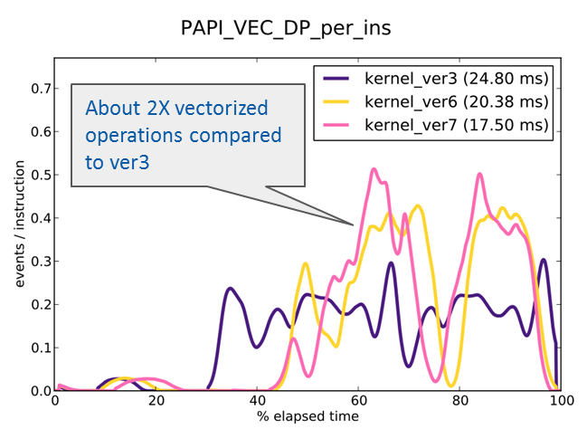
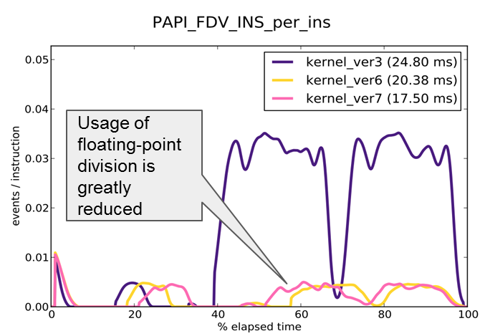
Computational Performance (Longwave)
Current kernel cost:
Baseline
RRTMG: 5.2 milliseconds
RRTMGP: 24.8 milliseconds (4.8x slower)
Optimizations to date
Increased vector utilization in solver
Reduced number of floating point divisions in solver
Improve L2 cache reuse in gas-optics
RRTMGP: 17.5 milliseconds (3.4x slower)
More improvement needed, but on a per-instruction basis, the performance of RRTMGP is similar to RRTMG
higher is better
lower is better

Slide 12
RRTMGP Status and Future Work
Readiness for community use
Coming soon
Incorporating into real applications will begin once spectroscopic data has been finalized later this summer for longwave and in the fall for shortwave radiation
Continued performance improvement (Pincus with NCAR/CISL)
Prototype implementation in Community Atmosphere Model of CESM (NCAR/GSD) but won’t be ready for CMIP6
NCEP and NRL also tracking development
RRTMGP should be available for initial testing in WRF later this year
Todo: make conforming with NUOPC Physics Interface (potentially part of the Navy project).

