Slide 1
Unifying the Production Suite at the NWS:
What does this mean for Convection Allowing Models?
Dr. Ir. Hendrik L. Tolman
Senior Advisor for Advanced Modeling System (SAAMS)
Office of Science and Technology Integration
National Weather Service /NOAA
Hendrik.Tolman@NOAA.gov

Slide 2
Background
Long push from external reviews to provide Strategic Plan for Production Suite
UCACN, UMAC
Three-pronged Planning approach to enable change
Strategic plan/vision: High-end view, broader modeling enterprise
Roadmap: Where to go in 5-10 years, more detail, longer view
Strategic Implementation Plan: What to do right right now (next 2-3 years) to move towards vision of Strategic Plan and Roadmap
This presentation:
High level view of SV and Roadmap
What does this mean for Meso Models and CAM
What does this mean for the WRF community
Notes:
Specific, Measurable, Attainable, Realistic & Time Bound https://en.wikipedia.org/wiki/SMART_criteria
Note: max of 2 presentation slides total for covering FY15 highlights and FY16 activities/milestones. Additional (if any) can be put in backup section.

Slide 3
Status
SV and Roadmap version 0.6 reviewed by
NCEP Centers, NWS Regions, HQ Offices, OAR Labs, OAR programs, OCIO, UMAC, NOAA LOs through UMTF/RC
Version 0.8 (present)
Many edits to address 400+ comments.
Co-author from OAR (John Cortinas)
General consensus on present manuscripts, but still need to add
Section with major time lines
Section with needed research foci.
Time line:
Version 0.8 distributed at SIP workshop (April)
Drafts for two new sections in Roadmap July-August 2017.
SIP writing meeting July-August 2017.
Further review and signatures from AAs time line TBD.

Slide 4
Strategic Vision
Focus on products supporting mission requirements
“WRN” end-to-end for NOAA enterprise, focus on models
Unified modeling and data assimilation
Coupled, ensemble based, reforecast and reanalysis
Including pre- and postprocessing, calibration, verification validation, dissemination, + (end-to-end WRN)
Focus on community modeling
Approach must work for operations and research!
Evidence-driven decisions
Same standards for all who contribute
Transparent and robust governance
Service requirements
Technical requirements / solutions
Prioritization

Slide 5
Strategic Vision: Temporal Domains
Unified Coupled Model
Unified Data Assimilation
Year+
(decadal- centennial)
Year
(seasonal)
Month
(outlook/
sub-seas.)
Week
(weather)
Day
(rapid refresh)
Hour
(Warn on Forecast)
Now
(analyses)
Global | Global | Global | Global |  |  | Global
 |  | Regional refinement | Regional refinement
Down-scaling | Down-scaling |  |  | Regional | Regional | Regional

Slide 6
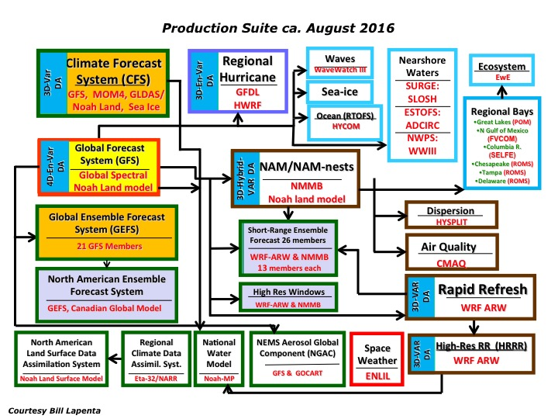
Roadmap: Production Suite
Starting from the quilt of models and products created by the implementing solutions rather than addressing requirements ….

Slide 7
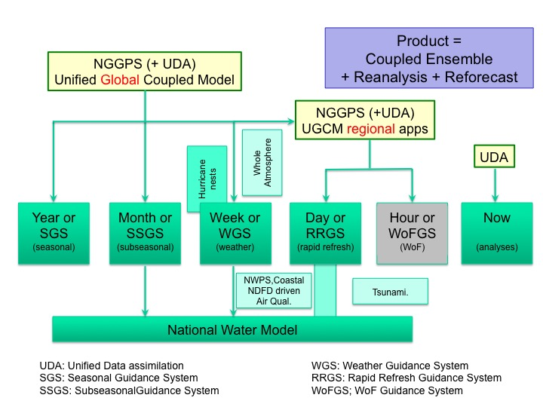
Roadmap: Production Suite
10-13km
global
3km - ??km
regional
… we will move to a product based system that covers all present elements of the productions suite in a systematic and efficient way

Slide 8
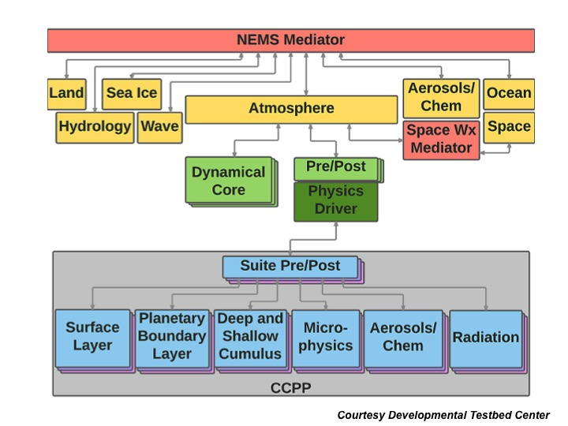
Roadmap: Architecture
ESMF / NUOPC /NEMS architecture enables unified global coupled modeling and DA
Consistent with broader NOAA (UMTF) and US vision (National ESPC)

Slide 9
CAM in production suite
Push to single unified modeling system
Experience of other centers (UK Met Office, ….)
Maintenace of one system rather than multiple systems
UMAC meeting 2016: FV3 dycore appears suitable for CAM applications
Executive decision of the NWS: we will go forward with developing a unified system accross all scales based on FV3 dycore
Short term assessment of work needed on FV3 dycore for CAM applications (#1 issue: stand alone regional capability)
Address improvements needed to make this the core of a world-class model accross all scales.
Physics on CAM scale as important as dynamic core

Slide 10
CAM in production suite
Short term strategy
Create initial capability for regional FV3 based model
Redirect resources at NWS and OAR to do this
NAM model now frozen, NMMB team →regional FV3 team
GFDL hurricane model retired, replaced by HMON (NEMS based coupling)
OAR involvement from start
Continue development of IPD / CCPP as critical part of NEMS
Focus on a select number of physics packages (GFS, RAP/HRRR, HWRF …)
HRRR development as basis for RRGS development
WRF-ARW until NEMS-FV3 is ready
Focus on ensemble and DA development (JTTI)

Slide 11
WRF / NCAR / NSF community
What does this mean for the WRF community:
Where does the WRF community see itself go?
Focus on mesoscale versus across scales (WRF → MPAS)
WRF as meso-only model has limited life span in NWS
NOAA / NWS intends to partner with CESM
Common architecture
Multiple options
Dynamic cores
Physics packages
Coupled components
Merging of Wx communities
Coupling benefits for Meso / CAM
NWM, Great Lakes, Coastal.

Slide 12
Thank You !

