Slide 1


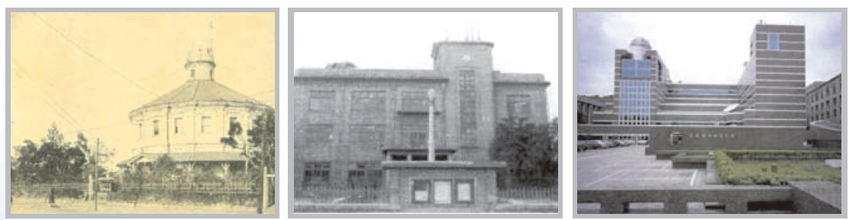
Development of the ensemble QPF in Central Weather Bureau (CWB) of Taiwan
Hong, Jing-Shan¹ , Treng-Shi Huang¹
Ming-Zhang Wu¹
¹Central Weather Bureau
²Taiwan Typhoon and Flood Research Institute
1897
1937
1996

Slide 2
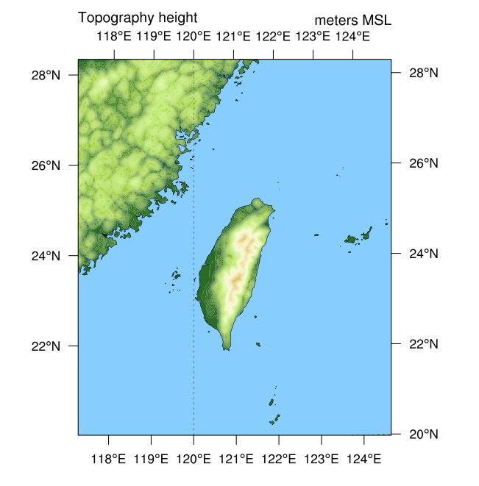
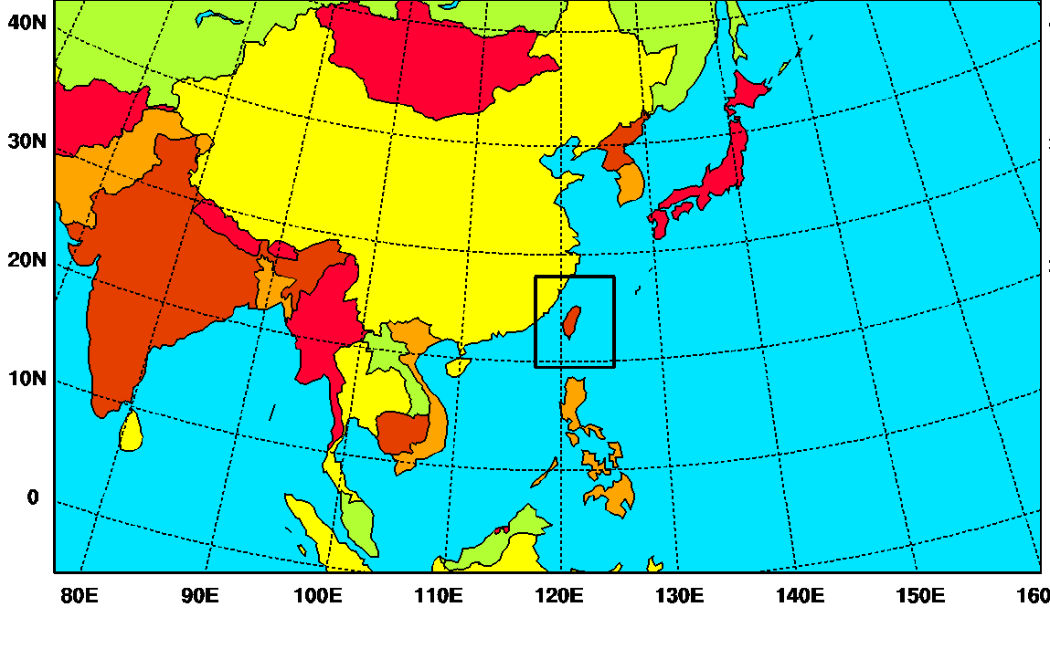
Configurations of the CWB EPS
4 times per day
20 members from
Control run from the deterministic analysis
Initial perturbation from EAKF 6-hr fcst perturbation
Boundary perturbation from the NCEP ensemble GFS
Model perturbation from 20-physics suite
15-/3-km resolution, 52 levels
Notes:
2
There are 3 nested domains with resolution of 45-15 and 5 km.
With steep mtn range, the ensemble QPF is more critical
CWB has a big investment and huge computer resource to run the EPS, with the same model configuration as deterministic run

Slide 3
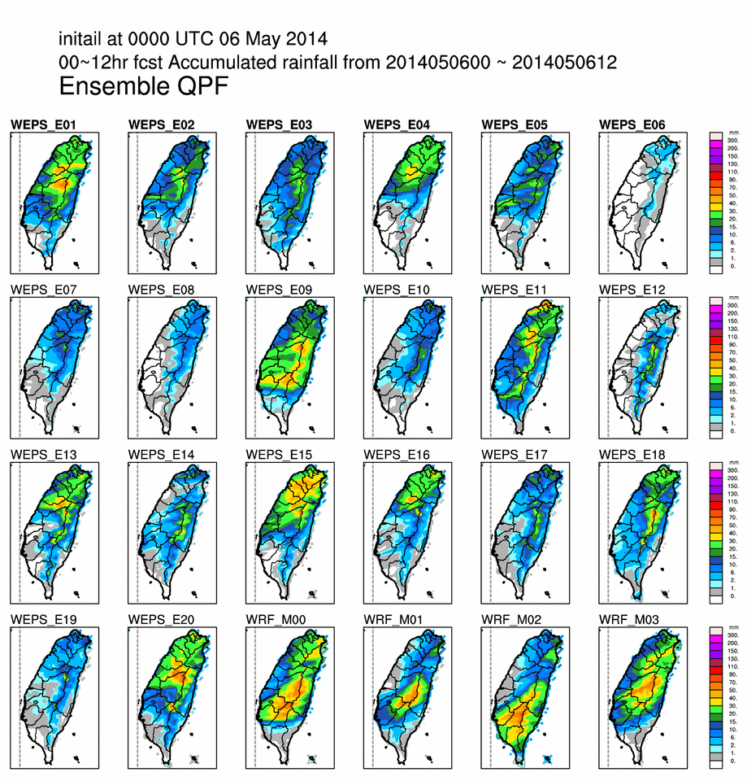
How to present the effective QPF guidance for disaster prevention and mitigation

Slide 4
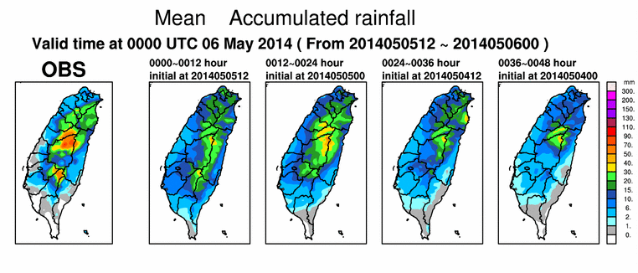
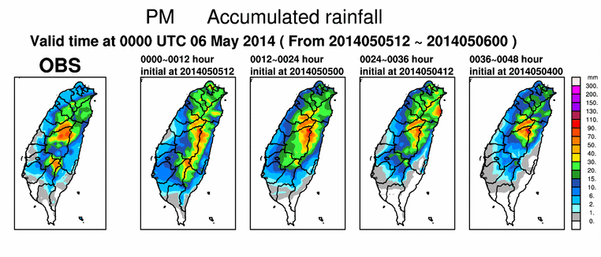
Probability match rainfall
Based on the ensemble mean
Out-performs the deterministic forecast with different lead-time
Re-construct the PDF of the ensemble mean rainfall using the PDF of the whole ensemble QPF
Without under-estimate the rainfall amount

Slide 5
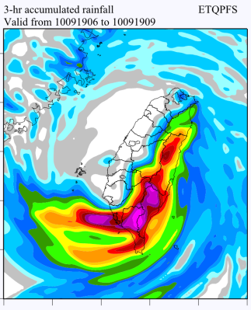
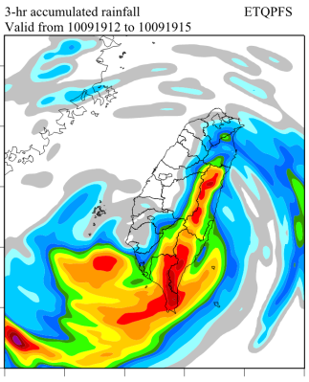
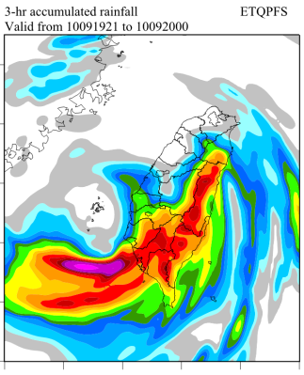
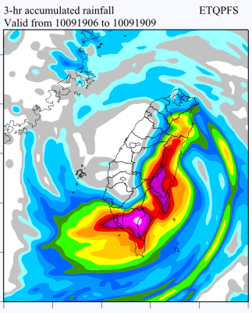
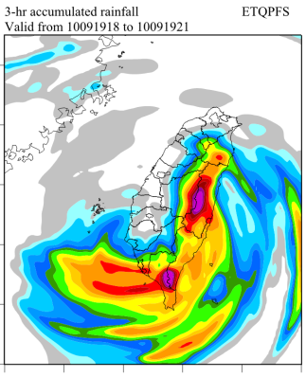
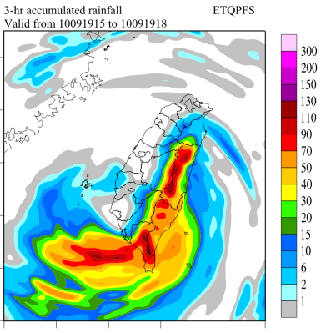
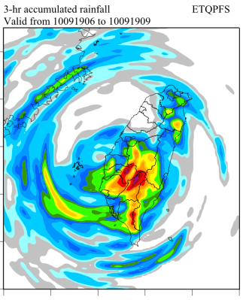
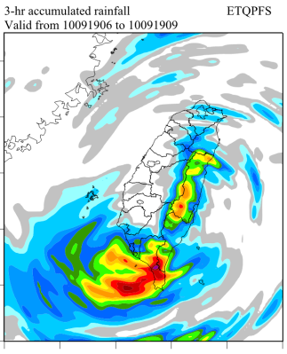
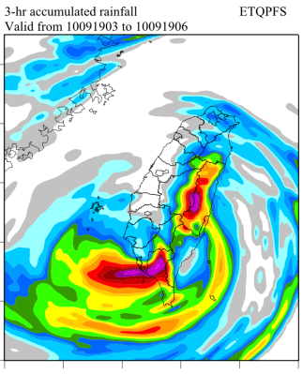
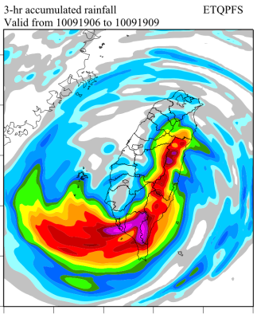
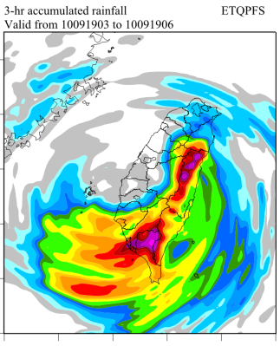
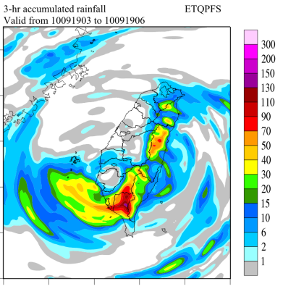
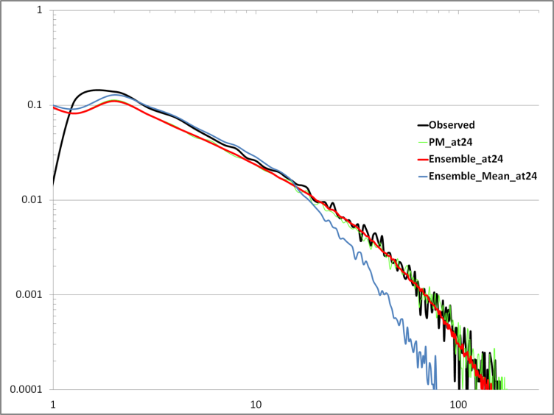
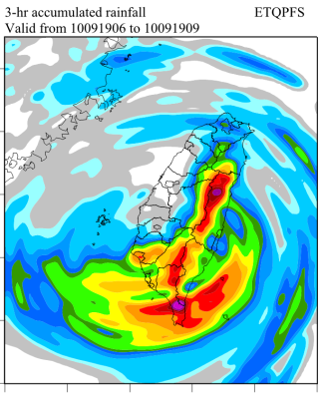
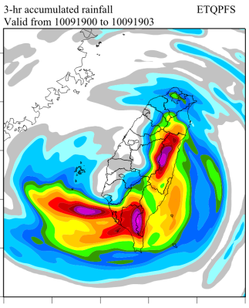
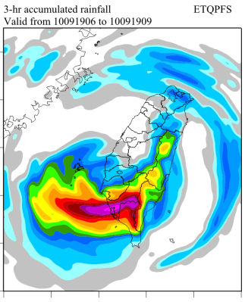
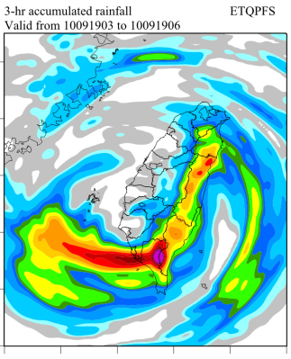
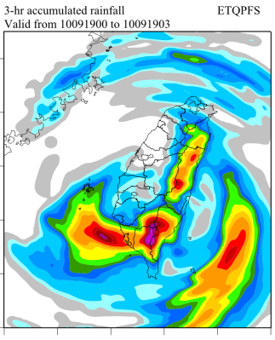
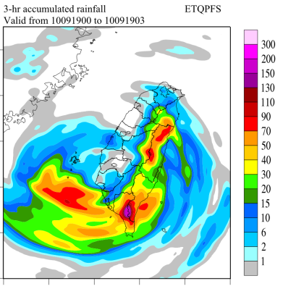
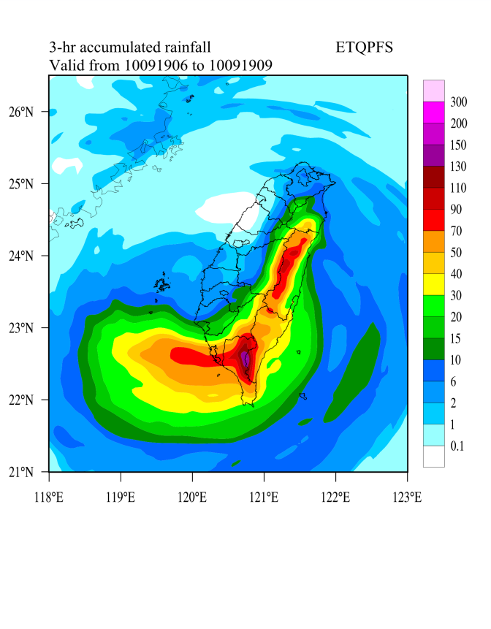
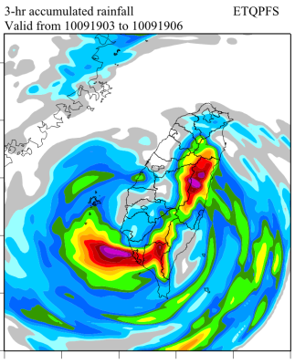
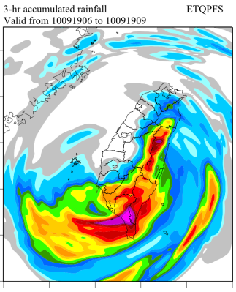
100X100
Smooth out the rainfall extremes due to the average process
“Mean” for the precipitation is not a good idea

Slide 6
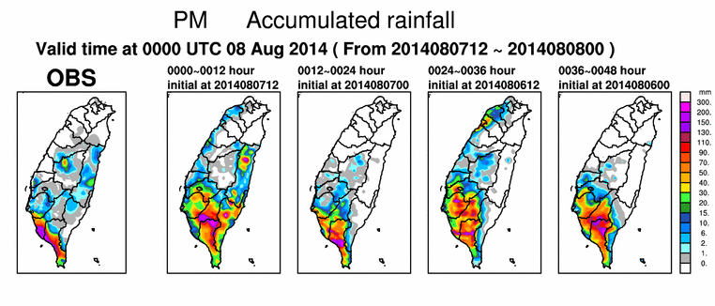
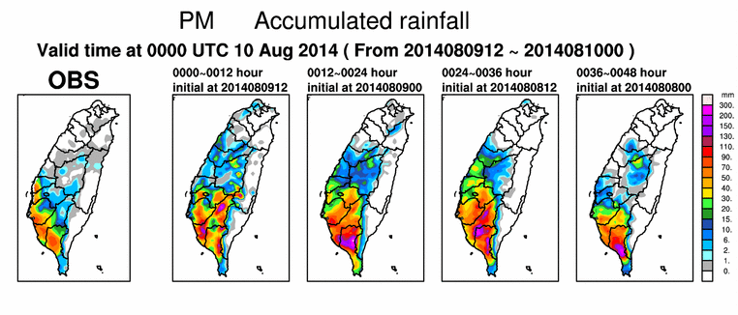
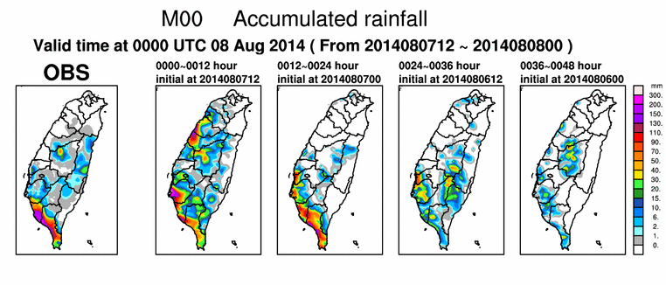
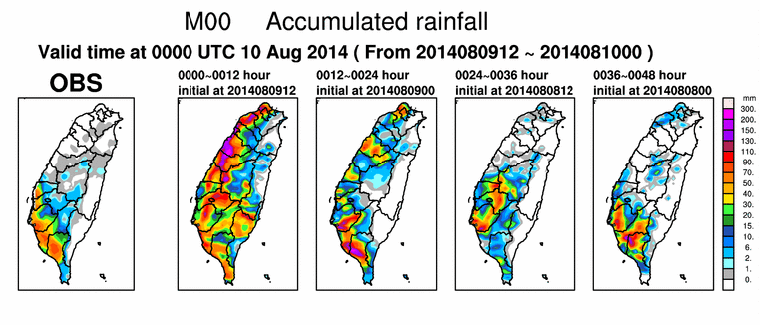
Valid time at 2014080712 ~ 2014080800
Valid time at 2014080912 ~ 2014081000

Slide 7
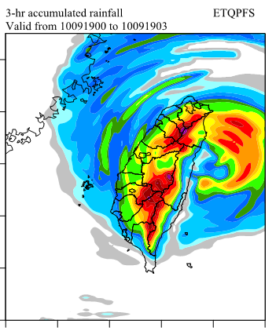
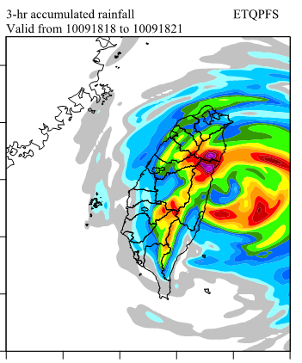
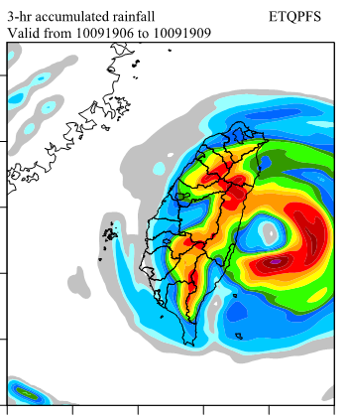
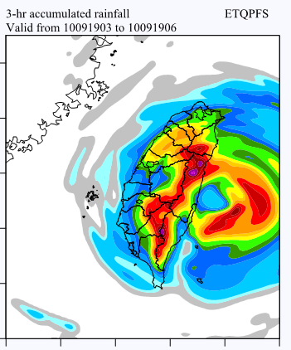
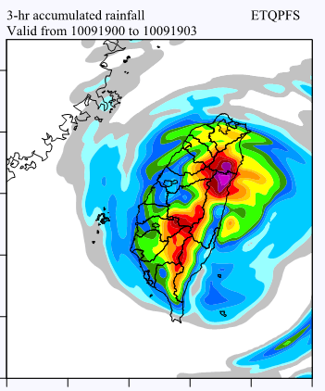
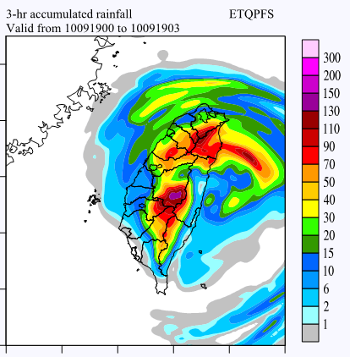
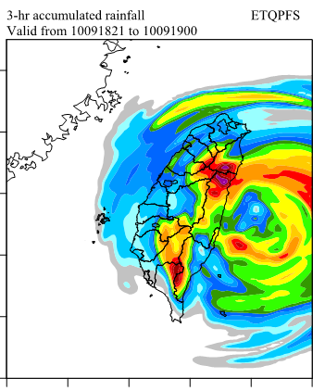
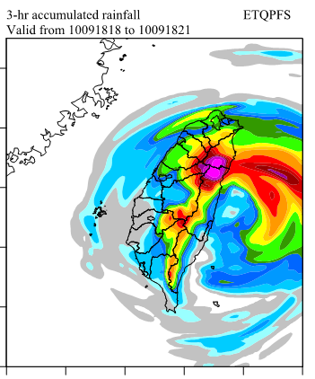
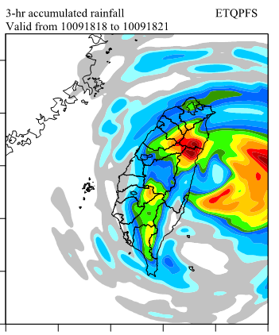
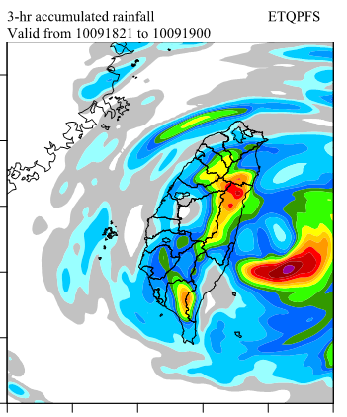
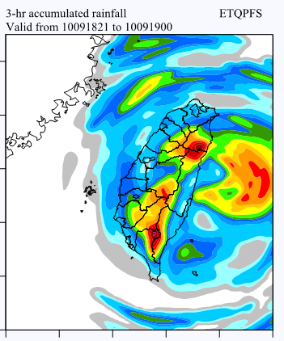
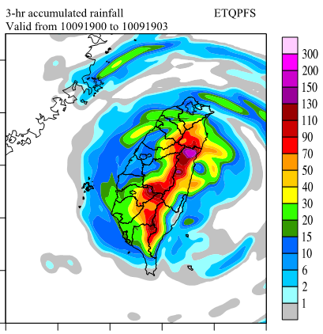
For Typhoon, the Probability Match rainfall can not function well

Slide 8
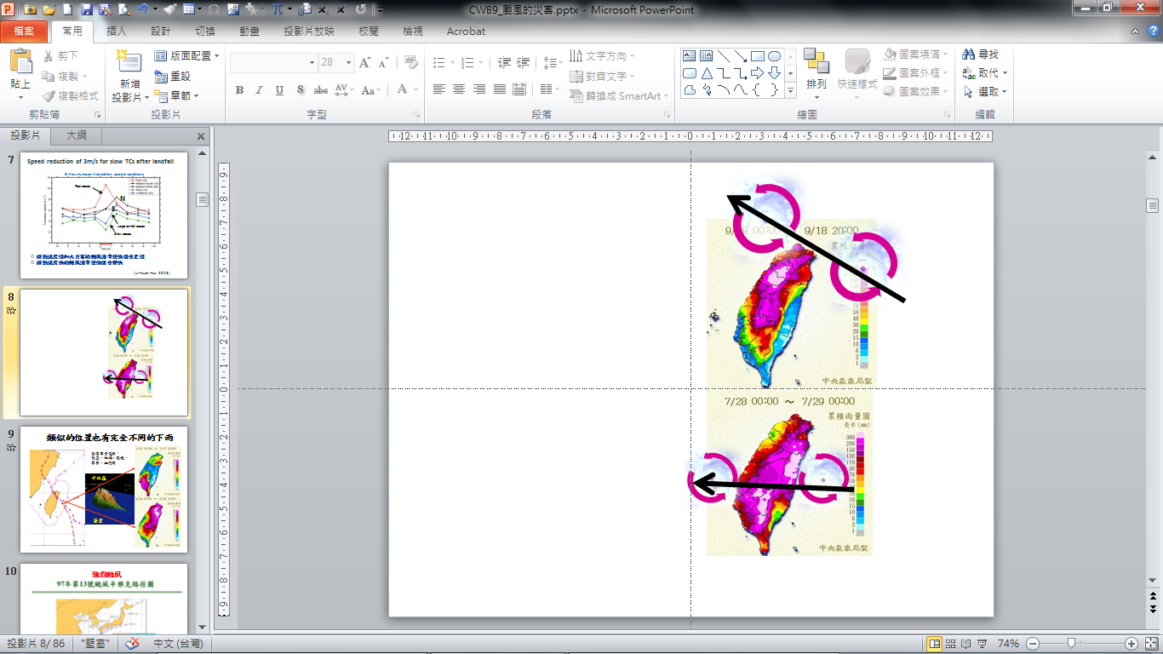
Due to the high mountain range, the distribution and amount of the typhoon rainfall over Taiwan is highly related to the typhoon position, it is so called topographic locking.
Notes:
Because of the remarkable Taiwin topography
If we collect a lot of the histroic typhoon case and its corresponding rainfall field over Taaiwan
Then we can construct a mapping between the rainfall and typosition.
This algorithm performaed well for the total rainfall amount during the typhoon affecting taiwan
In general, This algorithm can give a statistic based QPF

Slide 9
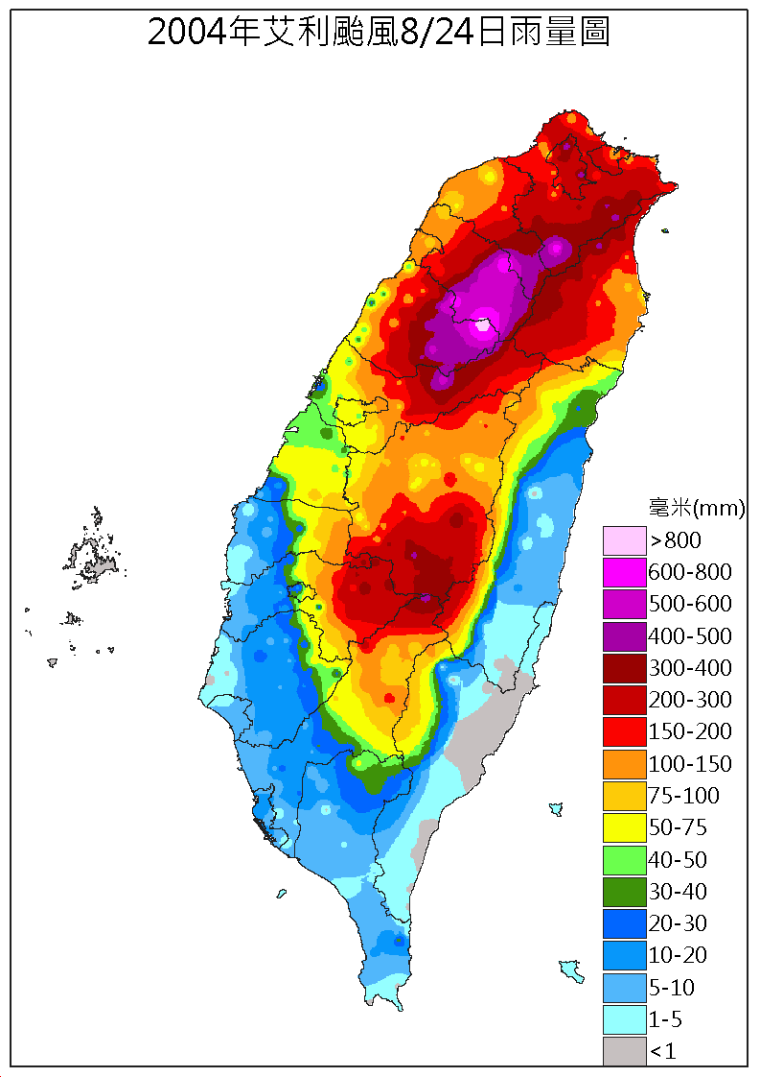
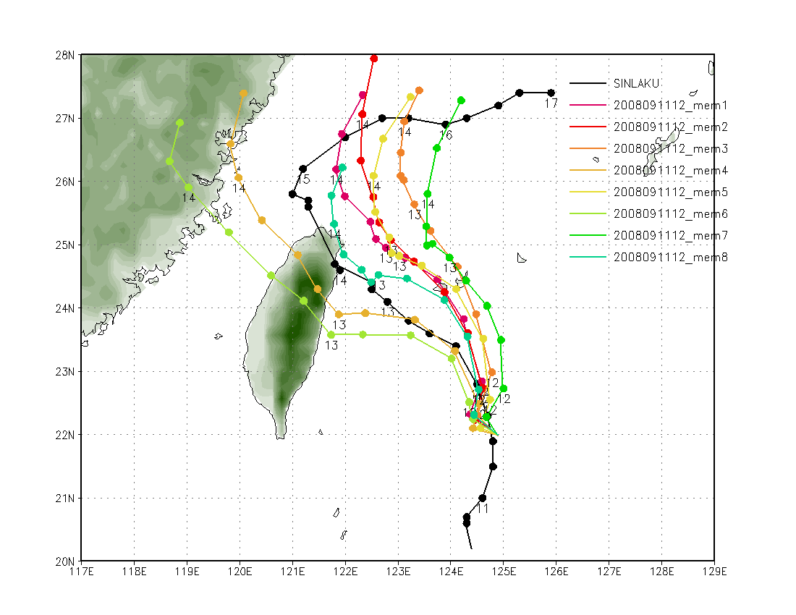
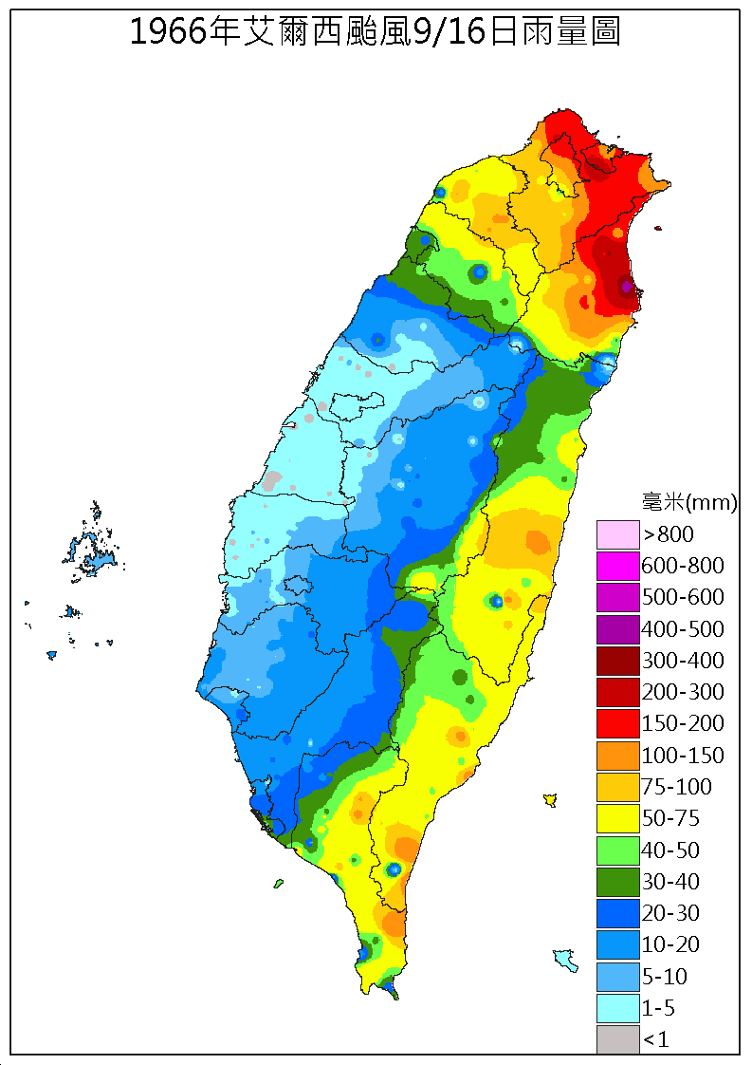
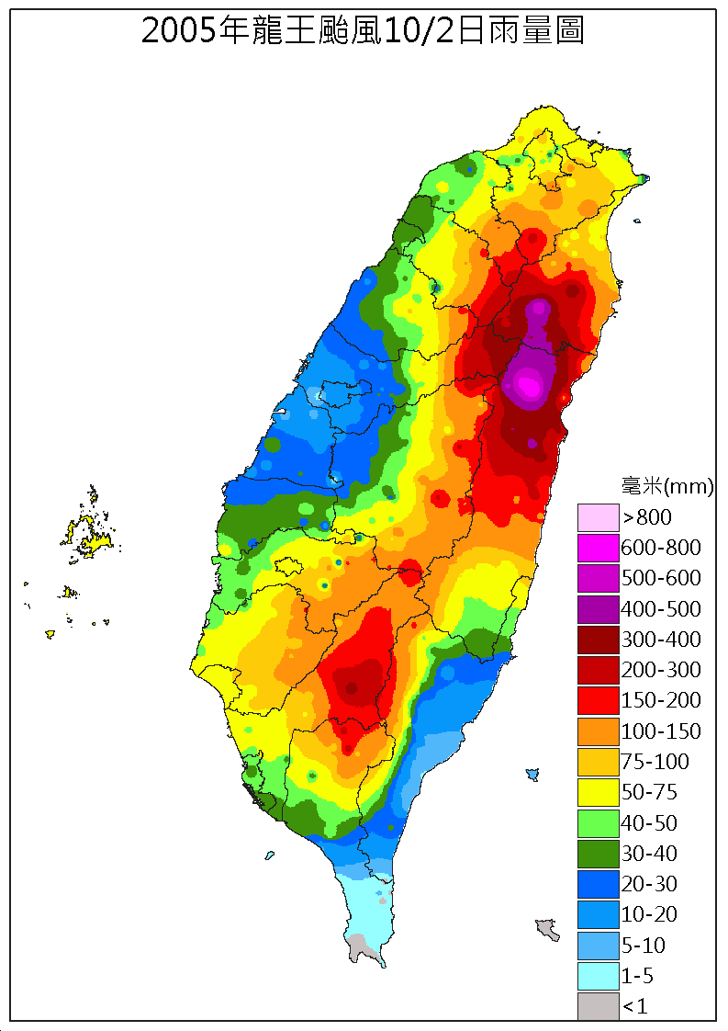
Take the ensemble mean? It is definitely not a good idea

Slide 10
Toward the Ensemble Typhoon QPF (ETQPF)

Slide 11
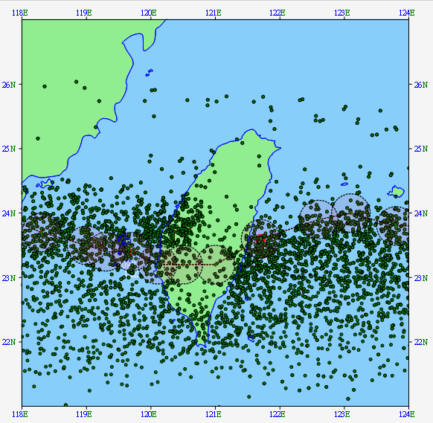

Typhoon locations with 3-hr intervals (ensemble cases) were given by the ensemble prediction systems. It is the total uncertainties from the EPS
Each ensemble case is associated with a 3-hr accumulated rainfall map.
We are trying to reduce the uncertainties according to the prior estimate of the track
3 days
4 runs per day
30 members per run
24 dots per mem (72/3 hr)
Total: 3x4x30x24=8640 dots
Notes:
There are many dots in this figure
BD is the location of the model typhoon every 3-hr, doesn’t matter with the initial and forecast time
The application of ensemble system on the typhoon QPF is another focus
Because of the high mountain range over Taiwan Island
Typhoon rainfall over Taiwan is highly depend on the typhoon location, it is so-called phase locking effect

Slide 12












A “QPF scenario” was provided by the given typhoon track. →ensemble typhoon QPF (ETQPF)
A kind of “data mining” from the huge ensemble dataset.
Typhoon track is as a probe to mining the ensemble dataset

Slide 13
Performance of the ETQPF
With best track (no tract error)

Slide 14






The Ensemble Typhoon QPF (ETQPF) for the typhoons affecting Taiwan in 2013
ETQPF
ETQPF
ETQPF
OBS
OBS
OBS
Ty Soulik (2013)
Ty Trami (2013)
Ty Kong-Rey (2013)

Slide 15




The Ensemble Typhoon QPF (ETQPF) for the typhoons affecting Taiwan in 2013
ETQPF
ETQPF
OBS
OBS
TY Usagi (2013)
TY Fitow (2013)

Slide 16




The Ensemble Typhoon QPF (ETQPF) for the typhoons affecting Taiwan in 2014
ETQPF
ETQPF
EPS
Max:956 mm
OBS
OBS
Max:995 mm
TY Matmo (2014)
TY Fung-wong (2014)

Slide 17






The Ensemble Typhoon QPF (ETQPF) for the typhoons affecting Taiwan in 2015
Ty Linfa
Ty Chan-Hom
Ty Soudelor

Slide 18




2016 3-day accumulated ETQPF for best track
OBS
OBS
ETQPF
ETQPF
TY Meranti
TY Malakas

Slide 19




2016 3-day accumulated ETQPF for best track
OBS
OBS
ETQPF
ETQPF
TY Nepartak
TY Megi

Slide 20
Performance of the ETQPF
With forecast track
(with tract error)

Slide 21







Observation
Better estimate of the typhoon track
→Better QPF

Slide 22






The forecast QPF scenario was created from the vast amount of the prediction data according to the prior estimate of the track
How accuracy of the QPF in traditional NWP
→ Aggressive attitude, result in the defensive application
How inaccuracy of the QPF in ETQPF
→ Defensive attitude, result in the aggressive application
Notes:
The forecaster can take the advantage from the IS to well handle the forecast unceranity.

Slide 23

ETQPFs
A user friendly GUI interface to level up the value of the ETQPF algorithm

Slide 24


Extend to ETWIND
6-hr ETWIND (Maximum wind speed within 6-hr interval) for TY Megi

Slide 25
In stead of the uncertainty of the track forecast, something important looks behind the ensemble members……

Slide 26



Clustering the ensemble QPF - To explore the rainfall scenario
Cluster I
Cluster II
Cluster III
Cluster IV
Notes:
Self-Organizing Maps

Slide 27




Mean
17/50
12/50
11/50
10/50
Clustering QPF is workable for non-typhoon rainfall event

Slide 28




32-hr forecast
6-hr Phase delay
Can we find this member (if exist) in EPS,
and assess the performance of the following 6-hr QPF

Slide 29

































Construct database to contain the hourly (6-72 hr fcst) predict radar CV from the recent 10 EPS runs, e.g.
A total of 10 IC*66 fcst*30 members =19800 ensemble cases
Referring the realtime radar CV, using the pattern recognition technique to mining the 19800 ensemble cases and rank the results
Calculate the 0-3, 0-6 hr QPF according to the selected members

Slide 30


Rank Top 10 of radar CV in Ty Kong-Rey (2013)
Observed radar CV

Slide 31





Rank Top 10 of the 3-hr QPE in Ty Kong-Rey (2013)
Observed 3-h QPE
Ensemble mean
It takes 1-min to process the pattern matching procedure after the radar MOSAIC arrived
Using the near-realtime EPS to conduct the QPN (Nowcasting)

Slide 32













QPE radar + rain gauges
Non selected
consensus
selected
Consensus Pattern
Rank Top 10 members

Slide 33



3-hourly QPF Verification for consensus
During a Mei-Yu Front period in May 2015
Selected consensus (top 10%)
1.0
Threat Score
Selected Consensus
3
6
9
12
Non-Selected Consensus
Non-Selected consensus
0
3
6
Fcst. hours
from 19th12UTC to 25th12UTC May 2015
Threshold : 10 mm/3-h
3
6
9
12
Notes:
Real time verification,

Slide 34

Summary
Many ensemble QPF products based on the data mining concept was developed in Central Weather Bureau of Taiwan
The data mining was strongly driven according to the meteorological domain knowledge
Applying the AI technique with less domain knowledge is possible to create the new view-point beyond the existed domain knowledge

