Slide 1
Evaluation of a CONUS-wide physics ensemble
Robert Fovell and Alex Gallagher
University at Albany, SUNY
rfovell@albany.edu

Slide 2
“Santa Ana” wind events
WRF-ARW high-resolution (<1 km) simulations of downslope windstorms, verified against very dense, homogeneous SDG&E mesonet
Most model configurations overforecast the wind (strength and spatial extent)
Surface roughness played key role in producing unbiased forecasts of network-averaged wind
Systematic biases remained for many stations, explained by local exposure and gustiness
Fovell and Cao 2015, 2017; Cao and Fovell 2016, 2017
Notes:
Want to test similar ideas for CONUS

Slide 3
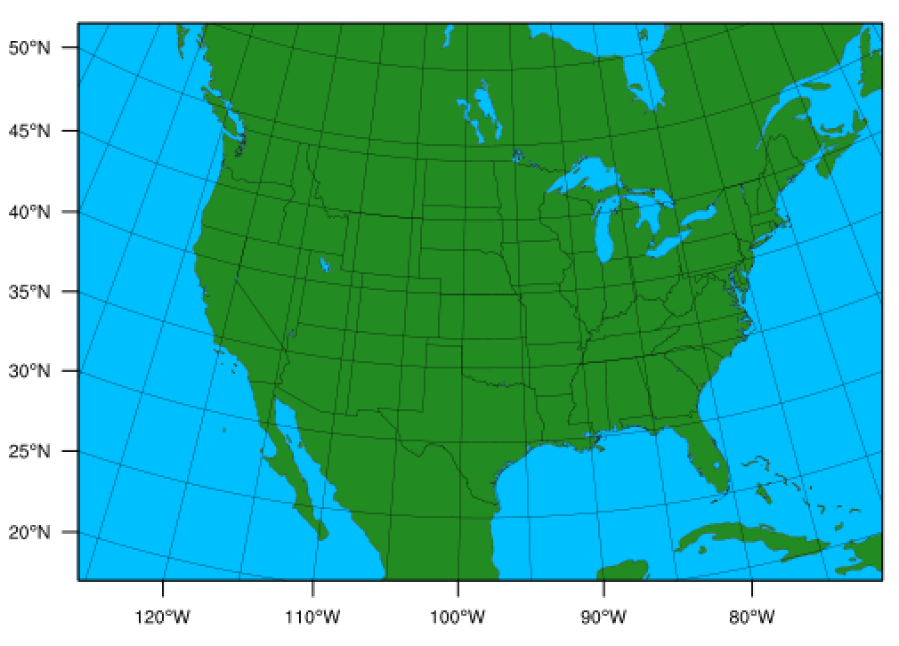

BWW ensemble
CONUS+ at 20 km
WRF v. 3.7.1
Initialized with 00Z GFS (or GEFS)
47 ensemble members (13 from UAlbany)
Since January 2016
Control:
MYJ PBL
Noah LSM
Kain-Fritsch cumulus
RRTMG radiation
Thompson microphysics
Model evaluation with MET on 3-hourly outputs

Slide 4
Objectives
Not a multi-physics ensemble, per se, but rather an experiment to isolate, explain and correct persistent forecast errors
Diagnose forecast wind speed biases
Testing the gustiness/exposure hypothesis using ASOS for CONUS
Examine boundary layer structure
Analysis of daily, overlapping 84 h simulations for July 2016, using Model Evaluation Tools (MET) software
Notes:
Not a multi-physics ensemble, per se, but rather an experiment to isolate, explain and correct persistent errors.

Slide 5
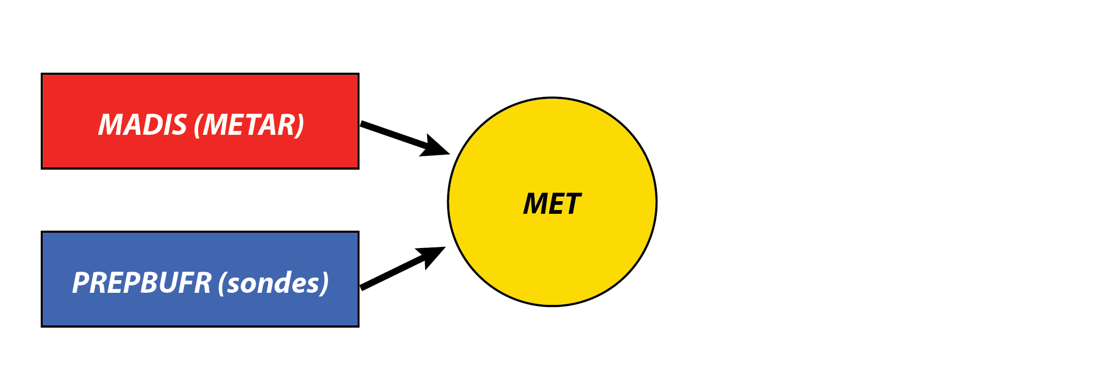
Model evaluation
ASOS stations and radiosondes

Slide 6
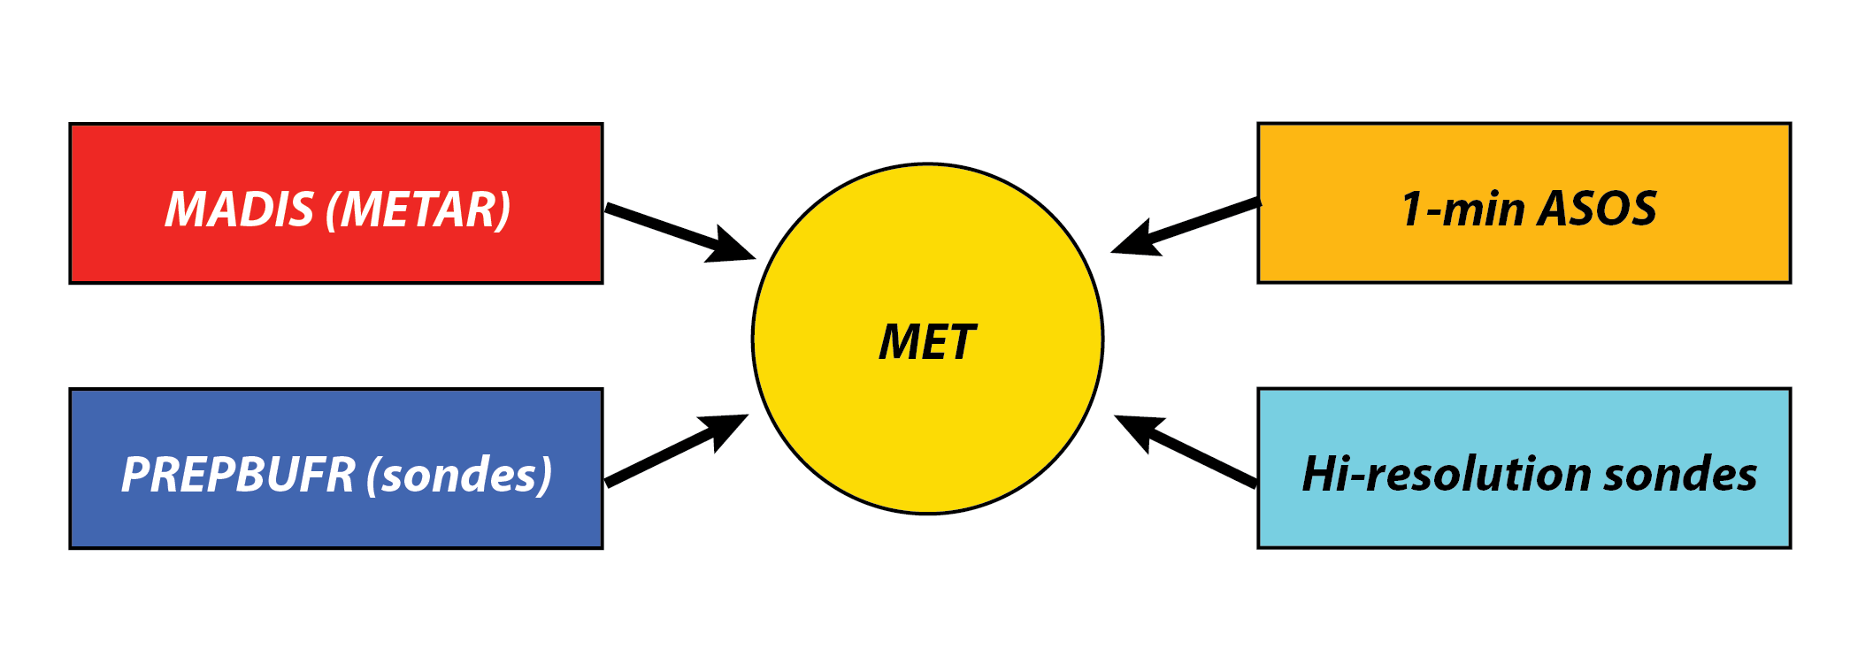
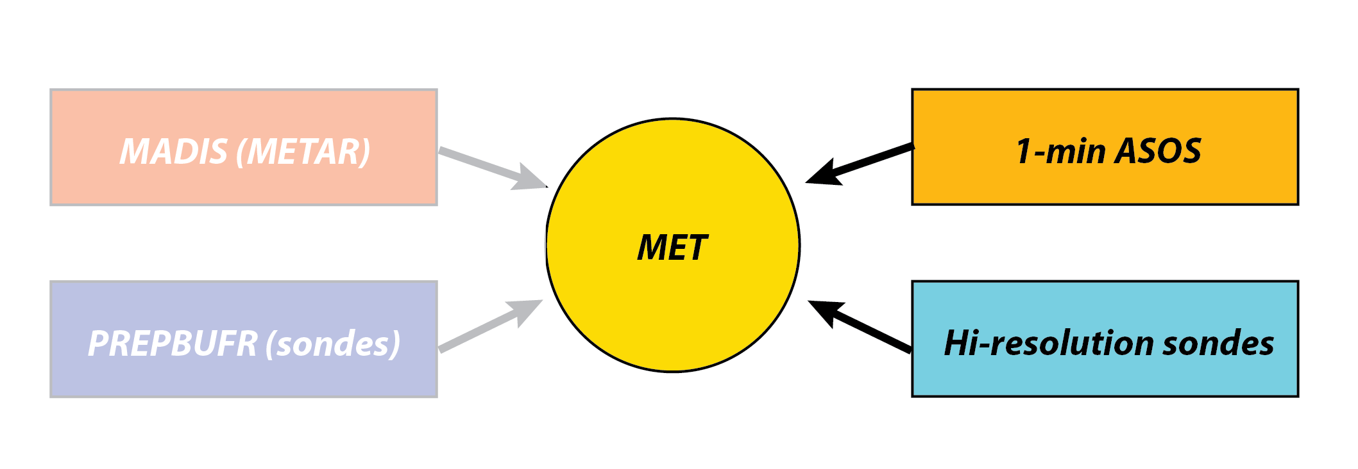
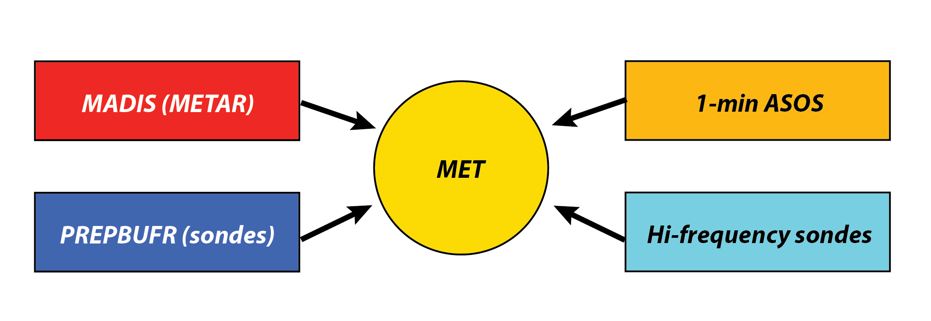
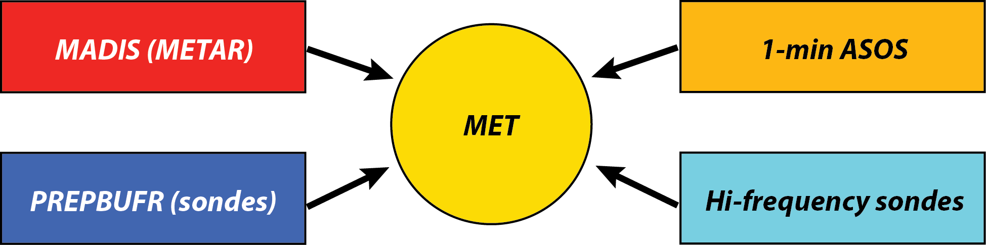
Model evaluation
ASOS stations and radiosondes

Slide 7
Control run: surface met fields
July 2016

Slide 8
Network-averaged 2-m temperature (up to 809 ASOS stations)
Red: observation
White: forecast
Grey: # obs
All ASOS stations
All July 2016 simulations
Notes:
Averaged over 4 time zones
31*800 ~ 25000
After first 12 h, pretty good. No trend. (Remember that)

Slide 9
Network-averaged 10-m wind speed (up to 809 ASOS stations)
Average bias = +0.08 m/s
(excluding initial time)
All ASOS stations
All July 2016 simulations
Notes:
July2016_alb01_ONEMIN_analysis.sas, july2016_ASOS_ONEMIN_analysis.xlsx

Slide 10
Control run – average forecast wind bias
Average bias = +0.08 m/s
Some problems caused by
misclassification over water
Averaged over all forecast hours
July 2016

Slide 11
The bias is (still) biased
N = 755 stations
(Removed stations misclassified over water,
and infrequently reporting sites)
R² = 0.41
r = -0.64
Very similar result in high-res San Diego experiments
See also Cao and Fovell (2016), Fovell and Cao (2014, 2017)
Notes:
Same information from previous slide, but plotted against July-avg obs wind speed

Slide 12
The bias is (still) biased
N = 755 stations
(Removed stations misclassified over water,
and infrequently reporting sites)
R² = 0.41
r = -0.64
Very similar result in high-res San Diego experiments
See also Cao and Fovell (2016), Fovell and Cao (2014, 2017)
Notes:
Same information from previous slide, but plotted against July-avg obs wind speed

Slide 13
Gust factor
Each station has its own GF, which varies with time and reflects its situation and how the observations are taken
Averaged over entire ASOS network, GF ~ 1.3
GF as a proxy for site exposure (as we did for San Diego)
Hypothesis: stations with GF ≠ 1.3 more likely to be over- or underpredicted
Higher GF == positive bias
Demonstrated for compact, high-density mesonet (Fovell and Cao 2014, 2017)
Notes:
Situation = literally: now it is sited

Slide 14
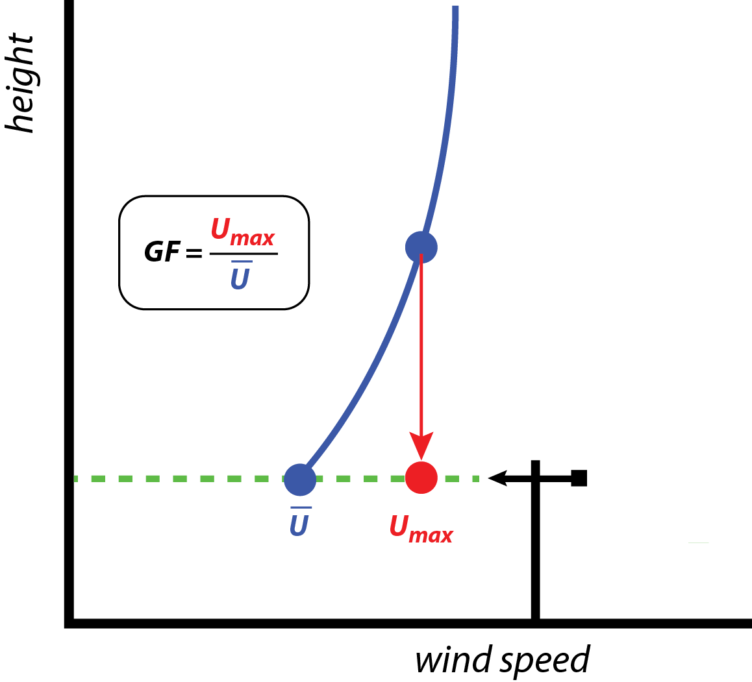
Gust factor and sheltering

Slide 15
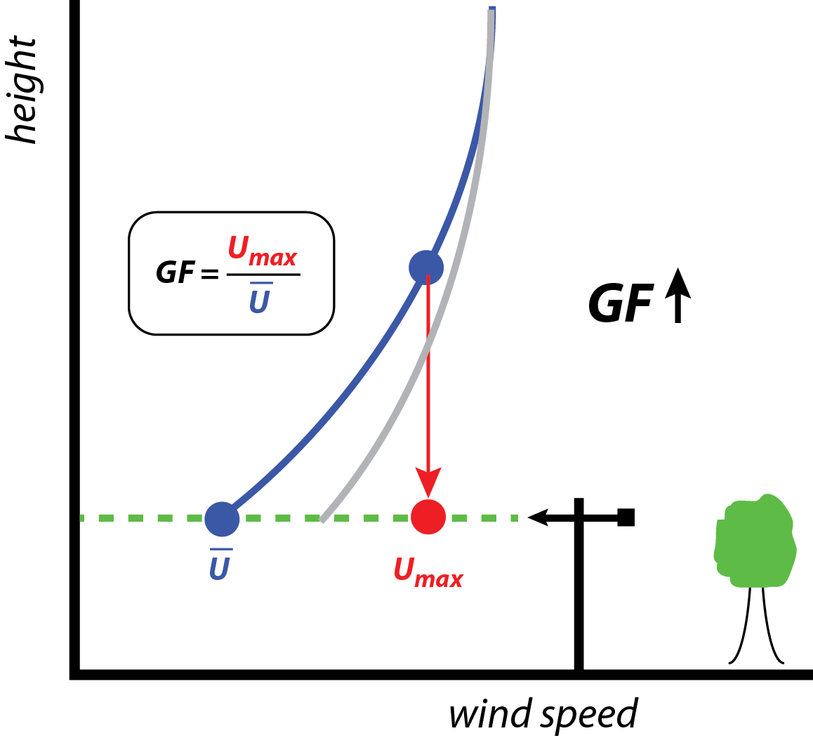
Gust factor and sheltering
Sheltering:
Gust U_{max} decreases
Wind U decreases more
thus, GF rises

Slide 16
Forecast bias vs. observed GF (departures from average)
N = 755 stations
(Removed stations misclassified over water,
and infrequently reporting sites)
R² = 0.35
r = 0.59

Slide 17
Average July gust factors (computed from 1-min data)
N = 755 stations

Slide 18
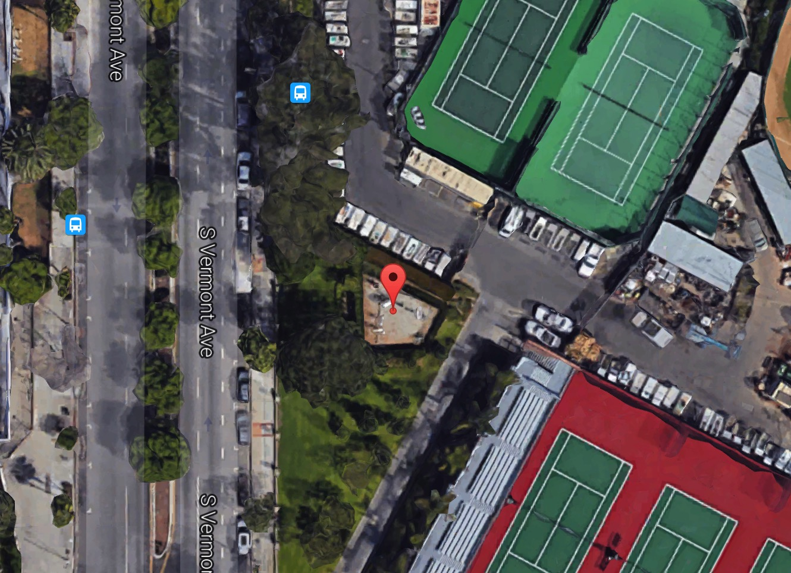
Average July gust factors (computed from 1-min data)
KCQT
(Downtown Los Angeles)
GF = 1.69
Notes:
2nd highest GF; highest is Mt Shasta

Slide 19
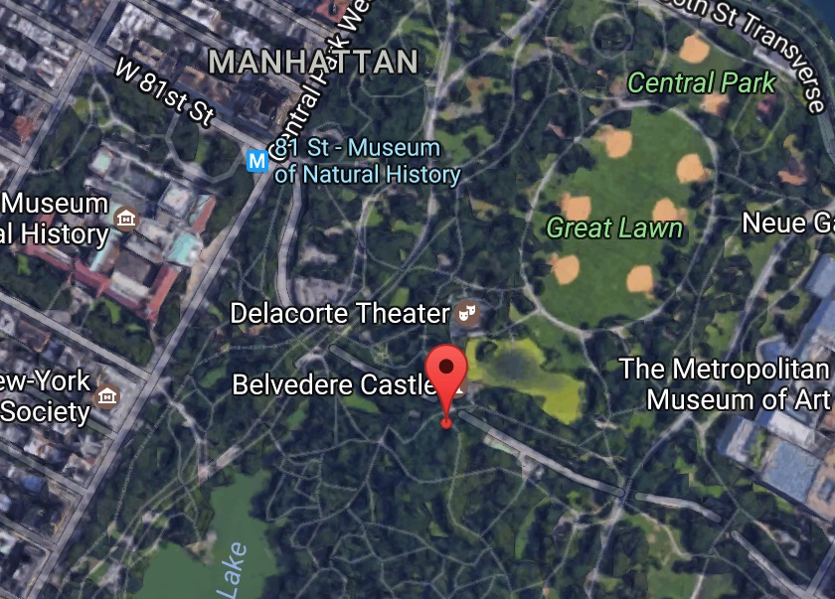
Average July gust factors (computed from 1-min data)
KNYC
(New York Central Park)
GF = 1.65
Notes:
#6
These prove my point but make the analysis a little messier

Slide 20
Stations with GF ≤ 1.4
expect overprediction
1.27
N = 713 stations
(GF < 1.4)
expect underprediction

Slide 21
Stations with GF ≥ 1.4
N = 713 stations
R² = 0.26
r = 0.51

Slide 22
Forecast bias adjusted for GF
The biased forecast bias
largely represents “unfixable” representativeness errors
revealed by the local station gust factor
R² = 0.00
r = 0.00
Notes:
What’s left is not small, but is what should be treated. At least it’s random.

Slide 23
Above-surface met fields
July 2016

Slide 24
Control run
850 mb T
Radiosondes
N = 72
Erroneous warming trend
Red: observation
White: forecast
Grey: # obs
2 m T
ASOS stations
N = 809
No error trend

Slide 25
Control run
850 mb T
Radiosondes
N = 72
700 mb T
Radiosondes
N = 72

Slide 26
Great Plains subset
High-resolution radiosondes

Slide 27
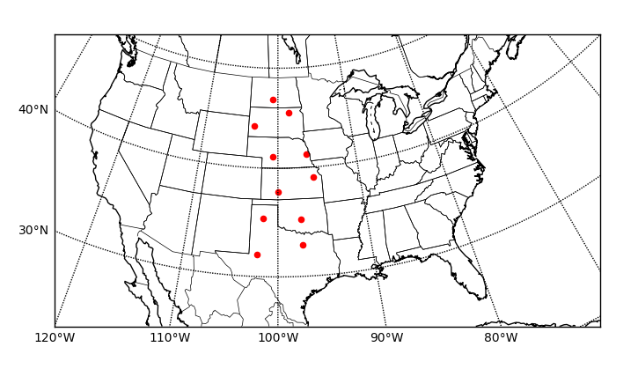
Great Plains subset N = 11
Notes:
From Midland, TX, to Bismark, ND
At least one station, Rapid City, is in different time zone

Slide 28
Potential temperature 00Z for control run (MYJ/KF/Noah)
All 00Z forecasts for
July 2016
(1364 obs)
Red: observation
White: forecast
Grey: ±1 std dev
Great Plains subset
Notes:
6PM CDT

Slide 29
Control run
(MYJ/KF/Noah)
MYJ/KF/Noah
← Lowest 600 m, semi-log scale
Notes:
HIFREQ_July2016_analysis.xlsx, Sheet1

Slide 30
MYJ/KF/Noah
Notes:
HIFREQ_July2016_analysis.xlsx, Sheet1

Slide 31
MYJ/NT/Noah

Slide 32
YSU/KF/Noah

Slide 33
YSUmod/KF/Noah
Notes:
YSUmod – no countergradient term on momentum

Slide 34
MYNN2/KF/Noah
Notes:
MYNN2 in this case used sfclay=1

Slide 35
ACM2/KF/PX

Slide 36
ACM2/KF/Noah
Notes:
PX usually has a cold bias. IN this case, the cold bias mitigates the model’s “natural” warm bias, so it’s not the right answer for necessarily the right reason

Slide 37
Great Plains subset at 12Z
Notes:
6AM CDT

Slide 38
MYJ/KF/Noah

Slide 39
YSU/KF/Noah
Notes:
YSUmod - almost no diff at night

Slide 40
MYNN2/KF/Noah

Slide 41
ACM2/KF/PX

Slide 42
~150 m
Systematic biases with respect to jet elevation
and change of bias sign suggests nocturnal mixing too weak

Slide 43
Summary
20 km CONUS physics ensemble reveals
10-m wind forecast bias explained by local gustiness/exposure, at least for ASOS stations
Many runs have spurious warming trend above surface
Sensitive to land surface model and convective parameterization (not shown here)
Most physics combinations overpredict T in boundary layer during daytime, and appear to mix too little at night
“What starts at the surface does not stay at the surface” (surface T biases, day and night, influence PBL stability and structure, as anticipated)

