Slide 1
Shallow cumulus evaluated with the LASSO (ensemble LES) framework
Wayne M. Angevine, Joe Olson, and Jaymes Kenyon
CIRES, University of Colorado, and NOAA ESRL
Outline:
What and why is LASSO?
The shallow cumulus challenge
Results
Areas for improvement

Slide 2
What and why LASSO?
Shallow cumulus present an ongoing challenge to WRF.
A variety of physics options intend to represent these clouds.
Finding a good configuration is complicated by the lack of good observations.
The DOE ARM project LASSO now provides several cases with shallow cumulus (alpha 1 used here) .
Cases are based on observations at the ARM Southern Great Plains site.
For each case, an ensemble of large eddy simulations were run using different initial conditions and advection terms.
A major advantage of LASSO is that we can distinguish between differences that are due to uncertainties in the case setup, versus those that are unambiguously caused by the WRF schemes themselves.
This presentation: WRF single-column tests using the LASSO framework
MYNN PBL with EDMF
TEMF PBL

Slide 3
EDMF schemes for PBL and shallow Cu
Originated with Pier Siebesma and Joao Teixeira about year 2000
Eddy Diffusion and Mass Flux in both subcloud and cloud layers
Mass flux provides non-local transport in convective BL (with or without cloud) and natural representation of BL-rooted clouds
Many EDMF schemes are in use for research and operations, mostly in Europe
Cloud top
h_{d}
LCL

Slide 4
MYNN-EDMF: Dynamic Multi-Plume Model
An attempt to explicitly model plumes of various sizes that are likely to exist in a given atmospheric state, following Neggers (2015, JAMES) and Suselj et al. (2013, JAS).
Total maximum number of plumes possible in a single column: 10.
Diameters ($ℓ$): 100, 200, 300, 400, 500, 600, 700, 800, 900, and 1000 m.
Lateral entrainment varies for each plume $∝$ ($wℓ$)⁻¹.
Plumes condense only if they surpass the lifting condensation level (LCL).
The scheme also includes “subgrid stratus” from a statistical diagnosis, quasi-independent from the MF clouds
LCL
Model grid column

Slide 5
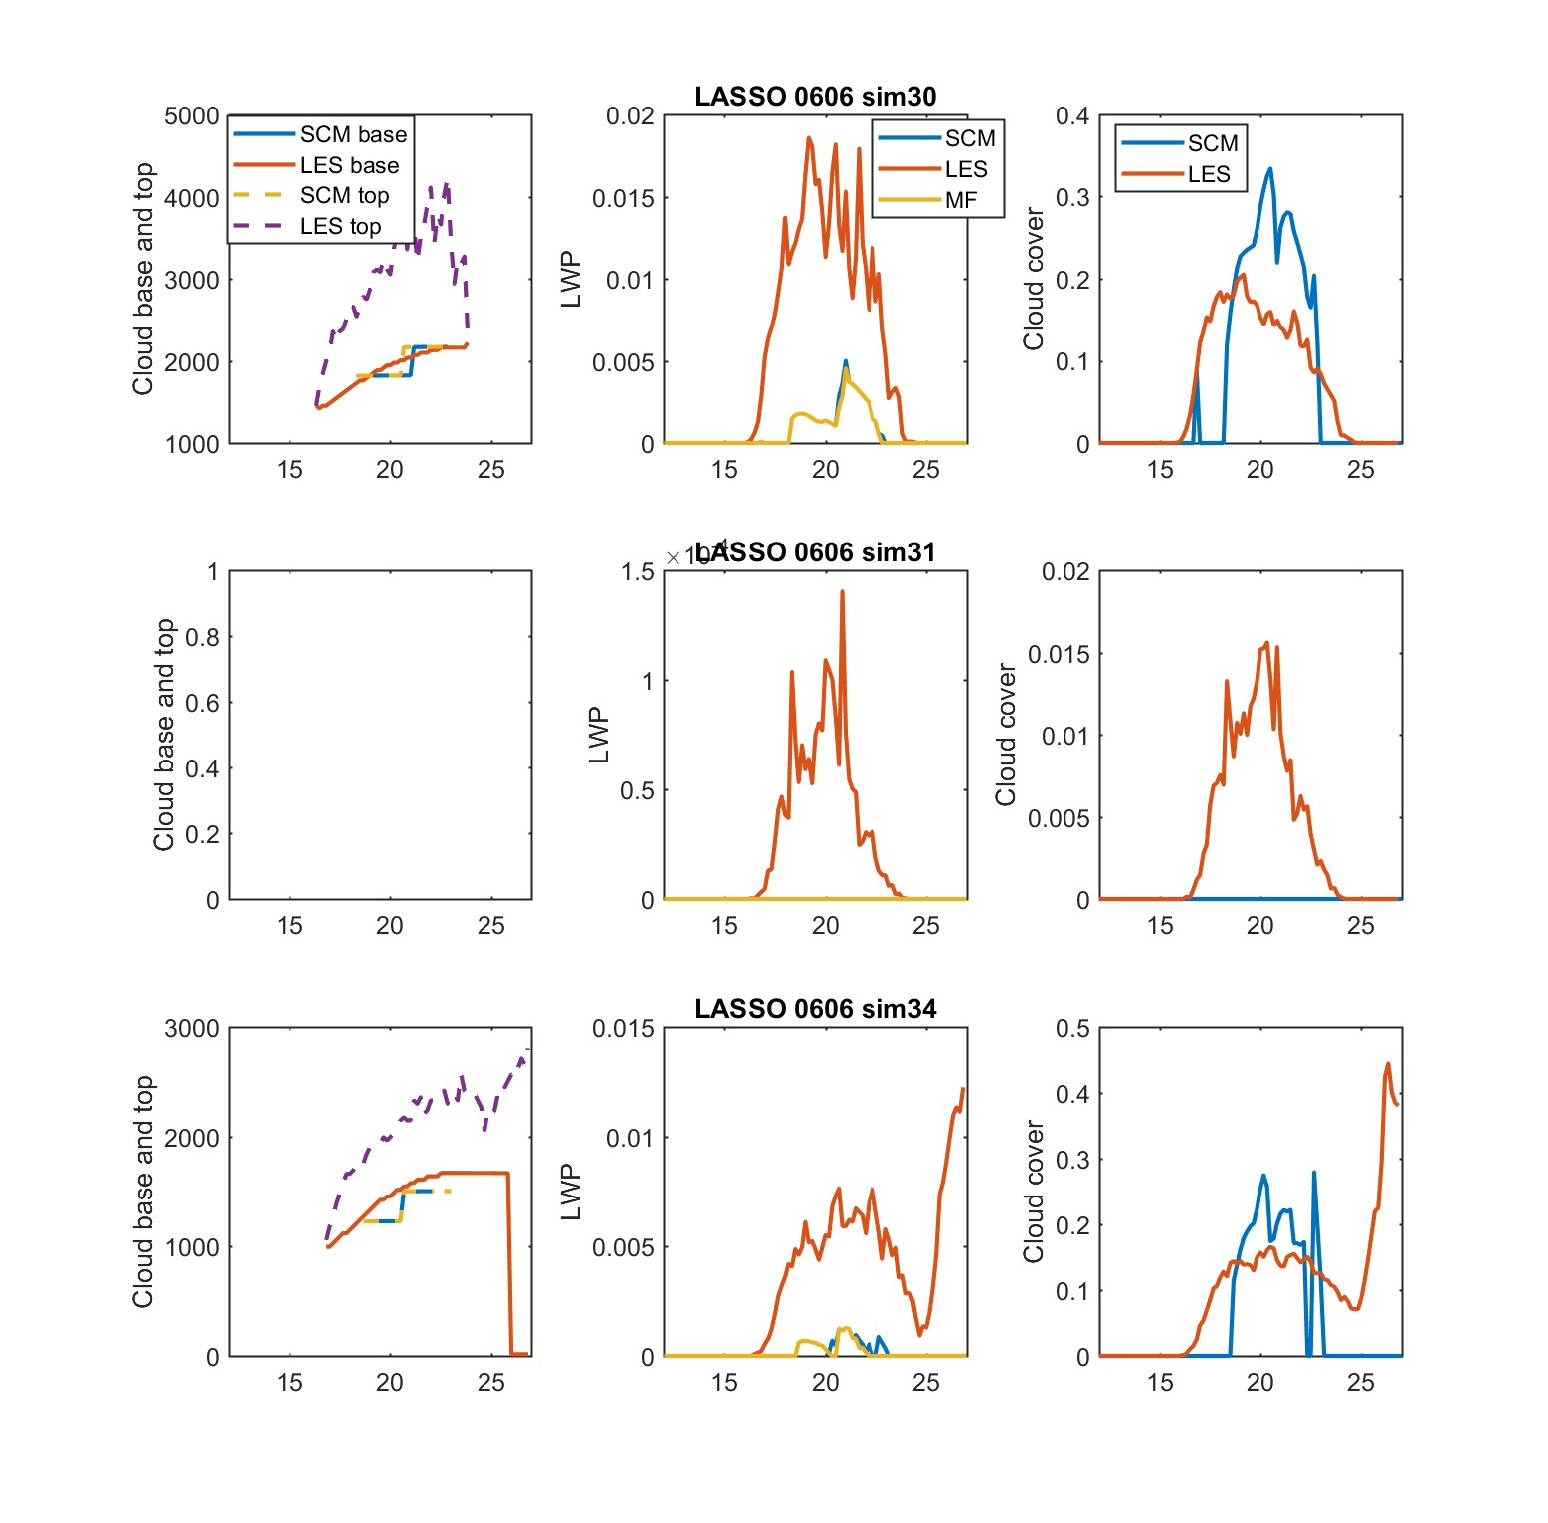
6 June case Cloud characteristics
Mass flux cloud only
Each day has 30+ LES simulations with different model, intial, and boundary conditions
All simulations are “good”, using well-developed analyses based on observations
I chose three simulations for each day, all with WRF LES.
Initial, boundary conditions and forcing all the same source:
sim30 VARANAL
sim31 MSDA
sim34 ECMWF
Note varying vertical scales!
1.5e-4
Tenuous cloud in LES,
None in SCM
Time UTC

Slide 6
6 June case Cloud characteristics
Mass flux cloud only
Different simulations are very different in cloud cover and LWP
Features to note:
SCM cloud base low
Top also low
Onset late
LWP underestimated
Cloud cover good
1.5e-4
Tenuous cloud in LES,
None in SCM

Slide 7
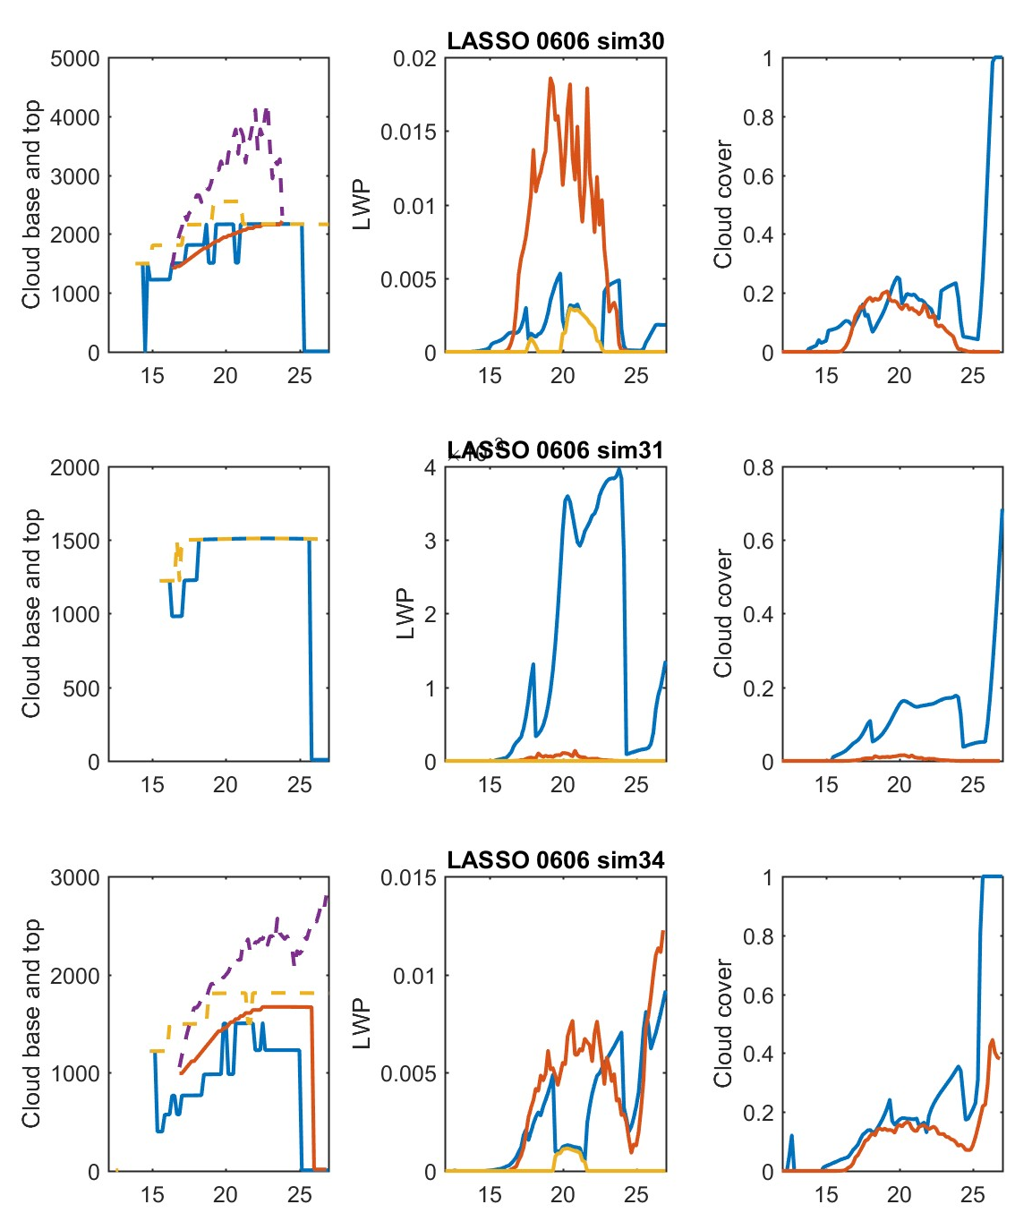
6 June case Cloud characteristics
Subgrid stratus cloud included
Adding subgrid stratus within MYNN-EDMF
Onset time much improved
Tenuous cloud in sim31 now present, but too much
SCM cloud base and top still low
LWP improved
Cloud cover good
Fog forms late in run
4e-3
Tenuous cloud in LES

Slide 8
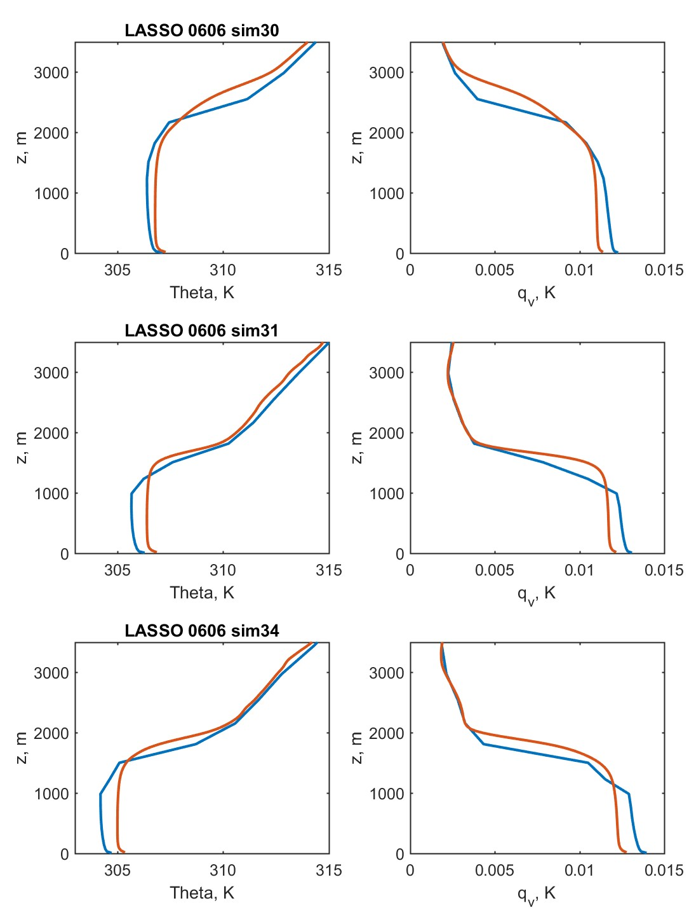
6 June case Profiles
Different simulations have very different boundary layer heights and surface temperatures
SCM generally:
Too cool
Too moist
Too shallow
Not smooth (vertical resolution)

Slide 9
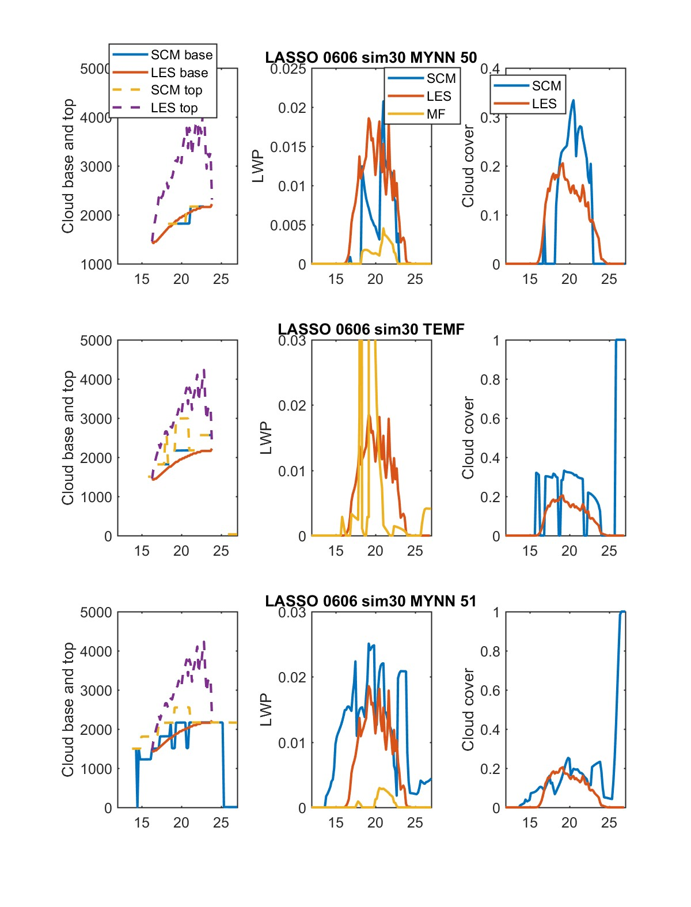
6 June case Cloud characteristics
Comparing MYNN-EDMF with TEMF
TEMF:
Onset time better
Cloud base a bit high
Cloud top better
Spikes of LWP up to 1
PBL very warm (not shown) – forcing issue?

Slide 10
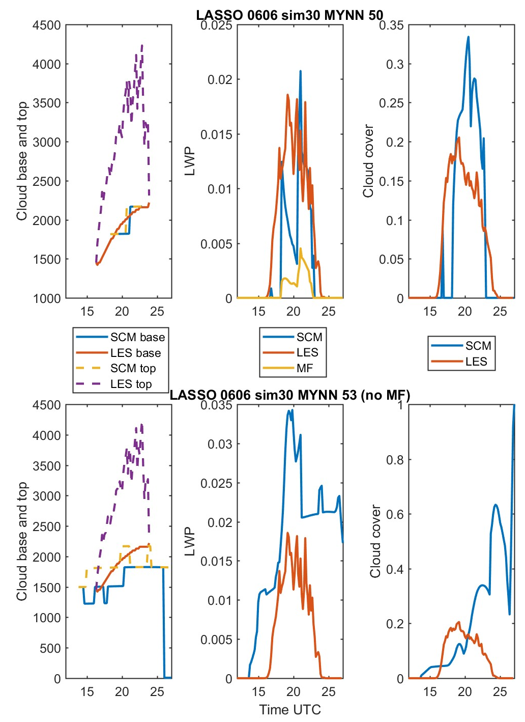
6 June case Cloud characteristics
What happens if mass flux is turned off completely?
Onset time too early
Cloud base too low
Cloud top too low
LWP and cloud cover too large

Slide 11
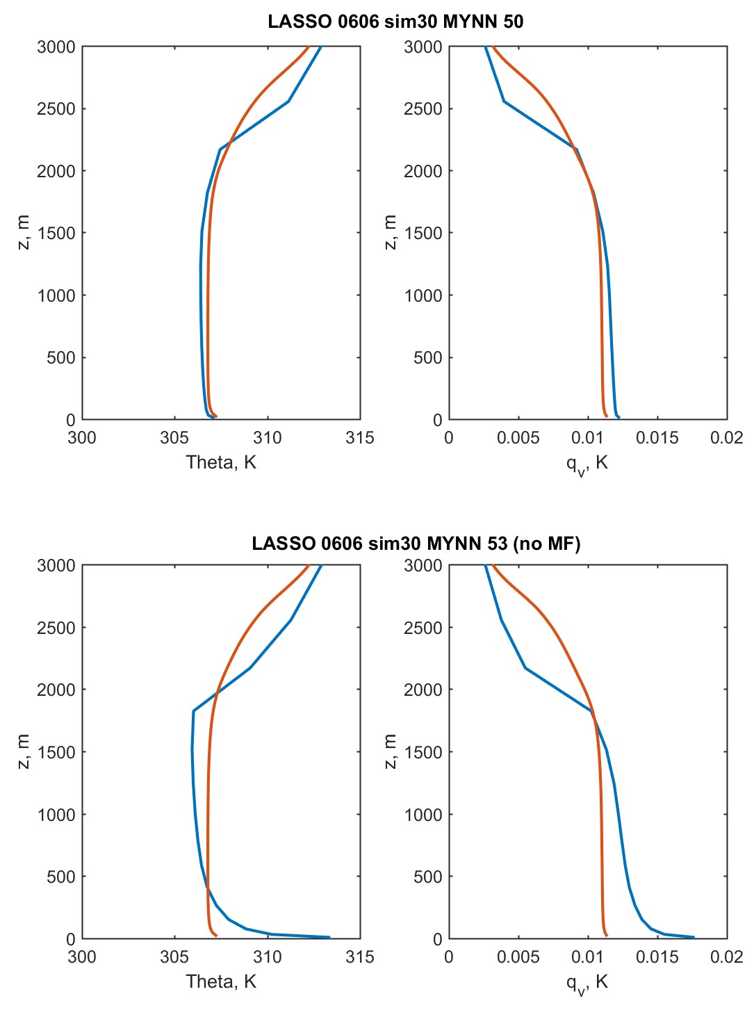
6 June case profiles (no MF)
What happens if mass flux is turned off completely?
Typical profiles for a purely local PBL scheme:
Too warm and moist near surface
PBL top too low, inversion too sharp

Slide 12
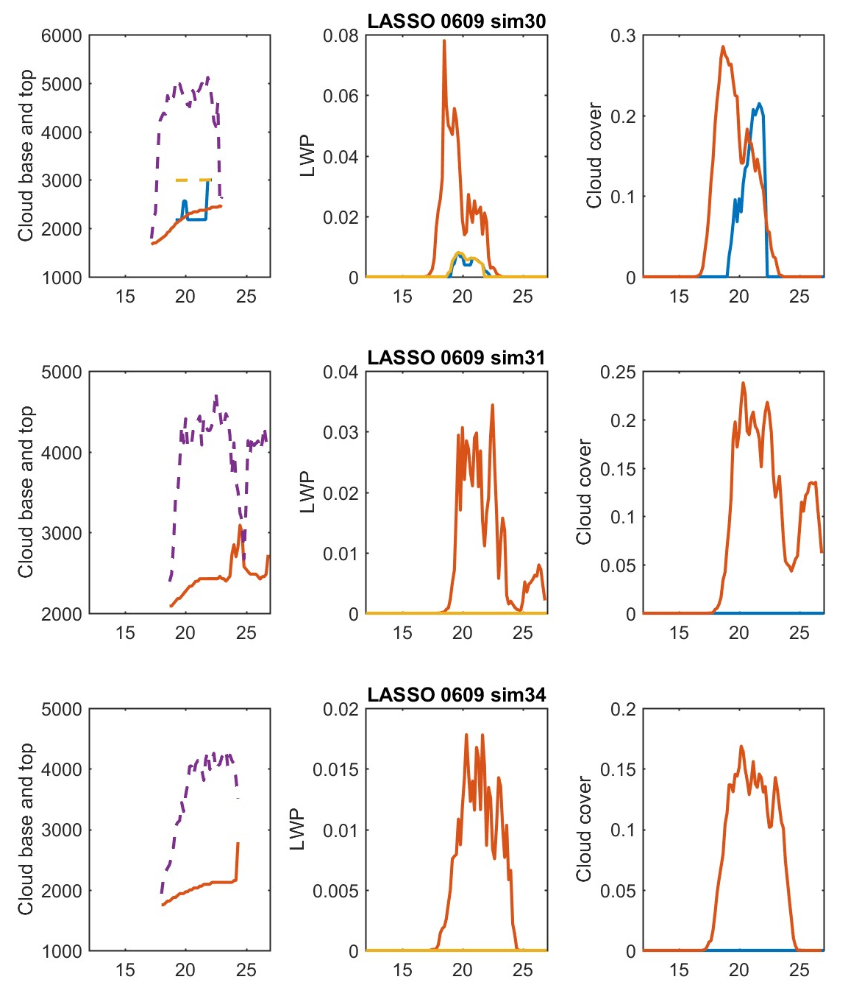
Next case : 9 June Cloud characteristics
Mass flux cloud only
Different simulations are very different in cloud cover and LWP
Features to note:
No mass-flux cloud in SCM in two simulations with weaker cloud in LES – is there a threshold?
Cloud base low
Top also low
Onset late
LWP underestimated
Cloud cover OK
No cloud in SCM
Time UTC

Slide 13
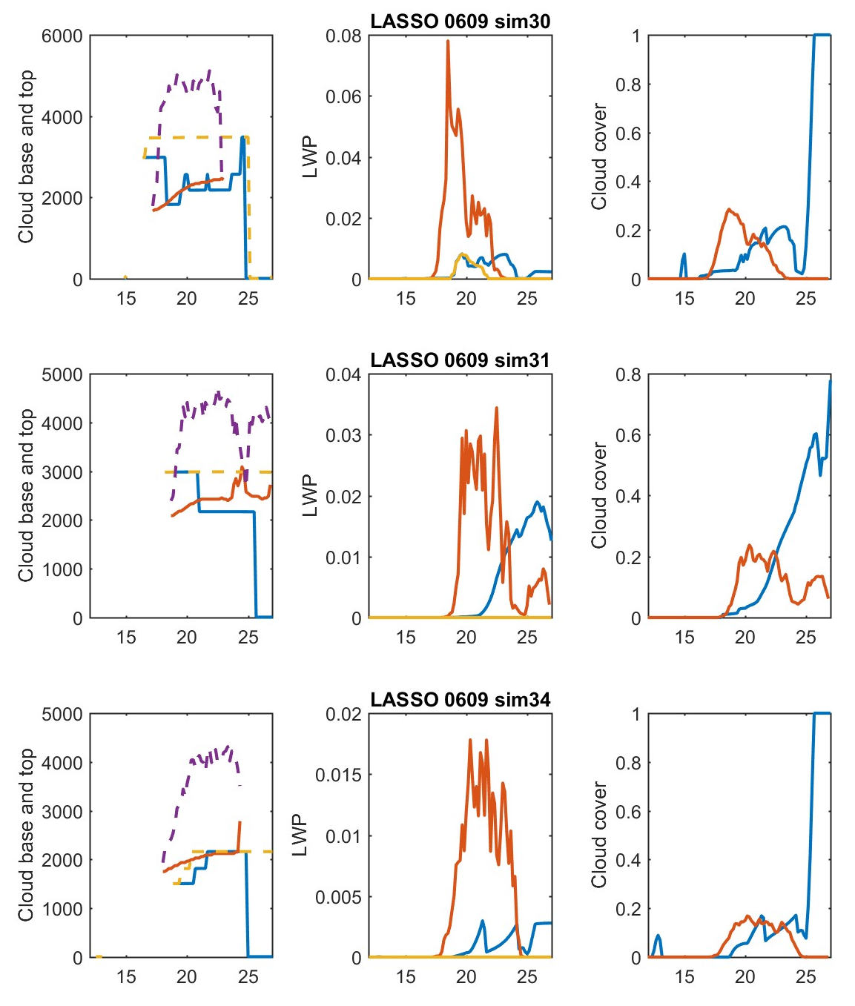
Next case : 9 June Cloud characteristics
Subgrid stratus cloud included
With subgrid stratus included
Cloud base low
Top also low
Onset still late
LWP underestimated
Cloud cover magnitude reasonable, but timing off (too much cloud cover late)
Time UTC

Slide 14
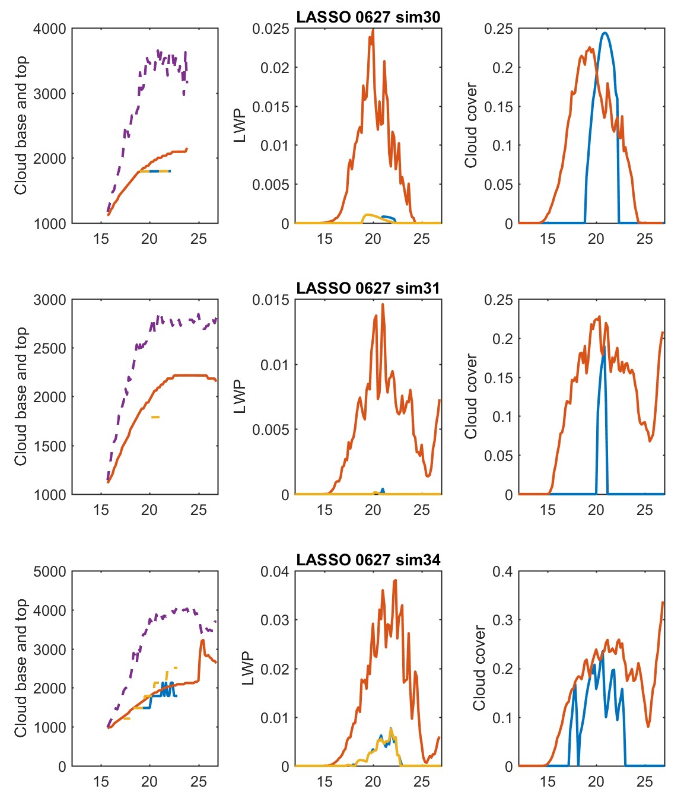
Third case : 27 June Cloud characteristics
Mass flux cloud only
No mass-flux cloud in SCM in sim31 with weak cloud in
Cloud base low
Top also low
Onset late
LWP underestimated
Cloud cover OK
No cloud in SCM
Time UTC

Slide 15
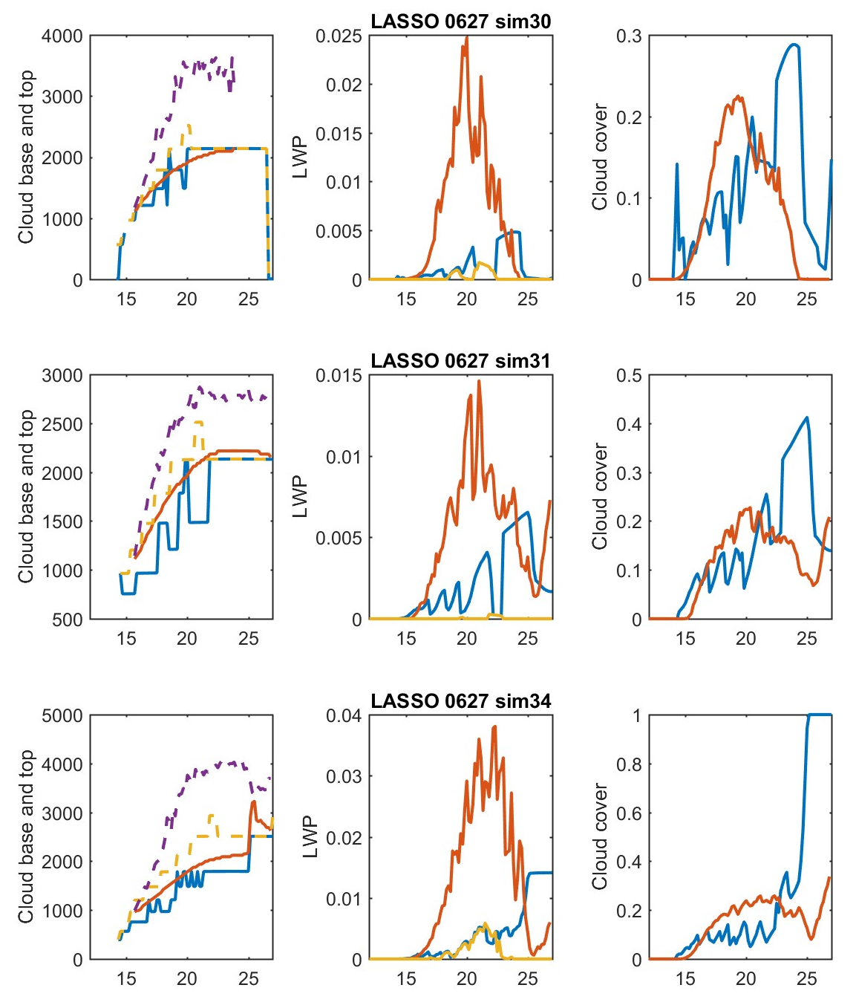
Third case : 27 June Cloud characteristics
Subgrid stratus cloud included
With subgrid stratus included
Cloud base low
Top also low
Onset OK
LWP underestimated
Cloud cover magnitude reasonable, but timing off (too much cloud cover late)
Time UTC

Slide 16
Summary
MYNN-EDMF is doing a reasonable job with these challenging cases, and much better than any PBL scheme unaware of clouds
LASSO provides us with process information that will allow for targeted action
Major differences between simulations based on different “good” analyses
We have only looked at a few of the many degrees of freedom in setup
General weaknesses of MYNN-EDMF with mass flux cloud only:
No mass-flux cloud in SCM in simulations with weaker cloud in LES – is there a threshold?
Cloud base low
Top also low
Onset late
LWP underestimated
PBL too cool, moist, and shallow
Profiles not smooth (vertical resolution?)
With subgrid stratus included:
Onset timing often improved
LWP underestimation reduced, but timing off (too much cloud cover late)
Need to improve consistency between MF cloud and subgrid stratus

