Slide 1


Coupled mesoscale-LES modeling to improve the representation of stably stratified atmospheric boundary layers
Domingo Muñoz-Esparza
Branko Kosović, Jeremy Sauer, Julie Lundquist
June 13th 2017
18th WRF Users’ Workshop, Boulder, CO

Slide 2
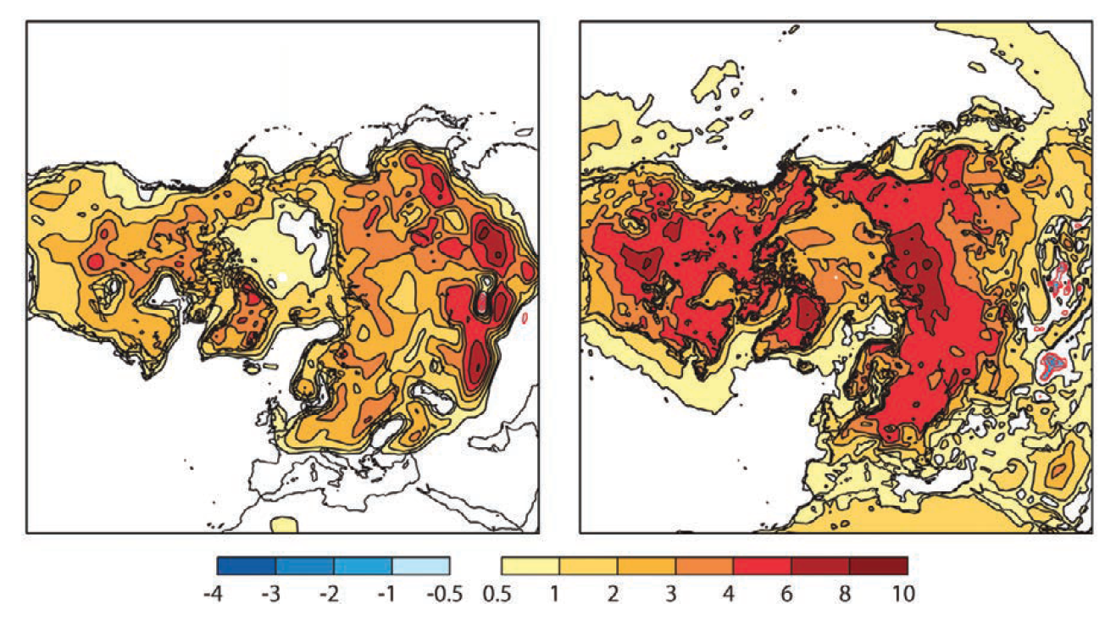
The stable ABL: “still” a challenge
Modeling of stably stratified ABLs in Numerical Weather Prediction (NWP) models remains a difficult task:
Low-level jets
Gravity waves
Turbulence intermittency
Kelvin–Helmholtz instabilities…
NWP sensitivity to mixing formulation in stable conditions
2-m temperature differences
Tight coupling between boundary layer and surface processes (soil, snow,…)
Model’s sensitivity is increasing, also making more difficult for new parameterizations not to diminish overall performance
ECMWF 1994
ECMWF 2011
Holtslag et al., BAMS (2013)
1/11

Slide 3
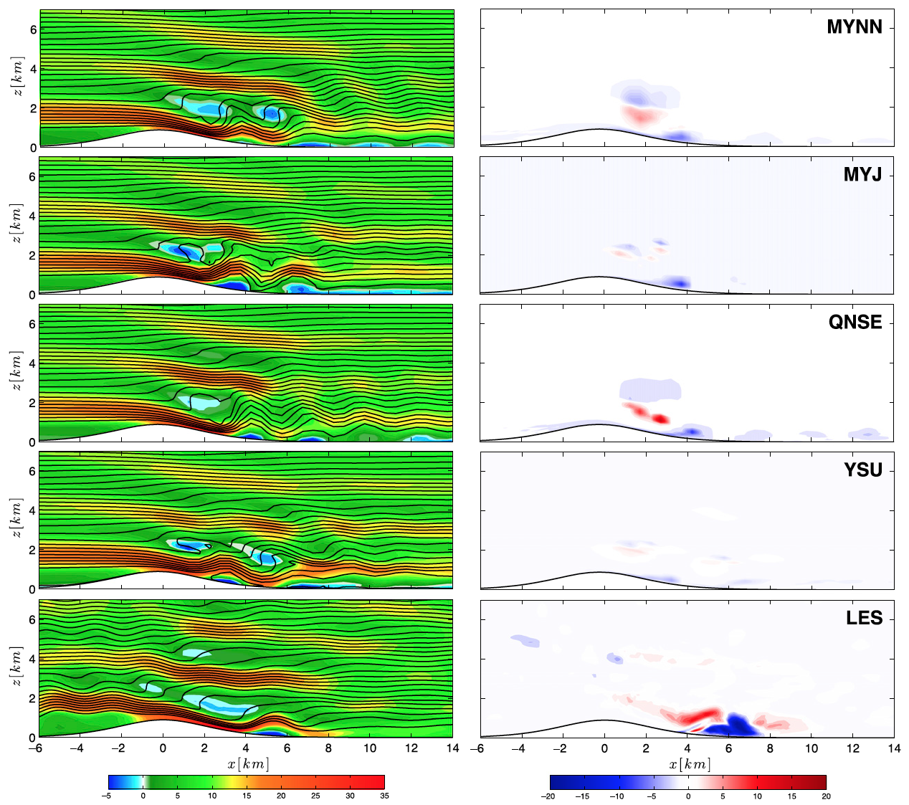
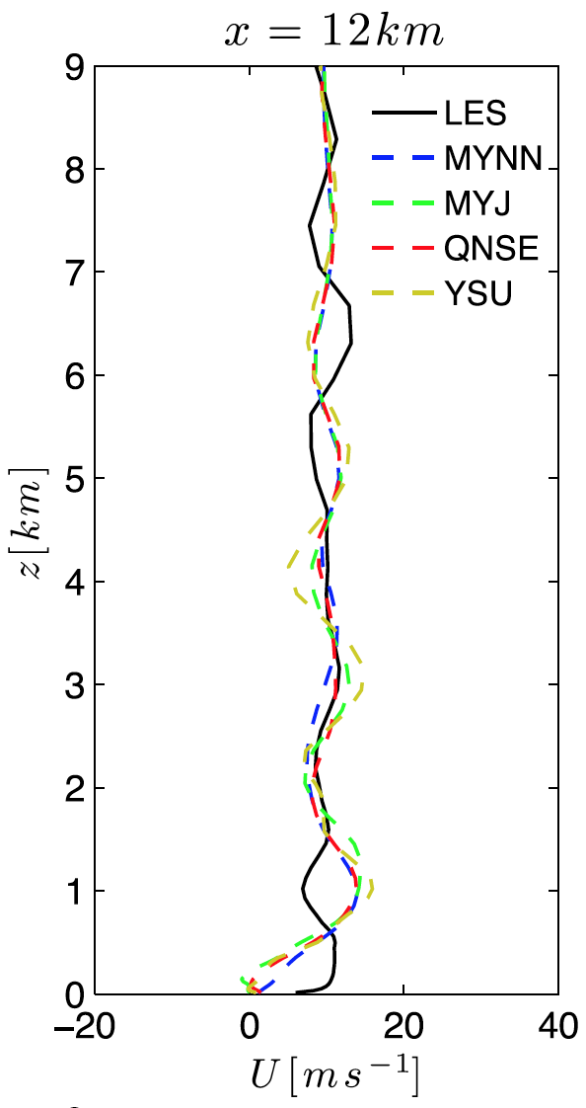
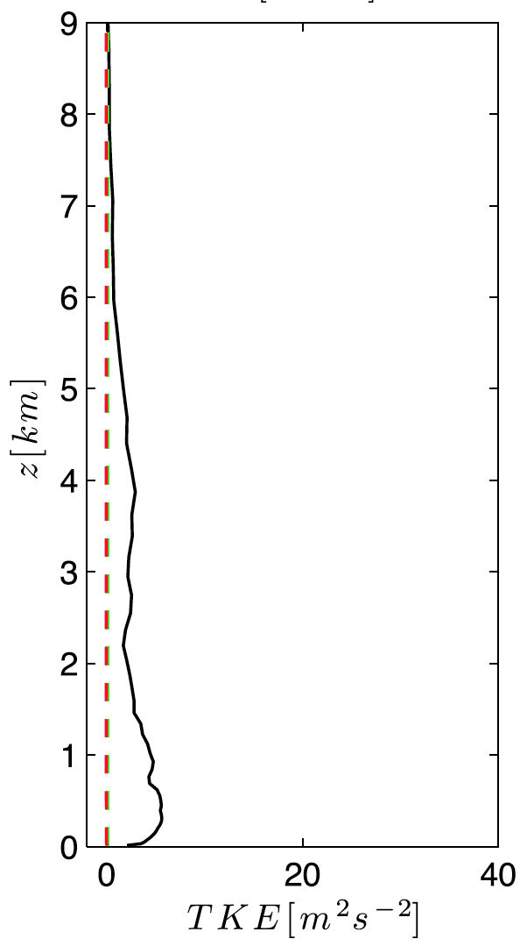
One-dimensional closure in PBL schemes
The lack of a three-dimensional turbulence parameterization induces errors in the presence of topography
Velocity
Momentum flux
Muñoz-Esparza et al., JAS (2016)
2/11

Slide 4
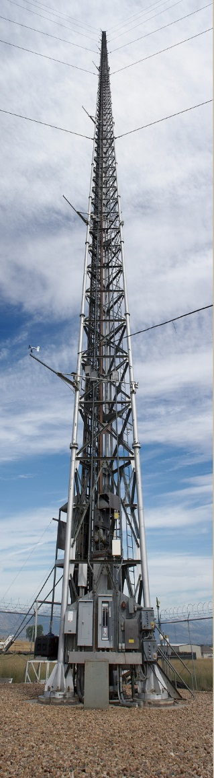
WRF mesoscale modeling during XPIA
Turbulent kinetic energy at the BAO tower during the XPIA campaign [Lundquist et al. BAMS (2017)] puts into evidence the limitations of 1D PBL schemes
March 2015, z = 50 m
BAO tower
Muñoz-Esparza et al., MWR (2017, submitted)
3/11

Slide 5
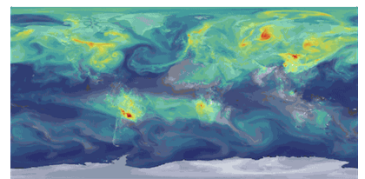
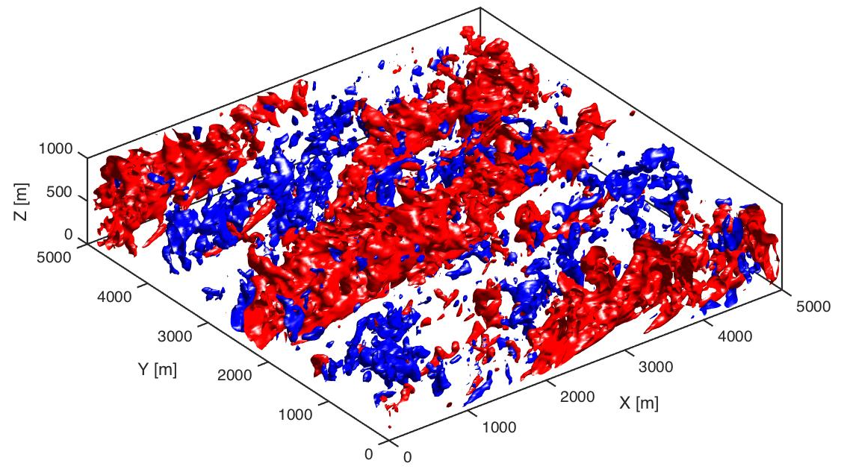
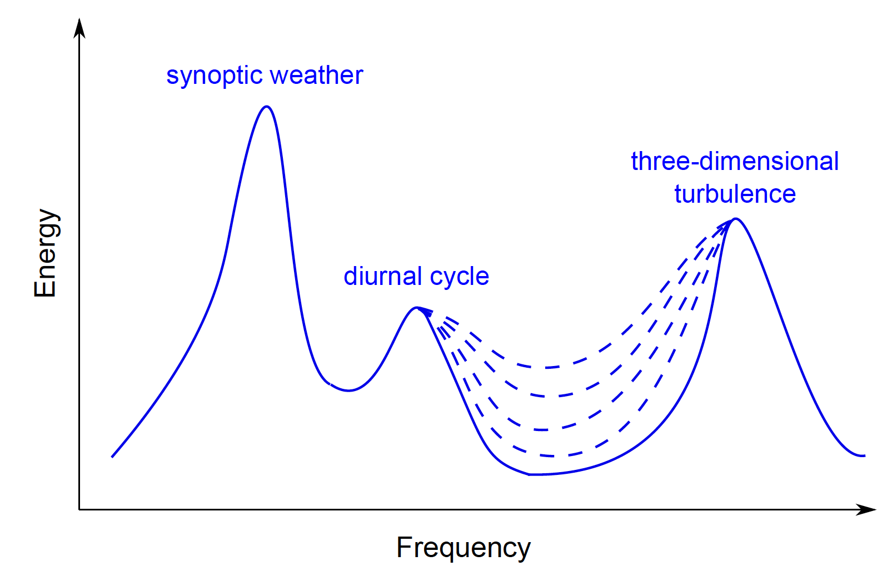
Coupled mesoscale-LES modeling
5 km
Length:
10⁷
10⁶
10⁵
10⁴
10⁻²
Wavenumber:
10⁻⁷
10⁻⁶
10⁻⁵
10⁻⁴
10²
NWP domain
LES domain
“terra
incognita”
Wyngaard
JAS 2004
Δ≈1km
Δ≈100m
4/11

Slide 6
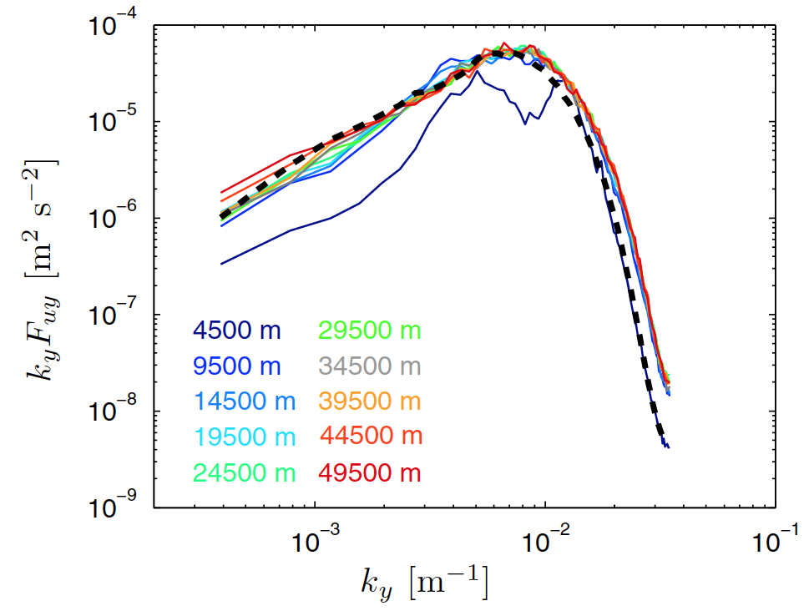
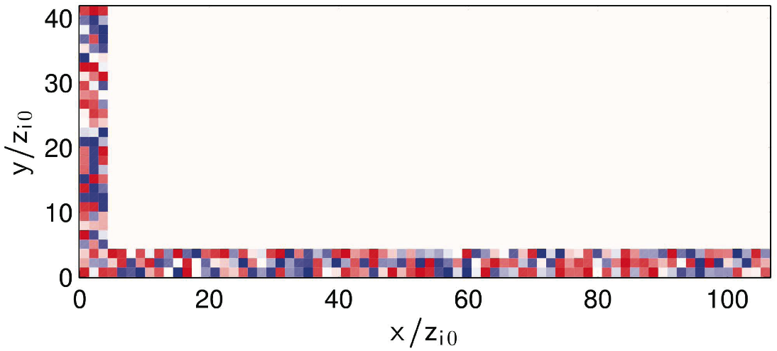
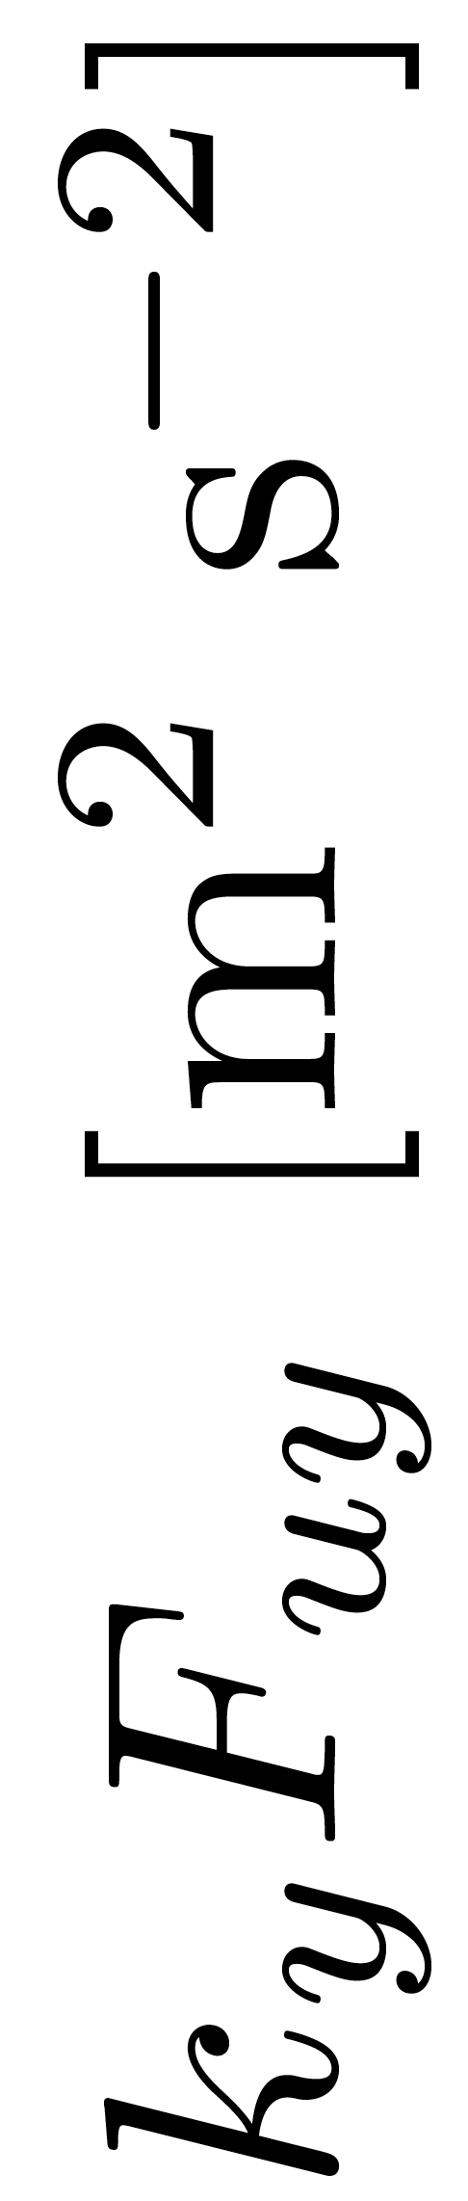
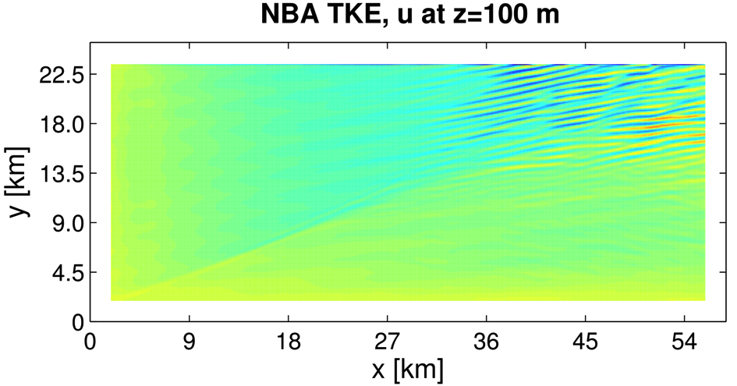
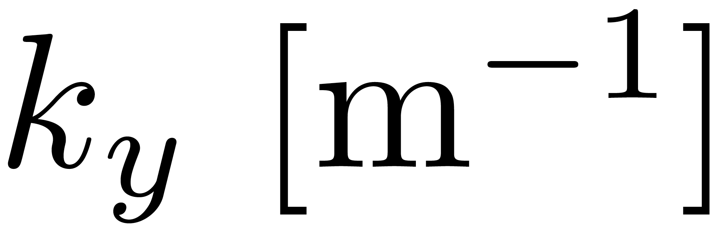
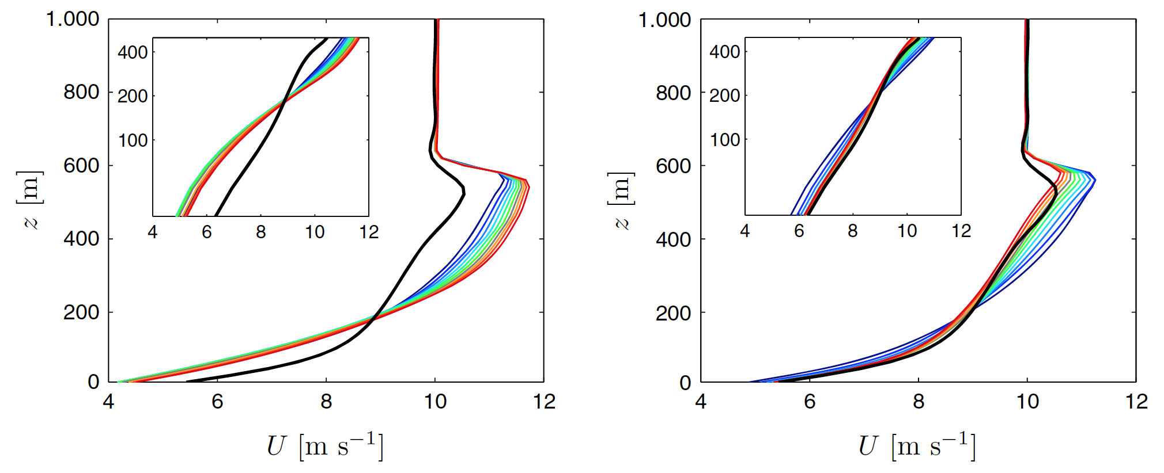
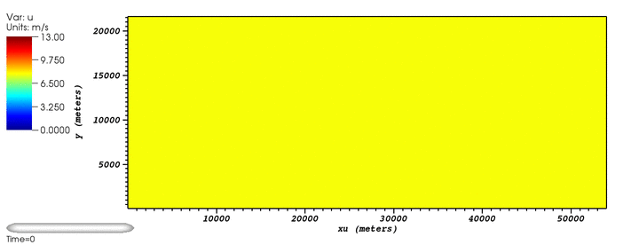
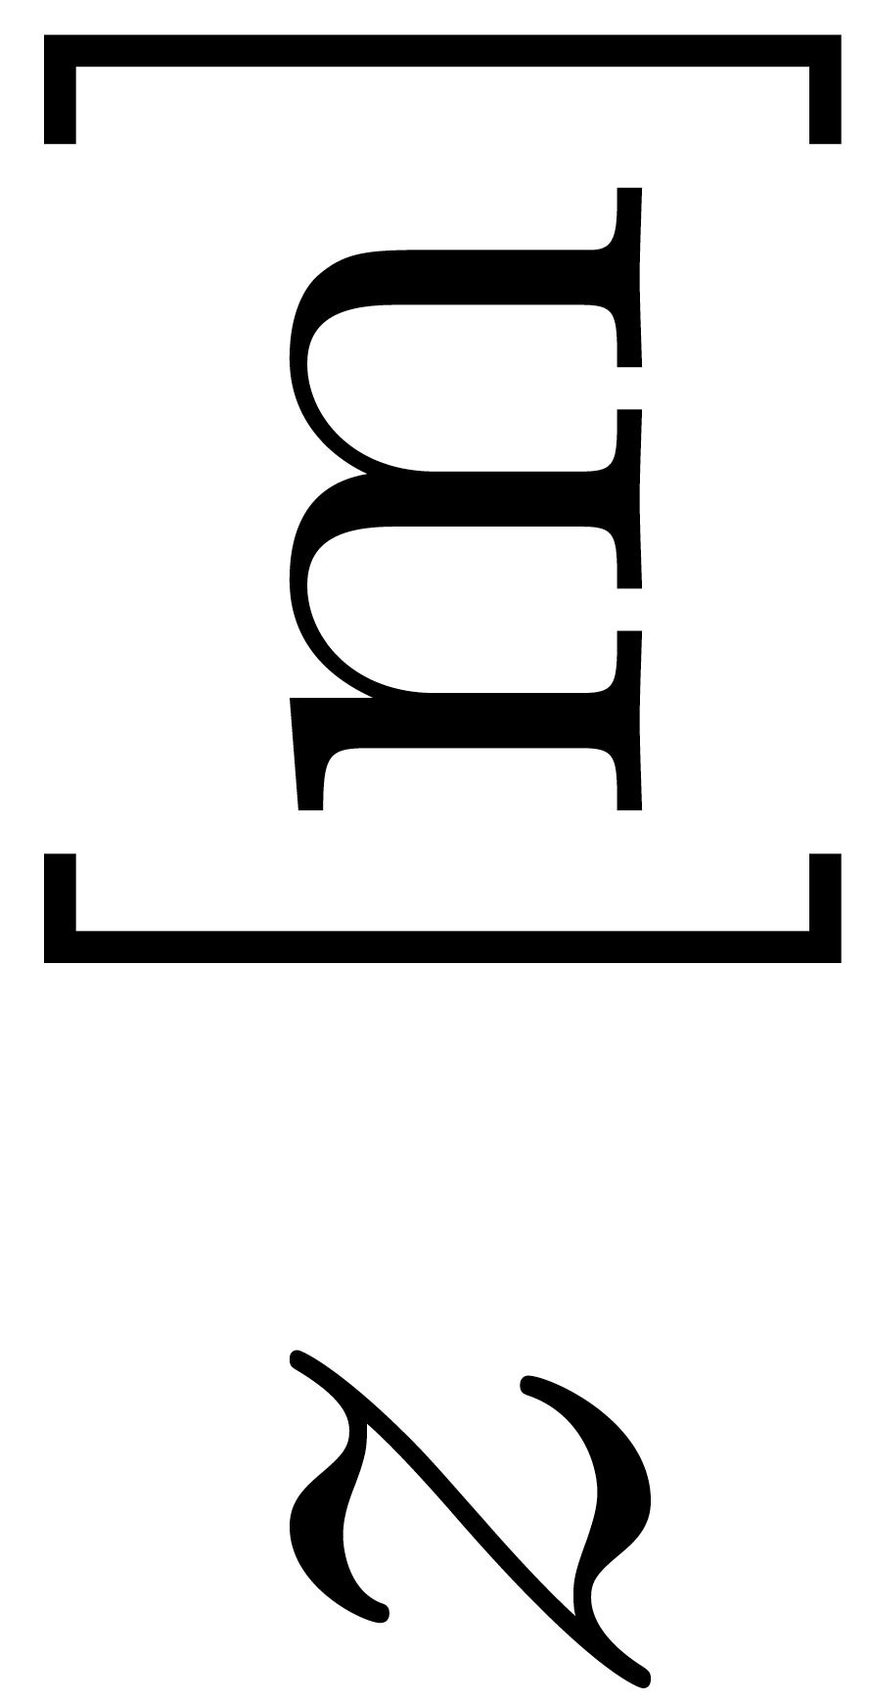
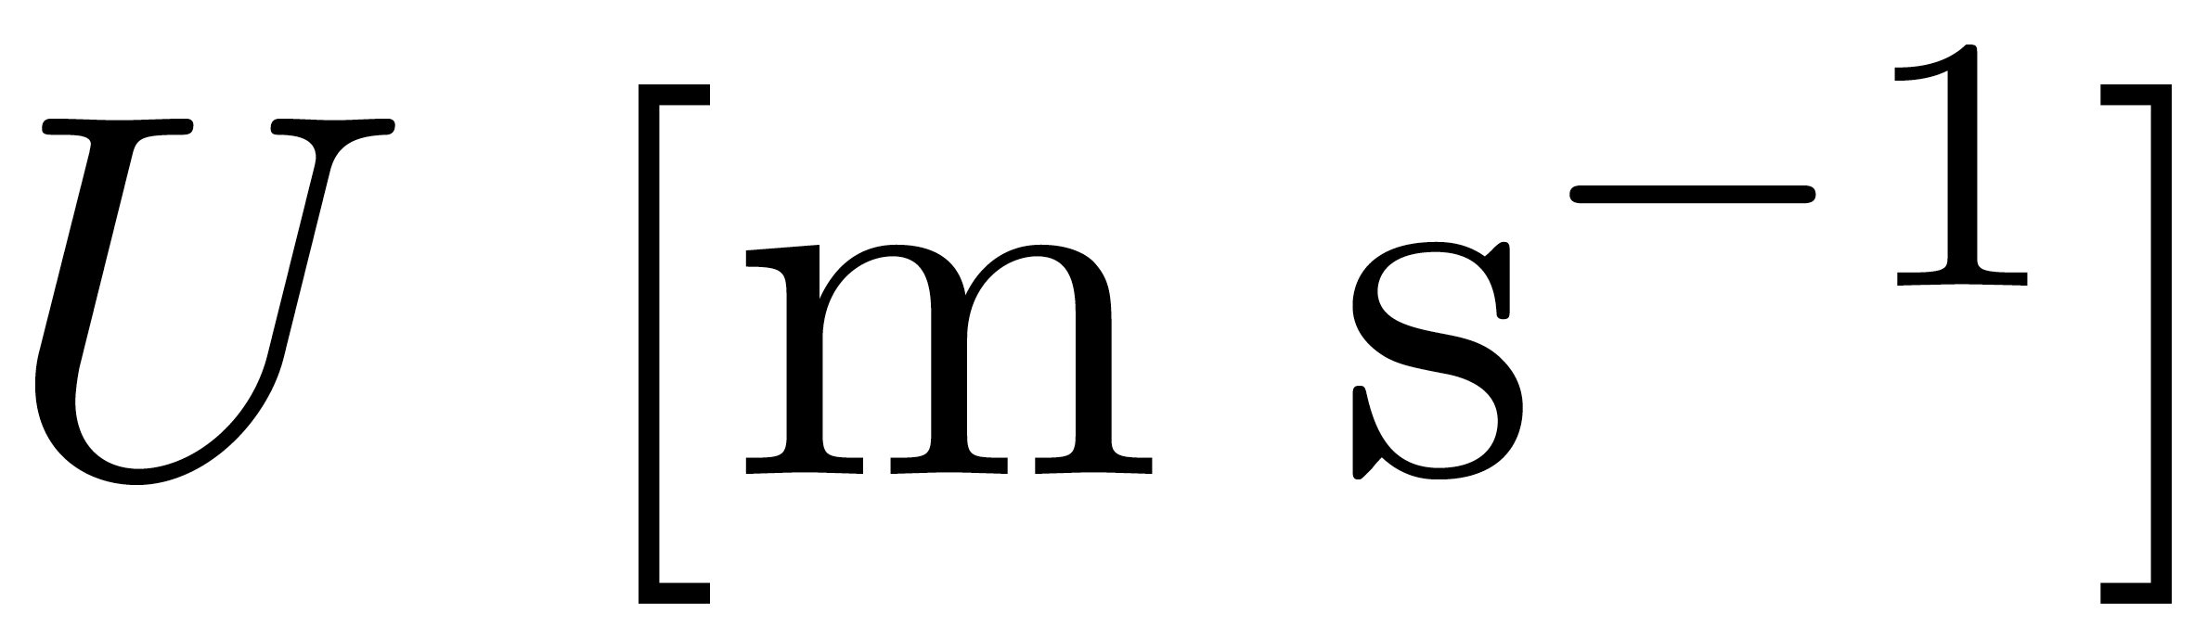
Mesoscale-LES transition
“Cell perturbation method”: Stochastic potential temperature perturbations within LES domain (near inflow region) [Muñoz-Esparza et al. BLM2014, POF2015]
FLOW
NO TURBULENCE GENERATOR
CELL PERTURBATION
NO TURBULENCE
CELL PERTURBATION
Accelerated transition to developed turbulence
Correct wind speed profile is achieved
Muñoz-Esparza et al., BLM (2014); POF (2015)
5/11

Slide 7
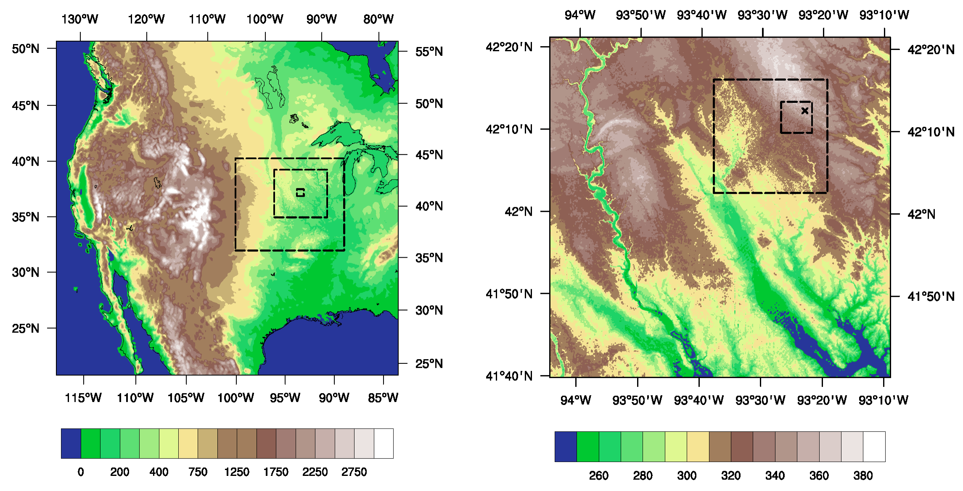
WRF multiscale modeling of a diurnal cycle
Crop Wind Energy Experiment (CWEX-13): 26th of August, 2013
7 km
75 km
 | Mesoscale (MYNN) |  |  | LES
 | d01 | d02 | d03 | d04 | d05
dx, dy (m) | 8910 | 2970 | 990 | 90 | 8.2
dz (m) | 73 grid points [10m-142m < 2 km, 42 grid points]
Muñoz-Esparza et al., JAMES (2017)
6/11

Slide 8
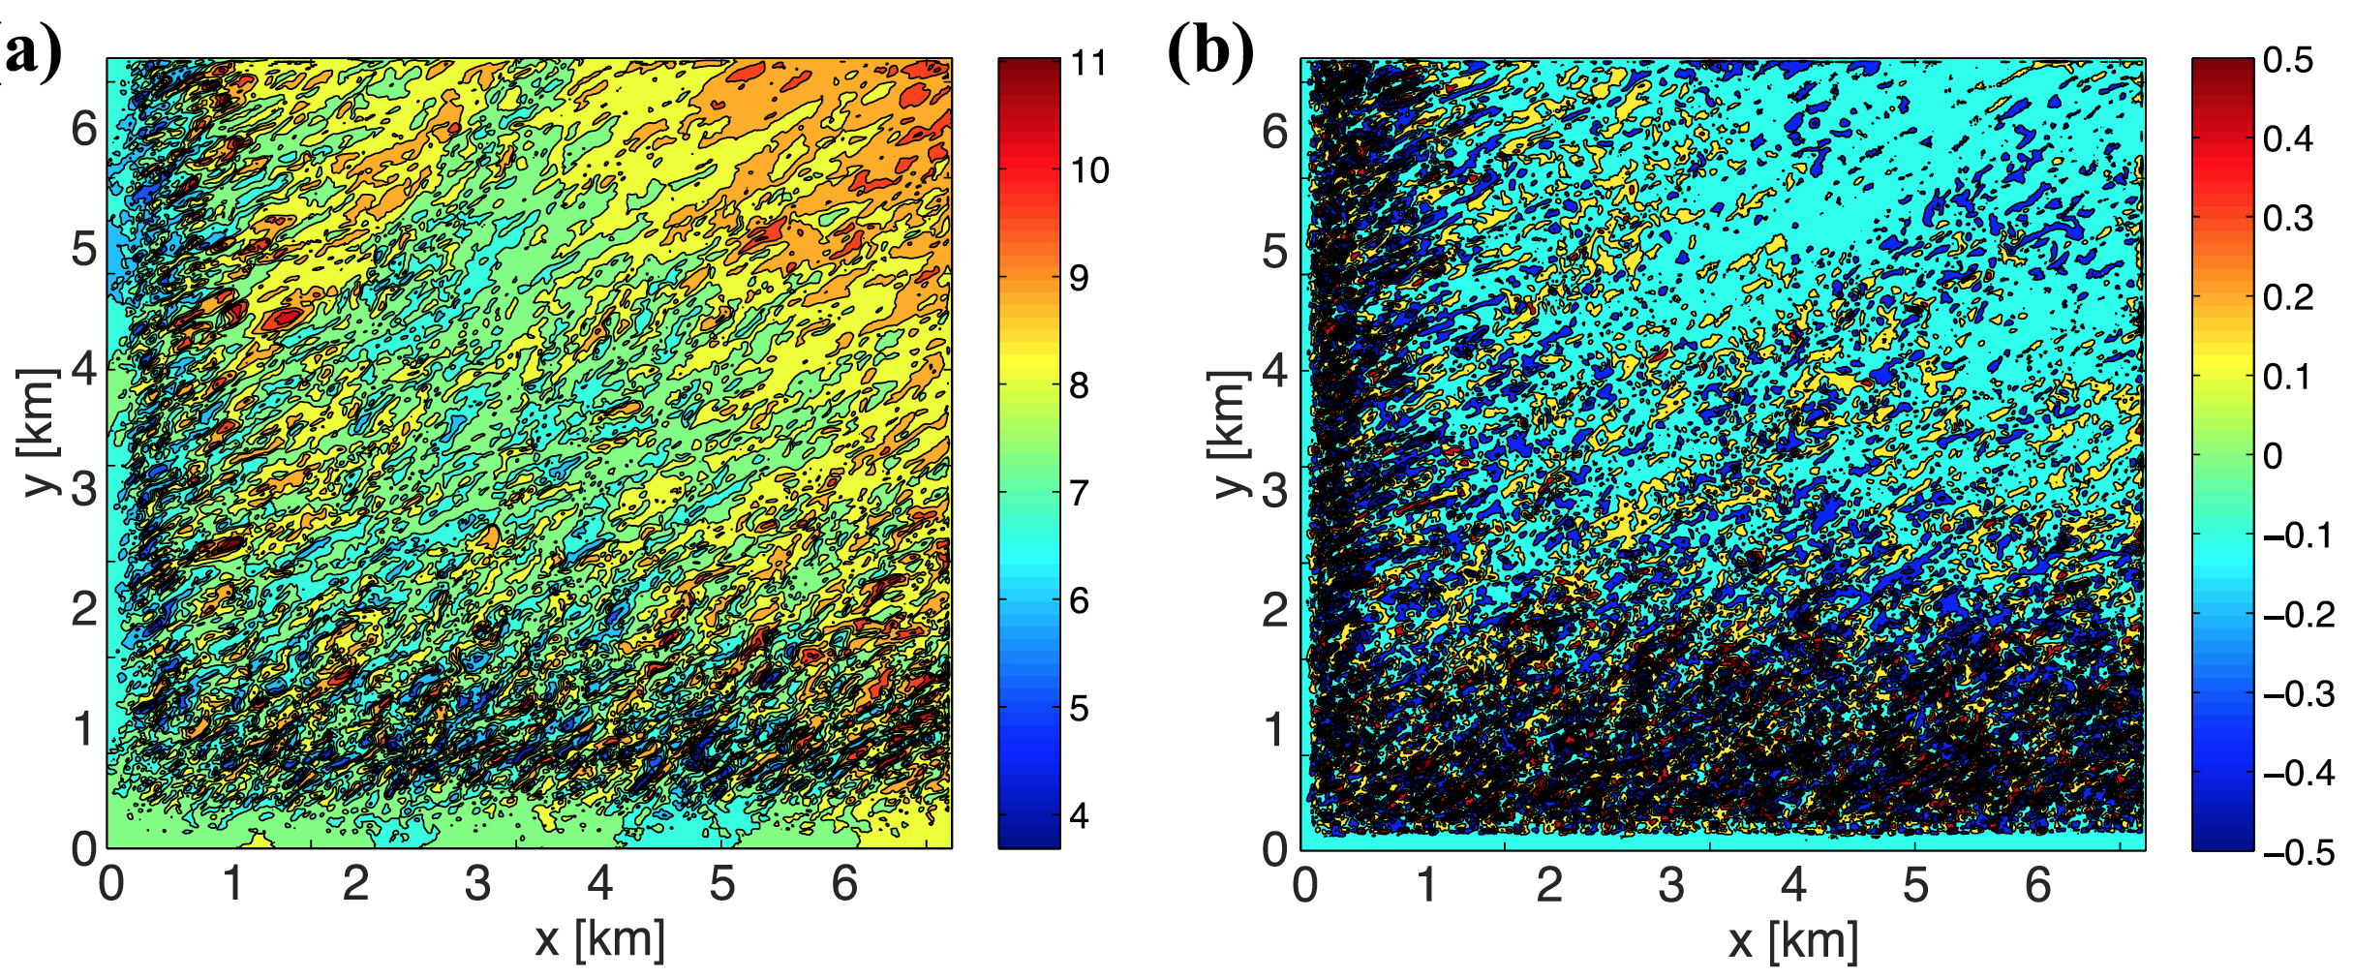
Turbulence generation in stable conditions
Results on domain D05 at z = 75 m (time: 0100 LT)
Zonal velocity [m s⁻¹]
Vertical velocity [m s⁻¹]
x
The cell perturbation method instigates realistic turbulence production (otherwise, no turbulence is generated)
8.2 m grid size allows resolution of stratified turbulence features [global intermittency]
7/11

Slide 9
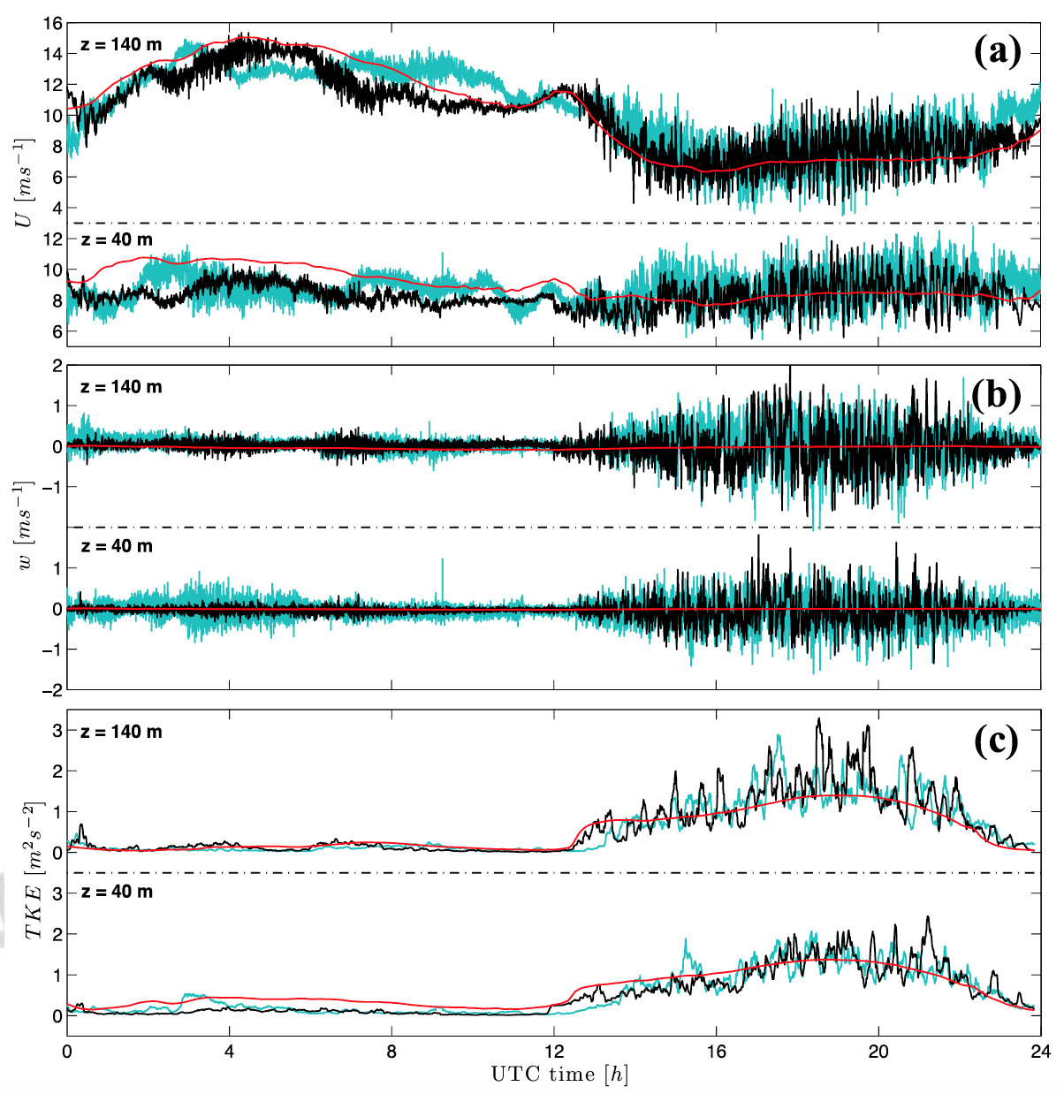
Time evolution of U, w and TKE
LiDAR
WRF-mesoLES
WRF-meso
Meso-LES does not only improve turbulence representation but also produces a more realistic intra-hour variability (frequency and amplitude)
More realistic TKE at the near-surface improves wind speed prediction
8/11

Slide 10
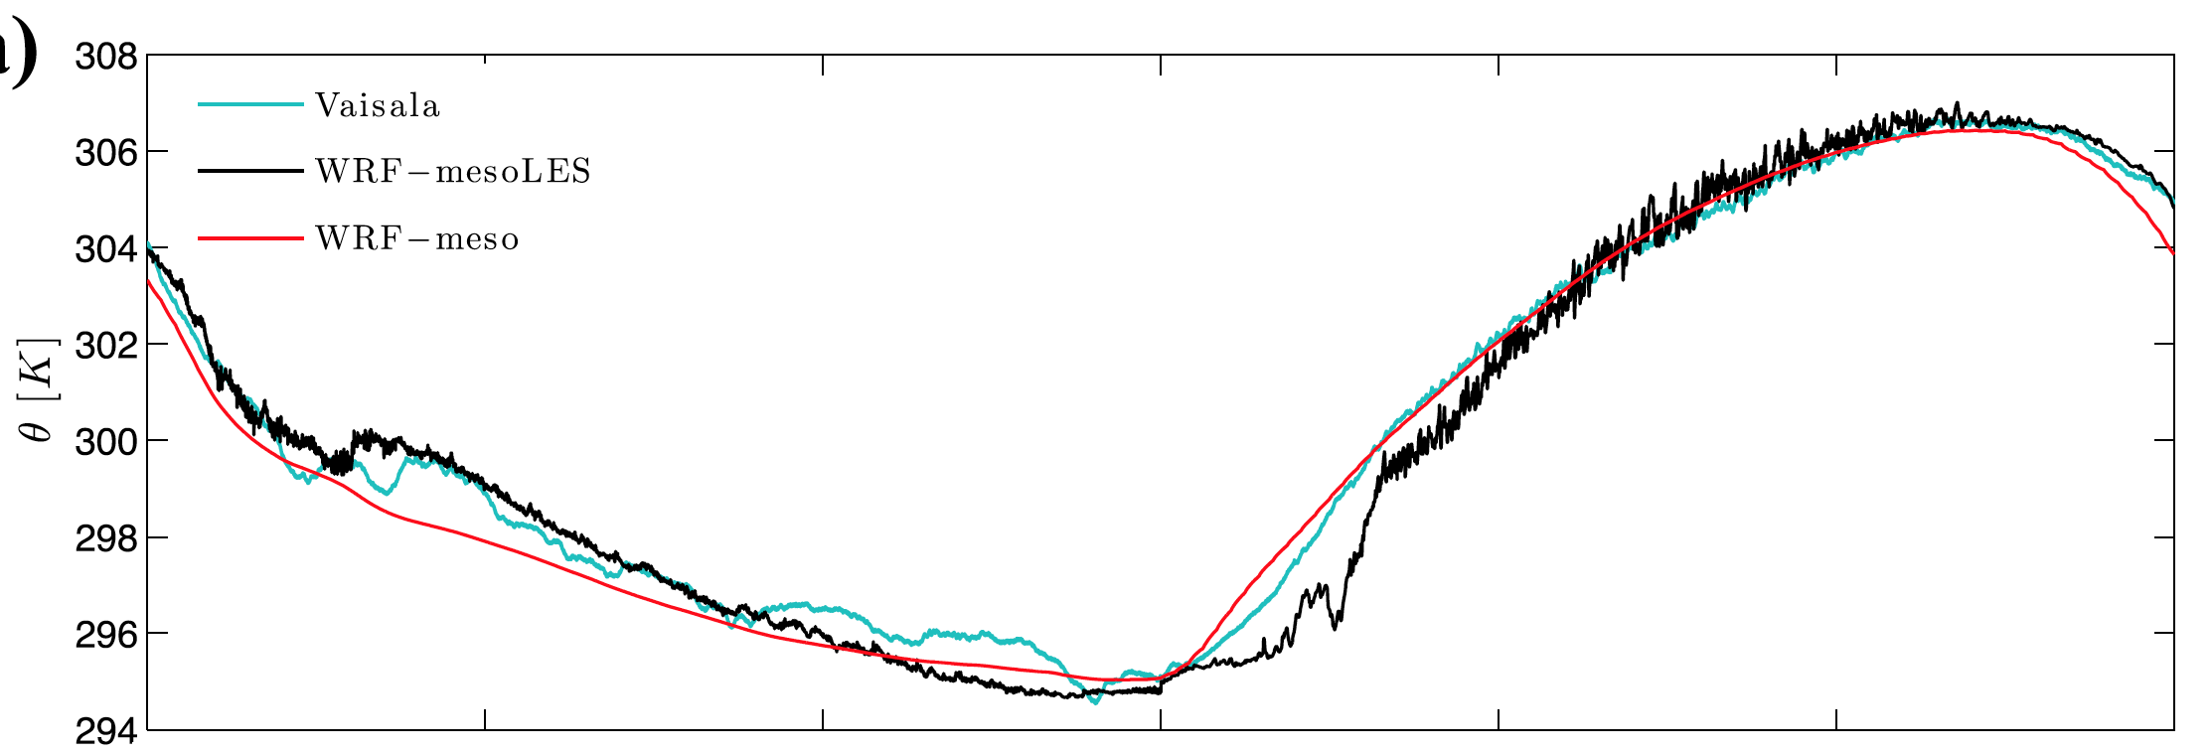
Time evolution of 8-m temperature
Measurements
WRF-mesoLES
WRF-meso
Resolved turbulence enables local temperature increases resulting from mixing with upper layers
Temperature evolution is overall improved
The strongest stratification at the end of the night may require higher resolution (and/or a less dissipative advection scheme)
9/11

Slide 11
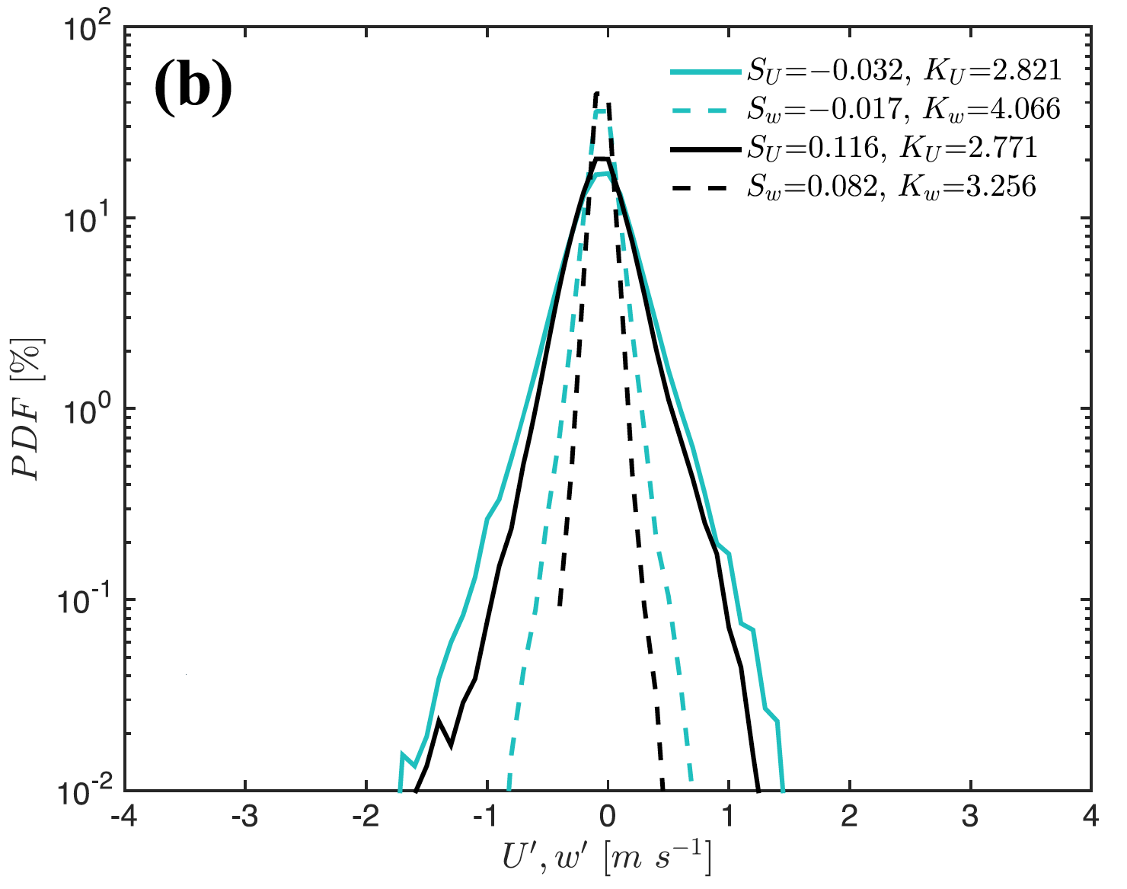
Turbulence statistics
Probability distributions of U’, w’
Energy spectra at z = 8 m
Measurements
WRF-mesoLES
WRF-meso
PDFs of resolved turbulent fluctuations almost identical to lidar observations
Realistic energy distribution even at z = 8 m (1st vertical grid point) [even better agreement found at higher heights]
10/11

Slide 12
Conclusions
Parameterization of SBLs in NWP models remains a challenge
Coupled WRF mesoscale-LES enabled by the cell perturbation method improves the representation of stably stratified turbulence in the ABL [waves, global intermittency, vertical mixing]
Not only improving turbulence statistics but also intra-hour variability, wind shear and surface temperature
With increasing computing capability, forecast at LES resolution is becoming a reality [see Talk 8.7 on Thursday at 12:00]
11/11

Slide 13

Thanks for your attention!!!
“Coupled mesoscale-LES modeling to improve the representation of stably stratified atmospheric boundary layers”
Dr. Domingo Muñoz-Esparza
domingom@ucar.edu
June 13th 2017
18th WRF Users’ Workshop, Boulder, CO
11/11

Slide 14
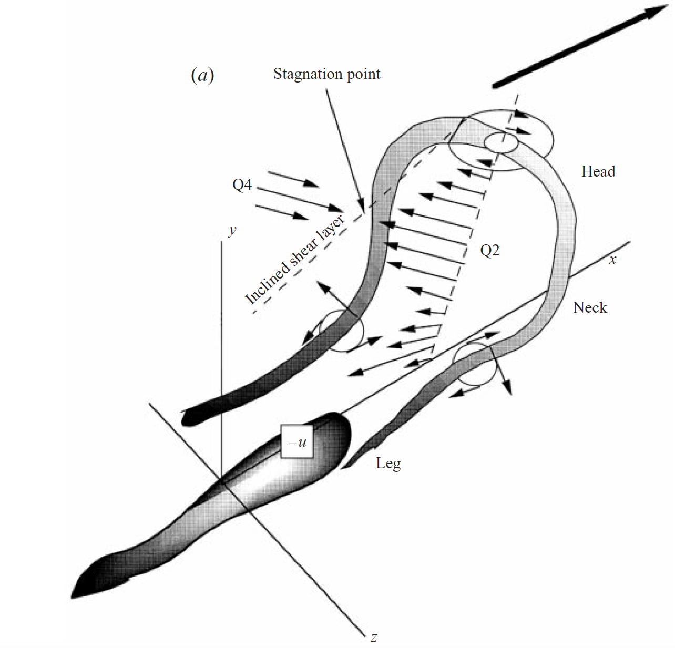
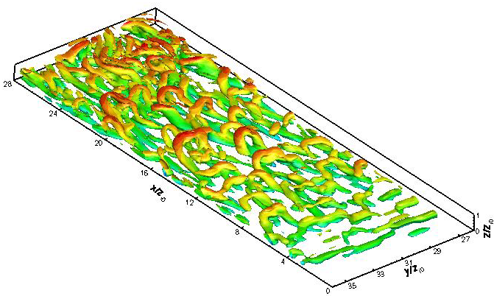
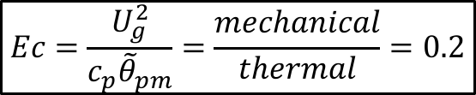
Generalized cell perturbation method (II)
“Perturbation Eckert number”
$$Ec=\frac{U_{g}^{2}}{c_{p}{\tilde{θ}}_{pm}}=\frac{mechanical}{thermal}=0.2$$
Q criterion for identifying turbulent structures
(colored by horizontal velocity)
Adrian et al. (JFM 2000)
Hairpin-like vortices develop for Ec = 0.2, breaking down into developed streaks
Similar mechanism to laminar-turbulent transition in wall-bounded viscous layers
Optimum transition to turbulence
Muñoz-Esparza et al., Physics of Fluids (2015)
1/BS

Slide 15
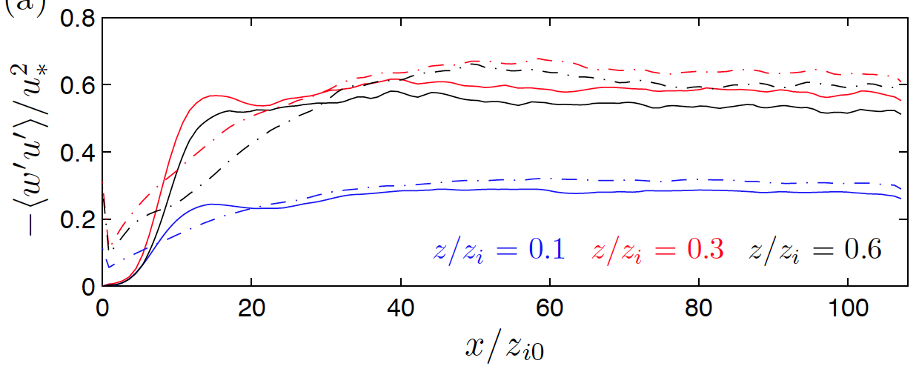
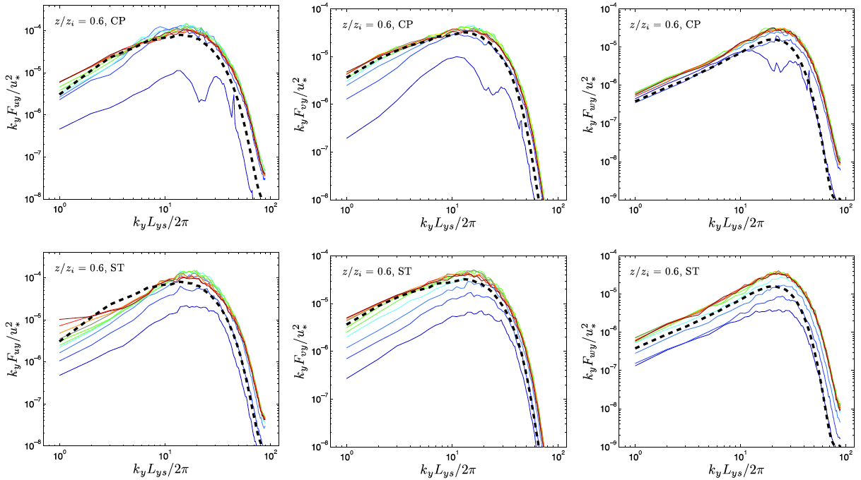
Cell perturbation vs. synthetic turbulence
Momentum fluxes
Cell perturbation method requires HALF the fetch
Cell Perturbation (solid)
Synthetic Turb. (dashed)
[Xie & Castro, FTC2009]
Cell perturbation method is 1000 TIMES faster
Turbulent kinetic energy spectra
Cell perturbation
u
v
w
Synthetic turbulence
u
v
w
2/BS

