Slide 1
Using WRF-Urban to assess summertime air conditioning electric loads and their impacts on urban weather in Beijing Xiaoyu Xu ^{a, b, c}, Fei Chen ^{c}, Shiguang Miao ^{b} and Michael Barlage ^{c}
ª NUIST, Nanjing, China ^{b} IUM, Beijing, China ^{c} RAL/NCAR, Boulder, USA

Slide 2
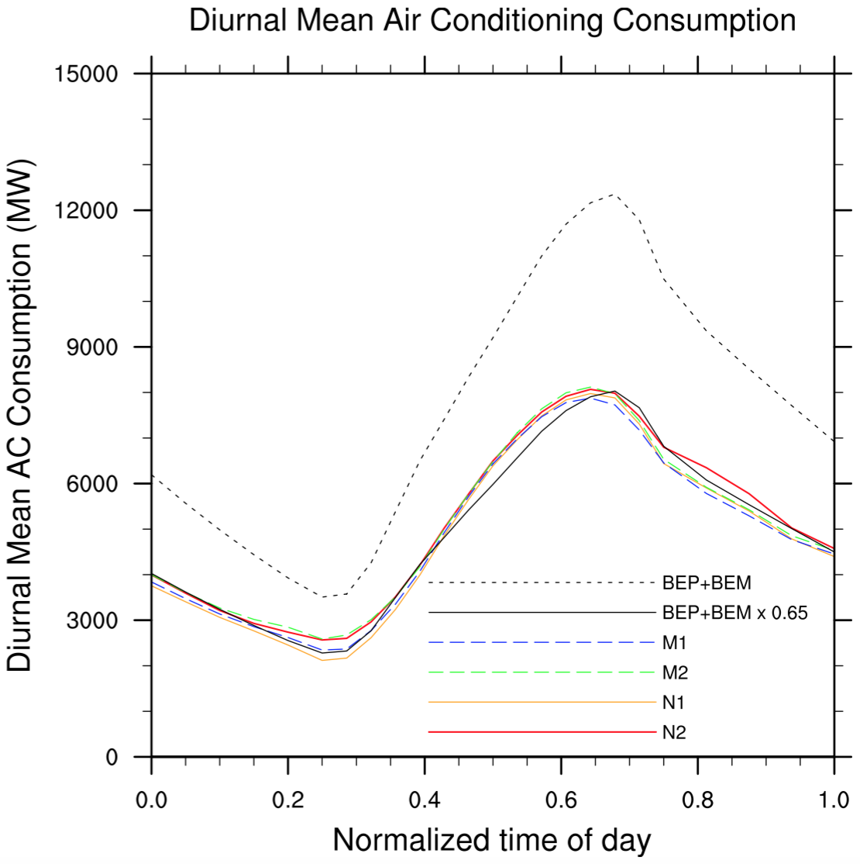
1 Background
More frequent and intense extreme heat days in the context of global warming (Tebaldi et al. 2006);
More air conditioning (AC) cooling energy consumption in cities with hot summers like Beijing during extreme heat days;
Few research on validation of AC consumption against observation. One example is Salamanca et al.(2013), in which only average diurnal cycle over Phoenix was evaluated and spatial verification was overlooked.
From Salamanca et al.(2013)

Slide 3
Objectives
Validating WRF-Urban results against observed AC electric loads spatially and temporally during a 5-day heatwave event (02/July/2010 – 06/July/2010) in Beijing.
Assessing impacts of waste heat release due to AC systems on urban weather (2-m air temperature).

Slide 4
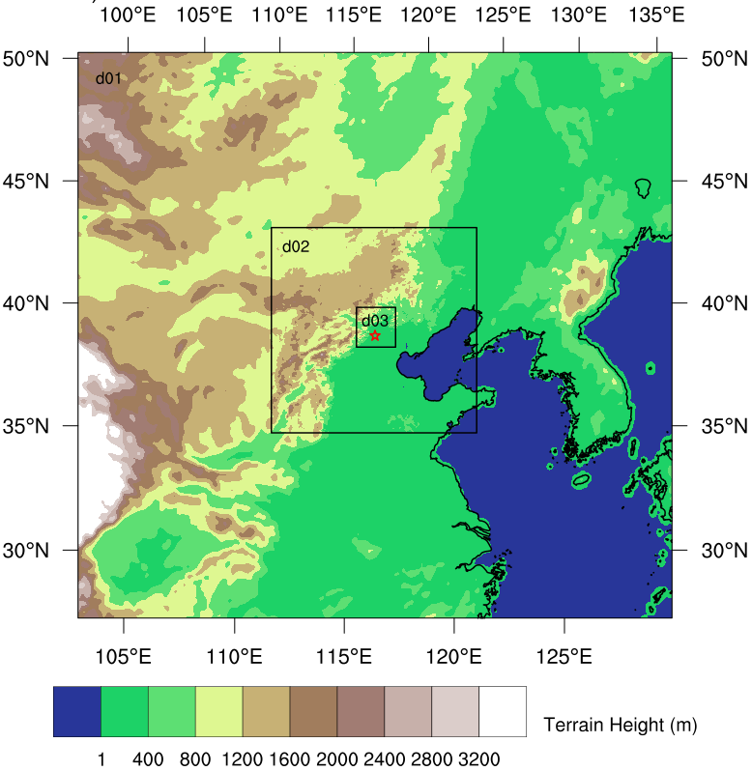
2 Methodology ⏤ model configuration
WRF Version 3.9
Tree two-way nested domains
9km (299285), 3km (310310) and 1km (178181)
38 sigma levels with 13 levels in the lowest 1km
Physical parameterizations
RRTMG shortwave and longwave radiation ;
WDM6 microphysics;
K-F cumulus scheme for d01 and d02;
MYJ PBL scheme;
Noah-MP with default options coupled to BEP+BEM.
Initial and boundary conditions: 6-hrly GFS (1°1°)
Heatwave case: 1200 UTC 1 July - 1800 UTC 6 July 2010, with a spin-up of 4 h

Slide 5
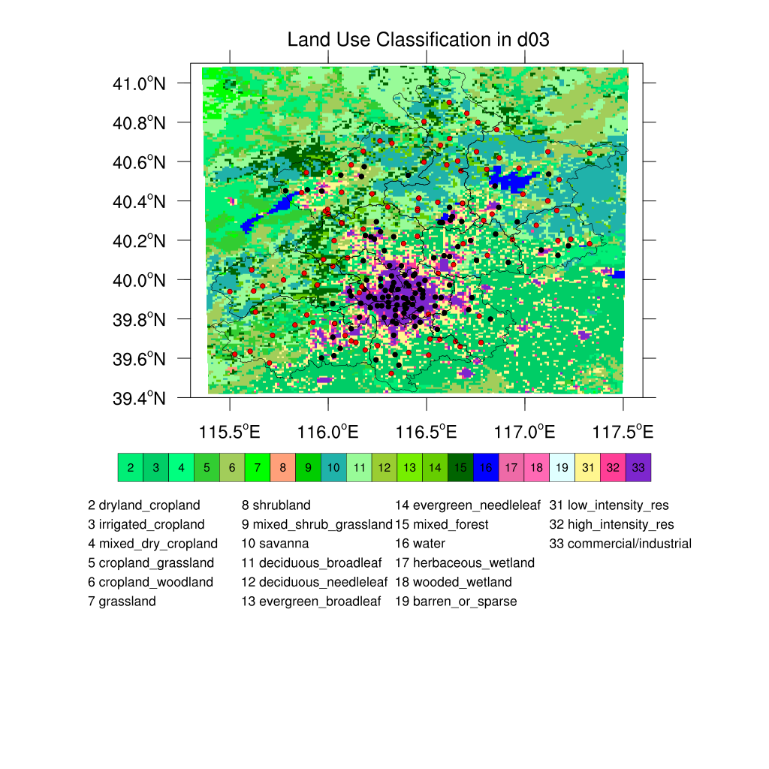
2 Methodology ⏤ evaluation data
Surface-meteorology data (hourly)
2-m air temperature, humidity and 10-m wind speed
115 urban stations (black dots)
95 rural stations (red dots)
Total electric loads in 15 districts in Beijing (quarter-hourly)

Slide 6
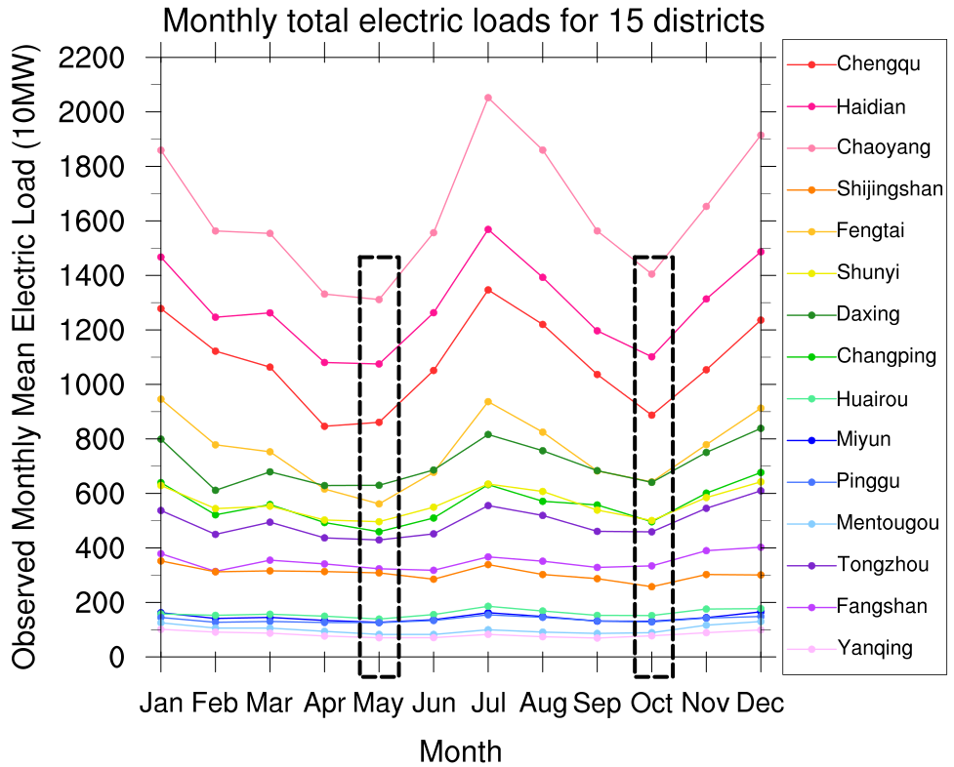
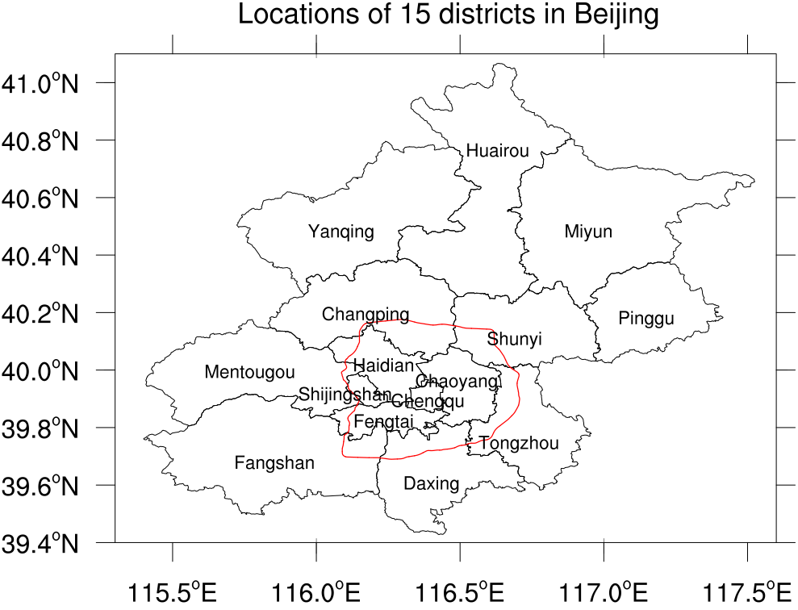
2 Methodology ⏤ how to separate AC loads from total electric loads?
Following the method of Salamanca et al. (2013) to calculate AC electric loads
Chaoyang
Huairou

Slide 7
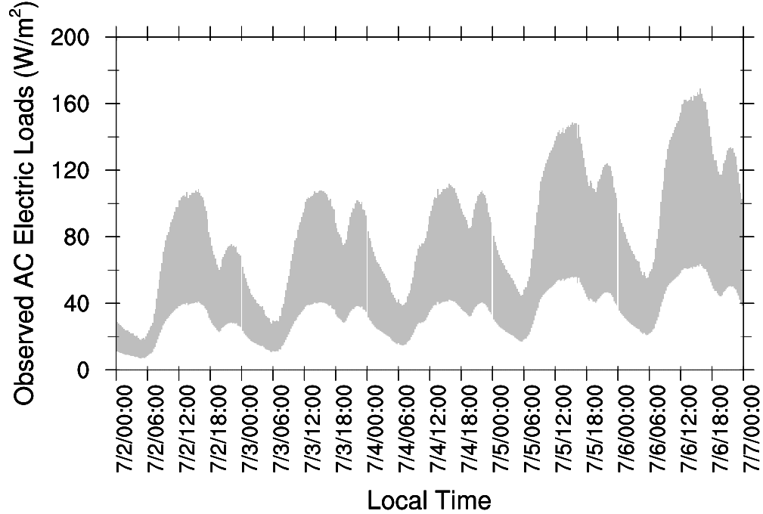
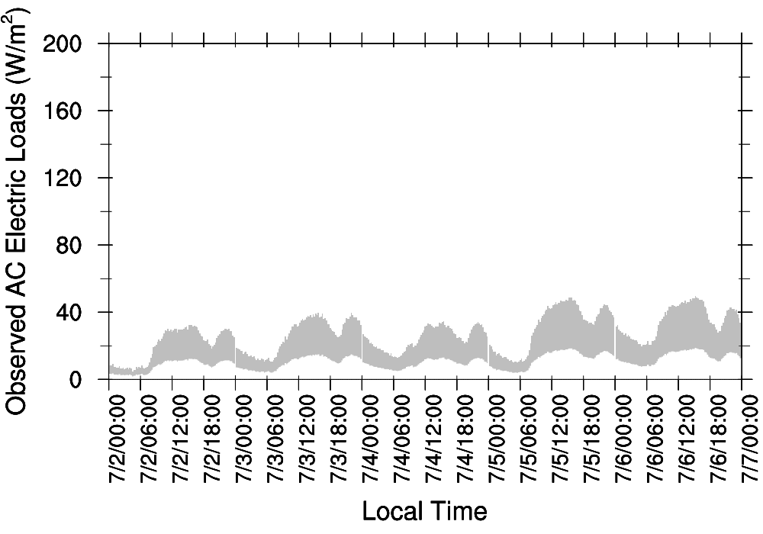
2 Methodology ⏤ AC load uncertainty range
Total area, impervious surface percentage and built-up area
District Name | Total Area (10⁶ m²) | Impervious Surface Percentage (%) | Min Built-up Area (10⁶ m²) | Max Built-up Area (10⁶ m²)
Chaoyang | 470.8 | 65.9 | 93.1 | 248.2
Huairou | 2557.3 | 2.6 | 19.9 | 53.2
A varying normalized roof width [0.3, 0.8] from Wang et al. (2011) is used to estimate the min and max built-up area.
Chaoyang
Huairou

Slide 8
3 Model performance ⏤ surface meteorology
Numerical experiments | Model setup
MP-BEP-BEM | Model configuration described above
NOAH-BEP-BEM | Same as MP-BEP-BEM, but with Noah coupled to BEP+BEM
T-2m, unit: °C
q-2m, unit: g/kg
WS-10m, unit: m/s

Slide 9
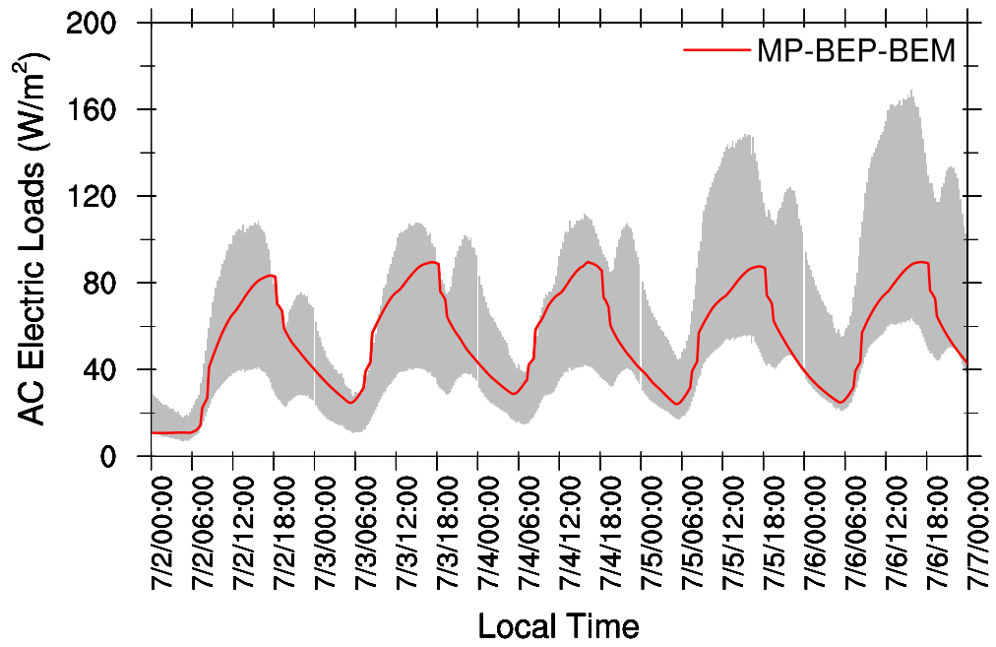
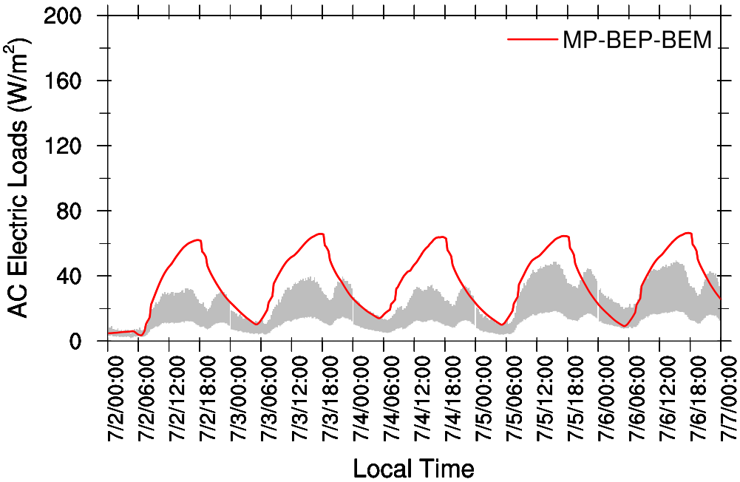
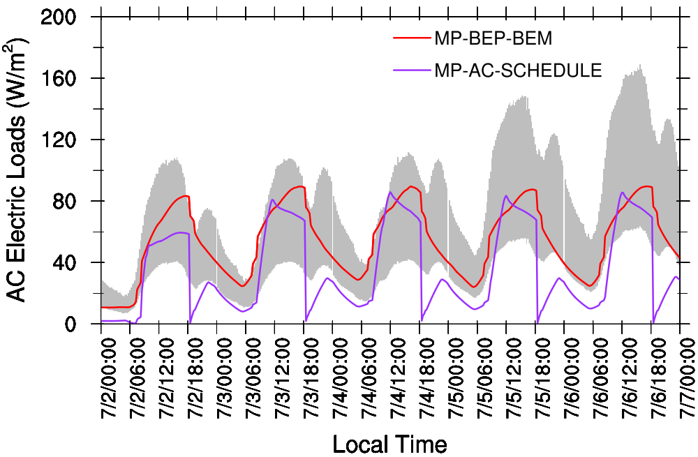
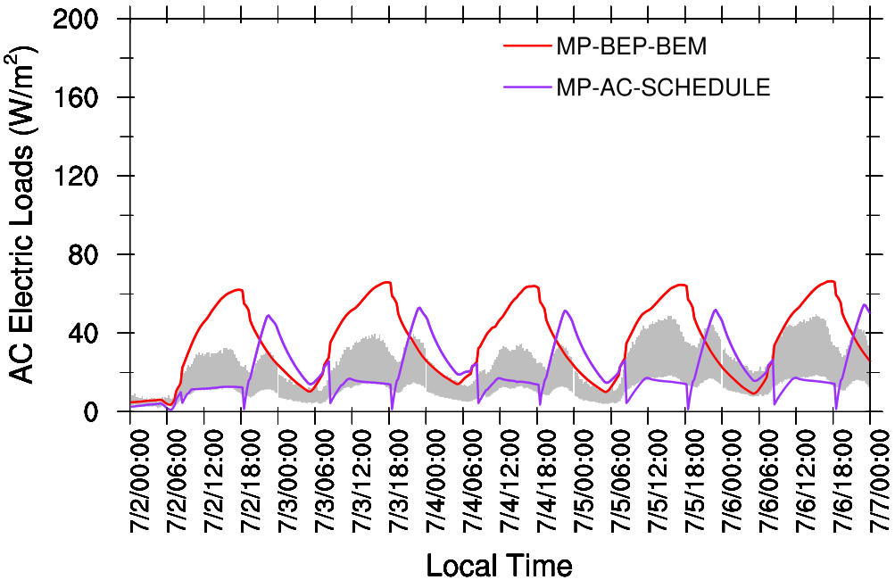
3 Model performance ⏤ AC electric loads
Chaoyang
Huairou
Chaoyang
Huairou
How to capture the double-peak structure?
New Experiment | Model setup
MP-AC-SCHEDULE | Same as MP-BEP-BEM, but with different AC working schedules for commercial and residential
 | MP-BEP-BEM | MP-AC-SCHEDULE
 | Commercial/Residential (whole day) 00:00 – 24:00 LT | Commercial (daytime) 08:00 – 18:00 LT | Residential (nighttime) 00:00 – 08:00 LT and 18:00 – 24:00 LT

Slide 10
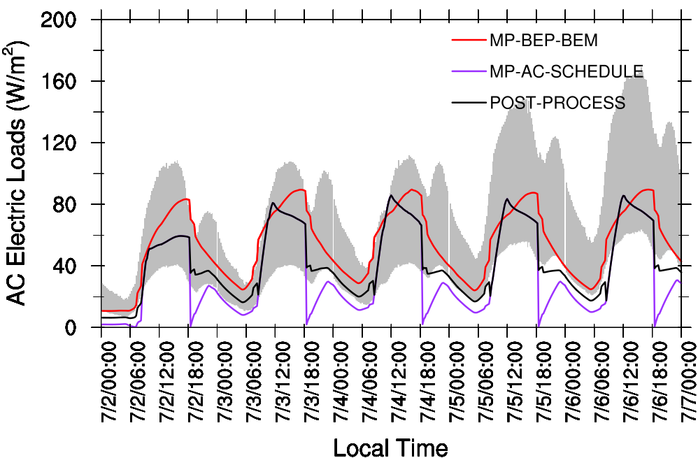
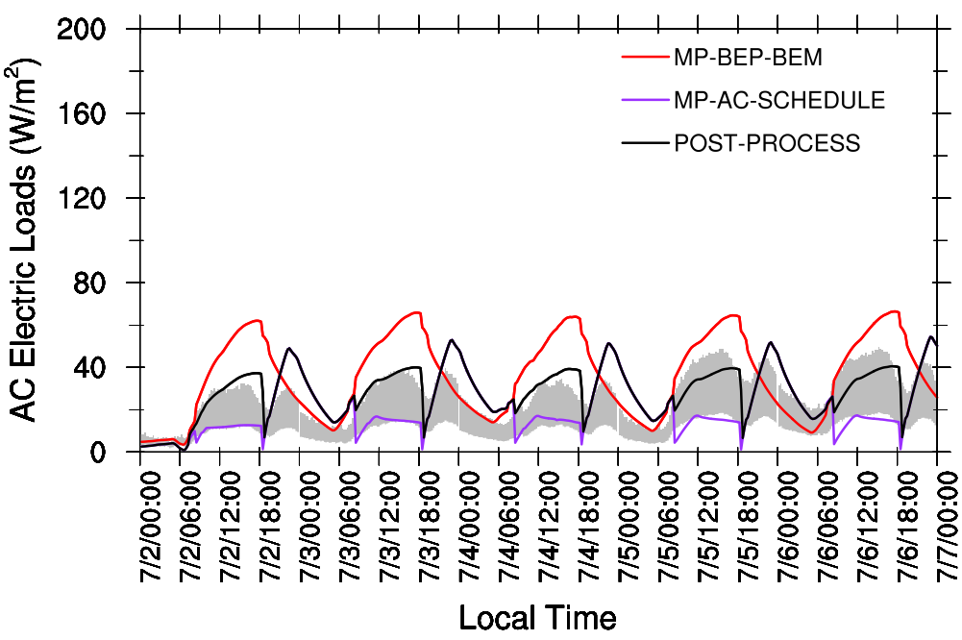
3 Model performance ⏤ AC electric loads
POST-PROCESS (based on MP-AC-SCHEDULE) | Chaoyang (commercial-dominant) | Huairou (residential-dominant)
 | Daytime: all commercial AC working Nighttime: all residential AC working + 50% commercial AC working | Daytime: all commercial AC working + 50% residential AC working Nighttime: all residential AC working
Chaoyang
Huairou

Slide 11
4 Results ⏤ spatial distribution at two peaks (July 5th)
AC loads, MP-BEP-BEM
AC loads, MP-AC-SCHEDULE
3:00 pm
9:00 pm
W/m²

Slide 12
4 Results ⏤ Impacts on T-2m at two peaks (July 5th)
MP-BEP-BEM minus MP-AC-SCHEDULE
°C

Slide 13
5 Conclusions
In this study, the newly-released WRF-Urban modeling system is used to explore the AC electric loads for Beijing during a 5-day heatwave event in 2010. Results show that,
Compared to Noah coupled to BEP+BEM, Noah-MP better reproduces 2-m air temperature and humidity in both urban and rural areas; 10-m wind speed is still overestimated at both sites;
Temporally, the double-peak structure (at 3pm and 9pm local time) in the diurnal variation profile of observed AC loads can be captured by WRF-Urban to some extent by applying different working schedules of AC systems to commercial and residential grids;
Spatially, high electric energy consumption due to AC cooling is concentrated in urban districts roughly encircled by the 6th ring road, featuring a very similar pattern to urban land use classification;
Anthropogenic heating increases the evening 2-m air temperature in urban districts by more than 2 °C though AC loads peak in the afternoon, when negligible impacts are found.

Slide 14
Thank you! Any questions?

