Slide 1
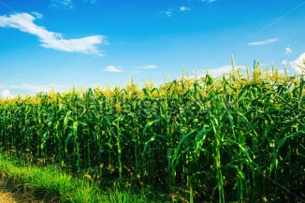
Noah-MP Land Surface Model Developments in WRFv3.9 and Beyond
Michael Barlage (NCAR)
Fei Chen (NCAR)
Xing Liu, Dev Niyogi (Purdue University)
Francisco Salamanca (Arizona State Univ.)
Shiguang Miao, Yizhou Zhang (IUM)
18th WRF Users’ Workshop – 13 June 2017

Slide 2
WRF v3.9 release cycle: Noah-MP modifications
Noah-MP capabilities/enhancements
This cycle focused primarily on providing necessary datasets to run crop and groundwater functions in Noah-MP and integrating single- and multi-layer urban models with Noah-MP
Added single-layer and multi-layer urban capability to Noah-MP:
sf_urban_physics = 1 -> single-layer urban model
sf_urban_physics = 2 -> multi-layer BEP urban model
sf_urban_physics = 3 -> multi-layer BEP/BEM urban model
See additional talk tomorrow by Salamanca
Soil water transport & snow ablation mods in support of NWM
SOILPARM.TBL was modified to make table fully consistent with Cosby

Slide 3
WRF v3.9 release cycle: Noah-MP modifications
Noah-MP capabilities/enhancements
Improved upon initial commit of crop model
added crop-specific parameters for corn and soybean to run crop model
added planting and harvest dates by state
added seasonal growing degree day map
added crop fraction and specific crop frequency
dveg = 10 -> crop model on (use maximum vegetation fraction)
To add new crop and groundwater fields in geogrid, use GEOGRID.TBL.ARW.noahmp
Many new capabilities also require additional datasets: how do we address this growing issue?

Slide 4
Noah-MP-Crop – expanded capability
Crop modeling module
DVEG option (5)
Crop land cover categories map, corn/soybean rotation pattern
MP-CROP (10)
Yield/grain pool
Noah-MP
TABLE LAI (4)
Management maps: irrigation, planting date
MODIS LAI (9)

Slide 5
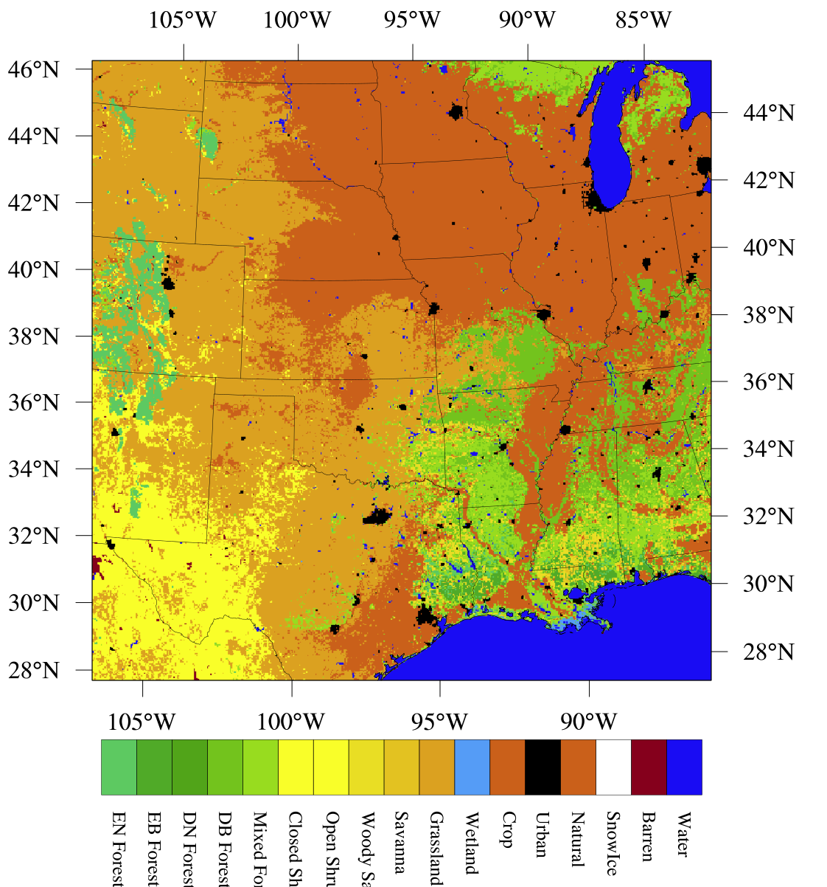
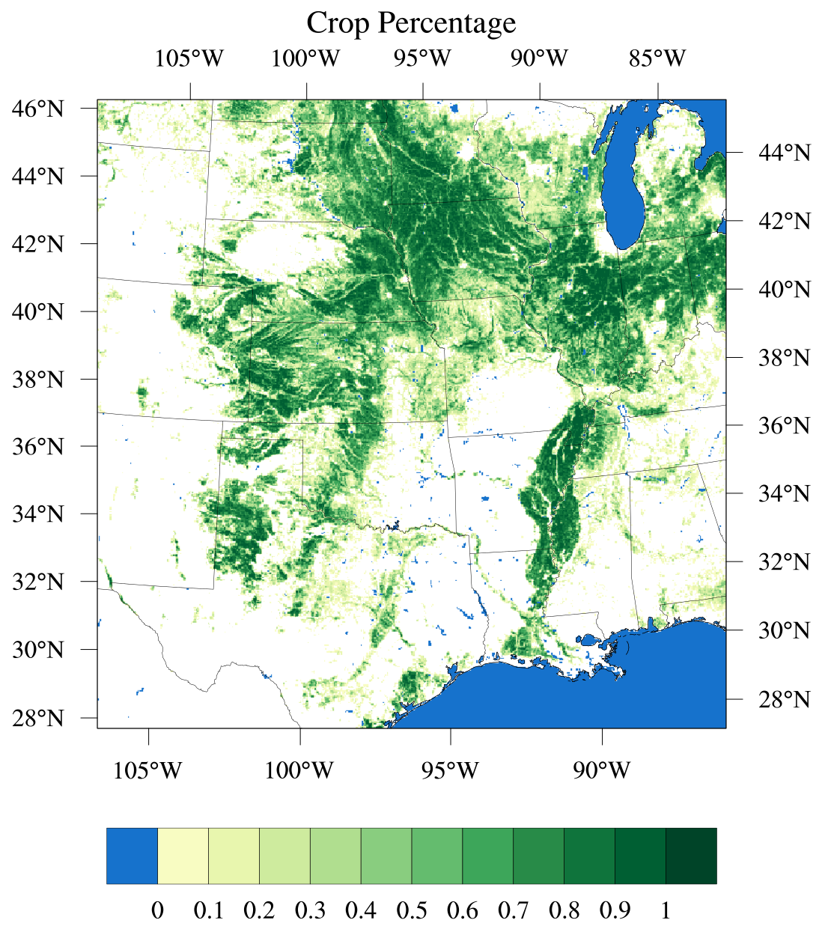
WRF v3.9 release cycle: Noah-MP modifications
Crop data based on Cropscape, a 30 meter US crop dataset by USDA/GMU
Contains 5 layers: corn crop frequency, soybean, wheat, cotton, crop planting frequency; plus season_gdd (NLDAS), planting and harvest dates

Slide 6
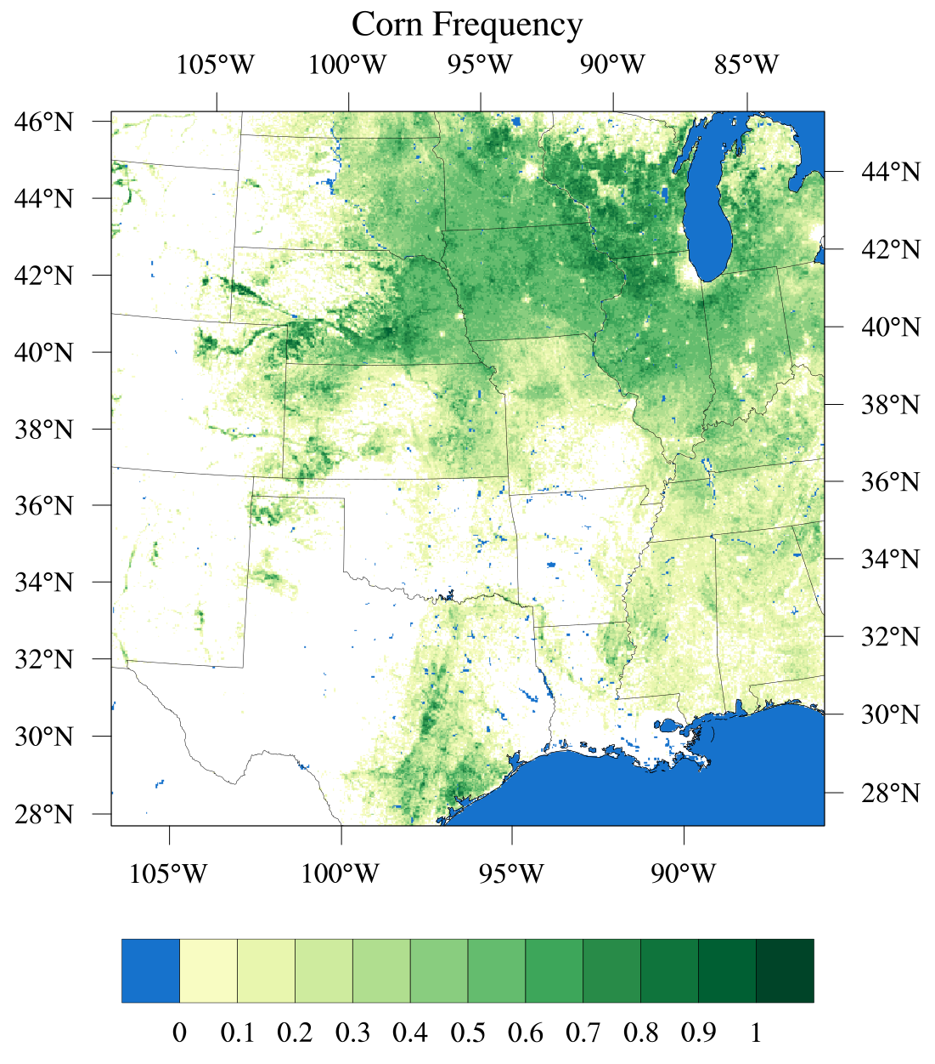
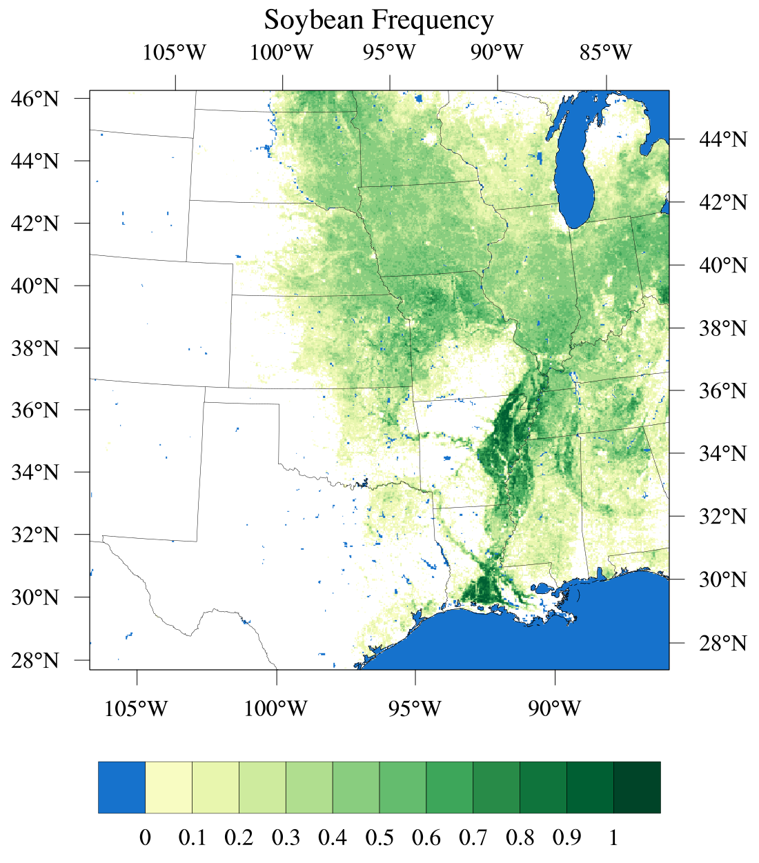
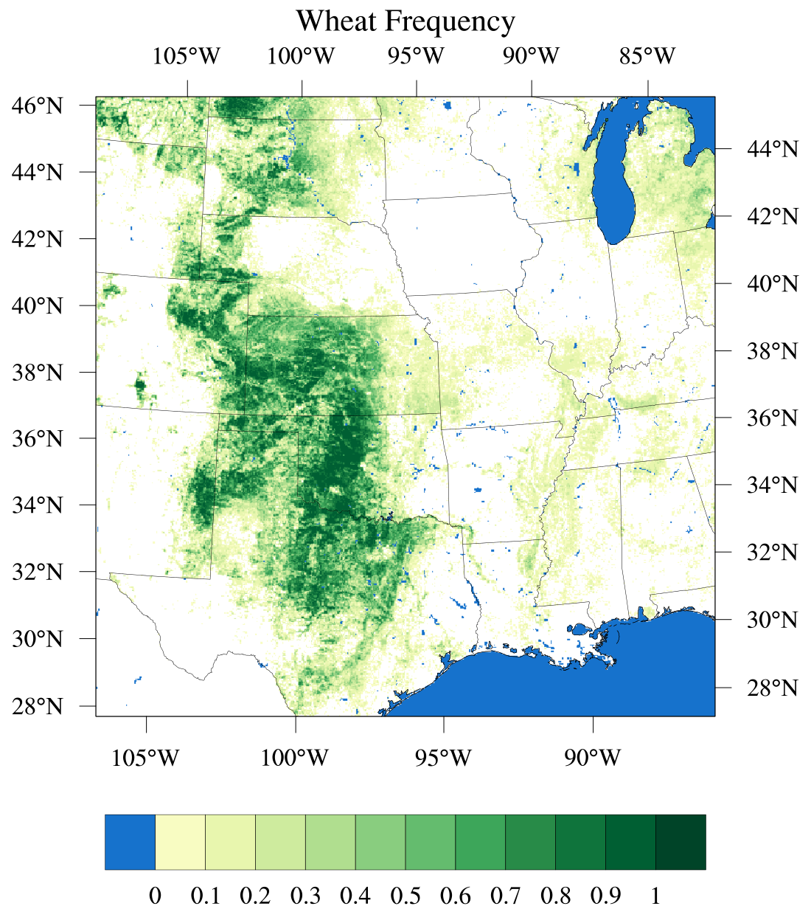
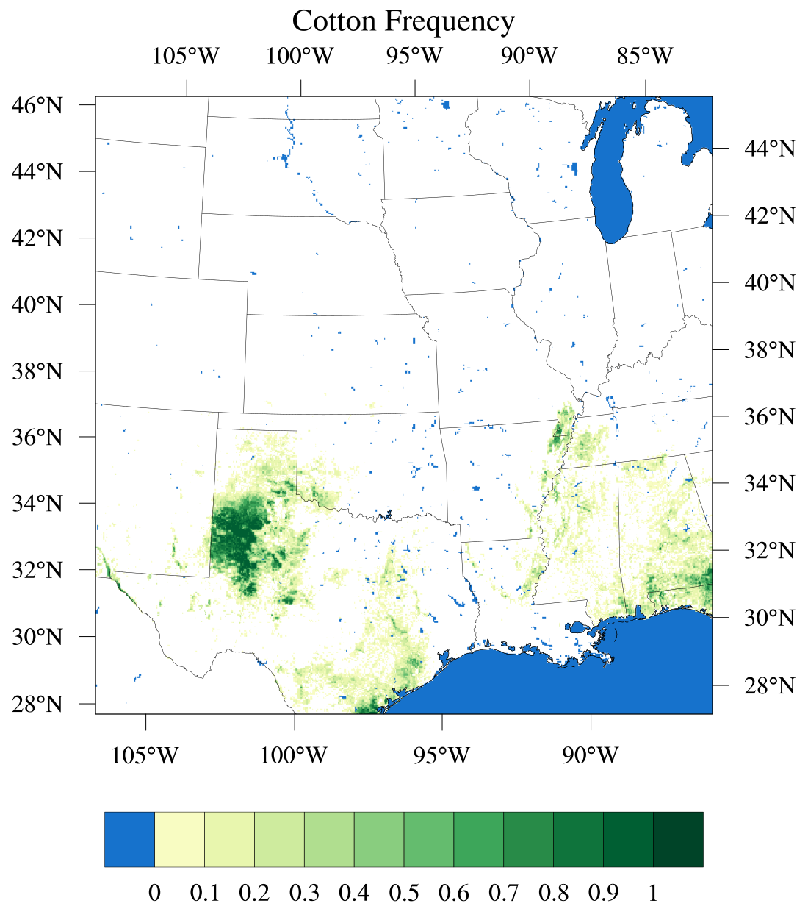

Slide 7
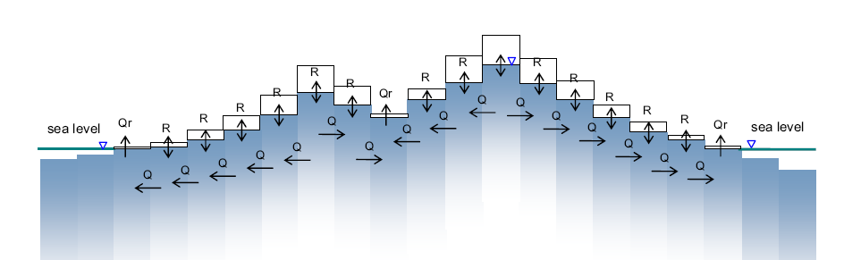
Miguez-Macho & Fan water table dynamics in Noah-MP
Noah-MP options exist for
free drainage soil lower boundary condition
1D aquifer interaction
new option added for 1D interaction with horizontal aquifer transport
User note: not a river routing, overland flow scheme (see WRF-hydro)
Mass balance in groundwater storage:
Cell ij
Qr
R
Water table depth (wtd)
Q₁
Q₂
Q₃
S_{g}
Cross section view
h _{i,j}
Q₈
Q₈
i, j
Q₄
i,j
w
Q₄
Plan view
Q₇
Q₆
Q₅
Mean sea level
Fan et al, JGR 2007
Miguez-Macho et al., JGR 2007

Slide 8
Noah-MP vs. NoahMP w/groundwater Surface Verification
Miguez-Macho & Fan water table dynamics in Noah-MP
Six-month 30km WRF simulations - 2010
Spin-up soil for one year using offline HRLDAS
IC/BC from NARR
Verification against ~2600 surface stations
Model | Season | Output field | Day bias | Day RMSE | Night bias | Night RMSE
Noah-MP | MAM | T_{2m} | 0.5 | 1.0 | 0.2 | 0.8
w/GW | MAM | T_{2m} | 0.4 | 1.0 | 0.2 | 0.8
Noah-MP | JJA | T_{2m} | 1.7 | 1.9 | 0.5 | 1.0
w/GW | JJA | T_{2m} | 1.1 | 1.6 | 0.1 | 0.9
Green: Noah-MP w/GW improves Red: Noah-MP w/GW degrades

Slide 9
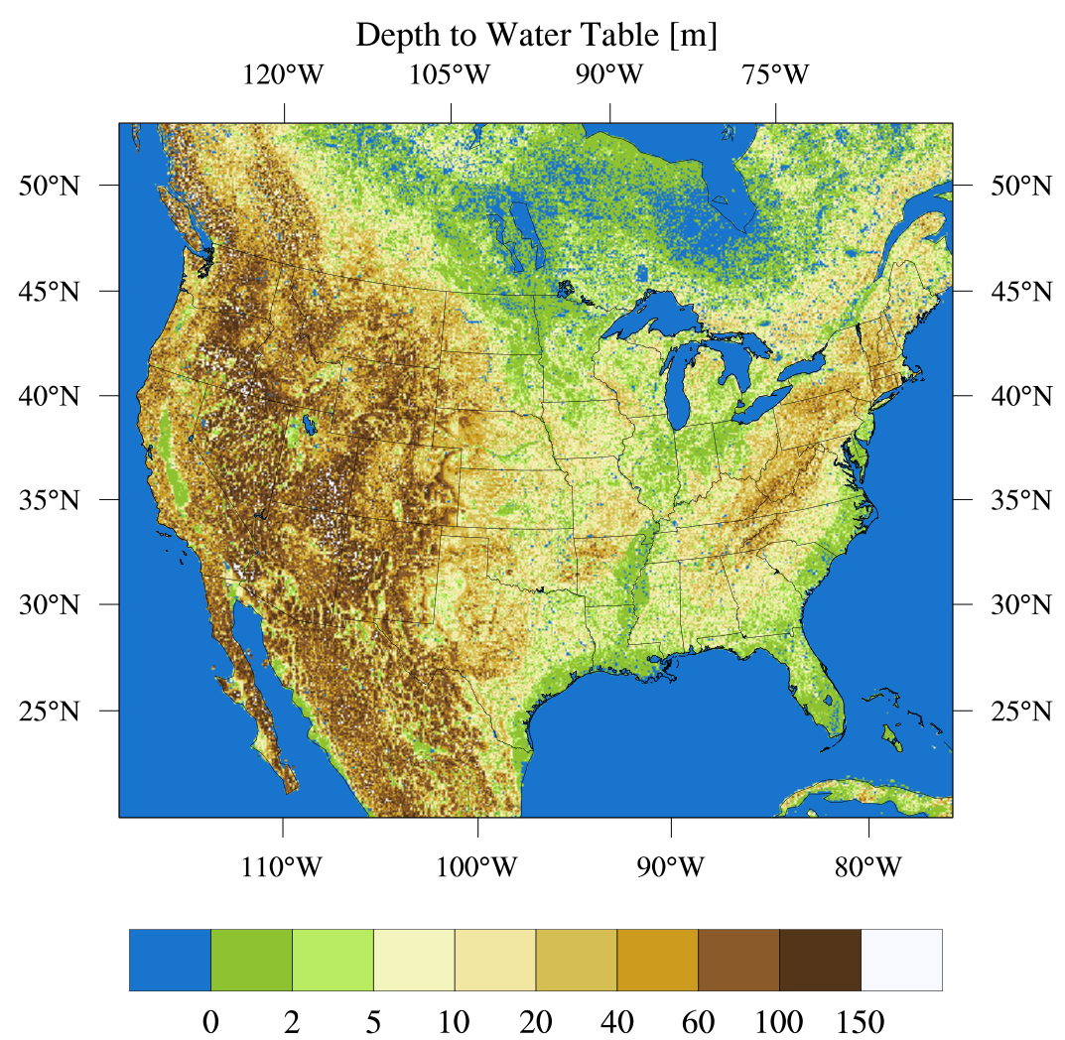
WRF v3.9 release cycle: Noah-MP modifications
Groundwater information based on Miguez-Macho and Fan
Contains 6 layers: depth to water table, climatological recharge, rivermask, K e-fold, and terrain of river and non-river.

Slide 10
WRF v3.9 release cycle: Noah-MP results
Focus on 2-meter temperature forecast in regional climate runs
Three-month simulations (May – July 2014) with different LSMs
LA2DVX: Noah
LA4DV4: Noah-MP with table LAI (dveg = 4)
LA4DV9: Noah-MP with satellite LAI (dveg = 9)
LA4DV5: Noah-MP with dynamic LAI (dveg = 5)
LA4DV0: Noah-MP with crop model (dveg = 10)
LA4DVG: Noah-MP with groundwater model (opt_run = 5)
Results are presented as relative improvement in bias:
Negative/blue mean an improvement in bias compared to Noah
Positive/red means a degradation in bias compared to Noah

Slide 11
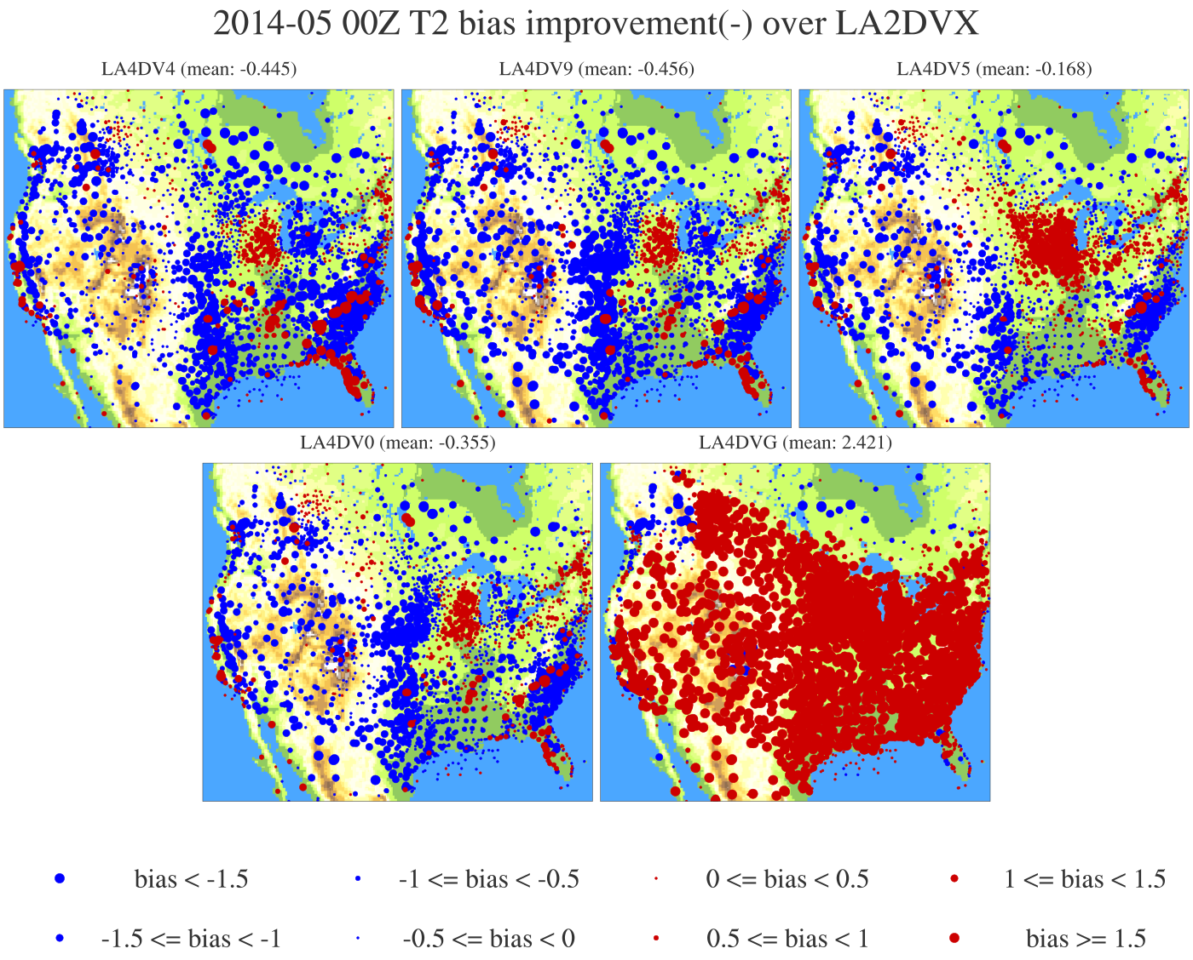
WRF v3.9 release cycle: Noah-MP results
-0.4
-0.5
-0.2
-0.4
2.4

Slide 12
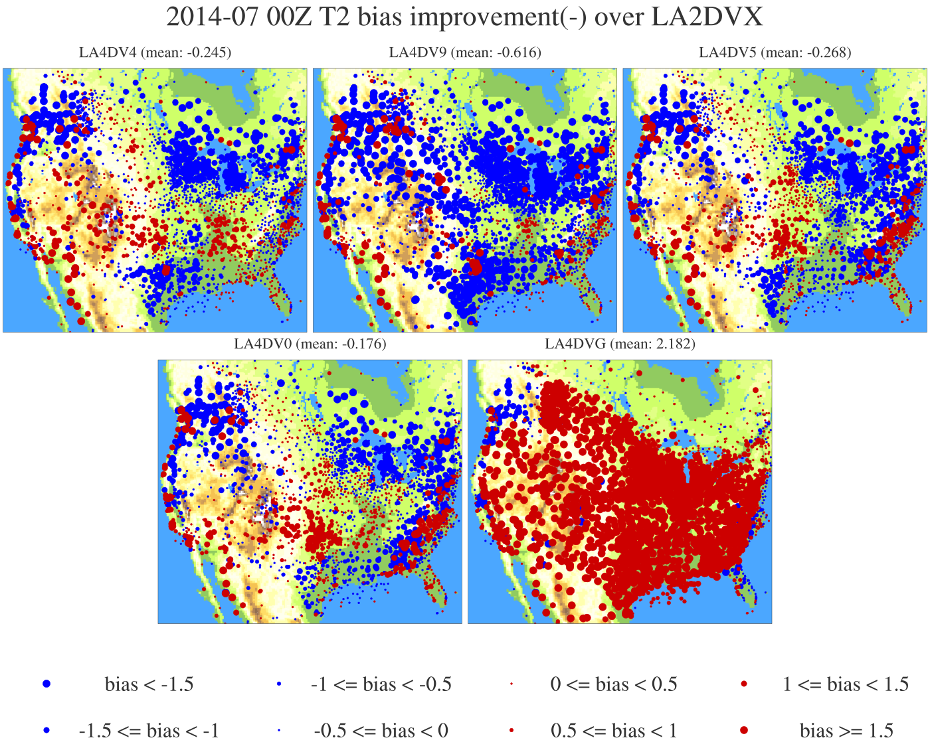
WRF v3.9 release cycle: Noah-MP results
-0.2
-0.6
-0.3
-0.2
2.2

Slide 13
WRF v3.9 release cycle: Noah-MP results
Negative/blue mean an improvement in bias compared to Noah-MP with dynamic vegetation
Positive/red means a degradation in bias compared to Noah-MP with dynamic vegetation

Slide 14
WRF-Crop Results
Spatial variation of yield fraction for the 73 corn/soybean climate zones
Best performance in the area around Lake Michigan (coincidence?)
Very poor performance in the irrigated corn regions
Also poor performance in the south
Parameter table driven (5 crop types)
Currently using generic corn – need to incorporate species
No irrigation
No dynamic roots
No pests
No fertilizers

Slide 15
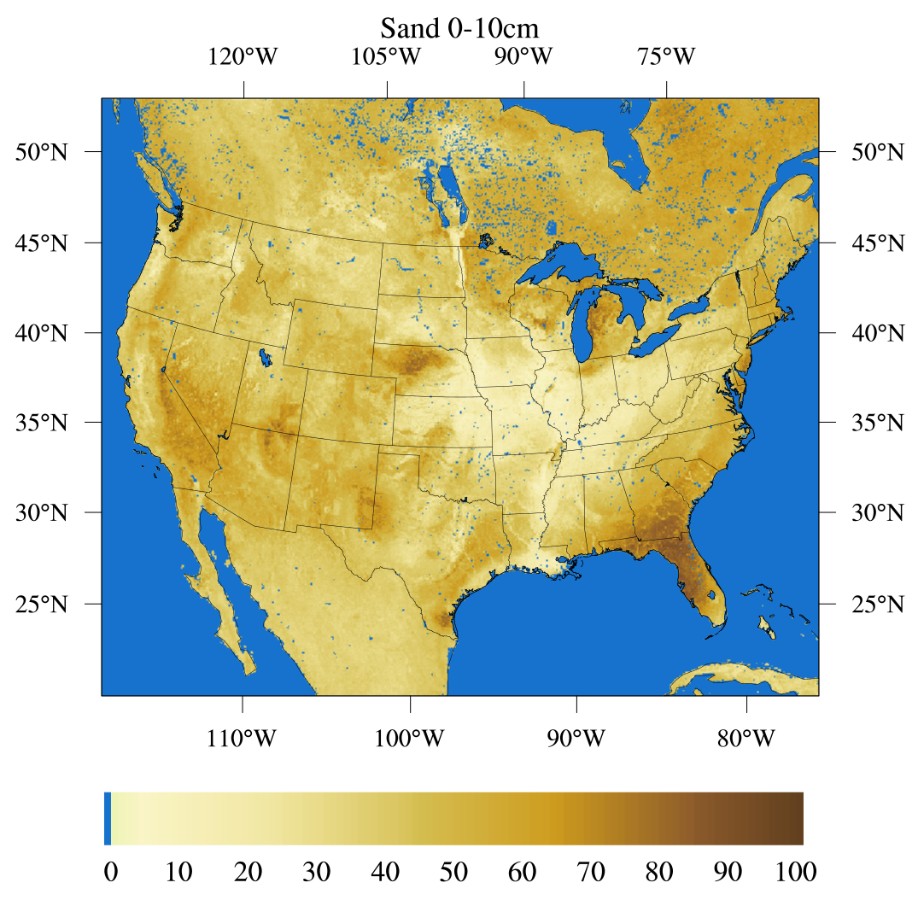
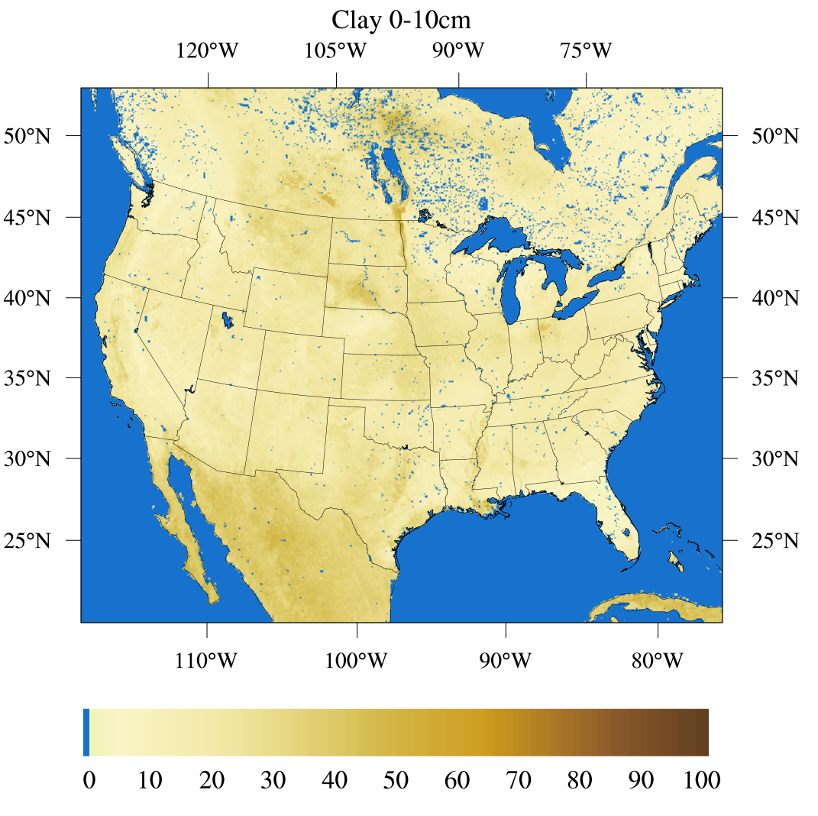
WRF future release: Noah-MP modifications
Noah-MP capabilities/enhancements
Added depth dimension to soil parameters and capability to read
Many of these new capabilities are developed through work with WRF-Hydro team.

Slide 16
Summary
Several new datasets were added to Noah-MP v3.9 in coordination with users and their needs and concerns, many utilizing existing or new code.
The more sophisticated urban models have been linked with Noah-MP and show encouraging results.
The future Noah-MP is focused on expanding soil capabilities and hydrology in general including non-standard datasets.
Users are encouraged to integrate the Noah-MP LSM into their studies, test/develop/propose new options, and interact with us on results/concerns.
http://github.com/NCAR/hrldas-release

