Slide 1
Individual and Combined Impacts of Projected Climate and Emission Changes on Future Air Quality over the U.S.
Chinmay Jena¹, Yang Zhang¹, Kai Wang¹, Patrick Campbell¹,
Fang Yan^{2,3}, Zifeng Lu ^{2,3}, David Streets^{2, 3}
¹Department of Marine, Earth, and Atmospheric Sciences, NCSU, Raleigh, NC
²Computation Institute, University of Chicago, Chicago, IL
³Energy Systems Division, Argonne National Laboratory, Argonne, IL
18th Annual WRF Users' Workshop
Notes:
Increase font size for names and also affiliation, they are way too small

Slide 2
Background and Motivation
Emissions Scenarios
Special Report on Emissions Scenarios (SRES, 2000)
Special Report on Emissions Scenarios (SRES, AR4, 2007)
Representative Concentration Pathways (RCP, AR5, 2014)
But both SRES and RCP scenarios neglecting relationship between socioeconomic factors and projected technology change
Dynamic Technology Model:
SPEW-Trend Projections
(Yan et. al., 2014)
Notes:
YZ: use the font size 20 for second bullet for consistency
Rapidly increases in modern society activities, economics and population are becoming complex and vulnerable to changes in weather, air quality and climate. Emission projections are critical elements in understanding future climate impacts on regional air quality.
In the past, emission projections have often been estimated by combining fuel consumption with an averaged emission factor that represents the whole emitter population while neglecting relationship between socioeconomic factors and projected technology change. The newly, developed dynamic technology model (Yan et al., 2014) can overcome this deficiency in projecting emissions. This is the model system that uses the dynamic technology model emission projections within the downscaled model system

Slide 3
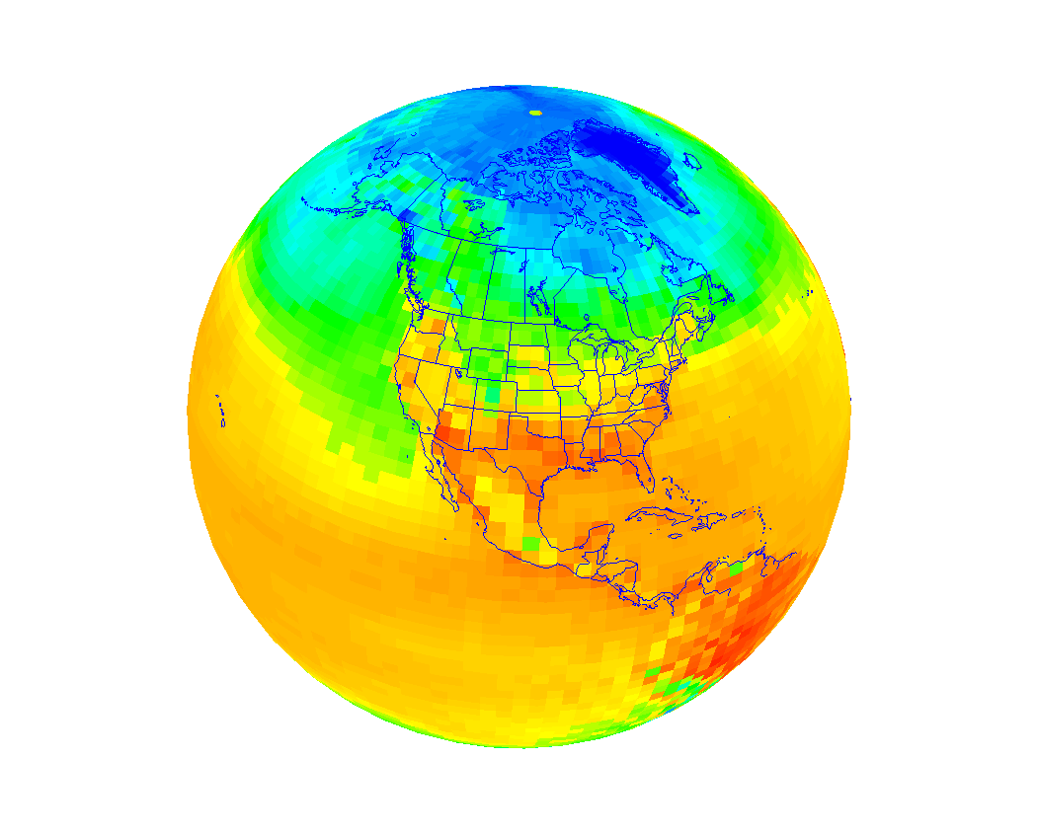
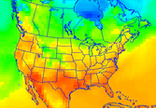
Technology Driver Model (TDM)
P
IEA energy statistics
(1970-2010)
Projected future energy use
CESM
Exogenous scenarios
(e.g. IMAGE and GCAM)
Fuel consumption
(1970-2050)
Socioeconomic variables
Distribution of
engine (all sectors) fuel
consumption by
region/fuel/tech/age
(SPEW-Trend)
Relationships that affect
technological changes
Downscaling Approach
Emission factor by
species/fuel/tech/age
Global and regional
emission projections
Diagrams of TDM Emission Projection Methods (SPEW-Trend, Yan et. al., 2014)
Growth Factors
Regions/Sectors/Species
Regional Online Couple Model
(WRF-Chem3.7)
Gridded Emissions
(SMOKE Model)

Slide 4
Objectives
Impacts on Future Air Quality over the U.S.
from
Emissions Change only
vs.
Climate Change only
vs.
Emissions & Climate Changes

Slide 5
Model Configuration
Domain and Period
Model | Online-coupled WRF-Chem 3.7
Period & domain | Current decade 2001-2010 and future decade 2046-2055 over CONUS
Horiz. & Vert. Resolution | 36-km & 34 layers vertically from surface to 100 hPa
WRF-Chem Physics and Chemistry Options
Radiation | Rapid and accurate Radiative Transfer Model for GCM (RRTMG)
Land and PBL | National Center for Environmental Prediction, Oregon State University, Air Force and Hydrologic Research Lab (NOAH) and Yonsei University (YSU)
Cumulus | Multi-Scale Kain Fritsch (MSKF)
Microphysics | Morrison 2-moment scheme
Gas-Phase Chemistry | Modified CB05 with updated chlorine chemistry
Aqueous-Phase Chemistry | AQ chemistry module (AQCHEM)
Aerosol Module | Modal Aerosol Dynamics Model/Volatility Basis Set (MADE/VBS)
Photolysis | Fast Troposphere Ultraviolet Visible (FTUV)
Input
Meteorological and Chemical (Initial and Boundary Conditions) | Modified CESM/CAM5 v1.2.2 (Glotfelty et al., 2016 a,b) for both meteorology & chemistry; meteorology ICs/BCs bias corrected with NCEP/FNL.
Anthropogenic Emissions Biogenic Emissions Dust and Sea Salt Emissions | U.S. EPA National Emissions Inventory 2002, 2005, 2008 for current decade; TDM-projected growth factor under the IPCC/A1B and B2 scenarios based on 2005 emission; Model of Emissions of Gases and Aerosols from Nature version 2 (MEGAN v2) AER/AFWA (Jones et al., 2012) and Gong et al. (1997) parameterization

Slide 6
Simulation Design
Simulation Details | Impacts on Air Quality
Current Climate Current GHG Levels Current emissions | Base Case
Future Climate Future GHG Levels Future emissions | Combined emissions and Climate changes
Current Climate Current GHG Levels Future emissions | Emissions change only
Future Climate Future GHG Levels Future emissions | Climate change only

Slide 7
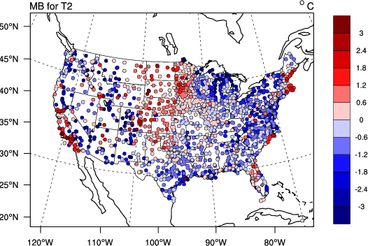
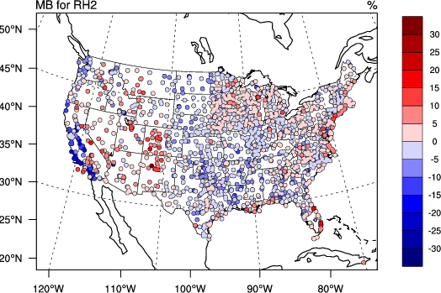
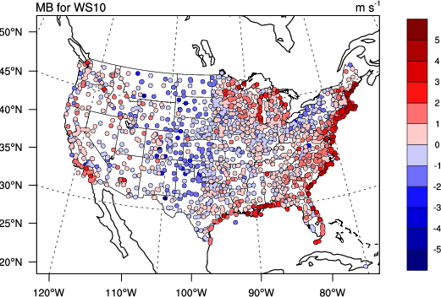
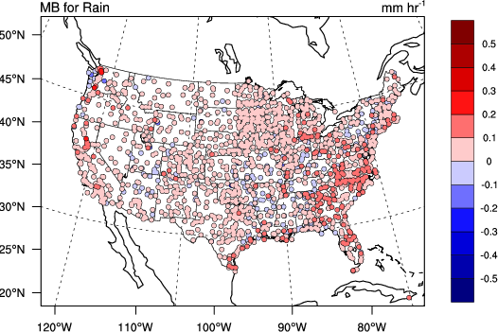
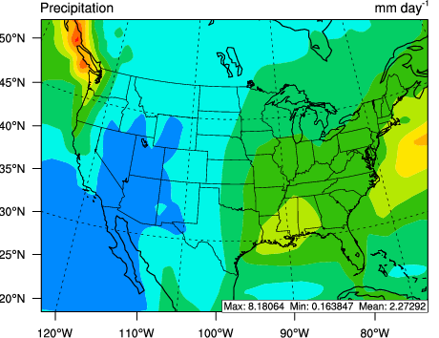
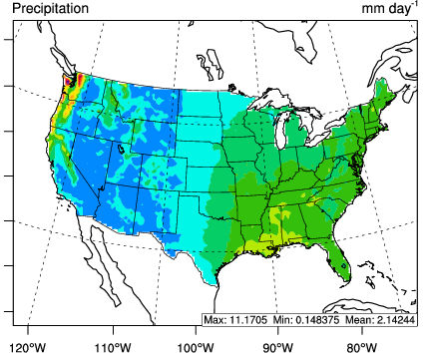
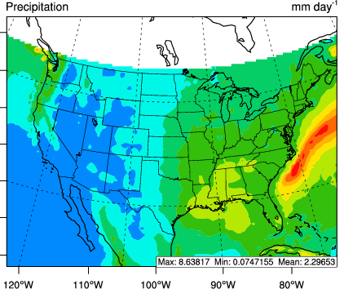
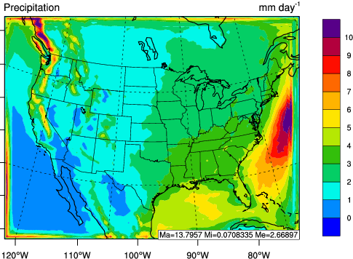
Meteorological Performance
T2
RH2
WS10
Rain
MB: -0.6°C, NMB: -4.9%
MB: -1.4%, NMB: -2.0%
MB: 0.04 mm hr⁻¹,
NMB: 57.5%
MB: 0.23 ms⁻¹ , NMB: 6.7%
Precipitation Performance against Satellite/Reanalysis Data
GPCP
PRISM
TMPA
TDM
MB:0.34 mm day⁻¹ ,NMB: 15%
MB: 0.25 mm day,
NMB: 11.7%
MB: 0.35 mm/day,
NMB: 15.5%
Generally cold biases for T2, overprediction of WS10 and RH2 in eastern and mountainous areas of U.S., precipitation overpredicted across the domain

Slide 8
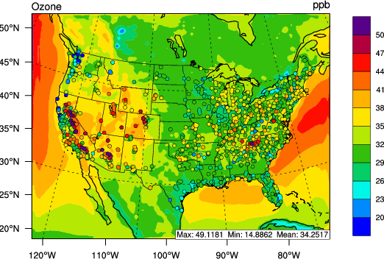
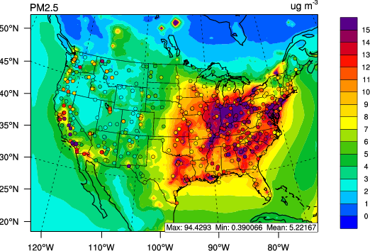
Simulated O₃ and PM_{2.5} Overlaid with Observations
Ozone
PM_{2.5}
CASTNET: NMB=-8.9%; AQS: NMB=2.3%
IMPROVE: NMB=12.9%; CSN: NMB=6.2%
Overall good performance for O₃ (NMB < ±10%), but locally large underpredictions exist in both eastern and western U.S.; PM_{2.5} performs well in eastern U.S., but there are larger negative biases in western U.S.

Slide 9
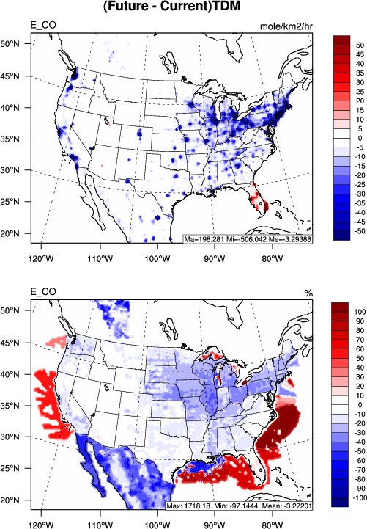
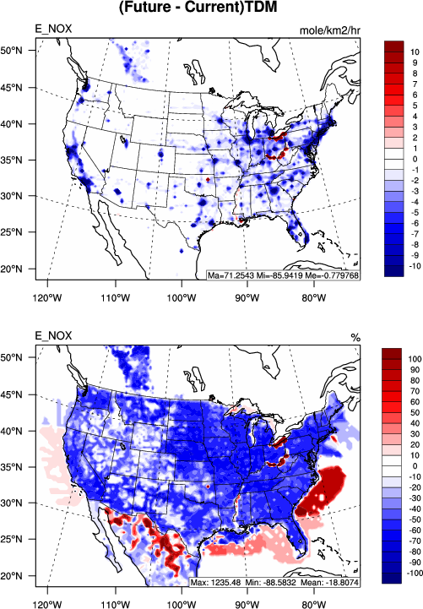
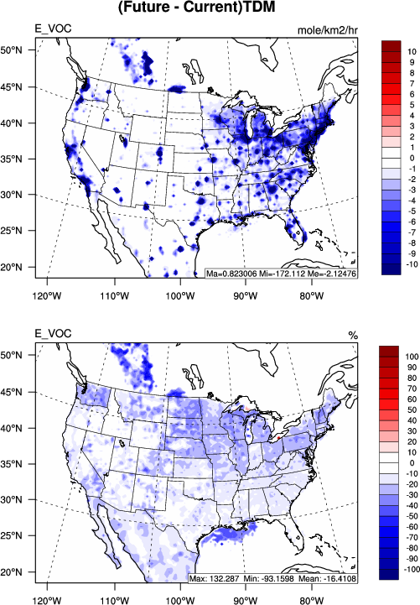
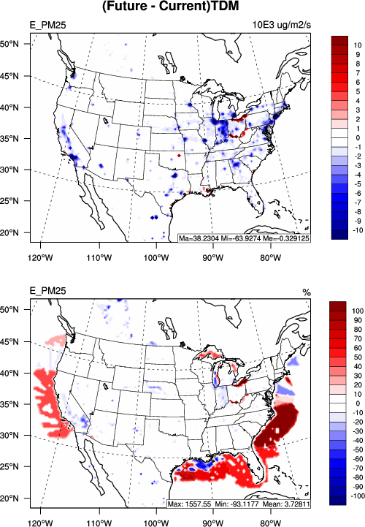
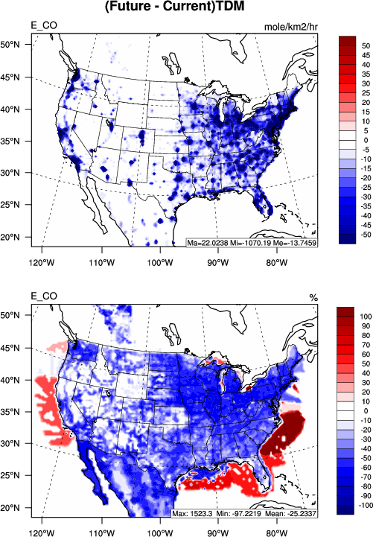
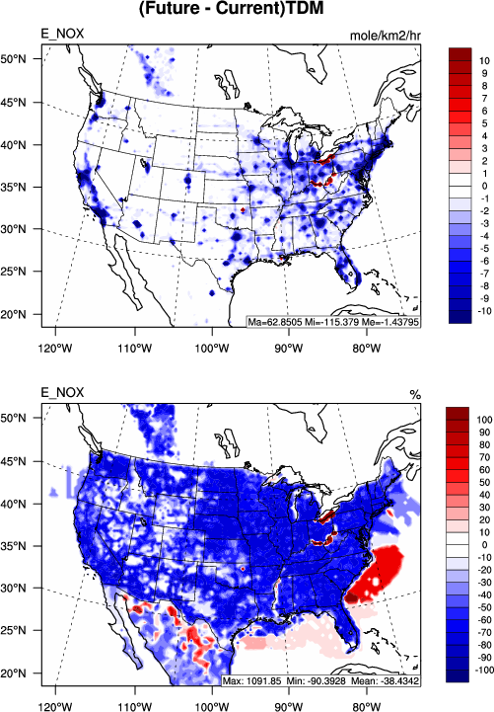
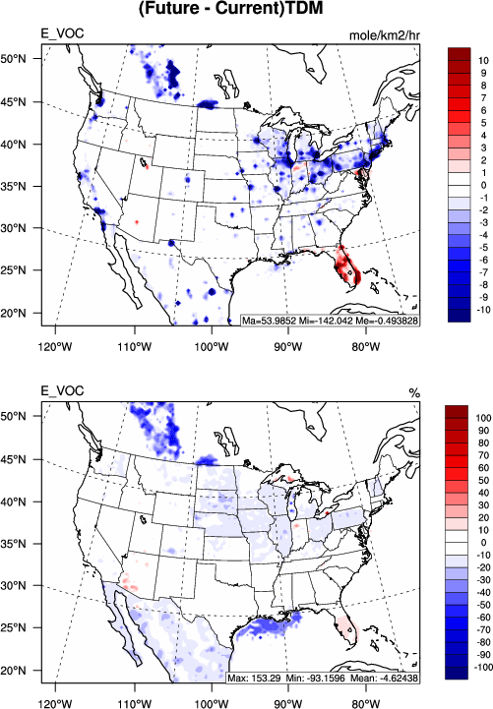
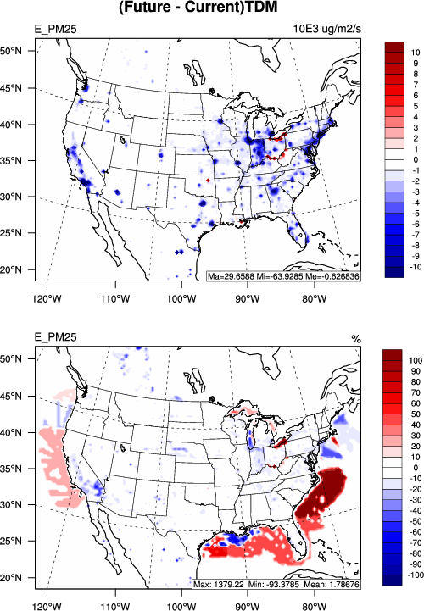
Projected Emission Changes
TDM B2 Scenario
TDM A1B Scenario
CO
NO_{X}
VOC
PM_{2.5}
Abs. changes
Rel. changes
Under the B2 scenario, emissions of CO, NO_{x}, VOCs, and PM_{2.5} are projected to decrease over large areas of domain with a few exceptions (e.g., Ohio River)
Under the A1B scenario, emissions of CO, NO_{X}, VOCs, and PM_{2.5} are projected to decrease over large areas of domain with a few exceptions (e.g., Florida and Ohio River)
Notes:
“with a few exceptions Ohio River” does not make sense, did you mean
with a few exceptions (e.g., Ohio River)

Slide 10
Projected Air Quality Changes
Daily Maximum 8-hr Avg. O₃
Daily 24-hr Avg. PM_{2.5}
TDM/A1B
TDM/B2
Emissions
Change only
Climate
Change only
Emissions and
Climate Changes
The maximum daily 8-h average surface ozone (MDA8h O₃) increases by ~3 ppb across the U.S. due to (i) enhanced CH₄ concentrations and subsequent higher T2, (ii) increased biogenic VOC emissions, and (iii) larger NO_{x} emission reduction than VOC emission reduction over VOC-limited regions
The daily 24-h average (DA24h) PM_{2.5} levels are projected to decrease over eastern U.S., mainly due to the decreases in primary anthropogenic emissions of PM species and gaseous precursors and secondary formation of inorganic aerosols as well as increased precipitation

Slide 11
Number of exceedance days for daily 24-hr Avg. PM_{2.5} > 35 µg m⁻³
Number of exceedance days for MDA8h Ozone > 70 ppb
TDM/A1B
TDM/B2
Emissions
Change only
Climate
Change only
Emissions and
Climate Changes
The number of exceedance days DA 24hr PM_{2.5} > 35 µg m⁻³ is significantly reduced over eastern U.S.
The number of exceedance days (MDA8h O₃ > 70 ppb) is significantly reduced in emission change only scenario but increased in climate change only scenario. Overall changes in number of exceedance days are dominant by emission change only scenario

Slide 12
Conclusions
The model shows overall good performance for meteorological variables, O₃ and PM_{2.5} over CONUS
The maximum daily 8-h average surface ozone (MDA8h O₃) increases by ~3 ppb across the U.S. The number of exceedance days (MDA8h O₃ > 70 ppb) is significantly reduced but some areas remain non-attainment
The daily 24-h average (DA24h) PM_{2.5} levels are projected to decrease over eastern U.S. The number of exceedance days (DA24hr PM_{2.5} > 35 µg m⁻³) is significantly reduced over eastern U.S.
The climate change dominates the changes in surface O₃ concentration under the TDM A1B scenario across the CONUS, while the changes in anthropogenic emissions dominate surface O₃ levels under the TDM B2 scenario and PM_{2.5} under both TDM A1B and B2 scenarios
The results will be useful for policy makers to develop integrated strategies to control anthropogenic emissions and mitigate adverse climate change

Slide 13
Acknowledgments
The National Science Foundation EaSM program (AGS-1049200) at NCSU and the USDA EaSM program (2012-67003-30192) at the University of Chicago/ANL
High performance computing support from Yellowstone (ark:/85065/d7wd3xhc) provided by NCAR’s Computational and Information Systems Laboratory, sponsored by the National Science Foundation; and from Stampede, provided as an Extreme Science and Engineering Discovery Environment (XSEDE) digital service by the Texas Advanced Computing Center (TACC) (http://www.tacc.utexas.edu), which is supported by National Science Foundation grant number ACI-1053575

