Slide 1
Improvements to the Noah Land Surface Model in WRF-CMAQ and its Application to Future Changes in the Chesapeake Bay Region
Patrick Campbell*, Jesse O. Bash, Chris G. Nolte,
Tanya L. Spero, and Ellen J. Cooter
Acknowledgments: Chesapeake Bay Program’s Lewis Linker, Kyle Hinson, Gary Shenk, and Gopal Bhatt
*Work supported by NRC RAP and the ACE AIMS and CIVA Project
2017 WRF Users’ Workshop
Session 5.2 - June 14, 2017

Slide 2
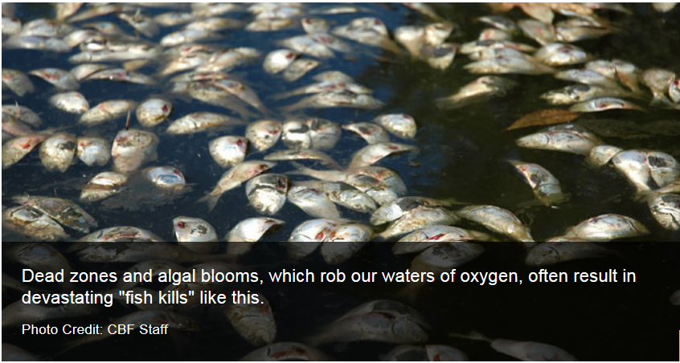
Regional Climate and Air Quality
Consistently study future climate, land use, air quality impacts in the Chesapeake Bay
Apply a “One-atmosphere” modeling system → Towards a “One-biosphere” system
~1 – 8 ft by 2100
Sources: http://www.cbf.org
https://insideclimatenews.org/
https://tidesandcurrents.noaa.gov/
Regional Impacts
Notes:
Future climate change is unequivocal, and the future impacts on global to the regional scale may be severe. Such impacts include sea level rise…
There are also simultaneous changes in future emissions that impact air quality and deposition on the regional scale, such as reduced NOx emissions but increasing NH3 emissions from agriculture leading to importance for nutrient loading to the watershed scale, such as the Chesapeake Bay, where…
The combined impacts of land use, climate change, emissions, and air/water quality changes can have significant impacts on the Chesapeake Bay watershed, which has already experienced significant increases in areas of anoxic dead zones, and the future nutrient loading scenarios are uncertain…thus we need to. Consistently model…
One-atmosphere: Meteorologically driven chemistry and physics of pollutant transport and fate solved simultaneously
“One biosphere” approach: Explicitly bring in human preferences and reactions e.g., economic drivers, human health and ecosystem endpoints
Climate Change & Sea level rise: More of a range: 0.3 m-2.5 m (~ 1 – 8 ft) global mean sea level (GMSL) range for 2100, and along regions of the Northeast Atlantic (Virginia coast and northward) and the western Gulf of Mexico coasts, RSL rise is projected to be greater than the global average. With only about 0.35 m (<14 inches) of local RSL rise, annual frequencies of such disruptive/damaging flooding could increase 25-fold by 2030.
Changing N emissions/deposition spectrum: . Recent efforts to lower nitrogen oxides emissions have substantially decreased nitrate wet deposition. Levels of wet ammonium deposition, by contrast, have increased in many regions. Together these changes have altered the balance between oxidized and reduced nitrogen deposition.
Agriculture Impacts: Agricultural lands also contribute nitrogen, phosphorus, and sediment pollution to our rivers and streams.
Air Pollution Impacts: Most of the nitrogen pollution is from power plant smokestacks and vehicle tailpipes. The Baltimore-Washington metropolitan region has the nation's second worst traffic and ozone problems.
Climate Change: Warmer waters have a decreased capacity to hold dissolved oxygen, exacerbating the Bay's fish-killing dead zones, squeezing fish into smaller and smaller oxygenated areas of the water column, and contributing to algal blooms. Sea level rise is exacerbated by land subsidence.
Land Use: A profound relationship exists between the water of the Chesapeake Bay and the 64,000 square miles of land and over 18 million people comprising the Bay's watershed. Approximately 100,000 rivers and streams run into the Bay.
Dead Zones: A direct consequence of the impacts of effluent discharges from wastewater treatment plants, agricultural fertilizer runoff, climate change, and air pollution/deposition. Excessive nitrogen and phosphorus pollution from human activities cause "dead zones"—or areas with low amounts of oxygen in the Bay.
“One biosphere” approach: Explicitly bring in human preferences and reactions e.g., economic drivers, human health and ecosystem endpoints
More Details:
In the NOAA study, sea level rise is discretized by 0.5-m increments and aligned with emissions-based, conditional probabilistic storylines and global model projections into six GMSL rise scenarios: a Low, Intermediate-Low, Intermediate, Intermediate-High, High and Extreme, which correspond to GMSL rise of 0.3 m, 0.5 m, 1.0 m, 1.5 m, 2.0 m and 2.5 m, respectively. Along regions of the Northeast Atlantic (Virginia coast and northward) and the western Gulf of Mexico coasts, RSL rise is projected to be greater than the global average for almost all future GMSL rise scenarios (e.g., 0.3-0.5 m or more RSL rise by the year 2100 than GMSL rise under the Intermediate scenario). With only about 0.35 m (<14 inches) of local RSL rise, annual frequencies of such disruptive/damaging flooding will increase 25-fold by or about (±5 years) 2080, 2060, 2040 and 2030 under the Low, Intermediate-Low, Intermediate and Intermediate High subset of scenarios, respectively.
Changing N emissions/deposition spectrum: Rapid development of agriculture and fossil fuel combustion greatly increased US reactive nitrogen emissions to the atmosphere in the second half of the 20th century, resulting in excess nitrogen deposition to natural ecosystems. Recent efforts to lower nitrogen oxides emissions have substantially decreased nitrate wet deposition. Levels of wet ammonium deposition, by contrast, have increased in many regions. Together these changes have altered the balance between oxidized and reduced nitrogen deposition. Across most of the United States, wet deposition has transitioned from being nitrate-dominated in the 1980s to ammonium-dominated in recent years. Recent expansion in ammonia observations, however, along with ongoing measurements of nitric acid and fine particle
ammonium and nitrate, permit new insight into the balance of oxidized and reduced nitrogen in the total (wet + dry) US nitrogen deposition budget. Observations from 37 sites reveal that reduced nitrogen contributes, on average, ∼65% of the total inorganic nitrogen deposition budget. Dry deposition of ammonia plays an especially key role in nitrogen deposition, contributing from 19%
to 65% in different regions. Future progress toward reducing US
nitrogen deposition will be increasingly difficult without a reduction
in ammonia emissions.
Agriculture Impacts: Agricultural lands also contribute nitrogen, phosphorus, and sediment pollution to our rivers and streams. We're losing farms because of sprawling suburban development, diminishing profits, increases in the cost of fuel and other operational expenses, and a steep decrease in the share of consumer food dollars received by farmers
Air Pollution Impacts: *Based on 2014 data from the Chesapeake Bay Program Watershed Model 5.3.2. Most of the nitrogen pollution is from power plant smokestacks and vehicle tailpipes. The Baltimore-Washington metropolitan region has the nation's second worst traffic and ozone problems. Nitrogen from vehicle exhaust washes into the Bay and contributes to algae blooms. These blooms cloud the water and absorb the oxygen, creating dead zones in the Bay that cannot support underwater grasses, crabs, fish, and other marine life. Other byproducts of haphazard sprawl—roads, parking lots, and other paved surfaces—make erosion and sediment pollution worse in the Bay.
Climate Change: Warmer waters have a decreased capacity to hold dissolved oxygen, exacerbating the Bay's fish-killing dead zones, squeezing fish into smaller and smaller oxygenated areas of the water column, and contributing to algal blooms. Sea level rise is exacerbated by land subsidence. This combination of processes has resulted in approximately one foot of net sea level rise in the Chesapeake Bay over the past 100 years—a rate nearly twice that of the global historic average.
Land Use: A profound relationship exists between the water of the Chesapeake Bay and the 64,000 square miles of land and over 18 million people comprising the Bay's watershed. Approximately 100,000 rivers and streams run into the Bay. This tributary system directly connects farms, forests, and developed communities in six states (Delaware, Maryland, New York, Pennsylvania, Virginia, and West Virginia) and the District of Columbia with the Chesapeake. More than 18 million people live in the Chesapeake Bay Watershed.
Dead Zones: A direct consequence of the impacts of effluent discharges from wastewater treatment plants, agricultural fertilizer runoff, climate change, and air pollution/deposition. Excessive nitrogen and phosphorus pollution from human activities cause "dead zones"—or areas with low amounts of oxygen in the Bay. With little or no oxygen, fish, crabs, oysters, and other aquatic animals literally suffocate. Further, an excess in these nutrients also fuels the growth of dense algae blooms that block sunlight that underwater grasses need to grow in order to continue providing food for waterfowl and shelter for blue crabs and juvenile fish.

Slide 3
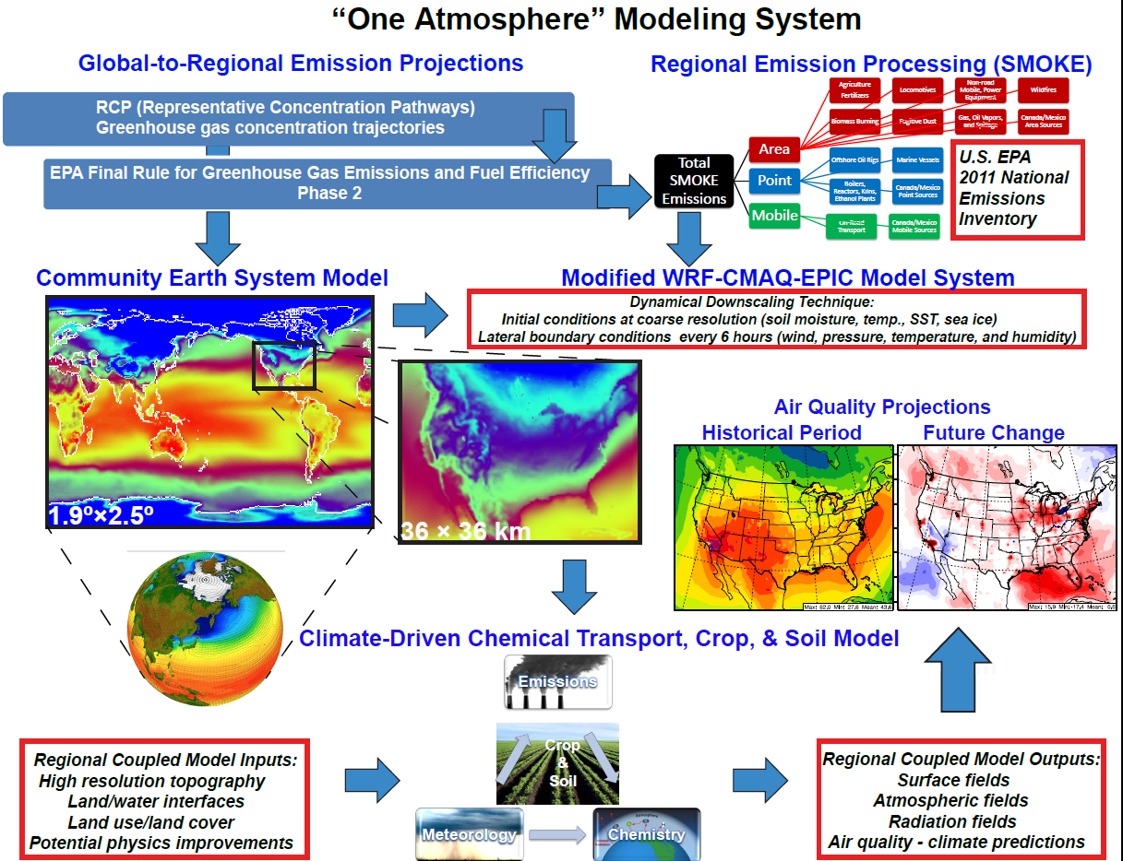
WRF-CMAQ Simulation Design
RCP4.5 Scenario
Historical Period: 1996 - 2005
Future Period: 2046 - 2055
Notes:
In this work we advance and apply a combined one-atmosphere model system, WRF-CMAQ (our open-source EPA developed Community Multi-scale Air Quality Model that is widely used in )
EPIC (Environmental Policy Integrated Climate) → couples agricultural cropping management and soil biogeochemical processes to CMAQ for improved nutrient modeling (e.g., NH3 emissions and NH4 fate)
The radiative forcing pathway of the RCP4.5 scenario is comparable to a number of climate policy scenarios and several low-emissions reference scenarios in the literature, such as the IPCC SRES B1 scenario. 3-month spinup period for WRF to drive CMAQ.
The U.S. Environmental Protection Agency and the Department of Transportation’s National Highway Traffic Safety Administration jointly finalized standards for medium- and heavy-duty vehicles that would improve fuel efficiency and cut carbon pollution by 2030 to reduce the impacts of climate change, while bolstering energy security and spurring manufacturing innovation. Point sector emissions are projected through on-the-books standards and regs by 2030.
The final phase two program promotes a new generation of cleaner, more fuel efficient trucks by encouraging the development and deployment of new and advanced cost-effective technologies. The product of four years of extensive testing and research, the vehicle and engine performance standards would cover model years 2018-2027 for certain trailers and model years 2021-2027 for semi-trucks, large pickup trucks, vans, and all types and sizes of buses and work trucks. The final standards are expected to lower CO₂ emissions by approximately 1.1 billion metric tons, save vehicle owners fuel costs of about $170 billion, and reduce oil consumption by up to two billion barrels over the lifetime of the vehicles sold under the program.

Slide 4
Noah LSM in WRF-CMAQ
Most WRF-CMAQ air quality modeling studies use Pleim-Xiu (P-X) LSM in WRF
P-X is not suitable for future climate applications as it relies on surface moisture and temperature nudging
Thus Noah is widely used in WRF for future climate/air quality applications
The current version of WRF/Noah is limited in its inputs to CMAQ and lacks physical consistency with some parameterizations in CMAQ
Motivation for our work to update WRF/Noah-CMAQ model system →
NCAR LSM group meeting (Fei Chen, 2007)
Noah stomatal conductance
Subgrid-scale land-use (Mosaic)
Update soil/vegetation tables
Modify top soil layer depth
Notes:
So in this presentation I do not focus heavily on our CMAQ chemistry changes, but rather some of the Noah changes that improve the physical consistency of using WRF/Noah coupled to CMAQ.
LSMsNeed to account for subgrid-scale fluxes
• The lower boundary is the only physical boundary for atmospheric models: Sensible Heat Flux, Latent Heat Flux, Outgoing LW, and reflected SW radiation- - maintain surface energy and hydrological balance
Noah LSM readily used in WRF since mid-1990s
Undergone relatively new updates including Noah Mosaic and MP
• LSM becomes increasingly important:
– More complex PBL schemes are sensitive to surface fluxes and cloud/cumulus schemes are sensitive to the PBL structures
– NWP models increase their grid-spacing (1-km and sub 1-km).
Need to capture mesoscale circulations forced by surface variability in albedo, soil moisture/temperature, landuse, and snow
• Not a simple task: tremendous land surface variability and complex land surface/hydrology processes
• Initialization of soil moisture/temperature is a challenge
Noah is widely used in both the operational weather forecasting (e.g., global GFS, regional NAM) and research (e.g., WRF and MPAS) communities
Surface layer parameterization (coupling between skin layer and first model level, depends on roughness lengths and wind speed) and fluxes are more sensitive to the treatment of roughness length for heat/moisture than to M-O based surface layer schemes themselves.
LSM may also be thought of as hydrological balance model.
The Atmospheric Boundary Layer (ABL) growth is strongly driven by surface sensible and latent fluxes.
upward longwave radiation QLu
– Alternatively: skin temperature and sfc emissivity
• upward (reflected) shortwave radiation aQS
– Alternatively: surface albedo, including snow effect
Two Important Transport Mechanisms
– Molecular conduction of heat, diffusion of tracers, and viscous transfer of momentum cause transport between the surface and the lowest millimeters of air diffusion
• Diffusivity for momentum, heat, and water vapor: ~ 10-5 m2s-1
• Require large gradient (e.g., 104 Km-1)
• Can be neglected above the lowest few centimeter
– Turbulent fluxes:
• Diffusion coefficient depend on height, wind speed,
friction, instability: ~ 100 m2s-1, about 104- 105 larger
than molecular diffusivity
• Caused by small and large eddies: very efficient
Noah-MP was developed in order to facilitate climate predictions with physically based ensembles. Multi-physics options allows for isolation and analysis of specific parameter schemes ultimately allowing 4,584 combinations to be assessed. In addition, to better predict climate, Noah MP is capable of coupling NCEP Global Forecasting System (GFS) and Climate Forecasting System (CFS) and in the near future, coupling will improve weather predictions with the Weather Research and Forecasting (WRF) modeling system. Some flaws in Noah-LSM have also been modified to better represent several parameters including: surface layer radiation balances, snow depth, soil moisture and heat fluxes, leaf area-rainfall interaction, vegetation and canopy temperature distinction, soil column and drainage of soil, and runoff.
Noah-MPC Scheme Options
Multi-Physics Options:
1. Options for dynamic vegetation: a) off b) on (together with OPT_CRS = 1) [default]
2. Options for canopy stomatal resistance a) Ball-Berry (must 1 when DVEG = 2) [default] b) Jarvis
3. Options for soil moisture factor for stomatal resistance a) Noah (soil moisture) [default] b) CLM (matric potential) c) SSiB (matric potential)
4. Options for runoff and groundwater a) TOPMODEL with groundwater (Niu et al. 2007 JGR) [default] b) TOPMODEL with an equilibrium water table (Niu et al. 2005 JGR) ; c) original surface and subsurface runoff (free drainage) d) BATS surface and subsurface runoff (free drainage)
5. Options for surface layer drag coeff (CH & CM) a) M-O [default] b) original Noah (Chen97)
6. Options for supercooled liquid water (or ice fraction) a) no iteration (Niu and Yang, 2006 JHM) [default] b) Koren’s iteration
7. Options for frozen soil permeability a) linear effects, more permeable (Niu and Yang, 2006, JHM) [default] b) nonlinear effects, less permeable (old)
8. Options for radiation transfer a) modified two-stream (gap = F(solar angle, 3D structure …)<1-FVEG) [default] b) two-stream applied to grid-cell (gap = 0) c) two-stream applied to vegetated fraction (gap=1-FVEG)
9. Options for ground snow surface albedo a) BATS; b) CLASS [default]
10. Options for partitioning precipitation into rainfall & snowfall a) Jordan (1991) [default] b) BATS: when SFCTMP<TFRZ+2.2 ; c) SFCTMP<TFRZ
11. Options for lower boundary condition of soil temperature a) zero heat flux from bottom (ZBOT and TBOT not used) b) TBOT at ZBOT (8m) read from a file (original Noah) [default]
12. Options for snow/soil temperature time scheme (only layer 1) a) semi-implicit [default] b) full implicit (original Noah)
Gao et al.: Dynamical downscaling CAM/Chem - Impacts of emissions and climate on O3 over U.S. with RCP4.5 and 8.5 emissions
Gonzalez-Abraham et al.: Dynamical downscaling ECHAM5 – A1B Scenario – Regional NEI 2002 Projected using MARKAL
Zhang et al.: Dynamical downscaling GFDL AM3 – Co-benefits of RCP emissions and climate reductions
Campbell et al.: Dynamical downscaling CCSM – IPCC A1B Scenario – Impacts of transportation sector emission changes from a technology driver model
WRF/P-X LSM was designed for retrospective meteorological applications not a real-time forecasting or long-term climate simulation application, because of the indirect soil nudging scheme. The indirect soil nudging requires accurate 2-m temperature and water vapor mixing ratio analyses (not available in real-time forecasting unless forecasted fields are used). These are computed by blending point surface observations and forecast model initial conditions using the Obsgrid preprocessor.
Additional work in MCIP had been done some time ago to better link CMAQ with the NOAH LSM (Chen and Dudhia, 2001).

Slide 5
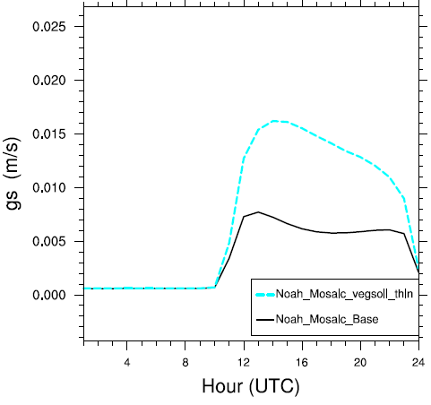
WRF/Noah R_{c} to CMAQ
WRF/Noah R_{c} (canopy resistance, i.e., bulk stomatal resistance) used as input into coupled WRF-CMAQ → Key parameter for CMAQ deposition
A. WRF/Noah-CMAQ
Old Stand-alone Calc. (s/m)
B. WRF/Noah Mosaic-CMAQ
New WRF/Noah Output (s/m)
Jun 01– Aug 31, 2011
Diurnal g_{c} (=1/R_{c}) m/s
B
R_{c}
R_{c}
A
May 26 – 31, 2011
Notes:
Stomatal resistance or conductance (gst = 1/Rst) controls the flux of gasses, including CO2 and water vapor, into and out of leaves, and is a key parameter for dry deposition in CMAQ.
Since stomatal resistance is the primary regulatory process for evapotranspiration, it is a key parameter for LSMs that are included in meteorology models.
Thus it makes sense to use the same parameterization of the stomatal pathway for the WRF meteorological and CMAQ chemical components of air quality modeling systems, but wasn’t done so until now…
Significant differences in Rc in many areas of CONUS, definitely impacted by sub-grid scale land-use heterogeneity from Noah-Mosaic tiling approach, and this is passed directly to CMAQ
Stand alone calculations solely a function of land-use type from look up tables…
In Noah, Rc calculation is similar methodology to Rs in P-X, where both are approximated by using the Jarvis model, and approximates model bulk (canopy level) stomatal resistance (or conductance), where the functions F1–4 represent the fractional degree of stomatal closure caused by the environmental stresses: photosynthetically active radiation PAR, root-depth soil moisture w2, relative humidity at the leaf surface RHs, and air temperature in the canopy Ta. In other words, F1 = amount of PAR, F2 = dry soil stress, F3 = dry air stress, and F4 = heat stress. Rc_min is the minimum canopy resistance as a function of vegetation type. Thus hot and dry air lead to stressed vegetation, reduced transpiration, and larger (smaller) resistances (conductance).
Increased spatial heterogeneity in Rs for modified Noah and Noah Mosaic in the west and northwest, and over numerous regions in the eastern U.S.
Default Noah Rs is a stand alone calculation in the met processor for CMAQ, MCIP, where the F2 dry soil stress is taken from look up table based on land use type.
An article cited for M3Dry (Pleim et al 2001) presents the dry deposition model as part of a coupled land surface model (LSM) for meteorology and chemistry. This article, and a more recent article by Pleim and Ran (2011), both explain that a key advantage of M3Dry over stand-alone dry deposition models such as the Wesely model is that the stomatal conductance and several other parameters are used directly from the LSM in the meteorology model. In this way, the stomatal pathway for dry deposition is proportional (scaled by the ratio of the chemical diffusivity to the diffusivity of water) to the stomatal conductance used to compute transpiration for surface moisture flux in the meteorology model. In the most recent model versions, dry deposition velocities are computed in CMAQ (M3Dry was removed from MCIP in 2011) using stomatal conductance that is output from the meteorology model (or typically the P-X LSM stomatal conductance) Thus the stomatal pathway for dry deposition in M3Dry is as good or bad as the stomatal pathway for evapotranspiration. If the stomatal conductance is not realistic, the meteorology simulation will not be accurate.
MCIP includes an option for a standalone stomatal conductance calculation (function of the land use type in MCIP resistcalc.F90) for use if this parameter was not available from the meteorology LSM model output. If the stomatal conductance for the M3Dry model runs do not use the stomatal conductance from the WRF LSM (in this case Noah), the results would not be representative of the model’s typical performance. We fix this.
Plots: For Offline Noah Base, Rs = 1/RSTOMI from MCIP (resistcalc routine) METCRO2D and slight regrid to WRF Domain for comparison
For Coupled Noah Dev Runs, Rs = RC2 from WRF Noah Dev output
Some significant differences in offline vs. coupled development Noah Rs values.
Use WRF/Noah lowest model layer wind speed and friction velocity, self consistent, where WSPD contains the convective velocity scale and subgrid-scale velocity Vg correction, inside w*, following Beljaars (1995, QJRMS), and Mahrt and Sun (1995, MWR) over land, and Wyngaard (1988) from old MM5 over water.
In w*, subgrid-scale velocity scale is important to remove anomously large area averaged surface fluxes where large scale flow is weak, and significant fluxes of heat and moisture are driven by mesoscale motions. The “subgrid” velocity scale correction must be included to account for generation of turbulent fluxes by subgrid mesoscale motions. The addition of the subgrid velocity scale reduces the dependence of the exchange coefficients on grid size.
In w*, the convective velocity scale is based on free convection from buoyancy at the surface and zi (top of mixed layer, bottom of overlying inversion).
Mean Ra is higher in the modified WRF/Noah, but the spatial distribution is quite similar to stand alone calculation in the base MCIP processor (
Plots: For Offline Noah Base, Ra = 1/RADYNI from MCIP (resistcalc routine) METCRO2D and slight regrid to WRF domain for comparison:.
For Coupled Noah Dev Runs, Ra = WSPD/USTAR**2 from WRF output

Slide 6
WRF/Noah Vegetation Tables
Default vegetation tables in WRF/Noah show unrealistic Leaf Area Index (LAI) compared to MODIS in many regions of North America
Updated Vegetation Tables:
Based on generalized linear model
Land use types regressed against MODIS LAI
January
January
January
July
July
July
Default Look Up Table
MODIS LAI
Revised Look Up Table
Notes:
One of the three key inputs into the Noah LSM are:
Land use (vegetation) type
Soil texture
Slope
Vegetation tables (i.e., VEGPARM.TBL) are a key input into Noah, and provide the albedo, roughness length, shade factors, number of root layers, stomatal/canopy resistance min, leaf area index, and other parameters as a function of land use category/class from (1). These tables are vastly outdated, and have unrealistic LAI values in many areas of the U.S.
Method based on generalized linear model of land use types regressed against MODIS LAI. A ten fold cross validation was run to assess variability in estimates and the mean land use factor was selected.

Slide 7
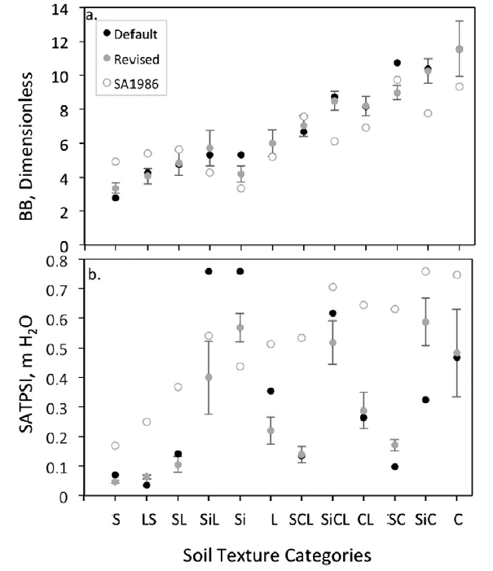
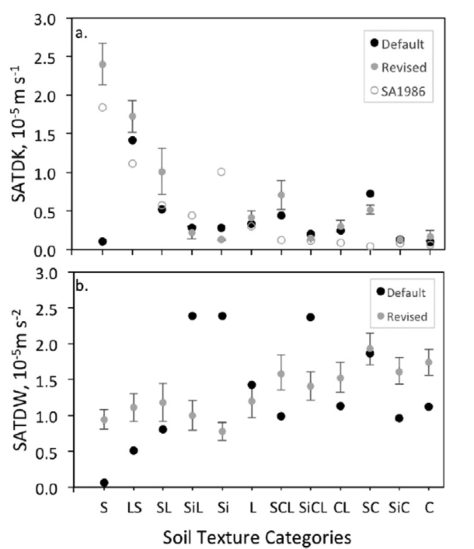
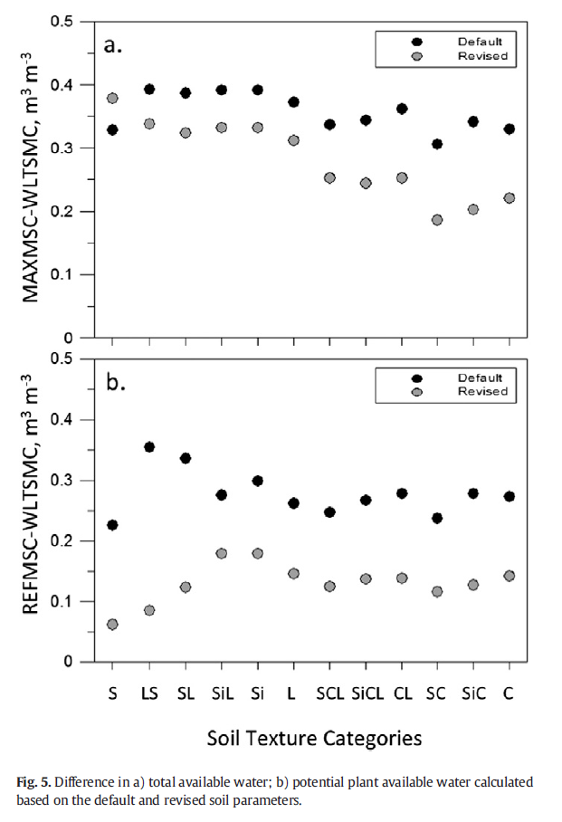
WRF/Noah Soil Tables
Default soil hydraulic tables in WRF/Noah are outdated (> 25 years)
New table values are adapted from Kishne et al. (2017)* → Based on a detailed study using the USDA - National Cooperative Soil Characterization Database (USDA-NRCS)**
Soil Moisture Release Function
“Volumetric Water Content”
Saturated Hydraulic Conductivity
Total available water
“Water Stress”
“Water Filling/Movement”
Coarse → Fine
35 – 76% lower
Air Entry Water Potential
“runoff vs. infiltration”
Saturated Hydraulic Diffusivity
“Water Pressure/Movement”
Potential plant available water
*Kishné, A. S., Y. T. Yimama, C. L.S. Morgan, B. C. Dornblaser (2017), Evaluation and improvement of the default
soil hydraulic parameters for the Noah Land Surface Model, Geoderma, 285, 247 – 259, doi: 10.1016/j.geoderma.2016.09.022.
**Data available: http://ncsslabdatamart.sc.egov.usda.gov
Notes:
Outdated soil texture/hydraulic properties, which are commonly used to characterize the water-holding characteristic of most agricultural soils (Saxton et al., 1986), and are important inputs to Noah, are largely outdated, and some values are rather a mystery where they came from…
The soil hydraulic tables used in WRF/Noah are important to many soil parameters, including Kt (thermal conductivity of the soil) that is used in calculating the ground heat flux, or soil moisture release functions→ water moving in and out of the soil…
USDA-NRCS Measurements: Soil records were selected that had measurements of percent clay, percent silt, percent sand; water content at air dry,−1500 kPa (permanent wilting point), and at−33 kPa (field capacity); and soil bulk density measured at−33 kPa. Remaining soil hydraulic parameters calculated from these measured values using theory from Cosby et al. (1984) and Chen and Dudhia (2001)
Most importantly…Due to changes in both MAXSMC and WLTSMC, total available water contents are 35–76% lower than predicted by default parameter values (Fig. 5a) for all classes except sand as discussed above. Similarly, changing REFSMC and WLTSMC strongly decreases potential soil water available for plants to transpire in all 12 soil texture categories (Fig. 5b). Impacts on plant transpiration impact stresses on canopy/stomatal resistances in WRF and resulting CMAQ deposition (because we now pass that directly from WRF/Noah to CMAQ).
They contain numerous variables (e.g., soil water content) at 1) ceased evaporation from top soil layer (DRYSMC), at saturation (MAXSMC), at field capacity (REFSMC), and at wilting point (WLTSMC)). Also included are the exponent in hydraulic functions relating water potential and volumetric water content (BB), the saturation matric potential or air entry water potential (SATPSI), saturated hydraulic conductivity (SATDK), and saturated hydraulic diffusivity (SATDW).
BB differences may still strongly impact the model results of the Noah LSM because of the role of parameter BB as an exponent in the soil moisture release function
SATPSI differences may lead to a large bias is expected in partitioning precipitation between runoff and infiltration as well as drainage simulations while using the default SATPSI values for areas dominated by silt loam and silt soil
The revised value of parameter SATDK or SATDW (similar to SATDK, but works on pressure, and not dependent on the filling of volume) portrays much faster water movement in sandy soils than what is predicted by the current default parameter value.
Soil water content at permanent wilting point (WLTSMC) is used in Noah land surface modeling as the lower threshold for calculating potential plant available water content, i.e. the difference between REFSMC (field capacity) and WLTSMC, and the total available water content, i.e. the difference between MAXSMC (saturation) and WLTSMC. Thus, its impact on model outcomes is usually stronger in calculating water stress for stomatal conductance for transpiration, hence latent heat flux.
Testing of significant difference: For testing differences of parameter means grouped by texture category and MLRA, t-tests with 95% confidence levels were applied using MatLab Statistical Tool.
Figures: The largest variation of parameter BB is in clay soils with average standard deviation of 1.62, 14%Although differences between the default and revised values do not seem too large across texture classes, the differences may still strongly impact the model results of the Noah LSM because of the role of parameter BB as an exponent in the soil moisture release function. The sensitivity analyses study conducted by Rosero et al. (2010) showed a strong dependence of Noah model output on this parameter.
The revised values of the SATPSI (air-entry water potential) parameter were found to be significantly different from the default table in all texture classes (Table 6). In general, default SATPSI values for silt loam and for silt were rather high compared to the revised values (Fig. 2b). The default values of SATPSI in these classes are greater than the recently estimated values by 90% and 34%, respectively. Thus, a large bias is expected in partitioning precipitation between runoff and infiltration as well as drainage simulations while using the default SATPSI values for areas dominated by silt loam and silt soil. Representing the air entry potential of the soil, a critical value of desaturation, the estimated values of SATPSI confirm the general trend indicated by Hillel (1998) in that it is the smallest in coarse-textured and well-aggregated soils and
tends to be greater in medium-textured or in fine-textured soils.
Parameter SATDK (saturated hydraulic conductivity) values were significantly different from the default values in all soil texture categories (Table 6). The greatest difference, more than 20-times, was found in sand. This finding was supported by the values estimated following Saxton et al. (1986) (Fig. 3a). The revised value of parameter SATDK portrays much faster water movement in sandy soils than what is predicted by the current default parameter value.
The revised values for parameter SATDW (Saturated hydraulic diffusivity) were estimated from the revised values of parameters BB, MAXSMC, SATPSI, and SATDK using the equations listed in Table 5, resulting in a smaller overall variability of hydraulic diffusivity across textures compared to the default values (Fig. 3b). For sand, the magnitude of revised SATDW is 16 times greater than the default value. In contrast, the revised value of SATDW was 2.4-times less for silt loam than the default value.
The revised MAXSMC values were significantly different for 10 soil textures, excluding loam and silty clay (Table 6).
The greatest differences were found in the coarser soil textural classes, where the revised REFSMC values were less than the default values by up to 0.24 m3 m−3. Consequently the use of the current default values of REFSMC may contribute to strong overestimation of plant available water primarily in coarse-textured soils.
Values of revised WLTSMC showed significant differences between the mean WLTSMC values by texture from the default values (Table 6). The magnitudes of the differences were rather small in sandy soils but increased across texture classes up to amore than two-fold increase for fine-textured soil (Fig. 4b).
Soil water content at permanent wilting point (WLTSMC) is used in Noah land surface modeling as the lower threshold for calculating potential plant available water content, i.e. the difference between REFSMC and WLTSMC, and the total available water content, i.e. the difference between MAXSMC and WLTSMC. Thus, its impact on model outcomes is usually stronger in calculating water stress for stomatal conductance for transpiration, hence latent heat flux.
The revised parameter DRYSMC values were significantly and consistently smaller than the default values (Table 6) that are the same as the corresponding WLTSMC values (Chen and Dudhia, 2001). The revised parameter values reflect that soils could dry to a lower threshold (air dry) which is less than the WLTSMC. In the Noah LSM, using DRYSMC instead of WLTSMC as the lower threshold in the direct evaporation calculation would increase total available water contents for direct evaporation in all texture classes.
Due to changes in both MAXSMC and WLTSMC, total available water contents are 35–76% lower than predicted by default parameter values (Fig. 5a) for all classes except sand as discussed above. Similarly, changing REFSMC and WLTSMC strongly decreases potential soil water available for plants to transpire in all 12 soil texture categories (Fig. 5b). For example, if we assume that the soil is 200 cm deep (no shallow bedrock or root limiting horizon), water available to plants will decrease from 50 to 36 cm for medium texture.
All changes (84 out of 88 parameter values 95% t-test significant) could significantly affect water and energy flux outputs simulated by the Noah model (e.g. Rosero et al., 2010; Breuer et al., 2012a; Zhang et al., 2014). Consequently, this would then affect the weather forecast and air quality modeling outputs that
depend on the Noah LSM providing the lower boundary conditions.
The revised parameter table improves modeling of soil hydraulic properties. For evaluating modeled soil water contents at field capacity and permanent wilting
point, we used the revised BB,MAXSMC, and SATPSI parameter values to estimate the soil-water retention curve. The results indicated good agreement between estimated soil water contents and mean measured values at field capacity and permanent wilting point in 11 texture classes (Fig. 6), except in sandy clay.

Slide 8
WRF/Noah Top Soil Depth
WRF/Noah top soil layer depth is changed from 10 to 1 cm for CMAQ processes (e.g., bi-directional NH₃ exchange and windblown dust)
Gray: Fluxnet Observations
Blue: WRF/P-X at 1 cm
Red: WRF/Noah at 1 cm
Notes:
Noah 4-layer soil thicknesses and depth changes (meters):
Default:
DZS (layer thickness) = 0.1, 0.3, 0.6, 1.0
Depth = 0.1, 0.4, 1.0, 2.0
Modified:
DZS (layer thickness) = 0.01, 0.09, 0.9, 1.0
Depth = 0.01, 0.1 1.0, 2.0
Soil moisture differences between NOAH and PX may also be impacted strongly by PX indirect soil nudging… (not apples to apples really)… differences in precip predicted by different PBL schemes YSU or ACM2
But even without the indirect soil nudging, the soil temp for Noah 1c is close to PX.
WRF/Noah vs. WRF/PX, not really apples to apples, as PX uses soil obs nudging. Will use Noah FASDAS obs nudging run for additional future work.
Change soil layers in share/module_soil_pre.F – need to re-run real.exe after changes are made
What is LSM Spin-up supposed to do?
1. Increase spatial variation of soil variables (downscaling)
(DEMONSTRATED)
2. Remove biases overall and/or in specific locations, land use or soil types
(PARTIALLY DEMONSTRATED)
3. Reduce scaling differences due to LSM formulation
4. Compensate for errors in parameters or formulation (LSM, PBL, etc.)
Wayne Angevine (NOAA):
Spinup increases spatial variation of soil variables (downscaling)
Initial adjustment is quick (a day or two)
Adjustment continues over months
Major flaw: Soil moisture results depend on quality of modeled precip, which is unreliable

Slide 9
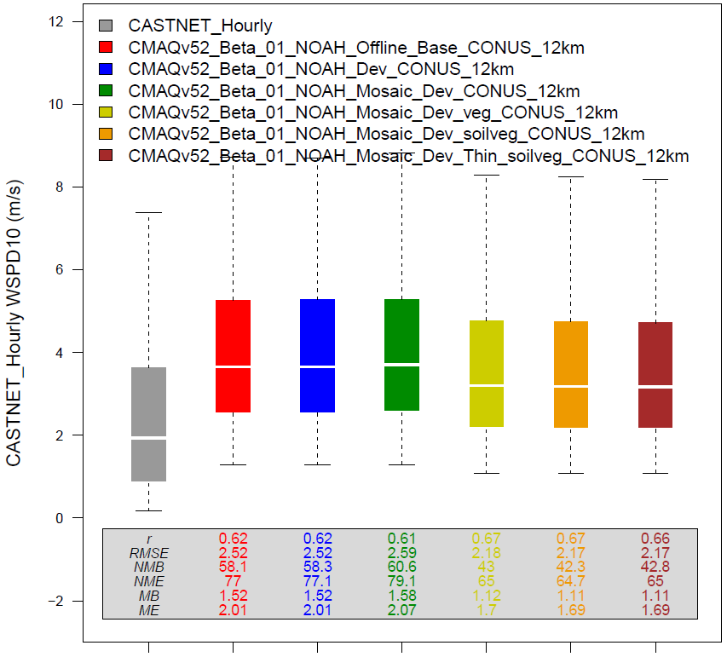
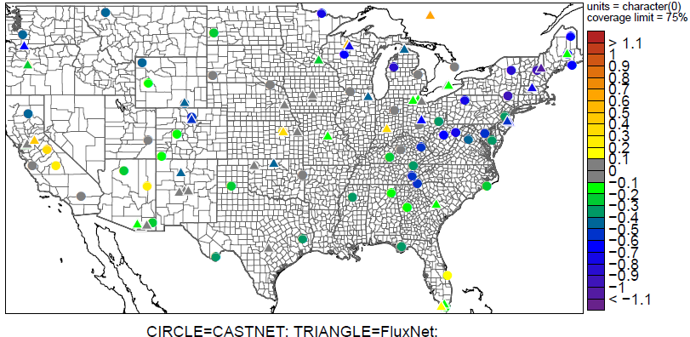
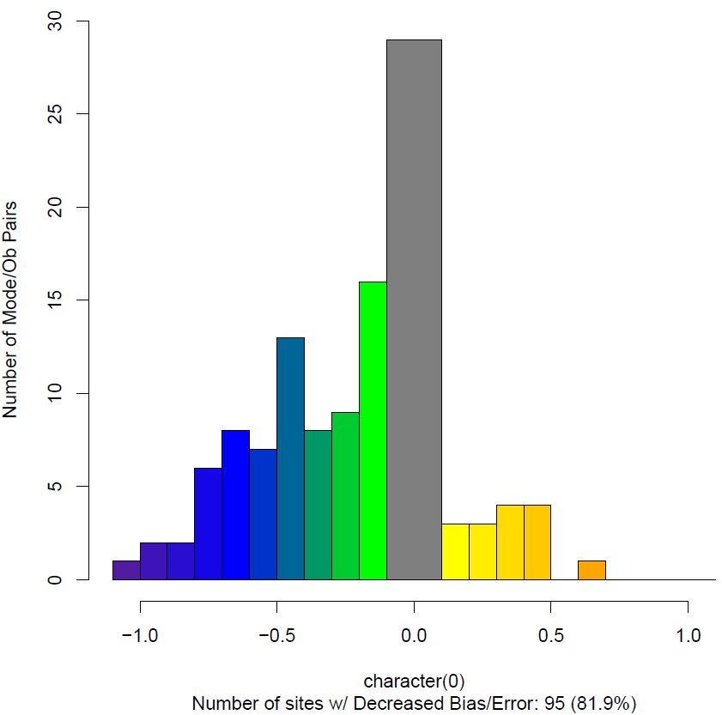
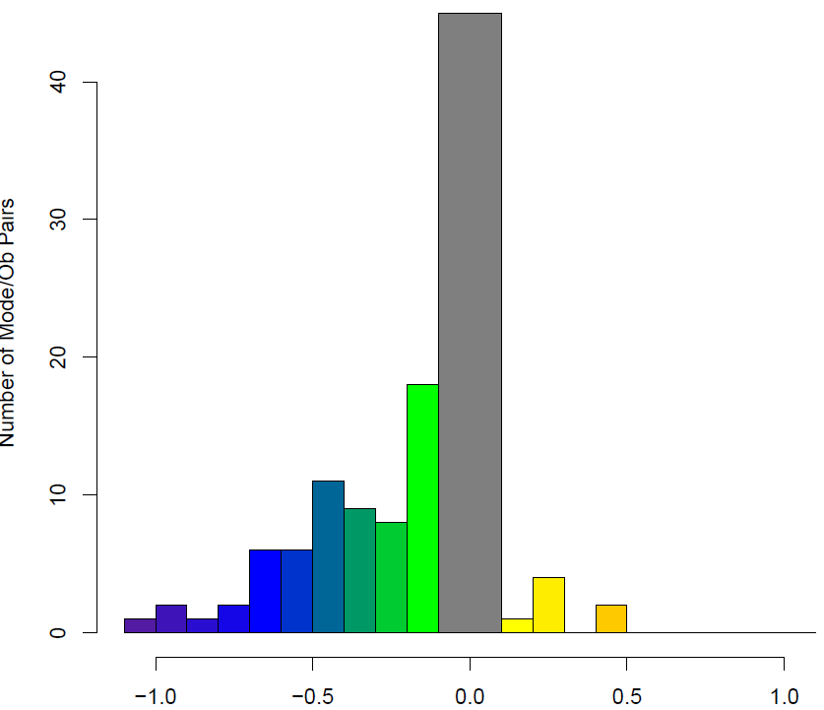
Impacts on Meteorology
Reductions in 10-m wind speed (WSPD10) bias and error
Boxplot comparison against
CASTNET Observations
WSPD10 (m/s)
A
B
C
D
E
F
Mean Bias Difference: Run F – Run A
MB Red. F - A
~ 82%
ME Red.
F – A
~ 75%
Run A: Base WRF/Noah-CMAQ
Run B: + Resistance (R_{c}) Updates
Run C: + R_{c} Mosaic Updates
Run D: + Vegetation Table Updates
Run E: + Soil Table Updates
Run F: + Thin Soil Layer Updates
MB (m/s)
ME (m/s)
Notes:
10 Wind speed (which is diagnosed from lowest model level wind speed and model level wind speed fields) is directly impacted by the increased roughness lengths in the VEGPARM.TBL updates in A4. Improvements in near surface wind speed are important to wind stress, or wind-surface current interaction, and its variability and impact on nutrient flux through the thermocline and into the mixed layer.
Ameriflux provides continuous observations from eddy covariance flux towers of high temporal resolution of ecosystem level exchanges of CO2, water, energy and momentum

Slide 10
Impacts on Dry Deposition
Increases in dry deposition of ozone (O₃) and nitrogen (N)
A
Chesapeake Bay Watershed
B
C
Run A: Base WRF/Noah-CMAQ
Run B: + Resistance (R_{c}) Updates
Run C: + R_{c} Mosaic Updates
Run D: + Vegetation Table Updates
Run E: + Soil Table Updates
Run F: + Thin Soil Layer Updates
A
F
D
E
F
O₃ (g/ha) May 26 – 31, 2011
Total N (g/ha) Jun 01 – Aug 31, 2011
Notes:
Increases in DDEP_O3 due to increases in gs in the Noah modified runs in some regions, and increases in canopy wetness, which also increases DDEP of water soluble species O3 and SO2

Slide 11
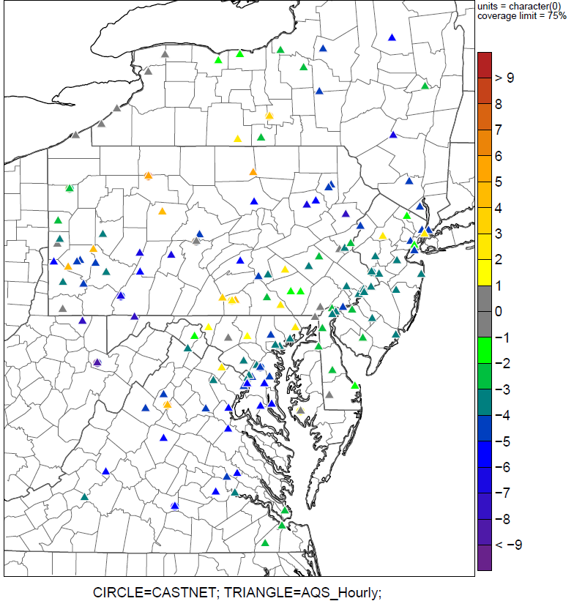
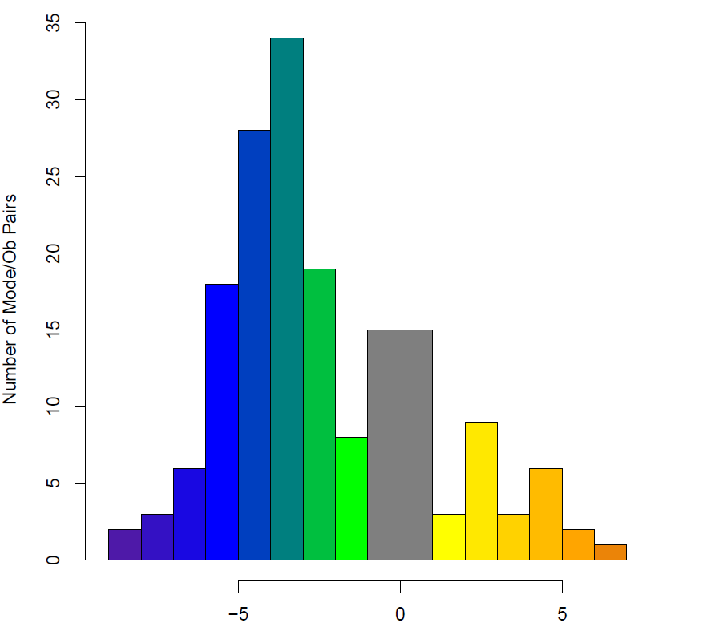
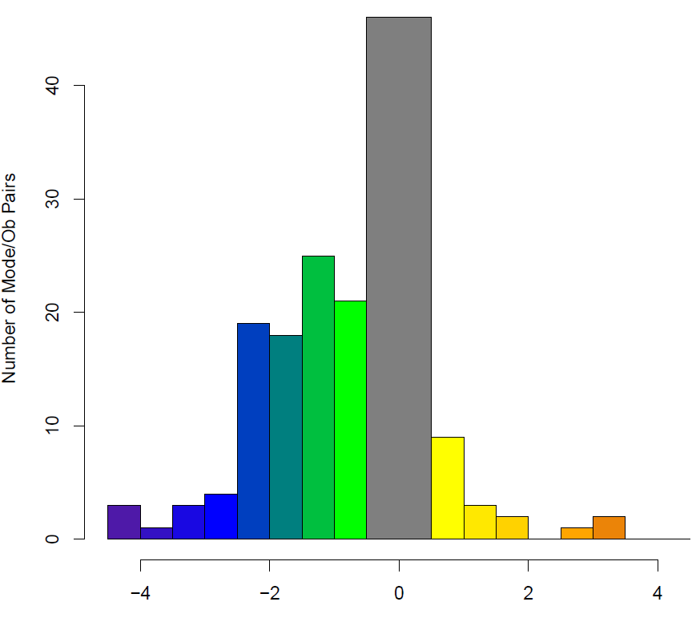
Impacts on Air Quality
Widespread reductions in mean bias and error for O₃
Jun 01 – Aug 31, 2011
Chesapeake Bay Watershed
Run A: Base WRF/Noah-CMAQ
Run B: + Resistance (R_{c}) Updates
Run C: + R_{c} Mosaic Updates
Run D: + Vegetation Table Updates
Run E: + Soil Table Updates
Run F: + Thin Soil Layer Updates
MB Red. F - A
~ 80%
ME Red. F - A
~ 75%
O₃ mixing ratio (ppb)
Mean Bias Difference: Run F – Run A
MB (ppb)
ME (ppb)
Notes:
Improved O3 mixing ratio predictions due to improved conductance and dry deposition in Noah modified runs, and also impacts of canopy wetness correction impacting O3 and SO2.
It is also found that surface wetness associated with dew significantly enhances ozone deposition, during the night as well as in the morning (eddy covariance measurements of O3 dry deposition over pine forests; Lamaud et al., 2002).

Slide 12
Total Nitrogen Deposition
Preliminary RCP4.5 Climate/Emission Results
1996 → 2048
Chesapeake Bay Watershed
23% reduction in total nitrogen
atmospheric deposition
Clear benefits from air-quality
standards
Largely dominated by reductions
in OXN deposition (~ 44%)
Slight increases in total REDN
deposition (3%)
Total
Oxidized
Reduced
1996
1996
1996
2048
2048
2048
Notes:
Although REDN deposition only increases by 3%, recent observations suggest that REDN ~ 65 % total inorganic nitrogen deposition budget (Li et al., 2016)
1996 and 2048 were chosen to show for example because the 10 years simulations are ongoing, and because they are both average precipitation years (based on previous decadal climate WRF simulations 10 year averages)
Approximate contributions to total deposition:
Dry Deposition ~ 58-59 %
Wet Deposition ~ 41-42 %
Overall N deposition has decreased due to air quality standards
Ratio of oxidized to reduced N deposition is changing
Oxidized N deposition is decreasing faster than total N deposition
In response to controls on combustion sources
Reduced N deposition is increasing
In response to changes in atmospheric composition and a lack of controls on NH₃ emissions

Slide 13
Conclusions
Use of Noah R_{c}, updates to vegetation and soil tables, use of Noah Mosaic R_{c}, and reducing top soil layer thicknesses for Noah result in:
Improved scientific consistency with soil-vegetation-chemistry interactions in CMAQ
Reduced bias and error for meteorology, soil, and air quality variables
Improved simulation of nitrogen budget in CMAQ—critical for future climate/emission Chesapeake Bay simulations
Initial simulations of changes to climate, air quality, and deposition in Chesapeake Bay show:
Nutrient deposition changes dominated by emission changes over climate in the future for Chesapeake Bay

Slide 14
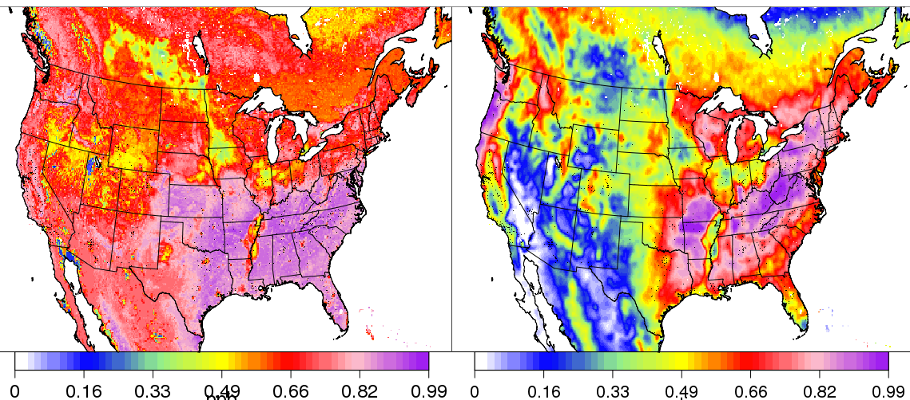
CMAQ Soil O₃ Resistance
CMAQ underestimates O₃ deposition to soil
Masked by the exaggerated vegetation fraction in WRF PX
Results in O3 biases when using Noah, CLM, or PX with MODIS based vegetation fraction (Ran et al. 2016)
Revised soil O₃ resistance based on Meszaros et al. (2009)
WRF PX
Vegetation Fraction
WRF Noah/CLM
Vegetation Fraction
$$r_{soil,O_{3}}=200+300\frac{θ}{θ_{FC}}$$
→Soil moisture content (ϴ) from modified WRF/Noah
Notes:
Meszaros, R., D. Szinyei, C. Vincze, I. Lagzi, T. Turanyi, L. Haszpra, and A. S. Tomlin (2009), Effect of the soil wetness state on the stomatal ozone fluxes over Hungary, Int. J. Environment and Pollution, Vol. 36, Nos. 1/2/3, 180 – 194.
Meszaros et al.: A coupled Eulerian photochemical reaction-transport model and a detailed ozone dry deposition model have been utilised for the estimation of stomatal ozone fluxes over Hungary.
Field Capacity is the amount of soil moisture or water content held in the soil after excess water has drained away due to gravity and the rate of downward movement has decreased.
Wilting point is the amount of soil moisture when plants have extracted as much water as they can.
Advanced Very High Resolution Radiometer (AVHRR)

