Slide 1
Evaluation of the Noah-MP LSM coupled to WRF in a semiarid urban environment
F. Salamanca¹, Y. Zhang², M. Barlage³, F. Chen³, A. Mahalov¹, S. Miao²
¹School of Mathematical and Statistical Sciences, ASU, AZ, USA
²Institute of Urban Meteorology, Beijing, China
³Research Applications Laboratory, NCAR, Boulder, CO, USA
18th Annual WRF Users’ Workshop 12-16 June 2017
NSF Grant DMS 1419593
USDA NIFA Grants 2015-67003-23508 and 2015-67003-23460

Slide 2
Evaluation of the Noah-MP LSM
coupled to WRF in a semiarid urban environment
Introduction
WRF-simulations
Results (WRF vs Observations):
  Rural areas (near-surface temp. and wind speed)
  Urban areas (near-surface temp. and wind speed)
  Urban and rural areas (daytime land surface temp.)
Conclusions
18th Annual WRF Users’ Workshop 12-16 June 2017

Slide 3
Introduction
We have augmented the existing capabilities of the WRF-urban modeling system by coupling three UCMs with the new community Noah with multi-parameterization options (Noah-MP) LSM.
These new WRF-urban modeling system’s capabilities are included in the public release of WRF and are available in WRFv3.9 (April 2017).
18th Annual WRF Users’ Workshop 12-16 June 2017

Slide 4
WRF-simulations
WRF-simulations | Land surface model | Urban parameterization
Noah-BULK | Noah | Bulk
Noah-SUCM | Noah | Single-layer UCM
Noah-BEPBEM | Noah | Multilayer BEP+BEM
NoahMP-BULK | Noah-MP | Bulk
NoahMP-SUCM | Noah-MP | Single-layer UCM
NoahMP-BEPBEM | Noah-MP | Multilayer BEP+BEM
18th Annual WRF Users’ Workshop 12-16 June 2017

Slide 5
WRF-simulations
WRF-model (V3.7.1) simulations were performed with three two-way nested domains with 276 x 296, 250 x 283, and 391 x 364 grid points, distanced, 9, 3, and 1 km respectively (the number of vertical sigma pressure levels was 40).
The simulations were conducted with the National Centers for Environmental Prediction Final Analysis data files (number ds083.2) for a 15-day clear-sky summertime period from June 15 (00 LT) to June 29 (23 LT) 2012.
The US Geological Survey 30m 2006 National Land Cover Data set was used to represent modern-day LULC within the Noah and Noah-MP land surface models for the urban domain. Three different urban classes describe the morphology of the cities: COI, HIR and LIR.
18th Annual WRF Users’ Workshop 12-16 June 2017

Slide 6
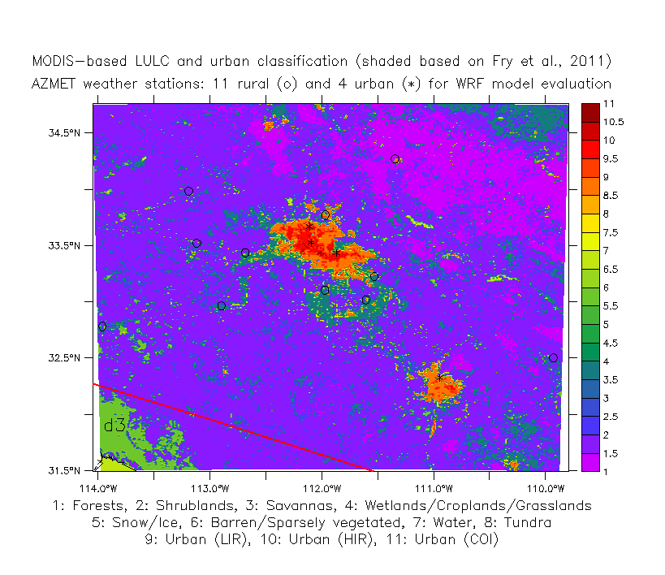
MODIS-based LULC and urban classification in the inner domain. AZMET weather stations locations for WRF model evaluation are indicated in the map

Slide 7
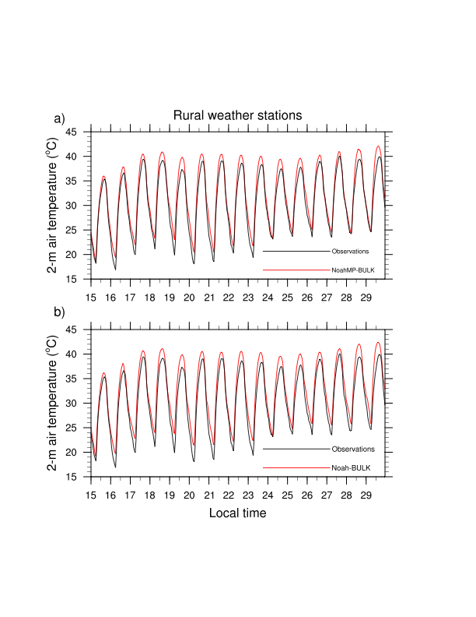
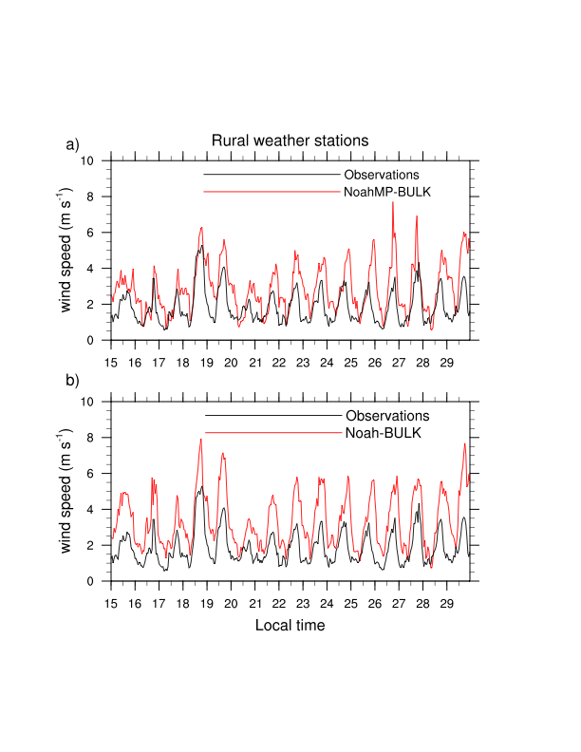
Time series of observed (black curves) and WRF-modeled (red curves) 2-m air temperature (left) and
10-m wind speed (right) averaged over all rural stations
Obs. vs. NoahMP-BULK
Obs. vs. NoahMP-BULK
Obs. vs. Noah-BULK
Obs. vs. Noah-BULK
18th Annual WRF Users’ Workshop 12-16 June 2017

Slide 8
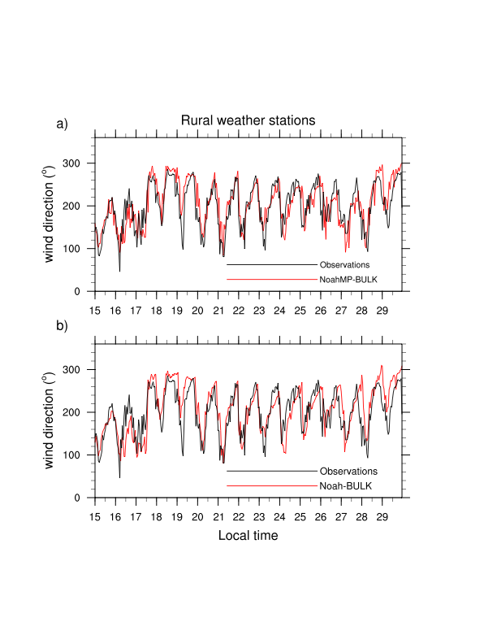
Time series of observed (black curves) and WRF-modeled (red curves) 10-m wind direction averaged over all rural stations
Obs. vs. NoahMP-BULK
Obs. vs. Noah-BULK
18th Annual WRF Users’ Workshop 12-16 June 2017

Slide 9
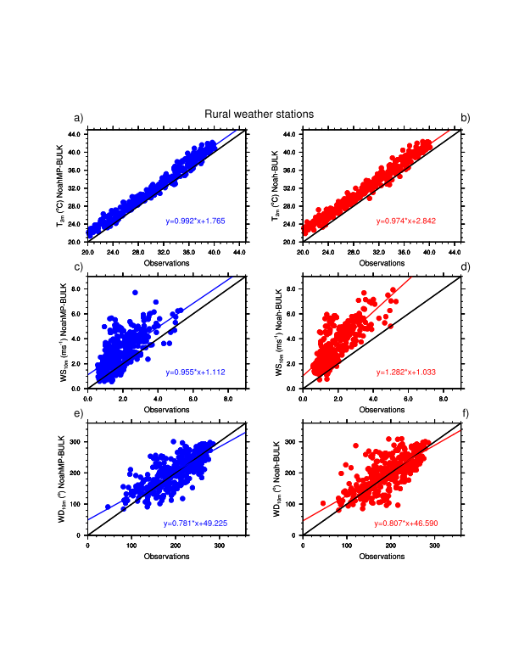
Scatter plots of WRF-modeled vs observed 2-m air temperature (top), 10-m wind speed (middle) and 10-m wind direction (bottom) averaged over all rural stations
NoahMP-BULK vs Obs.
Noah-BULK vs Obs.
18th Annual WRF Users’ Workshop 12-16 June 2017

Slide 10
RMSE and MAE for WRF-modeled 2-m air temperature (ºC) and 10-m wind speed (ms⁻¹) at the rural stations
WRF-experiment | RMSE (ºC) | MAE (ºC) | RMSE (ms⁻¹) | MAE (ms⁻¹)
NoahMP-BEPBEM | 1.772 | 1.529 | 1.361 | 1.082
Noah-BEPBEM | 2.113 | 1.915 | 1.851 | 1.602
NoahMP-SUCM | 1.780 | 1.543 | 1.388 | 1.098
Noah-SUCM | 2.091 | 1.887 | 1.913 | 1.657
NoahMP-BULK | 1.774 | 1.548 | 1.435 | 1.137
Noah-BULK | 2.248 | 2.056 | 1.828 | 1.563
18th Annual WRF Users’ Workshop 12-16 June 2017

Slide 11
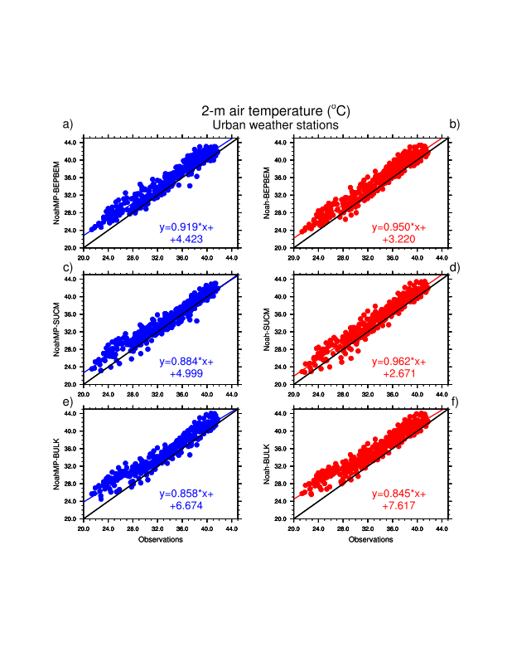
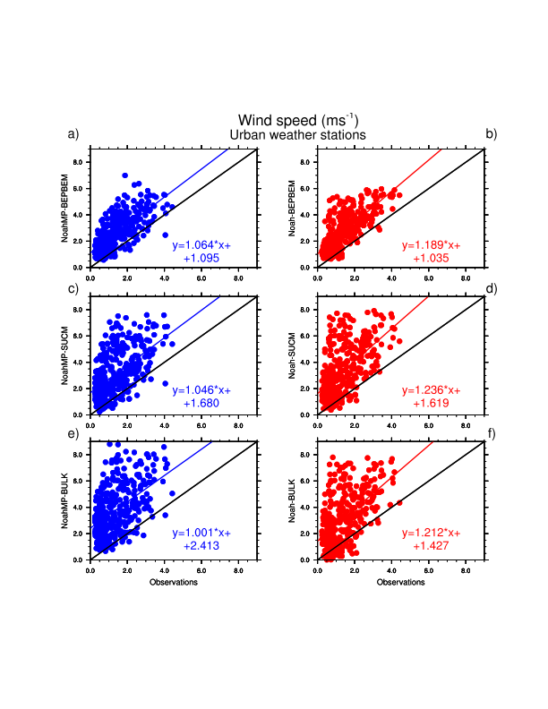
Scatter plots of WRF-modeled vs observed 2-m air temperature (left) and 10-m wind speed (right) averaged over all urban stations
BEPBEM
SUCM
BULK
Noah-MP
Noah
Noah-MP
Noah
18th Annual WRF Users’ Workshop 12-16 June 2017

Slide 12
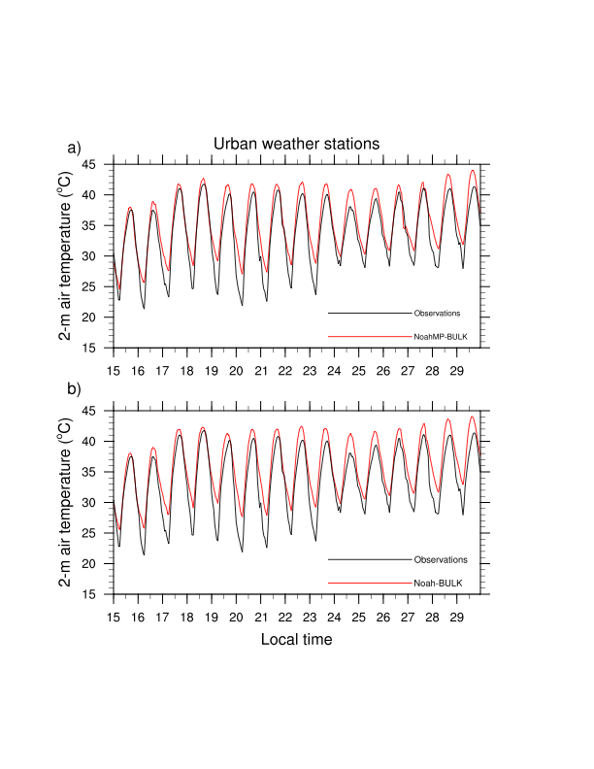
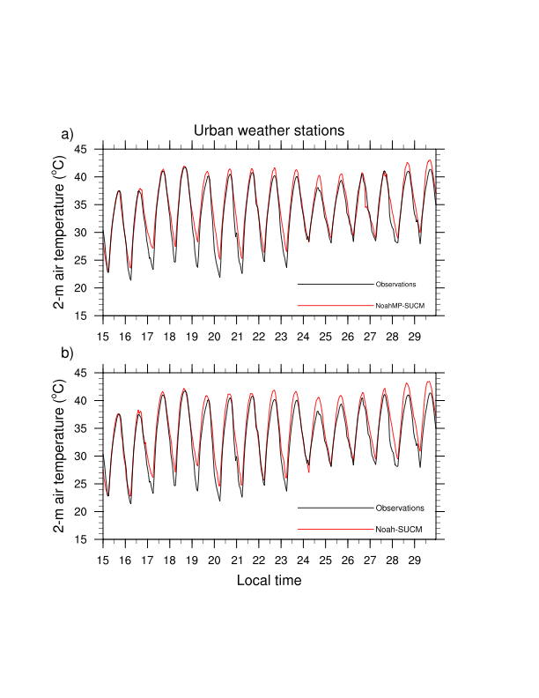
Time series of observed (black curves) and WRF-modeled (red curves) 2-m air temperature averaged over all urban stations
Obs. vs. NoahMP-BULK
Obs. vs. NoahMP-SUCM
Obs. vs. Noah-BULK
Obs. vs. Noah-SUCM
18th Annual WRF Users’ Workshop 12-16 June 2017

Slide 13
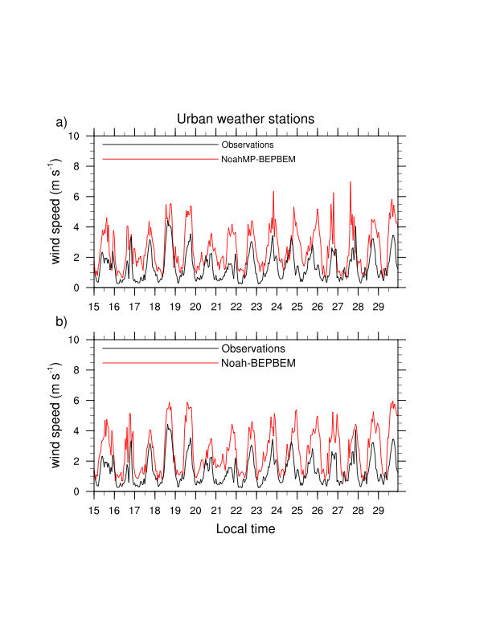
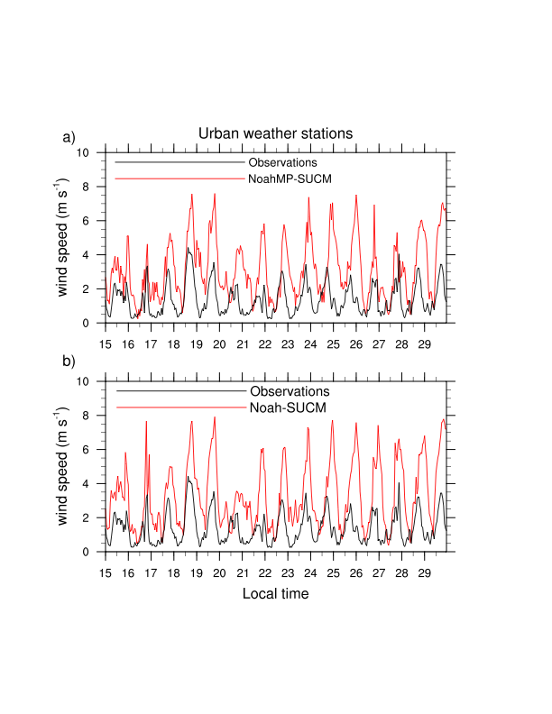
Time series of observed (black curves) and WRF-modeled (red curves) 10-m wind speed averaged over all urban stations
Obs. vs. NoahMP-BEPBEM
Obs. vs. NoahMP-SUCM
Obs. vs. Noah-BEPBEM
Obs. vs. Noah-SUCM
18th Annual WRF Users’ Workshop 12-16 June 2017

Slide 14
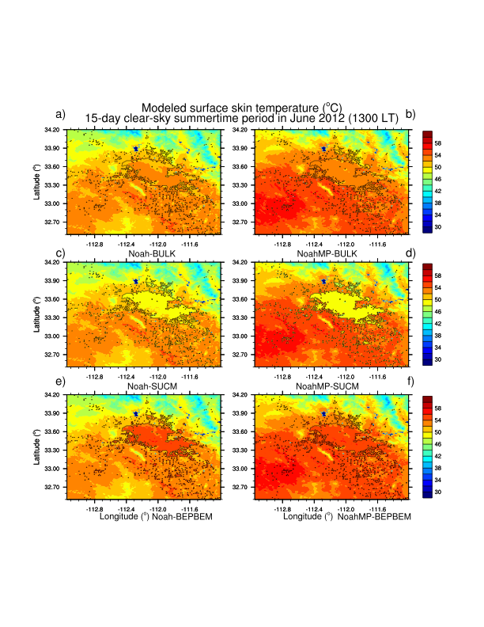
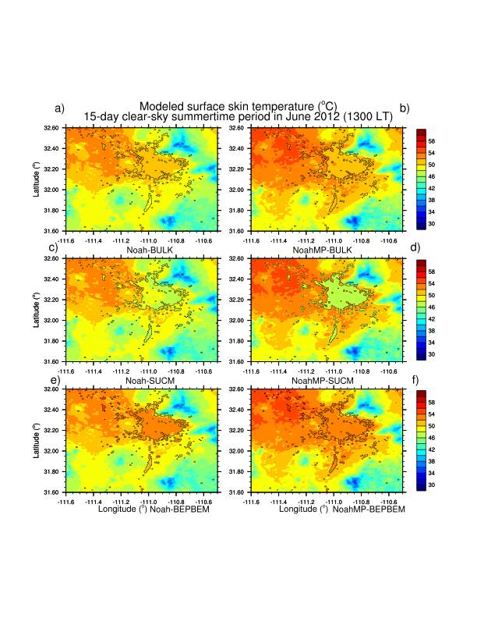
WRF-modeled mean surface skin temperature averaged for the entire 15-day clear-sky summertime period (at 1300 LT) and across the Phoenix (left) and Tucson (right) regions
Noah-MP
Noah
Noah-MP
Noah
18th Annual WRF Users’ Workshop 12-16 June 2017

Slide 15
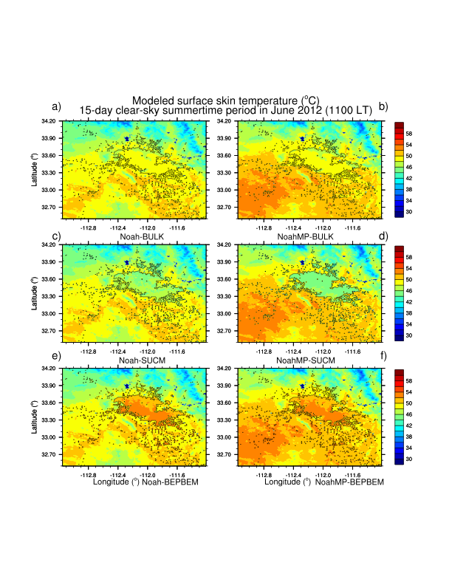
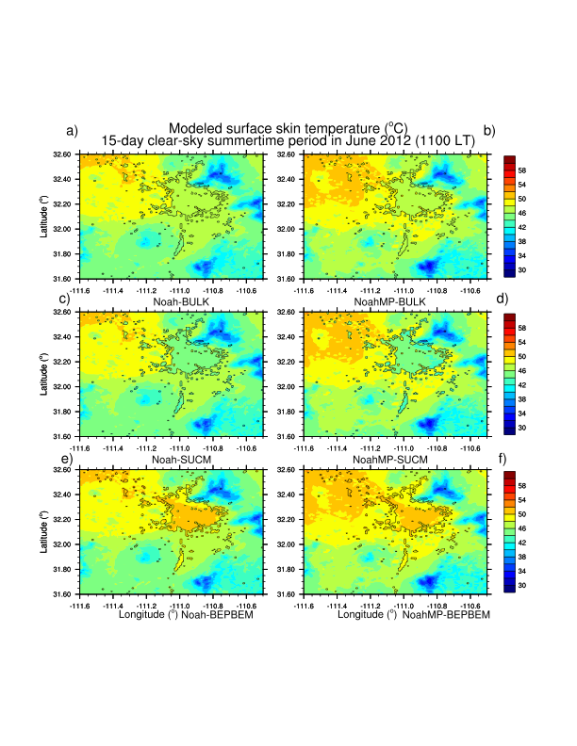
WRF-modeled mean surface skin temperature averaged for the entire 15-day clear-sky summertime period (at 1100 LT) and across the Phoenix (left) and Tucson (right) regions
Noah
Noah
Noah-MP
Noah-MP
18th Annual WRF Users’ Workshop 12-16 June 2017

Slide 16
Spatial mean of daytime MODIS-observed and WRF-modeled surface skin temperature averaged for the entire 15-day clear sky summertime period (at 1100 LT and at 1300 LT) and across the Phoenix (PHX) and Tucson (TUC) regions
WRF-experiments | PHX (ºC) (1300 LT) | TUC (ºC) (1300 LT) | PHX (ºC) (1100 LT) | TUC (ºC) (1100 LT)
NoahMP-BEPBEM | 52.986 | 50.109 | 49.437 | 46.878
Noah-BEPBEM | 50.908 | 48.663 | 48.004 | 46.073
NoahMP-SUCM | 52.296 | 49.534 | 48.756 | 46.292
Noah-SUCM | 50.289 | 48.156 | 47.355 | 45.544
NoahMP-BULK | 52.671 | 49.842 | 48.998 | 46.537
Noah-BULK | 50.622 | 48.430 | 47.619 | 45.771
MODIS | 55.224 | 53.932 | 51.808 | 49.553
Salamanca et al. (2017), J. Geophys. Res. Atmos. (submitted)

Slide 17
Conclusions
Noah-MP reproduces somewhat better than Noah the daytime surface skin temperature and the daily evolution of near-surface air temperature and wind speed.
Bulk urban parameterization seems to overestimate nighttime 2-m air temperature compared to the single-layer and multilayer UCMs that reproduce more accurately the daily evolution of near-surface air temperature.
Only the multilayer UCM is able to reproduce effectively the daily evolution of near-surface wind speed, while both the single-layer and bulk urban parameterizations overestimate it considerably.

