Slide 1
WRF as the Atmospheric Model in the Regional Arctic System Model (RASM)
Mark W. Seefeldt and John J. Cassano
Cooperative Institute for Research in Environmental Sciences (CIRES)
University of Colorado – Boulder
18th WRF User’s Workshop
Bolder, CO
June 14, 2017
Notes:
Mention DOE/ONR/NSF funding sponsorship & DOD/HPCMP computing resource support

Slide 2
RASM – Overarching Science Hypothesis
The Regional Arctic System Model (RASM) is a coupled atmosphere-land-ocean-sea ice model with a focus on climate simulations of the Arctic
Mesoscale processes and resulting feedbacks are critical to improved representation of the state of the Arctic Climate System and prediction of polar amplification of global climate change.
Some Arctic processes/feedbacks are poorly resolved/represented in ESMs
sea ice thickness distribution, deformation and export, fast ice
oceanic eddies, surface/bottom mixed layer, upper ocean heat content
atmospheric modes of circulation, clouds, fronts
shelf-basin, wave-ice and air–sea-ice interactions and coupling
18th WRF User’s Workshop
Bolder, CO
June 14, 2017
Notes:
This slides provides a selected list of processes and feedbacks, poorly or not at all represented in state-of-the-art Earth System Models, participating in CMIP5 and IPCC-AR5
Improved representation of such processes and feedbacks is expected to reduce model uncertainty and improve prediction of arctic climate change and variability

Slide 3
RASM – Overview
RASM 1.0 | Code | Configuration
Atmosphere | WRF | 50 km horizontal, 40 vertical levels
Land | VIC | 50 km (matching atmosphere), 3 Soil Layers
Ocean | POP2 | 1/12˚ (~9 km) & 1/48˚ (~2.4 km), 45 levels (7 in the top 42 m),
Sea Ice | CICE5 | 1/12˚ or 1/48˚, 5 thickness categories Anistropic (EAP) / Isotropic (EVP) rheology
Coupler | CPL7x | Flux exchange every 20 minutes, inertial resolving with minimized lags.
18th WRF User’s Workshop
Bolder, CO
June 14, 2017

Slide 4
RASM – Participants
RASM 1.0 | Code | Contributors
Atmosphere | WRF v3.2 | University of Colorado – Boulder: John Cassano, Mark Seefeldt, Alice DuVivier, Mimi Hughes, Matthew Higgins
Land | VIC | University of Washington: Bart Nijssen, Diana Gergel, Joseph Hamman
Ocean | POP2 | Naval Postgraduate School: Wieslaw Maslowski, Robert Osinski
Sea Ice | CICE5 | Naval Postgraduate School: Andrew Roberts
Coupler | CPL7 | Naval Postgraduate School: Anthony Craig
Additional Contributors |  | Iowa State University: William Gutowski, Brandon Fisel University of Arizona: Xubin Zeng, Michael Brunke
18th WRF User’s Workshop
Bolder, CO
June 14, 2017
Notes:
Emphasize that RASM is a relatively large project and a group effort

Slide 5
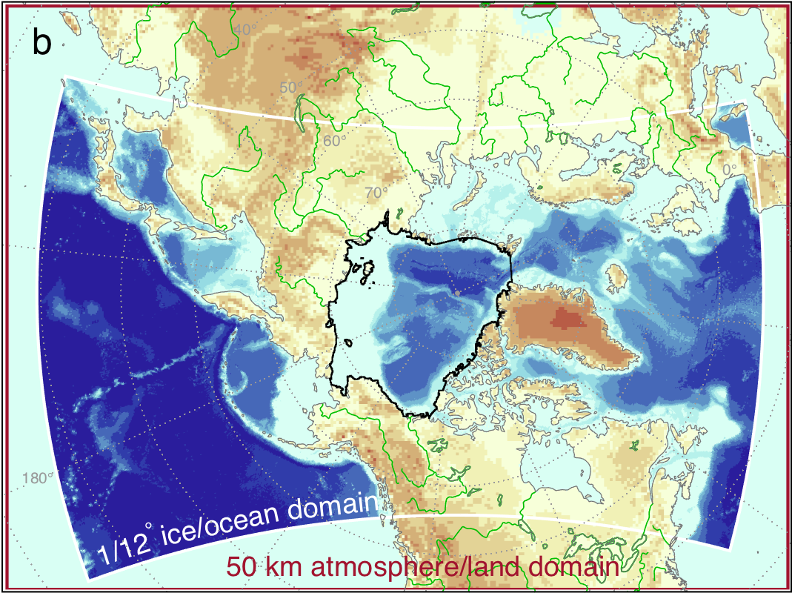
RASM – Domains
ESM Reanalysis Atmospheric Boundary Conditions
Atmosphere
WRF
Land
VIC
Sea Ice
CICE
Coupler
CPL7
Streamflow
Routing
RVIC
Ocean
POP
Model domain, components, and interactions of RASM
18th WRF User’s Workshop
Bolder, CO
June 14, 2017
Notes:
All of the fluxes and variables are passed through the coupler
An extended ocean climate domain is present beyond the actual ocean/sea ice domain

Slide 6
RASM / WRF History
Most of the initial work in implementing WRF with RASM was done with v3.2
RASM 1.0 simulations were completed with v3.2
Cassano et al., 2017, Journal of Climate
Amy Solomon of NOAA-ESRL upgraded WRF in a RASM branch to v3.6.1 for sea ice
In the past year, WRF was upgraded to v3.7.1 and verified with a series of simulations
Some of the changes and additions from v3.2 to v3.7.1 are beneficial to RASM (e.g. cumulus radiative feedback, pressure-level diagnostics)
18th WRF User’s Workshop
Bolder, CO
June 14, 2017

Slide 7
RASM / WRF History
The RASM modifications to WRF fall into three categories:
RASM/CESM coupling modifications
RASM physics modifications
RASM climate diagnostic output
It is likely that a number of the current RASM modifications in WRF are no longer necessary or were never needed
18th WRF User’s Workshop
Bolder, CO
June 14, 2017

Slide 8
RASM / CESM Coupling
WRF is coupled to the other RASM model components using the CPL coupler from CESM1
WRF transfers variables (radiation fluxes, lowest model level state variables) to CPL and CPL transfers variables to WRF
The coupling is done in 20 minute intervals – matching the radiation timestep
The surface layer and radiation parameterizations are the primary locations where the variables from the coupler are integrated into WRF
18th WRF User’s Workshop
Bolder, CO
June 14, 2017

Slide 9
RASM Physics Modifications
Difficulties in properly simulating clouds and the resultant surface energy balance have resulted in some modifications to the physics parameterizations
Morrison microphysics
Droplet concentration set to 250 cm⁻³ over land, 50 cm⁻³ over water / ice
RRTMG SW/LW radiation
Calculate radiative fluxes based on droplet size from Morrison microphysics
Divide the downward radiation into direct and diffuse
Shallow Cumulus
Run the shallow cumulus over ocean points but not land
18th WRF User’s Workshop
Bolder, CO
June 14, 2017

Slide 10
RASM Diagnostics
Timestep averaged output at user selected intervals of seconds, minutes, hours, days, or month
Provides output of surface meteorology state variables, surface fluxes, and TOA radiation
Designed to reduce the output load for long duration regional climate simulations
Contributed to the WRF repository and included in v3.9
See poster: P4
18th WRF User’s Workshop
Bolder, CO
June 14, 2017

Slide 11
RASM – WRF v3.7.1 Configuration
50 km horizontal grid, 40 vertical levels
Physics:
Microphysics: Morrison
Droplet concentration set to 250 cm⁻³ over land, 50 cm⁻³ over water / ice
Radiation: RRTMG LW and SW
Calculate radiative fluxes based on droplet size from Morrison microphysics
PBL: MYNN PBL
Surface layer: Revised MM5
Cumulus: Kain-Fritsch / Grell-Freitas / Grell 3D
Land: VIC
Spectral Grid nudging of wind and T (top 20 levels)
18th WRF User’s Workshop
Bolder, CO
June 14, 2017
Notes:
includes radiative impact of clouds for cumulus (cu_rad_feedback = .true.)
spectrally nudge WRF to ERA-Interim reanalyses
up to wavenumbers 4 and 3, nudge the temperature and wind with a strength of 0.0003
this configuration allows the atmosphere–ice– ocean boundary layer system to freely evolve under the constraint of large-scale upper atmospheric circulation, including the polar vortex

Slide 12
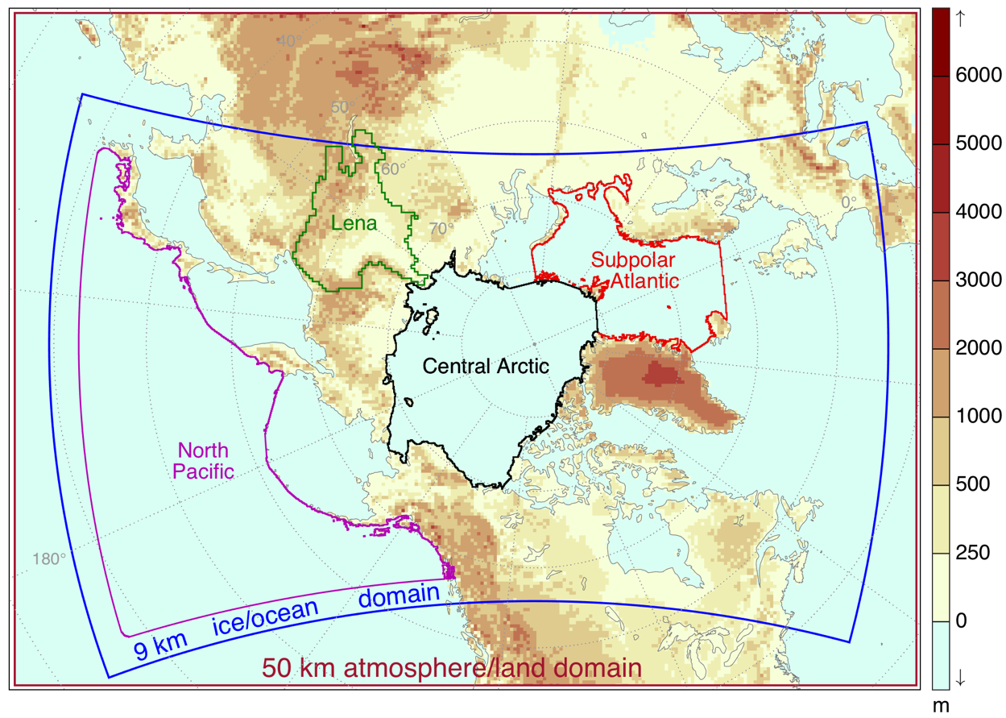
RASM Domains and Evaluation Regions
18th WRF User’s Workshop
Bolder, CO
June 14, 2017

Slide 13
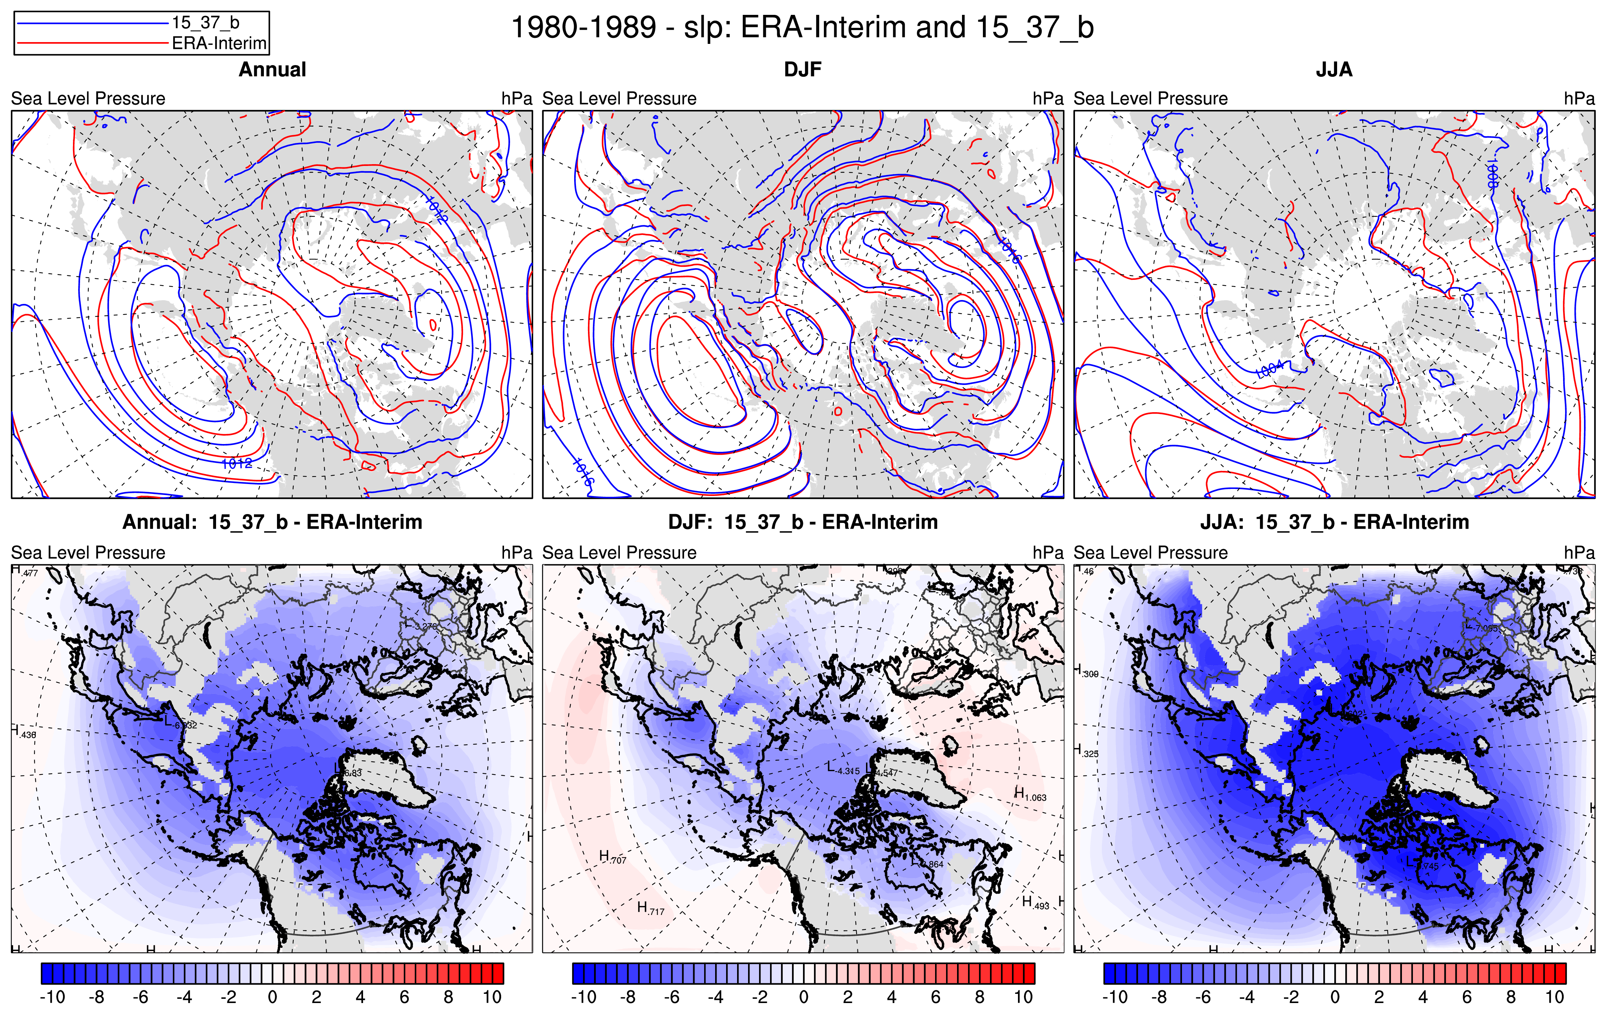
RASM: Sea Level Pressure
Sea-level pressure (atmospheric circulation) is well simulated
18th WRF User’s Workshop
Bolder, CO
June 14, 2017
Notes:
RASM simulates SLP well with very small biases. – baseline simulation with KF for Cu

Slide 14
RASM: Surface Temperature
Large warm-bias over land – especially during the JJA months
Slight warm bias over the North Pacific and North Atlantic
Only small biases in the Central Arctic
18th WRF User’s Workshop
Bolder, CO
June 14, 2017

Slide 15
New WRF Physics Configurations
Assessed changes to WRF boundary layer, microphysics, convective parameterizations, and inclusion of shallow convection
Largest improvements seen with cumulus / shallow conv. changes
Simulations discussed below:
15_37_b_G3
use Grell 3D instead of KF
15_37_b_G3_ShCu
use Grell 3D and shallow convection option instead of KF
15_37_b_GF
use Grell-Freitas instead of KF
15_37_b_GF_ShCu
use Grell-Freitas and shallow convection option instead of KF
15_37_d
use KF but with icloud = 3 instead of icloud = 1
18th WRF User’s Workshop
Bolder, CO
June 14, 2017

Slide 16
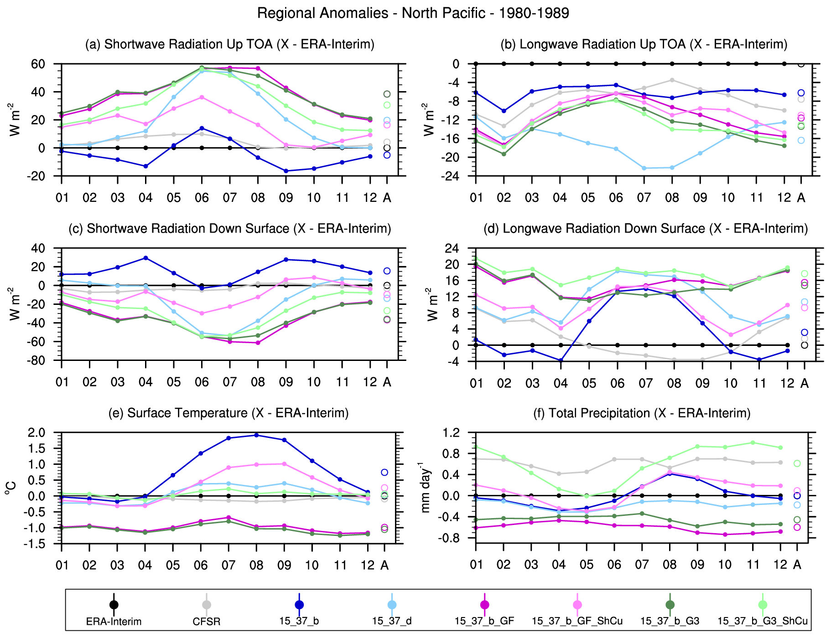
RASM: North Pacific
Tsfc:
Range in T_sfc biases from -1°C to 2°C
Simulations without ShCu have cold bias
KF and GF_ShCu have largest warm bias
G3_ShCu provides the best results
SW_d_sfc:
Range in biases from -60 W/m² to 20 W/m²
ShCu have large negative bias – related to large negative T_sfc
18th WRF User’s Workshop
Bolder, CO
June 14, 2017
Notes:
Tsfc: G3_ShCu and 15_37_d have near 0 bias
Simulations w/o ShCu have cold bias
15_37_b and GF_ShCu have largest warm bias
Precip: G3_ShCu positive bias, but similar to CFSR
15_37_d, 15_37_b and GF_ShCu near zero bias
Simulations w/o ShCu have negative bias
SWD: Small negative bias in GF_ShCu and 15_37_d
Positive bias in 15_37_b
Larger negative bias in G3_ShCu
Largest negative bias in simulations w/o ShCu
LWD: Generally opposite sign errors to SWD, except for 15_37_b which has positive bias in SWD and LWD

Slide 17
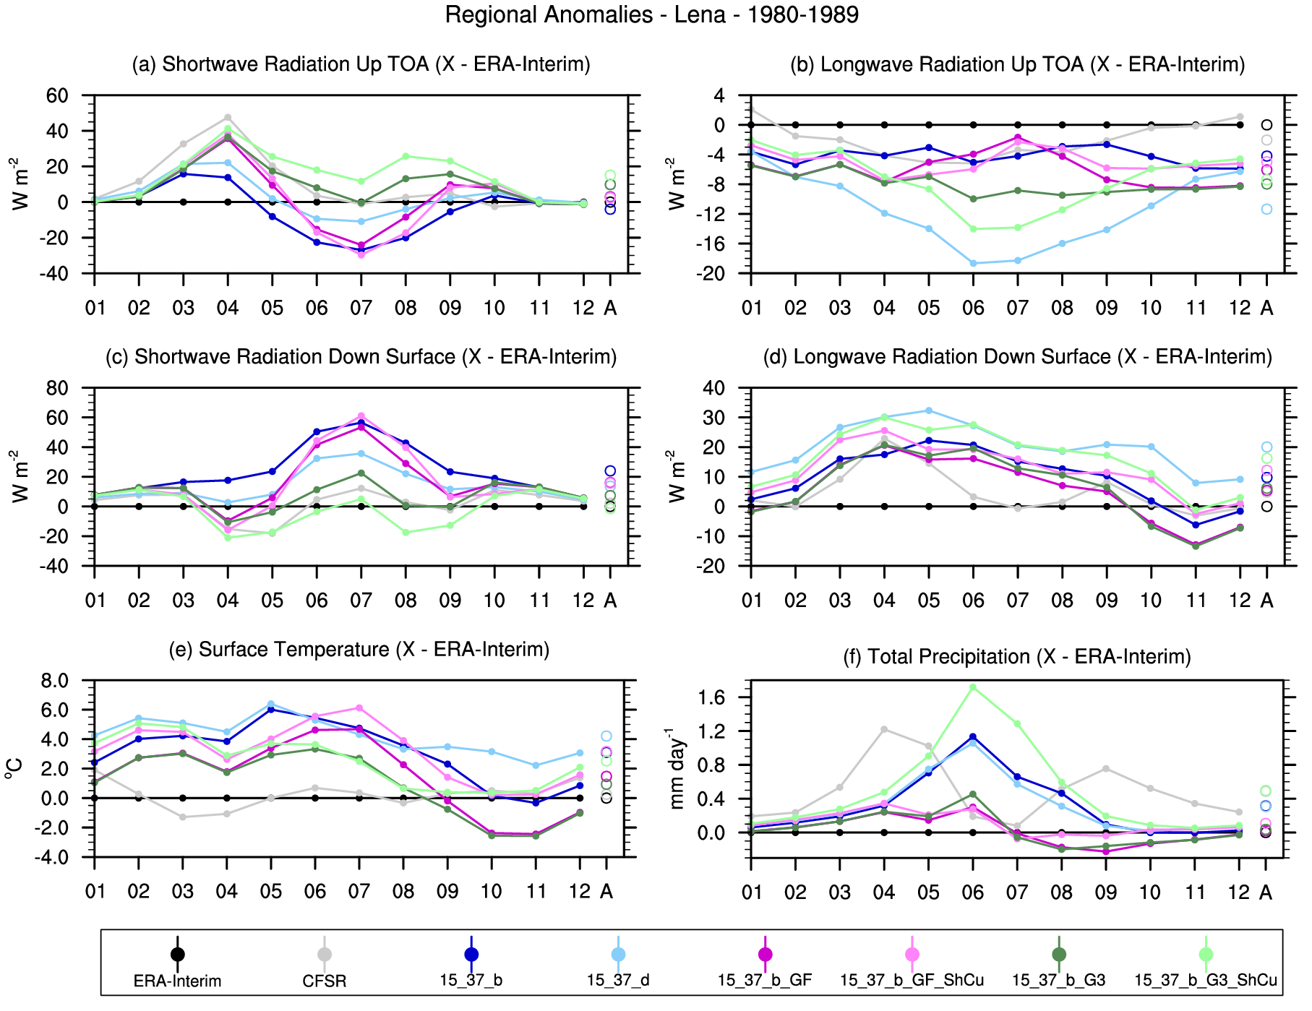
RASM: Lena
Tsfc:
Warm biases for all cases except for late in the year
G3 and GF (without ShCu) have the smallest warm bias
SW_d_sfc:
G3 and GF (without ShCu) have the smallest warm bias
Conclusion: ShCu works well over the ocean but not over the land
18th WRF User’s Workshop
Bolder, CO
June 14, 2017
Notes:
Tsfc: G3 and GF have smallest warm bias
Precip: Reasonable except G3_ShCu, 15_37_b, and 15_37_d which have large positive bias in summer
SWD: G3 / G3_ShCu have smallest biases followed by 15_37_d
LWD: All simulations have generally positive biases – G3_ShCu and 15_37_d have largest bias

Slide 18
RASM – Atmosphere: Conclusions
RASM climate shows significant sensitivity to WRF physical parameterization choices
Changing PBL and cumulus parameterizations changes the sign of large cloud / radiation biases
Improves ocean simulation but degrades land simulation and vice versa
These biases have a large impact on other aspects of the simulated climate including:
Surface temperature (resulting impacts on evaporation)
Precipitation
Sea ice thickness and extent
Next steps
Identify WRF physics options that produce realistic cloud cover and radiative fluxes across entire model domain
International Workshop on Coupled Modeling of Polar Environments
Ohio State University
June 4, 2016

Slide 19
RASM
Email:
Mark Seefeldt mark.seefeldt@colorado.edu
John Cassano john.cassano@colorado.edu
Acknowledgments:
Research supported by the Department of Energy
International Workshop on Coupled Modeling of Polar Environments
Ohio State University
June 4, 2016

