Slide 1
A high-altitude wind power (HAWP) climatology with global WRF
Mark Stoelinga, James McCaa, and Rhea George

Slide 2
High altitude wind power (HAWP)
500
0

Slide 3
High altitude wind power (HAWP)
500
0

Slide 4
High altitude wind power (HAWP)
Here’s where the gold is, if you can reach it. Wind resource is:
Stronger
Steadier
Less turbulent
500
0

Slide 5
Novel technologies

Slide 6
Wind Resource Assessment Mapping
Designed for “prospecting” wind energy
A “light” version of regional climate modeling:
Primary interest is recent climate
Relies on downscaling of global reanalysis datasets
Fewer freely forecasted aspects
Periodically reinitialized (every N days, N = 3 to 30)
Maintain fidelity to reanalysis
Parallelization in time

Slide 7
2007: 3TIER’s “FirstLook”
Global, 5-km resolution
10-year climatology
But….
Turbine hub-height winds
NCEP/NCAR Reanalysis
WRF V2
Simple nudging

Slide 8
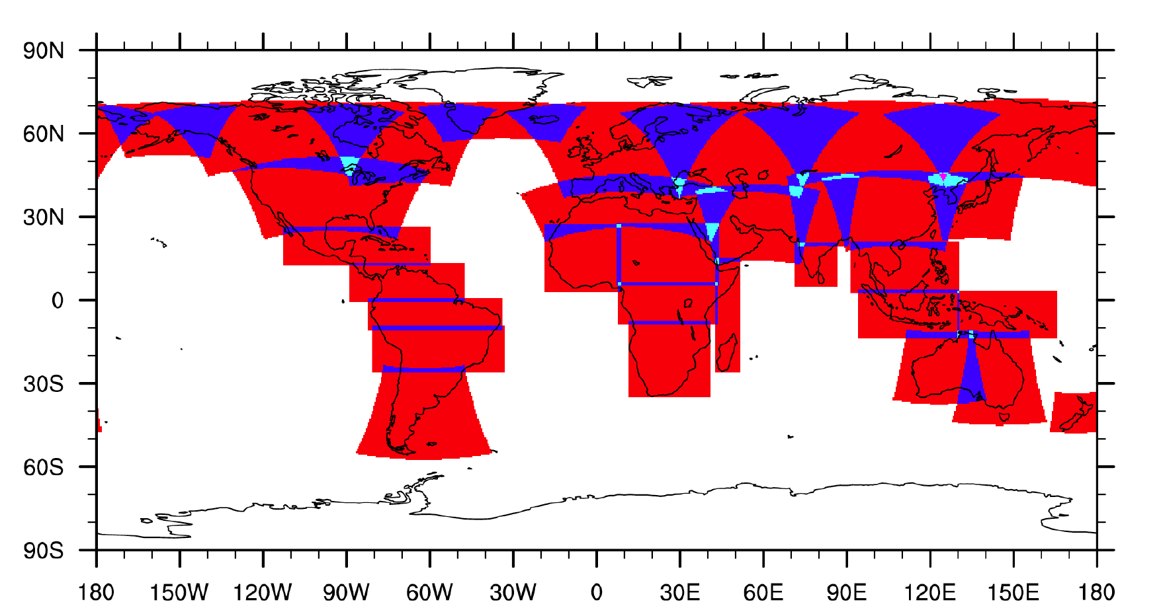
And…no global WRF

Slide 9
What did we want this time? How did we get there?
Global coverage including oceans: Global WRF V3.7.1
Avoid tiling and blending: Global WRF V3.7.1
More output variables, higher altitude: More storage
Better reanalysis: ERA-Interim
Better downscaling: Spectral Nudging
Higher resolution but faster production: Mass-conserving diagnostic flow model (10 km → 2 km)
Other configuration options: YSU PBL, Ferrier micro, RRTMG radiation

Slide 10
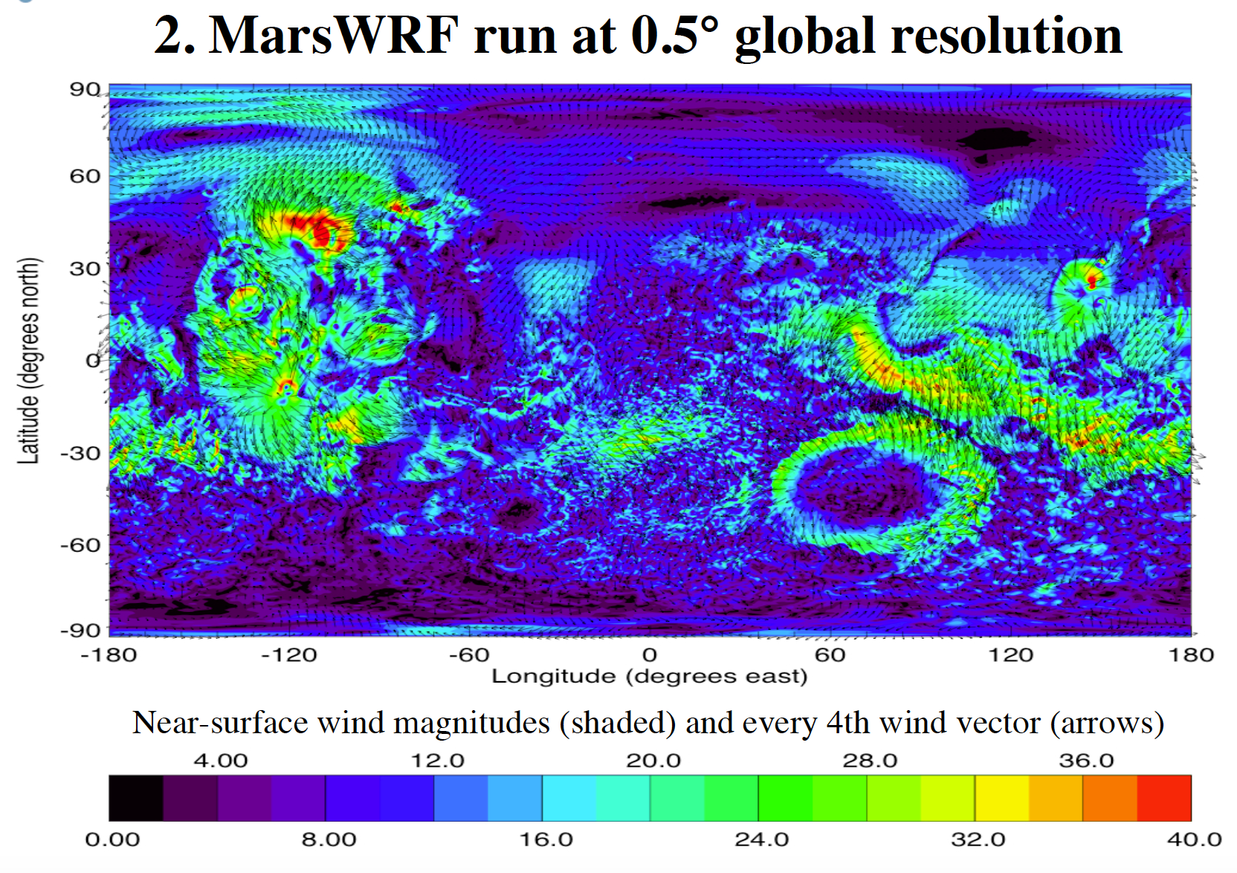
Global WRF
Derived from PlanetWRF
Major modifications:
Unequal map scale factors in x and y directions → allows for global lat/lon grid
Polar filter: northern and southern boundaries collapse to single point, requiring special treatment

Slide 11
Why not MPAS?
Experience with WRF
Physics options
Continuous mesh refinement not really needed
Spectral nudging required for reanalysis (or climate model) downscaling.
However, in the future…

Slide 12
Tribulations with Global WRF
Two bugs encountered in Global WRF (V3.6.1)
Polar filter generating negative mixing ratios
Polar point instability
Discovered and fixed both by us and WRF team in V3.7
Recurrent problems with interactions between:
Adaptive timestep
Restarts
ESMF
Delayed nests (not for global)

Slide 13
Finally, success!
5-day, hourly loop of 50-m wind speed
Note, speeds over ocean reduced by 1/2

Slide 14
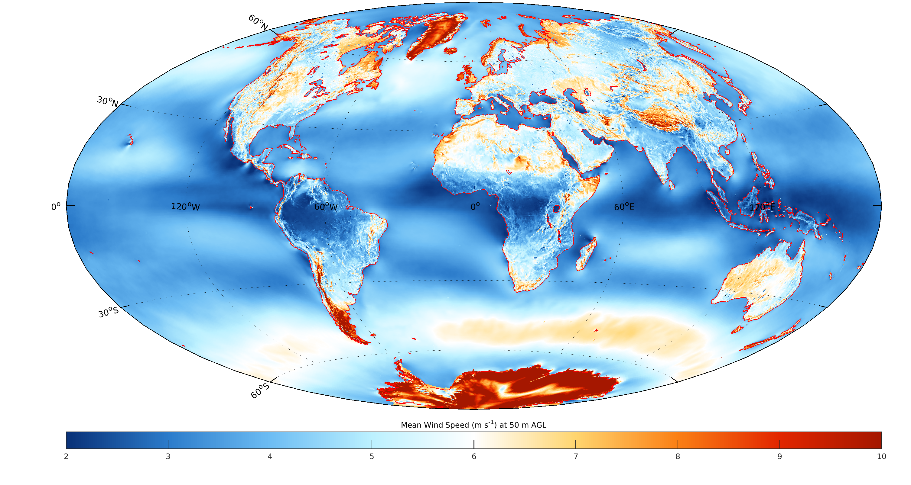
10-year mean wind speed, 50 m

Slide 15
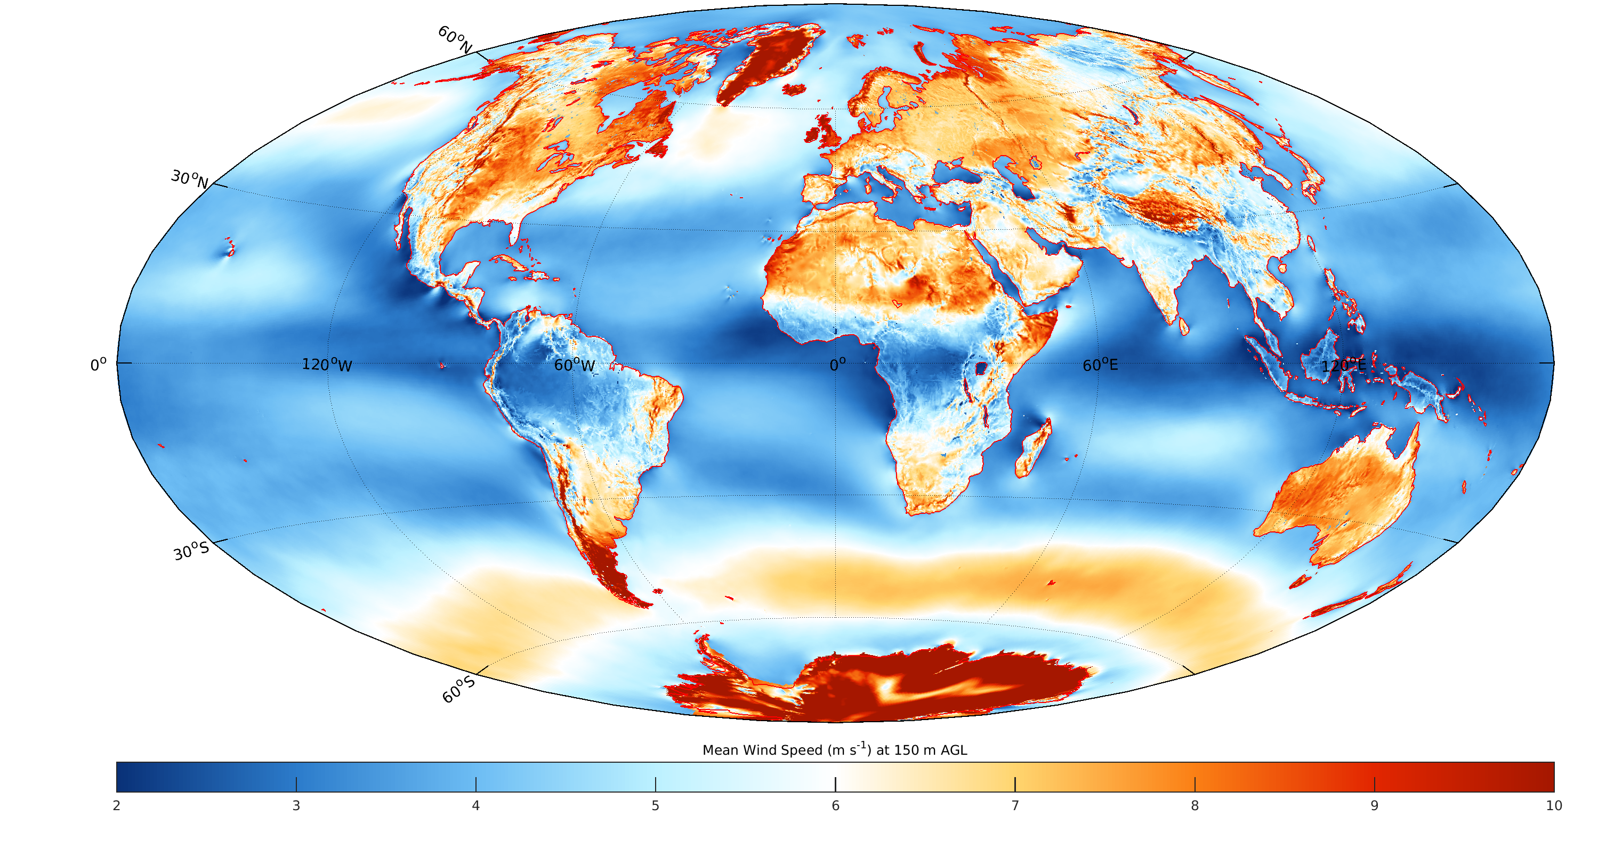
10-year mean wind speed, 150 m

Slide 16
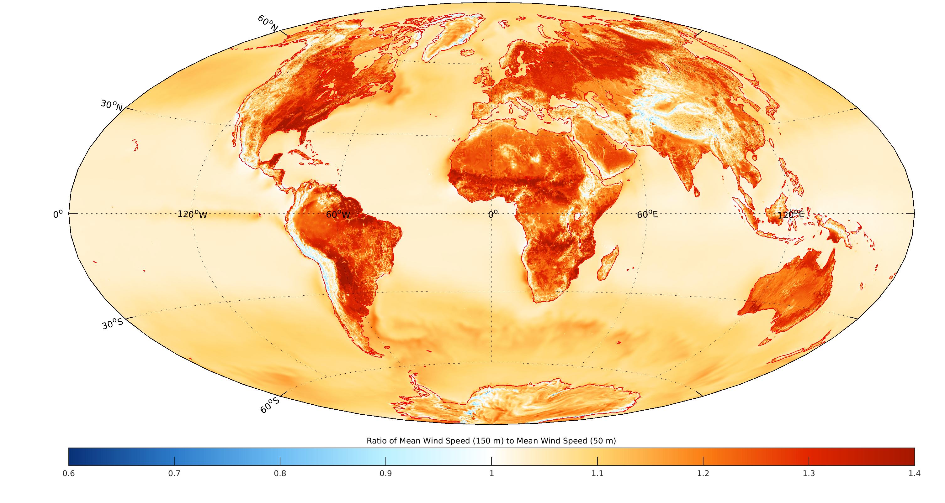
Ratio, 150-m to 50-m wind speed

