Slide 1
New developments and applications using the scale and aerosol aware Grell-Freitas convective parameterization
Georg A. Grell and Saulo R. Freitas
With major acknowledgements to:
RAP/HRRR crew, HWRF folks, FIM crew, GEOS-5 crew
And not to forget the folks that distribute the NGGPS funding

Slide 2
Grell-Freitas Convective Param
Scale-aware/Aerosol-aware (Grell and Freitas, 2014, ACP)
Stochastic approach adapted from the Grell-Devenyi (2002) scheme, but changed to include temporal and spatial perturbation patterns
Scale awareness through Arakawa approach (2011)
Aerosol awareness is implemented with empirical assumptions based on a paper by Jiang and Feingold
2014 version of GF operational at EMC in RAP, also in Brazil (using a version of B-RAMS)

Slide 3
Recent (since ACP paper) new implementations into GF scheme
Momentum transport (as in SAS and/or ECMWF)
Additional closure for deep convection: Diurnal cycle effect (Bechtold)
PDF approach for normalized mass flux profiles was implemented
Originally to fit LES modeling for shallow convection
allows easy application of mass conserving stochastic perturbation of vertical heating and moistening profiles
Provides smooth vertical profiles
Third type of cloud (congestus type convection)
Changed cloud water detrainment treatment
Stochastic part now coupled to Stochastic Parameter Perturbation (SPP), and Stochastic Kinetic Energy Backscatter (SKEBS) approach (J. Berner )
Additional closures for shallow convection (Boundary Layer Equilibrium (BLQE, Raymond 1995; W*, Grant 2001, Heat Engine, Renno and Ingersoll, JAS 1996)
Versions now used in WRF, FIM, GFS, GEOS-5, will be operational in RAP

Slide 4
Recent (since ACP paper) new implementations into GF scheme
Momentum transport (as in SAS and/or ECMWF)
Additional closure for deep convection: Diurnal cycle effect (Bechtold)
PDF approach for normalized mass flux profiles was implemented
Originally to fit LES modeling for shallow convection
allows easy application of mass conserving stochastic perturbation of vertical heating and moistening profiles
Provides smooth vertical profiles
Third type of cloud (congestus type convection)
Changed cloud water detrainment treatment
Stochastic part now coupled to Stochastic Parameter Perturbation (SPP), and Stochastic Kinetic Energy Backscatter (SKEBS) approach (J. Berner )
Additional closures for shallow convection (Boundary Layer Equilibrium (BLQE, Raymond 1995; W*, Grant 2001, Heat Engine, Renno and Ingersoll, JAS 1996)
Versions now used in WRF, FIM, GFS, GEOS-5, will be operational in RAP

Slide 5
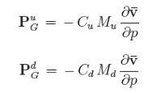
Momentum transport
Effect of cloud scale horizontal pressure gradients (Gregory et al. 1997, Zhang and Wu, 2000) is to adjust the in-cloud winds towards those of the large scale flow. For the ECMWF approach (follows Gregory et al., 1997), the entrainment rate is simply adjusted
E(u,v)_{up}=E_{up} +λD_{up}
D(u,v)_{up}=D_{up} +λD_{up}
Where E(u,v) and D(u,v) are simply the entrainment/detrainment rates.
For SAS approach equations follow directly Zhang and Wu, 2003
The pressure gradient force across the updraft is proportional to the product of mass flux and vertical shear of the mean wind,
Proportionality constant is -.55 for Zhang and Wu,
Gregory at al at first assumed the constant to be -.7
Both are very simple to implement. Proportionality constant was tested for Stochastic Parameter Perturbation (SPP)

Slide 6
Heat source from momentum transport: dissipation of kinetic energy
As in ECMWF, we also include an additional heat source representing dissipation of kinetic energy (Steinheimer et al 2007)

Slide 7
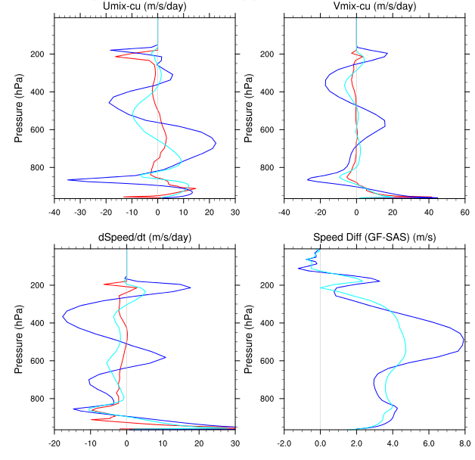
Runs with HWRF, Hurricane Sandy
Sandy: Momentum transport, 10-29-06
GF with EC or SAS method, compared to SAS
1⁰ radius
SAS
GF-SAS
GF_{ec}-SAS
GF-EC
GF_{sas}-SAS

Slide 8
Recent (since ACP paper) new implementations into GF scheme
Momentum transport (as in SAS and/or ECMWF)
Additional closure for deep convection: Diurnal cycle effect (Bechtold 2014)
PDF approach for normalized mass flux profiles was implemented
Originally to fit LES modeling for shallow convection
allows easy application of mass conserving stochastic perturbation of vertical heating and moistening profiles
Provides smooth vertical profiles
Third type of cloud (congestus type convection)
Changed cloud water detrainment treatment
Stochastic part now coupled to Stochastic Parameter Perturbation (SPP), and Stochastic Kinetic Energy Backscatter (SKEBS) approach (J. Berner )
Additional closures for shallow convection (Boundary Layer Equilibrium (BLQE, Raymond 1995; W*, Grant 2001, Heat Engine, Renno and Ingersoll, JAS 1996)
Versions now used in WRF, FIM, GFS, GEOS-5, will be operational in RAP

Slide 9
Improving the simulation of the diurnal cycle of convection in GF scheme
In the attempt to improve the diurnal cycle of convection in the GF scheme, we adopted a closure for non-equilibrium convection developed by Bechtold et al. (2014).
B2014 proposed the following equation for the convective tendency for deep convection:
$${\left.\frac{∂A}{∂t}\right|}_{conv}=−\left(\frac{A}{τ}−\frac{τ_{BL}}{τ}{\left.\frac{∂A}{∂t}\right|}_{BL}\right)$$
where A is called density-weight buoyancy integral, and τ and τ_{BL} are appropriated time scales.
The tendency on the right side of this equation, is the total boundary layer production given by:
$${\left.\frac{∂A}{∂t}\right|}_{BL}=−\frac{1}{T^{∗}}{\left.\int_{p_{surf}}^{p_{base}}{\frac{∂\overline{T_{v}}}{∂t}}\right|}_{BL}dp$$
T* is a scale temperature parameter with a range of about 1 to 4 K.

Slide 10
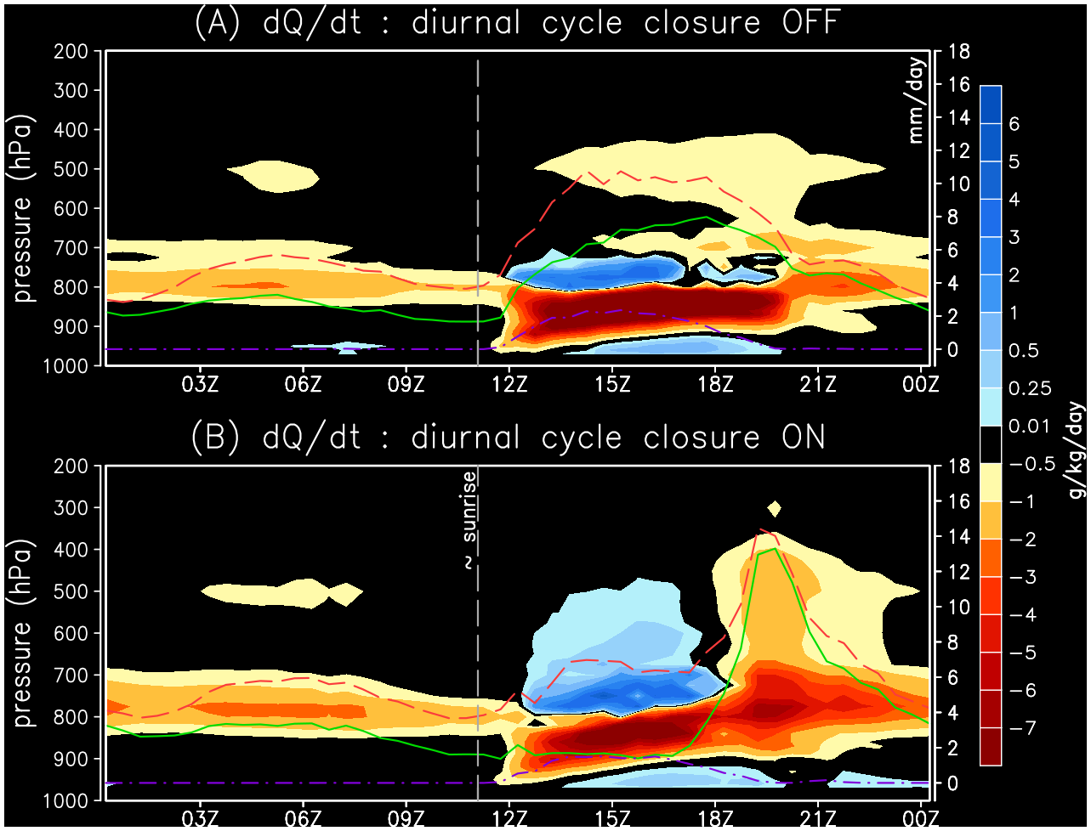
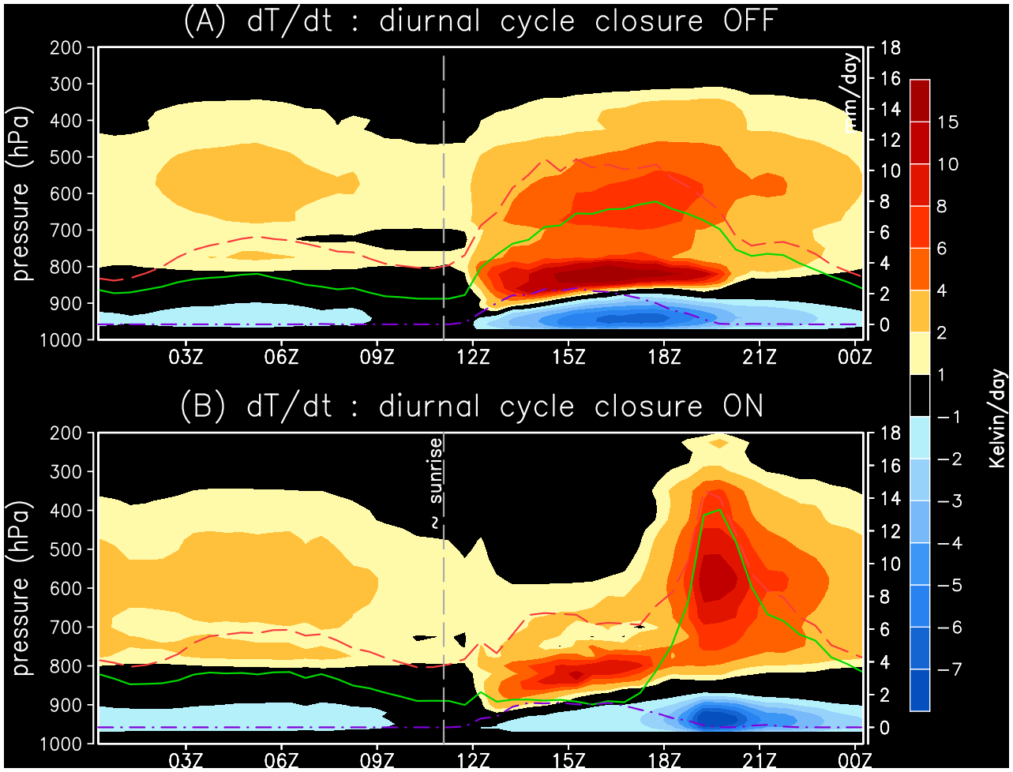
Diurnal cycle of convection over the Amazon Basin
Not applying the diurnal cycle closure, the 3 convective modes occur at the same time, with the deep convection occurring too early.
Drying tendencies
Heating tendencies
$$\frac{∂Q}{∂t}$$
$$\frac{∂T}{∂t}$$
Late morning and early afternoon low/mid tropospheric moistening by shallow and congestus
Late afternoon and early evening tropospheric drying by the rainfall from the deep cumulus
UTC time (LT=UTC-4h)

Slide 11
Recent (since ACP paper) new implementations into GF scheme
Momentum transport (as in SAS and/or ECMWF)
Additional closure for deep convection: Diurnal cycle effect (Bechtold)
PDF approach for normalized mass flux profiles was implemented
Originally to fit LES modeling for shallow convection
allows easy application of mass conserving stochastic perturbation of vertical heating and moistening profiles
Provides smooth vertical profiles
Third type of cloud (congestus type convection)
Changed cloud water detrainment treatment
Stochastic part now coupled to Stochastic Parameter Perturbation (SPP), and Stochastic Kinetic Energy Backscatter (SKEBS) approach (J. Berner )
Additional closures for shallow convection (Boundary Layer Equilibrium (BLQE, Raymond 1995; W*, Grant 2001, Heat Engine, Renno and Ingersoll, JAS 1996)
Versions now used in WRF, FIM, GFS, GEOS-5, will be operational in RAP

Slide 12
The original reason for implementing PDF’s for vertical mass flux: shallow convection

Slide 13
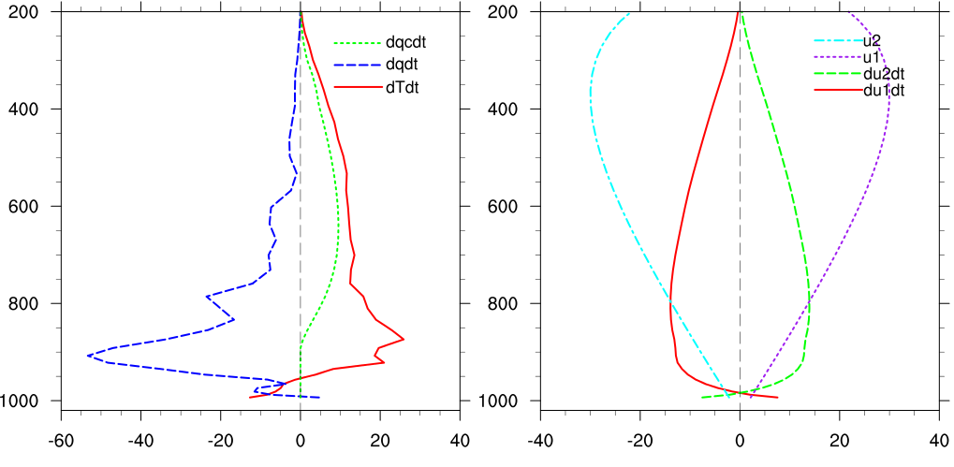
Changing the vertical mass flux PDF’s
Large changes in vertical redistribution of heat and moisture
Mass conserving for stochastic approaches
Significant impact on HAC’s,
Increases spread for ensemble data assimilation
PDF1
PDF2
1d version of GF only

Slide 14
Stochastic parameter perturbation in GF scheme
For stochasticism: significantly different from original approach through bringing in temporal and spatial perturbations, but still possible to perturb the ensembles from GD scheme
Apply directly to closure assumptions – for location and strength of convection
Apply to skewness and sharpness of vertical mass flux PDF’s: an easy way to significantly alter vertical heating and drying profiles, but conserving mass
Momentum transport

Slide 15
Using SPP to perturb normalized vertical mass flux PDF’s
Perturbed 8-member RAP ensemble mean is compared against deterministic RAP – initial results are for 4 days only
July 1, 3, 5, and 8, initial time 00Z
Preliminary results produced by Isidora Jankov

Slide 16
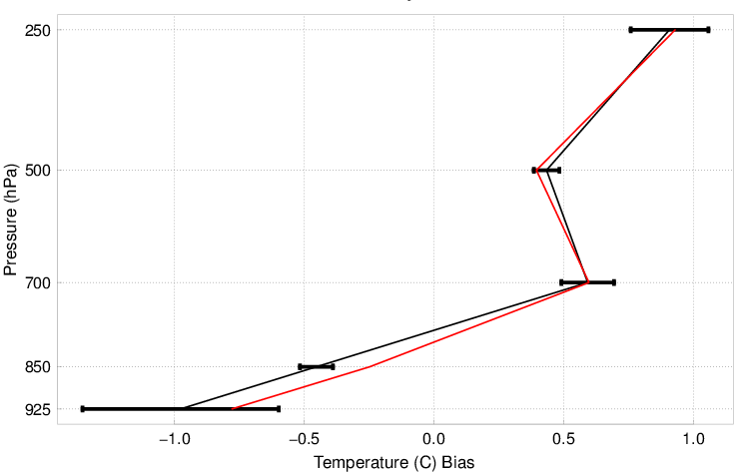
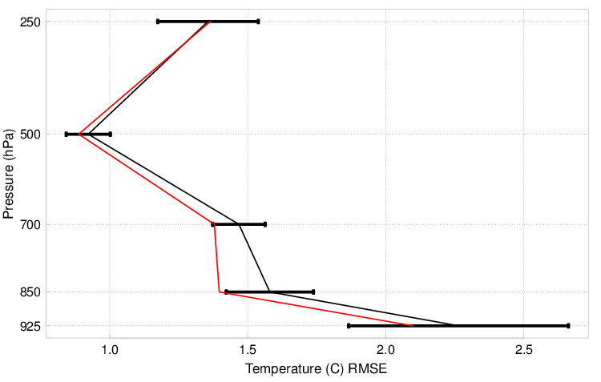
Temperature Bias and RMSE profiles for 24hr lead time

Slide 17
SPP with GF: Opportunities, but much work remains
Simple initial test for perturbing normalized vertical mass flux PDF’s: For most of the variables similar or improved performance from the ensemble mean (including RH, winds and precipitation)
Coupling with SKEBS (J. Berner)
Sensitivity: much to learn with “best” stochastic fields, but also limits to perturbation of PDF’s
Can this be tied more to physics?
Momentum

Slide 18
Recent (since ACP paper) new implementations into GF scheme
Momentum transport (as in SAS and/or ECMWF)
Additional closure for deep convection: Diurnal cycle effect (Bechtold)
PDF approach for normalized mass flux profiles was implemented
Originally to fit LES modeling for shallow convection
allows easy application of mass conserving stochastic perturbation of vertical heating and moistening profiles
Provides smooth vertical profiles
Third type of cloud (congestus type convection)
Changed cloud water detrainment treatment: Can be specified
Stochastic part now coupled to Stochastic Parameter Perturbation (SPP), and Stochastic Kinetic Energy Backscatter (SKEBS) approach (J. Berner )
Additional closures for shallow convection (Boundary Layer Equilibrium (BLQE, Raymond 1995; W*, Grant 2001, Heat Engine, Renno and Ingersoll, JAS 1996)
Versions now used in WRF, FIM, GFS, GEOS-5, will be operational in RAP

Slide 19
Large impact in physics from clw detrainment profiles
BIAS
RMSE
FIM-BIAS
Red using old GF
Blue using new GF
FIM, 120hr forecasts, 30 days, only change is a slight modification of clw detrainment
WRF, 12hr forecasts, RAP with cycling for 10 days, many other changes
Small changes in clw/ice detrainment can cause large impact in biases – interaction with microphysics

Slide 20
Tuning: usually done within a physics suite, will determine statistical performance for operational applications!
WRF version of GF was tuned to meet RAP standards (RAP/HRRR physics suite), focus on CONUS, short range storm scale type verification
Use in other suites may require significant amount of work
Example: GEOS-5 (NASA’s version of FV3)

Slide 21
RAP CSI/BIAS Precipitation Summer (Three Weeks Jul 2016)
1 hr
6 hr
12 hr
Red using old GF
Blue using new GF

Slide 22
GF in NASA GEOS Model, Summary of scale dependence tests: Saulo Freitas probably spent close to half a year tuning global precipitation (now very close to observed)
GEOS Model Resolution |  | Precipitation (mm/day)
 |  | PARAMETERIZED (PARAM/TOTAL) | TOTAL
C180 | ~ 50km | 1.75 (55%) | 3.20
C360 | ~ 25km | 1.59 (50%) | 3.21
C720 | ~ 12km | 1.19 (38%) | 3.17
C1000 | ~ 09km | 0.84 (26%) | 3.23
C1440 | ~ 06km | 0.54 (16%) | 3.28

Slide 23
Technical changes in new GF scheme
Splitting the module into three parts:
Driver (may be different for various physics suites)
Module for deep convection (independent of dynamic core or physics suite)
Module for shallow convection (also independent)
General clean up of unused arrays, and adding comments

Slide 24
Near future experiments with WRF and NGGPS: Memory and organization
Depending on how long the convective parameterization has been active:
Modify entrainment rate
Modify vertical mass flux pdf’s
Modify cloud water detrainment

