Slide 1
Testing of Grell-Freitas scheme with HWRF model
Mrinal K Biswas¹
Collaborators:
K. Newman¹, E. Kalina², E. Grell², L. Carson¹, J. Frimel², G. Grell³, and L. Bernardet²
¹DTC,NCAR, ²DTC,ESRL,CIRES, ³ESRL
18th Annual WRF Users’ Workshop, Boulder CO

Slide 2
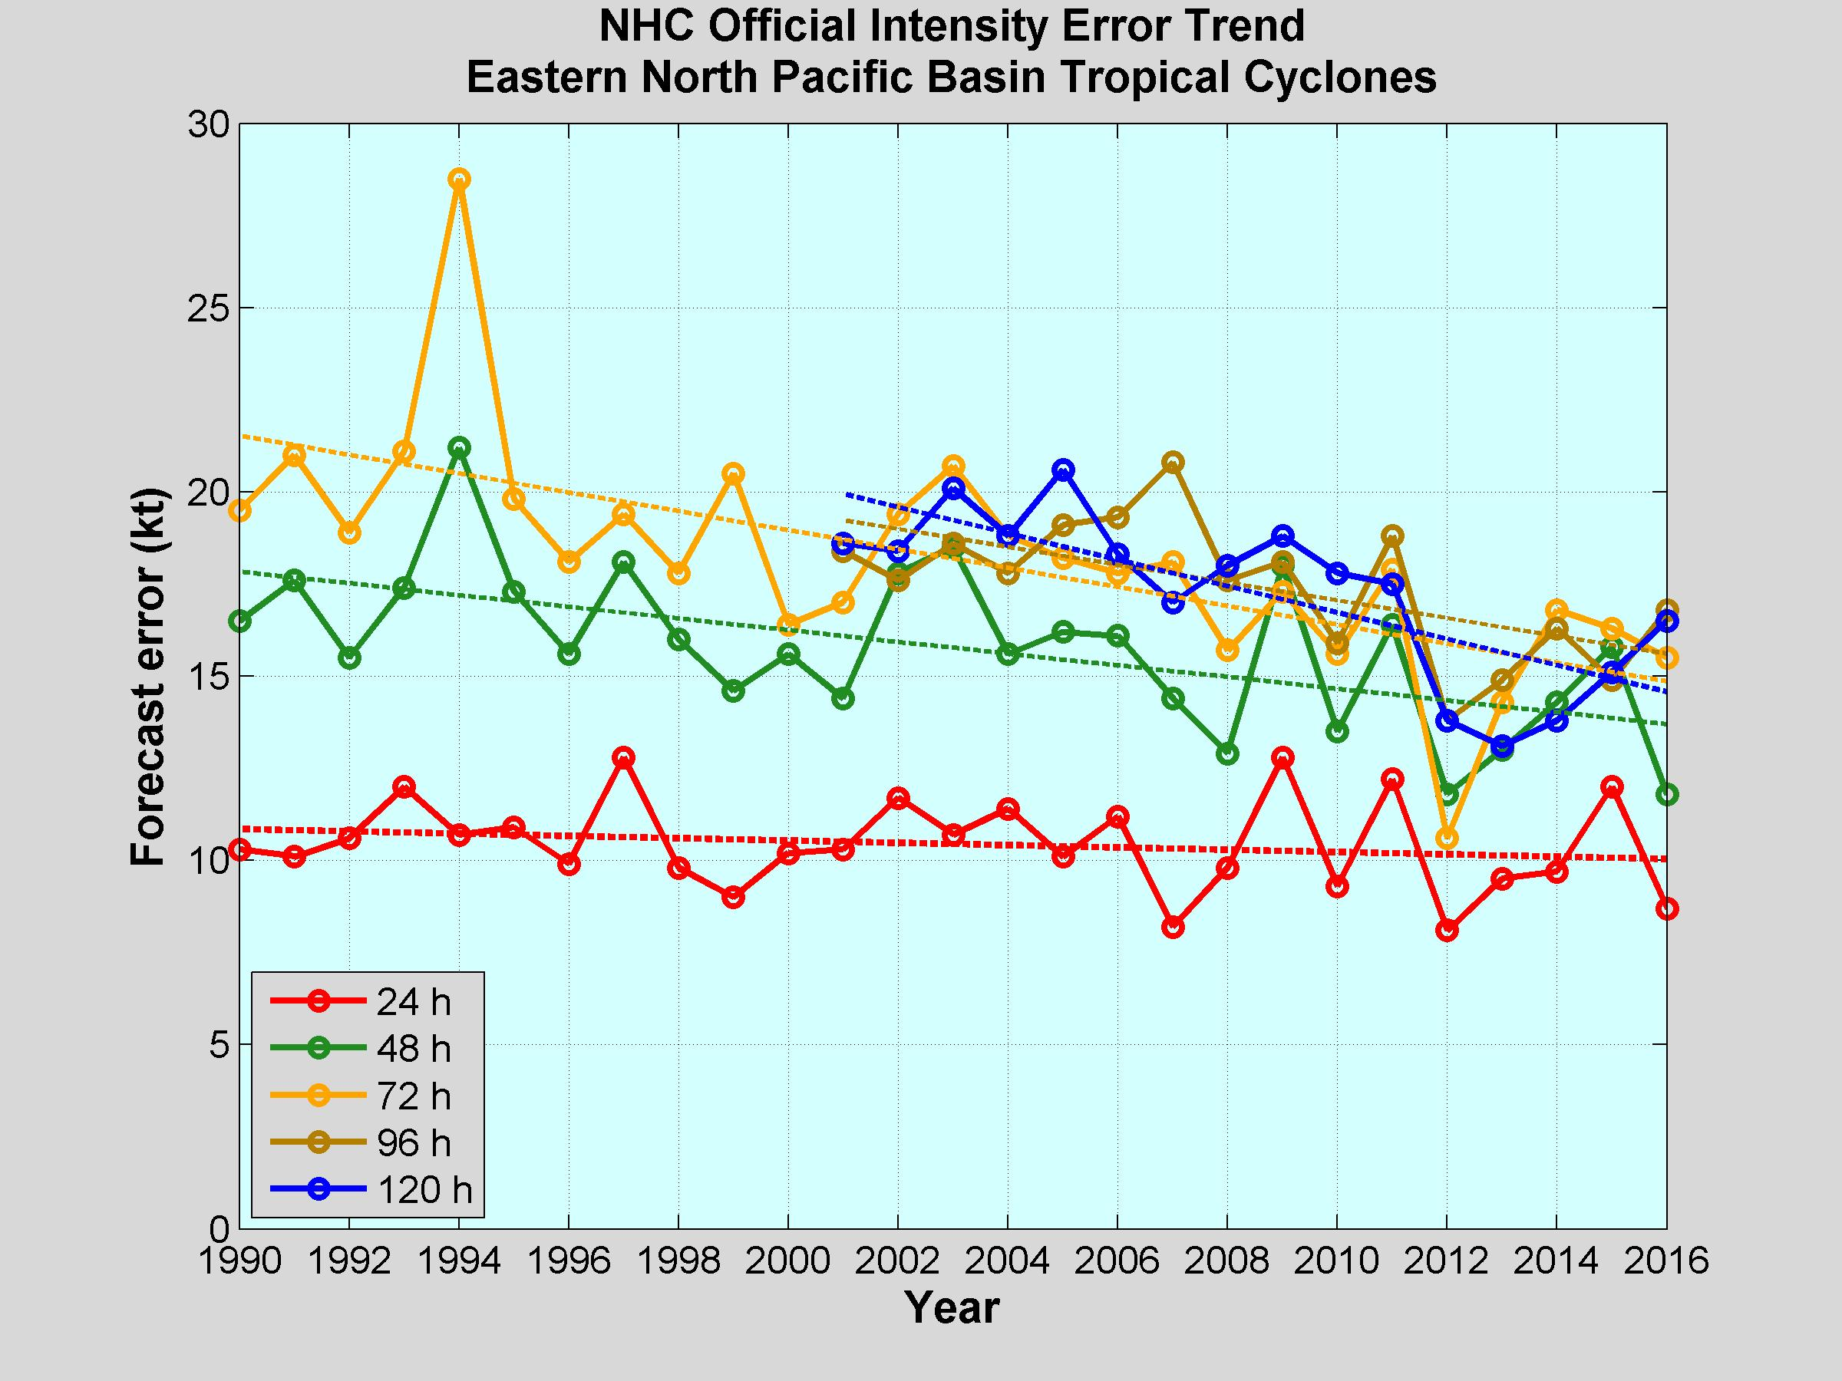
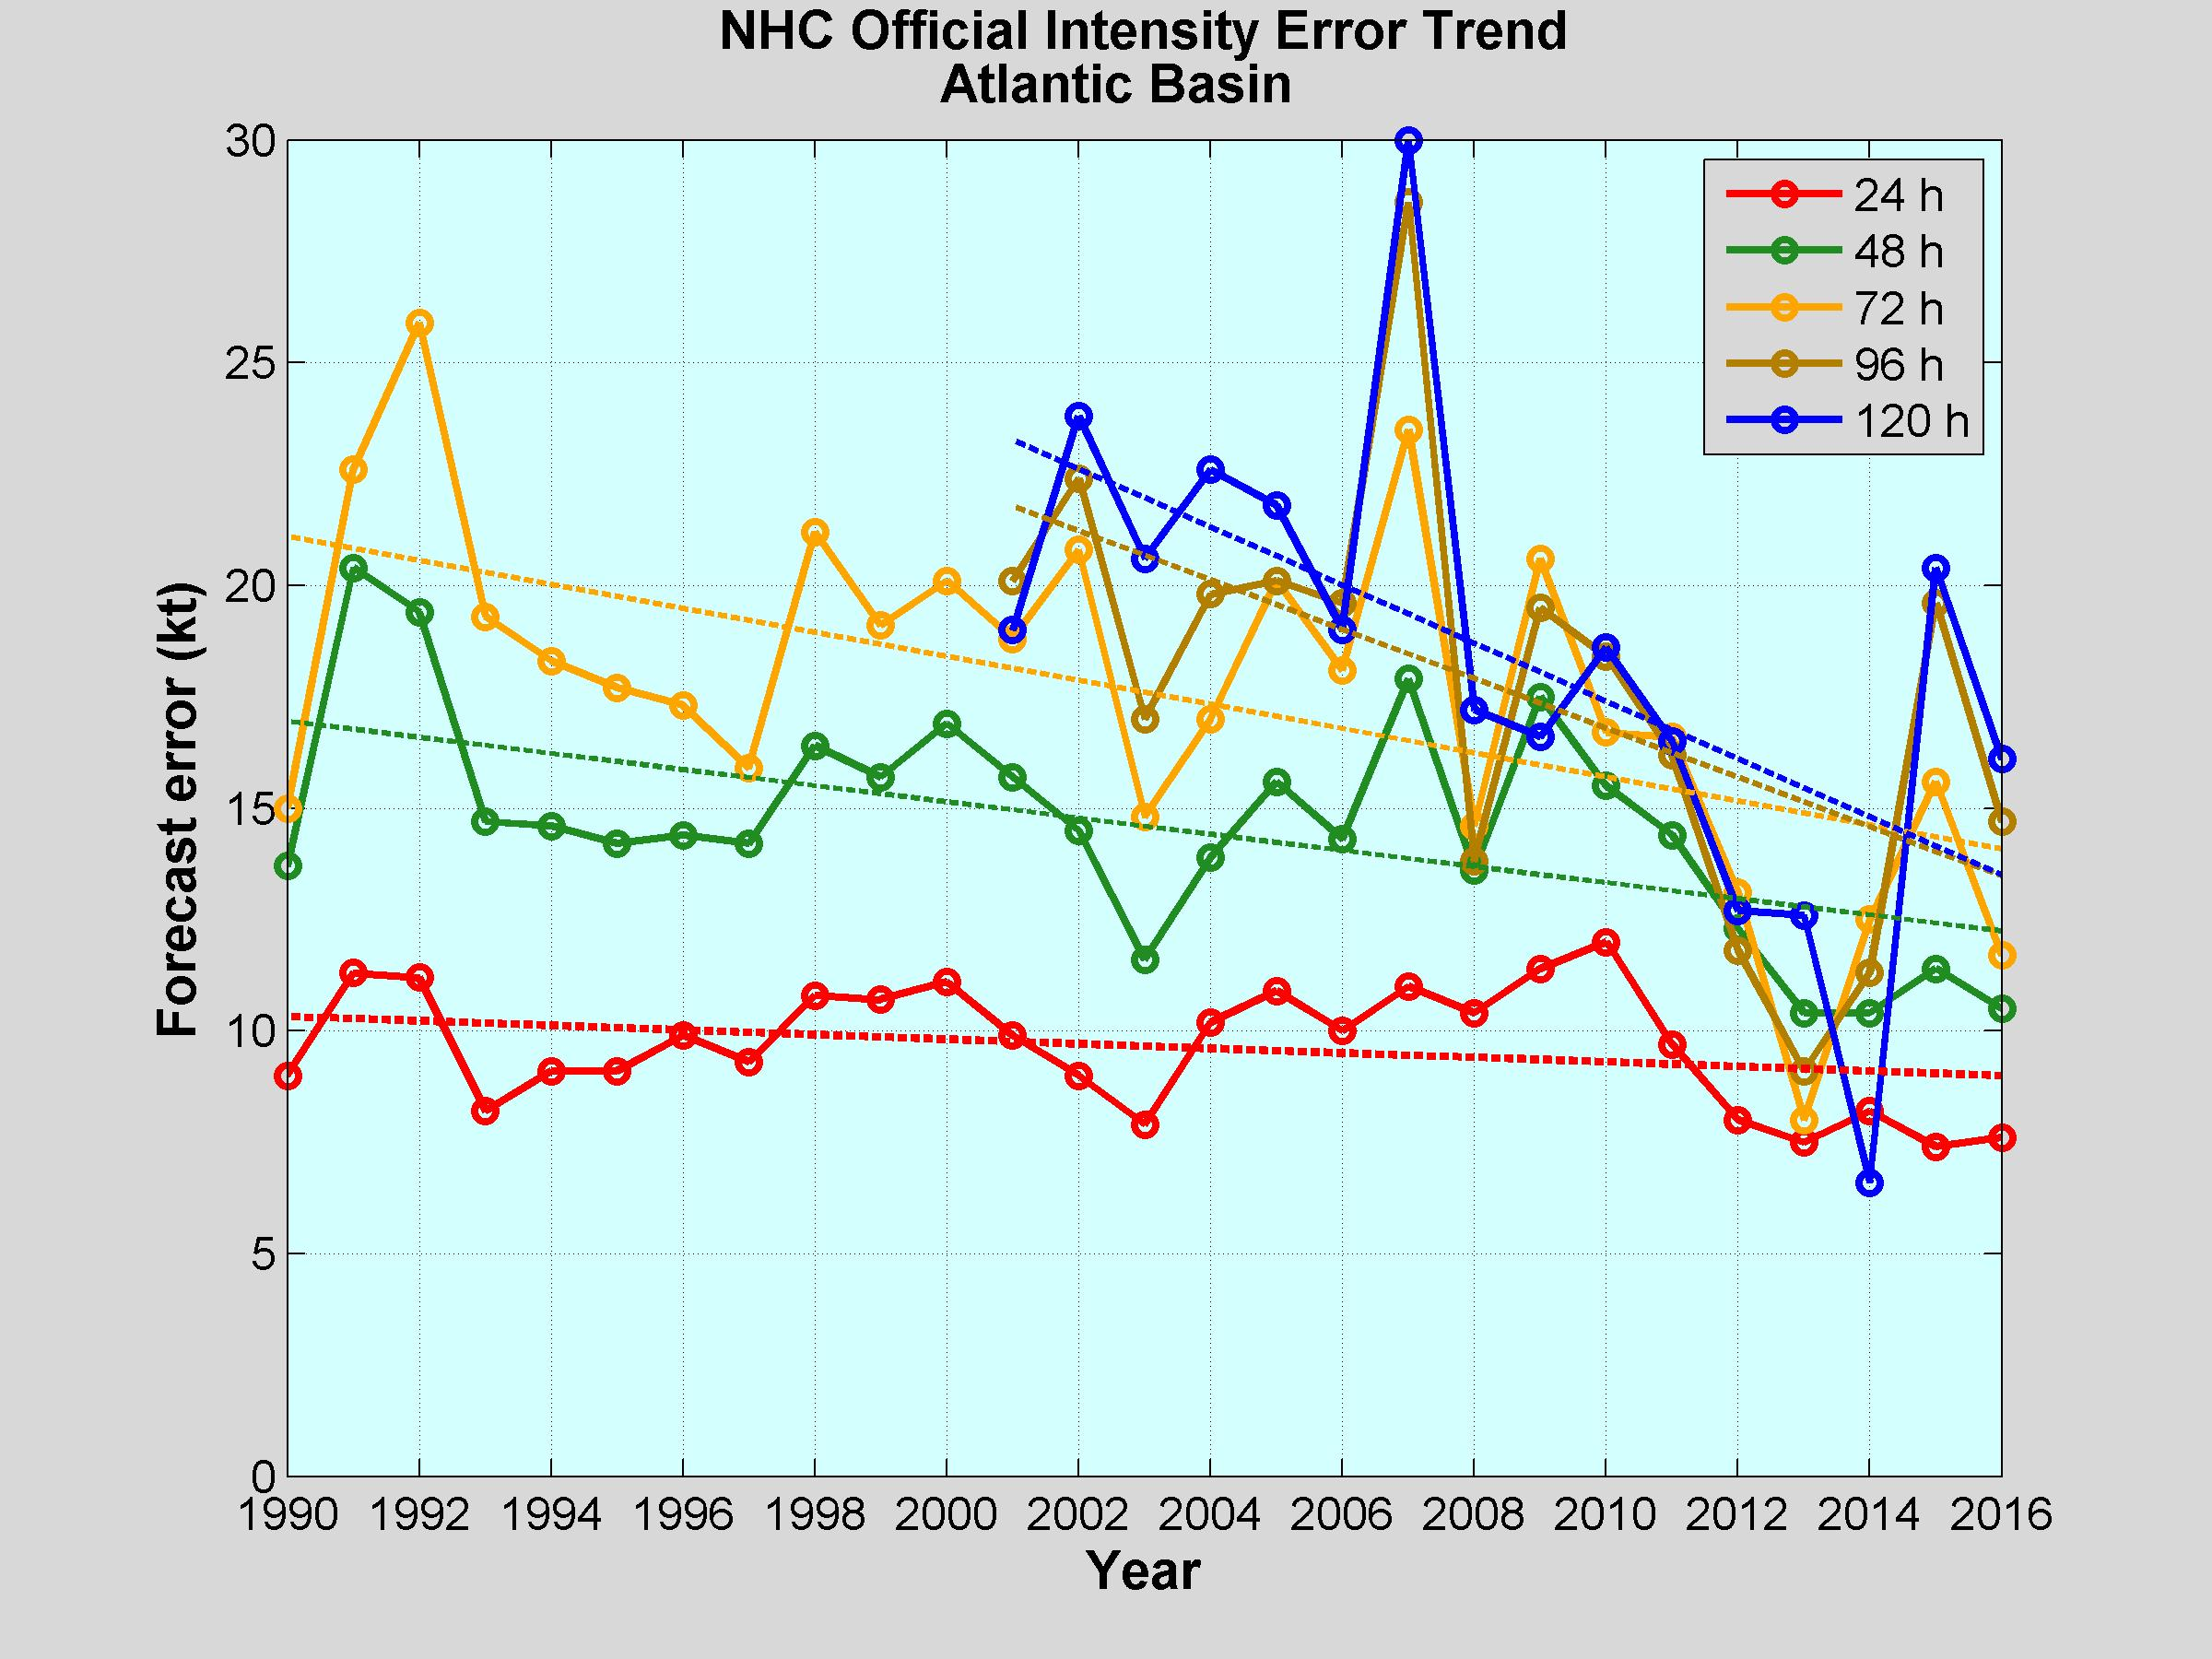
Motivation
Can we improve intensity forecasts
NHC’s official intensity error trend shows some improvement in intensity prediction
RI prediction still an issue
Avenues currently persued
Improvement in data assimilation
Ocean response
Physics advancements
Poster

Slide 3
DTC’s Testing Configurations
 | Control – HWRF with SASAS (H6CL) | HWRF with GF (H6GF)
Cumulus | Scale Aware SAS | GF
Microphysics | Ferrier-Aligo | Ferrier-Aligo
Surface layer | HWRF | HWRF
Land surface | Noah LSM | Noah LSM
PBL | GFS Hybrid EDMF | GFS Hybrid EDMF
Radiation | RRTMG | RRTMG

Slide 4
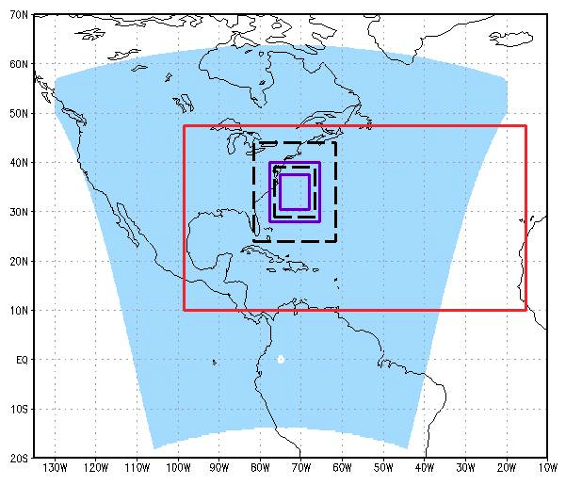
HWRF grid configuration
Atmospheric configuration
Horizontal grid spacing: 18, 6, 2 km
Inner nests move to follow storm
Domain location vary from run to run depending on storm location
61 vertical levels; top at 2 hPa
MPIPOM-TC Atlantic domain
Oceanic configuration – MPIPOM-TC
Horizontal grid spacing: 1/12 deg ( ~9km)
Location of grid depends of location of storm
Atlantic and N. Eastern Pacific
3-D model
23 vertical levels
d02
d03
d01

Slide 5
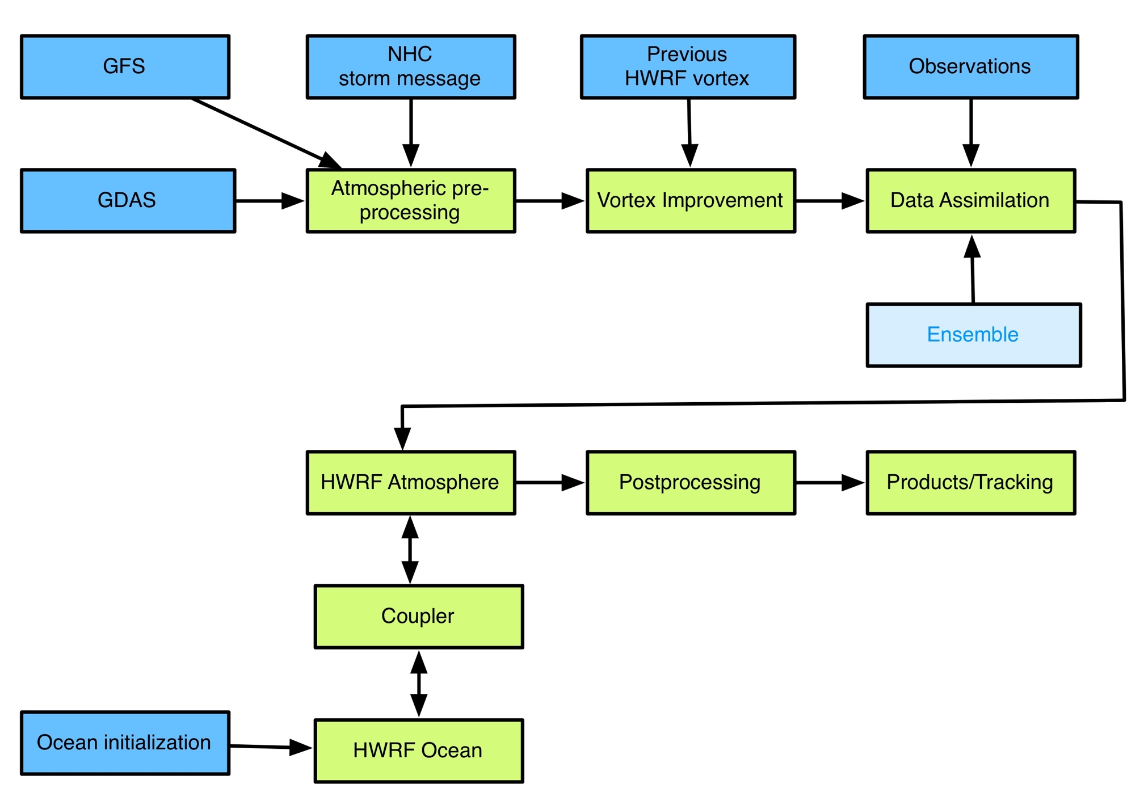
Components of HWRF system

Slide 6
Results

Slide 7
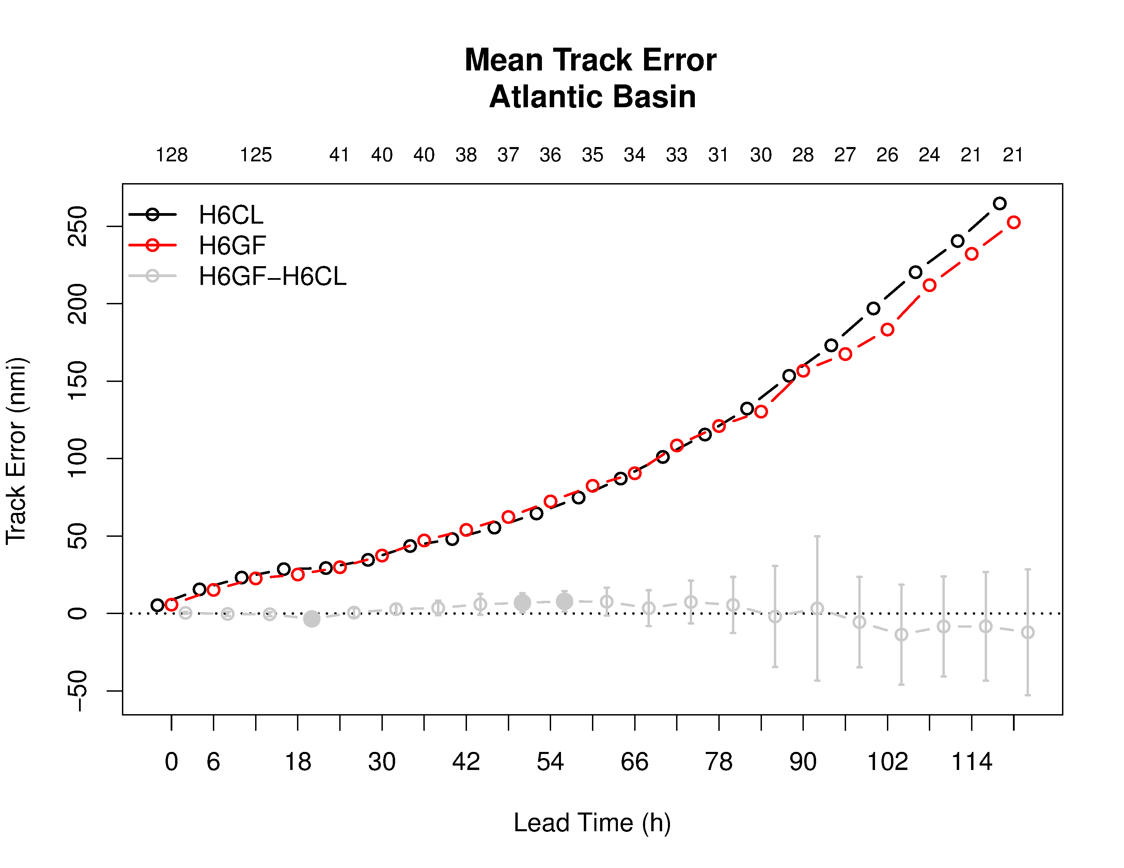
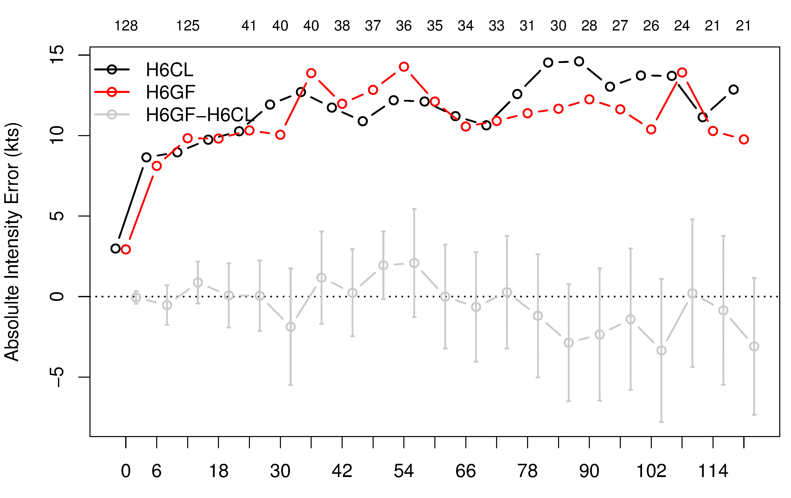
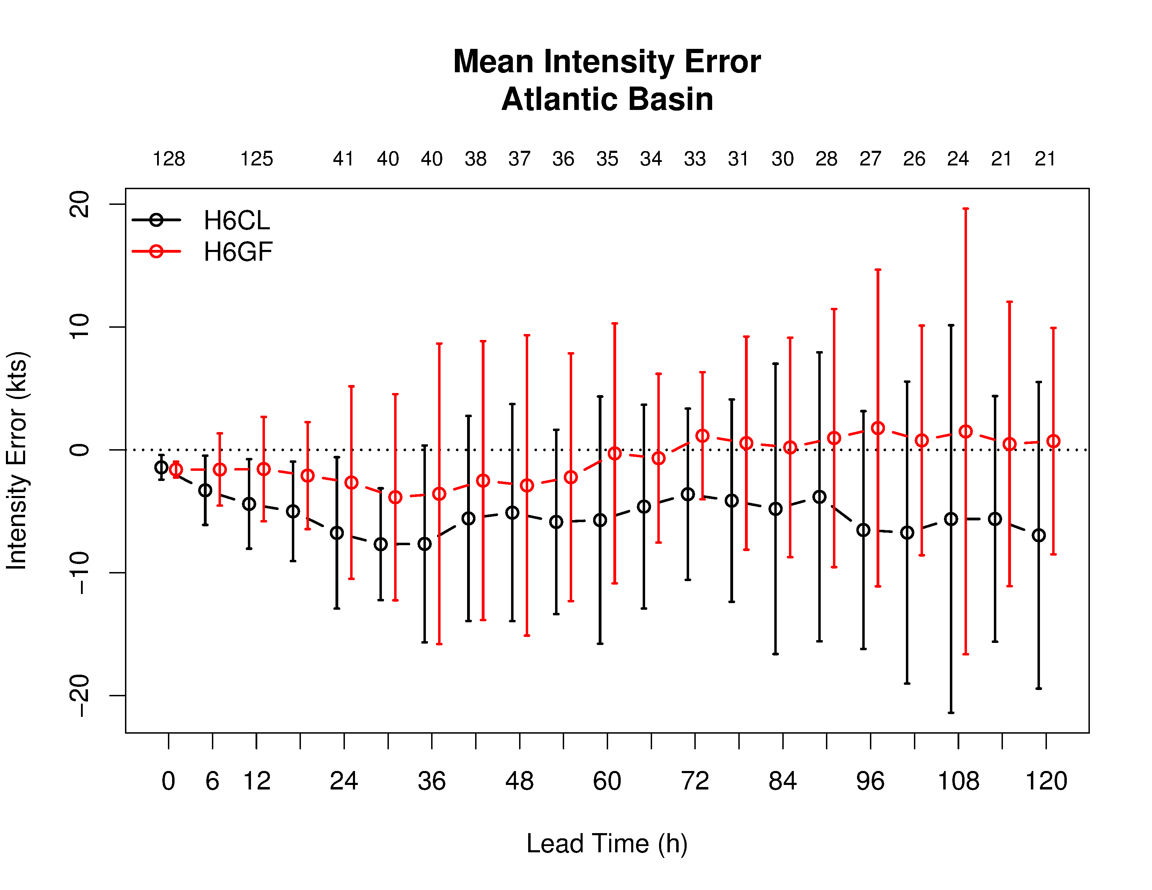
Track and Intensity errors
Storms included: Gonzalo (2014), Edouard (2014), Matthew (2016)
Negative intensity bias was alleviated for the GF scheme especially at longer lead times
Neutral to positive track forecasts improvements for GF scheme
Notes:
track errors indicate some small statistically signficiant (SS) differences between the H6GF and H6CL in early lead times (18-hr improvement and 48-,54-hr degredation for H6GF) whereas mean differences show non-SS lower track errors for H6GF at the longest lead times. H6GF configuration demonstrates a reduction in mean intensity biases. The operational HWRF is known to underpredict intensity for strong AL storms, which appear to be alleivated with H6GF.
Add absolute intensity and names of storms

Slide 8
Intensification
Control
GF
“RI” is defined as 20 kt intensity increase in 24 hr

Slide 9
Case study

Slide 10
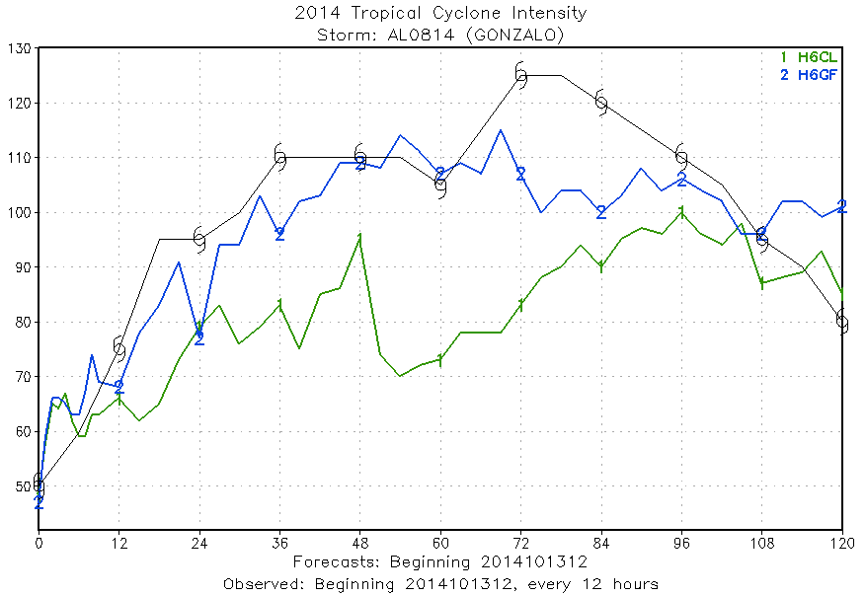
Case study – Gonzalo
Differences in the intensity forecast can come from
Initial conditions
Physics differences
Large scale environment
Storm scale environment

Slide 11
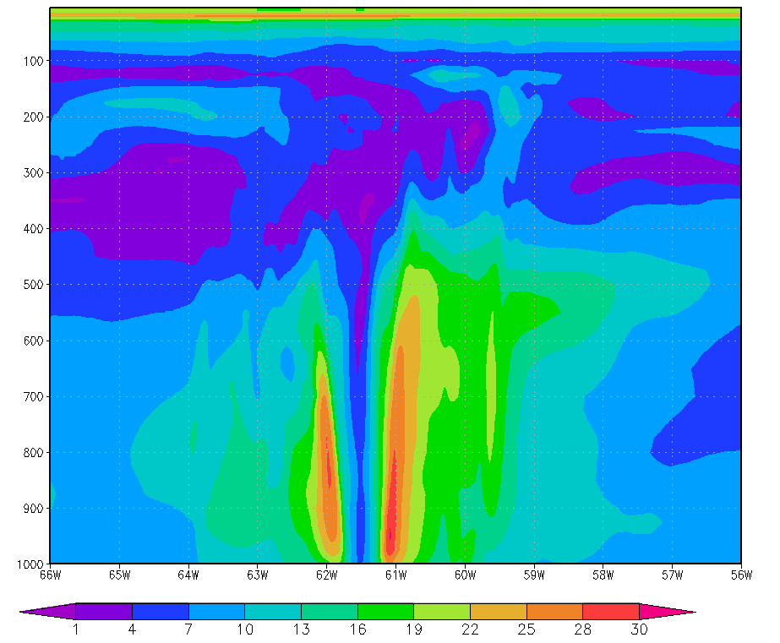
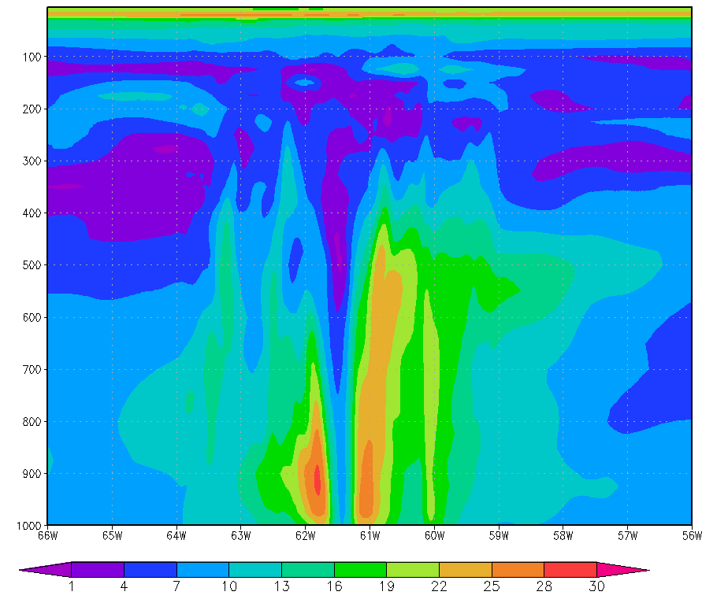
Wind analysis @ t=0
Cntrl
00 hr
GF
00 hr
Wind structure is different at t=0, due to cycling

Slide 12
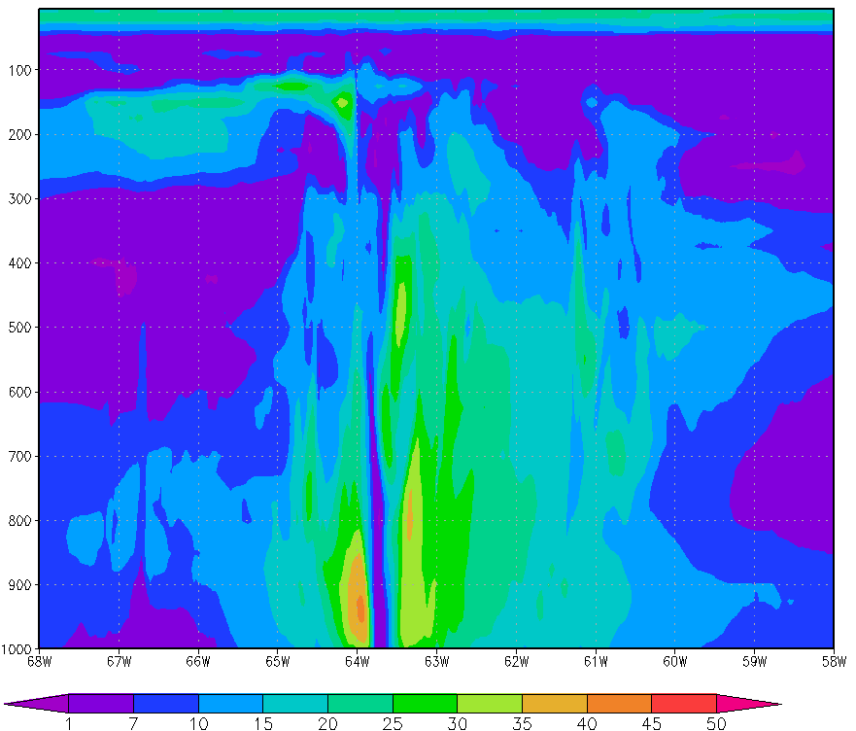
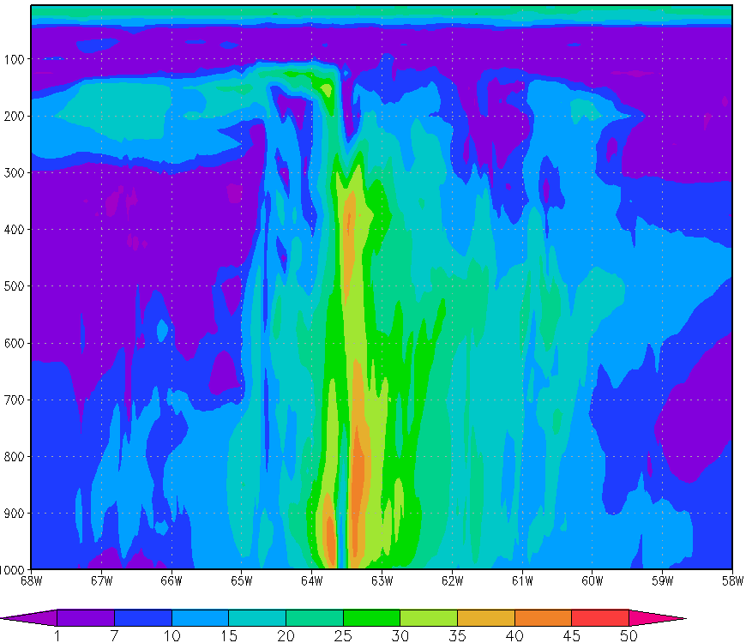
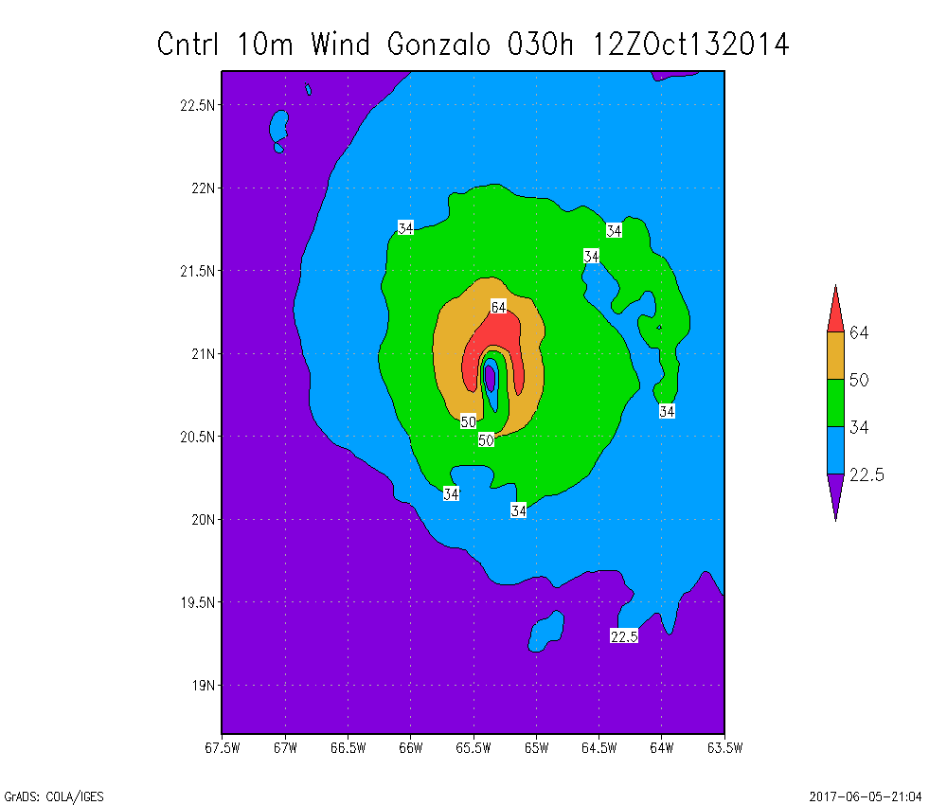
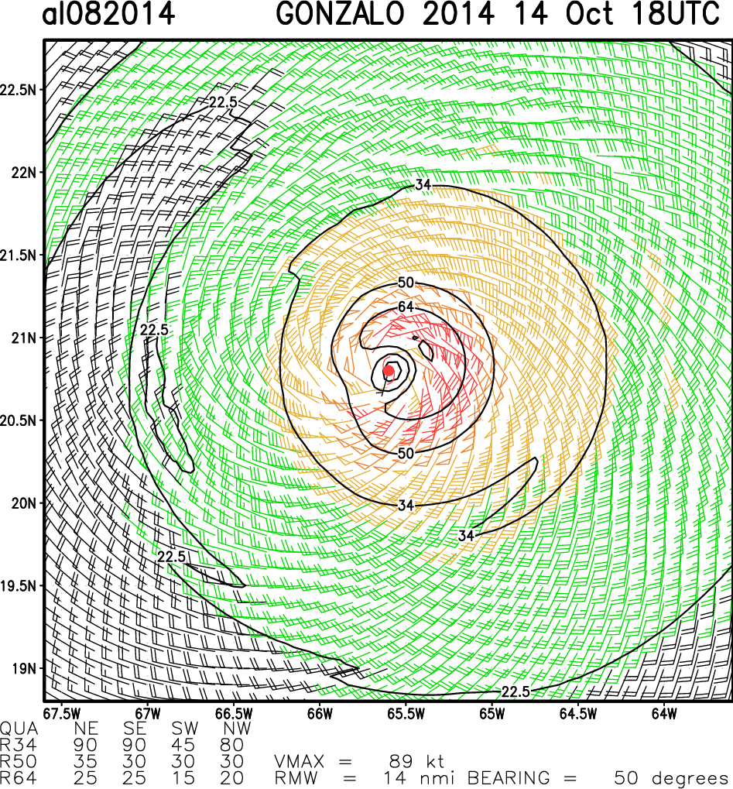
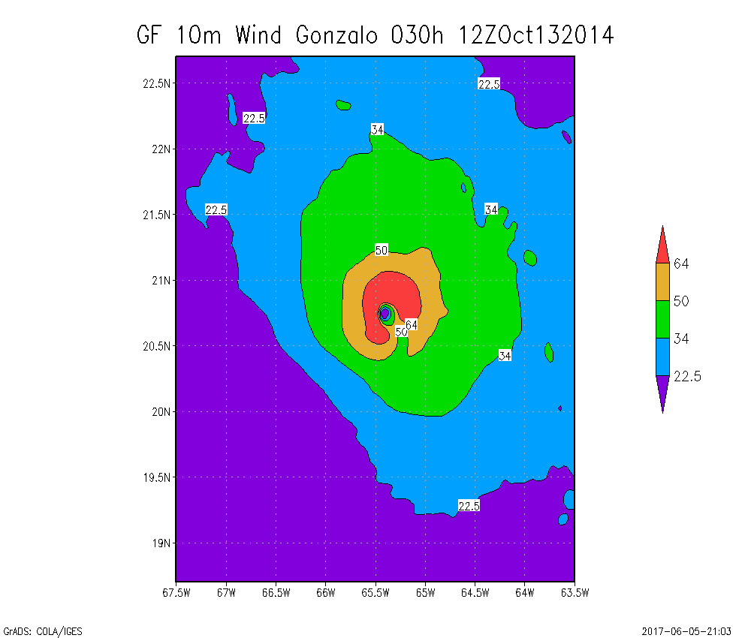
Wind forecast
Cntrl
15 hr
GF
15 hr
GF wind reach upper levels at t=15 h, when the intensities starts to diverge
GF 10m wind pattern is axisymetric at the center and is favorable for intensification
Notes:
http://rammb.cira.colostate.edu/products/tc_realtime/image_airctcwa.asp?product=airctcwa&storm_identifier=al082014&product_filename=2014AL08_AIRCTCWA_201410141800

Slide 13
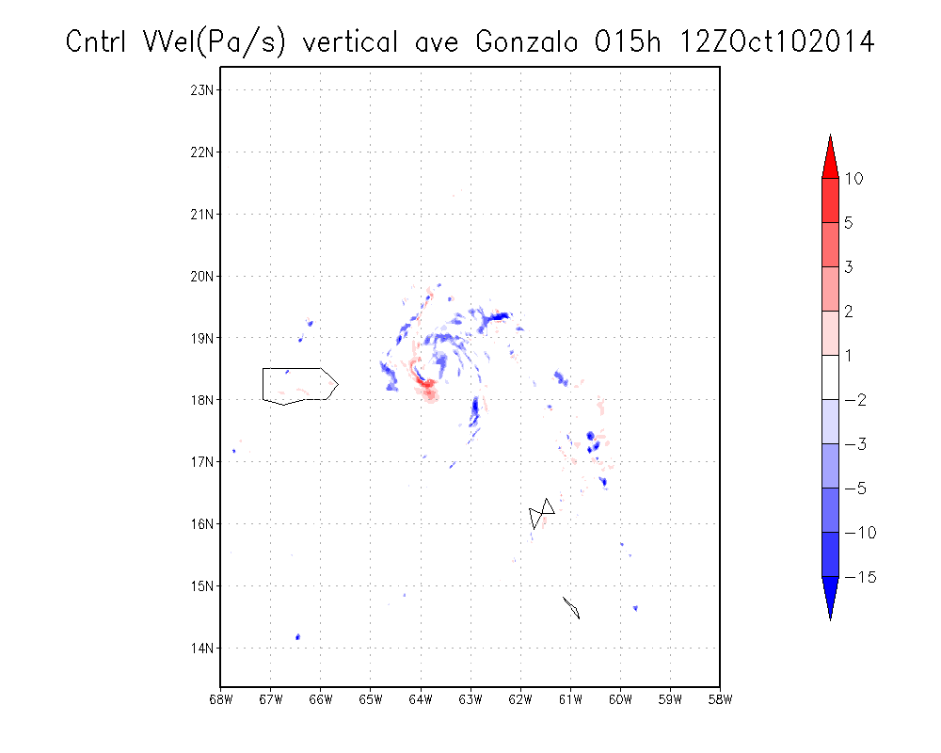
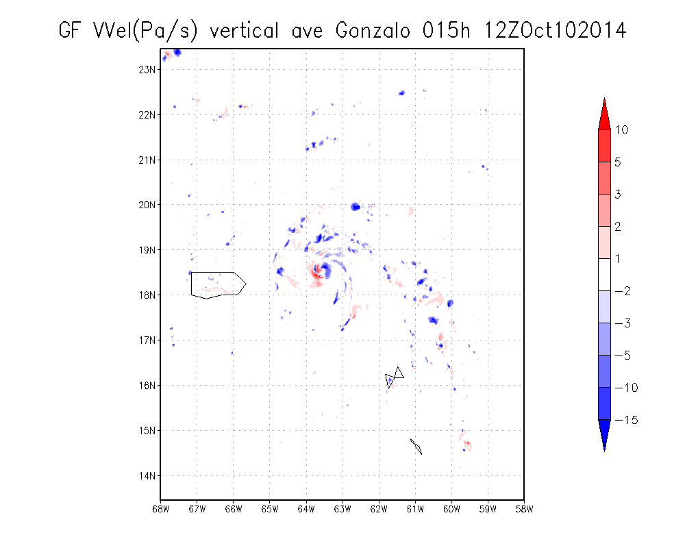
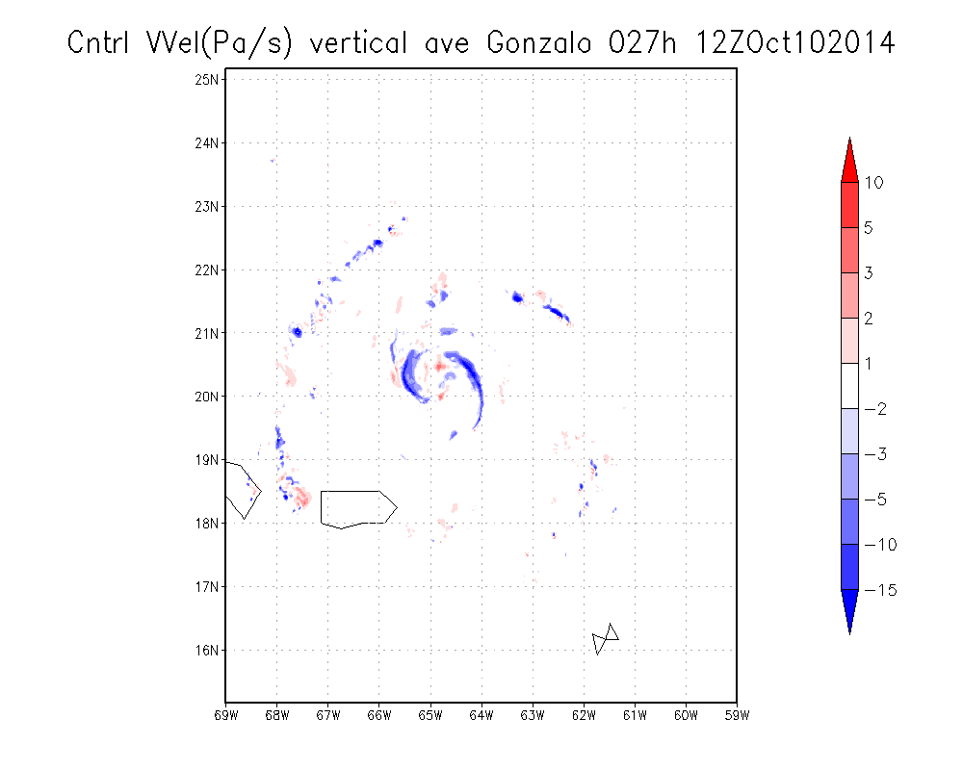
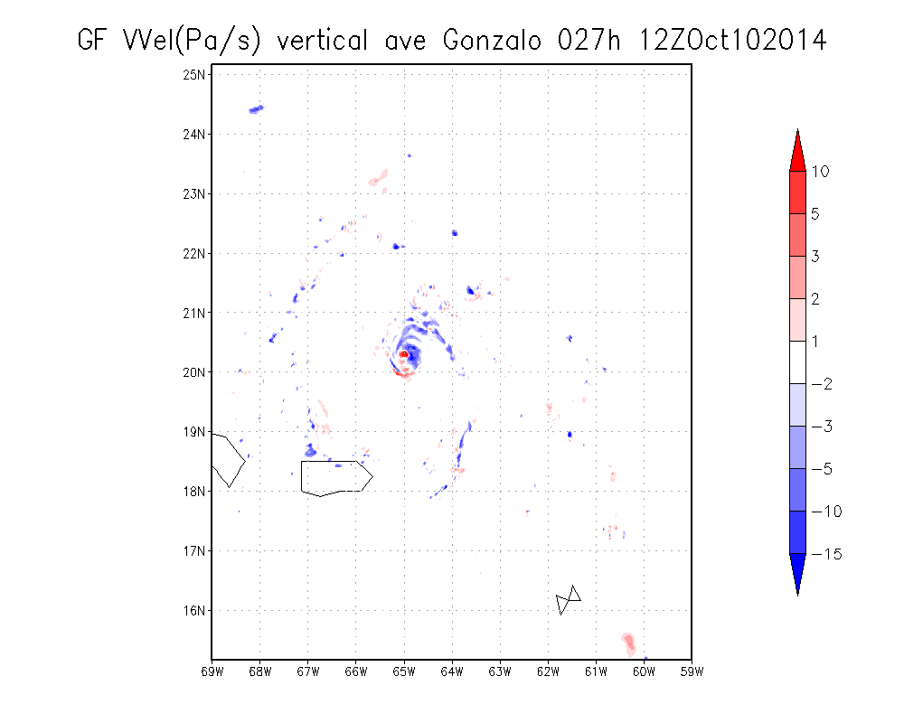
Vertical velocity
Cntrl 15 h
GF 15 h
Vertically averaged vertical velocity for GF shows strong updrafts near the eye-wall region.
These vertical velocity contours show the location of the roots of the updraughts.
Cntrl 27 h
GF 27 h
Notes:
The location of updrafts change in time but are one side of the eyewall most of the time.
These vertical velocity contours show the location of the roots of the updraughts. It is evident that vortical convective cells, highly asymmetric in nature, are ubiquitous throughout the period shown. In the inner core region of the vortex, the roots of the updraughts are largely associated with the cyclonic vorticity maxima and related vorticity filamentary structures, indicating that these vorticity features are the result of vortex tube stretching as individual convective cells intensify. However, the convectively intensified vorticity lingers after each cell has collapsed.

Slide 14
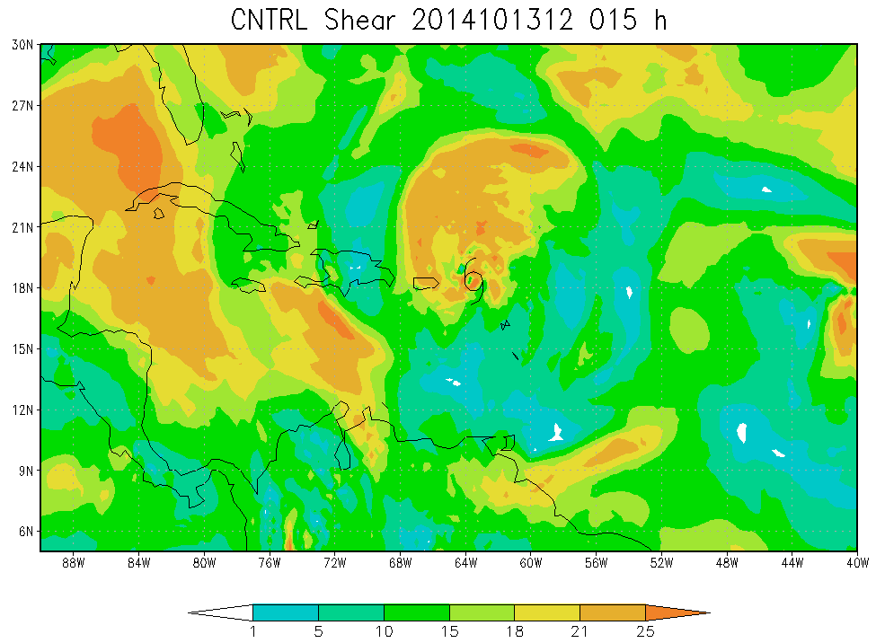
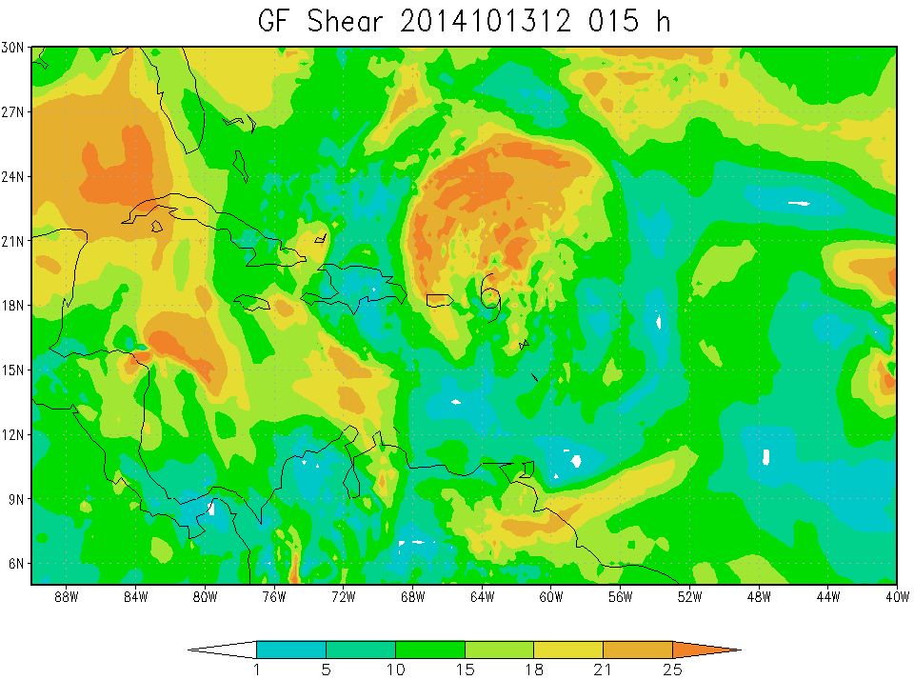
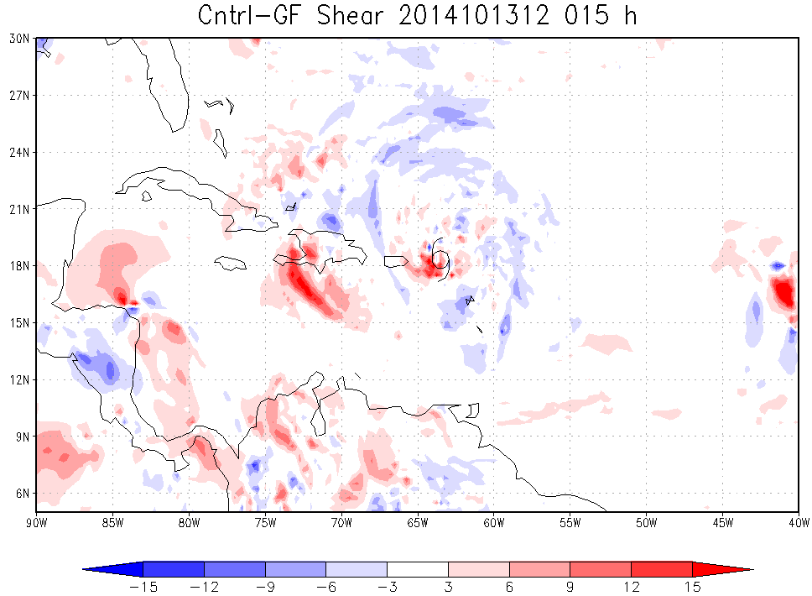
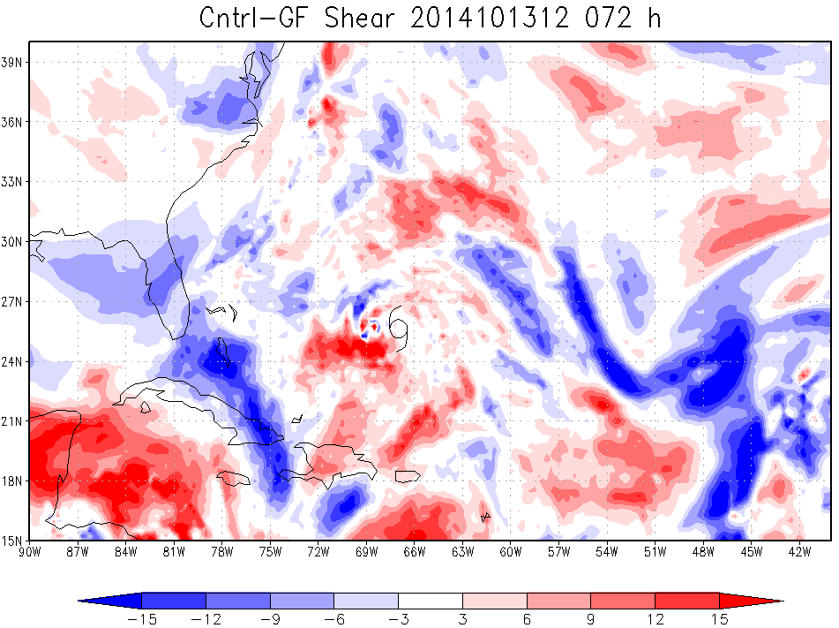
Wind shear
Shear differences shows increase in environmental shear for control at longer lead times

Slide 15
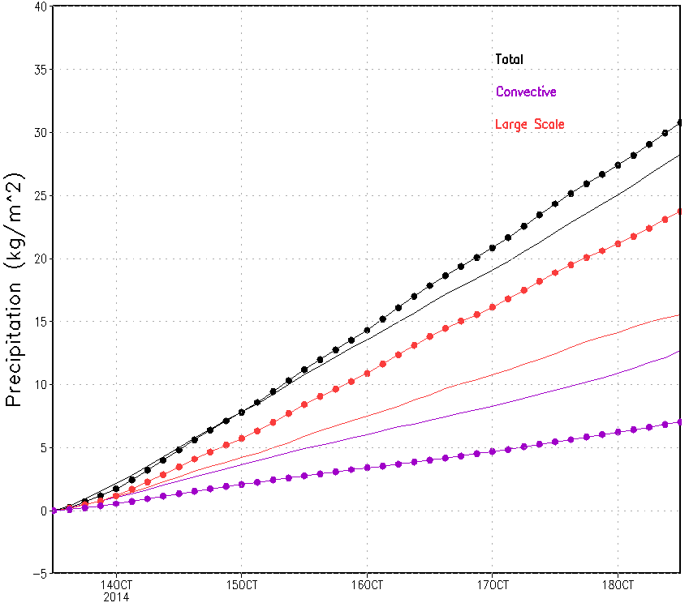
Precipitation
Time series of area averaged accumulated precipitation
Parent domain average
Closed circle - GF
Total precipitation
Grid scale precipitation
Convective precipitation
GF produces higher total precipitation than control
Large-scale precipitation higher than convective-scale in GF
Notes:
Cloud liquid water is more in convective clouds compared to stratiform clouds. The CL increases with height till

Slide 16
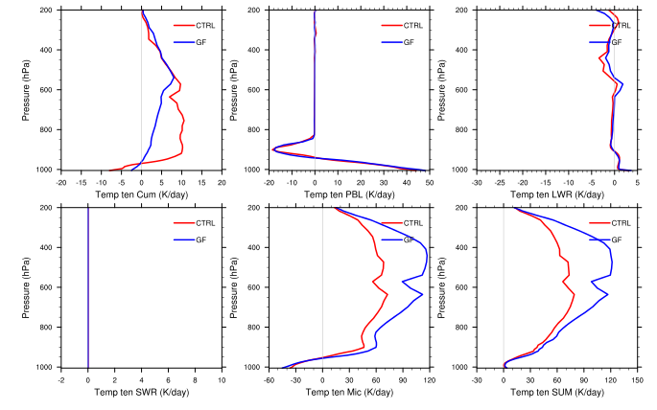
Temperature tendencies
Temperature tendency from the convective scheme is higher for control
Temperature tendency from microphysics is higher for GF

Slide 17
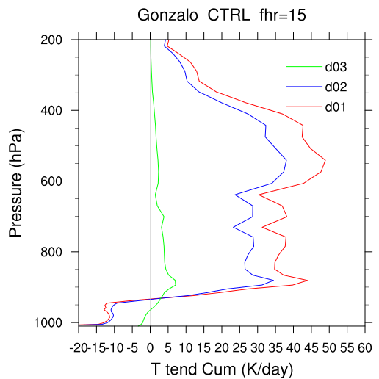
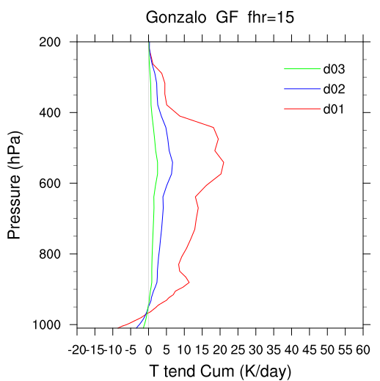
Scale Awareness

Slide 18
Summary
HWRF-GF produced neutral to positive track errors compared to control
HWRF-GF alleviates the negative intensity bias compared to control

Slide 19
DTC visitor program
HWRF-GF produced neutral to positive track errors compared to control
HWRF-GF alleviates the negative intensity bias compared to control

