Slide 1
Introducing Scale-Aware Microphysics and Aerosol Cloud Interactions to the Weather Research and Forecasting Model (WRF-ACI) Timothy Glotfelty¹, Kiran Alapaty¹, Jian He¹, Patrick Hawbecker², Hugh Morrison³, Xiaoliang Song⁴, and Guang Zhang⁴
¹National Exposure Research Laboratory, U.S. Environmental Protection Agency,
Research Triangle Park, NC, USA
²Department of Marine, Earth, and Atmospheric Sciences
North Carolina State University, University Park, PA, USA
³Mesoscale and Microscale Meteorology Division,
National Center for Atmospheric Research, Boulder, CO, USA.
⁴Scripps Institution of Oceanography,
University of California San Diego, La Jolla, CA, USA
Presented at the 18th Annual WRF User’s Workshop
June 14th, 2017
Disclaimer
The views expressed in this presentation are those of the authors and do not necessarily reflect the views or policies of the U.S. Environmental Protection Agency.

Slide 2
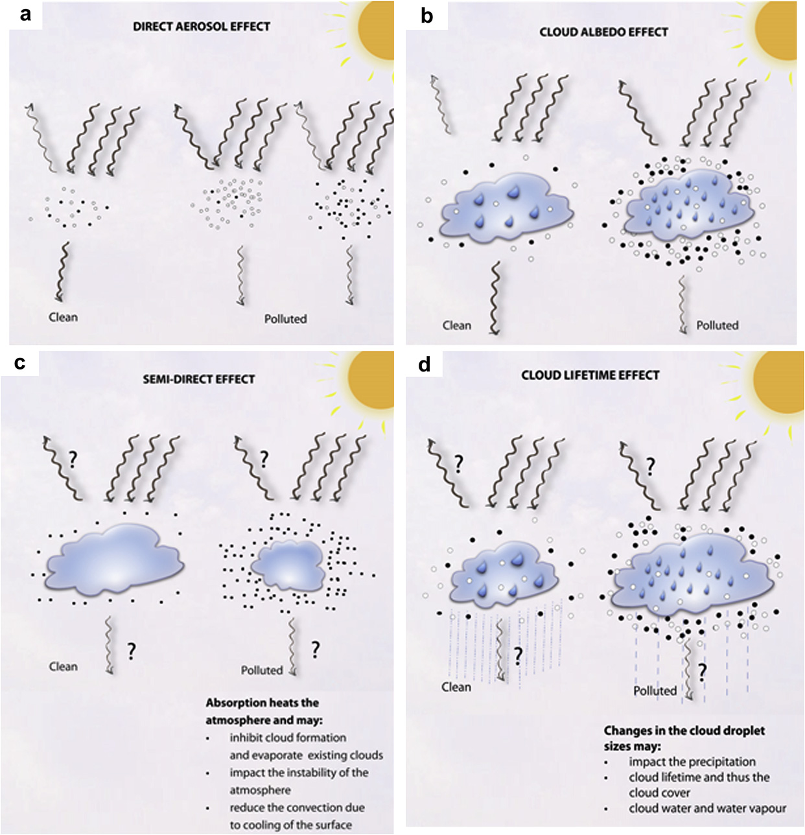
Aerosol Indirect Effects
Thermodynamic Invigoration
Cloud Albedo Effect
Cloud Lifetime Effect
Notes:
Aerosols have the ability to reduce precipitation in warm clouds by reducing the droplet size which leads to a reduction in precipitation efficiency and an increase in cloud lifetime. In convective mixed phase cloud the increase in cloud lifetime can lead to a thermodynamic invigoration effect once freezing begins by warming the updrafts and facilitating the formation of hail/graupel that increases precipitation. The reduced droplet size increases the clouds albedo. These effects have the largest uncertainty in global climate models according to the IPCC.

Slide 3
Major Objective
Develop a scale-aware modeling system to represent the impacts of aerosols on both grid-scale and subgrid-scale clouds for use in high resolution regional numerical weather prediction simulations supporting ecosystem and human health research studies at the
US Environmental Protection Agency

Slide 4
WRF-ACI:
Weather Research and Forecasting Model with Aerosol Cloud Interactions
WRF-ACI has four components:
Temporally and spatially varying bias corrected prescribed aerosol concentrations climatology with global coverage for current and future conditions
Modified Song and Zhang (2011) subgrid-scale microphysics
Consistent aerosol activation and ice nucleation parameterizations in both the grid-scale and subgrid-scale and microphysics packages
Coupling of subgrid- and grid-scale microphysics to the radiation scheme

Slide 5
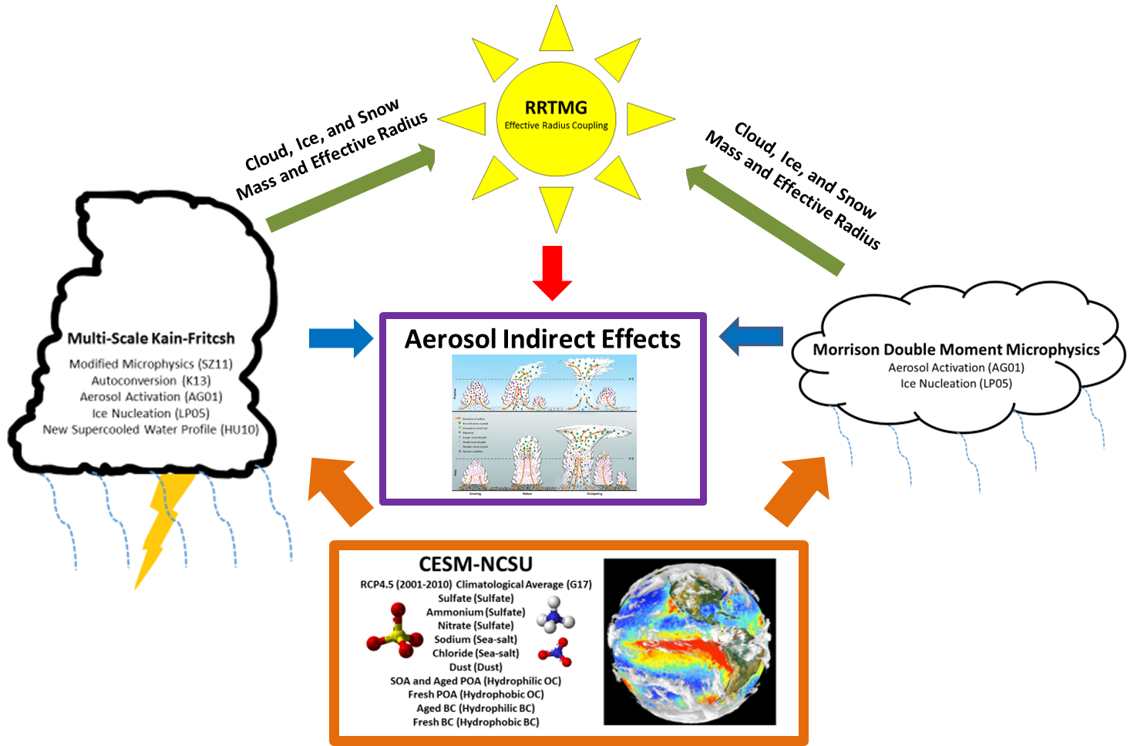
WRF-ACI System
Notes:
WRF-ACI System description. CESM-NCSU RCP4.5 aerosols are feed into MSKF and MDM to calculate cloud droplet activation and ice nucleation. The cloud droplet effective radius and cloud water paths are passed to RRTMG. This allows WRF-ACI to simulate aerosol indirect effects with limited computational expense.

Slide 6
WRF-ACI Physics Configurations
WRF Version: WRFv3.8.1
Boundary Layer: YSU
Land Surface Model: NOAH
Cumulus Scheme: MSKF
Microphysics: Morrison DMS
Radiation: RRTMG
Nudging: FDDA and FASDAS
Two Part Study: JJA 2006 (Summer) and NWP (7 day)
INPUTS: 12 km NAM, CESM-NCSU RCP4.5 (2001-2010)
Evaluation Data: QCLCD, CERES-EBAF, MODIS, and PRISM
Notes:
I made some changes here

Slide 7
Part I (Model Evaluation)
Configuration of Simulations
Time Period: 3 months (June, July, and August 2006)
Type: Seasonal /Long term Simulation
Resolution: 12km
Region: Eastern United States
Simulations
Default WRFv3.8.1 = WRF-BASE
WRF-ACI Updates = WRF-ACI
Objectives
Quantify the differences between WRF-ACI and WRF-BASE
Evaluate model performance of WRF-BASE and WRF-ACI

Slide 8
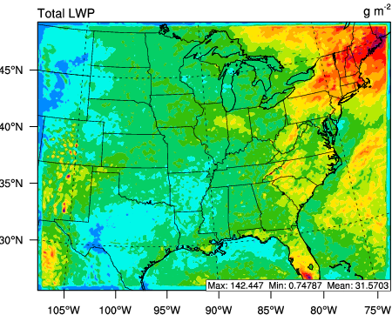
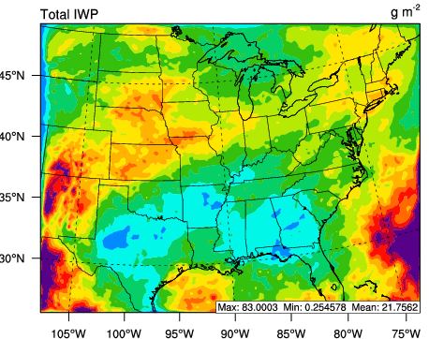
Performance Evaluation of JJA Liquid and Ice Water Path
WRF-BASE
WRF-ACI
Compared to MODIS
Stat | WRF-BASE | WRF-ACI
Corr. | 0.34 | 0.27
MB | -56.92 | -26.40
RMSE | 72.70 | 57.66
LWP (g m⁻²)
Max: 110.4 Min: 0.2 Mean: 20.7
Max: 142.4 Min: 0.7 Mean: 31.6
Compared to NOAA
Stat | WRF-BASE | WRF-ACI
Corr. | 0.005 | 0.03
MB | -130.47 | -92.28
RMSE | 151.06 | 123.68
IWP (g m⁻²)
Max: 27.5 Min: 0.4 Mean: 8.1
Max: 48.5 Min: 0.9 Mean: 17.1
Notes:
In general cloud liquid and ice water path data and underpredicted compared to satellite estimates and generally not well simulated. This a feature consistent across most global and regional weather and climate models due to large uncertainties in cloud modeling. One possible way to fix this is so called super parameterization which puts a cloud resolving model in each grid cell but that is beyond the scope of this work. The inclusion of subgrid scale microphysics lead to the formation of much more subgrid scale cloud water leading to an increase of ~ 11 g m⁻² on average. This decreases the MB against MODIS by about 30 g m⁻² . IWP is enhanced in WRF-ACI because the ice effective radius for autoconversion was increased from 125um to 350um. This value is arbitrary but it exists within the range of 90-500 um and the 350um brought the values into better agreement with observations. Increaseing the IWP ~9.0 g m-2 on average and decreaseing the mean bias of IWP by ~ 40 g m-2.

Slide 9
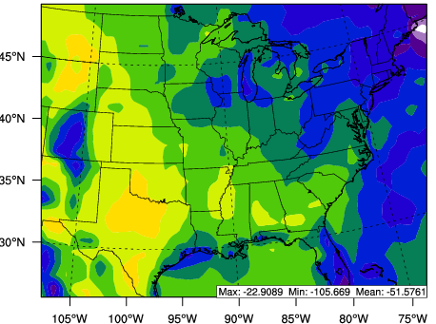
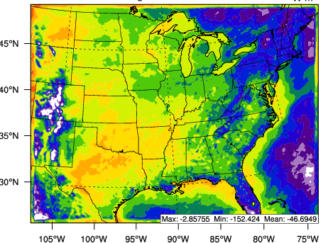
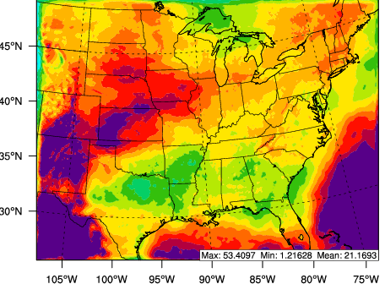
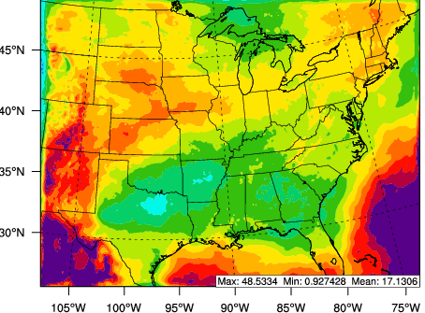
Performance Evaluation of JJA Radiation
WRF-BASE
CERES-EBAF Estimate
WRF-ACI
SWCF (W m⁻²)
Max: -3.6 Min: -139.7 Mean: -47.5
Max: -22.9 Min: -105.7 Mean: -51.6
Max: -2.9 Min: -152.4 Mean: -46.7
LWCF (W m⁻²)
Max: 53.4 Min: 1.2 Mean: 21.2
Max: 55.3 Min: 15.5 Mean: 31.0
Max: 48.5 Min: 0.9 Mean: 17.1
Stat (LWCF) | WRF-BASE | WRF-ACI
Corr. | 0.52 | 0.53
MB | -9.86 | -13.90
RMSE | 12.03 | 15.25
Stat (SWCF) | WRF-BASE | WRF-ACI
Corr. | 0.64 | 0.67
MB | -4.07 | -4.88
RMSE | 14.11 | 14.85
Notes:
In general cloud radiative forcing is underpredictred by both the base model and the WRF-ACI treatment. This is a result of the lack of subgrid scale cloud fraction scheme in the WRF model that underpredicts cloud coverage. General underpredictions in cloud coverage and depth were found by Thompson and coauthors 2016. SWCF only decreases slightly with WRF-ACI but is generally comparable to the default model. LWCF decreases by 4.0 W m⁻² with WRF-ACI. This is caused by the coupling of the cloud drop, ice, and snow effective radii to the RRTMG radiation scheme since the predicted values are generally larger that the prescribed values of RRTMG reducing the radiative cloud forcing. This is consistent with the reduction in cloud forcing seen in the work of Bae et al., 2016 that coupled WDM6 to the RRTMG scheme.

Slide 10
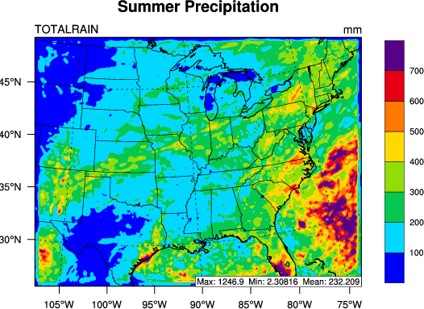
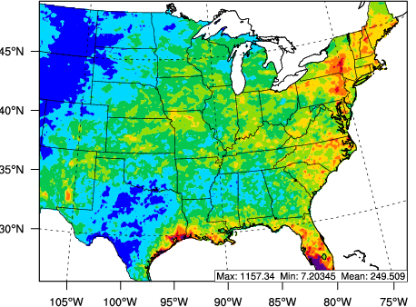
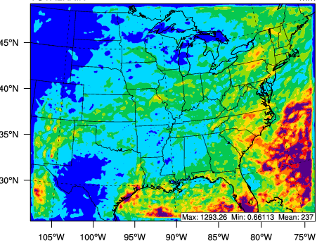
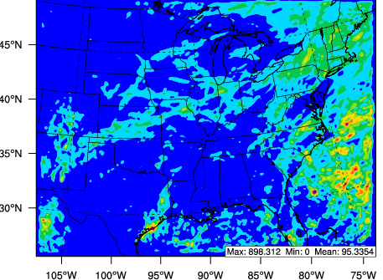
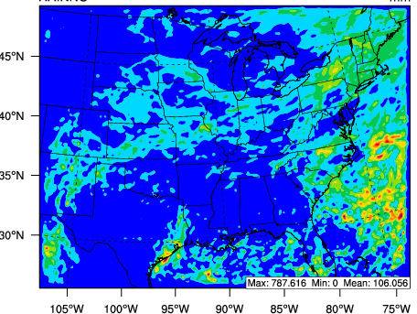
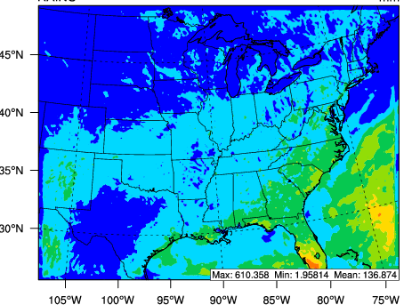
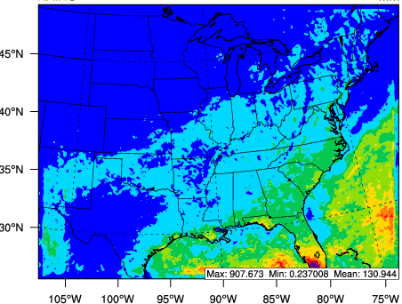
Performance Evaluation of JJA Precipitation
WRF-BASE
PRISM Estimate
WRF-ACI
Total (mm)
Max: 1246.9 Min: 2.3 Mean: 232.2
Max: 1157.3 Min: 7.2 Mean: 249.5
Max: 1293.3 Min: 0.7 Mean: 237.0
Grid-Scale (mm)
Stat | WRF-BASE | WRF-ACI
Corr. | 0.76 | 0.78
MB | -48.42 | -58.31
RMSE | 96.74 | 101.22
Max: 898.3 Min: 0.0 Mean: 95.3
Max: 787.6 Min: 0.0 Mean: 108.1
Subgrid-Scale (mm)
Max: 610.4 Min: 2.0 Mean: 136.9
Max: 907.7 Min: 0.2 Mean: 130.9
Notes:
WRF generally underestimates precipitation over the Plains and Midwestern States during this JJA simulation. This is likely due to the model’s inability to allow adequate propagation of convection from the Rockies into the Plain States. This issue is present in many modeling systems not just WRF. When WRF-ACI is introduced the microphysics scheme makes MSKF precipitation much more moisture dependent with dryer areas in the North and Western portions of the domain loosing precipitation. Some of this precipitation reduction is compensated by increases in grid scale precipitation over the region but the net effect is a drying that increases the simulated dry bias by approximately 10 mm.

Slide 11
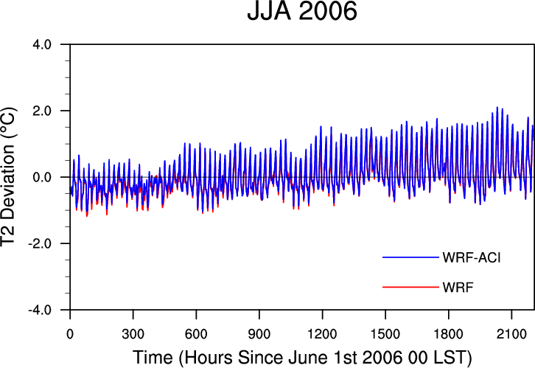
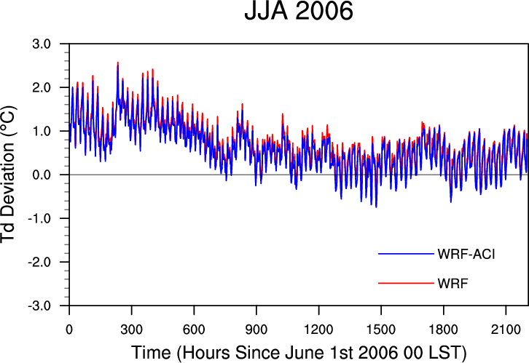
Performance Evaluation of JJA 2-m Temperature and Dew Point Temperature
Deviations from QCLCD Observations
Stat (T2) | WRF-BASE (Series) | WRF-ACI (Series) | WRF-BASE (Spatial) | WRF-ACI (Spatial)
Corr. | 0.99 | 0.99 | 0.95 | 0.95
MB | 0.02 | 0.11 | 0.02 | 0.11
RMSE | 0.54 | 0.60 | 1.12 | 1.14
Stat (T_{d}) | WRF-BASE (Series) | WRF-ACI (Series) | WRF-BASE (Spatial) | WRF-ACI (Spatial)
Corr. | 0.98 | 0.98 | 0.96 | 0.96
MB | 0.71 | 0.60 | 0.49 | 0.40
RMSE | 0.87 | 0.79 | 1.25 | 1.21
WRFv3.8.1
Notes:
Both the base model and WRF-ACI simulate 2m temperature and dew point well due to the use of the FASDAS system. The reduced SWCF from the effective radii coupling leads the a slight increase in the model’s warm bias while the air is drier either due to reductions in precipitation or greater conversion of moisture into cloud water.

Slide 12
Part II (Scale Dependency)
Configuration of Simulations
Time Period: 7-day (Jun 17th 00Z –Jun 24th 00Z 2006)
Type: Numerical Weather Prediction Simulation
Multiple Resolutions: 36km, 12km, and 4km
Region: Southeast United States
Simulations
WRF-ACI Updates = WRF-ACI
WRF-ACI with Aerosols Reduced by 90% = LAERO
Objectives
Quantify aerosol indirect effects on cloud properties, precipitation, and radiation
Determine the scale dependency of these aerosol effects

Slide 13
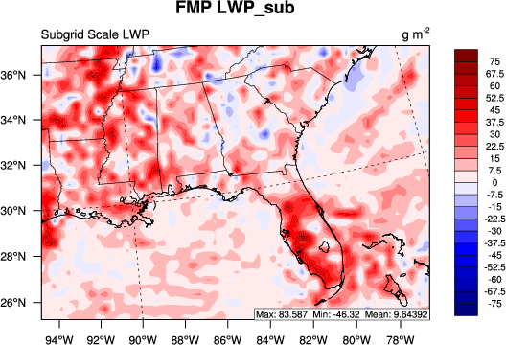
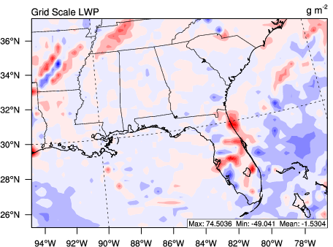
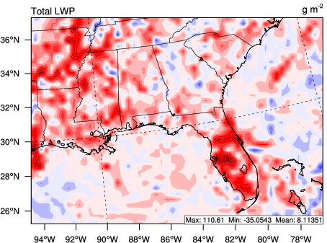
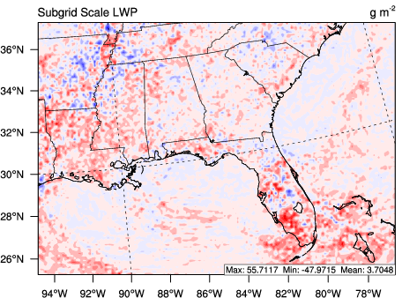
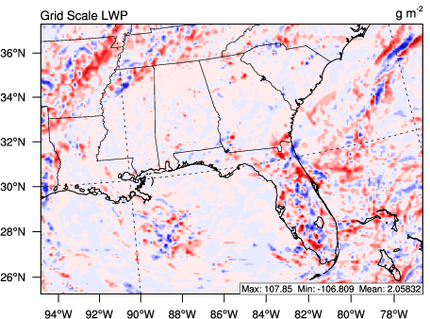
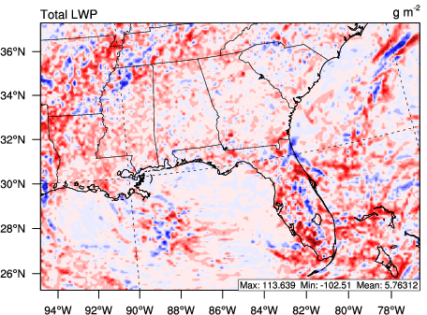
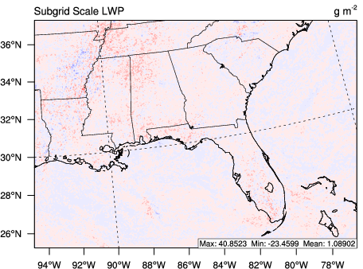
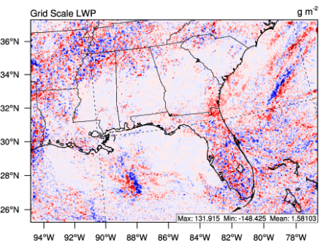
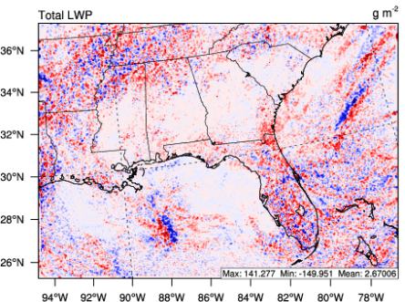
LWP Impact (Cloud Lifetime Effect)
(WRF-ACI minus LAERO)
Subgrid Scale LWP (g m⁻²)
Grid Scale LWP (g m⁻²)
Total LWP (g m⁻²)
36 km
Max: 83.6 Min: -46.3 Mean: 9.6
Max: 74.5 Min: -49.0 Mean: -1.5
Max: 110.6 Min: -35.1 Mean: 8.1
12 km
Max: 55.7 Min: -48.0 Mean: 3.7
Max: 107.9 Min: -106.8 Mean: 2.1
Max: 113.6 Min: -102.5 Mean: 5.6
4 km
Max: 40.9 Min: -23.5 Mean: 1.1
Max: 131.9 Min: -148.4 Mean: 1.6
Max: 141.3 Min: -150.0 Mean: 2.7
Notes:
There is clear decline in ACI induced changes in LWP with resolution. At 36km subgrid scale LWP changes are dominated by the subgrid scale and the grid scale component becomes dominant starting at 12km and continuing to 4km. Subgrid scale increases in LWP from aerosols occur due to the reduction in autoconversion and subsequently accreation when aerosols levels are higher this reduces the sinks in the qc tendency equations are leads to and increase in LWP. The reduction in rain and increase in cloud water is consistent with and increases cloud lifetime effect. At the grid scale this impact is not as clear and the grid scale tends to be impacted by changes in condensation from differences induced by aerosol feedbacks and the subgrid scale aerosol effects. However, the average increase in LWP in the grid scale indicates that there is somewhat of a cloud lifetime effect.

Slide 14
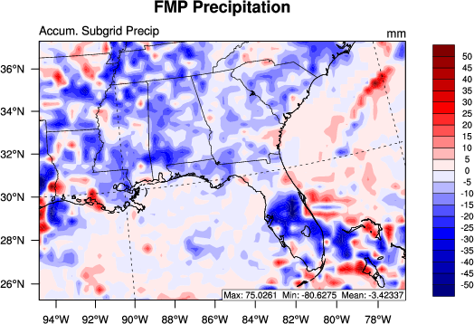
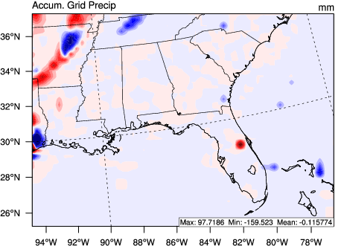
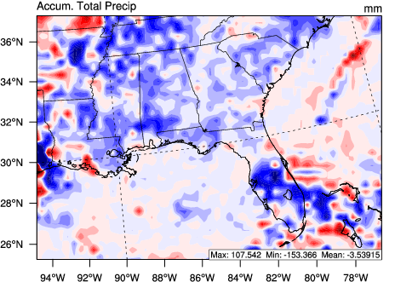
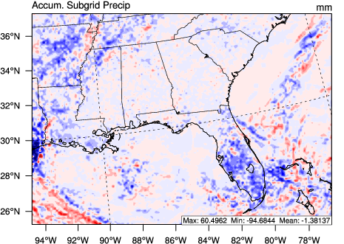
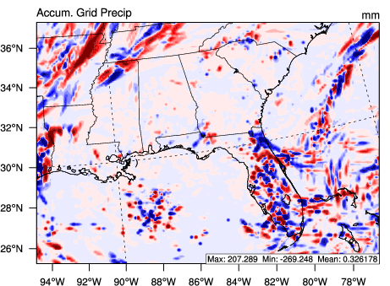
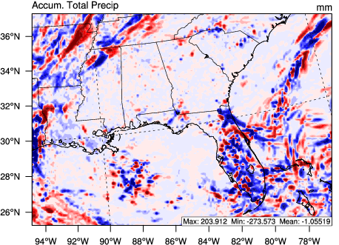
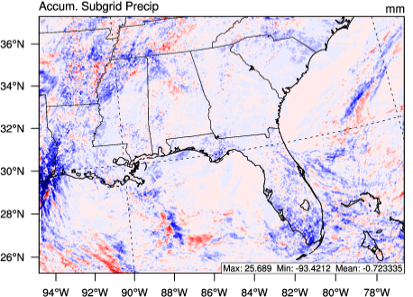
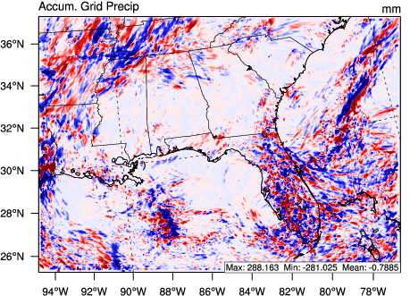
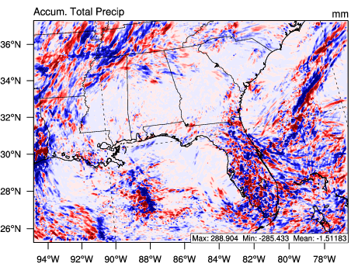
Precip. Impact (Cloud Lifetime/ Invigoration Effect
(WRF-ACI minus LAERO)
Subgrid Scale Precip. (mm)
Grid Scale Precip. (mm)
Total Precip. (mm)
36 km
Max: 75.0 Min: -80.6 Mean: -3.4
Max: 97.7 Min: -159.5 Mean: -0.1
Max: 107.5 Min: -153.4 Mean: -3.5
12 km
Max: 60.5 Min: -94.7 Mean: -1.4
Max: 207.3 Min: -269.2 Mean: 0.3
Max: 203.9 Min: -273.6 Mean: -1.1
4 km
Max: 25.7 Min: -93.4 Mean: -0.7
Max: 286.1 Min: -281.1 Mean: -0.8
Max: 288.9 Min: -285.4 Mean: -1.5
Notes:
Subgrid scale precipitation is suppressed more often than not due to aerosol impacts. Areas with increased precipitation tend to occur in regions with enhanced snow production from the thermodynamic invigoration effect. The impact on grid scale precipitation is not as clear. Especially since the sign of the average impact flips to positive. In general precipitation changes in the grid scale are tied to changes in condensation between the WRF-ACI and WRF-LAERO simulations due to feedbacks. This feed back is the strongest at 12km when the balance between both grid scale and sunbgrid scale precipitation is the most similar. Thus the average reduction in precipitation is the weakest at 12km.

Slide 15
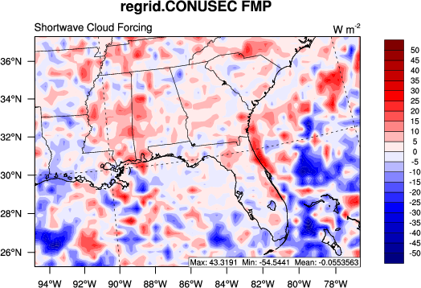
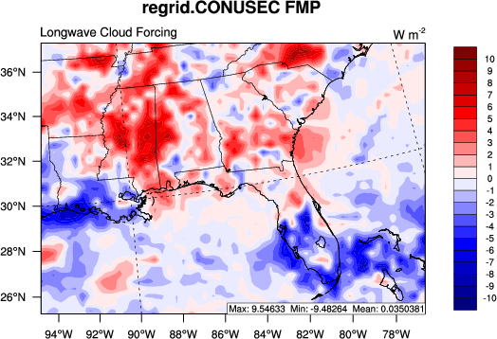
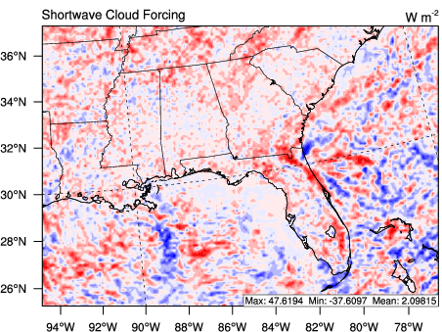
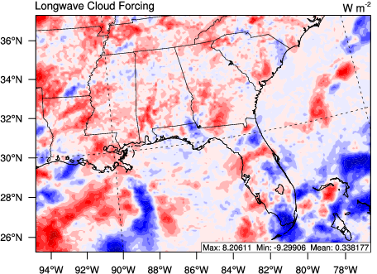
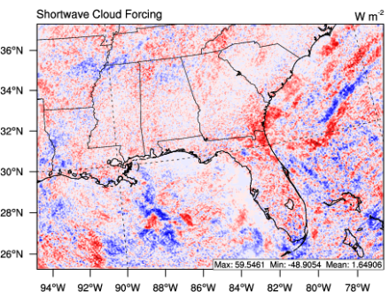
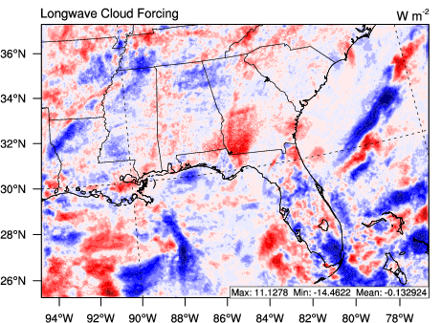
Radiation Impact (Cloud Lifetime Effect/ Cloud Albedo Effect)
(WRF-ACI minus LAERO)
Shortwave Cloud Forcing (W m⁻²)
Longwave Cloud Forcing (W m⁻²)
36 km
Max: 43.3 Min: -54.5 Mean: -0.1
Max: 9.5 Min: -9.5 Mean: 3.5x10⁻²
12 km
Max: 47.6 Min: -37.6 Mean: 2.1
Max: 8.2 Min: -9.3 Mean: 0.3
4 km
Max: 59.5 Min: -48.9 Mean: 1.6
Max: 11.1 Min: -14.5 Mean: -0.1
Notes:
Changes in SWCF across scales are controlled by LWP generally. The 36km SWCF is largely controlled by grid scale oceanic clouds which are reduced by aerosols at 36km leading to an anomalous change in radiation. At 12km and 4km the patterns in SWCF are similar with a little weakening at 4km. This pattern is the result of increases in SWCF from the cloud lifetime and cloud albedo effects. This effect declines with resolution somewhat due to reductions in the cloud lifetime effect The impact of aerosols on LWCF varies significantly across resolutions due to large variation in the impact of aerosols on cloud ice across resolutions.

Slide 16
Summary
The WRF-ACI system leads to improved LWP, IWP, and 2-m T_{d} but slightly worse LWCF, SWCF, Precipitation, and T2
The WRF-ACI system performs similarly to the default WRF model
A detectible cloud lifetime effect is present at all resolutions but it weakens with increasing resolution
Precipitation is generally suppressed in the Southeast U.S. due to aerosols
Changes in grid scale precipitation and cloud parameters from aerosols are not as straightforward as subgrid scale aerosol effects
The impact of aerosols on SWCF is fairly consistent across resolutions but the impact on LWCF varies significantly across resolutions
Overall, WRF-ACI provides the WRF community with a computationally efficient method for studying aerosol indirect effects on weather phenomena.

Slide 17
Thanks You
Questions?

Slide 18
Additional Material

Slide 19
Limitations and Future Work
The subgrid scale microphysics scheme over represents aerosol effects
Uncertainties are introduced by solving the grid scale microphysics after all other model physics processes
The scale dependency of aerosol formation is not considered in this study
Future work should focus linking the WRF-ACI and WRF-Chem frameworks
The subgrid scale microphysics scheme relies heavily on parameterizations designed for large scale clouds
Future work should focus on the development of more detailed subgrid scale microphysics based on deep convection
More case studies needed to be carried out to determine if the scale dependency of the aerosol effects vary by region or time period

