Slide 1
Using High-Resolution ARM Observations to Evaluate High-Resolution WRF Simulations
Jerome Fast and Larry Berg
Pacific Northwest National Laboratory
ARM Supersite Data
HRRR
HI-SCALE Campaign Data
Notes:
15-20 min

Slide 2
Motivation
Cumulus convection is an important component of the radiation budget and hydrologic cycle over many regions of the world, but …
Convective cloud parameterizations contain uncertainties due partly to insufficient coincident data coupling cloud macro- and microphysical properties to inhomogeneities in boundary layer and aerosols.
widespread cumulus
complex convective cloud populations
ARM SGP Supersite
ARM SGP Supersite
model grid cell
and
subgrid-scale variability
MODIS Terra ~1630 UTC
MODIS Aqua ~1950 UTC

Slide 3
ARM Southern Great Plains “Supersite”
Oklahoma
ARM Instrument Sites
Kansas
Oklahoma
Radar
Central Facility
Radiosonde (4 / day)
Radar Wind Profiler
Doppler Lidar
Micropulse Lidar
Raman Lidar
Atmospheric Emitted Radiance Interferometer (AERI)
surface meteorology
Central Facility
LES domain, 33 km wide
radar wind profiler, surface meteorology
Doppler Lidar, AERI,
surface meteorology
Tulsa
surface meteorology
surface meteorology includes radiation, fluxes, soil moisture
Goal: 4-D Observations
Oklahoma City
white dots = Oklahoma mesonet

Slide 4
Holistic Interactions of Shallow Clouds, Aerosols and Land Ecosystems (HI-SCALE) Campaign
Bartlesville
ARM Facilities
IOP 1: April 24 – May 20
17 flights, 57.8 hours total
3.4 h average duration
IOP 2: Aug 28 – Sept 23
21 flights, 47.8 hours total
2 flights / day on 5 days
G-1 flight paths
Tulsa
less
biogenic emissions
more
Oklahoma City
Central Facility

Slide 5
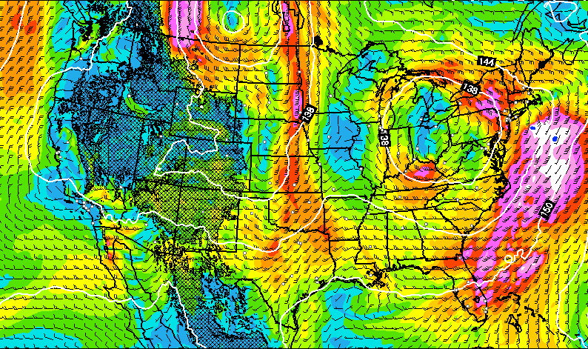
High-Resolution Rapid Refresh (HRRR)
Real-time operational forecasts for the CONUS (Δx = 3 km)
Forecasts produced every 1 h for up to 15 h forecast
Data assimilation used to create initial conditions, but does not use ARM data that can be used as an independent data set
In this study, 15-h forecasts (at hourly intervals) starting from 00, 06, 12, and 18 UTC with a focus on 1-6 h forecasts
April
May
June
July
August
September
HI-SCALE IOP 1
HI-SCALE IOP 2
HRRR v2
HRRR v3
microphysics: Thomspon
surface-layer and BL: MYNN
land-surface: RUC
radiation: Goddard
cumulus convection: off
known “low-level warm dry bias”
microphysics: Thomspon /aerosol
surface-layer and BL: MYNN
land-surface: RUC
radiation: RRTMG
cumulus convection: off

Slide 6
Questions
How well does HRRR / WRF represent the observed atmospheric conditions, particularly cloudiness and its effect on radiation, in the vicinity of the SGP site?
How well does HRRR / WRF represent the spatial and temporal variability that is seen in the observations?
100 km

Slide 7
Comparison with ARM Operational
and HI-SCALE Campaign Measurements
7

Slide 8
Cloudiness on May 3
MODIS Aqua ~1945 UTC

Slide 9
Observed and Simulated Radiation: May 3
E31
E09
E33
E34
E11
E32
E41
E12
observed simulated
C1
E13
impact of clouds on radiation too low
E15
E37
E39
E40
E38
E36
E35
E21

Slide 10
Variability in Downward SW on May 3
SW, 19 UTC
MODIS Aqua ~1945 UTC
ARM radiation measurements
SW, 20 UTC
low cloud fraction, 20 UTC
affected by only explicit clouds

Slide 11
Spatial Variability of Radiation during IOP 1
Mean and Range of SW Radiation at 16 ARM Sites
bias = 81 W m⁻²
PC
PC
PC
PC
PC
PC
PC
PC
PC = partly cloudy days
observed simulated
PC
PC
simulated radiation too high on most partly cloudy days
simulated radiation also too high on cloudy days

Slide 12
Observed and Simulated Radiation: Sept. 6
E31
E09
E33
E34
E11
E32
E41
E12
observed simulated
C1
E13
impact of clouds on radiation is reasonable
E15
E37
E39
E40
E38
E36
E35
E21

Slide 13
Variability in Downward SW on September 6
SW, 19 UTC
MODIS Aqua ~2000 UTC
ARM radiation measurements
SW, 20 UTC
low cloud fraction, 20 UTC
affected by only explicit clouds

Slide 14
Spatial Variability of Radiation during IOP 2
Mean and Range of SW Radiation at 16 ARM Sites
bias = 13 W m⁻²
PC
PC
PC
PC
PC
PC
PC
PC
PC
cirrus
cirrus
PC
PC
PC = partly cloudy days
observed simulated
cirrus
PC
PC
PC
range of simulated radiation closer to observed than during IOP 1

Slide 15
Surface Temperature and Humidity during IOP 1
Temperature, RH, and Specific Humidity at 16 ARM Sites
Diurnal Average
observed simulated
April
May
UTC
~2º warm bias during the day that leads to dry RH bias; bias increases significantly with forecast period
simulated spatial variability somewhat smaller than observed

Slide 16
Surface Temperature and Humidity during IOP 2
Temperature, RH, and Specific Humidity at 16 ARM Sites
Diurnal Average
observed simulated
August
September
UTC
much smaller temperature and RH bias than during IOP1, but bias in mixing ratio is higher during IOP2
simulated spatial variability less than observed

Slide 17
Skin Temperature: May 6 (Clear Sky, IOP 1)
Simulated Surface Temperature (contours)
simulated observed (30-s average)
18 UTC
lake
<300
305
310
temperature (K)
<300
lake
lake
311
Infrared Thermometer (1-s)
time (UTC)
Simulated skin temperature less variable and often too high. Does this bias contribute to the near surface temperature bias?

Slide 18
Skin Temperature: Sept. 11 (Clear Sky, IOP 2)
Simulated Surface Temperature (contours)
simulated observed (30-s average)
17 UTC
305
298
299
temperature (K)
302
Infrared Thermometer (1-s)
time (UTC)
Simulated skin temperature less variable, but bias is much smaller than during IOP1

Slide 19
Surface Wind Variability during IOP1
Observed and Simulated Winds at 16 ARM Sites
observed simulated
April
May
Simulated winds are less variable in space than observed

Slide 20
Surface Wind Variability during IOP2
Observed and Simulated Winds at 16 ARM Sites
observed simulated
August
September
Simulated winds are less variable in space than observed

Slide 21
Wind Profiles: Observed Low-Level Jet
stronger LLJ
E32 Doppler Lidar
E41 Doppler Lidar
September 13
I10 Radar Wind Profiler
I8 Radar Wind
Profiler
similar LLJ
Central Facility
RWP
Central Facility
DL
similar LLJ
I9 Radar Wind Profiler
stronger LLJ
E37 Doppler Lidar
E39 Doppler Lidar
I9 Radar Wind Profiler

Slide 22
Wind Profiles: Simulated Low-Level Jet
stronger LLJ
Comparison with radiosonde and doppler lidars or RWP derived
E32 Doppler Lidar
E41 Doppler Lidar
September 13
I10 Radar Wind Profiler
I8 Radar Wind
Profiler
similar LLJ
Central Facility
RWP & DL
similar LLJ
I9 Radar Wind Profiler
stronger LLJ
E37 Doppler Lidar
E39 Doppler Lidar

Slide 23
Wind Profile Variability
E32
I10
I8
E41
observed simulated
E37
C1
I9
E39
observed 09 UTC September 13
simulated 09 UTC September 13
central Radar Wind Profilers
western Doppler Lidars
spatial variability less than observed
eastern Doppler Lidars
~ observed
< observed
wind speed (m s⁻¹)
wind speed (m s⁻¹)

Slide 24
Boundary Layer Depth during IOP 1
all 5 sites
E32
E41
C1
Doppler Lidar
radiosonde
simulated
Simulated boundary layer too high on many days – consistent with temperature
E37
E39

Slide 25
Boundary Layer Depth on May 5 (Clear Sky)
all 5 sites
00 06 12 18 00
E32
E41
00 06 12 18 00
00 06 12 18 00
C1
C1
Doppler Lidar
radiosonde
simulated
00 06 12 18 00
E37
E39
lowest skin temperatures
00 06 12 18 00
00 06 12 18 00

Slide 26
Boundary Layer Depth during IOP 2
all 5 sites
E32
E41
C1
Doppler Lidar
radiosonde
simulated
Positive bias seen in IOP 1 is greatly reduced during IOP 2
E37
E39

Slide 27
Boundary Layer Depth on Sept. 11 (Clear Sky)
all 5 sites
00 06 12 18 00
E32
E41
00 06 12 18 00
00 06 12 18 00
C1
C1
Doppler Lidar
radiosonde
simulated
00 06 12 18 00
E37
E39
00 06 12 18 00
00 06 12 18 00

Slide 28
Summary
HRRR v3 performs much better when compared to ARM operational and HI-SCALE field campaign measurements
HRRR represents some of the spatial variability of meteorological quantities across the ARM supersite with Δx = 3 km, but the observations exhibit somewhat more variability
While the simulated radiation on partly cloudy days is better during IOP 2, HRRR can still underestimate the amount of cloudiness in regions where cloud fraction small
Lots of Work Remains to be Done
Evaluation of shallow convective parameterizations
More extensive evaluation of cloud properties and radiation
Inclusion of more heterogeneous variable land properties and inclusion of aerosol chemistry in WRF
Use of LES for insights into shallow cloud processes

Slide 29
LES Representation of Clouds
WRF LES 1950 UTC (Δx = 100 m)
MODIS AQUA 1950 UTC (Δx ~ 1 km)
August 30
SGP site
33 km
4.2
3.4
2.6
1.8
1.0
0.2
height (km)
wwest
water vapor mixing ratio and clouds
east

