Slide 1
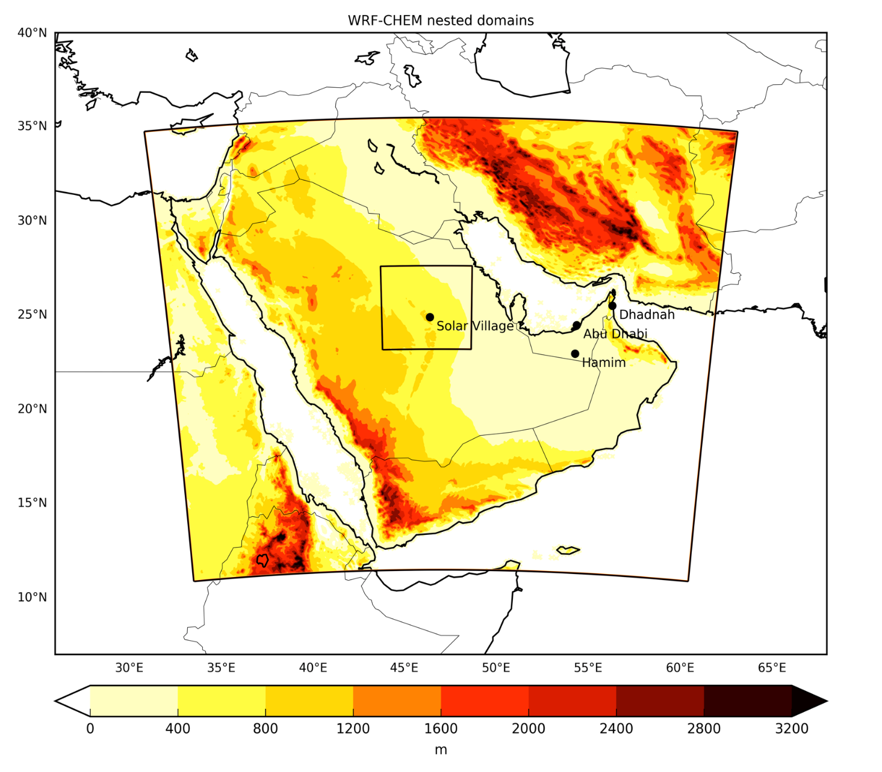
Evaluation of cloud-resolving modeling of haboobs using in-situ and remotely sensed observations
Anatolii Anisimov (1), Duncan Axisa (2), Suleiman Mostamandi (1), Paul A. Kucera (2), Georgiy Stenchikov (1)
(1) King Abdullah University of Science and Technology (KAUST), Physical Sciences and Engineering Division, Thuwal, Makkah, Saudi Arabia
(2) National Center for Atmospheric Research (NCAR), Boulder, CO, USA
Motivation
Arabian Peninsula is one of the major dust generation regions that at present is severely under-sampled (only single dust observational campaign in 2008).
Mesoscale dust storms (haboobs) in the AP (and everywhere) are studied even less in detail:
they are hardly identifiable from satellites;
large-scale models have problems simulating it.
At the same time, its contribution to total dust generation is significant (estimated to be from 20% to 50% depending on timing and location (Pantillion et al., 2016))
There is a demand to evaluate WRF-Chem performance in simulating haboobs and their physical properties in the AP
4.5 km
1.5 km
Aircraft measurements
The key element of the study is the unique dataset of aircraft measurements performed during the NCAR rain enhancement campaign in 2007. Features the measurements of aerosol size distribution within the haboob “dust cloud”.
Notes:
I prominent case study on mesoscale dust storms in the Arabian Peninsula
This region Is one of the major contributors to global dust burden. However, it has not been studied sufficiently enough. In particular, we focus on haboob dust storms…
Aircraft measurements obtained during the NCAR rain enhancement campaign in 2007.

Slide 2
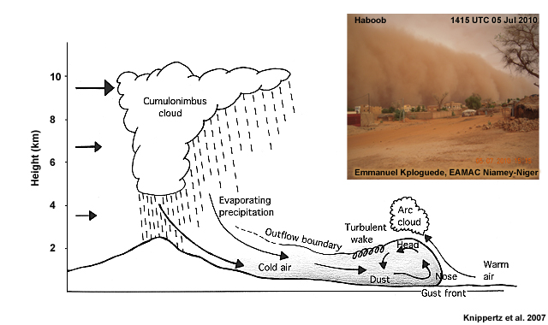
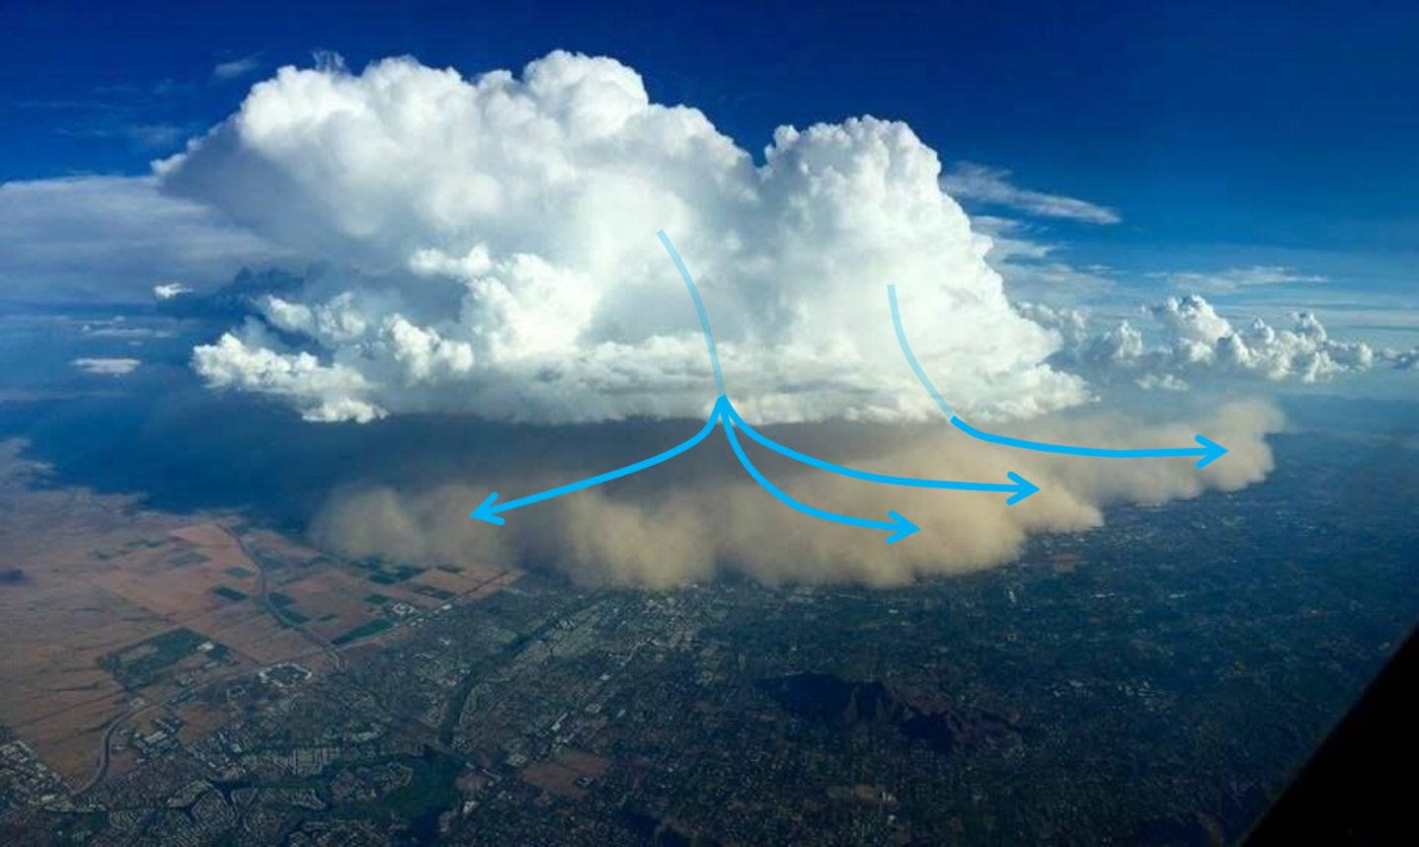
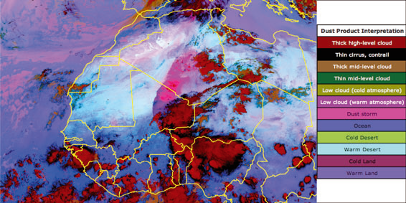
What is a haboob?
Haboobs are a type of mesoscale dust storm produced by cold pool outflows from precipitating convective clouds (e.g. MCS).
Falling precipitation evaporates and produces a downdraft or downdrafts, a cold pool at the surface, and strong winds.
The leading edge of the cold pool and strong winds form a gust front and, in areas where this leads to dust emissions from the surface, typically demarcates the leading edge of the haboob.
Phoenix, Arizona
22 August 2016
http://wasatchweatherweenies.blogspot.com/2016/08/what-is-haboob.html
Notes:
Haboob dust storms are initiated by cold pool outflows from precipitation thunderstorms. It happens in all parts of the world. It is a prominent feature in USA. In some cases, cold pools might reach synoptic scales, like on an example. Here, it is the so-called pink dust product based on SEVIRI instrument.

Slide 3
WRF-Chem v. 3.7.1 setup
Meteorology & BCs
14 days simulation: 1 – 14 April, 2007
2 nested cloud-resolving domains (4.5 + 1.5 km), 40 vertical layers
ECMWF IFS 25 km operational analysis for meteorological BC
Spectral nudging in both domains towards driving BC
EDGAR-HTAP anthropogenic emissions of gases and aerosols
Aerosols & chemistry
CBMZ chemistry + MOSAIC aerosols
(chem_opt=10: CBMZ_MOSAIC_8BIN_AQ):
MOSAIC 8-bin aerosol scheme: 9 species: dust, BC, POM, sulfate, nitrate, chloride, ammonium, sodium, water (Zaveri et al., 2008)
GOCART dust emission + MODIS source function, fixed size distribution at emission is assumed (Kok et al., 2011)
aerosol dry deposition & gravitational sedimentation in PBL (Binkowski & Shankar, 1995)
aerosol wet deposition (in-cloud and below-cloud) (Easter et al., 2004 & Chapman et al., 2009) and aerosol-cloud interactions (indirect effects) (Gustafson et al., 2007 & Chapman et al., 2009), coupled with Lin et al. microphysics
direct radiative effects (Zhao at al., 2013), coupled with RRTMG radiation in both SW and LW
sea salt emissions (Zhao et al., 2013)
aqueous chemistry (Fahey and Pandis, 2001)
Process | WRF option
Microphysics | Lin
Shortwave radiation | RRTMG
Longwave radiation | RRTMG
Cumulus parameterization | Off
Surface layer | Eta
Land-surface model | Noah
PBL | MYJ
Notes:
Given that we want to compare size distributions, we choose one of the most detailed 8-bin aerosol scheme with feedbacks – 8 bin MOSAIC
GOCART emission
3. Cumulus parameterizations is turned off in both domains. Resolution and boundary conditions.

Slide 4
Data
NASA MERRA-2 50-km reanalysis (assimilates AERONET & MODIS)
NASA MODIS Collection 6 combined Deep Blue/Dark target AOD
Meteosat SEVIRI qualitative “pink dust” product (Lensky and Rosenfeld, 2008)
Meteosat SEVIRI AOD product (Banks & Brindley, 2013)
AERONET AOD & inversion products (column-integrated size distribution)
Aircraft aerosol number size distribution measurements (Posfai et al., 2013)
Meteorological radar measurements in Riyadh
TRMM precipitation
Weather station data
Notes:
Here’s the list of the data sources used. The movie shows the SEVIRI pink dust product. So, here we see the series of thunderstorms, of different strength, moving from the east. The storms are initiated on the escarpment of Hidjaz and Asir mountains on the eastern coast of AP, enhancing and growing as they propogate to the center of AP.
The primary goal of this product is to visualize dust. It would appear pink. Here, you can see both the classical dust storms initiated by conventional winds. I hope that you are also able to spot haboobs here. They appear as dust clouds on the edge of thunderstorms, of cause they are often not seen below the anvils.

Slide 5
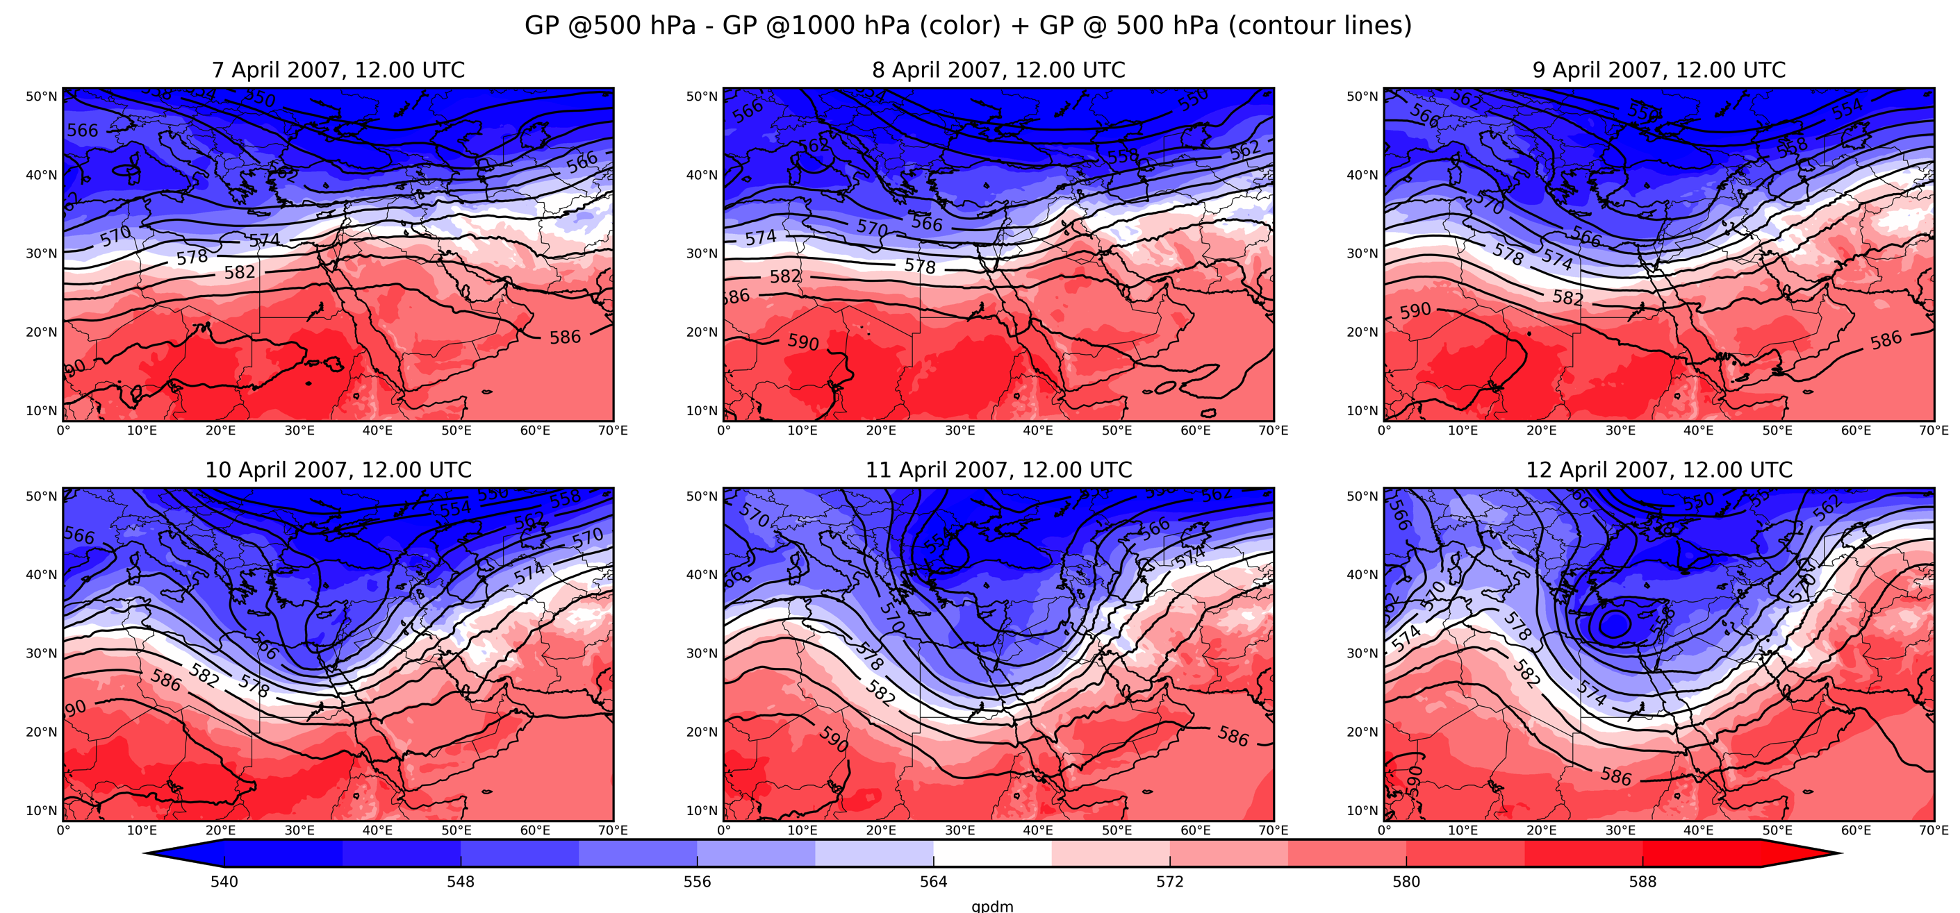
Synoptic situation during the observational campaign ECMWF operational analysis
Notes:
So, the primary conditions leading to intense convection are the upper layer trough, divergence, accompanied by low-level

Slide 6
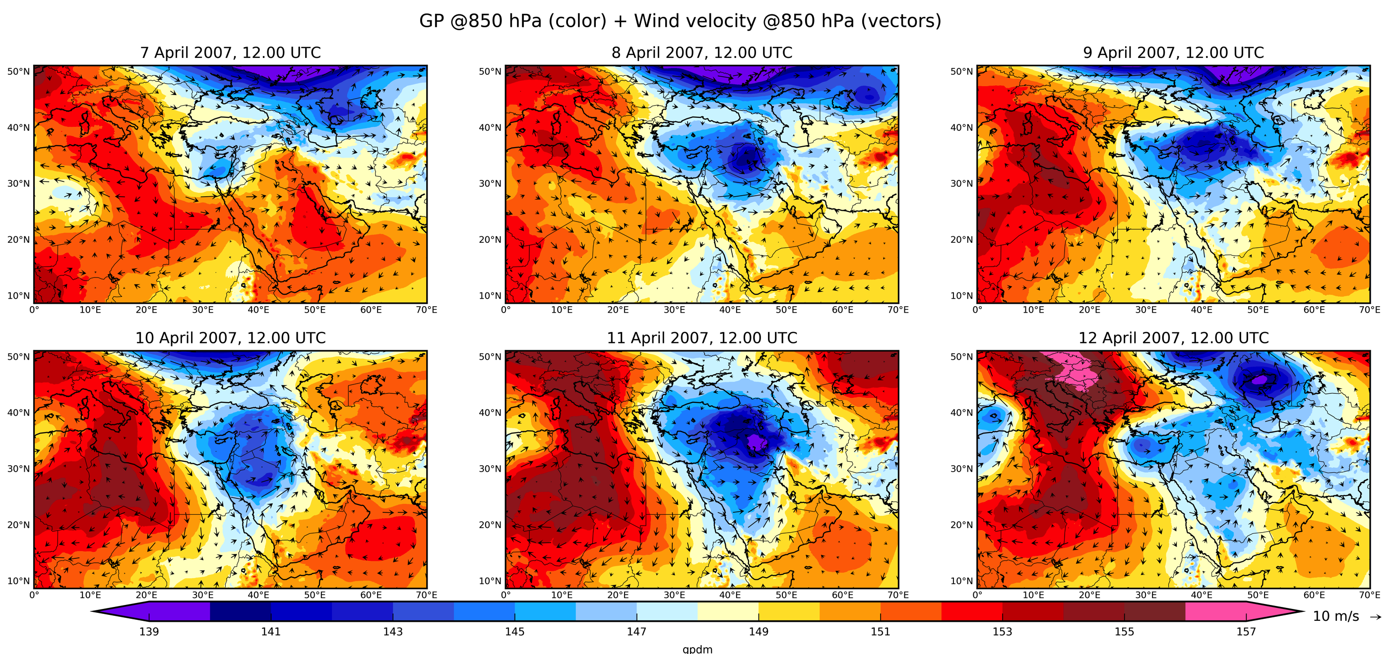
Synoptic situation during the observational campaign ECMWF operational analysis

Slide 7
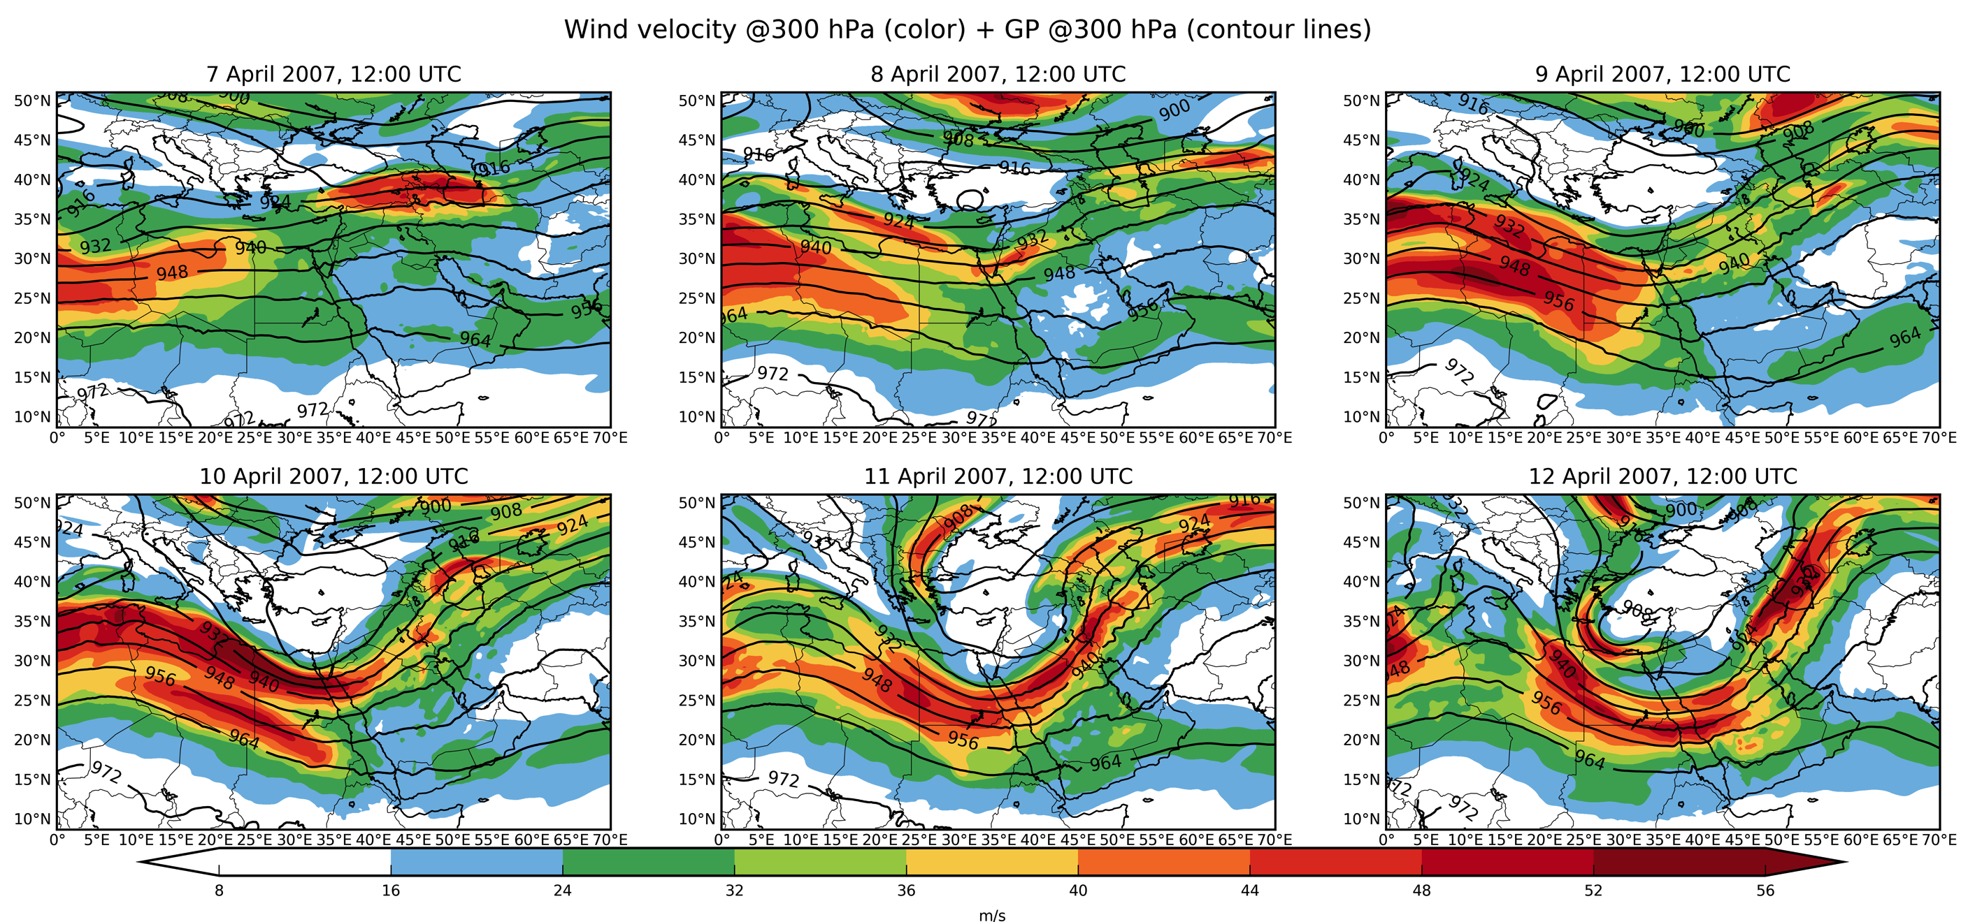
Synoptic situation during the observational campaign ECMWF operational analysis

Slide 8
Model evaluation: bias & RMSE

Slide 9
Notes:
What is it? Thunderstorms,
1. Thunderstorms moving to the east, precipiating and producing habobbs.
2.Clouds are initiated on the escarpment of the Hedjaz and Asir Mountains

Slide 10
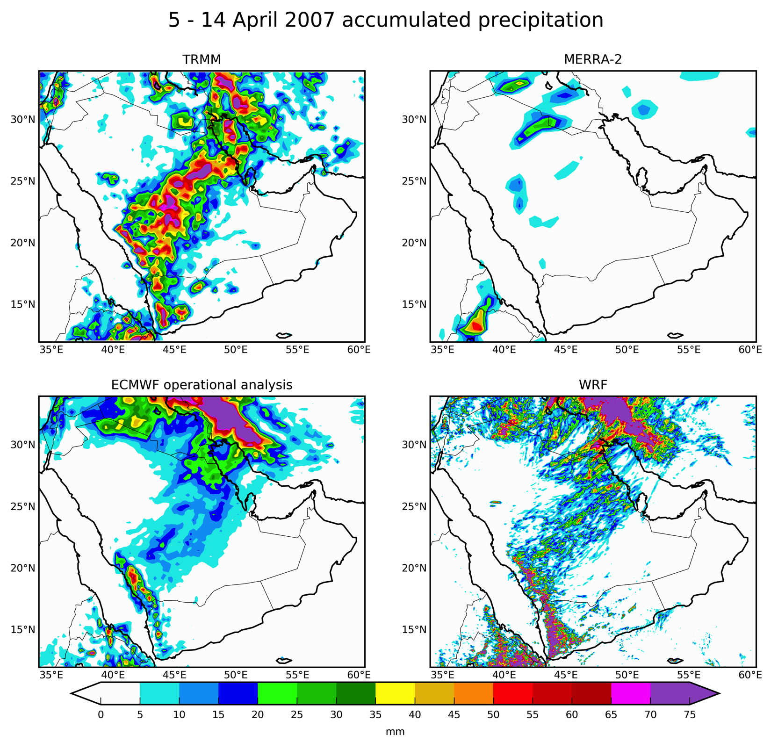
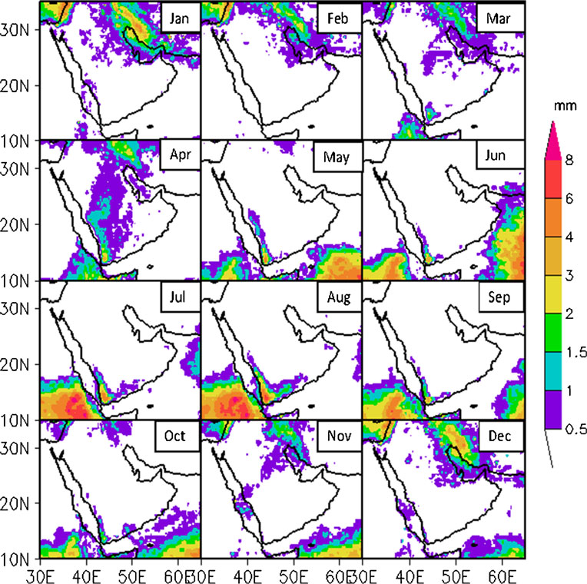
TRMM climatology 1999 - 2011 (mm/day)
Babu et al. (2016)
Notes:
MERRA misses this event.
ECMWF has some. WRF is in line with it.
The precip patter is consistent with April climatology.

Slide 11
Dust generation and deposition
Notes:
Most of the dust is generated in the central AP. Dry and wet deposition are about of the same order of magnitude.

Slide 12
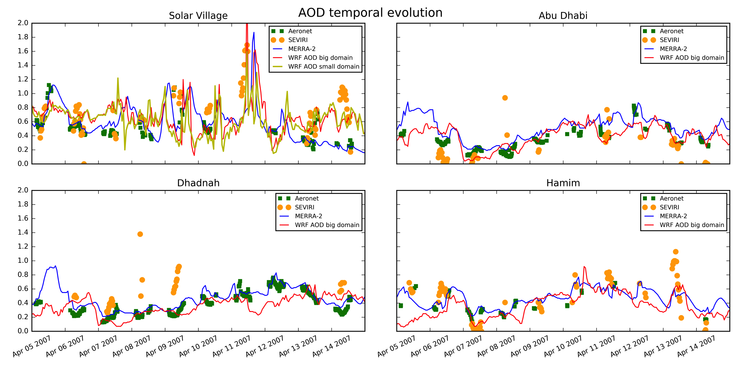
Model evaluation: AOD temporal evolution @ Aeronet sites
Notes:
Dots and circles are the AERONET and SEVIRI AOD retrievals, continuous lines are the models. The main figure is the upper left – the only one in the central AP, near Riyadh.
MERRA-2 is in fully consistent with AERONET as it assimilates it.
Difference in retrievals.

Slide 13
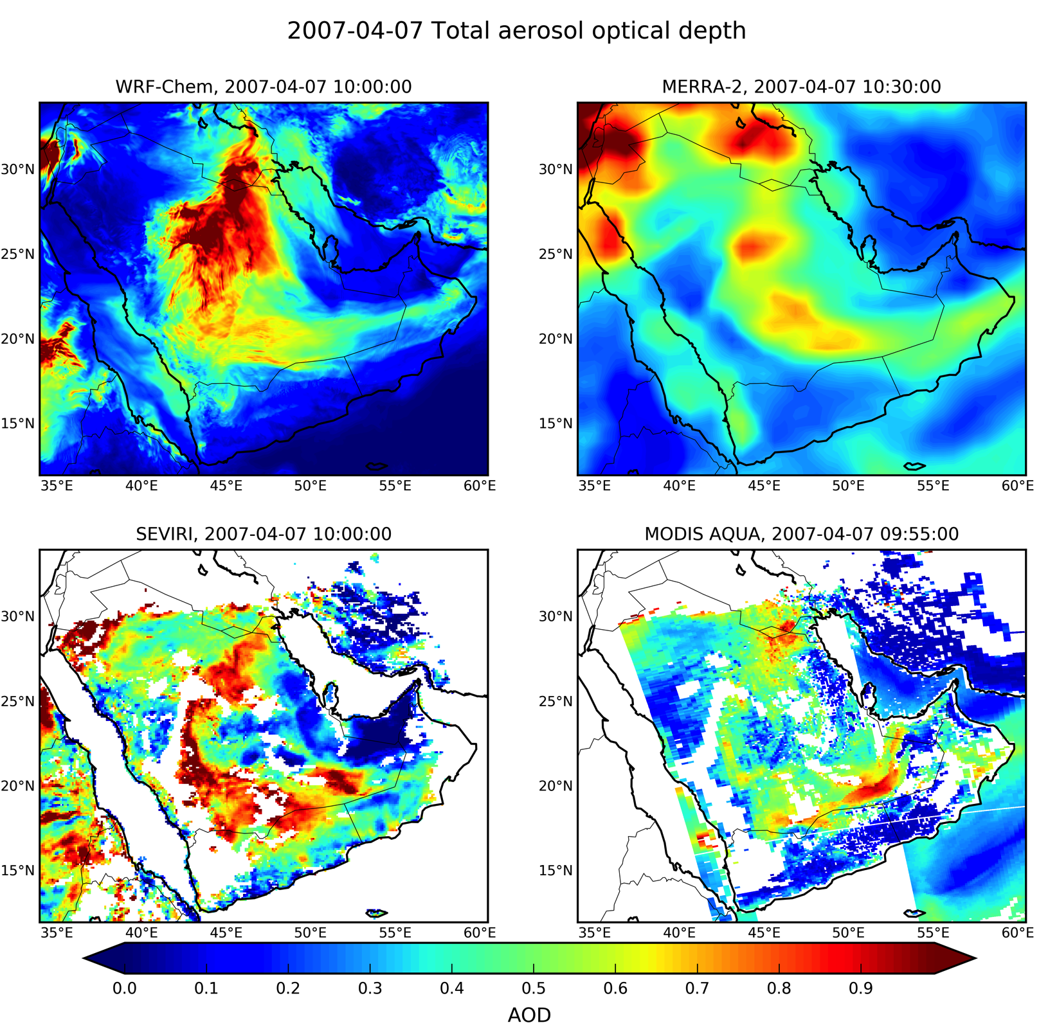
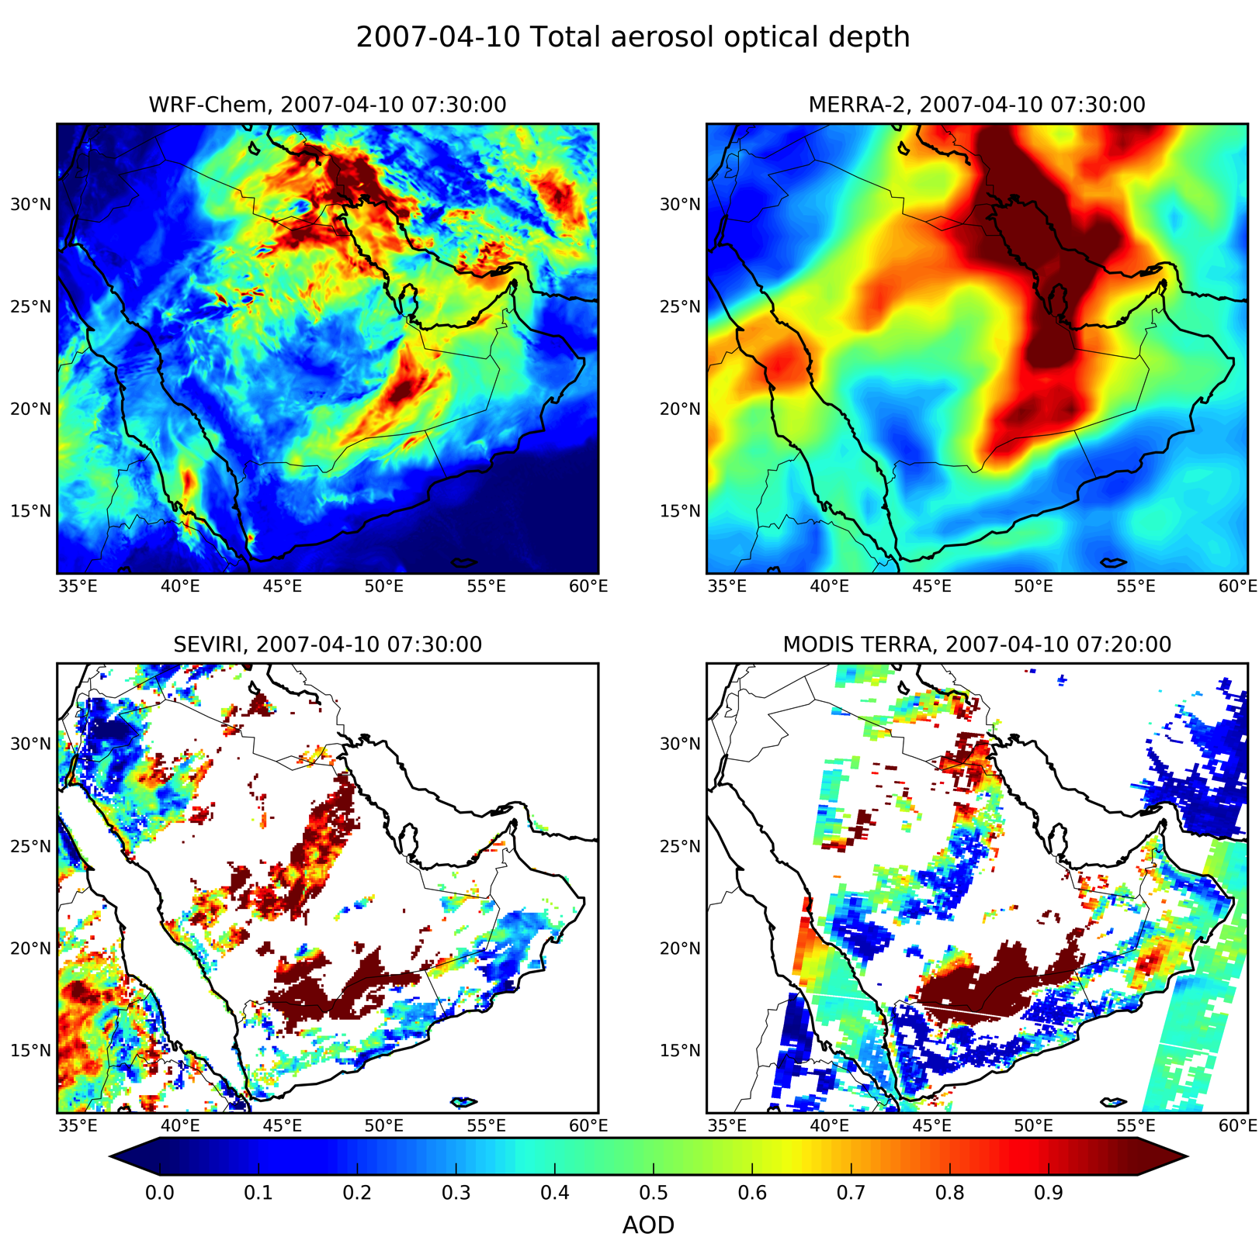
Model evaluation: AOD patterns
Notes:
Right pattern and difference in retrivals. SEVIRI AOD is considerably lower then MODIS. Satellite AODs are highly contaminated with clouds. Overall, we simulate reasonable patterns of dust loading.

Slide 14
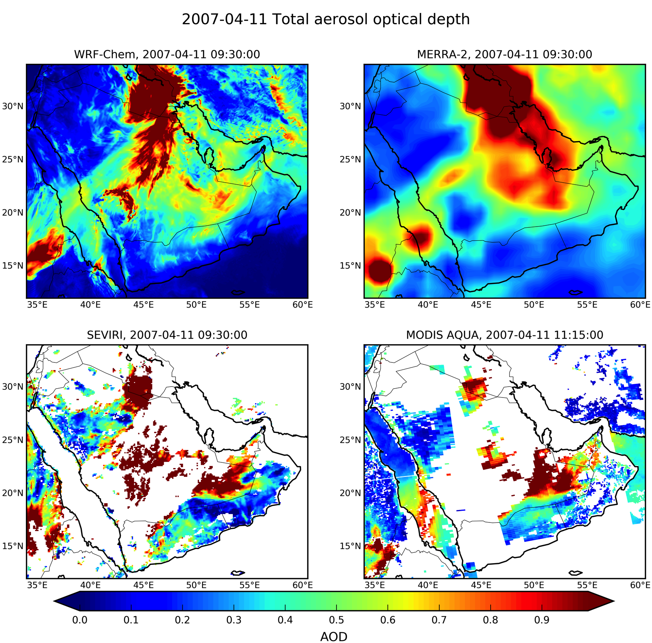
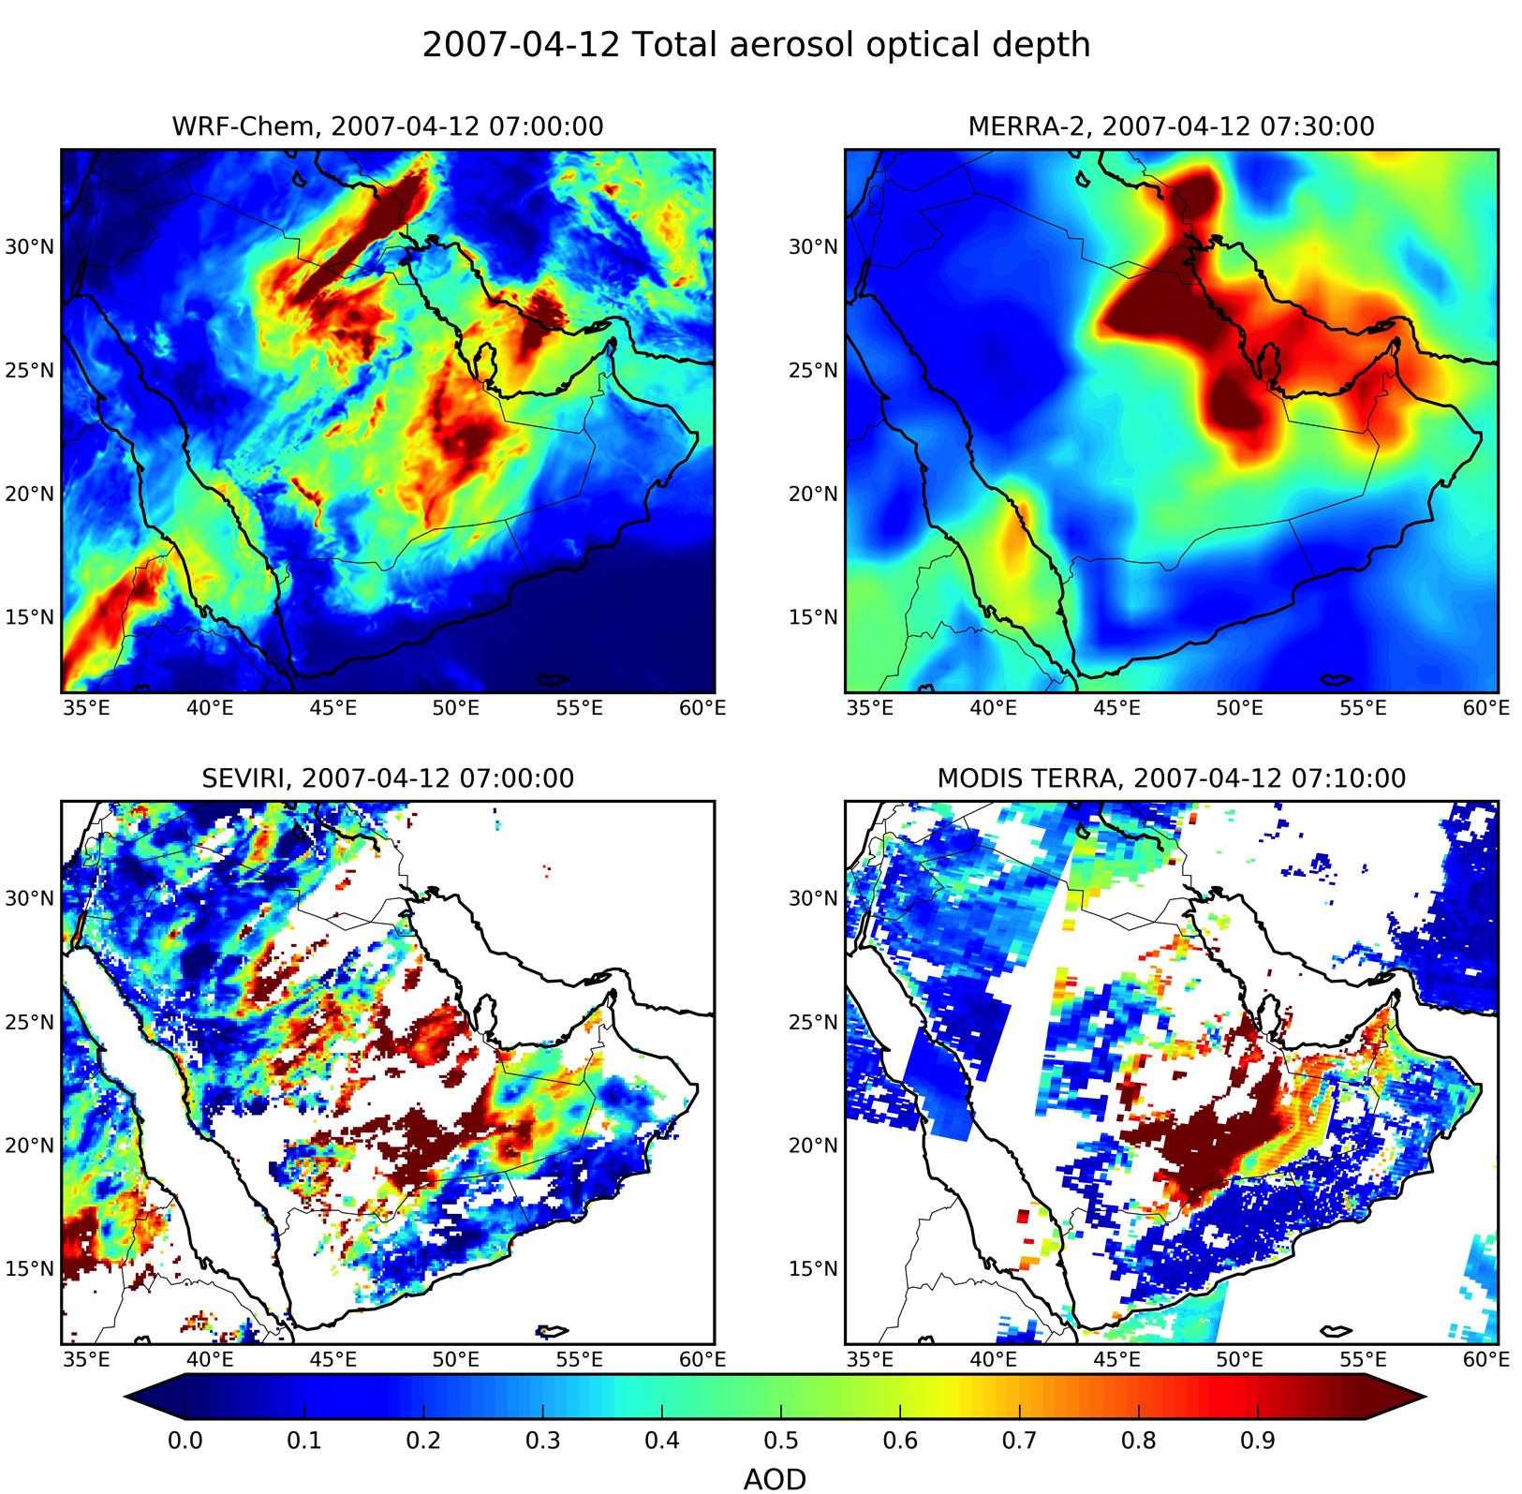
Model evaluation: AOD patterns

Slide 15
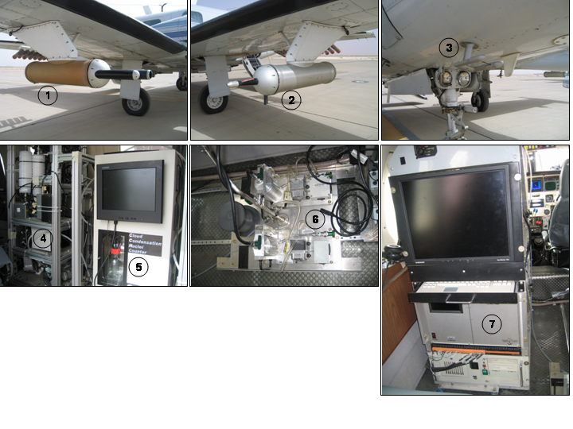
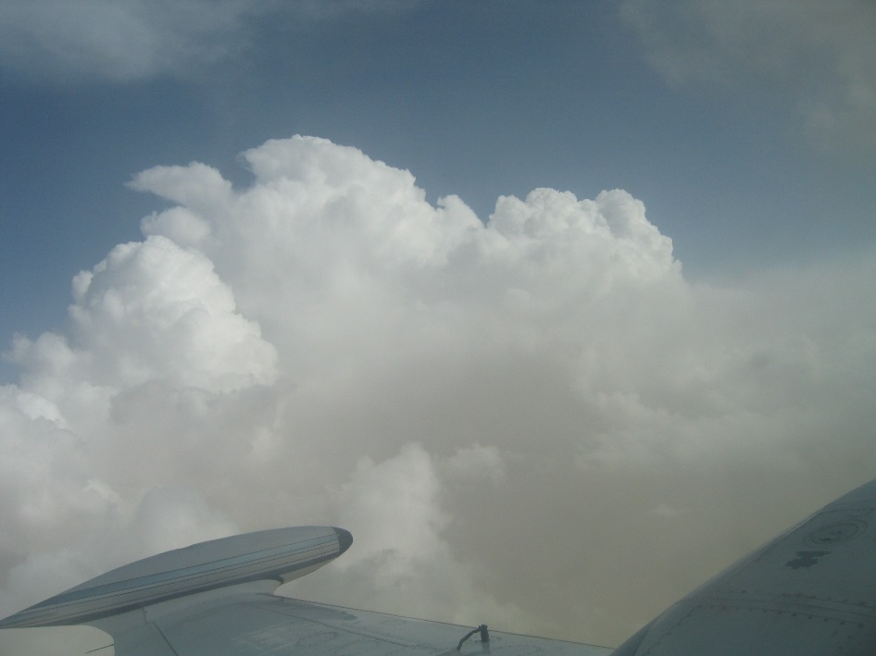
Aircraft equipment
Forward Scatter Spectrometer Probe (FSSP) – cloud droplets (3mm - 50mm)
Passive Cavity Aerosol Spectrometer Probe (PCASP) – aerosols (0.1 to 3mm)
King Liquid Water Content Probe (KLWC) – cloud liquid water content
TAMU Differential Mobility Analyzer (DMA) – aerosols (0.01mm to 0.38mm)
DMT Cloud Condensation Nucleus (CCN) counter
Arizona State University (ASU) Microanalysis Particle Sampler (MPS)
University of Wyoming CCN counter
Riyadh 2006 - 2008
CAS (Learjet)
PCASP
FSSP
DMA
0.01
2
3
4
5
6
7
8
9
0.1
2
3
4
5
6
7
8
9
1
2
3
4
5
6
7
8
9
10
D
(
μ
m)
p
Notes:
List of instruments and the range of particle sizes measured

Slide 16
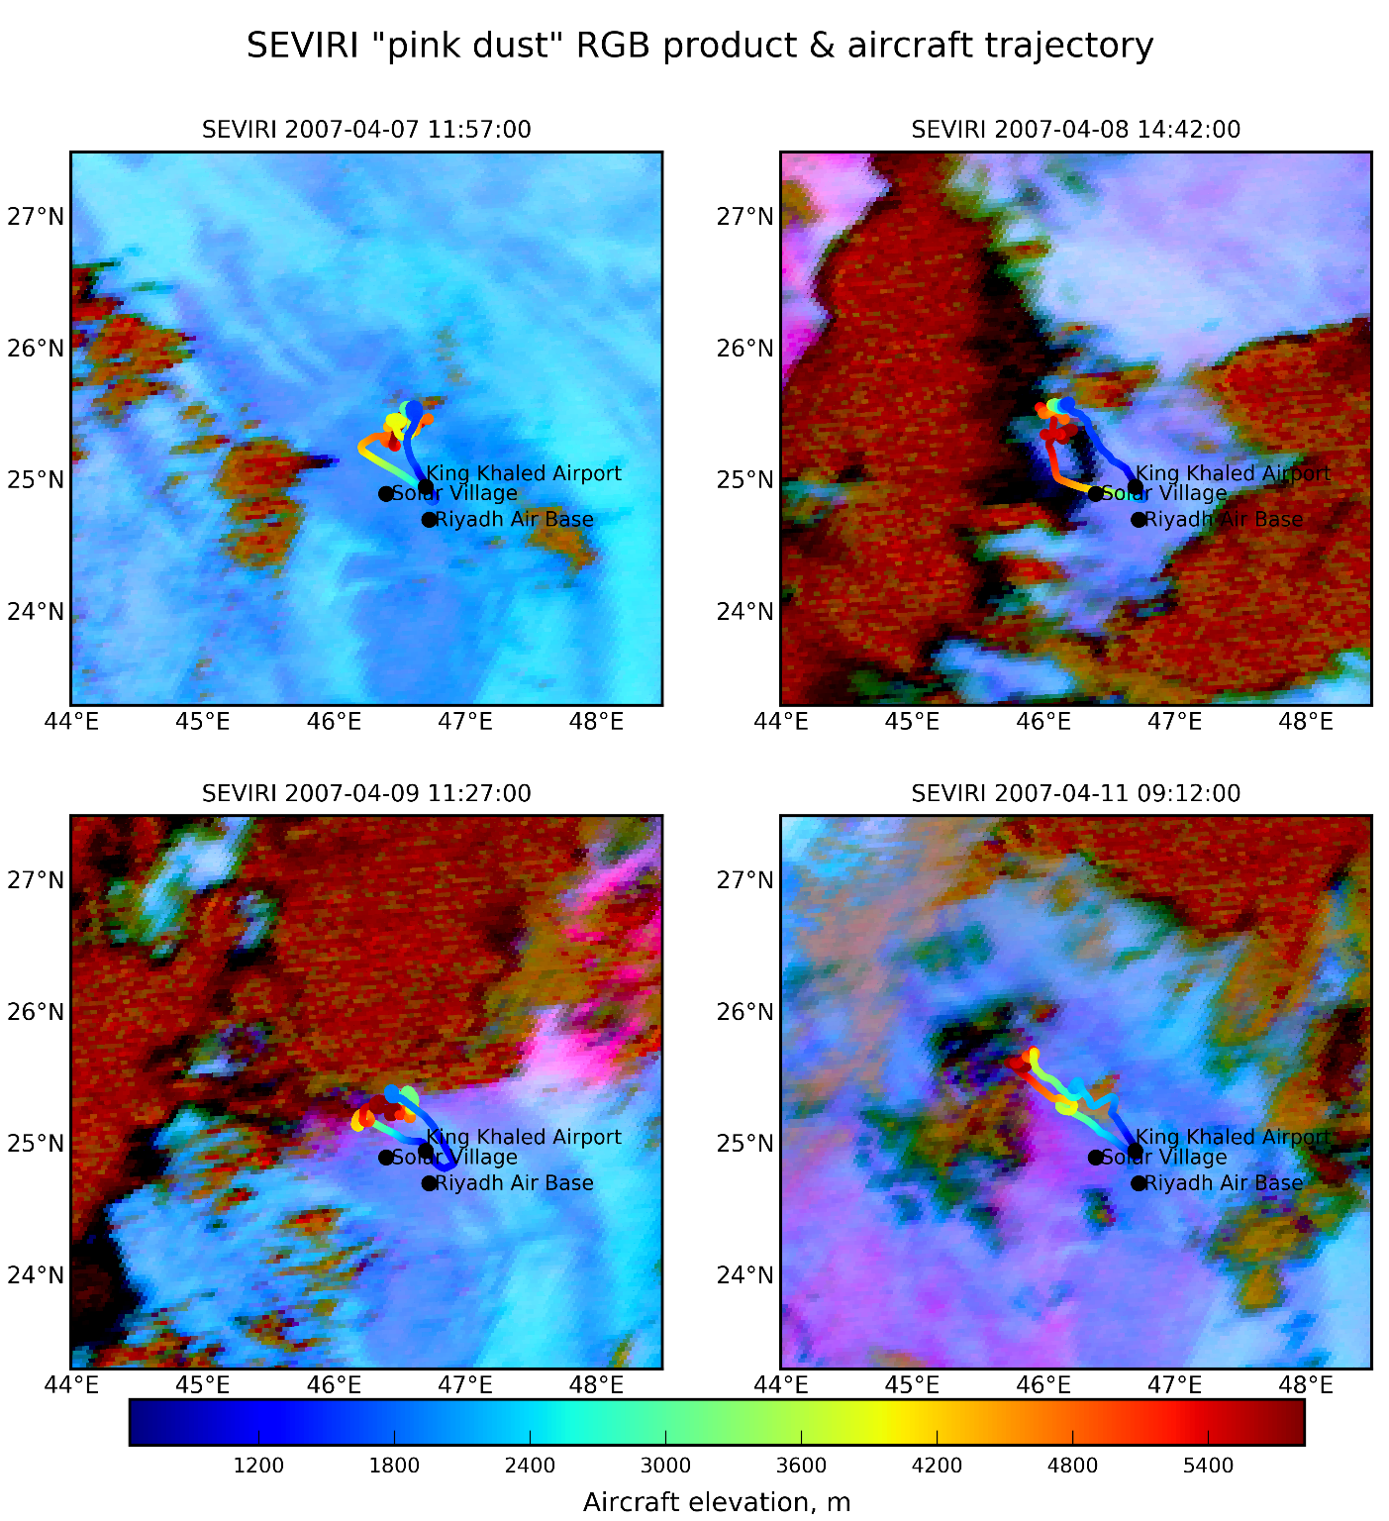
Aircraft measurements
Given the small spatial extent of the aircraft trajectory (but high altitudes reached), we perform the vertical integration and consider column averages.
Model vertically-integrated profiles are obtained by averaging within 1 x 1° around the aircraft trajectory area.
Model results are presented separately for all aerosols and dust-only aerosol.
The comparison is also performed against AERONET column-integrated size distribution inverse product.
Notes:
Individual clouds sampled by the aircraft. Given the small areal extent, we treat the
Every day except 7th there is dust. Stations although reported haboobs almost every day.

Slide 17
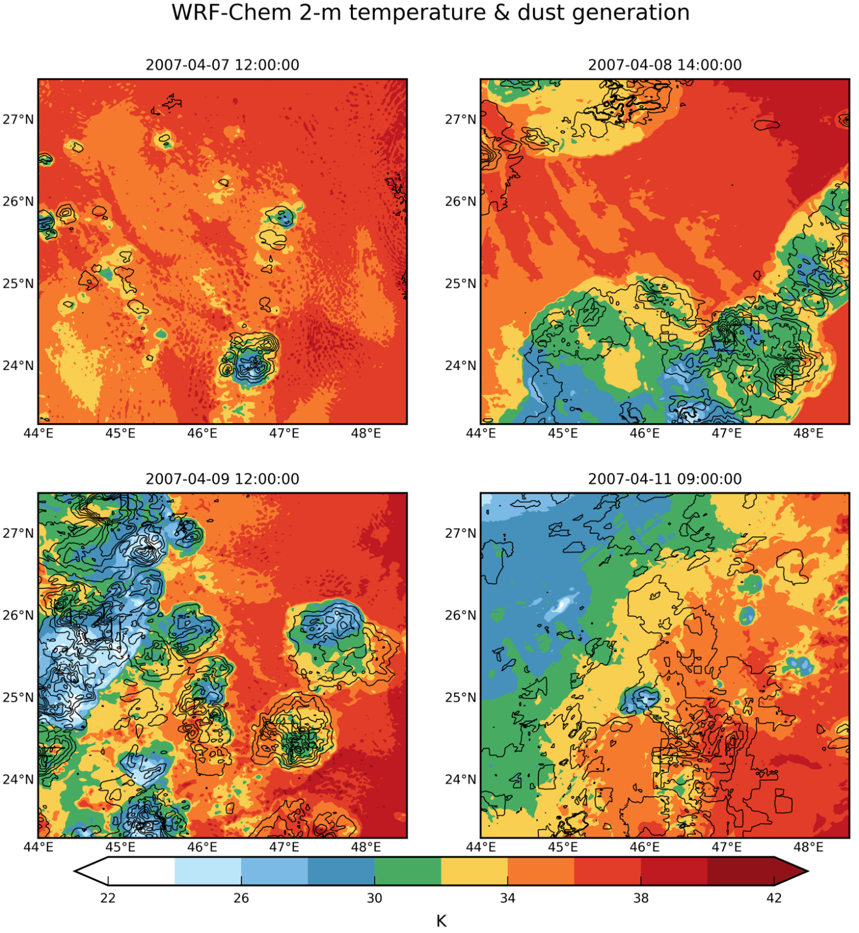
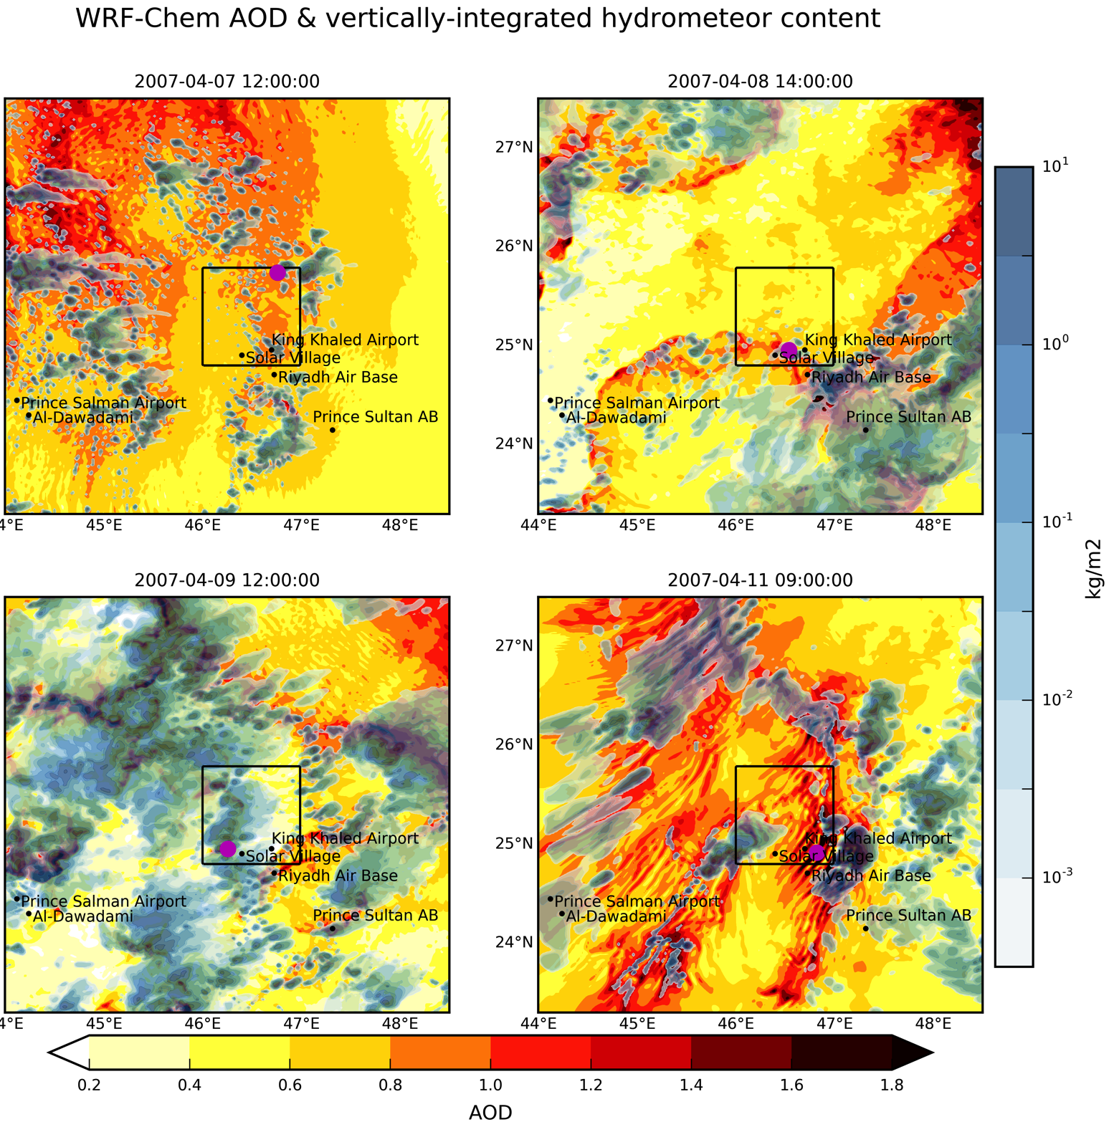

Slide 18
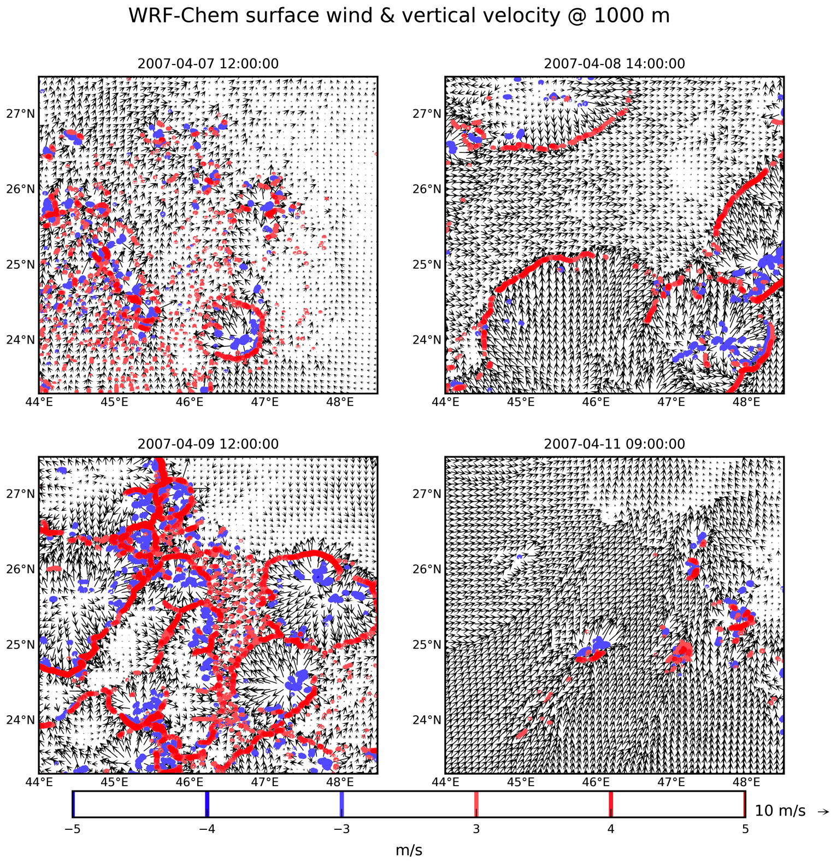
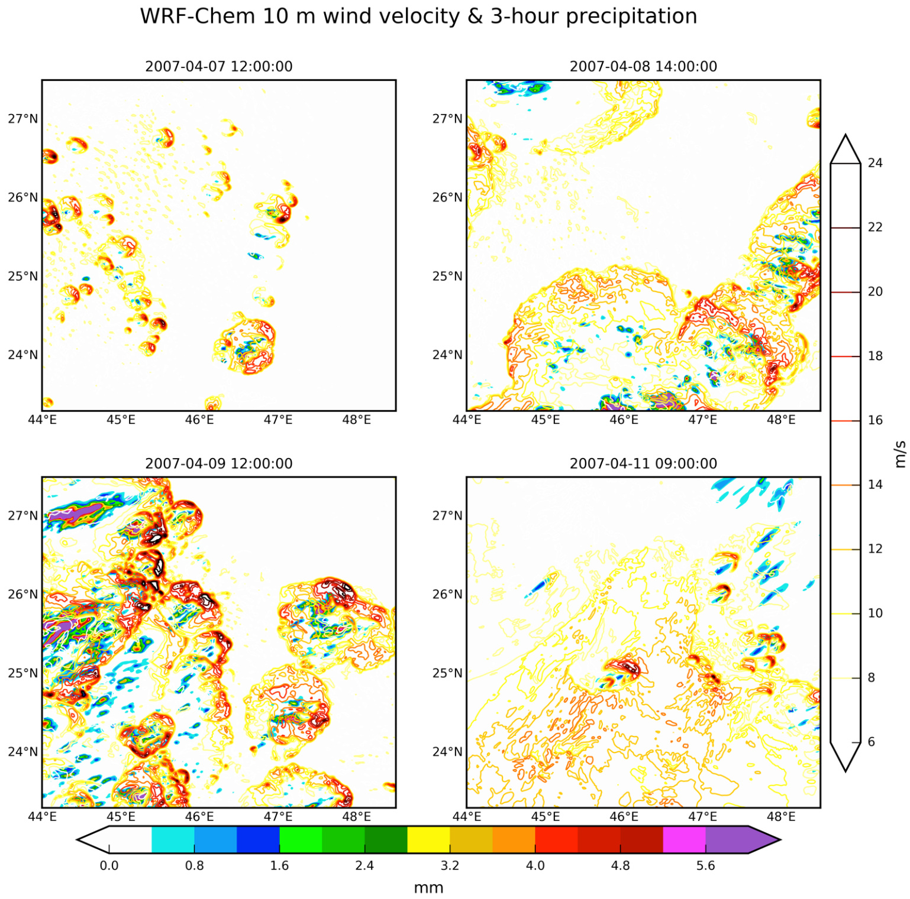
Notes:
Here you can see the vertical velocity at 1000 m plotted with color.

Slide 19
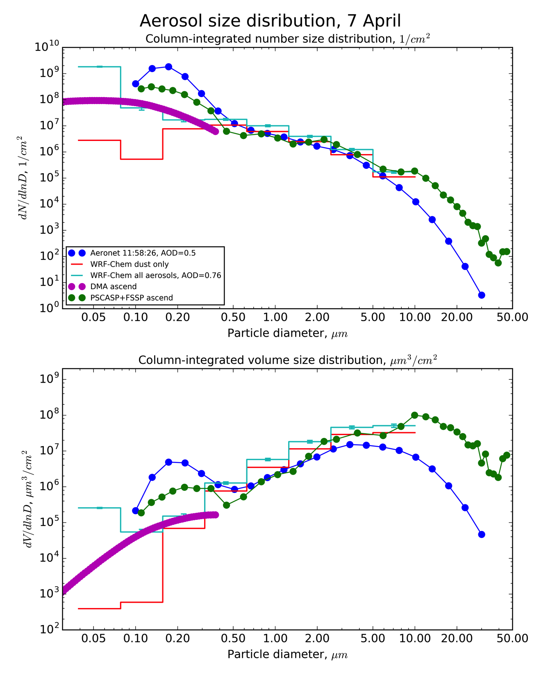
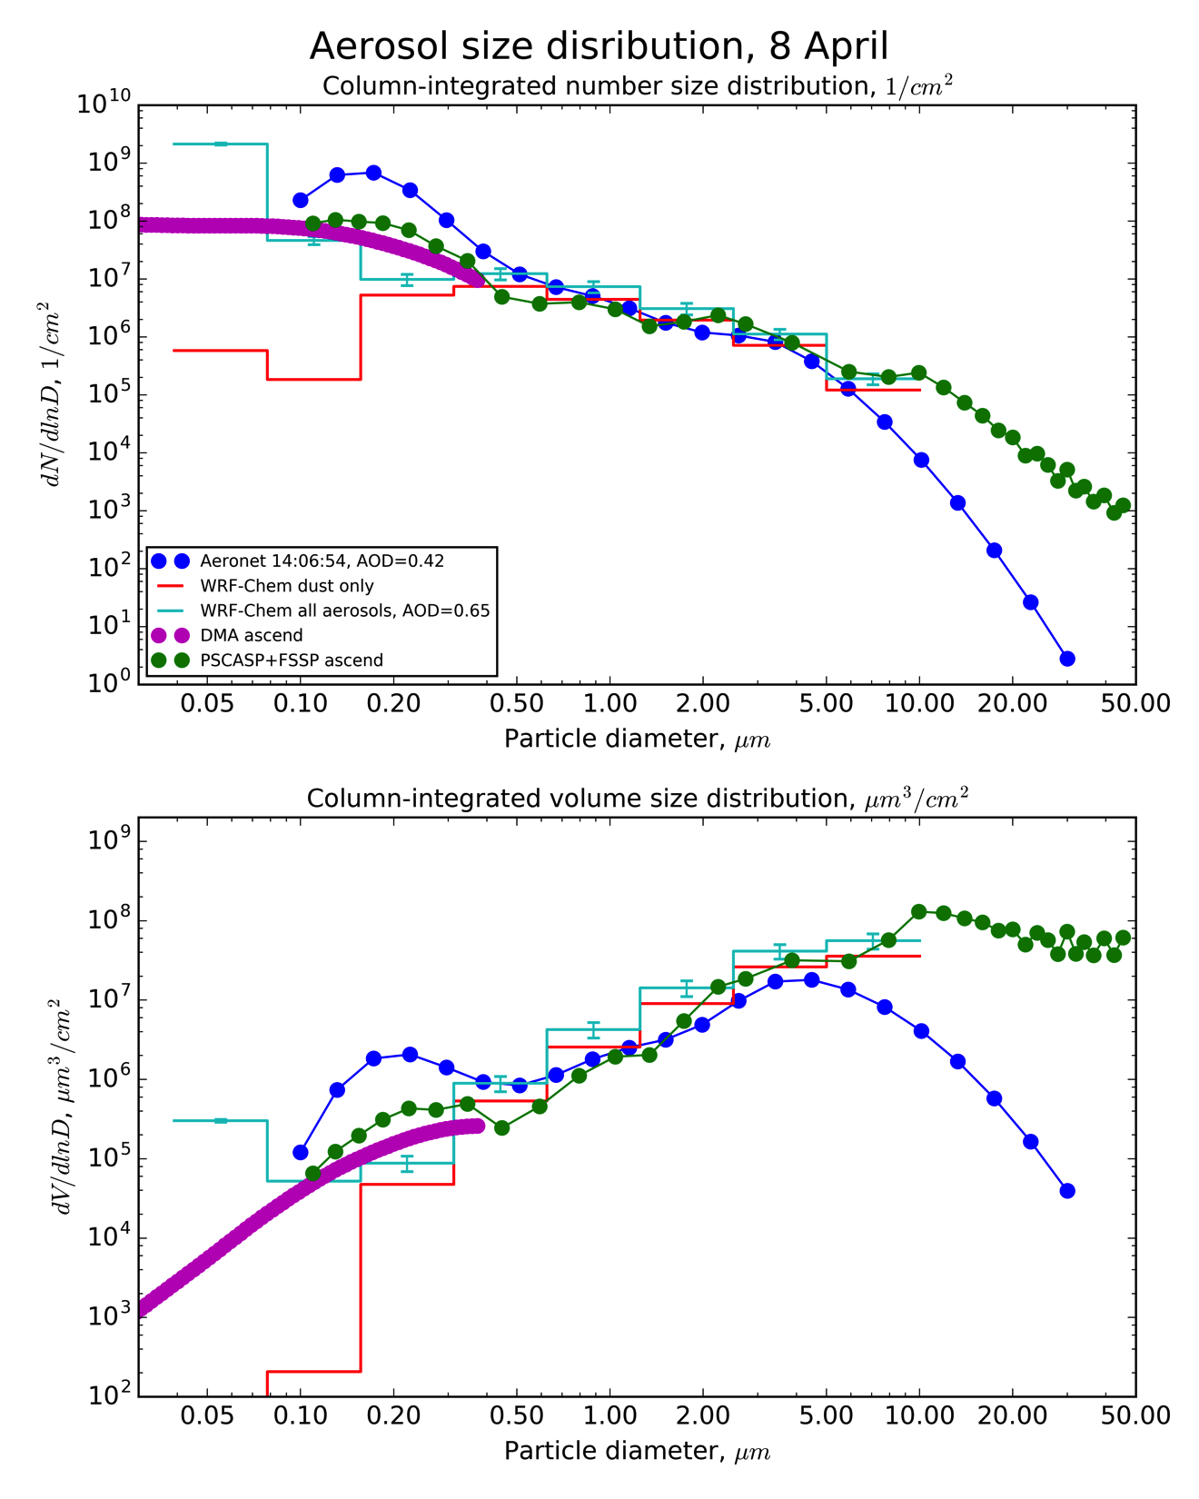

Slide 20
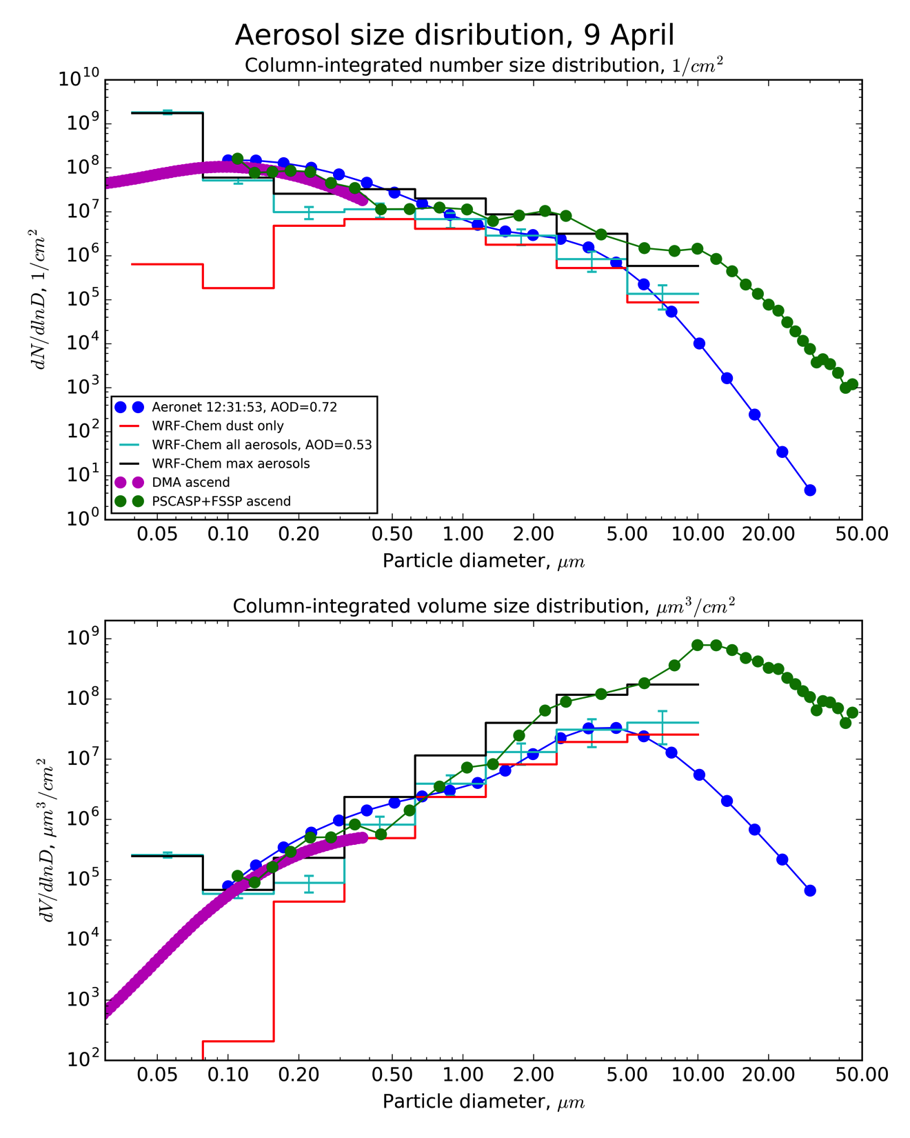
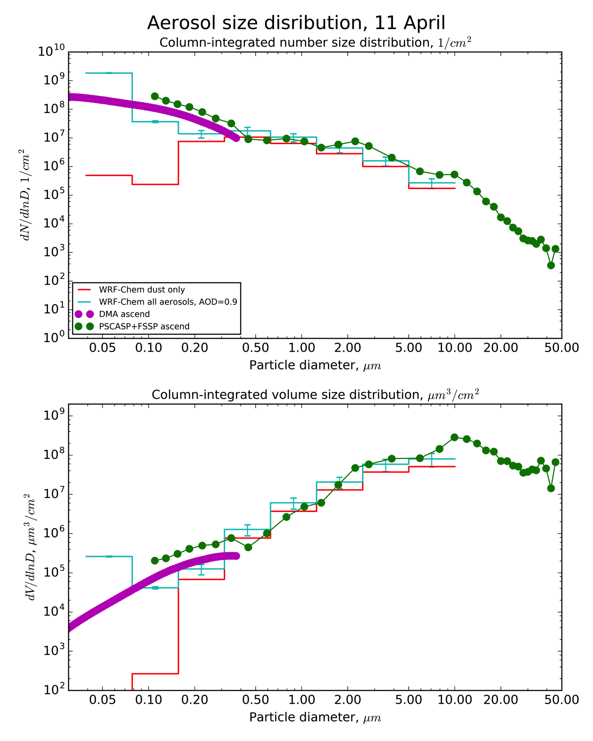
Haboob case

Slide 21
Conclusions
The April convection and associated rainfall maxima are weakly captured by large-scale models. Reproducing mesoscale dust storms is, therefore, a challenging task. Nevertheless, cloud-resolving WRF-Chem simulation does a fair job producing the reasonable rainfall pattern, consistent with input BCs, and compares well against station data.
The model large-scale AOD patterns across Arabian Peninsula are consistent with the remotely sensed SEVIRI & MODIS AOD and MERRA-2 reanalysis. The simulated AODs in the AERONET site locations are also in good agreement with observations. The model captures most of the dust events in the central Arabian Peninsula (Solar Village) near the source region. However, some events are missed. We attribute it to both imperfect model convection and deficiencies of bulk dust generation scheme.
The aerosol size distribution in the model is generally in good agreement with the aircraft observations and the AERONET inversion product. Both WRF-Chem and AERONET underestimate the coarse mode especially during the strong dust events in comparison with the aircraft observations. However, model results are in a better agreement with observations.
Overall, the modeled size distribution is relatively stable in our case-study as we sample it close to the dust source with a fixed emission size distribution.
Described case study might be a good test case for dust generation schemes. More sophisticated approaches to emission modeling and/or advanced source functions are the options to consider.

Slide 22
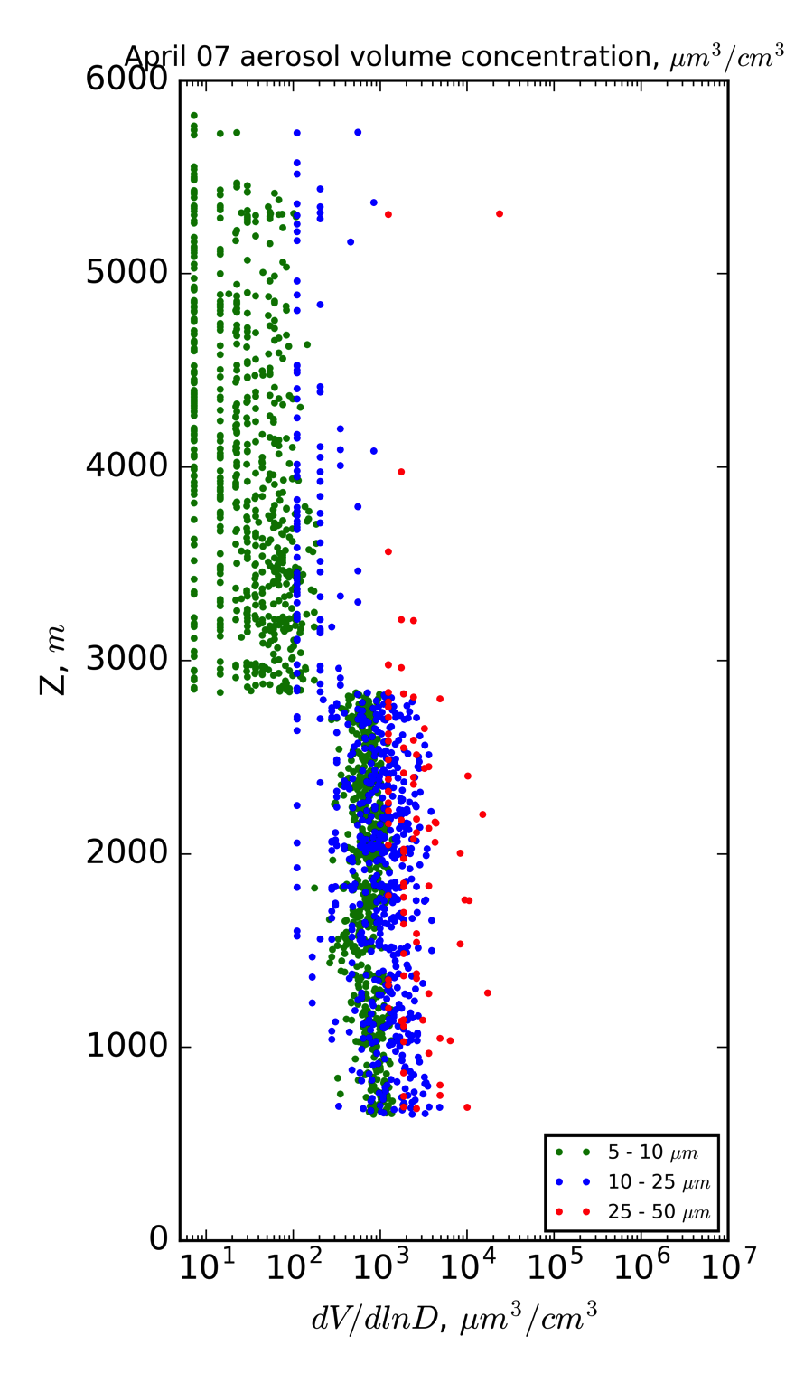
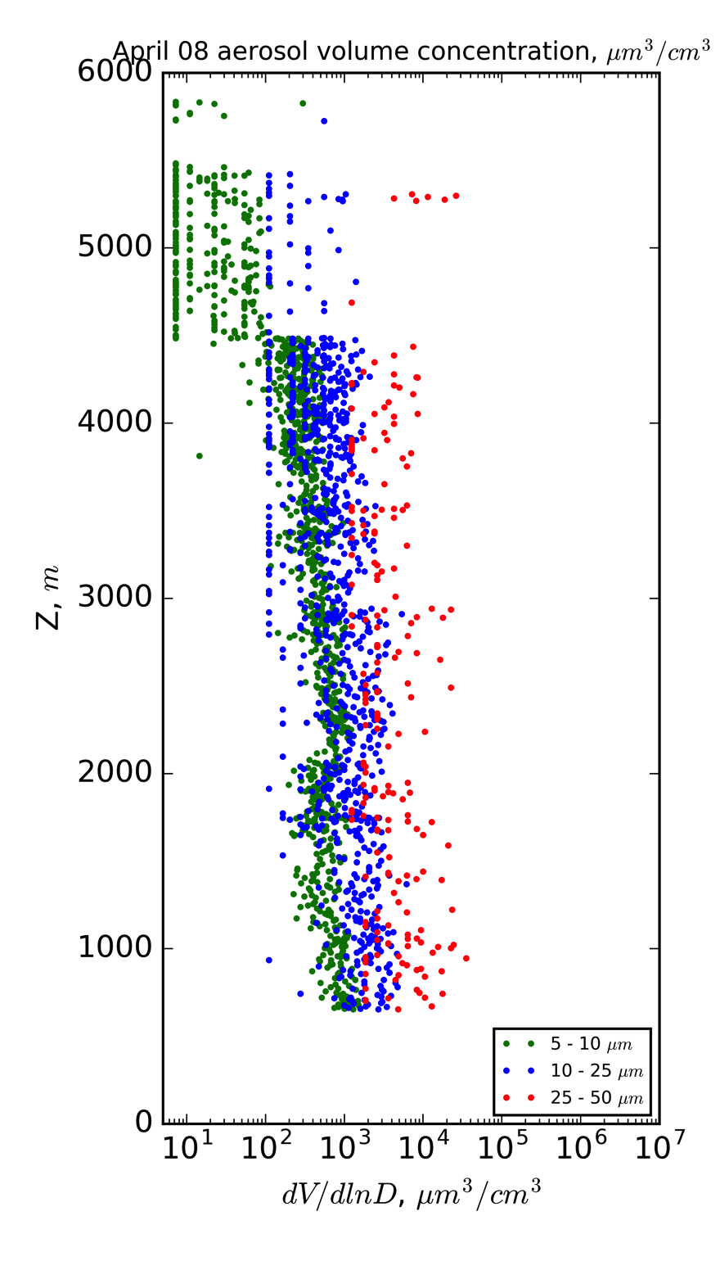
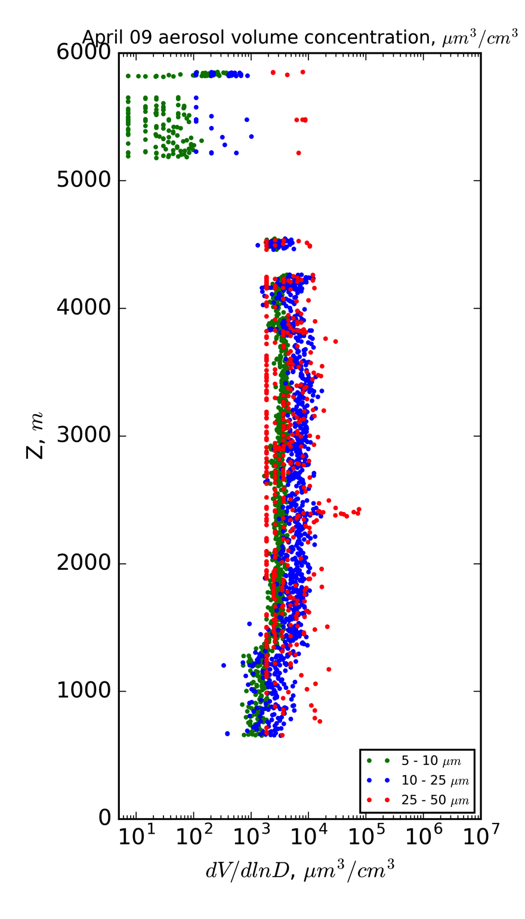
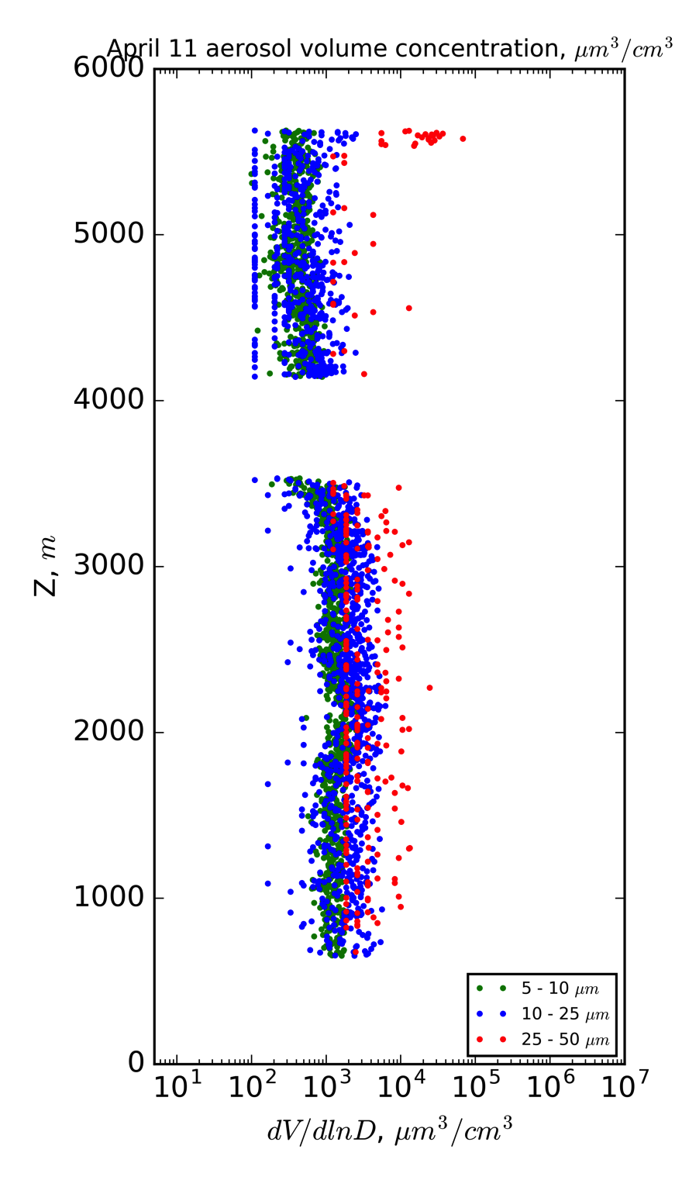
Aircraft observations: vertical profiles of aerosol volume concentrations
Haboob case
Cloud
contamination
(filtered)

Slide 23
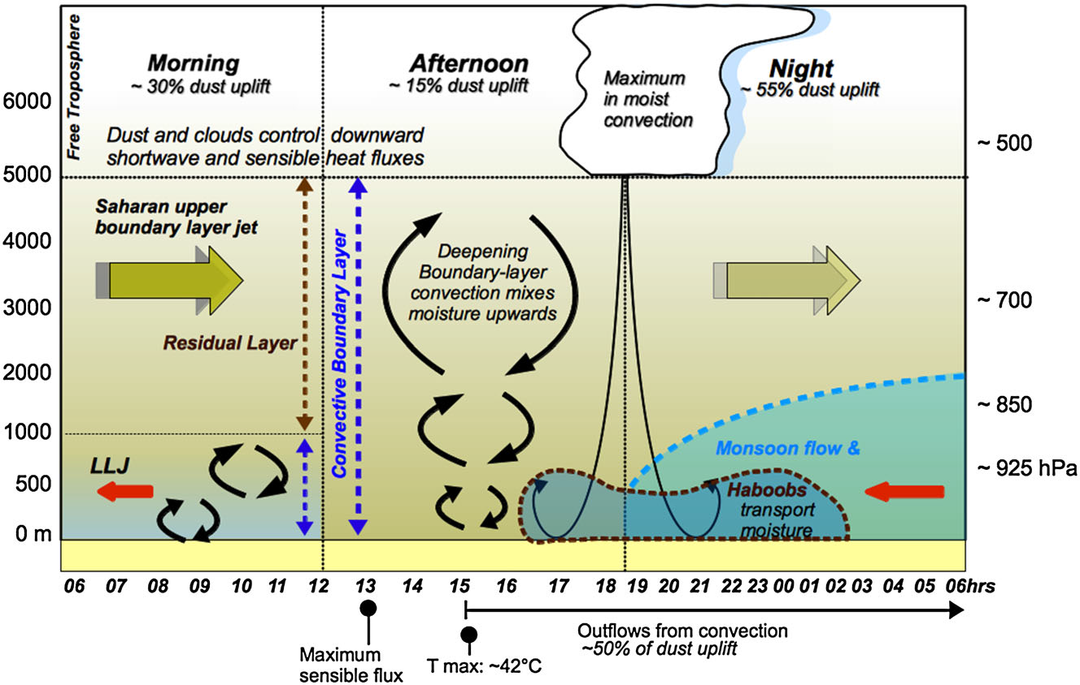

Slide 24
GOCART dust generation scheme
Ginoux et al. (2001)
C is a tuning constant, U_{10m} is a 10 m wind velocity, U_{t} is a threshold wind velocity dependent on surface wetness. s_{p} is a size bin fraction. GOCART calculates the dust flux into 5 size bins. The F_{p} dust fluxes are summed and the total flux F is re-distributed into 8 MOSAIC size bins according to Kok (2011) distribution.
S is a source function factor [0-1]:
Ginoux et al., 2012 source function
Dust generation source functions
Topographic (Ginoux et al., 2001)
Geomorphic (Zender et al., 2013)
Model-based (Gherboudj et al, 2016)
Satellite-based:
Frequency method – polar-orbiting satellites (TOMS, MODIS) (Ginoux et al. (2010, 2012)). Might miss some sources (up to 40% underestimation (Kocha et al., 2013))
Back-tracing method – geostationary sattelite, e.g. METEOSAT-SEVIRI (Schepanski et al. 2007, 2009, 2012); tested in (Heinold et al., 2016)
Advanced – CALIOP (Todd et al., 2016)
Combined (Parajuli et al., 2014; Evan et al., 2015)
Notes:
We use a very simple dust generation scheme. The primary element is the statistical source function, based on MODIS insturment. There is a large number of sf proposed for dust generation schemes. A similar, but a more advanced approach is back tracking.

Slide 25
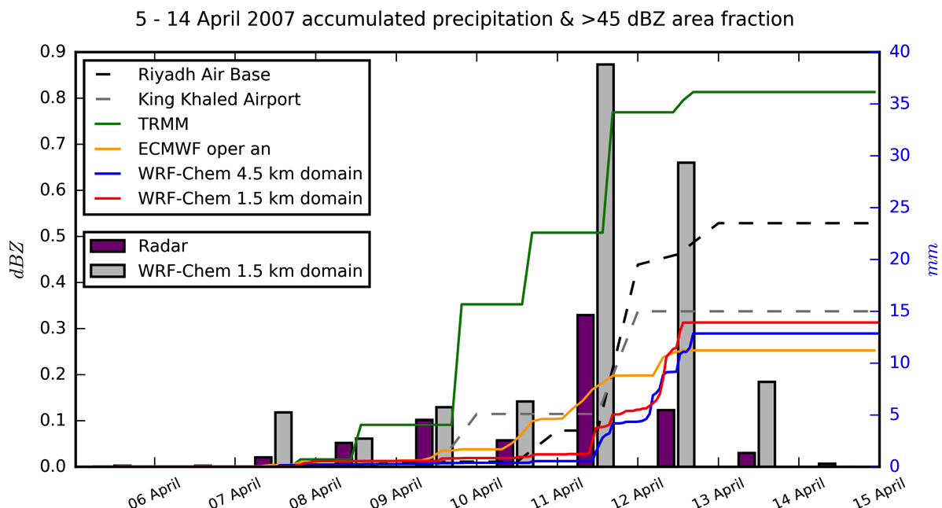
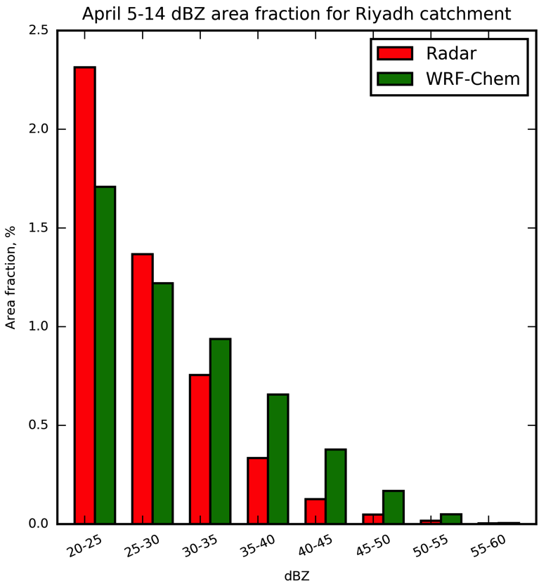
Radar and model convection & precipitation statistics
Radar & model dBZ column maximum statistics
The model tends to overestimate the area covered by intense convective cells, however, the precipitation is underestimated compared to TRMM, but in the same range as station measurements and input BCs.
Notes:
The cumulative plots + station data. So, as we seen, the model underestimates precipitation compared to TRMM, although it is close to station measurements, although it is in line withNo principal differences when using alternative microphysical schemes. The message is that despite larger areas are covered with high dBZ values in the model, precipitation amount is underestimated. It needs additional consideration, the likely explanation is narrower vertical extent of convective cells in the model.

Slide 26
Dust observational campaigns with aircraft measurements
UAE² campaign
The Saharan Aerosol Long-range TRansport and Aerosol-Cloud-Interaction Experiment 2 (SALTRACE) – Summer 2013-2014, Caribbean, Weinzierl et al., 2017 Dynamics-aerosol-chemistry-cloud interactions in West Africa (DACCIWA) – June 2016, West Africa,
Notes:
I would like to stress one more time that in situ aircraft obs. of aerosol loading is extremely valuable data, especially in Arabia. Here is the list of obs. Dust campaigns with aircraft data, none of the in our area. Not during the season of intense haboobs.

Slide 27
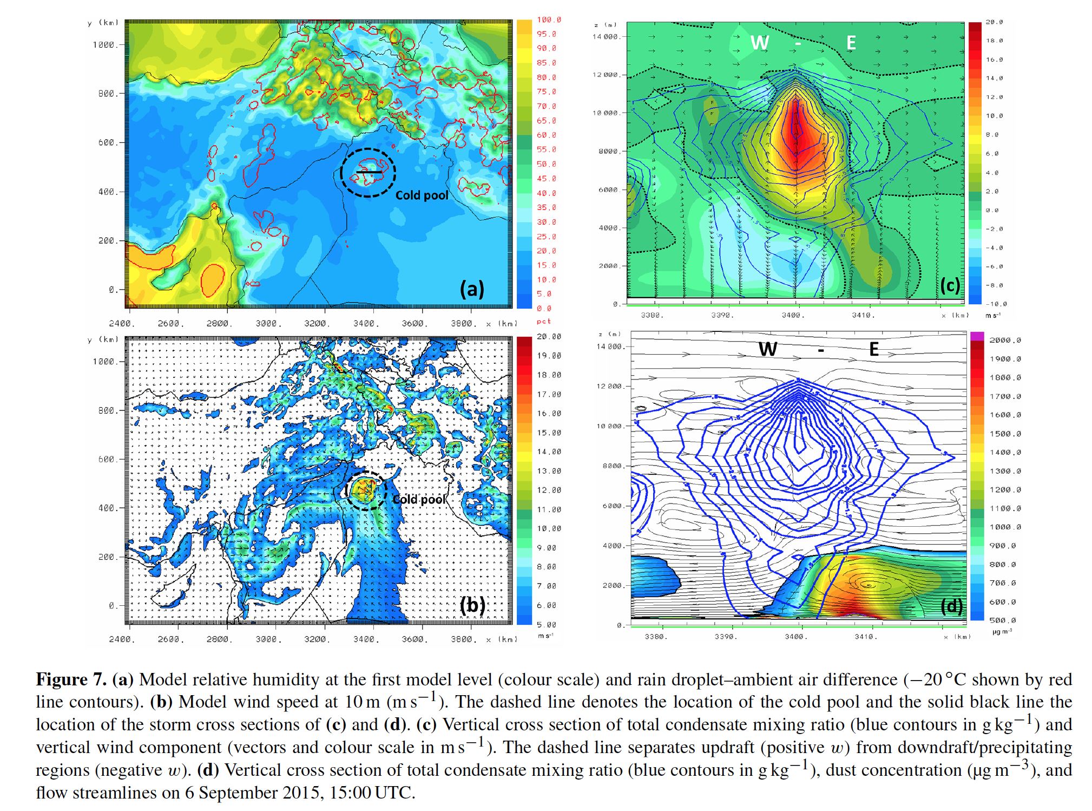

Slide 28
Outline
What is a haboob?
Model setup & data
Dust generation scheme & source function
Synoptic situation during the observational campaign
Model evaluation
Weather stations
Precipitation & convection statistics
Aerosol optical depth
Aircraft measurements
Aircraft equipment
Observational cases
Model results
Simulated haboobs
Aerosol size distribution
Conclusions
Notes:
So, this is our outline. I will focus briefly on model setup and data sources that were used. Present the model evaluation results. Show the comparison with satelltie and aircraft data, and discuss the main features of simulated dust events.

