Slide 1
Effects of satellite clouds-corrected photolysis rates on ozone
over CONUS
Young-Hee Ryu, A. Hodzic, J. Barre, G. Descombes
National Center for Atmospheric Research
P. Minnis
National Aeronautics and Space Administration (NASA)
G. Grell
National Oceanic and Atmospheric Administration/Earth Systems Research Laboratory/Global Systems Division (NOAA/ESRL/GSD)

Slide 2
Motivation
Relatively less attention in air quality community since cloud-free skies are conducive to high ozone levels
However, clouds play a critical role in UV radiation for photochemistry and so need to be well predicted.

Slide 3
Motivation
Relatively less attention in air quality community since cloud-free skies are conducive to high ozone levels
However, clouds play a critical role in UV radiation for photochemistry and so need to be well predicted.
Recent studies using satellite cloud retrievals to quantify the effects of clouds on actinic fluxes/photolysis rates (e.g., Ryu et al. 2017)
Ryu et al. (2017)

Slide 4
Motivation
Relatively less attention in air quality community since cloud-free skies are conducive to high ozone levels
However, clouds play a critical role in UV radiation for photochemistry and so need to be well predicted.
Recent studies using satellite cloud retrievals to quantify the effects of clouds on actinic fluxes/photolysis rates (e.g., Ryu et al. 2017)
A few studies on effects of satellite-constrained (corrected) photolysis rates on ozone formation (Pour-Biazar et al. 2007; Tang et al. 2015)
Ryu et al. (2017)

Slide 5
Goals and methods
Employ satellite-derived (GOES; Geostationary Operational Environmental Satellite) cloud optical depth and cloud boundaries in the WRF-Chem over CONUS for 2013 Summer
Goals
Evaluate vertical profiles of photolysis rates in the presence of clouds using aircraft data (SEAC⁴RS)
Evaluate ground-level ozone biases statistically for a long term period (4 months in 2013)
12-km WRFchem simulations
Simulation period: June–September 2013, Horizontal grid size: 12 km
Chemistry mechanism: MOZART_MOSAIC_KPP
New (updated) TUV for photolysis rate computations
Meteorology: reinitialized every 2 days using FNL reanalysis (6-hr spin up is allowed in each 2-day simulation) & No nudging
Control (CNTR) simulation: WRF-generated clouds
GOES simulation: satellite-derived clouds only in the photolysis computations (TUV in WRF-Chem).

Slide 6
Comparison of WRF and satellite clouds
Daytime (16–23 UTC) hourly Cloud Optical Depth (COD) over the WRF domain (land only) for the period of 11 June 2013 through 30 September 2013

Slide 7
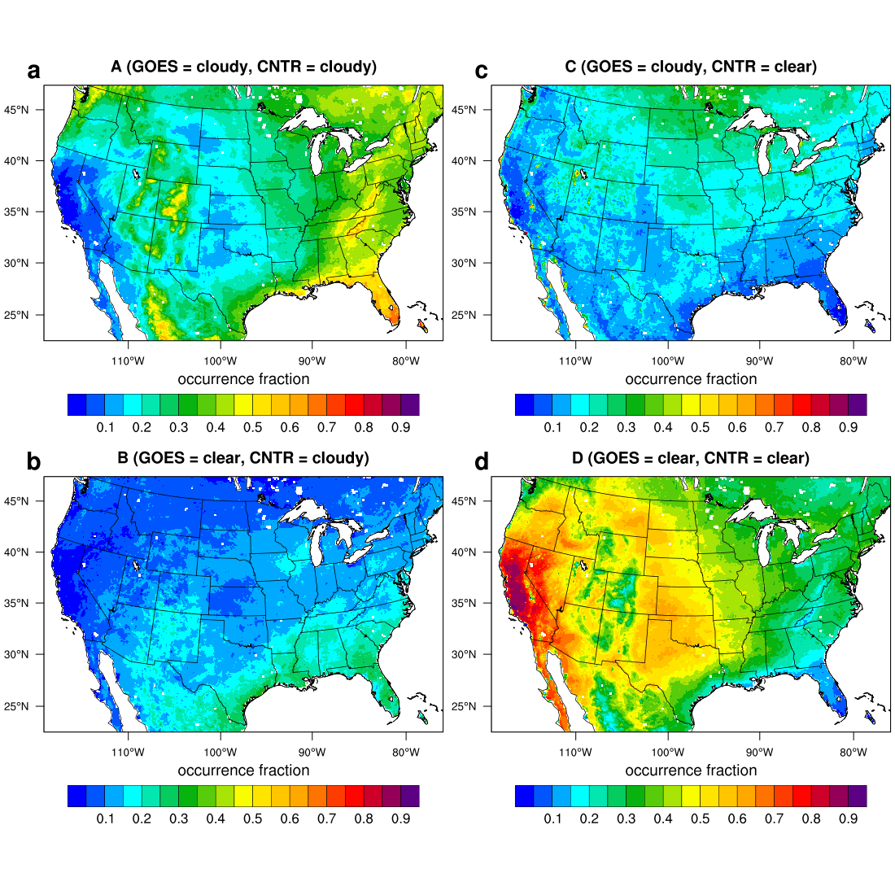
Cloud Evaluation ─ Contingency
 |  | GOES satellite
 |  | Cloudy | Clear
WRF | Cloudy | A (hit) | B (false alarm)
 | Clear | C (miss) | D (correct negative)
4-month domain averages
A = 27.1%
B = 12.4%
C = 17.5%
D = 43.0%
Probability of detection (POD), A/(A+C), = 60.8%

Slide 8
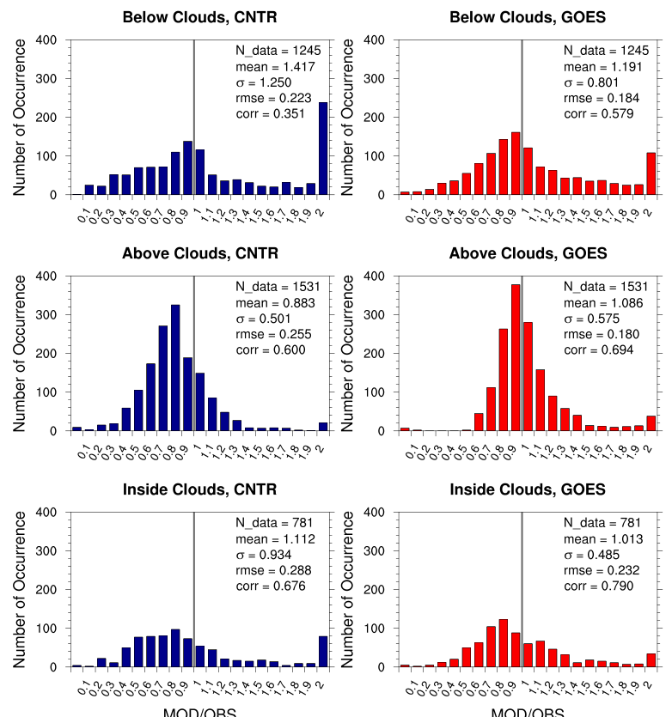
JNO₂ comparison with SEAC⁴RS data
Ratio of Model JNO₂ to OBS JNO₂
Cloudy-sky average
CNTR
GOES
OBS
Studies of Emissions and Atmospheric Composition, Clouds and Climate Coupling by Regional Surveys (SEAC⁴RS)

Slide 9
Effects of cloud correction on O₃
8-h Ozone (O₃) average, CNTR (Control)
average over 4 months
Difference in O₃, CNTR minus GOES
Max. diff.
~ 5 ppb

Slide 10
Effects of cloud correction on O₃
8-h Ozone (O₃) average, CNTR (Control)
average over 4 months
Difference in O₃, CNTR minus GOES
Max. diff.
~ 5 ppb

Slide 11
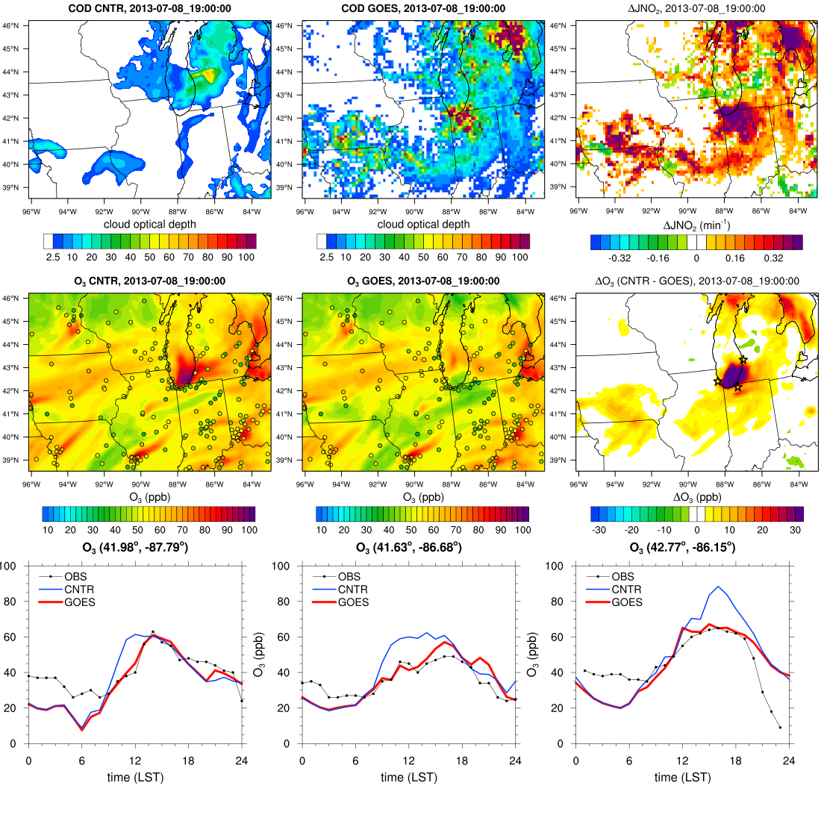
Cloud Optical Depth, CNTR
Cloud Optical Depth, GOES
ΔJNO₂ (CNTR – GOES)
Example in Midwestern US
13 LST 8 July 2013
Maximum O₃ difference ~60 ppb
O₃, CNTR
O₃, GOES
ΔO₃, (CNTR – GOES)

Slide 12
Reduction in 8-h O₃ bias due to clouds
8-h average O₃ bias is evaluated using EPA ground measurements for VOC-limited regimes and NOx-limited regimes.
$$\sum_{10 LST}^{17 LST}{1\left[\text{COD}\text{>}\text{COD} \text{threshold}\right]}≥4 \text{(}\text{hour}\text{)}$$
Cloudy sky conditions
O₃ bias due to clouds reduced by 5.4 ppb in VOC-limited regimes, 2.75 ppb in NOx-limited regimes under cloudy sky conditions with COD threshold of 20
Larger bias reduction in VOC-limited regimes

Slide 13
Reduction in 8-h O₃ bias due to clouds
8-h average O₃ bias is evaluated using EPA ground measurements for VOC-limited regimes and NOx-limited regimes.
$$\sum_{10 LST}^{17 LST}{1\left[\text{COD}\text{>}\text{COD} \text{threshold}\right]}≥4 \text{(}\text{hour}\text{)}$$
Cloudy sky conditions
O₃ bias due to clouds reduced by 5.4 ppb in VOC-limited regimes, 2.75 ppb in NOx-limited regimes under cloudy sky conditions with COD threshold of 20
Larger bias reduction in VOC-limited regimes

Slide 14
O₃ formation, OH, and HNO₃ with COD
Black line: median, cyan shading: 25 & 75 quartiles
Primary OH formation decreases as COD increases due to decreasing JO1D.
VOC-limited (high NOx)
OH reacts with NO₂ and is removed.
Low HO₂ (& RO₂)
Low O₃ formation
NOx-limited (low NOx)
OH mainly reacts with VOCs producing HO₂/RO₂
Considerable secondary OH sources (HO₂ + NO → OH + NO₂), which reaches a maximum at NOx ~ 1ppb (Weinstock et al. 1981)

Slide 15
Summary and next step
Satellite corrected photolysis rates and their vertical profiles show better agreements with airborne data.
Satellite corrected photolysis rates are found to reduce O₃ biases by 1–6 ppb on average at the ground level.
The reduction in O₃ (and bias) due to reduced radiation (due to clouds) is greater in VOC-limited regimes than NOx-limited regimes.
In other words, more accurate cloud predictions would benefit more accurate O₃ predictions in VOC-limited regimes (polluted regions).
Evaluate the effects and benefits of assimilation of satellite-derived clouds on O₃ predictions

Slide 16
Thank you!

Slide 17
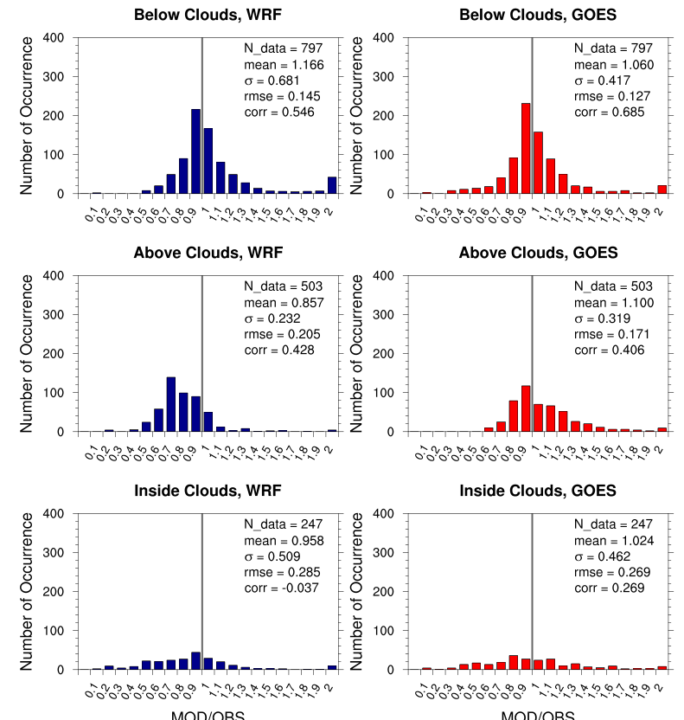
Comparison with NOMADSS campaign
Ratio of Model JNO₂ to OBS JNO₂
Cloudy-sky average
Nitrogen, Oxidants, Mercury and Aerosol Distributions, Sources and Sinks (NOMADSS)

Slide 18
Effects on 8-h O₃ bias
Cloudy sky conditions
$$\frac{\sum_{10}^{17}{1\left[\text{COD}\text{>}\text{COD} \text{threshold}\right]}}{8}≥0.5$$
O₃ bias due to clouds reduced by 2.7 ppb in VOC-limited regimes, 1.5 ppb in NOx-limited regimes under cloudy sky conditions with COD threshold of 5
Larger bias reduction in VOC-limited regimes

Slide 19
VOC-limited/NOX-limited regimes
For EPA ground stations, ratio ∆O₃/∆NO_{y} is used to identify the sensitivity regime.
NOx-VOC transition: ∆O₃/∆NO_{y} = 4–6 (Sillman and He, 2002)

Slide 20
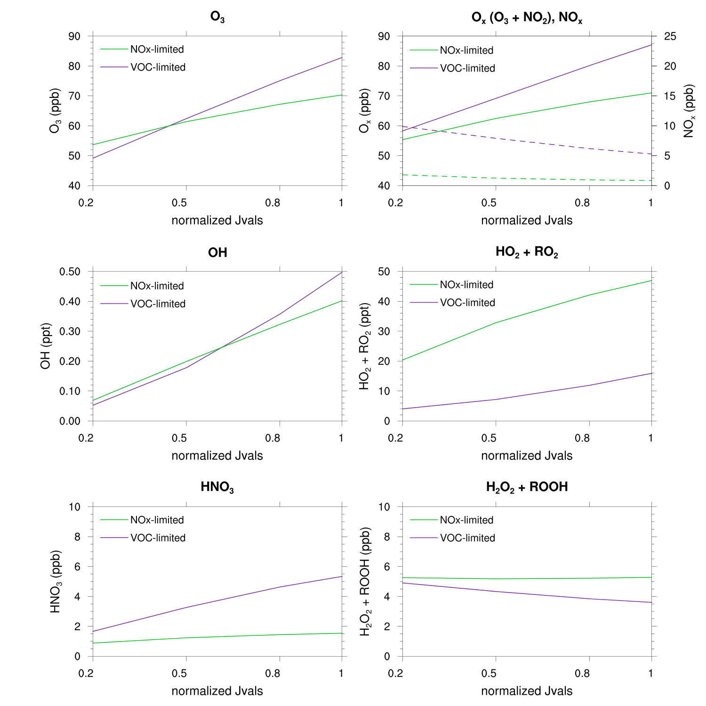
Test with a box model (BOXMOX)
Same chemical mechanism (MOZART-4)
Initial conditions/Emissions from WRFChem
VOC-limited: Chicago urban area
NOx-limited: Subruban of Chicago
12-hour runs

Slide 21
Effects on ground-level ozone
 |  | WRF
 |  | cloudy | clear
GOES | cloudy | A | B
 | clear | C | D

Slide 22
Effects on O₃ formation and radicals
Black line: median, cyan shading: 25 & 75 quartiles
Primary OH formation from O1D + H2O is linearly dependent on JO1D.
Larger sensitivity of O₃ formation and OH radical to changes in COD in VOC-limited regimes

Slide 23
Effects on radical sinks
Black line: median, cyan shading: 25 & 75 quartiles
VOC-limited regime: formation of HNO₃ is the major sink of HOx radicals
NOx-limited regime: formation of H₂O₂ (& ROOH) is the major sink of HOx radicals

Slide 24
12-km WRFChem simulations
WRFChem V3.6.1, a single domain over CONUS
Simulation period: June–September 2013, Horizontal grid size: 12 km
Chemistry mechanism: MOZART_MOSAIC_KPP
Meteorology: reinitialized every 2 days using FNL reanalysis (6-hr spin up is allowed in each 2-day simulation) & No nudging
Chemistry: cycled/continuous
Control (CNTR) simulation uses WRF-generated clouds.
GOES simulation uses GOES (Geostationary Operational Environmental Satellite) clouds
Available originally 8-km horizontal resolution every hour from 11 June 2013
In the GOES simulation, GOES cloud bottom/top height and cloud optical depth retrievals are used and updated every hour.
The GOES clouds are used instead of WRF-generated clouds only in the photolysis computations (TUV in WRF-Chem).
The GOES clouds are not used in other dynamics and physical processes such as atmospheric radiation and microphysics.

