Slide 1

Combined Impacts of Nitrous Acid and Nitryl Chloride on Lower Tropospheric Ozone: New Module Development in WRF-Chem and Application to China
18TH ANNUAL WRF USERS' WORKSHOP:
Li Zhang¹, Qinyi Li¹, Tao Wang¹, Ravan Ahmadov^{2,} ³, Qiang Zhang⁴, and Meng Li⁴
¹ Department of Civil and Environmental Engineering, The Hong Kong Polytechnic University, Hong Kong, China,
²Cooperative Institute for Research in Environmental Sciences, University of Colorado at Boulder, Boulder, CO, USA,
³Earth System Research Laboratory, National Oceanic and Atmospheric Administration, Boulder, CO, USA,
⁴Department of Earth System Science, Tsinghua University, Beijing, China
12-16 JUNE 2017, BOULDER, CO

Slide 2
Outline
Background
Model developments on HONO and Chlorine chemistry
Simulations of HONO and ClNO₂
Impact on tropospheric ozone in China
Summary

Slide 3
Introduction: HONO and N₂O₅/ClNO₂ processes
O₃
Daytime
hν
NO
O₃
NO₂
RO₂, HO₂
Notes:
• Nitrous acid (HONO) is a major source of the hydroxyl radical (OH) in the polluted troposphere (Su et al., 2011). The heterogeneous uptake of dinitrogen pentoxide (N₂O₅) produces the particulate nitrate and the nitryl chloride (ClNO₂) hence the chlorine radical (Cl) (Brown et al., 2006; Osthoff et al., 2008).
• The OH and Cl radical initiate the degradation of volatile organic compounds which results in the ozone formation (Atkinson et al, 2000; Thornton et al., 2010).
• The HONO and N₂O₅ process, therefore, influence the surface ozone and total nitrate formation.
• Photochemical (ozone) and haze (particulate) pollution has raised huge concerns in China in recent years. However, the collective role of HONO, N₂O₅ and ClNO₂ chemistry in the formation of air pollution in China is not quantified.
•

Slide 4
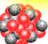

O₃
Daytime
hν
NO
O₃
NO₂
RO₂, HO₂
OH
Emission
HONO
Ground
Notes:
• Nitrous acid (HONO) is a major source of the hydroxyl radical (OH) in the polluted troposphere (Su et al., 2011). The heterogeneous uptake of dinitrogen pentoxide (N₂O₅) produces the particulate nitrate and the nitryl chloride (ClNO₂) hence the chlorine radical (Cl) (Brown et al., 2006; Osthoff et al., 2008).
• The OH and Cl radical initiate the degradation of volatile organic compounds which results in the ozone formation (Atkinson et al, 2000; Thornton et al., 2010).
• The HONO and N₂O₅ process, therefore, influence the surface ozone and total nitrate formation.
• Photochemical (ozone) and haze (particulate) pollution has raised huge concerns in China in recent years. However, the collective role of HONO, N₂O₅ and ClNO₂ chemistry in the formation of air pollution in China is not quantified.
•

Slide 5
O₃
Daytime
hν
VOCs
oxidation
NO
O₃
NO₂
OH
RO₂, HO₂
hν
OH
Emission
HONO
Ground
Notes:
• Nitrous acid (HONO) is a major source of the hydroxyl radical (OH) in the polluted troposphere (Su et al., 2011). The heterogeneous uptake of dinitrogen pentoxide (N₂O₅) produces the particulate nitrate and the nitryl chloride (ClNO₂) hence the chlorine radical (Cl) (Brown et al., 2006; Osthoff et al., 2008).
• The OH and Cl radical initiate the degradation of volatile organic compounds which results in the ozone formation (Atkinson et al, 2000; Thornton et al., 2010).
• The HONO and N₂O₅ process, therefore, influence the surface ozone and total nitrate formation.
• Photochemical (ozone) and haze (particulate) pollution has raised huge concerns in China in recent years. However, the collective role of HONO, N₂O₅ and ClNO₂ chemistry in the formation of air pollution in China is not quantified.
•

Slide 6
O₃
Daytime
hν
VOCs
oxidation
NO
O₃
NO₂
OH
RO₂, HO₂
OH
hν
OH
HNO₃ + NO₃⁻
Emission
HONO
Ground
Notes:
• Nitrous acid (HONO) is a major source of the hydroxyl radical (OH) in the polluted troposphere (Su et al., 2011). The heterogeneous uptake of dinitrogen pentoxide (N₂O₅) produces the particulate nitrate and the nitryl chloride (ClNO₂) hence the chlorine radical (Cl) (Brown et al., 2006; Osthoff et al., 2008).
• The OH and Cl radical initiate the degradation of volatile organic compounds which results in the ozone formation (Atkinson et al, 2000; Thornton et al., 2010).
• The HONO and N₂O₅ process, therefore, influence the surface ozone and total nitrate formation.
• Photochemical (ozone) and haze (particulate) pollution has raised huge concerns in China in recent years. However, the collective role of HONO, N₂O₅ and ClNO₂ chemistry in the formation of air pollution in China is not quantified.
•

Slide 7
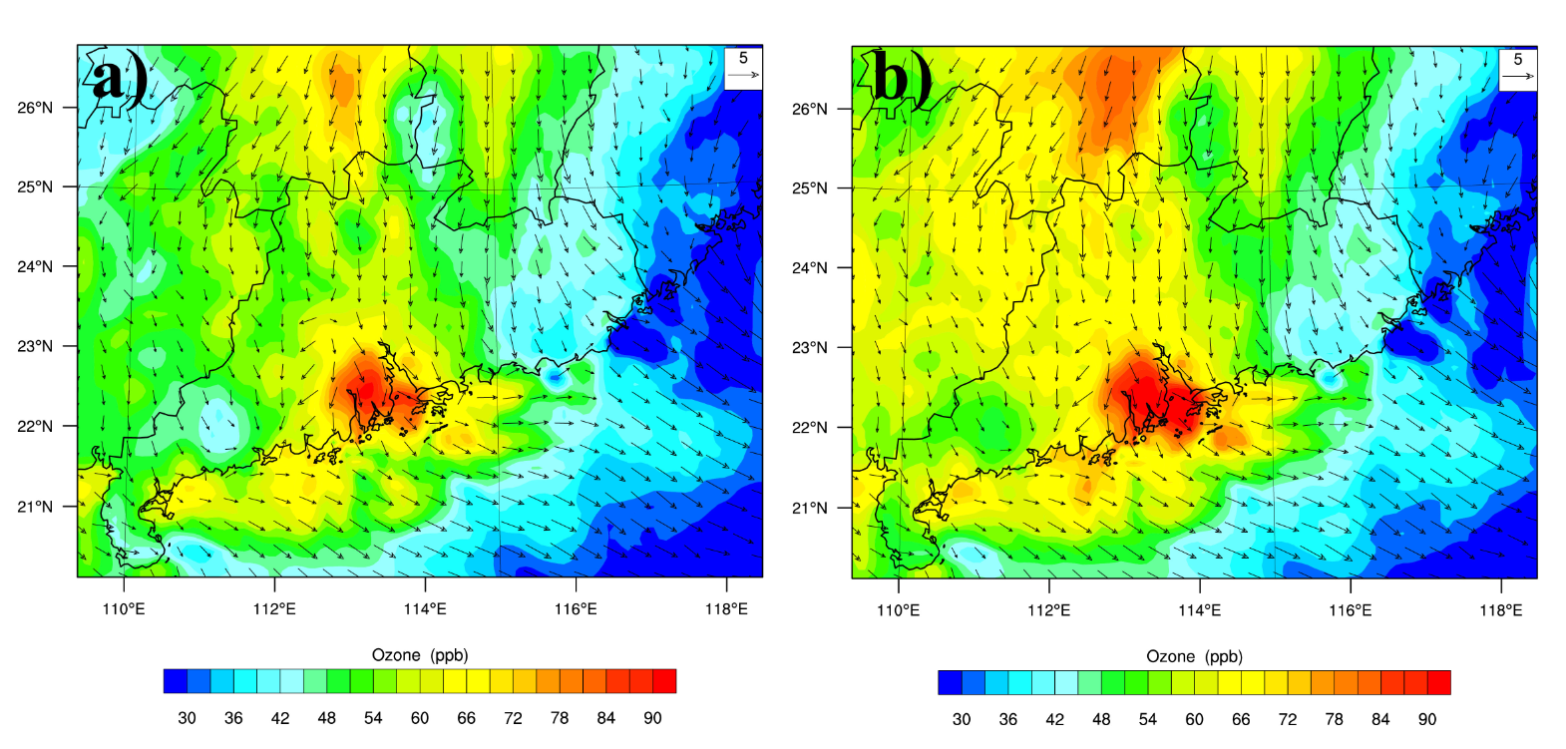
Comprehensive HONO sources (heterogeneous formations on various surfaces; gas-phase formations; oceanic source; traffic emissions; soil bacterial emissions) were considered into CBMZ_MOSAIC (Zhang et al., 2016, JGR)
O₃
Daytime
hν
VOCs
oxidation
NO
O₃
NO₂
OH
RO₂, HO₂
OH
Without HONO sources
With HONO sources
hν
OH
HNO₃ + NO₃⁻
Emission
6%-10% enhancement in O₃ over HK-PRD due to HONO sources/processes
HONO
Ground
Notes:
• Nitrous acid (HONO) is a major source of the hydroxyl radical (OH) in the polluted troposphere (Su et al., 2011). The heterogeneous uptake of dinitrogen pentoxide (N₂O₅) produces the particulate nitrate and the nitryl chloride (ClNO₂) hence the chlorine radical (Cl) (Brown et al., 2006; Osthoff et al., 2008).
• The OH and Cl radical initiate the degradation of volatile organic compounds which results in the ozone formation (Atkinson et al, 2000; Thornton et al., 2010).
• The HONO and N₂O₅ process, therefore, influence the surface ozone and total nitrate formation.
• Photochemical (ozone) and haze (particulate) pollution has raised huge concerns in China in recent years. However, the collective role of HONO, N₂O₅ and ClNO₂ chemistry in the formation of air pollution in China is not quantified.
•

Slide 8

Introduction: HONO and N₂O₅/ClNO₂ processes
O₃
Daytime
Nighttime
hν
O₃
O₃
NO₂
NO
NO₂
NO₃
N₂O₅
NO
M
Cl⁻
ClNO₂
Notes:
• Nitrous acid (HONO) is a major source of the hydroxyl radical (OH) in the polluted troposphere (Su et al., 2011). The heterogeneous uptake of dinitrogen pentoxide (N₂O₅) produces the particulate nitrate and the nitryl chloride (ClNO₂) hence the chlorine radical (Cl) (Brown et al., 2006; Osthoff et al., 2008).
• The OH and Cl radical initiate the degradation of volatile organic compounds which results in the ozone formation (Atkinson et al, 2000; Thornton et al., 2010).
• The HONO and N₂O₅ process, therefore, influence the surface ozone and total nitrate formation.
• Photochemical (ozone) and haze (particulate) pollution has raised huge concerns in China in recent years. However, the collective role of HONO, N₂O₅ and ClNO₂ chemistry in the formation of air pollution in China is not quantified.
•

Slide 9
O₃
Daytime
Nighttime
hν
O₃
O₃
NO₂
NO
NO₂
NO₃
N₂O₅
NO
M
Cl⁻
ClNO₂
Oxidation
O₃
Cl•
VOCs
Notes:
• Nitrous acid (HONO) is a major source of the hydroxyl radical (OH) in the polluted troposphere (Su et al., 2011). The heterogeneous uptake of dinitrogen pentoxide (N₂O₅) produces the particulate nitrate and the nitryl chloride (ClNO₂) hence the chlorine radical (Cl) (Brown et al., 2006; Osthoff et al., 2008).
• The OH and Cl radical initiate the degradation of volatile organic compounds which results in the ozone formation (Atkinson et al, 2000; Thornton et al., 2010).
• The HONO and N₂O₅ process, therefore, influence the surface ozone and total nitrate formation.
• Photochemical (ozone) and haze (particulate) pollution has raised huge concerns in China in recent years. However, the collective role of HONO, N₂O₅ and ClNO₂ chemistry in the formation of air pollution in China is not quantified.
•

Slide 10
O₃
Daytime
Nighttime
hν
O₃
O₃
NO₂
NO
NO₂
NO₃
N₂O₅
NO
M
OH
VOCs
H₂O
Cl⁻
HNO₃ + NO₃⁻
ClNO₂
Oxidation
O₃
Cl•
VOCs
Notes:
• Nitrous acid (HONO) is a major source of the hydroxyl radical (OH) in the polluted troposphere (Su et al., 2011). The heterogeneous uptake of dinitrogen pentoxide (N₂O₅) produces the particulate nitrate and the nitryl chloride (ClNO₂) hence the chlorine radical (Cl) (Brown et al., 2006; Osthoff et al., 2008).
• The OH and Cl radical initiate the degradation of volatile organic compounds which results in the ozone formation (Atkinson et al, 2000; Thornton et al., 2010).
• The HONO and N₂O₅ process, therefore, influence the surface ozone and total nitrate formation.
• Photochemical (ozone) and haze (particulate) pollution has raised huge concerns in China in recent years. However, the collective role of HONO, N₂O₅ and ClNO₂ chemistry in the formation of air pollution in China is not quantified.
•

Slide 11
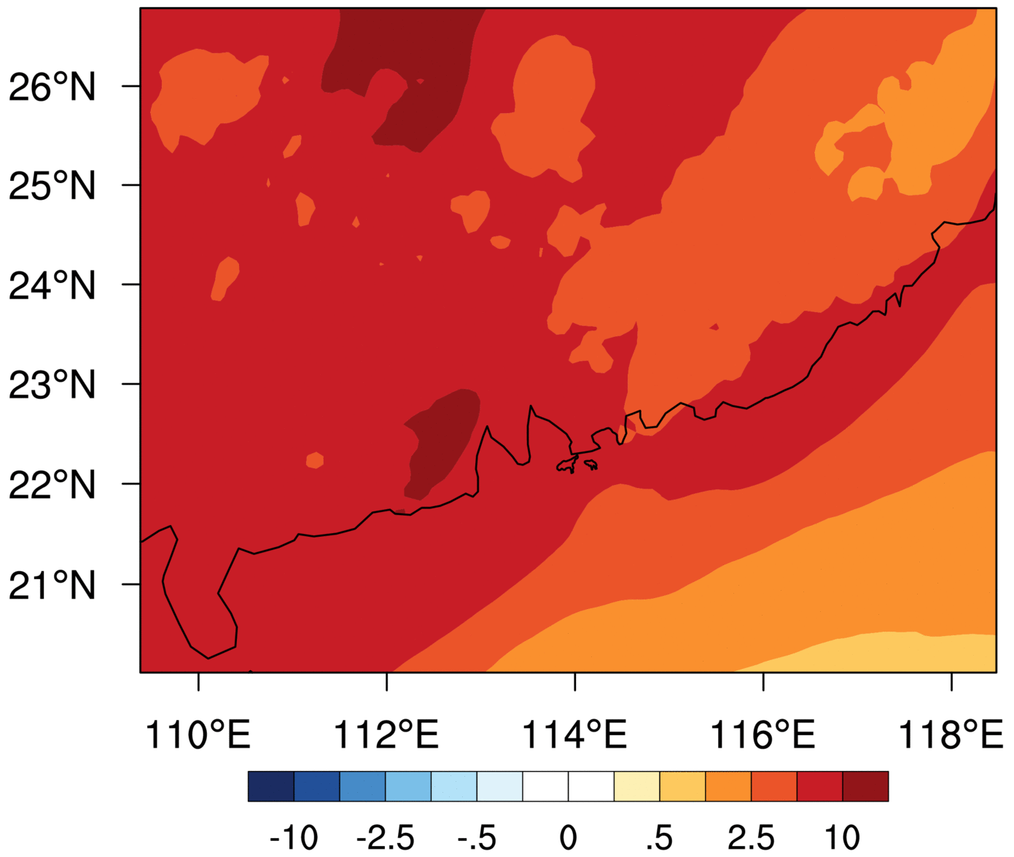
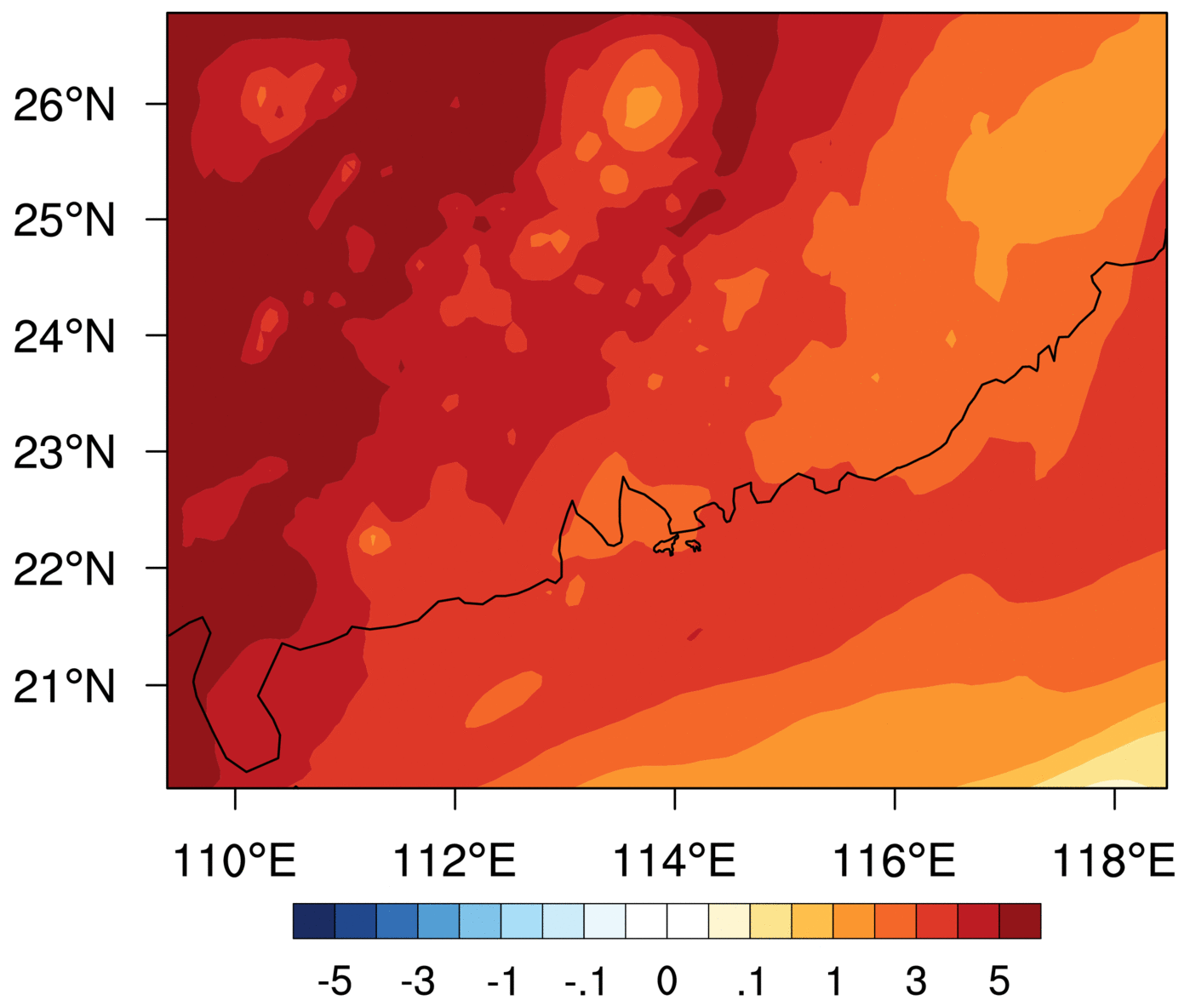
Incorporation of ISORROPIA II & heterogeneous processes of N₂O₅/ClNO₂ into MADE/VBS; Cl-initiated reactions in RACM_ESRL (Li et al., 2016, ACP)
O₃
Daytime
Nighttime
hν
O₃
O₃
NO₂
NO
NO₂
NO₃
N₂O₅
NO
M
OH
VOCs
H₂O
Cl⁻
HNO₃ + NO₃⁻
ClNO₂
Impacts on Total nitrate (μg m⁻³)
Impacts on Ozone (ppb)
Significant Impacts of N₂O₅ uptake and ClNO₂ production on total nitrate (13.45 μg m⁻³) and ozone (7.23 ppb) in the HK-PRD
Oxidation
O₃
Cl•
VOCs
Notes:
• Nitrous acid (HONO) is a major source of the hydroxyl radical (OH) in the polluted troposphere (Su et al., 2011). The heterogeneous uptake of dinitrogen pentoxide (N₂O₅) produces the particulate nitrate and the nitryl chloride (ClNO₂) hence the chlorine radical (Cl) (Brown et al., 2006; Osthoff et al., 2008).
• The OH and Cl radical initiate the degradation of volatile organic compounds which results in the ozone formation (Atkinson et al, 2000; Thornton et al., 2010).
• The HONO and N₂O₅ process, therefore, influence the surface ozone and total nitrate formation.
• Photochemical (ozone) and haze (particulate) pollution has raised huge concerns in China in recent years. However, the collective role of HONO, N₂O₅ and ClNO₂ chemistry in the formation of air pollution in China is not quantified.
•

Slide 12
Closer look at the HONO and N₂O₅/ClNO₂ processes
Competition between HONO and N₂O₅ processes.
Both of them change the partitioning of reactive nitrogen.
Emitted/formed during different period
HONO is emitted/formed both in the daytime and night-time.
N₂O₅ and ClNO₂ is produced in the night-time.
Emitted/formed from different regions and at different altitudes.
HONO can be emitted/formed in urban and rural regions
HONO can be emitted from the surface and formed aloft.
ClNO₂ is produced where N₂O₅ is concentrated, which is generally the immediate downwind region of urban areas
N₂O₅ is also elevated in the residual layer.

Slide 13
What if we consider HONO and ClNO₂ simultaneously?
O₃
Daytime
Nighttime
hν
VOCs
oxidation
O₃
O₃
NO₂
NO
NO₂
NO₃
N₂O₅
NO
M
OH
RO₂, HO₂
OH
VOCs
OH
H₂O
Cl⁻
hν
HNO₃ + NO₃⁻
ClNO₂
Emission
HONO
Oxidation
O₃
Cl•
VOCs
Ground
Notes:
• Nitrous acid (HONO) is a major source of the hydroxyl radical (OH) in the polluted troposphere (Su et al., 2011). The heterogeneous uptake of dinitrogen pentoxide (N₂O₅) produces the particulate nitrate and the nitryl chloride (ClNO₂) hence the chlorine radical (Cl) (Brown et al., 2006; Osthoff et al., 2008).
• The OH and Cl radical initiate the degradation of volatile organic compounds which results in the ozone formation (Atkinson et al, 2000; Thornton et al., 2010).
• The HONO and N₂O₅ process, therefore, influence the surface ozone and total nitrate formation.
• Photochemical (ozone) and haze (particulate) pollution has raised huge concerns in China in recent years. However, the collective role of HONO, N₂O₅ and ClNO₂ chemistry in the formation of air pollution in China is not quantified.
•

Slide 14
Motivation:
1. To complete this part of reactive nitrogen chemistry in WRF-Chem; 2. To investigate their impacts on secondary pollutants (e.g. ozone)
NO₃
NO₂
N₂O₅
surface
HNO₃
O₃
NO
Cl⁻
emission
NO₂
hν
ClNO₂
hν
Cl·
O₃, RO_{2,} HO₂
O₃ & SA
hv
surface
NO
OH
HONO
hν
OH
hν
emission
emission
These important chemistry affecting the atmospheric oxidation capacity have been missing in many CTMs !

Slide 15
Reactive Nitrogen Oxides Mechanism (CBMZ_ReNOM)
Gas phase chemistry
Chlorine chemistry
Aerosol phase chemistry
Heterogeneous uptake of N₂O₅ and NO₂ on aerosol and/or land surface to produce ClNO₂ and HONO
Photolysis
Chlorine species
Emission
HONO emission from soil and traffic
CBMZ-MOSAIC module in WRF-Chem
Details and validations are referred to Zhang et al. 2017, ACP, in review
Notes:
In this study, we use a revised version of the WRF-Chem model, which includes…
Weather Research and Forecasting model coupled with Chemistry (WRF-Chem) has been incorporated with comprehensive reactive nitrogen oxides mechanism (ReNOM), including the latest HONO sources, the heterogeneous uptake of N₂O₅ and the subsequent ClNO₂ production and chlorine chemistry (Zhang et al., in preparation).
The CBMZ-MOSAIC module (Archer-Nicholls et al., 2014) in WRF-Chem was further developed to include the emission and heterogeneous production of HONO (Zhang et al., 2016) and the gas phase chlorine chemistry (Sarwar et al., 2012), see Fig 2.
Original and updated WRF-Chem were then used to conduct simulations to model the abundance of HONO and ClNO₂, and to evaluate the impacts of model developments on air pollutants. Simulations were conducted in different setups, as shown in Table 1, in which MEIC and EDGAR emission inventory were used for China and other Asia regions, respectively, and RECI-China is reactive chlorine emission developed based on coal and biomass burning. All cases modeled air flow and air pollutants from July 1 to 31, 2014, focusing China.

Slide 16
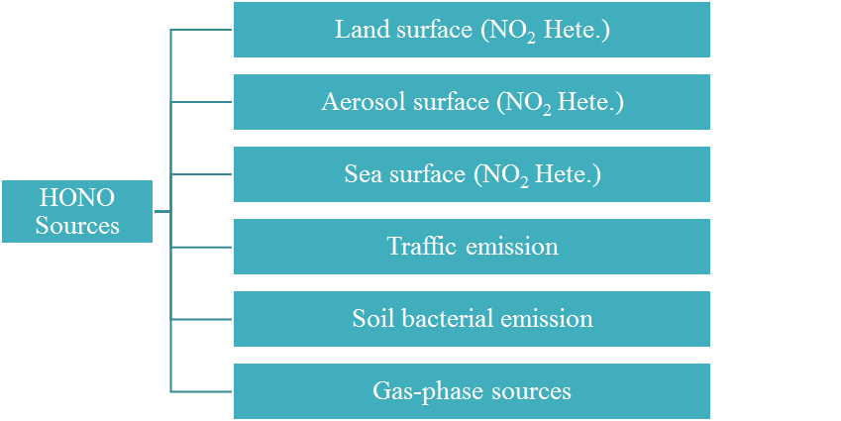
HONO Chemistry Development
1. Heterogeneous formations & gas-phase reactions of HONO were added into the CBMZ_ReNOM.
2. Traffic & Biological emissions of HONO were also considered.
(Zhang et al., 2017, ACP, in review)

Slide 17
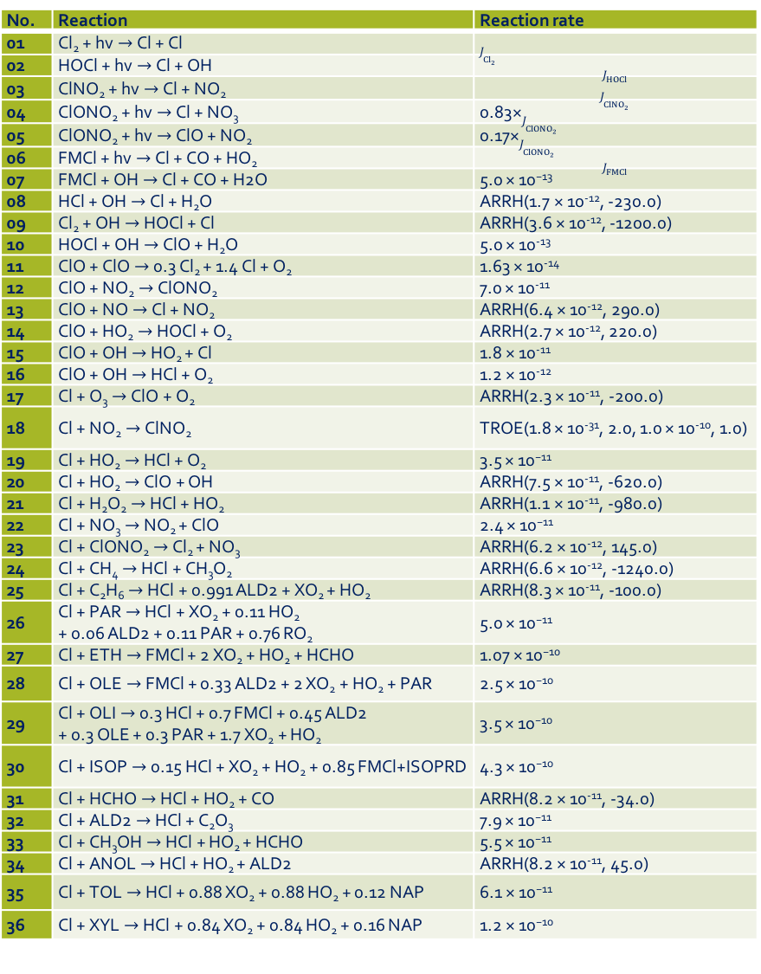
No. | Reaction | Reaction rate
01 | Cl₂ + hv$→$Cl + Cl | $J_{{Cl}_{2}}$
02 | HOCl + hv$→$Cl + OH | $$J_{HOCl}$$
03 | ClNO₂ + hv$→$Cl + NO₂ | $$J_{{ClNO}_{2}}$$
04 | ClONO₂ + hv$→$Cl + NO₃ | 0.83×$J_{{ClONO}_{2}}$
05 | ClONO₂ + hv$→$ClO + NO₂ | 0.17×$J_{{ClONO}_{2}}$
06 | FMCl + hv$→$Cl + CO + HO₂ | $$J_{FMCl}$$
07 | FMCl + OH$→$Cl + CO + H2O | 5.0 × 10⁻¹³
08 | HCl + OH$→$Cl + H₂O | ARRH(1.7 × 10⁻¹², -230.0)
09 | Cl₂ + OH$→$HOCl + Cl | ARRH(3.6 × 10⁻¹², -1200.0)
10 | HOCl + OH$→$ClO + H₂O | 5.0 × 10⁻¹³
11 | ClO + ClO$→$0.3 Cl₂ + 1.4 Cl + O₂ | 1.63 × 10⁻¹⁴
12 | ClO + NO₂$→$ClONO₂ | 7.0 × 10⁻¹¹
13 | ClO + NO$→$Cl + NO₂ | ARRH(6.4 × 10⁻¹², 290.0)
14 | ClO + HO₂$→$HOCl + O₂ | ARRH(2.7 × 10⁻¹², 220.0)
15 | ClO + OH$→$HO₂ + Cl | 1.8 × 10⁻¹¹
16 | ClO + OH$→$HCl + O₂ | 1.2 × 10⁻¹²
17 | Cl + O₃$→$ClO + O₂ | ARRH(2.3 × 10⁻¹¹, -200.0)
18 | Cl + NO₂$→$ClNO₂ | TROE(1.8 × 10⁻³¹, 2.0, 1.0 × 10⁻¹⁰, 1.0)
19 | Cl + HO₂$→$HCl + O₂ | 3.5 × 10⁻¹¹
20 | Cl + HO₂$→$ClO + OH | ARRH(7.5 × 10⁻¹¹, -620.0)
21 | Cl + H₂O₂$→$HCl + HO₂ | ARRH(1.1 × 10⁻¹¹, -980.0)
22 | Cl + NO₃$→$NO₂ + ClO | 2.4 × 10⁻¹¹
23 | Cl + ClONO₂$→$Cl₂ + NO₃ | ARRH(6.2 × 10⁻¹², 145.0)
24 | Cl + CH₄$→$HCl + CH₃O₂ | ARRH(6.6 × 10⁻¹², -1240.0)
25 | Cl + C₂H₆$→$HCl + 0.991 ALD2 + XO₂ + HO₂ | ARRH(8.3 × 10⁻¹¹, -100.0)
26 | Cl + PAR$→$HCl + XO₂ + 0.11 HO₂ + 0.06 ALD2 + 0.11 PAR + 0.76 RO₂ | 5.0 × 10⁻¹¹
27 | Cl + ETH$→$FMCl + 2 XO₂ + HO₂ + HCHO | 1.07 × 10⁻¹⁰
28 | Cl + OLE$→$FMCl + 0.33 ALD2 + 2 XO₂ + HO₂ + PAR | 2.5 × 10⁻¹⁰
29 | Cl + OLI$→$0.3 HCl + 0.7 FMCl + 0.45 ALD2 + 0.3 OLE + 0.3 PAR + 1.7 XO₂ + HO₂ | 3.5 × 10⁻¹⁰
30 | Cl + ISOP$→$0.15 HCl + XO₂ + HO₂ + 0.85 FMCl+ISOPRD | 4.3 × 10⁻¹⁰
31 | Cl + HCHO$→$HCl + HO₂ + CO | ARRH(8.2 × 10⁻¹¹, -34.0)
32 | Cl + ALD2$→$HCl + C₂O₃ | 7.9 × 10⁻¹¹
33 | Cl + CH₃OH$→$HCl + HO₂ + HCHO | 5.5 × 10⁻¹¹
34 | Cl + ANOL$→$HCl + HO₂ + ALD2 | ARRH(8.2 × 10⁻¹¹, 45.0)
35 | Cl + TOL$→$HCl + 0.88 XO₂ + 0.88 HO₂ + 0.12 NAP | 6.1 × 10⁻¹¹
36 | Cl + XYL$→$HCl + 0.84 XO₂ + 0.84 HO₂ + 0.16 NAP | 1.2 × 10⁻¹⁰
Chlorine Chemistry Development
1. Heterogeneous processes of N₂O₅ were in the modified MOSAIC by Archer-Nicholls et al., 2015 (GMD)
2. Seven new chlorine species were introduced into CBMZ_ReNOM (Cl, Cl₂, ClO, HOCl, ClNO₂, ClONO₂, and FMCl); six new photolysis reactions in Fast-J and Madronich modules
3. Mechanism of chlorine chemistry was added， including photolysis, gas-phase reactions with trace gases and VOCs
(Zhang et al., 2017, ACP, in review)

Slide 18
Simulation cases
Simulation cases | Descirption | Emission Inventory
BASE | Default model | MEIC+MICS
ReNOM_HONO | Only additional HONO | MEIC+MICS+RCEI
ReNOM_Cl | Only Chlorine chemistry | MEIC+MCIS+RCEI
ReNOM | Both HONO and Chlorine chemistry | MEIC+MICS+RCEI
Notes:
The revised WRF-Chem was adopted to simulate the spatial-temporal distribution of HONO and ClNO₂, and to investigate the contribution of nitrogen chemistry to the production of ozone and secondary nitrate in China in summer when photochemical pollution is severe, and to explore the impacts of nitrogen chemistry on the O₃ sensitivity on NOx and VOC emission.

Slide 19
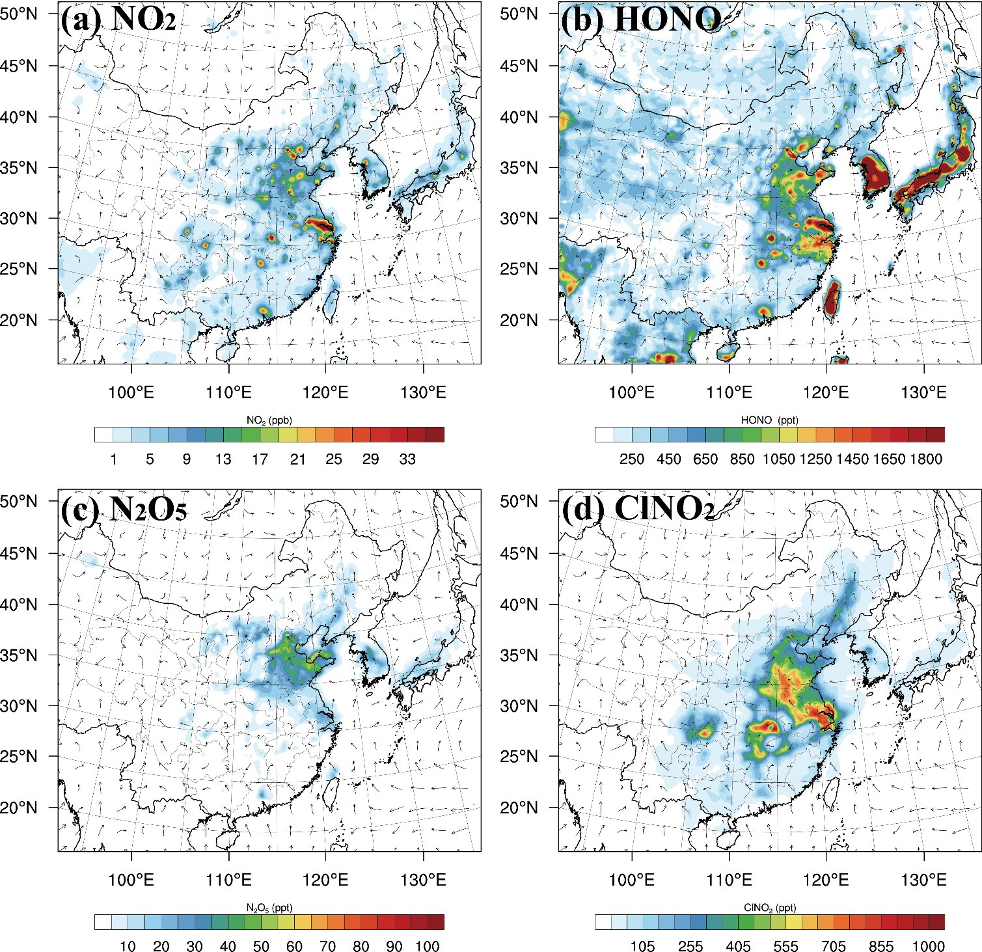
Model Performance: spatial distributions
HONO was concentrated over the NCP, YRD, and PRD regions, with levels of 800–1800 ppt at ground-level; N₂O₅ and ClNO₂ were abundant over the NCP, YRD, central China, and Sichuan Basin (where with intensive anthropogenic emissions of NO_{x} and chloride with average concentrations of 100–160 ppt and 800–1200 ppt, respectively.

Slide 20
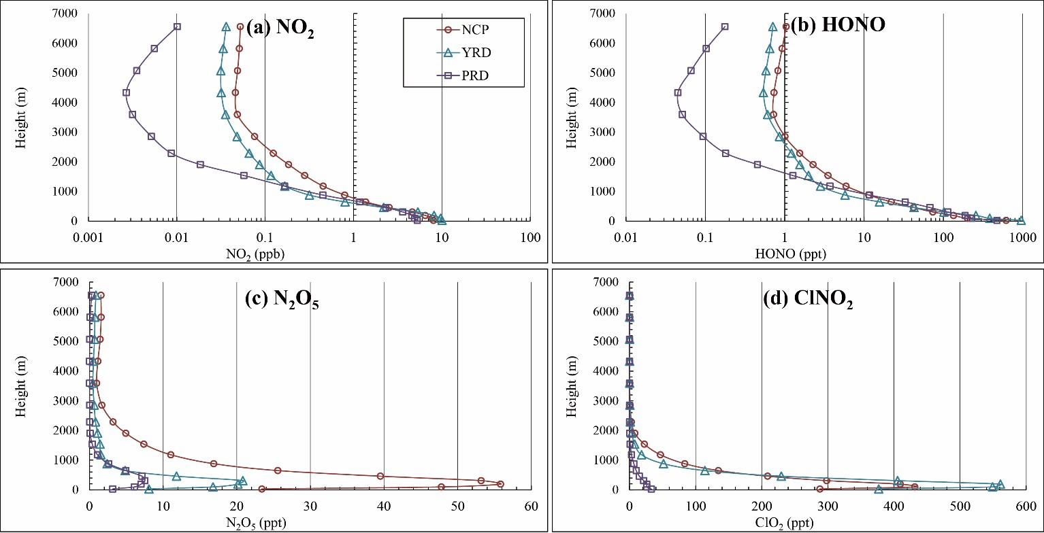
Model Performance: vertical distributions
HONO was concentrated at the surface (as its main precursor NO₂)
N₂O₅ and ClNO₂ were most abundant within the 0–600 m (its formation significantly occur within the residual layer during nighttime; downward mixing during morning)

Slide 21
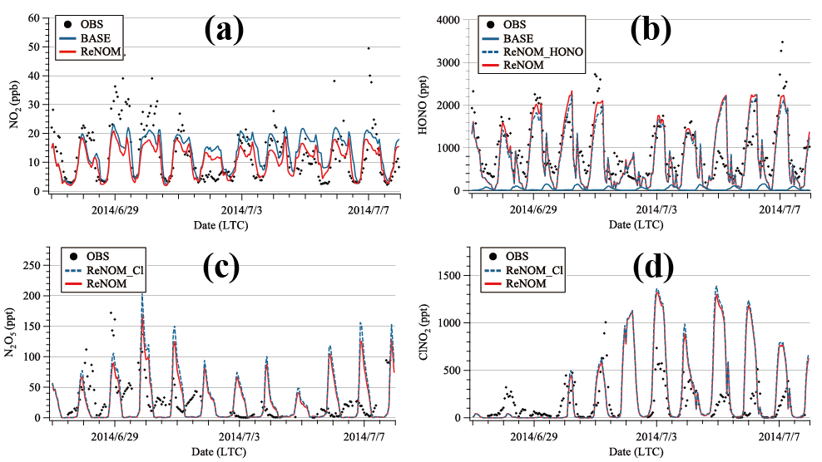
Detailed comparison against measurements in a intensive field campaign (CareBeijing 2014)
NO₂
HONO
Very good simulations of HONO (well captures the diurnal patterns and averages of the HONO observation)
N₂O₅
ClNO₂
Satisfactory performances in N2O5 and ClNO2 (overestimates during 1-7 Jun 2014 due to oversitmates in NO, incomplete consideration of sinks, and uncertainties in emission)
Figure S3. Observed and simulated (a) NO₂, (b) HONO, (c) N₂O₅ and (b) ClNO₂ at the Wangdu site during the simulation period (27 Jun - 7 Jul 2014).

Slide 22
Overall, the module offers satisfactory simulations of HONO, N₂O₅, and ClNO₂ over Asia (compared with the observations in China, Taiwan, Korea, and Japan)
Comparison against measurements in multiple regions in Asia

Slide 23
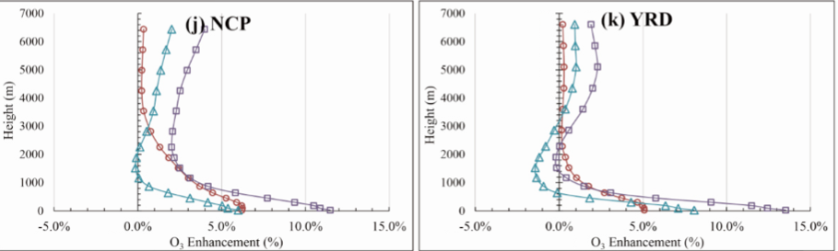

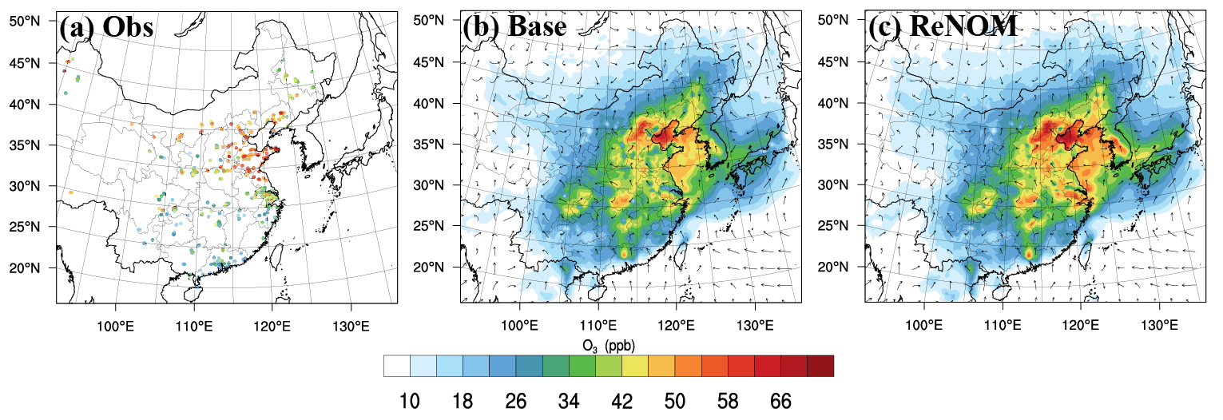
Impacts on Ozone
Noticeable impacts on lower tropospheric ozone over polluted regions in China
3-6% in PBL
6-13% at surface
Significant improvements in ozone predictions (~900 sites):
MB: -4.3 ppb --> 0.1 ppb
Zhang, L., et al., 2017, ACP, in review

Slide 24
Improvements in O₃ prediction: Statistics
Noticeably improved the predicted ozone in China, especially over the NCP and PRD
Region | Case | No. OBS | OBS | MOD | COR | MB | RMSE | NMB | NME
 | BASE | 49789 | 47.2 | 37.3 | 0.60 | -9.9 | 26.8 | -20.9% | 44.0%
 | ReNOM_Cl |  |  | 40.0 | 0.61 | -7.2 | 26.7 | -15.3% | 43.7%
NCP | ReNOM_HONO |  |  | 41.2 | 0.61 | -6.0 | 26.4 | -12.7% | 43.3%
 | ReNOM |  |  | 43.5 | 0.61 | -3.6 | 26.5 | -7.7% | 43.5%
 | BASE | 34857 | 31.5 | 36.8 | 0.56 | 5.2 | 29.3 | 16.6% | 68.2%
 | ReNOM_Cl |  |  | 39.4 | 0.56 | 7.9 | 31.9 | 25.1% | 72.7%
YRD | ReNOM_HONO |  |  | 43.3 | 0.54 | 11.8 | 34.3 | 37.3% | 77.5%
 | ReNOM |  |  | 45.3 | 0.54 | 13.8 | 36.3 | 43.8% | 81.7%
 | BASE | 15627 | 25.0 | 15.6 | 0.53 | -9.4 | 28.0 | -37.6% | 75.8%
PRD | ReNOM_Cl |  |  | 15.6 | 0.53 | -9.4 | 27.9 | -37.6% | 75.8%
 | ReNOM_HONO |  |  | 18.5 | 0.54 | -6.4 | 26.3 | -25.8% | 73.7%
 | ReNOM |  |  | 18.4 | 0.54 | -6.5 | 26.3 | -26.1% | 73.9%
 | BASE | 214596 | 35.3 | 31.0 | 0.51 | -4.3 | 27.3 | -12.2% | 57.5%
 | ReNOM_Cl |  |  | 32.6 | 0.51 | -2.8 | 28.0 | -7.8% | 58.5%
China | ReNOM_HONO |  |  | 34.1 | 0.52 | -1.2 | 26.7 | -3.5% | 56.6%
 | ReNOM |  |  | 35.5 | 0.52 | 0.1 | 26.1 | 0.4% | 55.8%
~900 stations

Slide 25
Summary
1. Introduction
2. Methodology
3. Results
4. Summary
4. Summary
We made several developments (CBMZ_ReNOM) in WRF-Chem to comprehensively consider processes/emissions of HONO and Chlorine chemistry.
ReNOM is able to satisfactorily simulate the observed HONO and ClNO₂.
ReNOM gives better predictions of O₃ in China, especially in the NCP and PRD regions.
HONO and ClNO₂ significantly enhanced the ozone pollution in China, and the combined effects of them were larger their linear sums

Slide 26
What’s Next…
To update the Chlorine Emission Inventory in China
To investigate these “new” reactive nitrogen chemistry’s impacts on ozone control strategy (VOC-limited or NOx-limited)
Impacts on PM_{2.5} (e.g. Nitrate)
More tests & Will contribute the codes to the next release of WRF-Chem (now upon request)

Slide 27
Acknowledgement
The authors are grateful to financial support from The Hong Kong Polytechnic University, the Hong Kong Research Grant Council, and the National Natural Science Foundation of China.
Thanks to Peking University for the measurement data from CareBeijing 2014 Campaign.
Thanks to Dr. Y.J. Tham at University of Helsinki and Dr. Z. Xu at Nanjing University.

Slide 28
Thanks for your attention.
L. Zhang: alex.zhang@connect.polyu.hk

Slide 29
APPENDIX

Slide 30
Reactive Nitrogen Oxides Mechanism (ReNOM)
HONO chemistry
HONO emission
NO₂ -heterogeneous
HONO Uptake
Gas-phase sources
N₂O₅ & ClNO₂ Chemistry
Chloride emission
N₂O₅ -heterogeneous
ClNO₂ production
Cl reactions
CBMZ-MOSAIC and RACM-SOA-VBS
CBMZ-ReNOM and RACM-ReNOM
Zhang et al., 2017, ACPD
Zhang et al., JGR, 2016;
Li et al., ACP, 2016

Slide 31
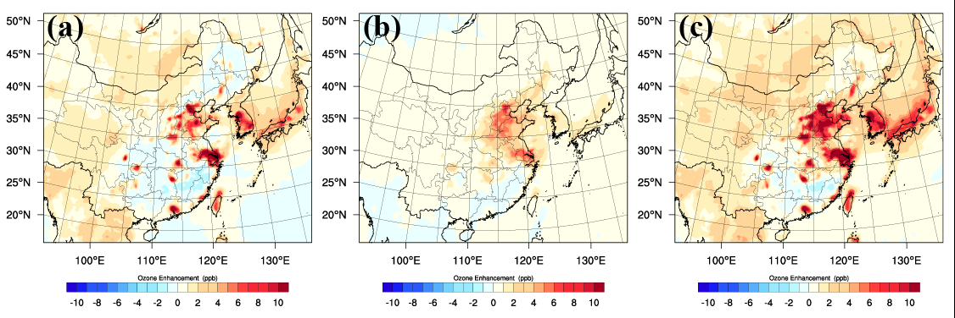
Enhancements in ground-level ozone
6-13% enhancements over polluted regions
ReNOM_HONO
ReNOM_Cl
ReNOM

Slide 32
Enhancements in ground-level ozone: statistics
Region | Case | Daily |  | 8 h Maximum |  | 1 h Maximum
 |  | Enhancement | Ratio | Enhancement | Ratio | Enhancement | Ratio
NCP | ReNOM_Cl | 0.64 | 2.3% | 0.77 | 2.1% | 0.78 | 2.0%
 | ReNOM_HONO | 1.14 | 4.1% | 1.43 | 3.8% | 1.43 | 3.7%
 | ReNOM | 1.93 | 7.0% | 2.39 | 6.4% | 2.40 | 6.3%
 | ReNOM_Cl | 0.03 | 0.2% | 0.03 | 0.2% | 0.03 | 0.2%
YRD | ReNOM_HONO | 1.33 | 9.5% | 1.78 | 9.8% | 1.86 | 10.1%
 | ReNOM | 2.13 | 15.3% | 2.89 | 15.9% | 3.03 | 16.4%
 | ReNOM_Cl | 0.02 | 0.2% | 0.02 | 0.1% | 0.02 | 0.1%
PRD | ReNOM_HONO | 1.02 | 9.6% | 1.30 | 9.9% | 1.31 | 9.9%
 | ReNOM | 1.70 | 15.9% | 2.15 | 16.3% | 2.16 | 16.3%
Whole Domain | ReNOM_Cl | 0.31 | 2.0% | 0.39 | 1.9% | 0.40 | 1.9%
 | ReNOM_HONO | 0.81 | 5.2% | 1.03 | 5.0% | 1.01 | 4.7%
 | ReNOM | 1.35 | 8.6% | 1.71 | 8.3% | 1.70 | 7.9%

Slide 33
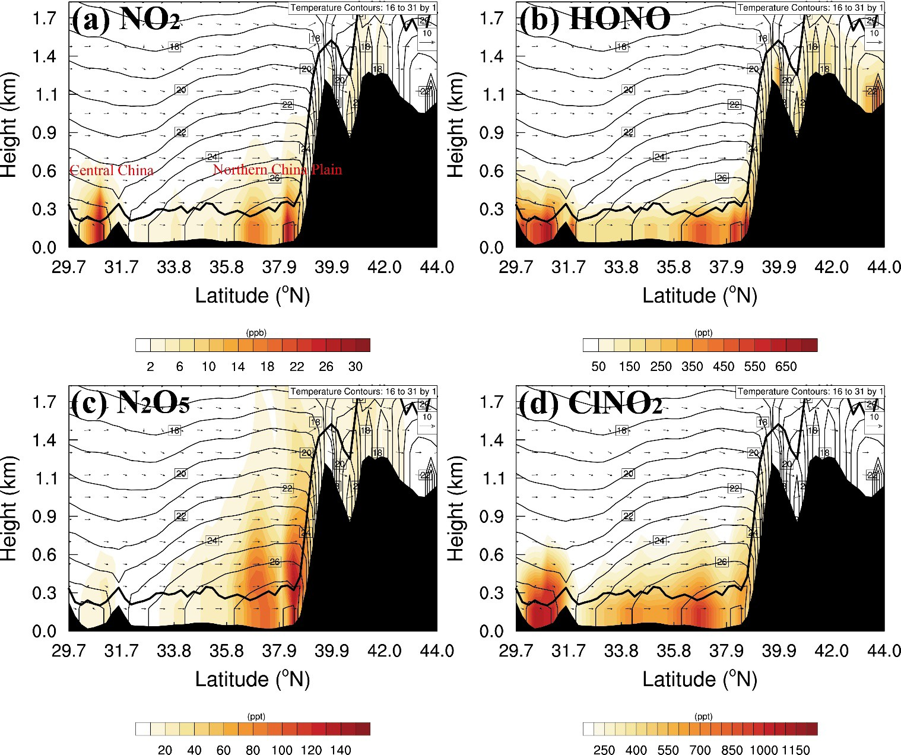

Slide 34
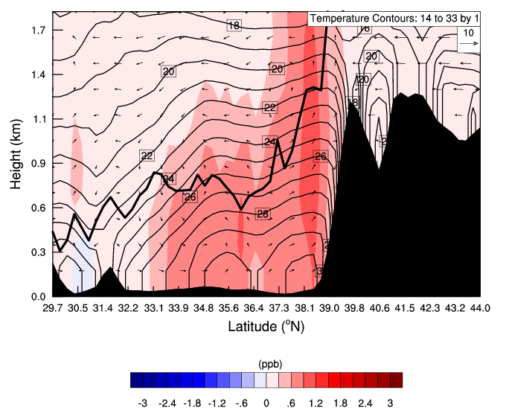
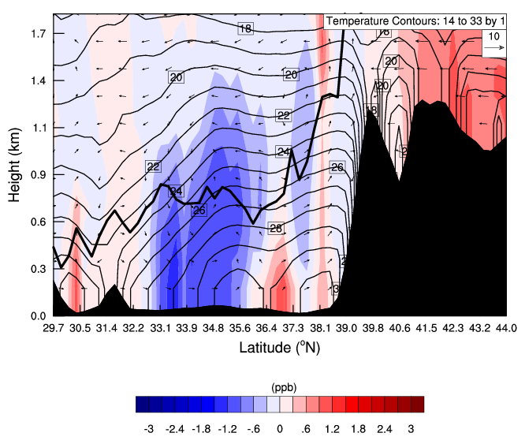
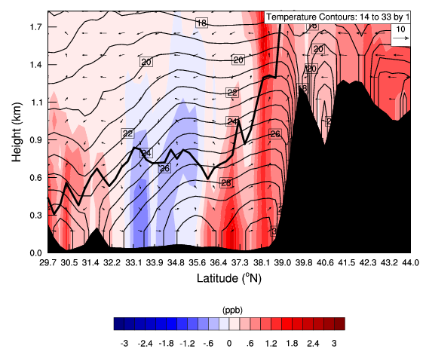
Impact on ozone: vertical distributions
ReNOM_Cl
ReNOM_HONO
ReNOM

Slide 35
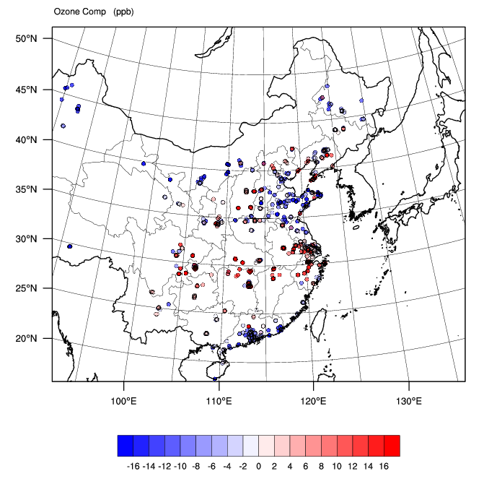
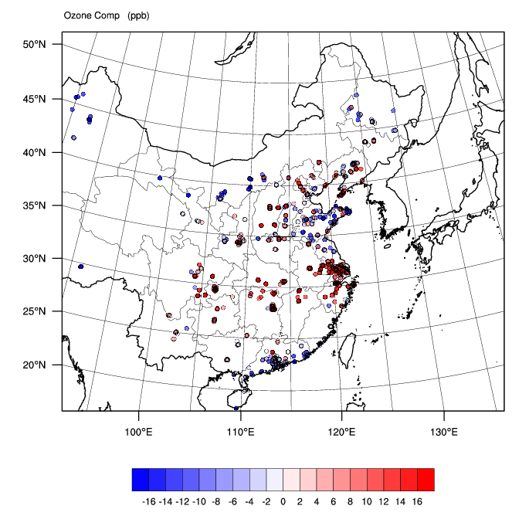
Improvements in O₃ prediction: MOD-OBS
BASE
ReNOM

Slide 36
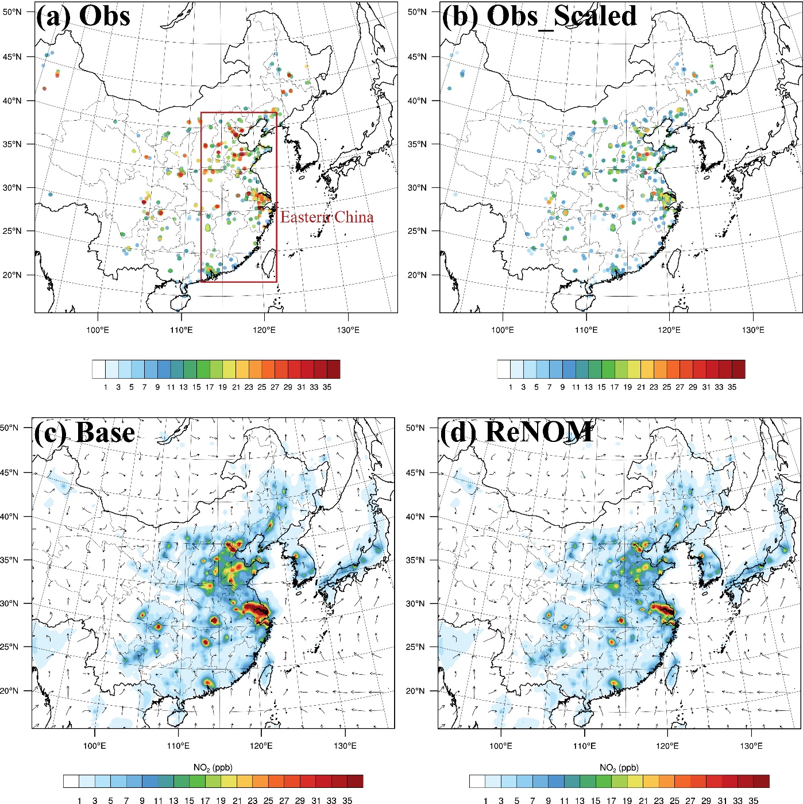
NO2 Performance

Slide 37
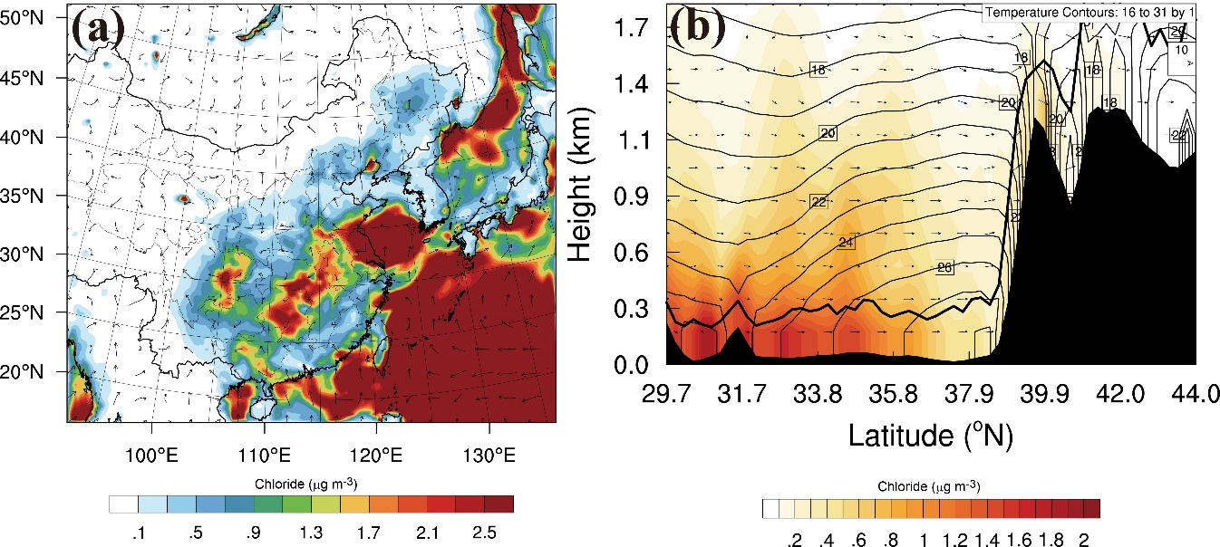
Figure S2. (a) Spatial and (b) vertical distributions of nighttime chloride (μg m⁻³) during the simulation period.

Slide 38
HONO and ClNO₂ simulation from revised WRF-Chem
Average of daily-maximum
Significant HONO (> 1ppb) over city-cluster and some rural areas
Significant ClNO₂ (> 0.3 ppb) over city-cluster and its immediate downwind area
Higher in winter than in summer. Possible causes?
Notes:
The simulated HONO from the ReNOM case concentrated (>1 ppb) in major city clusters, including Northern China Plain (NCP), Yangtze River Delta (YRD), Pearl River Delta (PRD), central China (CC) and Sichuan basin (SC) for traffic emission and heterogeneous production, and some rural areas for intensive soil emission at surface level. As to the HONO within the PBL, the WRF-Chem results showed lower concentration.
• The ClNO₂ modelled in the ReNOM case demonstrated noticeable levels (>0.3 ppb) in NCP, YRD, CC and SC regions at surface level. As for the ClNO₂ concentrations within the PBL, the ReNOM case modeled higher levels compared to those at surface.

Slide 39
Impacts on ozone
Elevated O₃ (> 70 ppb) simulated over city-clusters in summer
Significant impacts (> 10 ppb) on O₃ in both summer and winter, contributing to the formation of photochemical pollution
Higher impact in winter
Notes:
• The ReNOM case predicted elevated concentrations of O₃ and total nitrate especially in the five city clusters.
• The simulated O₃ and total nitrate at surface level were higher than those within the PBL.
• The HONO and N₂O₅ processes increased the O₃ formation in the urban area due to the extra source of OH and Cl radicals, suggesting the role of reactive nitrogen processes in the photochemical ozone pollution.
• The HONO and N₂O₅ chemistry significantly enhanced the formation of total nitrate, especially in the NCP region, which implies the potential importance of reactive nitrogen chemistry in the haze formation.

Slide 40
Implications for ozone control strategy
HONO and N₂O₅/ClNO₂ chemistry reshapes the O₃ sensitivity to the NOx and VOC emission.
Need to consider the new sources/processes of reactive nitrogen in ozone control strategy formulation.
Notes:
• With the WRF-Chem model incorporated with reactive nitrogen chemistry, the sensitivity of surface O₃ to NO_{x} emission significantly decreased in NCP, YRD, PRD, and major cities in China due to the addition of new radicals, and varied in the rural areas: increased in central China and decreased in southern China, probably due to difference of the HONO emission from soil.
• The sensitivity of O₃ to VOC emission increased in the urban area possibly attributed to the new source of OH and Cl radicals.
• The sensitivity of O₃ to NO_{x} and/or VOC emissions in a significant portion of the region will change if the reactive nitrogen chemistry is considered.

