Slide 1
WRF-Chem/DART: Introduction, Application, Verification, and Compact Phase Space
Retrievals (CPSRs)
Arthur P. Mizzi#
(mizzi@ucar.edu)
18th Annual WRF Users’ Workshop
June 12 – 14, 2017
NCAR/Center Green
Boulder, CO 80301
# NCAR/Atmospheric Chemistry Observations and Modeling Laboratory, Boulder, CO

Slide 2
WRF-Chem/DART: Introduction

Slide 3
WRF-Chem/DART
WRF-Chem/DART – a regional chemical weather forecast/ensemble data assimilation system (ensemble adjustment Kalman filter) developed by NCAR/ACOM and NCAR/IMAGe.
WRF-Chem – the Weather Research and Forecasting (WRF) model with online chemistry.
DART – the Data Assimilation Research Testbed (a flexible software environment for exploring different ensemble data assimilation methods, models, and observations).

Slide 4
WRF-Chem/DART cont.
WRF-Chem/DART:
Assimilates MOPITT and IASI CO total and partial column retrievals, IASI O₃ total and partial column retrievals (under development), OMI total column NO₂ retrievals, MODIS total column AOD retrievals, and AirNow and PANDA in situ observations.
Assimilates chemical species mixing ratios or log of mixing ratios.
Assimilates partial column retrievals as raw (RETRs), quasi-optimal (QORs), and compact phase space retrievals (CPSRs).
State variable localization to enable joint, independent, and specified correlation assimilation of meteorology and/or chemistry observations.
Uses State Augmentation Method (SAM) to obtain emission updates from assimilation of chemistry observations.

Slide 5
WRF-Chem/DART cont.
WRF-Chem/DART:
WRF-Chem/DART repository download link: https://svn-dares-dart.cgd.ucar.edu/DART/tags/wrf-chem.r11690
Sample input/output data:
Go to NCAR ftp site at ftp.ucar.edu
Go to ../pub/mmm/mizzi
Get the PANDA_REAL_TIME_DATA.tar file. This is the input data and directory structure.
Get the real_PANDA_RETR_VARLOC.tar file. This is the sample output data and directory structure.
WRF-Chem/DART Users’ Guide is not available so collaboration is recommended/necessary.

Slide 6
WRF-Chem/DART cont.
WRF-Chem/DART Applications:
Being applied to 2008 Case Study (NCAR/ACOM – Mizzi, Arellano, Edwards, and Anderson ); FRAPPE/Discover AQ (NCAR/ACOM – Mizzi, Pfister, and Edwards; UC-Berkley – Cohen and Liu), and PANDA (NCAR/ACOM – Mizzi, MPI-M – Brasseur and Bouarar, and Nanjing Univ. – Wang).
2008 Case Study – CONUS domain with western extension; 100 km (101x41x34) resolution; June 1 – June 30, 2008; 20-member ensemble; assimilate MOPITT and IASI CO as RETRs and CPRs and MODIS AOD as RETRs; real time scripting.
FRAPPE/Discover AQ – Western US nested domain with 15 km (180x140x37) and 3 km (321x291x37) resolutions; data assimilation on coarse grid; July 14 – August 3, 2014; 30-member ensemble; assimilate MOPITT CO as RETRs; real time scripting.

Slide 7
WRF-Chem/DART cont.
WRF-Chem/DART cont:
KORUS AQ –Korea/Southeast Asia nested domain with 15 km (140x140x37) and 3 km (231x231x37) resolutions; data assimilation on coarse grid; April 20 – June 14, 2016; 20-member ensemble; assimilate MOPITT CO and MODIS AOD; real time scripting.
PANDA – Central and East Asia nested domain with 60 km (150x112x37) and 20 km (148x157x37) resolutions; 10-member ensemble; assimilation on coarse grid; quasi-real time; assimilate MOPITT (development and testing).

Slide 8
FRAPPE Application (Assimilate MOPITT CO as RETRs, AirNow CO and O3 in situ observations, and emissions adjustment)

Slide 9
FRAPPE Application
July 2014

Slide 10
FRAPPE Application (MOPITT CO RETRs)
July 21, 2014 18 UTC
Met Ex
RETR Ex
Met Ex – RETR Ex

Slide 11
FRAPPE Application (MOPITT CO RETRs)
July 20, 2014 18 UTC
RETR Ex
No State Variable Loc
No Loc and Adj Emiss

Slide 12
FRAPPE (MOPITT CO RETRs)
July 20, 2014 18 UTC
RETR Ex
No State Variable Loc
No Loc and Adj Emiss

Slide 13
FRAPPE (MOPITT CO and AirNow CO, O3)
July 20, 2014 18 UTC
No State Variable Loc
In Situ
No Loc and In Situ

Slide 14
FRAPPE (MOPITT CO and AirNow CO, O3)
July 20, 2014 18 UTC
No State Variable Loc
In Situ
No Loc and In Situ

Slide 15
KORUS Application (Assimilate MOPITT CO and MODIS AOD)

Slide 16
KORUS (MODIS AOD)
May 25, 2016 06 UTC
Assimilated species
Interspecies
adjustment
Emissions
adjustment

Slide 17
Compact Phase Space Retrievals (CPRS): Full Retrieval Profiles

Slide 18
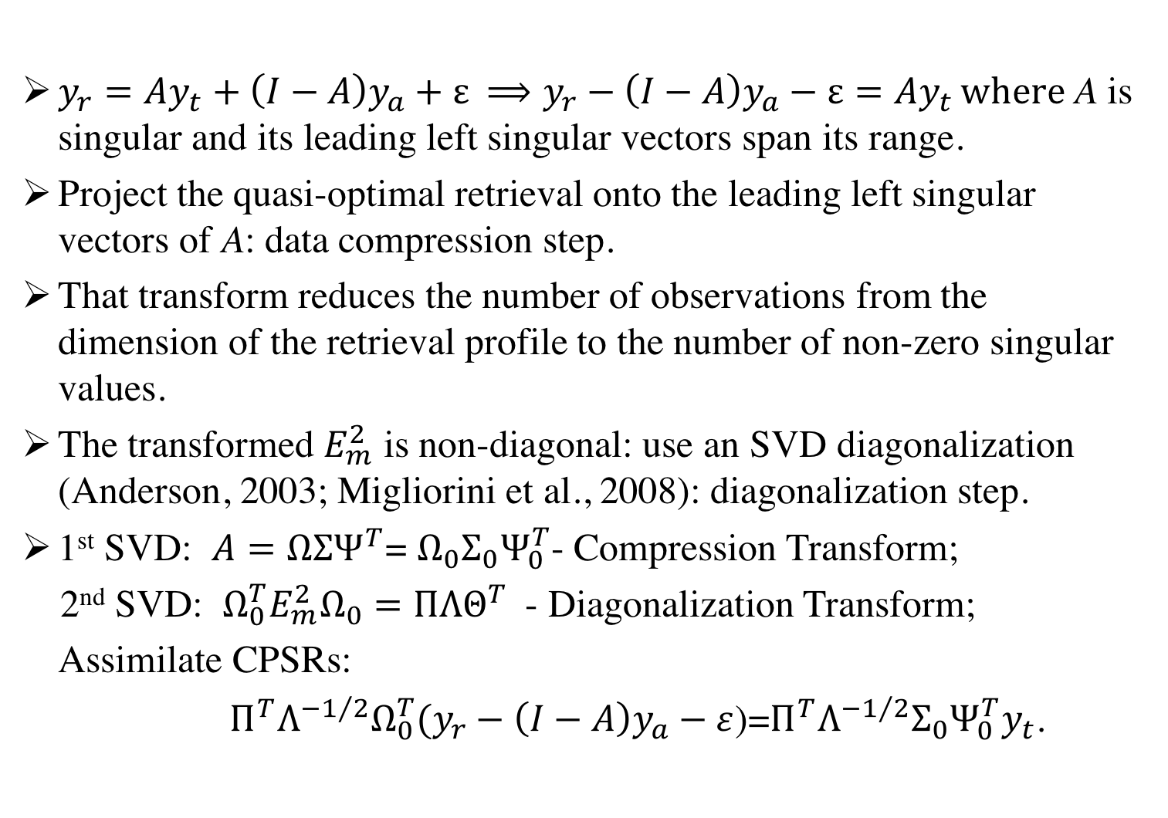
CPSRs: Full Retrieval Profiles
$y_{r}=Ay_{t}+\left(I−A\right)y_{a}+ε{ ⟹y}_{r}−\left(I−A\right)y_{a}−ε=Ay_{t }where$A is singular and its leading left singular vectors span its range.
Project the quasi-optimal retrieval onto the leading left singular vectors of A: data compression step.
That transform reduces the number of observations from the dimension of the retrieval profile to the number of non-zero singular values.
The transformed $E_{m}^{2}$ is non-diagonal: use an SVD diagonalization (Anderson, 2003; Migliorini et al., 2008): diagonalization step.
1st SVD: $A=ΩΣΨ^{T}$= $Ω_{0}Σ_{0}Ψ_{0}^{T}$- Compression Transform;
2nd SVD: $Ω_{0}^{T}E_{m}^{2}Ω_{0}=ΠΛΘ^{T}$ - Diagonalization Transform;
Assimilate CPSRs:
$Π^{T}Λ^{{−1}/2}Ω_{0}^{T}(y_{r}−\left(I−A\right)y_{a}−ε$)=$Π^{T}Λ^{{−1}/2}Σ_{0}Ψ_{0}^{T}y_{t}$.
18

Slide 19
2008 Case Study: Forecast Verification
Bias
Near-surface
insensitivity

Slide 20
Vertical Profiles (Full Retrieval Profiles)
Bias
Near-surface
insensitivity

Slide 21
Why do CPSRs loose near- surface sensitivity?

Slide 22
Dependence on DOFs
All
Left
Center
Right

Slide 23
Dependence on DOFS
All
Left
Center
Right

Slide 24
Summary and Conclusions

Slide 25
Summary and Conclusions
Presented an introduction to and summary of the current status of WRF-Chem/DART - a regional, quasi-real-time chemical weather forecast/ensemble data assimilation system.
Present results from the application of WRF-Chem/DART to: (i) 2008 Case Study, (ii) FRAPPE/Discover AQ, and (iii) KORUS AQ. Those results show that:
Assimilation of CO RETRs improved analysis fit and forecast skill when compared to not assimilating chemistry observations when compared to independent observations (in situ and retrievals)
Assimilation of CO CPSRs improved fit/skill when compared to assimilating CO RETRs at reduced computational costs when compared to independent observations (in situ and retrievals).
When we allowed interspecies adjustments (assimilation of observed chemical species adjusted unobserved chemical species) and turned off state variable localization (meteorological observations adjusted chemical species and vice versa) we obtained reasonable/consistent analyses and increments (not verified).

Slide 26
Summary and Conclusions cont.
When we turned on emissions adjustments we found reasonable/consistent adjustments to the analyses (not verified).
Introduced/discussed ”compact phase space retrievals” (CPSRs) as applied to full and truncated partial-column retrieval profiles.
Used an analysis of the compressed and rotated averaging kernels to explain why the assimilation of MOPITT CO showed little-to-no adjustment in the lower troposphere for CPSRs in the 2008 Case Study.

Slide 27
References
Mizzi, A. P., A. F. Arellano, D. P. Edwards, J.L. Anderson, and G. G. Pfister: Assimilating compact phase space retrievals of atmospheric composition with WRF-Chem/DART: A regional chemical transport/ensemble Kalman filter data assimilation system. Geosci. Model Dev., 9, 1-14, 2016.
Mizzi, A. P., D. P. Edwards, and J. L. Anderson: Assimilating compact phase space retrievals (CPSRs): Comparison with independent observations (MOZAIC in situ and IASI retrievals) and extension to assimilation of retrieval partial profiles. [under internal review], 2017a.
Mizzi, A. P., X. Liu, A. F. Arellano, J. Liang, R. C. Cohen, Y. Chen, D. P. Edwards, and J. L. Anderson: Assimilating compact phase space retrievals (CPSRs): Joint assimilation of MOPITT and IASI CO as CPSRs and MODIS AOD as raw retrievals with constrained emissions. [in preparation], 2017b.

Slide 28
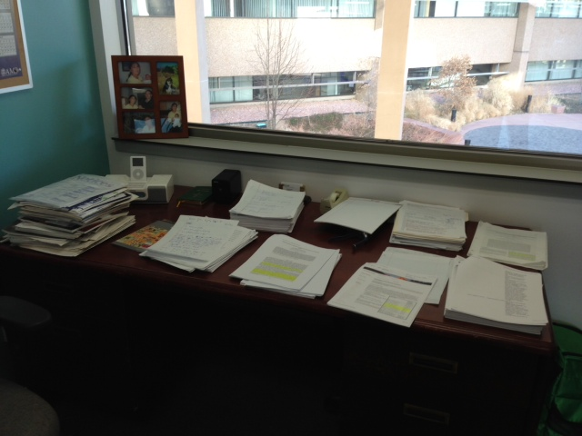
Questions ?

Slide 29
Addressing the Bias: Extension of Compact Phase Space Retrievals (CPRS): Truncated Retrieval Profiles

Slide 30
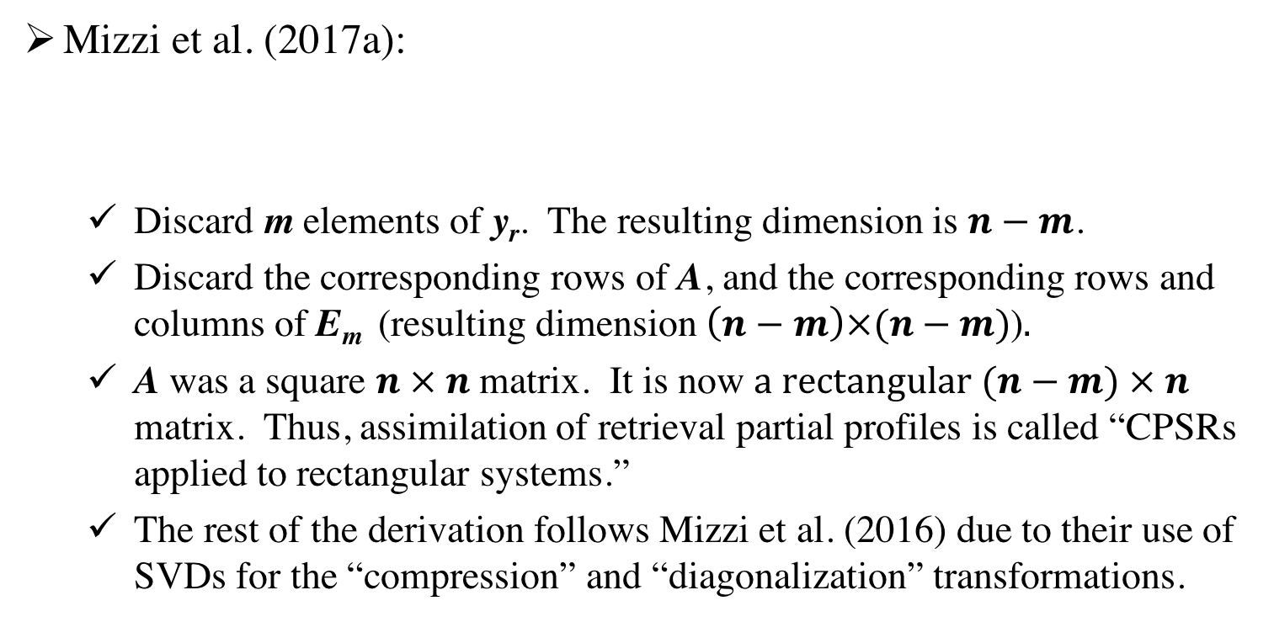
CPSRs: Extension to Truncated Retrieval Profiles
Mizzi et al. (2017a):
Discard m elements of y_{r}. The resulting dimension is $n−m$.
Discard the corresponding rows of A, and the corresponding rows and columns of E_{m} (resulting dimension $\left(n−m\right)×(n−m)$)$.$
A was a square $n × n$matrix. It is now $a rectangular (n−m) × n$ matrix. Thus, assimilation of retrieval partial profiles is called “CPSRs applied to rectangular systems.”
The rest of the derivation follows Mizzi et al. (2016) due to their use of SVDs for the “compression” and “diagonalization” transformations.
$$y_{r}−\left(I−A\right)y_{a}−ε=Ay_{t}$$

Slide 31
Vertical Profiles (Truncated Retrieval Profiles)

