Slide 1



Assimilation of Microwave Hydrometeor Retrievals and All-Sky Radiances in HWRF
Ting-Chi Wuª, Milija Zupanskiª, Louie Grassoª,
Chris Kummerow^{ab}, and Sid-Ahmed Boukabara^{c}
ªCooperative Institute for Research in the Atmosphere/Colorado State University
^{b}Department of Atmospheric Science/Colorado State University
^{c}NOAA/Center for Satellite Applications and Research
18th Annual WRF User’s Workshop, June 15, 2017, Boulder, CO

Slide 2
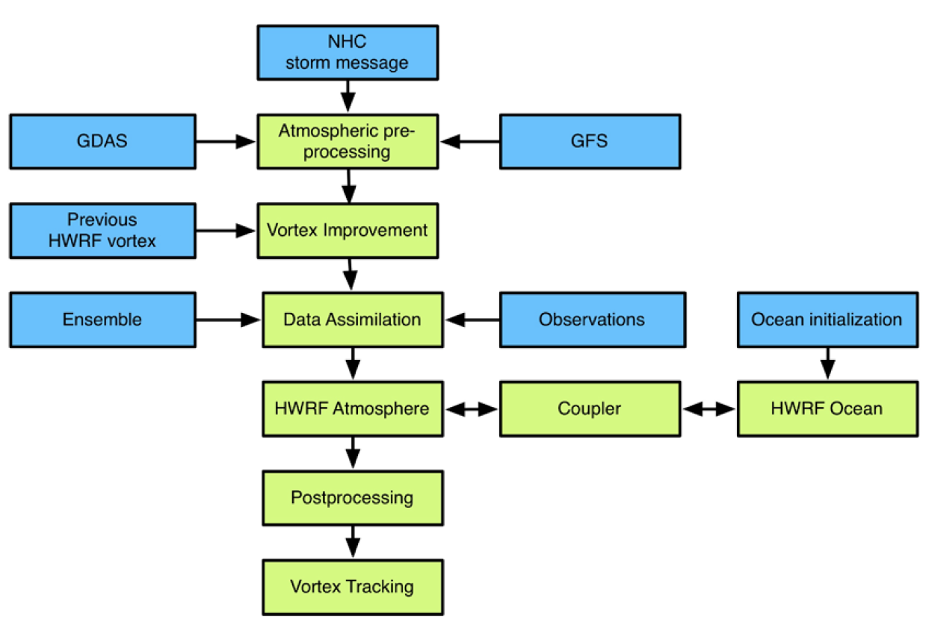

Hurricane WRF (HWRF) v3.7a System
v3.7a is functionally equivalent to
the 2015 operational version
or Vortex initialization / Vortex relocation
GSI: Gridpoint Statistical Interpolation
WRF NMM core
HWRF employs
the hybrid 3DEnVar GSI
20 % static + 80 % ensemble
background error covariance
HWRF Scientific Document
Tallapragada et al. (2015)

Slide 3
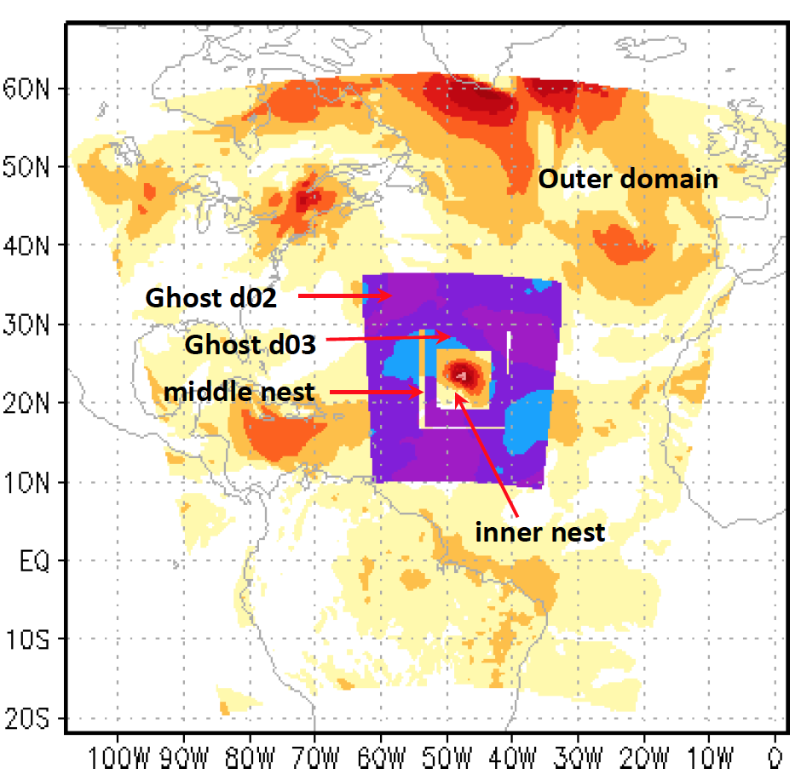
HWRF Configuration (v3.7a)
Domain (Δx) | Domain size | Data assimilation | Conv. observation assimilated | Satellite radiance assimilated
D01 (18 km) | 216 x 432 | Inherit from GDAS | - | -
ghost d02 (6km) | 166 x 336 | Hybrid 3DEnVar GSI | Yes | Clear sky only
ghost d03 (2km) | 250 x 500 | Hybrid 3DEnVar GSI | Yes | -
d01
d02
d03
60 vertical levels
Model top pressure = 2 mb
FGAT: -3 h, 0 h, +3 h
The Community Radiative Transfer Model
HWRF Scientific Document
Tallapragada et al. (2015)
To increase the utility of satellite observations in the core of hurricanes, we extends the HWRF-GSI capability to assimilate precipitation-affected data that includes microwave satellite retrievals and radiances.

Slide 4
Microwave Hydrometeor Retrievals
Hurricane GPROF

Slide 5
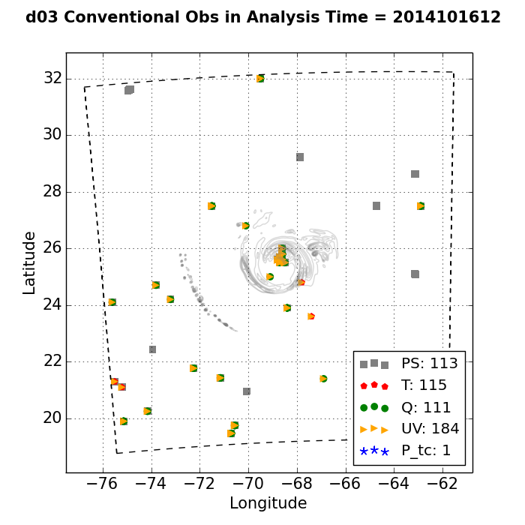
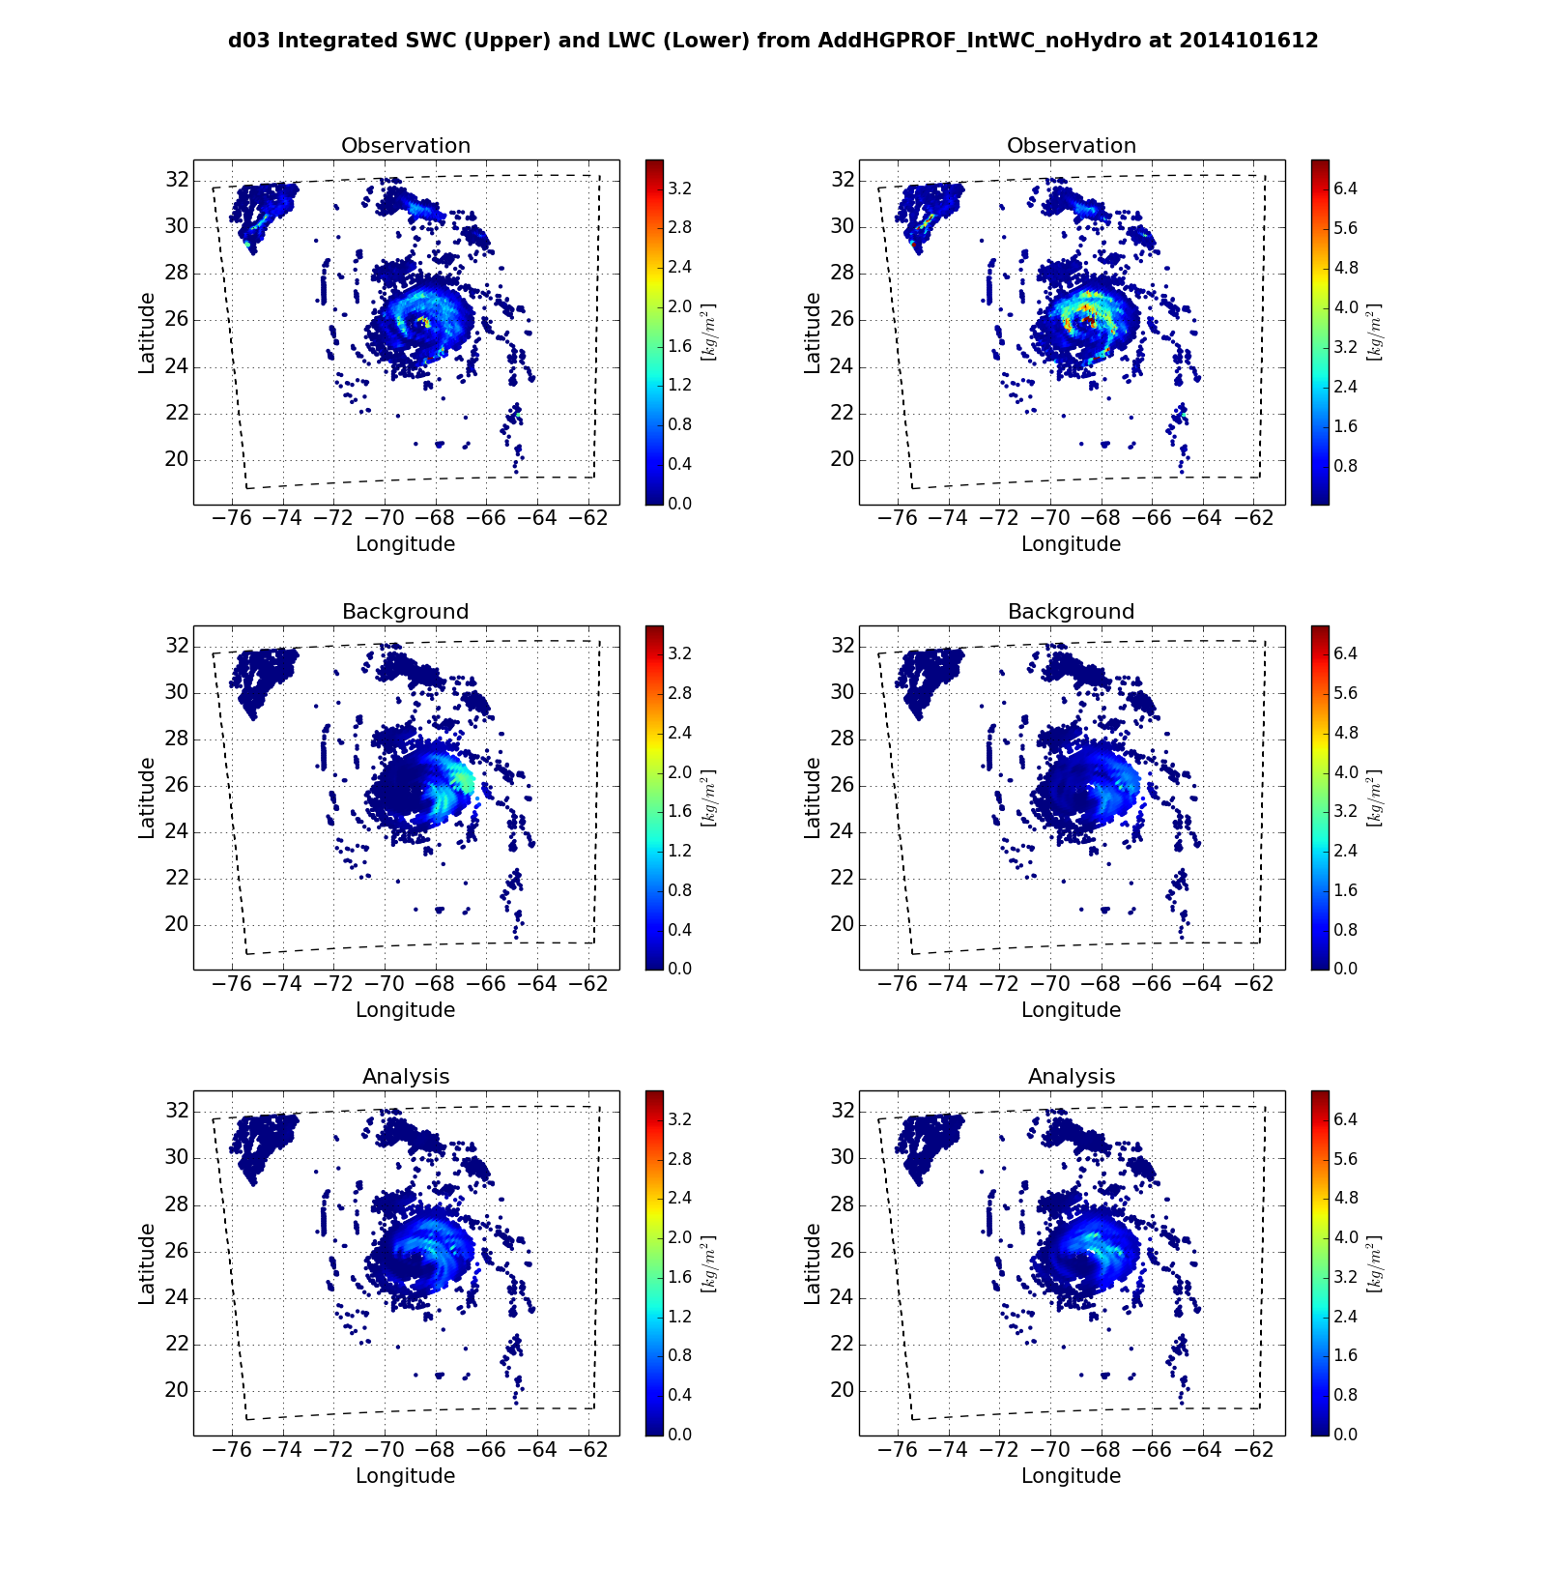
Hurricane GPROF
A hurricane-specific microwave retrieval that utilizes data from GMI/TMI and HURDAT2 info (Brown et al. 2016)
Provides retrieved instantaneous rain rates and hydrometeor profiles (cloud water, rain, mixed-phase, and ice)
Transformed into two vertically integrated quantities to be assimilated into HWRF:
  Integrated solid-water content (SWC) in kg m⁻²
  Integrated liquid-water content (LWC) in kg m⁻²
Conventional Obs
Integrated SWC
Integrated LWC
ghost d03
ghost d03
ghost d03

Slide 6
Choices for Observation Operator:
  Use current set of control variables that includes T, P, and q and assume super-saturated water vapor will condense out:
  Add cloud condensate control/state variables:
Integrated SWC
Integrated LWC
Wu et al. (2016)
HWRF uses Ferrier-Aligo microphysics scheme, prognostic microphysical variable is total cloud condensate mass (aka CWM) instead of individual hydrometeor species.
Also need to address the decomposition of CWM into individual hydrometeor
Wu and Zupanski (2017)

Slide 7
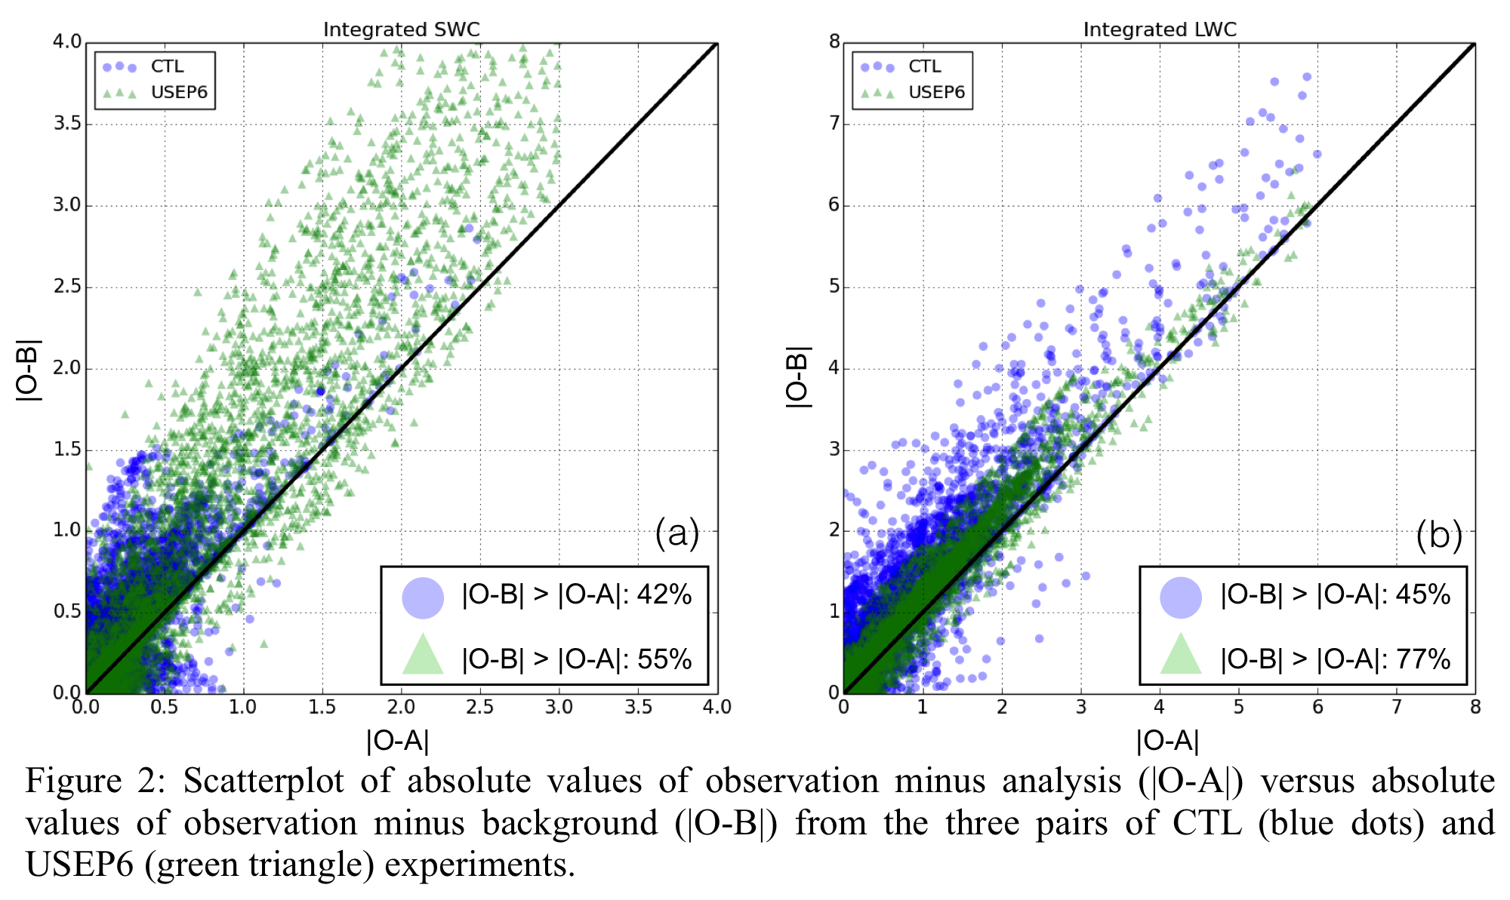
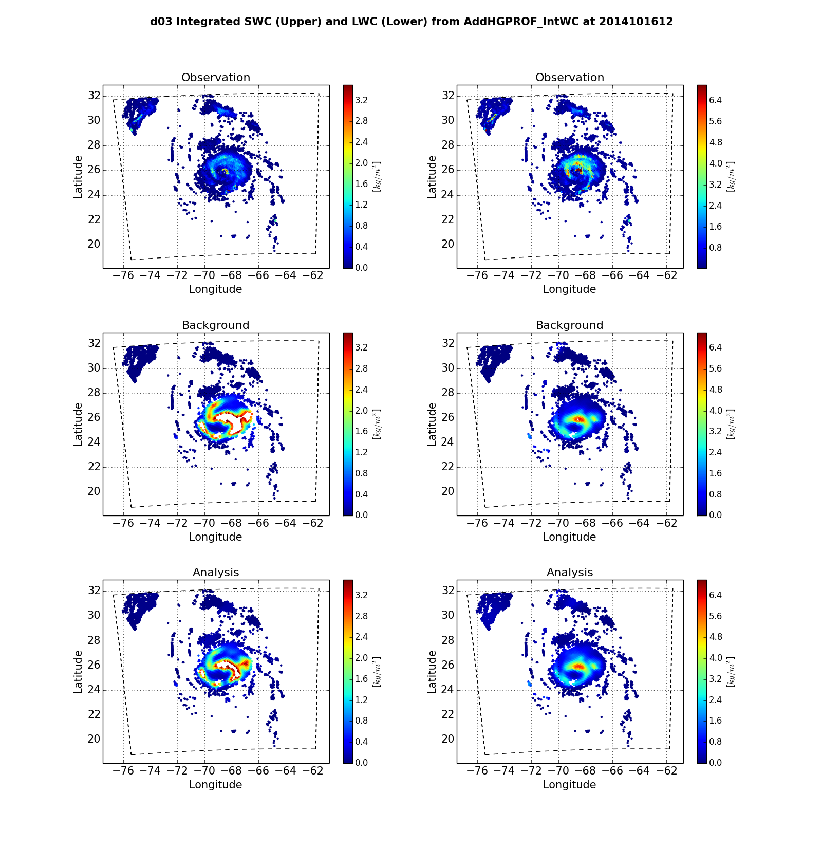
Integrated LWC
Hurricane Gonzalo (2014)
2014/10/16 1200 UTC
ghost d03
Operator a): values of liquid water contents are generally lower than observed
Operator b): background values of liquid water contents are comparable to observations

Slide 8
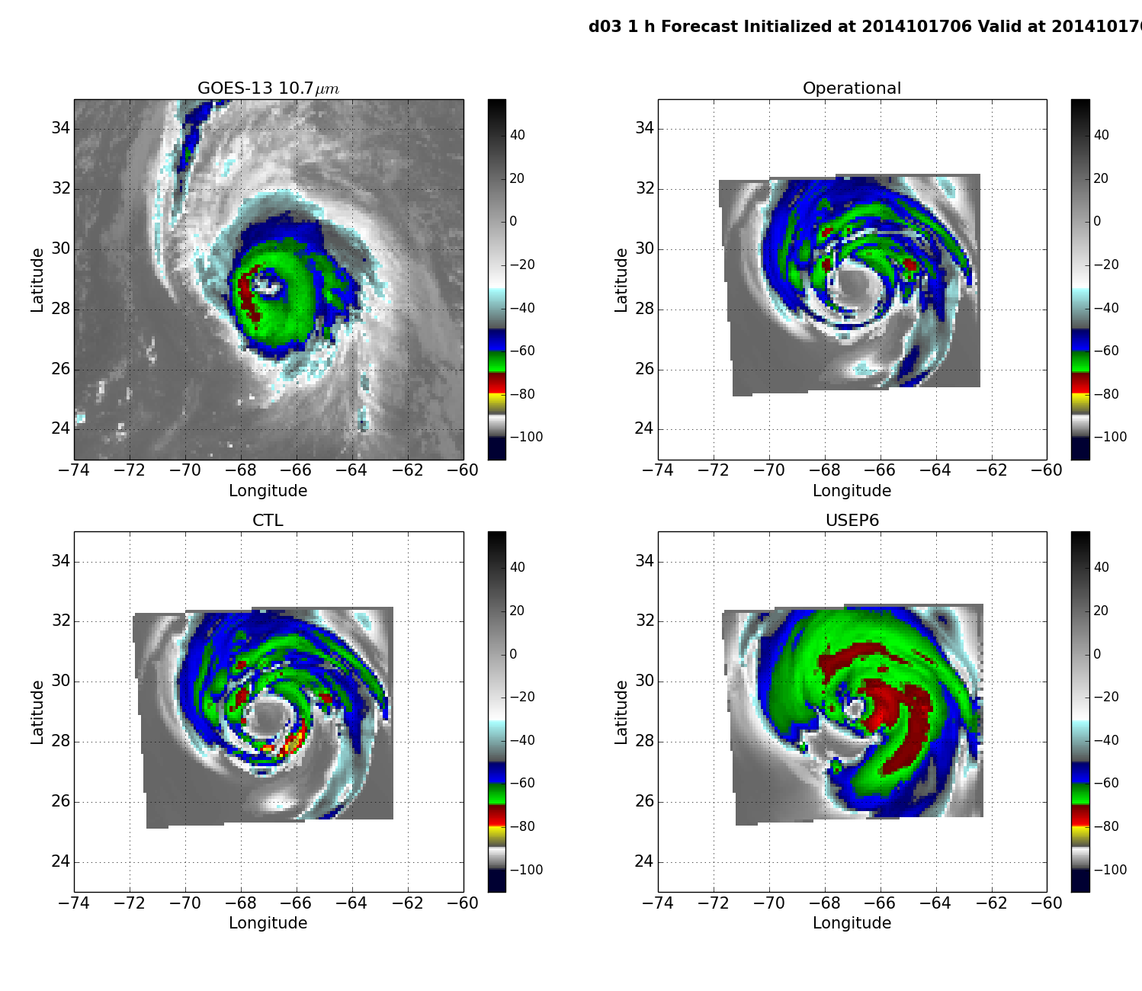
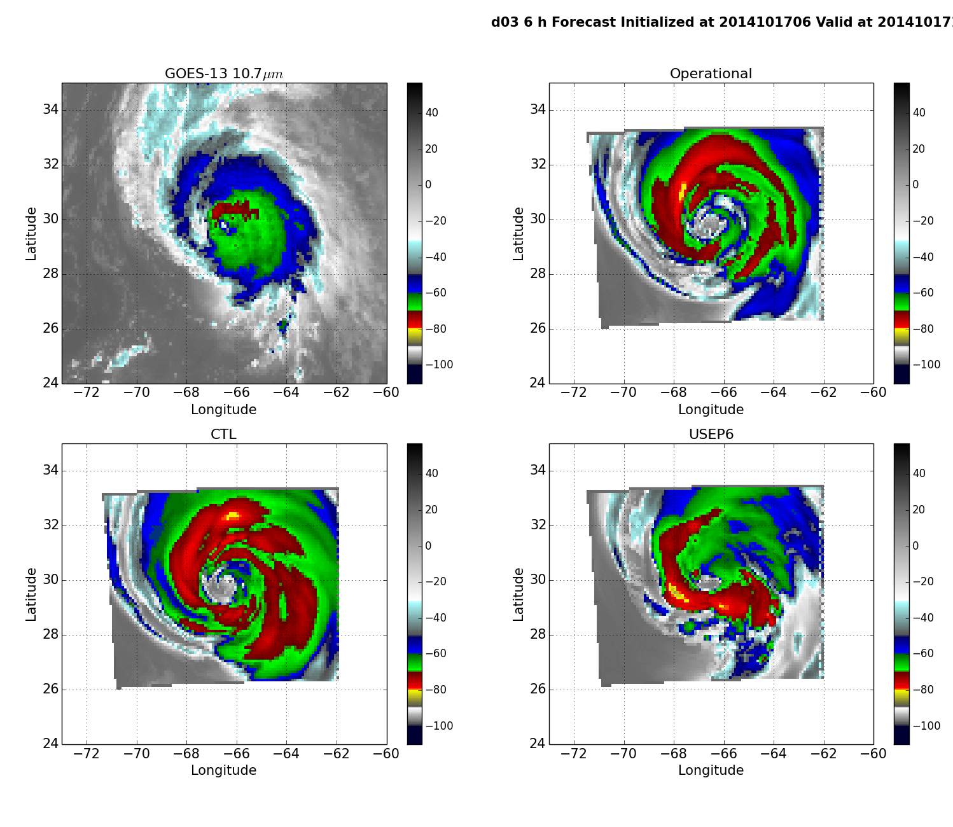
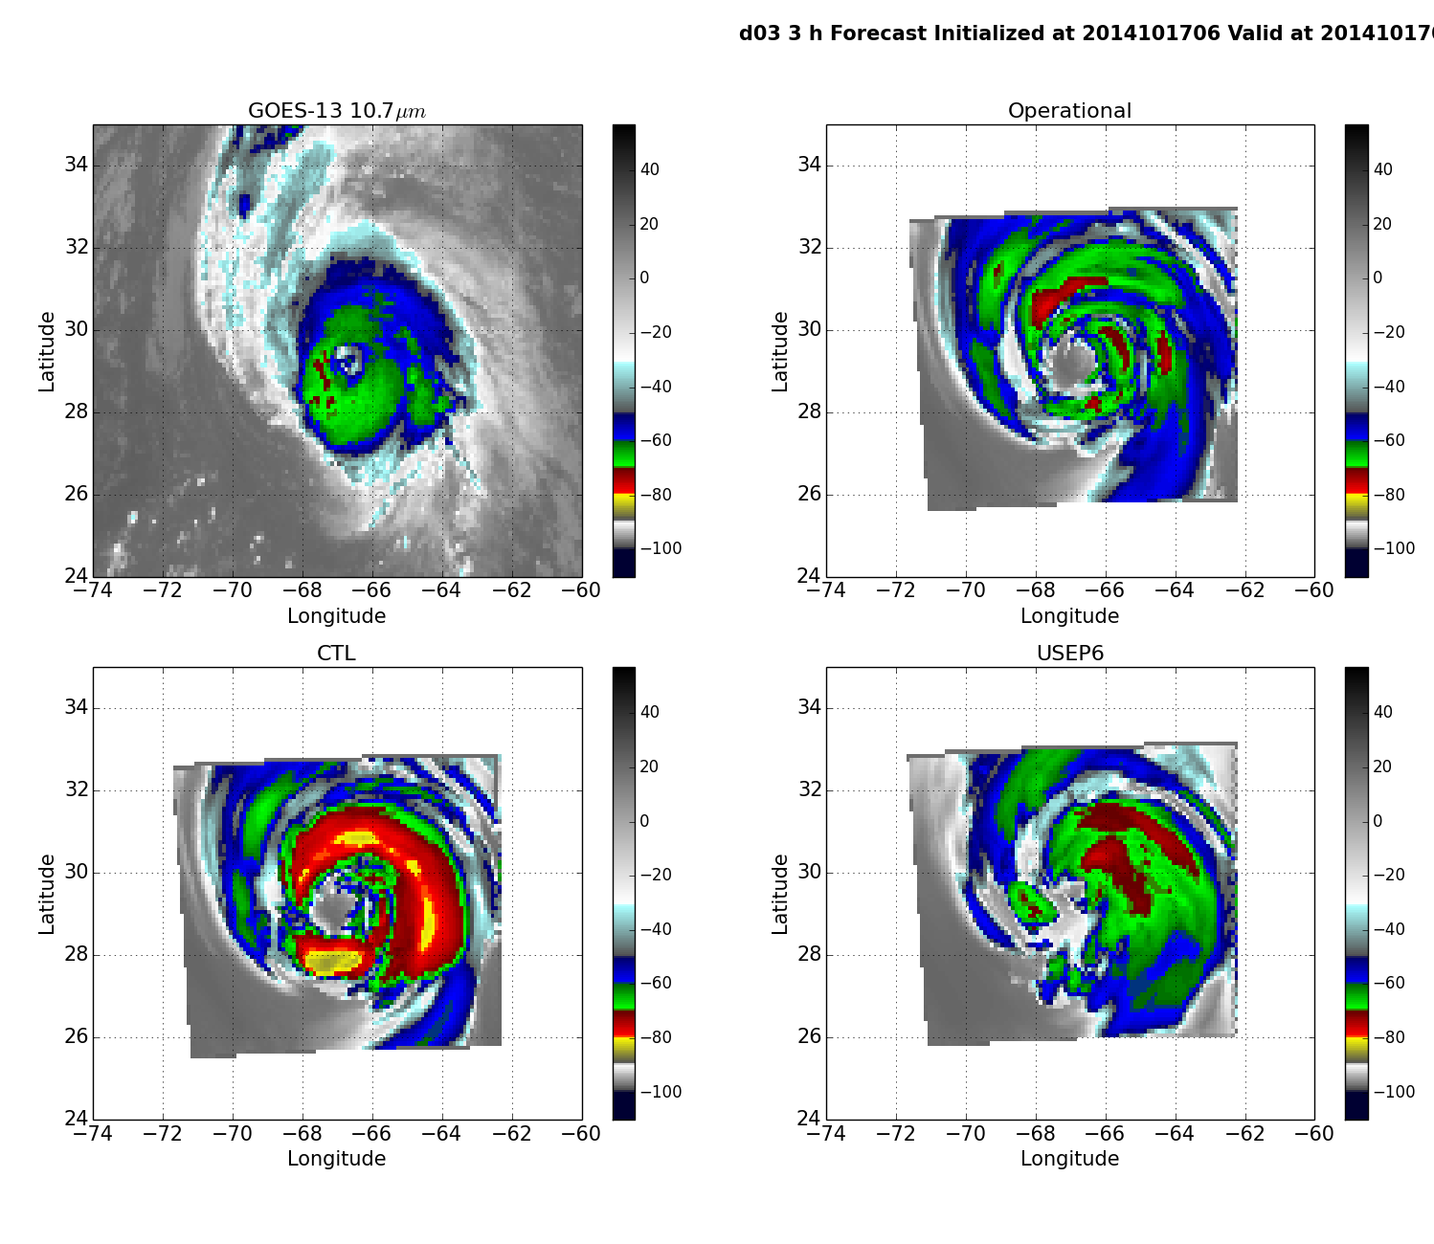
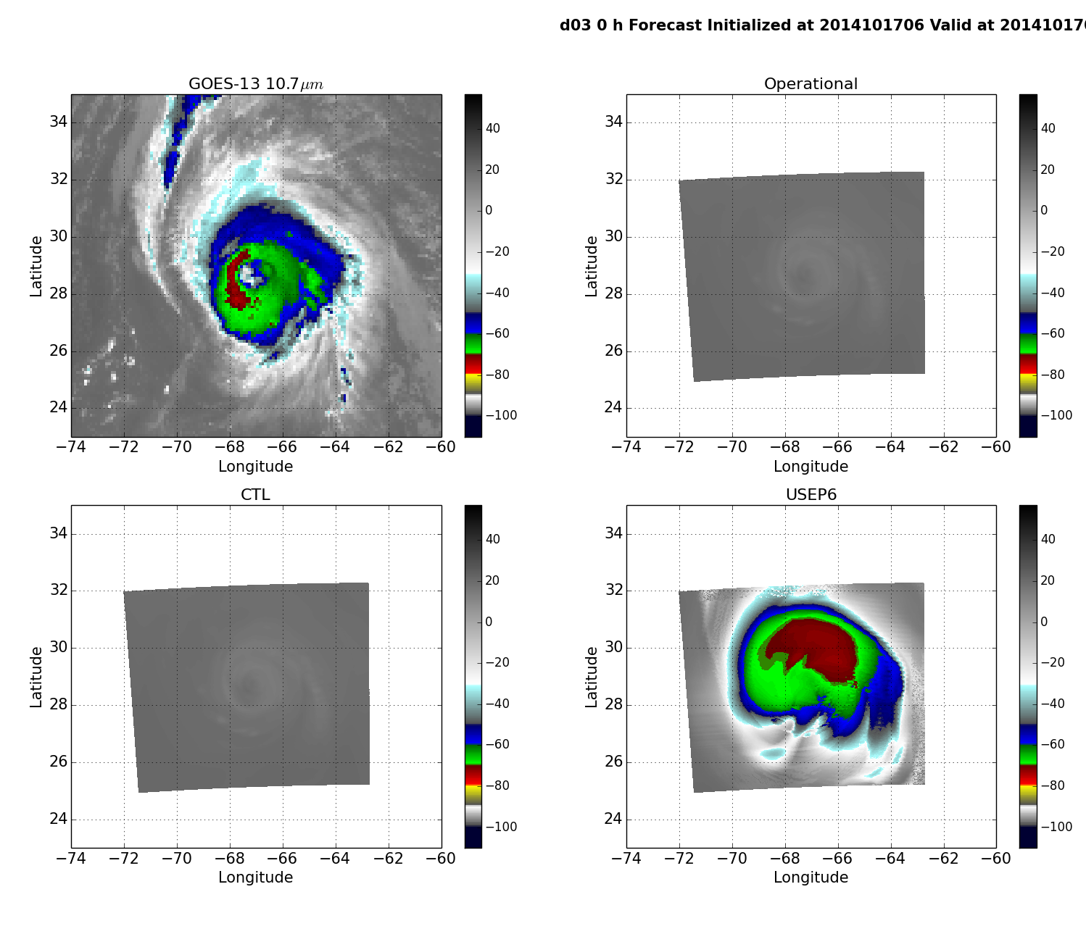
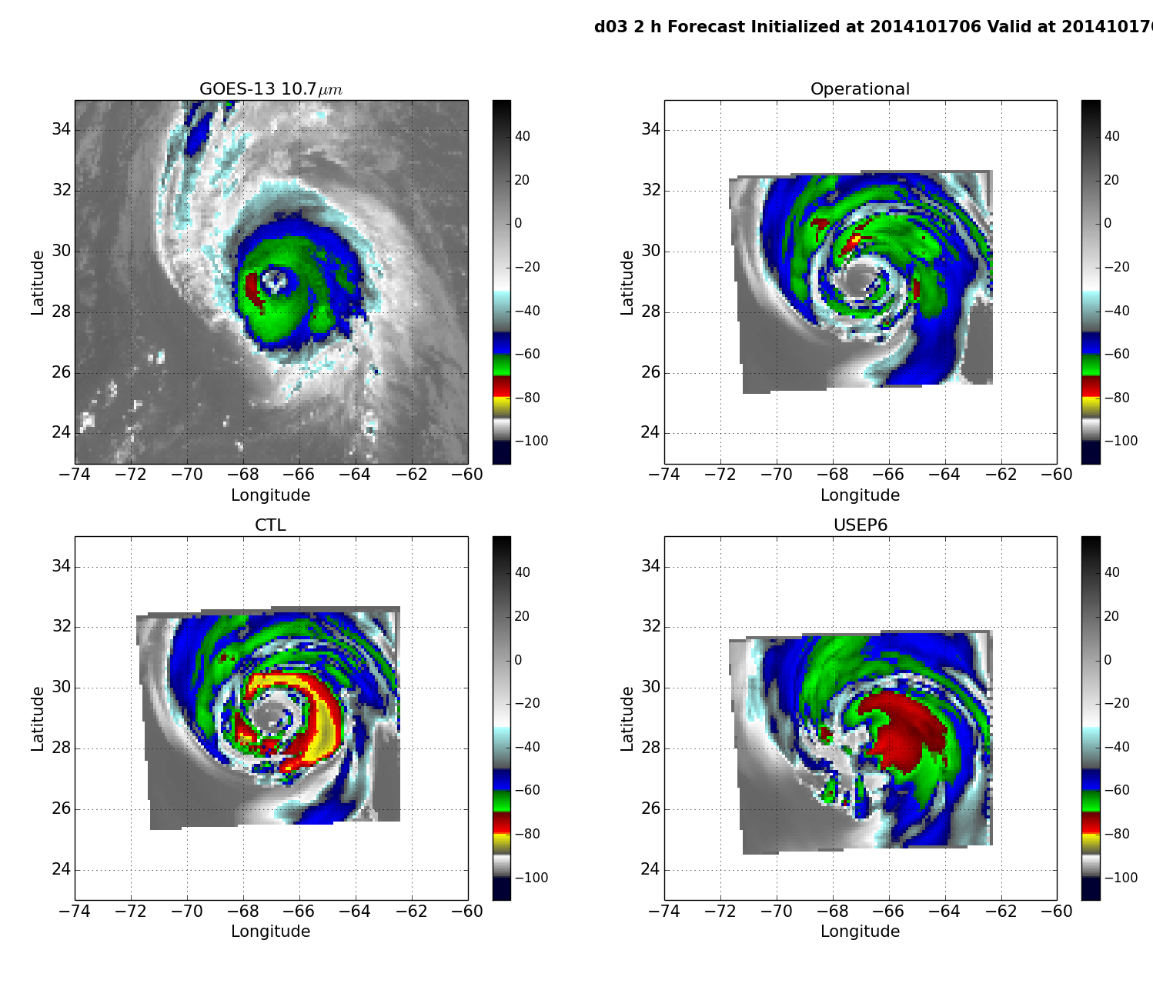
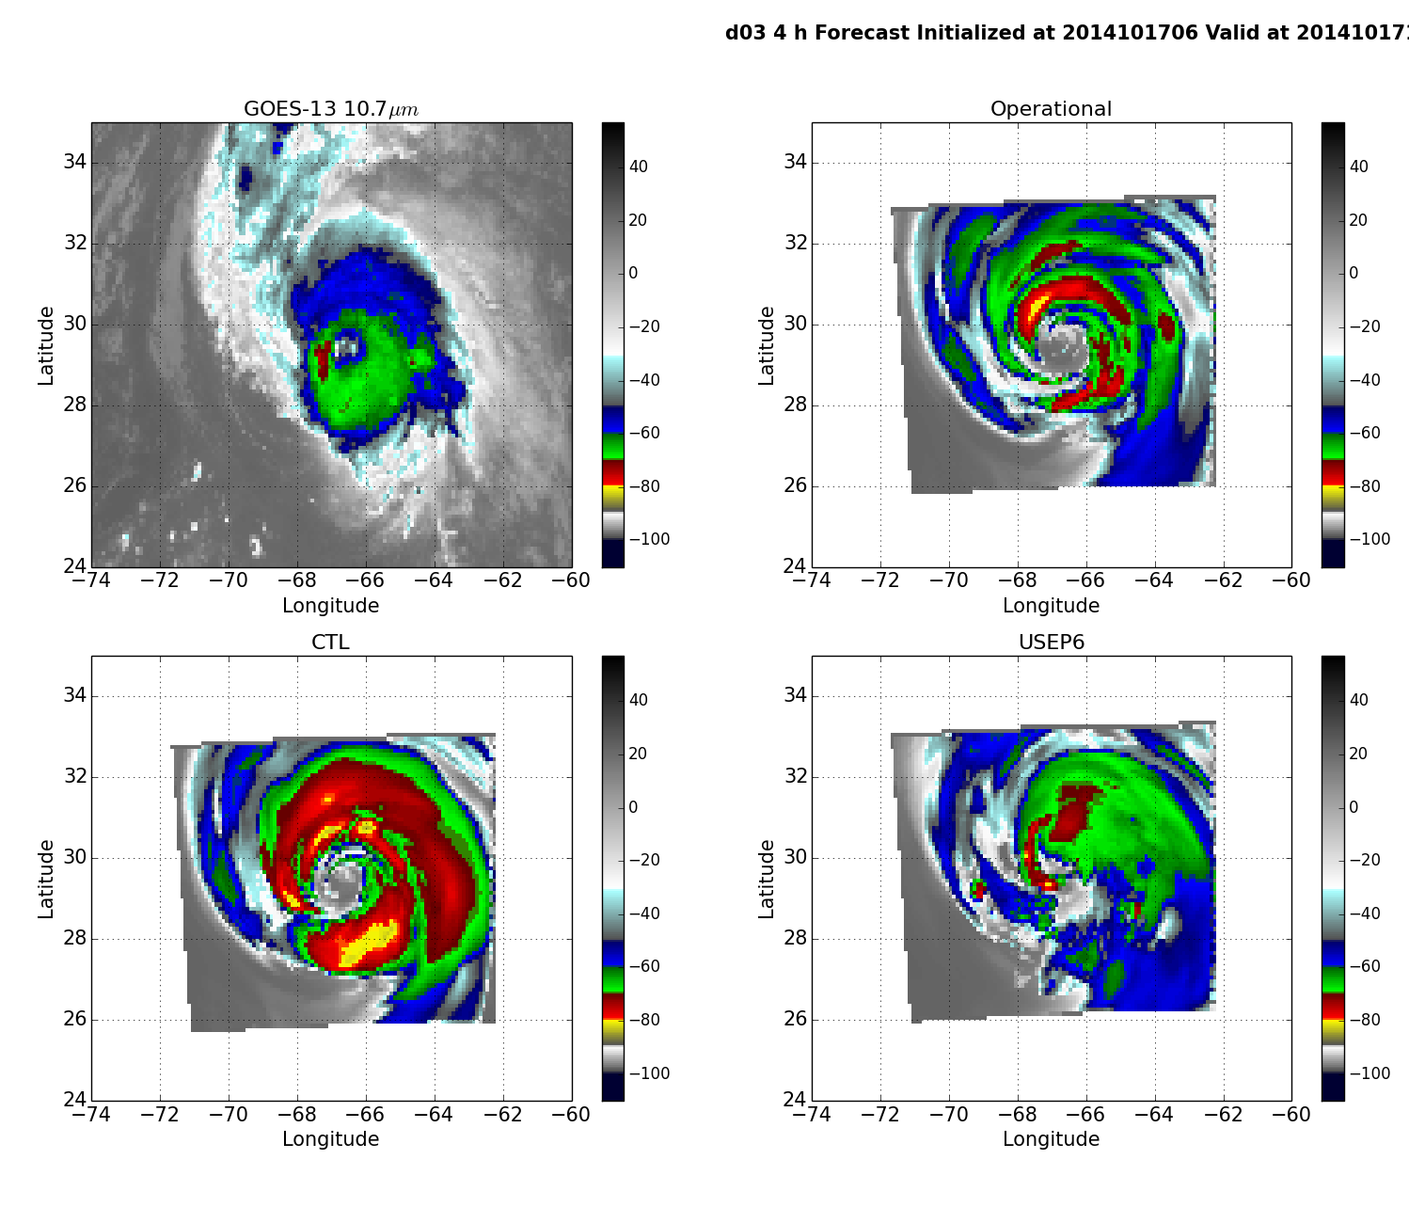
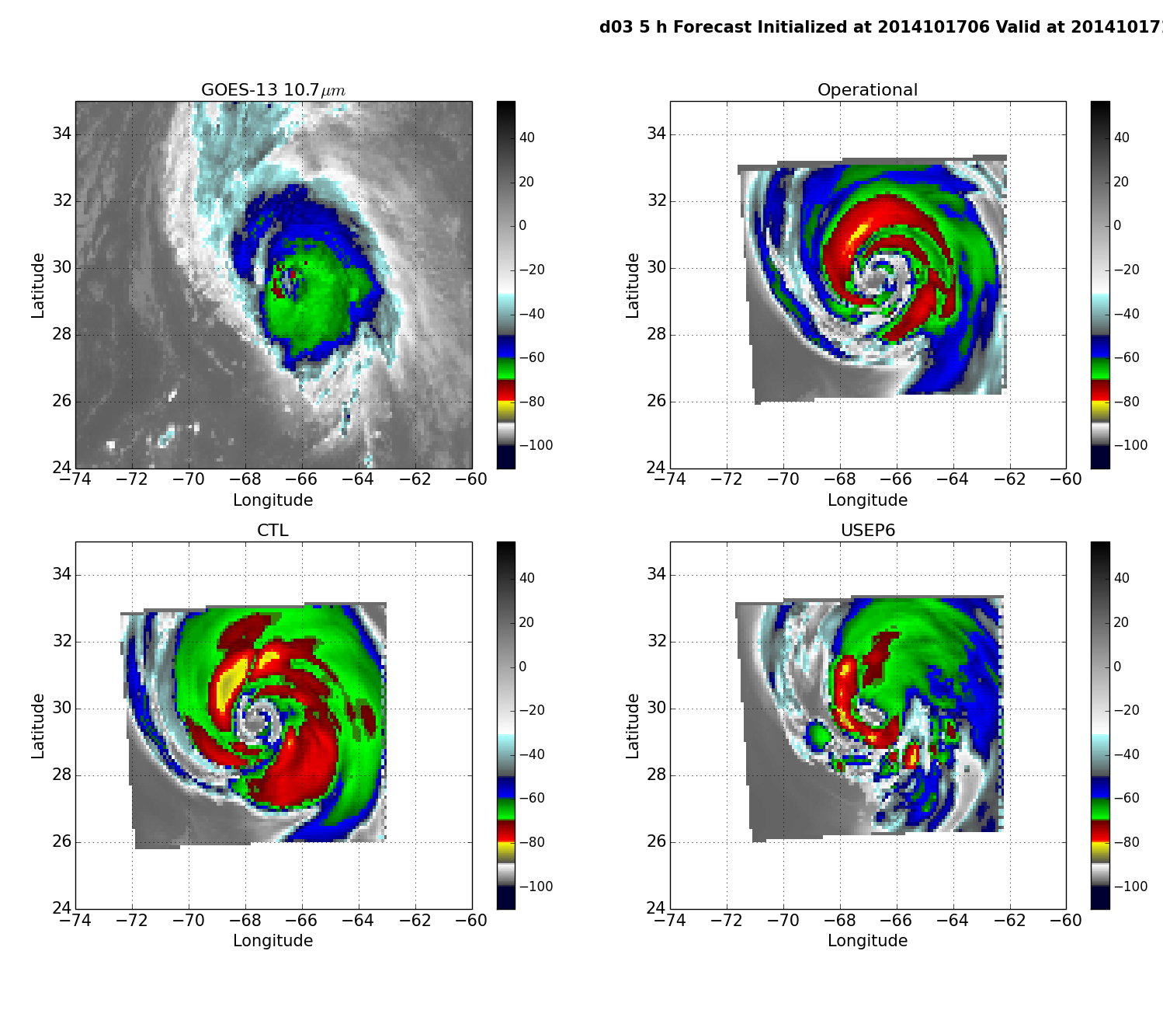
Compare w/ GOES-13 image at 10.7 μm
ghost d03
Operator a)
Operator b)
ghost d03
ghost d03
(Brightness Temperature in °C)

Slide 9
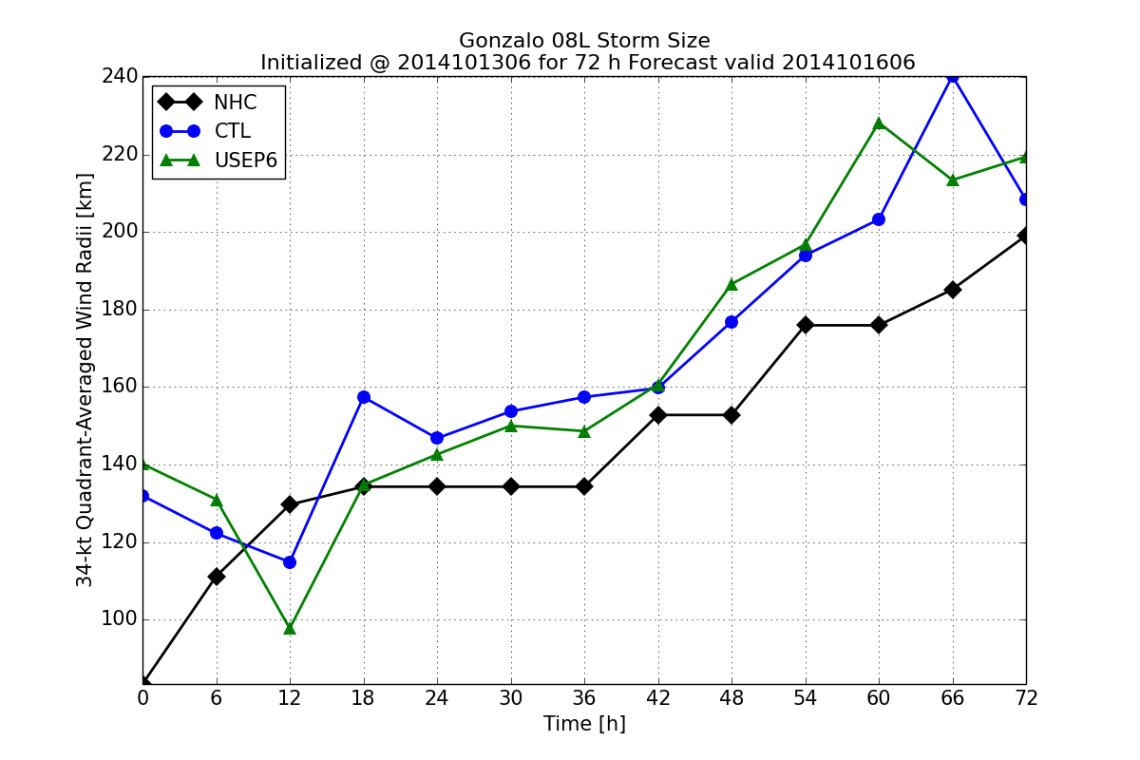
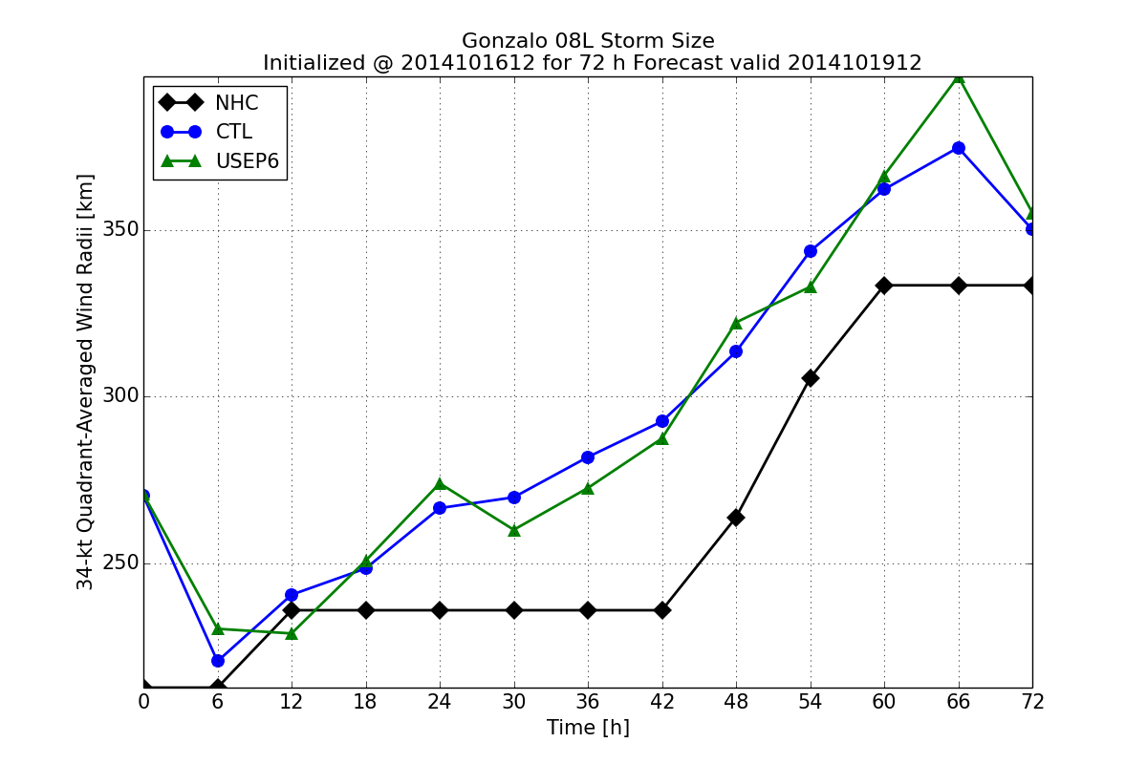
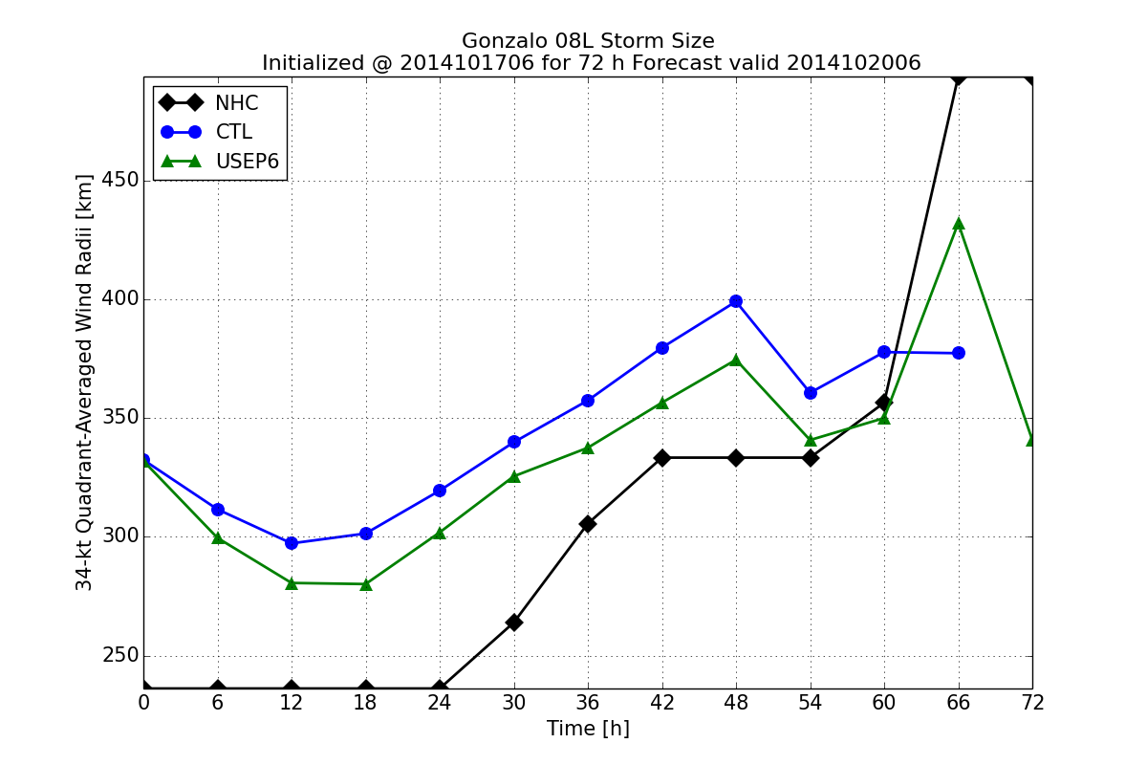
Track Error (km)
Intensity Error (hPa)
Size Error (km)
TS
Operator a)
Operator b)
HU
HU

Slide 10
Summary
Fit to observation was improved with operator b)
While there was no obvious improvement in forecast track and size forecast, intensity forecast was found slightly improved when operator with cloud condensate update (operator b) is used
Although initial cloud condensate field was comparable to observations (synthetic satellite image), there were too many cold clouds during HWRF forecast
 | Pros | Cons
a) | Relatively easy to implement Code modifications are limited to GSI only | Create bias from using already saturated-then-condensed water vapor from background guess No cloud condensate update
b) | In addition to dynamical variables, cloud condensate variables are also updated Align with all-sky radiance assimilation efforts (see the next few slides) | also need to modify procedures in HWRF related to cloud condensate (vortex relocation) Depends on cloud microphysics scheme used by HWRF

Slide 11
All-Sky ATMS Radiances

Slide 12
Preparations for all-sky radiances assimilation in HWRF
Inherit the GSI all-sky assimilation capability developed for GFS (Zhu et al. 2016) by adding CWM as control variable and including ql and qi as state variables, and extend to qr, qs, qg, and qh
  Static background error covariance
  Ensemble background error covariance (GFS ensemble, non-native)
An empirical formula based on Ferrier-Aligo microphysics scheme for partitioning CWM into ql, qi, qr, qs, qg, and qh with partition parameters (F_ICE, F_RAIN, and F_RIMEF) is available in GSI. The tangent linear and adjoint parts of the partition are included in cost function minimization (Wu and Zupanski 2017)
Append CWM and its partition parameters from forecast of a previous cycle to background guess, as they are currently not considered during the vortex initialization procedure, a step prior to GSI data assimilation within HWRF.

Slide 13
ATMS Ch 1: 23.8 GHz (Tb in Kelvin)
Hurricane Cristobal (2014) 1800 UTC, August 26
ghost d03
ATMS channels 1-4, 7-9, 16-20 are used, but only channel 1 is shown here
Ch 1 and 2 are sensitive to cloud liquid droplets and rain: ocean surface appears cold and condensate associated with hurricane ( ) appears warm (>240K)
Absolute innovation differences = |O-B|-|O-A|
Notes:
Ch 1-2: sensitive to cloud liquid droplets and rain
Ch 7-9: provides information about the warm core of hurricane
Ch 16: helps identify the location of the deepest convection through a scattering signal from precipitation-sized ice particles
Ch 17-20: water vapor channels make moisture sounding possible in clear-sky regions

Slide 14
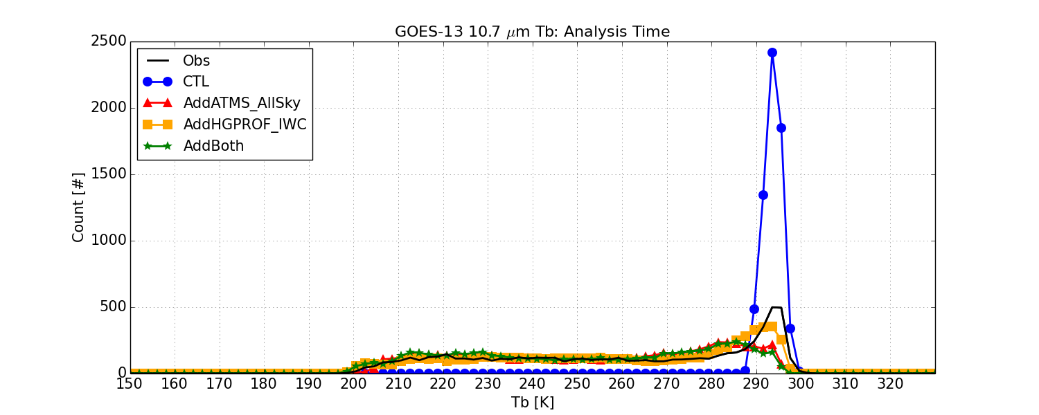
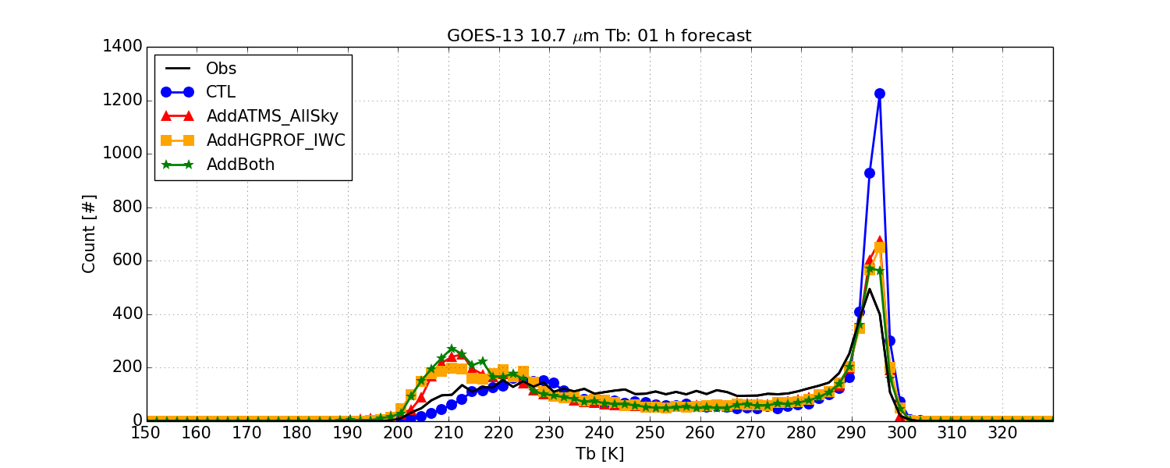
Compare w/ GOES-13 data
Histogram of Tb of observed GOES-13 image (black) and synthetic images (colored)
Analysis: t = 0
The distribution of brightness temperature at t = 0 is consistent with observation, except for CTL (blue) due to no cloud condensate.
Within the first hour of the forecasts, a discrepancy developed, where the brightness temperatures are around 210 K
Such discrepancy persists in the following (at least) 24 hours of forecast
Forecast: t = 1 h

Slide 15
Summary
and Future Work
Extended GSI capability to assimilate cloud and precipitation-affected satellite observations into HWRF.
Both Hurricane GPROF hydrometeor retrievals and ATMS all-sky radiances were successfully assimilated into HWRF.
Although forecast results from all-sky assimilation measured in metrics including track, intensity, and sizes were mixed (not shown), initial cloud fields (synthetic satellite images) from assimilation were comparable to observation.
HWRF appears to produce too many clouds with cloud top temperature that is too cold compared to observations.
Merge the extended capabilities to the HWRF and GSI repository (through DTC Visitor Program) to test and evaluate these new capabilities with more hurricane cases, as possible R2O consideration.
GOES-16 GLM lightning assimilation in HWRF

Slide 16
Thank you!
CIRA Data Assimilation Group http://da.cira.colostate.edu
References:
Brown P. J., Kummerow C. D., Randel D. L. 2016. Hurricane GPROF: an optimized ocean microwave rainfall retrieval for tropical cyclones. Journal of Atmospheric and Oceanic Technology 33: 1539–1556. https://doi.org/10.1175/JTECH-D-15-0234.1.
Tallapragada V., Bernadet L., Biswas M. K., Ginis I., Kwon Y., Liu Q., Marchok T., Sheinin D., Thomas B., Tong M., Trahan S., Wang W., Yablonsky R., Zhang X. 2015. Hurricane Weather Research and Forecasting (HWRF) Model: 2015 scientific documentation, http://nldr.library.ucar.edu/collections/technotes/TECH-NOTE-000-000-000-893.pdf
Wu T.-C., Zupanski M., Grasso L. D., Brown P. J., Kummerow C. D., Knaff J. A. 2016. TheGSI capability to assimilate TRMM and GPM hydrometeor retrievals in HWRF. Quarterly Journal of the Royal Meteorological Society 142: 2768–2787. https://doi.org/10.1002/qj.2867.
Wu T.-C., and Zupanski M. 2017. Assimilating GPM hydrometeor retrievals in HWRF: choice of observation operators. Atmospheric Science Letters 18: 238–245. https://doi.org/10.1002/asl.748.
Zhu Y., Liu E., Mahajan R., Thomas C., Groff D., Van Delst P., Collard A., Kleist D., Treadon R., Derber J. C. 2016. All-sky microwave radiance assimilation in NCEP’s GSI analysis system. MonthlyWeather Review 144: 4709–4735. https://doi.org/10.1175/MWR-D-15-0445.1.

Slide 17
Backup slides

Slide 18
Integrated SWC
Hurricane Gonzalo (2014)
2014/10/16 1200 UTC
Operator a): although values of solid water contents comparable to observed ones, they are displaced to the east of Gonzalo
Operator b): In general, distribution of solid water contents is similar to observed ones, but their values are much larger

Slide 19
Analysis increment
Operator a) noHydro Operator b) Hydro

Slide 20
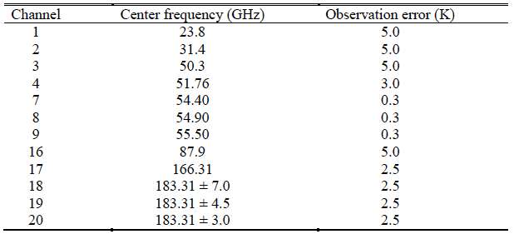
ATMS Channel Selection
clear-sky error for now
Ch 1-2: sensitive to cloud liquid droplets and rain
Ch 7-9: provides information about the warm core of hurricane
Ch 16: helps identify the location of the deepest convection through a scattering signal from precipitation-sized ice particles
Ch 17-20: water vapor channels make moisture sounding possible in clear-sky regions
Notes:
Ch 1-2: sensitive to cloud liquid droplets and rain
Ch 7-9: provides information about the warm core of hurricane
Ch 16: helps identify the location of the deepest convection through a scattering signal from precipitation-sized ice particles
Ch 17-20: water vapor channels make moisture sounding possible in clear-sky regions

