Slide 1

Testing and Evaluation of the Hybrid 4D EnVar GSI for 3-km High Resolution Regional Applications
Chunhua Zhou^{1,3}, Hui Shao^{1,3} , Ming Hu^{2,3,4} and Jeff Beck^{2,3,4}
¹ National Center for Atmospheric Research (NCAR)
² NOAA/ESRL/GSD
³ Developmental Testbed Center (DTC)
⁴ University of Colorado/Cooperative Institute for Research in Environmental Sciences (CIRES)
18th WRF Users’ Workshop - June 12-16, 2017

Slide 2
Hybrid 4D Ensemble-Variational (EnVar) Data Assimilation
Background term:
Climatology Part
Ensemble Part
Cost function of Hybrid 3D EnVar
Cost function of Hybrid 4D EnVar
Observation Term
Static background error covariance
x’: analysis increment vector
β: weighting function of static and ensemble BE
n: n-th ensemble member
k: k-th time bins
B: Static background error covariance
α: extended control variable
A: correlation matrix
H: foreword operator
y: observation vector
R: observation error covariance
Incorporating ensemble background-error information through extended control variable

Slide 3
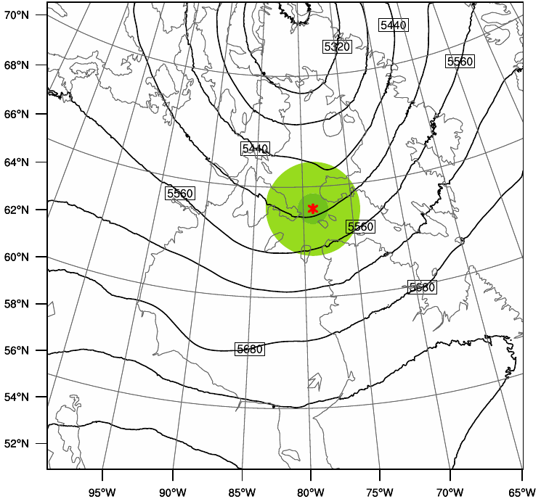
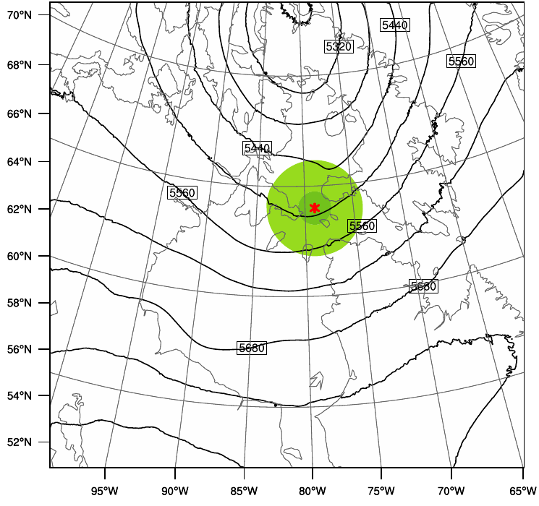
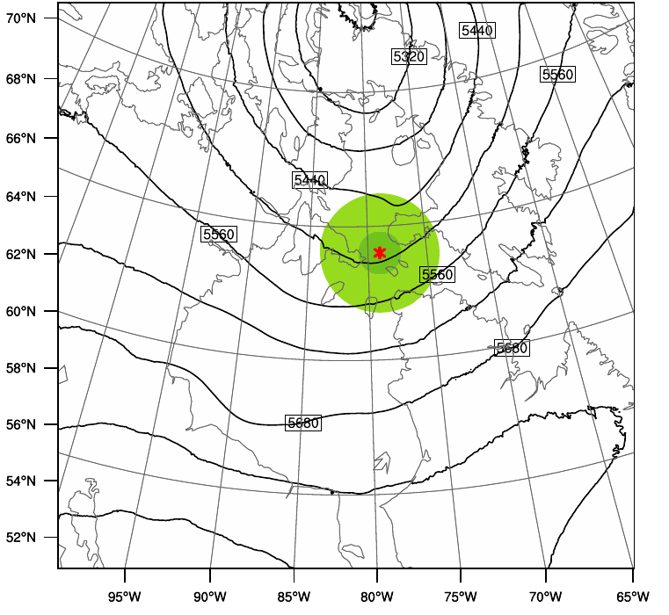
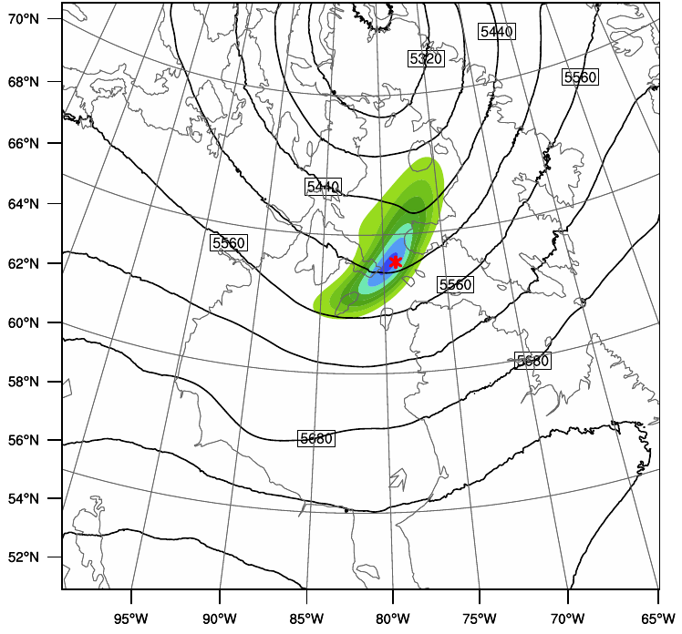

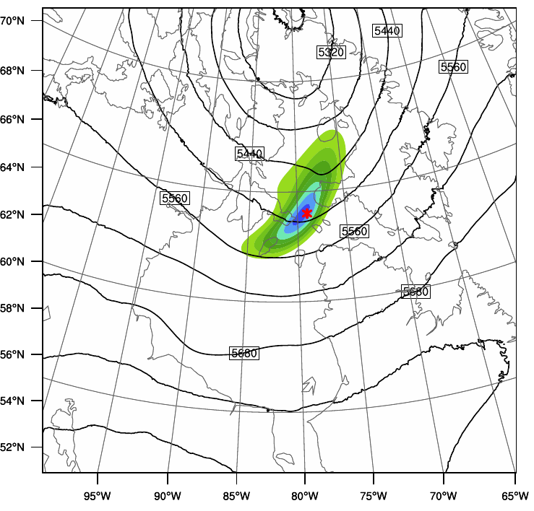
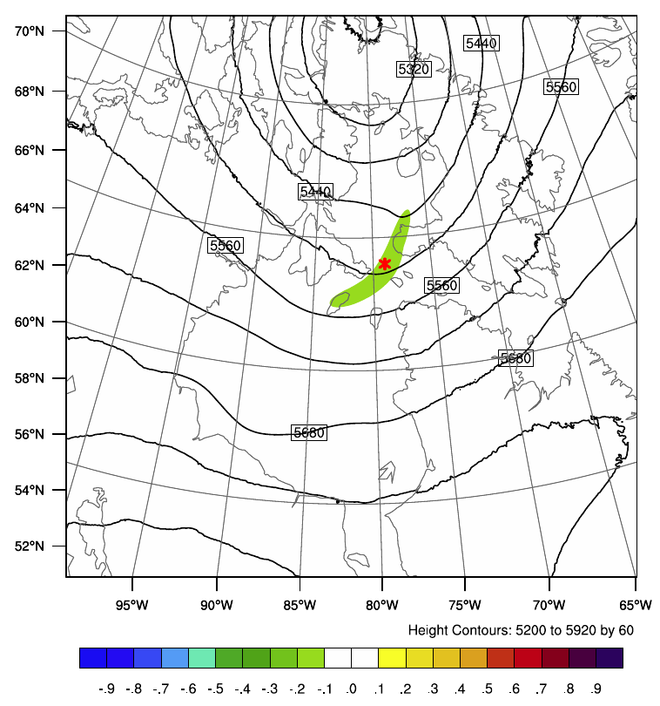

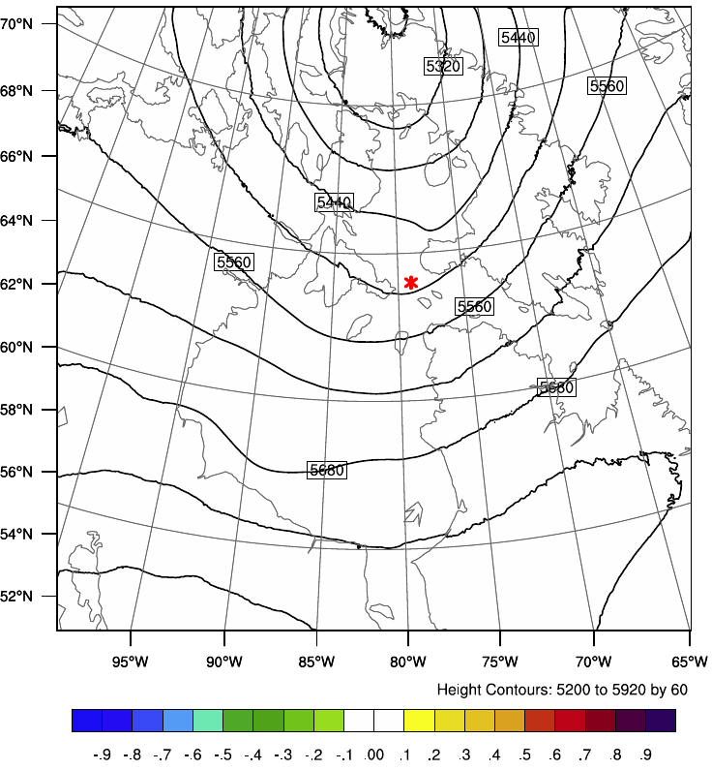
Observation @t-3h
Observation @t+0h
Observation @t+3h
3DVar: Isotropic
Hybrid 3DEnVar: Flow-dependent
Hybrid 4DEnVar: Flow-dependent and Time-variant

Slide 4
Experimental Design
HRRR: NOAA real-time 3-km resolution, hourly updated, cloud-resolving, convection-allowing atmospheric modeling system
Advanced Research WRF (ARW)
GSI 3D hybrid
Hourly data assimilation analysis from the 13km Rapid Refresh (RAP) provides ICs and boundaries
Experiments:
Testing period: 3-9 September 2016
Testing domain: Reduced HRRR domain in central US (computational constraint)
Hourly 3D (operational) and 4D hybrid EnVar runs
Using archived real-time observation feed
Removed radar data assimilation (“nudging”) during the 1-hour pre-forecast period
3D (CTL): 3D hybrid using GFS ensemble (operational configuration)
4D: 4D hybrid using GFS ensemble, 3 time bins for each analysis time window
3D_reg: Same as 3D, except for using ARW ensemble (case study)
3D_cycling, 4D_cycling: Hourly cycling 3D and 4D hybrid EnVar (case study)
Notes:
Beta1=0.25
Beta2=0.75

Slide 5
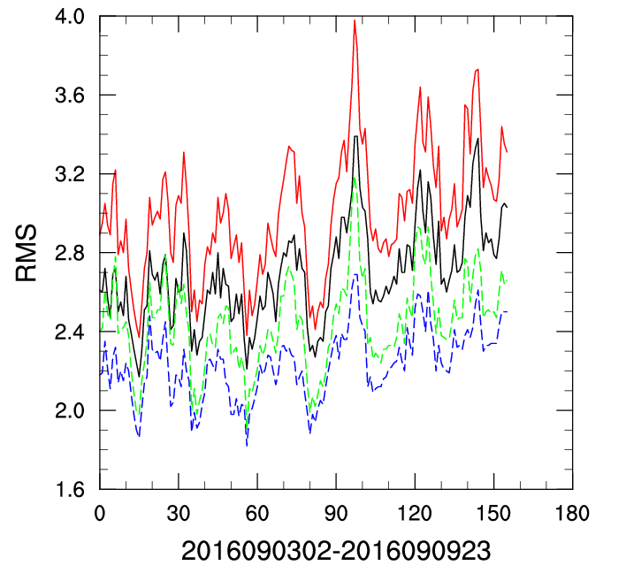
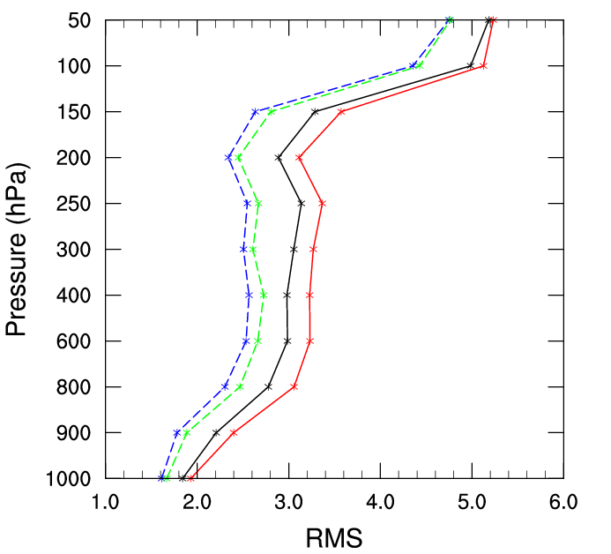
Domain-averaged Errors
Wind RMSE (m/s)
3D analysis
3D background
4D background
4D background
3D analysis
4D analysis
4D analysis
3D background
Positive impacts for wind background & analysis fit to observations
* 156 runs for verification

Slide 6
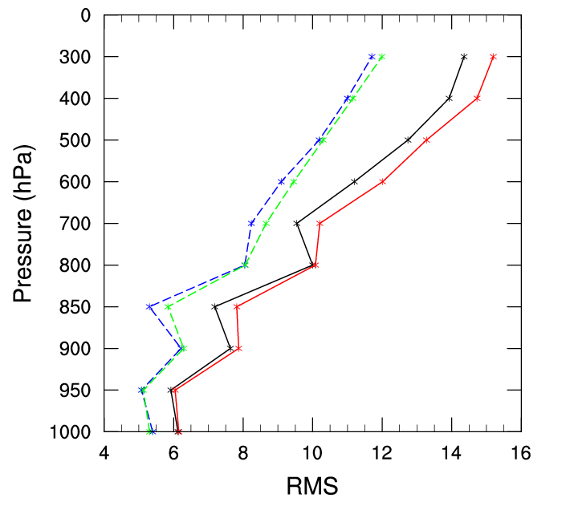
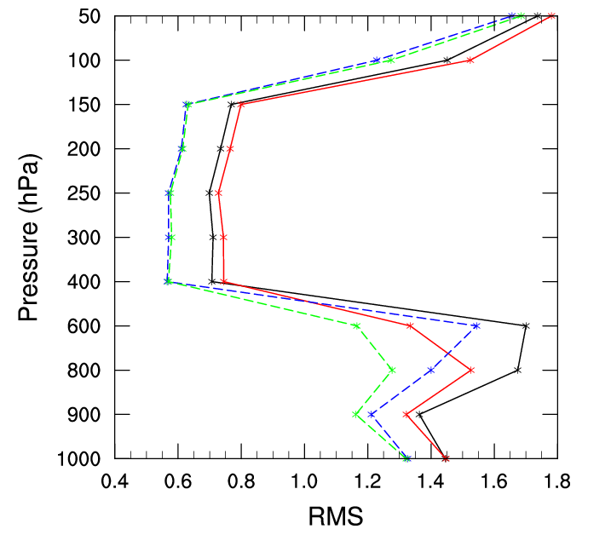
Domain-averaged Errors (cont)
Mixing ratio RMSE (g/g)
Temperature RMSE (K)
4D background
3D analysis
4D analysis
3D background
3D background
4D background
3D analysis
4D analysis
Positive impacts for humidity but negative impacts for temperature below 400 hPa
* 156 runs for verification

Slide 7
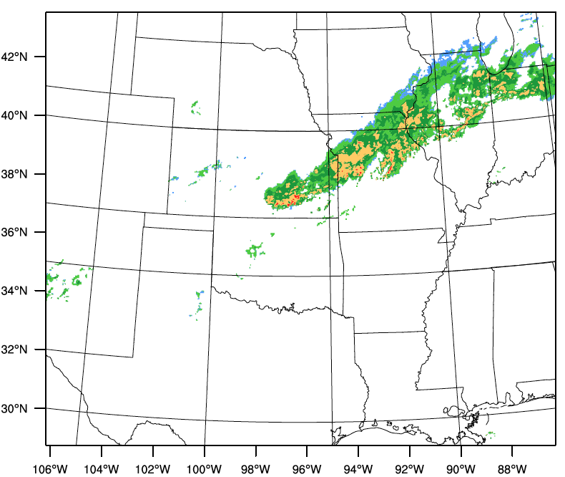
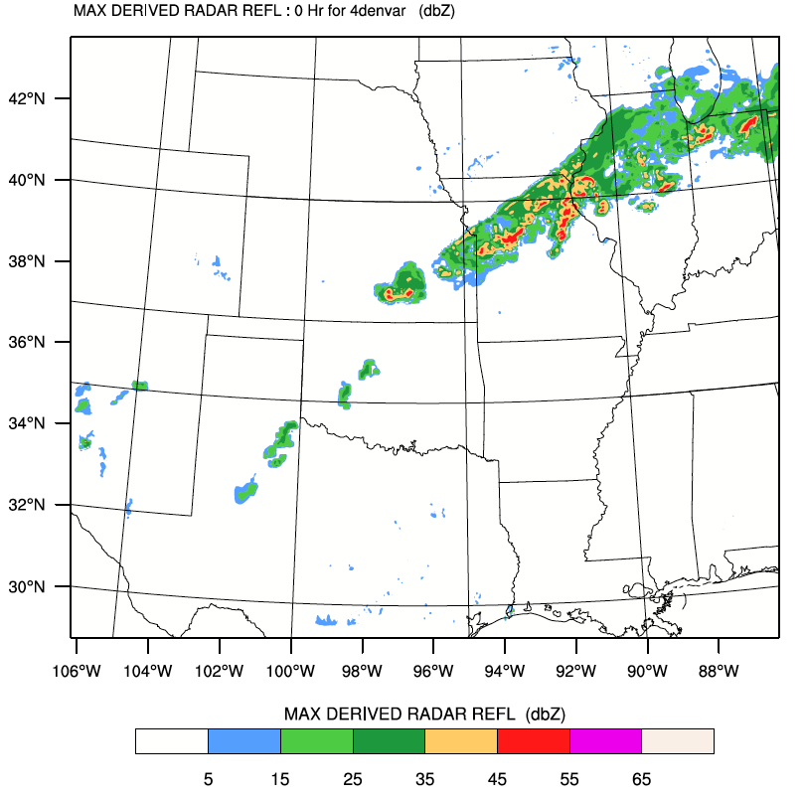
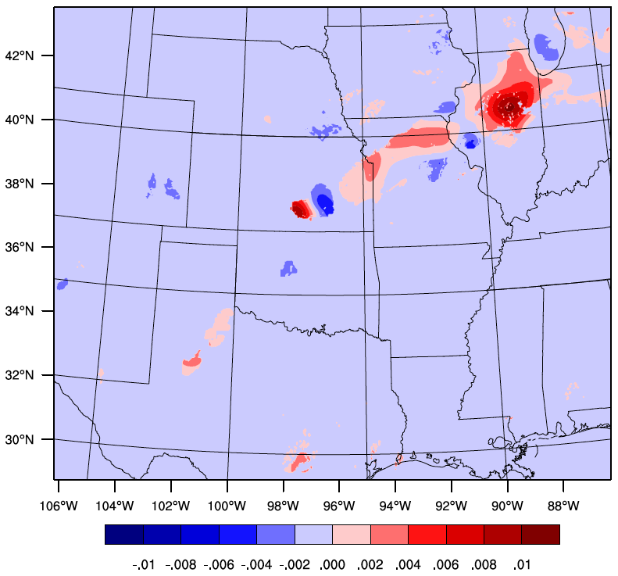
Reflectivity @2016090812
Obs
Both 4DEnVar and 3DEnVar capture the observed convection well at analysis time
The difference between 4DEnVar and 3DEnVar is negligible
4DEnVar
4D-3D

Slide 8
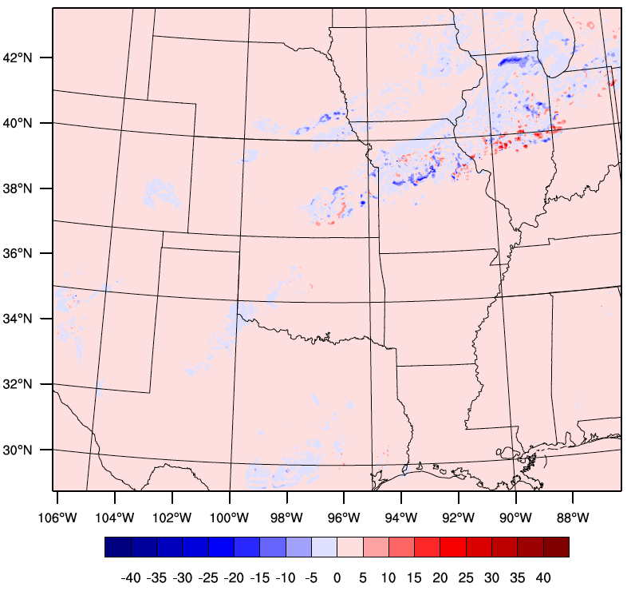
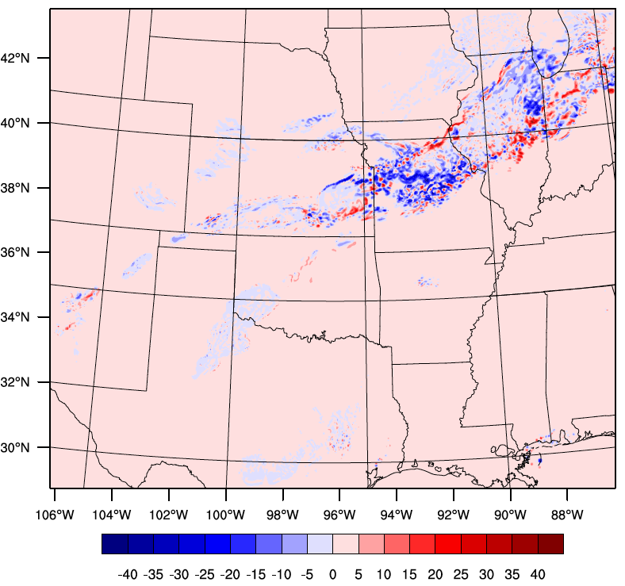
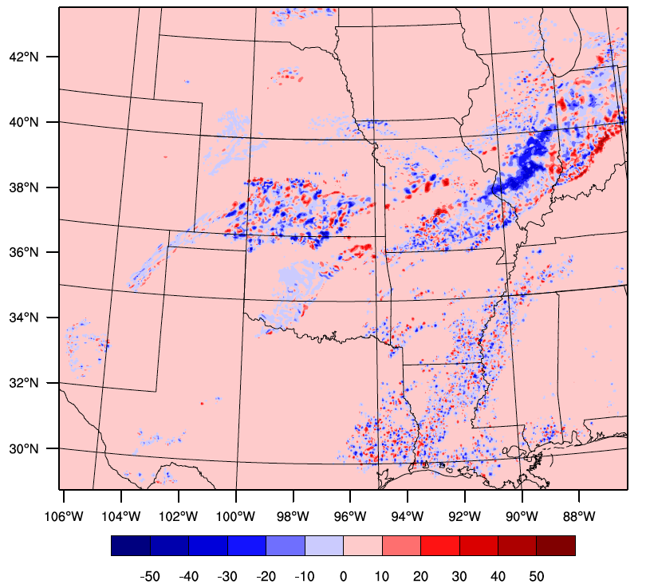
Reflectivity: 4D-3D
1h
Forecast differences become bigger with longer forecast ranges
Convective features
GFS ensemble
HRRR ensemble
3h
6h

Slide 9
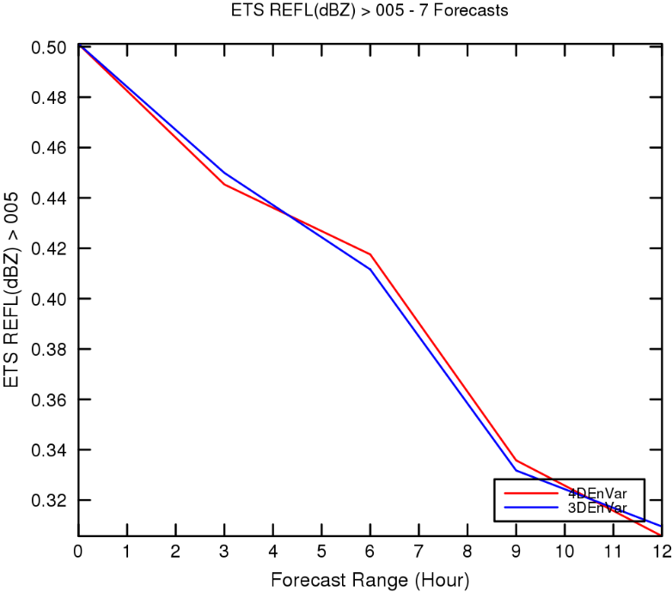
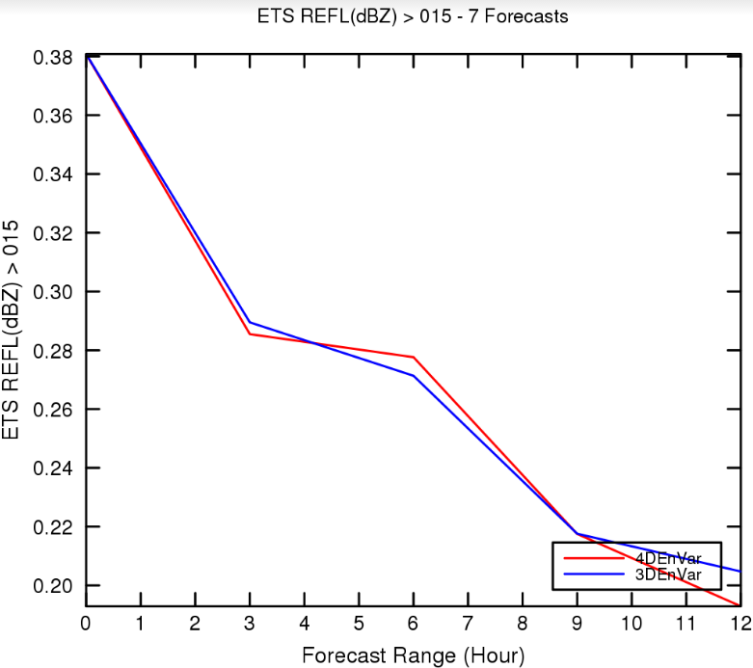
Composite reflectivity verification: ETS
3D
4D

Slide 10
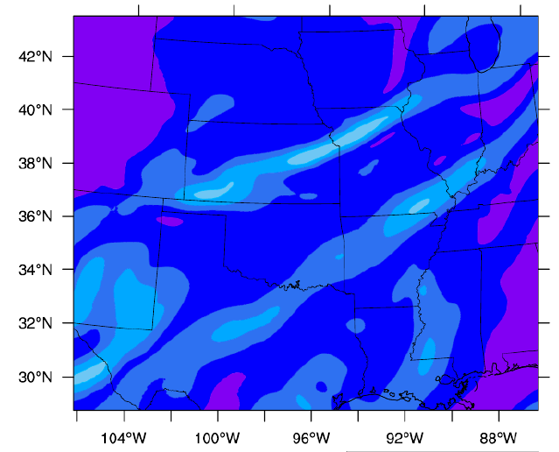
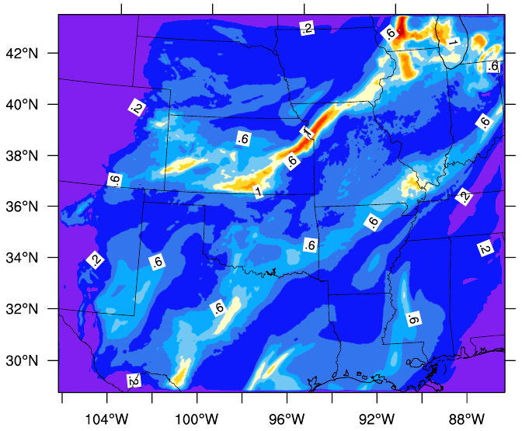
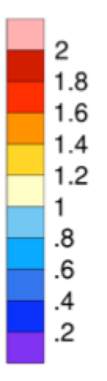
Ensemble Representation for Background Errors
ARW ensemble (3km) - dynamic downscaling from GFS ensemble
Improved magnitude and convective scale structure
Not yet enough for solving the under-dispersive issues (figure not shown)
GFS ensemble (~30km)
Heavily under-dispersive – lack of representation of BEs
GFS ensemble
HRRR ensemble
Ensemble spread for mixing ratio (g/g)

Slide 11
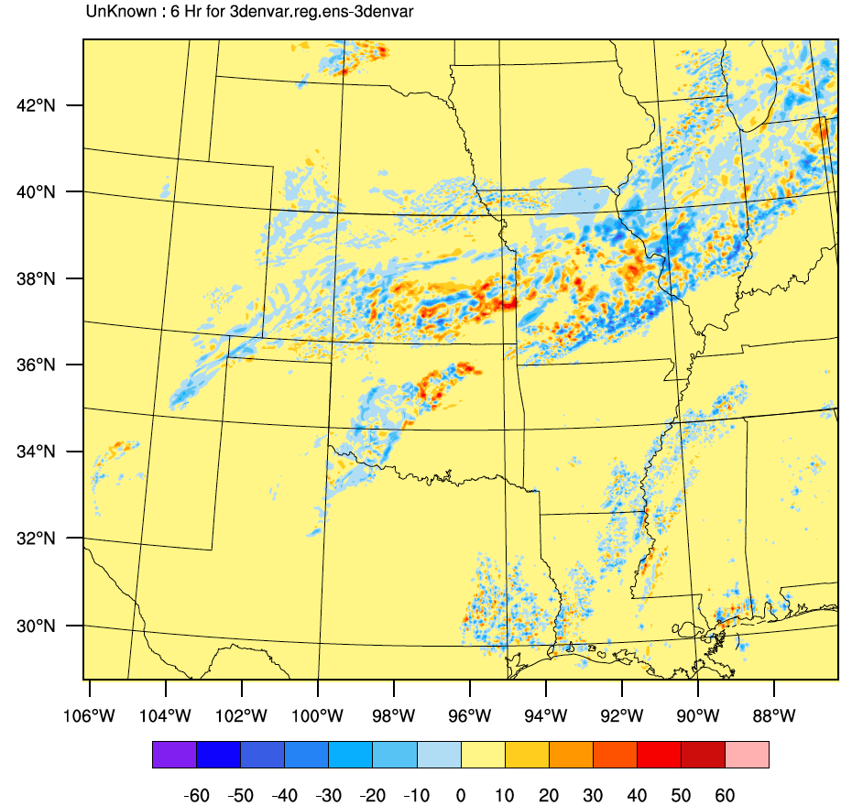
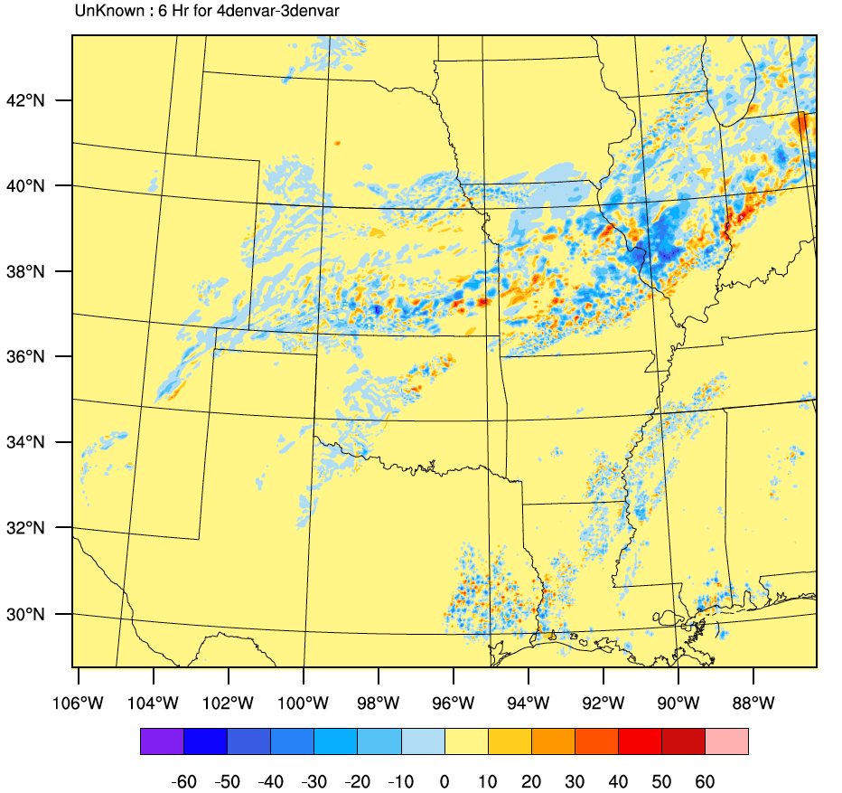
Composite Reflectivity 6h Forecast Differences
3D_reg -3D
4D -3D
GFS ensemble
HRRR ensemble
Though still under-dispersive, high-resolution ARW ensemble leads to significant differences in 3D hybrid runs, with comparable magnitudes to those between 4D and 3D runs
(dBZ, level 9)

Slide 12
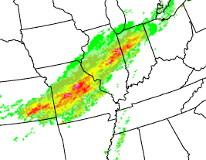
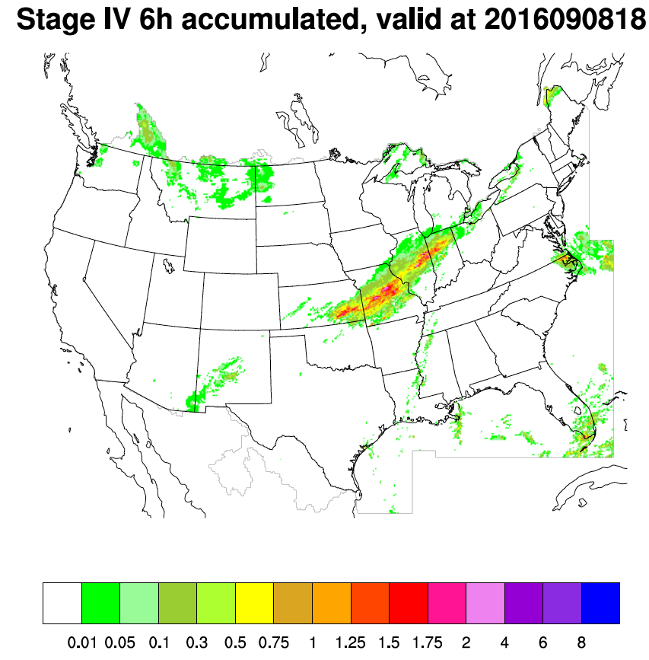
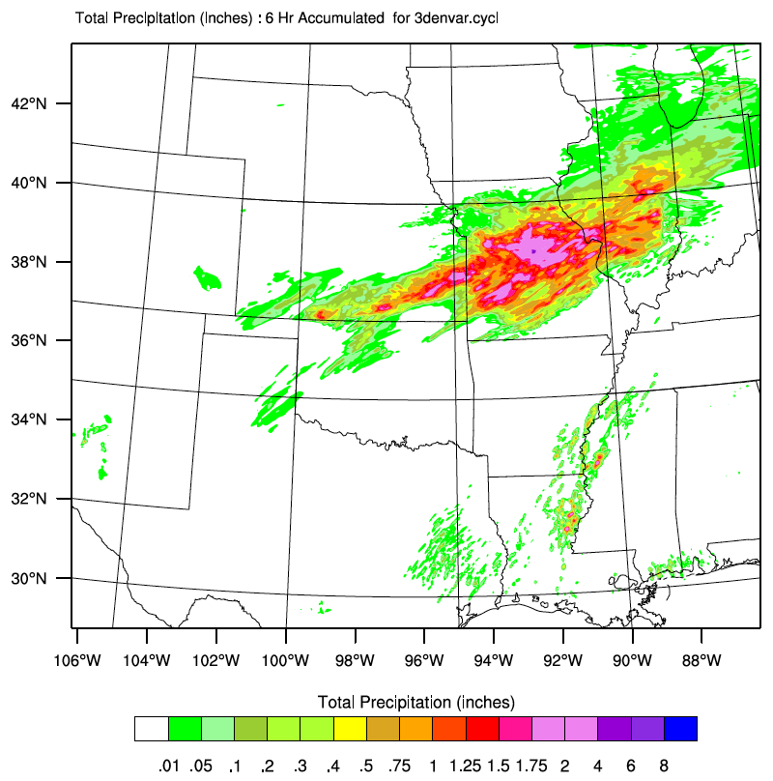
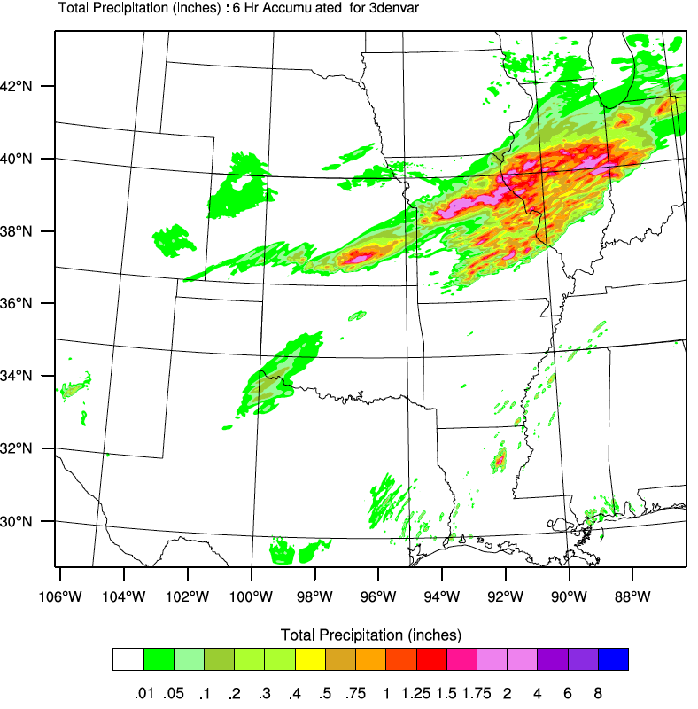
Cycling vs “Warm” Start: 3D
obs
3denvar.cycl
3denvar
6-hr accumulated rainfall
Notes:
Hrly cycled since 2016090800

Slide 13
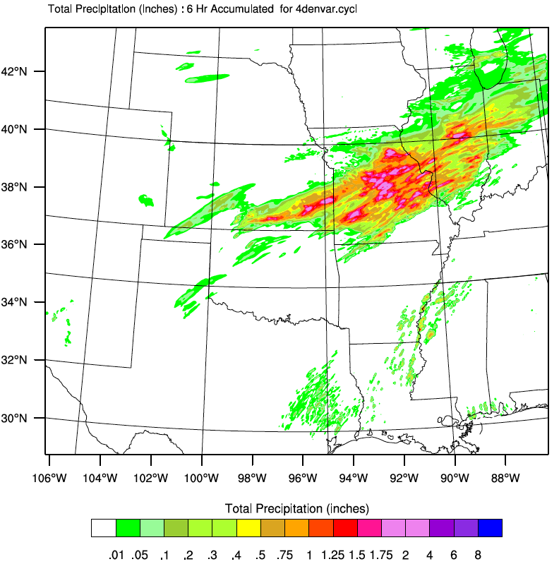

Cycling vs “Warm” Start: 4D
obs
4denvar.cycl
4denvar
6-hr accumulated rainfall

Slide 14
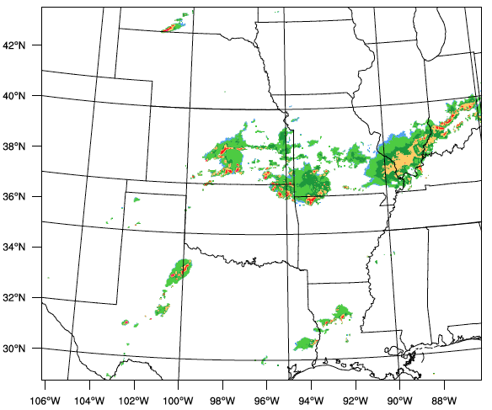
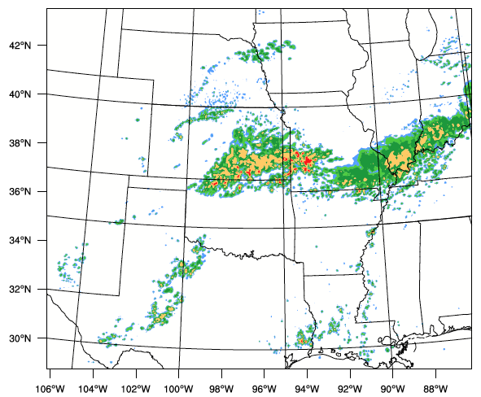
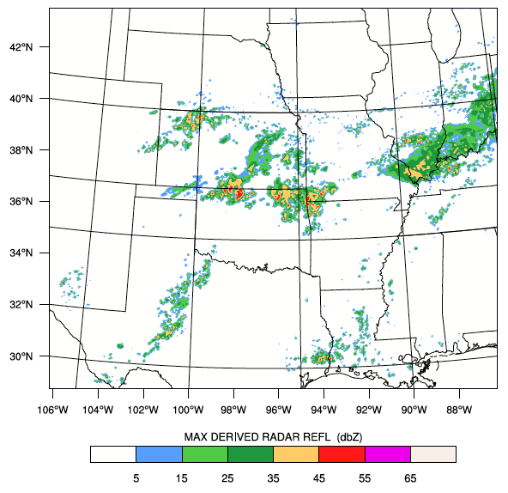
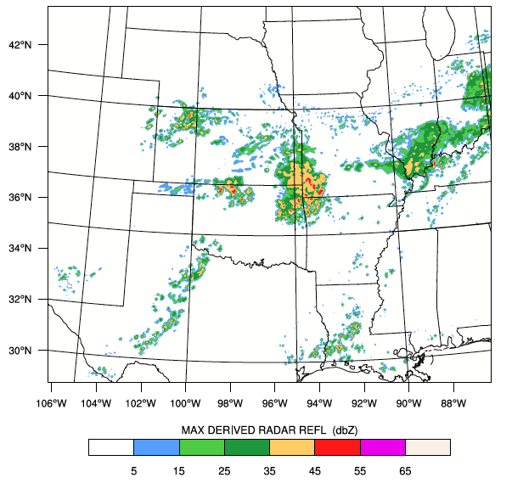
Reflectivity @2016090900
Cycling vs “Warm” Start
4DEnVar
Obs
Cycled 4DEnVar
Cycled 3DEnVar
12hr fcst

Slide 15
Summary
Hybrid 4DEnVar runs indicate positive impacts on HRRR backgrounds and analyses for wind and humidity (better fit to observations) but negative impacts on temperature below 400 hPa
Cycling 4DEnVar and 3DEnVar provides better forecast of the convective system than the “warm” start 4DEnVar and 3DEnVar
Cycling 4DEnVar improves the forecast upon cycling 3DEnVar
Ongoing work:
Ensemble background error representation:
Further studies on high-resolution ensemble and forecast impacts
Temporal representation is critical for 4D as well
DTC Visitor Program
Proposals to work directly with the DTC-supported Gridpoint Statistical Interpolation (GSI) and/or the NOAA Ensemble Kalman Filter (EnKF) DA systems are strongly encouraged.
http://www.dtcenter.org/visitors/opportunity/

