Slide 1



Impact of Assimilating GOES-Imager radiance with a rapid refresh assimilation system for convection-permitting forecast over Mexico
Chun Yang¹, Jake Liu², Feng Gao³, Peter Childs³, Jinzhong Min¹
¹Nanjing University of Information Science & Technology
²National Center for Atmospheric Research
³Panasonic Weather Solution

Slide 2
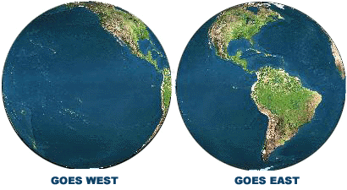
GOES-Imager
Data Source: NESDIS CLASS (Comprehensive large array-data stewardship system)
  NetCDF format
GOES-15 (West)
GOES-13 (East)
Full disk imagery of every 15 minutes from two satellites

Slide 3
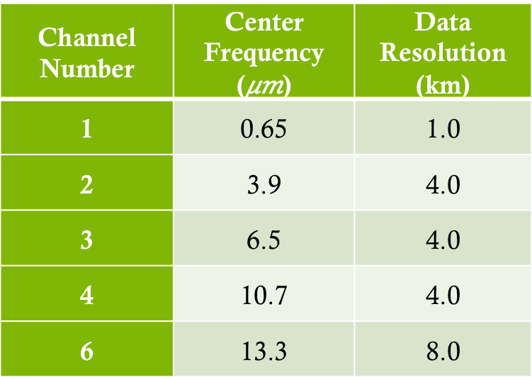
GOES-Imager
GOES-Imager: 5 channels
Channels weighting function
Channel Number | Center Frequency () | Data Resolution (km)
1 | 0.65 | 1.0
2 | 3.9 | 4.0
3 | 6.5 | 4.0
4 | 10.7 | 4.0
6 | 13.3 | 8.0
Water vapor channel

Slide 4
Data Calibration
GVAR count (0-1023) then converted to scene radiance
R = (X-b)/m
  R: radiance; X: GVAR count; m & b: calibration coefficients
Then convert radiance to effective temperature
Finally convert effective T to brightness T
Weinreb and Han（2011）

Slide 5
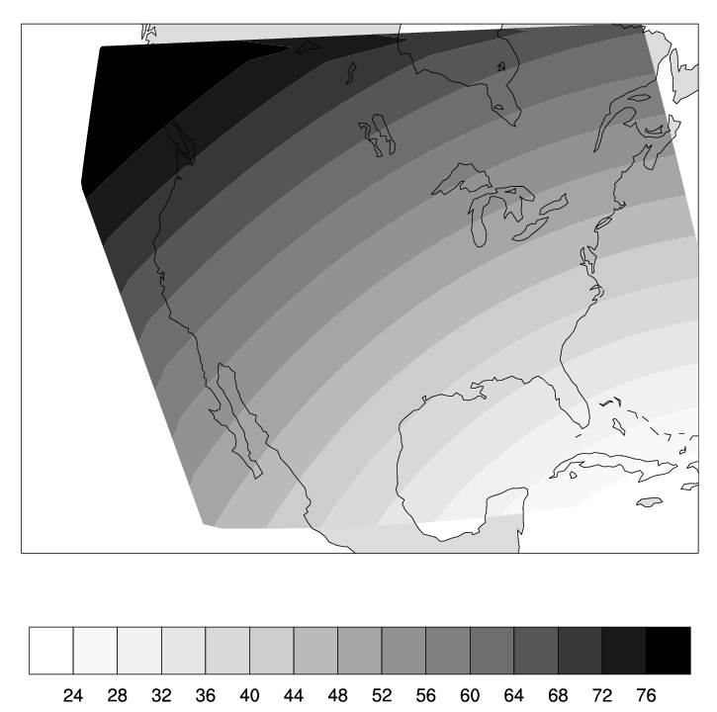
Data Geolocation
GOES-13 located at 75°W, ~36000km above equator
Satellite zenith angle，
Earth radius，
Satellite altitute

Slide 6
Quality Control
Reject pixels over mixed land surface
Channels 4 and 6 only used over water, channel 3 used over both land and water
Reject pixels with the model background CLWP>0.2mm
Cloud-detection: use Tb4 (model) – Tb4 (obs) (Hocking et al, 2010)
Background departure (OMB) check

Slide 7
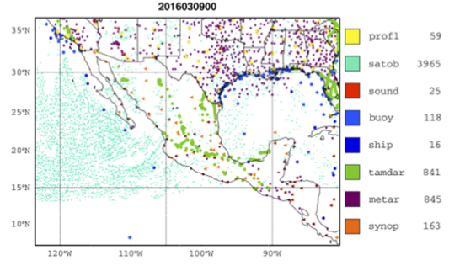
A heavy rainfall event
03/07/2016, (a) 12z (b) 03/08 00z, (c) 12z; (d) 03/09 00z.
500 Z (m) and wind (m/s)
24-h accumulated rainfall (mm)
Notes:
强大的副热带急流激发了一个逐渐加深的大槽，逐渐向东南方向的移动

Slide 8
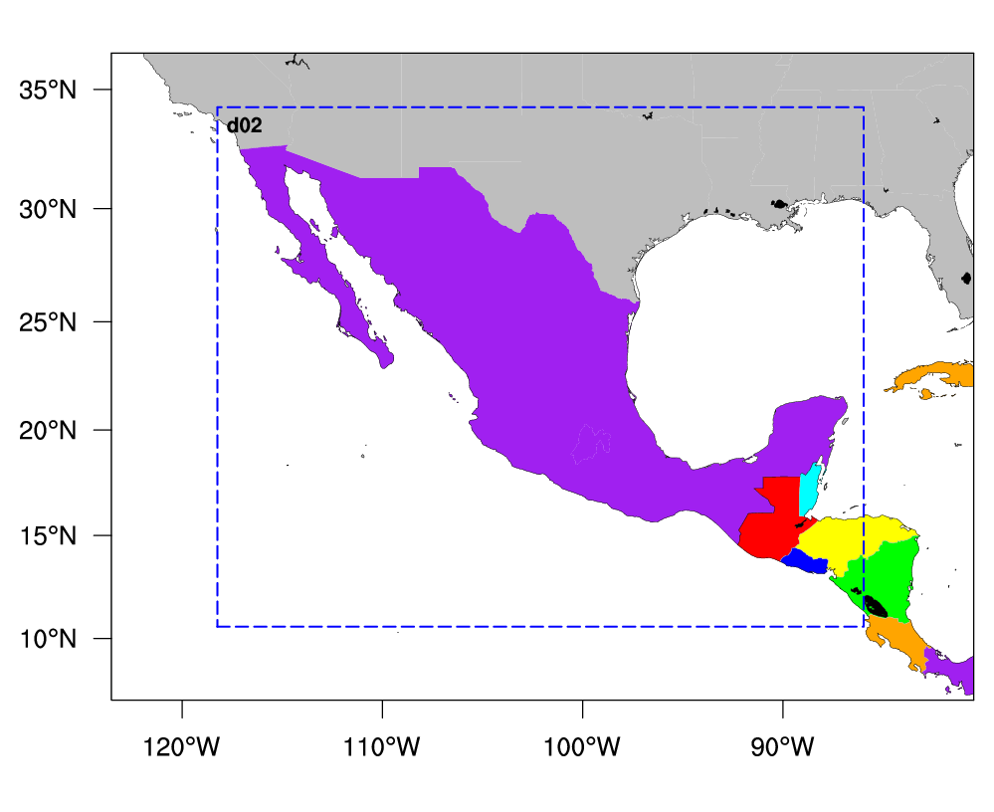
Configuration
WRF: V3.7.1
Model top: 50 hPa
Vertical levels: 51
Landuse: MODIS-based
mp_physics=10
ra_lw_physics=4 ra_sw_physics=4
sf_sfclay_physics=1
sf_surface_physics= 2
bl_pbl_physics= 1
cu_physics= 1, 0
898×721, 4km
400×300, 12km
2016030700-0900，hourly cycling, dual-res. Hybrid + blending
0712、0800、0812、0900 24-h forecast
CON: GTS+TAMDAR+AMSUA
GOES_IMG: GTS+TAMDAR+AMSUA+GOES-Imager（channels 3, 4, 6）

Slide 9
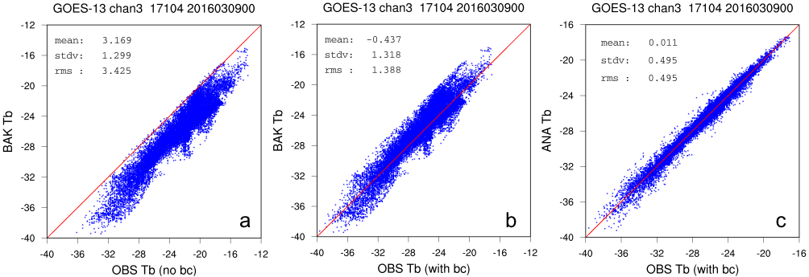
Radiance Variational Bias Correction

Slide 10
Time series of Analysis
Verify against TAMDAR
Notes:
凌晨没有飞机
得到更小的OMA， 飞机主要在陆地上，观测个数有限

Slide 11
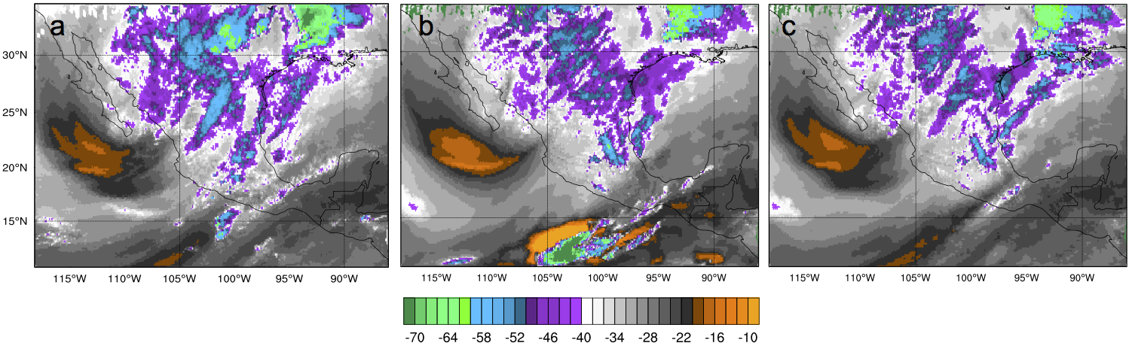
Analysis valid at
00 UTC, 2016/03/09
Observed WV channel
No GEOS-Imager DA
With GOES-Imager DA
Cloudy radiances

Slide 12
Analysis at 03/09/2016 00z
500 hPa Z and 850 hPa moisture difference

Slide 13
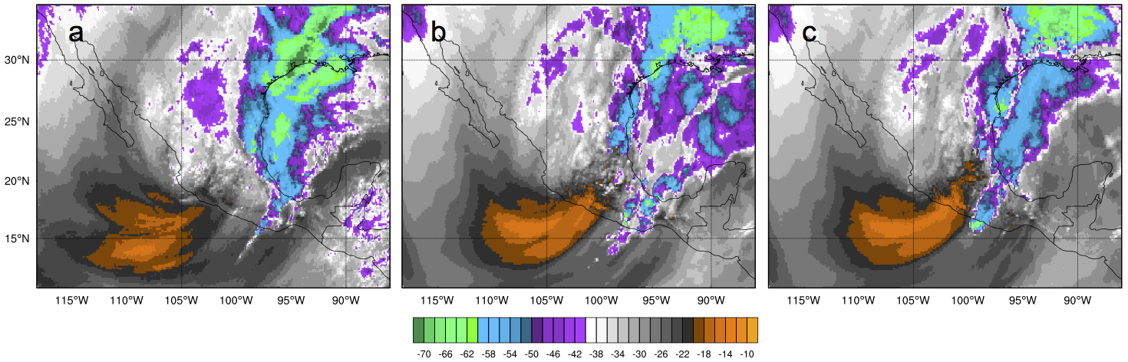
24-h forecast valid at
00 UTC, 2016/03/10
Observed WV channel
No GEOS-Imager DA
With GOES-Imager DA
Cloudy radiances

Slide 14
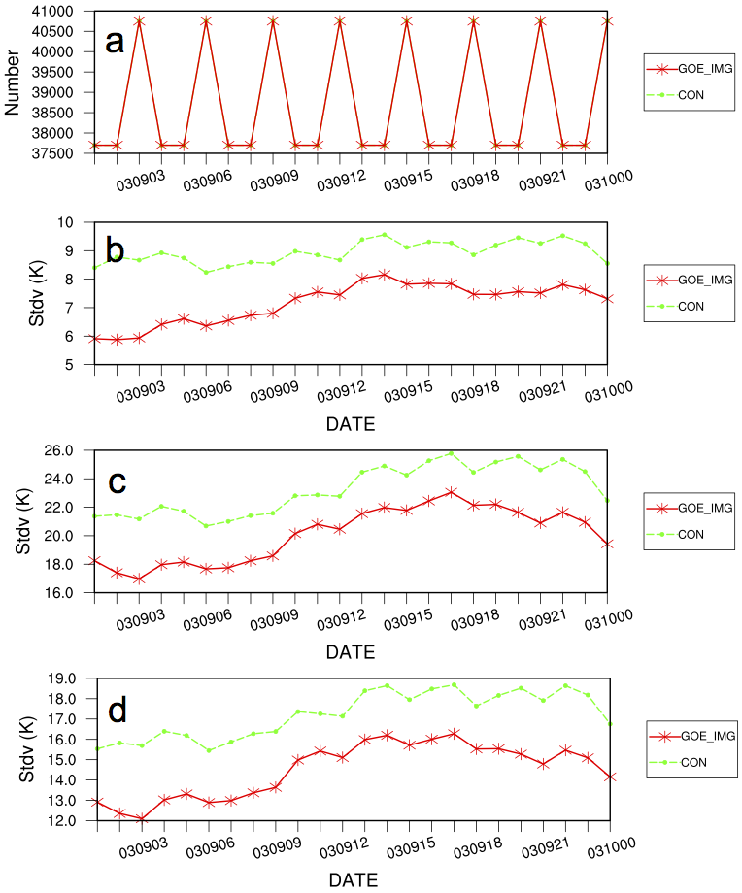
24-h forecast verify against
GEOS-Imager cloudy radiances
Channel 3
Channel 4
Channel 6

Slide 15
24-h precipitation forecast
CONTROL
GOES-Imager

Slide 16
Precip. Forecast Ccore

Slide 17
Summary
GOES-Imager radiance DA capability is implemented in WRFDA.
GOES-Imager Radiance DA improved T and Q analysis (and cloud field from DA cycling effect)
Lead to improved precipitation forecast for a heavy rainfall event
Yang. C., Z. Liu, F. Gao, P. Child, J. Min, 2017: Impact of Assimilating GOES-Imager Clear-sky Radiance with a Rapid Refresh Assimilation System for Convection-Permitting forecast over Mexico, J. G. R. Atmosphere, 122, 5472 – 5490.

