Slide 1
An OSSE study of RTFDDA radar data assimilation
Yongjie Huang
National Center for Atmospheric Research (NCAR)
15 June 2017
(Collaborators: Mei Xu, Yubao Liu, Yuewei Liu, Will Y.Y. Cheng)
• 18th Annual WRF Users’ Workshop •

Slide 2
Outline
RTFDDA Radar Data Assimilation
Observing System Simulation Experiments (OSSEs)
Results of OSSEs
Summary and future work
Notes:
During my presentation, firstly, I will introduce our RTFDDA Radar Data Assimilation method and the motivation of our study. Then we setup OSSE experiments and show some results of the OSSEs. Finally, I will give a brief summary and future work.

Slide 3
Radar Data Assimilation
Radar assimilation methods:
3DVAR (Xiao et al., 2005; Gao and Stensrud, 2012)
4DVAR (Sun and Crook, 1997)
EnKF (Tong and Xue, 2005; Dowell et al., 2011)
Nudging (Newtonian relaxation, Haase et al., 2000; Stephan, et al., 2008)

Slide 4
RTFDDA Radar Data Assimilation
RTFDDA-RDA
RTFDDA is a WRF-based real-time four-dimensional data assimilation and forecasting system developed at NCAR/RAL, which effectively assimilates diverse observations for real-time NWP.
RTFDDA-RDA is a radar data assimilation based on hydrometeor and latent heat nudging (HLHN) to assimilate radar reflectivity for improving short-term forecast of convection.

Slide 5
A Description of RTFDDA-RDA
RTFDDA-RDA procedures
Estimate hydrometeor (Qr/Qs) from radar reflectivity
Adjust the thermodynamic and microphysical fields based on the differences between model and observations.
Two tunable parameters: time window and nudging coefficient
Advantages: simplicity, ease of implementation and computational efficiency
Disadvantages: empirical relationships between the hydrometeor variables and observed reflectivity, uncertainties exist in nudging parameters
Notes:
RTFDDA-RDA has two basic steps: firstly, estimate/'ɛstə,met/ hydrometeor from radar reflectivity, and the second step is to adjust the thermodynamic and microphysical fields based on the differences between model and observations.
And there are two key tunable /'tjʊnəbl/ parameters/pə'ræmɪtɚ/: time window and nudging coefficient.
Obviously, advantages of this radar assimilation method include its simplicity/sɪm'plɪsəti/, ease of implementation/ˌɪmplɪmənˈteʃən/ and computational[kəmpju:'teiʃənəl] efficiency/ɪ'fɪʃənsi/. However, there are also some disadvantages, such as empirical/ɪm'pɪrɪkl/ relationships between the hydrometeor variables and observed reflectivity, and uncertainties exist/ɪɡ'zɪst/ in nudging parameters.

Slide 6
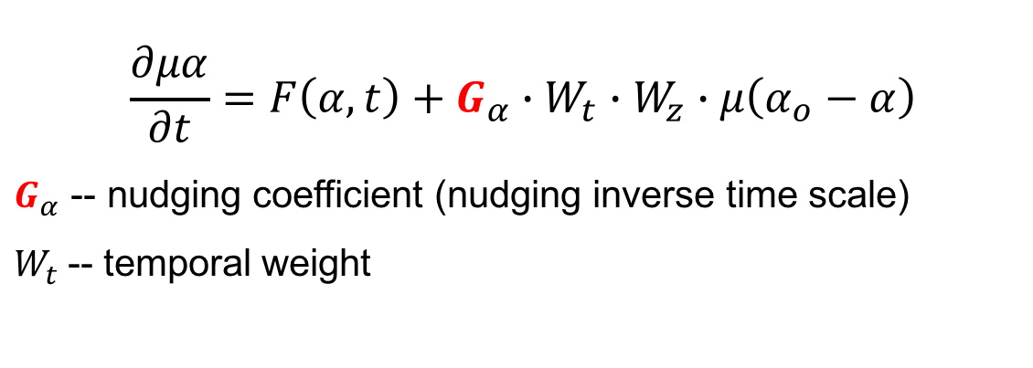

Motivation
The purpose of this study is to investigate the influence of varying nudging coefficients and assimilation time windows on the short-term precipitation forecasting.
$$\frac{∂μα}{∂t}=F\left(α,t\right)+G_{α}∙W_{t}∙W_{z}∙μ\left(α_{o}−α\right)$$
$G_{α}$ -- nudging coefficient (nudging inverse time scale)
$W_{t}$-- temporal weight
Time window
$$W_{t}$$
1
Time
0
t0
t1
t2
Notes:
$W_{z}$-- vertical weight (upper air and surface)

Slide 7
Observing System Simulation Experiments (OSSEs)
Convective storm: 2016-04-26
Truth Run
(FNL 0.25)
00:00
03:00
06:00
09:00
12:00
15:00
18:00
21:00
CTRL (NO DA) Run
(ERA-Intermin)
06:00
11:00
12:00
DA EXPs:
Nudging Radar Data: 11:00--12:00 available at every 15 min
EXP on time windows: 30, 15, and 9 minutes
EXP on nudging coefficient: 0.001, 0.003, 0.006, 0.01, 0.03, and 0.06
Notes:
For convenience, we carry out observing system simulation experiments. We select a convective storm occurred on April 26, 2016.
The truth run experiment initializes from 0 o’clock using NCEP FNL 0.25-degree resolution data, and the control run experiment with no data assimilation initializes from 6 o’clock using ERA-Intermin, different initial conditions. All other experiments with radar data assimilation run from 6 o’clock and nudging radar data from 1100—1200 every 15 minutes. We select 3 time windows, and 6 nudging coefficients in our study.

Slide 8
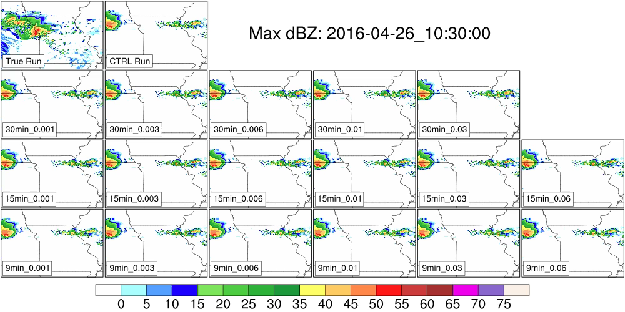
Experiment Results: Reflectivity
Truth Run
x
30min_0.06
TimeWindow_NudgingCoefficient
Animation from 10:30 to 18:00 at 5-min intervals
Notes:
Here is an animation shown evolution of radar reflectivity from 10:30 to 18:00 at 5-min intervals.
The two experiments in the top row are Truth run and control run. We can see that, distribution of radar reflectivity in the control run is very different from that of truth run.
The other experiments with data assimilation are in the next three rows, from left to right, the experiments are with same time window, and nudging coefficients are in increasing order. And from top to bottom, time windows are in narrow order. By the way, the experiment with 30-min time window and 0.06 nudging coefficient is crashed. So, no result show here.
From this animation[,æni'meiʃən], we can see radar reflectivity distributions in most of the experiments with data assimilation are similar to the truth run.

Slide 9
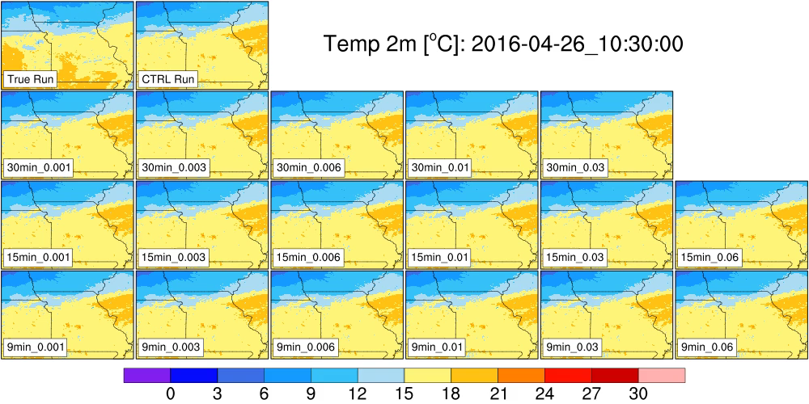
Experiment Results: Surface Temperatures
Truth Run
x
30min_0.06
TimeWindow_NudgingCoefficient
Animation from 10:30 to 18:00 at 5-min intervals
Notes:
And this animation shows surface temperatures from 10:30 to 18:00. On the whole, temperature in the truth run has a certain difference from other experiments, especially these two experiments with larger nudging coefficient.

Slide 10
Tolerance to Reasonable Nudging Parameters
1-hour Max radar equivalent reflectivity factor (dBZ) forecast (13Z)
Truth Run
3-hour Max radar equivalent reflectivity factor (dBZ) forecast (15Z)
Truth Run
Results are similar when nudging coefficient is in a certain range.
Notes:
In more detail, this slide shows 1-hour and 3-hour forecast of radar reflectivity in four experiments, they are truth run, control run, two experiments with radar data assimilation, respectively. These two experiments are using the same time window, and nudging coefficient in the last experiment is nearly twice as large as third one. However, from this figure, we can see, either the 1-hour forecast or 3-hour forecast, these two experiments have similar results.
So, there is a certain tolerance /'tɑlərəns/ to reasonable nudging parameters.

Slide 11
Mutual Compensation between Time window and Nudging Coefficient
1-hour Max radar equivalent reflectivity factor (dBZ) forecast (13Z)
Truth Run
3-hour Max radar equivalent reflectivity factor (dBZ) forecast (15Z)
Truth Run
Linear features exist in a short time window.
Notes:
This slide shows another group of experiments. They are the are truth run, control run, two experiments with data assimilation using different time window and different nudging coefficients. Time window of the third experiment is twice as large as that in the last one, and nudging coefficient is half of that in the last one. However, these two experiments have similar results either in 1-hour or 3-hour forecast. So, there may be a certain mutual/'mjutʃuəl/ compensation between time window and nudging coefficient.

Slide 12
Impact of Excessive Nudging Forcing
1-hour Max radar equivalent reflectivity factor (dBZ) forecast (13Z)
Truth Run
1-hour air temperature at 2 m (ºC) forecast (13Z)
Truth Run
Large nudging coefficient can cause strong cold pools near land surface
Notes:
However, we also need to be careful. This slide shows the impact of excessive nudging forcing. When using too large nudging coefficients, the model will generate some strong fallacious convections due to the strong cold pools near land surface.

Slide 13
Precipitation Forecasting Skill Score
(FSS)
Notes:
Finally, let’s see the fractions skill score of surface precipitation. This is the control run, and the others are experiments with 30-min time window and different nudging coefficients. The scores of the control run are nearly zero. With the nudging coefficient increasing in the reasonable range, scores increase and larger than those of control run. The scores in the other two groups of experiments with 15-min and 9-min time windows have similar results.

Slide 14
Summary
The nudging time window and nudging coefficients of the RTFDDA- RDA scheme is studied with OSSEs.
The simulation results are insensitive to the value of the nudging parameters when they are in a reasonable range.
For near-linear dynamics, the nudging time window length and nudging coefficient may mutually compliment.
An excessively large nudging coefficient can cause overly strong cold pools near land surface and stimulates fallacious convection.
RTFDDA-RDA presents a reasonable capability for nowcasting and short-term forecasting of convective precipitation systems
Notes:
Results indicate that the RTFDDA-RDA system is able to analyze certain mesoscale and convective-scale features and helps improve the short-term precipitation forecasting of convective storm through nudging cloud hydrometeors retrieved from radar reflectivity and latent heat.
Besides, difference of assimilation frequency and nudging coefficient (assimilation time window) in the radar assimilation experiments has a different influence on short term precipitation forecasting.
It is demonstrated that the RTFDDA-RDA can improve the initial conditions and then improve skills on QPF. A systematic evaluation of the performance of RTFDDA-RDA will be conducted in a flood season real-time test.

Slide 15
Future Work
Find reasonable location and amount of latent heating
Evaluate the performance of RTFDDA-RDA with a set of real weather convection cases, and study the impact of the nudging parameters on different convection systems.

Slide 16
Thank you!

Slide 17
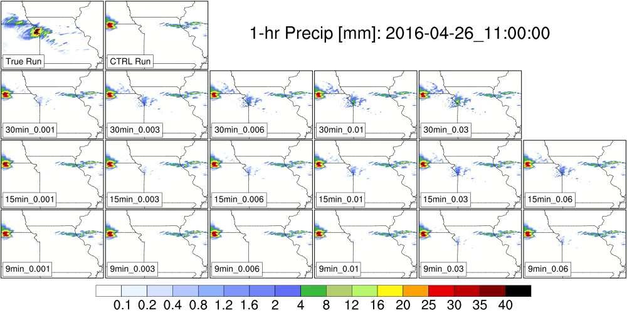
Experiment Results: Surface Precipitation
x
30min_0.06
TimeWindow_NudgingCoefficient
Animation from 10:30 to 18:00 at 5-min intervals

Slide 18
RTFDDA Radar Data Assimilation
Original scheme (Grid-nudging) :
Nudging term C = G(q_{B}-q_{A})/(t_{B}-t_{A})
q = … + C*dt
t
A
B
C
Limitations: 1) both q_{B} and q_{A} must exist,
2) weather processes between A and B must be linear,
3) and it performs badly for fast moving storms.
New scheme (Grid-Obs nudging hybrid) : C = Gq_{A}f(t-t_{A}) + Gq_{B}f(t-t_{B}) + Gq_{C}f(t-t_{C})
q = … + C*dt
f
f
f
t
A
B
C
From Liu
Advantage: effectively overcomes the disadvantages of the old scheme.

