Slide 1
An evaluation of the new hybrid vertical coordinate in the RAP and HRRR
Jeff Beck, John Brown, Joe Olson, Tanya Smirnova, Ming Hu, Tracy Hertneky, Christopher Williams, Trevor Alcott, Stan Benjamin, Curtis Alexander, Jimy Dudhia, Dave Gill, Wei Wang, and Joe Klemp
7/15/2017 – WRF Users’ Workshop

Slide 2
Motivation
Terrain-following coordinates are known to induce small-scale horizontal and vertical accelerations over areas of steep terrain due to the reflection of topography in model levels
Introduces error into the model equations and can impact model forecasts, particularly as errors are advected downwind of major mountain ranges
Operational models such as the RAP and HRRR are impacted by this “noise” and could benefit from an improved vertical coordinate
Development of a hybrid vertical coordinate to address these issues was undertaken at NCAR (Klemp et al., 2011)

Slide 3
A Collaborative Effort…
NOAA (OAR) funding provided to DTC for implementation, testing and evaluation within WRF
NCAR/MMM incorporated hybrid coordinate code into WRF v3.8.1
GSD and DTC contributed to evaluation in both the RAP and HRRR
GSD and MMM collaboration was crucial to implementation
Evaluations of extended retrospective runs and single case studies were conducted

Slide 4
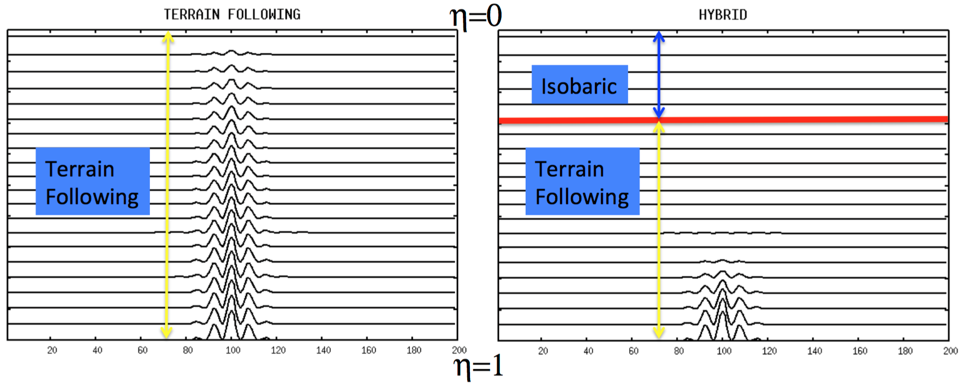
Terrain Following vs. Hybrid Coordinate
$$ηc$$
Transition
Zone
Gill et al., 2016 (WRF Users Workshop):
http://www2.mmm.ucar.edu/wrf/users/workshops/WS2016/oral_presentations/1.4.pdf

Slide 5
Testing and Evaluation
Several controlled cold-starts and one cycled, winter experiment with 13-km RAP, initialized from GFS
One cycled, summer 3-km HRRR experiment, initialized from non-hybrid coordinate RAP
Only difference for these retrospective runs is the hybrid coordinate change
For cold-season cases, focus was on strong westerly flow across western CONUS favoring vertically propagating mountain wave activity
700 hPa - 00z 7 Mar 17

Slide 6
7 March 2017 cold start RAP simulation (250 hPa wind speeds)
Initial fields as interpolated to 250 hPa are slightly different (see UT and CO)
Differences appear by 1 h and grow, but are mainly over or downstream of mountainous terrain
Smoothed coordinate surfaces result in less spurious accelerations, therefore less vertical mixing of horizontal momentum
No major differences over the Pacific Ocean except near land
Cool colors: Hybrid coordinate winds faster
Warm colors: Hybrid coordinate winds slower
Initial (0000 UTC on 7 March 2017)
6-h forecast (0600 UTC on 7 March 2017)
12-h forecast (1200 UTC on 7 March 2017)

Slide 7
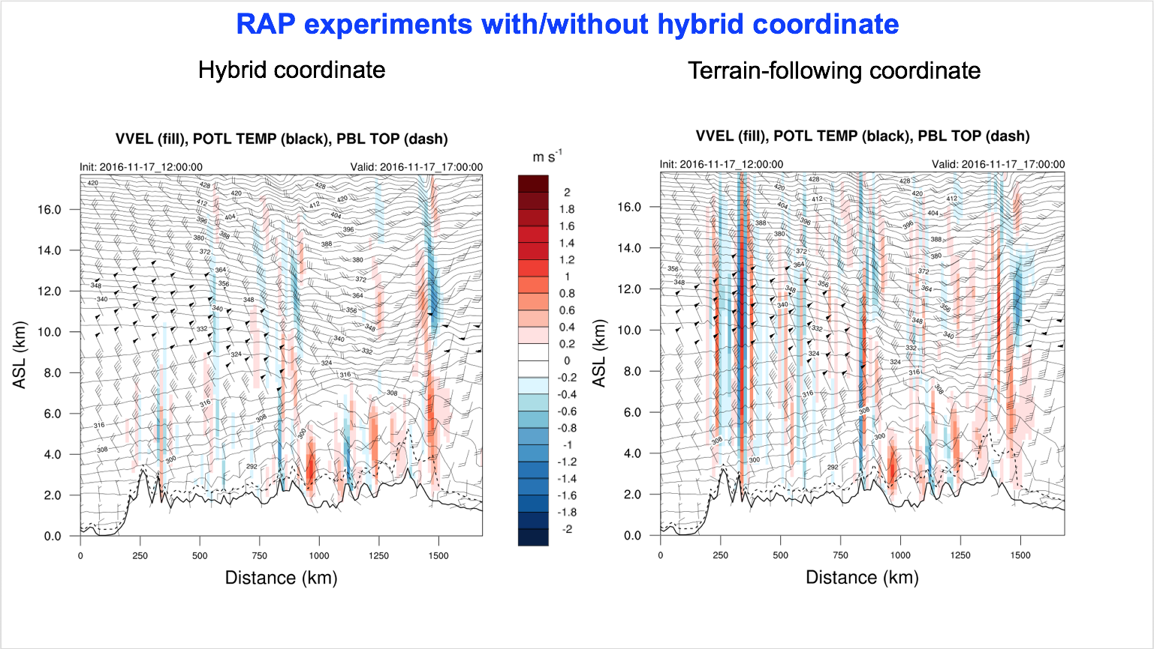
17 November 2016 cold start RAP simulation (5-h forecast of vertical motion)
$ηc=$ 0.2
California
Colorado
California
Colorado
Reduced spurious vertical motion over mountainous terrain
More coherent upwind-tilted vertical velocity features (mountain waves)

Slide 8
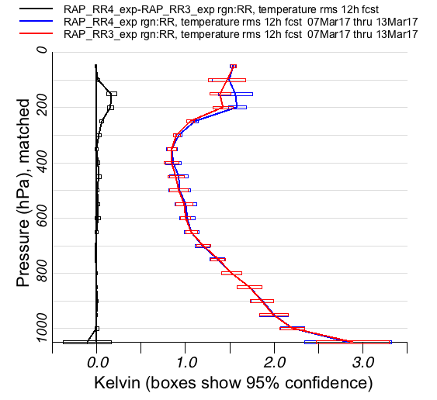
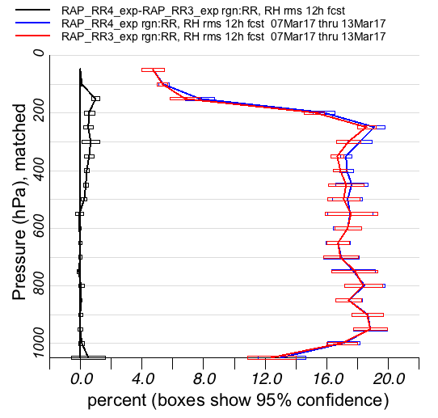
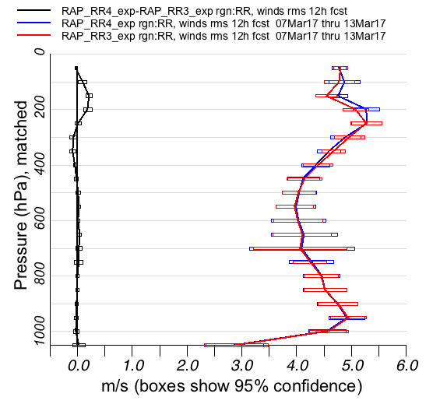
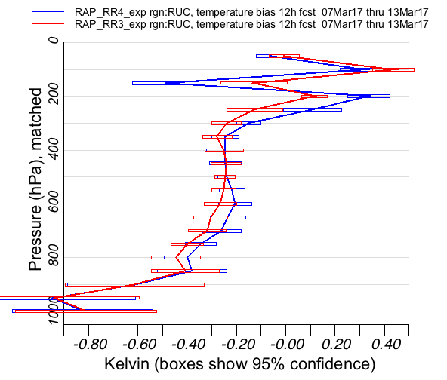
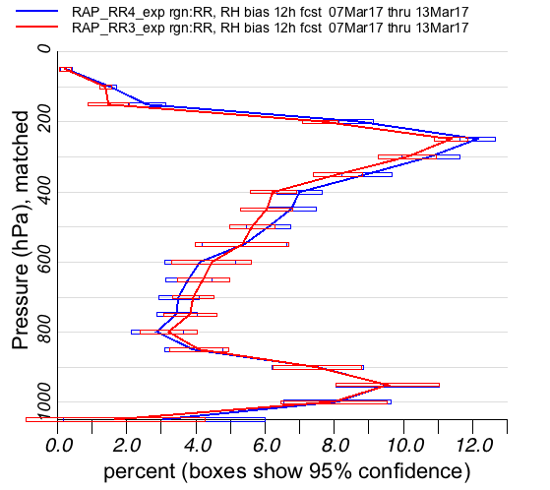
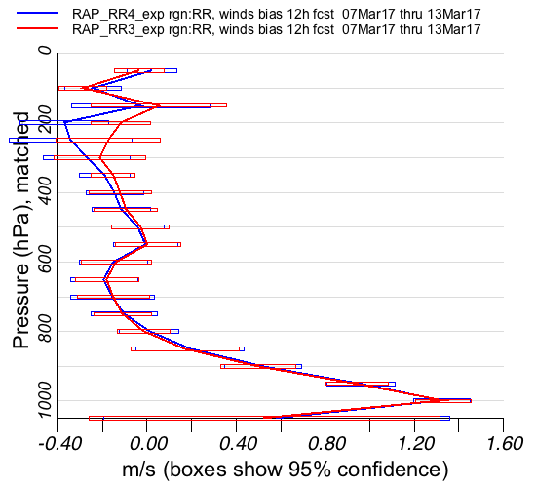
Late Winter Cycled RAP retro (7-13 March 2017)
Vertical Profiles of Upper Air RMS for 12-hour forecasts
Temperature
Wind Speed
Relative Humidity
T
Vertical Profiles of Upper Air Bias for 12-hour forecasts
Red: Hybrid Coordinate; Blue: Terrain-Following Coordinate; Black: Terrain Following – Hybrid (Difference)

Slide 9
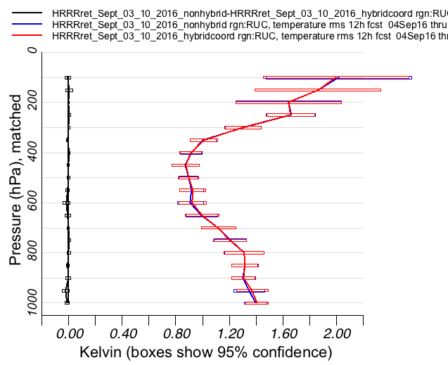
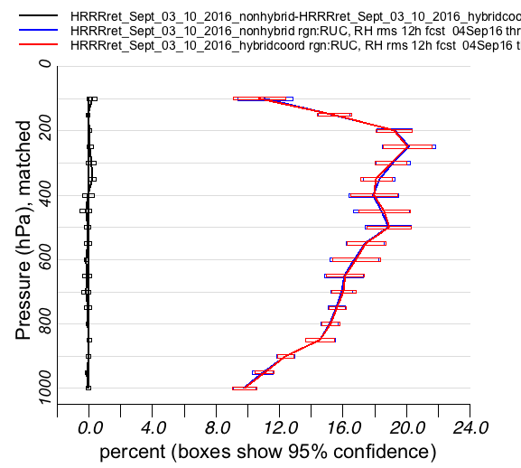
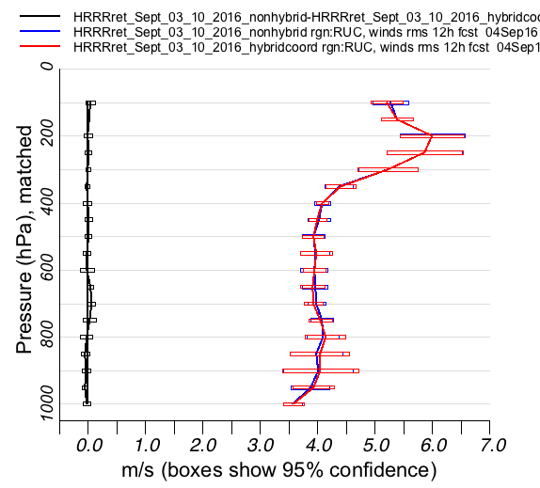
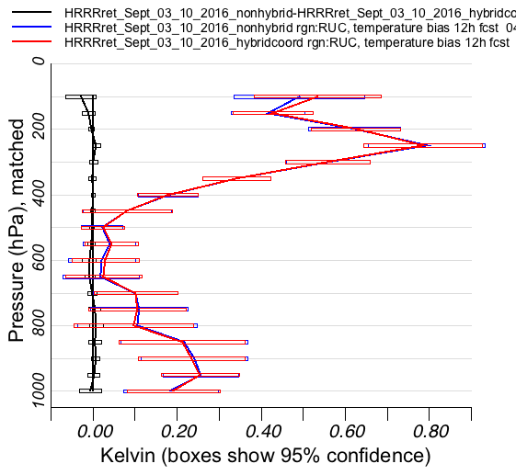
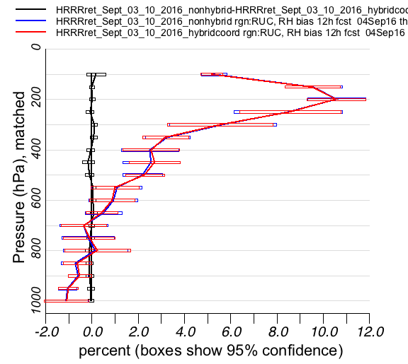
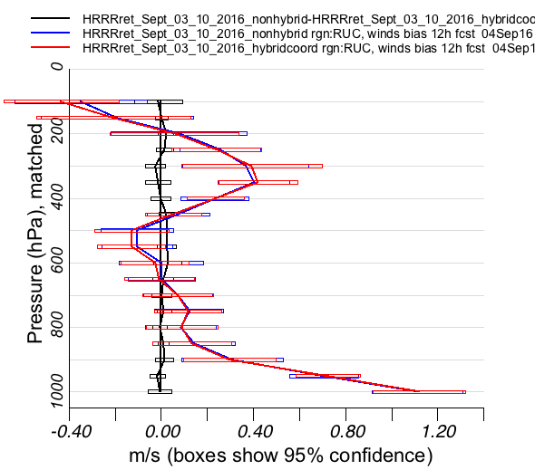
Cycled HRRR retro (3-10 September 2016)
Vertical Profiles of Upper Air RMS for 12-hour forecasts
Relative Humidity
Wind Speed
Temperature
T
Vertical Profiles of Upper Air Bias for 12-hour forecasts
Temperature
Relative Humidity
Wind Speed
Red: Hybrid Coordinate; Blue: Terrain-Following Coordinate; Black: Terrain Following – Hybrid (Difference)

Slide 10
Why is there no impact in the HRRR?
Relatively weak synoptic flow aloft (3-10 September 2016) minimized impact in the HRRR
Lack of cycling of atmospheric state (only soil state), so potentially no retention of hybrid coordinate benefits from hourly cycling, such as in the RAP retro
Potentially need:
A winter HRRR retro
A fully-cycled HRRR test
A hybrid RAP -> hybrid HRRR vs. non-hybrid RAP -> non-hybrid HRRR retrospective test
However…

Slide 11
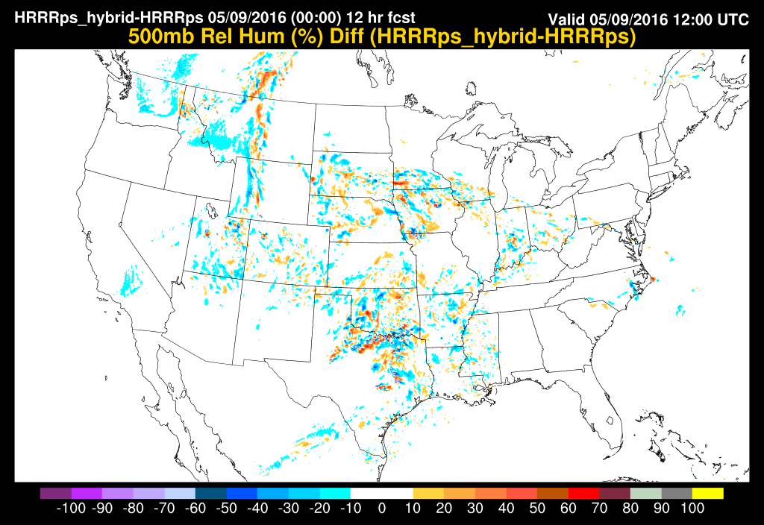
HRRR Spatial Difference Plots 12-hr forecasts from 1200 UTC on 9 May 2016
500 hPa Relative Humidity Differences (Hyb – Non-hyb)
250 hPa Wind Speed Differences (Hyb – Non-hyb)
Cool colors: Hybrid coordinate relative humidity is drier
Warm colors: Hybrid coordinate relative humidity is moister
Cool colors: Hybrid coordinate winds are weaker
Warm colors: Hybrid coordinate winds are stronger

Slide 12
Conclusions
The hybrid vertical coordinate was successfully implemented in WRF, and tested within the RAP and HRRR models for extended periods
Smoothed vertical coordinate generally results in improved temperature, relative humidity, and winds aloft in the RAP
No real differences were found in the extended HRRR retro, but weak flow aloft likely to blame
Spatial difference plots of select HRRR cases showed an impact of the new hybrid vertical coordinate, especially downwind of high terrain
Operational implementation of the hybrid vertical coordinate in the RAP and HRRR to take place in 2018 (RAPv4, HRRRv3, and HRRR-AK)

Slide 13
Thank you!

Slide 14
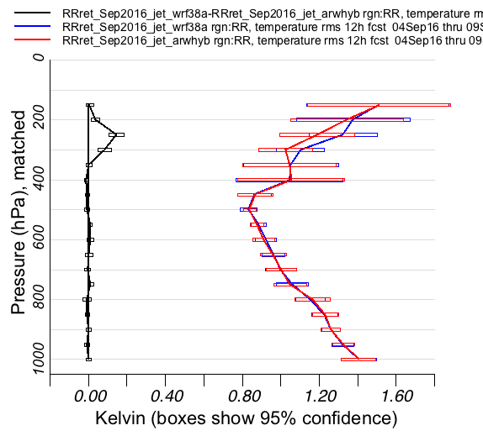
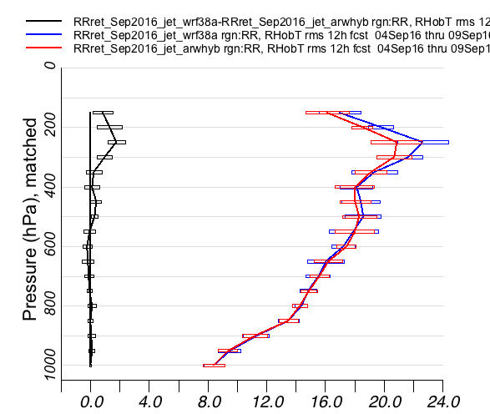
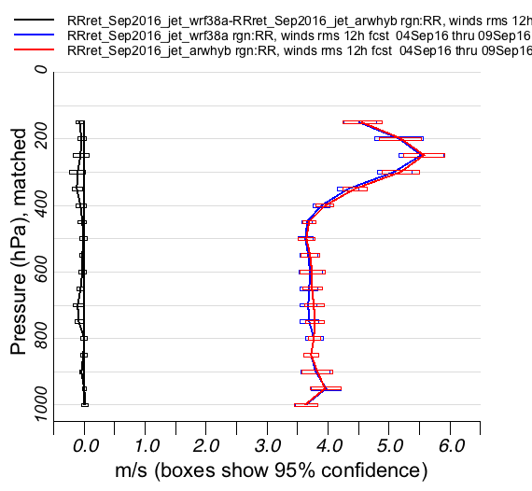
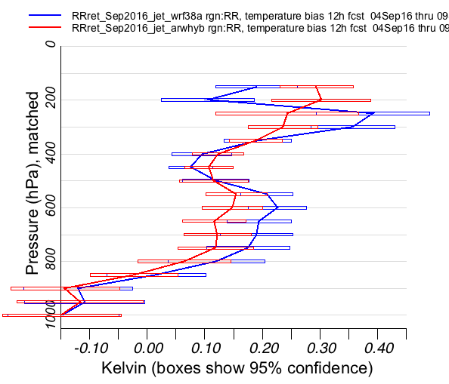
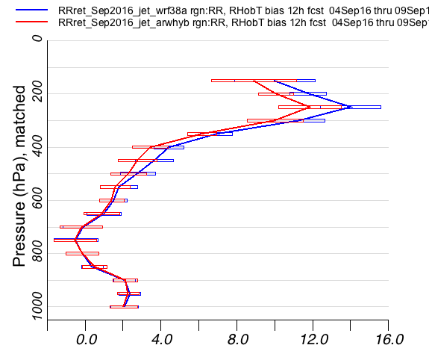
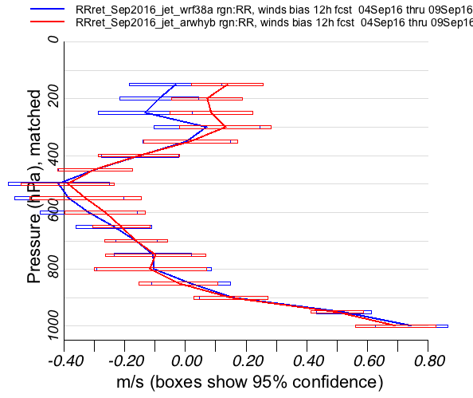
Late Summer Cycled RAP retro (4-9 September 2016)
Vertical Profiles of Upper Air RMS for 12-hour forecasts
Wind Speed
Relative Humidity
Temperature
T
Vertical Profiles of Upper Air Bias for 12-hour forecasts
Wind Speed
Relative Humidity
Temperature
Red: Hybrid Coordinate; Blue: Terrain-Following Coordinate; Black: Terrain Following – Hybrid (Difference)

